Slide 1

An-Najah National University
Faculty of Engineering and Information Technology
Civil Engineering Department
Graduation Project II
Structural Analysis and Design of Economy and Management Building-Khodori
Prepared by:
Ahmad dawoud – Reg. : 11422545
Muhammad Abu – Rub – Reg. : 11523492
Muhammad Asfour – Reg. : 11440473
Sha’ban Al Zeer – Reg. : 11524492
Under supervision of:
Dr. Abdulrazzaq Touqan

Slide 2
Outline:
Introduction
Preliminary design
Project modeling
Model checks
Type of structural system
Seismic analysis and checks
Soil interaction effects
Final design of the building
Design and design checks

Slide 3
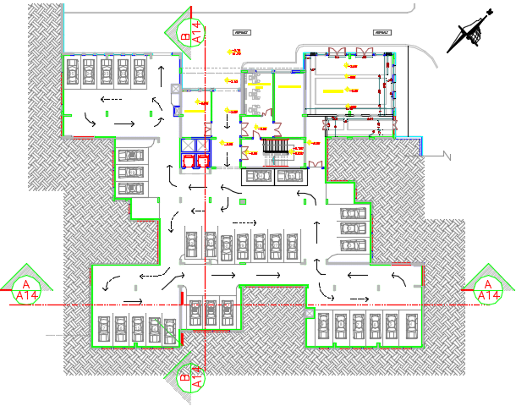
Basement

Slide 4
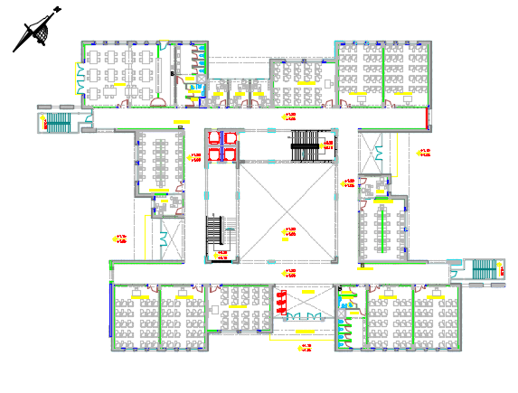
Ground floor

Slide 5
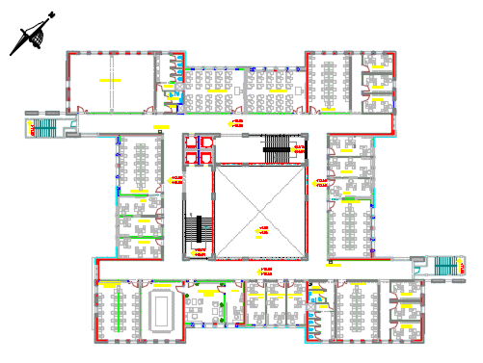
The rest of the floors

Slide 6
Introduction
The project is a college with auditorium in Khadouri University in Tulkarm city. It consists of five floors, one basement floor level, ground floor level and three floors above it.

Slide 7
Soil investigation
Based on soil investigation report, the foundations are designed for allowable bearing capacity equal to 3 kg/cm² at depth not less than 2 m (about 4 m ) .

Slide 8
Codes and standards
The following codes and standards are used in the analysis and design process :
ACI 318-14 : American Concrete Institute’s Building Code Requirements for Structural Concrete
American Society of Civil Engineering (ASCE 7-10): It is used for the seismic design and to determine live loads.

Slide 9
Materials
Reinforced concrete
Property | Value
Compressive strength, fc ( MPa ) | 24
Modulus of elasticity, Ec ( GPa ) | 23
Unit weight (kN/m³ ) | 24.5
Note : For footings ( Mat foundation) , fc = 34 MPa
Steel reinforcement
Property | Value
Yielding strength, fy ( MPa ) | 420
Modulus of elasticity, Es ( GPa ) | 200

Slide 10
Non – structural elements
Material | Ɣ in kN/m³
Blocks | 12
Filling Materials | 18
Tiles | 26
Plaster | 23
Aggregate | 13
Concrete Mortar | 23
Masonry Stone | 30

Slide 11
Loads
Gravity loads
Dead loads
Superimposed loads
Live loads
Lateral loads

Slide 12
Gravity loads
Dead loads : represents the own weight of the elements
Live loads :
- 5 kN/m² for ground floor ( Lobbies )
3 kN/m² for the rest of floors
5 kN/m² for staircase
Superimposed loads
5 kN/m² for floors
3.5 kN/m² for staircase
2 kN/m² for shear wall cladding
10 kN/m for stone walls

Slide 13
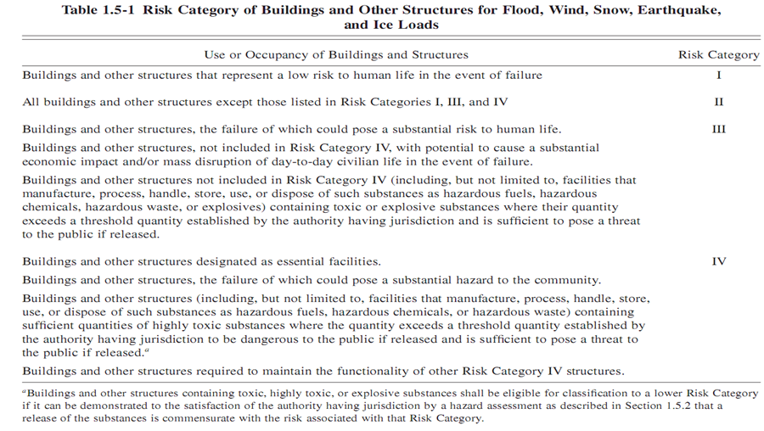
Lateral loads
Select the most appropriate risk category
Risk category ΙΙΙ

Slide 14
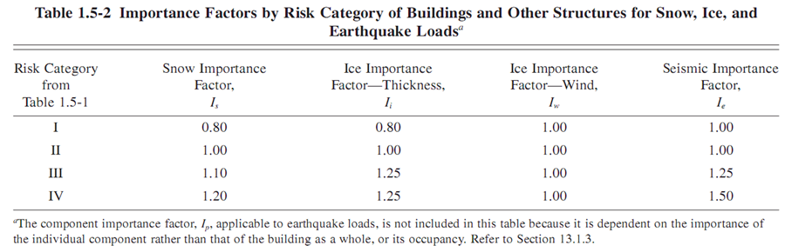
Set the importance factor
I_{e} equals to 1.25

Slide 15
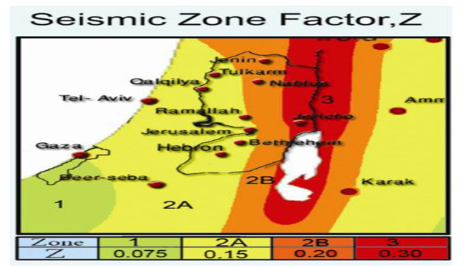
Determination of S_{s} & S₁
For Tulkarem, Z = 0.15
S_{s} = 2.5 x 0.15 = 0.375
S₁ = 1.25 x 0.15 = 0.1875
These values are for 10% probability of exceedance, for 2% probability of exceedance:
S_{s} = 1.5 x 0.375 = 0.5625
S₁ = 1.5 x 0.1875 = 0.28125

Slide 16
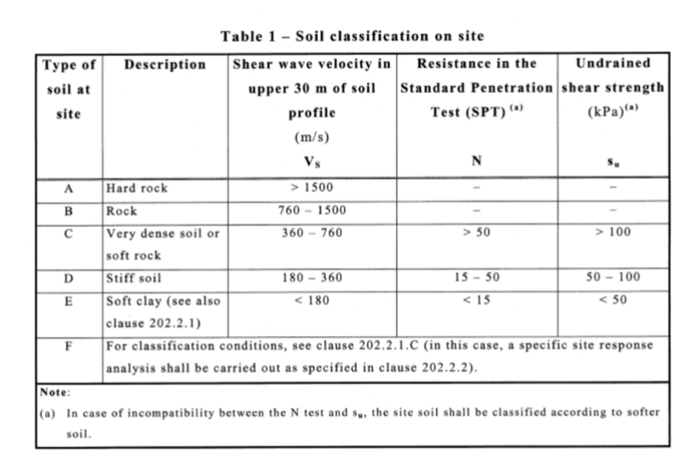
Determination of site classification
Site class is C

Slide 17
Determination of response accelerations S_{ms} & S_{m1}
S_{ms} = 1.175 x 0.5625 = 0.6609
S_{m1} = 1.52 x 0.28125 = 0.4275

Slide 18
Calculate the design spectral accelerations S_{DS} & S_{D1}
For 10% probability of exceedance of return period 50 years.
S_{DS} = 2/3 S_{Ms} = 0.4406
S_{D1} = 2/3 S_{M1} = 0.285
Determination the seismic design category
Based on risk category and design spectral accelerations ( S_{Ds} & S_{D1} ), the seismic design category is D

Slide 19
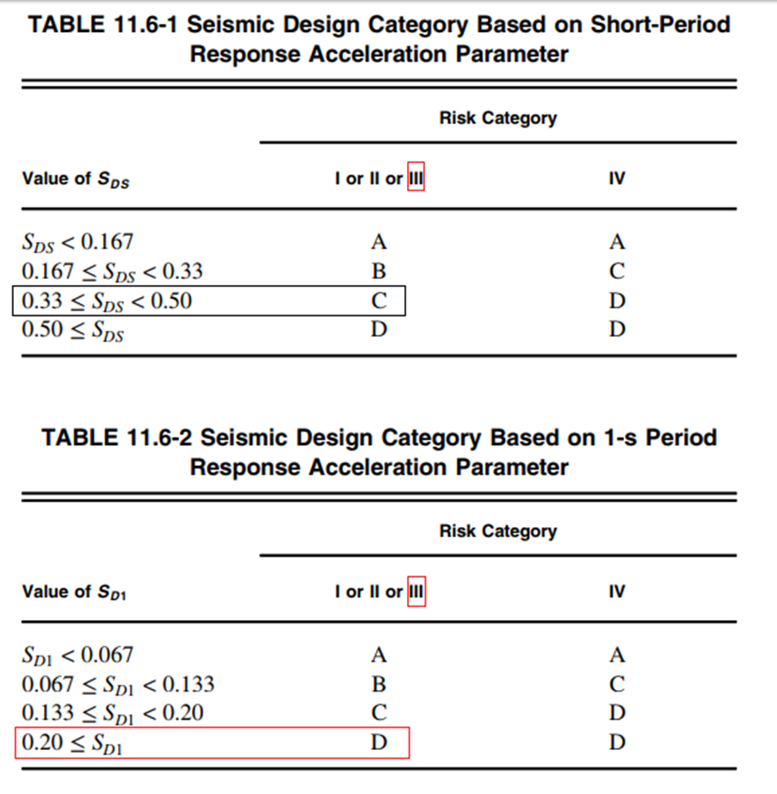

Slide 20
Load combinations
Ultimate load combinations
According to the "ACI 318-2014 and ASCE7-10, the load factors that are used in the analysis and design are:
a) 1.4 D
b) 1.2D + 1.6 L
c) 1.2D+E+L
d) 0.9D +E
Service load combinations
a) D +L
b) D +0.75L
c) D +0.7E
d) D +0.75L +0.75(0.7E)
e) 0.6 D+ 0.7E

Slide 21
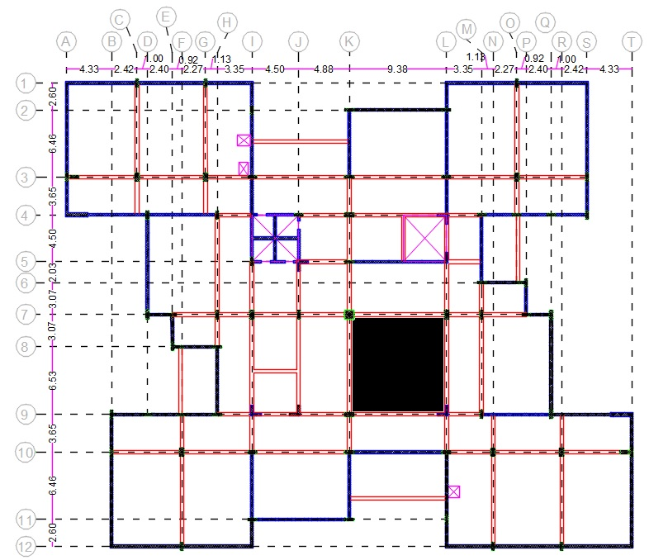

Preliminary design
Slab thickness
Two way solid slab with beams .
Ground slab
h $=\frac{ln (0.8+\frac{fy}{1400})}{36+9β}$
h = 23 cm,
use 25 cm.

Slide 22
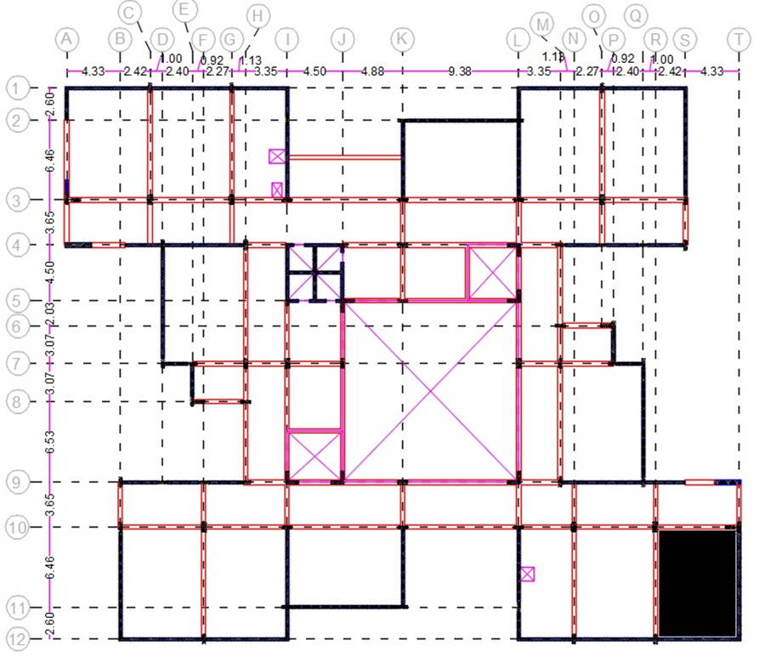
The rest of floors
h = 21 cm, use 23 cm in all floors except ground floor

Slide 23
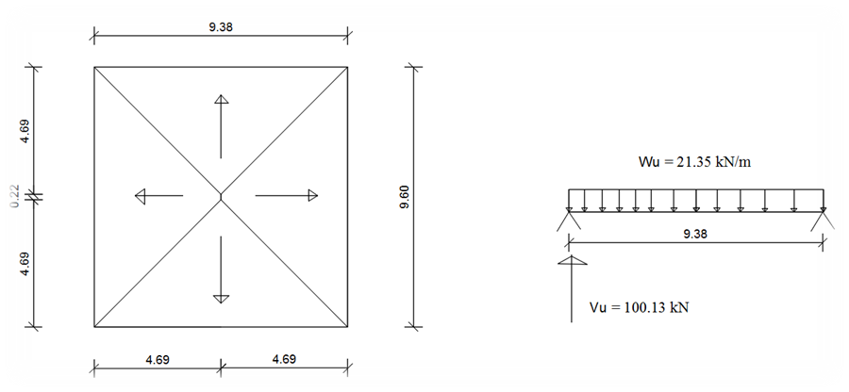

Check shear for slab
- Ground floor
$∅Vc=\frac{1}{6}∗0.75bd\sqrt{Fc}$ = 129 kN
Where f_{c} =24 MPa, b=1000 mm, and d = 250 – 40(cover) = 210 mm.
W_{u} = 1.2 ( 0.25 x 24.5 + 5 ) + 1.6 ( 5 ) = 21.35 kN/m²
Since V_{u} = 100.13 < 129 kN, slab thickness is adequate for resisting shear. So there is no need for shear reinforcement

Slide 24
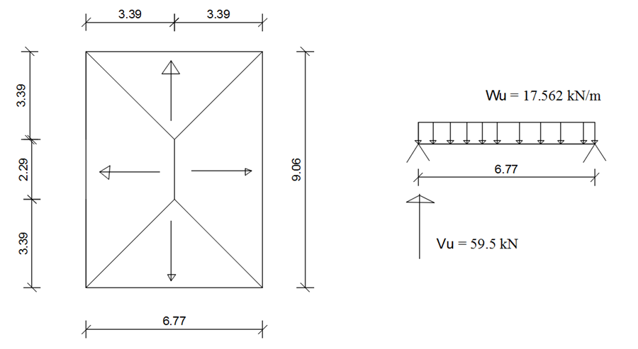
- Rest of floors :
∅Vc = 116 kN.
Where f_{c}=24 MPa, b=1000 mm, and d = 230 – 40(cover) = 190 mm.
W_{u} = 1.2 ( 0.23 x 24.5 + 5 ) + 1.6 ( 3 ) = 17.562 kN/m²
Since V_{u} = 59.5 < 116 kN, slab thickness is adequate for resisting shear. So there is no need for shear reinforcement.

Slide 25
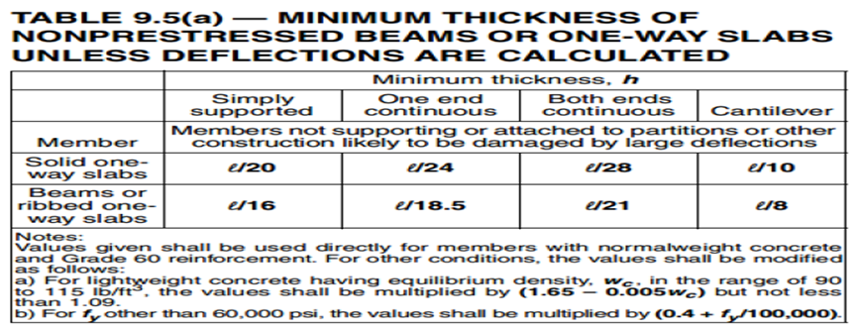
Preliminary design for beams
Group number | Dimension
1 | 800X350 mm
2 | 600X350 mm
3 | 250X350 mm
Group number | Dimension
1 | 830X350 mm
2 | 630X350 mm
3 | 230X350 mm

Slide 26
Preliminary design for columns
By using tributary area method
Group number | Dimensions
1 | 800X250 mm
2 | 800X400 mm
3 | 800X800 mm

Slide 27
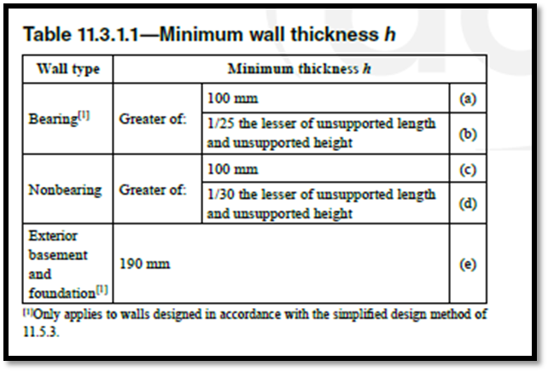

Preliminary design for shear walls
By using tributary area method and this equation:
$φP$ =$0.55φf_{c }A_{g}\left[1−{ \left(\frac{K𝓁_{c}}{32h}\right)}^{2}\right]$ (11.5.3.1)
Group Number | Thickness ( mm )
1 | 200
2 | 250
3 | 530

Slide 28
Project modeling
1. Bring the layout of the project from AutoCad architectural drawing.
2. Define the materials used in the building (concrete and steel).
3. Define element sections of the structure with their suitable modifiers.
4. Define area section (slabs and shear walls) with their suitable modifiers.
5. Define load patterns on the structure, such as Dead, Superimposed and live loads.
6. Define load combinations according to the code for analysis and design.
7. Draw the structural elements (sections) and slabs (area sections).
8. Assign the loads ( except own weight -dead- ) on structural elements and slabs according to the values of superimposed , and live loads.

Slide 29
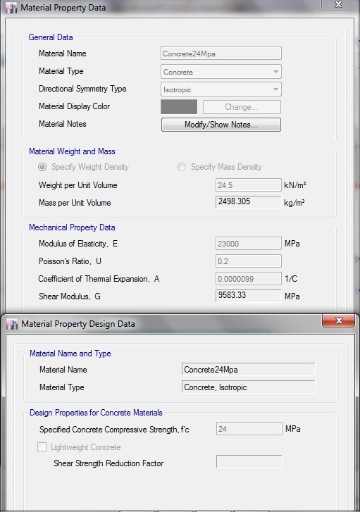
Definition of materials

Slide 30
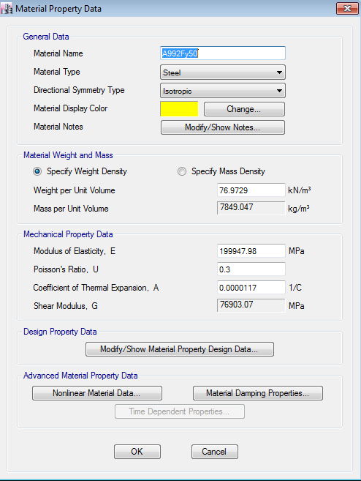

Slide 31
Stiffness modifiers
Slabs 0.35
Beams 0.35
Columns and shear wall 0.7

Slide 32
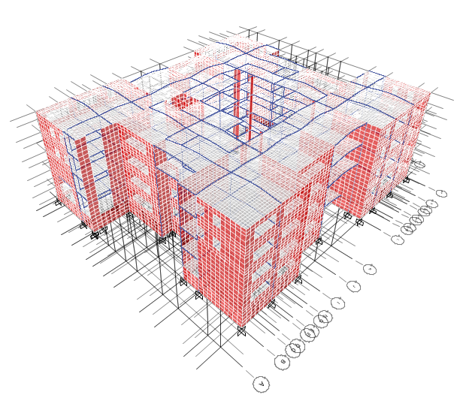
Model checks
Compatibility check

Slide 33
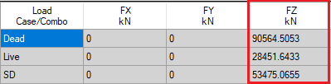
Equilibrium check
 | Hand calculation | ETABS | %Difference | < 5%
Dead | 91105.07 | 90564.5 | 0.59 | OK
SD | 53551.65 | 53475.06 | 0.14 | OK
Live | 28493.1 | 28451.64 | 0.14 | OK

Slide 34
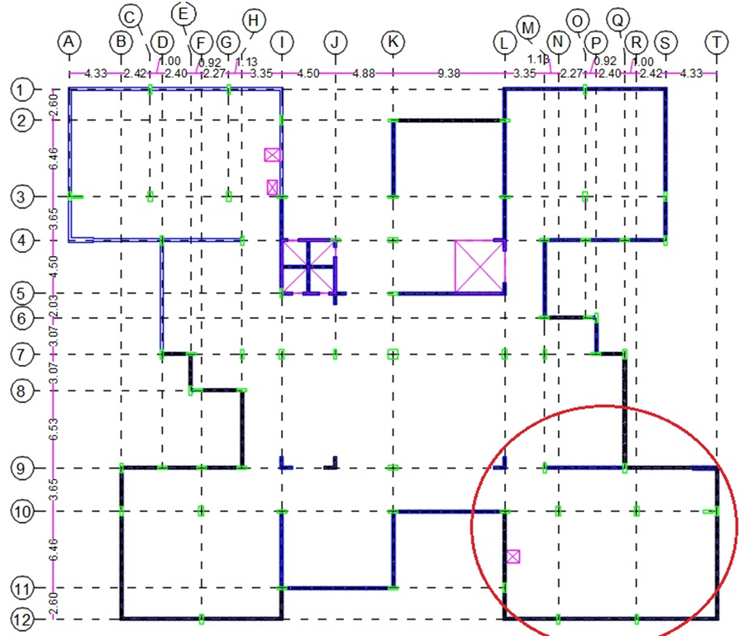
Stress – strain check

Slide 35
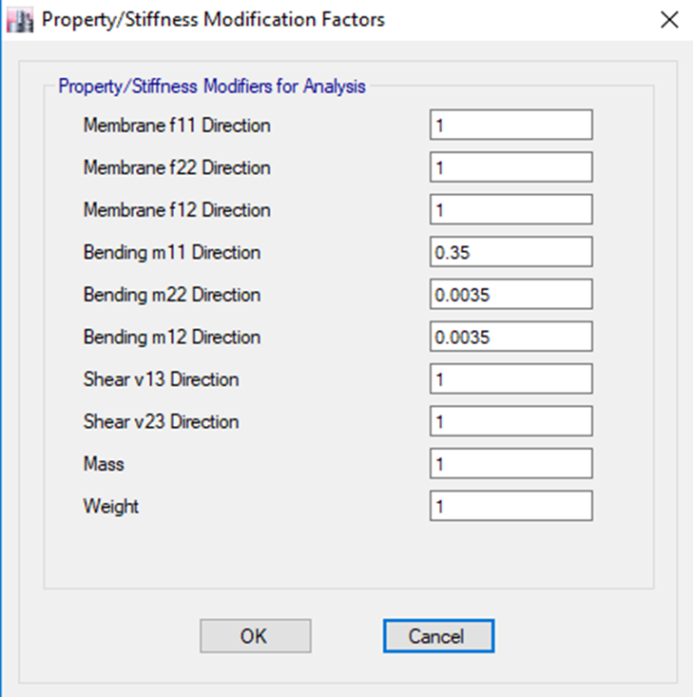

Slide 36

Slab check
Manual calculations
For service loads, W = (0.25x24.5+5) +5 = 16.125 kN/m²
M◦ = $\frac{WLnL^{2 }}{8}$ = $\frac{16.125 x {6.25}^{2}}{8}$ =78 kN.m
ETABS results
M⁻ right = 45 kN.m
M⁺ at mid of the span = 38 kN.m
M⁻ left = 29 kN.m
M (model) =M (middle) + (M left +M right)/2
M (model) = 38 + (29 + 45)/2 = 75 kN.m
%Difference = $\frac{78−75}{78}$ x 100% = 3.85% < 10% .OK

Slide 37
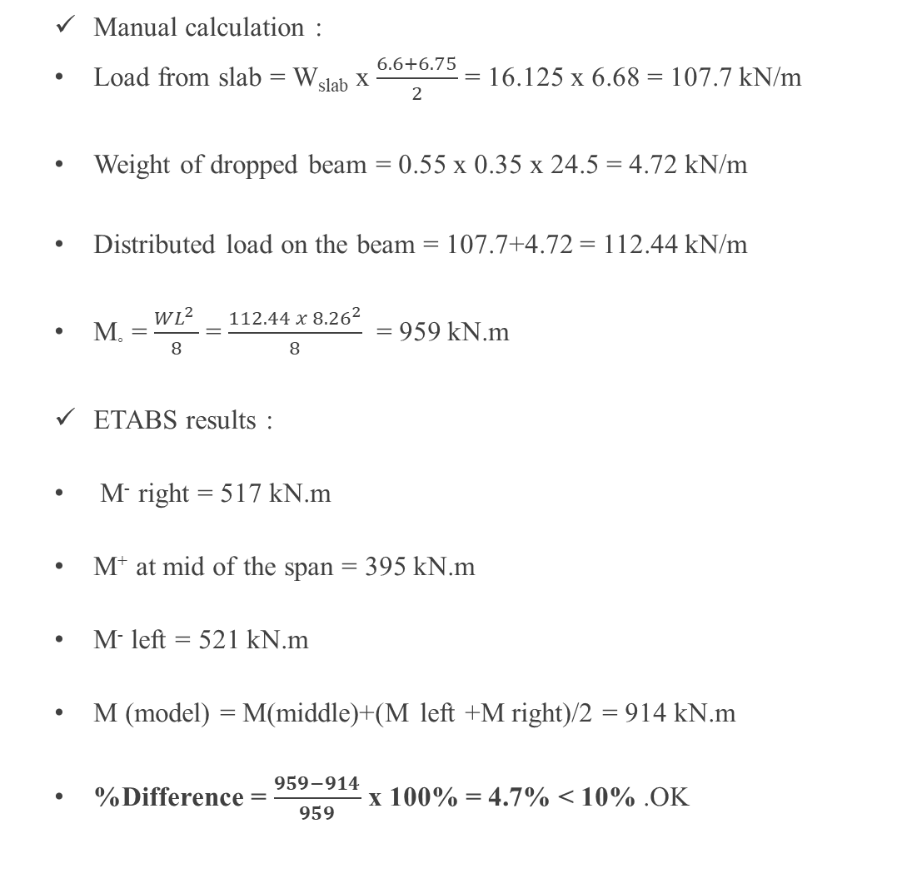
Beam check
Manual calculation :
Load from slab = W_{slab} x $\frac{6.6+6.75}{2}$ = 16.125 x 6.68 = 107.7 kN/m
Weight of dropped beam = 0.55 x 0.35 x 24.5 = 4.72 kN/m
Distributed load on the beam = 107.7+4.72 = 112.44 kN/m
M◦ = $\frac{WL^{2 }}{8}$ = $\frac{112.44 x {8.26}^{2}}{8}$ = 959 kN.m
ETABS results :
M⁻ right = 517 kN.m
M⁺ at mid of the span = 395 kN.m
M⁻ left = 521 kN.m
M (model) = M(middle)+(M left +M right)/2 = 914 kN.m
%Difference = $\frac{959−914}{959}$ x 100% = 4.7% < 10% .OK

Slide 38

Column check
Manual calculations :
By using tributary area
Total axial load = {(16.125 + 54.54) x (42.5)} + 154.8 + 41.4 + 185 = 3384 kN
ETABS results :
Axial load = 3181 kN .
%Difference = $\frac{3384−3181}{3384}$ x 100% = 6% < 10% .OK

Slide 39

Wall check
Manual calculations :
By using tributary area:
Load carried by wall = 54.5 + 184.4 + 121 + 39.48 = 399.4 kN
ETABS results :
Fz = 361 kN
%Difference = $\frac{399.4−361}{399.4}$ x 100% = 9.6% < 10% .OK

Slide 40
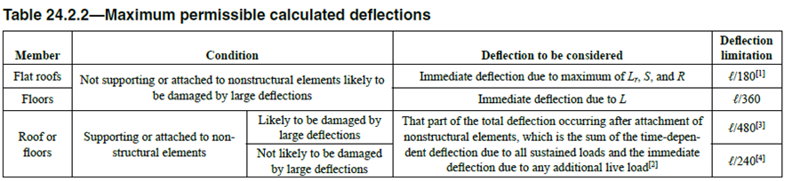
Deflection check
This check is important to check the deflection in the building and make sure that it will not exceed the allowable limits.

Slide 41
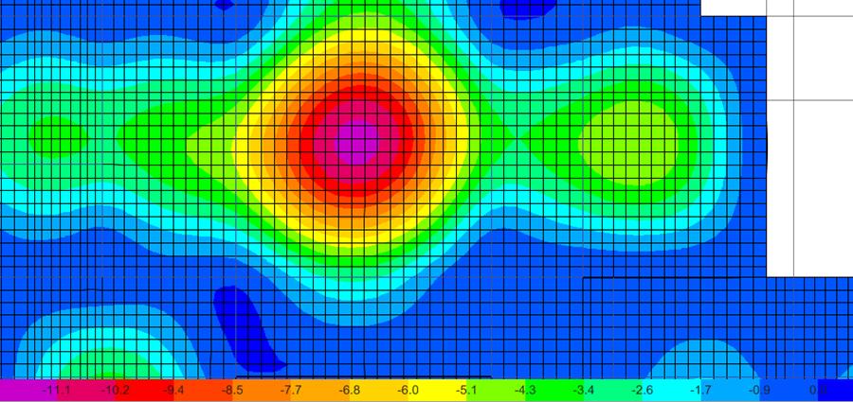
- Ground floor
According to ACI 318-14, deflection due to floors not supporting to nonstructural element likely to be damaged by large deflection shall be less than L/360.
Total deflection = deflection in the middle of the whole panel - average deflection of the four columns.
Total deflection = 11.7 mm. ( neglect corners deflection)
Allowable deflection according to ACI is equal to L/360 = 9.38/360 =26 mm.
So there’s no problem in ground floor.

Slide 42
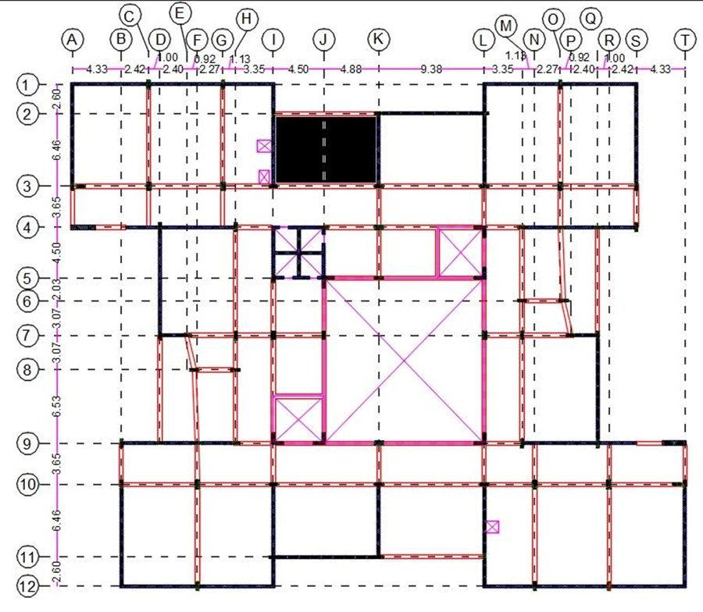
- Rest of floors
Another check is done for a panel attached to non-structural system that is not likely to be damaged by large deflection at grids of ( I - K , 2-3 ) in the roof.
This panel is the critical panel for all floor except the ground floor

Slide 43
Relative deflection ( mm ) | Load Case
6.2 | Dead load
5.2 | Superimposed load
3.2 | Live load
Total deflection = 2 ( 6.2 + 5.2 ) + 1.3 ( 3.2 ) = 26.96 mm
By assuming that 0.3 of live load is sustained, and this is acceptable, because in universities ( colleges ) the sustained live load is very small compared with the normal buildings ( such as residential buildings ), and this is because the live load after the end of work in colleges ( sustained ) is very small compared with the live load during the work times, so use 0.3 instead of 0.5 .
Allowable deflection according to ACI=L/240= 6.46/240 x1000 = 27 mm > 26.96 mm. ( OK )

Slide 44
Type of structural system
Our expectation is around Bearing Wall System and to ensure that, forces that are taken by wall shall be 50% of gravity loads.
Using ETABS it appears that columns takes 32% of vertical loads and walls takes 68% of vertical loads, which means that our expectation is right.

Slide 45
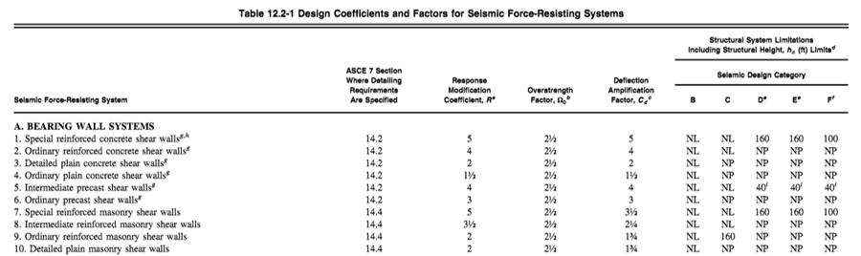
From the figure above ( Table 12.2-1 in ASCE 7 – 10 )
the structural system allowed to be used for seismic design category D for concrete structure is Special reinforced concrete shear walls.
The response modification coefficient ( R ) = 5
Over strength factor ( Ω_{o} ) = 2.5
Deflection amplification factor ( C_{d} ) = 5 .
The design of frames will be ordinary frames while shear walls will be special shear walls.

Slide 46
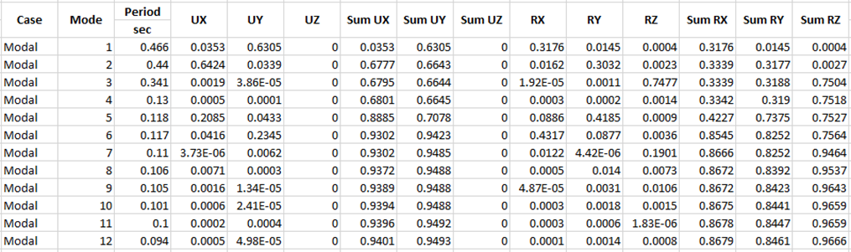
Seismic analysis and checks
  Modal Mass Participation Ratio
From the table above, it obvious that the summation of modes are more than 0.9, which is mean that most masses of the structure move in these modes ( the main motion are in X and Y direction ) .

Slide 47
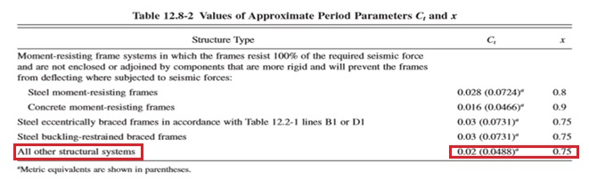

Period calculations
Ta = C_{t}×${hn}^{x}$
Ta =0.0488×${20.8}^{0.75}$ = 0.475 sec.

Slide 48
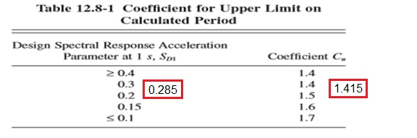
Cu is found by linear interpolation ,Cu = 1.415
Cu Ta = 0.6725 sec
.

Slide 49
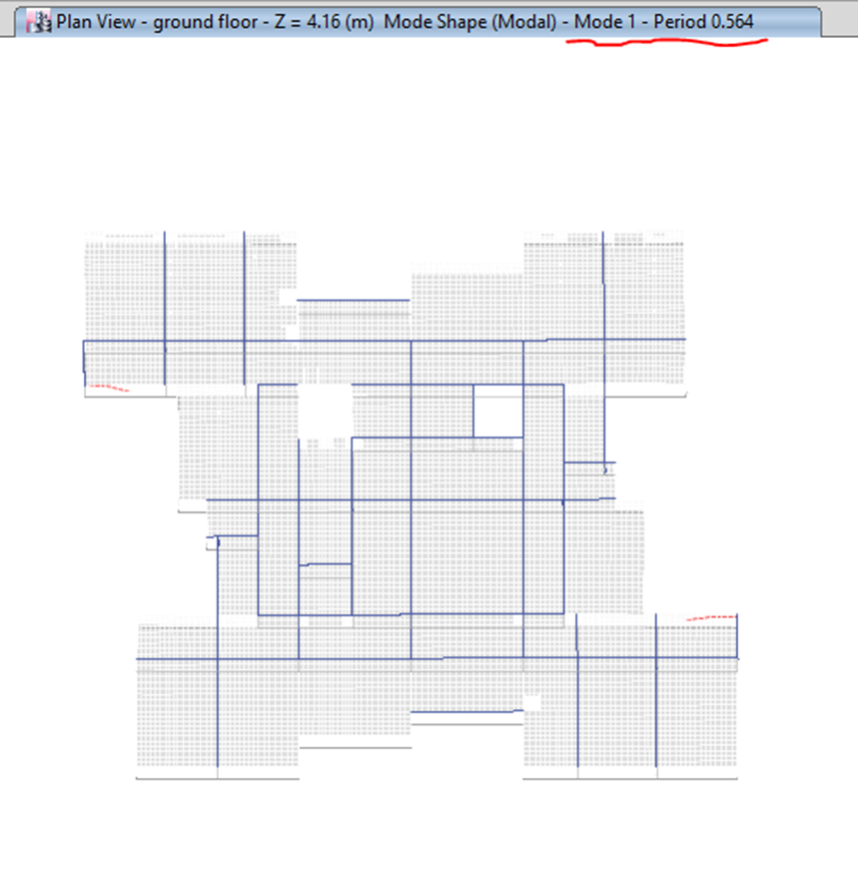
Fundamental period for the structure = 0.564 sec which is less than 0.6725 sec.

Slide 50

Base shear
Hand calculations
V = Cs x W ,
Where :
Cs : the seismic response coefﬁcient
W : the effective seismic weight
Cs =$\frac{Sds}{\frac{R}{Ie}}$ =$\frac{0.4406}{\frac{5}{1.25}}$ = 0.11015, but this value should not exceed :
Cs =$\frac{Sd1}{T\frac{R}{Ie}}$ for T ≤ T_{L}
Cs = $\frac{0.285}{0.564\frac{5}{1.25}}$ = 0.12633
So, use Cs = 0.11015

Slide 51
W = Dead load + Superimposed load.
where :
Superimposed load = 53475 kN,
Dead load = 91105.07 kN as obtained from equilibrium check.
The half weight of columns and shear walls in ground floor should be abstracted from the total dead load.
So, ( W ) = ( 91105.07 – 4046.7 ) + 53475 =140533.37 kN.
V= 0.11015×140533.37 = 15479.75 kN
The structural element | Total weight ( kN ) | Half weight ( kN )
Column | 1084.43 | 542.22
Shear walls | 7008.97 | 3504.49
 | Total | 4046.70

Slide 52
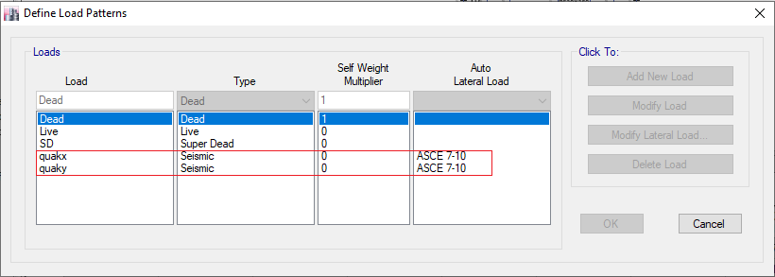
Definition of ELF in ETABS

Slide 53
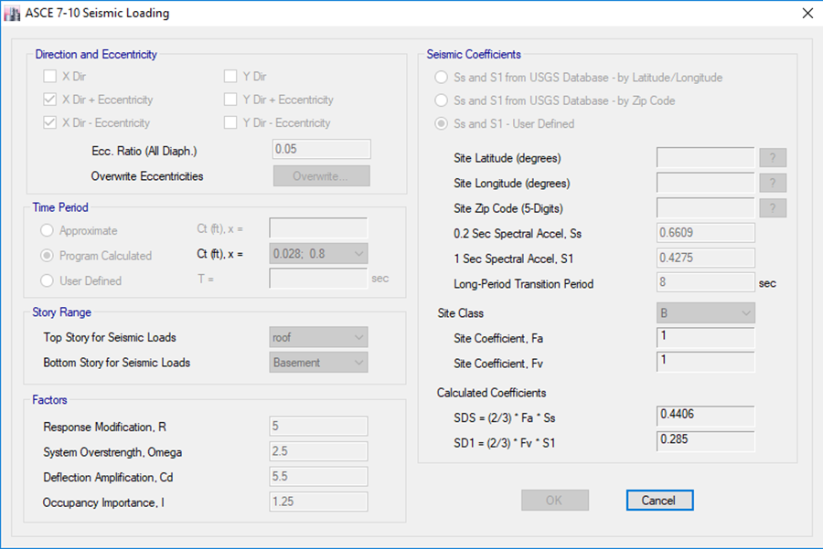
ELF in X – direction

Slide 54
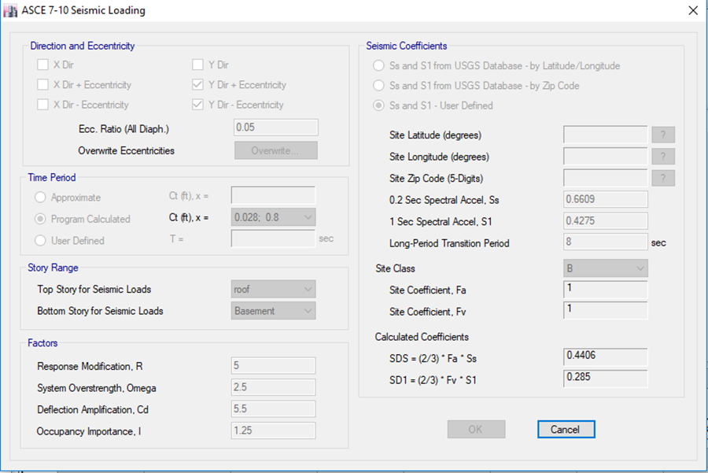
ELF in Y – direction

Slide 55
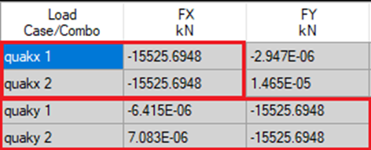

Base shear in ETABS
%Difference = $\frac{ELF \left( ETABS \right)−ELF \left( HAND \right)}{ELF \left( HAND \right)}$ x 100% = $\frac{15525.7−15479.75}{15479.75}$ x 100% = 0.3% .
The difference between hand results and ETABS results is less than the allowable(15%), which is ok .

Slide 56
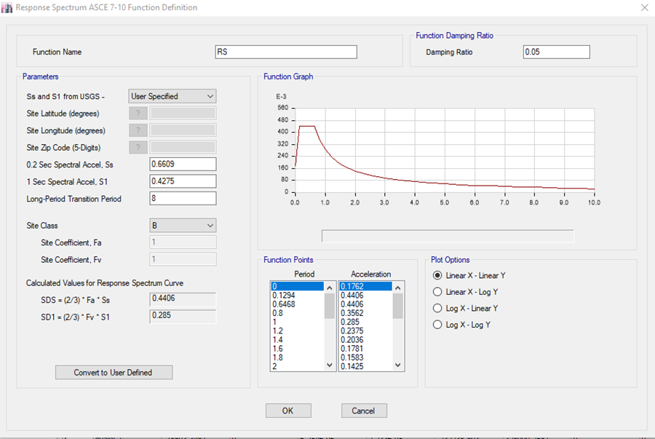
DEFINITION OF RESPONSE SPECTRUM

Slide 57
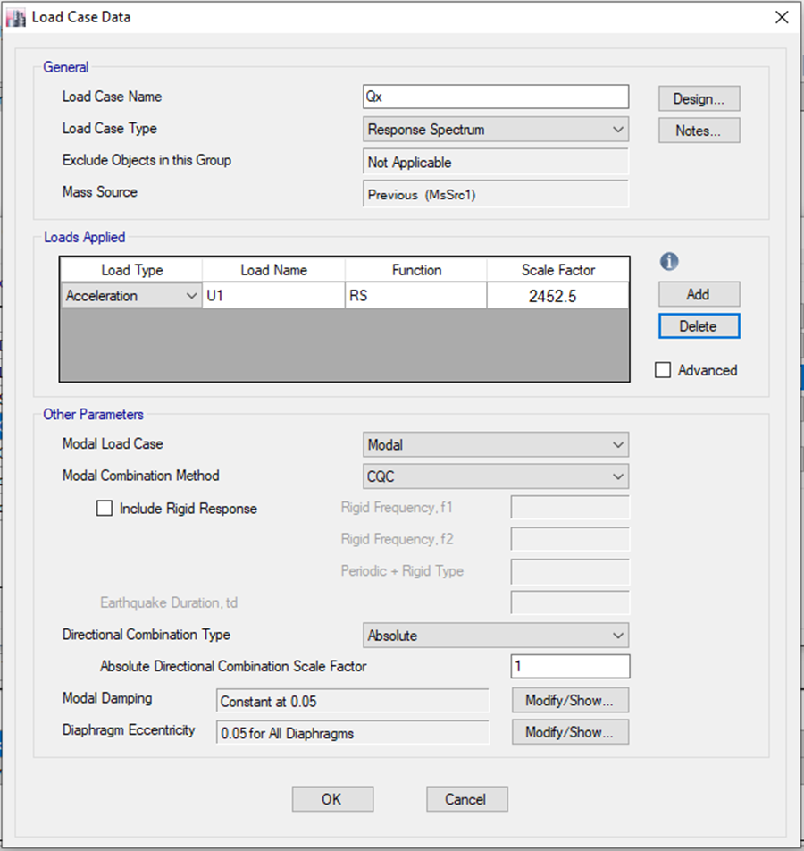
Response spectrum in X – direction

Slide 58
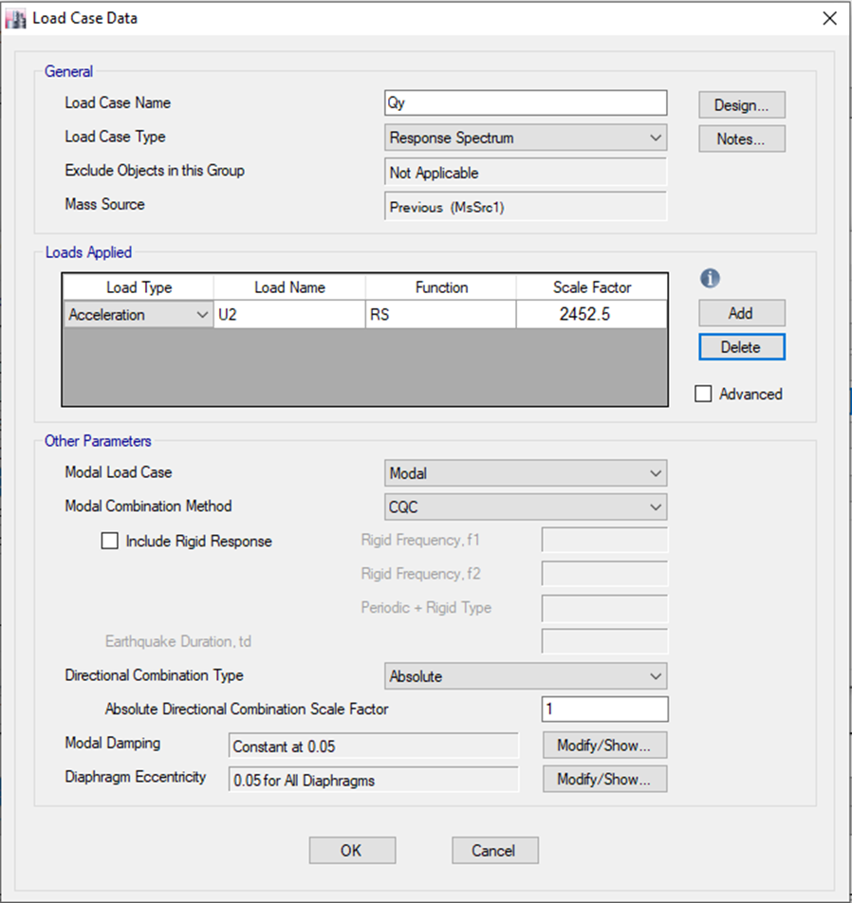
Response spectrum in Y – direction

Slide 59
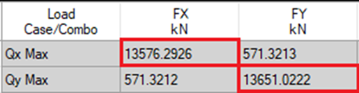
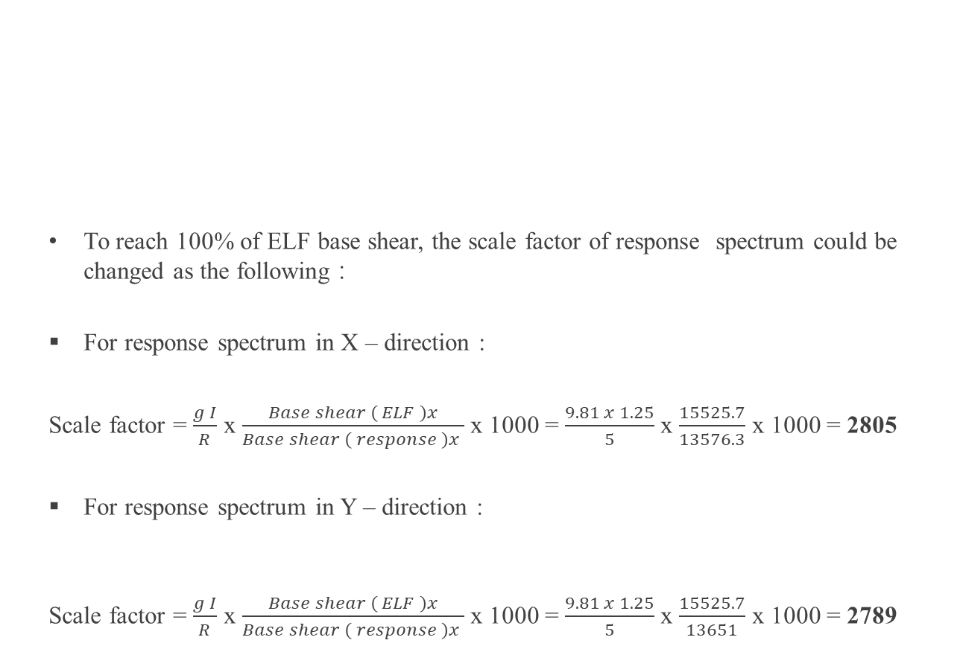
Base shear from response spectrum before adjustment
To reach 100% of ELF base shear, the scale factor of response spectrum could be changed as the following :
For response spectrum in X – direction :
Scale factor = $\frac{g I}{R}$ x $\frac{Base shear \left( ELF \right)x}{Base shear \left( response \right)x }$ x 1000 = $\frac{9.81 x 1.25}{5}$ x $\frac{15525.7}{13576.3}$ x 1000 = 2805
For response spectrum in Y – direction :
Scale factor = $\frac{g I}{R}$ x $\frac{Base shear \left( ELF \right)x}{Base shear \left( response \right)x }$ x 1000 = $\frac{9.81 x 1.25}{5}$ x $\frac{15525.7}{13651}$ x 1000 = 2789

Slide 60
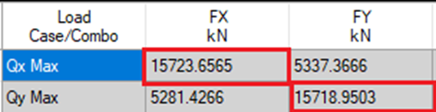
Base shear from response spectrum before adjustment

Slide 61
Response spectrum curve

Slide 62
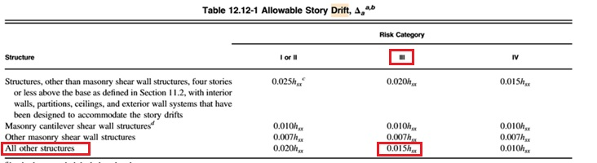
Seismic checks
Drift check
The design story drift (Δ) shall not exceed the allowable story drift ( Δa) as obtained from Table 12.12-1 in ASCE 7-10 for any story which is ≤ 0.015h_{x}.

Slide 63
Drift in X – direction
Story | Load Case/Combo | Direction | Elastic drift (m ) | In elastic drift ( m ) | Allowable drift ( m )
Roof | 1.0617D+0.7Qx Max | X | 0.001681 | 0.006723 | 0.0624
Third floor | 1.0617D+0.7Qx Max | X | 0.001797 | 0.007188 | 0.0624
Second floor | 1.0617D+0.7Qx Max | X | 0.001868 | 0.007471 | 0.0624
First floor | 1.0617D+0.7Qx Max | X | 0.001847 | 0.007388 | 0.0624
Ground floor | 1.0617D+0.7Qx Max | X | 0.001593 | 0.006373 | 0.0624
Drift in Y – direction
Story | Load Case/Combo | Direction | Elastic drift ( m ) | In elastic drift ( m ) | Allowable drift ( m )
Roof | 1.0617D+0.7Qy Max | Y | 0.002438 | 0.009751 | 0.0624
Third floor | 1.0617D+0.7Qy Max | Y | 0.002508 | 0.0100339 | 0.0624
Second floor | 1.0617D+0.7Qy Max | Y | 0.002454 | 0.0098176 | 0.0624
First floor | 1.0617D+0.7Qy Max | Y | 0.0025 | 0.0100006 | 0.0624
Ground floor | 1.0617D+0.7Qy Max | Y | 0.002292 | 0.0091686 | 0.0624

Slide 64
Torsional irregularity
Horizontal torsional irregularity
Torsional irregularity shall be considered when the maximum story drift, computed including accidental torsion, at one end of the structure transverse to an axis is more than 1.2 times the average of the story drifts of the two ends of the structure.
At the first time, the ratio ( maximum drift / average ) for ground floor exceeded 1.2, and the torsional irregularity type is considered to be extreme torsional irregularity. So, to avoid this, different changes to the model are done to neglect the horizontal torsional irregularity by making the center of rigidity very close to the center of mass.

Slide 65
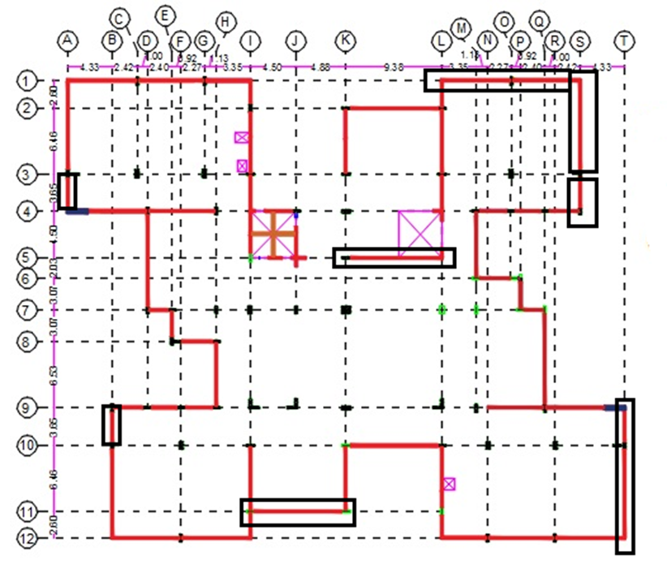

Slide 66
According to the figure, the changes are :
1. Increase the external shear wall thickness located at grids of ( T , 10 – 12 ) , ( S , 1-3 ) and ( L – S , 1 ) in the basement story ( ground floor in ETABS ) from 25 cm to 30 cm .
2. Remove the external shear walls located at grids of ( T , 9 –10 ) , ( S, 3– 4 ) , ( A, 3-4 ) and ( B, 9- 10 ) in basement story ( ground floor in ETABS ) .
3. Remove the external shear wall located at grids of ( I – K , 11 ) in all stories .
4. Remove internal shear wall located at grids of ( K – L , 5 ) in basement story ( ground floor in ETABS ) and it can be placed with brick wall.

Slide 67
Horizontal torsional irregularity in X – direction
Horizontal torsional irregularity in X – direction
Story | Load Case/Combo | Direction | Maximum | Average | Ratio
 |  |  | mm | mm
Roof | 1.0617D+0.7Qx Max | X | 9.2 | 7.941 | 1.159
Third floor | 1.0617D+0.7Qx Max | X | 7.513 | 6.546 | 1.148
Second floor | 1.0617D+0.7Qx Max | X | 5.715 | 5.025 | 1.137
First floor | 1.0617D+0.7Qx Max | X | 3.869 | 3.431 | 1.128
Ground floor | 1.0617D+0.7Qx Max | X | 2.048 | 1.846 | 1.109
Story | Load Case/Combo | Direction | Maximum | Average | Ratio
 |  |  | mm | mm
Roof | 1.0617D+0.7Qy Max | Y | 12.566 | 11.893 | 1.057
Third floor | 1.0617D+0.7Qy Max | Y | 10.098 | 9.558 | 1.057
Second floor | 1.0617D+0.7Qy Max | Y | 7.593 | 7.18 | 1.058
First floor | 1.0617D+0.7Qy Max | Y | 5.054 | 4.784 | 1.056
Ground floor | 1.0617D+0.7Qy Max | Y | 2.68 | 2.508 | 1.068

Slide 68

Vertical torsional irregularity
1. Stiffness irregularity – soft story: by inspection, the stories of this structure have already the same stiffness's so this irregularity does not exist. ( all stories have shear walls )

Slide 69

2. Weight (mass) irregularity: this is considered when the effective mass of any story is more than 150 percent of the effective mass of an adjacent story, but in this structure all story masses are close to each other.
3. Vertical geometry irregularity: by inspection, the horizontal dimension of the lateral force resisting system in any story is not more than 130 percent of that in adjacent story.

Slide 70
4. In-plane discontinuity in vertical lateral –force-resisting element :
this irregularity does not exist in this structure, because the in-plane offset of the lateral – load-resisting elements is not greater than the length of those elements.
5. Discontinuity in capacity –weak story : all stories have approximately the same strength, so weak story does not exist.

Slide 71



P – Delta check
$θ$ = $\frac{P ∆ Ie}{V h Cd}$
X – direction
Y – direction
Story | P | V_{X} | In elastic drift in X – direction ( m ) | $$θ$$
 | kN | kN
Roof | 25415.01 | 5079.49 | 0.00677248 | 0.002036
Third floor | 58773.31 | 8969.39 | 0.00722176 | 0.002844
Second floor | 91524.28 | 11715.24 | 0.00753792 | 0.003539
First floor | 122439.58 | 13579.45 | 0.00745472 | 0.004039
Ground floor | 161514.95 | 15003.49 | 0.00642304 | 0.004155
Story | P | V_{Y} | In elastic drift in Y – direction ( m ) | $$θ$$
 | kN | kN
Roof | 25415.01 | 5188.20 | 0.00946816 | 0.002787
Third floor | 58773.31 | 9079.85 | 0.0098176 | 0.003819
Second floor | 91524.28 | 11786.13 | 0.00960128 | 0.004481
First floor | 122439.58 | 13623.11 | 0.00971776 | 0.005249
Ground floor | 161514.95 | 15047.28 | 0.00886912 | 0.005721

Slide 72

Soil interaction effects
As you know, that the most of structural engineers make the model of building assuming fixed base, but it appears that there are effects using soil interaction.
The following figures show the effects of displacement on structural elements.

Slide 73

After adding a displacement to the middle joint.
There are differences in reinforcement. So, it’s important to make soil interaction since it reflects the reality.

Slide 74

  Comparisons between fixed supports and soil interaction
For fixed supports model, the reinforcement for elevation ( A – T , 7 ) are as shown in the following figure.

Slide 75

For the model with soil interaction, a mat foundation is used to see the differences in reinforcement.
It appears that there are differences in reinforcement, especially in columns, this is due to differential settlement that could happen in the soil.

Slide 76
Final design of the building
Slab
Floor | Thickness ( m )
Ground floor | 0.25
First floor | 0.23
Second floor | 0.23
Third floor | 0.23
Roof | 0.23

Slide 77
Beams
Group Number | Dimensions ( mm )
1 | 800 X 400
2 | 600 X 400
3 | 250 X 350
Group Number | Dimensions ( mm )
1 | 830 X 400
2 | 630 X 400
3 | 230 X 350

Slide 78

The following figure shows the distribution of beams in ground floor.

Slide 79
Columns
Grouping Number | Dimensions ( mm )
1 | 800 X 250
2 | 800 X 400
3 | 600 X 600
4 | 800 X 300

Slide 80

The following figure shows columns layout in basement story.

Slide 81
Shear walls
Grouping Number | Dimensions ( mm )
W1 | 200
W2 | 250
W3 | 530
W4 | 300

Slide 82

The following figure shows the distribution of shear wall in basement story

Slide 83
Footings
Why we used mat foundation ?!
1. As you know, for any structure there is a ground slab sets on the ground, and because the basement floor for our project is garage, the ground slab shall have a good thickness and leveled surface, so it’s better to use mat foundation.
2. Using single footings and tie beams will cause more wastage in formwork, and this means more labor cost.
3. The building is college, so the time needed to finish the construction is important, then using mat foundation is better than single footings, since it needs less time.

Slide 84

Definition of mat foundation in ETABS
By inspection and some trials, the mat foundation thicknesses are as shown in the following figure.
The red areas are mat with 850 mm thickness and total area equals to 1527.01 m²
The blue area is mat with 750 mm thickness and area equals to 436.14 m²

Slide 85


Slide 86


Slide 87


  Differences between the architectural drawings and the final model in ETABS
The model as in architectural drawings

Slide 88


The model in ETABS

Slide 89

Seismic checks in the final model
Period check
Fundamental period for the structure = 0.547 sec which is less than 0.6725 sec (as shown in the figure ) .

Slide 90

Scale factor for response spectrum
Scale factor for response spectrum in X – direction

Slide 91

Scale factor for response spectrum in Y – direction

Slide 92

Base shear

Slide 93
Drift check
Drift in X – direction
Drift in Y – direction
Story | Load Case/Combo | Direction | Elastic drift ( m ) | In elastic drift ( m ) | Allowable drift ( m )
Roof | 1.0617D+0.7Qx Max | X | 0.001364 | 0.0054579 | 0.0624
Third floor | 1.0617D+0.7Qx Max | X | 0.001477 | 0.0059072 | 0.0624
Second floor | 1.0617D+0.7Qx Max | X | 0.001548 | 0.0061901 | 0.0624
First floor | 1.0617D+0.7Qx Max | X | 0.001564 | 0.0062566 | 0.0624
Ground floor | 1.0617D+0.7Qx Max | X | 0.001227 | 0.0049088 | 0.0624
Story | Load Case/Combo | Direction | Elastic drift ( m ) | In elastic drift ( m ) | Allowable drift ( m )
Roof | 1.0617D+0.7Qy Max | Y | 0.002142 | 0.0085696 | 0.0624
Third floor | 1.0617D+0.7Qy Max | Y | 0.002205 | 0.0088192 | 0.0624
Second floor | 1.0617D+0.7Qy Max | Y | 0.002138 | 0.008553 | 0.0624
First floor | 1.0617D+0.7Qy Max | Y | 0.002321 | 0.0092851 | 0.0624
Ground floor | 1.0617D+0.7Qy Max | Y | 0.001934 | 0.0077376 | 0.0624

Slide 94
Torsional irregularity check
Horizontal torsional irregularity
X – direction
Y – direction
Story | Load Case/Combo | Direction | Maximum | Average | Ratio
 |  |  | mm | mm
Roof | Qx-TORSION Max | X | 10.245 | 8.885 | 1.153
Third floor | Qx-TORSION Max | X | 8.381 | 7.357 | 1.139
Second floor | Qx-TORSION Max | X | 6.37 | 5.679 | 1.122
First floor | Qx-TORSION Max | X | 4.294 | 3.918 | 1.096
Ground floor | Qx-TORSION Max | X | 2.365 | 2.147 | 1.102
Story | Load Case/Combo | Direction | Maximum | Average | Ratio
 |  |  | mm | mm
Roof | Qy-TORSION Max | Y | 14.844 | 13.923 | 1.066
Third floor | Qy-TORSION Max | Y | 11.949 | 11.22 | 1.065
Second floor | Qy-TORSION Max | Y | 8.984 | 8.429 | 1.066
First floor | Qy-TORSION Max | Y | 6.049 | 5.645 | 1.072
Ground floor | Qy-TORSION Max | Y | 3.249 | 2.918 | 1.114

Slide 95
P – delta check
X – direction
Story | P | V_{X} | Drift-x | P-delta x
 | kN | kN | m
Roof | 25842.6611 | 4834.03 | 0.005458 | 0.001753
Third floor | 60023.235 | 8540.41 | 0.005907 | 0.002495
Second floor | 93632.8647 | 11152.8 | 0.00619 | 0.003123
First floor | 125358.6448 | 12928.8 | 0.006257 | 0.003646
Ground floor | 165123.8821 | 14318.2 | 0.004909 | 0.003402

Slide 96
Y – direction
Story | P | V_{y} | Drift-y | P-delta y
 | kN | kN | m
Roof | 25842.6611 | 5398.79 | 0.00857 | 0.002465
Third floor | 60023.235 | 9439.51 | 0.008819 | 0.00337
Second floor | 93632.8647 | 12236 | 0.008553 | 0.003933
First floor | 125358.6448 | 14135.6 | 0.009285 | 0.004949
Ground floor | 165123.8821 | 15655.7 | 0.007738 | 0.004904

Slide 97
Design and design checks
The ultimate load combination used in the design
Combination ID | Components
UDCon1 | 1.4 D + 1.4 SD
UDCon2 | 1.2 D + 1.2 SD + 1.6 L
UDCon3 | 1.2881 D + 1.2881 SD + 1.3 Q_{x} + L
UDCon5 | 1.2881 D + 1.2881 SD + 1.3 Q_{Y} + L
UDCon7 | 0.8119 D + 0.8119 SD + 1.3 Q_{x}
UDCon9 | 0.8119 D + 0.8119 SD + 1.3 Q_{Y}

Slide 98

Beam design
Flexural design

Slide 99

Hand calculations
b = 400 mm , h = 800 mm , d = 760 mm
Mu⁺ = 147 kN.m , Mu⁻ = 342 kN.m and P = 353 kN
0.1 x f_{c} x A_{g} = 0.1 x 24 x 400 x 800 / 1000 = 768 kN > 353 kN . the element considered to be a beam.
For Mu⁺ = 147 kN.m , $ρ$ = 0.002146 .
A_{s} = 0.002146 x 400 x 760 = 652 mm² .
A_{s.min} = 0.0033 x 400 x 800 = 1056 mm ( Use it )
For Mu⁻ = 342 kN.m
$ρ$ = 0.0052
A_{s} = 0.0052 x 400 x 760 = 1580 mm² ( Use it )
A_{s.min} = 0.0033 x 400 x 800 = 1056 mm

Slide 100


ETABS results

Slide 101

Shear and torsion design
Vu = 144.4 kN , Tu = 4.5 kN.m
- Shear design
$∅$V_{c} = 0.75 $\frac{\sqrt{fc}}{6}$ bd
where :
f_{c} = 24 MPa , b = 400 mm and d = 760 mm
$∅$V_{c} = 186 kN > 144 kN → No need for shear reinforcement, but minimum shear reinforcement will be used .

Slide 102

- Torsion design
T_{th} = $∅$ $\frac{\sqrt{fc}}{12}$ x $\frac{{Acp}^{2}}{Pcp}$
Where :
$∅$ = 0.75
f_{c} = 24 MPa
A_{cp} = Area of cross – section = 400 x 800 = 320000 mm²
P_{cp} = Perimeter of the cross – section = 2 x ( 400 ) + 2 x ( 800 ) = 2400 mm
→T_{th} = 13 kN.m > 4.5 kN.m, since T_{th} is larger than T_{u} , torsion can be ignored.

Slide 103

ETABS results

Slide 104

Beams detailing's
Group number | Area of steel in mid-span ( bottom bars ) mm² | Area of steel in edge-span (top bar) mm² | Bottom bars | Top bars
B1(630*400 mm) | 940 | 1256 | 3$∅$20 | 3$∅$25
B2(630*400 mm) | 1570 | 1960 | 5$∅$20 | 4$∅$25
B3(630*400 mm) | 1960 | 2400 | 7$∅$20 | 5$∅$25
B4(600*400 mm) | 940 | 1256 | 3$∅$20 | 3$∅$25
B5(600*400 mm) | 1570 | 1960 | 5$∅$20 | 4$∅$25
B6(600*400 mm) | 1960 | 2400 | 7$∅$20 | 5$∅$25
B7(830*400 mm) | 1960 | 2455 | 7$∅$20 | 6$∅$25
B8(830*400 mm) | 2400 | 3200 | 8$∅$20 | 7$∅$25
B9(830*400 mm) | 1256 | 1570 | 4$∅$20 | 4$∅$25
B10(800*400 mm) | 1960 | 2455 | 7$∅$20 | 6$∅$25
B11(800*400 mm) | 2400 | 3200 | 8$∅$20 | 7$∅$25
B12(800*400 mm) | 1256 | 1570 | 4$∅$20 | 4$∅$25
B13(230*350 mm) | 400 | 600 | 2$∅$20 | 2$∅$25
B14(250*350 mm) | 400 | 600 | 2$∅$20 | 2$∅$25

Slide 105

Some beams in the roof have large compression axial loads ( exceeds 0.1f_{c} A_{g} ) , so it should be designed as beam-column.

Slide 106


Slide 107

Column design

Slide 108

Column dimensions : 600 x 600 mm
Axial load = 1524 kN , Ultimate M3 = 350.4 kN.m and ultimate M2 = 367 kN.m
The lateral stiffness of shear walls elements are more than 12 times the stiffness of columns, so consider the columns are braced.

Slide 109

0.1 x f_{c} x A_{g} = 0.1 x 24 x 600 x 600 / 1000 = 864 kN < 1524 kN , the element considered to be a column.
Columns with h/c < 5 shall be designed for shear as in intermediate
h : clear column height , c : larger dimension of the cross – section
4.16 / 0.6 = 6.93 > 5 , design as ordinary frames ( don’t use Ω_{o} )
Slenderness effect can be ignored if : $\frac{K Lu}{r}≤34−12\frac{M1}{M2}≤40$
0.5 $≤$ K $≤$ 1 for braced columns, use K = 1 ( critical value for considering the column is short ) .
L_{u} = Unsupported length = 4.16 m
r = radius of gyration = 0.3 h = 0.3 x 0.6 = 0.18 m
$\frac{K Lu}{r}$ = $\frac{4.16}{0.18}$ = 23.11
Since the moment is double curvature, $\frac{M1}{M2}$ will be negative , so the value of ( $34−12\frac{M1}{M2}$ ) will be greater than 34, so the column is short.

Slide 110



Check the adequacy of amount of steel for this section using Breslar method :
$\frac{1}{φPn}=\frac{1}{φPn3}+\frac{1}{φPn2}+\frac{1}{φPno}$
$∅$P_{no} = 0.65 x 0.8 ( 0.85 x 24 x ( 600 x 600 ) + 420 x 0.01 x ( 600 x 600 ) )
→ $∅$P_{no} = 4605 kN .
To find $∅$P_{n3} and $∅$P_{n2} , draw interaction diagram for $ρ$ = 0.01 in both directions.
→ $∅$P_{n} = 1577 kN > 1524 kN , then 1% reinforcement is adequate

Slide 111

Columns detailing's
Group Number | Reinforcement
1 | 8$∅$20
2 | 12$∅$20
3 | 8$∅$32
4 | 8$∅$20
5 | 10$∅$25
6 | 14$∅$20
7 | 12$∅$20
8 | 14$∅$20

Slide 112


Slide 113

Shear wall design

Slide 114


Wall dimensions and forces
Length of wall: w = 9.06 m
Thickness of wall: h = 0.3 m
Height of wall: hw = 4.16 m

Slide 115
Forces from each load combination
Design Combination | Axial (KN) | M3-3 (KN.m) | M2-2 (KN.m) | In-plane shear (KN) | Out of plane shear (KN)
UDCon1 | 7206 | 5240 | 46 | 0.65 | 111
UDCon2 | 7805 | 5692 | 55 | 38 | 139
UDCon3 | 7927 | 8408 | 220 | 425 | 283
UDCon5 | 8159 | 12583 | 198 | 1181 | 130
UDCon7 | 4446 | 5875 | 206 | 435 | 232
UDCon9 | 4725 | 10005 | 116 | 1171 | 147

Slide 116

Out of plane shear
$φ$Vc $=\frac{0.6}{6}×\sqrt{fc }×bw×d$ = $=\frac{0.6}{6}×\sqrt{24 }×9.06×260$ = 1154 kN
Critical combination is UDCon3
Vu = 283 kN < 1154/2 kN

Slide 117

In-plane shear
d = 0.8 $𝓵$w
Vc $= 0.25×\sqrt{fc }×h×Lw$ = $0.25×\sqrt{24 }×300 ×9.06$ = 3328 kN.
$∅Vc=0.6×3328=1997$kN
From the previous table UDCon5 give the maximum shear
Vu = 1181 kN
Vu > 0.5 $∅Vc$
As Vu > 0.083Acw$\sqrt{fc }$ = 0.083(300 x 9060)$\frac{ \sqrt{24}}{1000}$ =1105 kN
So minimum $ρL$ , $ρt$ shall be at least 0.0025
Horizontal reinforcement for the wall is two curtains of 1$∅12$/300 mm

Slide 118

Flexural design
Out of plane moment :
the critical design combination is UDCon5
M2-2 = 198 kN.m
(8159kN) x e = 198 kN.m
e = 0.024 m which is < 1/6(h) = 0.05 m
This means that simplified design method could be applied.
$φP$ =$0.55φf_{c }A_{g}\left[1−{ \left(\frac{K𝓁_{c}}{32h}\right)}^{2}\right]$
$φP$ =$0.55×0.65×24×9060×300\left[1−{ \left(\frac{1×4.16}{32×0.3}\right)}^{2}\right]/1000$ = 18941 kN
18941 kN > 8159 kN. (OK)

Slide 119
In plane moment :
Pu = 8159 kN
M3-3 = 12583 KN.m

Slide 120

ETABS results
Minimum vertical and horizontal reinforcement is required 1$∅12$/300 mm

Slide 121

Boundary element check
Displacement method : C $≥$ $\frac{Lw}{600 \left(1.5\frac{δu}{hw}\right)}$
Stress method
As h_{w}/L_{w} = 4.16/9.06 = 0.46 < 2, so stress method is used to check the need for the boundary element .

Slide 122



Slide 123

Length of boundary element is the greater of { C – 0.1L_{w} } and { C/2 }
C – 0.1L_{w} = 2039 – 0.1 (9060) = 1133 mm .
C/2 = 2039/2 =1019.5 mm .
→ Take it 1200 mm

Slide 124





P_{Left} or P_{Right} = $\frac{Mu}{Lw−boundary element length}$ = $\frac{12583}{9.06−1.2}$ = 1600 kN
A_{s} $=\frac{P}{∅fy}$
As = $\frac{1600 x 1000}{0.9 x 420}$= 4221 mm² , 20 $∅16$ for each end.
hx < 2/3 thickness
< 350 mm
A_{sh /} ( s b_{c} ) >
A_{sh /} ( s b_{c} ) >
S > 1/3 min dimension
> 6db
>

Slide 125

The previous wall will be designed as wall on grid I (1-3)
24$∅20$
hx = 154 mm
A_{sh} = 11 x 113 =1243 mm²
A_{g} = 0.48 m²
A_{ch} = 0.343 m²
= 0.006
= 0.005
S > 100 mm
> 120 mm
> 165 mm
A_{sh /} ( s b_{c} ) = 0.0079 > 0.006

Slide 126


Slide 127

Spandrel check

Slide 128
Dimensions of this spandrel : h = 2.3m, b = 0.25m, L = 4.2m
UDCon3 is the critical combination
Vu = 1066 kN
Pu = 88 kN
Mu = 2010 kN.m

Slide 129


Flexural design :
𝜌 = $\frac{0.85 fc}{fy}$ (1- $\sqrt{1−\frac{2.61 Mu}{bd^{2}fc}}$ ) = $\frac{0.85×24}{420}$ (1- $\sqrt{1−\frac{2.61×2010×\left({10}^{6}\right)}{250×\left({2260}^{2}\right)×24}}$ )
ρ = 0.00435 > 0.00333
As = 0.00435 x 250 x 2260 = 2459 mm²
% Difference = $\frac{2465−2459}{2465 }X 100\%=0.24 \%$

Slide 130

Shear design :
L_{n}/h = 4.2/2.3 = 1.83 < 2
V_{u} = 1066 kN > $0.33\sqrt{24}×2.3×250$ = 929.6 kN
So diagonal reinforcement shall be used.
$V_{n}=2A_{vd}f_{y}sinα ≤0.83\sqrt{f_{c}}A_{cw}$
Where : $α$ is the angle between the diagonal bars and the longitudinal axis of the spandrel beam
$V_{n}=1066/0.85 ≤0.83\sqrt{24} ×250×2.3=2338 kN$
$sinα= \frac{0.8Hs}{\sqrt{{Ls}^{2}+{0.8Hs}^{2}}}$
$A_{vd}=\frac{1066}{2×0.85×420×0.4 }$ = 3732 mm²
Minimum area of horizontal and vertical reinforcement is required
A_{h} = A_{v} = 0.0025 x 250 x 1000 = 625 mm²/m

Slide 131


Slide 132


Slide 133


Slide 134


Slide 135

Slab design
For all slabs except ground floor, the dimension are :
h = 230 mm, b = 1000 mm and d= 200 mm
A_{smin} = 1000 x 230 x 0.0018 = 414 mm² (4 Ø 12 )
a = (As x f_{y}) / (0.85 x f_{c} x b ) = 9.65 mm ( where f_{c} = 24 MPa ) ,
$∅$Mn = 0.9 x f_{y} x A_{s} x ( d - $\frac{a}{2}$) = 33.4 kN.m.

Slide 136


Maximum moment from ETABS = 51 kN.m
$ρ$ = $\frac{0.85 fc}{fy}$ ( 1- $\sqrt{1−\frac{2.61 Mu}{bd^{2}fc}}$ ) = 0.00345 ( for the maximum moment)
$ρ$ = 0.0035 , A_{s} = 0.0035 x 1000 x 230 = 804 mm²
The same way is done for the reinforcement in X – direction

Slide 137


Slide 138


Slide 139


Mat foundation design
Top steel for mat with thickness of 750 mm
$∅$Mn ( for minimum steel ) = 330 kN.m
By drawing a contour line of moment m₁₁ and m₂₂ between (-330,0)

Slide 140

As shown in the figures above, the maximum moment in the top face of mat foundation is less than -330 kN.m which corresponding to minimum steel.
Minimum steel = 0.0018×1000×750 =1350 mm²
So use 5Ø20 / 1 meter top in both direction.

Slide 141
Top steel for mat with thickness of 850 mm
Minimum steel =0.0018×1000×850 =1530 mm²
So use 5Ø20 / 1 meter top in both direction .

Slide 142


Bottom steel for mat with thickness of 750 mm
$∅$Mn ( for minimum steel ) = 330 kN.m
By drawing a contour line of moment m₁₁ and m₂₂ between ( 0 , 330 )

Slide 143


the maximum moment in the bottom face of mat foundation is more than 330 kN.m.
the maximum value of moment in both direction is less than 580 kN.m, by reading the value of moment with blue color far away the center of column and shear wall.
$ρ$ = $\frac{0.85×34}{420}×(1−\sqrt{1−\frac{2.61×(480)×{10}^{6}}{1000×{700}^{2}×34}} )$=0.0032
As =0.0032$×1000×700$ = 2240 mm²
So use 5Ø25 / 1 meter bottom steel in both direction in dark blue area , far away from the center of column and shear wall.

Slide 144


Bottom steel for mat with thickness of 850 mm
$∅$Mn ( for minimum steel ) = 430 kN.m
By drawing a contour line of moment m₁₁ and m₂₂ between (0, 430)

Slide 145


The maximum moment in the bottom face of mat foundation is more than 430 kN.m.
The maximum value of moment in both direction is less than 680 kN.m, by reading the value of moment with blue color far away the center of column and shear wall.
$ρ$ =$\frac{0.85×34}{420}×(1−\sqrt{1−\frac{2.61×(680)×{10}^{6}}{1000×{800}^{2}×34}} )$ = 0.00286
As =0.00286$×1000×800$ = 2288 mm²
Use 5Ø25 / 1 meter bottom steel in both direction in dark blue area , far away the center of column and shear wall.

Slide 146

Punching check

Slide 147


Slide 148


Slide 149
Staircase design
Dimensions of staircase
The width of single flight is 2.1 m
Riser = 17 cm
Tread = 28 cm
Span of staircase = 3.1 m
Landing = 1.1 m
Slab waist as 15 cm.

Slide 150
Loads
Dead = average height of steps x width of steps x 24.5
= (15+17/2) x 2.1 x 24.5 =12.1kN/m.
Superimposed dead = width of steps x 3.5 = 2.1 x 3.5 = 7.5 kN/m
Live= width of steps x 5=2.1 x 5=10.5 kN/m .
W_{u}=1.2 x (12.1+7.5) + 1.6 x 10.5 = 42 kN/m.

Slide 151

Flexural design
M = $\frac{W L^{2}}{8}$= 52.9 kN.m
𝜌 = $\frac{0.85 fc}{fy}$ ( 1- $\sqrt{1−\frac{2.61 Mu}{bd^{2}fc}}$ )
ρ = 0.009 > 0.0033
ρ_{max}= 0.375 β $\frac{0.85 fc}{fy}$ = 0.015 ( where $β$= 0.85 for f_{c} $≤$ 28 MPa )
A_{s} = 0.009 x 150 x1000 = 1370 mm², 9Ø14/ m in longitudinal direction.
A_{smin} = ρ_{min} x b x h = 492 mm², 4Ø14/ m in transverse direction

Slide 152

Shear design
V_{u}= $\frac{W L}{2}$ = 68.2 kN.
V_{n} = V_{u}/∅ = 68.2/0.75 = 91 kN
V_{c} = $\frac{\sqrt{fc} }{ 6}$ bd = $\frac{\sqrt{24} }{ 6}$ x 1000 x 130 = 106 kN
V_{c} > V_{n} , so use minimum shear reinforcement .
( Av/s )_{min} = max. (0.062 $\sqrt{fc}$ $\frac{bw}{fyt}$ , $\frac{0.35 bw}{fyt}$) = 0.833 mm²/mm
S = Av/0.833 = 2 x 79/ 0.833 = 185 mm
Shear reinforcement (stirrups) : 5Ø10/ m

Slide 153


Slide 154

THANK YOU FOR LISTENING

