Slide 1
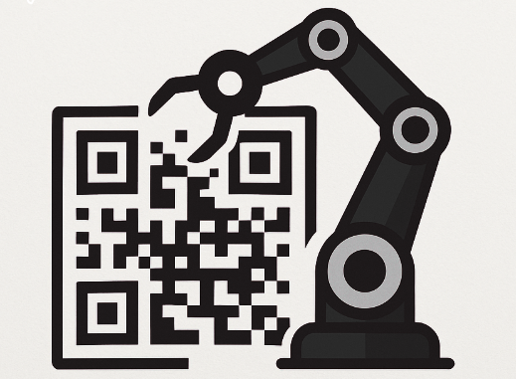
QR Robotic Arranger
SUBPERVISED BY: DR. HEKMAT DARAWSHEH
AHMAD HANANI & ABD ALBASET RAJAB

Slide 2
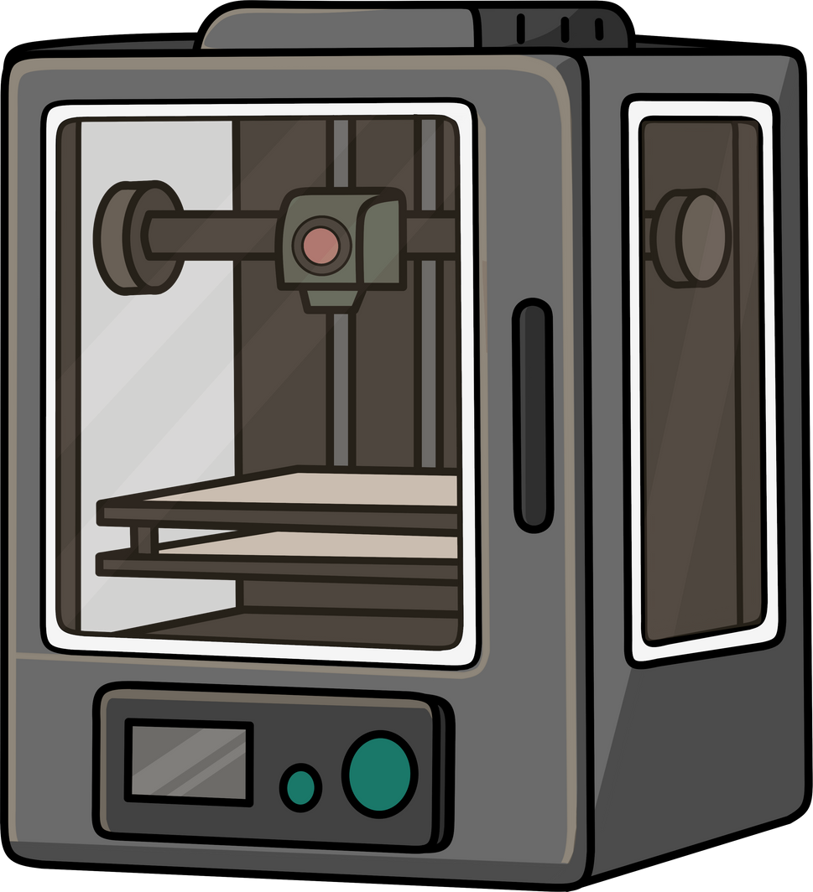
INTRODUCTION
The QR Robot is a smart, interactive product recognition and delivery system that uses QR codes. It operates in an enclosed cube where products are placed, each with its own QR code.

Slide 3


THE MAIN PROBLEM
Relying on manual product searches causes slowness and errors.

Slide 4

OBJECTIVES
1.Smart QR picking
2.Make user interaction simple and smart.
3.Use the system in smart stores, exhibitions, and storage systems
4.Faster and easier selection

Slide 5
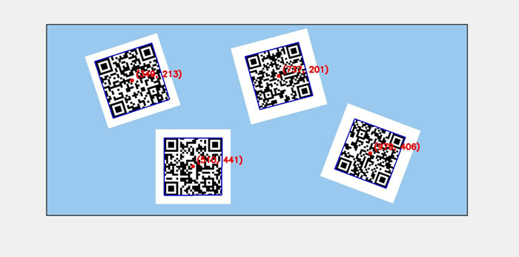
IMPLEMENTATION
first :
We defined the idea, tested it, and got these results.

Slide 6



IMPLEMENTATION
Assembly
Programming
Calibration

Slide 7


FEATURES
QR Code Recognition
Smart Product Picking
User-Friendly Interface
Accurate Position Detection
Time and Effort Saving
Error Reduction

Slide 8
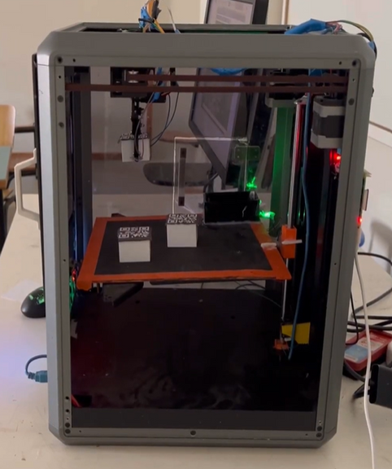
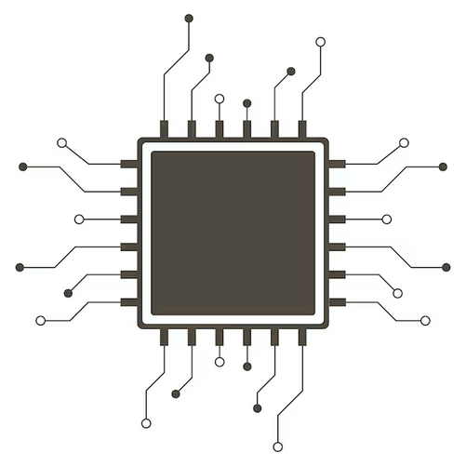
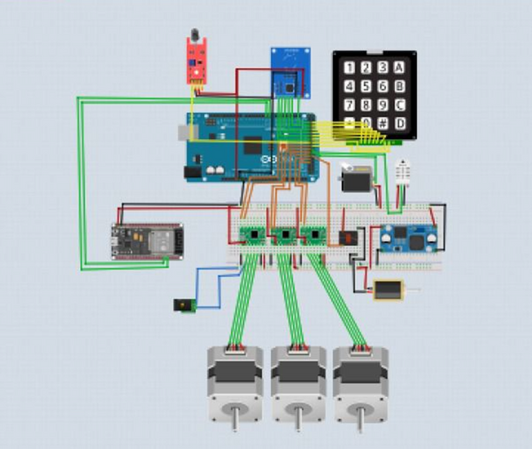
HARDWARE COMPONENTS

Slide 9
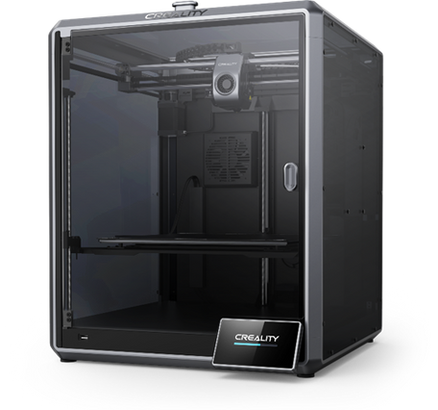
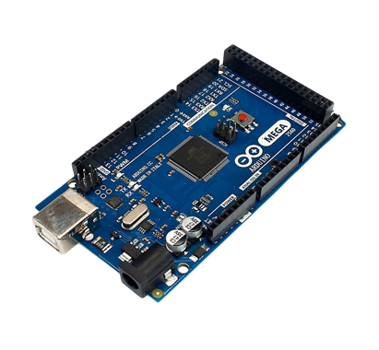
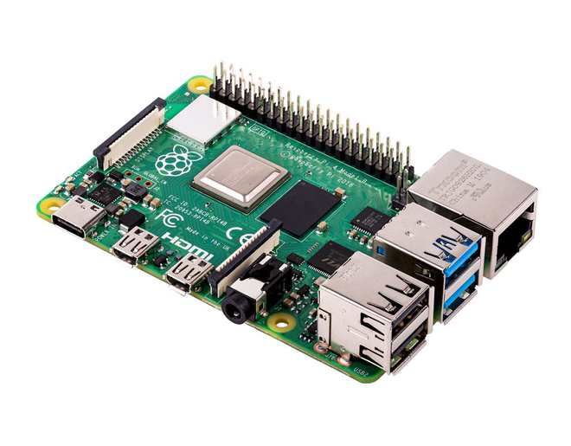
HARDWARE COMPONENTS
Creality K1
Arduino Mega
Raspberry pi 4

Slide 10
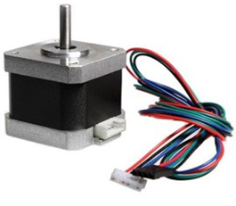
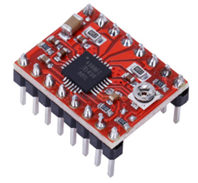
HARDWARE COMPONENTS
Stepper Motor NEMA17
A4988 driver

Slide 11
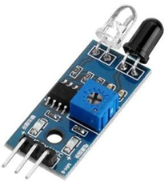
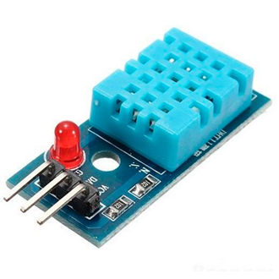
HARDWARE COMPONENTS
IR sensor
Dht11

Slide 12
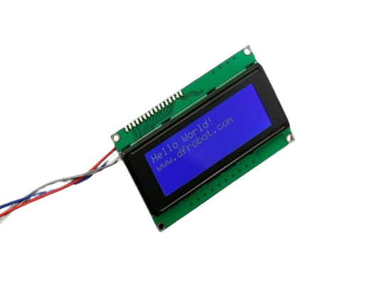
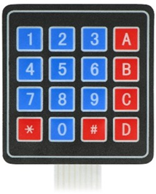
HARDWARE COMPONENTS
Keypad
I2C 20X4 LCD

Slide 13
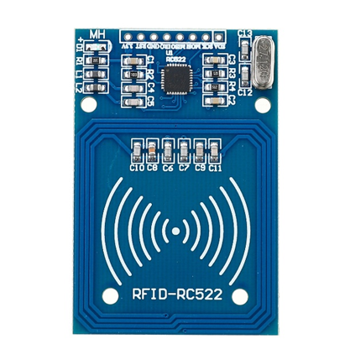
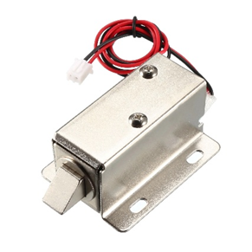
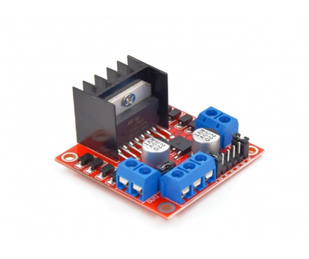
HARDWARE COMPONENTS
RC522 (RFID)
H-bridge
Solenoid lock

Slide 14
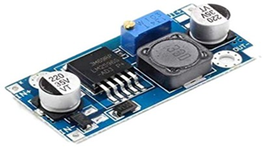
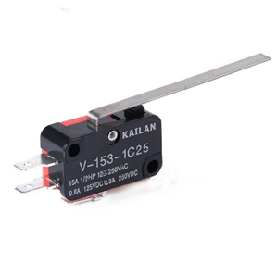
HARDWARE COMPONENTS
Step Down Buck Converter Module
Limit Switch

Slide 15
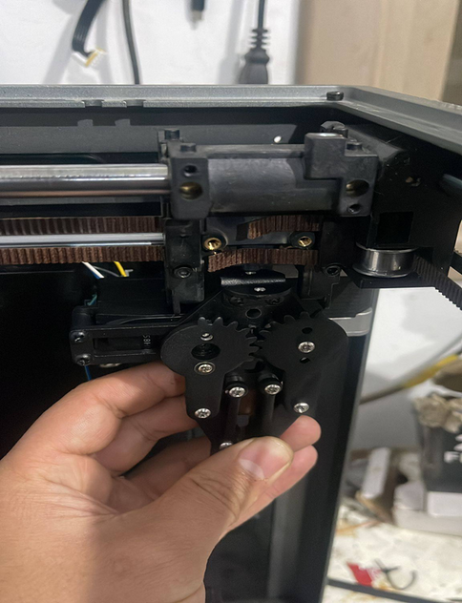
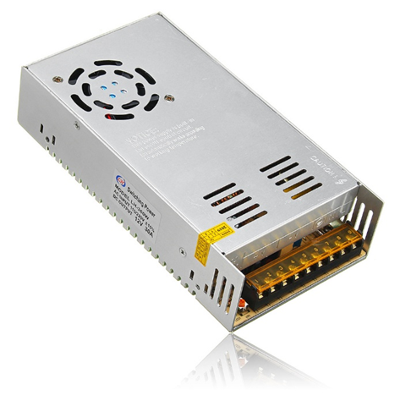
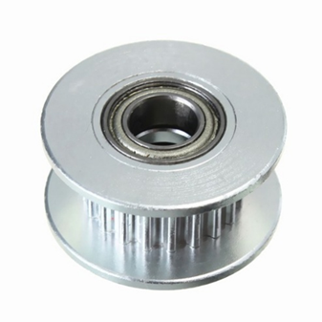
HARDWARE COMPONENTS
GT2 20T Dual Bearing Aluminum
Power Supply
Robotic Arm

Slide 16
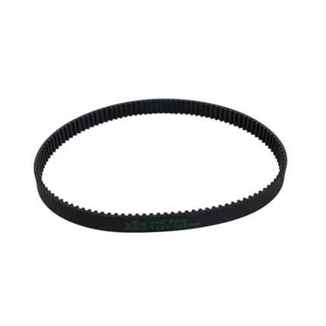
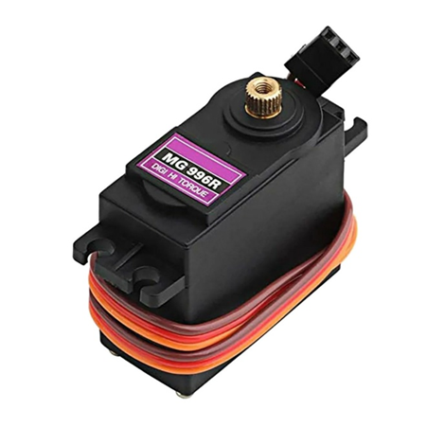
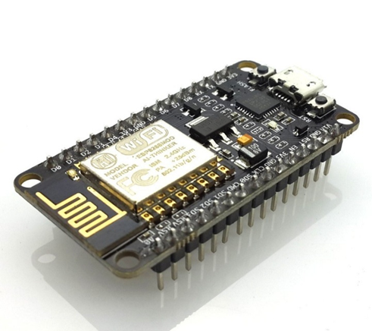
HARDWARE COMPONENTS
Esp8266
Mg996r

Slide 17
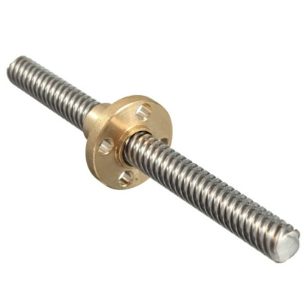
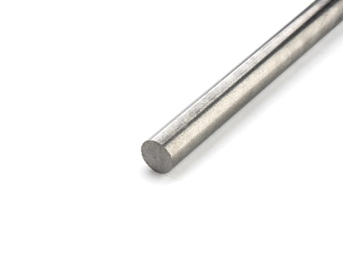
HARDWARE COMPONENTS
Lead Screw
stainless steel round bar

Slide 18
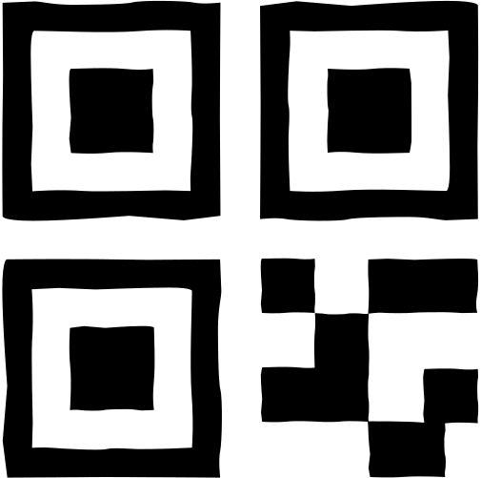
SOFTWARE IMPLEMENTATION
QR Code Reading Mechanism in the System :
1.Capture image and convert to grayscale.
2.Enhance image using several techniques like CLAHE, thresholding, and inversion.
3.Decode QR code using pyzbar.
4.Match value and determine direction.

Slide 19

SOFTWARE IMPLEMENTATION
Product Location Detection:
1.Using pyzbar, x and y of QR corners are extracted.
2.x_coords: X positions of all QR corners
y_coords: Y positions of all QR corners
(x1,y1)
(x2,y2)
3. (x1,y1)= (Min(x-coords)),(Min(y-coords))
(x2,y2)= (Max(x-coords)),(Max(y-coords))
(cx,cy)
4.to find the center: cx = (x1 + x2) / 2
cy = (y1 + y2) / 2
(x3,y3)
(x4,y4)

Slide 20
SOFTWARE IMPLEMENTATION
The center of the camera frame is calculated as a reference point.The center of the detected QR code is also calculated.
The difference between the QR center and the frame center (dx, dy) tells the robot how to move to align with the QR code.
frame_center_x = frame_width / 2
frame_center_y = frame_height / 2
(x1,y1)
(x2,y2)
(cx,cy)
dx = cx - frame_center_x
dy = cy - frame_center_y
(x3,y3)
(x4,y4)

Slide 21

SOFTWARE IMPLEMENTATION
Mobile App:
"We used the ESP8266 to create a local Wi-Fi network and run a web-based system. Users can connect, then add, update, or order products. All product data is saved in a file using LittleFS. When a product is ordered, the ESP sends the QR code to the Arduino through Serial. The Arduino then moves the robotic arm to deliver the product."

Slide 22
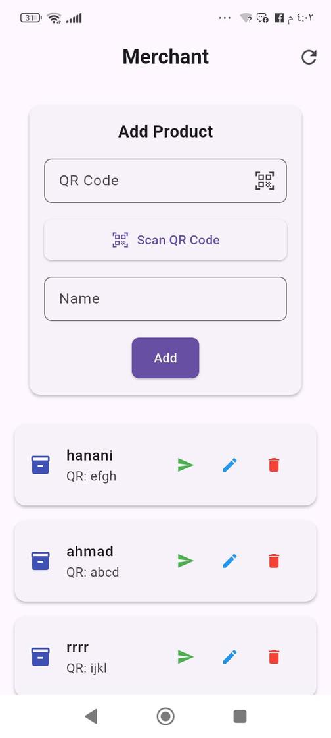
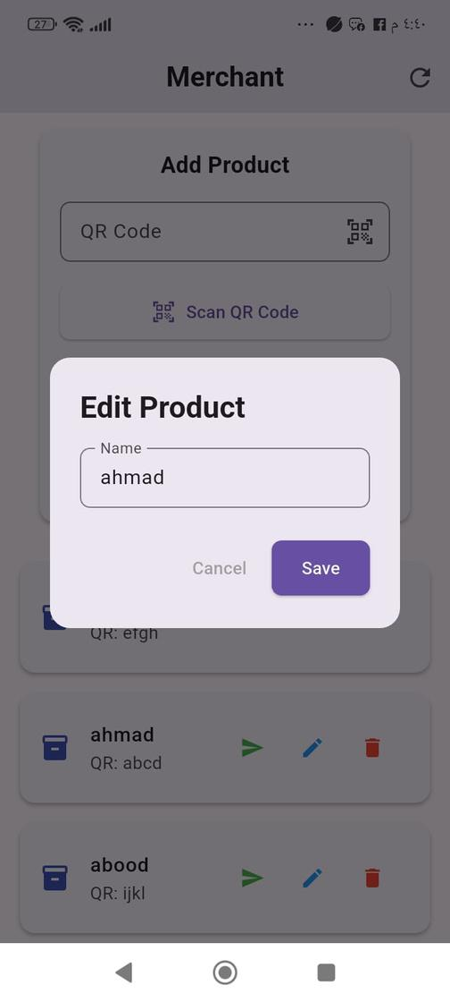
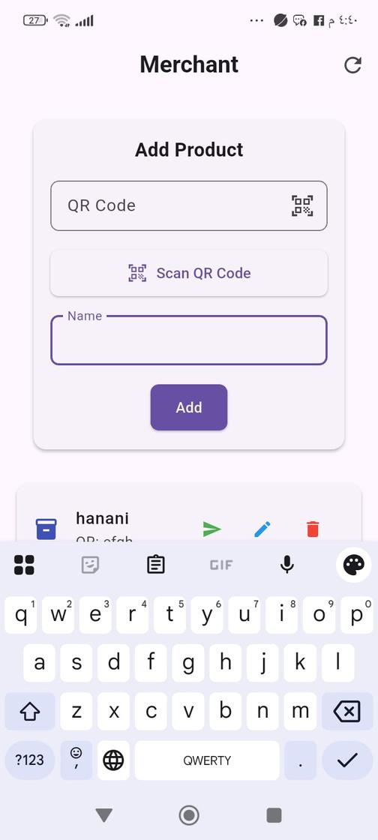
SOFTWARE IMPLEMENTATION
Mobile App:
The following images show the user interface of the application

Slide 23

CONSTRAINTS
  High cost of CNC and robotic systems
  Difficulty picking tilted products accurately
  We faced challenges with precise robotic arm movement, solved by using limit switches.

Slide 24

FUTURE WORK
  Improve gripping at tilted angles
  Improve arm precision and speed
  Real-time remote monitoring and control
  Upgradable to a shelf-arranging robot.

Slide 25

any questions ?

