Slide 1
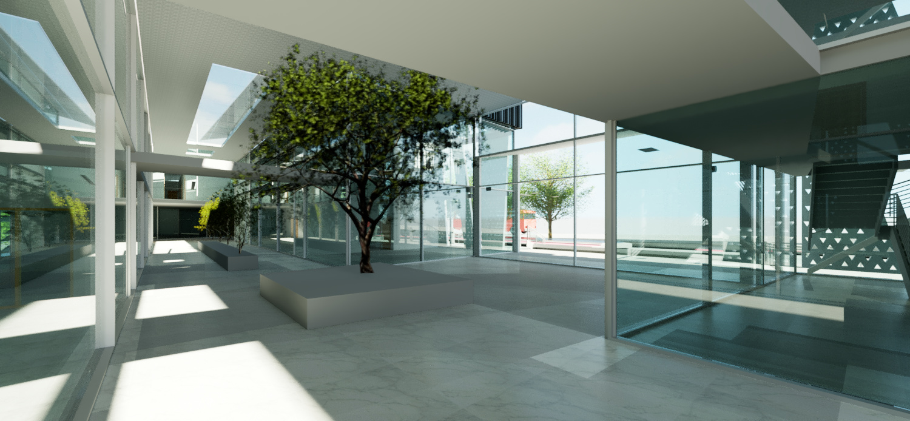

INTEGRATED DESIGN OF A DIRECTORATE OF EDUCATION IN NABLUS
Najah National University
Building Engineering department
Second semester 2019/2020
Graduation project Ⅱ
Prepared by:
- Manar Awad
Shatha Ghassan
Haya Bustami
Supervised by:
Dr. Monther Dwaikat

Slide 2
ARCHITECTURAL-ENVIRONMETNAL ASPECTS
STRUCTURAL ASPECTS
ELECTRO-MECHANICAL ASPECTS
QUANTITY SURVYING, COST ESTIMATION AND LIFECYCLE ANALYSIS
TOPICS

Slide 3
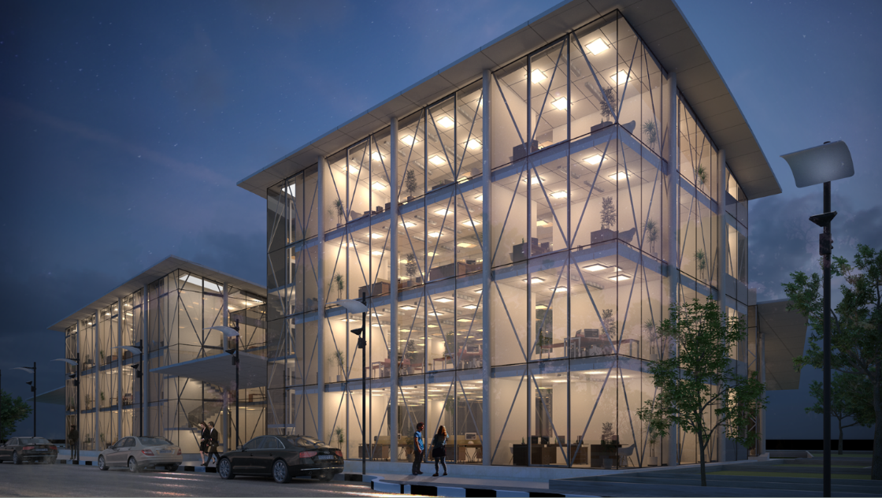
INTRODUCTION
Location : Nablus – Near Ministry of health
Case : Redesign of a directorate of education (Architectural) (Not existing)
Design of structural, mechanical and electrical systems.

Slide 4
ARCHITECTURAL ASPECTS
SITE ANALYSIS
BUILDING
CIRCULATION
ENVIRONMENT
SURROUNDINGS
FIRSTLY: SITE ANALYSIS
Topography and contours
Surroundings and nearby buildings
Roads and circulation
Setbacks and footprints
Landscaping
Sun path and wind direction

Slide 5
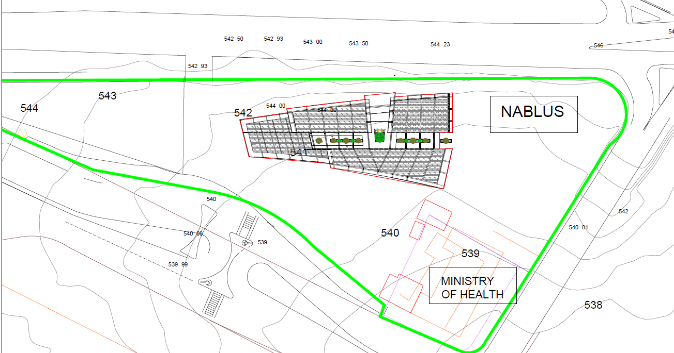
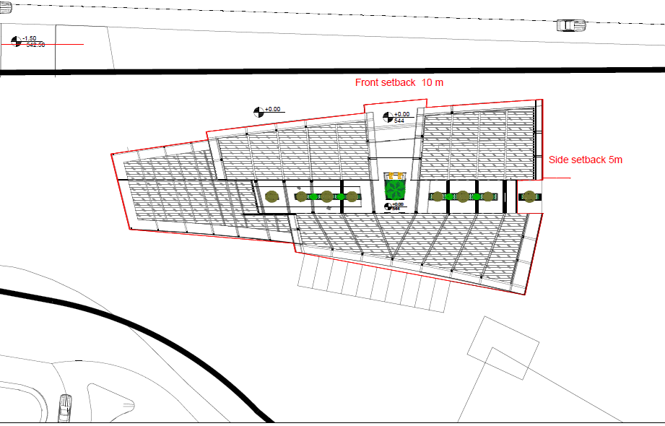

Slide 6
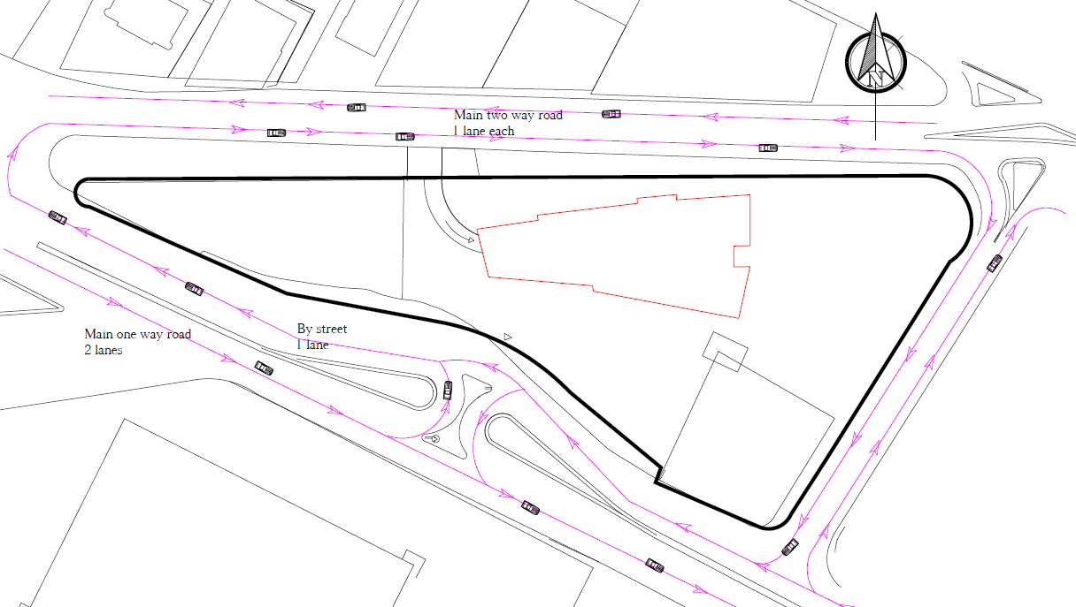

Slide 7
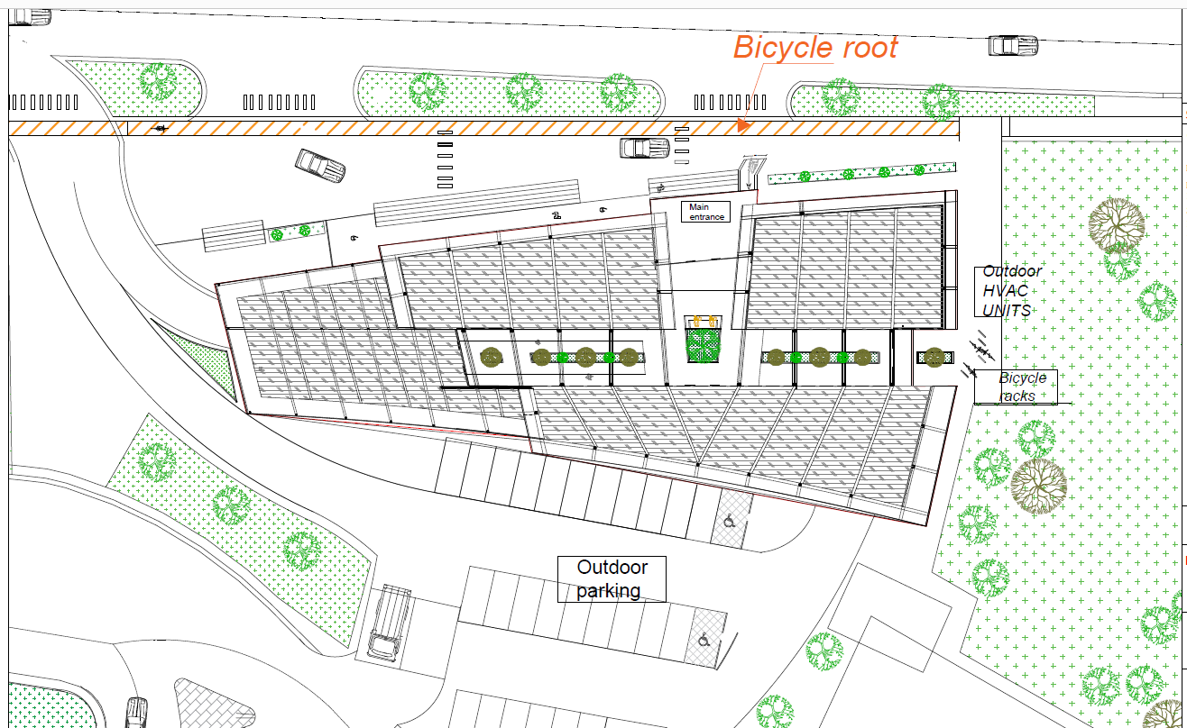
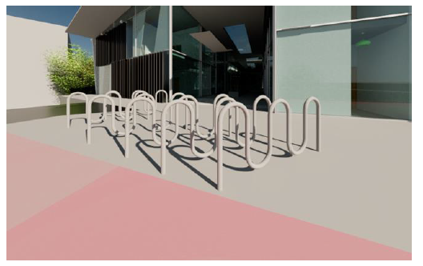

Slide 8
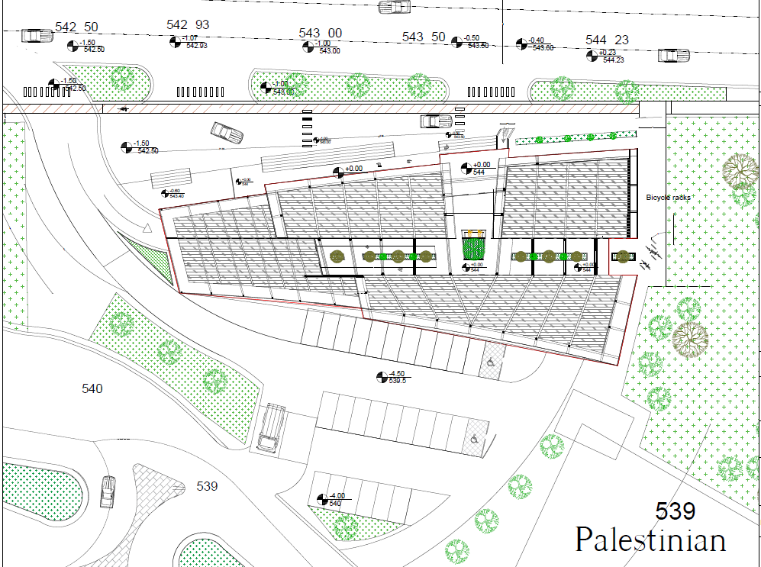

Slide 9
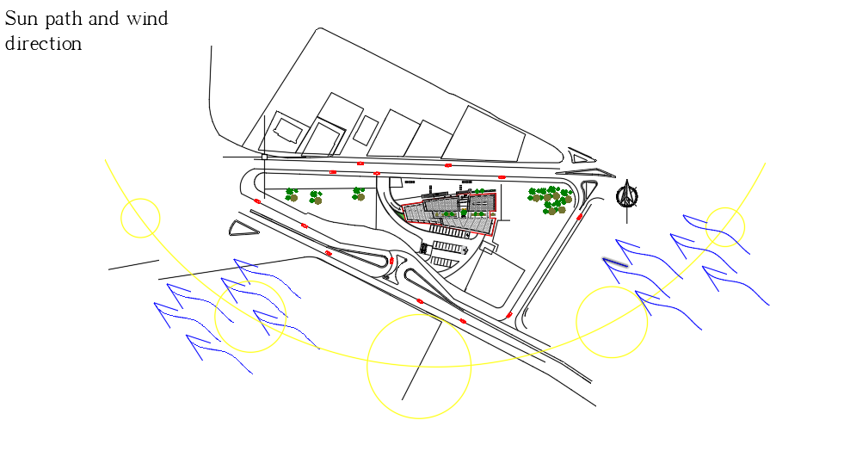

Slide 10
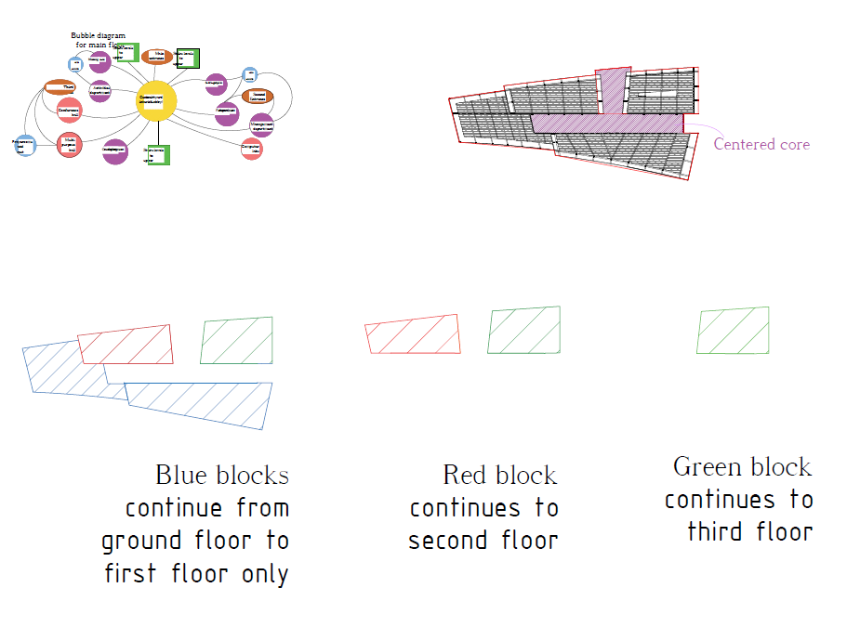
ARCHITECTURAL ASPECTS
SECONDLY: SPACIAL REDESIGN
Interior spaces including: Offices, storage rooms, multipurpose halls, conference hall, undercroft car parking and outdoor car parking, interior court.
Entrances, exits, circulation
organization
Vertical transportation
Emergency and evacuation plans
SPACES
EMERGENCY EXITS
MOVEMENT AND CONNCECTIVITY

Slide 11
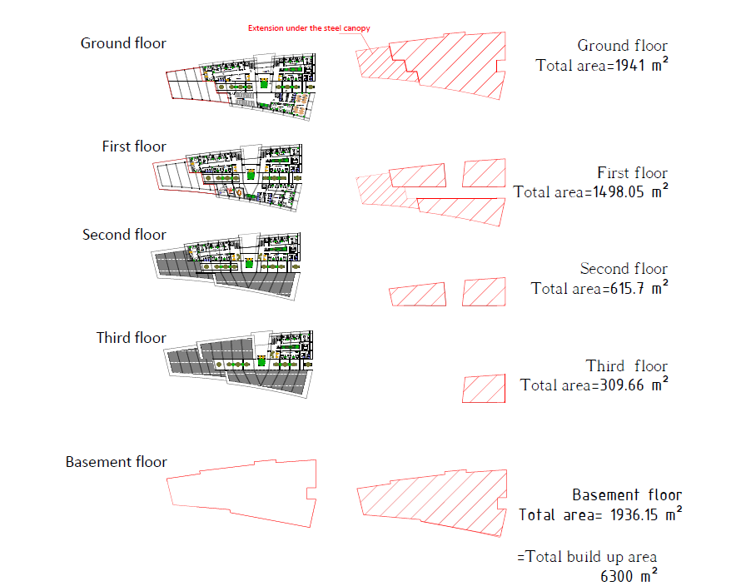

Slide 12
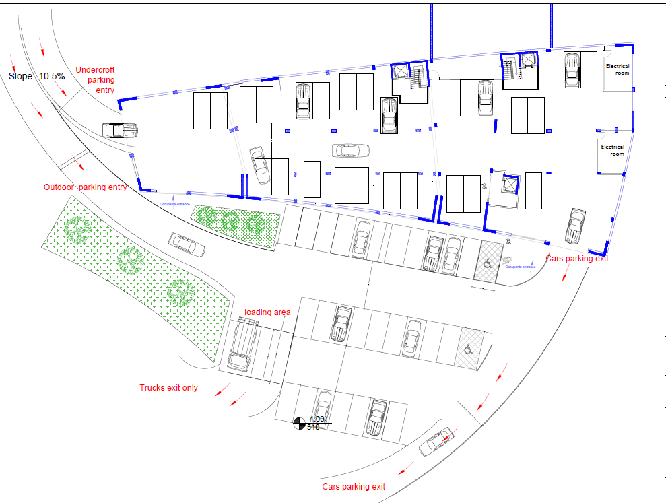
BASEMENT PARKING

Slide 13
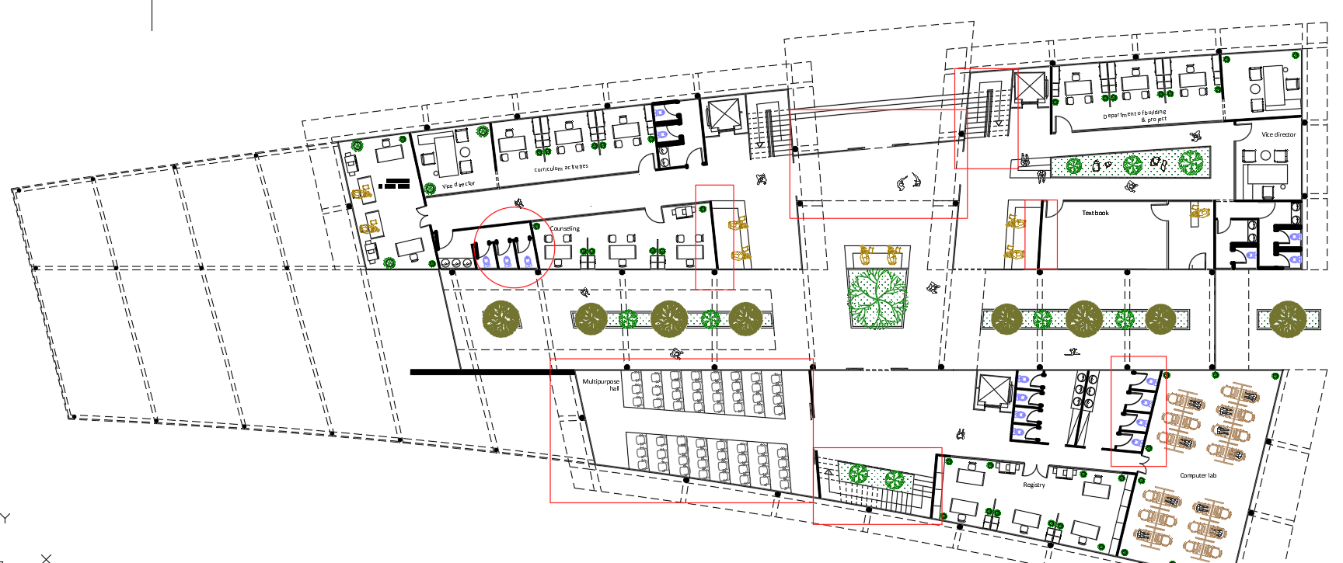
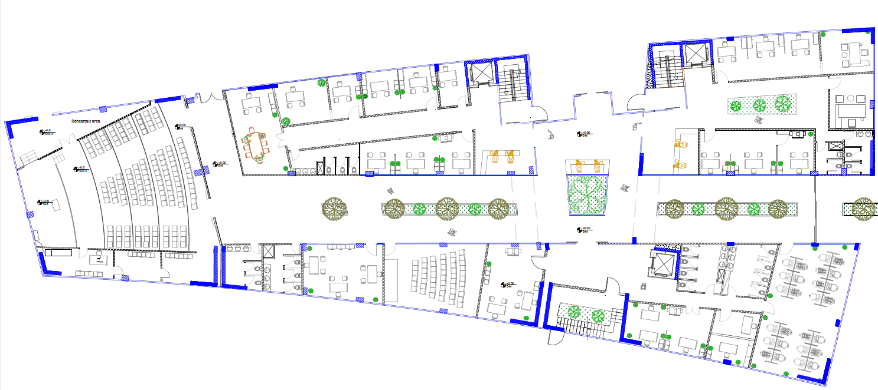
GROUND FLOOR
BEFORE
REDESIGNED:
1- inclined partitions
2- Emergency exits
3- Stairs
4- Optimizing area in a conference hall
5- Rearranging seats in multipurpose hall
AFTER

Slide 14
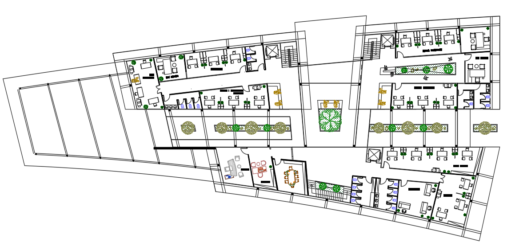
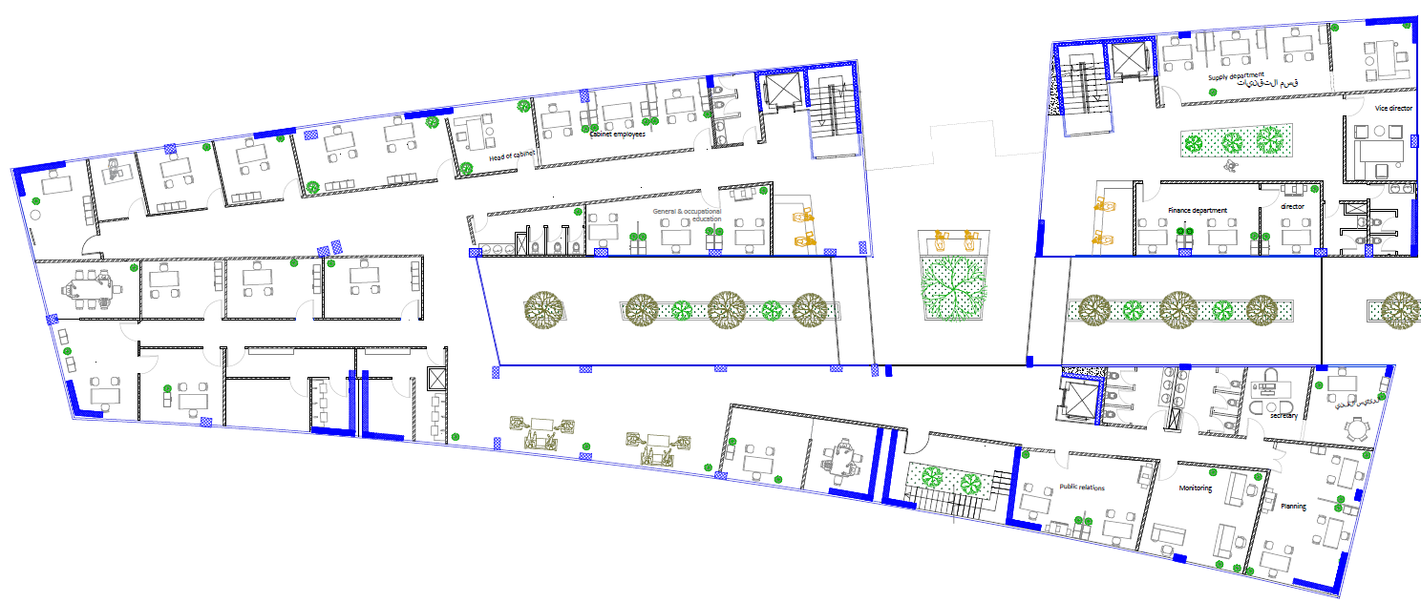
FIRST FLOOR
BEFORE
REDESIGNED:
1- inclined partitions
2- Emergency exits
3- Stairs
4- Providing prayer rooms and ablutions
5- Adding supervision offices as required
AFTER

Slide 15
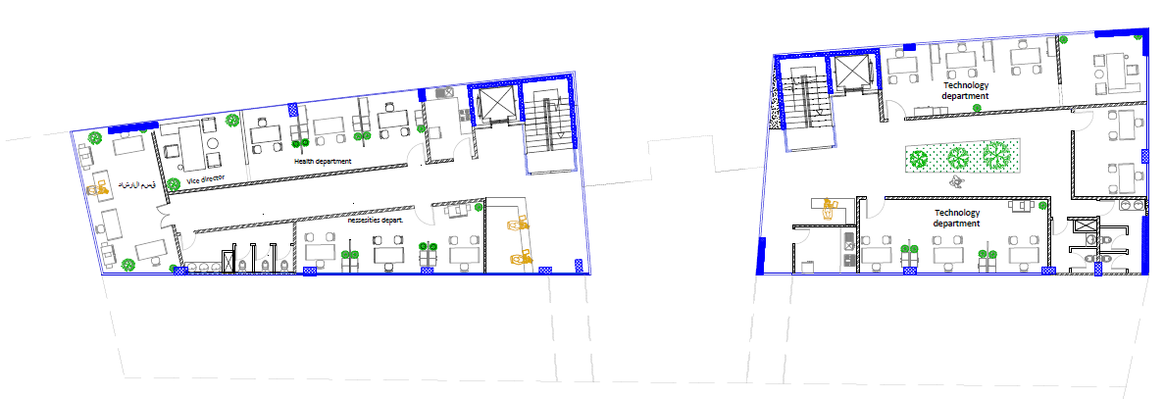
SECOND FLOOR

Slide 16
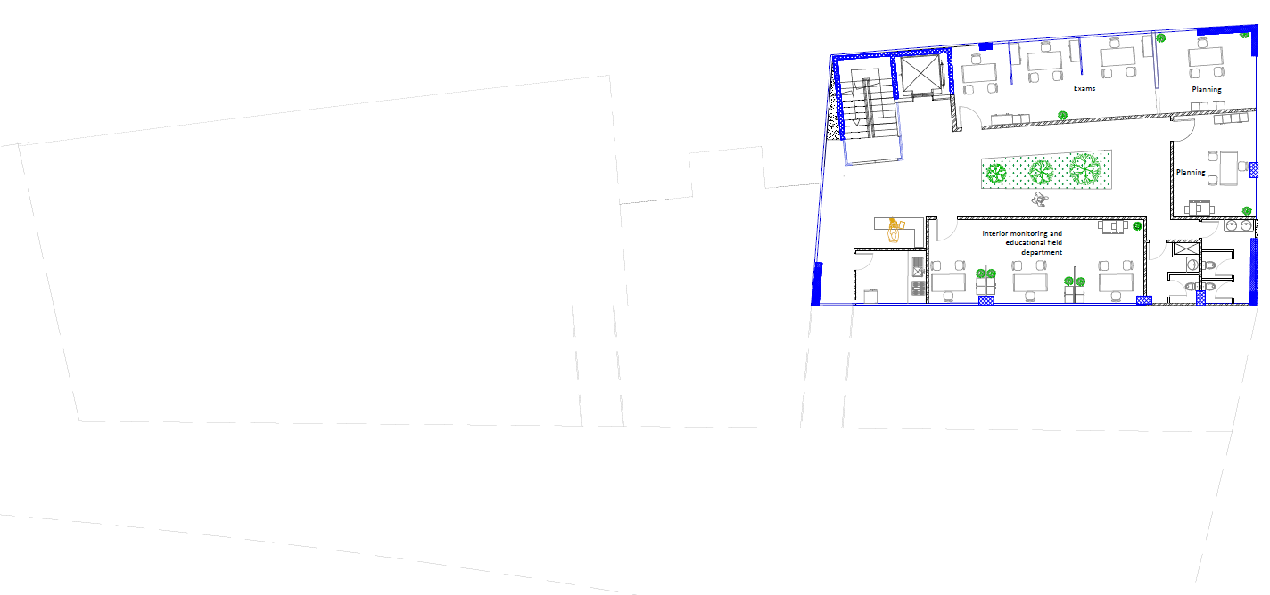
THIRD FLOOR

Slide 17
ENVIRONMENTAL ASPECTS
ENVRIONEMTNAL ASPECTS
VISUAL COMFROT
ACOUSTICAL COMFORT
THERMAL COMFORT
SOCIAL COMFORT
FIRSTLY: ENVIRONMENTAL ANALYSIS
DAYLIGHT ANALYSIS
SOLAR ANALYSIS
OVERSHADOWING ANALYSIS
ACOUSTICAL ANALYSIS
THERMAL ANALYSIS

Slide 18
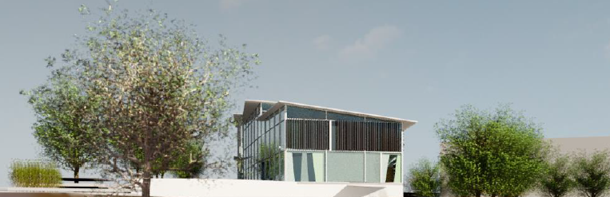
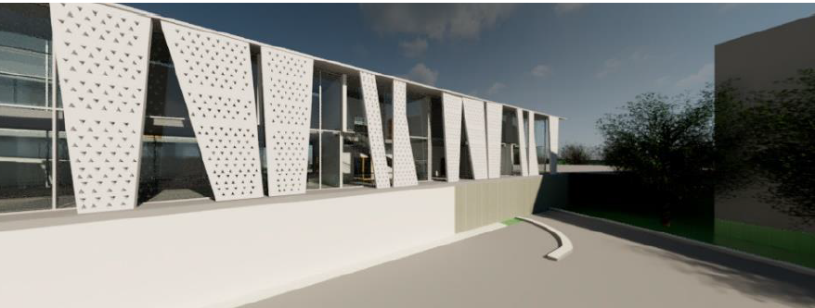
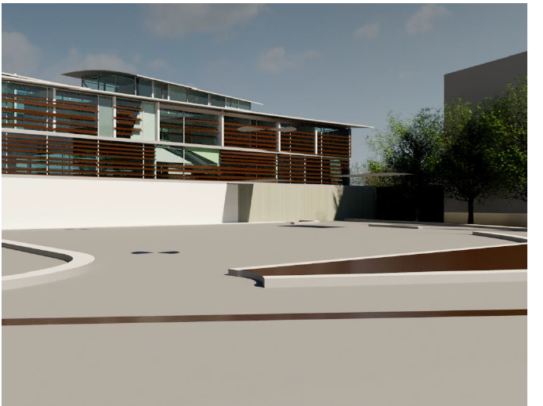
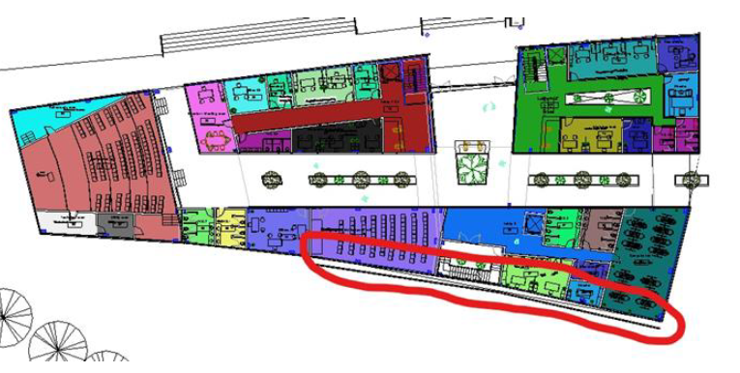
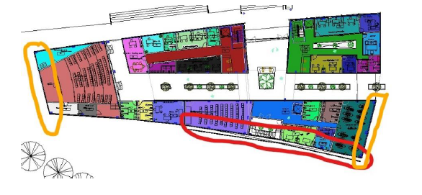
ENVIRONMENTAL SOLUTIONS

Slide 19
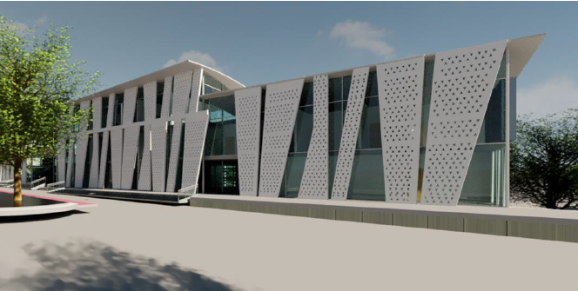
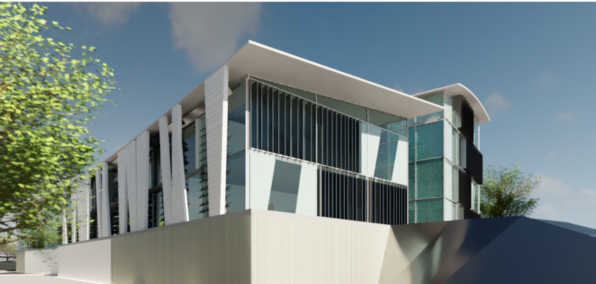
ENVIRONMENTAL SOLUTIONS
-Perforated panels with 10% voids
Horizontal and vertical adjustable louvers depending on the elevation
Cantilevers within the building roof with a length of 1.26 m
Low u value double glass

Slide 20
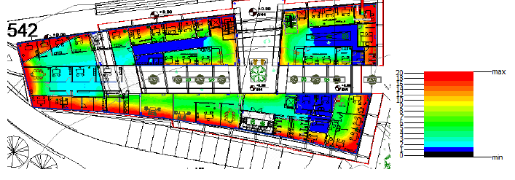
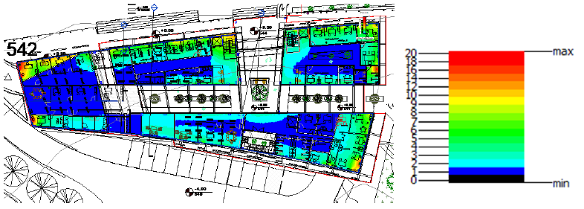
DAYLIGHT ANALYSIS
BEFORE
-Rapid decrease in
daylight factor
AFTER

Slide 21
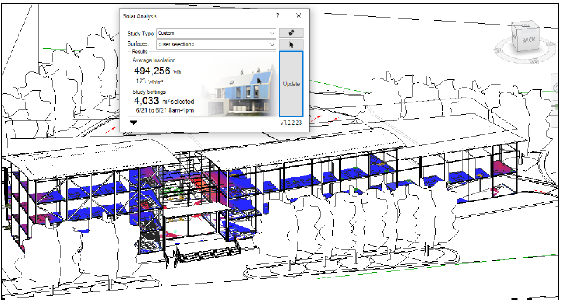
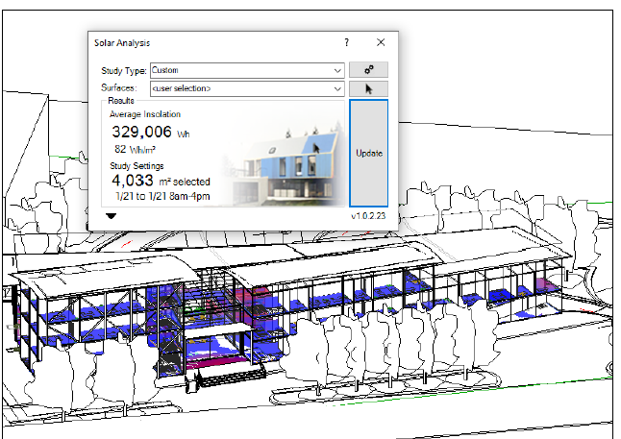
SOLAR ANALYSIS
SUMMER CASE
WINTER CASE

Slide 22
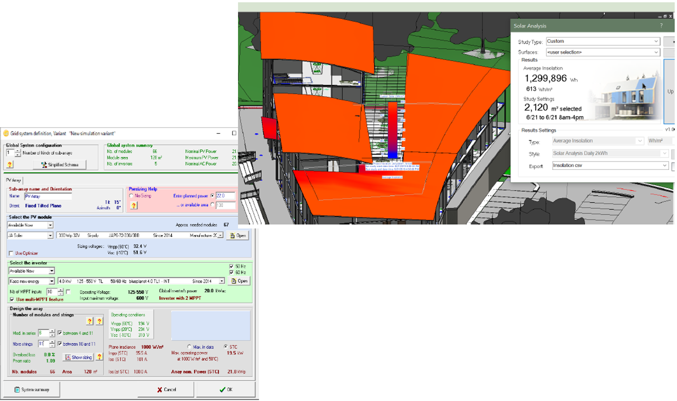
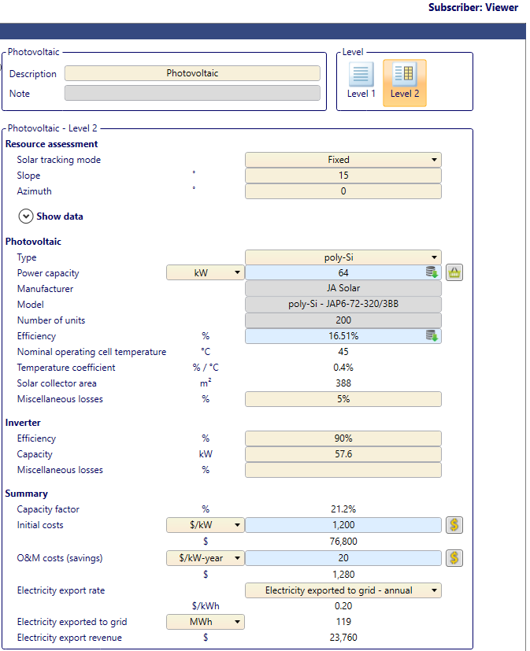
ROOF SOLAR ANALYSIS

Slide 23
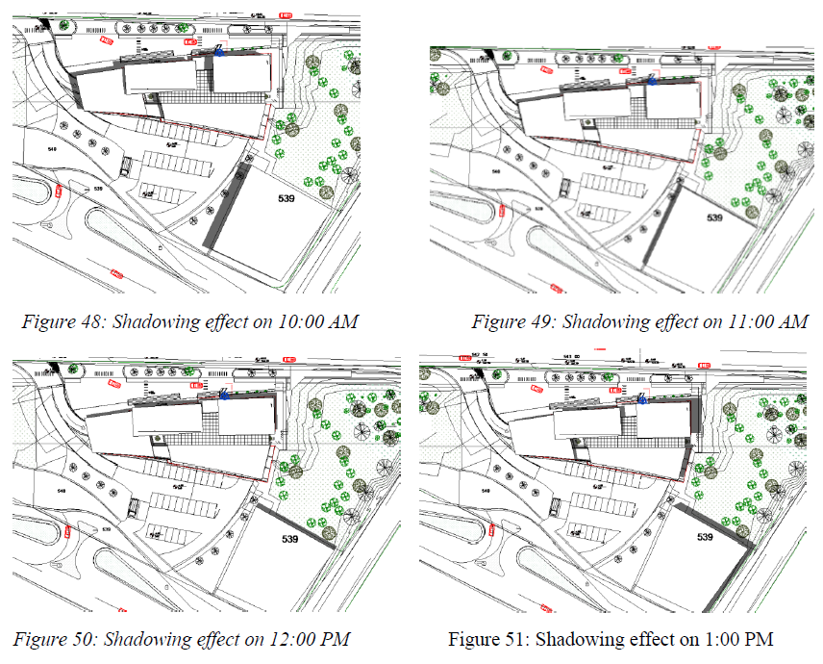
OVERSHADOWING ANALYSIS

Slide 24
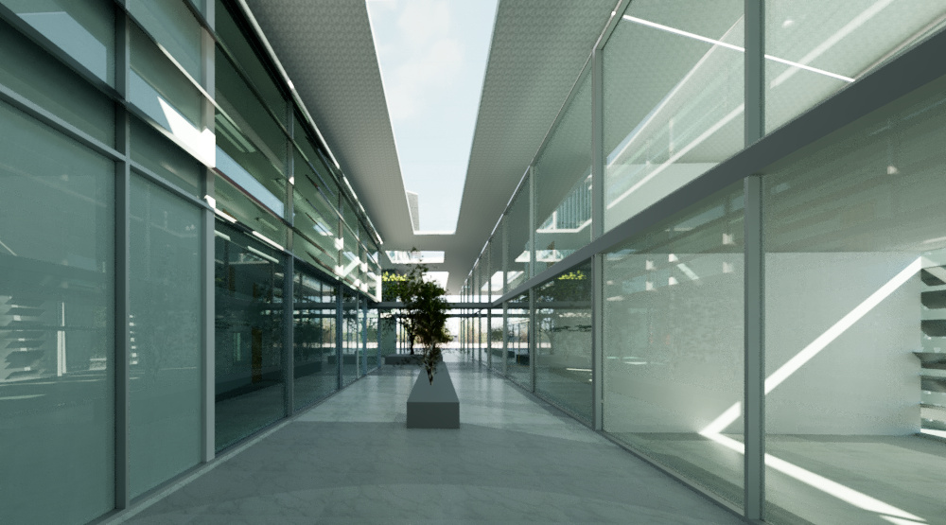
COURT SOLUTIONS

Slide 25
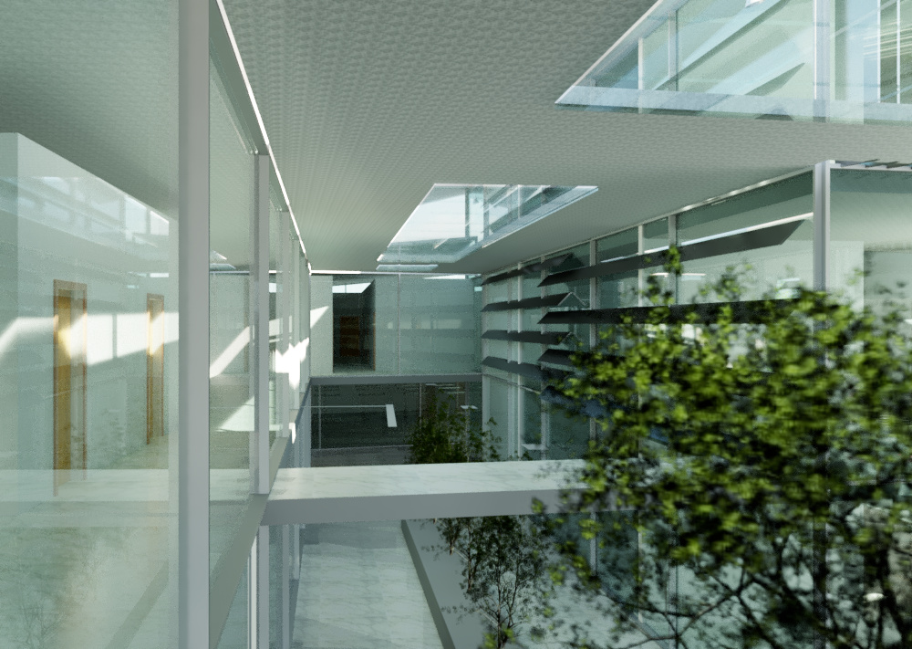
COURT SOLUTIONS

Slide 26
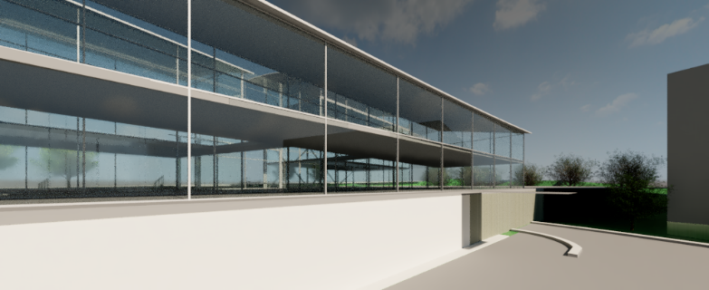
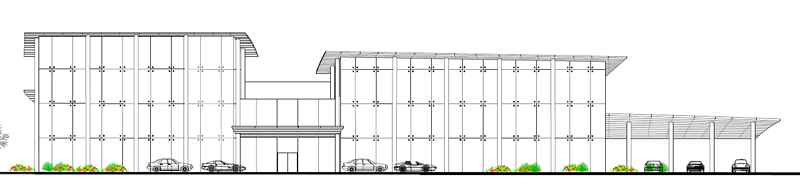
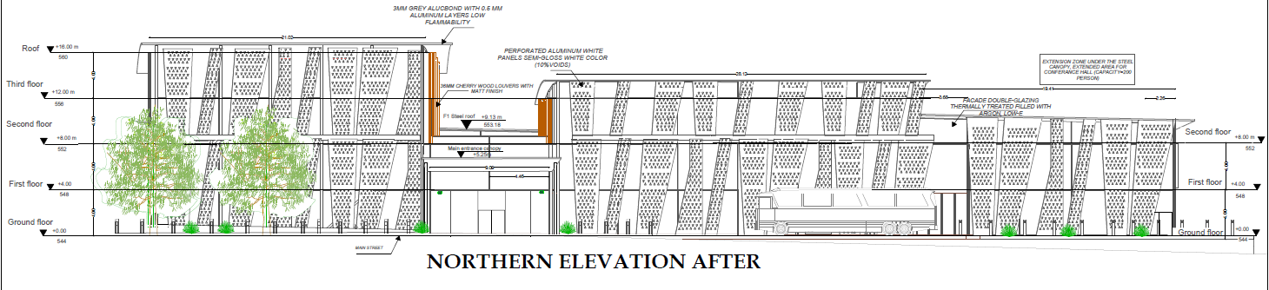
ELEVATIONS AND SECTIONS

Slide 27
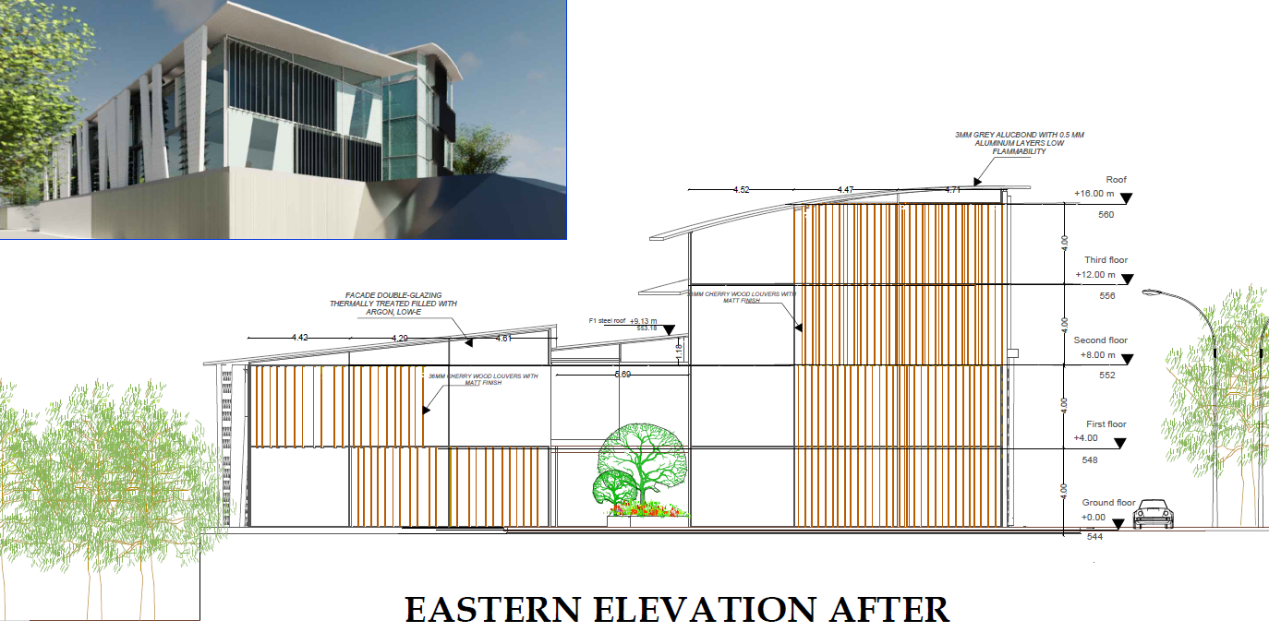
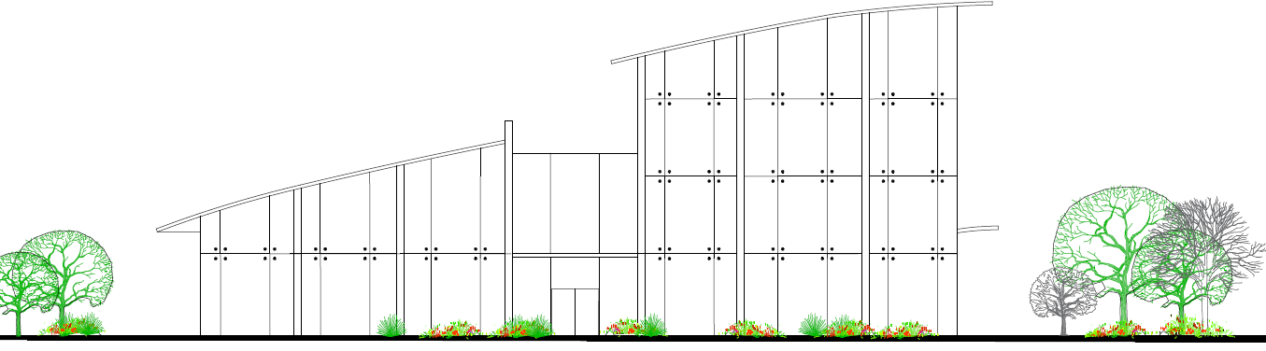
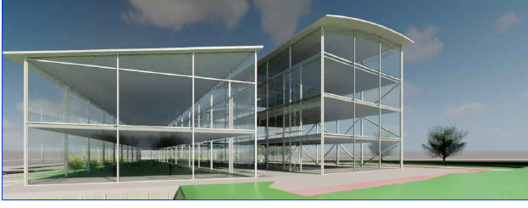
ELEVATIONS AND
SECTIONS

Slide 28
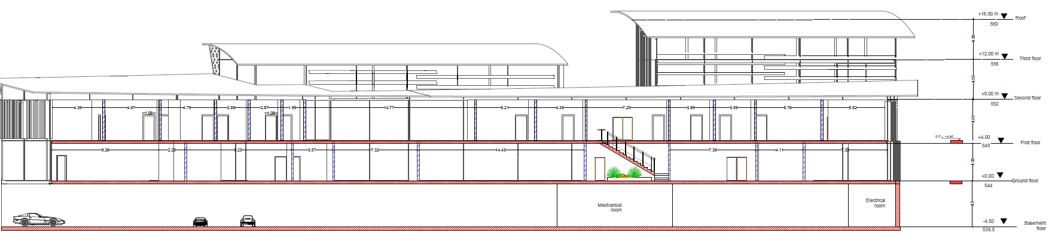
ELEVATIONS AND SECTIONS

Slide 29
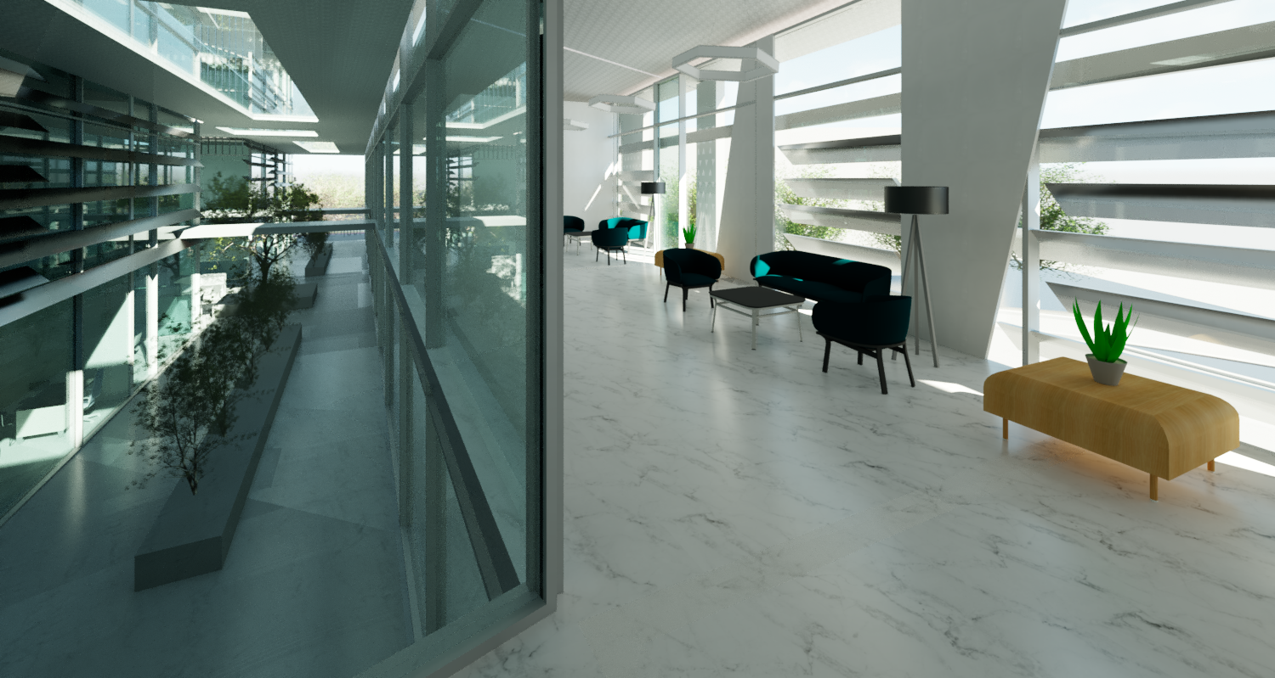
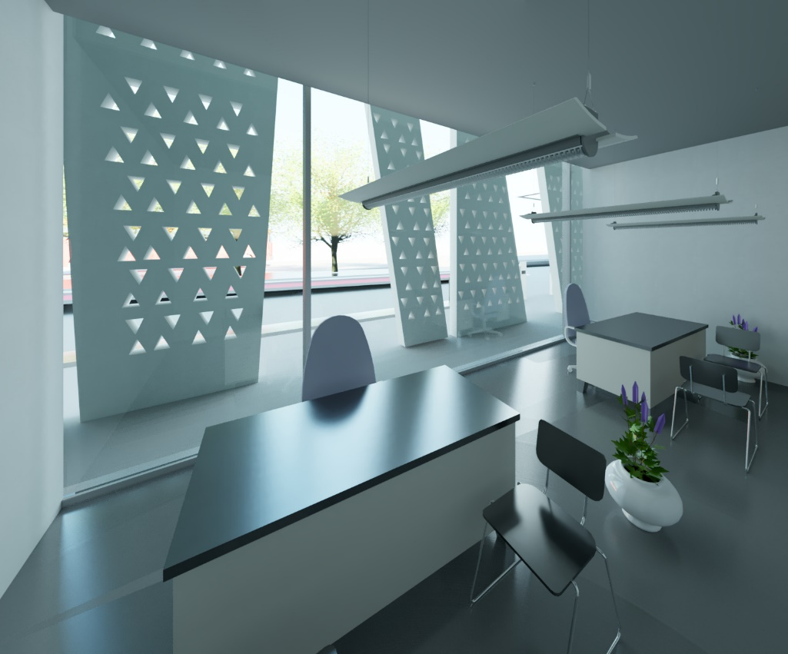
INTERIORS
-WIDE
-BRIGHT SCHEME OF COLOURS
-TRANSPARENT
-PRACTICIAL
-ENHANCES PRODUCTIVITY
AND CONNECTIVITY

Slide 30
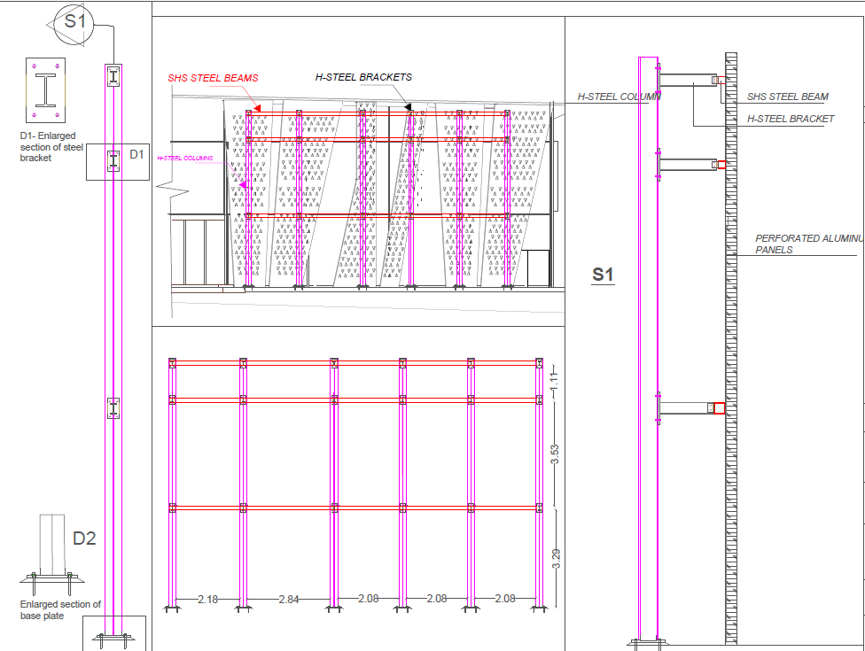
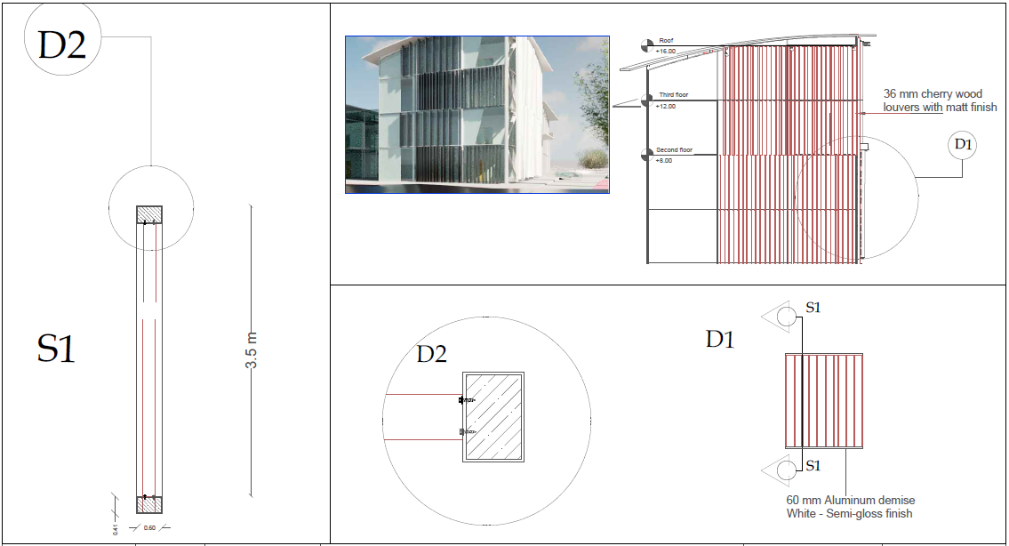
CONSTRCUTION
DETALS

Slide 31
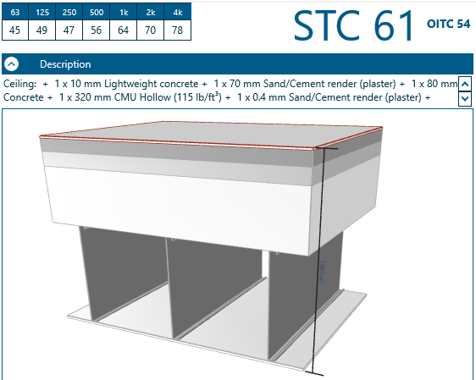
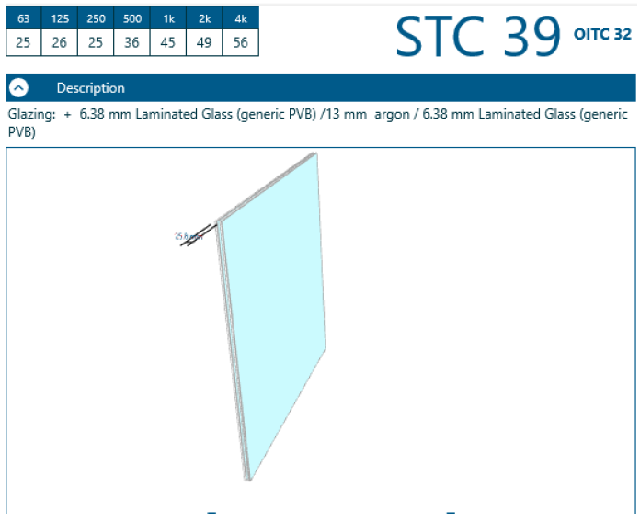
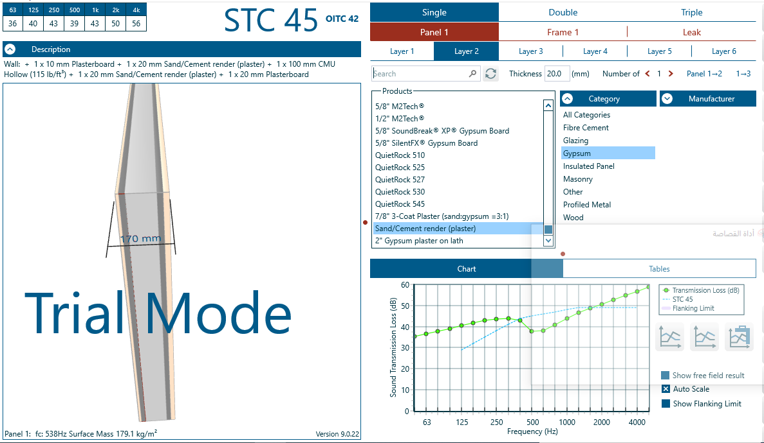
ACOUSTICAL ANALYSIS AND DESIGN
Classroom
Conference Hall
Multipurpose Hall

Slide 32
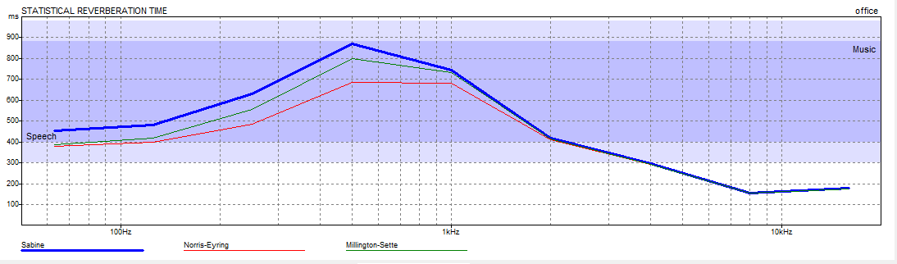
FREQ | TOTAL ABSPT
63Hz | 0.45
125Hz | 0.48
250Hz | 0.63
500Hz | 0.79
1kHz | 0.74
2kHz | 0.42
4kHz | 0.30
8kHz | 0.16
16kHz | 0.18
Offices

Slide 33
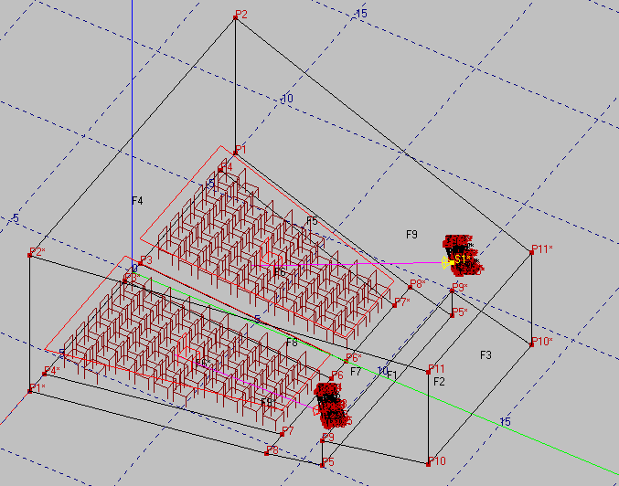
Conference Hall

Slide 34
Freq[Hz] Noise[dB] RT[s]
250 30.00 1.16
315 30.00 1.19
400 30.00 1.22
500 30.00 1.26
630 30.00 1.22
800 30.00 1.19
1000 30.00 1.16
1250 30.00 1.22
1600 30.00 1.29
2000 30.00 1.36
2500 30.00 1.36
3150 30.00 1.34
4000 30.00 1.30
Frequency | Direct SPL
250 Hz | 85.33
315 Hz | 86.10
400 Hz | 86.40
500 Hz | 85.79
630 Hz | 84.88
800 Hz | 84.47
1000 Hz | 85.59
1250 Hz | 85.87
1600 Hz | 86.15
2000 Hz | 86.08
2500 Hz | 86.22
3150 Hz | 86.17
4000 Hz | 85.44
Frequency | STI
250 Hz | 0.70
315 Hz | 0.70
400 Hz | 0.70
500 Hz | 0.70
630 Hz | 0.70
800 Hz | 0.70
1000 Hz | 0.70
1250 Hz | 0.70
1600 Hz | 0.70
2000 Hz | 0.70
2500 Hz | 0.70
3150 Hz | 0.70
4000 Hz | 0.70
Frequency | Articulation Loss
250 Hz | 3.86
315 Hz | 3.86
400 Hz | 3.86
500 Hz | 3.86
630 Hz | 3.86
800 Hz | 9.00
1000 Hz | 10.00
1250 Hz | 11.00
1600 Hz | 12.00
2000 Hz | 13.00
2500 Hz | 14.00
3150 Hz | 15.00
4000 Hz | 16.00

Slide 35

Multipurpose Hall

Slide 36
Freq[Hz] Noise[dB] RT[s]
250 30.00 1.06
315 30.00 1.05
400 30.00 1.03
500 30.00 1.01
630 30.00 1.02
800 30.00 1.03
1000 30.00 1.04
1250 30.00 0.95
1600 30.00 0.88
2000 30.00 0.81
2500 30.0 0.82
3150 30.0 0.81
4000 30.00 0.80
Frequency | Direct SPL
250 Hz | 78.56
315 Hz | 78.60
400 Hz | 78.26
500 Hz | 77.89
630 Hz | 77.01
800 Hz | 75.92
1000 Hz | 74.28
1250 Hz | 73.63
1600 Hz | 73.72
2000 Hz | 74.65
2500 Hz | 74.61
3150 Hz | 73.81
4000 Hz | 73.08
Frequency | STI
250 Hz | 0.67
315 Hz | 0.67
400 Hz | 0.67
500 Hz | 0.67
630 Hz | 0.67
800 Hz | 0.67
1000 Hz | 0.67
1250 Hz | 0.67
1600 Hz | 0.67
2000 Hz | 0.67
2500 Hz | 0.67
3150 Hz | 0.67
4000 Hz | 0.67
Frequency | Articulation Loss
250 Hz | 6.87
315 Hz | 6.87
400 Hz | 6.87
500 Hz | 6.87
630 Hz | 6.87
800 Hz | 9.00
1000 Hz | 10.00
1250 Hz | 11.00
1600 Hz | 12.00
2000 Hz | 13.00
2500 Hz | 14.00
3150 Hz | 15.00
4000 Hz | 16.00

Slide 37


STI | 0.65-0.7
RT(60) | 1-1.2
SPL | >70dB
AL | <15%
STI | 0.65-0.7
RT(60) | 1.2-1.4
SPL | >70dB
AL | <15%
Multipurpose Hall
Conference Hall

Slide 38
ELECTRO-MECHANICAL ASPECTS
HVAC SYSTEM
DRAINAGE AND PLUMBING
ELECTRICAL SYSTEMS
FIREFIGHTING SYSTEMS

Slide 39


Slide 40



Slide 41


Slide 42


Slide 43



Slide 44




Slide 45

HVAC SYSTEM
2
1
4
3
Block Number | Heating Capacity(kW)
Block 1 | 16.44
Block 2 | 27.5
Block 3 | 43.44
Block 4 | 63.7
Block Number | Cooling Capacity(kW)
Block 1 | 26
Block 2 | 44.11
Block 3 | 38.9
Block 4 | 51.62

Slide 46

HVAC system-Outdoor units
Cooling load is greater than heating load
so we designed the system based on cooling load.
Figure below shows outdoor units
which are (REYQ72TTJU , REYQ96TTJU)
from Daikin Company,
with (19.64 , 26.38)kW in cooling capacity .
Block Number | Cooling Capacity(kW) | Number of outdoor units | Type of units
Block 1 | 26 | 1 | REYQ96TTJU
Block 2 | 44.11 | 2 | REYQ72TTJU REYQ96TTJU
Block 3 | 38.9 | 2 | REYQ72TTJU REYQ96TTJU
Block 4 | 51.62 | 2 | REYQ96TTJU

Slide 47

HVAC system-Indoor units
 | Design Size Maximum Total Cooling Capacity [kW] | Capacity of indoor unit (KW) | Number of indoor units | Type of indoor units
General & occupational education | 2.29 | 2.8 | 1 | FXMQ9PBVJU
Multipurpose hall | 2.92 | 3.52 | 1 | FXMQ12PBVJU
Department of building & project | 3.07 | 3.52 | 1 | FXMQ12PBVJU
AUDITORIUM | 35.86 | 14.1 | 3 | FXMQ48PBVJU

Slide 48


 | Design Size Maximum Cooling Air Flow Rate [m3/s] | Diffuser Flow Rate [m3/s] | Number of diffusers
General & occupational education | 0.18 | 0.035 | 6
Multipurpose hall | 0.16 | 0.047 | 4
Department of building & project | 0.21 |  | 6
AUDITORIUM | 1.88 | 0.135 | 14
HVAC system-Diffusers
The diffusers were selected from
Air-master Emirates Company,
the figures below shows the technical specification
of the selected diffusers.

Slide 49

HVAC SYSTEM- GROUND FLOOR PLAN

Slide 50




Slide 51





Drainage system
Drainage system in the building had been separated into two lines for the gray water and black water.
Two types of pipes were used 2” pipe and 4” pipes

Slide 52




For the manholes 6” pipes with
1% slope were used

Slide 53



Firefighting system

Slide 54

GROUND FLOOR
EVACUATION PLAN

Slide 55








Lighting design

Slide 56


Lighting design
Lighting design

Slide 57



Electrical system
Socket distribution

Slide 58


Wire design and drop voltage

Slide 59



Control panels

Slide 60
STRUCTURAL ASPECTS
Reinforced concrete
Steel structure

Slide 61
Reinforced concrete analysis and design codes and standards
ACI318-11
ACI350
UBC

Slide 62


The building was divided into 3 blocks with expansion joints each 31 meters. Loads were assigned to the structure including 5 kN/sqm live load, superimposed dead load=5.09 kN/sqm Exteior glazing load= 1.08 kN/m

Slide 63



Analysis checks
Compatibility check
Deflection check
Equilibrium checks

Slide 64

Seismic design
According to UBC97, and considering the parameters mentioned earlier the building was designed seismically as a Building frame system.
Using the adequate load combinations.
Sway-special.

Slide 65



Seismic design parameters
Seismic zone
Soil profile
Occupancy category
Seismic coefficients

Slide 66
Seismic design parameters
Zone 2B, z=0.2
Soft clay, SE
I=1
R=5.5 , Cv=0.64, Ca=0.34

Slide 67
Seismic design checks
Period check and mass participating ratios
Base shear check
Drift check
P-delta check

Slide 68



Seismic design checks
BASE SHEAR CHECK
PERIOD AND MASS PARTICIPATING RATIO
DRIFT CHECK

Slide 69


Seismic design checks
BASE SHEAR CHECK
PERIOD AND MASS PARTICIPATING RATIO
DRIFT CHECK

Slide 70


Seismic design checks
BASE SHEAR CHECK
PERIOD AND MASS PARTICIPATING RATIO
DRIFT CHECK

Slide 71
Seismic design
Building skeleton
Columns
Shear walls
Special structures
Retaining walls
Building skeleton
Special structures
Water tank
Slabs and beams
Mat foundation

Slide 72
Building skeleton

Slide 73

Special columns design and detailing
Designed according to ACI318-11 21.6 Special moment frame members considering both design and detailing requirements

Slide 74


Special columns design
Longitudinal reinforcement tables

Slide 75


Special columns design
Transverse reinforcement tables

Slide 76




Special columns detailing

Slide 77



Special columns detailing

Slide 78



Special beams design
Designed according to ACI318-11 21.6 Special moment frame members considering both design and detailing requirements

Slide 79



Special beams design
Reinforcement tables

Slide 80

Special beams detailing

Slide 81


Special beams detailing

Slide 82
Diaphragm design

Slide 83


Diaphragm design

Slide 84


Diaphragm
detailing

Slide 85


Diaphragm
detailing

Slide 86


Diaphragm
detailing

Slide 87


Shear walls design and detailing

Slide 88



Slide 89


Mat foundation design
Designed using SAFE2016

Slide 90



Mat foundation design checks
Checks
Deflection
Punching shear
Shear
Bearing capacity

Slide 91



Mat foundation design

Slide 92



Mat foundation design

Slide 93
Special structures

Slide 94




Water tank design

Slide 95



Water tank design checks
Checks
Shear check on walls, base and roof
Tension check on walls
Bearing capacity check

Slide 96


Water tank detailing

Slide 97





Slide 98



Basement wall design and detailing

Slide 99



Retaining wall design and detailing

Slide 100



Stairs, car ramp and expansion joint
According to UBC97:
Designed as a solid slab

Slide 101
STRUCTURAL ASPECTS
Reinforced concrete
Steel structure

Slide 102


Slide 103




Steel structure design codes, standards and sections
ASCE7-10 WIND LOAD PROVISIONS
AISC360-10
EUROPEAN SECTIONS

Slide 104




Modeled on SAP with distributed loads of
the Alucobond cladding,
snow and maintenance live loads, 0.06 KN/sqm,
2.1 KN/sqm,
0.96 KN/sqm according to ACI-16
Sections adopted from
Euro code I sections for columns,
and c channels for truss members

Slide 105





Slide 106





Slide 107



Steel connections design

Slide 108


Slide 109


Slide 110


Slide 111


Slide 112


Slide 113


Slide 114


Slide 115



Slide 116
PROJECT BUDGETED COST
QUANTITY SURVYING
LIFE-CYCLE ANALYSIS
COST ESTIMATION

Slide 117

BILL OF QUANTITES
TOTAL BUDGETED COST = 12,884,222 NIS.

Slide 118



LIFE-CYCLE COST ANALYSIS OVER 20 yrs.
Inverters need to be replaced periodically every 8 years so they’ll be added as negative cash flows over 20 years, since they will be replaced in year 8 and year 16.
Aftermath, the payback period will be after 4 years and after that the savings will be considered as pure revenues to the project, and will insure 100% energy consumption savings at the first years and 82% energy savings after 20 years.
To maintain and improve the efficiency of cells over the years, O&M procedures will be taken and added as a periodic cost to the year it is needed. 81,800 which is equal to 61,000 American dollar.

Slide 119
Renderings shots of the project

Slide 120


Slide 121


Slide 122


Slide 123


Slide 124


Slide 125


Slide 126


Slide 127


Slide 128


Slide 129


Slide 130


Slide 131


Slide 133


Slide 134


Slide 135


Slide 136


Slide 138

END OF PRESENTATION
Thank you all for your support and guidance through the way.

