Slide 1

Electronic Menu
Sondos & Sarah

Slide 2

Our Menu Today …
--Abstract
--Components
--How it works
--Problems
--Demo
☺

Slide 3

Abstract
Automating any ordering process , As an application we have chosen a Restaurant Menu.

Slide 4

Why Electronic Menu ??
    Waiting for the waiter to come
    Losing time
    Saves money
    We like new tech in EVERYTHING

Slide 5

Electronic Menu Consists
Display
transport method
Receiving End

Slide 6

Components
Display
    Touchscreen
    GLCD
    LCD
Wireless
    MRF24J40MA (2)
Microcontroller
    PIC18LF4620 (2)
    PIC18F4620
4*4 keypad
a PC at the receiving end
×

Slide 7
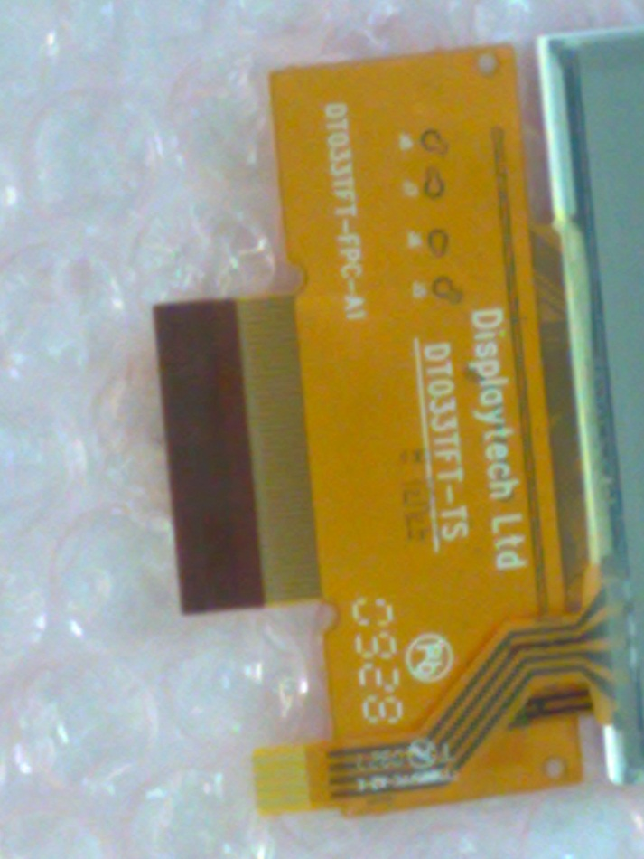
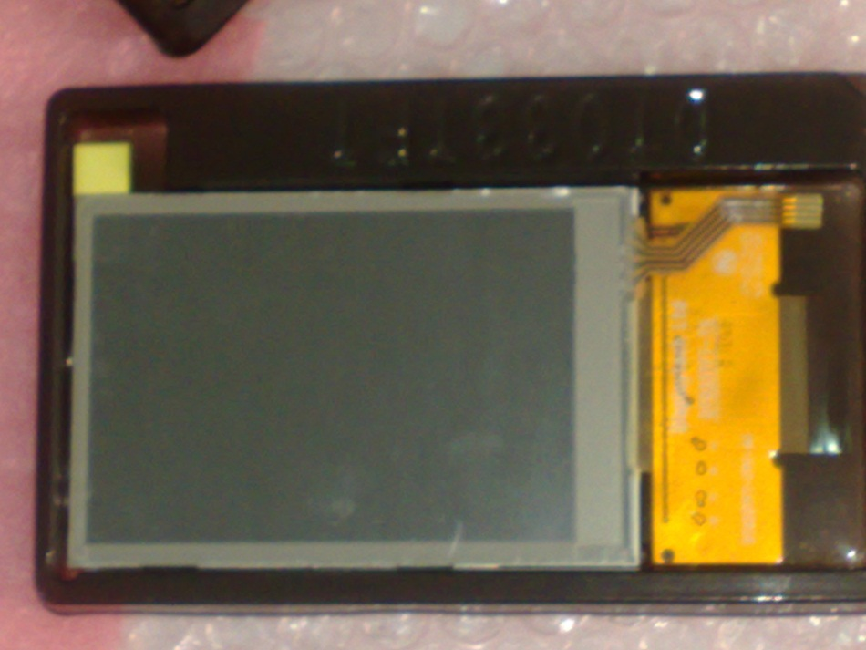
Components

Slide 8
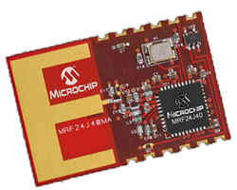
Components
MRF24J40MA (MiWi)
  light and simple
  Low cost
  low data rate (suitable)
  low power consumption.

Slide 9
Used Programs
    MPLAB 810
    PIC C compiler
    Microsoft Visual studio 2010

Slide 10
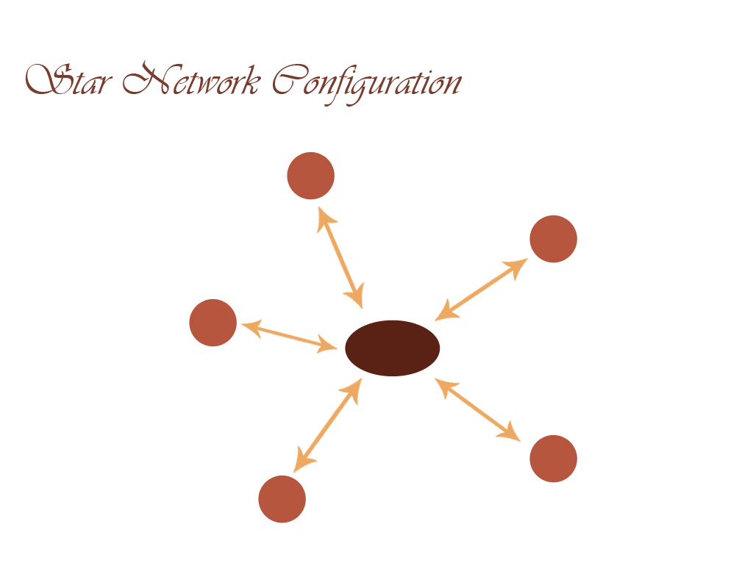
How it works

Slide 11

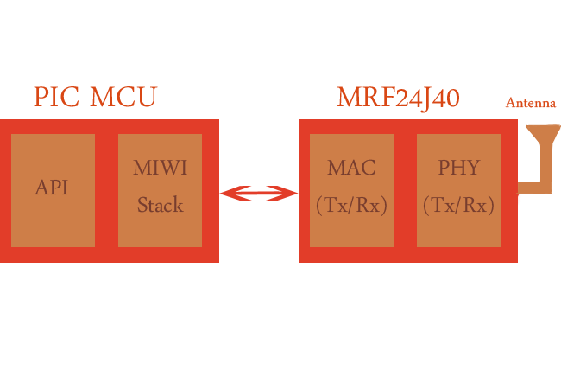
SPI
MiWi interface

Slide 12

Problems
MiWi gets disconnected

Slide 13


