Slide 1

Next Step
Khaled Jeetan
Abdullah Shanti
Supervisor :
Dr. Haya Samanneh

Slide 2

Agenda
Motivations
Idea
Tools & Technology
Recommendation System
Challenges
Future Work

Slide 3
Motivations
1: The motivation behind the "Next Step" application is to offer a comprehensive solution that simplifies the construction and finishing process
2: Provide easy services for Assigning Vendor, searching, filtering Supplies and user friendly .
3: provide step-by-step guidance, and support to clients throughout their project.

Slide 4


The Idea
1: CROSS PLATFORM APPLICATION THAT PROVIDES AN ENVIRONMENT FOR CLIENTS, VENDORS AND SUPPLIERS FOR
TAKING SERVICES .
2: THE "NEXT STEP" APPLICATION IS DESIGNED TO SIMPLIFY THE CONSTRUCTION AND FINISHING INDUSTRY.

Slide 5





Goals :
HAVE A USER-FRIENDLY DESIGN .
PROVIDE BUDGET TRACKING SYSTEM
SIMPLIFY USERS COMMUNICATION & INTERACTIONS
BUILDING A STEP BY STEP GUIDE
PROGMONITORING
SYSTEM

Slide 6
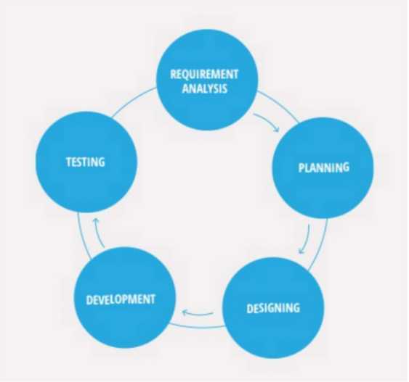
Software Development Process
Agile Model

Slide 7





Tools and Technology : Frontend

Slide 8





Tools and Technology : Backend

Slide 9





Next Step has Four parts :
CLIENT
SUPPLIER
VENDOR
ADMIN-web

Slide 10



Features Implemented
Finding and Assigning Vendor
Status & Progress
Tracking
Real Time notification & Messaging

Slide 11



Features Implemented
Finding Material & Supplies
Budget Tracking
Rating & Review

Slide 12


Features Implemented
Dark Mode
Multi-Language Support
Arabic & English

Slide 13
Features Implemented
Monitoring System .
Step-by-Step
Guide.
EMail Verification

Slide 14
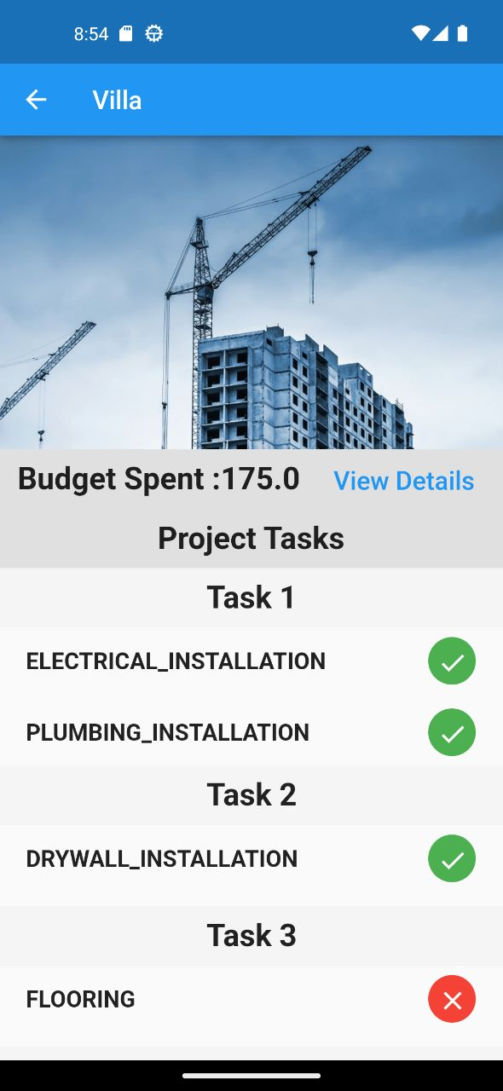
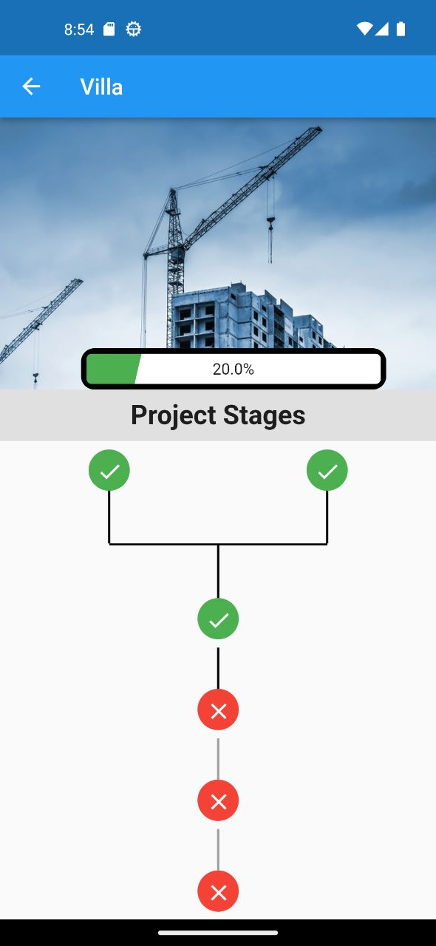
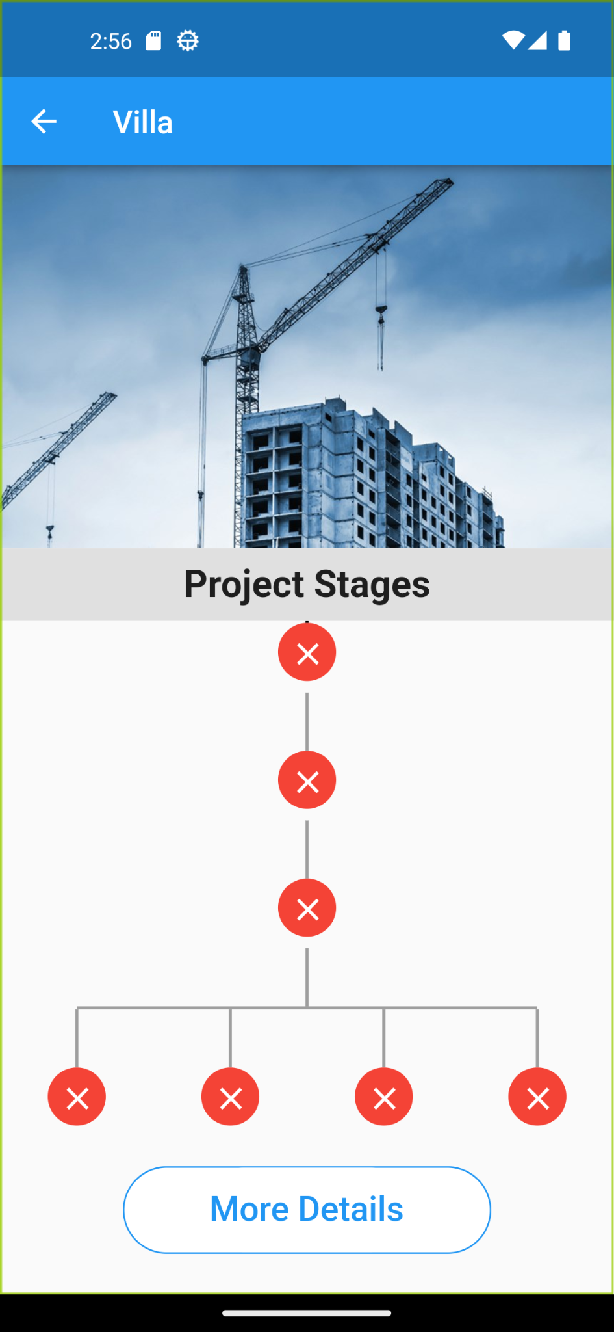
STEP BY STEP
GUIDE

Slide 15
Monitoring
Generate Construction Plan
Assign Vendors
Monitor ( Status & Progress & Budget )

Slide 16
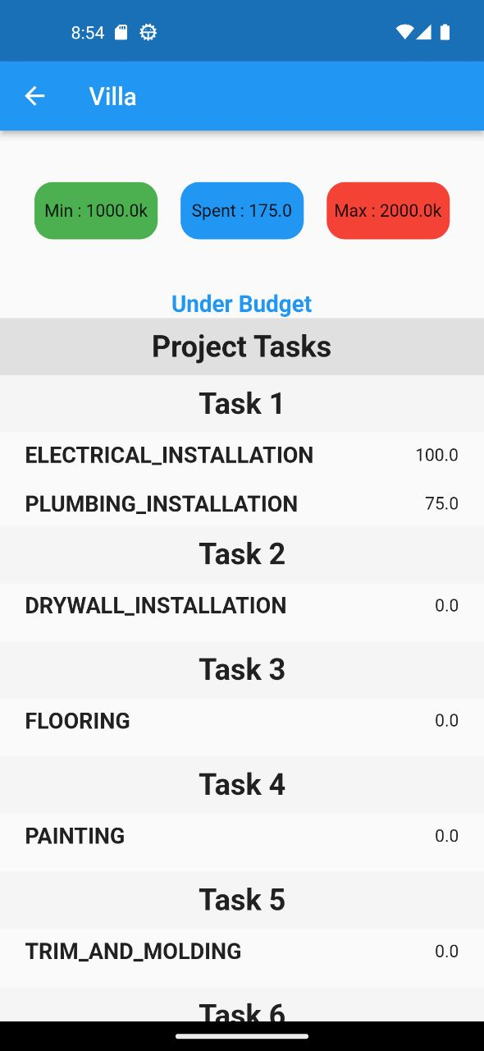
Budget Tracking

Slide 17
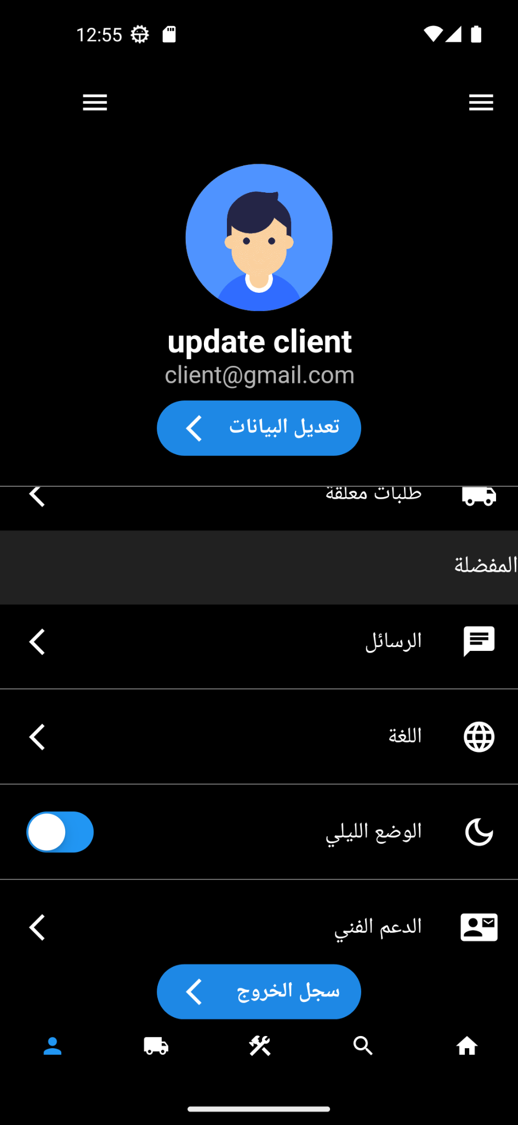
Dark Mode & Arabic Language

Slide 18
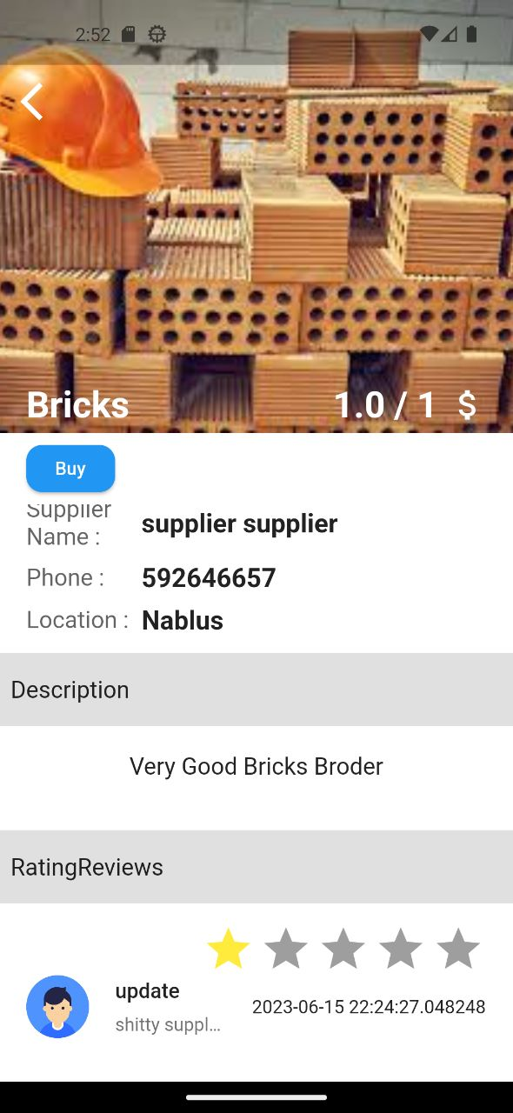
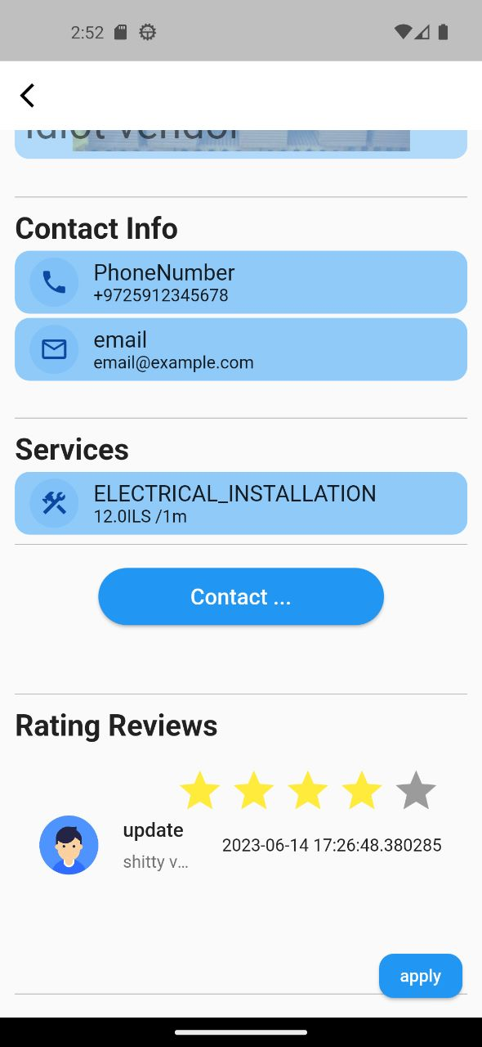
Rating Review ...

Slide 19
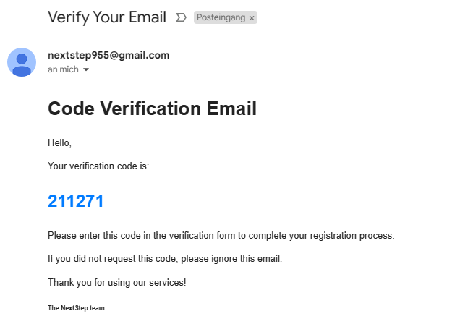
Email Verification ...

Slide 20

Challenges

Slide 21

Time Limit

Slide 22
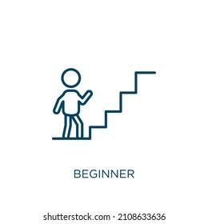
Limited Experience

Slide 23

Some Features are paid

Slide 24
Future Work
1
2
3
4
Piding System For
Vendors to Get
Tasks
Add
recommendation system.
Add payment methods such as PayPal .
Enhance user Interface.

Slide 25
Thank you
Khaled Jeetan
Abdullah Shanti

