Slide 1


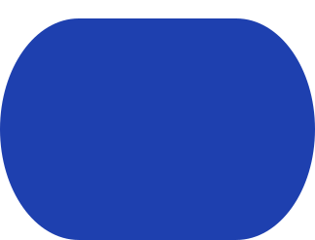

VISION-ASSISTED CARTESIAN ROBOTIC SYSTEM FOR 3D BLOCK CONSTRUCTION
Ahmed Gharib
Mohie Halawa
Khalil Qanabita

Slide 2

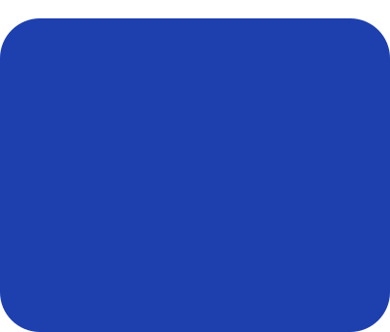
TABLE OF CONTENTS
Motivation & Objectives
Bill of Materials
System Design
Testing & Results
Vision & Control System
Conclusion & Future Work

Slide 3
BACKGROUND & MOTIVATION
Why This Project?
• Industrial pick-and-place systems must do more than move parts.
• Real assembly cells must verify staging, gripping, placement, and failures.
• Timing-based systems assume success instead of confirming it.
• The goal is a machine that verifies every stage rather than relying on assumptions.

Slide 4
THE PROBLEM
WHAT AN OPEN-LOOP MACHINE CANNOT SEE
Stacking is sequential: block 7 has to be right or block 18 falls off it. A timing-based machine cannot tell success from failure, so it never stops — it turns one silent failure into a pile.
1
A block that was never staged
The operator confirms the pickup area is loaded. Nothing checks. The claw closes on nothing and the cycle reports success.
2
A block that lands off its cell — or moves after it lands
A knock, a settling stack, a hand. No encoder reports it, and block 18 is stacked on the error.
3
Lost steps
Open-loop steppers lose steps against a stall, and nothing in the motor reports it.
4
A hand in the workspace, or a controller reset
A person moves a block, or a USB open reboots the board un-homed. The machine's model is silently wrong.

Slide 5




OBJECTIVES
Develop a robotic assembly cell for repeatable 3D block construction from a browser-designed model.
1
Place blocks at any addressable grid cell and stack level within the machine workspace.
2
Support both vertical and horizontal block orientations through a rotating end-effector and dual-grid system.
3
Detect, localize and verify blocks using an overhead vision system with calibrated grid mapping — and check every placement against the ledger.
4
Provide a browser-based platform for structure design, execution, and safe operation of the robotic system.
5

Slide 6
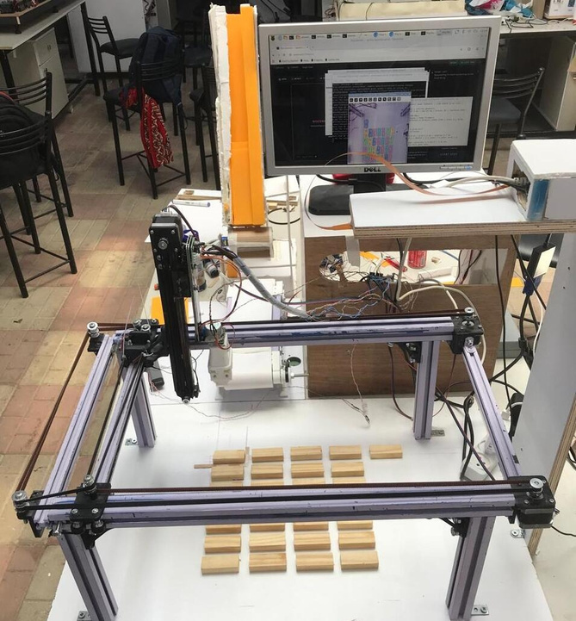
01
SYSTEM DESIGN
The two-controller architecture, the mechanics, and the components the machine is actually made of.

Slide 7
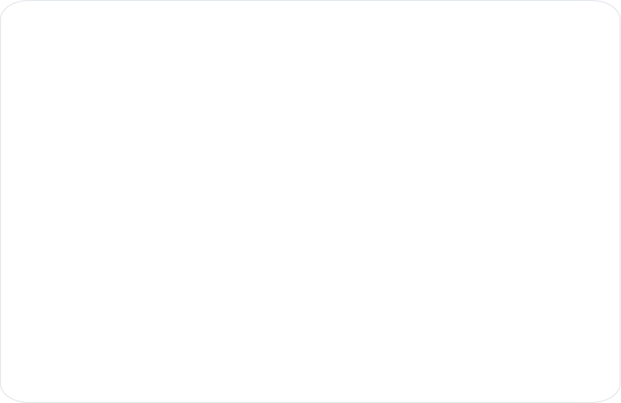
TWO CONTROLLERS, ONE MASTER
ONE MASTER, ONE MOTION CONTROLLER
Raspberry Pi 5
Arduino MEGA 2560
8 GB · THE MASTER
THE GANTRY · 9600 8N1
    Camera capture and the whole vision pipeline
    FastAPI web service, WebSocket event stream
    The Studio and the browser application
    Placement supervision and the as-built ledger
    Every safety gate and the session lock
    X, Y and Z step generation and direction
    Homing, hardware and software limits
    Grid-to-steps arithmetic, both grids
    Gripper servo and rotation stepper
    The fourteen-phase build cycle
The Mega cannot originate a command. It moves only on a message the Pi decided to send, and it reports every phase before it runs it — so the master’s model of the machine is built from what the machine said, never from what it was told to do.

Slide 8

HOW ONE BLOCK GETS BUILT
DESIGN › COMPILE › STAGE › PLACE › VERIFY
1
DESIGN
2
COMPILE
3
STAGE
4
PLACE
5
VERIFY
A person places blocks in the Studio, on the machine's real lattice.
Sorted bottom-up, grouped by orientation, emitted as B col row level.
The operator places one block at the pickup cell and confirms it. The claw descends open and waits for a second, explicit consent before it closes.
Only then the fourteen-phase pick, rotate, place and park cycle.
The camera compares the board against the ledger and returns a verdict per cell; the twin mirrors the build from phase telemetry.
Nothing in this chain is advanced by a timer. Every machine stage waits for a durable terminal result from the stage before it, and a stage that cannot prove what happened stops the build instead of continuing. Staging is the one link the operator supplies — which is exactly why the camera checks the result.

Slide 9


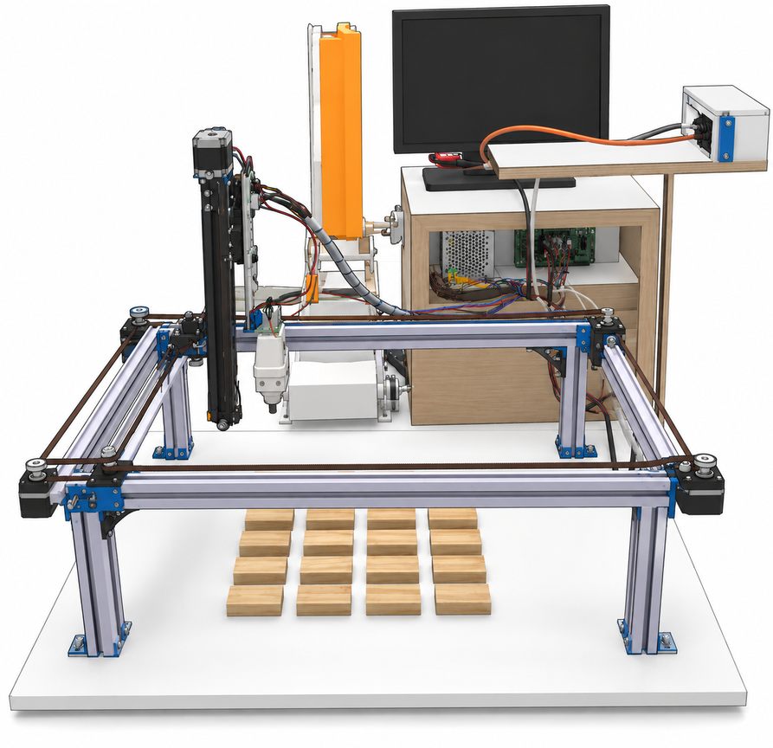
MECHANICAL DESIGN
      X-axis motion system
      Y-axis gantry
      Z-axis actuator
      End-effector (gripper)

Slide 10

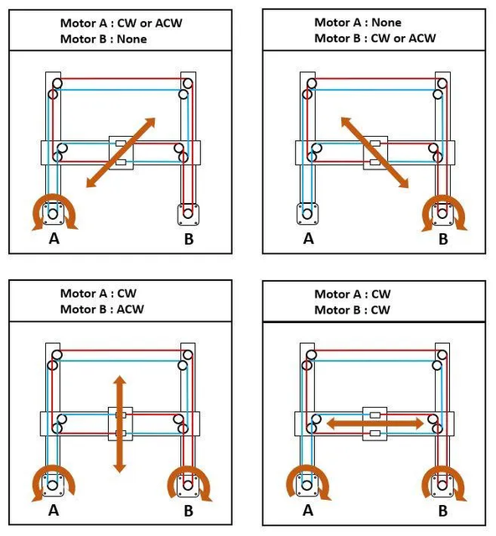
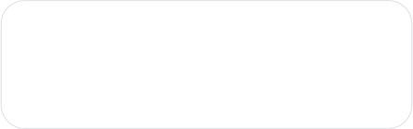
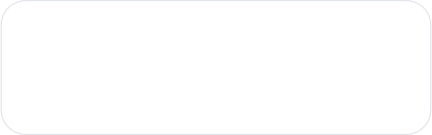
THE X/Y STAGE: COREXY
BOTH MOTORS OFF THE MOVING BEAM
    Same sense › the carriage walks along X. Opposed senses › it walks along Y.
    Two NEMA17 motors are fixed to the frame and drive one continuous GT2 belt path, so the beam stays light and the envelope stays large.
    Guidance is eight castor wheels on 3D-printed carriages running on the aluminium profile.
22.8 cm
38.0 cm
X holder travel · 4,550 steps
Y holder travel · 7,600 steps
200
4
Verified on the machine by watching the shafts
steps per cm (X 199.6, Y 200.0)
limit switches, all NC
CoreXY skeleton and limit-switch homing after Greg06, “Automated Chessboard”, Instructables 2022. Z, the claw, the camera and both controllers were built on top of it.
Homing drives each axis into its own switch; the corner where both are pressed is machine position (0, 0).

Slide 11
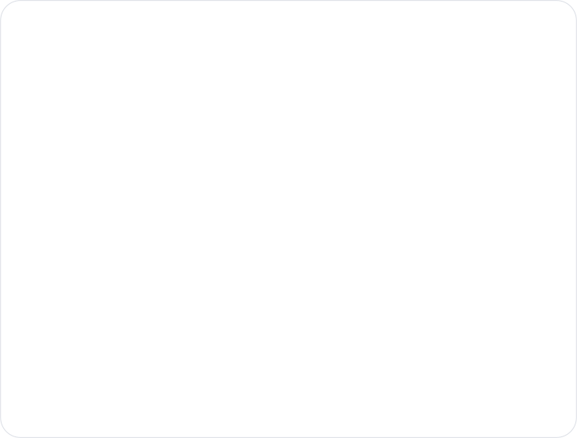
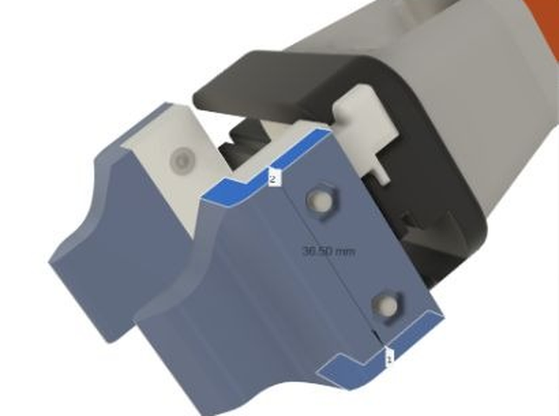
Z AXIS AND END EFFECTOR
LIFT, GRIP, AND A QUARTER TURN
Z axis
One NEMA17 on the moving carriage, on the 15 mm linear rail. 26.5 cm of travel, 1,350 steps.
Both ends are switches
Every build re-zeroes Z on the bottom switch and carries at the top. Neither end is a remembered number.
The claw
One servo, two positions: OPEN 0°, CLOSE 52°, on the block's 2.2 cm face. No sensor at all — hence a fixed 600 ms settle.
Rotation
A 28BYJ-48 through a ULN2003 turns the claw 512 of 2,048 steps at 10 rpm — the second block orientation.
3D-printed two-jaw claw — the reference design's electromagnet is no solution for wooden blocks
The grip centre sits (−0.3, +0.6) cm off the rotation axis, so a 90° turn swings the block round that axis. That swing is corrected as a per-rotation tool offset — not as a grid error.

Slide 12
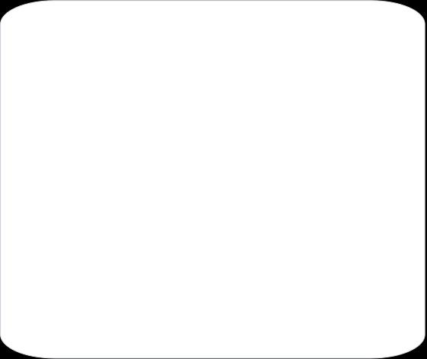

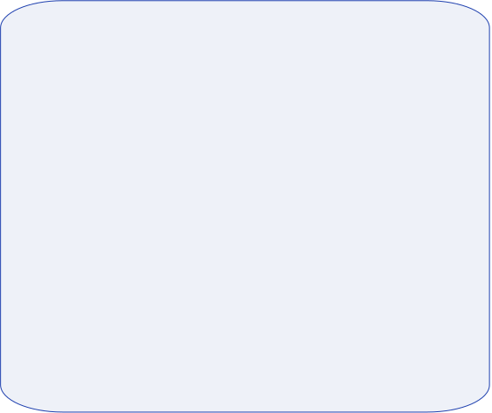
THE PICKUP HANDSHAKE
TWO CONSENTS, AND THE CLAW WAITS FOR THE SECOND
1
2
3
One reserved cell
The claw stops with its jaws open
Closing is a separate decision
[0,0] is where blocks are picked up, in both grid modes, and is never built on. Its centre is the home corner, so a pick-up is a plain home with no move afterwards.
The Pi sends M <col> <row> <level>; the firmware runs the same validated route as a normal build but pauses after the open claw reaches the ground switch and announces await_manual_close.
Only an explicit C closes the jaws. The operator aligns the block against a claw that is already in position — the machine is not trusting a promise about where the block was.
Nothing in the pickup is assumed: the claw is put in position first, and only a second, explicit message closes it.

Slide 13

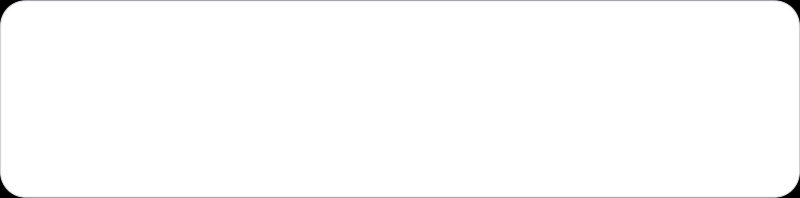
TWO GRIDS, NOT ONE GRID WITH A FLAG
ONE ENVELOPE, TWO LATTICES, ONE PICKUP CELL
One envelope
Both lattices share the same 22.8 × 38.0 cm holder travel — a block lying down does not move a limit switch.
One pickup cell
[0,0] is the pickup cell in both modes and is never built on: 7×6−1 = 41 standing, 3×10−1 = 29 lying.
+1.9 cm registration
VERTICAL · 2.2 × 6.0 cm
HORIZONTAL · 6.0 × 2.2 cm
(6.0 − 2.2)/2 = 1.9 — exactly the overhang of the rotated face, so horizontal [0,0] seats flush against vertical [0,0].
7 × 6 addressable, 41 buildable
pitch 3.8 × 7.6 cm
3 × 10 addressable, 29 buildable
pitch 7.6 × 3.8 cm
cell [0,0] — the pickup cell, never built on; its centre is the home corner

Slide 14

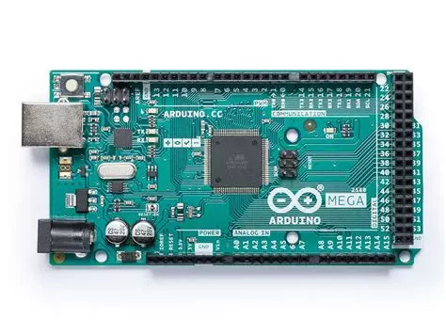
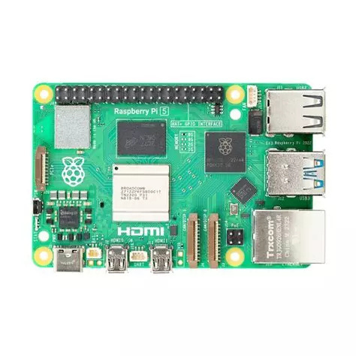
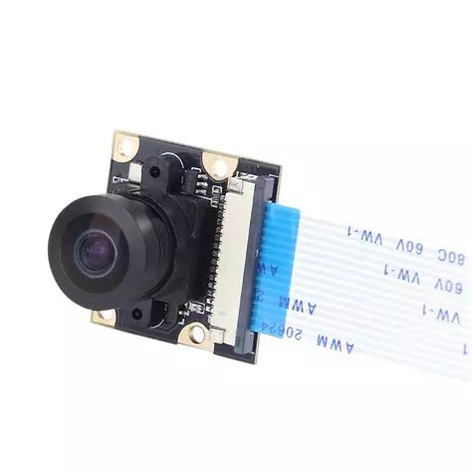
Bill Of Material - 1 of 3
Components - Computing
Arduino MEGA
Raspberry Pi 5
Raspberry Pi 5 Camera Module

Slide 15

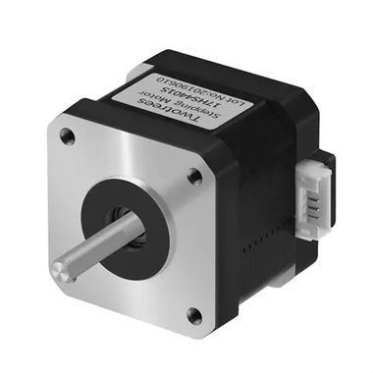
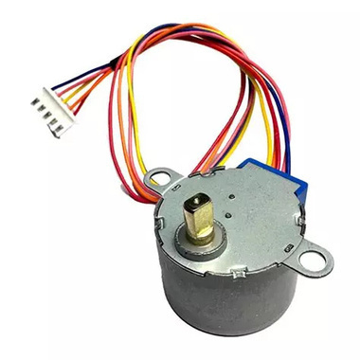
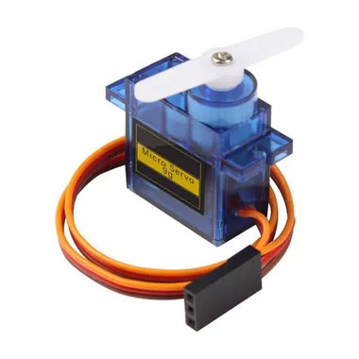
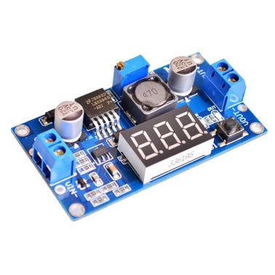
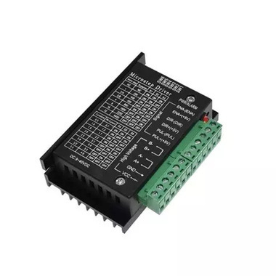
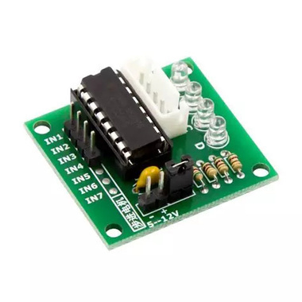
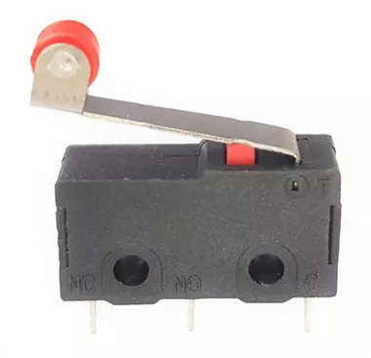
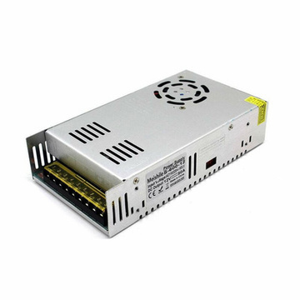
Bill Of Material - 2 of 3
Components - Electrical and Power
3x NEMA17 Stepper Motor
Stepper Motor 28BYJ-48
1X Servo Motor
Adjustable Buck Converter
3x TB6600 Driver
ULN2003 Driver
4x Limit Switch
Power Supply, 12V 15A

Slide 16
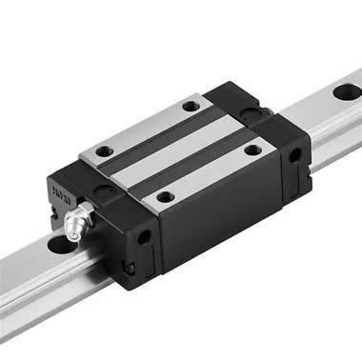
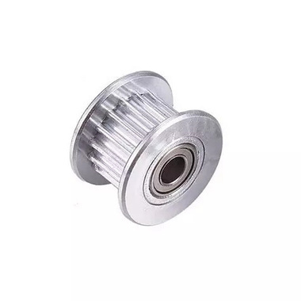
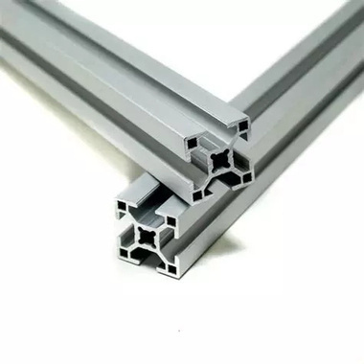
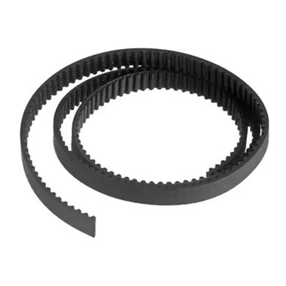
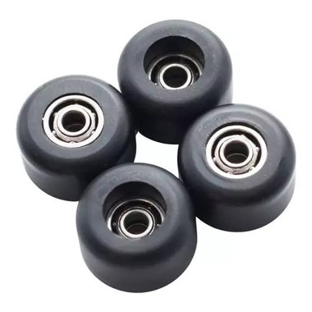
Bill Of Material - 3 of 3
Components - Mechanical
Linear Rail + Linear Motion Bearing
Timing Pulley
Aluminum Profile
GT2 Belt
Bearing Wheels

Slide 17
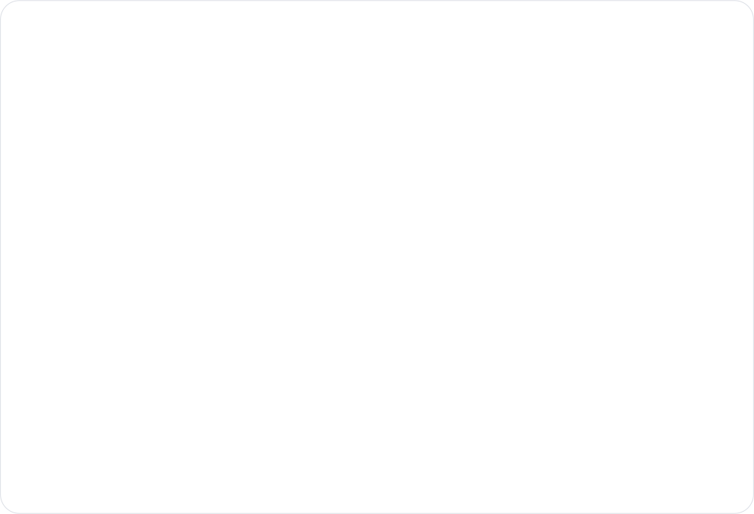
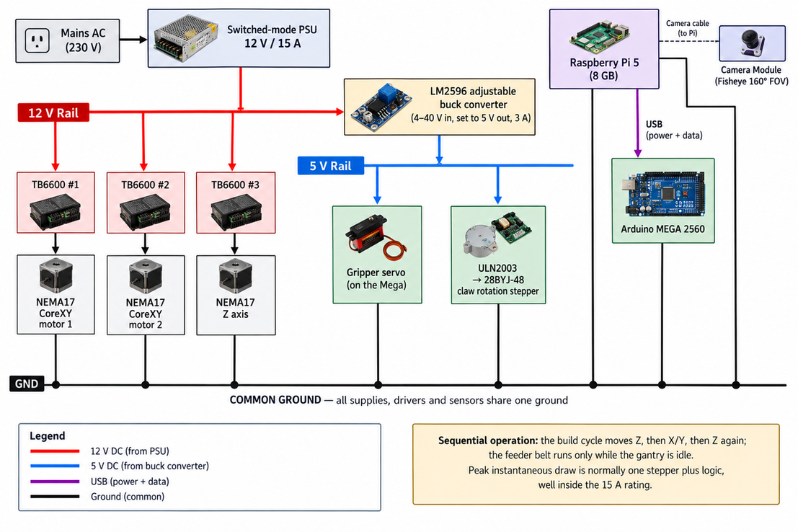
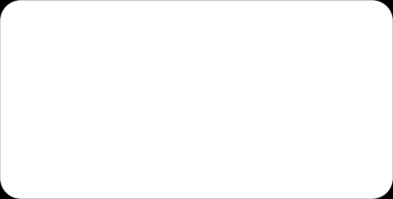
POWER ARCHITECTURE
ONE 12 V RAIL, ONE 5 V RAIL, ONE COMMON GROUND
    12 V rail — the three TB6600 drivers.
    5 V rail — an LM2596 buck converter feeds the gripper servo and the ULN2003.
    The Mega — powered over USB from the Pi, which is also how they communicate.
Why 15 A is not overspecified
The build cycle moves one thing at a time, so the instantaneous draw is usually a single stepper plus logic.

Slide 18
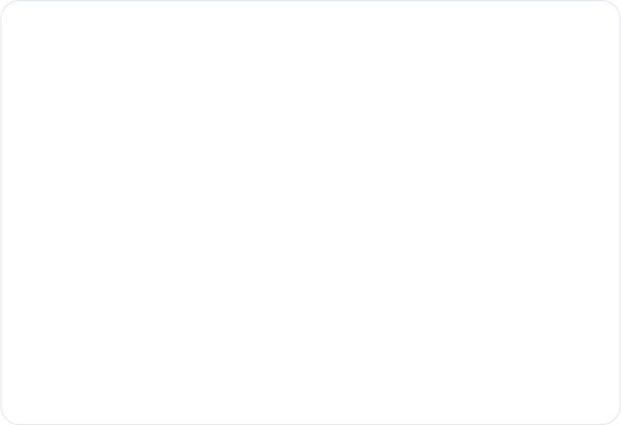
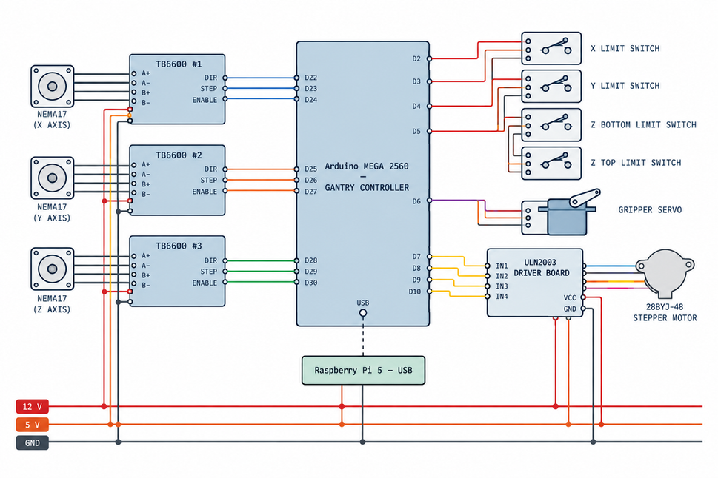
WIRING
TAKEN DIRECTLY FROM THE FIRMWARE SOURCE
Arduino MEGA 2560 — three TB6600 drivers, four limit switches, gripper servo, ULN2003 rotation stepper
Motor and sensor runs use connectors rather than direct solder joints, so a motor can be swapped and the gantry dismantled for transport. There is no enclosure and no cable chain.

Slide 19
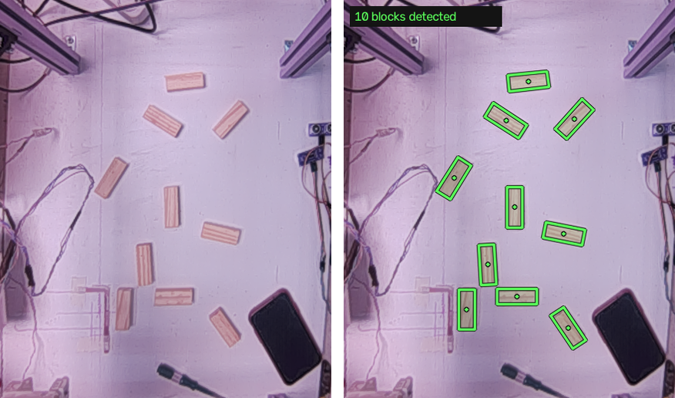
02
VISION & CONTROL SYSTEM
What the camera sees, how a pixel becomes a cell, the protocol that decides when the machine is allowed to move — and what the camera says about what was built.

Slide 20
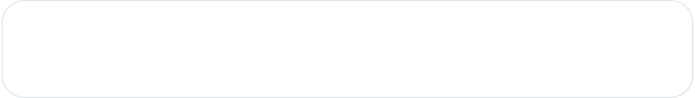
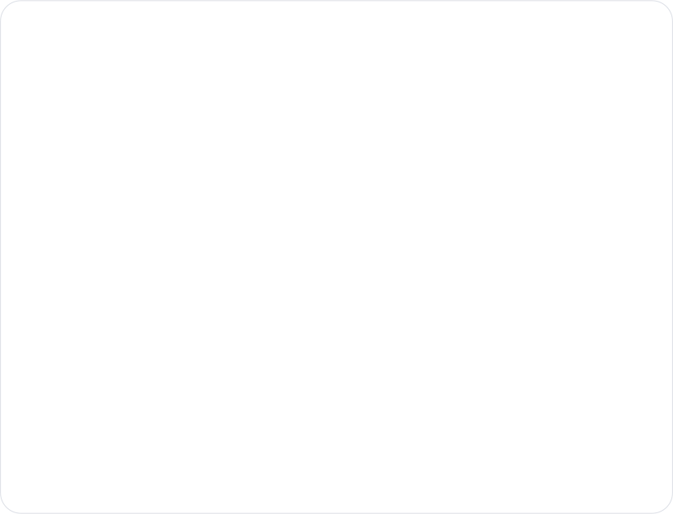
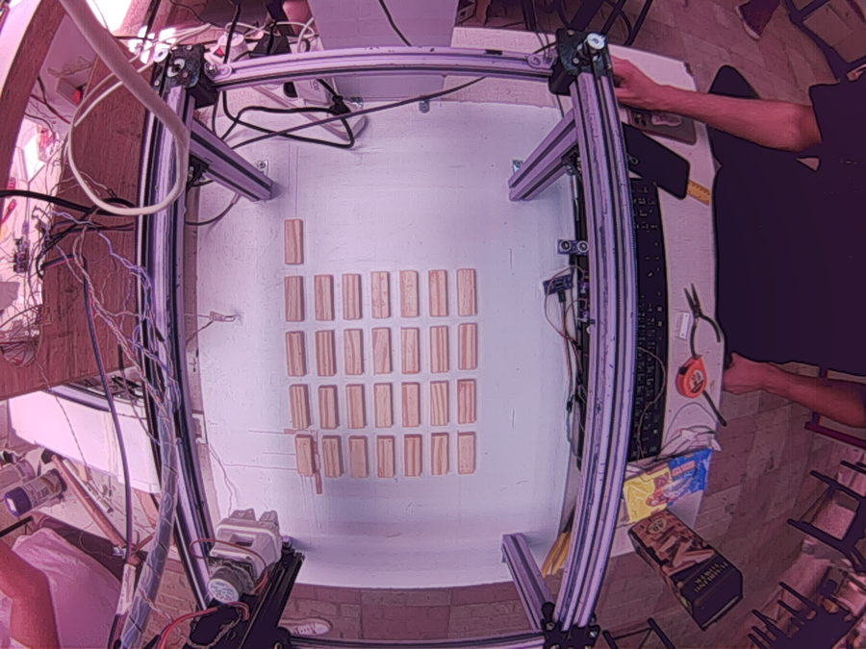

ONE LENS, TWO COSTS
WHAT A 160° FISHEYE AT 50 CM BUYS, AND COSTS
Sensor
OV5647, 5 MP, DORHEA module on the Pi 5 CSI bus
Lens
160° fisheye, mounted rigidly ≈ 50 cm above the surface
Capture
1296 × 972 through Picamera2 — the binned full-field mode
Why binned
It keeps the whole 23 × 38 cm workspace in one frame, and the per-frame cost inside budget
Lens model
Equidistant, 120° output — tuned by eye, not checkerboard-calibrated
THE TWO COSTS
    Severe barrel distortion — the aluminium rails are straight on the machine and curved in the image
    A colour cast strong enough to be a functional fault, not a cosmetic one
A raw frame straight off the camera, before any correction

Slide 21
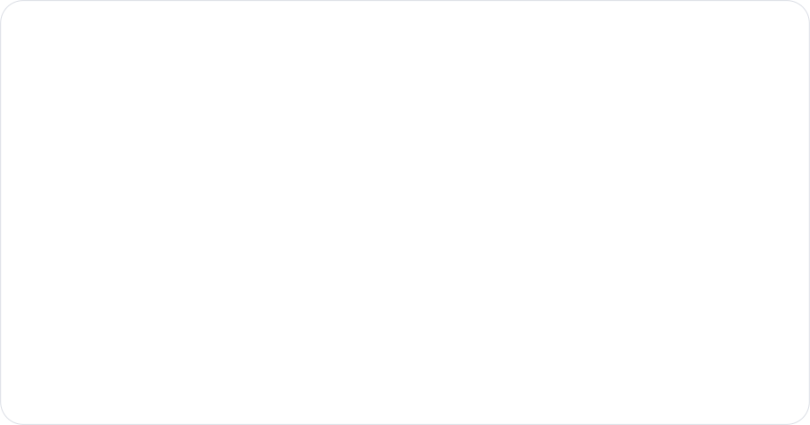
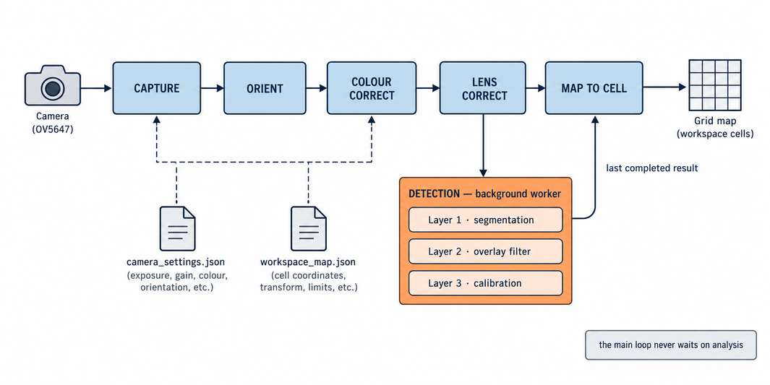
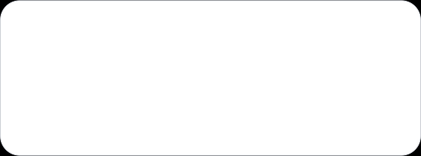
THE VISION PIPELINE
ONE PROCESS OWNS THE CAMERA; ONE FIXED ROUTE
Colour correction runs once, at the captured frame
Detection runs on a background worker
The Pi picks the cell; the firmware turns it into steps
Applied immediately after orientation and before every detector, so every tool in the system sees identical pixels. Colour is deliberately not part of the saved projection identity.
At a lower rate than the video, with the main loop drawing the last completed result. A slow analysis can never stall the stream.
The saved homography converts a pixel to physical centimetres and then to a [col, row]. The Pi never needs a motor step to draw or select one.

Slide 22
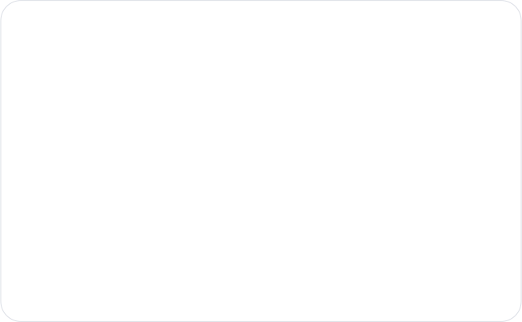
BLOCK DETECTION
A HYPOTHESIS, THEN AN ANSWER — THREE LAYERS
Segmentation
1
Warm material by red-minus-blue and red-minus-green, never by brightness — the work surface is overexposed, so a brightness cutoff selects the table and not the blocks.
Live overlay
2
Rejects, then rectifies: duplicates by IoU, boxes running off the frame (the rails), anything further than 0.34 cells from a lattice site (the holder offcuts).
Calibration
3
Ten blocks deliberately off the lattice — all ten found, everything else rejected
Runs once, deliberately, and is the only layer allowed to write a calibration.
TWO RULES KEEP THE OVERLAY HONEST — BOTH ASSERTED BY TESTS
    The measured centre is never snapped to the lattice — snapping would hide the misplaced block the overlay exists to show.
    The lattice filter never fires on a partial view: under six detections, or if it would reject over 30 % of what it saw, everything is kept.

Slide 23

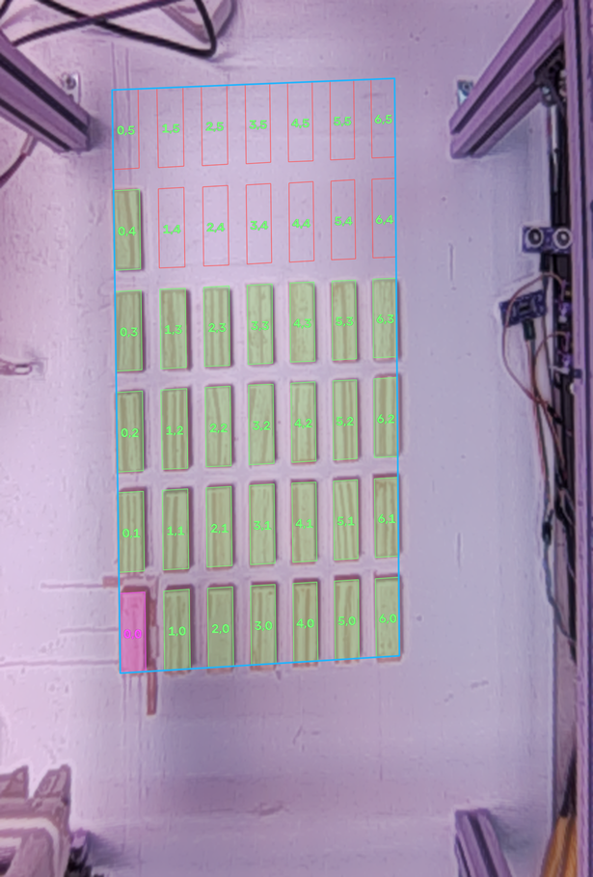
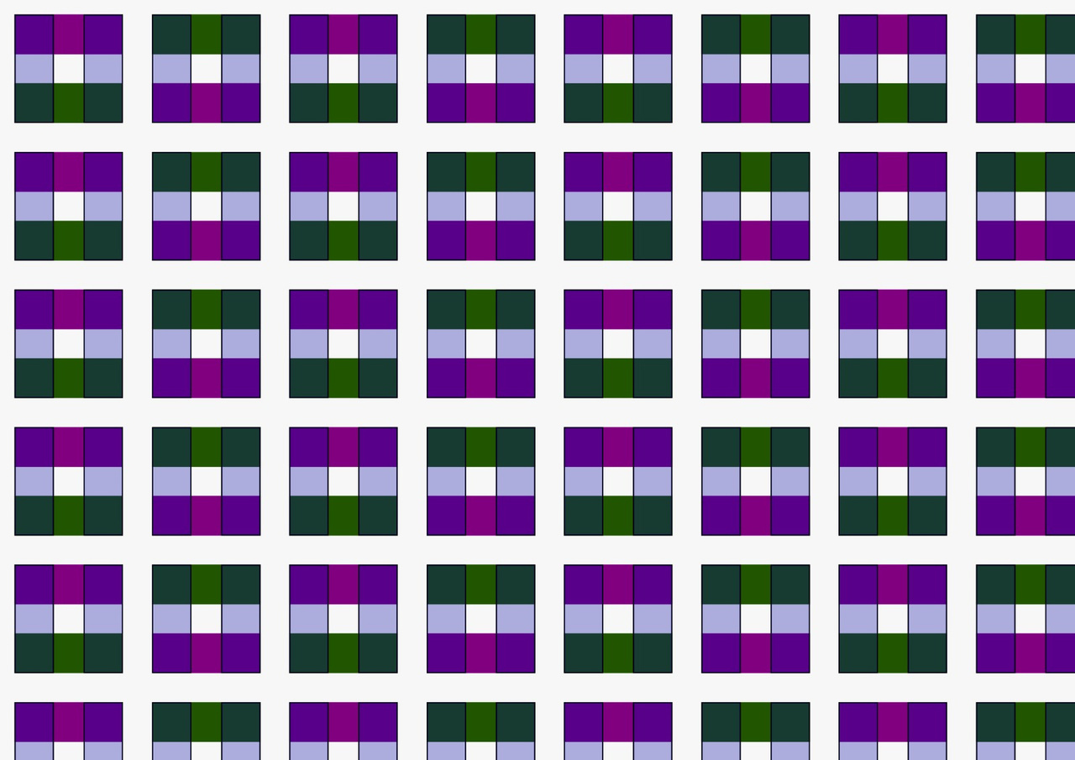
GRID CALIBRATION
WHERE THE MACHINE'S GRID SITS ON THE CAMERA IMAGE

Slide 24
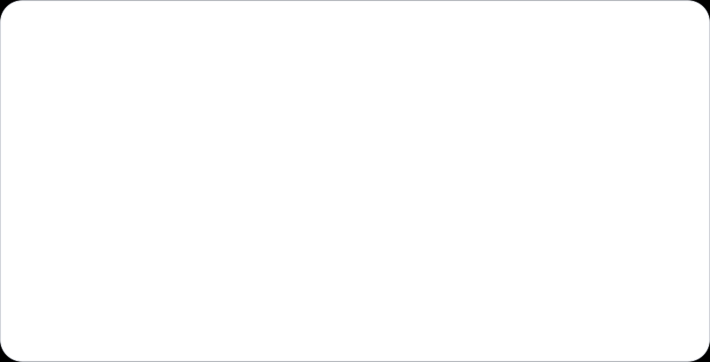
CONTROL HIERARCHY
THE PI DECIDES WHETHER; EACH ARDUINO DECIDES HOW
HIGH LEVEL · RASPBERRY PI
LOW LEVEL · THE MEGA
    Chooses the target cell, the stack level and the grid mode
    Coordinates staging, then the guarded build
    Applies every safety gate and owns the session lock
    Decides whether a command may be issued at all
    Never sends a motor step, a direction bit or a delay
    Holds the as-built record and judges the board against it
    Step generation, direction polarity, homing, limits
    The grid-to-steps arithmetic for both modes
    Servo and stepper timing, the phase sequence
    The fourteen-phase sequence and the manual-close pause
    Everything that cannot change without reflashing
WHY THE BOUNDARY IS DRAWN THERE
The firmware owns the step caps, the Z calibration, the servo angles, the pin map and the direction polarity — physical facts nothing can push over serial, so a stale copy on the Pi would be a lie nobody notices until the rig drives into something. A handful of values genuinely exist twice, and an automated test parses the live sketch — all 237 checks — and fails if either side has moved.

Slide 25

THE ACKNOWLEDGEMENT PROTOCOL
ONE LINE FOR THE HUMAN, ONE LINE FOR THE PI
EIGHT KINDS · FOUR OF THEM TERMINAL
BUILD COMPLETE - block placed at [3,5] level 0
Place time: 31.6s
@12 OK col=3 row=5 level=0
BOOT
READY
RECV
STEP
ERR
SAFE
HELD
OK
Every machine line starts with @ — a character no other line in the sketch begins with, so the Pi's filter is one string test. Key=value and not JSON because on an 8 KB AVR at 9600 baud braces and quotes cost SRAM and airtime for nothing.
Filled = terminal. Exactly one terminal acknowledgement per command.
SAFE
HELD
Refused on validation. Nothing moved, and a retry is fine.
Failed part way through. The claw may still be gripping a block and the position is unknown. It needs a person.
They are separate kinds rather than a flag, so that Pi-side code cannot collapse them into a generic “if not ok: retry”. The retry is the thing that breaks the machine.

Slide 26
THE FOURTEEN-PHASE BUILD CYCLE
EVERY PHASE ANNOUNCED BEFORE IT RUNS
1
raise_clear
Raise Z into the top switch
8
move_to_target
Home, then Y to the row, X to the column
2
home_feeder
Home X/Y to the pickup cell [0,0]
9
rotate_to_grid
Apply the active grid's rotation
3
neutralise_claw
Return the claw to neutral
10
lower_to_level
Lower Z to the target level
4
open_claw
Open the jaws, still clear above
11
release
Open the claw. The block is placed
5
lower_to_ground
Lower Z into the bottom switch — re-zeroes Z
12
park_clear
Raise Z clear of the block just placed
6
grip
Close the claw. The block is held
13
park_home
Return X and Y to the origin
7
lift_block
Raise Z to carry height
14
park_rotation
Return the claw to neutral
Phase 5 — in manual staging the claw stops here, down and open, and waits for the operator's C before phase 6 closes it.
Phases 1–11 place the block; 12–14 park the rig. Parking is not decoration — placed but not parked is not a success, and the terminal result is downgraded from OK to HELD.

Slide 27
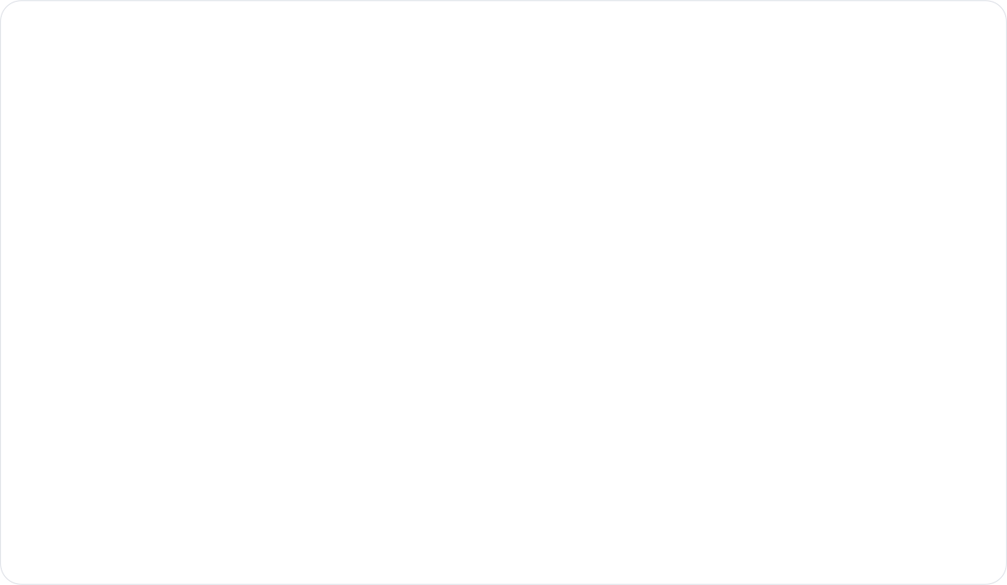
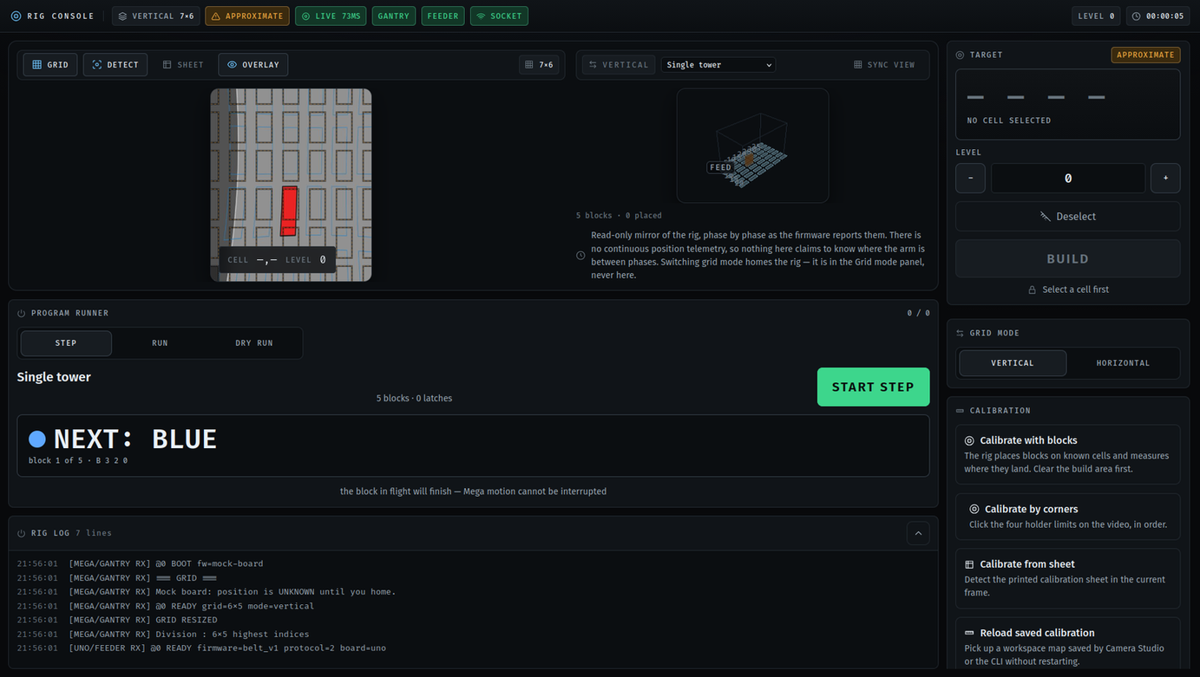
THE OPERATOR CONSOLE
LIVE CAMERA, TAP A CELL, TWO TAPS TO MOVE
Tap a cell.
Selection moves nothing and shows the exact command, B 3 2 1.
Tap BUILD, then CONFIRM.
Confirm the block is staged, then close the claw when the rig says it is in position. Two deliberate taps, and the second one is the rig asking.
Three outcomes.
PLACED (green, selection cleared), REJECTED (amber, nothing moved), ABORTED (red, session locked).
No cancel, no retry.
There is no such control, because the machine cannot honour either.

Slide 28
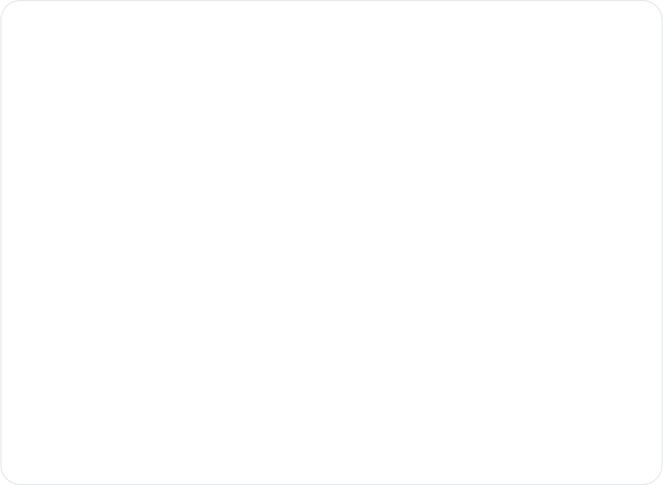
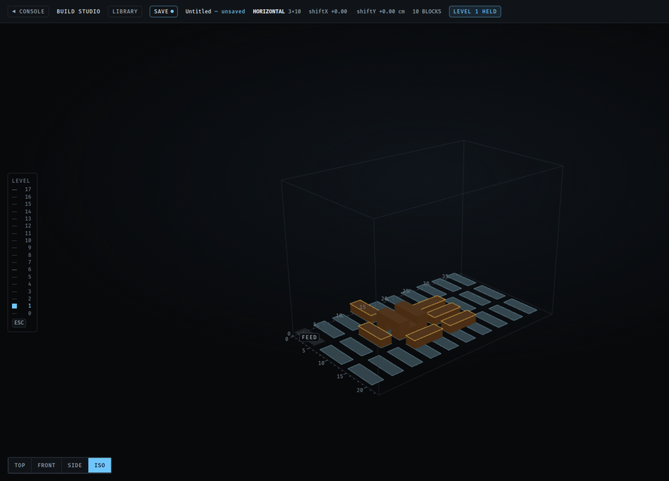
THE 3D BUILD STUDIO
DESIGN, VALIDATE, COMPILE — THEN RUN IT
THE VALIDATOR ASKS THREE QUESTIONS
    Support — a centre-of-mass toppling test, not a contact-ratio shortcut.
    Collision — in machine space, not grid indices, so a horizontal block spanning two columns is checked correctly.
    Reachability — inside the active grid, under the firmware's build ceiling.
THE COMPILER RUNS IN FOUR STEPS
    Support graph — which blocks rest on which, from footprint overlap.
    Ordering — Kahn's algorithm, bottom-up, grouping same-orientation runs to minimise mode latches.
    Emission — a mode command only on an actual change.
    Summary — blocks, latches, levels and a time estimate.
AND IT LAYS A BOND
Deterministic — twenty compiles, byte-identical output. An invalid model compiles to nothing at all, never to a half-program.
A course can carry a half-pitch offset on the run axis, so a block bridges the joint of the two beneath it — centred, equal overlap each side. Studio, compiler, twin and rig all agree on where it goes.

Slide 29

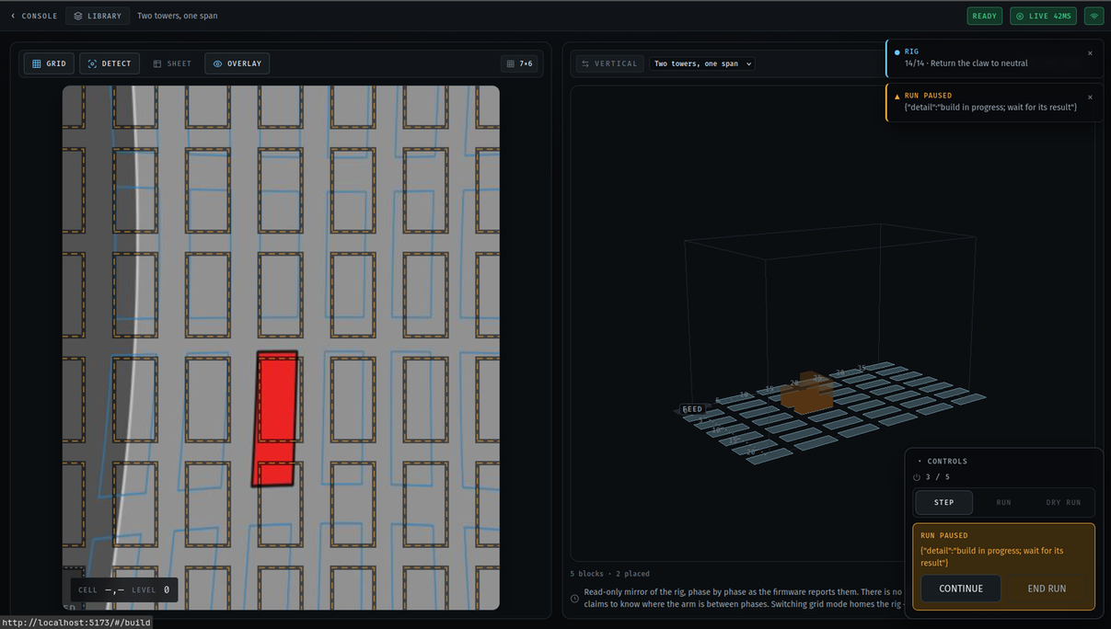
THE LIVE DIGITAL TWIN
IT DRAWS WHAT THE FIRMWARE SAID — AND NOTHING ELSE
It never invents state.
A block is drawn as placed because the server reported a terminal placed result for it, and for no other reason.
After an abort it stops.
A locked session freezes the animation, desaturates every block and demotes everything unconfirmed to a ghost.
Phase-driven, not clock-driven.
An earlier version interpolated a 1.6 s descent from the browser's clock and looped it — a 40 s build showed twenty-five descents that never happened.
If Z jams,
the block glides down, stops just short of the cell and sits there visibly not landing — which is the truth.

Slide 30


PLACEMENT SUPERVISION
THE MACHINE KNOWS WHAT IT BUILT — AND CHECKS
The rig places a block and forgets it. Supervision gives it a memory — a ledger of every cell it was commanded to fill — a way to look at the board, and the discipline to say when the two disagree, without ever guessing.
THE VERDICTS
amber pauses the run, red stops it
AGREES
the board matches the ledger
run continues
SUPERVISION OVERLAY — SCREENSHOT TO BE ADDED
NOT_DETECTED
a commanded cell reads empty
amber — pause
REMOVED
cells emptied, nothing arrived anywhere
amber — pause
It only looks when the rig is parked.
A measured quiet-window gate — under 1 % of pixels changing — means the camera never judges a board the gantry is still moving over. The constants were measured on the rig, not guessed.
MOVED
one cell emptied, a different valid cell filled
amber — pause
DISPLACED
same event, but the block landed in a gap
amber — pause
FOREIGN
something on the board that was never commanded
red — stop
“I could not see” is never “nothing is there.”
A detector failure or a stale frame raises NO_VISION, which is deliberately not a verdict. Collapsing it into an empty board would make the feature lie.
DISAGREES
both sides changed; the change cannot be paired
red — stop
A CORRECTION button closes the loop: verdict → the server re-checks safety → the firmware's pick-from-cell verb → re-verify. It is scoped hard — vertical mode, level 0, axis-aligned, no taller neighbour, destination clear — and it refuses a diagonal correction outright, because a block shoved into a corner closes two escape corridors at once.
Built and tested across three suites; not yet watched on a real camera frame, and the firmware's correction verb is written but unflashed.

Slide 31

03
TESTING & RESULTS
Sixteen complete builds on hardware, two reference boards, and over 900 automated checks across three suites.

Slide 32
TESTING METHODOLOGY
EVERY QUESTION ANSWERED AT THE CHEAPEST HONEST LEVEL
Automated software tests
Grid arithmetic, protocol parsers, the compiler, the twin, the homography. The Python and TypeScript grids are held to each other by shared fixtures.
1
no hardware
Protocol-level simulation
A fake MEGA speaks the same acknowledgement grammar, including failure, reset and lock-out. This is how the guarded command path and every terminal-result branch were tested exhaustively, with no rig.
2
no hardware
Firmware host builds
A stub-Arduino harness proves the sketch parses and that its output is byte-for-byte the protocol. A second test holds its 237 constants against config/rig.json, so a value edited on one side fails the build.
3
no hardware
Hardware runs on the rig
Anything touching motion, limits or Z. Every run appends to two logs — a stopwatch per build, and every serial line with the gap since the last one.
4
the real machine
The rig takes half a minute to answer one question, and a wrong answer can drive a claw into a stack — so the logs from level 4 are the primary evidence, and everything else is rehearsal.

Slide 33



CYCLE TIME AND REPEATABILITY
SIXTEEN BUILDS ON HARDWARE, ALL SIXTEEN PLACED
26.1 s
19.8 – 32.2 s
< 45 s
12.57 s
0.18 s
mean cycle, per block
fastest and worst case
the objective
the nine fixed phases
their standard deviation
Mean duration of each build phase, over sixteen builds (seconds)
Light bar = minimum to maximum across all sixteen · solid bar = mean
4.53
4.68
2.91
2.89
2.80
2.76
0.42
0.58
0.41
0.93
0.95
0.49
0.71
0.52
1
2
3
4
5
6
7
8
9
10
11
12
13
14
build phase 1 – 14
Measured over sixteen builds on the automatic pick-up path. Manual staging adds an operator-paced pause inside phase 5, which the machine does not time.
Nine phases never move
The variation is travel, and nothing else
Nine of the fourteen have no distance or level dependence at all on the automatic path. Across all sixteen builds they summed to 12.57 s ± 0.18 s — six of them identical to the 0.01 s logging resolution.
Only phases 8 and 13 range widely, 1.48 s to 8.53 s. With no acceleration ramp, a move of N steps takes N times a fixed period.

Slide 34

THE X-RAIL SKEW
A MEASURED MECHANICAL FAULT, CANCELLED IN SOFTWARE
A block placed with pure Y motion lands exactly where the grid says. A placement involving X motion lands off along Y — and the error grows with how far along X the rig travels. It is not a constant offset.
Column index
Y error introduced
0
0.000 cm — no X travel
1
0.115 cm
2
0.230 cm
3
0.345 cm
k
0.115 × k cm
Linear in the column index, with no row dependence.
Why it happens
Why we cancel it in software
The arm holder rides the X rod and is not supported symmetrically — its own mass, the cable-chain drag and the belt's side load all pull on one side. That constant pull bows the rod slightly out of square with Y, so the further the carriage travels along X, the more it also drifts along Y.
Re-machining the rod was out of scope. Instead the firmware commands Y to a position offset by exactly the drift the slanted rod will add, per axis and per grid mode, so the two cancel and the block lands where the ideal grid says.

Slide 35




VISION RESULTS
TWO REFERENCE BOARDS, TWO NEGATIVE RESULTS
29 / 29
33 › 29
37 – 103 ms
0.85 px
0.27 cm
blocks found, both boards
hypotheses after rejection
per analysed frame
mean fit residual
mapping error on a 2.2 cm block
WHAT THE FIT CHOSE, AND WHY
TWO NEGATIVE RESULTS
    Chosen on held-out prediction, not training error. Similarity 101.4 px, affine 1.38, homography 1.22, homography + curvature 1.09.
    Pitch is static to within 2 %. X 29.38 px (sd 1.24), Y 69.14 px (sd 1.08).
    An independent geometry check. The view is 17.7 % anisotropic; two independent estimates agree to 4 %.
Higher resolution finds nothing extra
29/29 at every width from 384 to 1024 px. Illumination flattening costs up to 3,894 ms a frame and finds exactly the same 29.
White balance is right for the sheet, wrong for the board
On the printed sheet it takes the green mask from 0 pixels to 87,836. On a board of blocks it pulls the wood toward the surface: 28 of 29 with it on, 29 with it off.
The 0.27 cm is the saved four-corner format flattening the fit — not the fit itself.
29 blocks, the rails, and two wooden offcuts that are not blocks

Slide 36
04
CONCLUSION & FUTURE WORK
What the machine proves, the limits that are real, and the one item on the list that is not optional.

Slide 37

LIMITATIONS, STATED PLAINLY
LIMITS OF THE HARDWARE, NOT OF THE APPROACH
No hardwired emergency stop
Motion cannot be interrupted
Nothing removes motion energy independently of the software. The stop of last resort is the supply. The machine is run attended.
The gantry does not read serial while it moves, so software stop is stop-after-current-block by construction.
No watchdog
Open-loop steppers, no stall detection
If the Pi crashes or the cable is pulled, the MEGA finishes the command it already holds.
No encoders, no current sensing. A stall produces step pulses that go nowhere.
The lens is tuned, not calibrated
The claw angle is not sensed
Adjusted by eye against straight edges — visually straight, not measurement-grade. The file records source: estimated.
The operator is trusted to start neutral. If not, every placement that session is turned 90°.
Staging is not verified
The operator confirms a block is at the pickup cell and the machine believes it. Nothing between that confirmation and the claw closing checks that a block is there.
Supervision does not judge above level 3. A stacked block's apparent position shifts under the fisheye, so an absent detection up there is a filter artifact, not a missing block — those cells are hatched and counted as unjudged rather than reported.

Slide 38

FUTURE WORK
ONE ITEM IS NOT OPTIONAL; THE REST ARE
SAFETY, FIRST
    A hardwired emergency stop — a latching mushroom button in series with a contactor on the 12 V motor rail
    A stop that is observable during motion, and a communications watchdog that brings the rig to a defined state
Close the loop on placement
Measure properly
Protocol and capability
    A bench session — the verdict path has never seen a real camera frame
    Flash and watch the pick-from-cell verb on the rig
    Bounded automatic repair, currently built and deliberately switched off
    Lift the level-3 ceiling by folding parallax into the saved map
    Restore automatic staging
    A checkerboard or ChArUco lens calibration
    A per-cell table in the saved map, removing the 0.27 cm flattening error
    Fix the camera, not the matrix — the colour correction is at its limit
    Controller-supplied command ids
    Encoders or stall detection — also worth about a third of the cycle time
    A faster serial link, and a larger workspace

Slide 39

CONCLUSION
THE CONTRIBUTION IS NOT THE GANTRY
Cartesian gantries are a solved problem. What this project demonstrates is the layer student-scale automation usually leaves out: every physical transition confirmed by something other than a clock.
The camera
The gantry
checks the board against a record of what was commanded, and names the cell when they disagree — or says it could not see.
narrates each of its fourteen phases before running it.
The twin
And when it cannot prove
draws what the firmware said, and stops short of the cell until the release event arrives.
what happened, it locks and asks for a person rather than retrying.
16 / 16
26.1 s
5
29 / 29
900+
hardware builds placed
mean cycle
levels on one cell
blocks detected
automated checks

Slide 40
THANK YOU
QUESTIONS
Ahmed Gharib · Mohie Halawa · Khalil Qanabita
Supervised by Dr. Samer Arandi
Department of Computer Engineering · An-Najah National University

