Slide 1

An-Najah National University
Computer engineering department
Smart parking system
Prepared by:
Aseel Hamdan & Bayan Azar
Supervised by:
Dr.Mohannad Al jabi

Slide 2
Outline:
-Introduction
-Main features
-System Unit
-Problems
-Future Work
-Conclusion

Slide 3
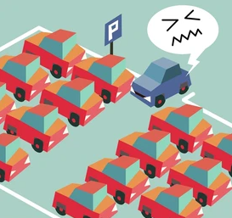
Introduction cont.
why smart parking system?
Smart Parking is solution to organize cars in the parking without human intervention and solves a common problem ,which is parking crisis.

Slide 4
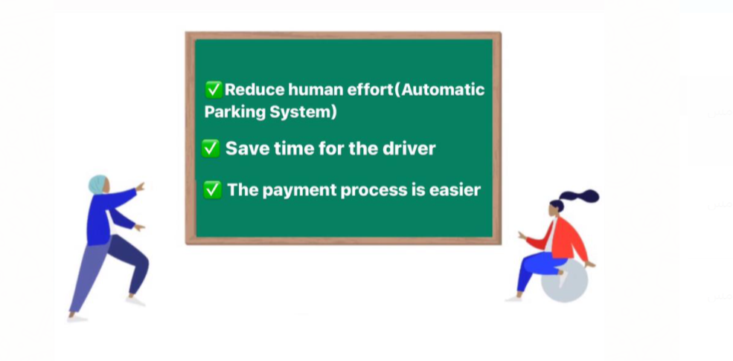
The Advantages of smart parking system:

Slide 5
Main features
System Features
Car
detection
Card
charging
Automatic payment using Card
Automatic Gate Barriers for Entry

Slide 6
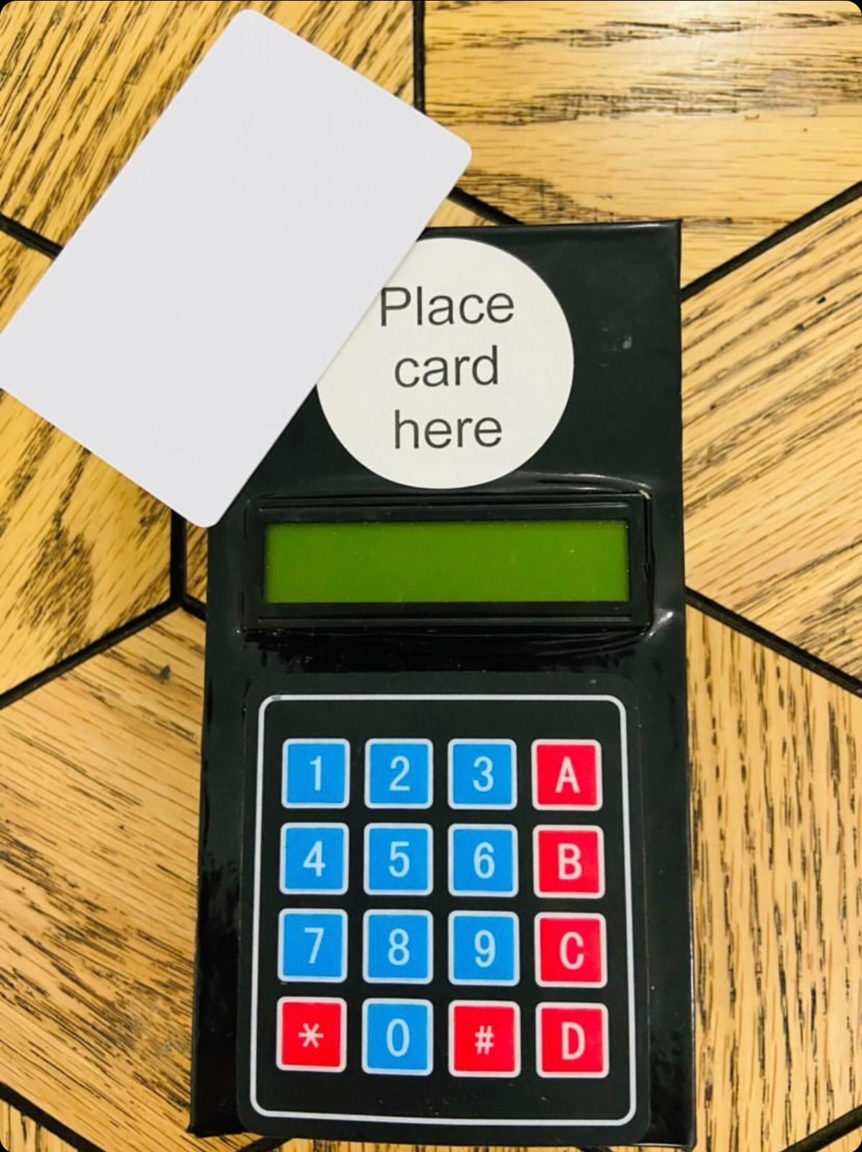
System Units
Our project consists of two controlling units:
Card charging unit
In this unit the card is recharged with the balance that enables the driver to enter the parking
This unit consist of:
Microcontroller (arduino uno)
Keypad
Lcd
I2c
RFID reader
Card

Slide 7
System Units cont
Parking Unit
This unit Consists of two car parks, right and left,each one fits two cars, There is a counter next to each car park showing the number of empty slots.
This unit consist of:
Microcontroller (arduino mega)
Lcd
servo motor
ultrasonic sensors
RFID reader
Card
Leds
7-Segment display

Slide 8
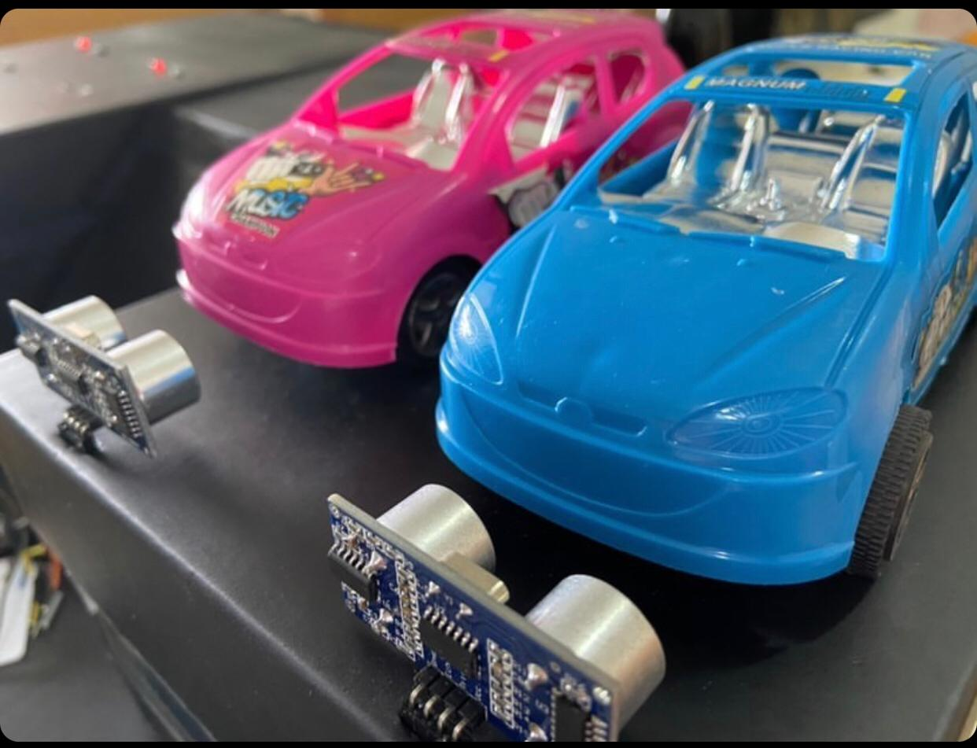
Car detection
The presence of a car or not in each slot is checked by using the ultrasonic sensor.

Slide 9
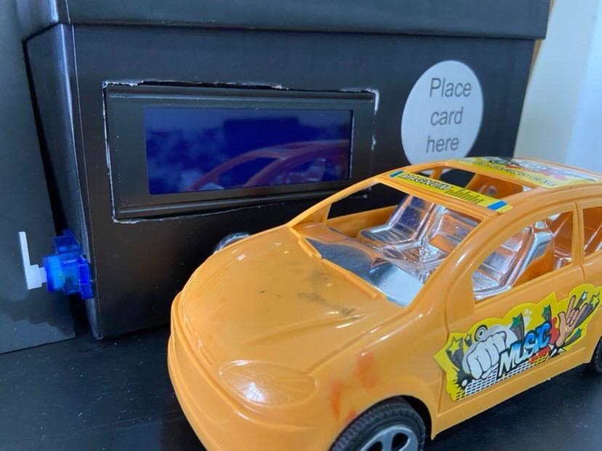
Automatic payment using Card and Automatic gate barriers for entry
If the balance is sufficient (10nis or more),and there is an empty slot, an amount of money(10nis) is deducted from the balance stored in the card automatically and also the gate opens automatically.

Slide 10
Problems
1- As we are not quite familiar with connecting hardware components and sensitive ICs, it was a little bit difficult to find the right connecting protocols and using the IC's efficacy.
2- The sensors confuse each other thus make an error in detecting the presence of a car in the slot or not.
3- When the last car enters the parking and before it reaches the empty slot, the counter indicates that there is an empty slot, and in in these moments another car can come and enter the parking to discover later that in fact the parking was full.
4- LCD display consume a lot of pins in the arduino

Slide 11
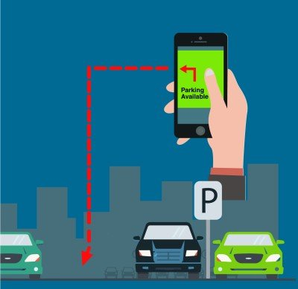
Future Work
1-we can implement other ways for the payment. For example connect the payment with the driver’s bank account.
2-An application can be made that shows the driver's balance, and whether there is an empty slot in the parking or not.

Slide 12
Conclusion
There has been a tremendous growth in the number of vehicles on road in past few years. But unfortunately the road networks and road widths have not grown in proportion to vehicle numbers. This has created in huge parking crisis. At such times Smart Parking Systems are the need of the hour.

