Slide 1

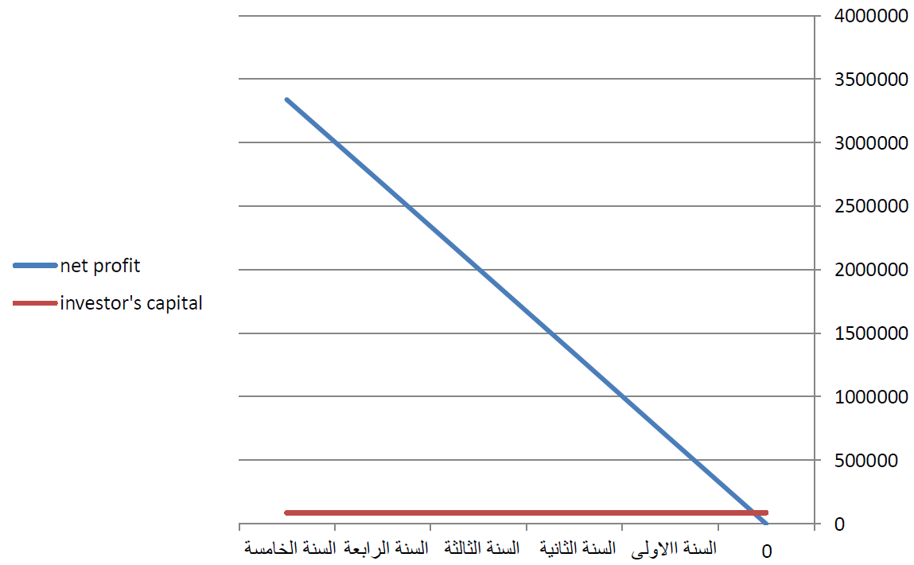
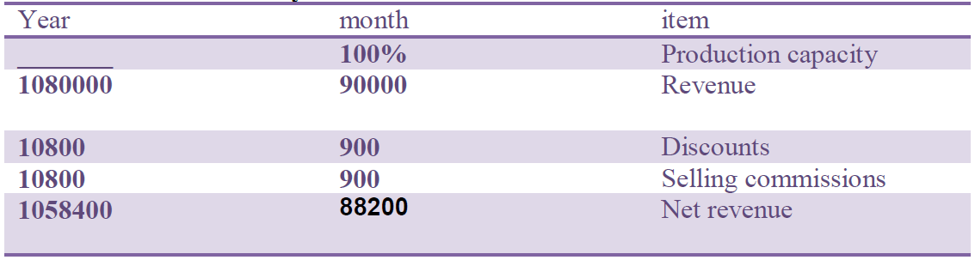
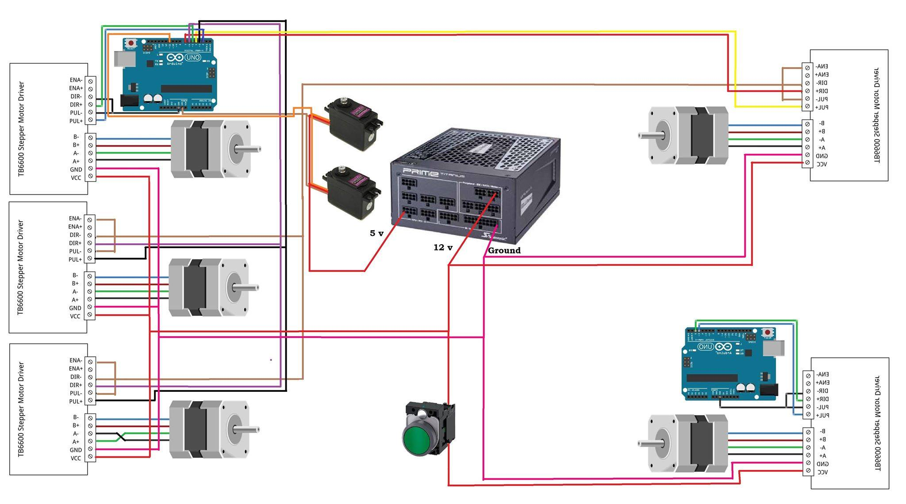
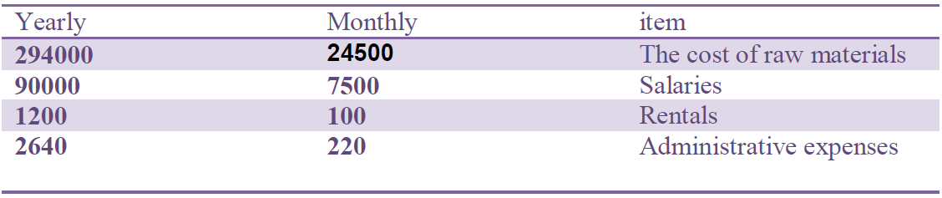
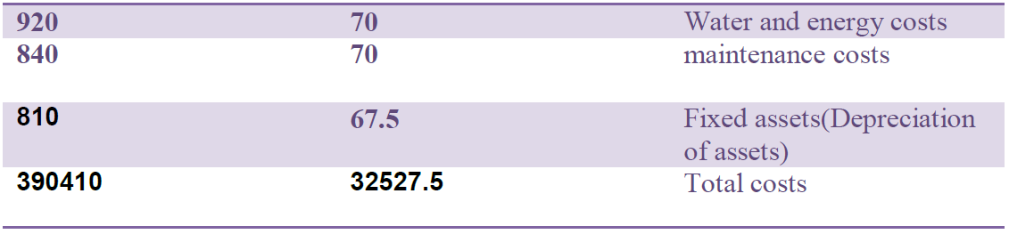
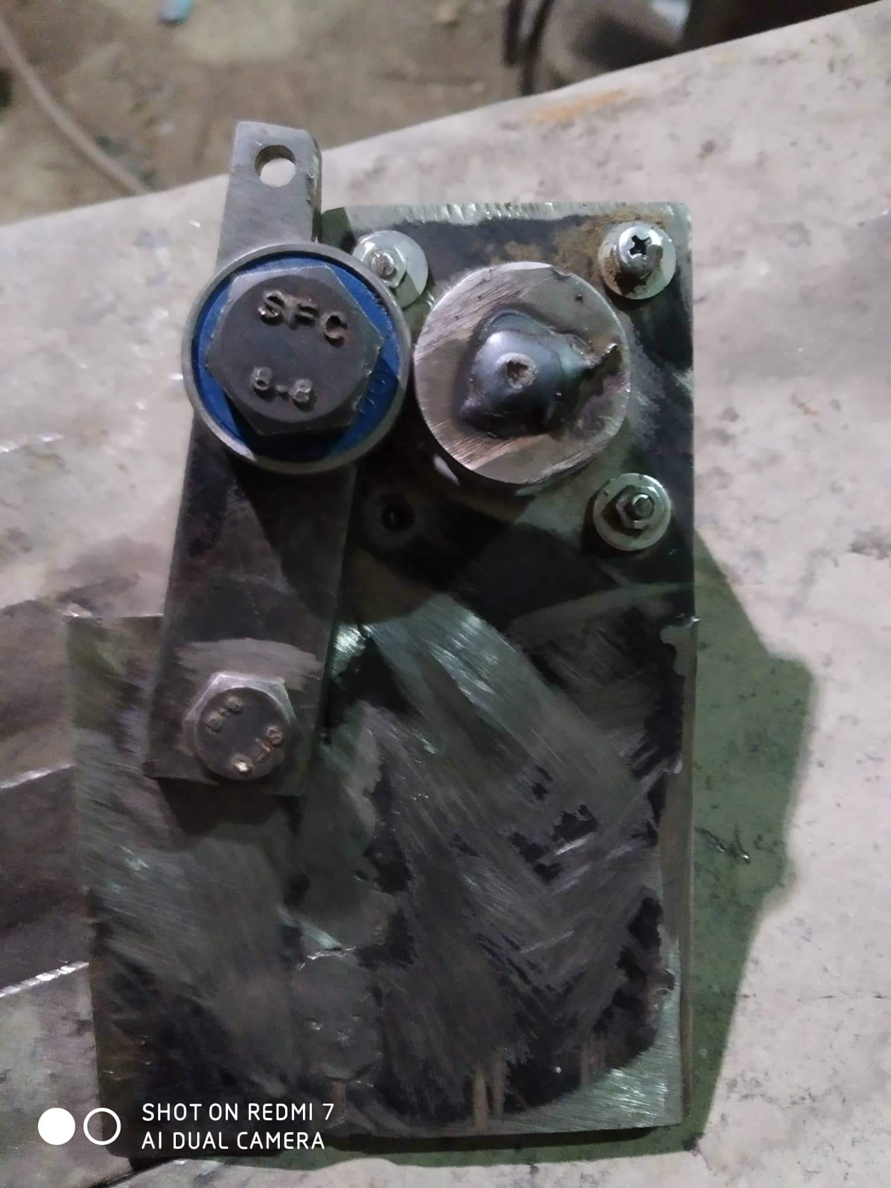
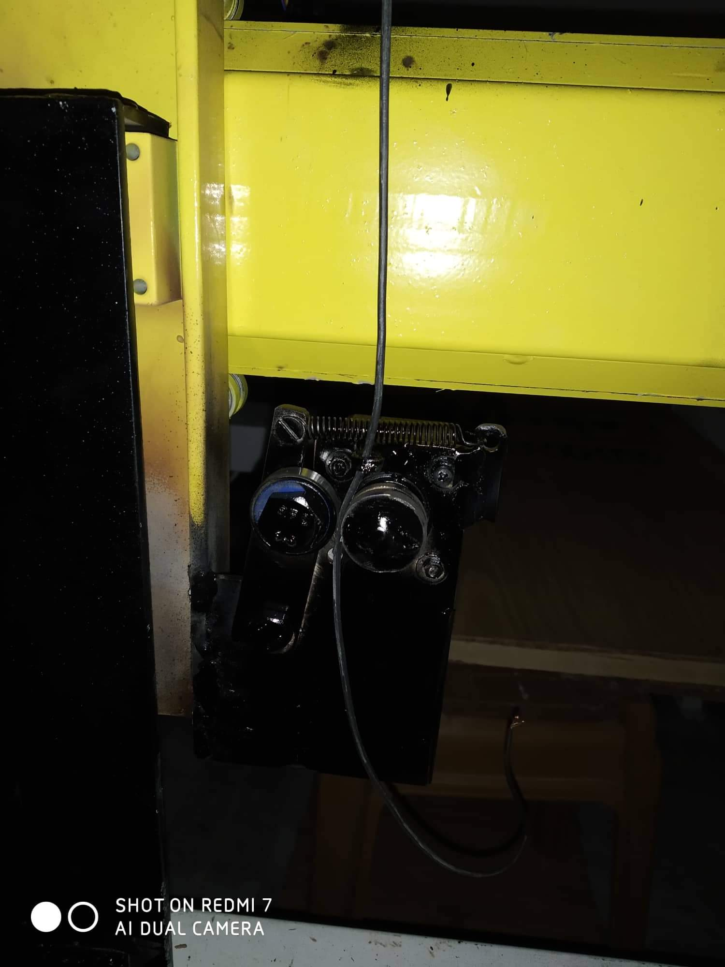
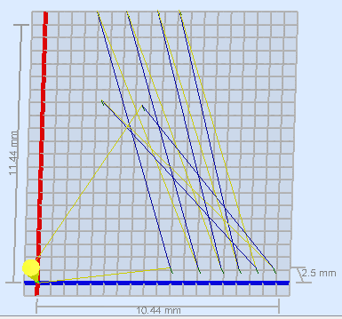
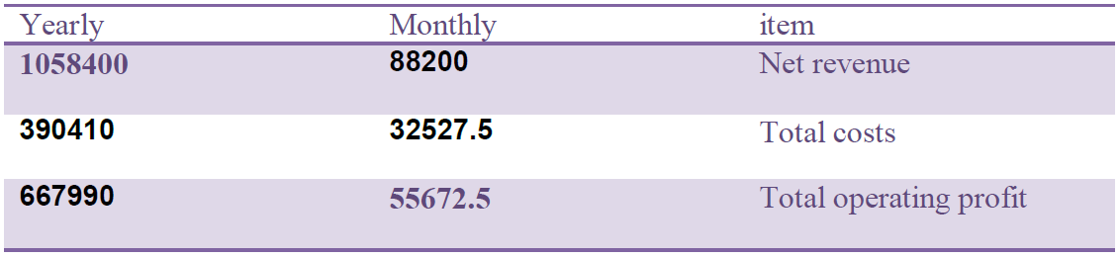
Abstract
Relation between net profit & investors capital
Internal connection of distribution board machine
Is an electrical device capable of Installed distribution boards with
all sizes.
Principle of work: The device receives electrical connections through a
specific application on the computer such as AutoCAD or Artcam and other
programs to convert sketch file from computer to controller.
Or register traditional connections such as connections of the control panels of(
pumps and elevators and power factor correction) and other popular distribution
boards.
The equipment such as (circuit breakers and cables ….etc.) is placed inside the machine so
that the outputs are electrical distribution boards for needed projects.
Using equipment : stepper motors , power supplies ,Arduino , mechanical body
has shape like CNC machine.
The device can be developed with suitable software to receive the
information, manufacture the painting body, paint it and assemble it
in a short time.
Internal Connection Of Distribution Board Machine
Power Supply:
Income statement for the first year
The power supply of the PC was best power solution for the project.
why this type of power supply?!
because the project need high number of amperes with low voltage, four
drivers of the steppers need about 20A for the project and this power supply
give us what we want as the following:
Overview
The hand of the robot
The machine made with 5 steeper motors ,four of them for
direction, two for y axis Because it carries more weight and therefore
Needs more torque , one for x axis , one for z axis ,and fifth one for wire
roller Which it will explain later, and three servo motors , one makes the
hand hold the pieces, and servo motor for holding the wire at one time and
cutting it at another time, and servo motor to make rotational motion( like hand )
, and two arduinounokits"second one for wire roller stepper motor .
In the previous semester, a SolidWork design made to understand the project that will
be doing in this semester.
What is the different that the project make in the grble library ?
cost
The project add two servo motor and delay for the time and make a
G-code commands for them by using visual studio code to control the
hand and the wire cutting and make a delay in the motions .
And the servo of cutting designed to press on a push button to run the stepper
of pulling the wire .
And this editing in the library solve the problem 5 .
What things used in the project?
The wires catcher
Stepper motors , servo motors , drivers ,power supply,
microcontrollers, racks , gears , and Stainless steel round bar, smooth
bar and bell to make the moving parts due to it's light weight .
The paths of the robot moving
profit
Final calculation
Net profit for five years = 667990*5=3339950
investor's capital = 85948
Profit per year = 667990
Pay back period = 85948 /667990
=0.128667 Year = 1 month and 16 days

