Slide 1
Real-time Tracking system
-RTS-

Slide 2
Outline
Introduction .
What problem does PAS solve.
The solution
Parts.
Project Timeline.
Final Product.
Future Work.

Slide 3
1.
Introduction

Slide 4
RTS is a real-time tracking system to monitoring the product when it pass on the production line to helps to discover defects, and in the event of their recurrence, production is stopped and the production line is maintained, which leads to reducing waste and costs, ensuring quality and increasing productivity.

Slide 5
What problem does RTS solve

Slide 6


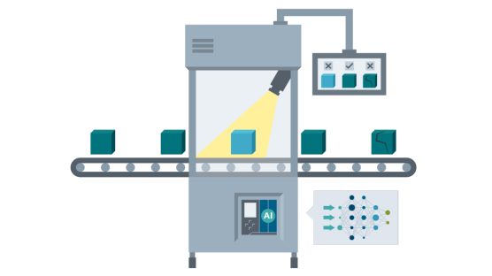

What problem does RTS solve
Defect Detection
Predictive Maintenance

Slide 7
Solution
build a hardware to make the process easy for the employees and to detect defects.

Slide 8
Parts
-Mechanical
-Electric

Slide 9
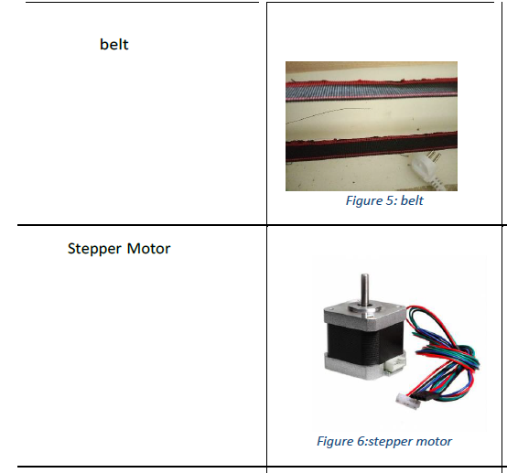
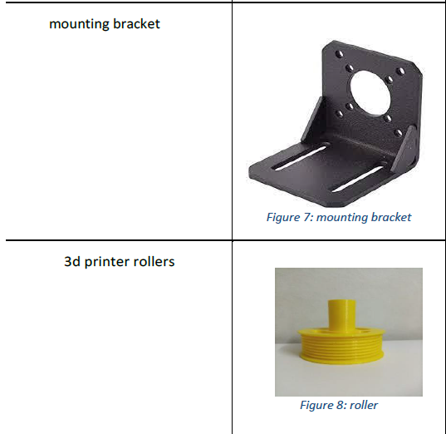
Mechanical Part

Slide 10
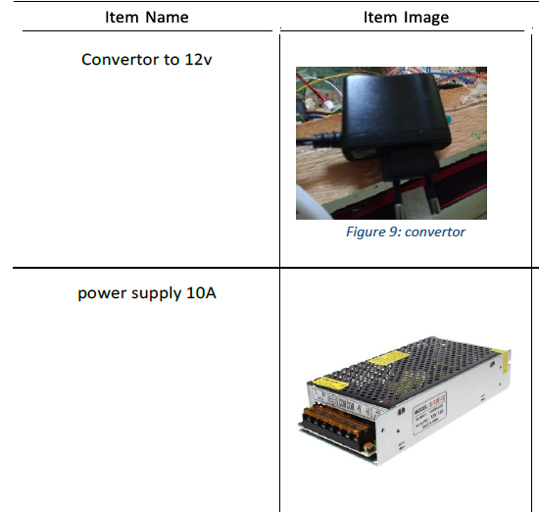
Mechanical Part

Slide 11
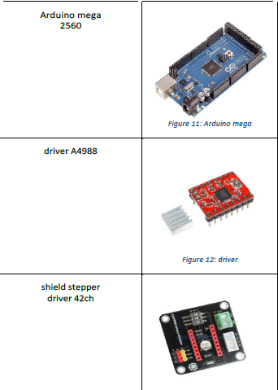
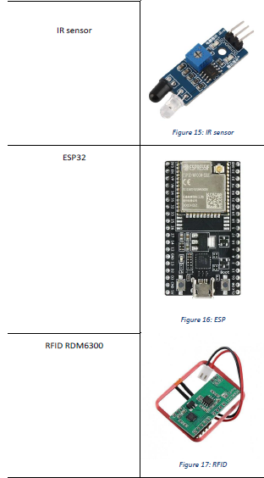
Electric Part

Slide 12
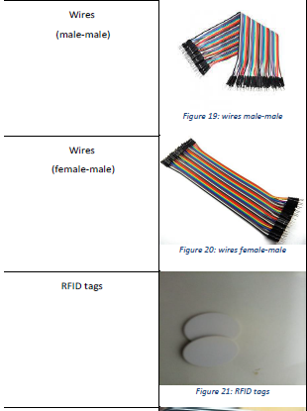
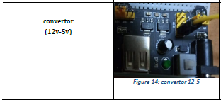
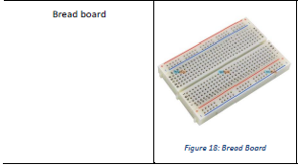
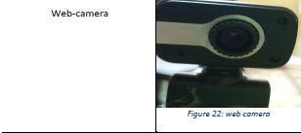
Electric Part

Slide 13
Project Timeline
buy parts
Connecting electrical parts to the project
Confirm the idea
1
3
5
2
4
6
Planning how to implement the idea
Building the project structure
Testing

Slide 14
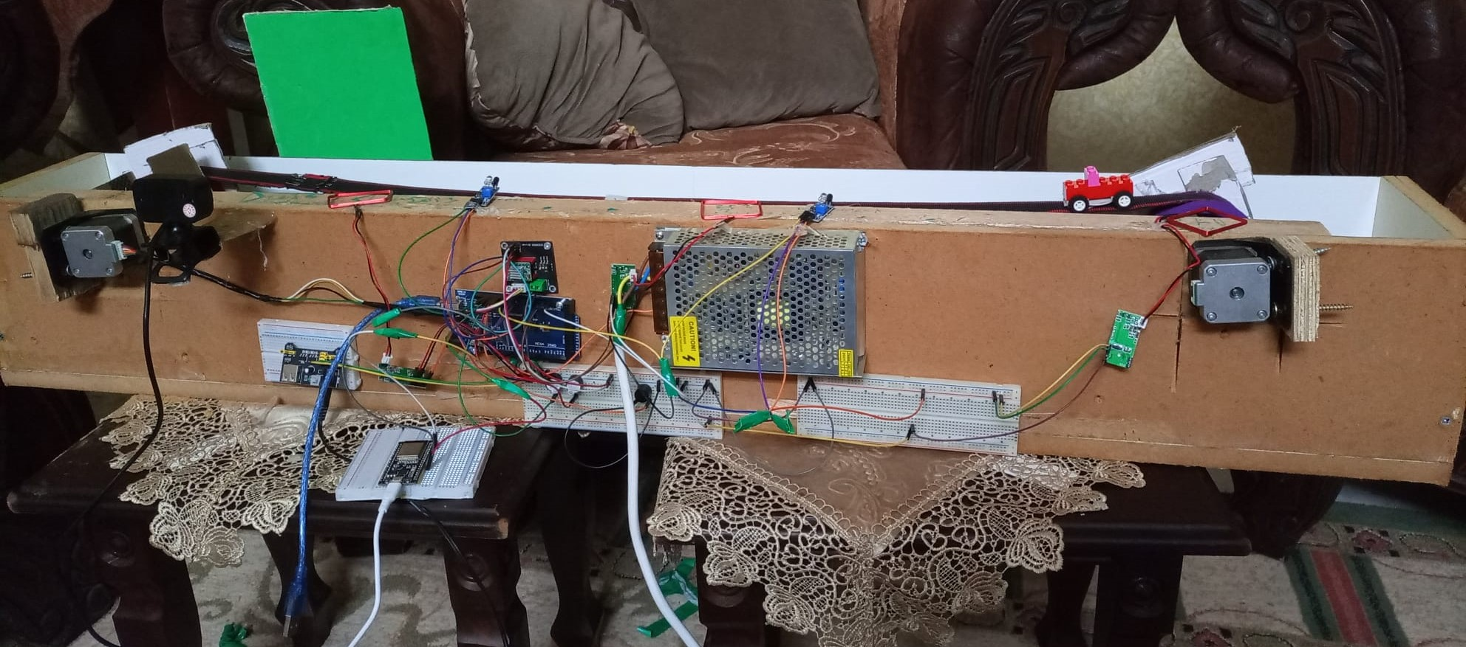
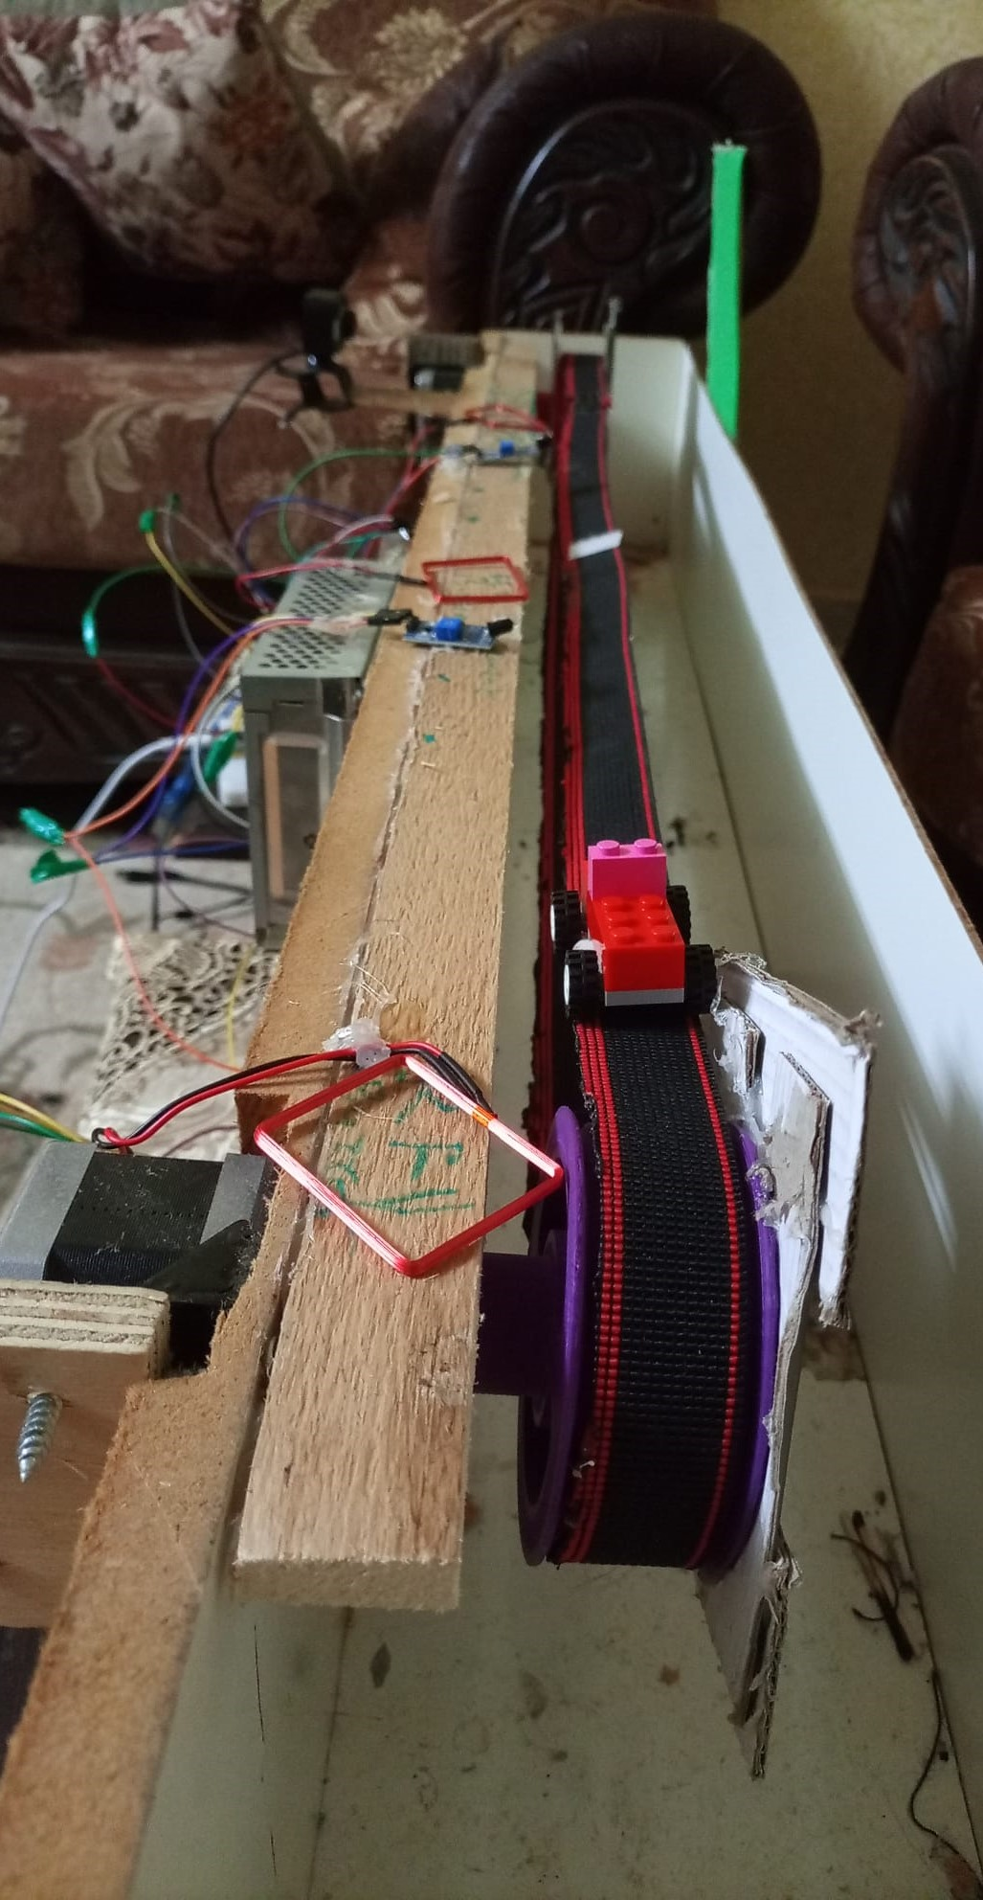
Final Product

Slide 15
Future work
-we can implement our functionality on a real time production line, so we don’t have to worry about the mechanical part as you know it’s not our field, now we have the idea looking forward to make it real and applicable.

Slide 16


Team Presentation
Omar Dere
Ibraheem Arda

Slide 17
THANKS!
Any questions?

