Slide 1
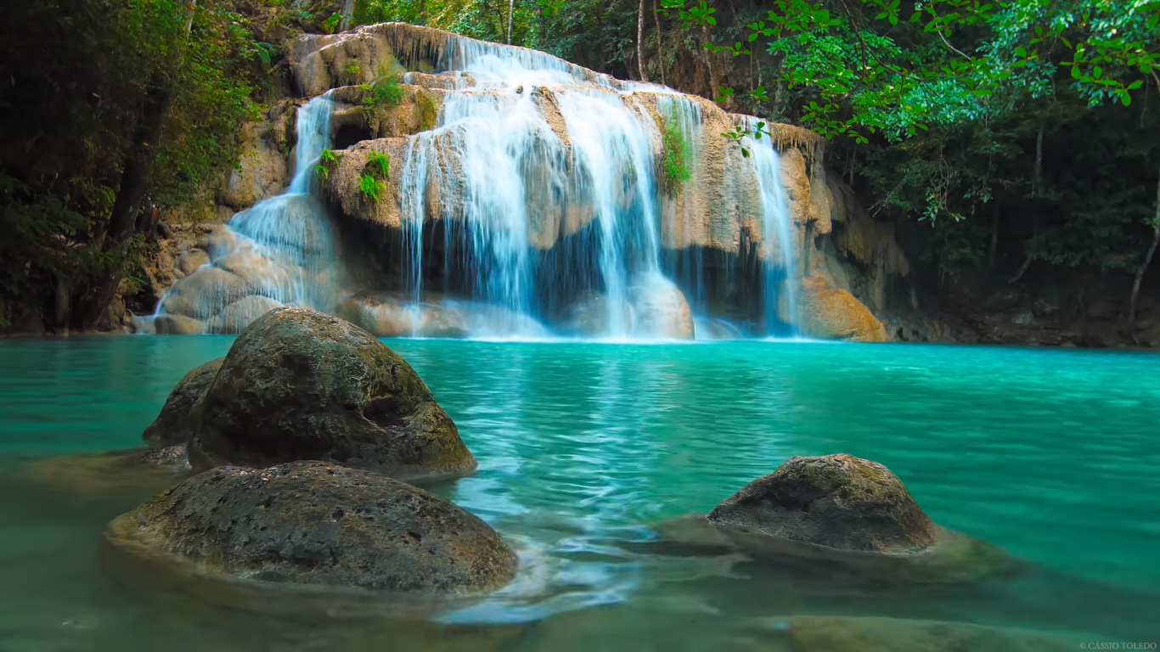
Waterfall Printer
Presented By :
Suhaib Baba & Mahdi Nassar
Supervisor:
Dr. Raed Qadi
Notes:
hi

Slide 2
Outline:
What is Waterfall Printer
Components
Overview
Future Work
Demo

Slide 3
What is Waterfall Printer:
It’s a model:
to make user write characters and print images by controlling waterfall through interruptions of water flow.

Slide 4
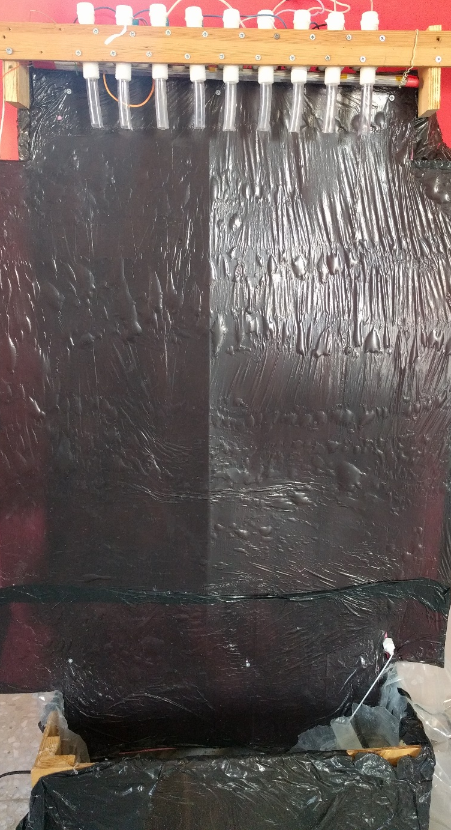
What is Waterfall Printer:

Slide 5
Components

Slide 6
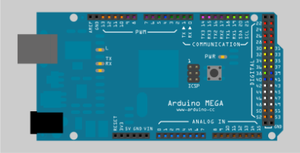
Components: Arduino Mega

Slide 7
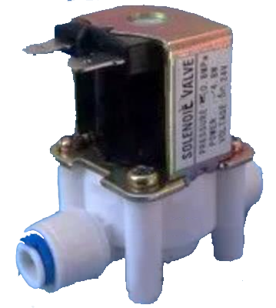
Components: Solenoid Valves

Slide 8
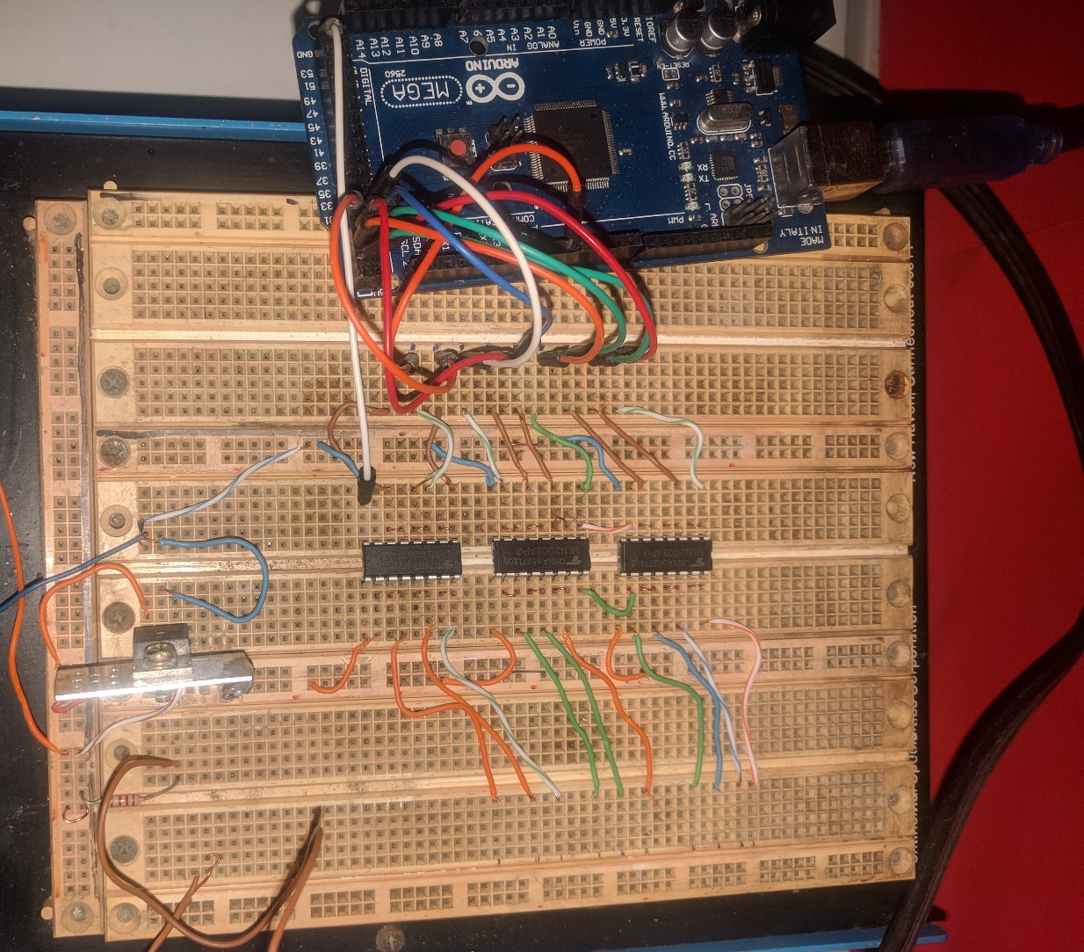
Components: Drivers ULN2003

Slide 9
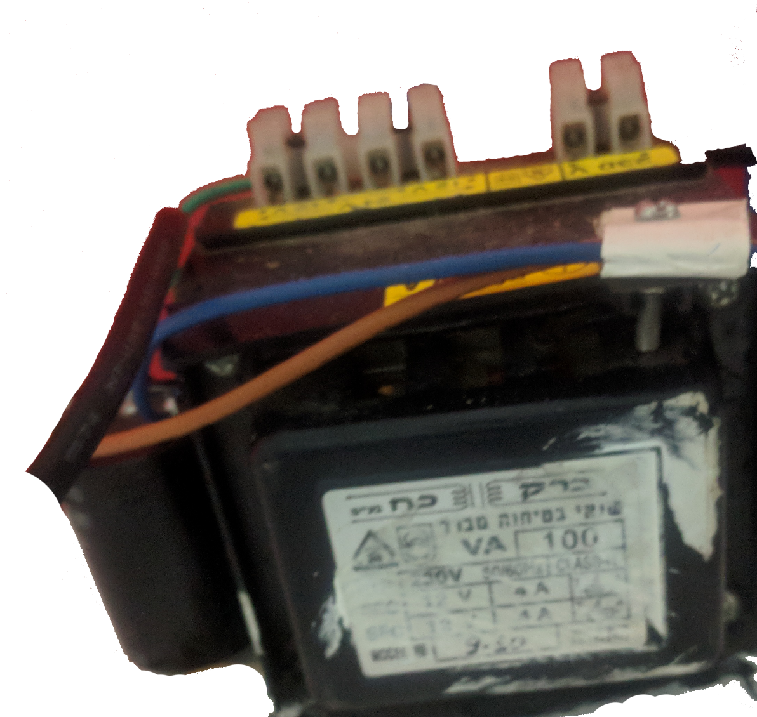
Components: Power Supply
12 Volts
10 amperes

Slide 10
Part 1 : Hardware

Slide 11
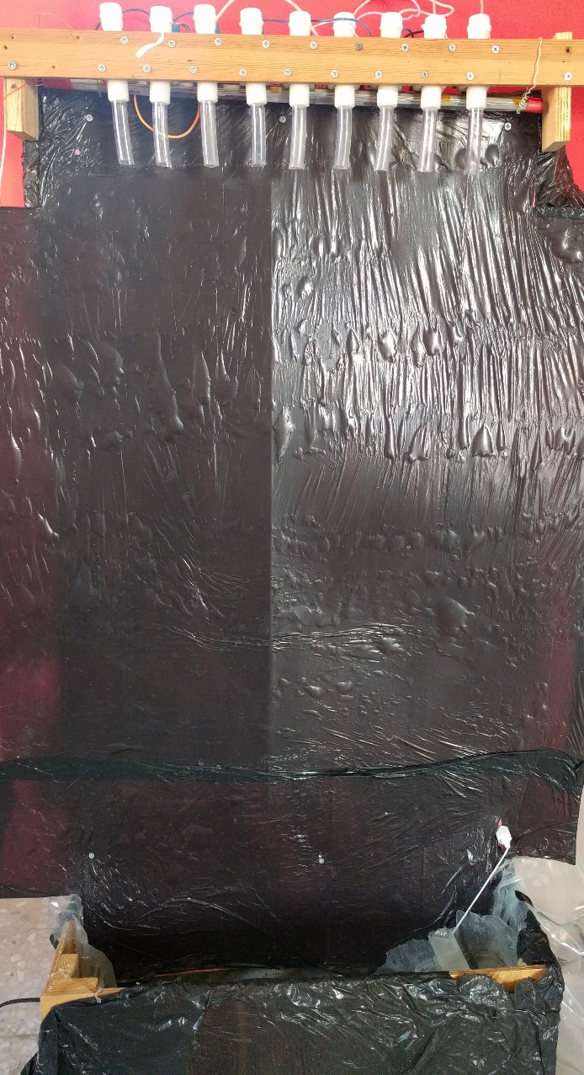
Model:
80 cm
1.8 m

Slide 12
Some problems:

Slide 13
Model
Model
Model
1
2
3
Pressure distribution was not uniform all times.
Due to high pressure, water speed is relatively high
Pressure distribution was unbalanced for all valves.
When most of valves were open, water flow and water speed drops sharply.
Solve all Problems

Slide 14
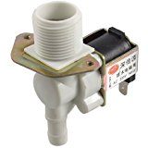
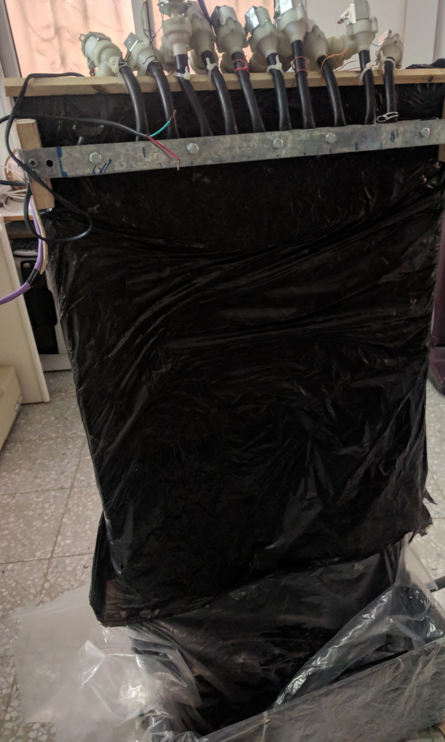
Model 1:
Using 12-volts Diaphragm Water Valve

Slide 15
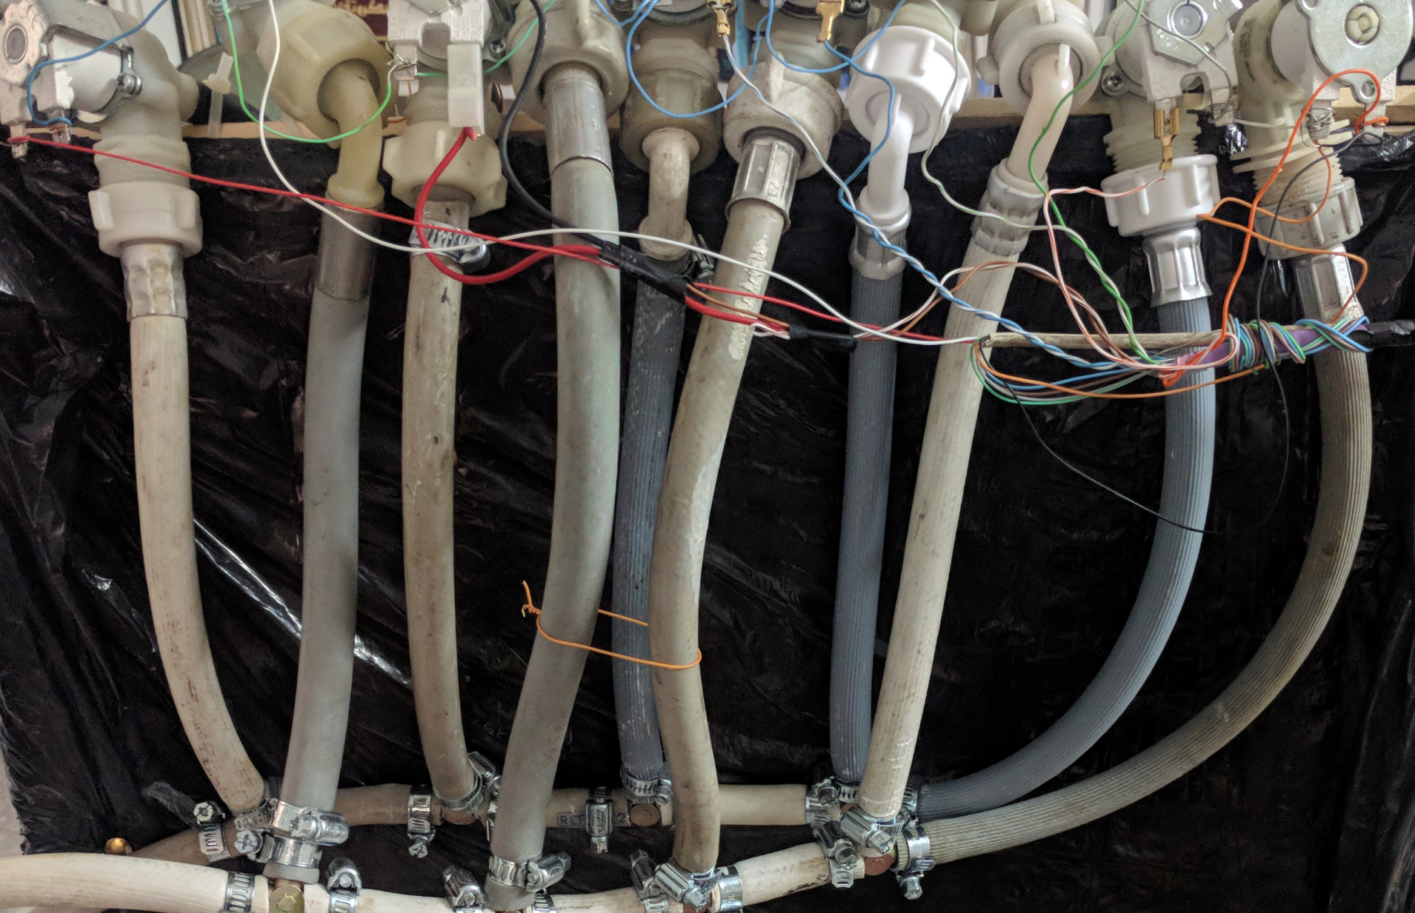
Model 1:

Slide 16
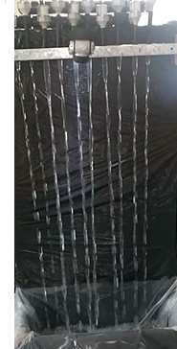
Model 1:

Slide 17
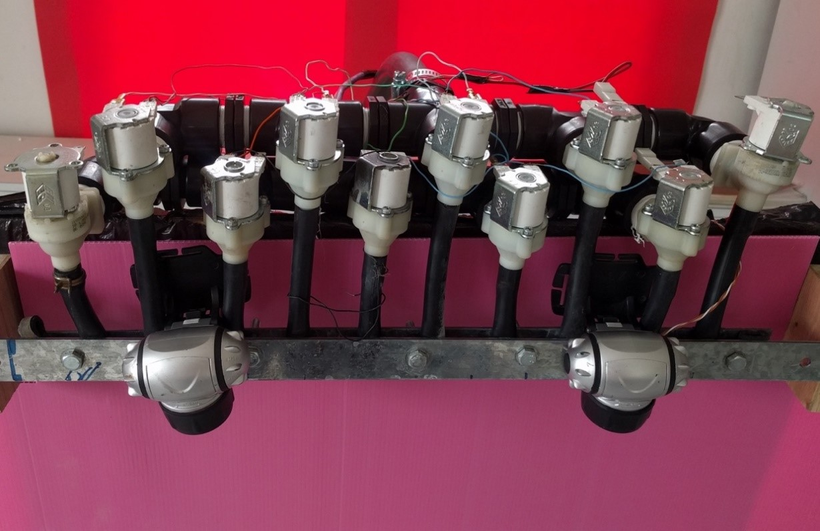
Model 2:

Slide 18
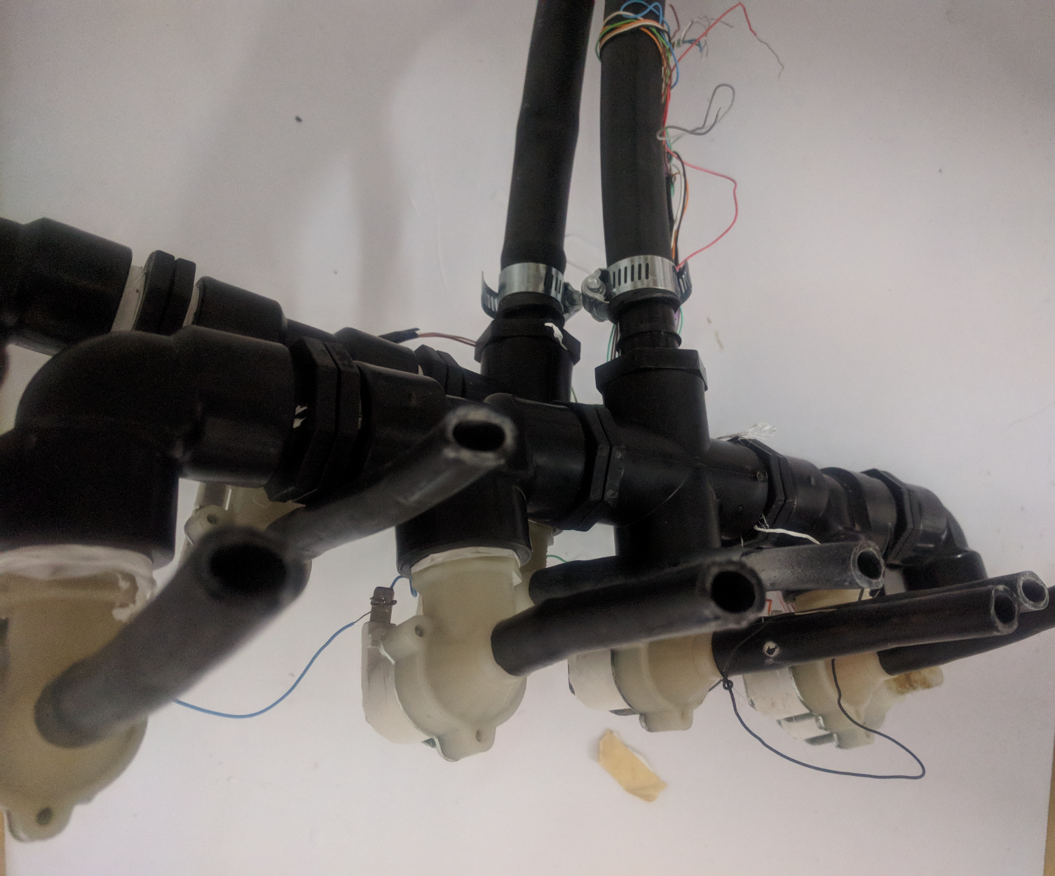
Model 2:

Slide 19
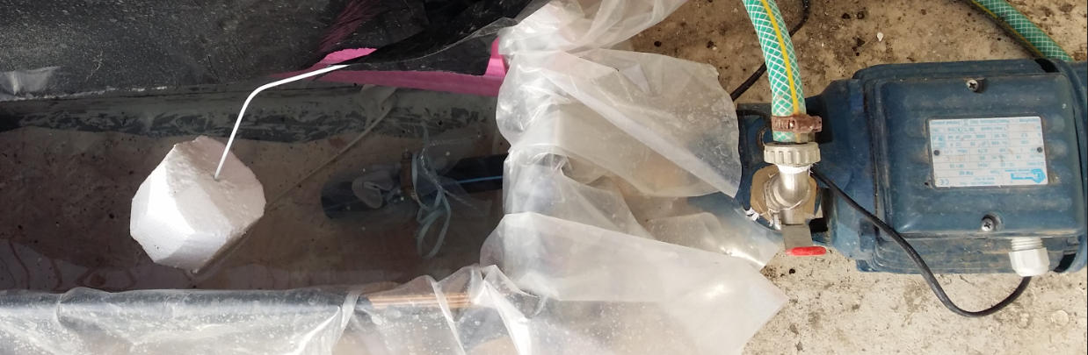
Model 2:
Water pump:

Slide 20
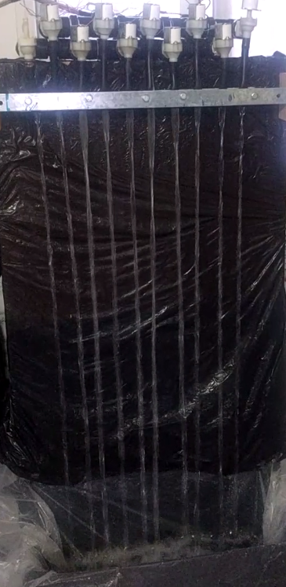
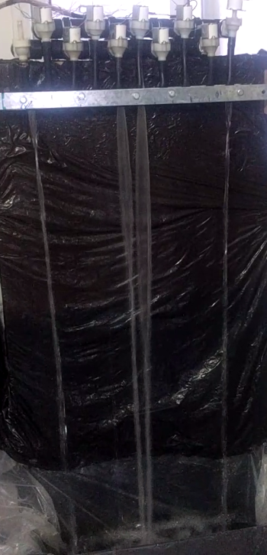
Model 2:

Slide 21

Model 3:
Using 12-volts Solenoid Water Valve

Slide 22
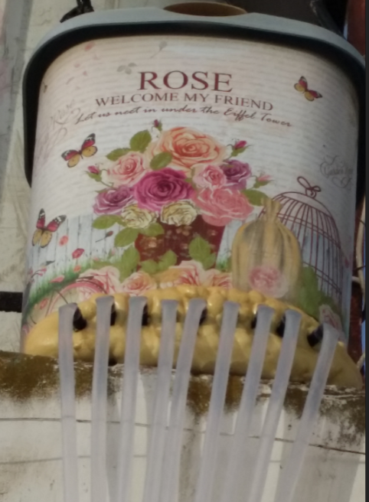
Model 3:
Water tank:

Slide 23
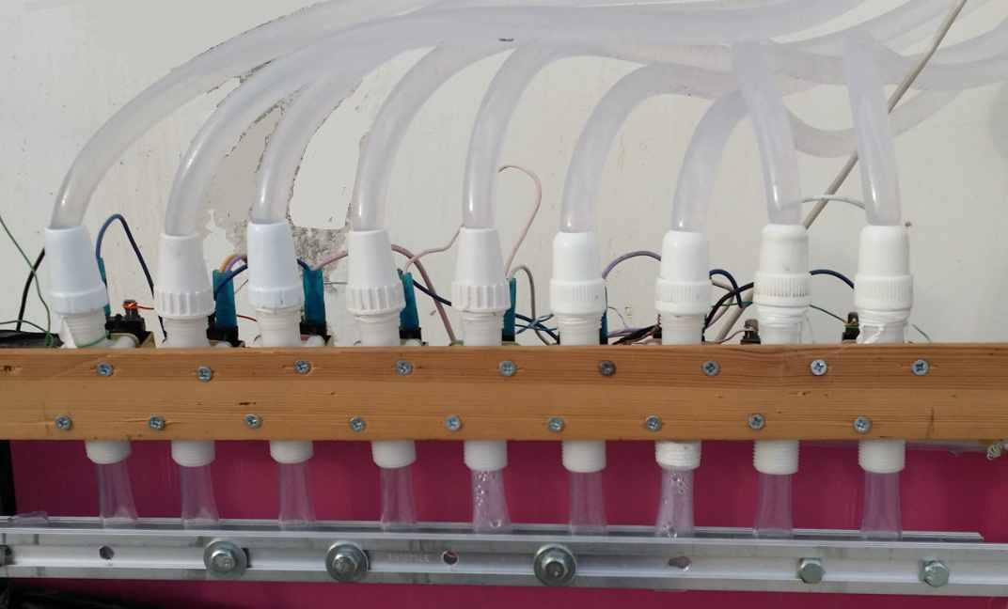
Model 3:
9 Valves:

Slide 24
Model 3:
Water pump:

Slide 25
Part 2 : Software

Slide 26
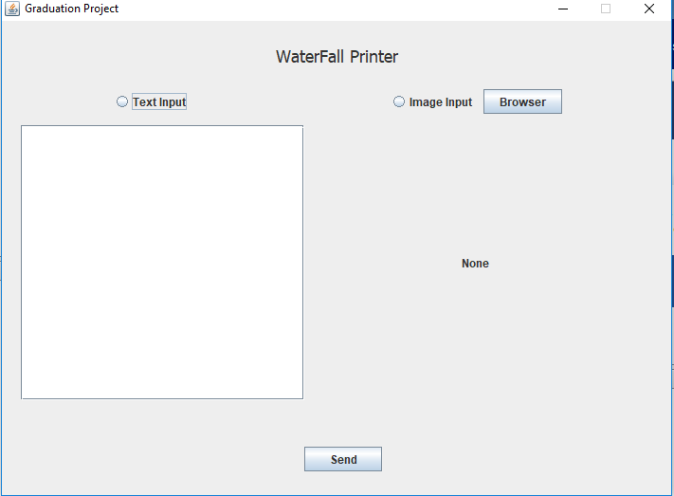
Java Application

Slide 27
Algorithm

Slide 28
A user chooses to print character or pictures in java application
Create image contains user input Characters/Strings with fixed width
Convert image to array of bits and save it as a file and send to Ardinuo

Slide 29
000000000
000111000
011111110
011111111
110000111
111111000
011111110
001111111
110001111
111000111
111111111
011111110
00111000
00000000
1111111
11111111
11 11
11111
111111
11111
11 1111
111 111
111111111
1111111
S

Slide 30
0000111000
0011111110
0111111110
0111001111
1110000100
1110000000
1110000000
1110000111
0111001111
0111111110
0011111110
0000111000
0000000000
111
1111111
11111111
111 1111
111
111
111
111 111
111 1111
11111111
1111111
111
C

Slide 31
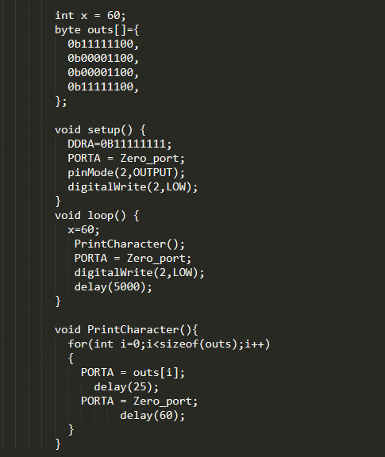
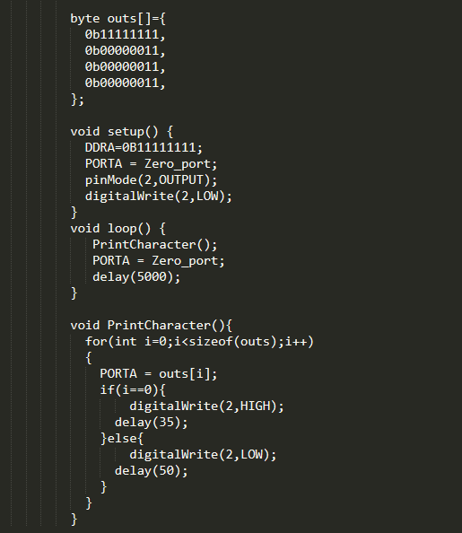
Problems

Slide 32
Future Work :
Increase Number of Valves.
Add colors to water to make the shapes more beautiful.

Slide 33

Video

Slide 34

Any Questions ?

Slide 35
Thank You

