Slide 1

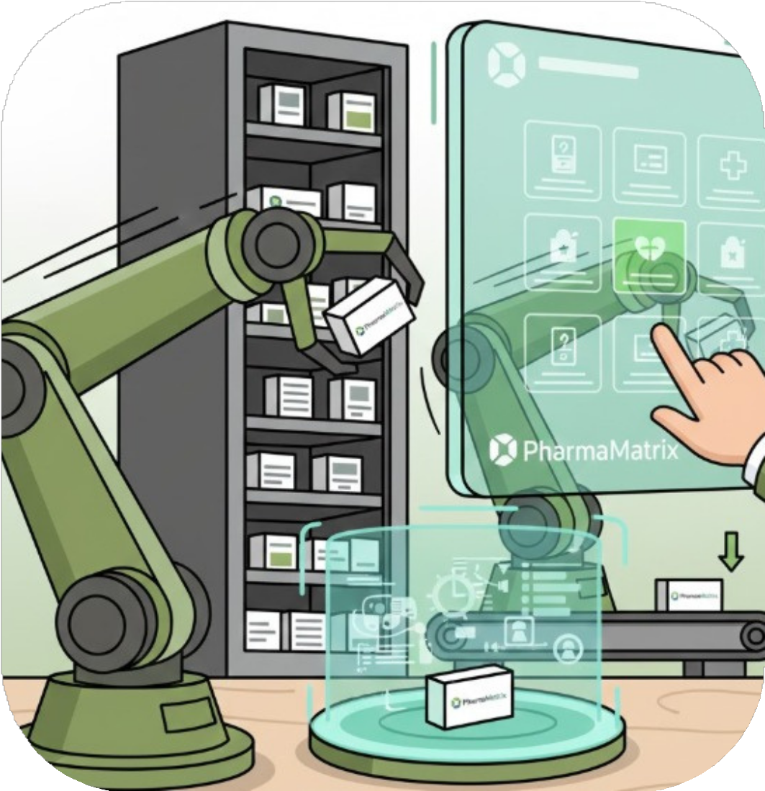
PPHHAARRMMAAMMAATTRRIIXX
AAUUTTOOMMAATTEEDD MMEEDDIICCAATTIIOONN SSTTOORRAAGGEE && DDIISSPPEENNSSIINNGG SSYYSSTTEEMM
Computer Engineering – Graduation Project
Done By: Haneen Alhajali & Deema Daraghmeh Supervisor: Dr. Abdallah Rashed
janurary 28, 2026

Slide 2

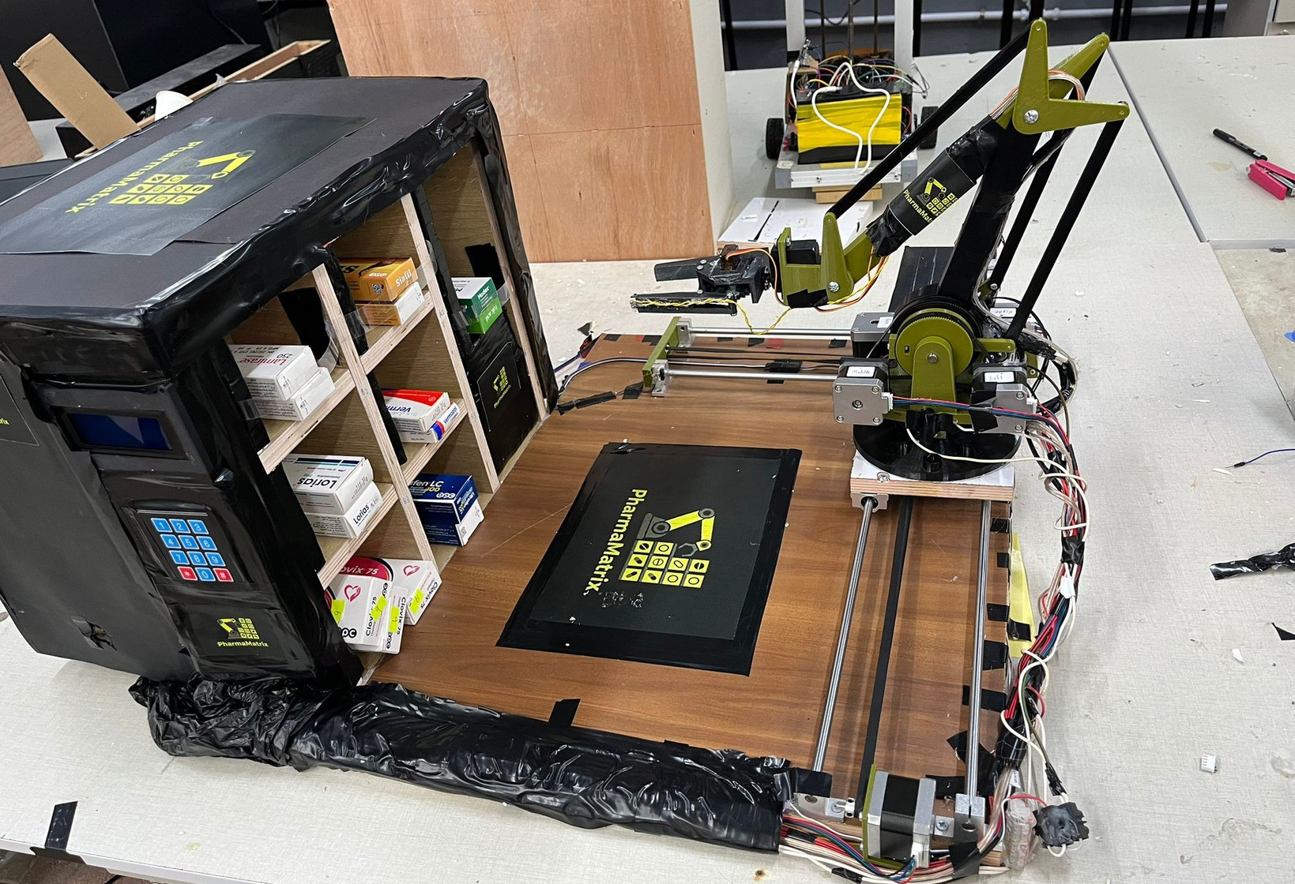

Slide 3

CONTENT
01
Introduction
02
Problem Statement
03
System Overview
04
System Design (Hardware & Software)
05
Results
06
Future Work
07
Conclusion

Slide 4
Introduction
The increasing demand for efficient and accurate medication management has highlighted the limitations of traditional manual pharmacy systems. These systems are prone to human error, slow
operation, and poor inventory control.
PharmaMatrix is an automated medication storage and dispensing system that uses a robotic arm, sensors, and embedded controllers to safely store, retrieve, and manage medications. The system improves accuracy, reduces workload, and enhances overall pharmacy efficiency.
01

Slide 5

Problem Statement
1
Medication storage and dispensing are mostly done manually.
Increasing workload makes pharmacy operations inefficient.
This leads to human errors, slow service, and poor inventory tracking.
A reliable automated solution is needed to improve accuracy and efficiency

Slide 6
System Overview
2
Pharma Matrix is an automated medication storage and dispensing system.
The system consists of a robotic arm, storage shelves, and dual rail mechanisms.
An Arduino Mega controls motion, sensors, and system states.
An ESP32 provides Bluetooth communication with a mobile application.
The system supports adding, dispensing, and automatic stock refilling

Slide 7
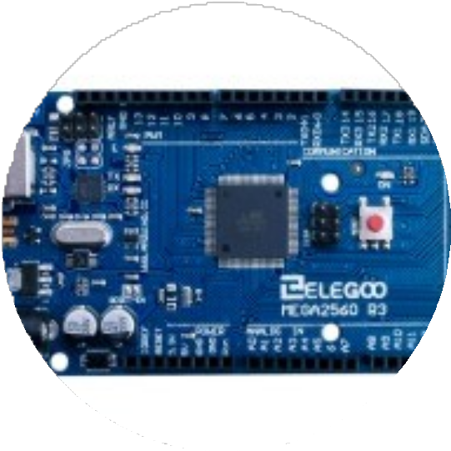
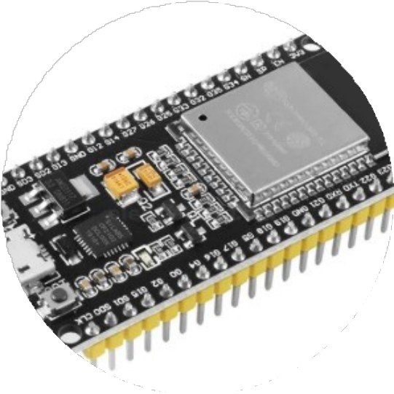
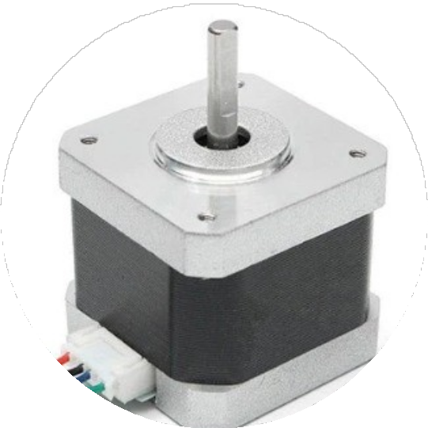
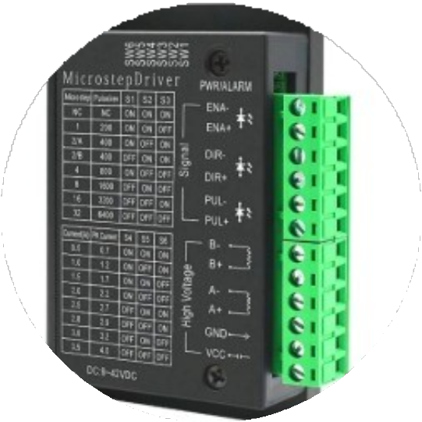
Hardware System Design: Key Components
Arduino Mega 2560
Main system controller
ESP32
Bluetooth communication module
Stepper Motors (NEMA 17)
Robotic arm and rail movement
Motor Drivers (TB6600 )
Base Stepper motor control

Slide 8
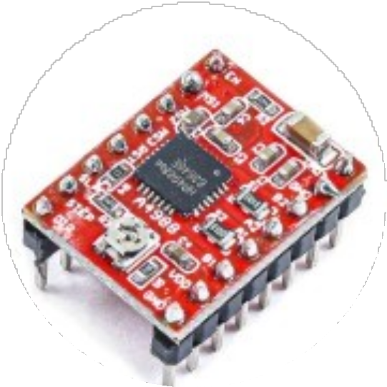
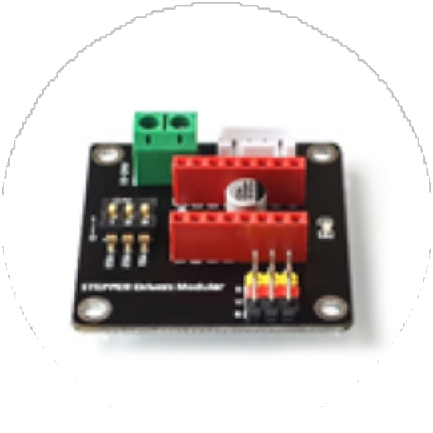
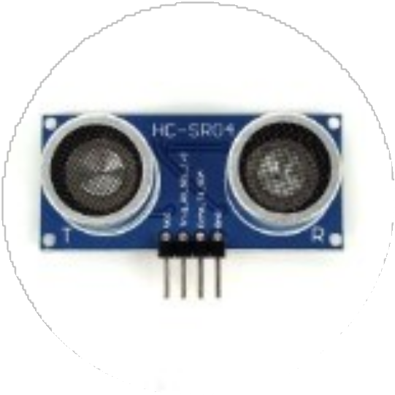
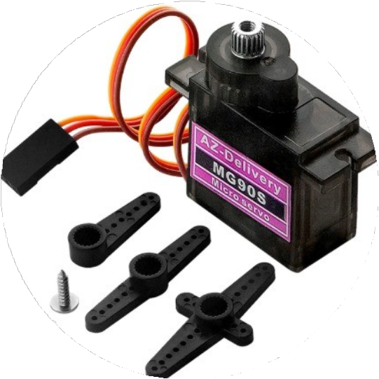
Hardware System Design: Key Components
Motor Drivers (A4988)
Stepper motor control
42CH Driver Shield Simplifies wiring; allows A4988 drivers to be mounted easily
Ultrasonic Sensors (HC-SR04)
Distance and object detection
Servo Motor MG996R
Gripper control

Slide 9
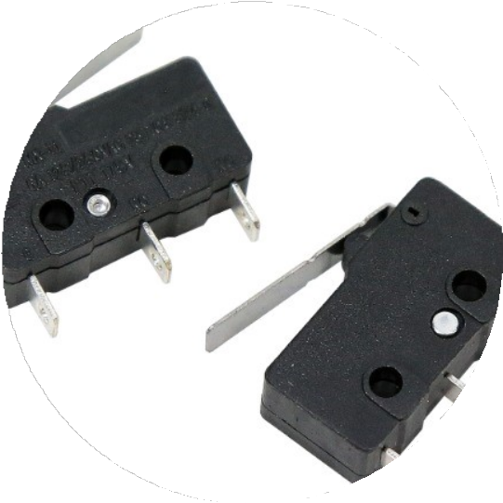
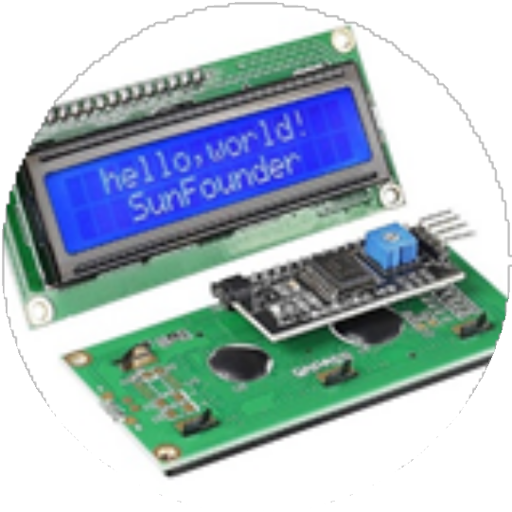
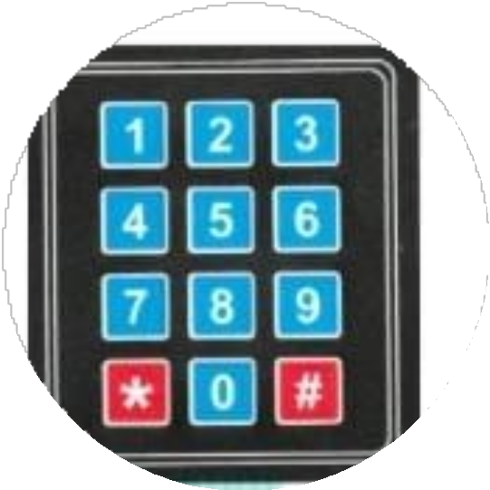
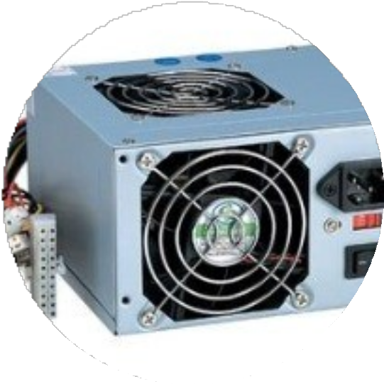
Hardware System Design: Key Components
Limit Switches Position and homing detection
LCD Display User interface display
Keypad 3x4
User input control
Power Supply Unit System power management

Slide 10
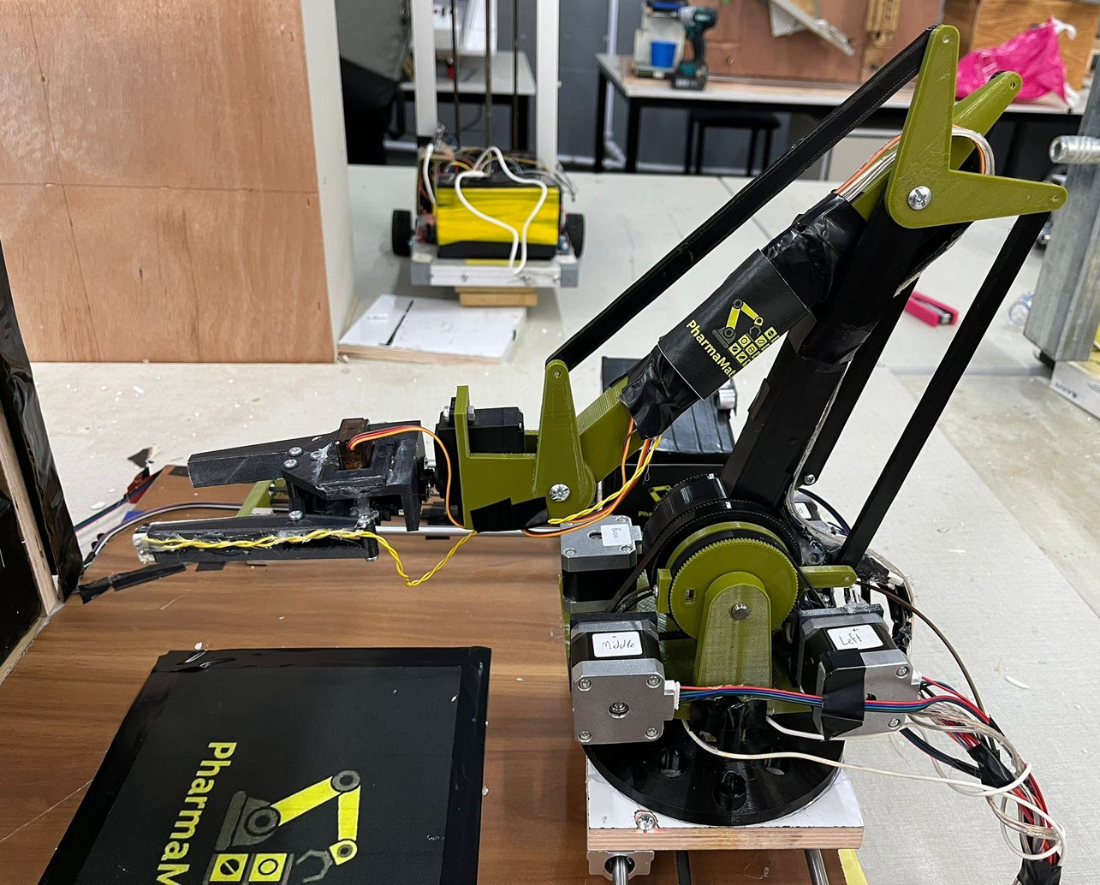
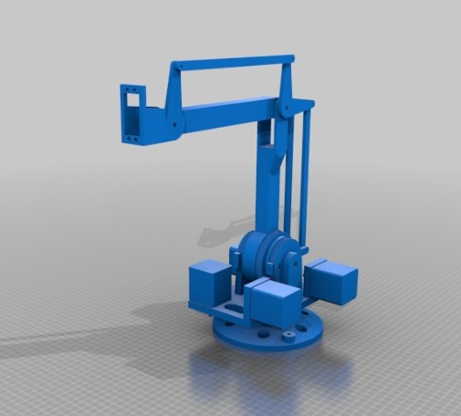
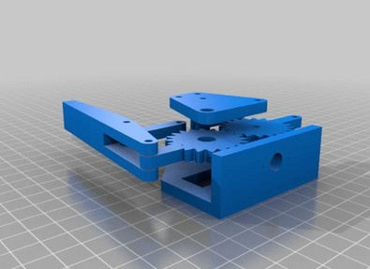
4-degree-of-freedom robotic arm

Slide 11
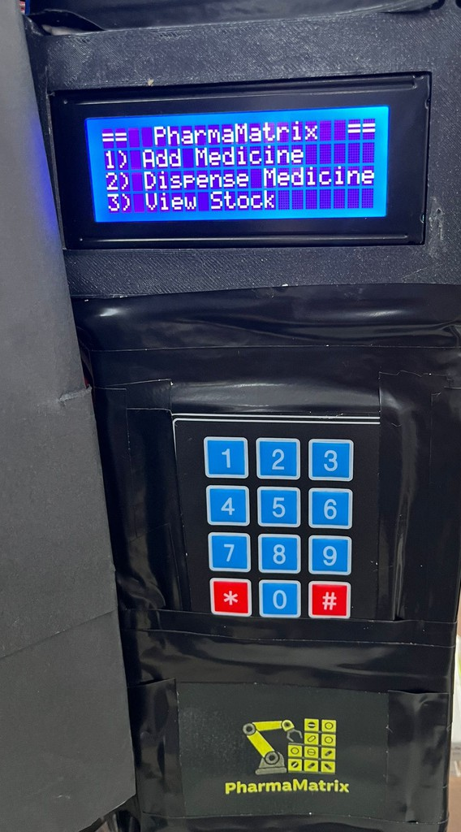


Operations
View stock Adding medicine
Dispensing medication

Slide 12
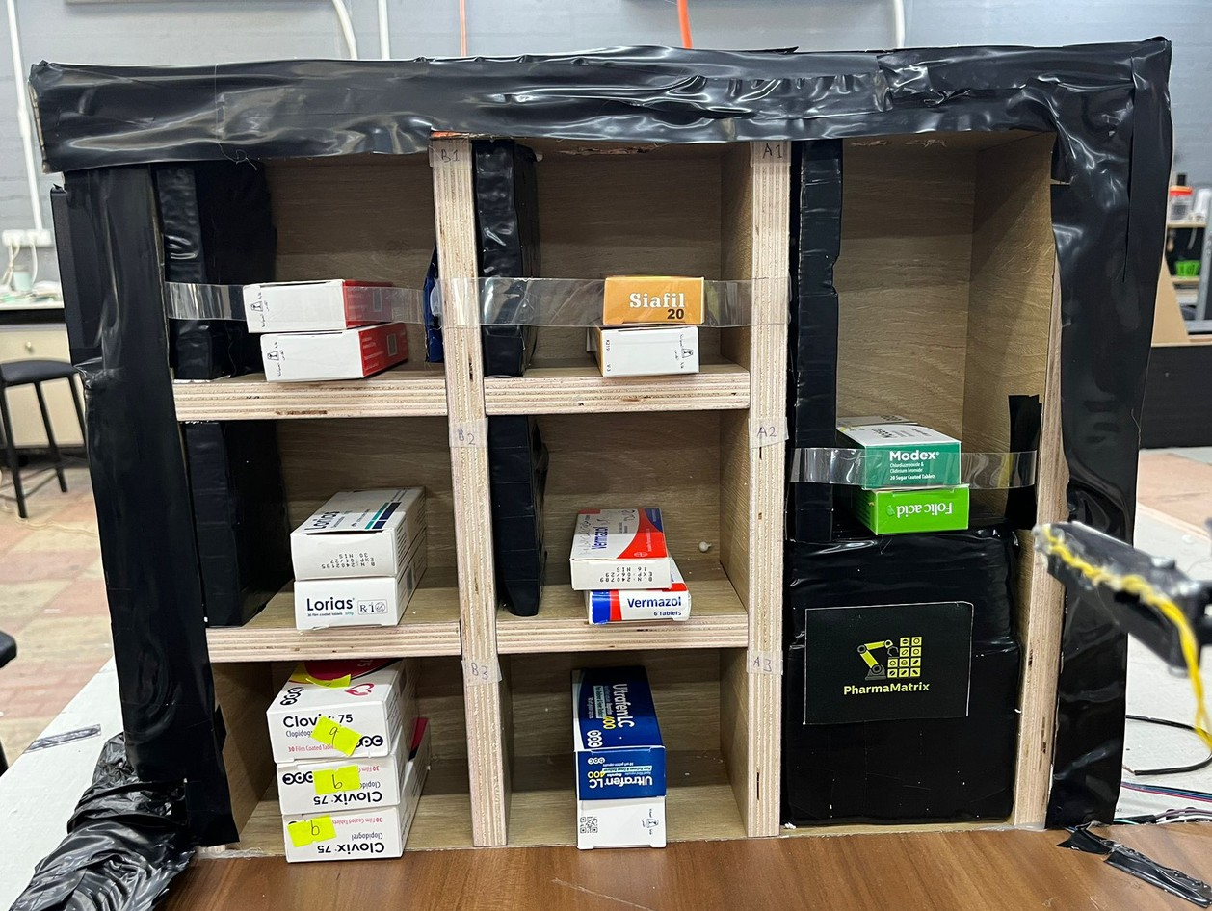
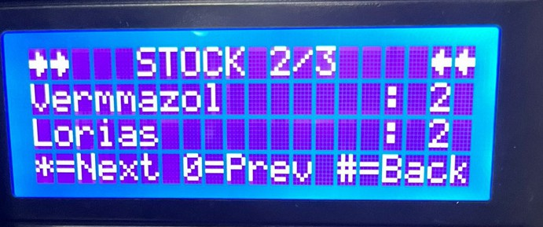
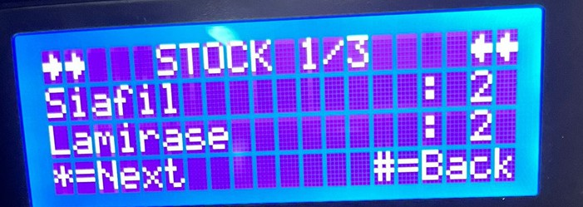
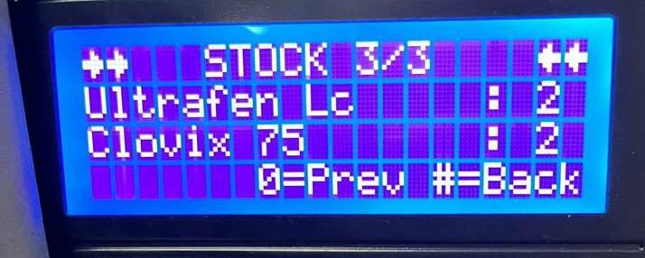
1) View stock

Slide 13
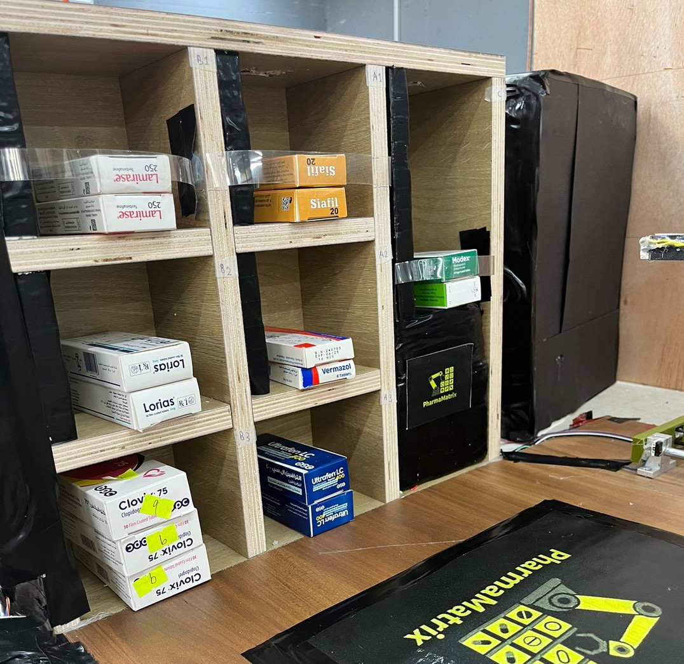
2A) Adding : Shelf has free space

Slide 14
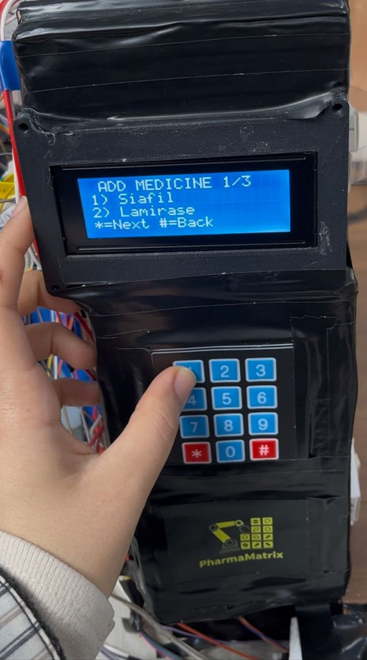
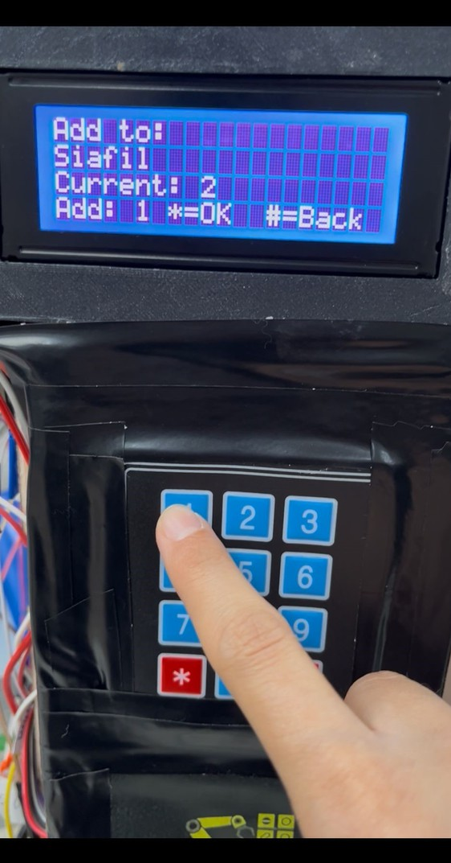
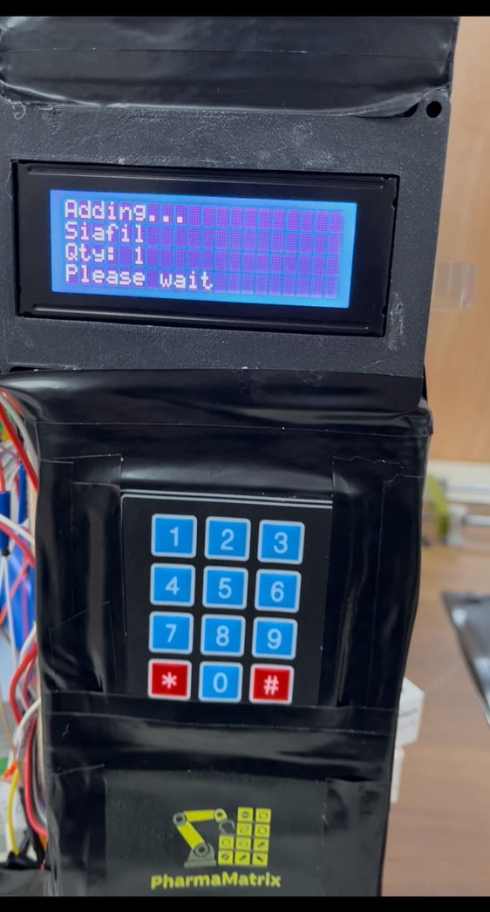
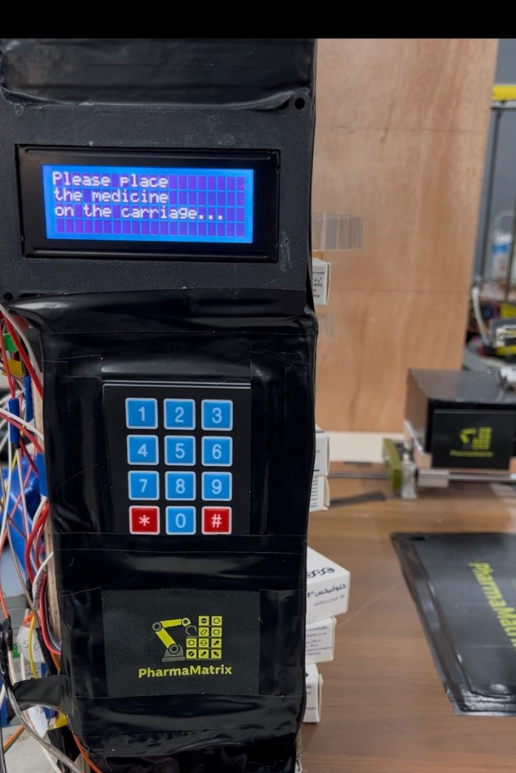

Slide 15
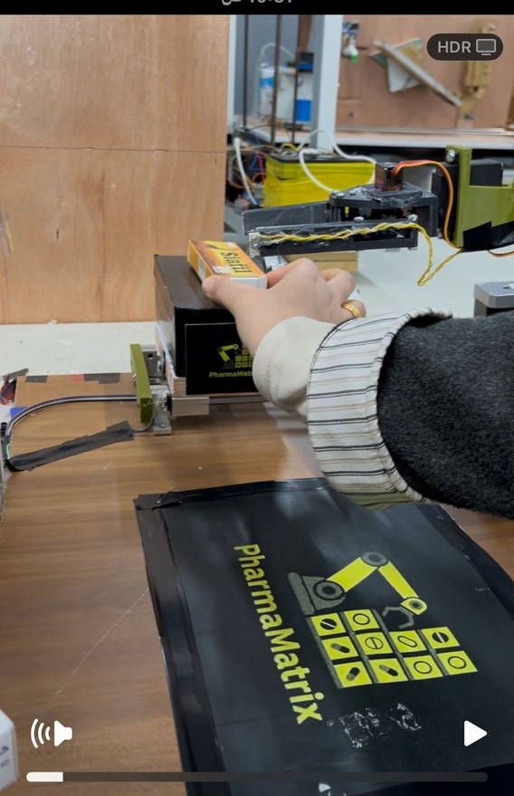
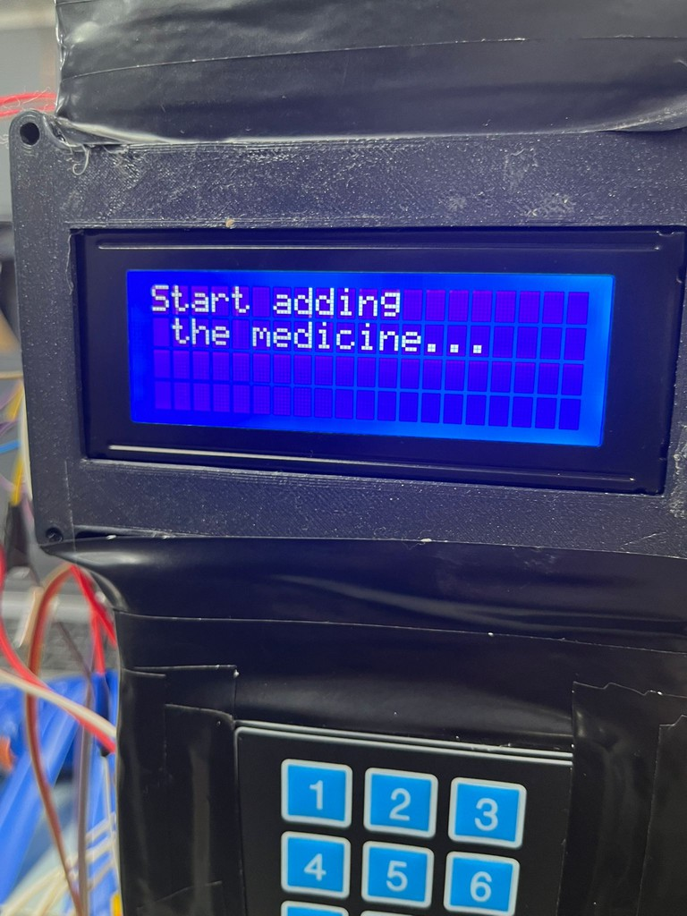
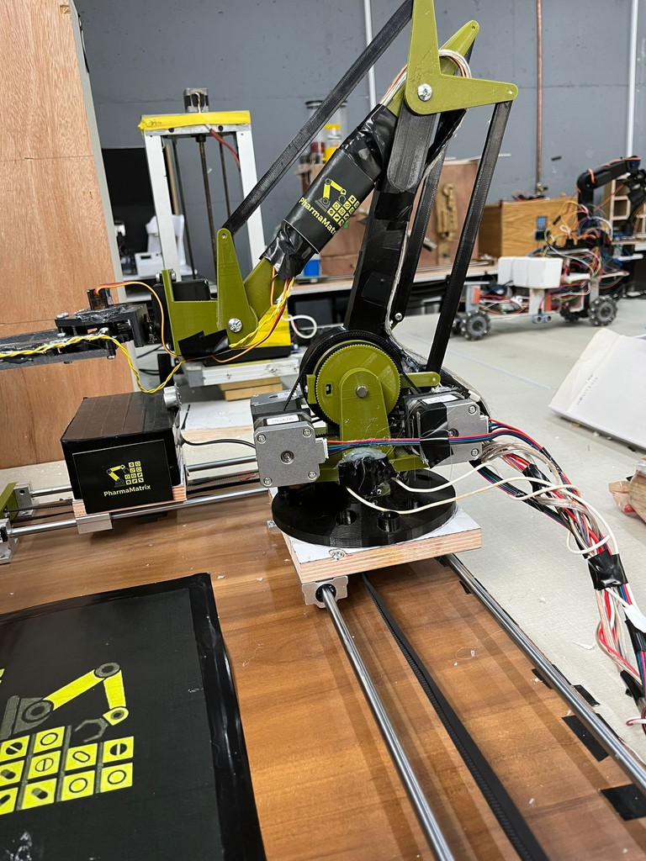

Slide 16
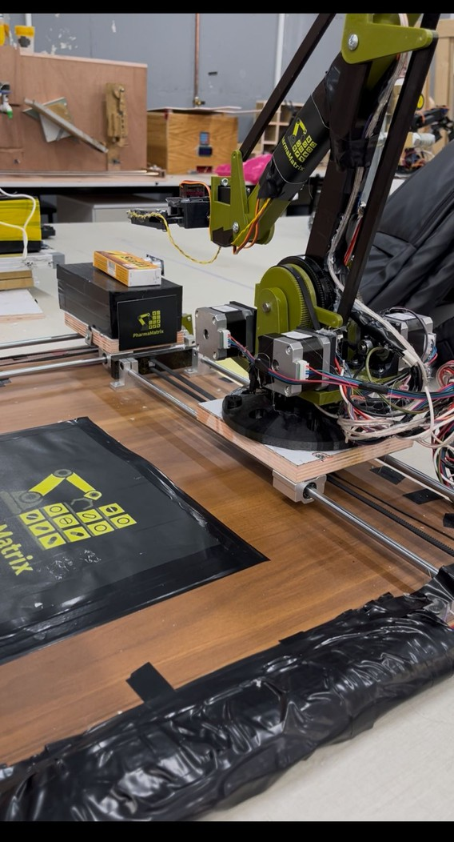
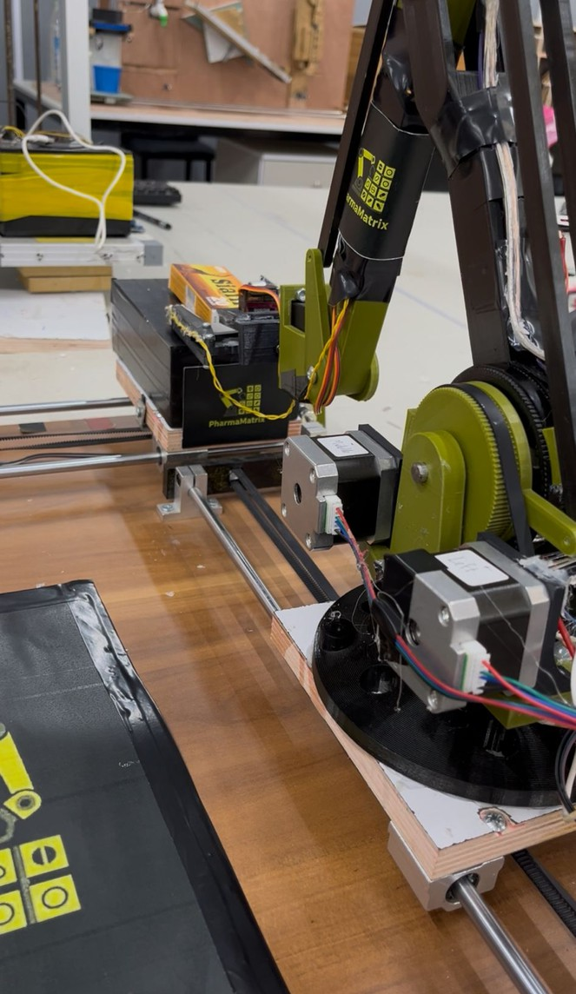
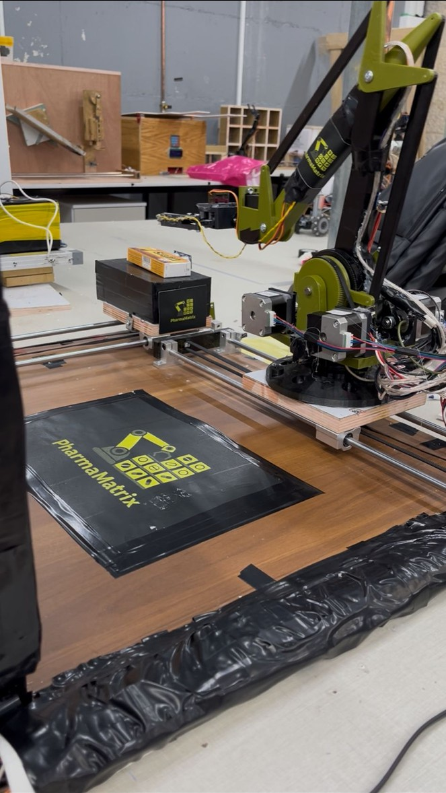

Slide 17
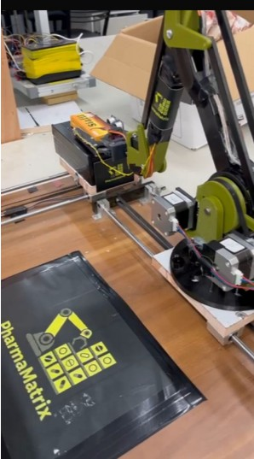
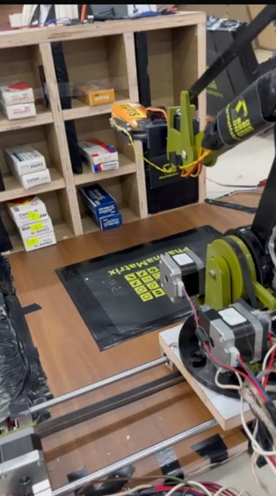
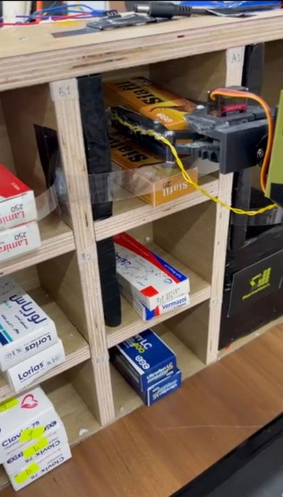

Slide 18
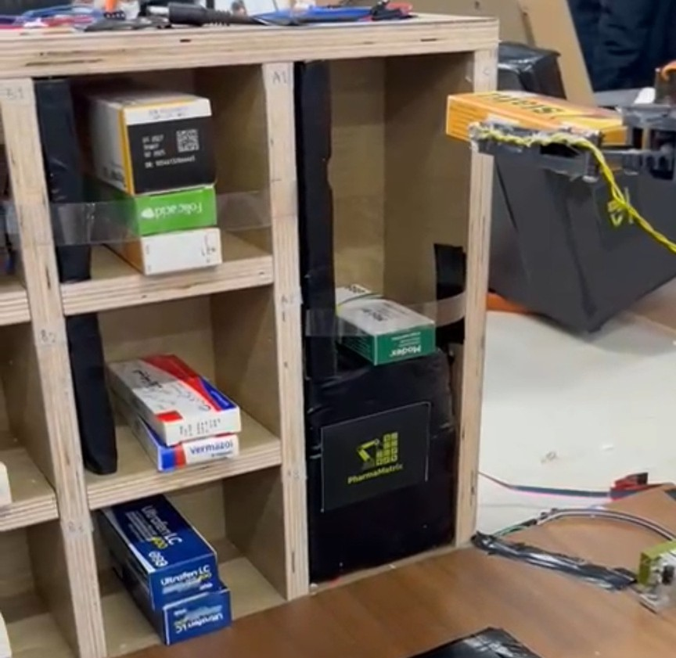
2B) Adding : Shelf full but stock has space

Slide 19
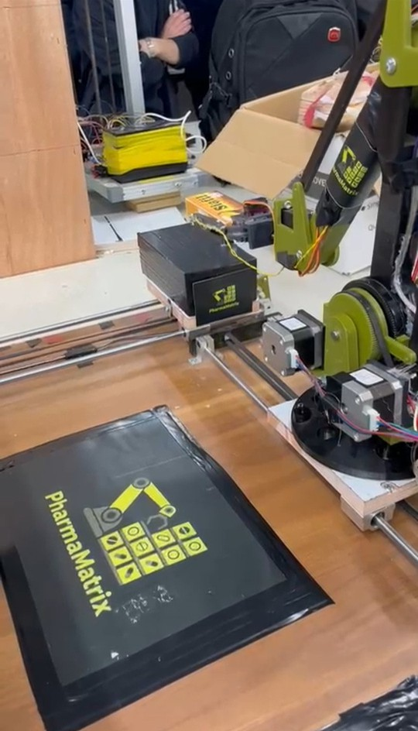
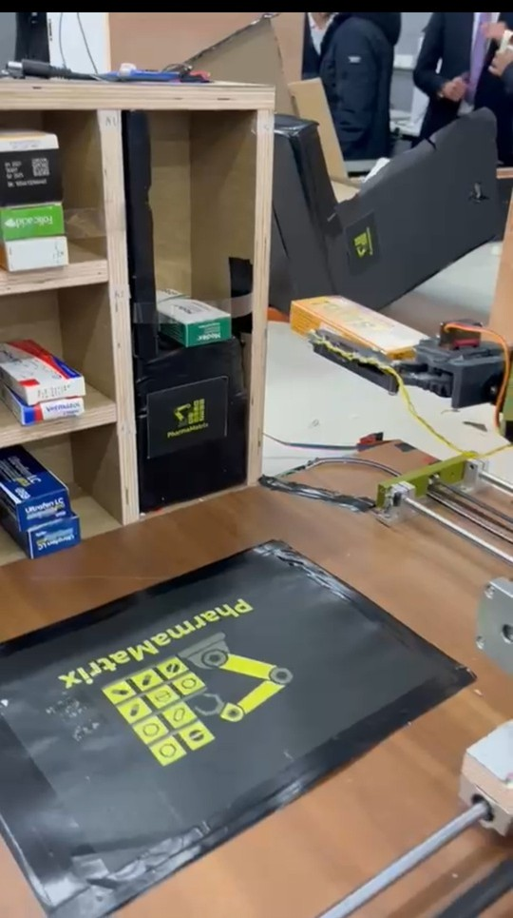
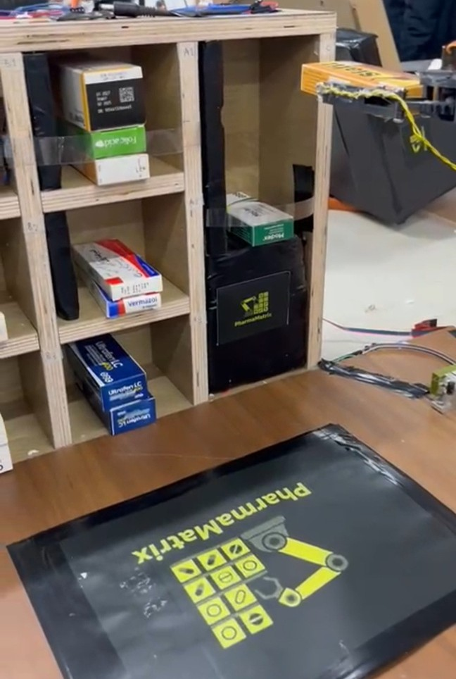
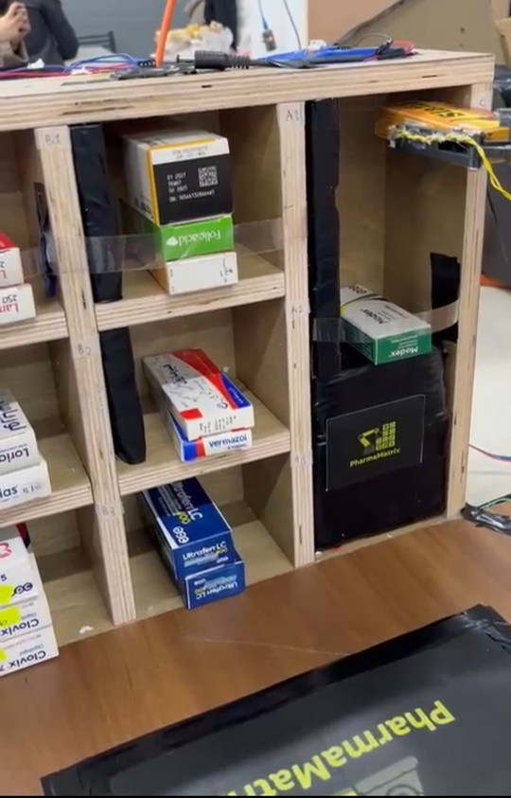
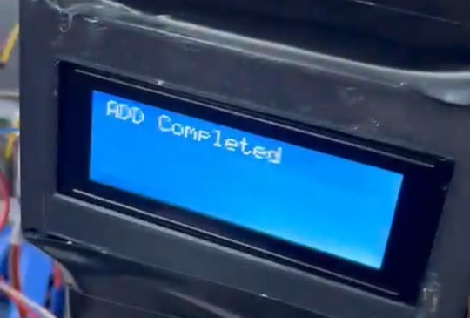

Slide 20
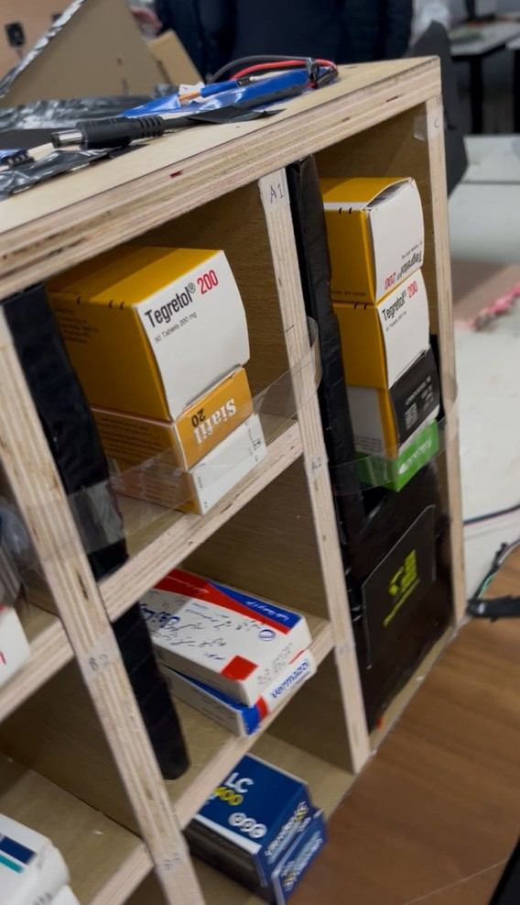
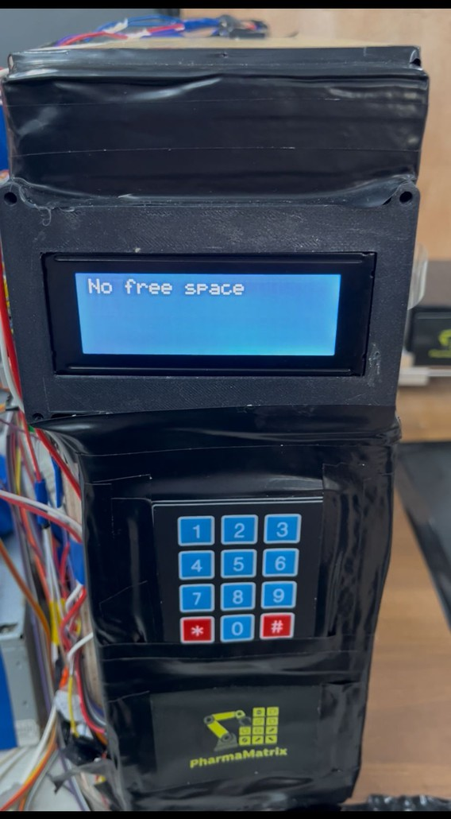
2C) Adding : Shelf and stock are full

Slide 21
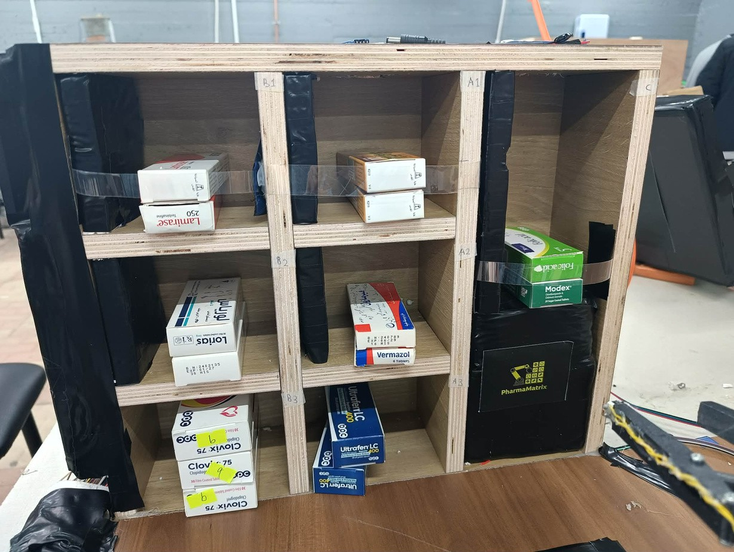
3A) Dispensing : Medicine available on shelf

Slide 22
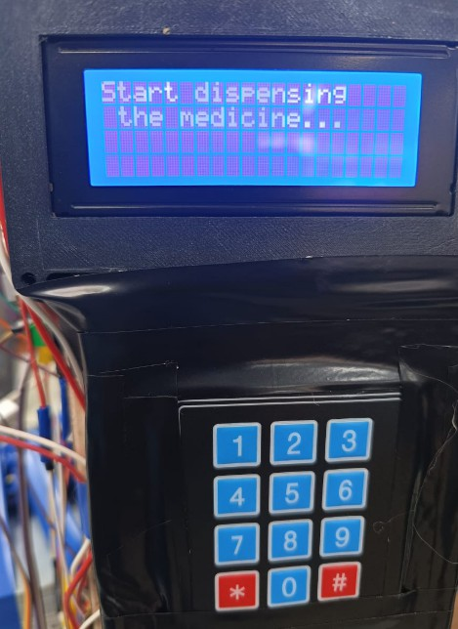
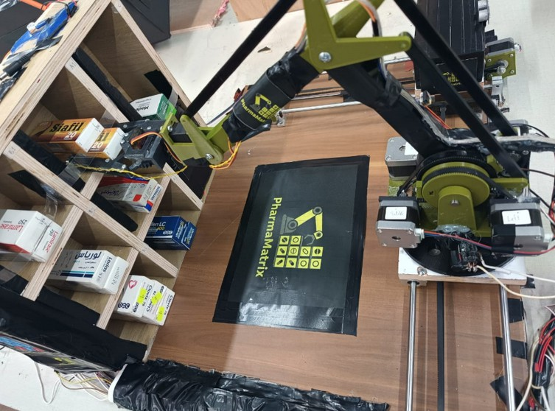
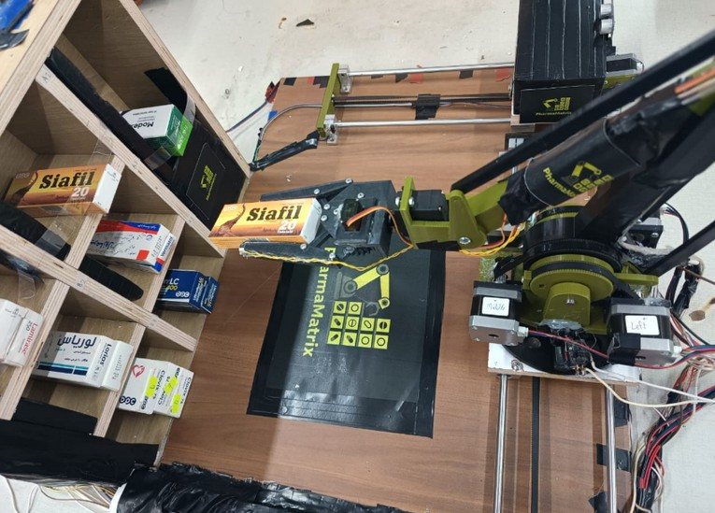
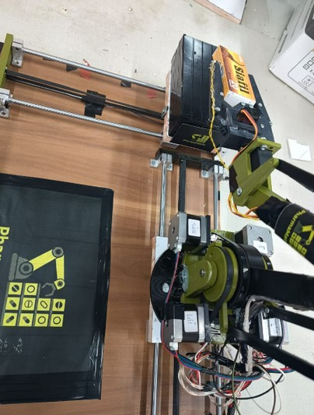
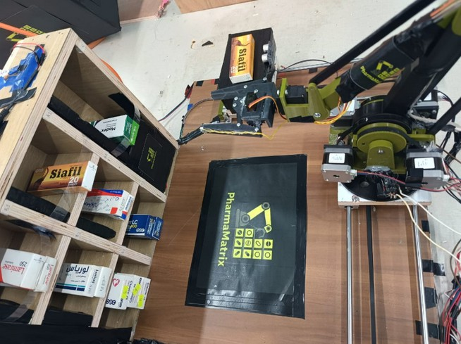


Slide 23

3B) Dispensing : Medicine not on shelf but available in stock

Slide 24




Slide 25





Refilling shelf:

Slide 26



Slide 27


3C) Dispensing : Medicine unavailable

Slide 28
SOFTWARE ARCHITECTURE
Programmed using Arduino C/C++
State-based architecture to manage system operations
Communication between Arduino Mega and ESP32 via serial interface
Real-time inventory update after each operation
Separate modules

Slide 29





SOFTWARE ARCHITECTURE
SEPARATE MODULES FOR:
User input handling
Sensor reading
Motor control
Bluetooth communication

Slide 30




Mobile Application

Slide 31



Mobile Application

Slide 32




Results
01
Accurate medication dispensing
02
Reduced human errors
03
Faster operation compared to manual systems
04 Automatic inventory update and stock refil

Slide 33






Expanding storage capacity
FUTURE WORK
Integrating a camera for medication
identification
Adding barcode scanning component
Improving system speed and reliability
5

Slide 34
Thank You

