Slide 1
Smart land marketplace
Made by Ahmad Samaana and Hazim Haydar
Under the supervision of Dr.Haya Samaana

Slide 2
Introduction
Constrains
Tech stack
Features
Future work

Slide 3
Introduction
SmartLand Marketplace is a modern web platform designed to simplify the process of buying, selling, and discovering land properties.
The platform connects buyers and sellers through a secure, user-friendly environment that provides detailed land information, advanced search capabilities, AI-powered assistance, real-time communication, and appointment scheduling.
Our goal is to make land transactions more transparent, efficient, and accessible while helping users find the most suitable opportunities based on their needs and preferences.

Slide 4
Why Smart land marketplace?
Traditional land searching and selling methods are often inefficient, time-consuming, and lack transparency.
Buyers struggle to find suitable lands, while sellers face difficulties reaching interested customers.
SmartLand Marketplace addresses these challenges by providing:
A centralized platform for land listings.
Advanced filtering and search tools.
Easy appointment scheduling and availability management.

Slide 5
Objectives
The specific objectives of the project include:
1
2
To enable users to browse apartment listings and access detailed information, including images, and descriptive content.
To ensure that all apartment listings
are relevant, accurate, and tailored to
student needs.
3
4
To enhance transparency
and build trust in student
housing information.
To provide students with a centralized
Platform for searching and
comparing apartments near campus.

Slide 6
Objectives
The specific objectives of the project include:
1
2
Provide a centralized marketplace for land buyers and sellers.
To ensure that all apartment listings
are relevant, accurate, and tailored to
student needs.
3
4
To enhance transparency
and build trust in student
housing information.
To provide students with a centralized
Platform for searching and
comparing apartments near campus.

Slide 7
Objectives
The specific objectives of the project include:
1
2
Provide a centralized marketplace for land buyers and sellers.
Increase transparency through
detailed property information and
visual documentation.
3
4
To enhance transparency
and build trust in student
housing information.
Making it easier for students
to have a centralized hub
for searching apartments.

Slide 8
Objectives
The specific objectives of the project include:
1
2
To enable users to browse apartment listings and access detailed information, including images, and descriptive content.
Increase transparency through
detailed property information and
visual documentation.
3
4
Enable users to quickly find suitable land using advanced search and filtering tools.
To provide students with a centralized

Slide 9
Objectives
The specific objectives of the project include:
1
2
To enable users to browse apartment listings and access detailed information, including images, and descriptive content.
Increase transparency through
detailed property information and
visual documentation.
3
4
Enable users to quickly find suitable land using advanced search and filtering tools.
Facilitating the land sale process
and preventing exploitation and brokerage opportunities.

Slide 10
System Roles
Normal User
ADMIN
Lawer

Slide 11
7
6
8
1
5
Normal User
4
2
3

Slide 12
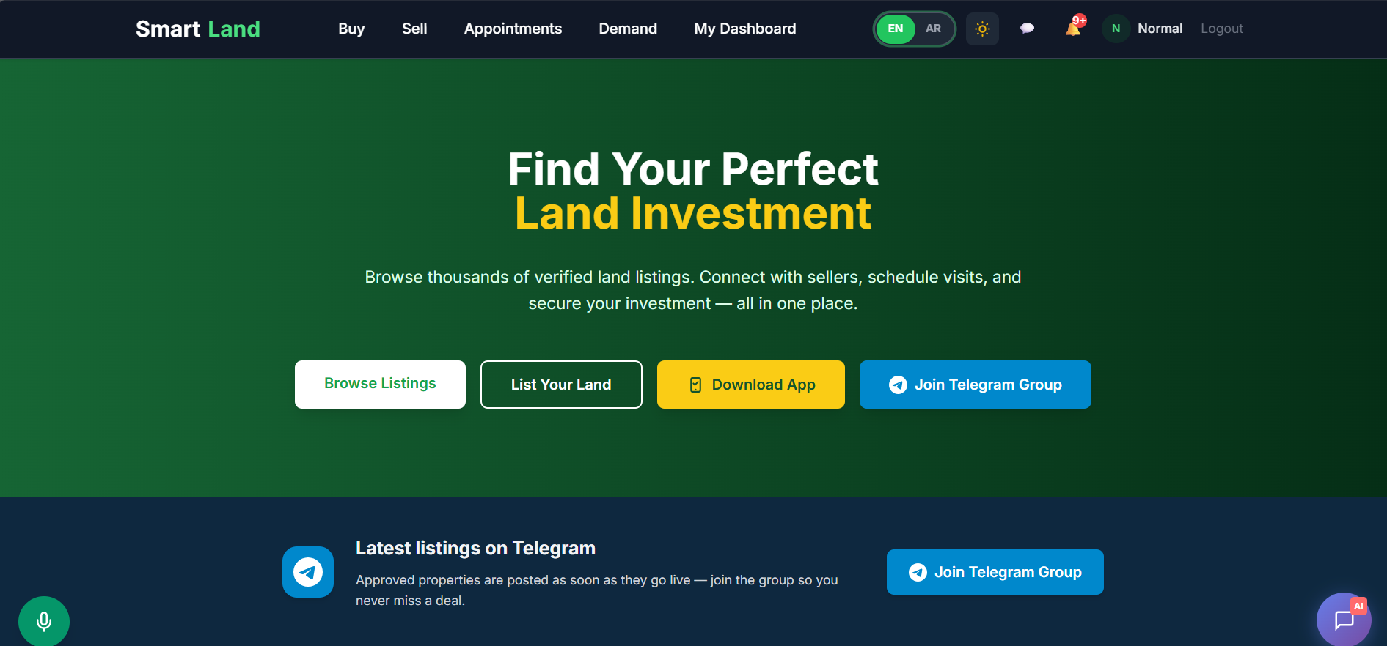
7
8
6
9
5
Normal User
2
4
3

Slide 13
7
1
6
1. Property Management
User can:
Create listings
Edit listings
Delete listings
Upload multiple images and land plans
9
5
Normal User
2
4
3

Slide 14
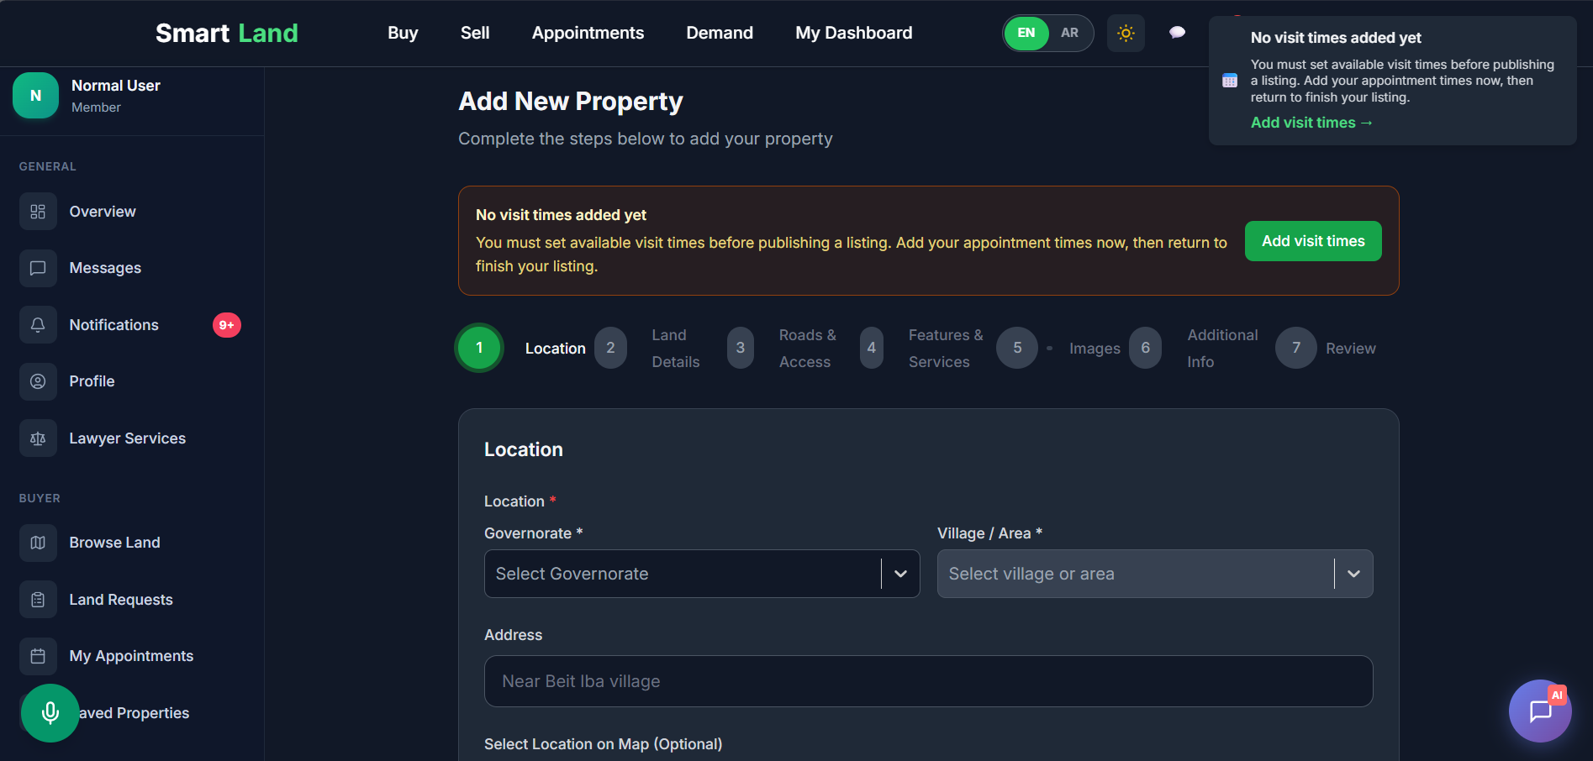
7
8
6
9
5
Normal User
2
4
3

Slide 15
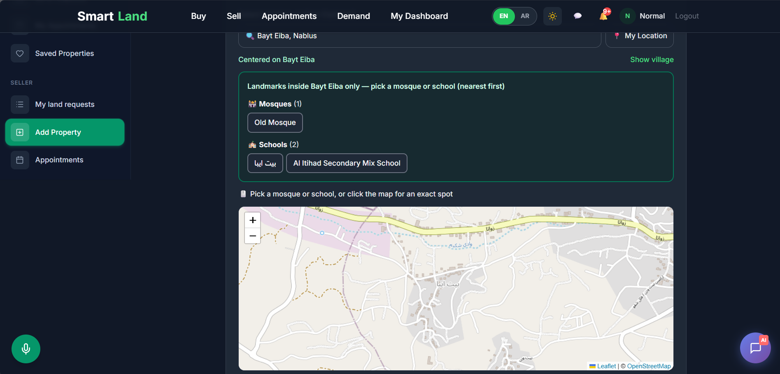
7
8
6
9
5
Normal User
2
4
3

Slide 16
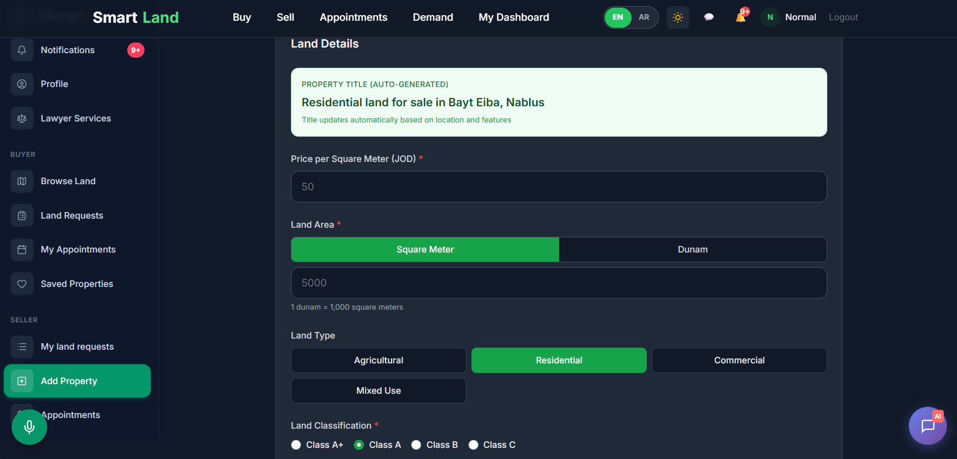
7
8
6
9
5
Normal User
2
4
3

Slide 17
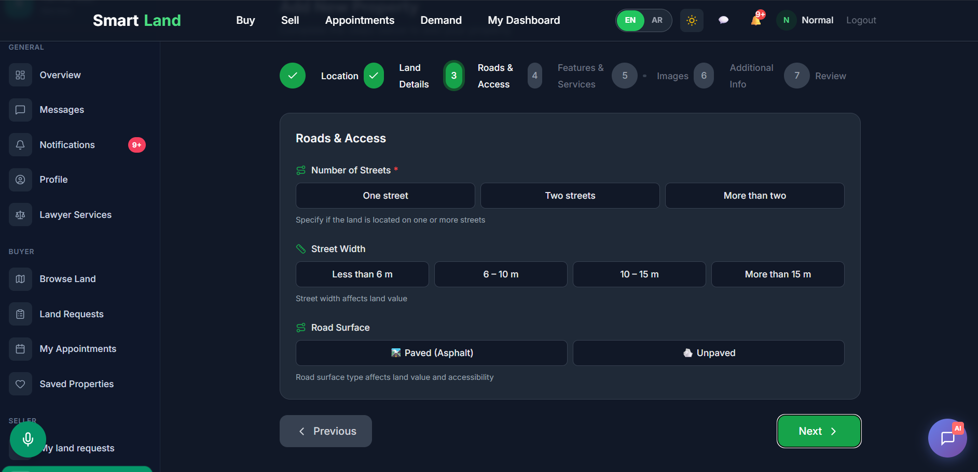
7
8
6
9
5
Normal User
2
4
3

Slide 18
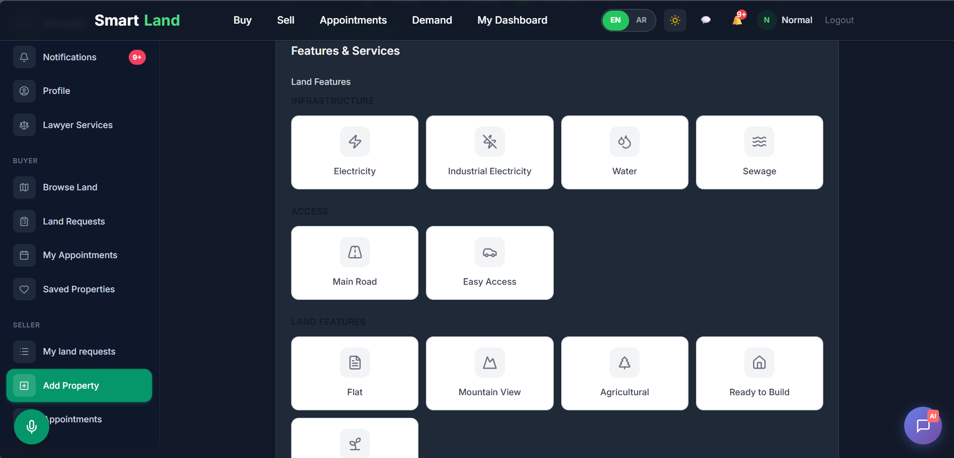
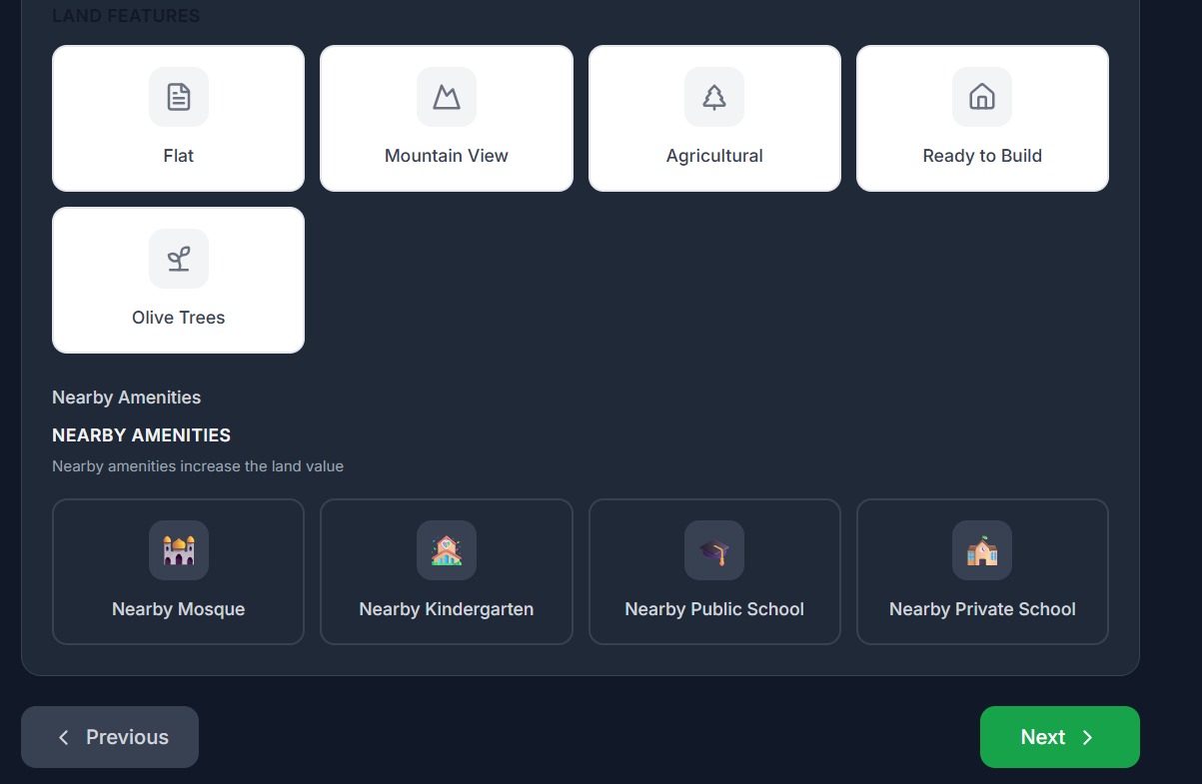
7
8
6
9
5
Normal User
2
4
3

Slide 19
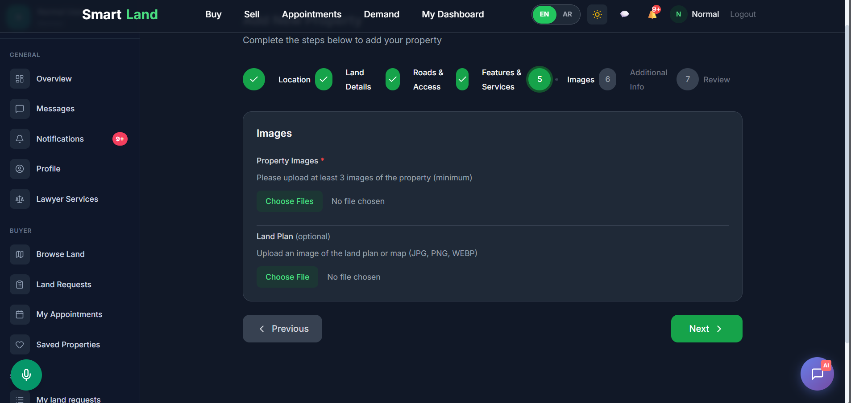
7
8
6
9
5
Normal User
2
4
3

Slide 20
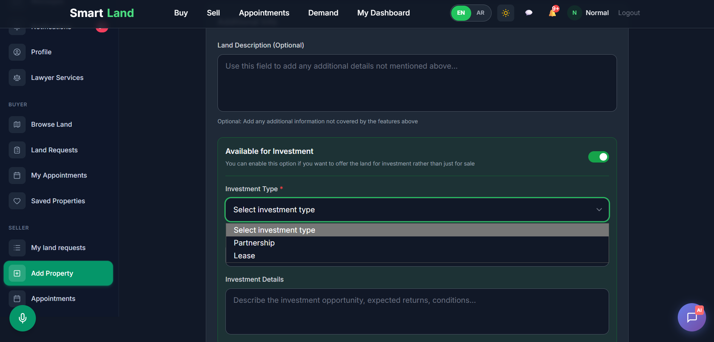
7
8
6
9
5
Normal User
2
4
3

Slide 21
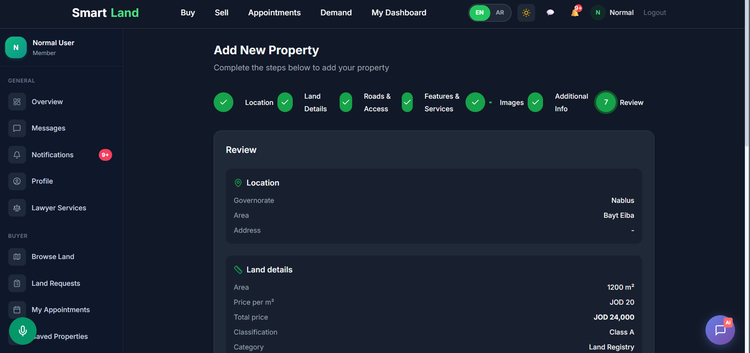
7
8
6
9
5
Normal User
2
4
3

Slide 22
7
6
8
2. Land Search & Filtering
Users can search for lands using advanced filters such as:
Location
Price range
Area
Land type
Investment suitability
Voice search
2
5
Normal User
4
2
3

Slide 23
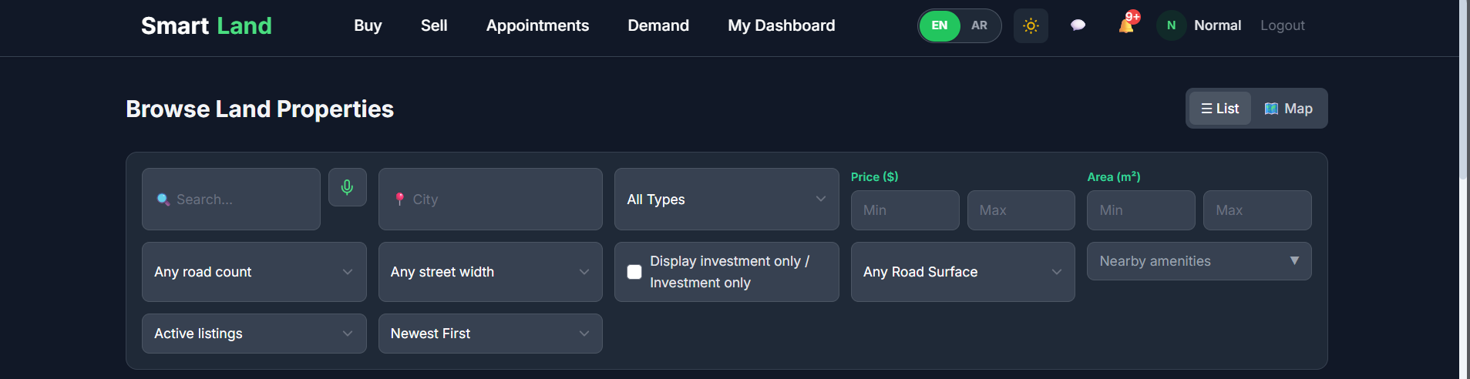
7
6
8
1. Land Search & Filtering
Users can search for lands using advanced filters such as:
Location
Price range
Area
Land type
Investment suitability
1
5
Normal User
4
2
3

Slide 24
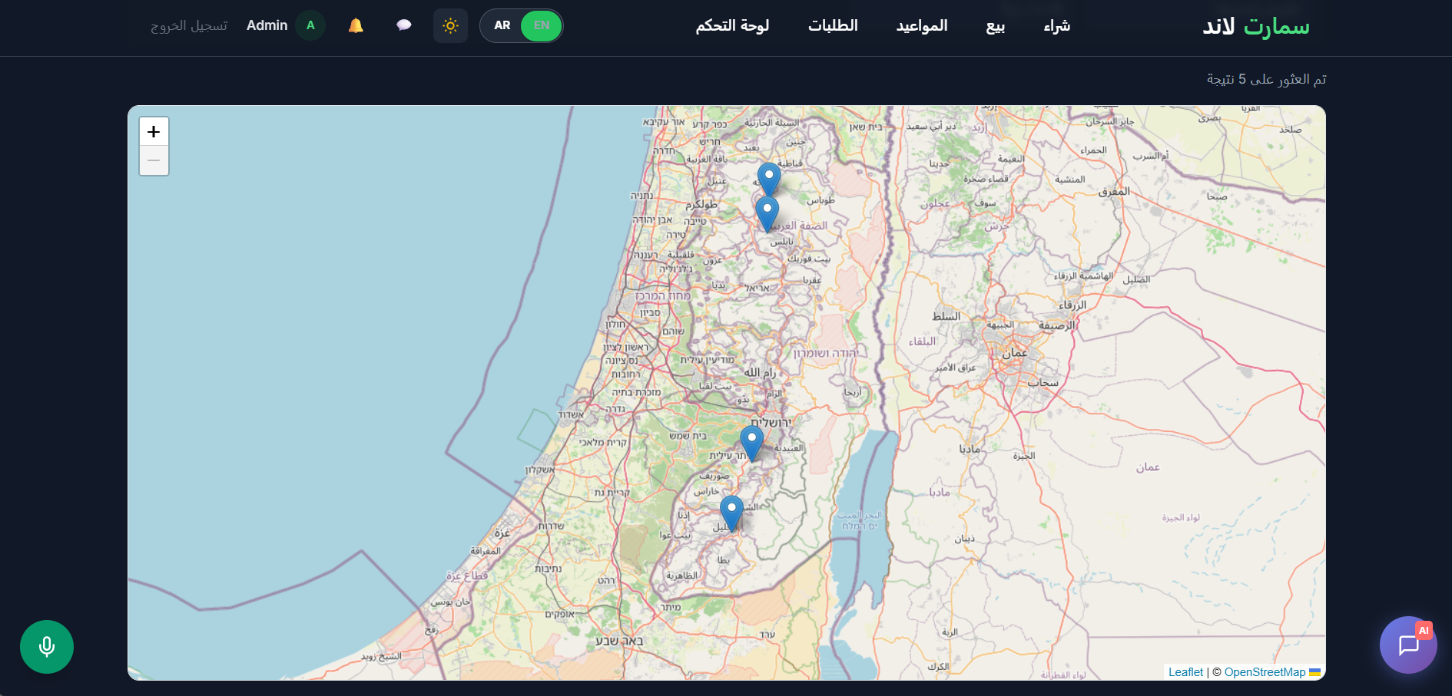

Slide 25
7
6
8
3. Land Details
Each listing provides:
Property images
Land plan image
Detailed description
Location information
price details
1
5
Normal User
4
3
2

Slide 26
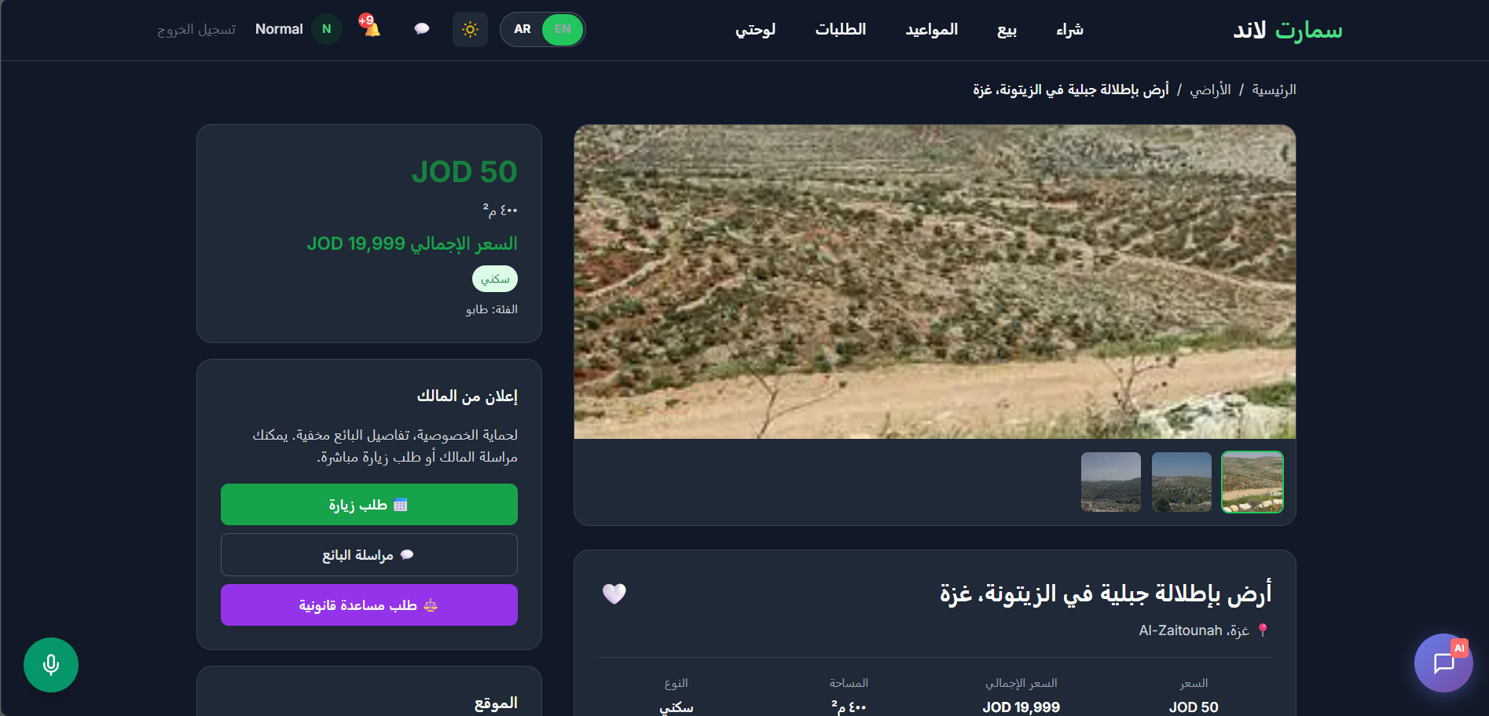
7
6
8
2. Land Details
Each listing provides:
Property images
Land plan image
Detailed description
Location information
Seller information
1
5
Normal User
4
2
3

Slide 27
7
6
8
4. Direct Messaging
Buyers can communicate directly with sellers
through an integrated chat system.
1
5
Normal User
5
2
4

Slide 28
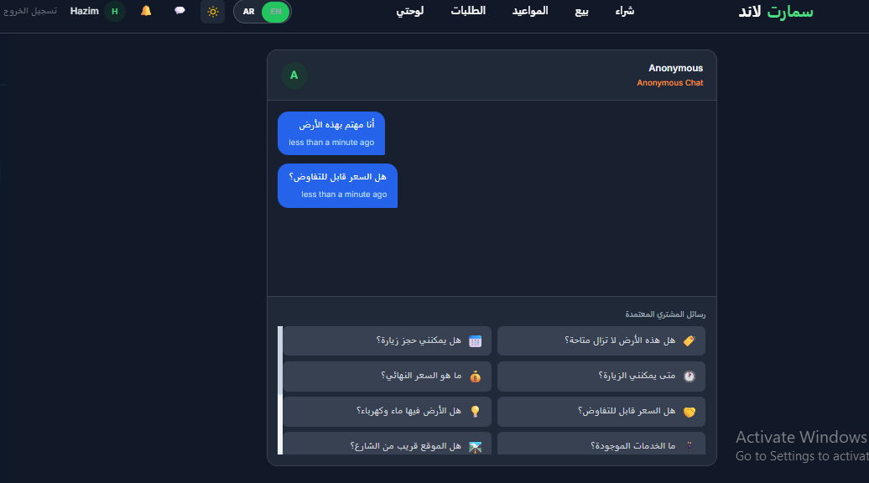
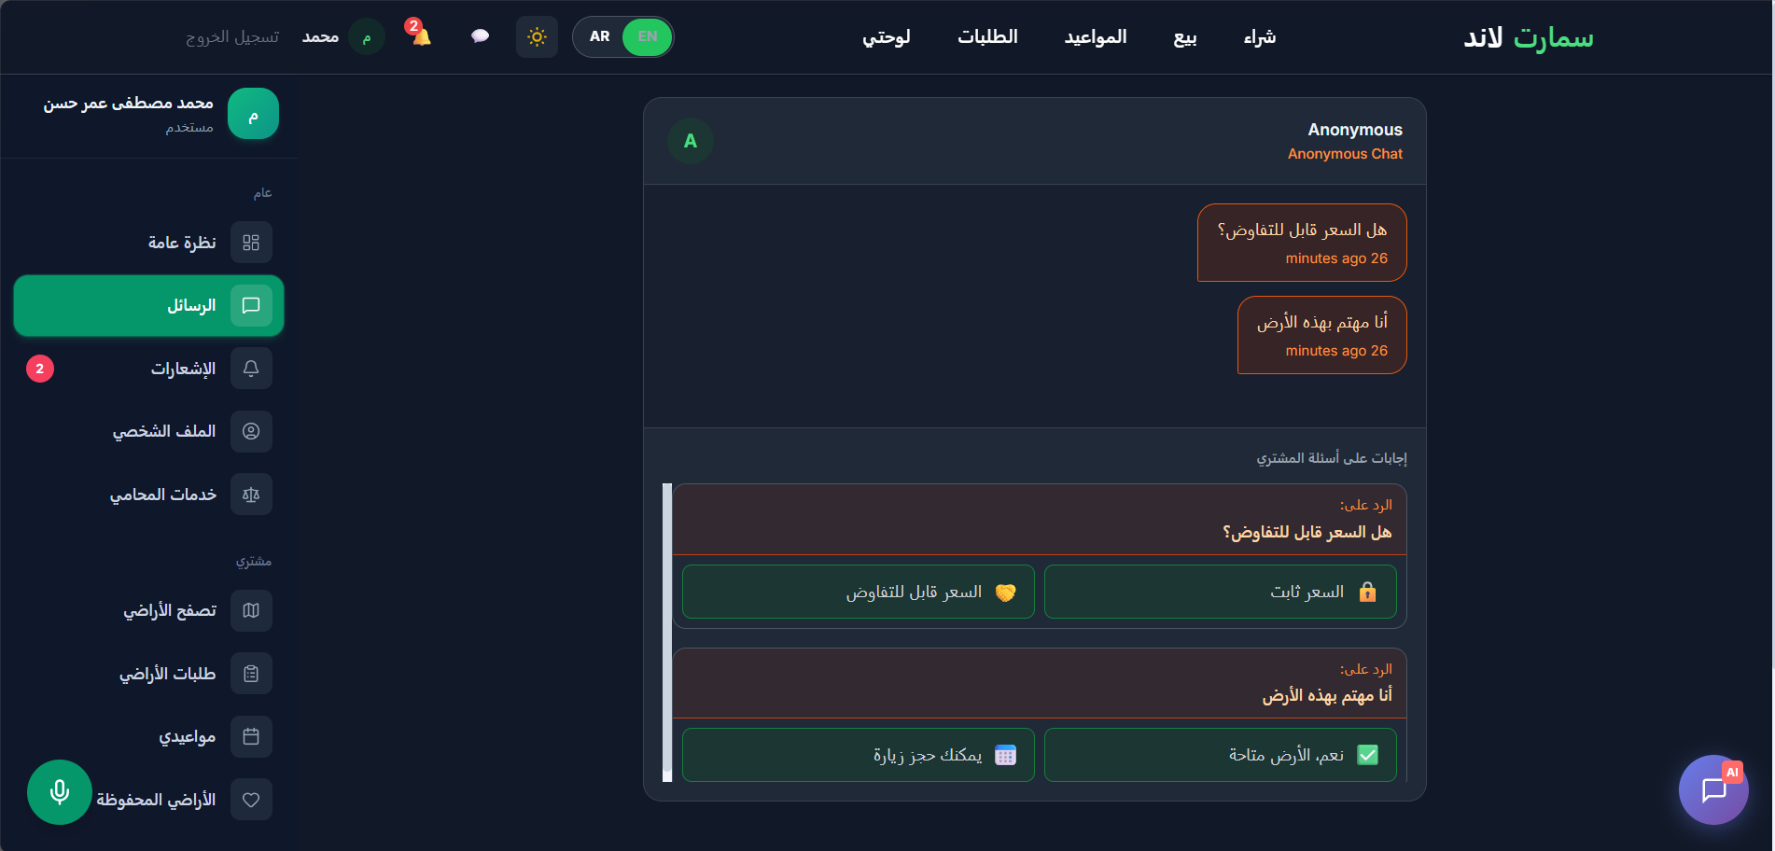
7
6
8
1
5
Normal User
4
2
3

Slide 29
7
6
8
5. Appointment Requests
Buyers can request property visits based on
seller availability.
1
6
Normal User
2
5
3

Slide 30
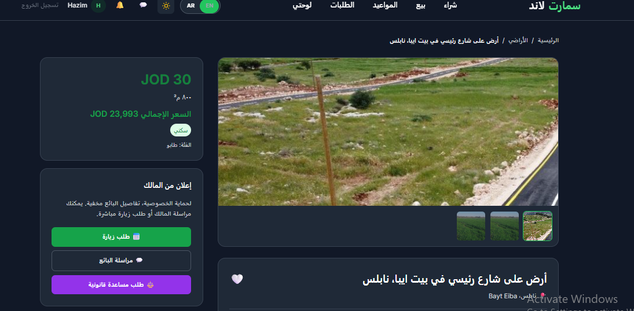
7
6
8
1
5
Normal User
2
4
3

Slide 31
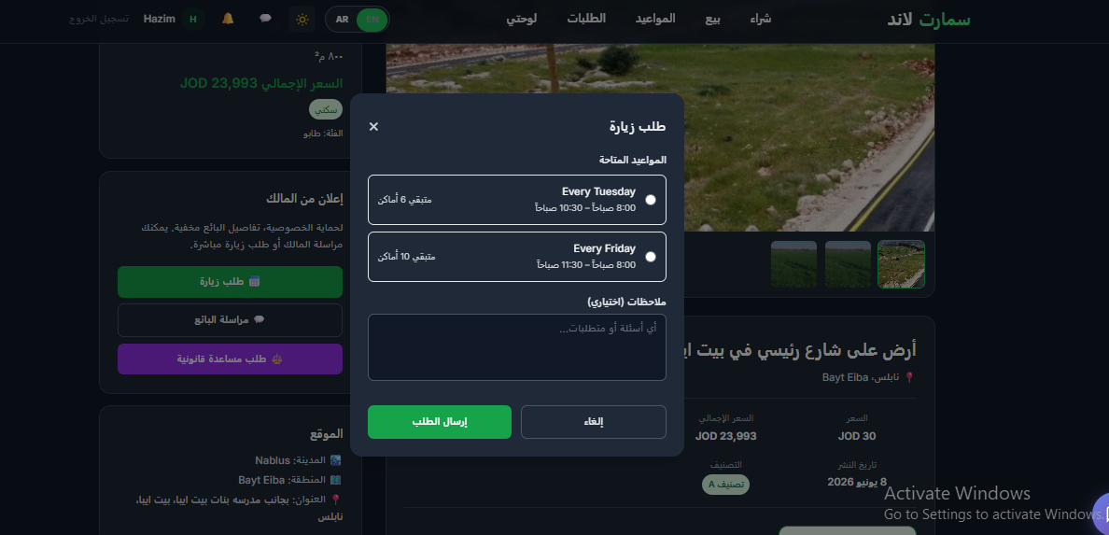
7
6
8
1
5
Normal User
2
4
3

Slide 32
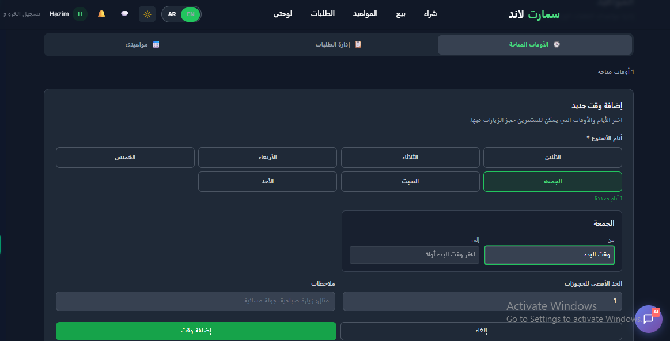
7
6
8
1
5
Normal User
2
4
3

Slide 33
7
6
8
6. AI Assistant
The platform provides an intelligent assistant
that helps users discover suitable lands and
navigate platform services.
1
6
Normal User
2
4
3

Slide 34
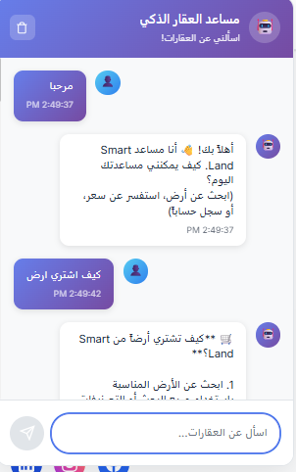
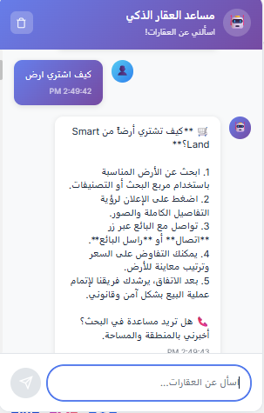
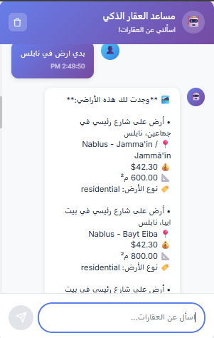
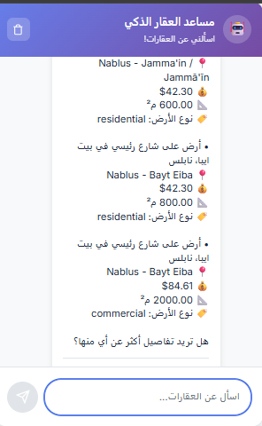
7
6
8
1
5
Normal User
2
4
3

Slide 35
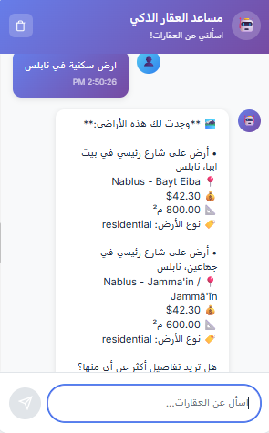
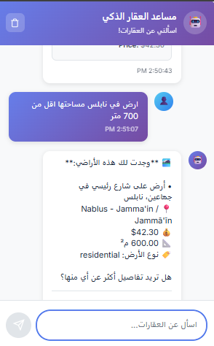
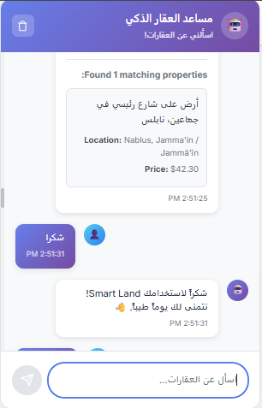
Normal User

Slide 36
7
7
6
7. Lawyer Assistance Service
The platform allows users to request
legal assistance from qualified lawyers
available through the system.
10
5
Normal User
2
4
3

Slide 37
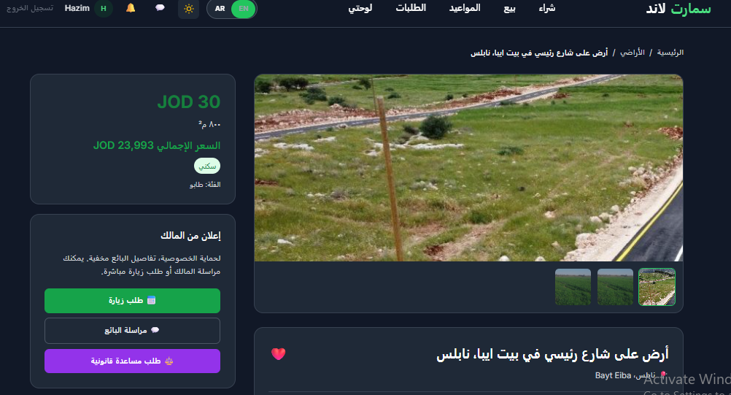
7
9
6
10
5
2
4
3

Slide 38
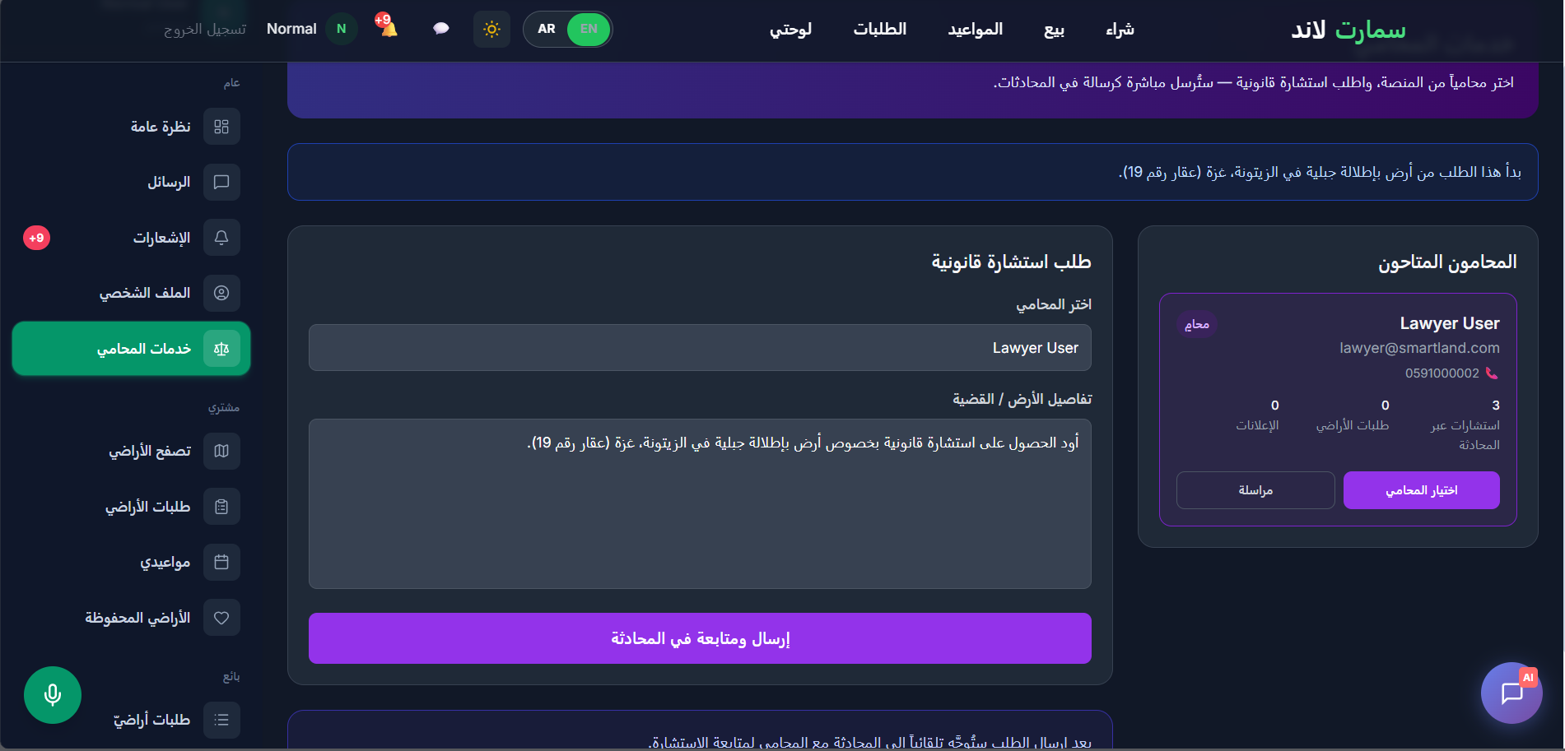
7
9
6
10
5
2
4
3

Slide 39
7
8
6
8. Land Request Marketplace
Users can submit custom land requests
when they cannot find a suitable listing.
11
5
Normal User
2
4
3

Slide 40
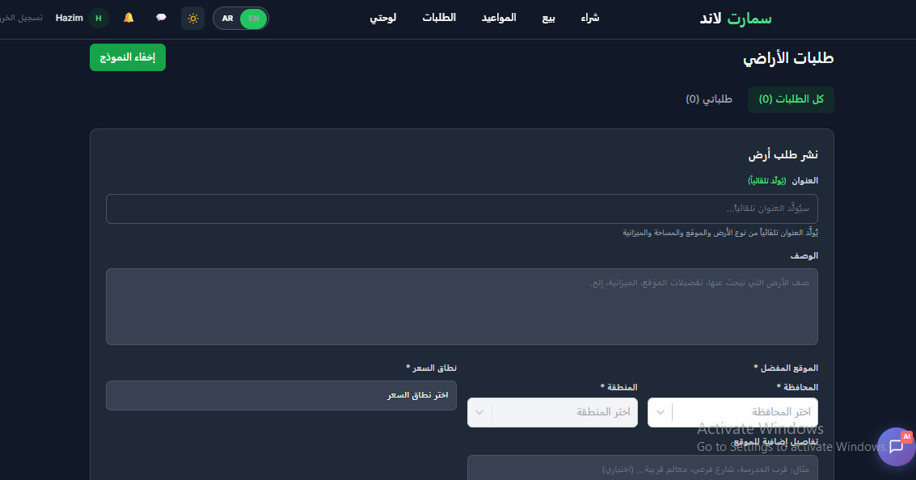
7
10
6
11
5
Normal User
2
4
3

Slide 41
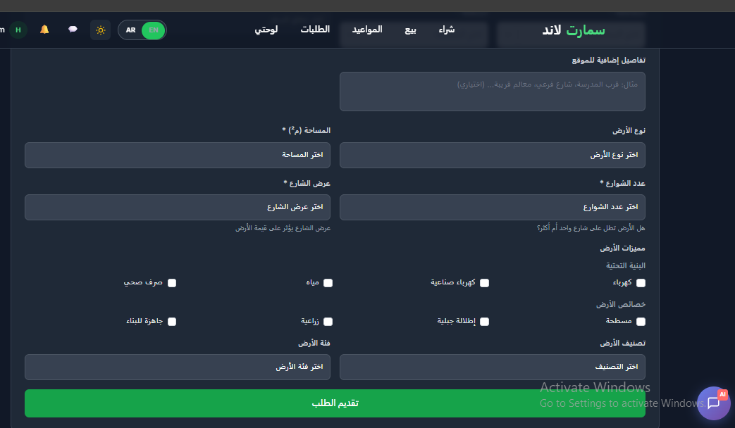
7
10
6
11
5
Normal User
2
4
3

Slide 42
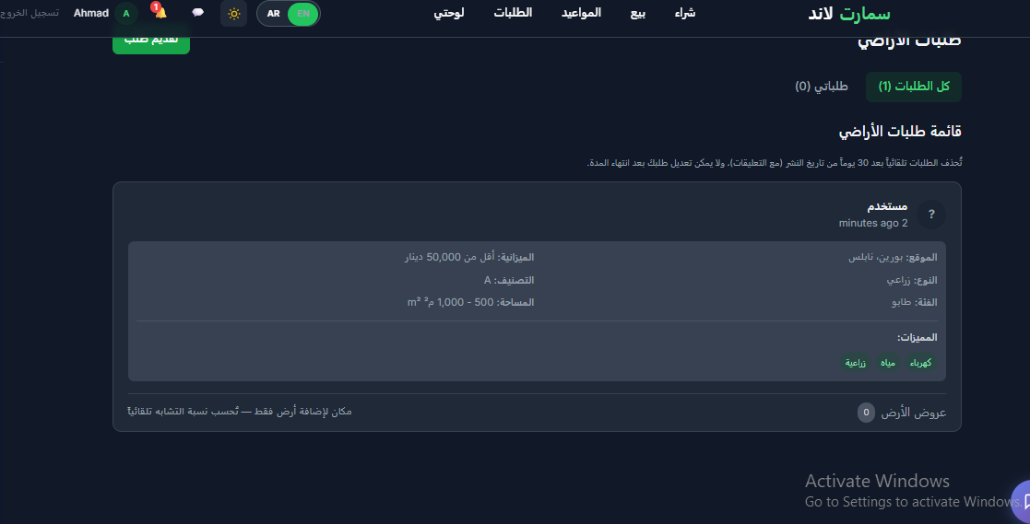
7
10
6
11
5
Normal User
2
4
3

Slide 43
System Roles
Normal User
ADMIN
Lawer

Slide 44
Admin
1.User Management
Manage user accounts and permissions.

Slide 45
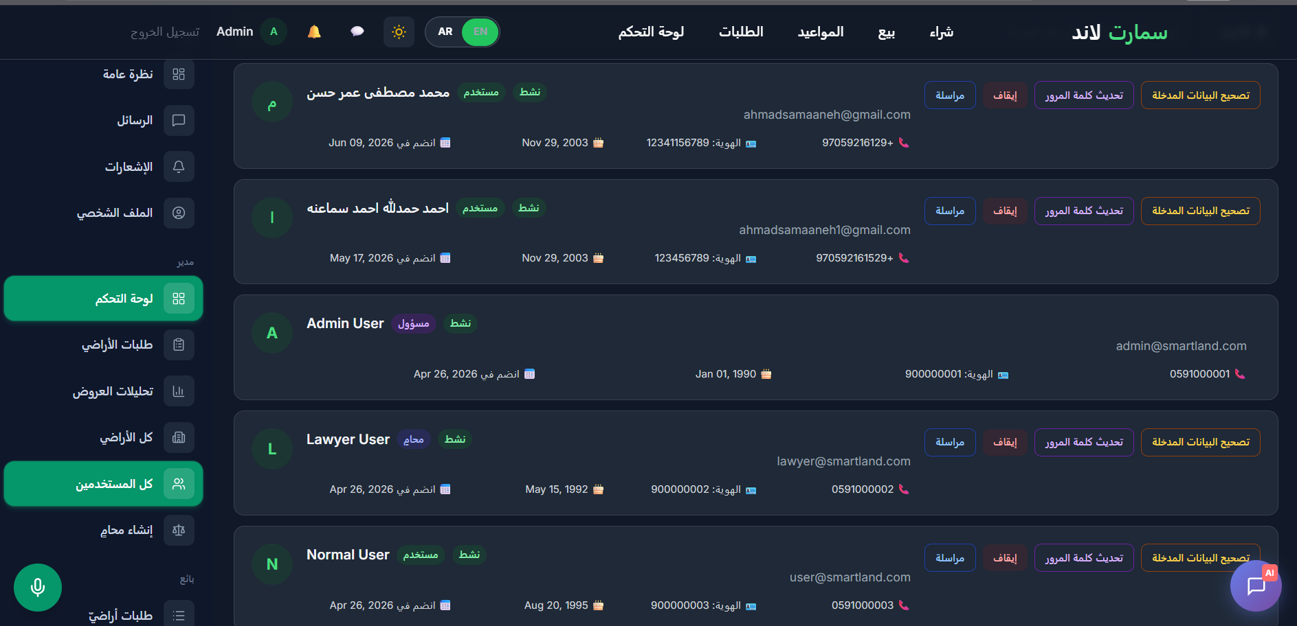

Slide 46
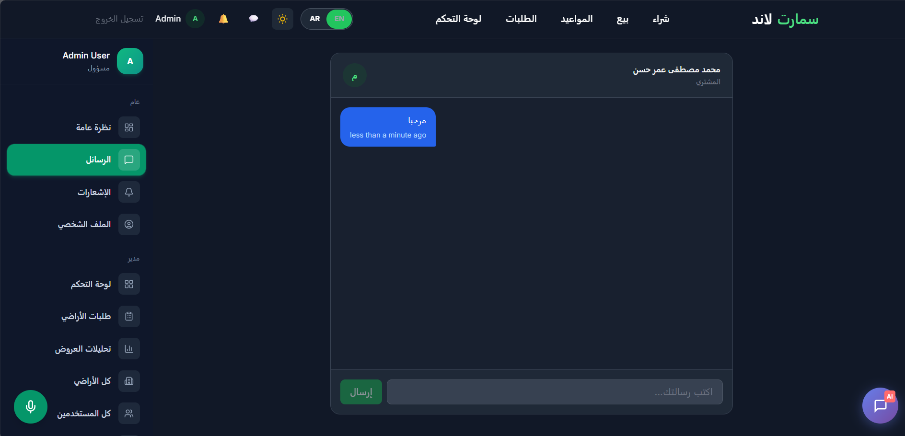

Slide 47
Admin
1.User Management
Manage user accounts and permissions.
2. Listing Moderation
Review, approve, reject, or remove property listings.

Slide 48
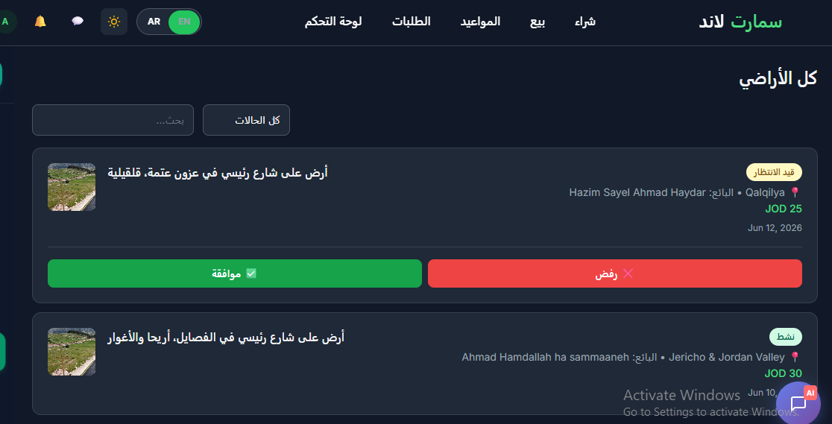

Slide 49
Admin
1.User Management
Manage user accounts and permissions.
2. Listing Moderation
Review, approve, reject, or remove property listings.
3. Admin land listing
Land for sale advertised with a label indicating it is certified by the administration

Slide 50
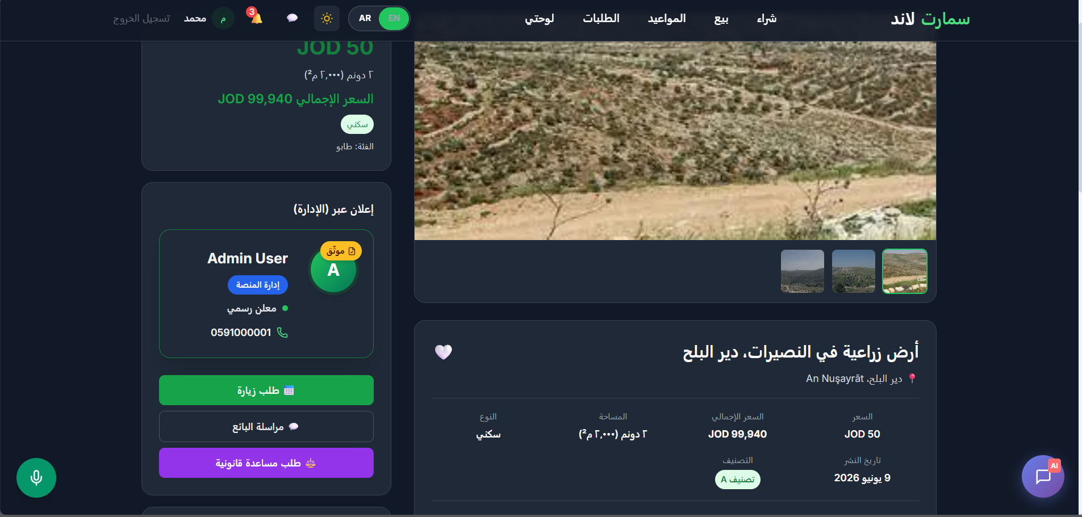

Slide 51
Admin
1.User Management
Manage user accounts and permissions.
2. Listing Moderation
Review, approve, reject, or remove property listings.
3. Admin land listing
Land for sale advertised with a label indicating it is certified by the administratin
4. Platform Monitoring
Track platform activity, statistics and performance.

Slide 52
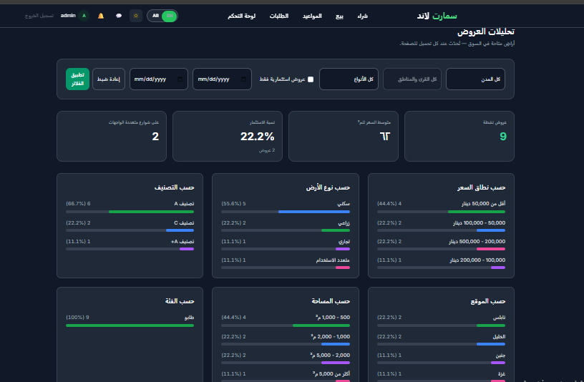

Slide 53
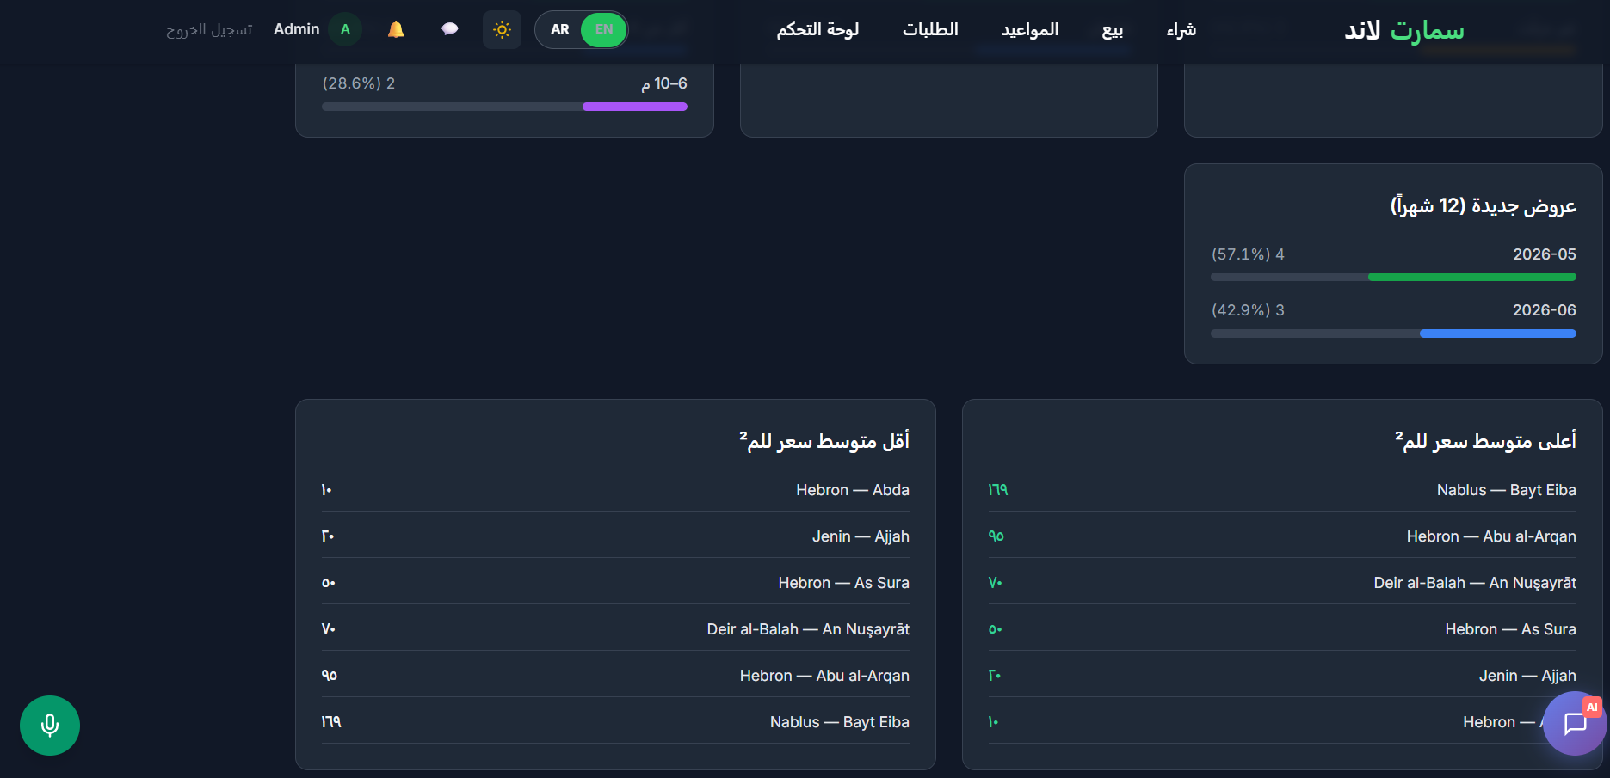

Slide 54
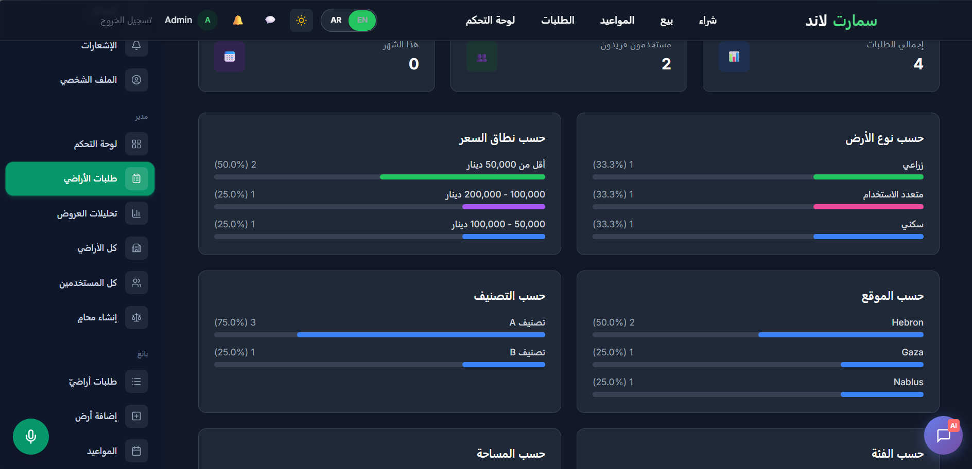

Slide 55
Admin
1.User Management
Manage user accounts and permissions.
2. Listing Moderation
Review, approve, reject, or remove property listings.
3. Admin land listing
Land for sale advertised with a label indicating it is certified by the administratin
4. Platform Monitoring
Track platform activity, statistics and performance.
5. Lawyer Management
Create and manage Lawyers accounts.

Slide 56
System Roles
Normal User
ADMIN
Lawer

Slide 57
Lawyer
1.
2.
Content Moderation
- Pin/unpin forum posts
- Lock/unlock discussions
- Delete posts and comments

Slide 58
Lawyer
1.
Legal Consultation Services
Lawyers can provide professional legal consultations to users regarding land transactions an ownership procedures.
2.

Slide 59
Lawyer
1.
Legal Consultation Services
Lawyers can provide professional legal consultations to users regarding land transactions, ownership procedures, contracts, and property-related regulations.
2.
Transaction Representation
Users can authorize lawyers to handle land purchase procedures on their behalf.

Slide 60
Lawer
3.
Report Management
- Report reasons: spam, harassment, inappropriate_content, scam, hate_speech, threats, other
- Actions: dismiss, warning, suspend (messaging), ban (account)
- View conversation history for context
- Admin notes for internal tracking
- Unsuspend users
Forum Management
- Full moderation powers over all posts/comments

Slide 61
Lawyer
3.
Strategic Advisory Role
Lawyers have access to platform statistics
like admins to support decision-making and provide recommendations.

Slide 62
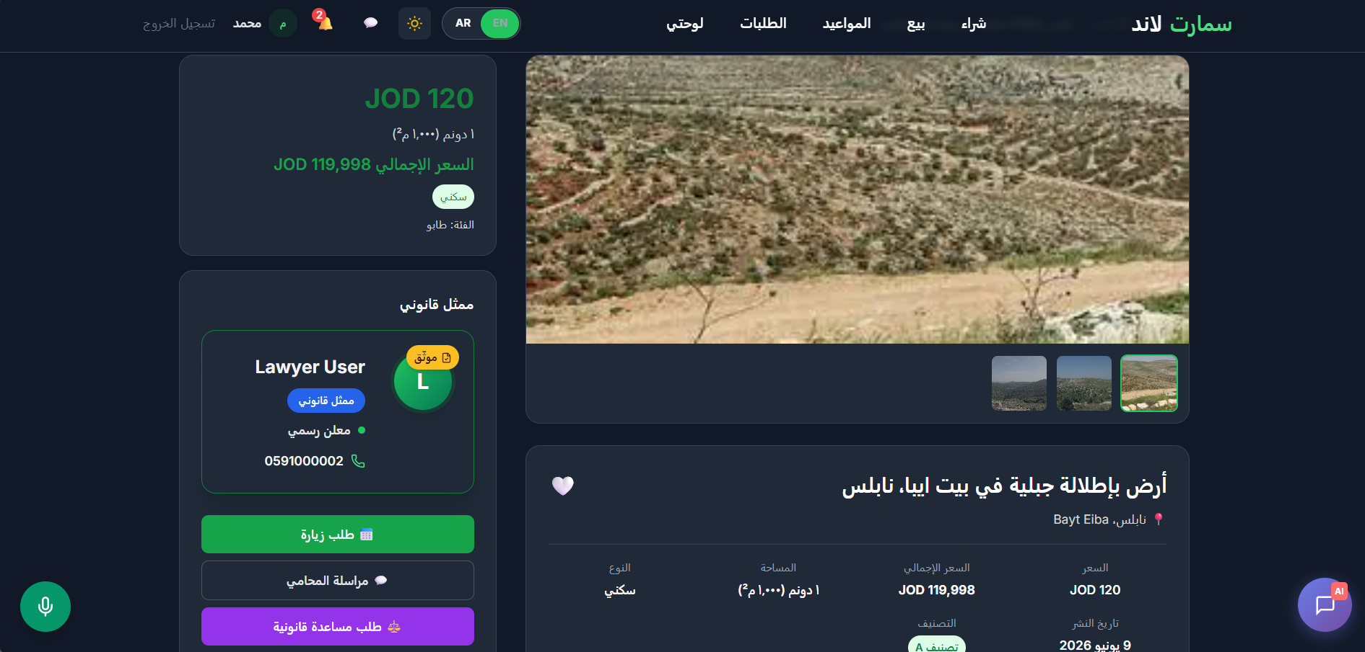

Slide 63
TECHNICAL FEATURES
1.
2.
3.

Slide 64
TECHNICAL FEATURES
1.
2.
3.
Authentication & Authorization
Secure login and registration
JWT authentication
Role-based access control

Slide 65
TECHNICAL FEATURES
1.
2.
3.
Authentication & Authorization
Secure login and registration
JWT authentication
Role-based access control
Real-Time Communication
Live messaging
Instant notifications

Slide 66
TECHNICAL FEATURES
1.
2.
3.
Authentication & Authorization
Secure login and registration
JWT authentication
Role-based access control
Real-Time Communication
Live messaging
Instant notifications
Multilingual Support
Arabic language support
English language support
Dynamic language switching

Slide 67
TECHNICAL FEATURES
4.
5.

Slide 68
TECHNICAL FEATURES
4.
5.
Image Management
Multiple image uploads
Land plan image support
Optimized image storage

Slide 69
TECHNICAL FEATURES
4.
5.
Image Management
Multiple image uploads
Land plan image support
Optimized image storage
Appointment Scheduling
Seller availability management
Property visit requests

Slide 70
TECHNICAL FEATURES
6.
7.
AI Integration
Ollama -powered chatbot
Natural language search assistance
Voice-based land search
Voice-Based Availability Management
Telegram Integration
Automatic Property Publishing
Real-Time Listing Announcements
Social Media Exposure

Slide 71
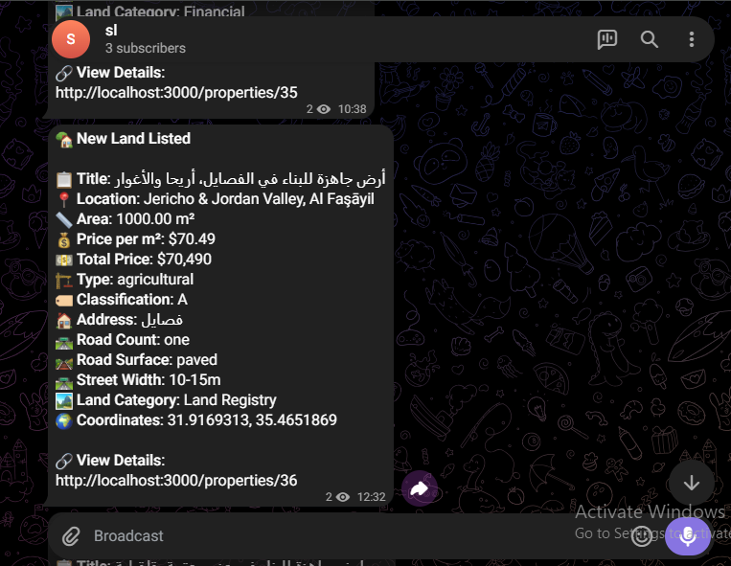
6.
7.
AI Integration
Ollama -powered chatbot
Natural language search assistance
Voice-based land search
Voice-Based Availability Management
Telegram Integration
Automatic Property Publishing
Real-Time Listing Announcements
Social Media Exposure

Slide 72
7
6
8
1
5
Tech stack
4
2
3

Slide 73
7
6
8
💻 Node.js
Implements the backend server and RESTful APIs
handling business logic and data communication.
1
5
Tech stack
4
2
3

Slide 74
7
6
8
⚡ Express.js
Provides routing and middleware
for managing HTTP requests
and responses.
1
5
Tech stack
4
2
3

Slide 75
7
6
8
🗄️ MySQL
Stores and manages platform data
users, land listings, and transactions
with high performance and reliability
1
5
Tech stack
4
2
3

Slide 76
7
6
8
⚛️ React
Powers the web frontend with a dynamic,
responsive, and component-driven
user interface.
1
5
Tech stack
2
4
3

Slide 77
7
6
8
📱 React Native
Delivers a cross-platform mobile app
with a consistent experience alongside
the web platform.
1
5
Tech stack
2
4
3

Slide 78
7
6
8
🔧 Postman
Tests and validates all backend
API endpoints during development
ensuring reliability before deployment.
1
5
Tech stack
2
4
3

Slide 79
7
6
8
🌍 Git & GitHub
Manages version control,
team collaboration, and code reviews
across the entire project lifecycle.
1
5
Tech stack
2
4
3

Slide 80
Constraints
3
1
2
4
Third-party map and geocoding APIs may have usage limits or costs.
Data Accuracy
The platform depends on information provided by property owners.
Location and distance calculations may have minor inaccuracies due to GPS and geocoding services.
Free Ai apis have no support for
tool function calls.

Slide 81
Constraints
1
3
2
4
Data Accuracy
The platform depends on information provided by property owners.
Third-party map and geocoding APIs may have usage limits or costs.
External Services
Performance may be affected by third-party APIs and internet connectivity.
Free Ai apis have no support for
tool function calls.

Slide 82
Constraints
1
2
Data Accuracy
The platform depends on information provided by property owners.
External Services
Performance may be affected by third-party APIs and internet connectivity.
4
3
Free Ai apis have no support for
tool function calls.
User Adoption
Platform effectiveness increases with active user participation and listing availability.

Slide 83
Constraints
1
2
Data Accuracy
The platform depends on information provided by property owners.
External Services
Performance may be affected by third-party APIs and internet connectivity.
4
3
AI Limitations
AI-generated recommendations depend on available data and user queries.
User Adoption
Platform effectiveness increases with active user participation and listing availability.

Slide 84
Future work
Several enhancements can be considered
to further improve the SmartLand MarketPlace platform:
Government Integration
Integrate with official land registry systems.

Slide 85
Future work
Several enhancements can be considered
to further improve the SmartLand MarketPlace platform:
Government Integration
Integrate with official land registry systems.
AI Property Valuation
Provide automated land value estimation.

Slide 86
Any questions?

