Slide 1


Milkshake Factory
This presentation explores the design and development of an automated milkshake making system,
A graduation project at An-Najah National University, by Osama Salah & Mohammad Kittani, supervised by Dr. Anas Toma.

Slide 2
Introduction
The Problem
The Solution
Manual milkshake preparation suffers from inefficiency and inconsistency. Measuring ingredients manually introduces errors.
Our project introduces a fully automated milkshake factory, eliminating human error and ensuring quality control.

Slide 3

Problem Statement
Taste Inconsistency
Slow Preparation
Manual ingredient measurement leads to variations in taste and texture, frustrating customers.
Manual preparation is time-consuming, especially during peak hours, leading to long wait times.
Ingredient Waste
Customer Demand
Inaccurate measurement and inconsistent preparation lead to wasted ingredients and inefficient resource utilization.
Customers desire personalized milkshakes with precise ingredient ratios and customization options.

Slide 4
Project Objectives
Automation
Consistency
Minimize manual work and increase efficiency through robotic processes.
Ensure uniform taste and texture in every milkshake by automating ingredient dispensing.
Customization
Speed
Enable users to select specific ingredient ratios and create personalized milkshakes.
Maximize production capacity while minimizing waste through automated processes.

Slide 5





System Components Overview
Microcontrollers
Motors
Sensors
Pumps
Arduino Mega & ESP32: Control system operations, communication, and real-time monitoring.
NEMA 17 stepper motors for precise dispensing and DC motors for cup conveyor and sealing.
Ultrasonic sensors for ingredient level monitoring and IR sensors for cup positioning.
Water and milk pumps for ingredient transfer and a cleaning pump for automated sanitation.
User Interface
Web-based real-time tracking, LCD display and keypad for manual input, and RFID scanner for user preferences.

Slide 6
Microcontrollers
Arduino Mega 2560
ESP32
The primary microcontroller responsible for controlling all system operations, including ingredient dispensing, motor control, sensor readings, and overall system logic.
Provides wireless communication capabilities, enabling real-time monitoring, data logging, and a user-friendly web interface for order tracking and customization.

Slide 7

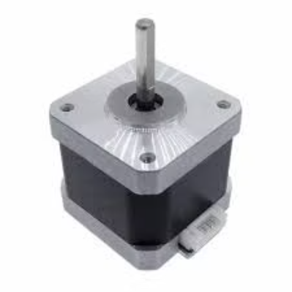

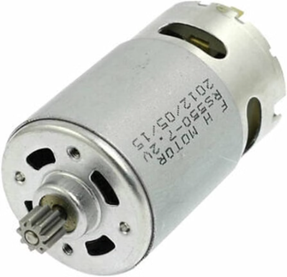
Motors
NEMA 17 Stepper Motors
Precisely control the dispensing of ingredients, ensuring accurate measurement and consistency in every milkshake.
DC Motors
Power the cup conveyor belt, moving cups through the production process, and operate the sealing unit for finished milkshakes.

Slide 8


Sensors
Ultrasonic Sensors
1
Monitor ingredient levels in storage tanks, ensuring sufficient supply for continuous operation and preventing shortages.
IR Sensors
2
Detect cup positioning on the conveyor belt, triggering the dispensing process at the appropriate time and ensuring accurate ingredient placement.

Slide 9
Pumps
Water & Milk Pumps
1
Transfer liquid ingredients, such as water, milk, and syrups, from storage tanks to the mixing chamber, facilitating the milkshake blending process.
Cleaning Pump
2
Automates the cleaning process after each production cycle, ensuring hygiene and sanitation of the system.

Slide 10
User Interface
1
2
3
Web Interface
LCD Display
RFID Scanner
Provides real-time order tracking, allowing customers to monitor the progress of their milkshakes.
Enables manual order input through a user-friendly keypad for customers who prefer to manually customize their orders.
Recognizes saved user preferences, automatically configuring the system to prepare previously customized milkshakes for returning customers.

Slide 11
Sweet Success: Challenges & Solutions
Power Management
Precision in Mixing
Multiple voltage levels were carefully managed for optimal performance.
Fine-tuned motor speeds ensure every shake is perfectly blended.
Cup Alignment Issues
IR sensors ensure every cup is perfectly positioned for a flawless shake.

Slide 12





Results & Benefits:
Faster Production
Consistent Taste
Reduced manual labor means quicker shakes for everyone!
Precise ingredient measurement guarantees deliciousness every time.
Lower Waste
Scalable Business
Improved efficiency reduces waste and saves resources.
Perfect for small and medium businesses, ready to grow with demand!

Slide 13





The Future is Sweet: Enhancements Ahead
AI Recommendations
Get personalized suggestions for your next milkshake adventure!
Mobile Ordering
Order your favorite shake from anywhere, anytime!
Self-Cleaning Magic
Enjoy a sparkling clean factory, effortlessly!
Larger-Scale Production
Scaling up to meet the milkshake demands of the world!

Slide 14
Thanks For Listing
Any Questions?

