Slide 1


Design of Wastewater and Stormwater Collection Networks for
Bait Wazan Village
By
Dawlat Najjar
Beesan Jamal
Rawand Sha’ar
Supervisor
Dr. Mohammad N. Almasri
December 2013

Slide 2
OUTLINE
INTRODUCTION
OBJECTIVES
METHODOLOGY
RESULTS FOR SEWAGE SYSTEM
RESULTS FOR STORMWATER NETWORK
CONCLUSIONS & RECOMMANDATIONS

Slide 3
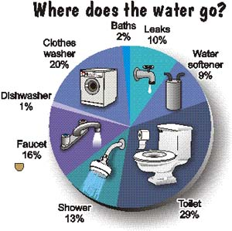
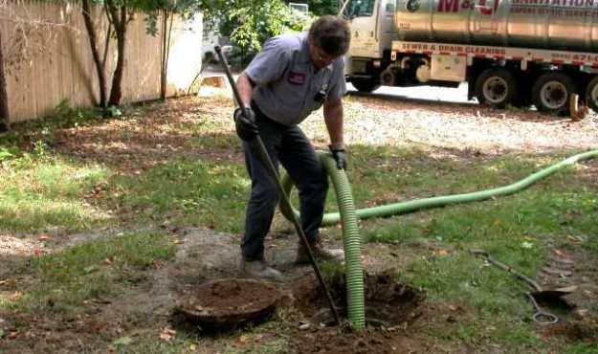

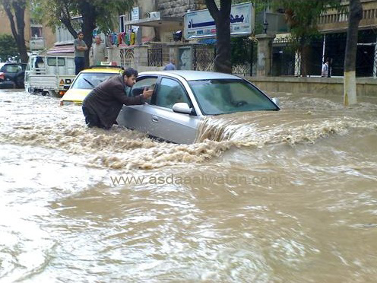
INTRODUCTION

Slide 4

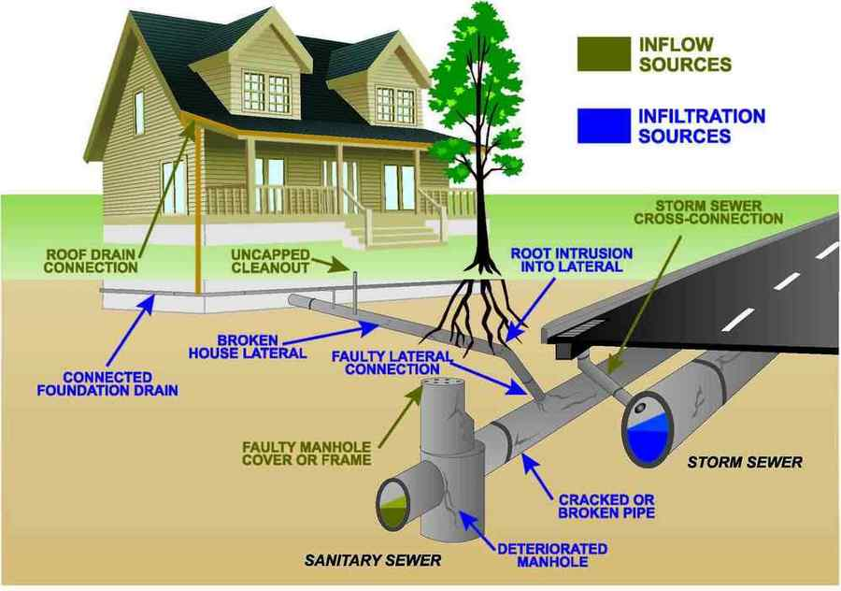


Slide 5

DESIGN
THE STORM NETWORK USING
STORMCAD
DESIGN THE wastewater collection NETWORK USING SEWERCAD

Slide 6
ENGINEERING CONCEPTS
GOOD DESIGN
EFFICIENT SOFTWARE
Effective WASTEWATER & STORMWATER COLLECTION NETWORKS

Slide 7

METHODOLOGY
Selection of the study area
Data collection
Network delineation
For sewer
For storm
Design the network using the SewerCAD
Design the network using the StormCAD
Determination of design constraints
Distribution of manholes and estimate the load
Distribution of catch basin and estimate the area
Estimate the cost of network
Conclusion and recommendation

Slide 8

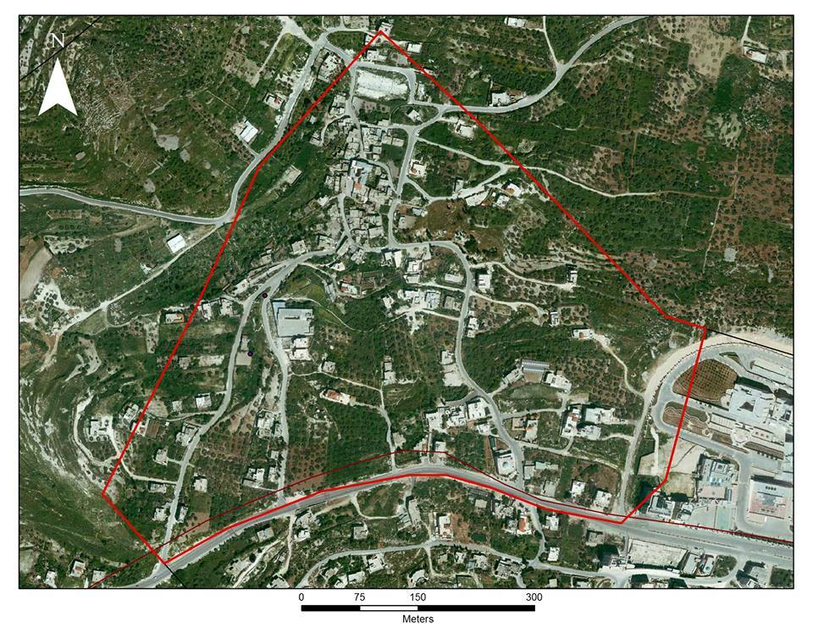
LOCATION
Bait Wazan Village
An- Najah National University

Slide 9
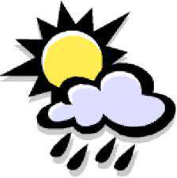

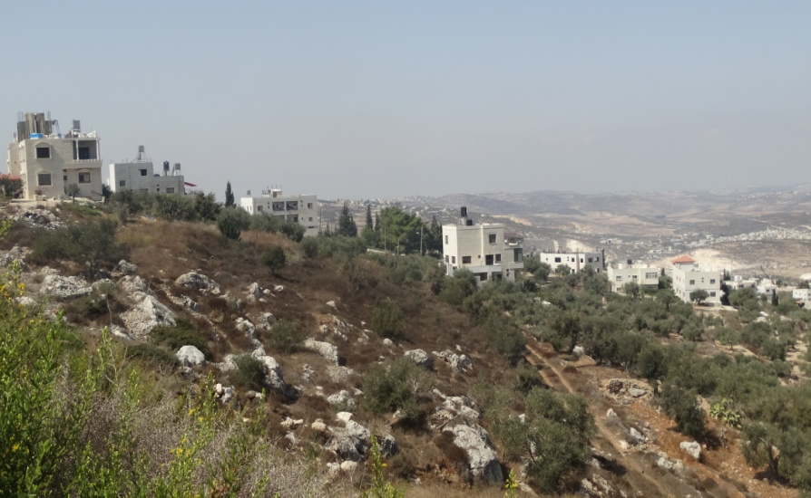
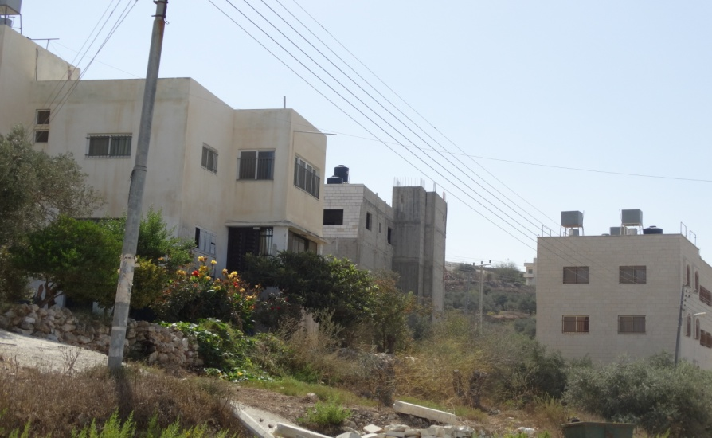
About Bait Wazan Village

Slide 10


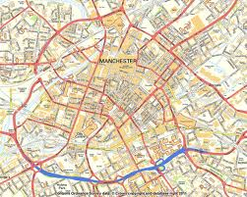
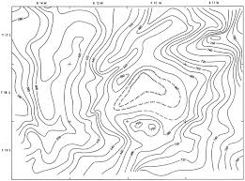
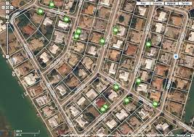
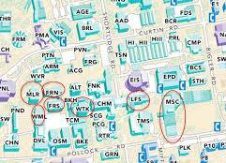
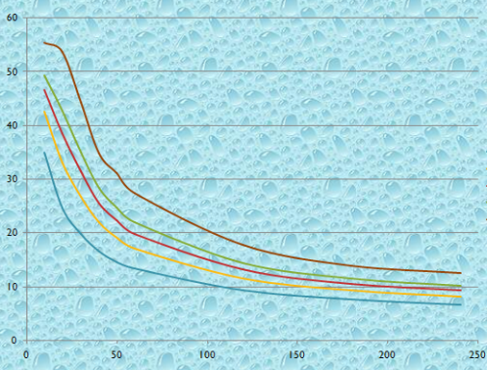
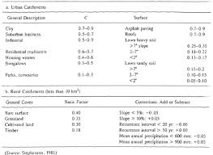
DATA COLLECTION

Slide 11

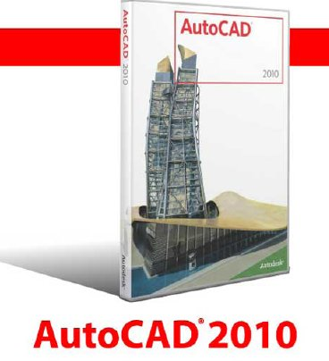



SOFTWARE USED FOR DATA PROCESSING

Slide 12
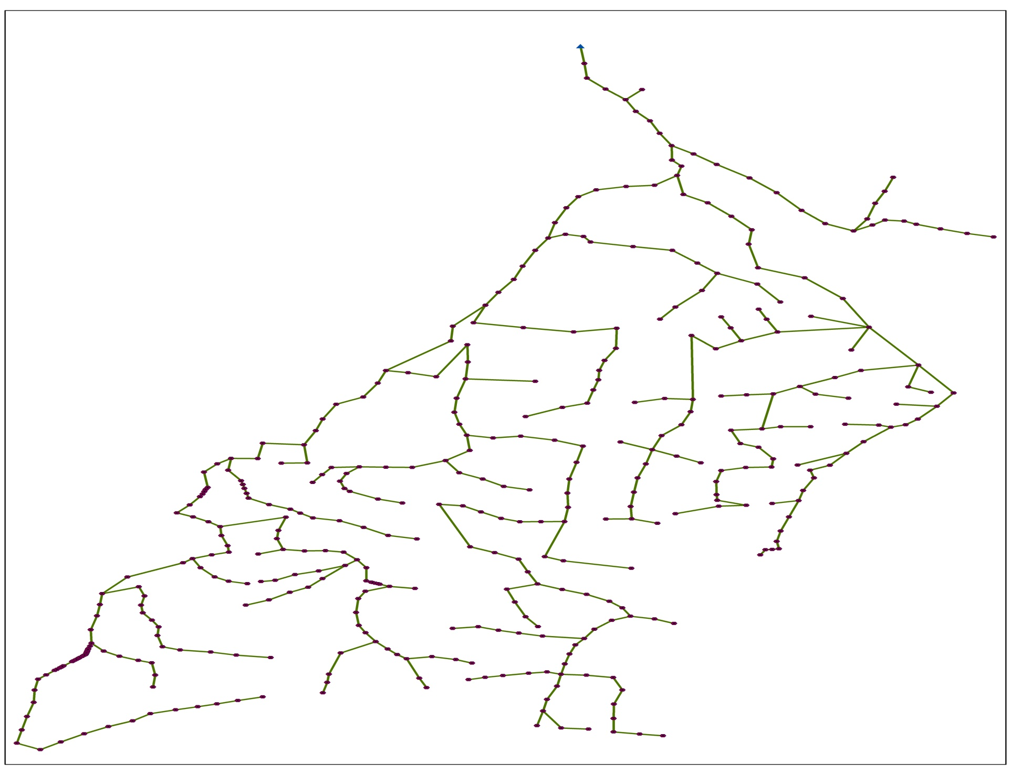
Plan for network

Slide 13


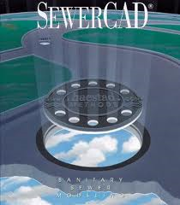





Design and analysis using SewerCAD & StormCAD

Slide 14
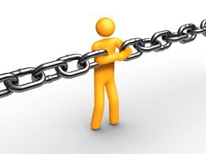
Design Constraints
Item | minimum | Maximum
Velocity(m/s) | 0.6 | 3
Slope(%) | 1 | 12
Cover(m) | 1 | 3.5

Slide 15
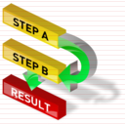
PROCEDURES
Wastewater network cost
effective wastewater network design

Slide 16



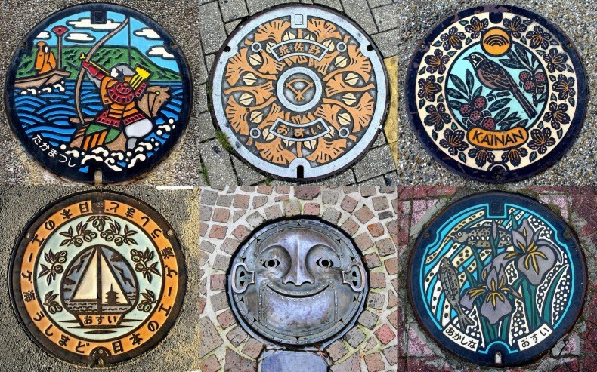
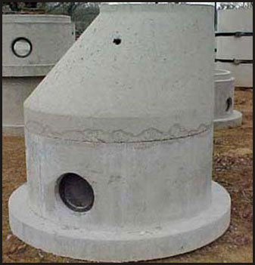
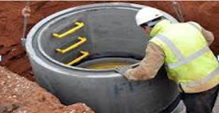
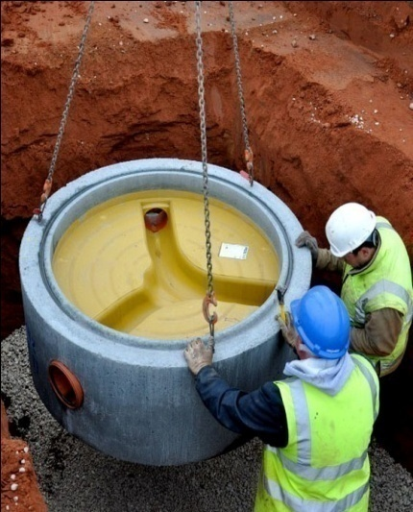
The cost of wastewater Network
Manholes
Cover’s Manhole
Cone’s Manhole
Ring’s Manhole
Base’s Manhole

Slide 17
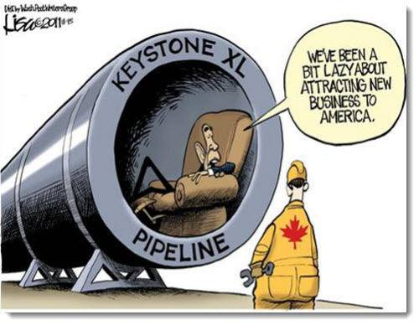

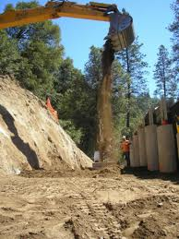

UPVC
Sand
Backfill
Excavation

Slide 18

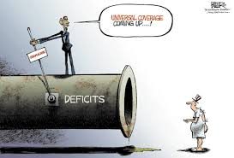
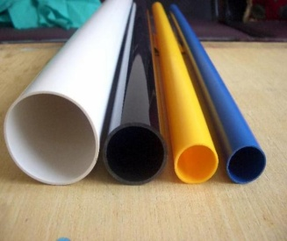

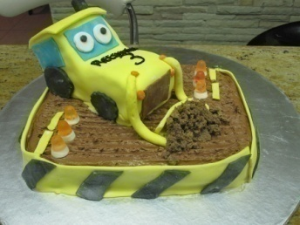
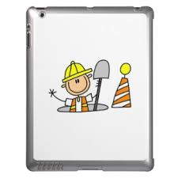

92$/m
$170
$170
$80
$280
$700
$400

Slide 19

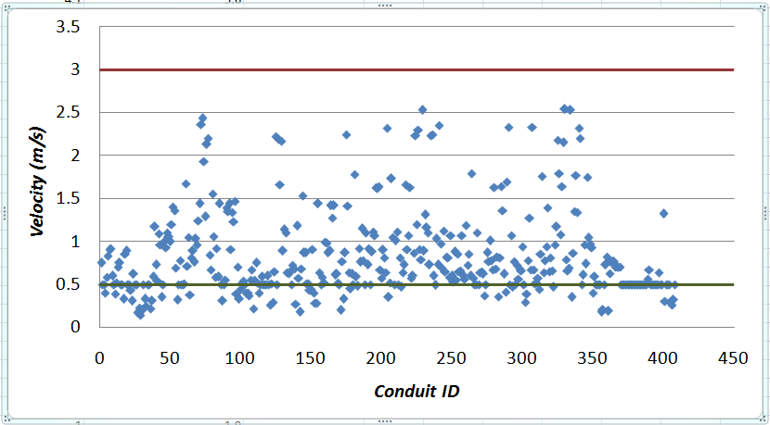
Velocity Constraints

Slide 20
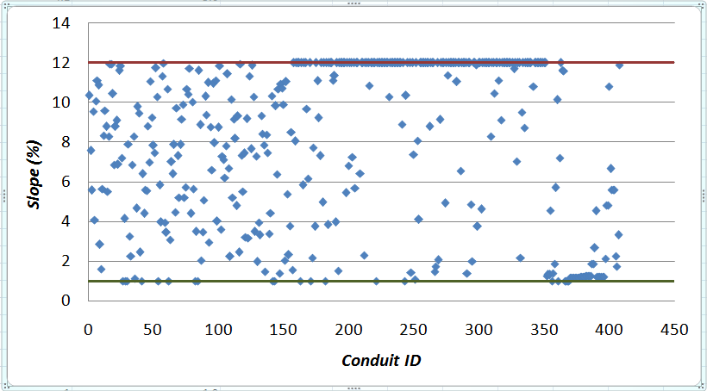
Slope Constraints

Slide 21
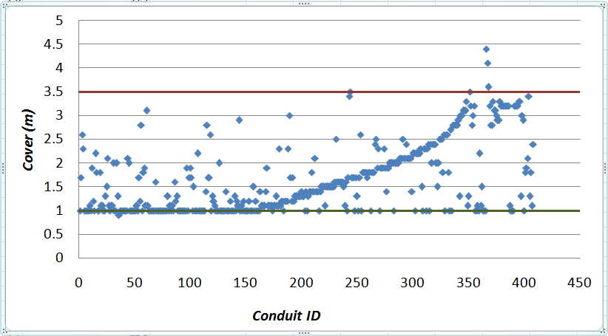
Cover Constraints

Slide 22

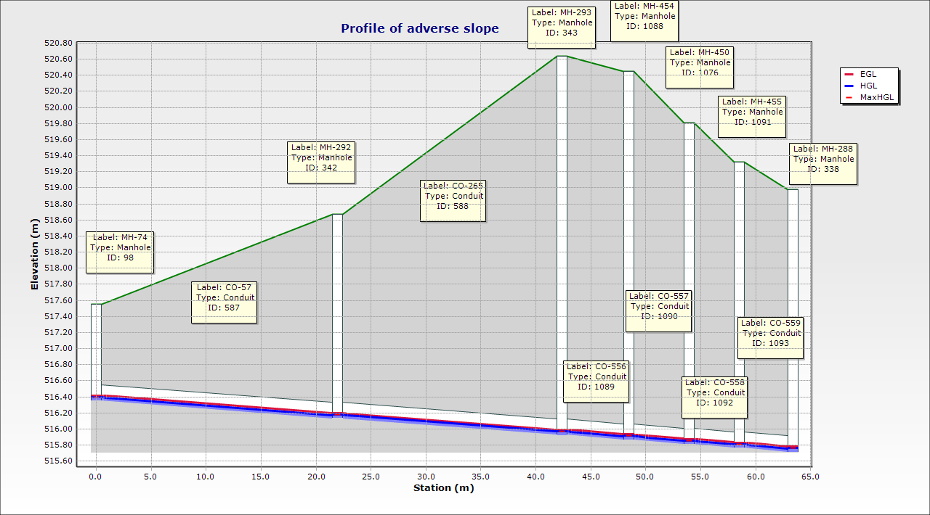
Profile of Street adverse slope

Slide 23
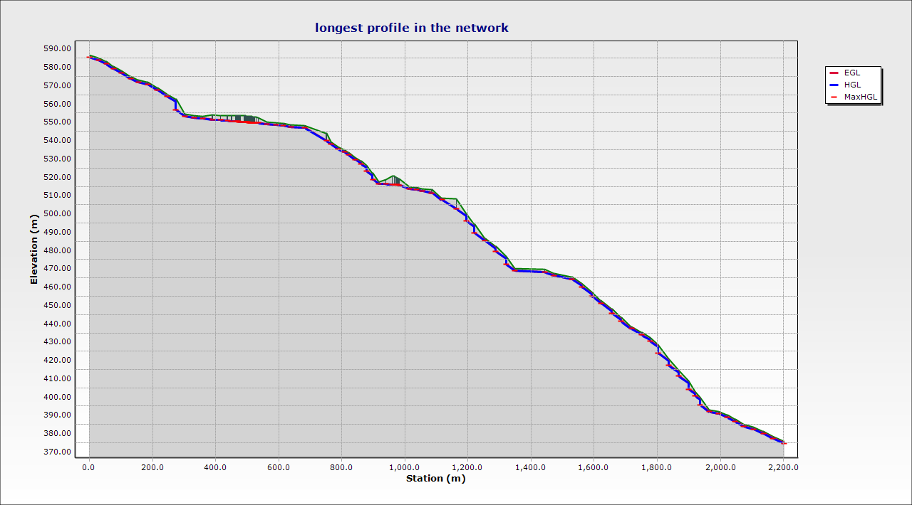
Longest profile in the network

Slide 24
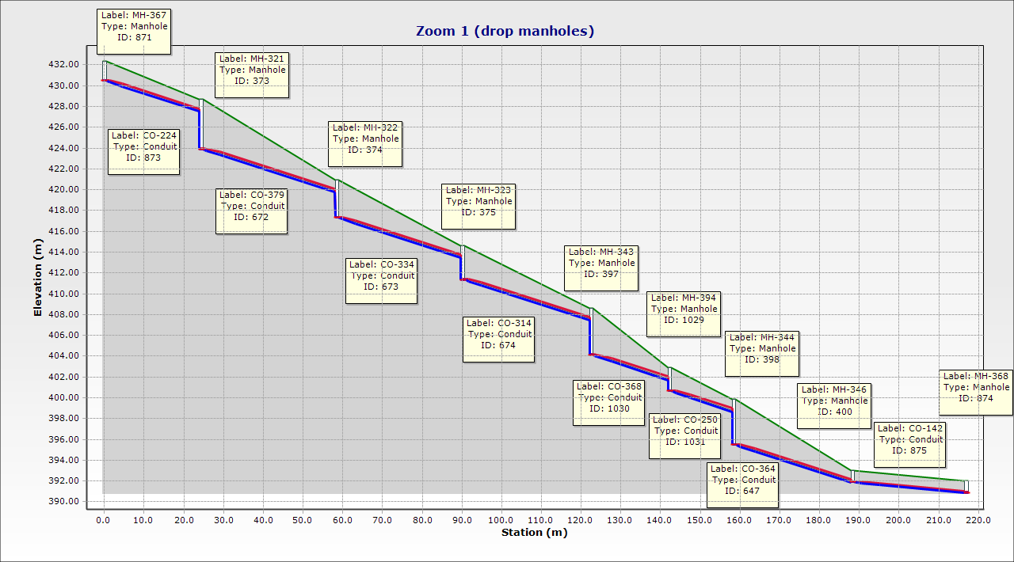
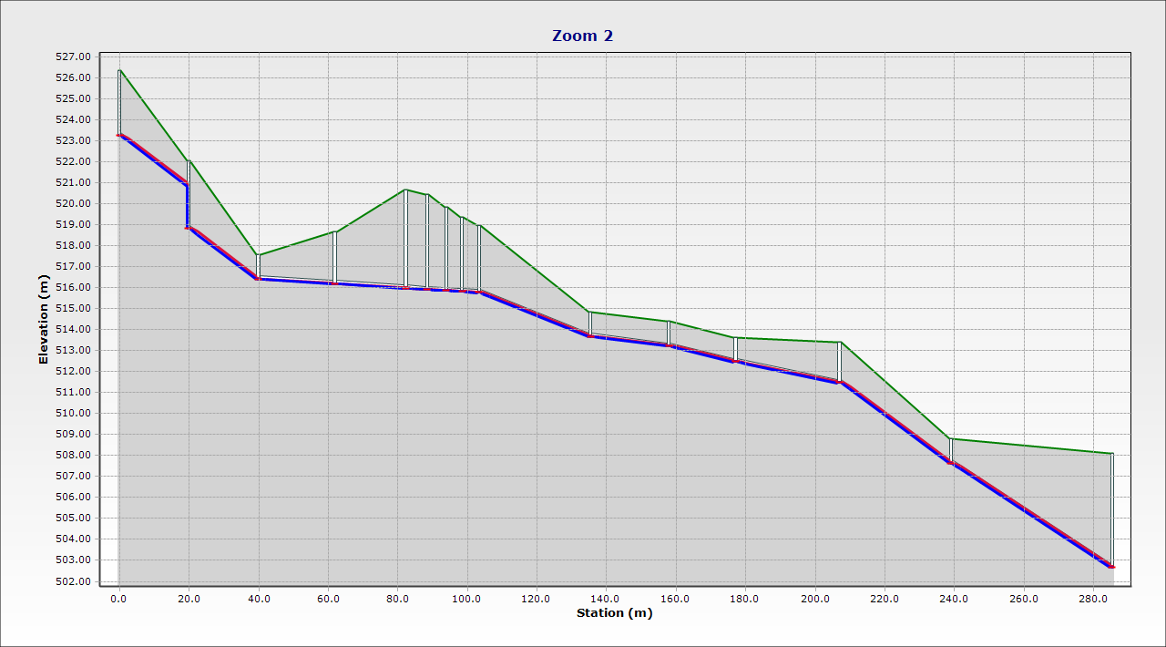

Slide 25
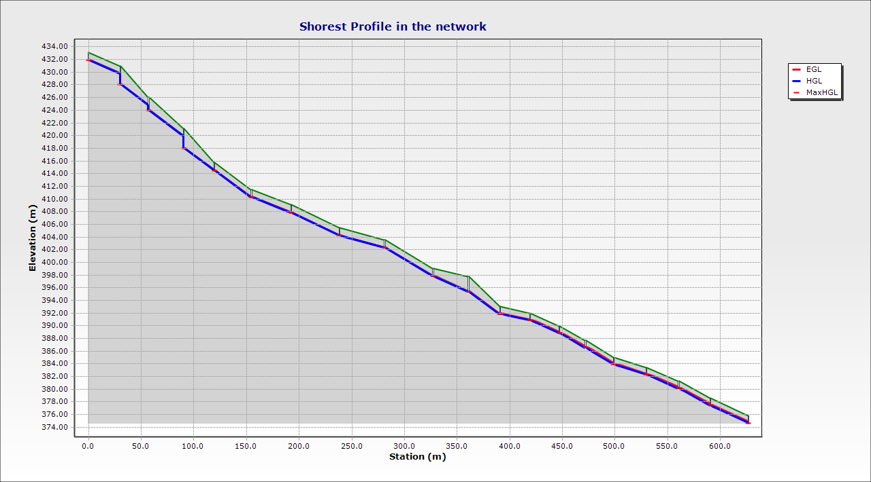
Shortest profile in the network

Slide 26
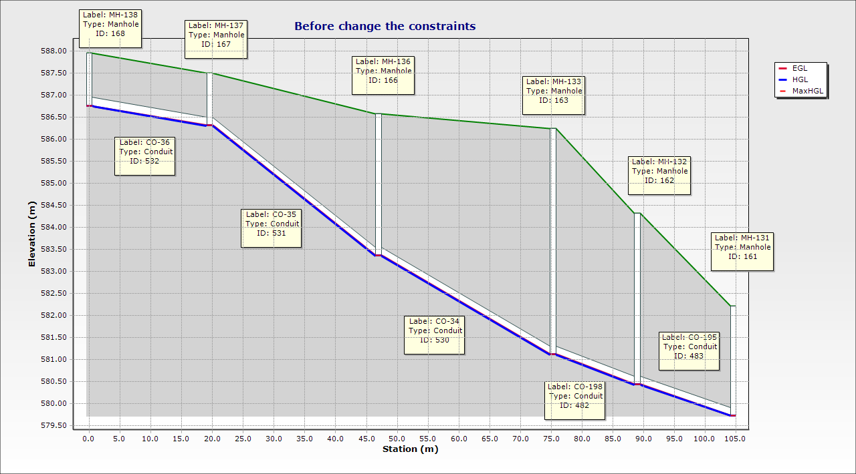
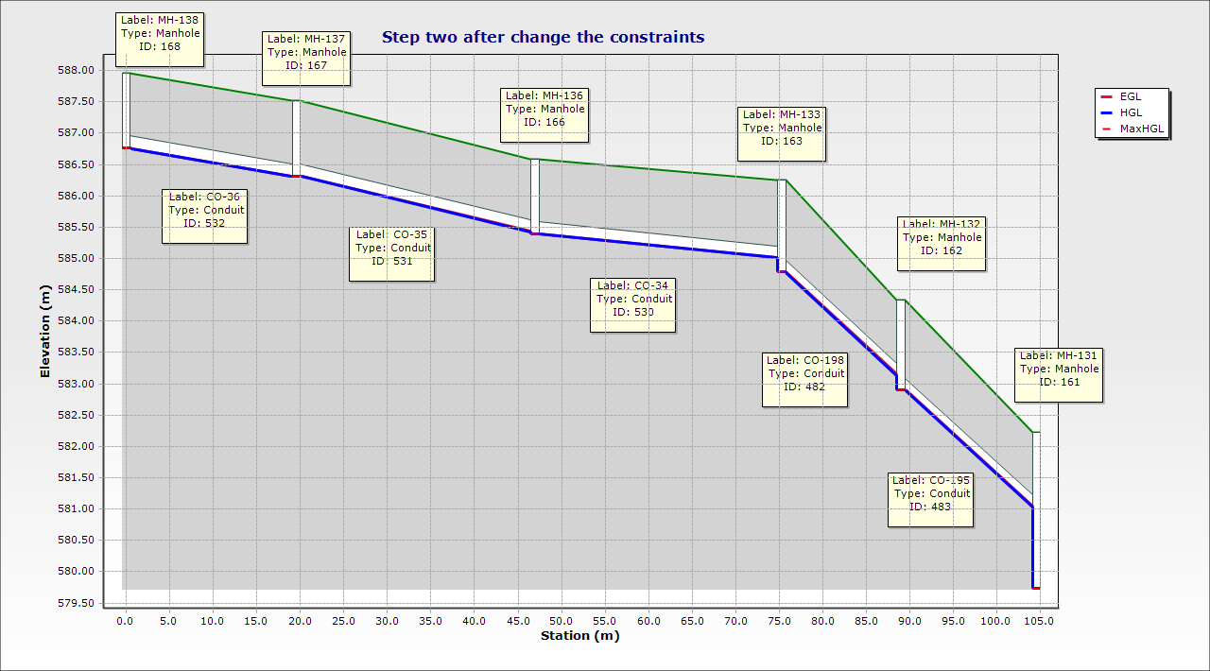
An example of profile

Slide 27

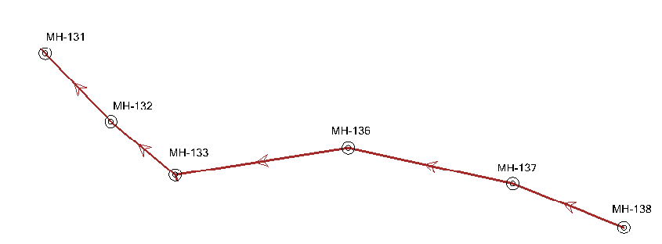
Top view of profile
Conduit ID: CO-195
before:-
cover: 3m
velocity: .5 m/s
slope: 4.57%
after2-
cover: 1.1m
velocity: .69 m/s
slope: 12%
Conduit ID: CO-198
before:-
cover: 4.3m
velocity: .5 m/s
slope: 4.97%
after:-
cover: 1.1m
velocity: .67 m/s
slope: 12%
Conduit ID: CO-35
before:-
cover: 2m
velocity: .5 m/s
slope: 10.77%
after:-
cover: 1m
velocity: .33 m/s
slope: 3.24%
Conduit ID: CO-34
before:-
cover: 4m
velocity: .5 m/s
slope: 7.91%
after2-
cover: 1m
velocity: .27 m/s
slope: 1.34%
Conduit ID: CO-36
before:-
cover: 1m
velocity: .25 m/s
slope: 2.27%
after:-
cover: 1m
velocity: .25 m/s
slope: 2.27%

Slide 28

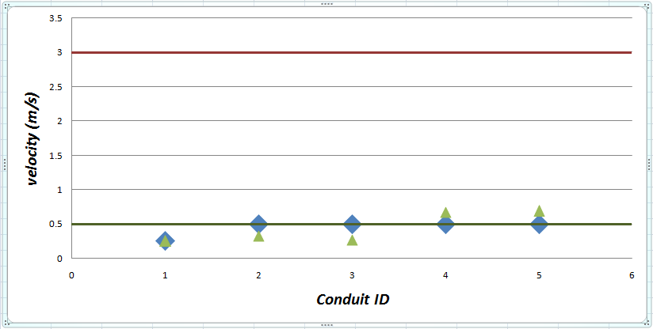
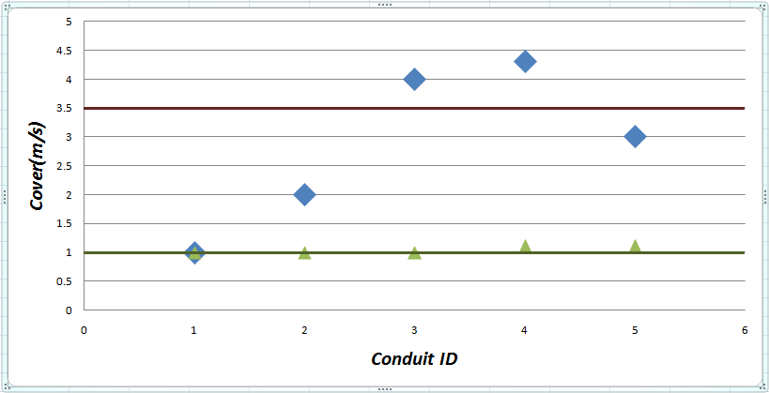
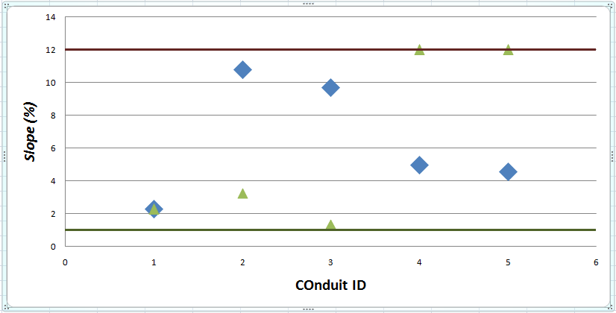

Slide 29
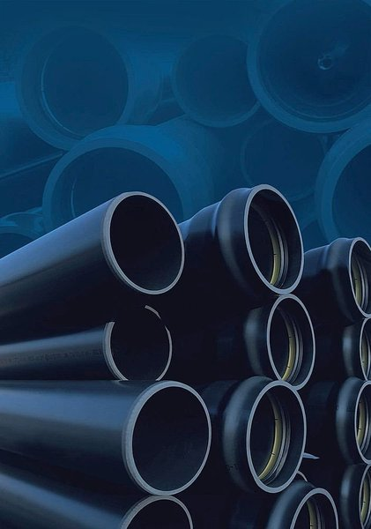
408 manholes with 1 meter diameter
408 conduit in sewer network with 8 inch diameter
12 km the length of network
The wastewater Network

Slide 30

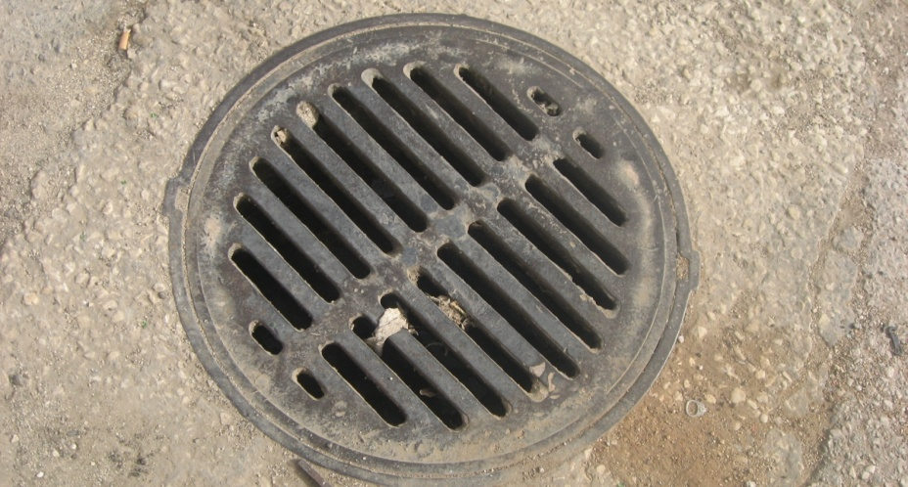
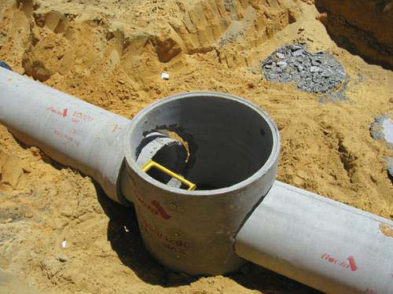
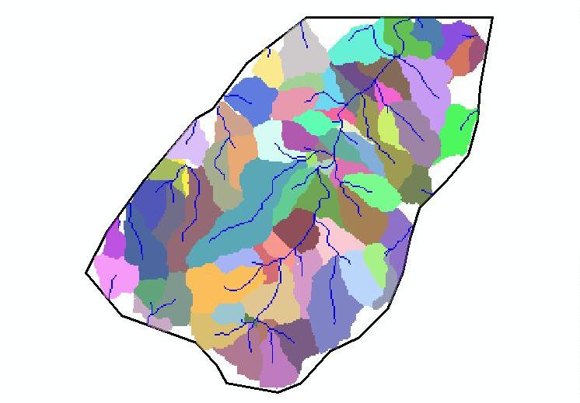
Inlet
Catchment area
Conduit

Slide 31


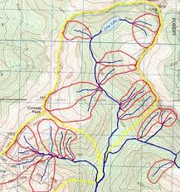


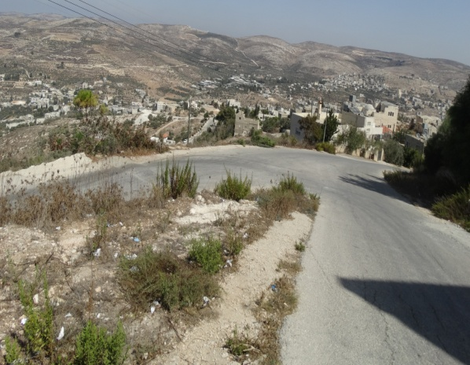
Factors affecting the Stormwater
From Rational method
Soil type
Shape of drainage area
Runoff coefficient
Previous moisture conditions
Slope of watershed

Slide 32

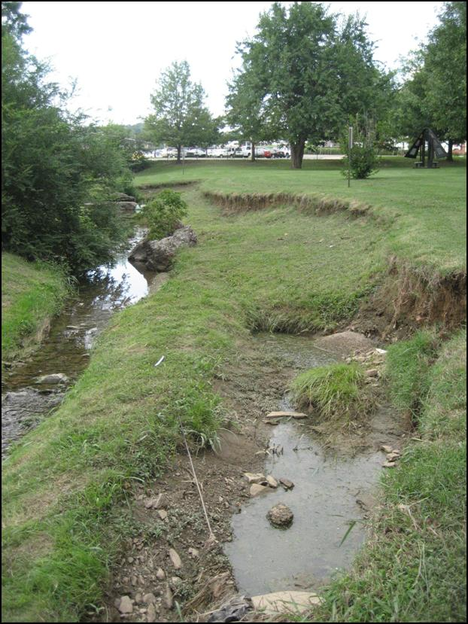



Amount of impervious soil
Land use

Slide 33



Study area
Contribution area
Residential
Rocky area
Streets
Paved

Slide 34

The Key parameter that have effective impact is
Runoff coefficient(C)
In order to assess the value of C that are closer to reality we studied the previous case that simulate to our case (north-eastern part of the City of Nablus) . Since they make calibration between the real case and the model output.

Slide 35



When finding that the value of C must be low . we revisited the study area and found that there are few depressions that impact the generation of stormwater

Slide 36



In addition, the rocks of the study area are oriented in away that obstructs the stormwater

Slide 37

Rainfall intensity is defined as the rate of rain that falls during a storm event
Design value of intensity depend on :-
Tc
Return period
Intensity

Slide 38

Tc depend on:-
t
tf = L/V
Return period
In residential areas (2-5) years design period is considered and we use 2 years

Slide 39
For our study area
IDF for Nablus (PWA)

Slide 40



Catchment Area

Slide 41

 |  |  | C=.2 |  | C=.1 |  | C=.3
location | Conduit ID | Parameter | Wastewater | stormwater | Wastewater | stormwater | Wastewater | stormwater
At the beginning | CO-1 | Velocity (m/s) | 0.5 | 1.24 | 0.5 | 1.02 | 0.5 | 1.4
 |  | Flow (m3/d) | 10.37 | 3473.28 | 10.37 | 2855.3472 | 10.37 | 3919.104
 |  | Slope (%) | 7.58 | 2.56 | 7.58 | 2.56 | 7.58 | 2.56
 |  | Diameter ( in) | 8 | 8 | 8 | 8 | 8 | 8
At the middle | CO-130 | Velocity (m/s) | 0.5 | 1.71 | 0.5 | 1.93 | 0.5 | 1.93
 |  | Flow (m3/d) | 6.15 | 4790.88 | 6.15 | 5402.7648 | 6.15 | 5402.7648
 |  | Slope (%) | 11.9 | 8.62 | 11.9 | 8.62 | 11.9 | 8.62
 |  | Diameter ( in) | 8 | 8 | 8 | 8 | 8 | 8
At the end | CO-247 | Velocity (m/s) | 2.3 | 5.26 | 2.3 | 4.42 | 2.3 | 5.91
 |  | Flow (m3/d) | 974.8 | 132641.28 | 974.8 | 62664.0019 | 974.8 | 149030.72
 |  | Slope (%) | 12 | 10 | 12 | 10 | 12 | 10
 |  | Diameter ( in) | 8 | 24 | 8 | 18 | 8 | 24

Slide 42

2-year return period
 |  |  | 2-year
location | Conduit ID | Parameter | Wastewater | stormwater
At the beginning | CO-1 | Velocity (m/s) | 0.5 | 1.24
 |  | Flow (m3/d) | 10.37 | 3473.28
 |  | Slope (%) | 7.58 | 2.56
 |  | Diameter ( in) | 8 | 8
At the middle | CO-130 | Velocity (m/s) | 0.5 | 1.71
 |  | Flow (m3/d) | 6.15 | 4790.88
 |  | Slope (%) | 11.9 | 8.62
 |  | Diameter ( in) | 8 | 8
At the end | CO-247 | Velocity (m/s) | 2.3 | 5.26
 |  | Flow (m3/d) | 974.8 | 132641.28
 |  | Slope (%) | 12 | 10
 |  | Diameter ( in) | 8 | 24

Slide 43




5-year return period
Conduit 130 :-

Slide 44


10-year return period
Conduit 130 :-

Slide 45
The Stormwater Network
we have 390 catch basin
we have 390 conduit in Storm network
12 km the length of network
Rang of the diameter
Diameter (in) | Length (m)
24 | 1280
18 | 994
15 | 1447
12 | 437
10 | 2025
8 | 5940

Slide 46



Conclusions
8 inch diameter sewer lines from UPVC were used in design of the wastewater collection network. And (24,18,15,12,10,8) inch diameters are used in design of the stormwater collection network .
Cost of the WASTEWATER NETWORK is $92/M .
SewerCAD and StormCAD are efficient software for the design of wastewater and stormwater collection networks .
Though the designs we made cannot be used for implementation as they are yet they provide a good approximation to the real networks along with realistic cost .
This project helped us to broaden our way of thinking and that design constraints can be compromised to arrive at realistic conditions .

Slide 47




