Slide 1
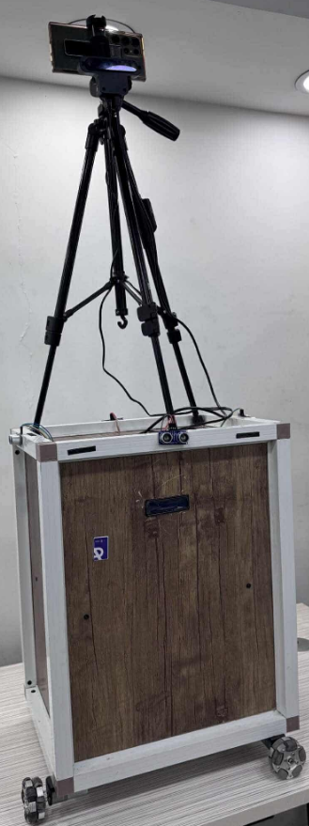
Cambot
AI Person Tracker Robot

Slide 2
Introduction
Cambot is an assistive mobile camera robot designed to automate video capture by tracking a person using gesture control and face recognition. It aims to replace traditional cameramen in lectures, conferences, and personal content creation, enhancing convenience and efficiency.

Slide 3

Project Overview

Slide 4
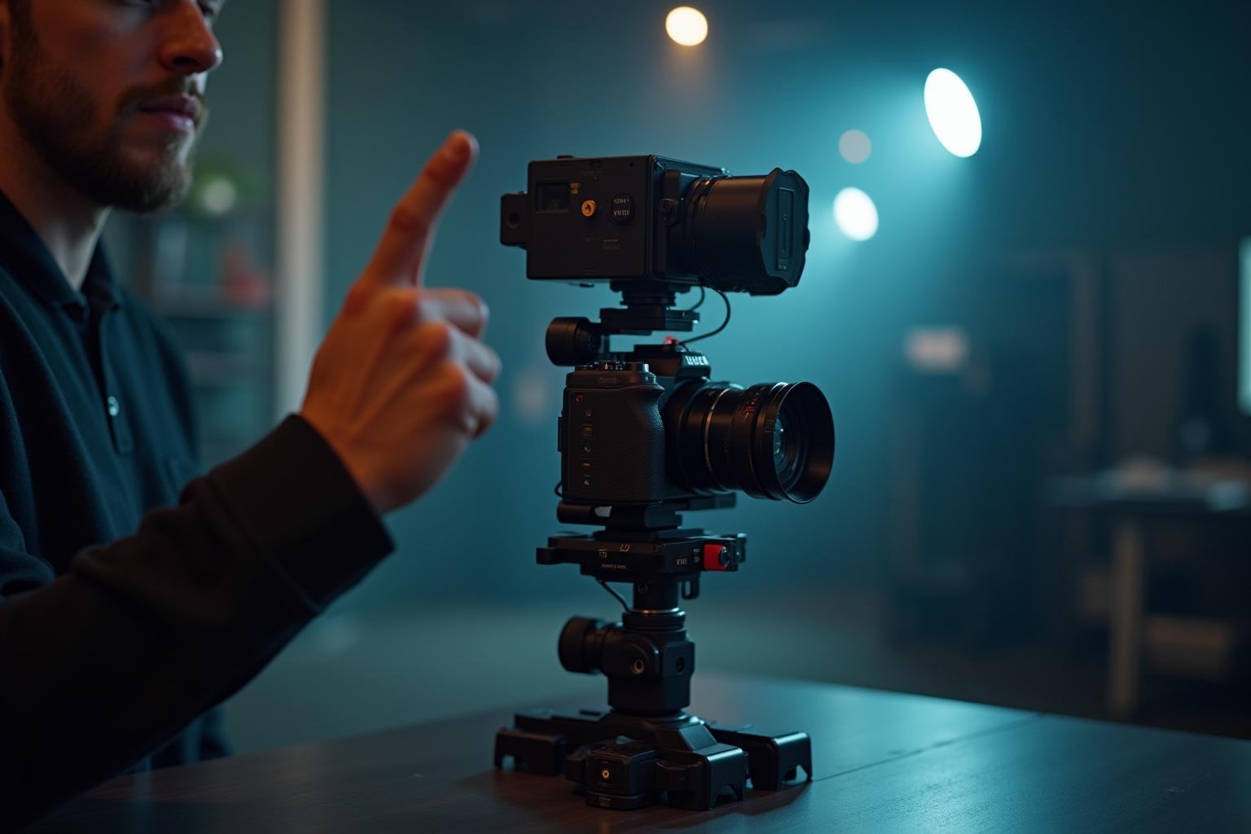
Concept and Motivation
Cambot uses AI-powered tracking with the OAK-D camera and Raspberry Pi 5 to follow a person. The system providing a modern, automated alternative to manual camerawork.

Slide 5
Key Objectives
The primary goals are to enable exclusive person tracking, initiate tracking via hand gestures (Thumbs Up = start, Stop Sign = stop), adjust the position when person isn’t at the center, and support AI as well as manual remote control modes.

Slide 6
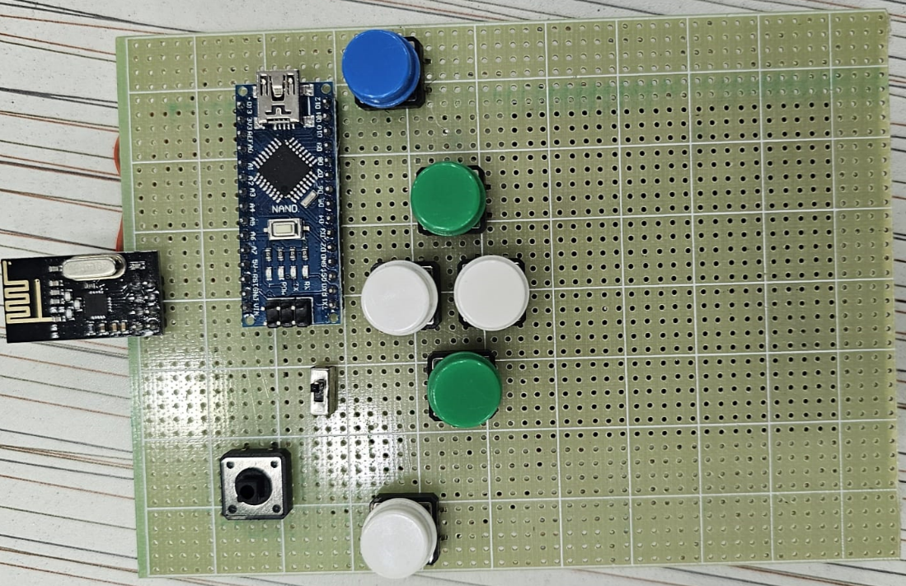
Campot Architecture
The Cambot system integrates a Remote control (Arduino Nano + NRF24L01) with receivers and controllers (Arduino Uno and Mega) managing motors. Parallel AI control is handled by a Raspberry Pi 5 and OAK-D camera.

Slide 7
Campot advantages
Dual Control Mode.
AI-Powered Tracking.
Gesture recognition.
Seamless Mode Switching.
Real-Time Feedback.
Obstacle Avoidance.
Stable Power Distribution.

Slide 8
Campot advantages
Intelligent Lost-Target Recovery.
Safe Startup Sequence.
Omni-Wheel Mobility.
Human-Friendly Interaction.

Slide 9
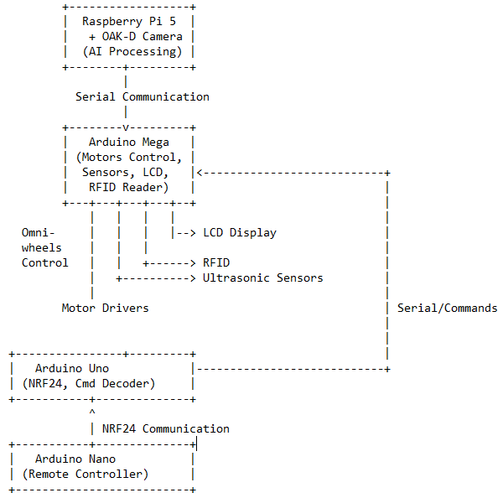
System Architecture

Slide 10
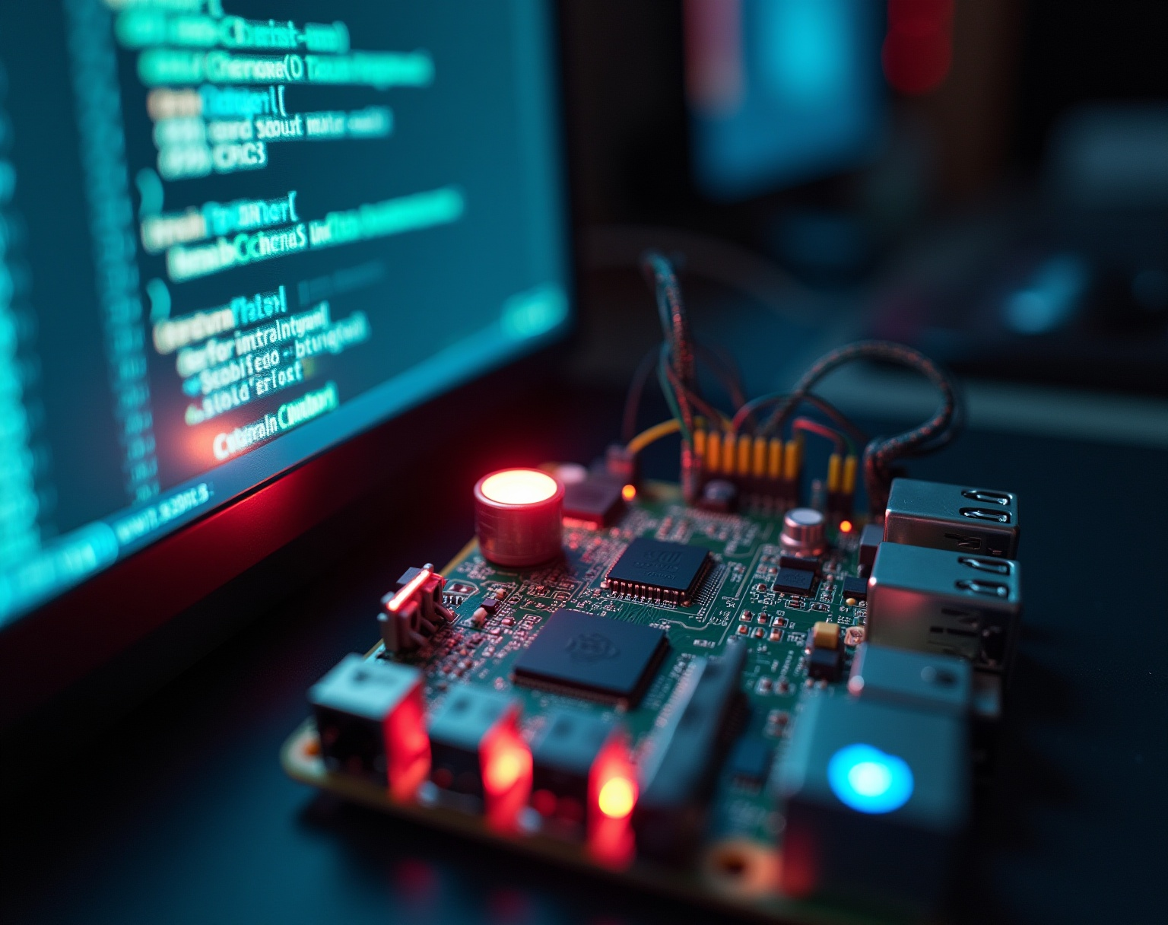
Hardware Details

Slide 11
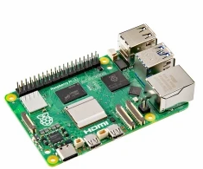
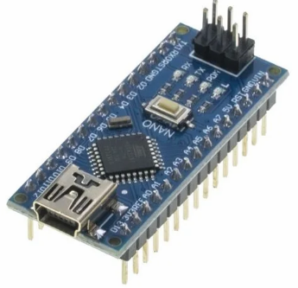
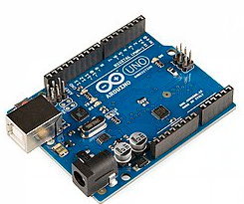
Components:
Raspberry PI 5
Arduino Nano
Arduino Uno

Slide 12
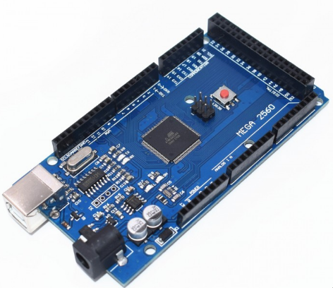
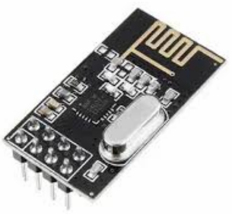
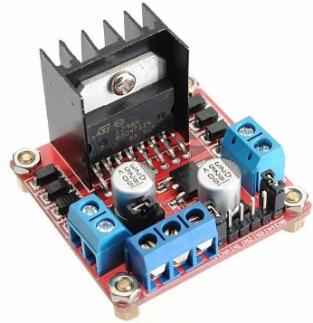
Components:
Arduino Mega
NRF24L01 Module
L298N Motor Driver Module

Slide 13
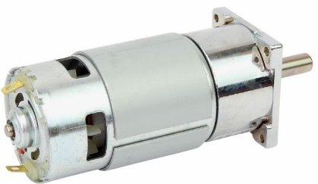
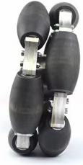
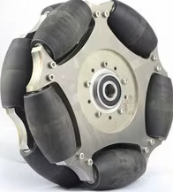
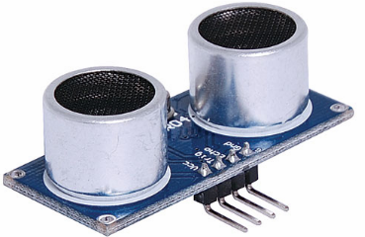
Components:
DC Motors
Aluminum Omni Wheels
Ultrasonic Sensors

Slide 14
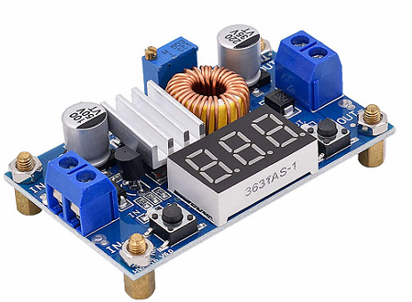
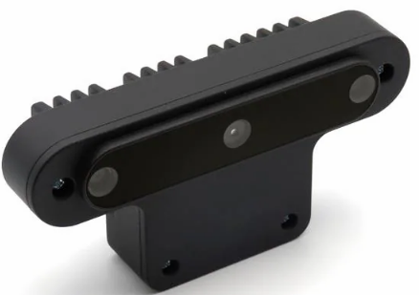
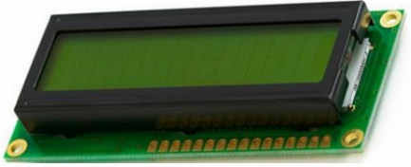
Components:
Xl4015 DC-DC Buck Converter
OAK-D Camera
LCD Display (16×2)

Slide 15
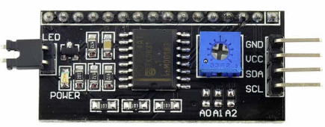
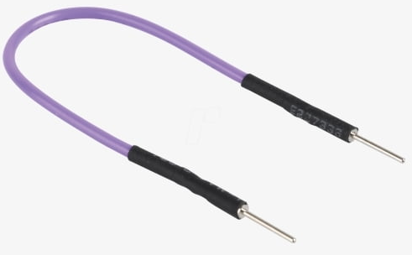
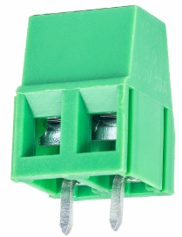
Components:
I2C Module
Jumper Wires
PCB Mount Screw Terminal Block Connectors

Slide 16
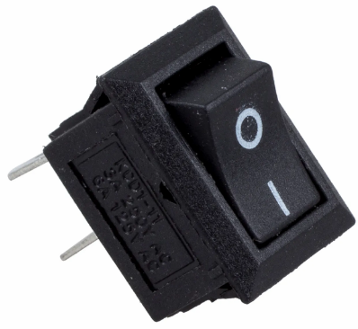
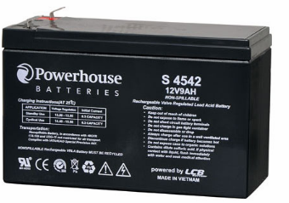
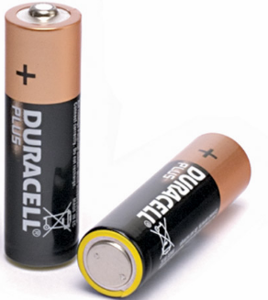
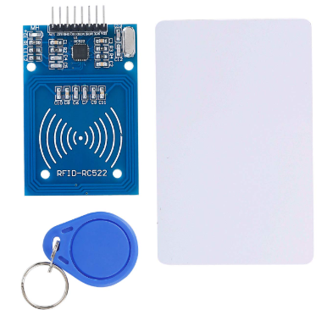
Components:
Switches
Gel battery 12V/9A Along with 4*1.5V Batteries
Radio Frequency Identification
(RFID)

Slide 17
Implementation challenges
Problems
Choosing The Right Wheels for heavy Weight.
Poor Energy Distribution.
Slow Motors Movements For Tracking.
Controllers prioritization.
Arduino Uno Overloading.
Solutions
Aluminum Omni Wheels.
Distribute Power Using two Buck Converters.
Using Rotation Instead of Movement.
Prioritize Human Action (Remote control).
Moving The Load To Arduino Mega.

Slide 18
Future Features
Improved Obstacle Detection with LiDAR.
Enhanced Locomotion with Multi-Motor Chain Drive System.
Integrated Touch Screen for Local Monitoring.
Mobile Application for Remote Streaming and Storage.
High-RPM Motors for Improved Maneuverability.
Automatic Mode Switching Between AI and Manual Control.
Camera Stabilizer.

Slide 19
Conclusions
Cambot successfully combines AI-driven tracking and gesture control in a modular robotic platform. It demonstrates effective integration of hardware and software to automate video capture, delivering a foundation for advanced, reliable mobile camera robotics applications.

