Slide 1
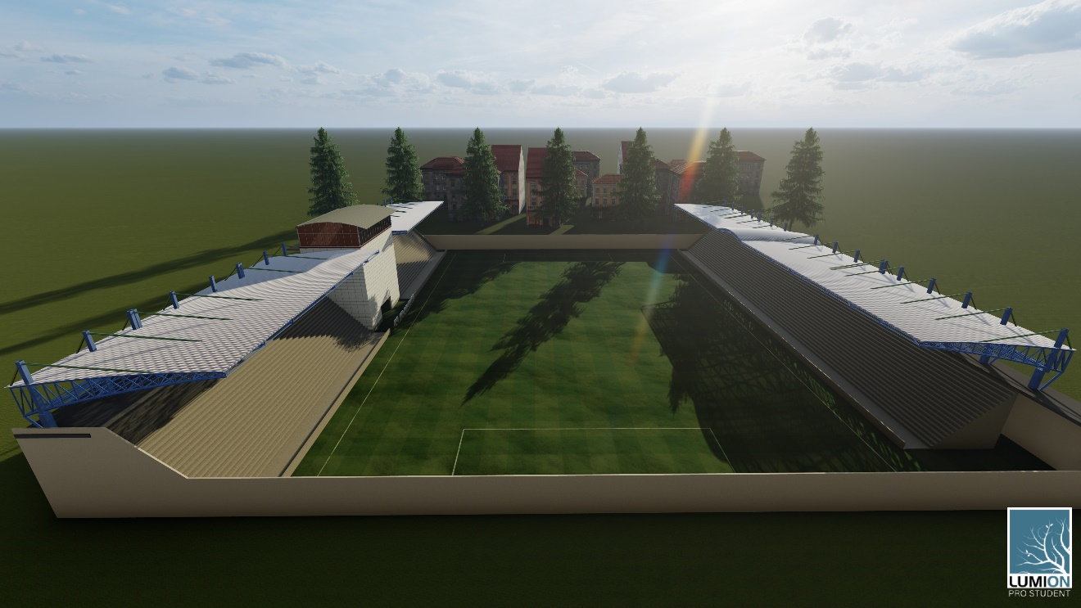
An-Najah National University
Faculty of Engineering
Graduation Project Report II
“ Analysis and design of
the municipal stadium coverage “
Supervisor:
Dr. Abdul Razzaq Touqan
Prepared by:
Abdulrahman zyoud
Iz-deen bani odeh

Slide 2
Outline:
Introduction.
preliminary DESIGN, 3D modeling &analysis (EXPERIMENTAL)
preliminary DESIGN, 3D modeling &analysis (FINALITY)
Structural Design
Connection design

Slide 3
Introduction
  Project Description
The Municipality of Nablus Stadium is one of the most important monuments in the city of Nablus, the area of whole playground stadium is 10500m², that containing two stadium sides, the eastern dimension is 111.5m x 16m, and the western dimension is 112m * (16-18)m, and greasy field with area is 7140 m^{2.}
The existing columns 60cm* 60cm and the distances between them are irregular as they range around 6m,as shown in figure below. .

Slide 4
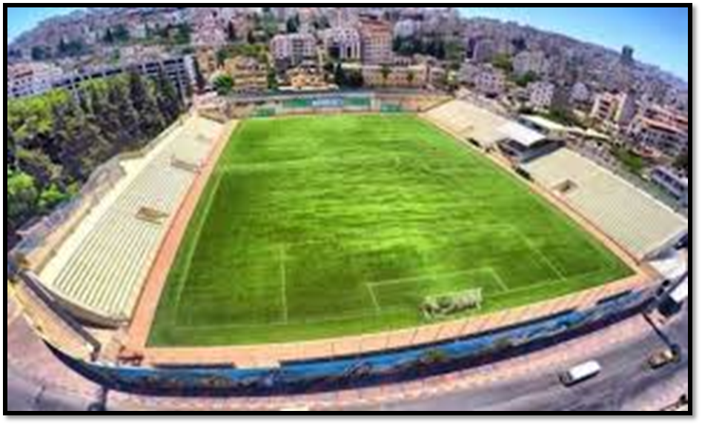
Municipal stadium

Slide 5
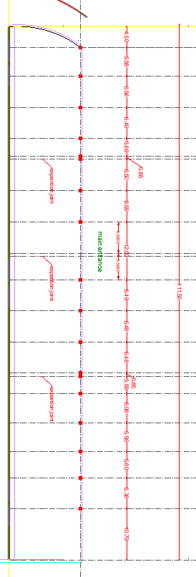
The column centers of the eastern side of the stadium from AutoCAD

Slide 6
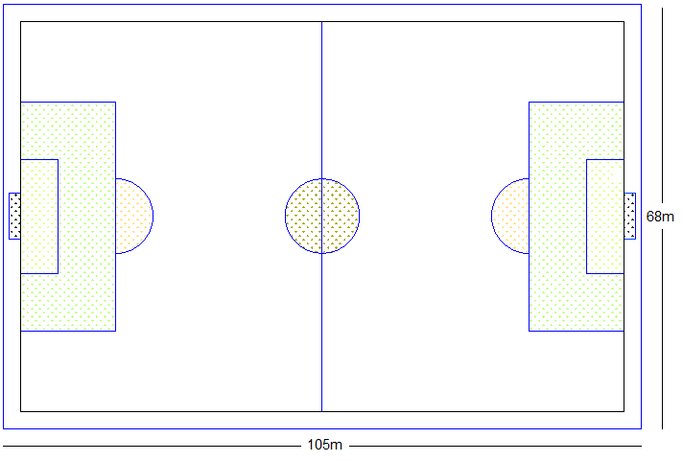
The grassy surface of the stadium from AutoCAD

Slide 7
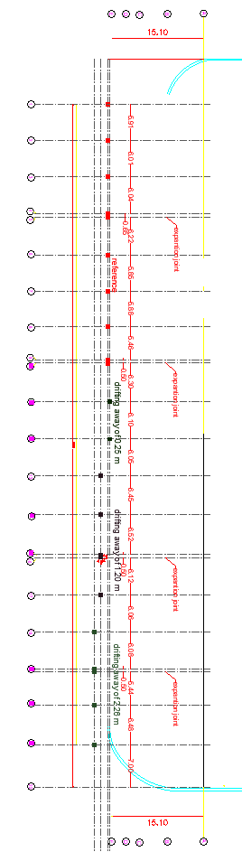
The column centers of the other side of the stadium from AutoCAD

Slide 8
  2. Analysis and design principles
There are many methods that can be used for design process such as Design for Strength Using Load and Resistance Factor Design (LRFD) and Design for Strength Using Allowable Strength Design (ASD). In this project we will use (LRFD) method.

Slide 9
  3. Codes and standards
The Jordanian Code for loads and forces
(ASCE 7-16) :American Society of Civil Engineers.
(AISC 360-16): Specification for Structural Steel Buildings.
(ACI 318-19): American Concrete Institute.
(ASTM):for material specification .

Slide 10
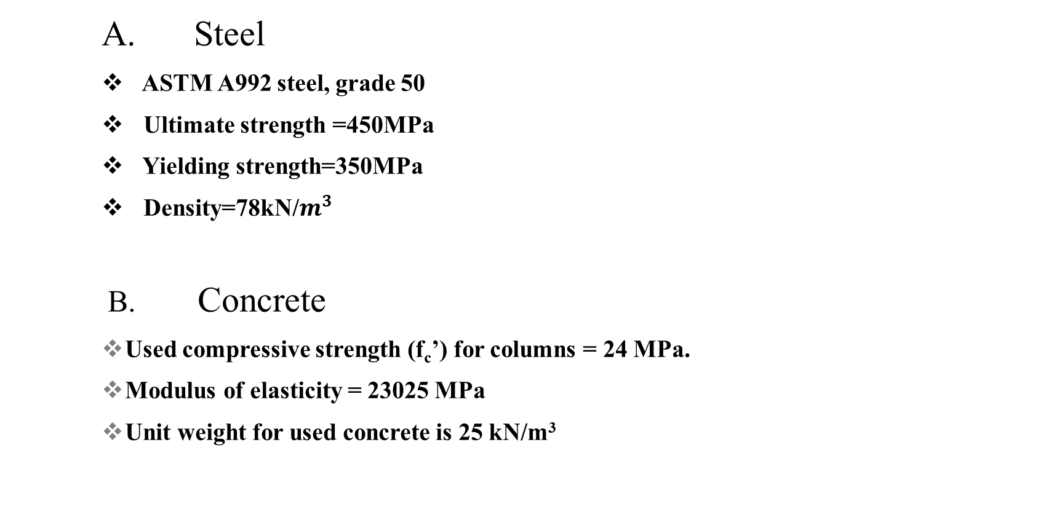
4. Structural Materials
    Steel
    ASTM A992 steel, grade 50
    Ultimate strength =450MPa
    Yielding strength=350MPa
    Density=78kN/$m^{3}$
    B. Concrete
    Used compressive strength (f_{c}’) for columns = 24 MPa.
    Modulus of elasticity = 23025 MPa
    Unit weight for used concrete is 25 kN/m³

Slide 11
B. Reinforcement steel
  Yielding Stress for used Steel is 420 MPa
  Modulus of Elasticity is 200,000 MPa
  Unit Weight (ɣ) is 77kN/m³

Slide 12
5. Programs
Sap2000 v.22
Autocad2019
Rivet
Word2013
excel2013

Slide 13
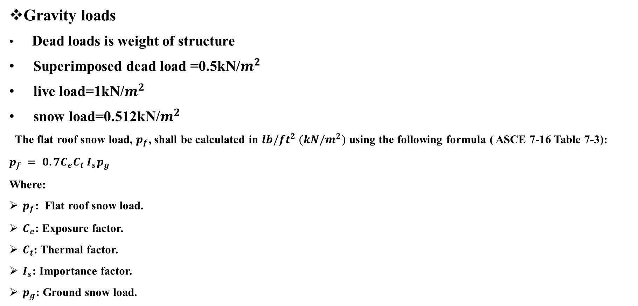
6. Loads
Gravity loads
      Dead loads is weight of structure
      Superimposed dead load =0.5kN/$m^{2}$
      live load=1kN/$m^{2}$
      snow load=0.512kN/$m^{2}$
The flat roof snow load, $p_{f}$, shall be calculated in $lb/{ft}^{2} (kN/m^{2})$ using the following formula ( ASCE 7-16 Table 7-3):
$p_{f} = 0.7C_{e}C_{t} I_{s}p_{g}$
Where:
$p_{f}$: Flat roof snow load.
$C_{e}$: Exposure factor.
$C_{t}$: Thermal factor.
$I_{s}$: Importance factor.
$p_{g}$: Ground snow load.

Slide 14
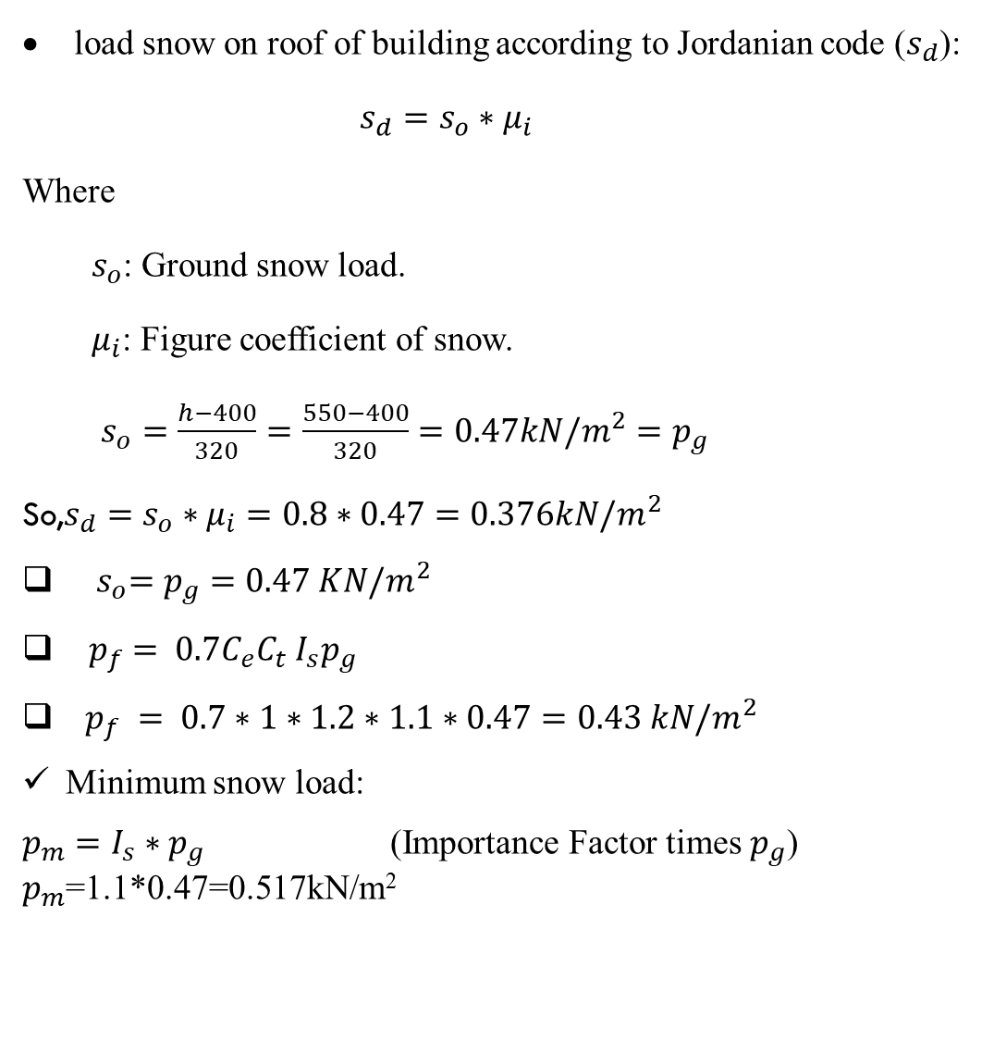
load snow on roof of building according to Jordanian code ($s_{d}$):
$$s_{d}=s_{o}∗μ_{i}$$
Where
$s_{o}$: Ground snow load.
$μ_{i}$: Figure coefficient of snow.
$s_{o}=\frac{h−400}{320}=\frac{550−400}{320}=0.47kN/m^{2}=p_{g}$
So,$s_{d}=s_{o}∗μ_{i}=0.8∗0.47=0.376kN/m^{2}$
${ s}_{o}=p_{g}=0.47 KN/m^{2}$
${ p}_{f} = 0.7C_{e}C_{t} I_{s}p_{g}$
$p_{f} = 0.7∗1∗1.2∗1.1∗0.47=0.43 kN/m^{2}$
Minimum snow load:
$p_{m}=I_{s}∗p_{g}$ (Importance Factor times${ p}_{g}$)
$p_{m}$=1.1*0.47=0.517kN/m²

Slide 15
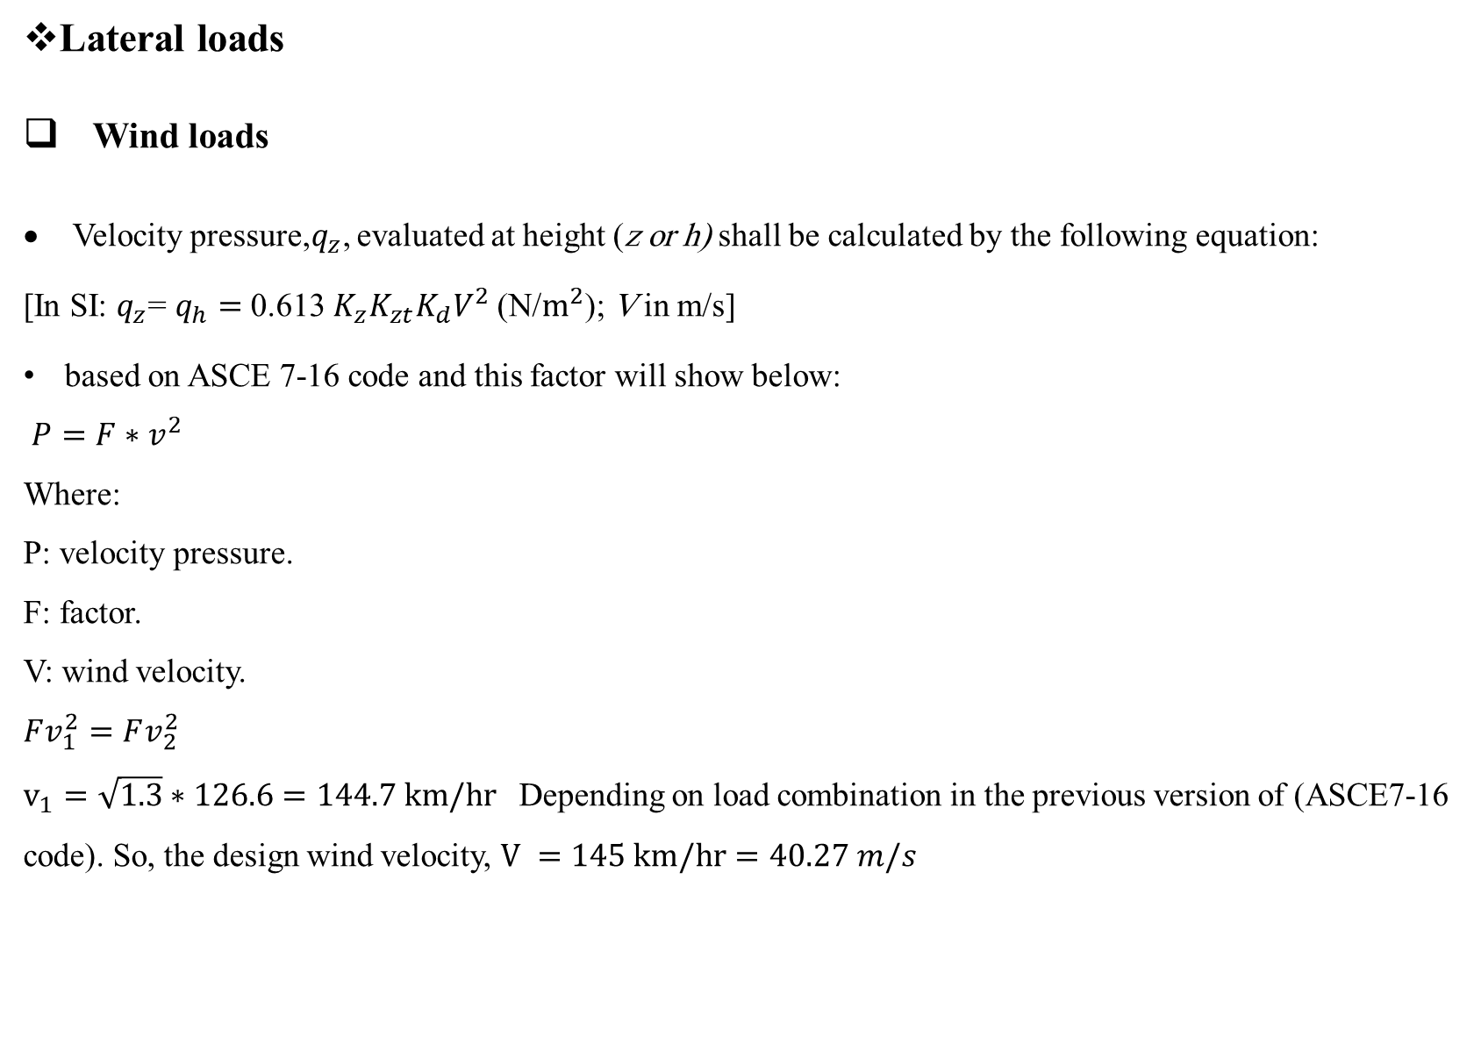
Lateral loads
      Wind loads
Velocity pressure,$q_{z}$, evaluated at height (z or h) shall be calculated by the following equation:
[In SI: $q_{z}$= $q_{h}=$ 0.613$K_{z}K_{zt}K_{d}V^{2}$ (N/$m^{2}$); V in m/s]
based on ASCE 7-16 code and this factor will show below:
$P=F∗v^{2}$
Where:
P: velocity pressure.
F: factor.
V: wind velocity.
$$Fv_{1}^{2}=Fv_{2}^{2}$$
$v_{1}=\sqrt{1.3}∗126.6=144.7 km/hr$ Depending on load combination in the previous version of (ASCE7-16 code). So, the design wind velocity, $V =145 km/hr$ $=40.27 m/s$

Slide 16
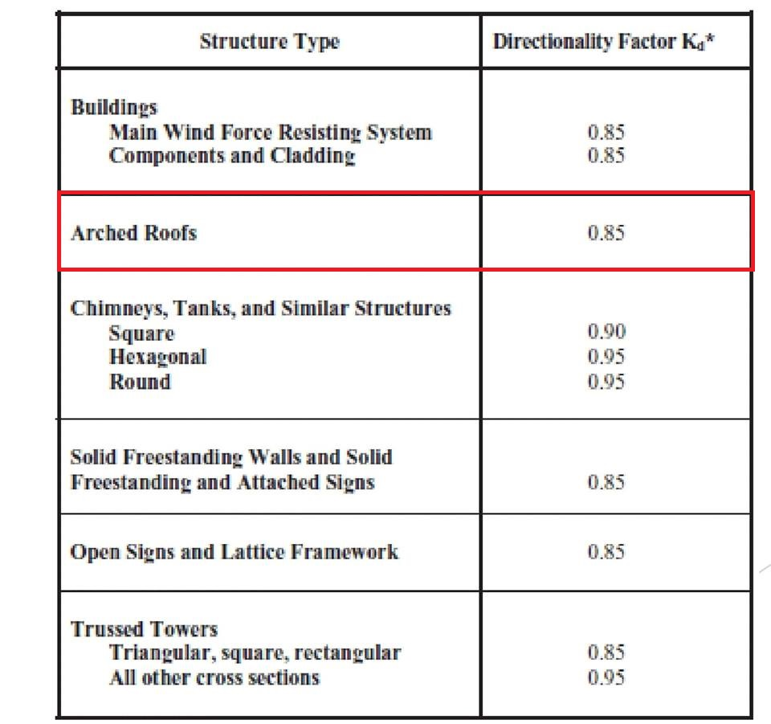
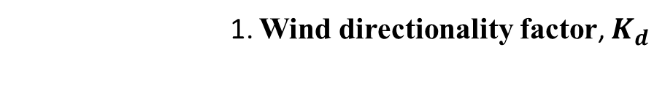
        1. Wind directionality factor, $K_{d}$
We assumed the direction of the wind on our structure as shown in the figure. The value of Kd is equal to 0.85 as shown in table (1.16) (ASCE 7-16 Table 26.6-1).

Slide 17
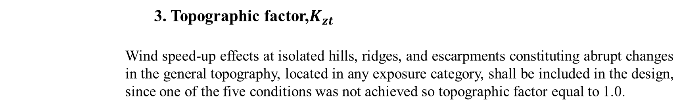
        2. Exposure category:
In this project the exposure category is C so, K_{z} =1.09
        3. Topographic factor,$K_{zt}$
        Wind speed-up effects at isolated hills, ridges, and escarpments constituting abrupt changes in the general topography, located in any exposure category, shall be included in the design, since one of the five conditions was not achieved so topographic factor equal to 1.0.
        4. Gust-effect factor:
This factor is depending on the type of building rigid or flexible, for this building the rigidity assumption will be considerable and the gust-effect factor for a rigid building or other structure is permitted to be taken as 0.85

Slide 18
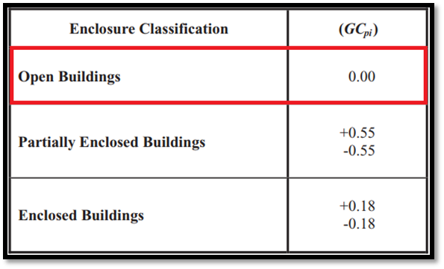
        5. Enclosure classification
For the purpose of determining internal pressure coefficients, all buildings shall be classified as enclosed, partially enclosed, or open in this project is open
        6. Internal pressure coefficient, ${GC}_{pi}$
Internal pressure coefficients, (GCpi), shall be determined based on building enclosure classifications the (GCpi)
is determined as shown in figure (ASCE 7-16 Table 26.11-1) below.

Slide 19
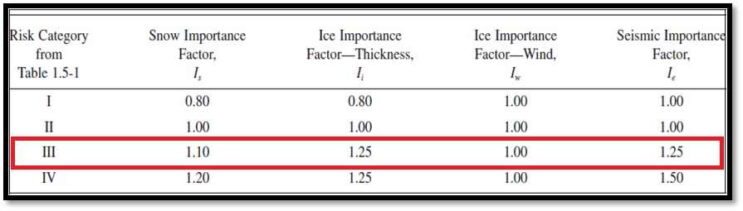

        7. Importance factor,${ I}_{w}$
The factor that related to the importance of building and from ASCE 7-16 (Table 1.5-2). As shown in figure below,
the value of the factor different from wind to snow to rain and is equal to 1 for wind effect.

Slide 20
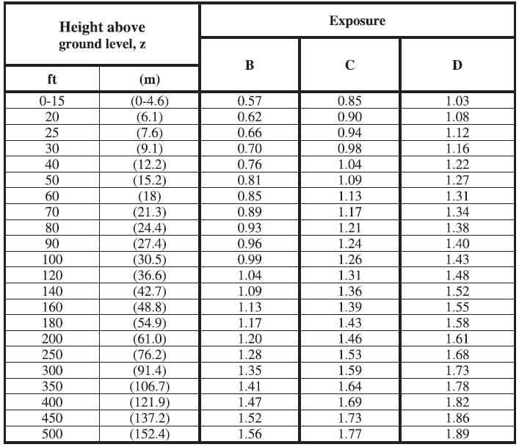
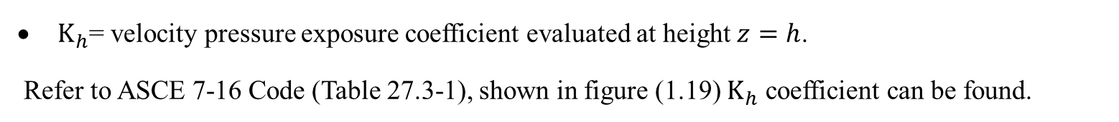
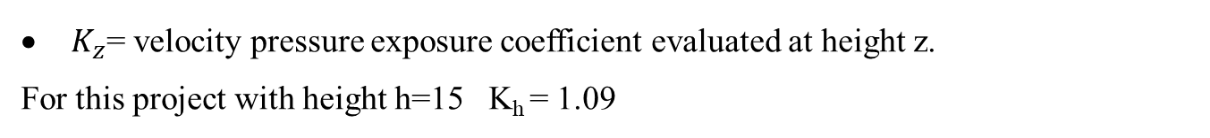
        8. Velocity pressure exposure Coefficient, $K_{z}$or $K_{h}$
$K_{h}$= velocity pressure exposure coefficient evaluated at height$z=h$.
Refer to ASCE 7-16 Code (Table 27.3-1), shown in figure (1.19) $K_{h}$ coefficient can be found.
$K_{z}$= velocity pressure exposure coefficient evaluated at height z.
For this project with height h=15 K_{h} = 1.09

Slide 21
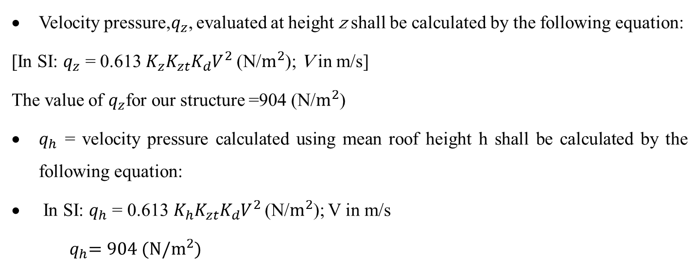
        9. Velocity pressure $q_{z }$or $q_{h}$:
Velocity pressure,$q_{z}$, evaluated at height z shall be calculated by the following equation:
[In SI: $q_{z}$ = 0.613$K_{z}K_{zt}K_{d}V^{2}$ (N/$m^{2}$); V in m/s]
The value of $q_{z}$for our structure =904 (N/$m^{2}$)
$q_{h}$ = velocity pressure calculated using mean roof height h shall be calculated by the following equation:
In SI: $q_{h}$ = 0.613$K_{h}K_{zt}K_{d}V^{2}$ (N/$m^{2}$); V in m/s
${ q}_{h}=904 (N/m^{2})$

Slide 22
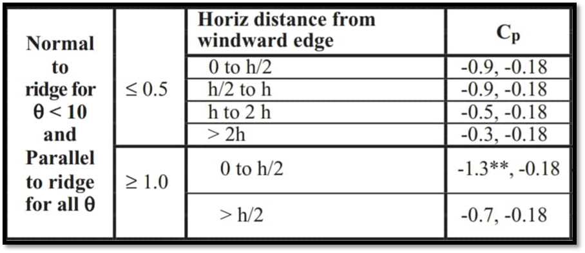
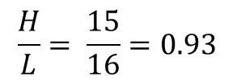
        10. Roof pressure coefficient, Cp:
This coefficient is deferent depend on the direction of wind and the surface expose to as shown in figure below
from ASCE 7-16 (Table 27.4-1).
$$\frac{H}{L}= \frac{15}{16}=0.93$$

Slide 23
pressure of wind applied to short direction
H (m) | Cp | P ( N/m²)
0 -7.5 | -0.9 , -0.18 | -691
7.5-15 | -0.9 , -0.18 | -691
15-16 | -0.5 , -0.18 | -384
pressure of wind applied to long direction
H (m) | Cp | P ( N/m²)
0 - 7.5 | -0.9 , -0.18 | -691
7.5 - 15 | -0.9 , -0.18 | -691
15 – 30 | -0.5 , -0.18 | -384
30 - 118 | -0.3 , -0.18 | -230
So we take P = 770 (N/m²), as a minimum for all value from ASCE7-16 code.

Slide 24
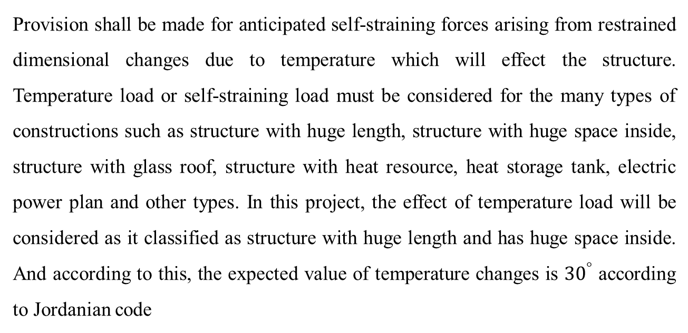
    Temperature load
Provision shall be made for anticipated self-straining forces arising from restrained dimensional changes due to temperature which will effect the structure. Temperature load or self-straining load must be considered for the many types of constructions such as structure with huge length, structure with huge space inside, structure with glass roof, structure with heat resource, heat storage tank, electric power plan and other types. In this project, the effect of temperature load will be considered as it classified as structure with huge length and has huge space inside. And according to this, the expected value of temperature changes is ${30}^{°}$ according to Jordanian code

Slide 25
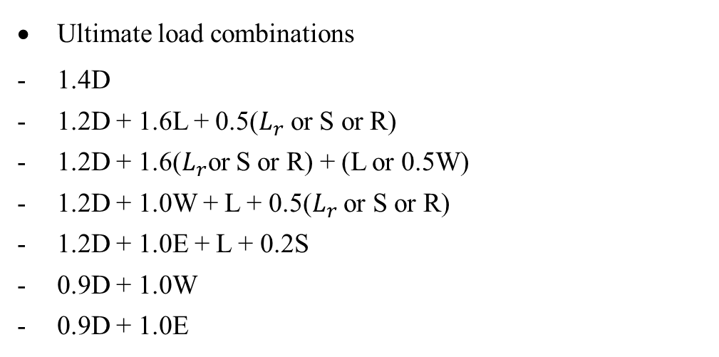
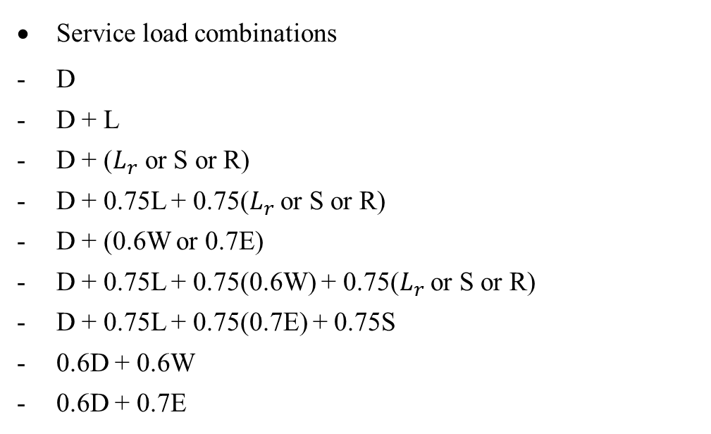
  7. Load combinations
Service load combinations
D
D + L
D + ($L_{r}$ or S or R)
D + 0.75L + 0.75($L_{r}$ or S or R)
D + (0.6W or 0.7E)
D + 0.75L + 0.75(0.6W) + 0.75($L_{r}$ or S or R)
D + 0.75L + 0.75(0.7E) + 0.75S
0.6D + 0.6W
0.6D + 0.7E
Ultimate load combinations
1.4D
1.2D + 1.6L + 0.5($L_{r}$ or S or R)
1.2D + 1.6($L_{r}$or S or R) + (L or 0.5W)
1.2D + 1.0W + L + 0.5($L_{r}$ or S or R)
1.2D + 1.0E + L + 0.2S
0.9D + 1.0W
0.9D + 1.0E
According to ASCE 7-16, as the temperature load will be included, the load factor for the temperature load in this project is considered to be (1).

Slide 26
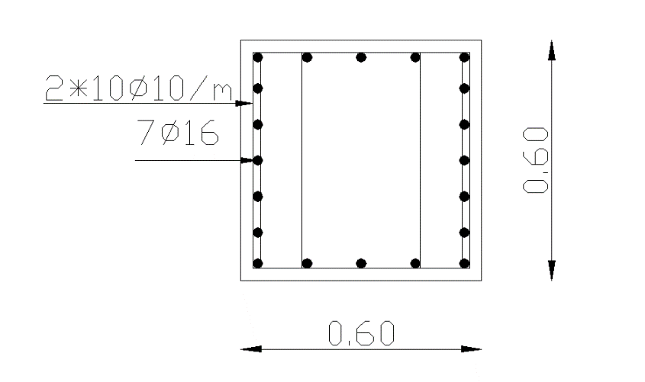
preliminary DESIGN, 3D modeling &analysis (EXPERIMENTAL)
Concrete column
There are a lot of pillars scattered around the perimeter of the stadium, which are similar to the cross section 60*60m, with different distances, most of which range around 6 m, some of which reach 12 m, and all of them have the same height 2.5m and their reinforcement is 20Ø16, as shown in the figure.

Slide 27
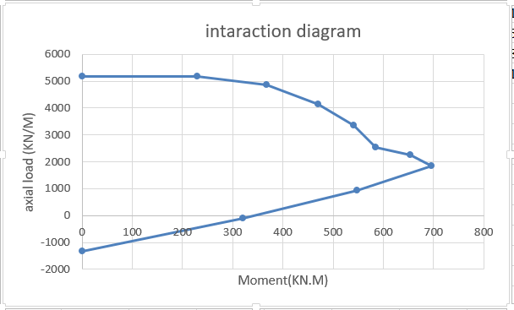
To find out the amount of the shaft bearing the axial force and moment together, we must find an interaction diagram in order to search for the appropriate structural design of this column in reality without resorting to changing the dimensions of the columns, and the interaction diagram for this column as shown in figure below (2.2).

Slide 28
First model
1- Preliminary Dimensions
This coverage with three span as a sample to study the behavior of the structure under the loads on it to reach preliminary results, Coverage is designed with a fixed slope 5% and straight element without curvature, take part of project with spacing between columns (6+5.6+6.4m), each truss supported with steel column consist of four I section member steel a 4m height placed above the column of concrete with 60*60m dimension and 2.5 height. Coverage length of 16 m with two meters extended back. Coverage start with the maximum vertical member height is (3m), and end with the minimum vertical member height (0.5 m).as shown in figure below.

Slide 29
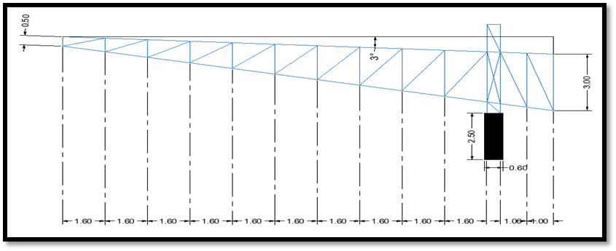
- It should be noted that the force resisting system was considered to be OMF (ordinary moment frame) in tow direction.

Slide 30
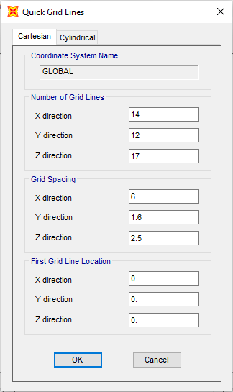
2- Three-Dimensional Modeling
The truss was designed using the computer program, SAP2000, where (14) gridlines used in the X-Direction, (12) gridlines used in the Y-Direction, and (17) gridlines used in theZ-Direction, as shown in figure (2.5).
The model was designed using metric units (i.e. Meters, Kilo Newton and Degrees Celsius).

Slide 31
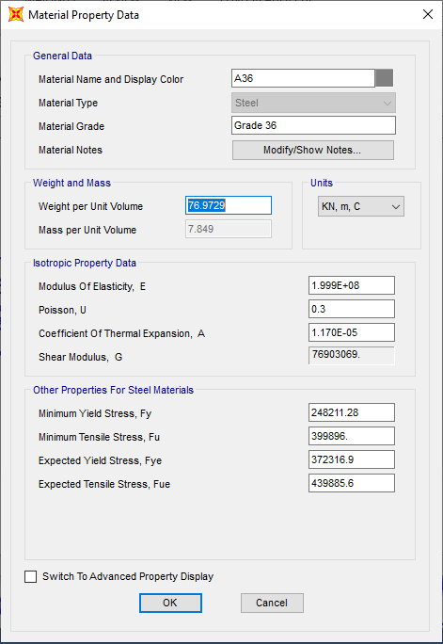
The material used for this model was, A36 steel, defined in SAP2000, as shown figure

Slide 32
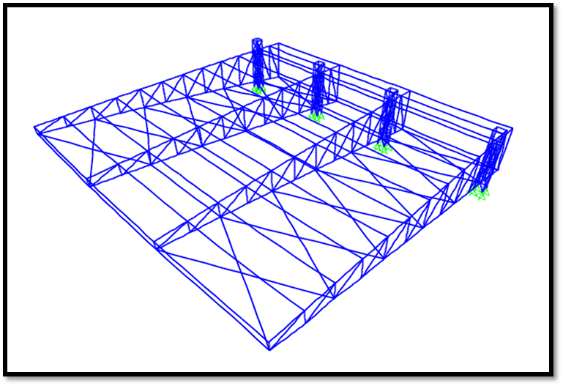
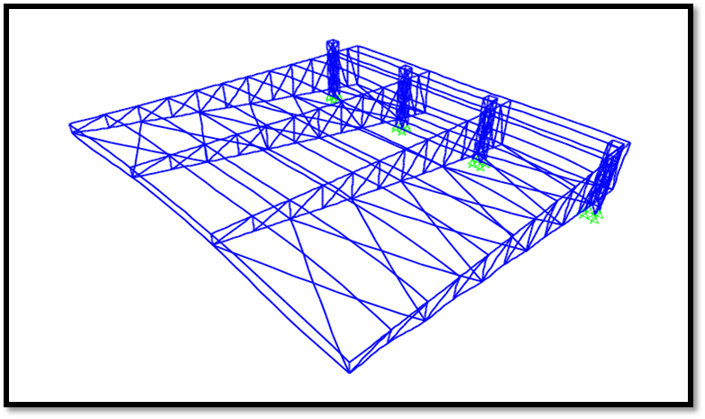
3- Verification of Structural Analysis
A- Compatibility Check
The truss moves as one unit, and thus, the check is passed.as shown in figures.

Slide 33
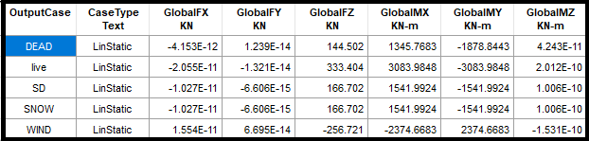
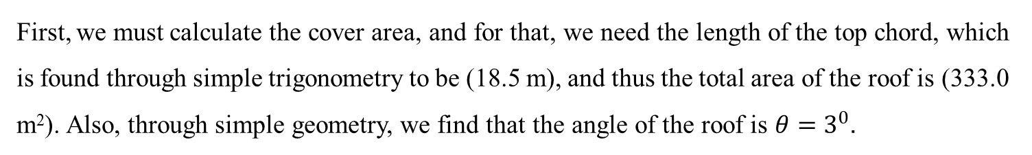
B- Equilibrium Check
First, we must calculate the cover area, and for that, we need the length of the top chord, which is found through simple trigonometry to be (18.5 m), and thus the total area of the roof is (333.0 m²). Also, through simple geometry, we find that the angle of the roof is $θ=3^{0}$.

Slide 35
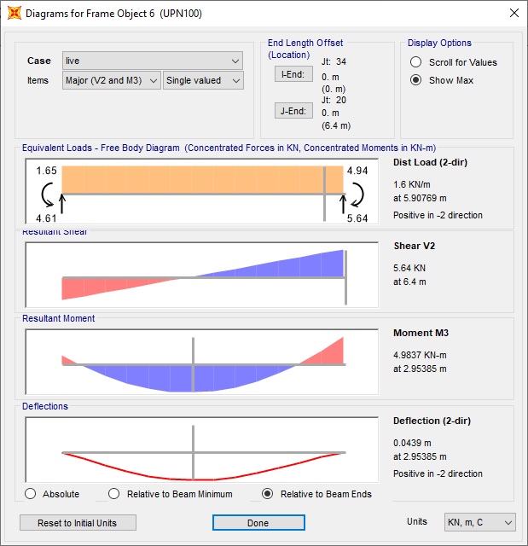
C- Verification of Internal Forces
For the purposes of this check, we will use the Live load only, the check will be done on the purlin member of the truss that lies on the gridline (X = 1.6 m), but before we start, we must calculate the distributed load transferred to each joint;
$w=LL ×{Area}_{Tributary}=1.0×1.6=1.6 kN$/m
This is true for all the member, except for the exterior ones which will only take 0.8 kN/m each.

Slide 36
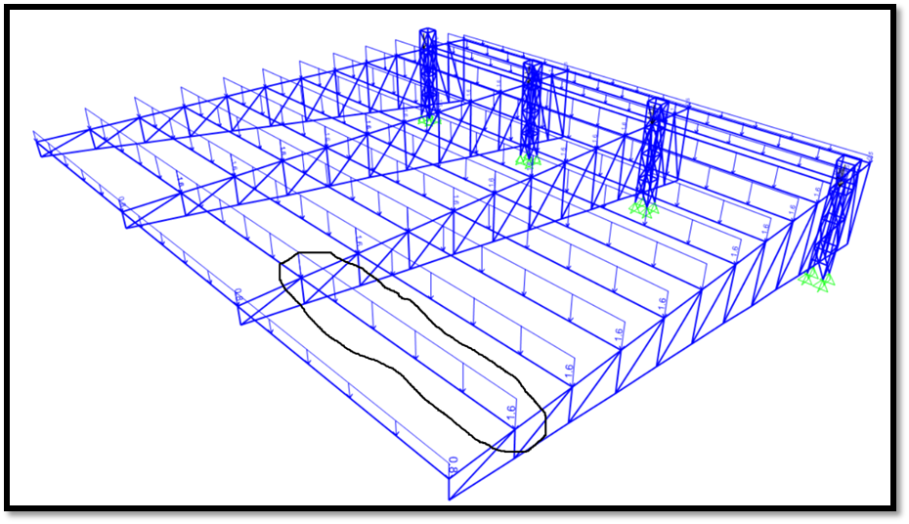
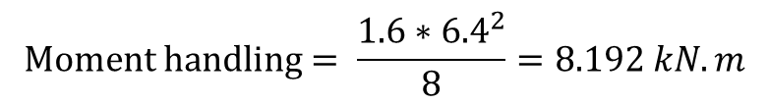
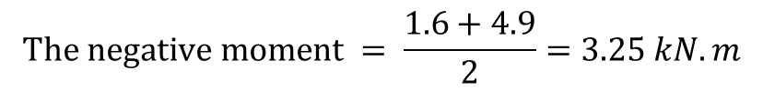

$$Moment handling= \frac{1.6∗{6.4}^{2}}{8}=8.192 kN.m$$
$$The positive moment = 4.98 kN.m$$
$$The negative moment = \frac{1.6+4.9}{2}=3.25 kN.m$$
The total moment from sap = 4.98 + 3.25 = 8.23 kN.m
$\% difference= \frac{8.192−8.23}{8.23}×100\%=0.46\% (acceptable$)

Slide 37
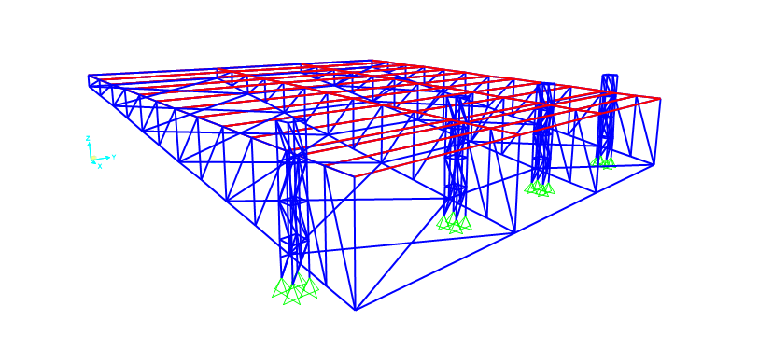
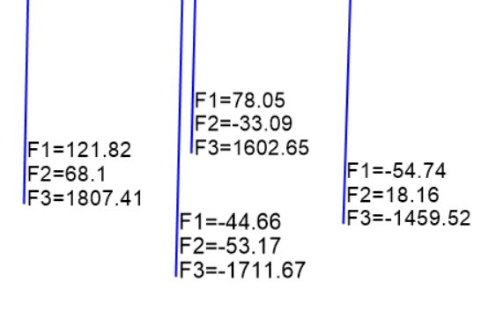

Slide 38

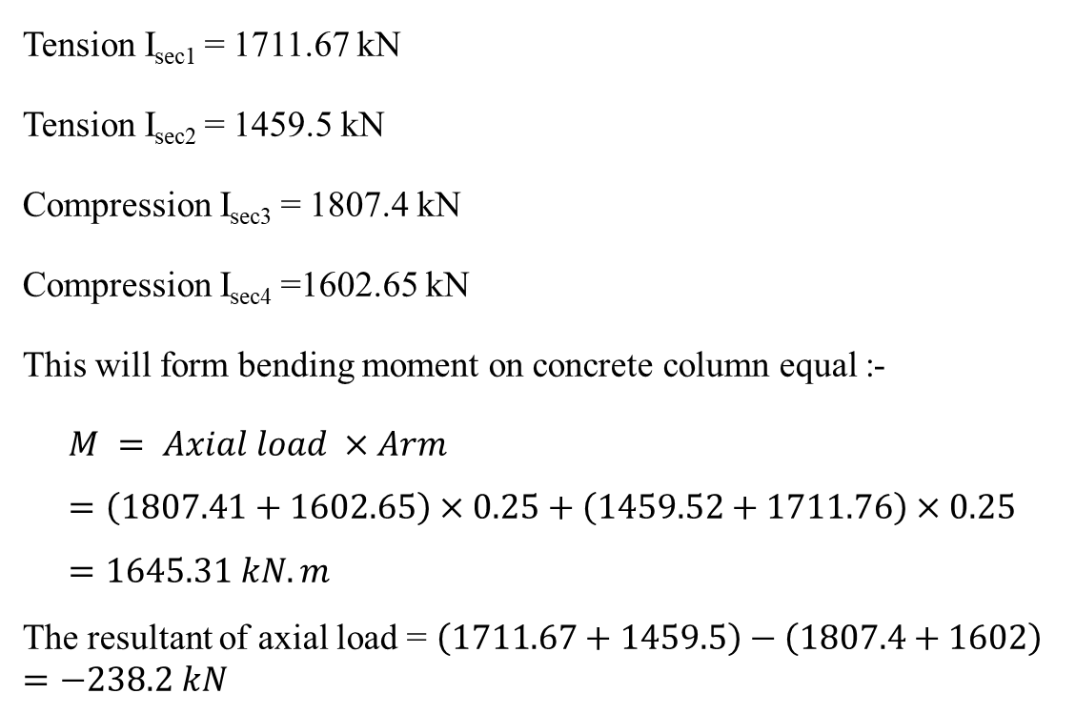
Tension I_{sec1} = 1711.67 kN
Tension I_{sec2} = 1459.5 kN
Compression I_{sec3} = 1807.4 kN
Compression I_{sec4} =1602.65 kN
This will form bending moment on concrete column equal :-
$$M = Axial load ×Arm=\left(1807.41+1602.65\right)×0.25+\left(1459.52+1711.76\right)×0.25=1645.31 kN.m$$
The resultant of axial load = $\left(1711.67+1459.5\right)−\left(1807.4+1602\right)=−238.2 kN$
$→$(compression load)

Slide 39
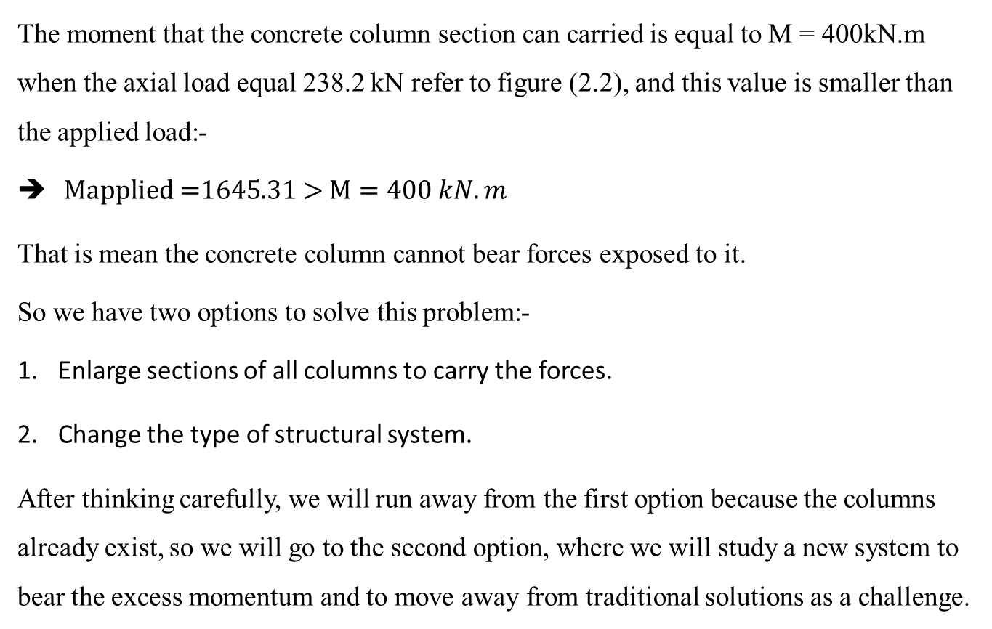
The moment that the concrete column section can carried is equal to M = 400kN.m when the axial load equal 238.2 kN refer to figure (2.2), and this value is smaller than the applied load:-
$\text{Mapplied}\text{ =}\text{1645.31 }\text{> }\text{M}=400 kN.m$
That is mean the concrete column cannot bear forces exposed to it.
So we have two options to solve this problem:-
Enlarge sections of all columns to carry the forces.
Change the type of structural system.
After thinking carefully, we will run away from the first option because the columns already exist, so we will go to the second option, where we will study a new system to bear the excess momentum and to move away from traditional solutions as a challenge.

Slide 40
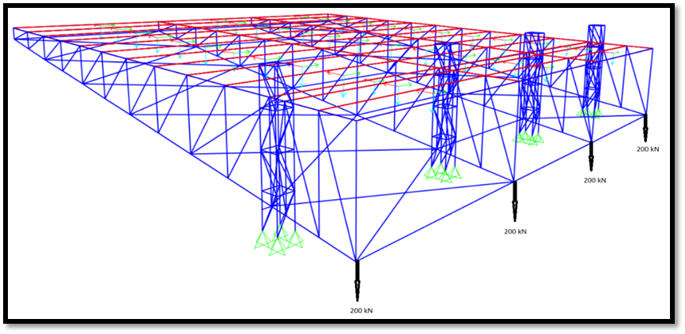
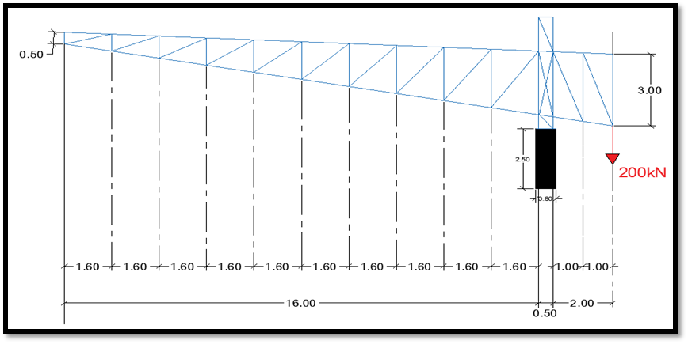
Second alternative model
An additional load of 200 kN has been added as point load to the back extension, to try to counteract the main Moment to reduce the result moment, but it must be taken into account that the added force constitutes a Moment that reflects only the Moment from dead loads and it is not possible to reflect the Moment coming from live loads due to load cases.

Slide 41
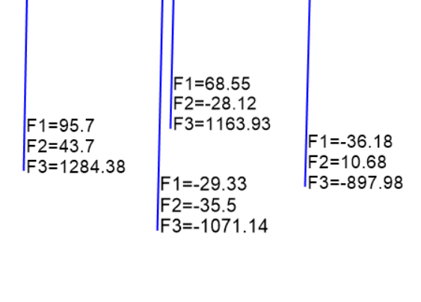
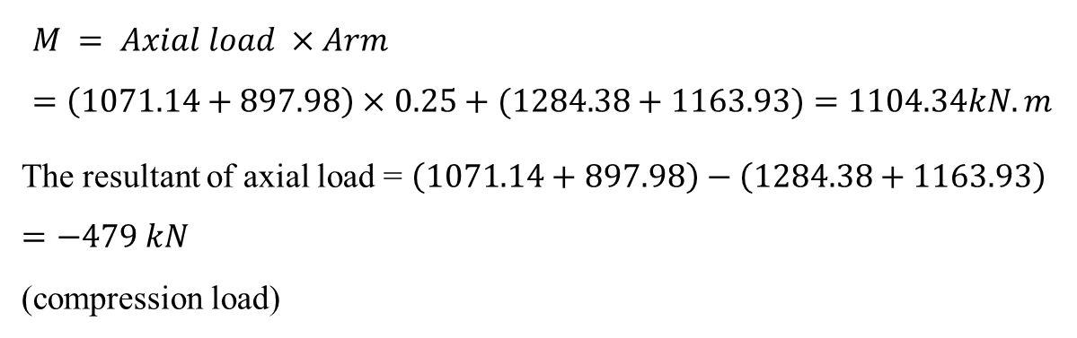
$$M = Axial load ×Arm=\left(1071.14+897.98\right)×0.25+(1284.38+1163.93)=1104.34kN.m$$
The resultant of axial load = $\left(1071.14+897.98\right)−\left(1284.38+1163.93\right)=−479 kN$
(compression load)

Slide 42
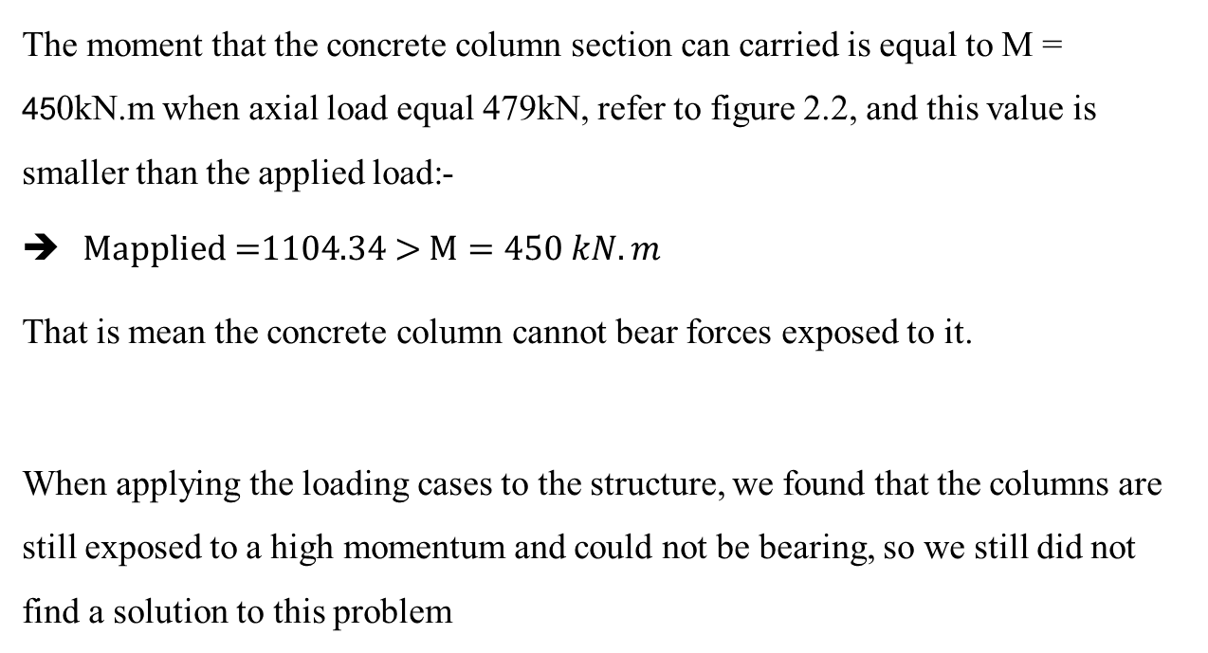
The moment that the concrete column section can carried is equal to M = 450kN.m when axial load equal 479kN, refer to figure 2.2, and this value is smaller than the applied load:-
$\text{Mapplied}\text{ =}\text{1104.34} \text{> }\text{M}=450 kN.m$
That is mean the concrete column cannot bear forces exposed to it.
When applying the loading cases to the structure, we found that the columns are still exposed to a high momentum and could not be bearing, so we still did not find a solution to this problem

Slide 43
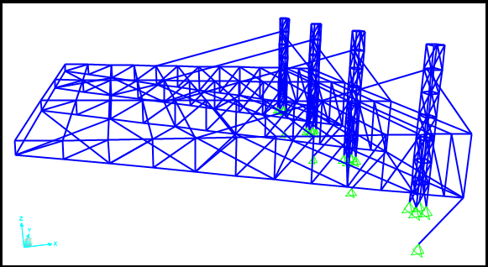
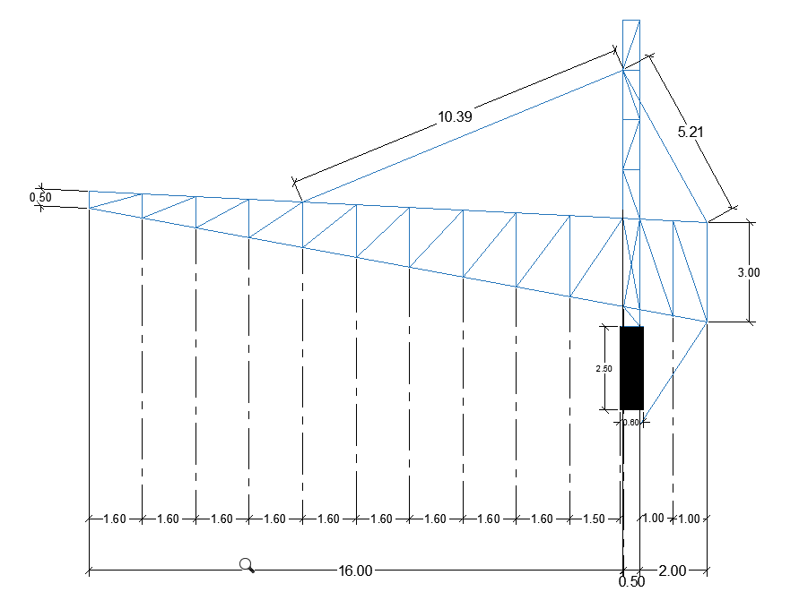
Third alternative model
Coverage is designed with cable to transmit tension load, with a 7m length of column steel that consist of four I section member steel a 4m height placed above the column of concrete with 60*60m dimension and 2.5 height and cables on the top of the truss that connect between the start of truss and top of column, and another cable in behind the truss to connect between the end of truss and the bottom of the concrete column. The structure shown in figures.

Slide 44
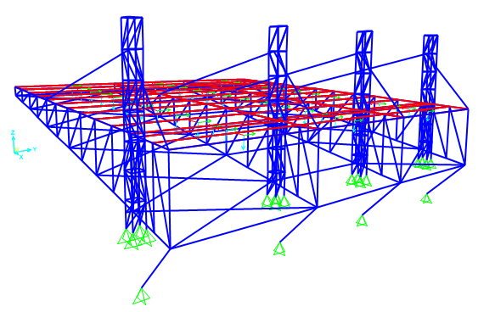
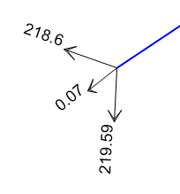
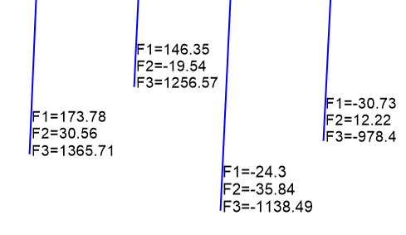


$$M = Axial load ×Arm=\left(1138.49+978.4\right)×0.25+\left(1365.71+1256.57\right)∗0.25=1184.79 kN.m$$
The resultant of axial load = $\left(1138.49+978.4\right)−\left(1365.71+1256.57\right)=−505.39 kN$
$→$(compression load)

Slide 45

The moment that the concrete column section can carried is equal to M = 450kN.m when the axial load equal 505.3 kN, refer to figure (2.2), and this value is smaller than the applied load:-
$\text{Mapplied}\text{ =}\text{1}\text{184}\text{.}\text{79} \text{> }\text{M}=450 kN.m$
That is mean the concrete column cannot bear forces exposed to it.
After we made this design, we found that it could not bear the moment, as it reduced the value of the moment a little, so it changed the position of the momentum effect on the column from place to another in the same column.
So, we will search for another solution to the problem of a moment.

Slide 46


Fourth alternative model
This coverage with circular steel column placed above the column of concrete while in this try modeled the column as a roller in Z-direction and spring in X&Y-direction, For consideration stiffness of column and the resulting deflection, The covering was attached to the slab by members from the back extension, to resist the tensile and compression forces, and then the structure would be stable. Three span as a sample to study the behavior of the structure under the loads on it to reach preliminary results.

Slide 47
















Stiffness of concrete column
$$f^{′}c=24 MPa$$
$$fy=420 MPa$$
$$h=2500mm$$
$$P=606 kN$$
$$M_{p}=PL=606×2.5=1515 kN.m$$
$Mcr=\frac{fr Ig}{Yt}$ $→$ $fr=0.62?\sqrt{f^{′}c}=3.03 MPa$
$$Mcr=\frac{3.037×1.08×{10}^{10}}{300}=109kN.m$$
$$3Mcr=328kN.m<Mp=1515kN.m$$
$$∴use Icr$$
$$600\left(x\right)\left(\frac{x}{2}\right)=n Ar \left(d−x\right)$$
$$△=4.1 cm$$
$$x=150mm$$
$$Icr=\frac{600x^{3}}{3}+n As (d−x)^{2}=3.33×{10}^{9}$$
$$∴K=\frac{P}{△}=\frac{606}{0.041}=14780.5 kN/m$$

Slide 48

After we designed this structure The results are as follows:
$φPn=5000 kN>1556 kN$ $→$ it’s ok in Axial
Shear capacity $φVn=350>346 kN$but There are a span of up to 12 meters So it cannot bear the shear forces exposed to it, and a deflection in the column reached 10 cm $∆=$ $\frac{L}{180}$= $\frac{2.5}{180}×100=1.388 cm ,$and at the end of the truss it reached 60 cm $≫\frac{L}{180}=\frac{16}{180}×=8.89 cm$, so the serviceability is not ok. Hence , this design is not successful
This design is as close as possible to the correct design but still needs to be adjusted, so we will add a steel plate to increase a capacity of column.

Slide 49
preliminary DESIGN, 3D modeling &analysis (FINALITY)
Eastern Coverage
Here we reached the final design, where we implemented the full coverage of the eastern side, not part of it like in previous models. We chose to have the arch cover in order to give an aesthetic appearance, as it is better to transfer the loads in this path and enable us to reduce the dimensions of the parts used. Also at the entrance there is a cover between two columns 12 meters away and it is designed with a curve on both direction (X&Y) axis.
There are also some expansion joints present at the stadium, which led to the division of coverage into three parts.
A steel plate was added to the column to be designed as a composite column, and cables were added to reduce deflection.

Slide 50

A- Preliminary dimension
Coverage is designed with a radius of 134.5m, and angle of 9⁰ for top curve, radius of 120 m, and angle of 16⁰ for bottom curved. Spans length between columns range (5-7) m, and there is a span with 12 m length at main entrance. Each truss supported with square steel column a 5.5m height placed above the composite column with (62*60) cm dimension as shown in figure (1), and 2.5 height. Coverage length of 16 m in addition 2 m extended back. Coverage start with the maximum vertical member height is (2.78m), and reach to (0.5 m) at end of truss.as shown in figures (2 to 6).
Figure (1)

Slide 51


Figure (2) : 3D view
Figure (3) : two truss at entrance

Slide 52


Figure (2) : truss for middle block
Figure (2) : truss for other block

Slide 53


Slide 54

B- Three-Dimensional Modeling
The truss was designed using the computer program, SAP2000, where (19) gridlines used in the X-Direction, (13) gridlines used in the Y-Direction, and (20) gridlines used in the Z-Direction. As shown in figure.

Slide 55

The model was designed using metric units (i.e. Meters, Kilo Newton and Degrees Celsius).
An area, defined as “none”, has been used to apply wind loads on the truss.
The material used for this model was, A992Gr50 steel, defined in SAP2000, as shown in figure.

Slide 56


C- Verification of Structural Analysis
1- Compatibility Check
The truss moves as one unit, and thus, the check is passed

Slide 57

2- Equilibrium Check
First, we must calculate the projection cover area, and for that, we need the projection length of the top chord, which is found through simple trigonometry to be (18.00 m),and the total length of spans is ( 96.94 m), and thus the total projection area of the roof is (1744.92 m²).

Slide 59


3- Verification of Internal Forces
For the purposes of this check, we will use the Live load only, the check will be done on the purlin member of the truss that lies on the gridline (X = 1.6 m), but before we start, we must calculate the distributed load transferred to each joint;
$w=LL ×{Area}_{Tributary}=1.0×1.6=1.6 kN$/m
This is true for all the member, except for the exterior ones which will only take 0.8 kN/m each

Slide 60




$$Moment handling= \frac{1.6∗{6.4}^{2}}{8}=8.192 kN.m$$
$$The positive moment = 3.72 kN.m$$
$$The negative moment = \frac{3.4+5.61}{2}=4.5 kN.m$$
The total moment from sap = 3.72 + 4.5 = 8.22 kN.m
$$\% difference= \frac{8.192−8.22}{8.22}×100\%=0.34\% (acceptable)$$

Slide 61
Western coverage
Here we reached the final design, where we implemented the full coverage of the western side, not part of it like in previous models. We chose to have the arch cover in order to give an aesthetic appearance, as it is better to transfer the loads in this path and enable us to reduce the dimensions of the parts used.
On the western side there is a suspension room in the middle, dividing the coverage into two parts. Misalignment of Some columns reach to 2 m.
There are also some expansion joints present at the stadium, which led to the division of coverage into five parts.
A steel plate was added to the column to be designed as a composite column, and cables were added to reduce deflection

Slide 62
A- Preliminary dimension
Coverage is designed with a radius of 134.5m and angle of 9⁰ for top carve, and radius of 120 m and angle of 16⁰ for bottom carved, Spans length between columns range (5-7) m, each truss supported with square steel column height rang is about (5.2-5.8) m placed above the composite column with (60*62) m, as shown in figure(1), Except for two of expansion joints there concrete column with (40*62) m dimension as shown in figure (2), and 2.5 height. Coverage length of 16 m in addition 2 m extended back. Coverage start with the maximum vertical member height is (3.1m), and reach to (0.5 m) at end of truss.as shown in figures (3 to 6).

Slide 63


Figure(1) : section of composite column (60*62) in Section designer from sap2000
Figure(2) : section of composite column (40*62) in Section designer from sap2000

Slide 64


Figure(3) : 3D view of structure from sap
Figure(4) : side view for the lift side of coverage with original column center

Slide 65


Figure(5) : side view of the 1.2 m offsite
Figure(6) : side view of the 2.26 m offsite.

Slide 66

The materials used for this model was, A992 Grade 50 steel, as shown figure (1), and A416Gr270 for cable, as shown in figure (2), definition in SAP2000.
figure (1)
figure (2)

Slide 67




B- Verification of Internal Forces
For purlin :
$$Moment handling= \frac{1.6∗{6.5}^{2}}{8}=8.45 kN.m$$
$$The positive moment = 5.46 kN.m$$
$$The negative moment = \frac{7.6+0}{2}=3.8 kN.m$$
The total moment from sap = 3.8 + 5.46 = 9.22 kN.m
$$\% difference= \frac{8.45−9.22}{9.22}×100\%=8.3 \% (acceptable)$$

Slide 68


For Bottom chord :
The axial force form sap2000 as shown in figure (1) & (2).
figure (1) : Diagrams for selected bottom chord
figure (1) : Axial force of bottom chord

Slide 69




The load from handled calculated.
$$ΣM_{A}=0$$
$$2.6×1.6−F\left(0.68\right)=0$$
$$F=\frac{2.6×1.6}{0.68}=6.11 kN$$
$$\% difference= \frac{6.11−6.79}{6.79}×100\%=9.9 \% (acceptable)$$

Slide 70

Structural Design
1- Eastern coverage
A- design preference
For the steel design preference menu, the code AISC360-16 is chosen and the framing type is OMF as shown in figure (4.1)

Slide 71

B- Design Group
The design groups were inserted into SAP2000 as shown below in figure.

Slide 72


C- Design load combination
The strength and serviceability load combinations are shown in figures.

Slide 73

D- The Period Check
The period design targets were set and deactivated until the design was finished, as shown in figure.
The period from sap for our truss was 0.46 s we think it`s ok.

Slide 74

E- The deflection check
The limitation for cantilever truss is L/150 refer to AISC360-16 as shown in figure.

Slide 75

The deflection from sap as shown below;
L/150 = 16/150 = 10.6cm
Δ (D+SD) = 13cm
Δ (L) = 11cm
Δ (D+SD+L) = 24cm > 10.6cm so it is not ok

Slide 76

As our design headed into all of its test iterations, the main problem that we faced was the deflection for the truss; we couldn’t get it to be less than (10.6 cm), this was later fixed in the final design through:-
Choosing a larger section for columns and top chord members, which in hindsight, should’ve been obvious, because the larger that section is, the larger the stiffness for the structure will be.
Cables were added as it pulls the truss upwards, which reduces the deflection.
The material used in the elements of the truss has been changed from A36 steel to A572 Grade50 steel, Where the properties of the material stronger.
We recommend that upon implementation, the steel should be installed so that it is tilted up by 13 cm to reflect the deflection of dead and super loads.
$∴$ Δ (L) =11cm $≈10.6$ (acceptable).

Slide 77




F- The capacity check
A sample design is made on one of the members of the top chord which is shown in figure ;
the axial load on the member is, P_{u} = 521.62 kN
$$∴A_{g}= \frac{P_{u}}{0.9 f_{y}}= \frac{521.62 ×{10}^{3}}{0.9 ×344}=1684.8 mm^{2}$$
But, the section used is TUBE-D219.1x5, which has a total area of, A_{g} = 0.003 m²
$$∴\frac{Demand }{Capacity}= \frac{1684.8 ×{10}^{−6}}{0.003}=0.561$$
$$\% difference= \frac{0.561−0.573}{0.573}=2.1\% (acceptable)$$

Slide 78

G- The final section

Slide 79
Group | Section Type | Section Dimension ( mm )
Bottom Chord | Tube | D 273 * 5.6
XY Bracing | Tube | 90 * 90 * 10
Top Chord | Tube | D 219.1 * 5
Diagonal Member | Tube | D 88.9 * 3.2
Purlins Special purlins | C section Tube | UPN 180* 180 * 90 *8
Vertical Member | Tube | D 114.3 * 3.6
Tension Member | Tube | D 273 * 5.6
Steel Column | Tube | 400 * 400 * 40
Composite Column | Column | 600 * 600
 | plate | 600 * 20
Bottom Entrance | Tube | D 76.1 * 3.2
Top Entrance | Tube | D 76.1 * 3.2
Diagonal Entrance | Tube | D 76.1 * 3.2
Vertical Entrance | Tube | D 76.1 * 3.2
Cable | Cable 5strand (Grade 270) | 5 * 140 = 700 mm
Back Member | Tube | D 298.5 * 5.9

Slide 80

2- Western coverage
The final section

Slide 81
Group | Section Tybe | Section Dimension
Bottom Chord | Tube | D 193.7 * 4.5
Back Member | Tube | D 244.5*5.4
XY Bracing | Tube | 90*90*10
Top Chord | Tube | D 139.7 * 4
Diagonal Member | Tube | D 76.1*3.2
Tension Member | Tube | D 244.5*5.4
Purlins | C section | UPN 180*
Vertical Member | Tube | D 114.3*3.6
Cable | Cable 5strand (Grade 270) | 5 * 140 = 700 mm
Column | Tube | 400*400*40

Slide 82
Some photo from Revit & adjustment lumion.

Slide 83


Slide 84


Slide 85


Slide 86


Slide 87


Slide 88


Slide 89



Analysis and design of connection
1- Design composite column and connected with steel column
The steel column shifted back to the edge of the concrete column. In addition, it designed as a single piece, with an extension from the back up to the slab in length 2.5 m.
Check shear for connection just for plate of steel :-
$φR_{n}=φ\left(0.6×F_{u}×A_{u}\right)$
$=0.75×\left(0.6×450×40×400\right)$
$=3240kN>700 kN$
So no needed to calculate bars shear capacity.

Slide 90






Check capacity of composite column :-
Where
$f_{c}^{′}=24Mpa$
${ E}_{s}=200000 Mpa$
$${ E}_{c}=4700×\sqrt{f_{c}^{′}}=23025.2 Mpa$$
$When n=\frac{E_{s}}{E_{c}}=8.68$
Width of steel is $=40×8.68=3472 mm$
$$y^{−}=\frac{\sum{y}A}{\sum{A}}=389.08 mm$$
$$I_{xx}=\frac{1}{12}bh^{3}+Ad^{2}=I_{steel}+I_{concrete}$$
$$=2.108×{10}^{10}mm^{4}$$

Slide 91








Maximum stress =$−\frac{P}{A}+\frac{−MC}{I_{xx}}$
Where
P=axial force in ($N$)
A=cross section of the member in $({mm}^{2}$)
M=bending moment on the section in ($N.mm$)
${ I}_{xx}$=moment of inertia for section in (${mm}^{4}$)
$$σ_{max→conc}=\frac{− 1520×{10}^{3}}{\left.\left(600×600\right)+(40×347\right)}+\left(\frac{− 700×{10}^{6}×3899}{2.1×{10}^{10}}\right)$$
$$=−3.04−12.97=−16.017 Mpa$$
$$16.017 Mpa < ∅×f_{c}^{′}=0.85×24=20.4 Mpa→ ∴ ok$$
$$σ_{max→steel }$$
$$=−3.04+\frac{700×{10}^{6}×251}{2.1×{10}^{10}}=−3.04+8.37=5.64 Mpa$$
$$σ_{max→steel }$$
$$=σ_{max}×n=5.64×8.68=59 Mpa<0.9×350=315Mpa ∴ it^{′}s ok$$

Slide 92





Number of bolts needed in plate from sudden change of stresses(lag shear)
$$f_{nv(in plate) }=\frac{σ×A}{1000}=\frac{59×400×40}{1000}=944 kN$$
Where
${ f}_{nv(in plate) }$= axial load in steel plate /shear lag (kN)
$σ$= average stress in steel plate section (Mpa)
A= cross section of steel plate (${mm}^{2}$ )
Refer to next figure from AISC Code
$use bolt M20 GroupA (A325)$,
Normal shear strength $=372 Mpa$.
$$F_{nv}=A_{bolt}×f_{nv}=\frac{π}{4}×d^{2}×372=116.8 kN → for one bolt$$
Where
${ F}_{nv}$= shear force capacity of bolt

Slide 93


To calculate # of bolts
$$\# of bolts=\frac{944}{0.75×116.8}=11 bolt at least to carying shear lag$$
Use 12 bolt to restriction load by slab.
Using 24 bolt Group A A(307) to distributed on column to distribute the stresses evenly in column and to behavior as one unit as shown in figure below.

Slide 94





Check tension for back plate
$$F_{nt}=0.75×A_{n}×f_{u}$$
$$where$$
$F_{nt}$ = nominal net tension capacity of plate.
${ F}_{nt} =0.75×\left(\left(40×400\right)−3×\frac{π}{4}×{25}^{2}\right)×448$
$=4881 kN>944 kN$ From previous calculation. $∴$It’s ok.
Check bearing for back plate
$$φR_{n}=0.75×2.4×\left( t d_{s} f_{u} \right)$$
Where
$φR_{n}$= nominal bearing capacity of plate.
t = thickens of plate.
$d_{s}$= diameter of bolt
$φR_{n}=0.75×2.4×\left(40×20×448\right)$
$=645kN>\frac{944}{12}=78 kN∴it^{′}ok$

Slide 95


Check tearing for back plate
$$φR_{n}=0.75×1.2×\left(t×l_{c}×f_{u}\right)$$
Where
$φR_{n}$= nominal tearing capacity of platy
$l_{c}$ = the clear distance in the load direction, from the edge of the bolt hole to the edge . of the adjacent hole or to the edge of the material
t = thickens of plate.
$$φR_{n}=0.75×1.2×\left(150×20×440\right)=1209 kN>\frac{994}{12}=78 kN∴it^{′}s ok$$
When
$l_{c}min<l_{c} <l_{c}max$
Where
$l_{c} min=1.67d_b=33.4mm$
${ l}_{c}$max= the minimum of $→or \begin{matrix}300mm \\ 24t=24×40=960mm\end{matrix}$

Slide 96

Note the distance between bolts and edge plate it is suitable for requirement AISC Code as shown in figure below.

Slide 97



Check base plate on concrete column
To calculate the force in bolts
$M_{center of steel column}=700−R×0.37=0$
$$700kN.m=R×0.37$$
$$R=1891.9 kN$$
$$M_{plate}=R×0.15m=1891.9×0.15=283.7 kN.m$$
This is a moment applying on plate.
Design for plate
$$=\frac{bh^{3}}{4}=\frac{\left(600×{80}^{2}\right)}{4}=96×{10}^{4}mm^{3}$$
$$M_{p}=φ×Z×f_{y}=0.9×96×{10}^{4}×350Mpa$$
$$302.2 kN.m>M_{plate}=283.7kN.m$$
$$∴ use plate with depth 80mm$$
$$∴ use a minimum of weld size \left(a_{min}=5mm\right)$$
$$between base plate\&steel column because it^{′}s exposed to compression force$$

Slide 98

Case two to design this connection with another load combination (0.9D + 1.0W).
The results load from this combination as shown in figure 5.10, are very small and not revers to other direction, so the previous design is very good and suitable. For reverse forces, we are satisfied with the use of the existing steel bars as bolts to resist the tension obtained, if any, which has a maximum capacity moment up to 450 kN.m.as shown in figure 2.2, in chapter two (interaction diagram).

Slide 99

2- Connection between truss and steel column
This joint designed to connect both the top member of the truss and the diagonal member with the steel column, from the front and back sides of the column. It is should be noted the govern load combination in this connection is 1.2D+1.6L+0.5W with loads as shown in figure below.

Slide 100


    1- Connection between top chord & column.
Weld
Assume a = 5 mm , $F_{E80}$
$$parameter=2πR=2×π×\frac{219}{2}=688 mm$$
$$A_{weld}=688×5 mm=3440 mm^{2}$$
$$capacity of weld={φ×f_{uv}×A}_{weld }$$
$$=0.75×\left(0.6×80×7\right)×3440×0.707$$
$$=612.85 kN>450 kN ∴ its ok$$
When
$a_{min}≤a≤a_{max}$
Where
$${ a}_{min}=3mm$$
$${ a}_{max}=t=5$$

Slide 101


It is should be noted the limits of weld size (a) coming from recommendation of AISC 7-16 code as shown in figure below.
Note: we used four stiffeners about the section with diminutions 90*90*10mm and same weld size to be the capacity of the connection more than the capacity of the member.

Slide 102



Bolts
Use M20 , n = 4 , Group A325 , tensile stress ($f_{ut})$ = 620 Mpa,
By refer to table J 3.2 AISC in figure 5.6
$$capacity of bolts={φ×n×f_{ut}×A}_{bolt}=4×0.9×620×\frac{π}{4}×{20}^{2}$$
$=701 kN>450 kN ∴ it^{′}s ok$
Plate
$$Moment for 1 bolt=\frac{450 kN×40.7 mm}{4}=4.57 kN.m$$
$$this very small value$$

Slide 103

Capacity shear of plate
Use 10mm thickness
One bolt have $=\frac{450}{4}=112.5 kN$
$$Parameter=2πR_{holes}=2×3.14×12.5=78.5 mm$$
$$Area shear =Parameter×t=78.5×10=785 mm^{2}$$
$$capacity={φ×f_{uv}×A}_{shear}=785×0.75×0.6×448 Mpa$$
$$=158.2 kN>112.5∴ it^{′}s ok$$
Note: this connection it’s designed to be suitable for three types with difference in dimensions, which are 1- Connection between front top chord & column 2- Connection between back top chord & column 3- Connection between back diagonal & column.

Slide 104



    2- Connection between diagonal & column.
Weld
$$parameter of weld=2πR=2×π×\frac{88.9}{2}=279.29 mm$$
$$A_{weld}=279.29×3 mm=837.87 mm^{2}$$
$$capacity of weld={φ×f_{uv}×A}_{shear}$$
$=0.75×\left(0.6×80×7\right)×837.87×0.707$
$=149.2 kN>72 kN ∴ it^{′}s ok$
Bolt
Use M16 , n = 4 , Group A307 , tensile stress ($f_{ut})$ = 310 Mpa
$$capacity={φ×n×f_{ut}×A}_{bolt}$$
$$=4×0.75×310×\frac{π}{4}×{16}^{2}$$
$=186 kN>72 kN∴it^{′}s ok$
Plate
Use same thickness (10mm) plate for top chord with column

Slide 105


3- Connection of diagonal member with bottom &top chord.
The design contains two types of diagonal elements, one in the front area and the other in the back, and the design of each of them differs according to the loads on it.
Front diagonal
Maximum tension axial force (T) from sap for diagonal is = 72 kN & for compression was 67kN but it is ignored and used the same connection of tension member to be more conservative.
Assume thickness of welding t = 3 mm, it is ok according (Table J2.4) from AISC
$$a_{min}≤a≤a_{max}$$

Slide 106

$$Area of welding=t×2πR=3×2×3.14×\left(\frac{88.9}{2}\right)=837.4mm^{2}$$
$$f_{nv}=\frac{{φ×f_{uv}×A}_{weld }}{1000}$$
$$=\frac{0.75×\left(0.6×80×7\right)×0.707×837.4}{1000}$$
$$=149 kN>72kN\left(diagonal\right)$$
So, it’s ok for tension member.

Slide 107


Back diagonal
Where
L = 250 mm
a = 5 mm
When
$$L_{min}=4a≤l≤l_{max}=100a$$
$$f_{nv(of weld)}=\frac{{φ×f_{uv}×A}_{shear}}{1000}=\frac{0.75×\left(0.6×80×7\right)×\left(5×0.707×4×250\right)}{1000}$$
$$=890.8kN>719kN=maximxm tention from sap$$
$$φR_{for member }=\frac{φ×0.6×Fu×A_{area of connected member}}{1000}$$
$$=\frac{0.75×0.6×448×4×250×5.9}{1000}=1295.6kN>719kN$$
$so,used plate with thickness=20mm^{2}>thickness of member =5.9mm^{2}∴$It will be ok.

Slide 108


4- Connection for cable
In the design of the cables, steel pieces were welded with a hole corresponding to the diameter of the used cable (29.9mm) on both the steel column and the upper part of the top member in the front and back sides, and then the cable was passed through it and fixed.
Maximum Force in cable from sap is = 273 kN
The diameter of cable = 29.9 mm
$$Area of cable =\frac{{29.9}^{2}×3.14}{4}=700 mm$$

Slide 109


The diameter of holes is 60 mm
Length of plate is =250mm / thickness = 20mm
$Area of plate=250×20mm=5000 mm^{2}$
$$A_{net}=\left(250−60\right)×\left(20\right)=4400 mm^{2}$$
$$F_{nt}=0.9×A_{n}×f_{u}=0.9×\frac{4400×448}{1000}$$
$=1774 kN>273kN∴ok$
For weld
Use L = 250 mm / a = 5 mm
$$F_{v}=\frac{{φ×f_{uv}×A}_{shear}}{1000}$$
$$=\frac{0.75×\left(0.6×80×7\right)×\left(5×2L×0.707\right)}{1000}$$
$$=445.41 kN>273 kN_{.} ∴ok$$

Slide 110


5- Connection between back tension member and truss
Where
-Length of welding $L=400 mm$
-Spacing between bolts $l_{c}=70 mm ,l_{e}=70mm$
When every dimensions according AISC code
- Thickness of two plate for each one $t=30 mm$
Check weld
Use $a=5 mm$ &$F_{80}ksi$
$$F_{v}=\frac{{φ×f_{uv}×A}_{shear}}{1000}$$
$$=0.75×\left(0.6×80×7\right)×\left(5×4×400×0.707\right)$$
$$=1425 kN>1300 kN$$

Slide 111

2- For bolt used $M_{30}$ \ Group B not excluded (A 490)
Check for shear strength bolts
$$F_{v}=φ×n×f_{nv}×A_{b−shear}$$
$$=\frac{0.75×3×469×\left(\frac{π}{4}×{30}^{2}×2\right)}{1000}=1491 kN>1300kN$$
3- Checks for plate
$check for plate yelding$
$${ f}_{t}=φ×A_{n}×f_{u}$$
$$=\frac{0.75×30×\left(350−3\left(35\right)\right)×448}{1000}=2469kN>1300kN$$
$check for plate bearing$
$$φR_{n}=0.75×2.4×\left(t×d_{s}×fu\right)=0.75×2.4×\left(30×30×448\right)$$
$$=725.7kN>\frac{1300}{3}=433kN_{force for each bolt}$$
Check for plate tearing
$φR_{n}=0.75×\left(1.2×L_{c}×t×f_{u}\right)=0.75\left(1.2×70×30×448\right)=846kN>\frac{1300}{3}kN$ $∴ok$

Slide 112


6- Connection between tension member and slab
Used two plates in both side to connected back tension member with another two plates that connected in slab with bolts, and its have:
$$Thickness t=20 mm$$
Length $L=300 mm$
$\#bolts=6$ $M_{30}$
Group B not excluded (A 490)

Slide 113







Check the bolts shear strength
$$F_{v}=φ×n×f_{vn}×A_{b}$$
$$=0.75×6×469×\left(\frac{π}{4}×{25}^{2}×2\right)$$
$$=2070kN>1300kN$$
Check for member yielding
$$f_{t}=φA_{n}f_{u}$$
$$=0.75×\left(5423−2×\frac{π}{4}×{30}^{2}\right)×448$$
$$=1347kN>1300kN$$
For plate it’s ok because it’s have $A_{plate}>A_{section of member}$
Check for member bearing
Check for member tearing
$$φR_{n}=0.75×\left(1.2L_{c}tf_{u}\right)$$
$$=0.75×1.2×60×5.9×448$$
$=142kN>108kN$
$$φR_{n}=0.75×2.4×\left(td_{s}f_{u}\right)$$
$$=0.75×2.4×5.9×25×448=119kN>\frac{1300}{12}=108kN$$
And for plate will be ok due to $t=20>5.9$

Slide 114






The big bolts (rod)
Group c (F 3043) are exulted $M_{50}$
Check shear stress for (rod)
$$φR=0.75f_{u}A_{b}$$
$$=0.75×779×\left(\frac{π}{4}×{50}^{2}×2\right)=2293 kN>1300 kN$$
Check rupture tensile to plats shown in figure 5.24
$$φR=0.75A_{n}f_{u}$$
$$=0.75×\left(20×\left(300−55\right)\right)×448×2$$
$$=3292 kN>1300 kN$$
Check tearing for plate
$$φR=0.75\left(1.2L_{c}tf_{u}\right)$$
$$=0.75×1.2×110×20×448$$
$$=887kN>\frac{1300}{2}=650kN$$
$$∴so used the same t \& L_{c} for plates on slap$$

Slide 115


Weld connection
Length of weld = 300 mm \ a = 10 mm
$$F_{v}=0.75×\left(0.6×F_{80}×7\right)×A$$
$$=0.75×\left(0.6×80×7\right)×\left(2×300×10×0.707\right)$$
$$=1068.9 kN>\frac{1300}{2}=650 kN$$
Bolts
Use 4 bolt at each plate \ $M_{30}$ \ Group B (A 490) not exulted

Slide 116


Check shear
$$F_{v}=φ×n×A_{b}×f_{uv}$$
$$=0.75×\left(4×\frac{π}{4}×{30}^{2}\right)×469$$
$=994 kN>540.7 kN$
Check normal
$$F_{nt}=φ×n×A_{b}×f_{ut}$$
$$=0.75×\left(4×\frac{π}{4}×{30}^{2}\right)×780=1653.2 kN>360 kN$$
Combined shear & tension
$$\frac{f_{t}}{φf_{nt}}+\frac{f_{v}}{φf_{nv}}≤1.3 → \frac{360}{1653}+\frac{540.7}{994}=0.76<1.3 ∴ ok$$
Used thickness $t=30 mm$ for base plate, it’s enough because the $M=26 kN$ very small.

Slide 117


7- Connection between XY bracing with bottom member
A. Three bracing with bottom
Check weld design
Assume $a=3 mm$ / $L_{effective of weld}=300 mm$
Plate thickness $=10 mm F_{80}Ksi$ / $L_{e}=40mm$
Maximum result load in tension $=82$kN
$$F_{v}=0.75\left(0.6×80×7\right)×\left(07.07×2×300×3\right)$$
$$=320 kN>82 kN$$
Check for bolts
Use $n=1$ / $M_{20}$ / group A (325) bolts
$$F_{v}=075×372×2×\left(\frac{π}{4}×{20}^{2}\right)=175 kN>82 kN$$

Slide 118

Check for plate
$$f_{t}=φ×f_{y}×A_{ }=0.9×\left(350\right)×\left(450×10\right)=1417 kN>82 kN$$
$$f_{nt}=0.75×f_{u}×A_{n}=0.75×448×\left(450−3×25\right)×10=1260kN>220.3 kN$$
Check bearing
$$φP_{n}=0.75×2.4×\left(t d_{s} f_{u}\right)$$
$$=0.75×2.4×\left(10×20×448\right)=161.2 kN>80kN$$
Check tearing
$$φR_{n}=0.75×1.2×\left( t L_{c} f_{u} \right)$$
$$=0.75×1.2×\left(10×40×448\right)=161.2 kN>80 kN$$
Check for member tension
$$f_{t}=0.75×A_{n}×f_{u}=0.75×\left(A_{section}−2×A_{holes}\right)×\left(f_{u}\right)$$
$$=0.75×\left(3200−2×\left(490+100\right)\right)×448=678.7 kN>80 kN$$

Slide 119



B. one bracing with bottom
Use bolt $M_{20}$ Group A(325)
Assume weld $a=5 mm$ / $L=100 mm$ $L_{e}40mm$ / $t_{plate}=10 mm$
$∴$ Its ok dependent on previos connection

Slide 120



8- The entrance connection
A. Vertical & diagonal
Use weld $a=3 mm$ / $F_{80}Ksi$
$$F_{v}=0.75×\left(0.6×80×7\right)×\left(3×0.707×2π\left(\frac{76.1}{2}\right)\right)$$
$$=127.7 kN≫any internal force \left(20 kN\right)$$

Slide 121



B. The end connection
Use bolt M16 & plate t$=10 mm$
Check tension for member
$$F_{nt}=0.75×A_{n}×f_{u}$$
$=0.75×(732.9−2\left(\left(\frac{π}{4}×{16}^{2}\right)+100\right)×448$
$$=43.7 kN≫any internal force$$
Check for plate bearing
$$φRn=0.75×2.4×\left( t d_{s} f_{u} \right)$$
$=0.75×2.4×2×\left(3.2×16×448\right)=82.2 kN≫10kN$
Check for plate tearing
$$φR_{n}=0.75×1.2×\left(L_{c} d_{s} f_{u} \right)$$
$$=0.75×1.2×2×\left(40×16×448\right)=516 kN≫10 kN$$
$∴$ its ok for another similar connection

Slide 122


9- Connection of purlin
    A. General purlin
Used bolt M16 / Group A307
$$F_{v}=0.75×\left(\frac{π}{4}×{10}^{2}\right)×186$$
$=28 kN>20 kN$
Check for plate bearing
$$φR_{n}=0.75×2.4×\left(t d_{s} f_{u}\right)$$
$$=0.75×2.4×\left(9×16×448\right)$$
$$=116kN≫20 kN$$
Check for plate tearing
$$φR_{n}=0.75×1.2×\left(L_{c} d_{s} f_{u} \right)$$
$$=0.75×1.2×\left(40×16×448\right)$$
$$=258 kN≫20kN$$

Slide 123


    B. Purlin for (entrance)
Used one bolt M16 Group A307.
$$F_{v}=0.75×A_{bolt}×F_{u}$$
$$=0.75×\frac{π}{4}×{16}^{2}×186$$
$$=28 kN>10 kN$$
No need to other check because every check it’s ok after back to previous connection.

