Slide 1


Slide 2



Oday Jihad Ibrahim
Tariq Ziad Yameen
Dr. Ashraf Armoush Supervisor
Notes:
15 , 27, 29

Slide 3
Outline
Introduction
Existing Problem
Related work
Technology used in MCtionary
The Benefit of MCtionary
The main feature
  Context-Based Info-Piece feature
  Skipping mode
User registration in MCtionary
Search Feature
IMDB feature

Slide 4
Introduction
MCtionary application is a media player that
can play movies/videos, also it can add
subtitle to videos .
for each word in the subtitle, MCtionary give
users the meaning of this word in the context of the
subtitle.
MCtionary combine the two basic concept Education and Entertainment, so It become Edutainment .

Slide 5
Existing Problem
So far, every single dictionary, has not been able to help language learners “crack” the following two language-learning dilemmas:
A. Retaining one /multiple meaning/s in
one’s memory for as long as possible.
B. Selecting the right or used meaning/s of the
word being looked up!

Slide 6
Exiting Problem cont.
Some movies contain inappropriate scenes for some audiences to view. Those could be horrible, sexual, offensive, etc.
A lot of users wish if they could –somehow- have the ability of blocking or skipping those for themselves, for others, or maybe even both.

Slide 7
Existing Problem cont.
A lot of people worldwide “waste” hundreds and even thousands of hours on movies They never try to learn a second language while watching them.
This happens because there has never been a tool or utility that help them to combine the two;
Entertainment and Education .

Slide 8
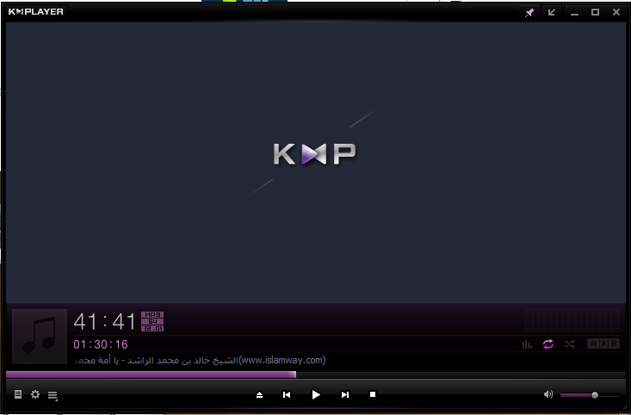
Related work
KMPlayer, as an example, plays sounds and videos of every single format there is. In addition, users are able to add subtitles.
However, no video- or media-player gives any kind of translation of subtitles at all. Also, none of them enables users to skip unwanted/inappropriate scenes at all.

Slide 9
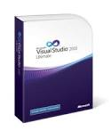

  Technology used in MCtionary
In our project we used the following things:
1. Visual Studio 2010 environment
2. C# language, C language
3. Wamp server
4. MySQL database

Slide 10
Video
Subtitle
Merge with picture
Input 1
Video Mixing Renderer
Input 0

Slide 11
The Benefit of MCtionary
Giving the meaning of the word in the context of the movies or videos.
Every user can watch movie with “customized” cuts or skips.
Skipping mode gives the user a good and easy control of his/her movies without any changes to the original files.

Slide 12
The main feature
Context-Based Info-Piece
Offline mode:
The user selects to be a viewer just and cannot modify anything(like voting or adding meaning/s). The user must select a file with format .accdb to switch to viewer-mode.
The user must have a .accdb file to be in an offline mode so user must to download the file.

Slide 13
Context-Based Info-Piece feature cont.
Online mode
  Unregistered users:
MCtionary users are free to individually create
their own accounts to meet their own needs and
personal settings.
However, a user who chooses not to create one, will be limited to the following basic functions within this feature:

Slide 14
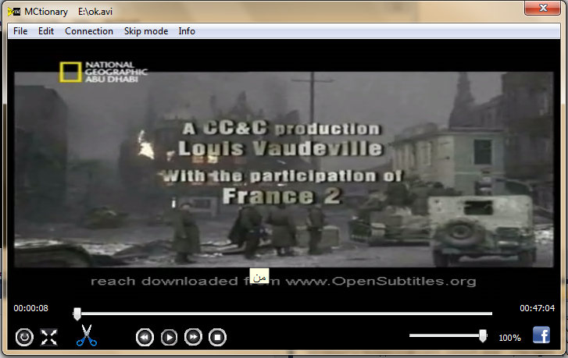
Context-Based Info-Piece feature cont.
  a. View the meaning/s –if already added by Authors
  b. Viewing any vote/s –if already done by Authors

Slide 15
Context-Based Info-Piece feature cont.
To display the information about any word in the subtitle just pointing at the target word to be translated while the video is being played already!
A pop-up window shows up with any meanings available.

Slide 16
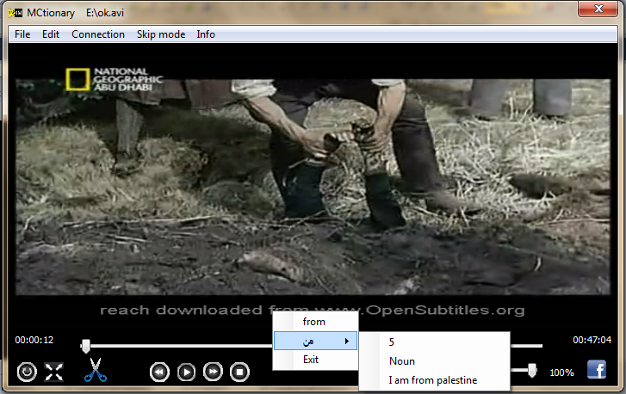
Context-Based Info-Piece feature cont.
Context-Based Info-Piece feature for unregistered users .

Slide 17
Context-Based Info-Piece feature cont.
  Registered users
In addition to the functions mentioned in previous section, registered users –also referred to as “Authors”- are automatically granted the following functions and privileges over the unregistered ones.

Slide 18
Context-Based Info-Piece feature cont.
Adding one meaning or a grammatical piece of info for every word in the subtitle.
our application allow user to insert three meaning for each word in the subtitle , one meaning at once. and when he ask for the meaning of some word, The application show him/her the meaning with highest vote only .

Slide 19
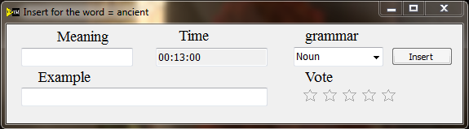
Context-Based Info-Piece feature cont.
Figure show how users add the meaning of some word in the subtitle.

Slide 20
Context-Based Info-Piece feature cont.
Registered users feature cont.
2. Voting on the meanings or grammatical piece/s of info added by other users. Users must be online for their vote to get retrieved and stored within the database on the server.

Slide 21
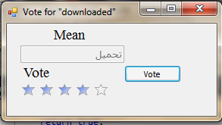
Context-Based Info-Piece feature cont.
Figure below show how registered users vote on meaning of some word in the subtitle

Slide 22
The main feature cont.
Skipping feature
This feature is both unique and essential! It’s unique as it’s never been made available in any other media- or video-player before!
Also, it’s essential as many users worldwide, and for many reasons of their own, sometimes need to skip scenes they regard as inappropriate or disturbing.

Slide 23
The main feature cont.
Skipping feature
Offline mode:
The user selects to be a viewer just and cannot modify anything (like added or voting on some scenes).User must select a file with format .accdb to be a viewer.
The user must have a .accdb file to be in an offline mode so he must to download the file.

Slide 24
Skipping feature cont.
Online mode
  Unregistered users :
a user who chooses not to create account, will be limited to the following basic functions within this feature:
Applying a (set of skips/cuts) to the current
movie if already made available by registered
user/s.

Slide 25
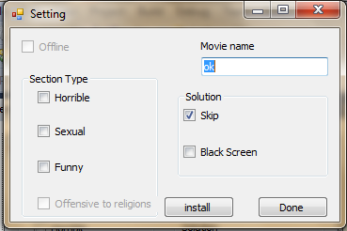
Skipping feature cont.
Figure below show the skipping feature for unregistered users.

Slide 26

Skipping feature cont.
  Registered users
Defining a (Skip) by simply setting its beginning and end about any scene. This is made easy by using the intuitive scissor-button.
Voting on the (Skip scenes) that added by other users, such as (sexual, horrible) etc.

Slide 27
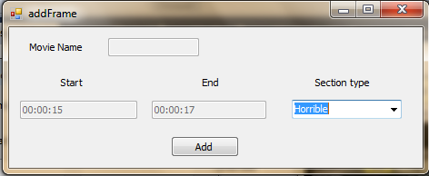
Skipping feature cont.
Figure below show the skipping feature for registered users .

Slide 28
User registration in MCtionary by Facebook account
MCtionary users are free to individually create their own accounts to meet their own needs and personal settings. However, a user who chooses not to create one, has a limited access to some feature of MCtionary.
To be able to register you must have a Facebook account, so we take permission from you to be able to see your details and be able to post on your Wall.

Slide 29
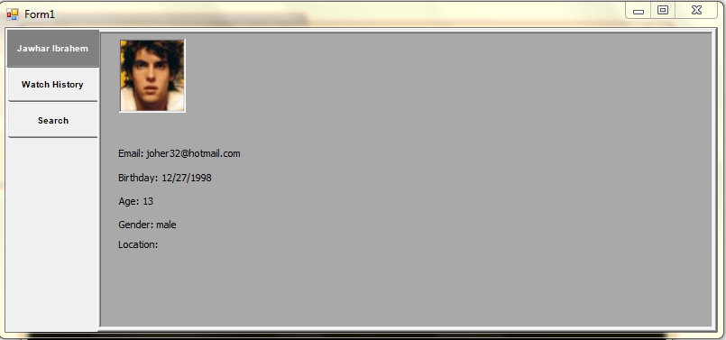
User registration in MCtionary
Figure below user registered via Facebook account

Slide 30
Search Feature
One of the major functions of MCtionary is (Search Function) which contain the two thing :
1- Meaning-based Search
2-Grammar-based Search
This feature is allowed only by registered users .

Slide 31
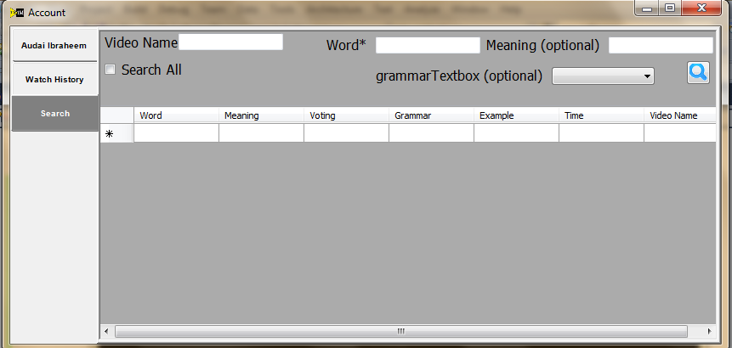
Search Feature
Figure below search feature with registered users

Slide 32
IMDB feature
When the film start run , the MCtionary program make connection to the IMDB site and get some information about movie from it such as rating , film type (action, crime , drama) and other thing.
This feature is available for registered and unregistered users.

Slide 33
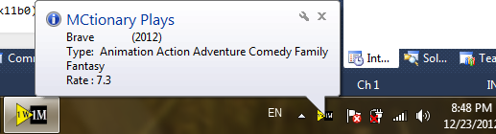
IMDB feature cont.
Figure below show the IMDB feature:

Slide 34
Demo
Time

