Slide 1
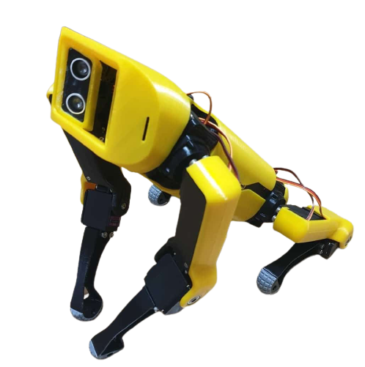
AKITA
Security DOG
Done by :
Rami Khaled Salman
Hamza Ammar Sader
Supervised by:
Dr. Ashraf Armoush

Slide 2
Contents
Introduction
Contribution
Project Parts
General structure
Implementation
Challenges and Constraints
Future Work

Slide 3
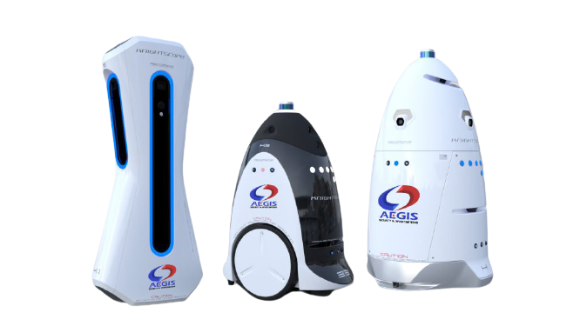
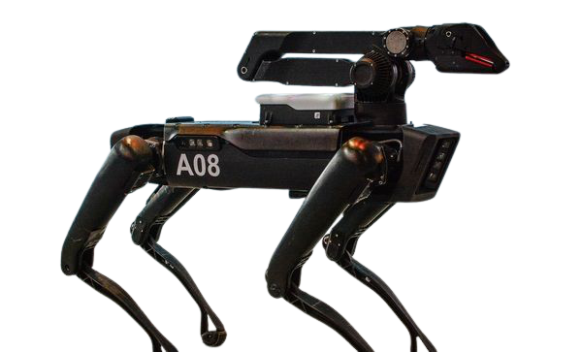
INTRODUCTION
Security robots are quickly becoming an extension of smart buildings and organizations.
  Accomplish task without human efforts.
  Not constrained by human limitations.
  protect the welfare of the human workforce.
However, They are not easy to afford.

Slide 4
Contribution
An inexpensive robot that is able to :
Carry out daily guarding tasks.
  Detect intruders and different kinds of animals.
  Capture surveillance images.
  Send notifications upon detecting intruders.
  Launch an alarm if needed.
Navigate the surrounding environment via :
  A wireless interface to control its movement.
  A voice assistant that will execute voice-activated commands.

Slide 5
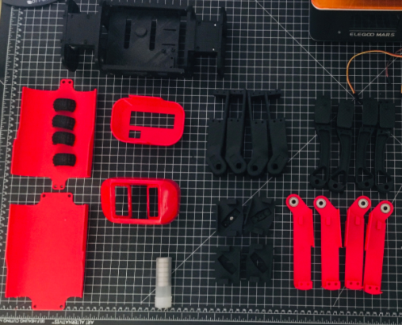
Project Parts

Slide 6
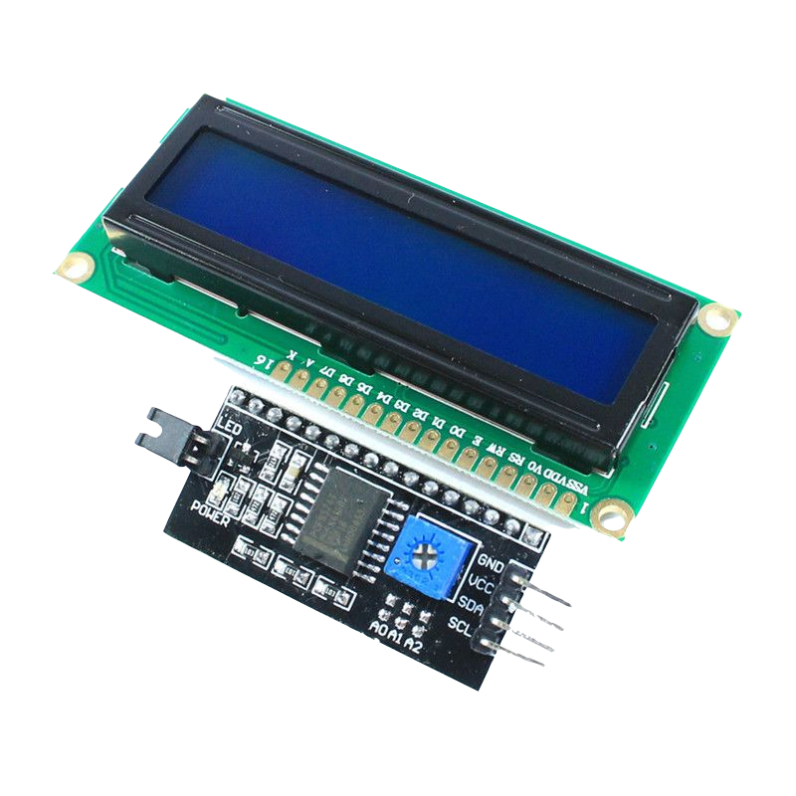
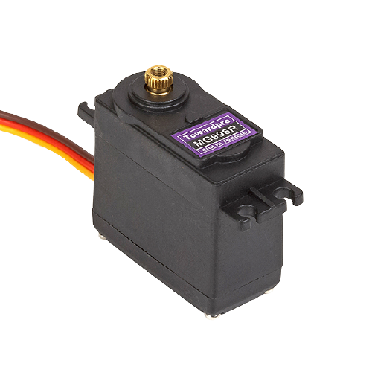
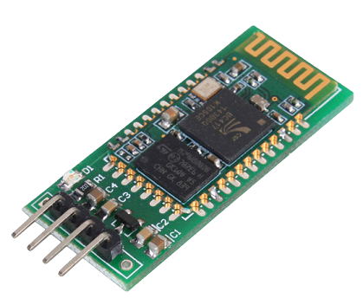
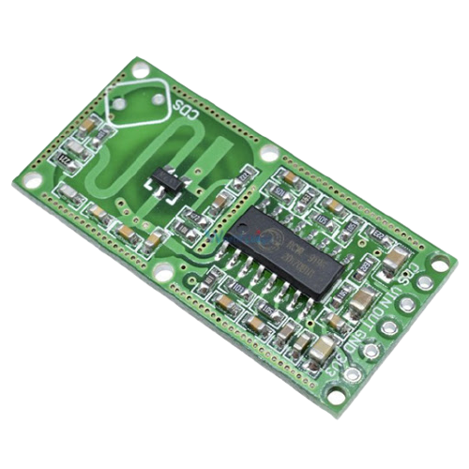
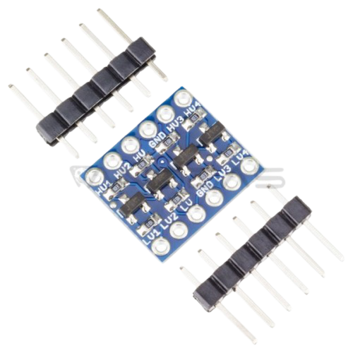
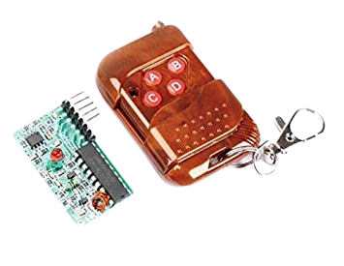
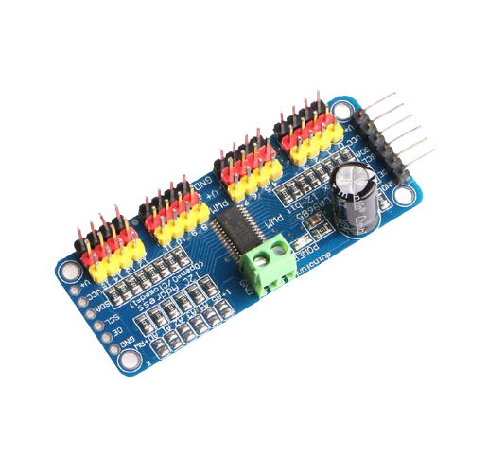
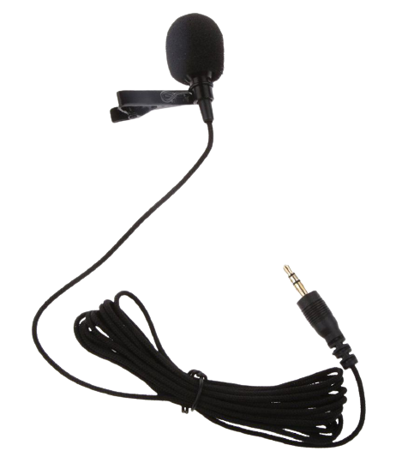
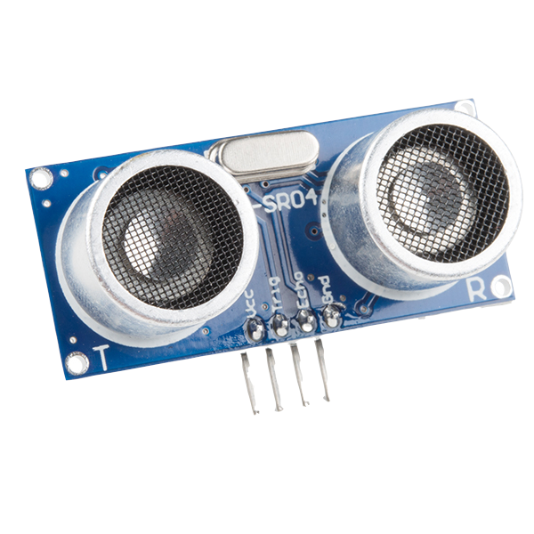
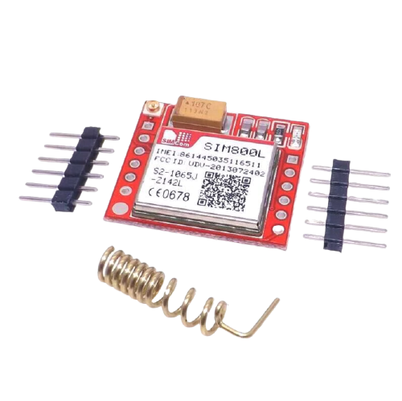
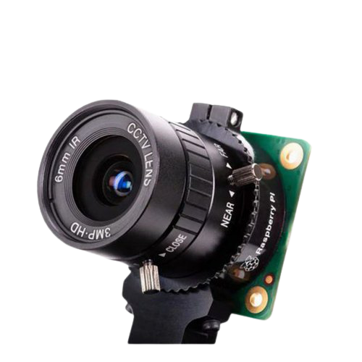
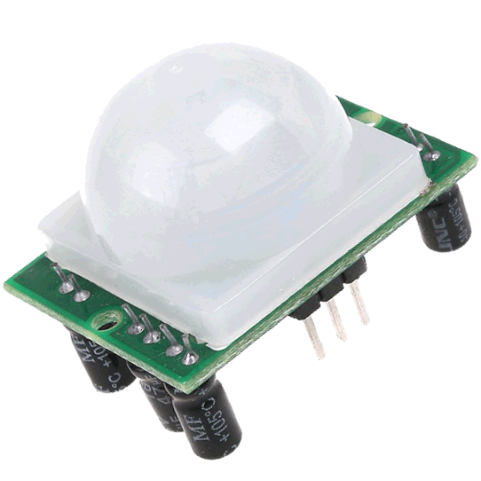
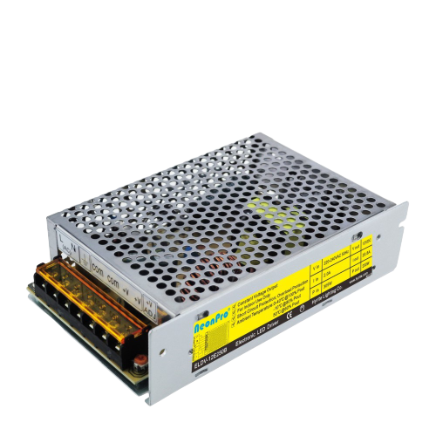
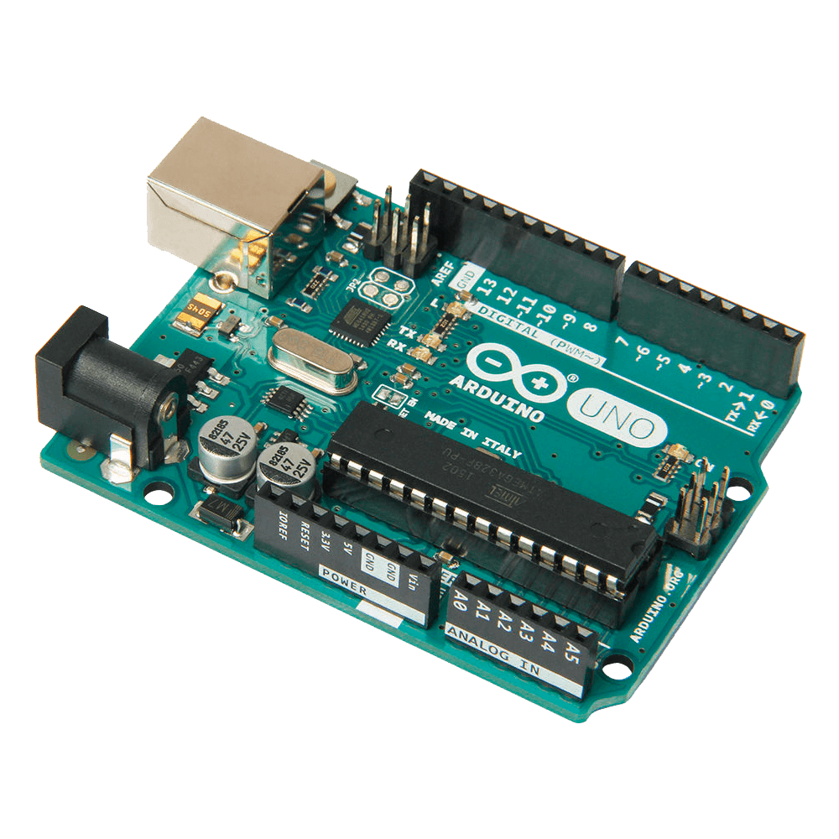
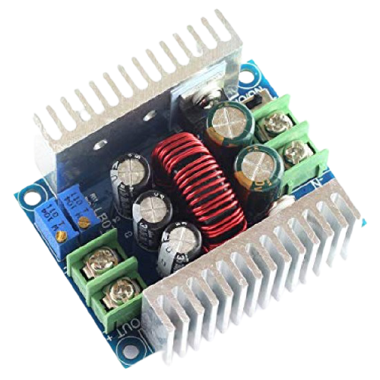
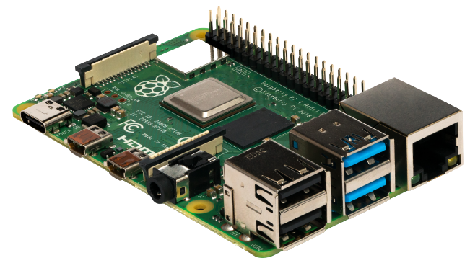
Project Parts

Slide 7
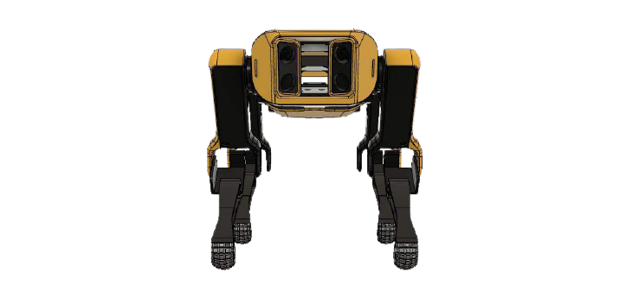
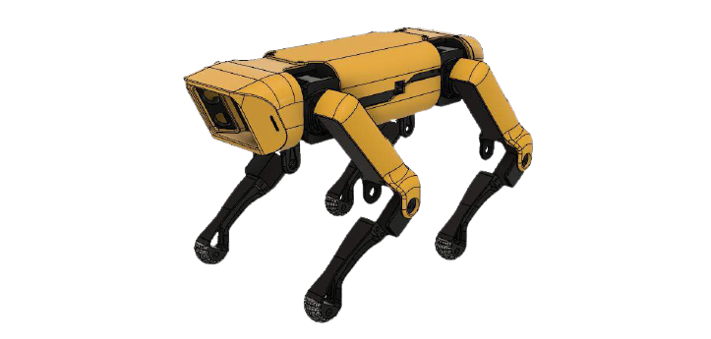
General Structure
The Design :
  Based on the SpotMicro open-source project

Slide 8
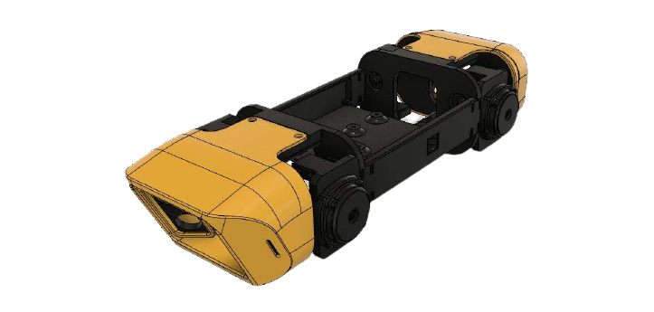
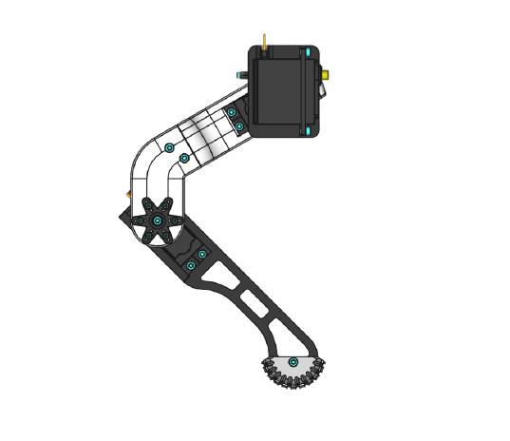
General Structure
The Body :
  Connects all the robot parts.
  Contains all necessary processing units and sensors.
The Legs :
  Two pairs of mirrored legs Each consists of five parts.
  Each leg has 3 degrees of freedom.

Slide 9
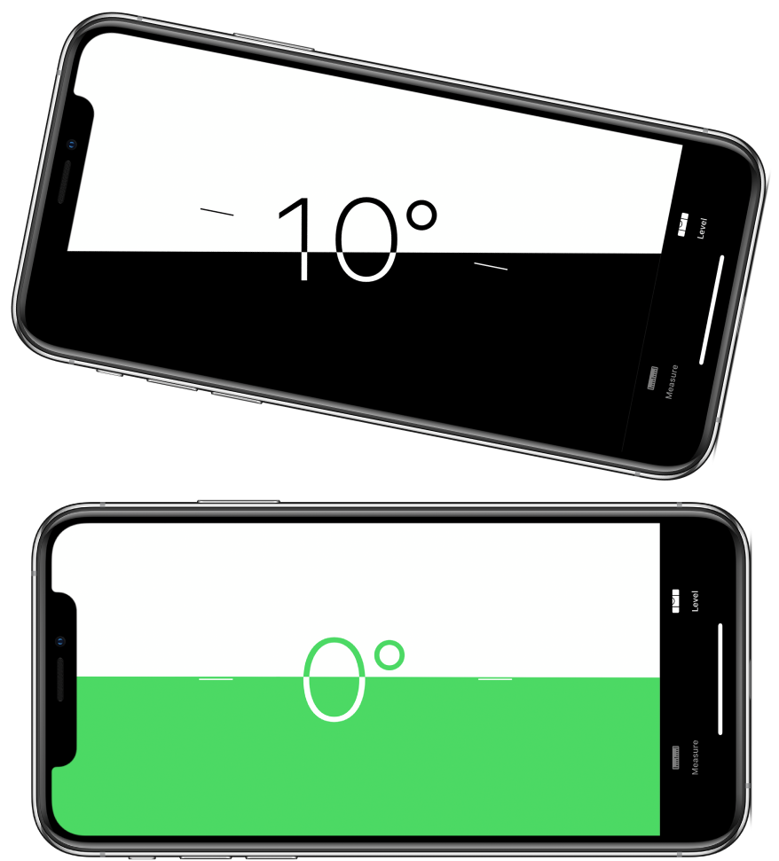
Servo Calibration
Make sure the servos cover the correct range of movement.
Determine servo values at the center and minimum position of each leg part to figure out the right angles.
An inclinometer was used to measure the angles precisely.

Slide 10
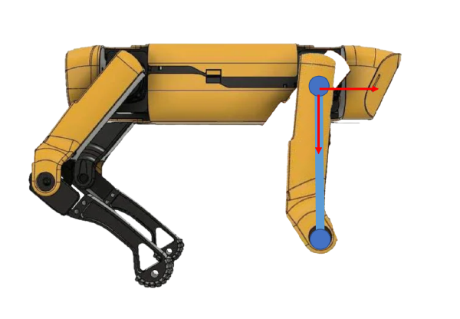
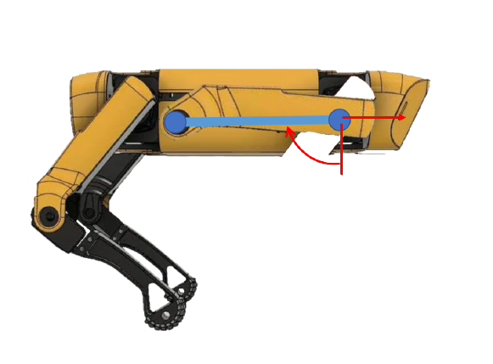
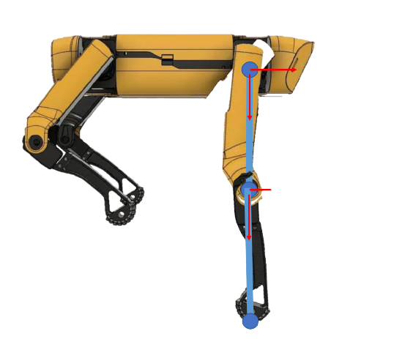
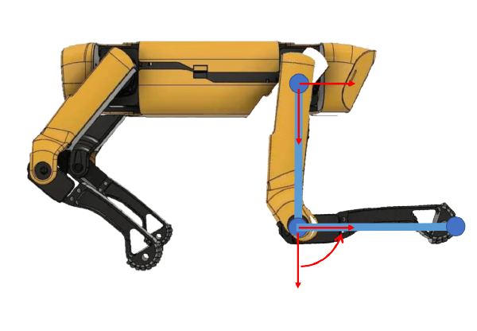
01
02
03
04
1)
2)
3)
4)

Slide 11
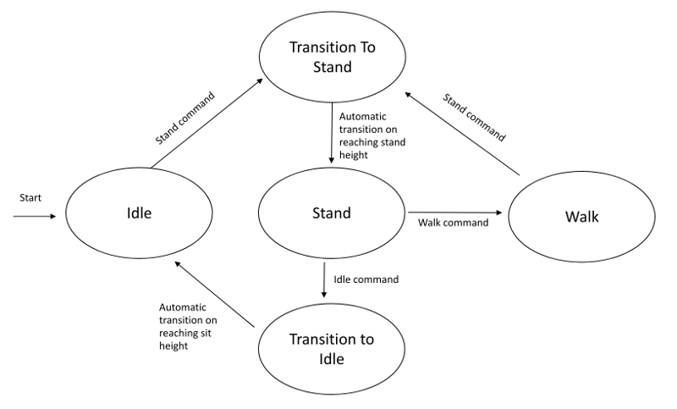
Movement
01
can be represented with 5 states.

Slide 12
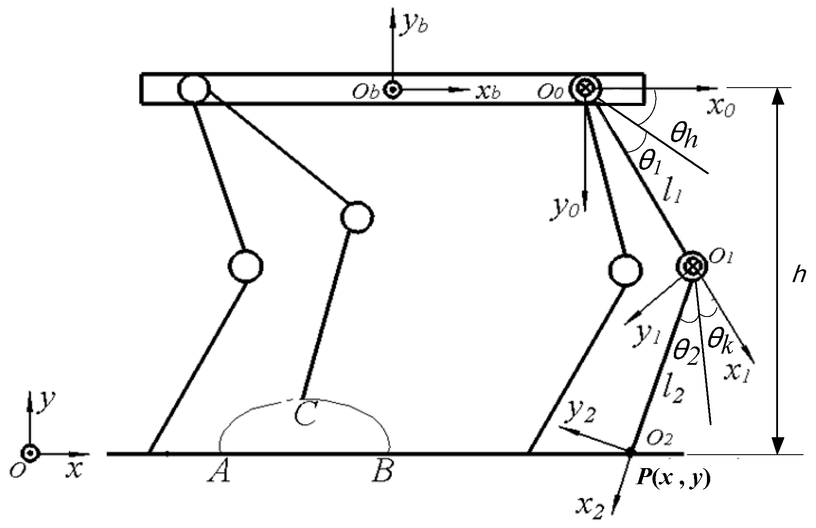
Forward & Inverse Kinematics :
Forward kinematics: refers to the use of the kinematic equations of a robot to compute the position of the end-effector from specified values for the joint parameters

Slide 13
Idle state
  Must be in stand state before the transition.
  Upper and Lower leg angles will go up.
  Servo will be set to idle after a small delay.
Stand state
  Can transition from both walk and idle states.
  Upper and lower leg angles will gradually go down.

Slide 14
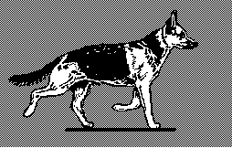
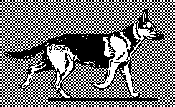
Walking state
  A 4-phase gait.
  Diagonal legs move simultaneously.
  Forward kinematics used to balance the robot`s height.
  Operates in 4 different directions :
    Forward.
    Backward.
    Right.
    Left.

Slide 15
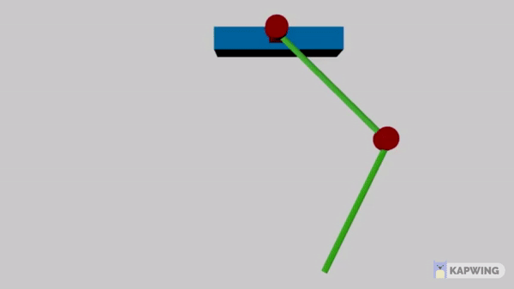
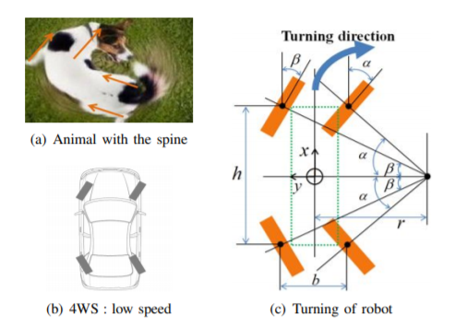
Movement
Stance phase
which the foot is in contact with the ground.
Swing phase
which the foot is lifted and moved forward

Slide 16
01
ALARM MODE
During the Alarm Mode,the robot works as an intruder detector featured with an authentication

Slide 17
Movement detection
PIR SENSOR
RCWL 0516 Microwave Radar
Optix based detection

Slide 18
Face Recognition
Pi Camera Module
Frame/Image
Detect Faces in the image
Recognize face
Compare 128-d vector to known database
Compute 128-d face embeddings via deep metric network

Slide 19
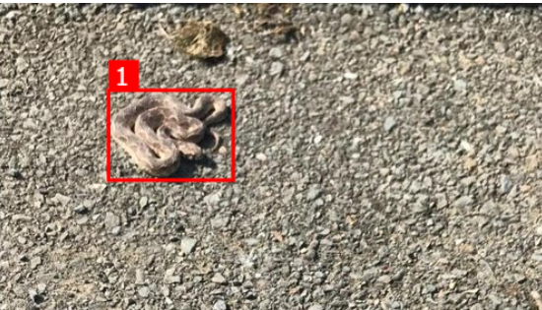
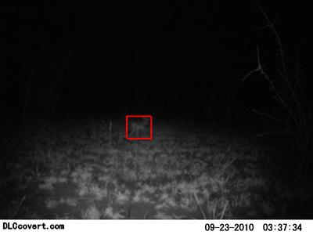
Animal Detection
AI FOR EARTH
Microsoft Mega Detector

Slide 20
Remote control
Four Channel Wireless RF Remote Control Transmitter Receiver Module.

Slide 21
Notification System
SIM800L GSM/GPRS

Slide 22




Notification System

Slide 23
02
SAFE MODE
During Safe mode, The robot provide the following functionalities

Slide 24
Bluetooth Control
HC05 Bluetooth Module

Slide 25



Voice Assistant

Slide 26
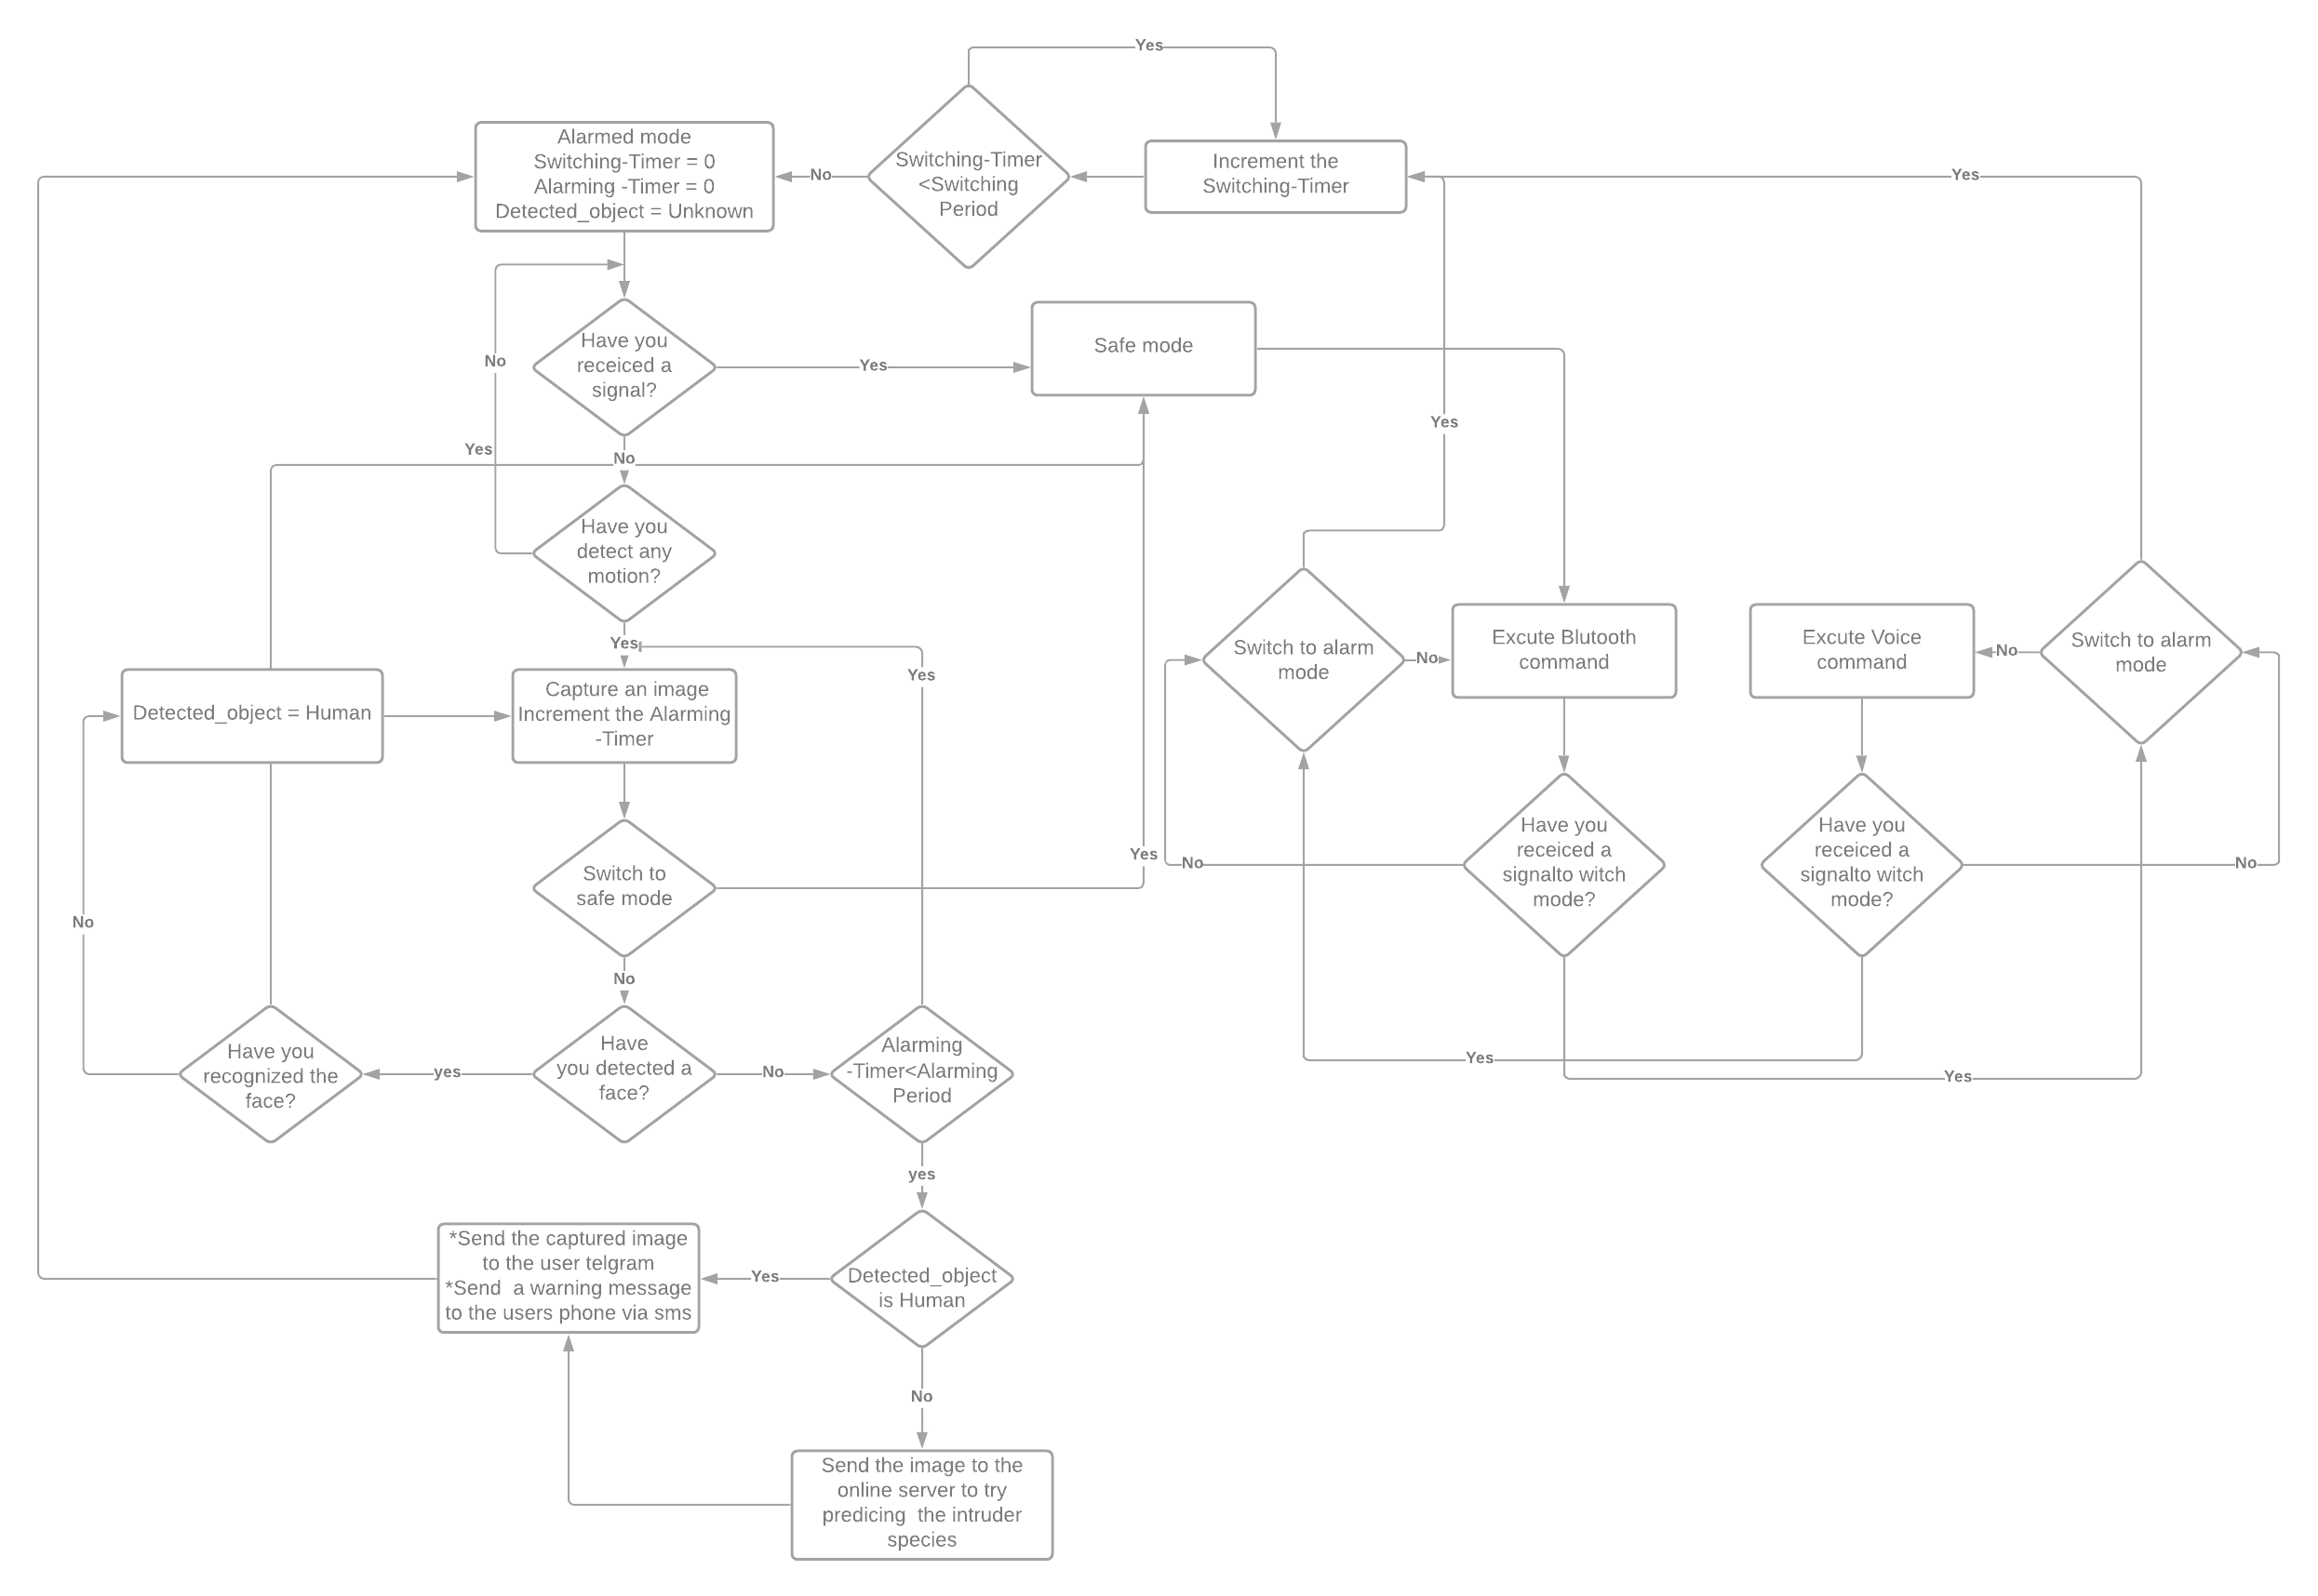

Slide 27
Constraints
Cost Of Material
Servo Motors Failure
Sensors Quality
Power Supply

Slide 28

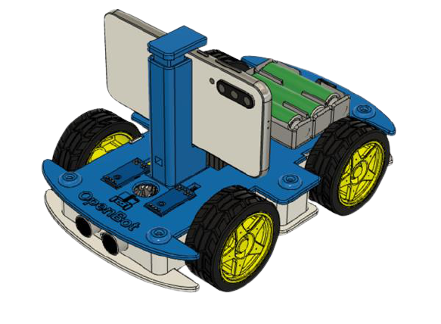

Slide 29
Future Work
1 -
Find better and more powerful servo motors that are compatible with our current design to overcome the current servo constraints
2-
Improve the current walking gait and implement different ones and study each mode’s advantages and effect on robot stability.
3-
Integrate our robot with other modules like lidar to achieve autonomous navigation.
4-
Test new techniques to detect motion in non-stationary robots to achieve higher accuracy and immunity against any false positives.

Slide 30
THANKS for watching !

