Slide 1
Control and Design of PV-Battery Charger with Maximum Power Point Tracker (MPPT)
Graduation Project-Ι submitted to:
Department of Electrical Engineering
Faculty of Engineering and Information Technology
An–Najah National University
In partial fulfillment of the requirements for Bachelor degree in Electrical Engineering
Supervised by: Dr. Moien Omar

Slide 2
Outlines
Introduction
Problem statement
Objectives
Project Work
MPPT VS PWM
MPPT algorithm
(P-V) and (I-V) curves
Charging time of battery with & without MPPT
Results & Conclusion
Second phase work

Slide 3
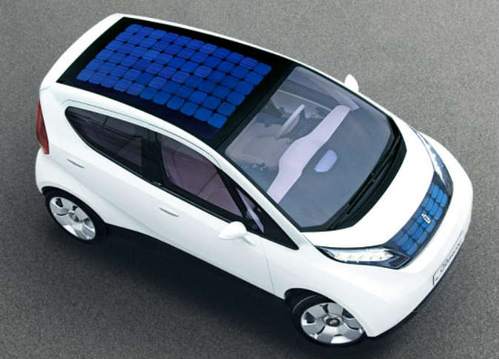
Introduction
Solar energy is one of the most important renewable energy sources that have been gaining increased attention in recent years. Solar energy is plentiful, it has the greatest availability compared to other energy sources, it is clean and free of emissions.
We can use the PV system to charging a battery which using in many application as houses, factories and cars.
The main problem appears when the battery is charged, that is the disability of using the maximum power during charging the battery with Pulse Width Modulation (PWM) technique, which makes the time of charging battery very long.
In this project, we will discuss how we can charge the battery with maximum power and decrease the time of charging.
That can be accomplished by designing a device which can get the maximum power from the PV system and it is called Maximum Power Point Tracker (MPPT).

Slide 4
Problem Statement
Objectives
Project Work
Recently, research and development of low cost solar panels, thin-film devices, concentrator systems, and many innovative concepts have increased.
The energy generated from the PV module is mainly dependent on the temperature and solar radiation.
Nowadays, the costs of small solar-power modular units and solar-power plants are economically feasible for large-scale production and use of solar energy.
MPPT is used to extract the maximum power from the PV panel in order to maximize the overall efficiency of the system, thereby reducing the overall system cost.
In this work, a battery charger form photovoltaic (PV) solar cell with maximum power point tracking is proposed.
In the first phase of the project, a mathematical model is presented and simulated in order to understand system operation and functions.

Slide 5
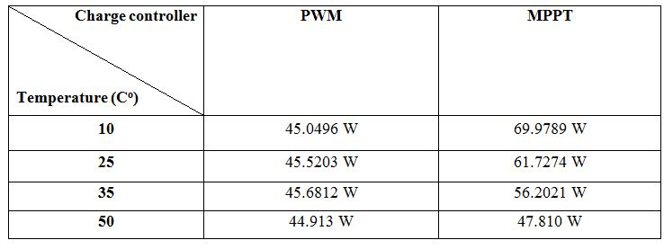
MPPT VS PWM
MPPT and PWM charge controllers used to charge the batteries from a solar array.
PV output power at different temperatures using MPPT and PWM shown in the following table:

Slide 6
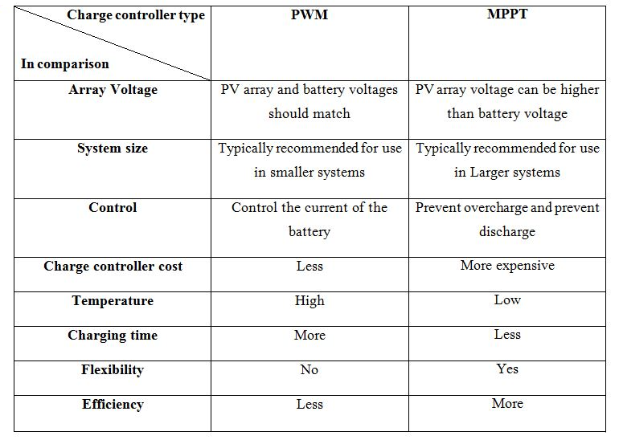
There are some advantages and disadvantages for both technique, the following table summarizes the advantages and drawbacks of each controller:

Slide 7
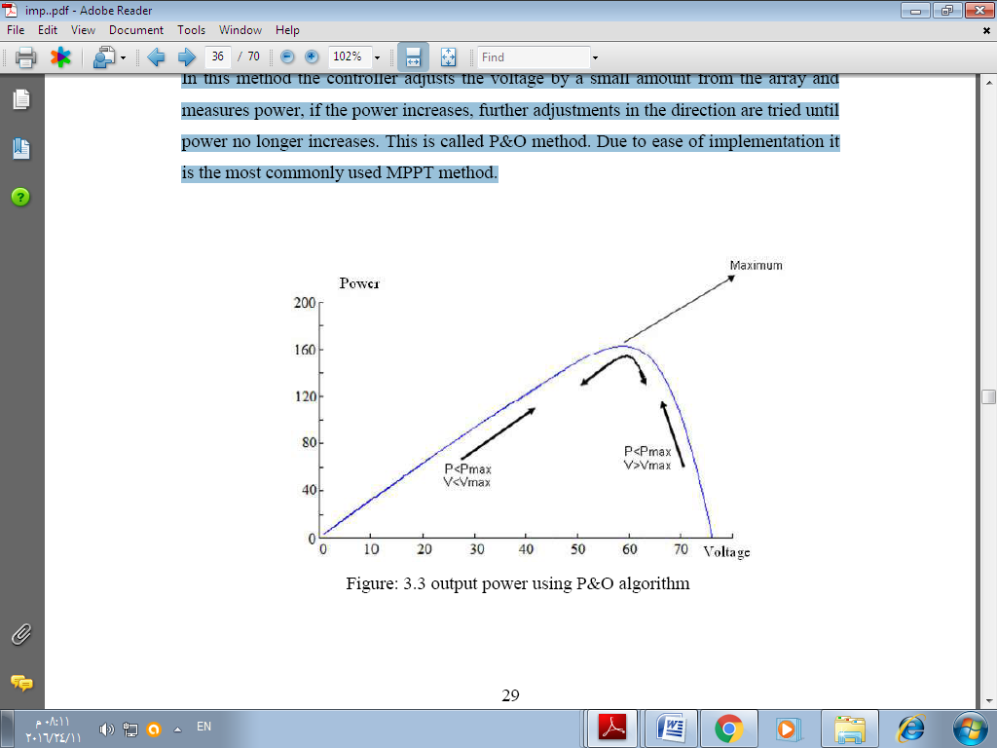
MPPT algorithm
There are many algorithm used to implement the MPPT, the most common methods are :
Perturb and Observe (P&O).
Incremental Conductance method.
Open Circuit Voltage method.
Short Circuit Current method.
In this project (P&O) method is used according to :
Its simplicity in algorithm.
Ease of implementation.
Low cost.

Slide 8
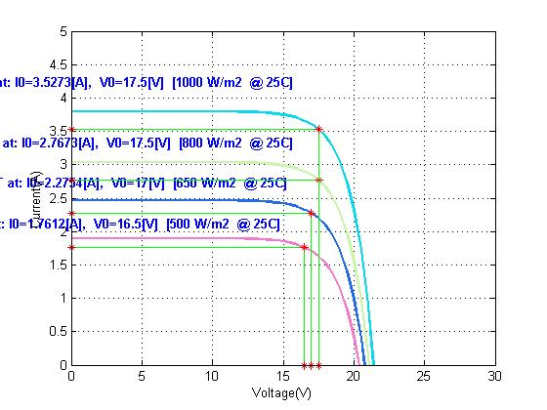
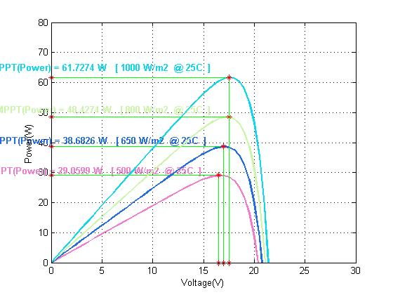
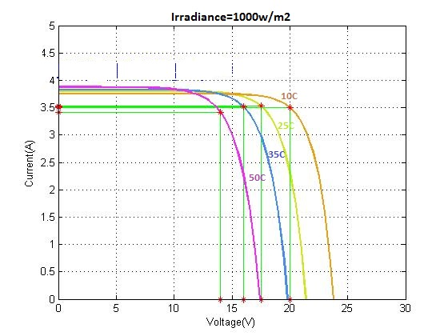
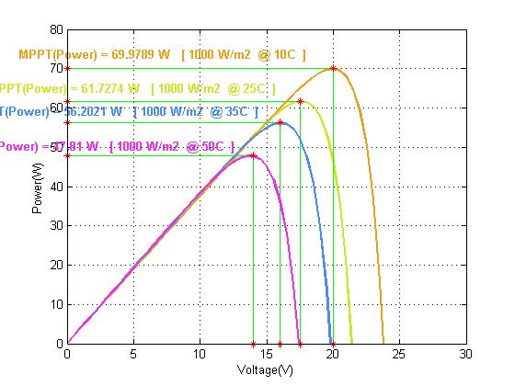
(P-V) and (I-V) curves
The MATLAB simulation of (I-V) characteristics and (P-V) curve for different irradiance of a PV panel are shown in the following figures :
The MATLAB simulation of (I-V) characteristics and (P-V) curve for different temperatures are shown in the following figures :

Slide 9
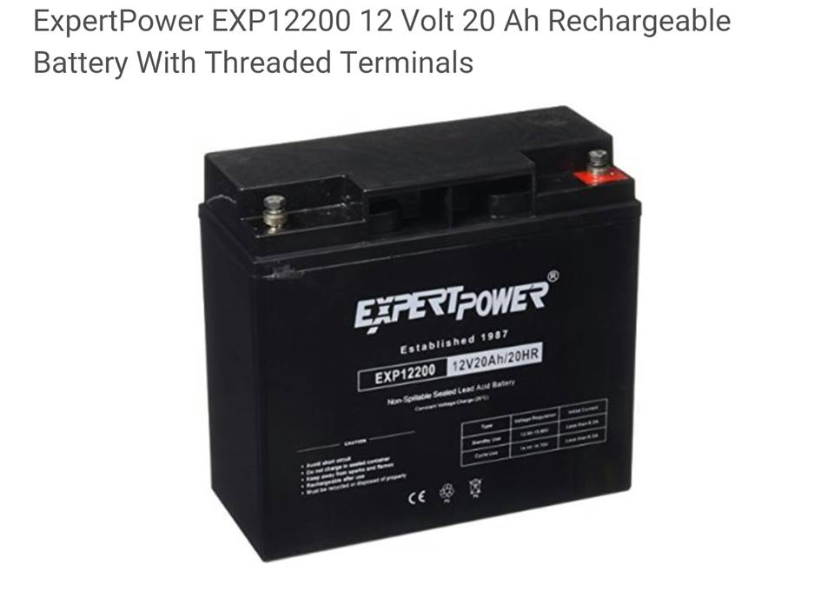
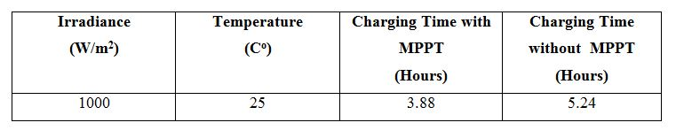
Charging time of battery with & without MPPT
The charging time at (STC):

Slide 10
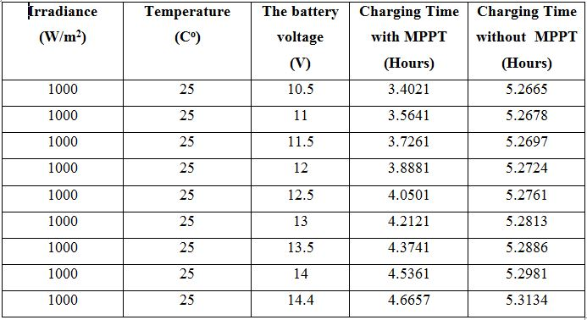
Battery charging time with the variation of its voltage

Slide 12
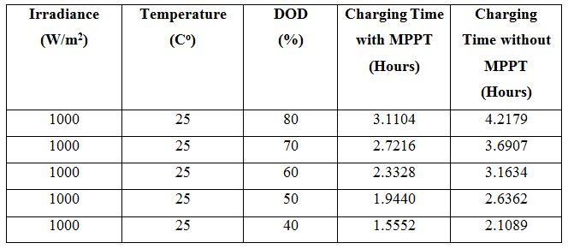
Battery charging time with different DOD values

Slide 14
Results & Conclusion
Power produced by the PV module varies greatly depending on its irradiance and temperature.
After simulating the MPPT using MATLAB/SIMULINK and getting the results we confirmed the importance of MPPT in the PV systems to get the maximum power.
MPPT is more efficient at low temperatures, but at high temperatures no significant difference in power values between PWM and MPPT.
MPPT charge controller, it is flexible, efficient, appropriate for the large systems and gives short charging time than PWM.
It is recommended to use MPPT charge controller, it is appropriate for the systems that need immediate and short time charging.
MPPT is necessary to protect the battery block against deep discharge and over charge.

Slide 15
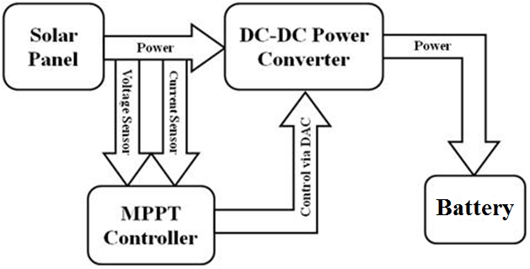
Second phase work
Using a microcontroller to designed and implemented the (MPPT).
The microcontroller senses both the panel and battery voltages and takes decisions to activate different components of the circuits, after taking the measurements of voltage and current, the tracking algorithm (Perturb and Observe) will control the operation and give orders to the controller.

Slide 16
We will build an MPPT using arduino controller with all required components. The complete MPPT design and implementation will be done in next semester due to shortness of time.
To make good and complete design and implementation for the MPPT charge controller we need to be familiar with the following :
MPPT algorithm (Perturb and Observe).
PV module.
Lead acid battery appropriate to the power generated from the PV module.
LED indication for the state of charge.
Voltage, current and power sensors.
Arduino microcontroller.
Buck-Boost Converter.
LCD display.
It is expected to face a several problems throughout the design and implementation of the circuit that we will like to avoid and come over them in the future.
The most expected problem (challenge) which a shorter design and test period, with such a serious time constraint.
We think it is beneficial to spend more time testing rather than taking the time to make sure that each part was the ideal one for the circuit. Either way, more time or better time management will be a key issue that should definitely be worked out for future reference.

Slide 17


