Slide 1
An Integration Design for An-Najah Hostel
Prepared By:
Farah Shaar
Mohammed Al Sakhil
Mueen Abu Odeh
Supervisor: Dr. Ahmed Al Haj Saleh

Slide 2
Contents
Site Analysis
Architectural Design
Structural Design
Environmental Design
Acoustical Design
Mechanical Design
Electrical Design
Fire And Safety Design
Cost Estimation

Slide 3
Architectural design

Slide 4
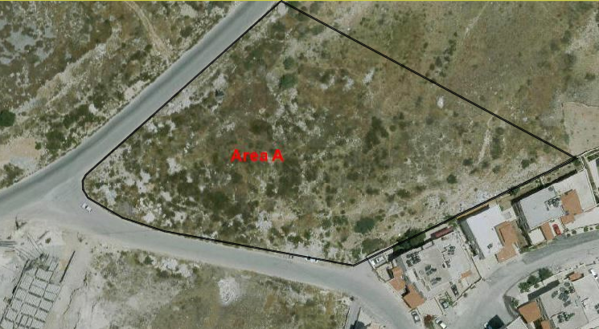
Site analysis
The site is located in Al Junid Area, West of Nablus City, on the road behind An-Najah National University, the total area for land is 5815 m2, with 5m end slope parallel with main street direction, and 5 kilometers away from city center.

Slide 5
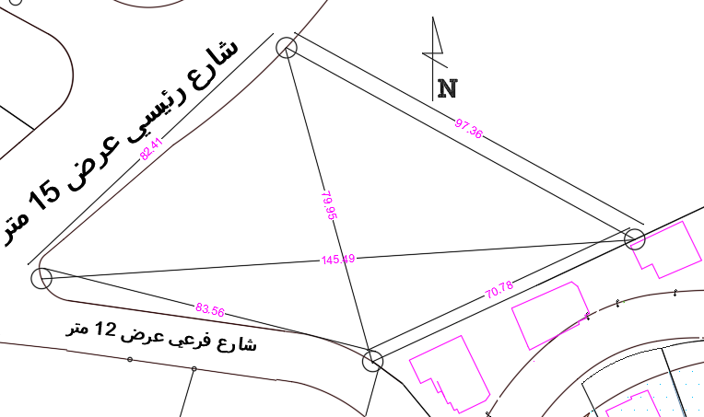
Site analysis

Slide 6
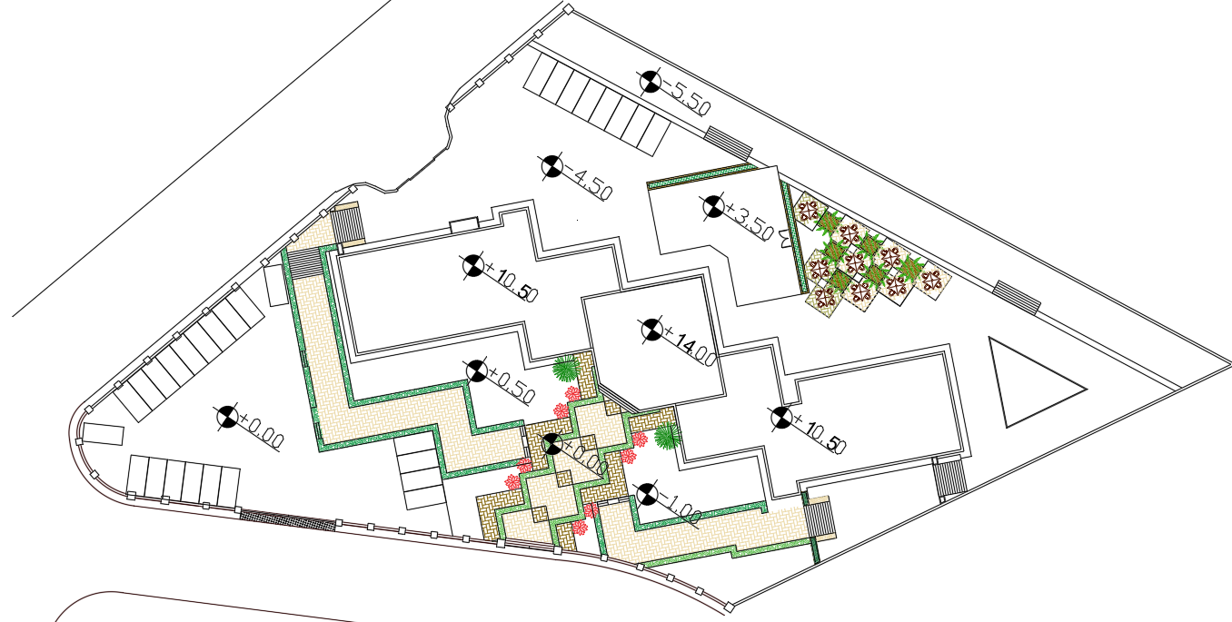
Site analysis

Slide 7
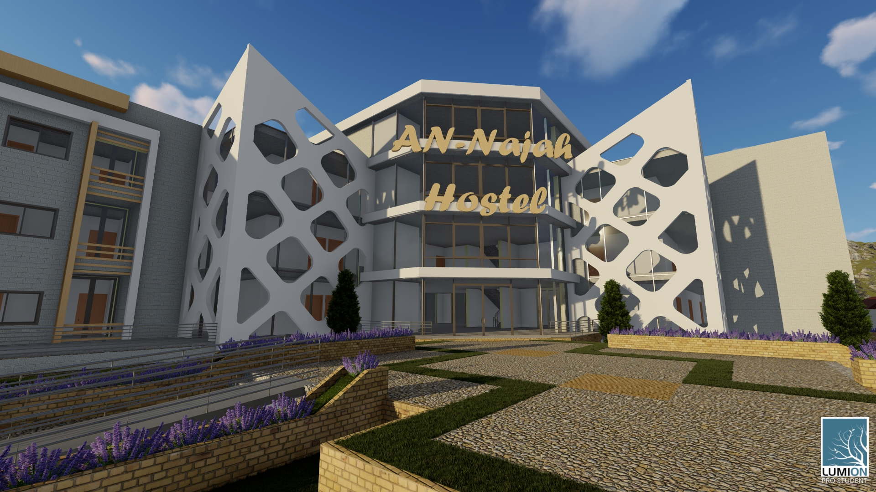
3d models from lumion

Slide 8
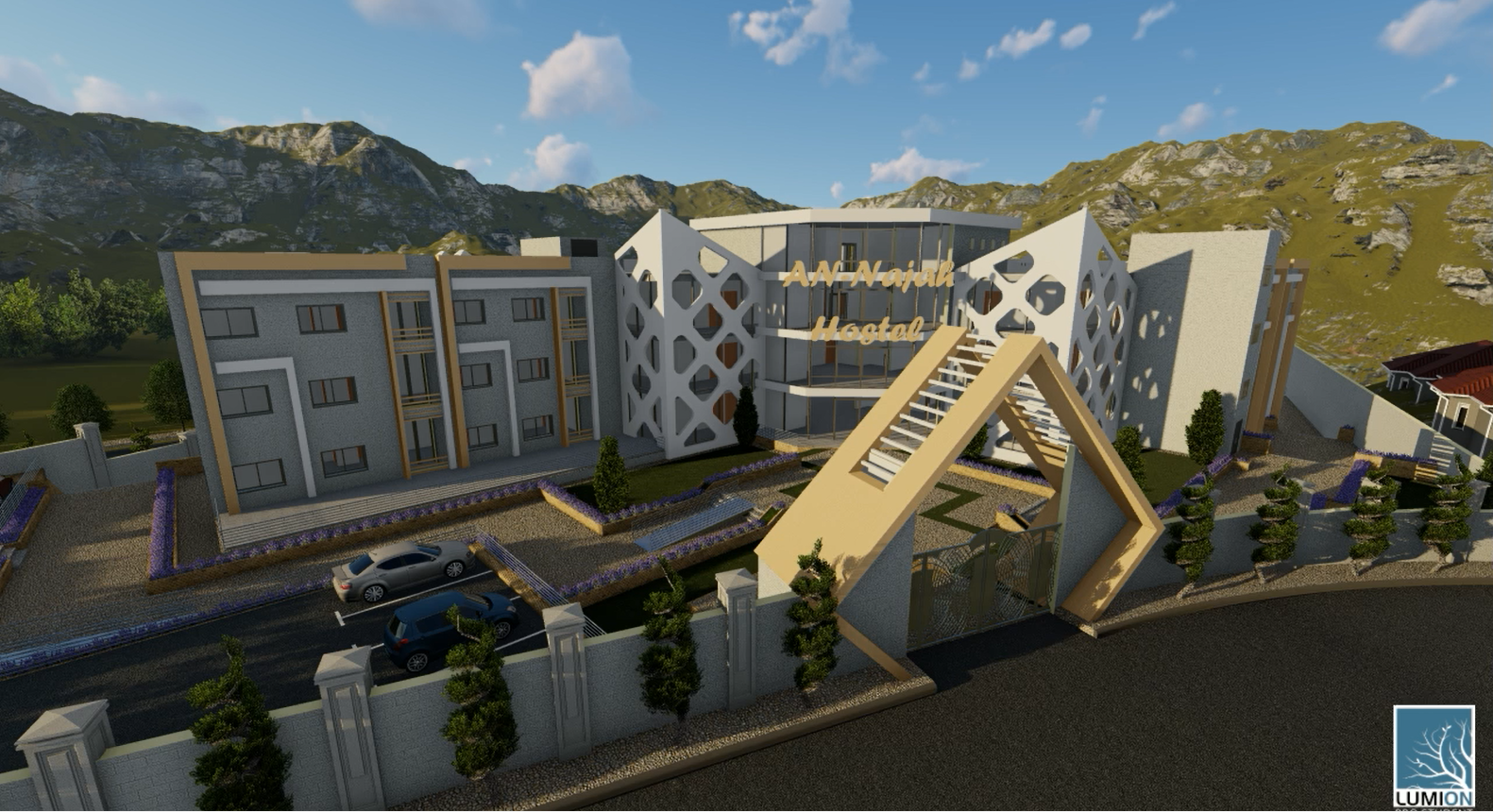

Slide 9
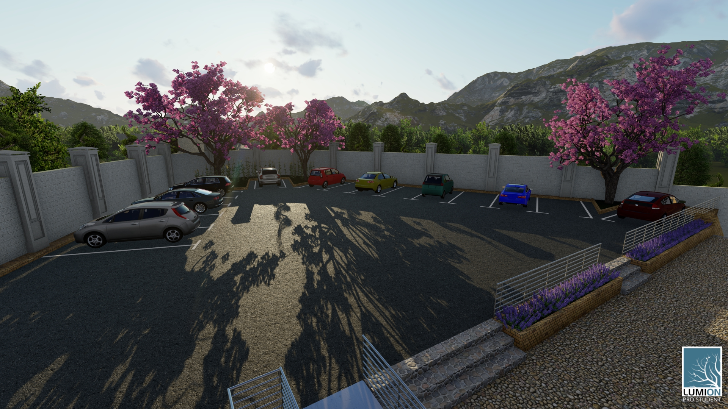

Slide 10
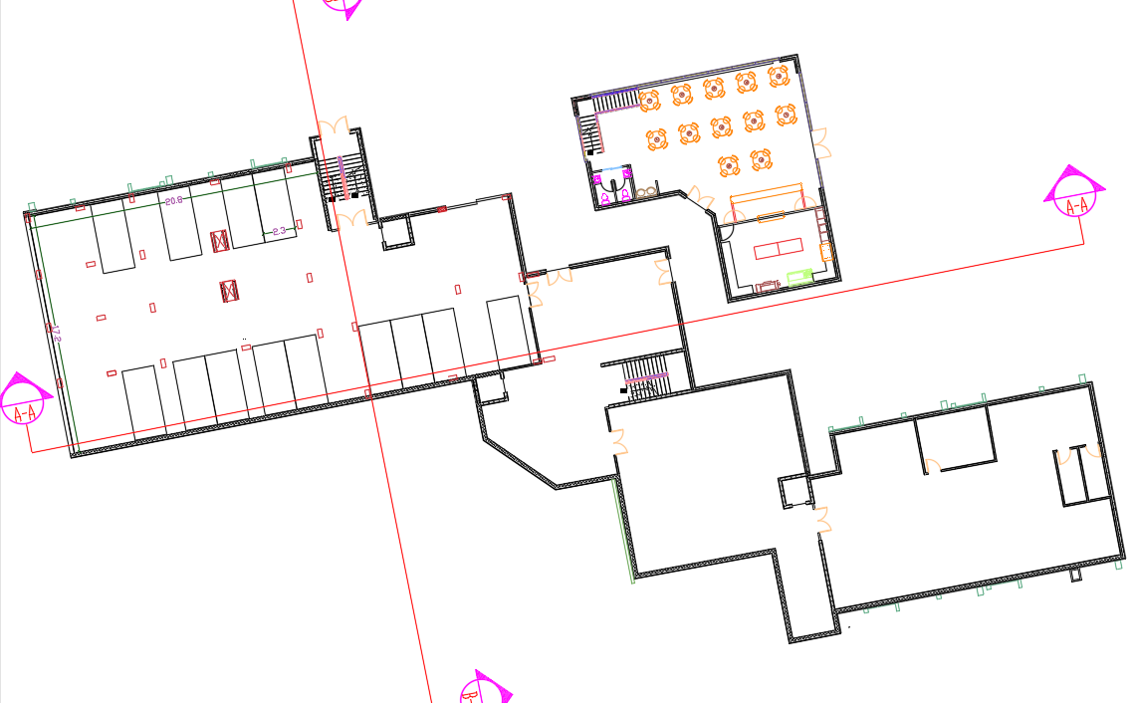
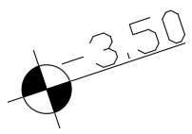
Basement floor
Basement Floor area for cafeteria = 204 m²
Basement Floor area = 1195 m²

Slide 11
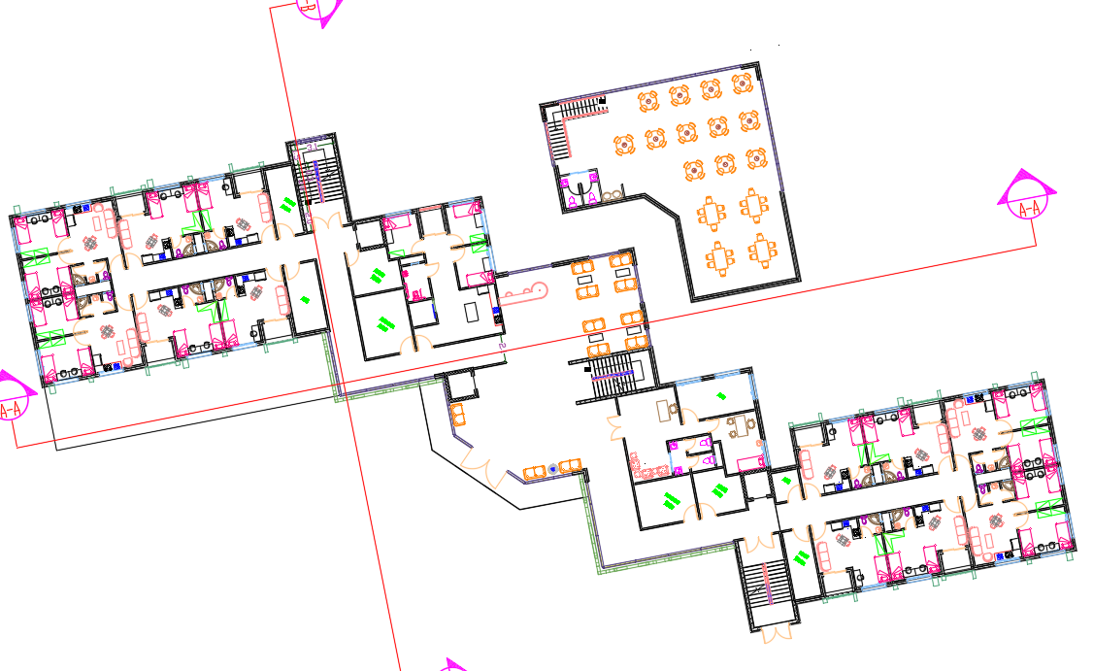
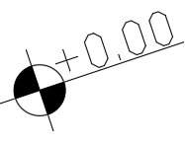
Ground floor
Ground Floor area for cafeteria = 204 m²
Ground Floor area = 1195 m²

Slide 12
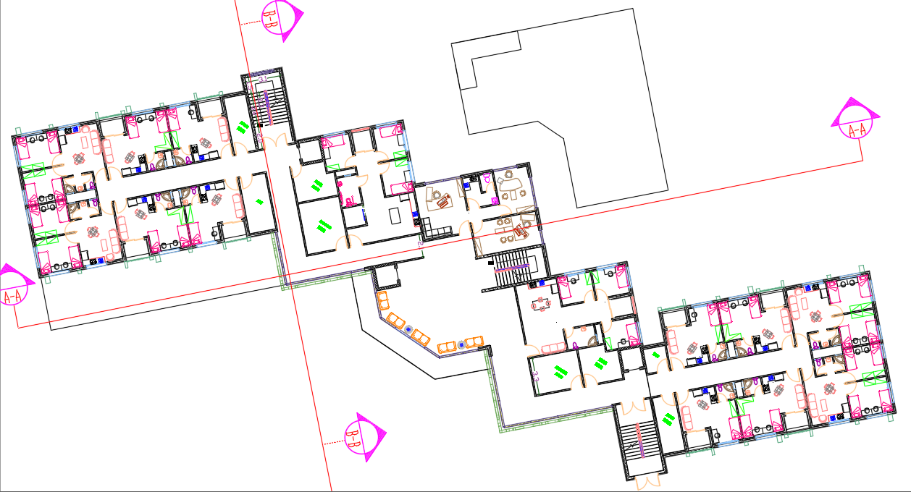
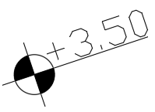
First floor
First Floor area = 1195 m²

Slide 13
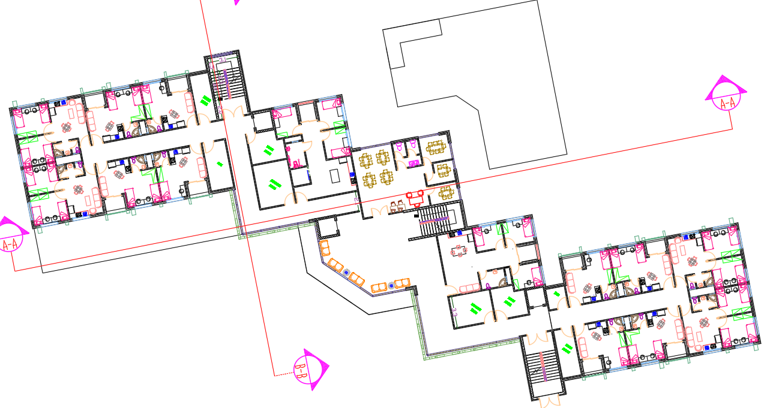
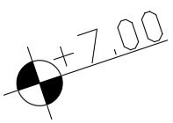
Second floor
Second Floor area = 1195 m²

Slide 14
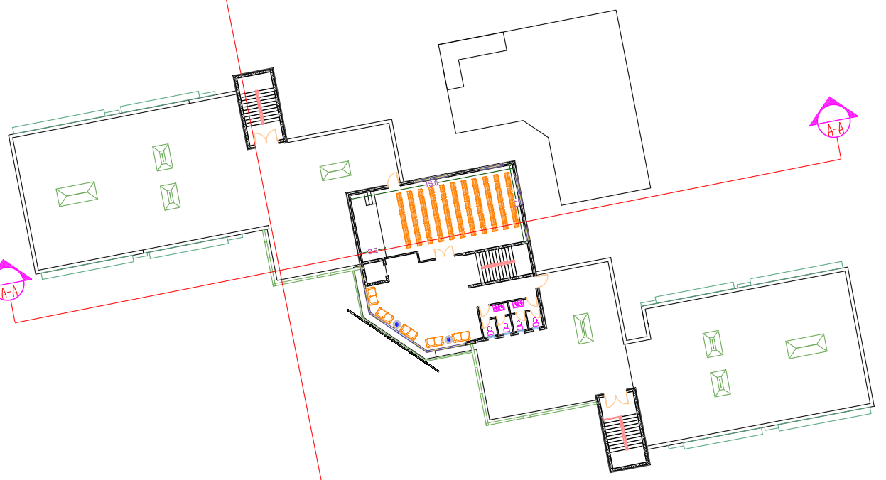
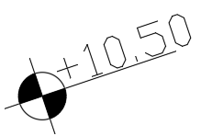
Third floor
Third Floor area = 285 m²

Slide 15
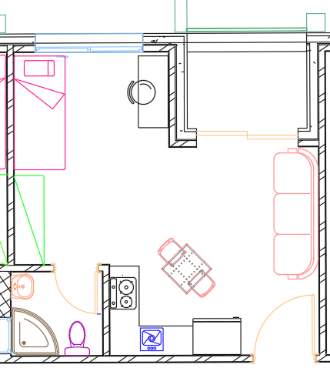
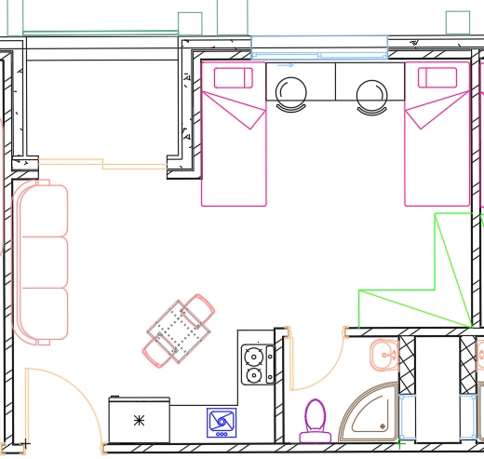
Enlarge plan “Bed room”
Department for one person=26m2
Department for two person=30.5m2

Slide 16
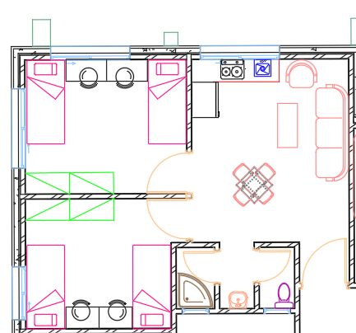
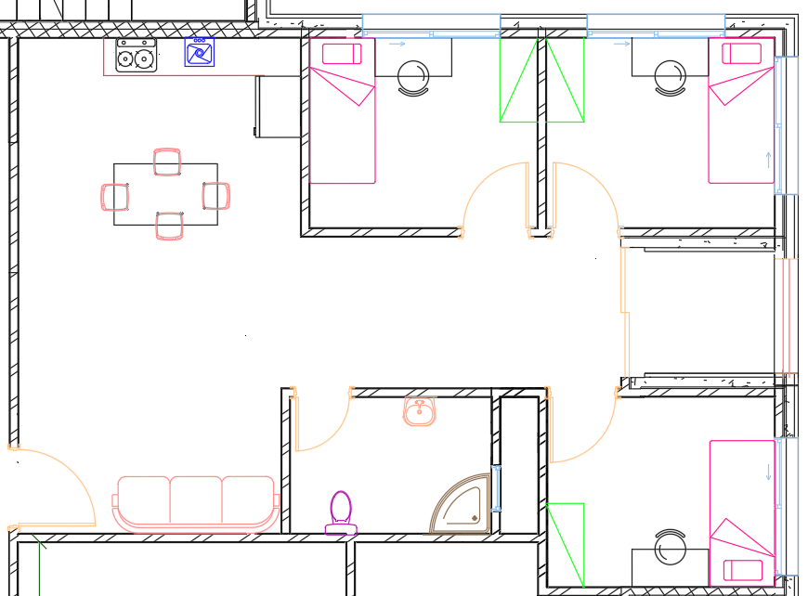
Enlarge plan “Bed room”
Department for four person=44m2
Department for three person=65m2

Slide 17
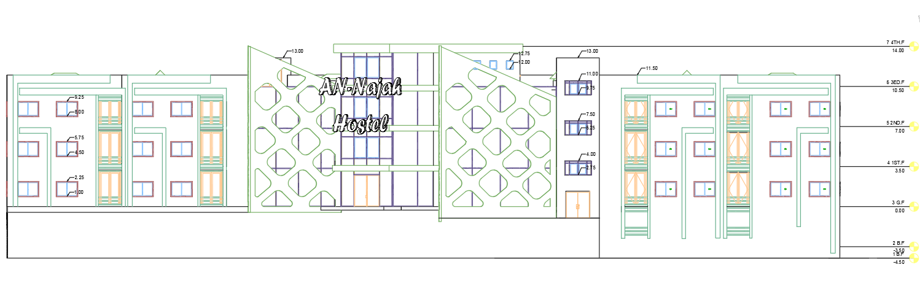
Southern Elevation

Slide 18
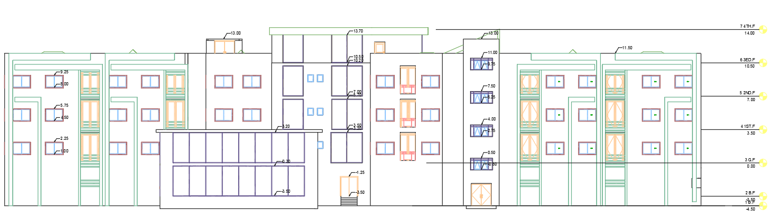
Northern Elevation

Slide 19
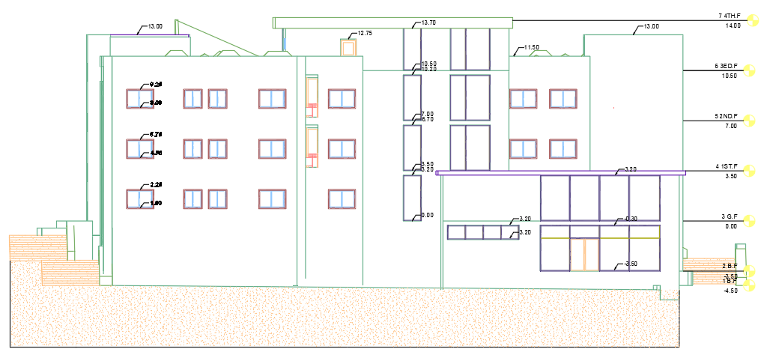
Eastern Elevation

Slide 20
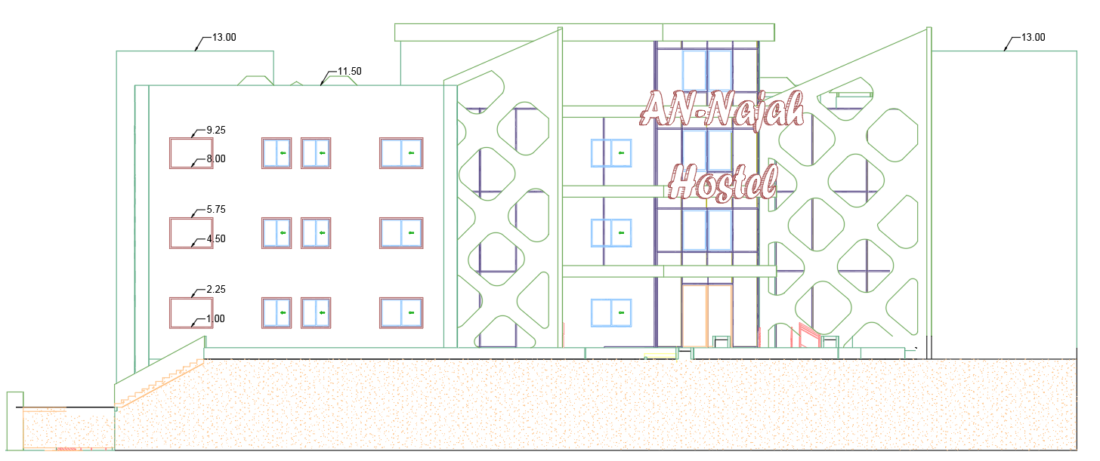
Western Elevation

Slide 21
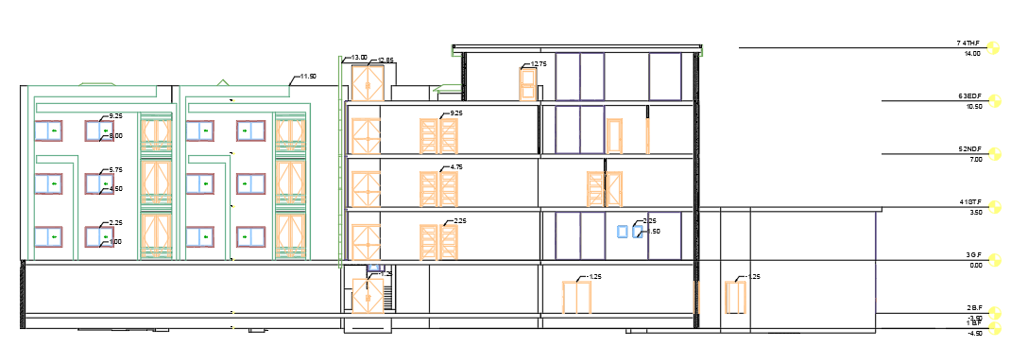
Section A-A

Slide 22
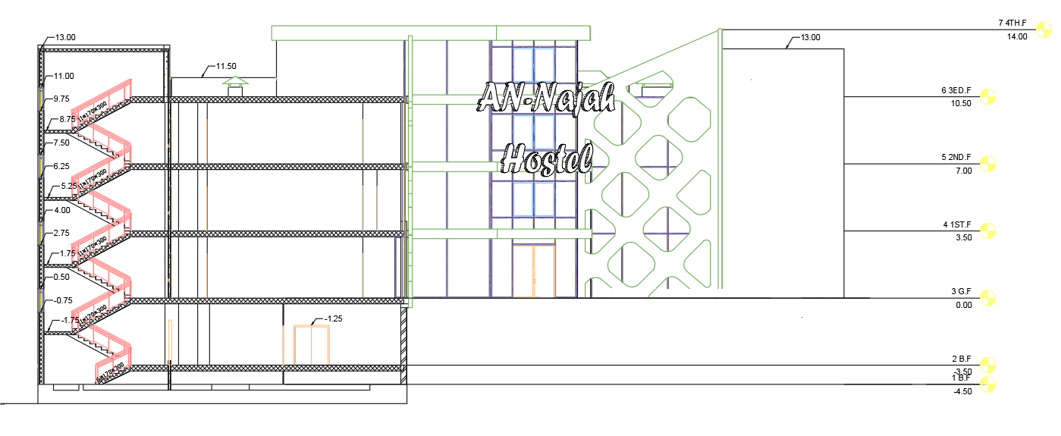
Section B-B

Slide 23
Structural Design

Slide 24
Codes and Loads and Materials
Codes
ACI 318-14 for reinforced concrete design
UBC 97 for seismic design and its load combinations
Loads
Dead Load
Superimposed Load = 3.5 kN/m2
Live Load = 3 kN/m2
Materials
Concrete B300 and B350
Yield Strength of Steel= 420 MPa
Soil Bearing Capacity = 250 kN/m2

Slide 25

Seismic analysis:
Seismic zone : 2B.
Soil profile : SC.
Acceleration-dependent seismic coefficients Ca=0.24.
Velocity-dependent seismic coefficients Cv= 0.32.
Importance factor I=1.
Force reduction factor R=5.5 (Building Frame System- Shear Walls).

Slide 26
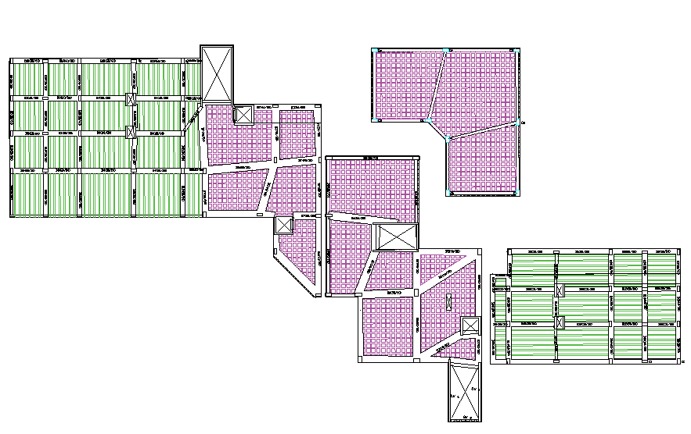
Slab system:
There is two type of slab have been used which is one way and two way ribbed slab with 300mm thickness.
Beams system:
Drop and hidden beams.

Slide 27
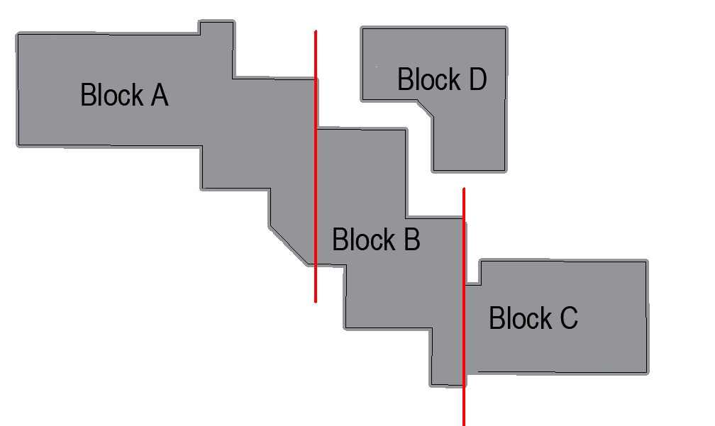
Structural separation

Slide 28
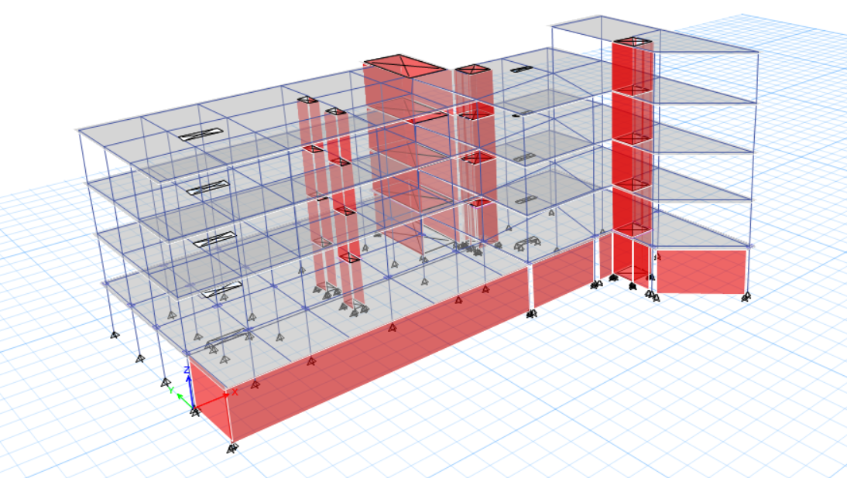
3D-Modeling

Slide 29
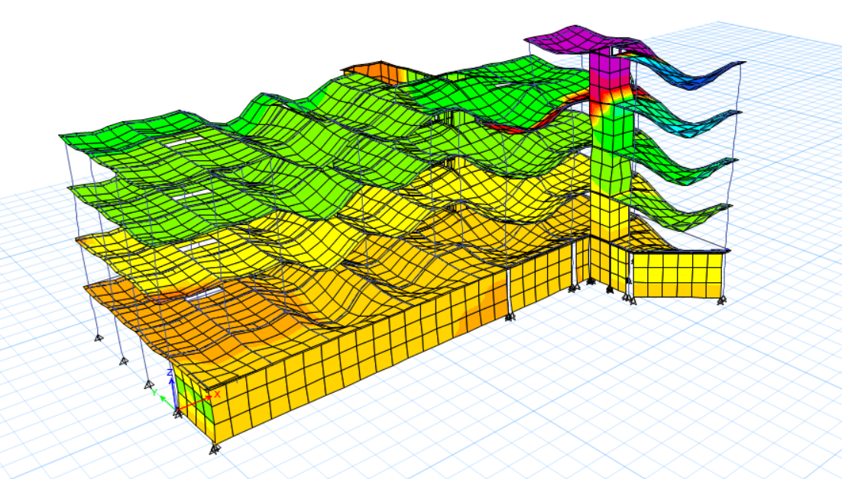
Model Checks
Compatibility check

Slide 30
Model Checks
Equilibrium checks
Done for Dead, SID and Live load within difference less than 5 %.
Stress –strain relation (local equilibrium) checks
Check beams and column from live load within difference less than 10 %.

Slide 31
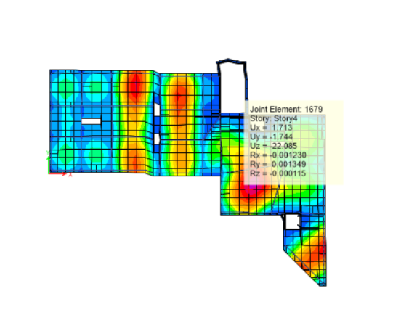
Model Checks
Deflection Check
Limit = L/240
= 8800/ 240
= 36.66 mm

Slide 32
Model Checks
period checks
Period from ETABS = 0.23 sec.
Period from hand calculation= 0.41sec
T from ETABS < 1.4 from hand calc.
0.23 sec.< 0.57 sec.

Slide 33
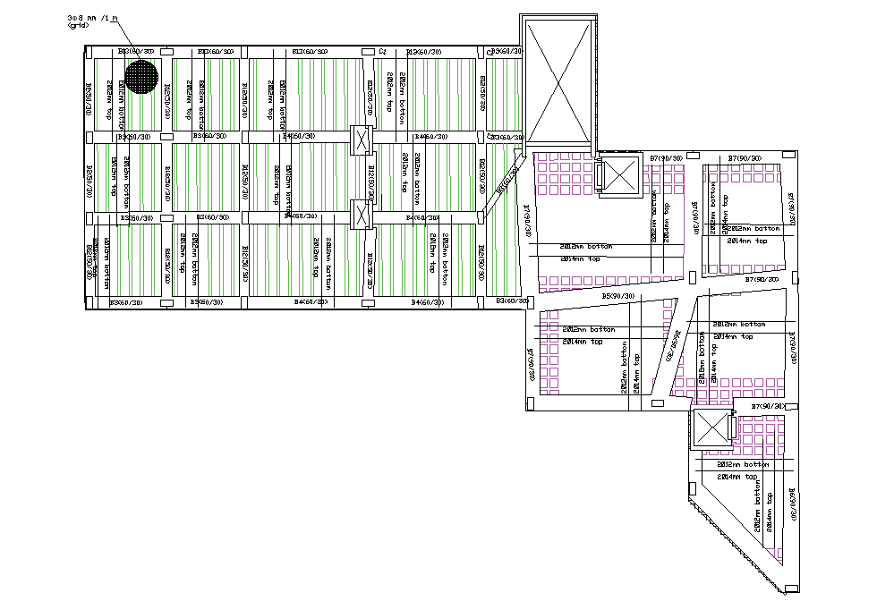
Slab Reinforcement

Slide 34
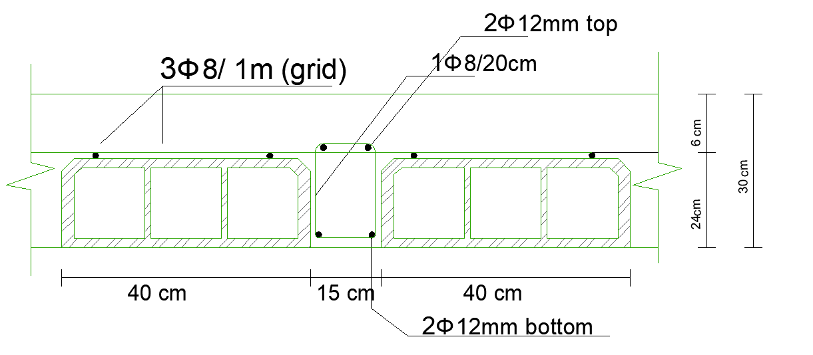
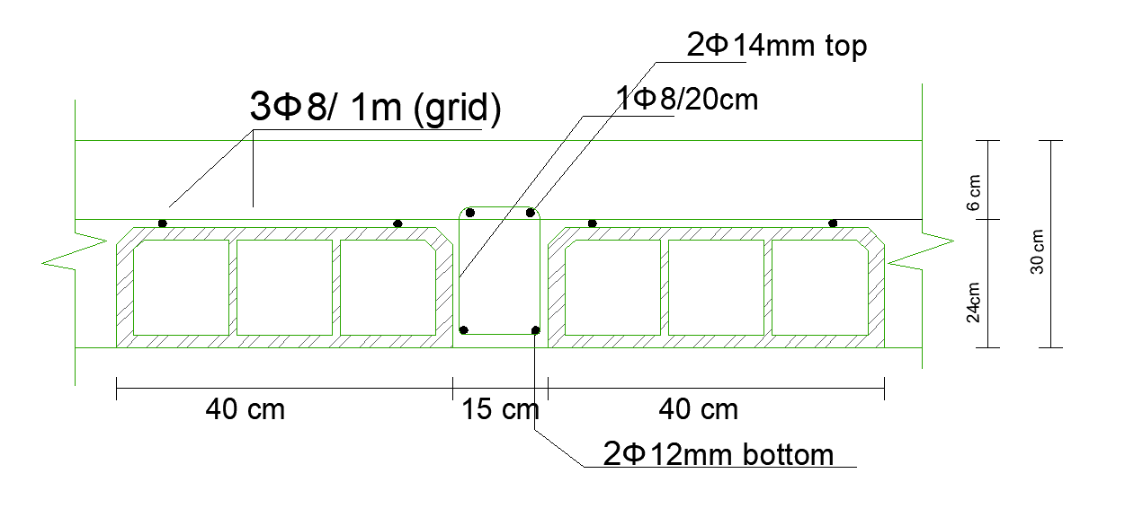
Slab Reinforcement
detailing of one-way slab.
detailing of two-way slab.

Slide 35
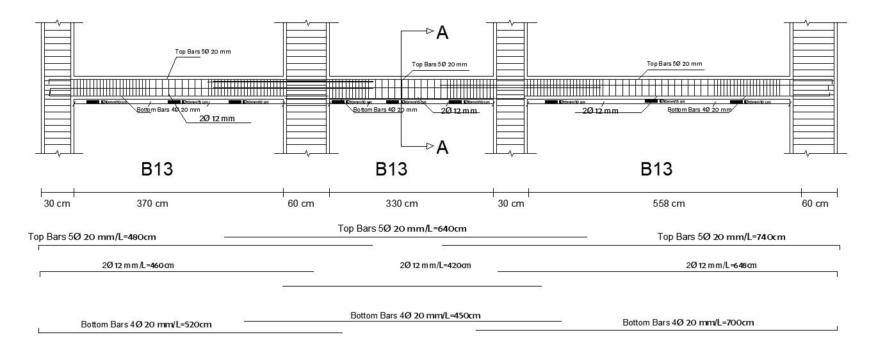
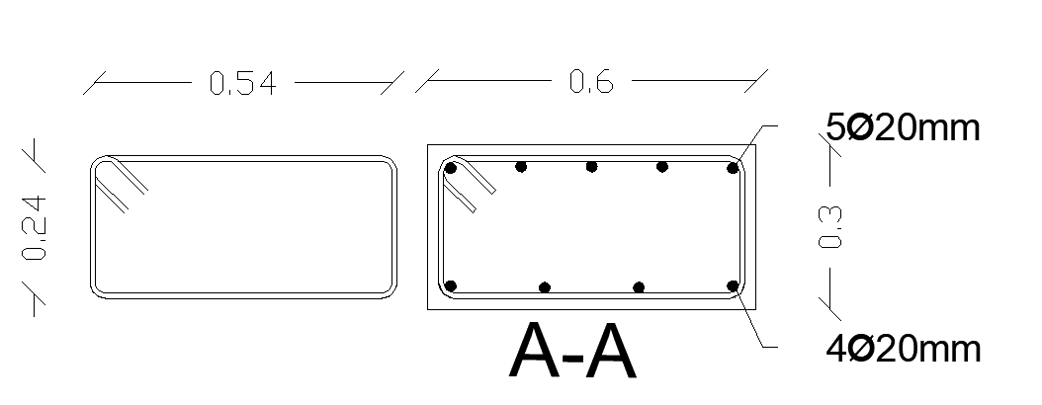
Beam Reinforcement

Slide 36
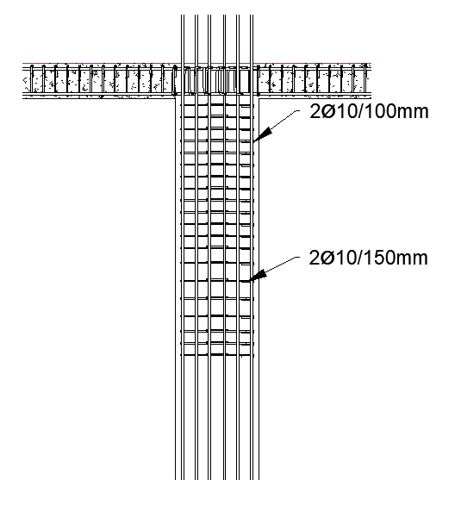
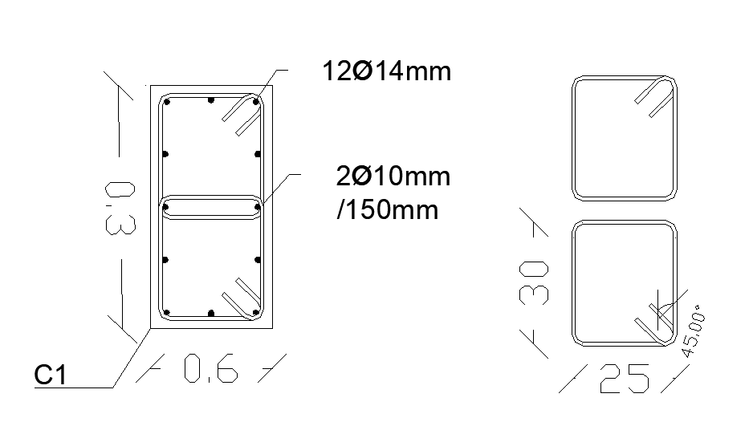
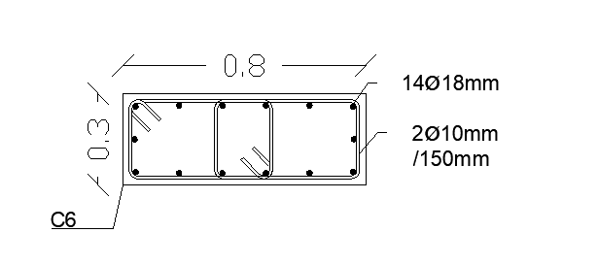
Column Reinforcement

Slide 37
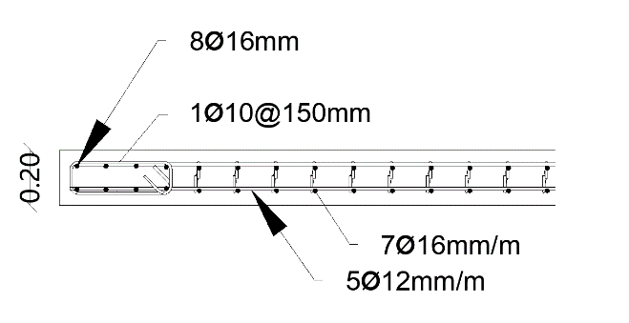
Shear wall Reinforcement

Slide 38
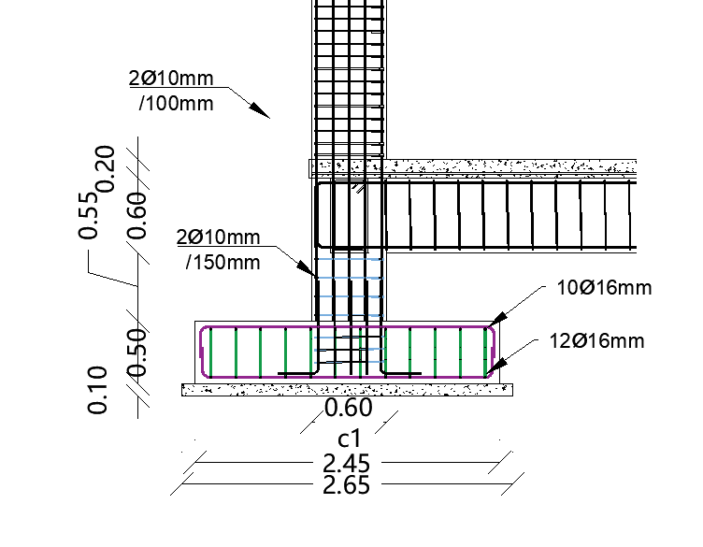
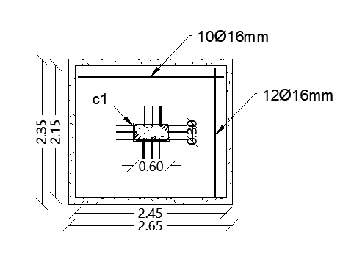
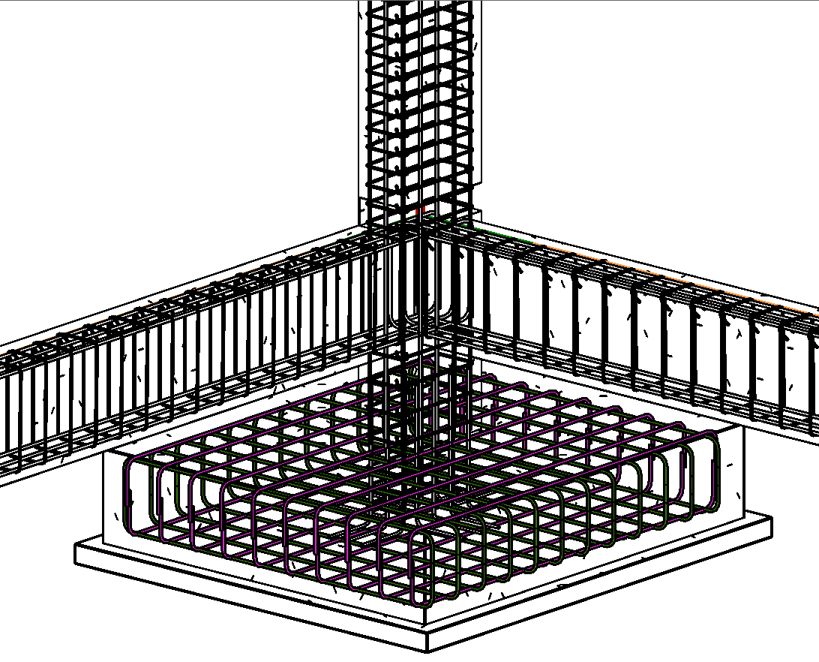
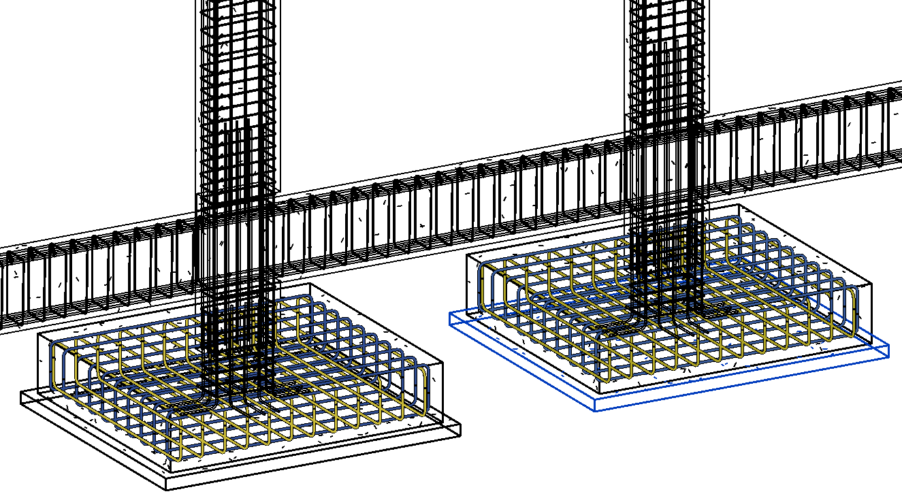
Footing Reinforcement

Slide 39
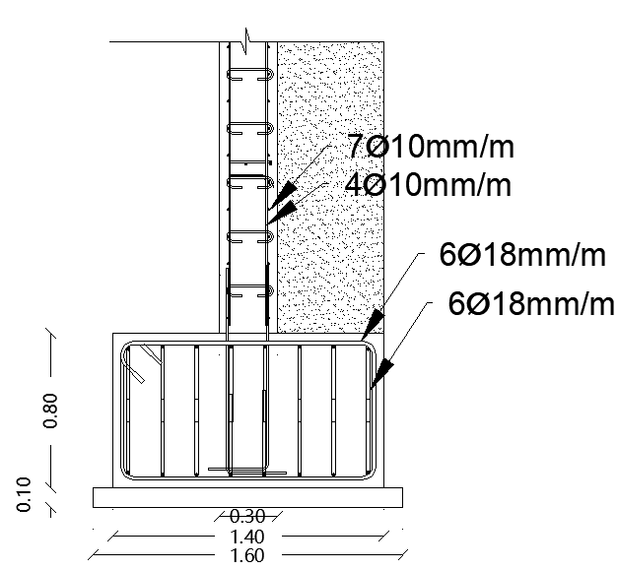
Retaining wall Reinforcement

Slide 40
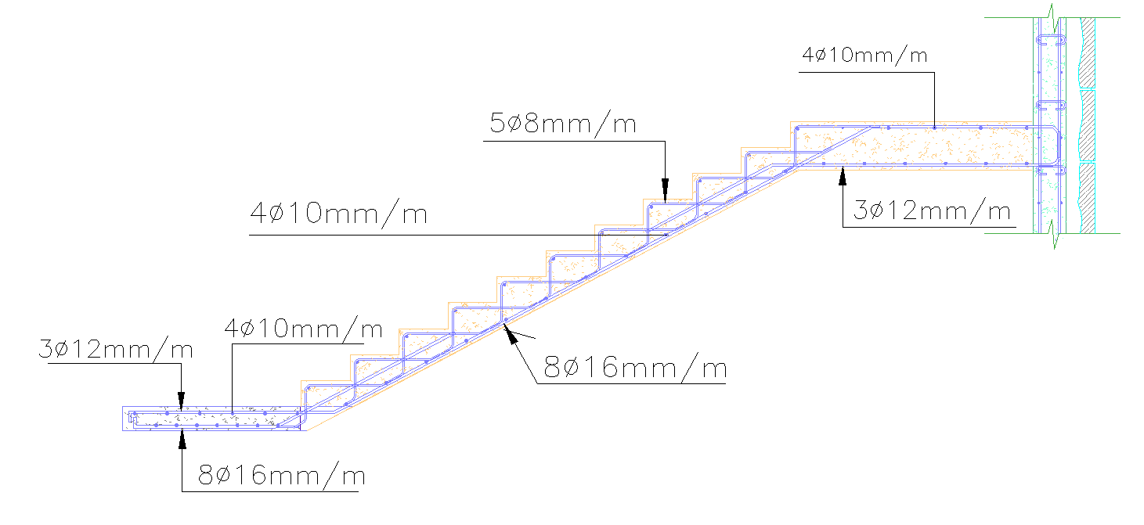
Stair Reinforcement

Slide 41
Environmental Design

Slide 42
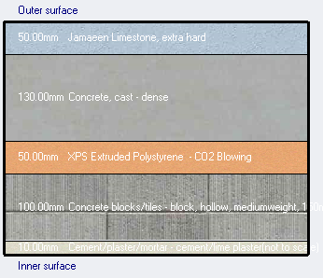
1. Thermal Design
External Wall layers
U-value =0.523 w/m²-k

Slide 43
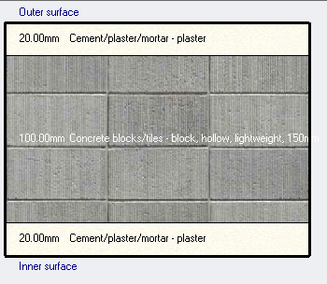
1. Thermal Design
Internal Wall layers
U-value =1.716 w/m²-k

Slide 44
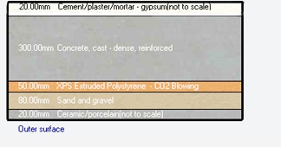
1. Thermal Design
Floor layers
U-value =0.461 w/m²-k

Slide 45
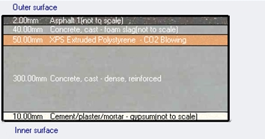
1. Thermal Design
Roof layers
U-value =0.458 w/m²-k

Slide 46

1. Thermal Design
Thermal properties for windows (Double glass, low e, 6mm)

Slide 47

2. Shading
3-D model (design builder) & Sun path

Slide 48


2. Shading
Shading and sun path in Summer
Shading and sun path in Winter

Slide 49


2. Shading
Summer day (sun path 21/7 at 8:00 am )
Summer day (sun path 21/7 at 3:00 pm )

Slide 50


2. Shading
Winter day (sun path 21/1 at 8:00 am )
Winter day (sun path 21/1 at 3:00 pm )

Slide 51
3. Design builder results
Heating and cooling load
Hostel Cooling load = 129 KW
Cafeteria Cooling load = 25 KW
Hostel Heating load = 117 KW
Cafeteria Heating load = 20 KW

Slide 52

3. Design builder results
Comfort PMV ( Predict mean vote)

Slide 53


4. Daylight analysis
D.F% | Space
2.90 | Bedrooms
3.50 | Reception
5.85 | cafeteria

Slide 54

4. Daylight analysis

Slide 55
Acoustical Design

Slide 56
RT60 (Reverberation Time)
component | Finish layer | Absorption coefficient(α)
 |  | 125Hz | 250Hz | 500Hz | 1000Hz | 2000Hz | 4000Hz
Ceiling | Acoustic Tile Suspended | 0.76 | 0.93 | 0.83 | 0.99 | 0.99 | 0.94
wall | Plaster | 0.12 | 0.09 | 0.07 | 0.05 | 0.05 | 0.04
Floor | Tile on concrete | 0.02 | 0.03 | 0.03 | 0.03 | 0.03 | 0.02
window | Double Glazed | 0.41 | 0.35 | 0.25 | 0.2 | 0.15 | 0.14
Door | Hollow Core Plywood | 0.41 | 0.35 | 0.25 | 0.2 | 0.15 | 0.14

Slide 57
RT60 (Reverberation Time)
RT60 for multipurpose hall
At 50 % Occupancy
FREQ. | RT(60)
63Hz: | 0.87
125Hz: | 0.91
250Hz: | 0.93
500Hz: | 0.99
1kHz: | 0.76
2kHz: | 0.52
4kHz: | 0.39
8kHz: | 0.36
16kHz: | 0.38
The Recommended Range (1-1.7 second)
The reverberation time at 500Hz is 0.99 second, which is lower than require range, it's acceptable.

Slide 58
RT60 (Reverberation Time)
RT60 for Conference and studying room
At 50 % Occupancy
FREQ. | RT(60)
63Hz: | 0.76
125Hz: | 0.88
250Hz: | 0.85
500Hz: | 0.55
1kHz: | 0.2
2kHz: | 0.16
4kHz: | 0.21
8kHz: | 0.15
16kHz: | 0.15
The Recommended Range (0.4-0.6 second)
The reverberation time at 500Hz 0.55 second, which is within require range, it's acceptable.

Slide 59


Sound transmission class (STC)
STC for External wall of conference and studying room
STC value is 55 more than 52, which is acceptable.

Slide 60


Sound transmission class (STC)
For conference and studying room adjacent to
conference and studying room.
STC value is 51 more than 50, which is acceptable..

Slide 61

Impact insulation class(IIC)
IIC for conference and studying room
IIC value is 70 more than 52, which is acceptable.
IIC = 70 dB

Slide 62



Loud Speaker Distribution
Distribution of load speaker for cafeteria
The LC1 Modular Ceiling Loudspeaker used

Slide 63



Loud Speaker Distribution
Distribution of load speaker for multipurpose hall
Wall moment speaker (F160G) used

Slide 64
Mechanical Design

Slide 65

    Water drainage system

Slide 66


    Water drainage system

Slide 67

    Water drainage system

Slide 68

    Water drainage system

Slide 69

    Rainwater drainage system

Slide 70

    Rainwater drainage system

Slide 71

    Water supply system

Slide 72

    Water supply system

Slide 73

    Water supply system

Slide 74

    Water supply system

Slide 75

    Water supply system

Slide 76
    Water supply system
pipes | Diameters
Vertical pipes | 2 in
Horizontal pipes | 1.5 in
Branch pipes | 3/4 in

Slide 77

    Water supply system

Slide 78

    Water supply system

Slide 79

    Water supply system

Slide 80
    HVAC system
VRF system used
From Design Builder
Hostel Cooling load = 129 KW
Hostel Heating load = 117 KW
Cafeteria Cooling load = 25 KW
Cafeteria Heating load = 20 KW

Slide 81


    HVAC system
VRF system (Outdoor Unit)
LG selected company
Cooling capacity = 77 KW
Heating capacity = 85 KW
2 Outdoor units for hostel
1 Outdoor units for cafeteria
LG (MULTI V 5) MODEL NO: ARUM264BTE5

Slide 82


    HVAC system
VRF system (Fan coil)
LG selected company
Cooling capacity = 2.20 KW
Heating capacity = 2.50 KW

Slide 83

    HVAC system
Ground floor HVAC system layout

Slide 84

    HVAC system
Reflective Ceiling plans

Slide 85

    HVAC system
Reflective Ceiling plans

Slide 86

Elevators design
Number of elevators should be used in building is 2+1 capacity 1143 kg with speed 2 m/s.

Slide 87
Electrical Design

Slide 88

Power (Sockets) plan for bedrooms

Slide 89

Low voltage plan for bedrooms

Slide 90

Hostel Ground floor lighting plan

Slide 91



Hostel Bedrooms lighting plan

Slide 92

Cafeteria First floor lighting plan

Slide 93

Luminaires used

Slide 94

3D Rendering from Dialux Evo 8

Slide 95


3D Rendering from Dialux Evo 8

Slide 96

3D Rendering from Dialux Evo 8

Slide 97




3D Rendering from Dialux Evo 8
UGR = 13 < 19
Illuminance avg. = 206 Lux
Illuminance avg. = 210 Lux

Slide 98
Fire & Safety Design

Slide 99

Fire system
1. Fire extinguishers

Slide 100



Fire system
2. Sprinklers system
Pendant sprinklers
Side wall sprinklers

Slide 101

Fire system
3. Hose Station

Slide 102

Fire system
4. Emergency Exit

Slide 103
Cost Estimation
Hostel and Cafeteria | Total Direct Cost (NIS)
Structural work | 6,174,752
Finishing Work | 3,898,847
Mechanical Work | 1,541,642
Electrical Work | 334,463
Total direct project cost | 11,949,704
Unit Direct Cost = 11949704/5026 = 2377 Nis /m²
Unit Direct Cost = 465 JD /m²

Slide 104
References
ACI. (2008). Building code requirements for structural concrete (ACI 318M-08) and Commentary. American Concrete.
ASCE Code (for load combination).
Adler, D. (2007). METRIC HANDBOOK Planning and Design Data.
E. Neufert and P. Neufert, “Architects’ Data.” p. 648, 2000.
Benjamin Stein and John S. Reynolds, “Mechanical and Electrical Equipment for Buildings”, 11th Edition, 2010, John Wiley & Sons.
“Arriyadh Housing - Birzeit University” Drawing and Specifications

Slide 105
THANK YOU

