Slide 1
DESIGN OF JENAN BUILDING
PREBERD BY:
OSAMA GHANNAM
AHMAD KALBOUNEH
QUSAY DEEB
RBEE`JDAAN

Slide 2
Design of beams
sample calculation (B3) at grid 11(E-H). :
As top = 2000 mm² (Flexure) + 267 mm² (Torsion) = 2267 mm².
As,min = 0.00333*b*d = .00333* 600 * 310 = 620 mm² … (2000 > 620 )
Use top steel=9∅18
bars spacing : 600 - 2*50 = 8*S + 9*18 …… S = 42 mm
As bottom from sap = 1547 mm²
Use bottom steel = 7∅18
bars spacing : 600 - 2*50 = 6*S + 7*20 …… S = 77 mm

Slide 3
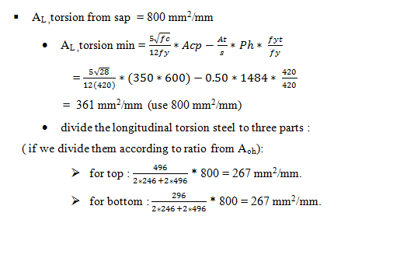

Slide 4
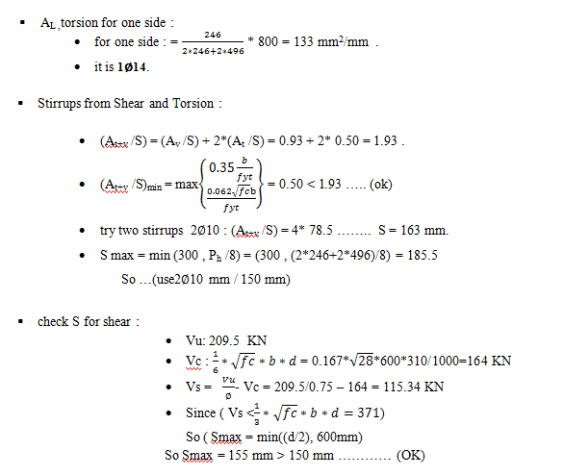

Slide 5
Design of beams
Beam | width cm | Depth cm | Top reinforcement | bottom reinforcement | One-side reinforcement
B1 | 40 | 35 | 6∅16 | 4∅16 | 1∅14
B2 | 40 | 35 | 4∅16 | 3∅16 | 1∅14
B3 | 60 | 35 | 9∅18 | 7∅18 | 1∅14
B4 | 60 | 35 | 8∅18 | 6∅18 | 2∅12
B5 | 60 | 35 | 9∅18 | 6∅18 | 1∅12
B6 | 50 | 35 | 6∅16 | 4∅16 | 1∅14
B7 | 35 | 35 | 3∅16 | 4∅16 | 2∅12
B8 | 100 | 35 | 8∅18 | 7∅18 | 2∅12
B9 | 60 | 35 | 6∅16 | 5∅16 | 1∅12

Slide 6
Beam | width | Depth | (A_{v}/S)_{sap} | (A_{t}/S)_{sap} | (A_{t+v}/S) _{=Av/S+2(At/S)} | (A_{t+v}/S)_{min} | (A_{t+v}/S)_{used} | Shear and torsion reinforcement
B1 | 40 | 35 | 0.33 | 0.125 | 0.58 | 0.33 | 0.58 | 1∅8 mm /130 mm
B2 | 40 | 35 | 0.33 | 0.130 | 0.59 | 0.33 | 0.59 | 1∅8 mm / 130 mm
B3 | 60 | 35 | 0.93 | 0.500 | 1.93 | 0.50 | 1.93 | 2∅10 mm / 150 mm
B4 | 60 | 35 | 0.56 | 0.760 | 2.08 | 0.50 | 2.08 | 2∅10 mm / 150 mm
B5 | 60 | 35 | 0.42 | 0.400 | 1.22 | 0.41 | 1.22 | 2∅12 mm / 150 mm
B6 | 50 | 35 | 0.60 | 0.364 | 1.33 | 0.41 | 1.33 | 1∅12 mm / 150 mm
B7 | 35 | 35 | 0.20 | 0.520 | 1.24 | 0.29 | 1.24 | 1∅12 mm / 120 mm
B8 | 100 | 35 | 0.50 | 0.900 | 2.3 | 0.83 | 2.3 | 2∅10 mm / 130 mm
B9 | 60 | 35 | 0.56 | 0.760 | 2.08 | 0.50 | 2.08 | 2∅10 mm / 150 mm

Slide 7
Design of columns
C8 | C7 | C6 | C5 | C4 | C3 | C2 | C1 | Floors
1000x300 | 400x1100 | 500x1100 | 500x1300 | 1300x500 | 1100x500 | 1200x500 | 1100x400 | base2 – 2
1000x300 | 400x1000 | 500x1000 | 500x1200 | 1200x500 | 1000x500 | 1100x500 | 1000x400 | 3- 4
900x300 | 400x900 | 500x900 | 500x1100 | 1100x500 | 900x500 | 1000x500 | 900x400 | 5-7
800x300 | 400x800 | 500x800 | 500x1000 | 1000x500 | 800x500 | 900x500 | 800x400 | 8- 10
700x300 | 400x700 | 500x700 | 500x900 | 900x500 | 700x500 | 800x500 | 700x400 | 11-12
600x300 | 400x600 | 500x600 | 500x800 | 800x500 | 600x500 | 700x500 | 600x400 | 13- 15
C10 | C9 | Floors
600x300 | 700x300 | base2 – base 1
……… | 700x300 | GF -2

Slide 8
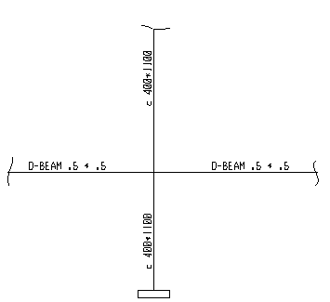

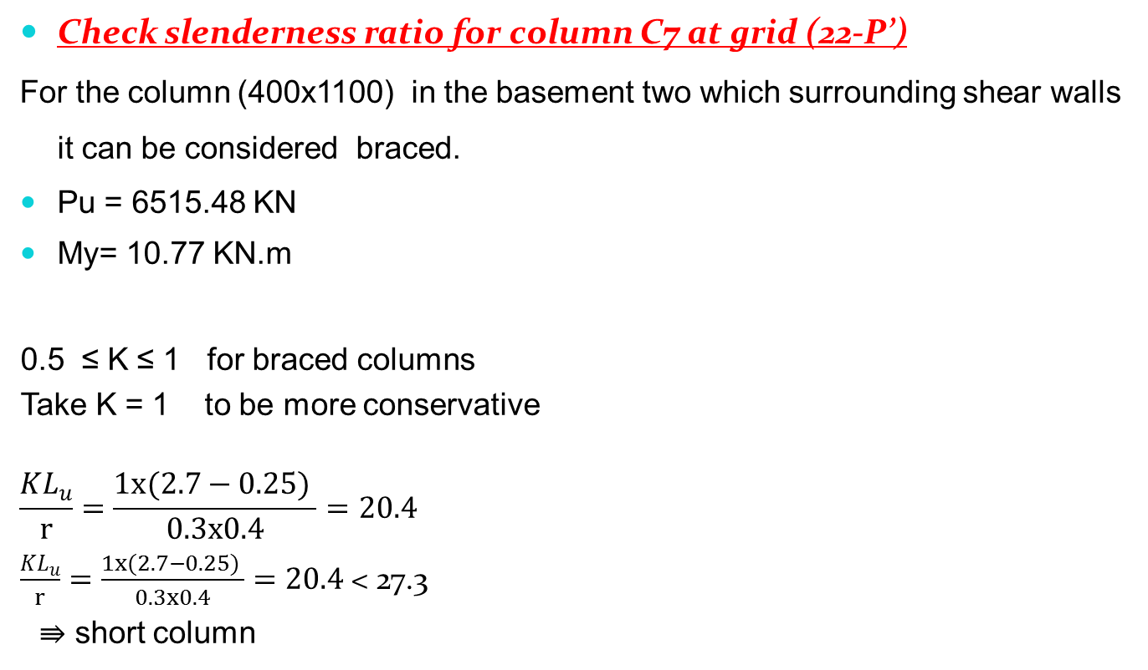
Check slenderness ratio for column C7 at grid (22-P’)
For the column (400x1100) in the basement two which surrounding shear walls it can be considered braced.
Pu = 6515.48 KN
My= 10.77 KN.m
0.5 ≤ K ≤ 1 for braced columns
Take K = 1 to be more conservative
$$\frac{KL_{u}}{r}=\frac{1x(2.7−0.25) }{0.3x0.4}=20.4$$
$\frac{KL_{u}}{r}=\frac{1x(2.7−0.25) }{0.3x0.4}=20.4$< 27.3
⇛ short column

Slide 9
M_{ymin} = P_{u} (0.015+0.03h)
= 6515.48 x (0.015+0.03 x 0.4) = 176.0 KN.m > M_{y}= 10.77 KN.m
Design loads : Pu = 6515.48 KN, Mu = 176.0 KN.m
By using interaction diagrams:
ρ = 0.01 = 1.0%
From SAP ρ = 1.0% , OK…. As = 4400 mm²
Using 18φ18 mm

Slide 10
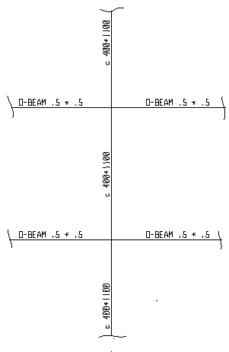

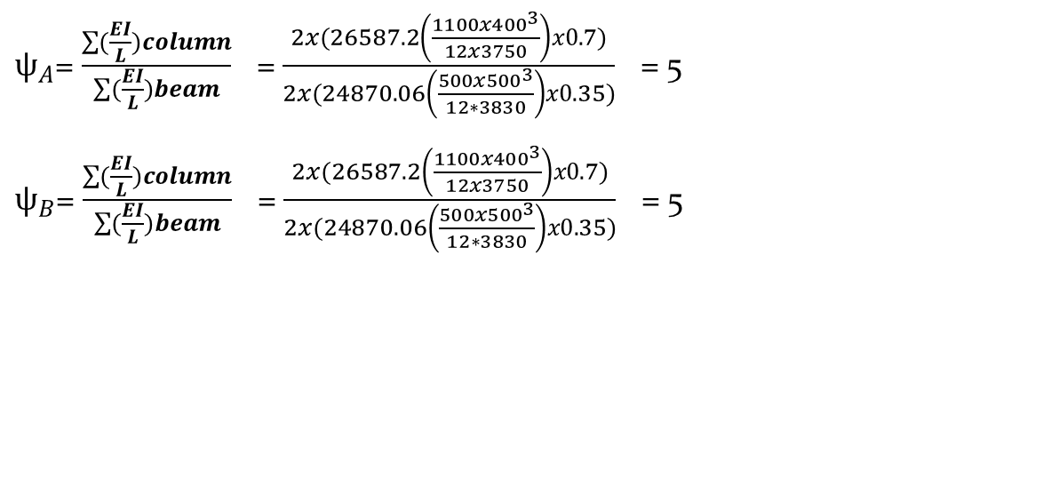
For un-braced column at ground floor level to the roof
$ψ_{A}$= $\frac{\sum{(\frac{EI}{L})column}}{\sum{(\frac{EI}{L})beam}}$ = $\frac{2x(26587.2\left(\frac{1100x{400}^{3}}{12x3750}\right)x0.7)}{2x(24870.06\left(\frac{500x{500}^{3}}{12∗3830}\right)x0.35)}$ = 5
    $ψ_{B}$= $\frac{\sum{(\frac{EI}{L})column}}{\sum{(\frac{EI}{L})beam}}$ = $\frac{2x(26587.2\left(\frac{1100x{400}^{3}}{12x3750}\right)x0.7)}{2x(24870.06\left(\frac{500x{500}^{3}}{12∗3830}\right)x0.35)}$ = 5

Slide 11
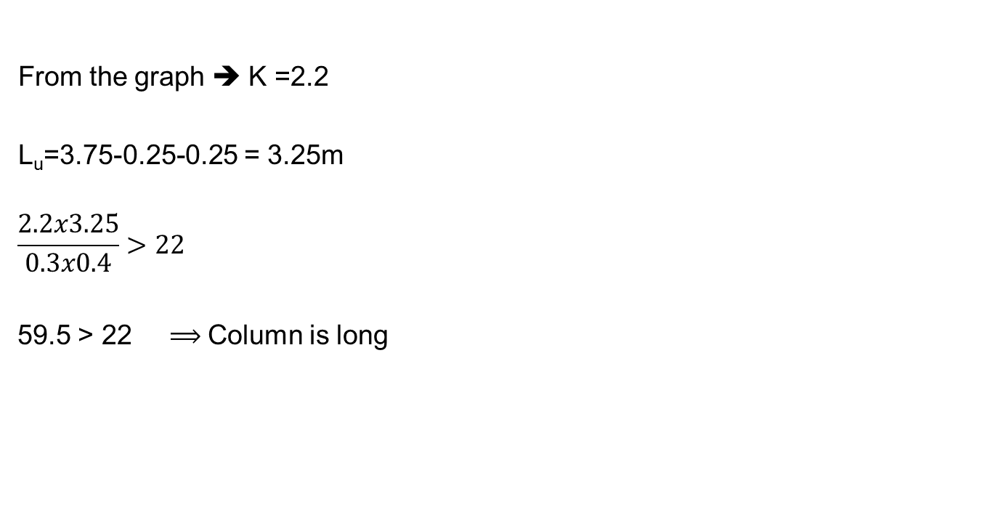
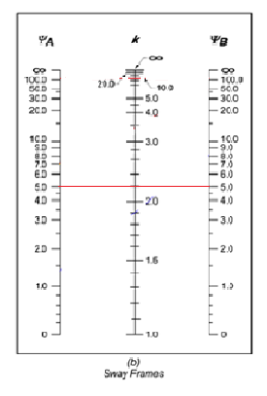
Pu = 5518 KN.
MY= 7.1 KN.m
Mymin= Pu (0.015+0.03h) (h in m)
= 5518 x(0.015+0.03x 0.4) = 150 KN.m > 7.1KN.m
take My = 150 KN.m

Slide 12
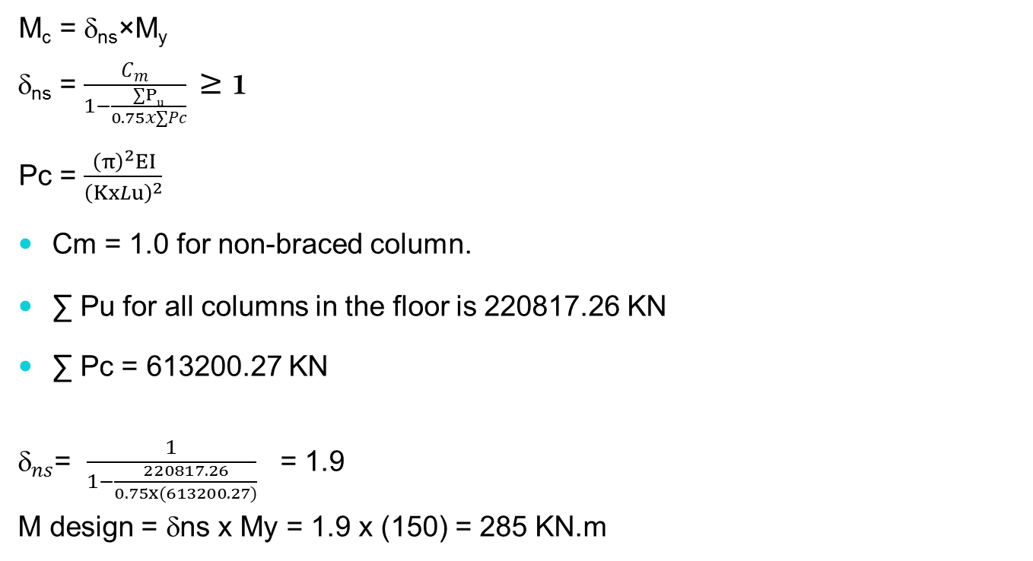

Slide 13
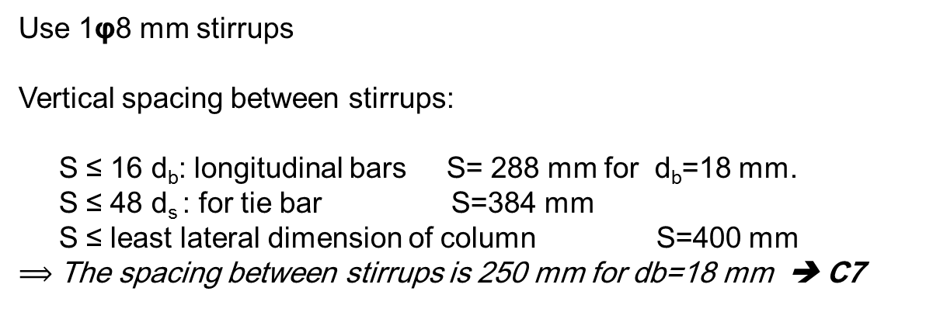
By using interaction diagrams:
ρ = 0.01 = 1.0%
From SAP ρ = 1.0% , OK…. As = 0.01x1100x400 = 4400 mm² Using 18φ18 mm
Design of stirrups

Slide 14
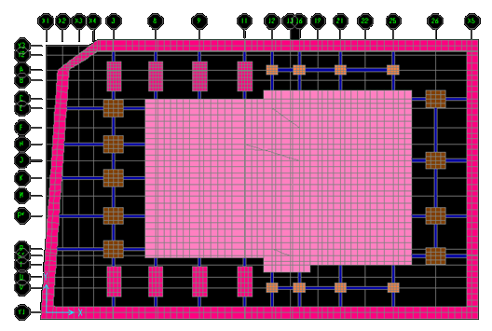
Design of footings
Footings must be designed to carry the column loads and transmit
them to the soil safely while satisfying code limitations.
The area of the footing based on the allowable bearing soil capacity.
Wide beam shear.
Punching shear.
Differential settlement
Bending moment and
steel reinforcement required.

Slide 15
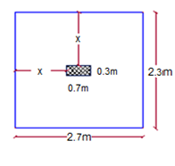
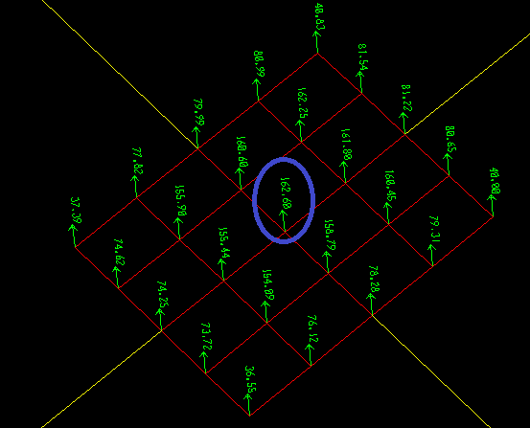
Single Footing Design
Take the sample footing "F1" for column grid "P'-3"
Column dimension 0.7x0.3
Area = Service load / qall =2370/ 400 = 5.93 m²
Area = 2.7x2.3 = 6.21m²
H= 700mm
Check stress under the footing
For stress taking the maximum one
, which is 162.6 KN.
Tributary area of mish =0.4 m²
162/0.4 = 406.5 KN/m²,
approximately equal qall (400 KN/m² )
which is OK

Slide 16
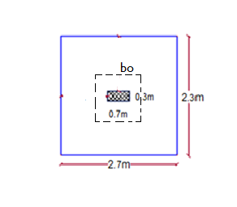
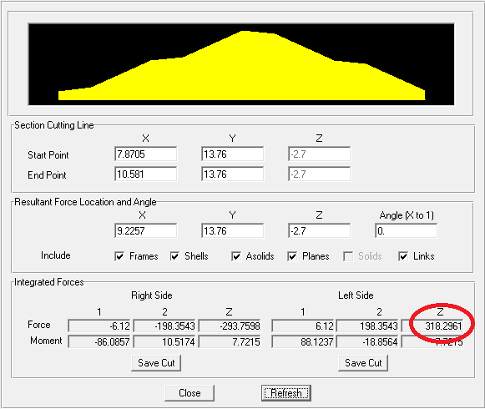
Check for punching
Pu = 3055.9 KN
H= 700mm, D= 630mm
Bo =4520mm. Ao = 1.237 m²
qu = 494.57 KN/m² Vup = 2444.12 KN.
ØVcp = 3767 KN.
Vup < ØVc OK.
wide beam shear
ϕVc = 1125 KN/ 2.7 m
Vu at distance "d"= 630 mm
Vu = 318.30 KN

Slide 17
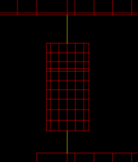
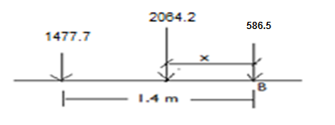
Reinforcement
+Mu =505.62 KN.m / 2.7m
ρ = 0.00126
As = 0.00126 x 2700 x 630 = 2143.481 mm².
As,min = 0.0018x 2700x700= 3402 mm²,
use As min 7Ф16/m.
Combined Footing Design
A-9 P service = 1477.7 KN
B-9 P service = 586.5 KN
Total service load = 2064.2 KN
area = 2 x 4 = 8 m²
Try : H = 600mm d = 530mm

Slide 18
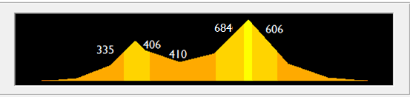
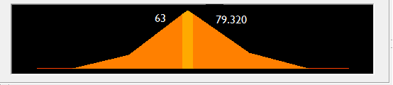
Reinforcement
Longitudinal steel
+Mu =684.1 KN.m
ρ = 0.00331
As= 0.00331 x 2000 x 530 = 3508.6 mm².
As min = 2160mm² < As
use As , use 17 ϕ 16 / 2 m ……… , 9ϕ 16/m
use shrinkage steel = 0.0018 x 1000 x 600 = 1080 mm² , 6ϕ 16/m
In the transverse direction
+Mu =79.32 KN.m
ρ = 0.00055
As= 396.44 mm².
As min = 1468.8 mm²
use As min , use 8 ϕ 16 / 1.3 m ………6ϕ 16 / m

