Slide 1
An Attempt To Predict The Daily And Monthly Prices Of Public Shareholding Companies Traded In The Palestinian Stock Exchange (PEX)

Slide 2
INTRODUCTION
Research Introduction
Teem Members
Supervisor
Basheer Sa’d
Sondos Abushihab
Ghadeer Daraghmeh
Dr. Maher Arafat

Slide 3
OUTLINE
Problem Specification
Project Scope
Methodology
Conclusion & Recommendations

Slide 4
Problem Specification

Slide 5
Problem Specification
Extraordinary profits can not be gained by the investor.
Is it possible to rely on current stock prices to predict future stock prices?
Is it possible to identify which sectors are most suitable for investment?
What is the accuracy of the prediction process?

Slide 6

What Is the Palestinian Stock Exchange (Pex)
About the Palestinian Financial Market
The Palestinian Stock Exchange (PEX)
Is the only stock exchange in Palestine based in Nablus. The first trading session was held on February 18, 1997. It was the first Arab stock exchange to allow the use of electronic and mechanical technology for money trading.

Slide 7
Data Filtering and Arrangement
Neural networks and their working mechanisms:
Data History "Companies": -
High Price
Low Price
Volume
Value
Close Price

Slide 8
Methodology of Work

Slide 9
Methodology
A background for the current used methodology and the proposed analysis.
In A description of the new methodology, the characteristics of it ,
the reasonable views on why would our study be an efficient way to solve the previously mentioned problems.

Slide 10
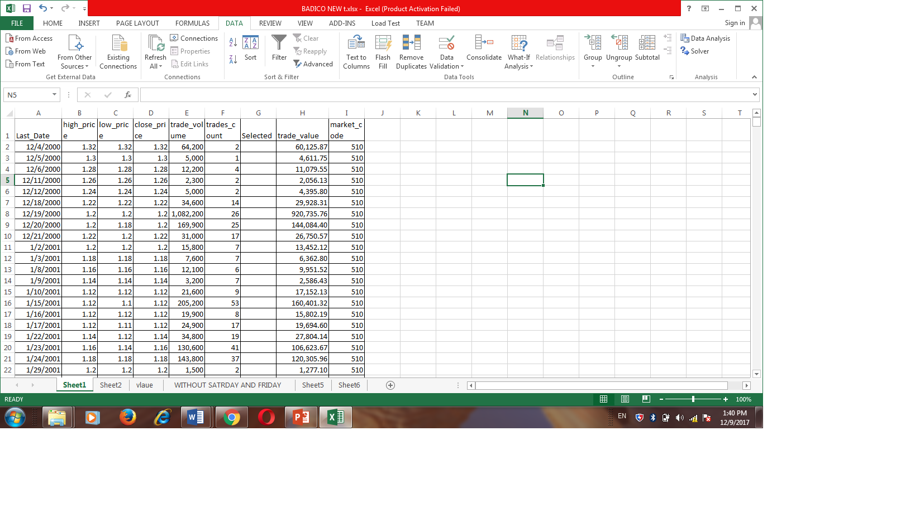
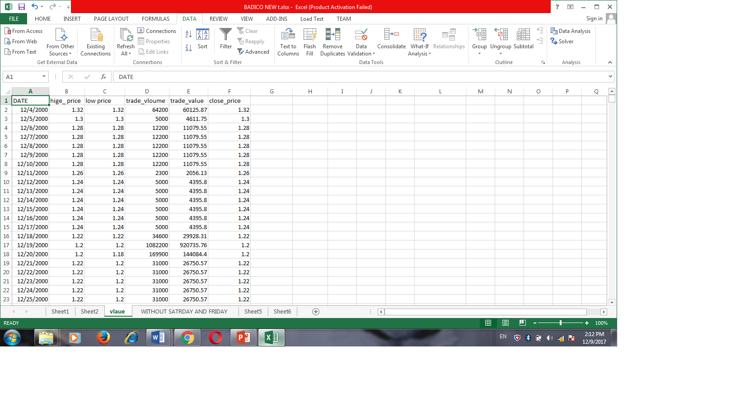
Data Filtering and Arrangement
The data were arranged to be suitable to be used for neural networks.
Figure a1: Data history before being ordered and used as listed in the financial market
Figure a2: Data History after being order to be prepared for prediction

Slide 11
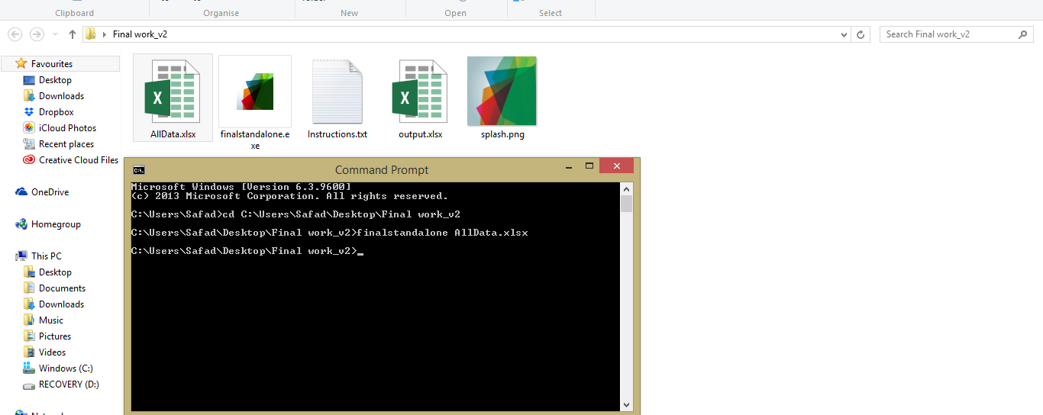
Neural Network
Figure 2: A screenshot of using the neural network

Slide 12
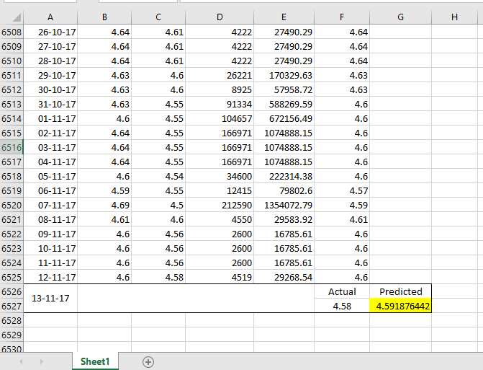
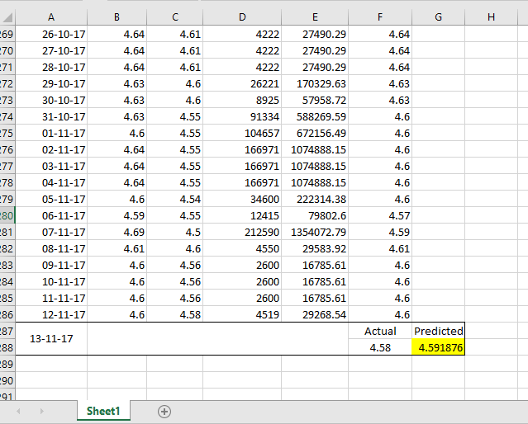
PREDICTING THE CLOSE PRICE
All Data From 2000-2017
One Year

Slide 13
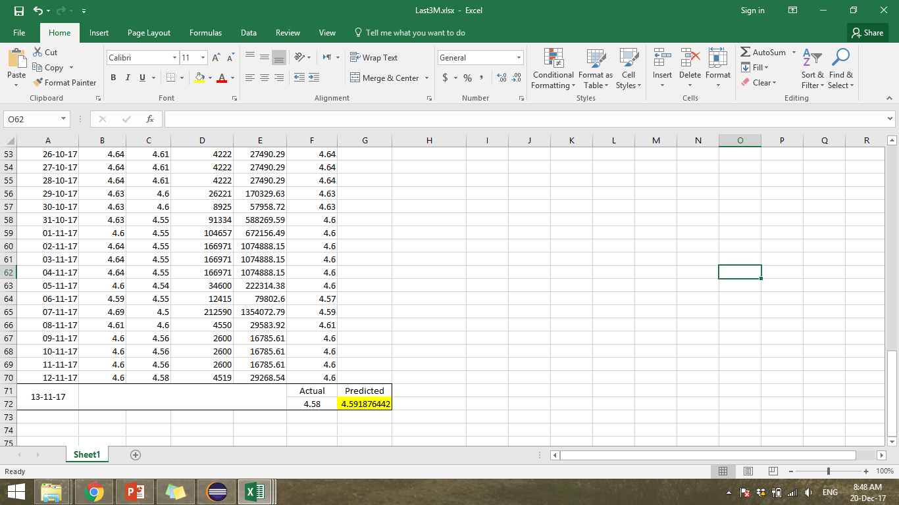
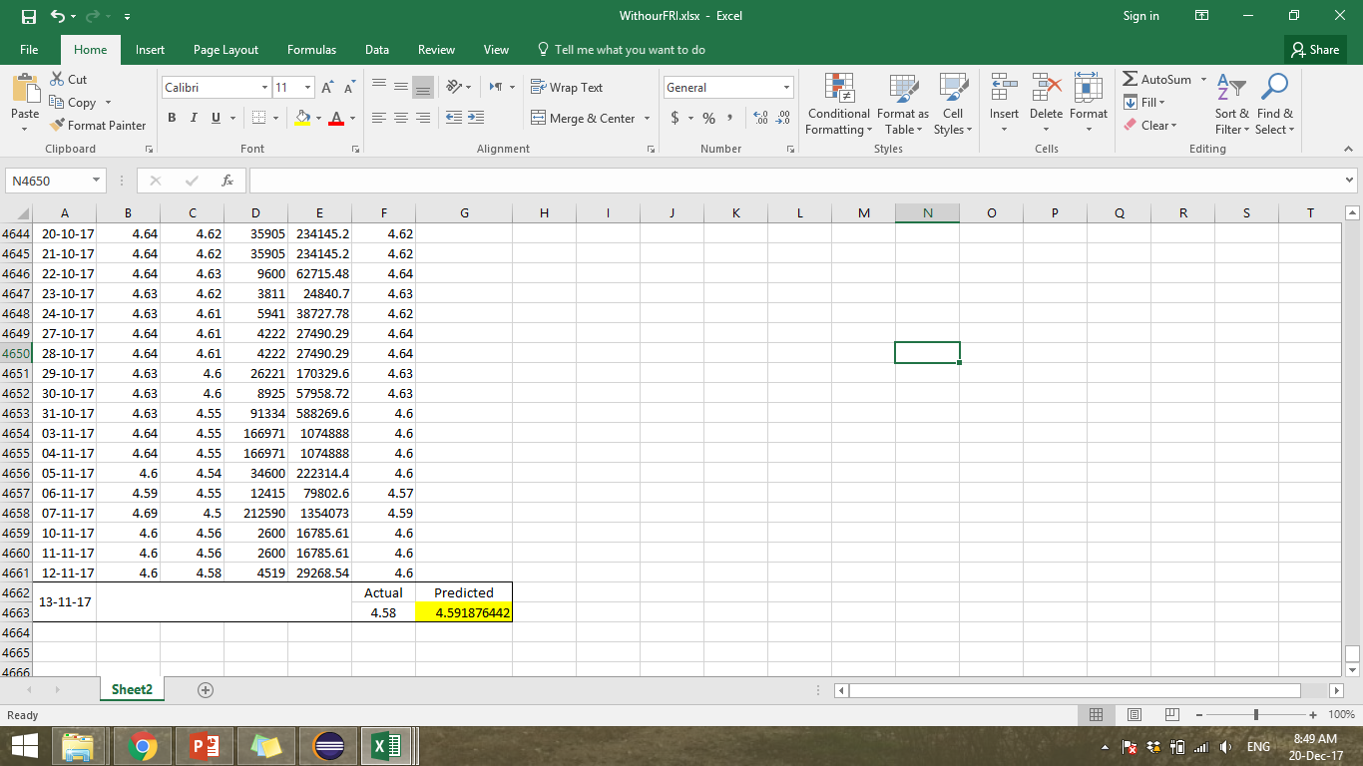
PREDICTING THE CLOSE PRICE
Last 3 Months
Without Fridays and Saturdays

Slide 14
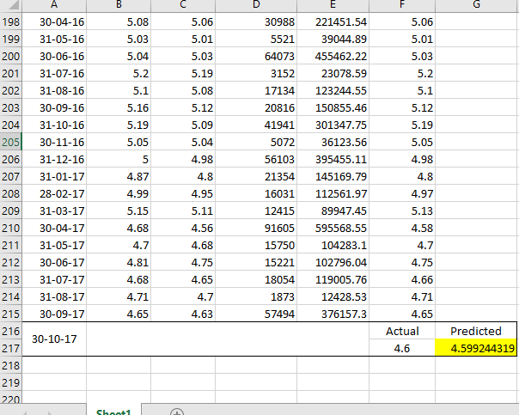
PREDICTING THE CLOSE PRICE
Months

Slide 15
SECTORS

Slide 16
SECTORS
Banking
Arab Islamic Bank, Bank Of Palestine, Palestine Islamic Bank, Palestine Investment Bank, Palestine Securities Exchange, Al Quds Bank, The National Bank
Industry
Arab Company For Paints Products, Palestine Poultry, Beit Jala Pharmaceutical, Birzeit Pharmaceuticals, Al Shark Electrode, Golden Wheat Mills, Jerusalem Cigarette, Jerusalem Pharmaceuticals, Palestine Plastic Industries

Slide 17
Insurance
Ahliea Insurance Group(**), Global United Insurance, Al Mashriq Insurance, National Insurance, Palestine Insurance, Al-takaful Palestinian Insurance, Trust International Insurance
Investment
Arab Palestinian Investment "Apic“, Al-aqariya Trading Investment, Arab Investors, Jerusalem Real Estate Investment, Palestine Development & Investmen, Palestine Investment & Development ,Palestine Industrial Investment
Services
Al-wataniah Towers, The Arab Hotels, Arab Real Estate Establishment(*), Globalcom Telecommunications(*), Nablus Surgical Center, Palaqar For Real Estate Dev.

Slide 18
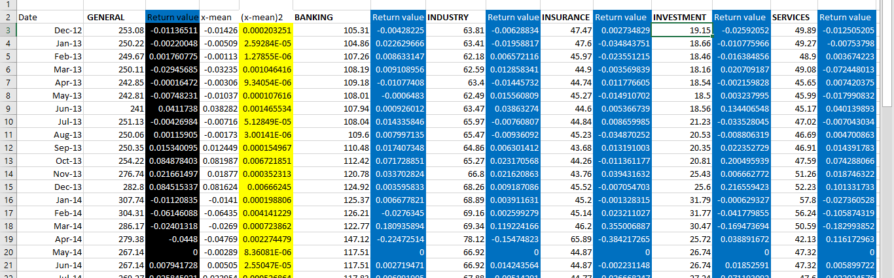
SECTORS
Figure 3: A screenshot of All Sectors Before Ordering And Statistical Analysis

Slide 19
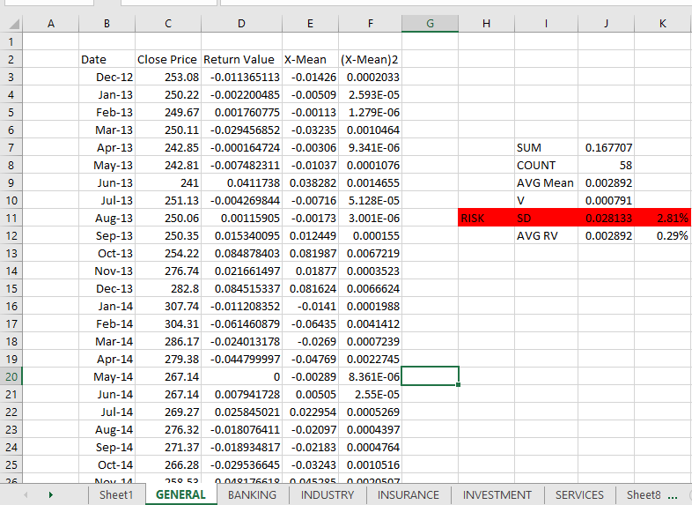
SECTORS
Figure 4-a: A screenshot of the General Sector

Slide 20
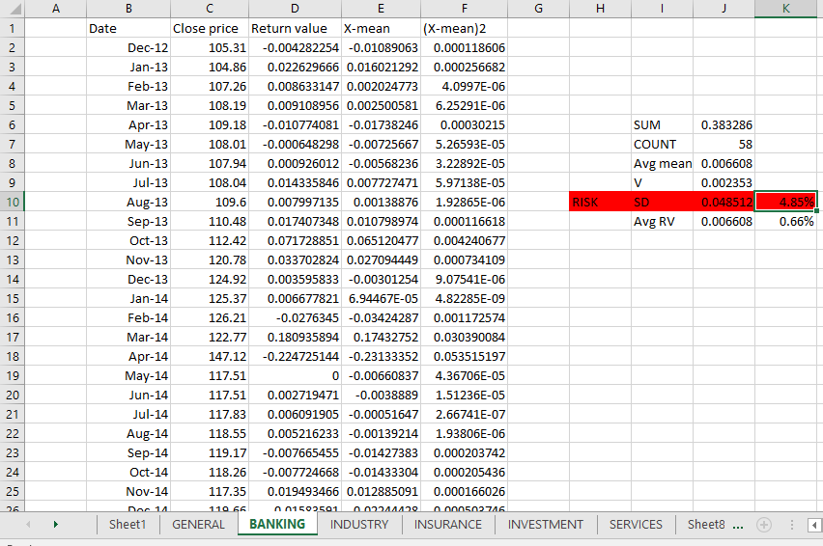
SECTORS
Figure 4-b: A screenshot of the Banking Sector

Slide 21
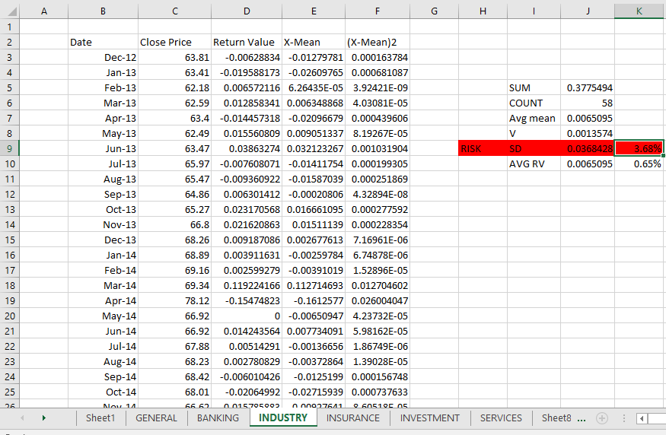
SECTORS
Figure 4-c: A screenshot of the Industry Sector

Slide 22
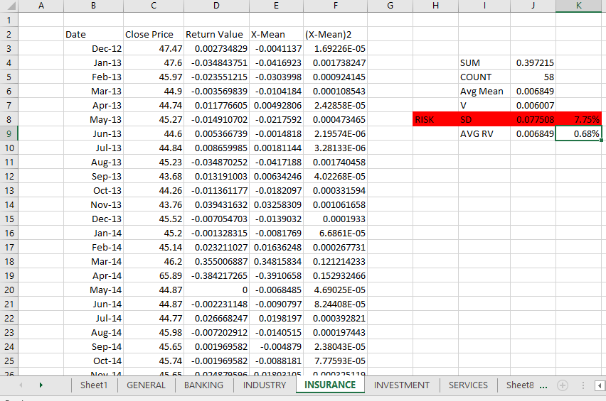
SECTORS
Figure 4-d: A screenshot of the Insurance Sector

Slide 23
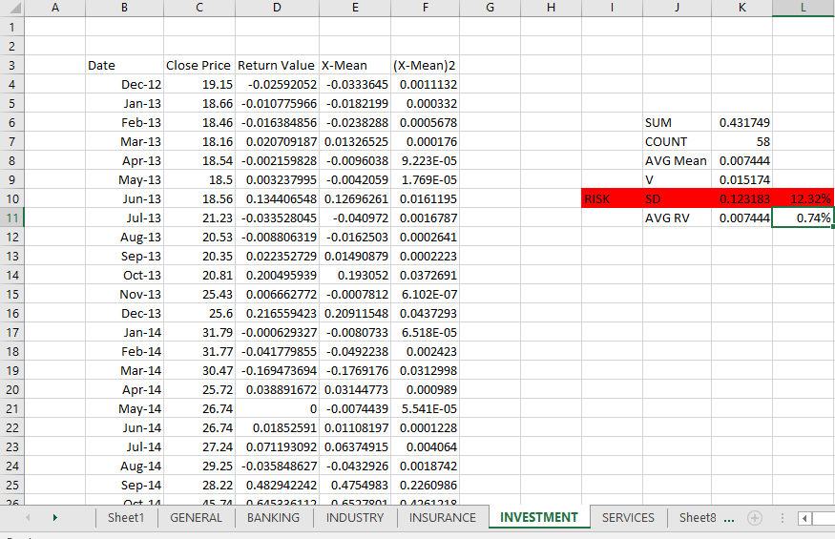
SECTORS
Figure 4-e: A screenshot of the Investment Sector

Slide 24
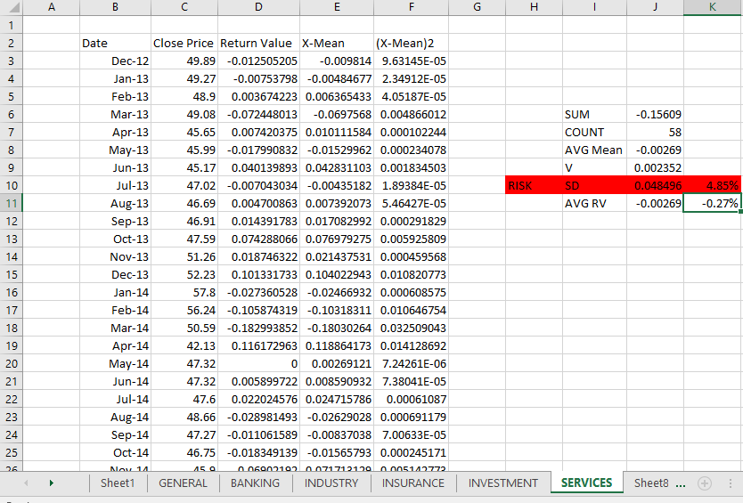
SECTORS
Figure 4-f: A screenshot of the Services Sector

Slide 25
SECTORS
Figure 5: Investment Risk and Return Value of All Sectors

Slide 26
RETURN VALUE
Figure 6: Return value of the companies in the Investment Sector

Slide 27
5 IMPORTANT RESULTS
Ability to find the best way to use data history in the prediction process
ACCORDING TO OUR STUDY
Prove that it is possible to rely on previous data history for companies in the prediction process.
Ability to predict the close price of any company through its previous data on a daily and monthly basis.
Ability to determine the accuracy of reliance on the data of the previous data history of companies in the monthly and daily predicting process, which appears through the results of the technology used.
Ability to identify the best sectors economically

Slide 28
RECOMMENDATIONS
The huge role of the experience and intuition of the investor
The factor of experience and intuition of the investor plays a huge role and no less important than the technique followed, so it can be considered that the proportion of the accuracy of technology is intuition and experience.
Taking in Consideration :
The economic situation of the country
Currency exchange rates,

Slide 29
THANK YOU!
Any Questions?

