Slide 1
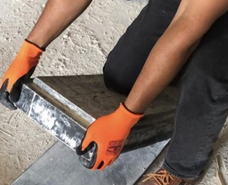

Design and Construction of Automatic Demolding Machine for Artificial Stone
Graduation Project 2
An- Najah National University
Faculty of Engineering & Information Technology
Department of Industrial and Mechanical Engineering
Prepared by:
Ehab Alfe
Tahseen Odeh
Waled Rashed
Supervisor
Dr.Ahmad Ramahi
4.7.2024

Slide 2
OUTLINE
01
02
03
04
05
06
Design of the Automatic Demolding Machine
INTRODUCTION
METHODOLOGY
Manufacturing and Assembly Operation
Preliminary Financial Analysis
CONCLUSION

Slide 3
01
INTRODUCTION

Slide 4

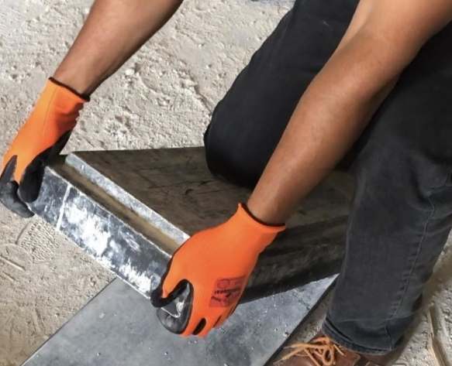
Problem Statement
Problem
Solution
Automate the production processes in the Artificial stone industry, in particular, automate the demolding process.
Increased demand for artificial stone.
However, factories rely on manual labor in the demolding process.
Manual demolding has limited production capacity.
The main goal of this project Design and fabricate an automatic demolding model for artificial stone to replace human labor.

Slide 5
02
METHODOLOGY

Slide 6
Conduct a preliminary market study
Explore the different working principles of machines
Choose the best working principle of the machine
Design and Fabrication
financial analysis
Implement the working principle with all necessary components on SolidWorks.

Slide 7
The demolding process represents a bottleneck.
The manual demolding rate is 157 stones/hour
Stone demolding machines have been studied around the world.
After practical trials, the vibrator was chosen

Slide 8
03
Design of the Automatic Demolding Machine

Slide 9
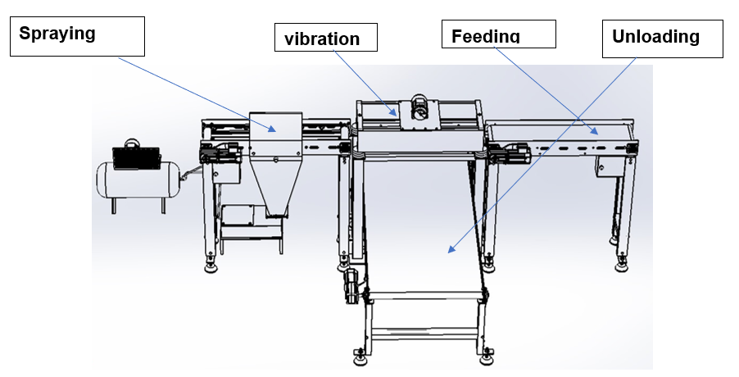
1- Machine building blocks (Processes)

Slide 10
Feeding Conveyer

Slide 11
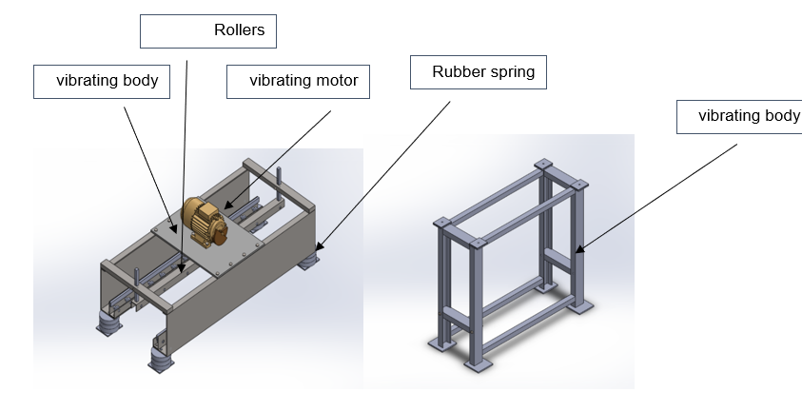
Vibrator

Slide 12
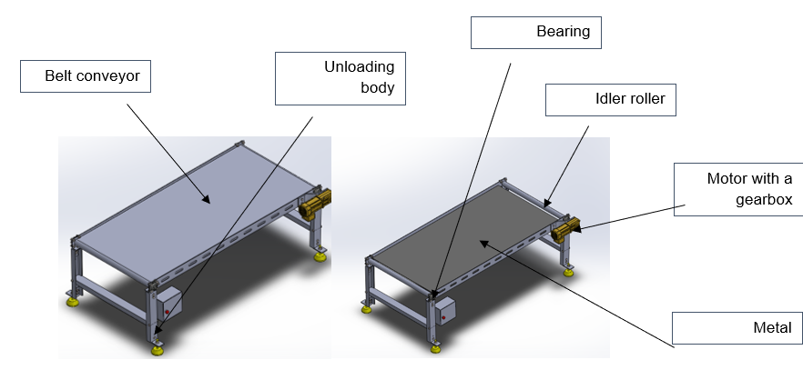
Unloading Conveyor

Slide 13
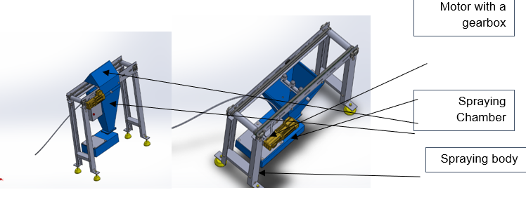
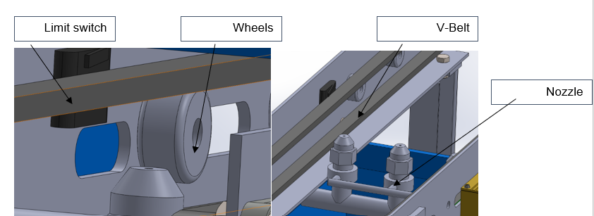
Spraying conveyor

Slide 14
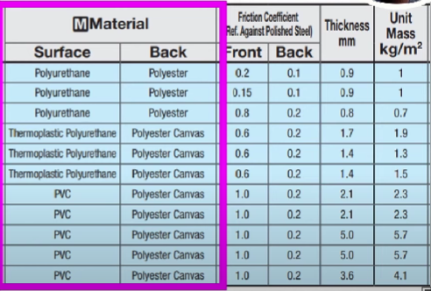
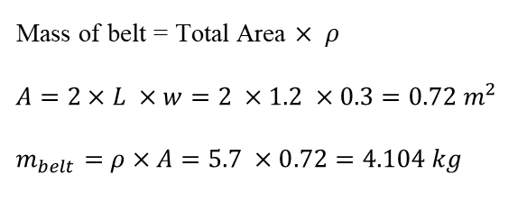
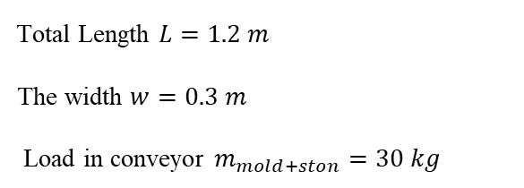
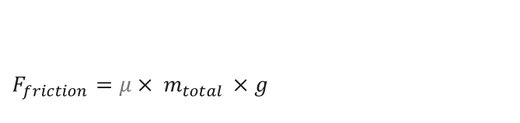
Detailed design
1-Belt Design
$$F_{friction}=μ× m_{total }×g$$
For the Design of the belt conveyor for feeding
$m_{total }= m_{mold+ston}+ m_{belt}$
Mass of belt = Total Area $× ρ$
$$A=2×L ×w=2 ×1.2 ×0.3=0.72 m^{2}$$
$$m_{belt}=ρ×A=5.7 ×0.72=4.104 kg$$
Total Length $L=1.2 m$
The width $w=0.3 m$
Load in conveyor $m_{mold+ston}=30 kg$
$$m_{total }=34.104 kg$$
$$F_{friction}=0.2× 34.104 ×9.81=66.9 N$$

Slide 15
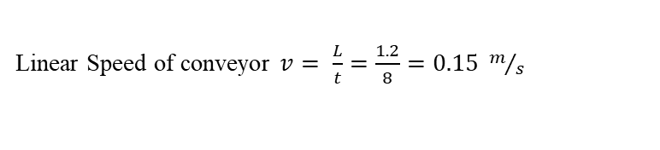
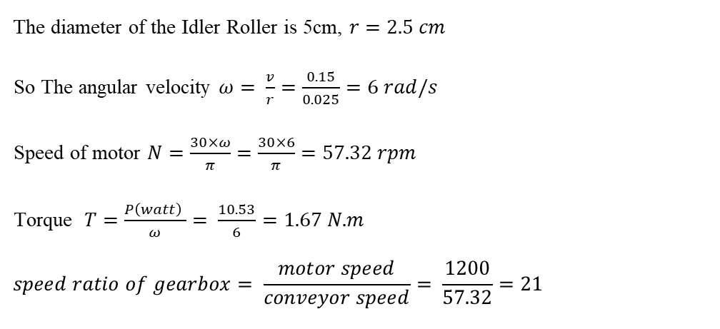

Demolding rate 450 stone/hr ------0.125stone/seconds------8 seconds for each stone.
The Power of Motor $P =F_{friction}× v$
Linear Speed of conveyor $v= \frac{L}{t}=\frac{1.2}{8}=0.15 m/s$
Take safety factor $n=2$
$$P_{hp}=n× \frac{P}{746}=2× \frac{10.035}{746}=0.0269 hp$$
$$P =66.9 ×0.15=10.035 watt$$
The diameter of the Idler Roller is 5cm, $r=2.5 cm$
So The angular velocity $ω= \frac{v}{r}=\frac{0.15}{0.025}=6 rad/s$
Speed of motor $N=\frac{30×ω}{π}=\frac{30×6}{π}=57.32 rpm$
Torque $T=\frac{P\left(watt\right) }{ω}= \frac{10.53}{6}=1.67 N.m$
$$speed ratio of gearbox= \frac{motor speed}{conveyor speed}= \frac{1200}{57.32}=21$$
Feeding motor: 0.33 hp, 1200 rpm, Three-phase motor.`

Slide 16
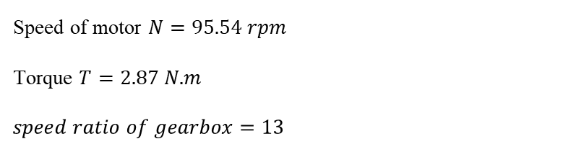
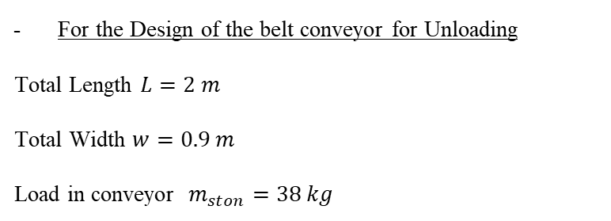
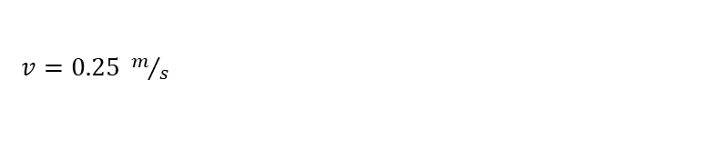
For the Design of the belt conveyor for Unloading
Total Length $L=2 m$
Total Width $w=0.9 m$
Load in conveyor $m_{ston}=38 kg$
$$F_{friction}=114.81 N$$
$v=0.25 m/s$
Power of motor $P =28.7 watt$
$$P_{hp}=0.077 hp$$
Unloading motor: 0.5 hp, 1200 rpm, Three-phase motor.`
Speed of motor $N=95.54 rpm$
Torque $T=2.87 N.m$
$$speed ratio of gearbox=13$$

Slide 17
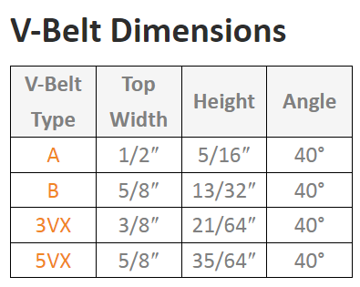
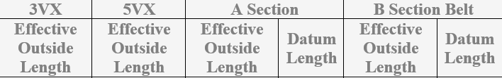
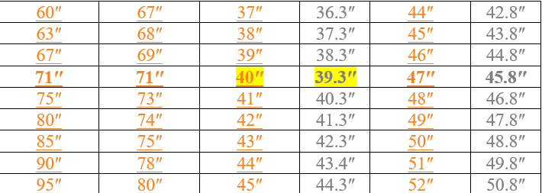
2-V-belt
Spraying motor: 0.33 hp, 1200 rpm, Three-phase motor.`

Slide 18
3- Vibrator
We notice that the force exerted by the vibrator on the stone is greater than 580 N in both samples and thus the demolding process is expected to be successfully achieved.

Slide 19

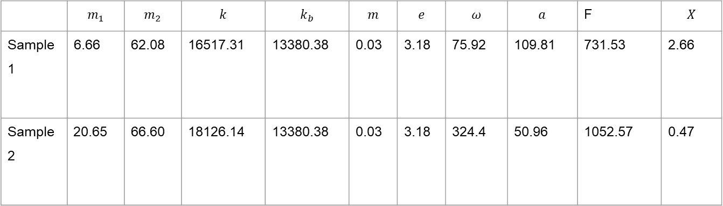

 | $$m_{1}$$ | $$m_{2}$$ | $$k$$ | $$k_{b}$$ | $$m$$ | $$e$$ | $$ω$$ | $$a$$ | F | $$X$$
Sample 1 | 6.66 | 62.08 | 16517.31 | 13380.38 | 0.03 | 3.18 | 75.92 | 109.81 | 731.53 | 2.66
Sample 2 | 20.65 | 66.60 | 18126.14 | 13380.38 | 0.03 | 3.18 | 324.4 | 50.96 | 1052.57 | 0.47
$$a=\frac{−m_{1}ω^{4}\left(meω^{2}\right)}{m_{1}m_{2}ω^{4}−2km_{1}ω^{2}−4k_{b}m_{1}ω^{2}−2km_{2}ω^{2}+8kk_{b}}$$
$$X=\frac{\left[{2k−m}_{1}ω^{2}\right]\left(meω^{2}\right)}{m_{1}m_{2}ω^{4}−2km_{1}ω^{2}−{4k}_{b}m_{1}ω^{2}−2km_{2}ω^{2}+8kk_{b}}$$

Slide 20
The maximum height that the vibrating body reaches is 2.66 mm, which is a good number so that the vibrating body stays very close to the height of the conveyors, and this height was taken into account in the design.
Vibrator motor: A 0.5 HP, Three-phase motor with a rotation speed of 3600 rpm was selected for the vibrator, connected to an inverter to control the rotation speed.

Slide 21
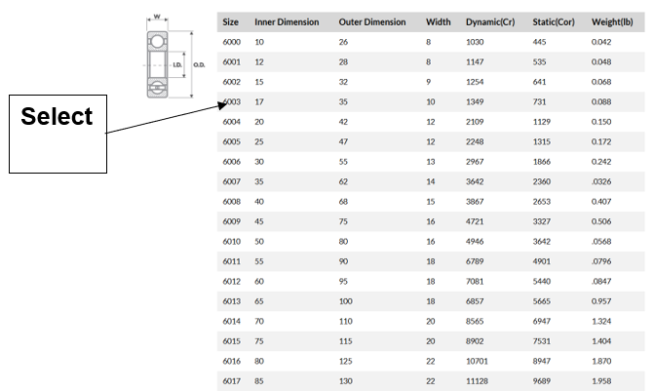
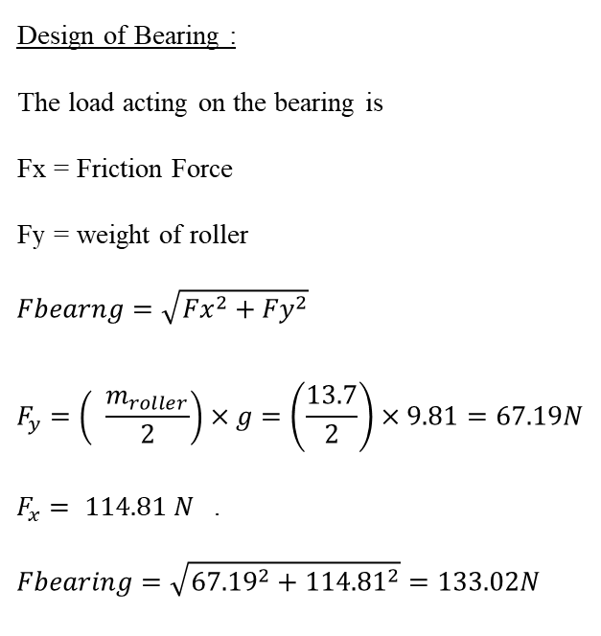
4 Selection of Standard Component
Bearing selection
Design of Bearing :
The load acting on the bearing is
Fx = Friction Force
Fy = weight of roller
$$Fbearng=\sqrt{{Fx}^{2}+{Fy}^{2}}$$
$$F_{y}=\left( \frac{m_{roller}}{2}\right)×g=\left(\frac{13.7}{2}\right)×9.81=67.19N$$
$F_{x}= 114.81 N$ .
$$Fbearing=\sqrt{{67.19}^{2}+{114.81}^{2}}=133.02N$$

Slide 22
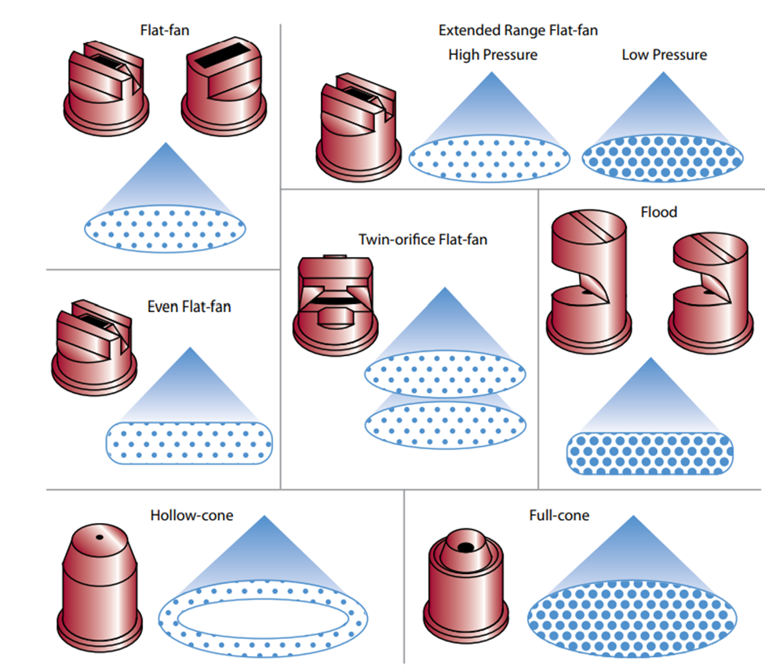
Nozzle selection
We have added three flood nozzles in the spraying stage to ensure complete coverage of the Mold with insulating material.

Slide 23
04
Manufacturing and Assembly Operation

Slide 24
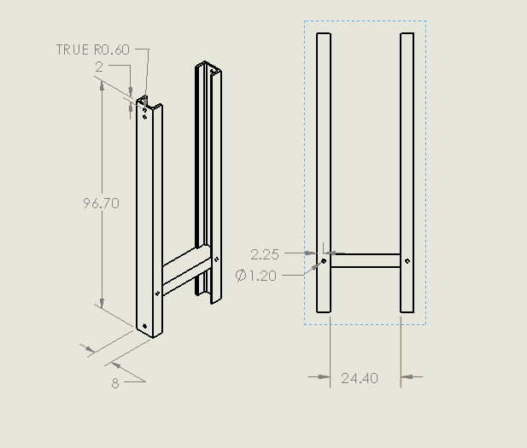
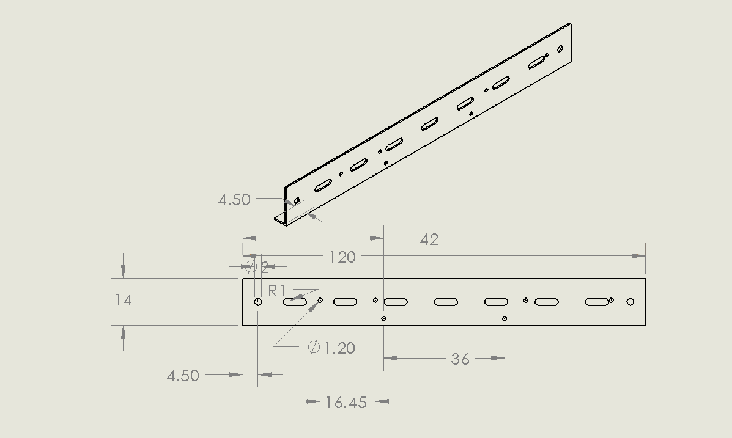
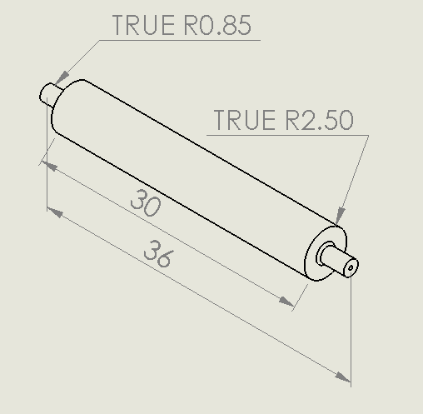
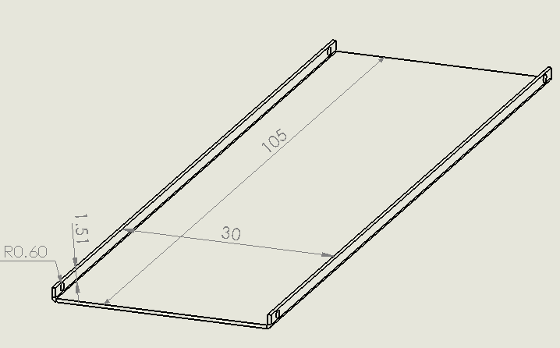
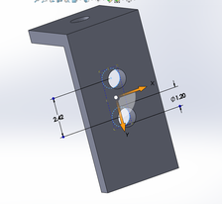
1- Manufacturing of Feeding Conveyor

Slide 25
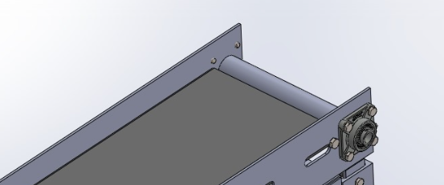
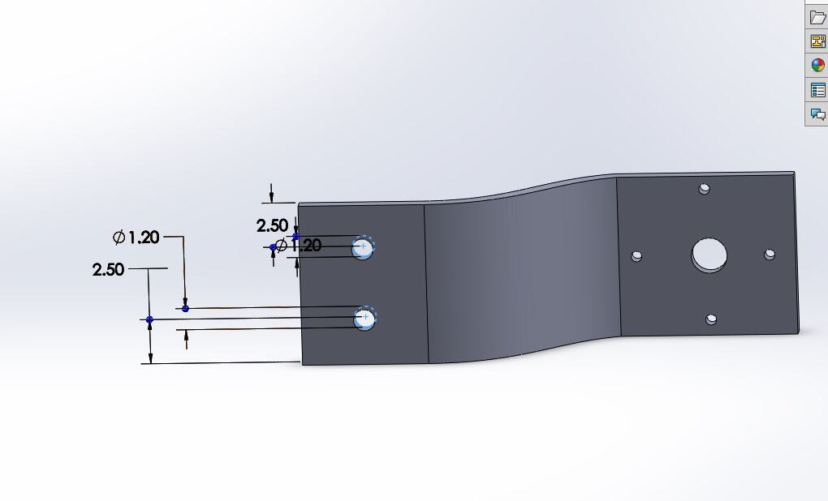
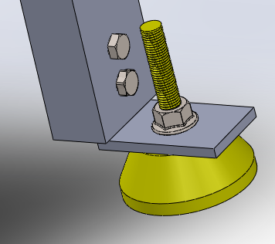

Slide 26
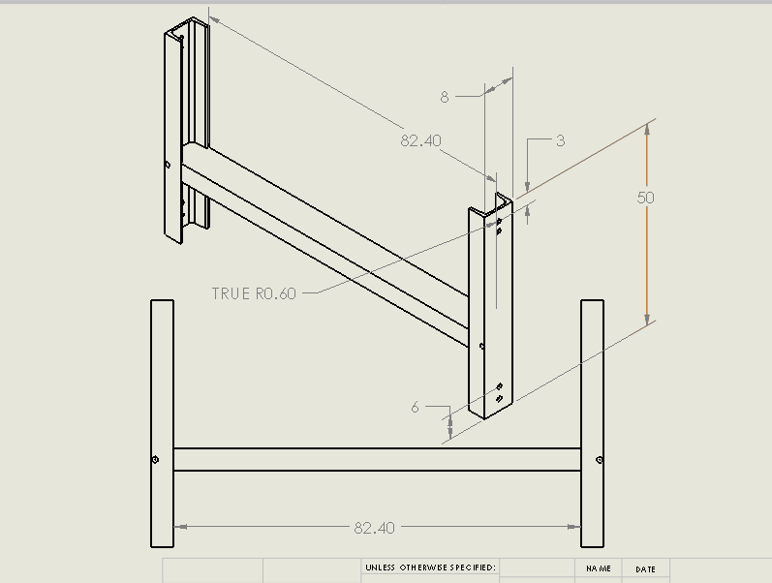
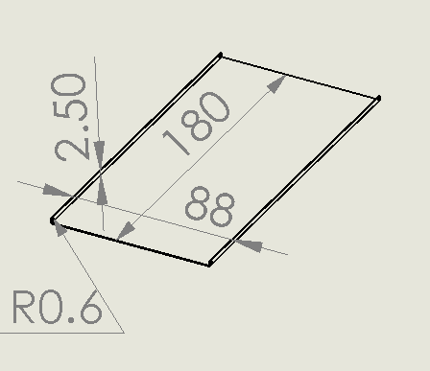
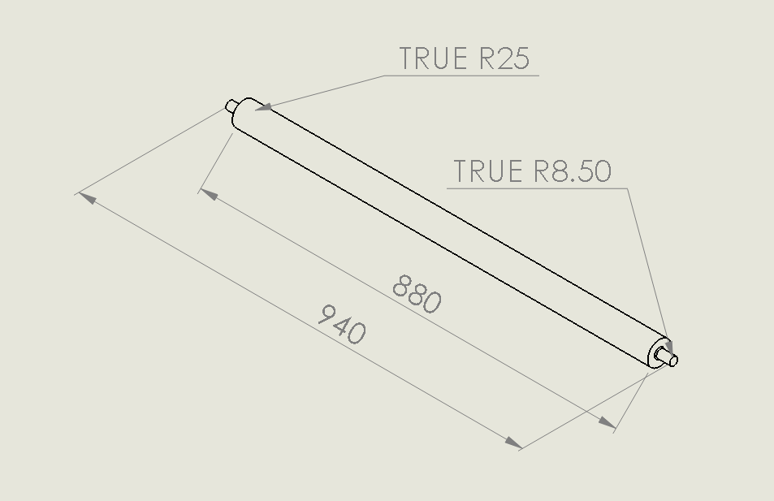
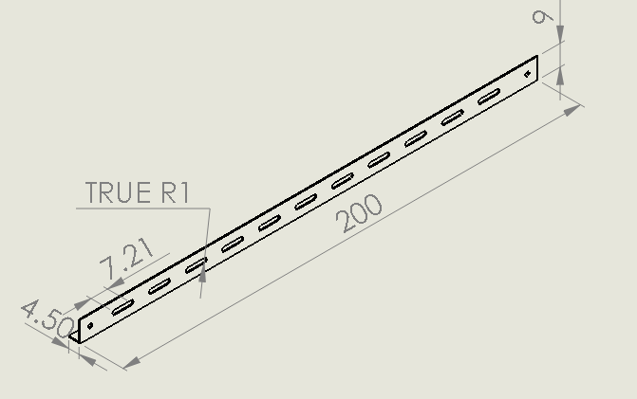
2- Manufacturing of Unloading Conveyor

Slide 27
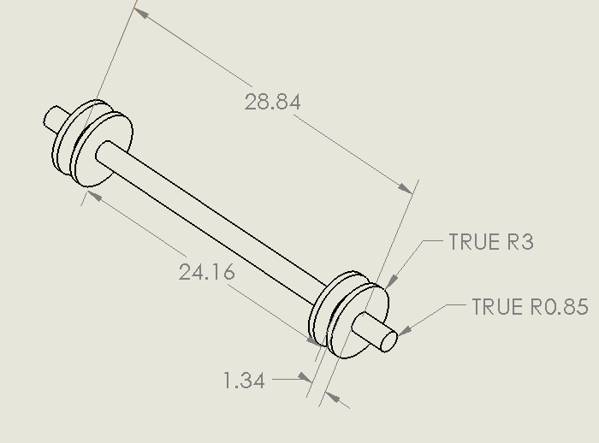
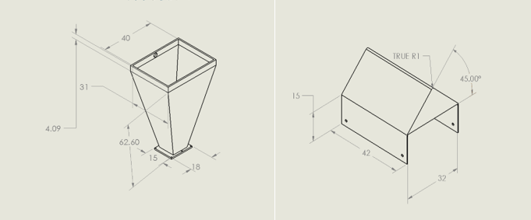
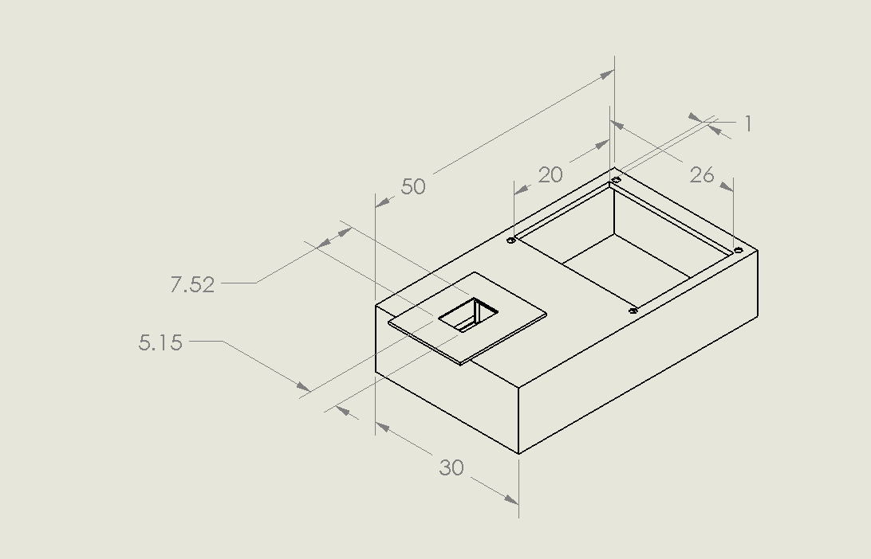
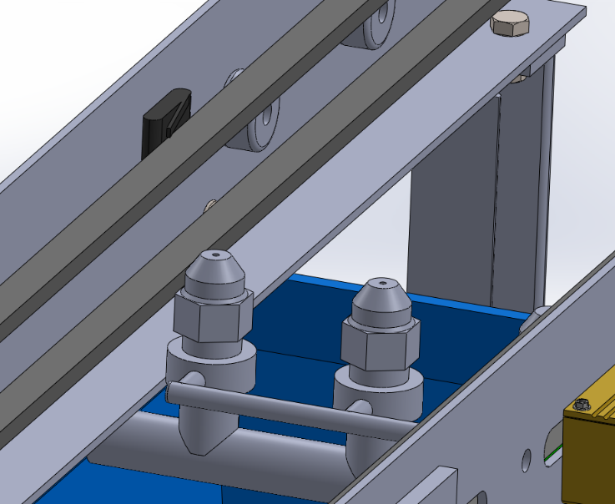
3- Manufacturing of Spraying Conveyor

Slide 28
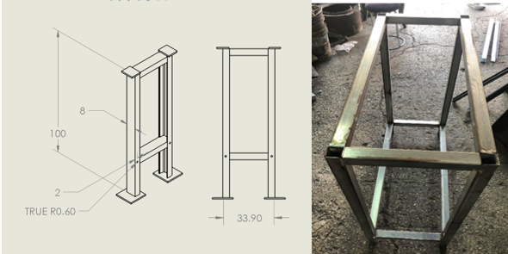
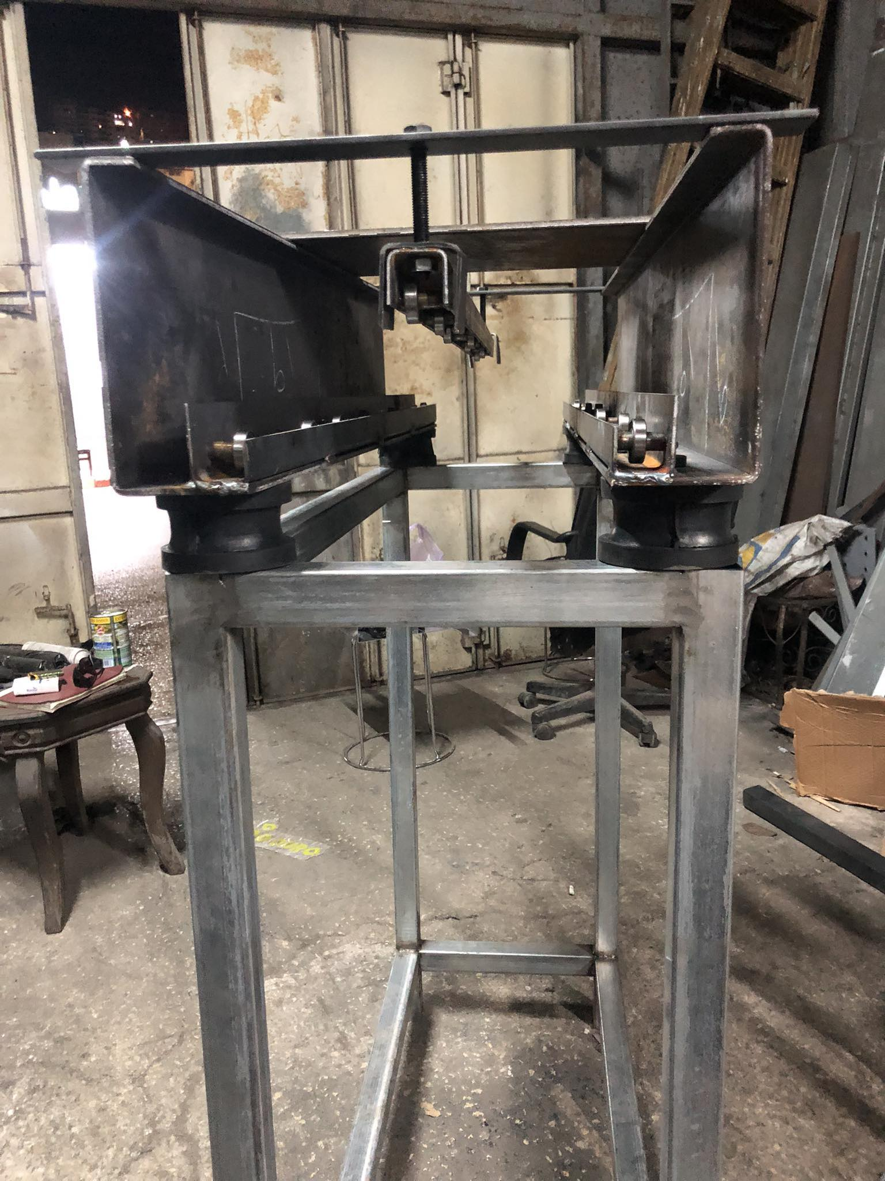
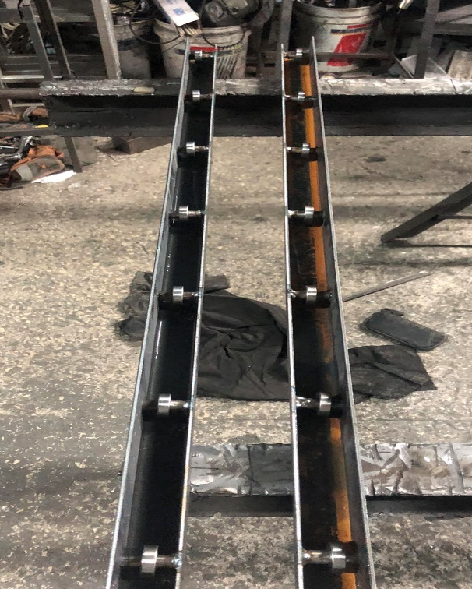
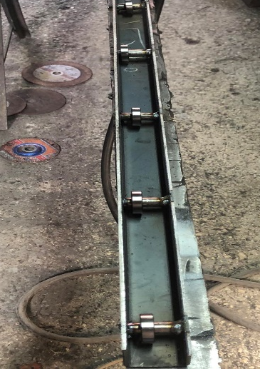
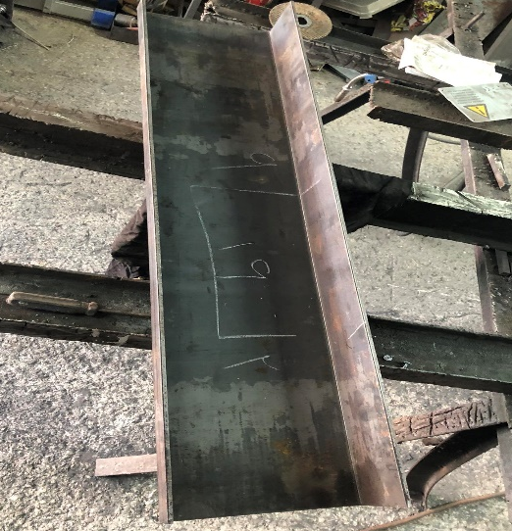
4- Manufacturing of Vibrator

Slide 29
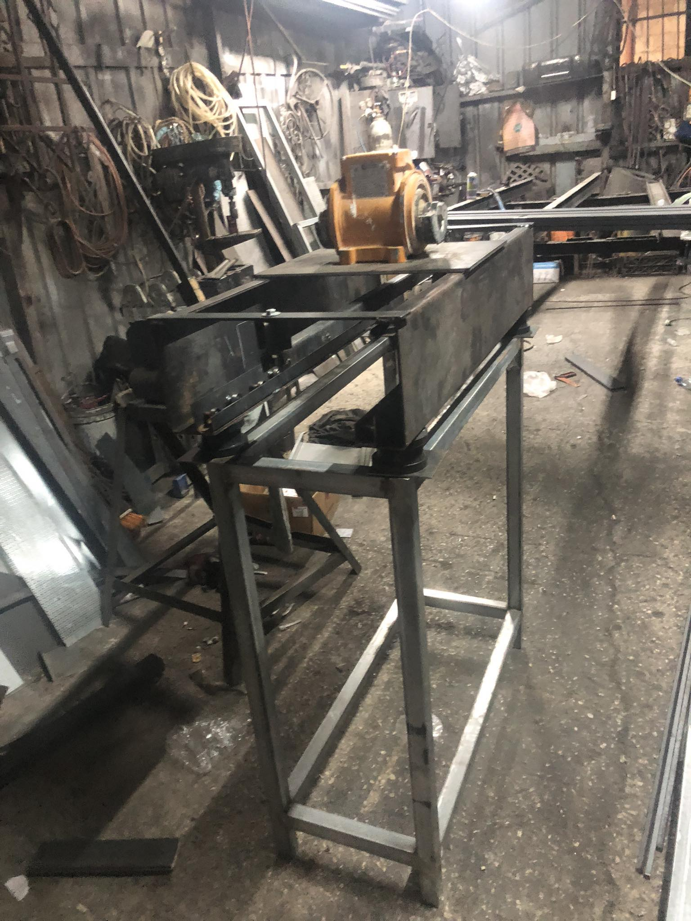
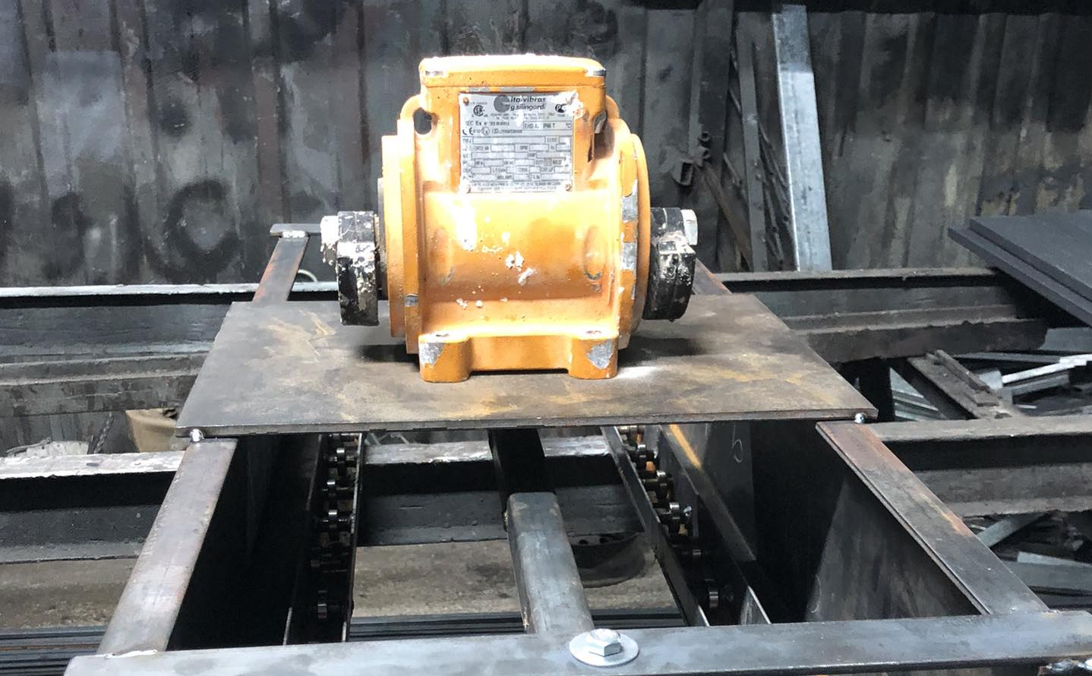

Slide 30
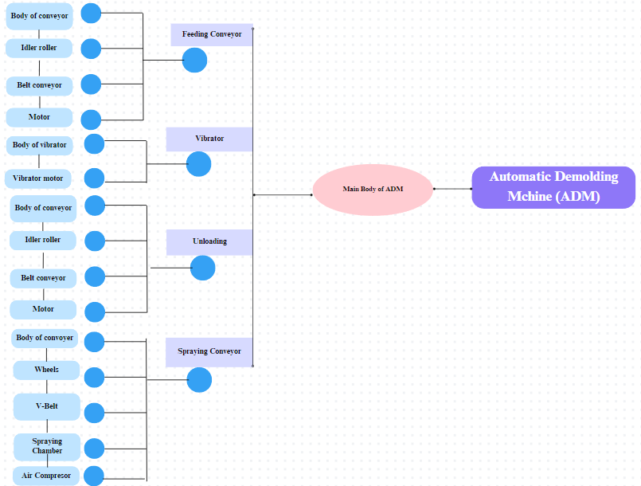

Slide 31
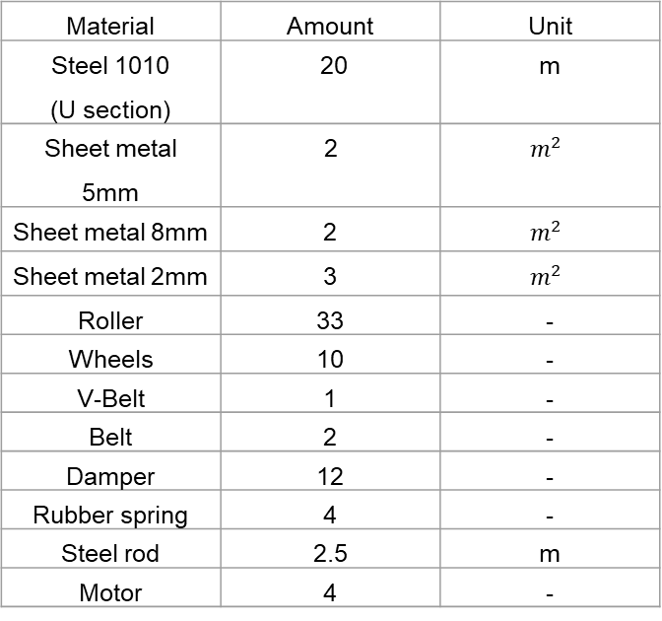
Material | Amount | Unit
Steel 1010 (U section) | 20 | m
Sheet metal 5mm | 2 | $$m^{2}$$
Sheet metal 8mm | 2 | $$m^{2}$$
Sheet metal 2mm | 3 | $$m^{2}$$
Roller | 33 | -
Wheels | 10 | -
V-Belt | 1 | -
Belt | 2 | -
Damper | 12 | -
Rubber spring | 4 | -
Steel rod | 2.5 | m
Motor | 4 | -
After presenting the design to multiple manufacturers and considering the cost, the average has been calculated. Approximate cost of manufacturing the machine = 22,000 Nis

Slide 32
05
Preliminary Financial Analysis

Slide 33
Production Efficiency:
Manual Production:
  4 workers produce 157 stones per hour
Machine Production:
  Operates with 2 workers and produces 450 stones per hour.
Operating Expenses:
  Electricity cost: 1.5KW*1hr*1NIS/Kwhr =1.5 NIS/hr.
  Maintenance cost plus contingencies: 5 NIS/hr.
  The machine's annual cost: UAC=IC(A/P, i, n), i=0.06, n=8.
  UAC=22000(0.161)=3542 NIS/yr
  3542/(50*6*2.5) = 4.7 NIS/hr
  The wage of one worker is 15 NIS per hour.

Slide 34
Daily Operational Cost Analysis:
Daily Operational Cost Comparison:
  Manual Demolding: 4 workers* 15 NIS/hr * 6 hr/day = 360 NIS/day
  Automatic Demolding:
  (2 workers* 15 NIS/hr + 4.7 NIS/hr + 1.5 NIS/hr + 5 NIS/hr) * 2.5 hr/day = 103 NIS/day
Daily Operational Cost Savings:
  The daily operational cost saving = Manual daily cost – Automatic daily cost
  = 360 – 103 = 257 NIS
  Unit cost saving = daily manual cost/(157 stone/hr* 6 hr) – daily automatic cost/ (450 stone/hr *2.5) = 360/942 – 103/1125 = 0.29 NIS/stone

Slide 35
Payback Period:
Payback Period Calculated based the daily savings :
  Payback Period = Initial Investment / daily savings
  Payback Period = 22,000 Nis / 257 NISs/day =85.6 day.
  Payback Period = Approximately 85 days / 26 days/ months =3.5 months
  The payback period is very encouraging to replace the manual demolding with automatic demolding.

Slide 36
05
Conclusion
and RECOMMENDATIONS

Slide 37
Conclusion
There is a great demand for automatic stone demolding machines in Palestine.
The proposed design is relatively simple which has a positive reflection on the cost of the machine.
The entire machine was designed using Solid Work software.
The Vibrator was manufactured and the concept of demolding by vibration was proved.

Slide 38
Recommendations
Optimize the design by automating the stone loading and mold unloading processes.
The current model is specific to certain types and dimensions of molds; it is recommended to improve the design to accommodate all available molds.
Improve the design to reduce the weight and cost of the machine and create modified versions for commercial purposes.

Slide 39
THANKS!

