Slide 1
Hardware Graduation Project (2)
Seminar
Prepared by :
Belal Mazen Qaddara
Mohammed Wajeeh Abu Aisha

Slide 2
Outline
Project abstract view and features .
Mechanical Part of “iLock “system.
Electrical and Electronic Part in “iLock” system.
“iLock” system more and more.
Demo and Show.

Slide 3
What is iLock ?!
iLock is Keyless entry using Phone or PC .
iLock is Keyless entry by typing password to built in keypad and LCD on the door.
iLock is Key entry using traditional methods.
iLock lets you Lock or unlock your door from any where in the world.
iLock lets you to see if your door is locked or not and opened or not when you’re gone.

Slide 4
Cont.
iLock will send a notification when anyone lock or unlock the door using phone or Pc or Keypad.
iLock send SMS messages and notification when someone knocks on your door.
iLock connect to the internet via Wi-Fy module.
iLock connect to any smartphone via Bluetooth as well as via wifi wireless network.
iLock connect to GSM network thanks to GSM Module.

Slide 5
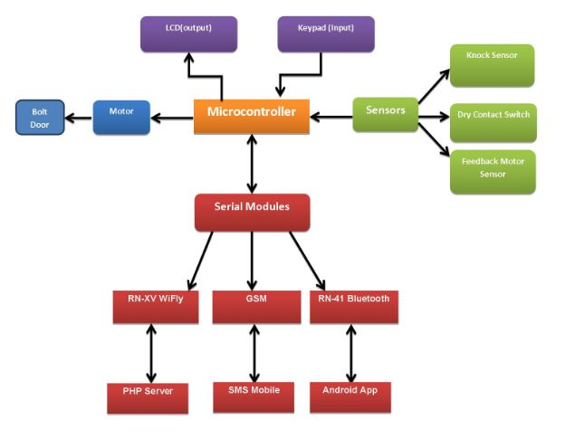
iLock System’s blocks

Slide 6
Mechanical View for iLock system
Because iLock is keyless or key entry. We need the deadbolt support this feature .
This is the first challenge in our Project.
Now we must find the deadbolt that easily interface with motor without change of the normal behavior for normal deadbolts.

Slide 7
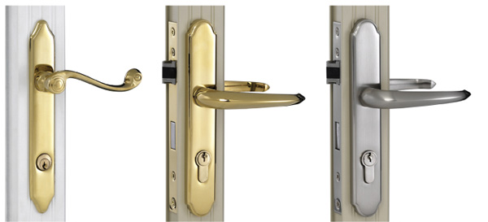
The Normal Deadbolt

Slide 8
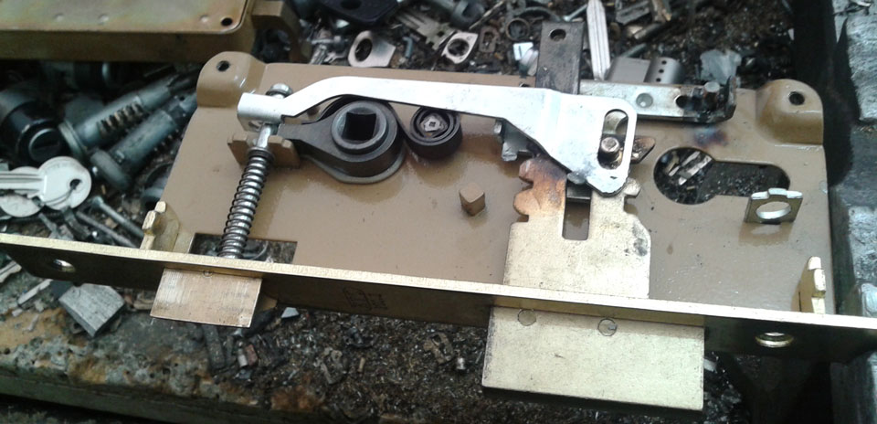
The customized deadbolt

Slide 9
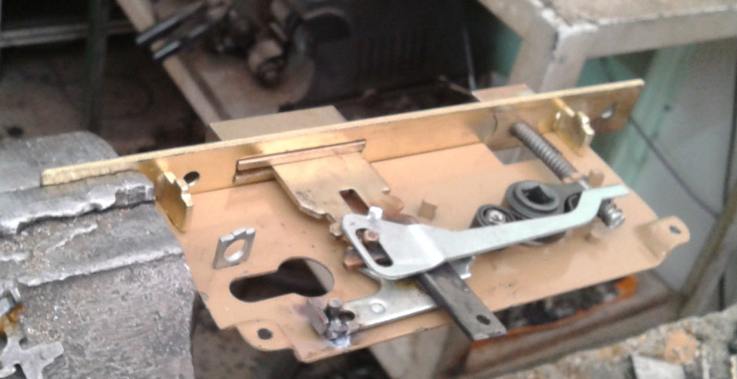
Cont.

Slide 10
The Prototype Door
The door that we designed for the iLock Project is
a prototype door to apply the required features .
The Door has following characteristics:
    Dimensions of the iLock System are 70*50 cm
    The door was designed using iron metal
    Door Cover made from Aluminum

Slide 11


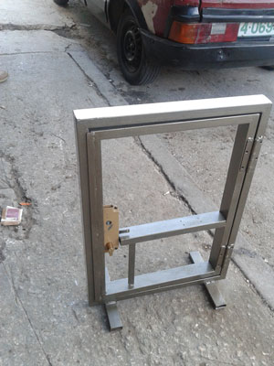
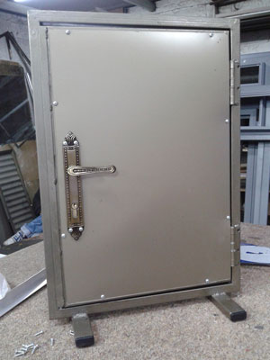

The Door’s Design

Slide 12
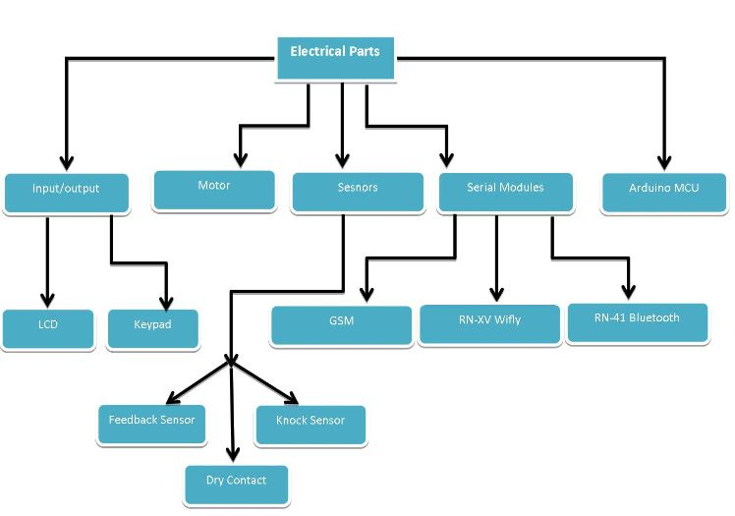
The Electronics and Electrical Part

Slide 13
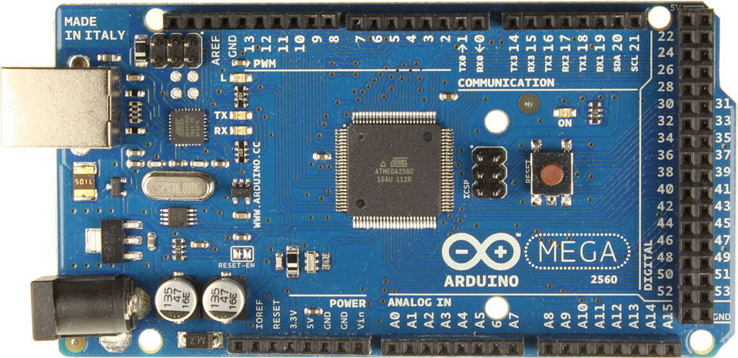
Microcontroller
ilock’s system use Arduino Mega 2560 which is based on the ATmega2560 AVR microcontroller.
The main feature for this which is support multi hardware serial pins and of course multi software serial .

Slide 14
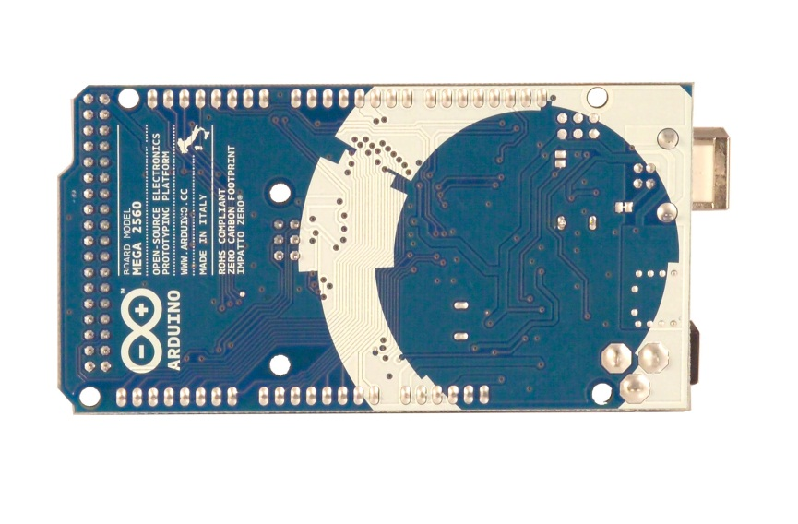
Cont.
The Arduino Mega 2560 has
  54 digital input/output pins (of which 14 can be used as PWM outputs).
  16 analog inputs.
  4 UARTs (hardware serial ports).
  a 16 MHz crystal oscillator, a USB connection, a power jack, an ICSP header, and a reset button.

Slide 15
Wireless Module
iLock connect to the internet via wireless wifi module.
We use RN-XV Wi-Fly module .
The RN-XV module is based upon Roving Networks' robust RN-171 Wi-Fi module.
  Incorporates 802.11 b/g radio .
  32 bit processor, TCP/IP stack, real-time clock, crypto accelerator, power management unit and analog sensor interface.

Slide 16
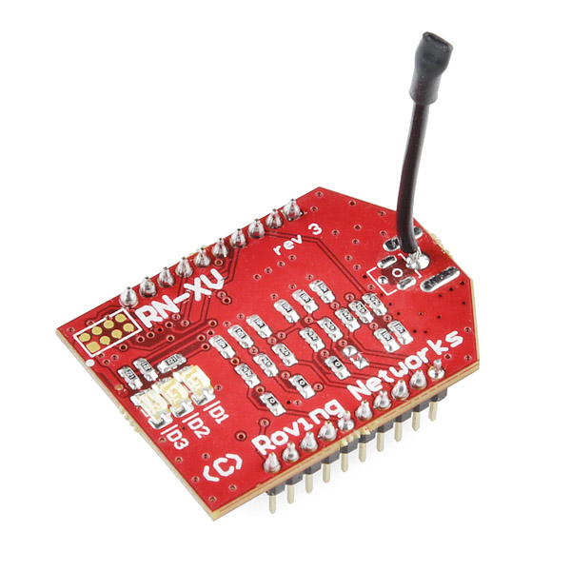
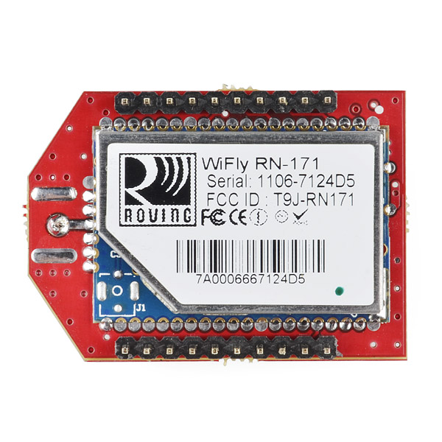
In the simplest configuration, the hardware only requires four connections (PWR, TX, RX and GND) to create a wireless data connection.

Slide 17
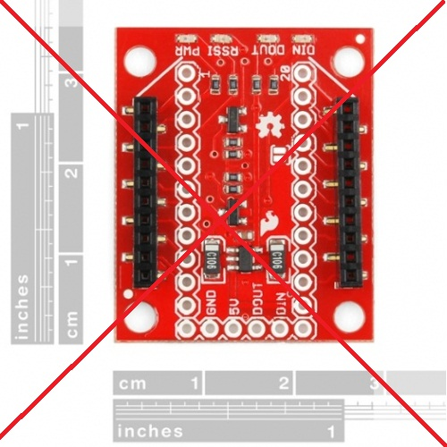
How we configure Wi-Fly Module ?!
At first stage , this module operates on 3.3 voltage and so we use regulated breakout that support 3.3 voltage for all input (Pwr,TX,RX) of Wifly module .
But it was nightmare , we found this breakout isn’t compatible with RN-171 wifly.

Slide 18
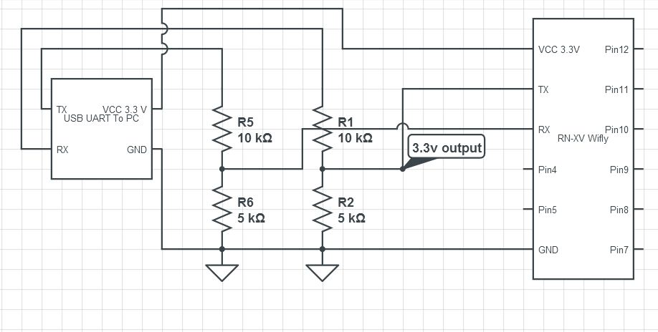
Now we must configure wifly module in order to connect local wireless network.
We built the following circuit that interface our computer serially and entering command mode for this module .

Slide 19
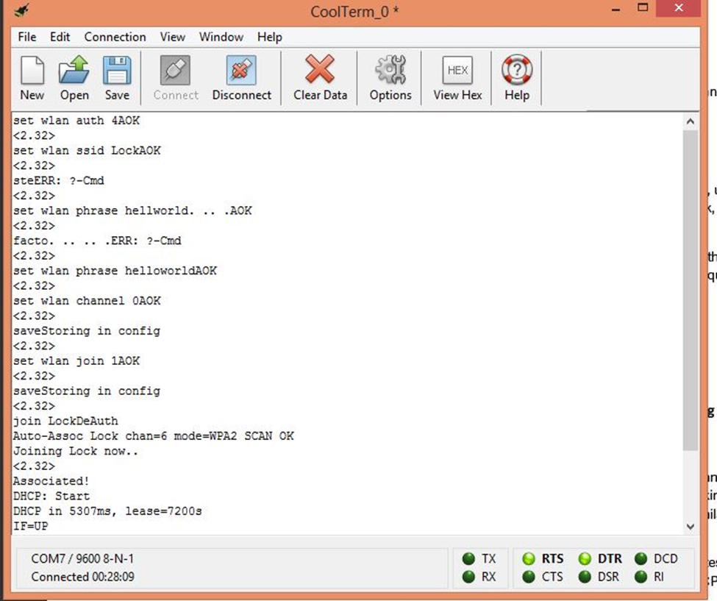
We configure the wifly module using specific commands from it datasheet .
We make it able to associate wireless Access point, after that it take an ip address , DNS , GW.

Slide 20
Interface Wifly module to MCU
The interface circuit for MCU is the same for interfacing PC .
MCU send data serially to wifly module by hiring software serial pins .
Wifly module now can post or get data to the webserver on the internet and vice versa passing received data to MCU.

Slide 21
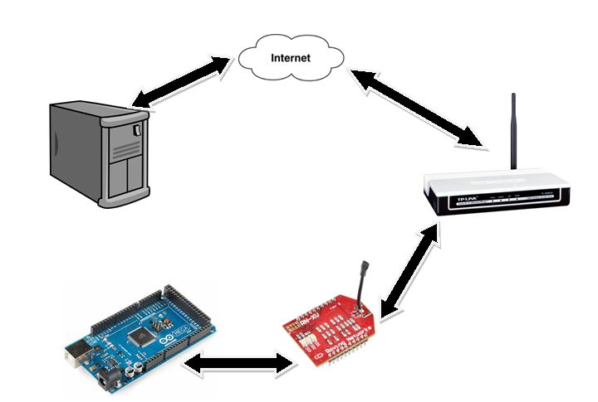
How iLock operate in the internet

Slide 22
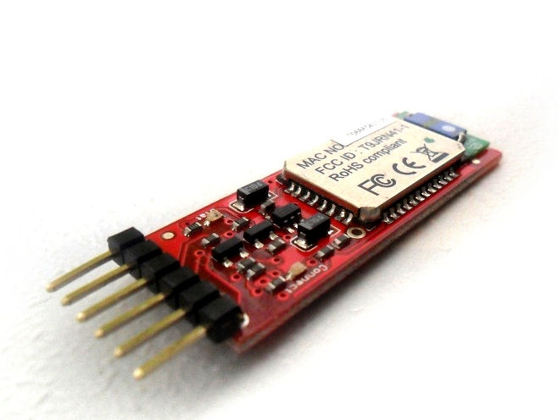
Bluetooth Module
iLock uses Bluetooth communication to connect any smartphone to lock or unlock your door.
We use RN-41 Bluetooth model from Roving Network.

Slide 23
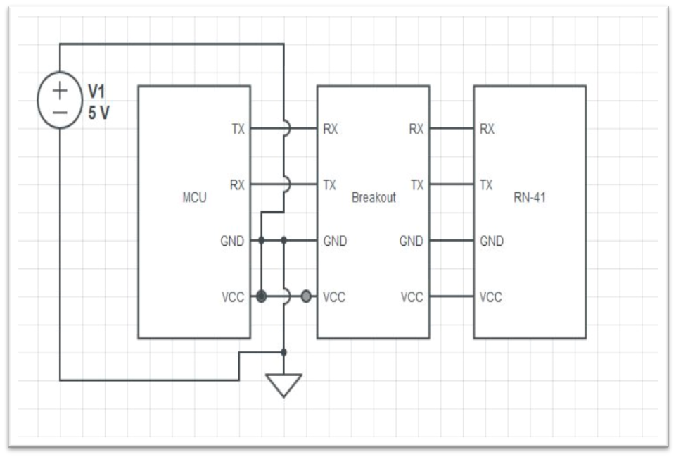
Cont.
We interface Bluetooth module to MCU so it receive and send data serially to MCU using Hardware serial .

Slide 24
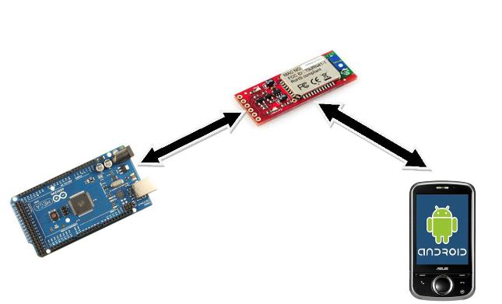
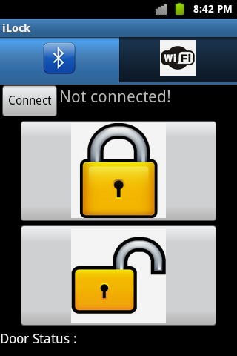
How iLock operate via Bluetooth

Slide 25
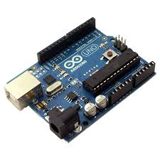
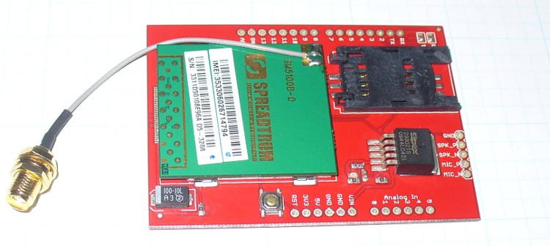
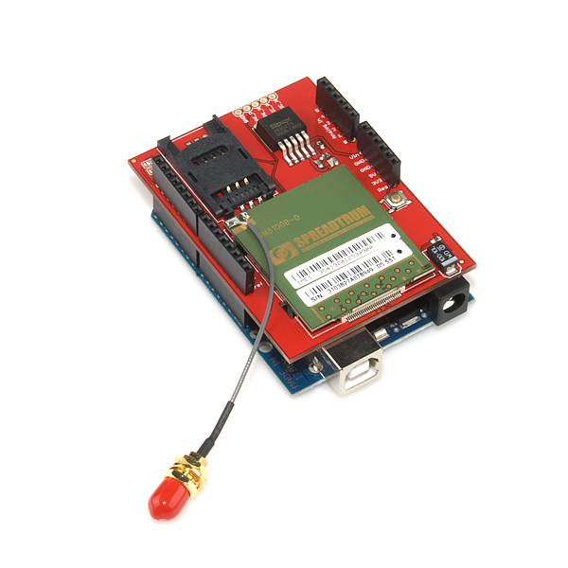
GSM Module
GSM in iLock:
+
=
ATmega328 MCU
GSM Sm5100B
GSM arduino shield

Slide 26


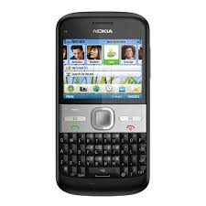
Cont.

Slide 27
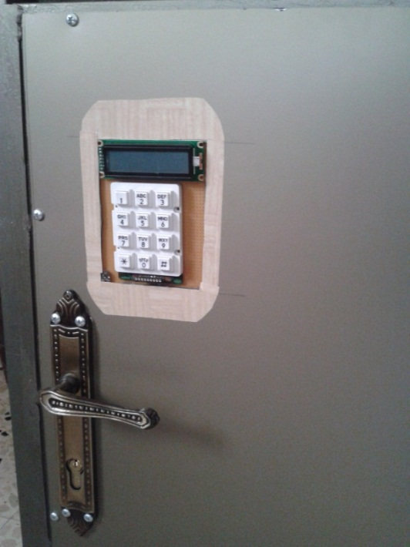
LCD and Keypad
iLock built in LCD and Keypad interfaced to MCU allows user to type specific password then posted to webserver via HTTP protocol to lock or unlock your door.
Webserver application do the validation.
LCD also print the status of the door.

Slide 28
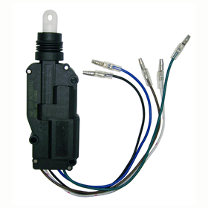
The Motor
The main and first consideration of iLock system .
We used Central Door Locking that available in cars and vehicles doors.
It comes with five wires:
  Power wire (12 volt).
  Ground.
  Normally open with ground.
  Normally close with ground .
  The common between NO and NC.
the output signal is on/off switching
State.

Slide 29
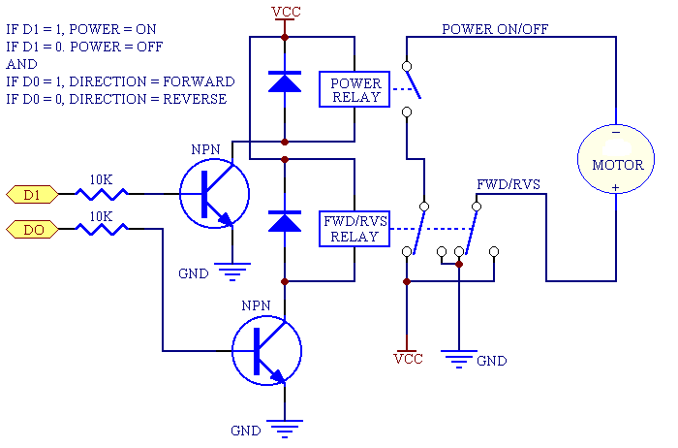
How we interface the motor to MCU ?

Slide 30
Shock Sensor
iLock system detect if someone knocking on the door or not .
To implement this feature we use shock sensor that available for car alarm system.
This sensor operates on 12 volt. And the signal given is analog signal that interfaced to voltage divider to transform it to range (0-5 volt).
The output signal inserted to ADC that available in MCU .

Slide 31
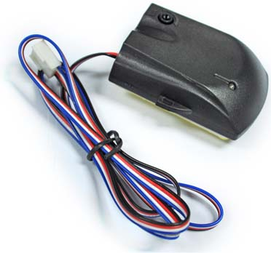
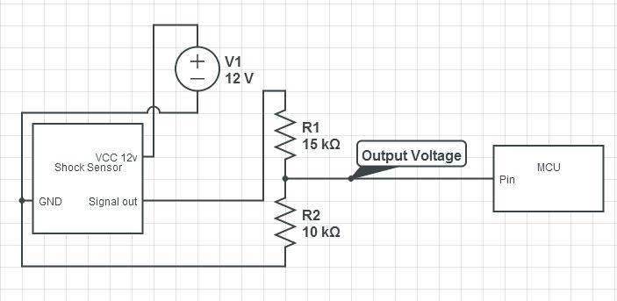
The main advantage for this sensor we can tune the sensitivity .
MCU detect via given threshold to determine if someone knocking or not .

Slide 32
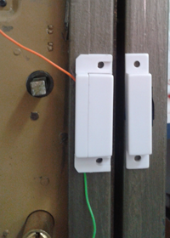
Dry contact switch sensor
This sensor is used to know if you’re door is open or close .
It based on magnetic field between two pieces . If the are adjacent the Dry sensor will close it circuit and give the MCU input signal (Switching on/off) signal .

Slide 33
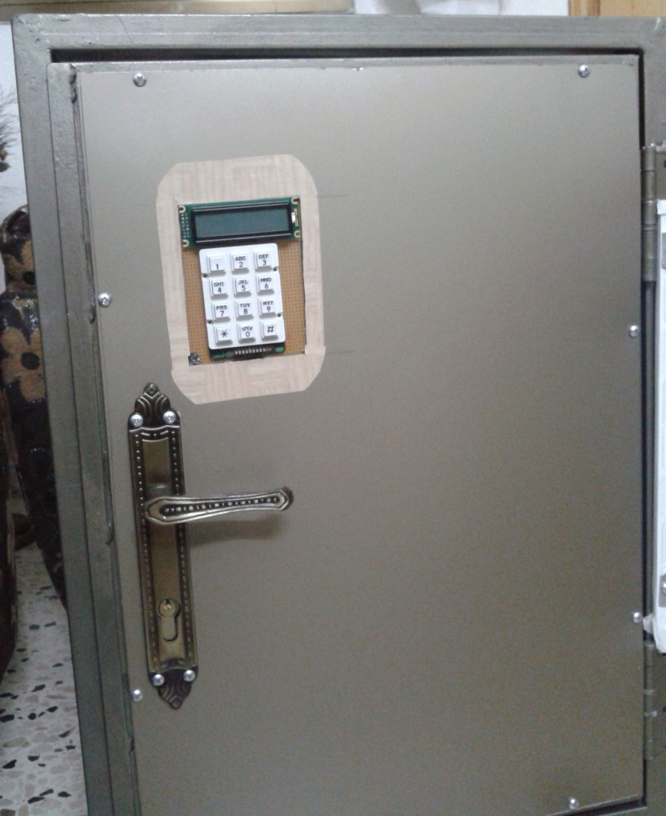
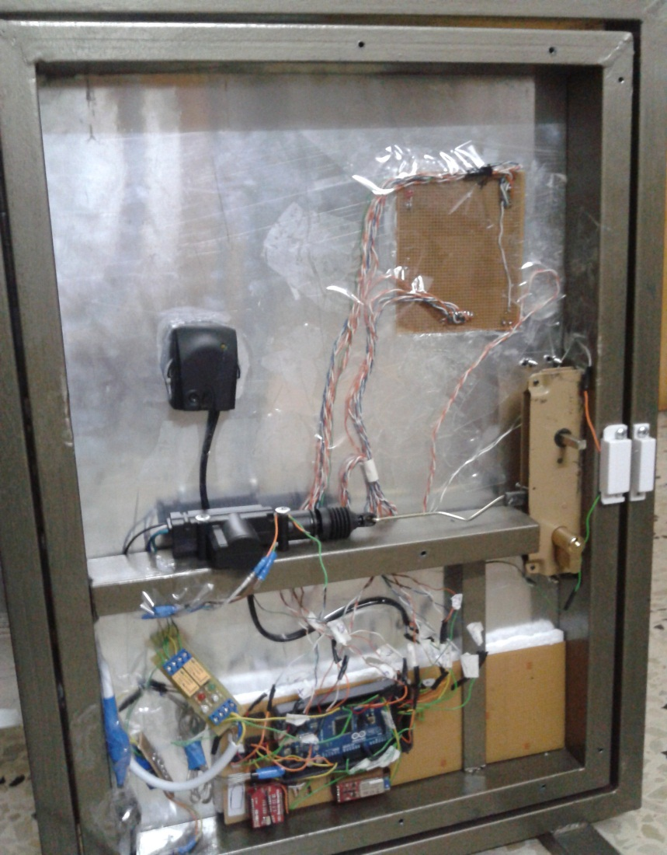
Demo And Show

