Slide 1

Dynamic Email Classifier
Prepared by:
Haya Al-Barghouthi Najeeb Aqel
Supervisor:
Dr.Manar Qamhieh

Slide 2
Outlines:
Where did the idea come from?
Primary Market Research.
What is Dynamic Email Classifier?
Motivation, Objectives and Main idea.
About the system.
Programming techniques.
Future work.

Slide 3
Where did the idea come from?
BIG DATA : More than 80% of data that companies collect about their customers is an unstructured data and just very few of them make good use of it
Emails: Emails are considered one of the biggest channels of unstructured data for companies, for some it’s the main tool to reach and interact with their customers and unfortunately traditional classification techniques are usually primitive and un-flexible, leading to un-meaningful output that of no help for users.

Slide 4





Primary Market Research
Since the idea was too broad and its potential to have many unclear options and choices was high. So, a large share of the project time was taken to do good Primary Market Research and search well about the idea and its possible features.
The interviews were in different manners, like having the interviews in-person in the companies themselves like ‘Jawwal’ , ‘Wataniya’ ,‘Reach’ and ‘Sbitany’. Also, a video call with Turkish called ‘Rent n Connect/ Turkey’ company also had been done.

Slide 5

Jawwal
They follow Facebook posts that have mentioned Jawwal explicitly
They have BLT (below the line) campaigns to target specific type of customers based on their history, using in-house system
problem with getting the feedback from their customers,
1- voice call
2- survey in their stores.

Slide 6
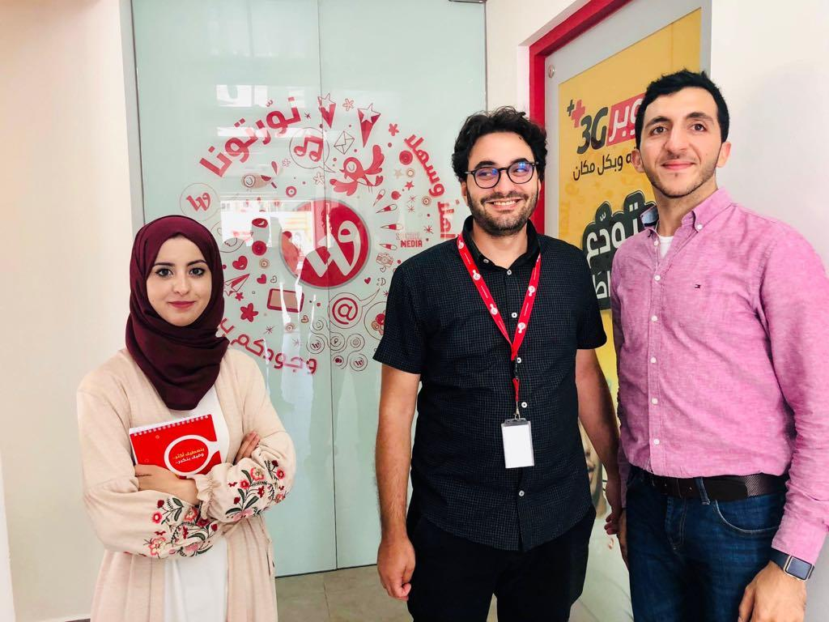
Wataniya
Customer record analysis
don’t have any automatic tools to go for the BLT campaigns.
More than 50% of the data they have about their customers is unstructured data.
Depending on sales not customer’s feedback in estimations.

Slide 7

Reach
B2B business model.
The current system they’re using in Social media monitoring system called Siebel, which is Outsourcing system instead of in-house development.
They categorize phone calls based on the call reason and provide daily reports of all the calls.

Slide 8

Rent n Connect/ Turkey
A lot of customers feedback on Twitter, but they deal with it manually.
60 thousand email per season,
Currently working on a solution to analyze the data they have so they can provide products based on the customers’ needs.

Slide 9
What is Dynamic Email Classifier System?
A dynamic continuous refinement-approach has been taken to reach a more meaningful classification of emails.
It’s a website that can do the analysis for various businesses’ emails , and then provide different clear visualizations..

Slide 10








Competition Mapping

Slide 11
The structure of the system
Data Preprocessing.
Training the machine learning model.
System Alignment (Interactive Topic Modeling).
Monitoring the flow of data.

Slide 12
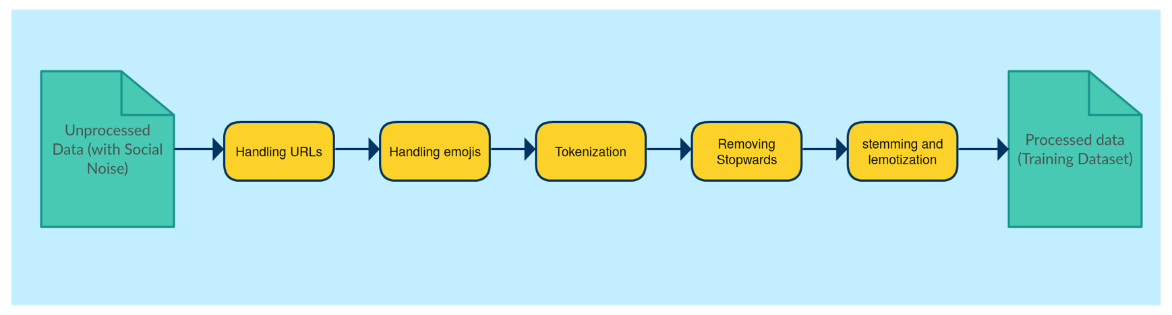
1.Data Preprocessing
Cleaning data from any noise and elements that’s not relevant to the extraction process
Social Noise is a major challenge where people can send literally about any topic, language of emails is usually following the flow of nonstandard-language and of course grammatical looseness.

Slide 13
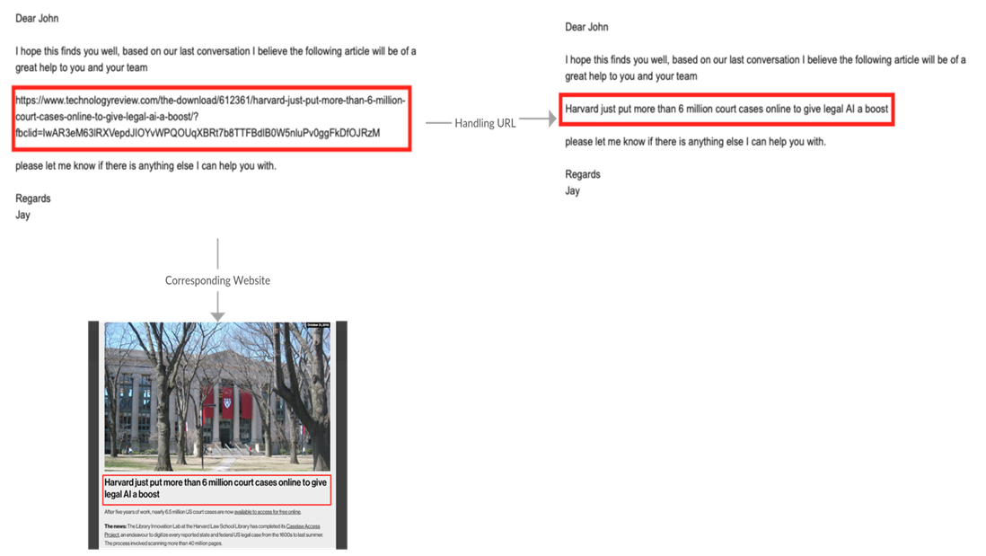
-Handling URLs:
it will be misread by the algorithm and would might affect the categorization process of the whole email.
URLs will be replaced by the main title of the indicated html page using html parsers.

Slide 14
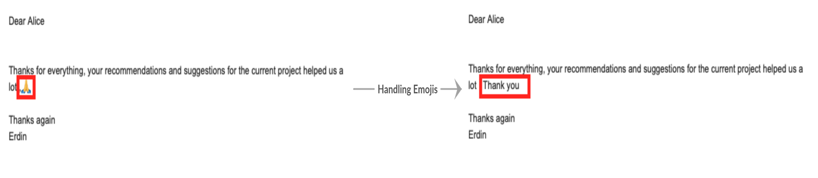

-Handling Emoji’s
emojis will be replaced by their description using emoji’s dictionaries
some emojis may have different meanings depending on the message-context so a sentiment analysis will be applied to the whole message before translating the emoji like this one, the grinning face

Slide 15
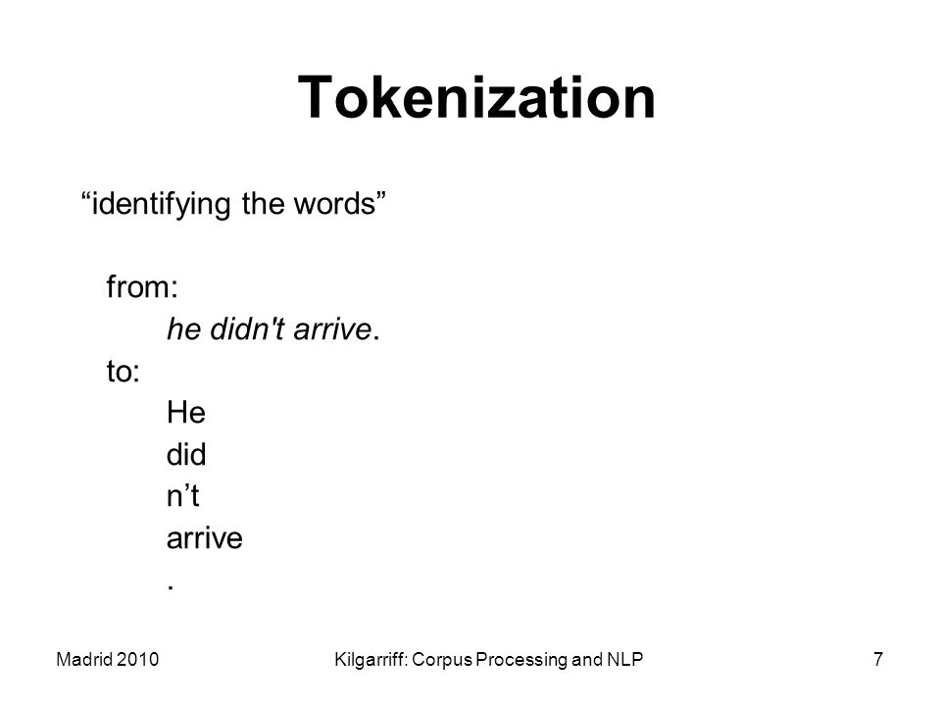
-Tokenization
each email will be separated into words, removing punctuations and lowercasing.

Slide 16
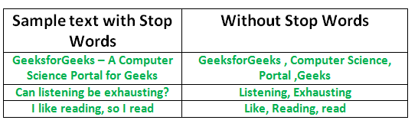
-Removing stop-words
after emails have been separated to words, each word will be compared to a dictionary of stop-words thus removing all the stop words

Slide 17
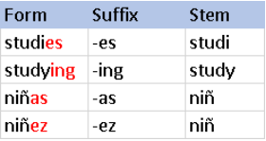
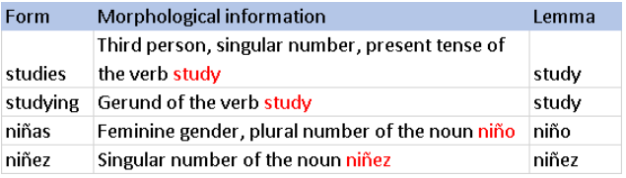
-Stemming and lemmatization
stemming
It involves transforming words into their roots, the difference between stemming and lemmatization is that stemming work on word-level (not aware of the whole context of the email), unlike lemmatization which is aware of the whole structure of the email, typically lemmatization is used to convert between third-person and first-person forms.
lemmatization

Slide 18
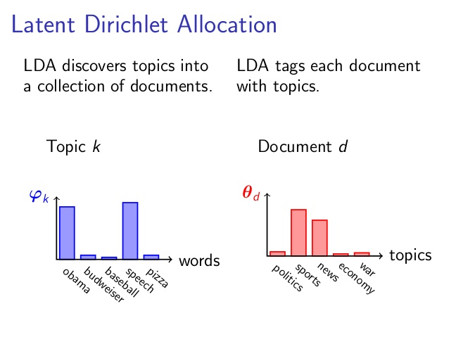
2-Training the machine learning model
Unsupervised learning of a great amount of data is being fed into the algorithm, to classify the data into categories based on common features and properties.
Latent Dirichlet Allocation model (LDA).
Which classifies text as unstructured data in a document to a certain topic depending on bag of words it creates from document's words.
It creates a Dirichlet distributions of the analyzed data (Topics) that will give deeper insights for a better systematic decision making of businesses.

Slide 19
3- Interactive continuous refinement approach (Aligning the system)
Due to the black-box nature of LDA and the instability of the algorithm especially due to the small size of emails, that can result into unreliable output in which the extracted topics would be hard to be understood and interpreted by the users, also LDA is a static algorithm so topics won’t evolve over time.
Labeling Topics
Merging Topics
Removing/adding terms to the topic
Removing/adding Topics
Relationship graphs

Slide 20
4- Monitoring the flow of the data
Deriving deep informative insights from emails.
Interactive tree-map dashboard, in order to
Time-graph, to monitor the behavior of Topics’ frequencies over time
2. Notify the users when a major change is recorded at one of the topics
  -the user can assign an email address to each of the topics along with a threshold value, whenever the frequency of the topic exceeded the threshold value the linked email will be automatically notified, to ensure that company will have a high response-rate when a major action or change happens.

Slide 21

Languages & Tools
Database Schema
Databases Languages:
  SQLALchemy Language.
Programing Languages:
  Website (Web Server):
  Back End: Python with Flask Framework.
Front End : HTML5, CSS3, JavaScript, JSON

Slide 22
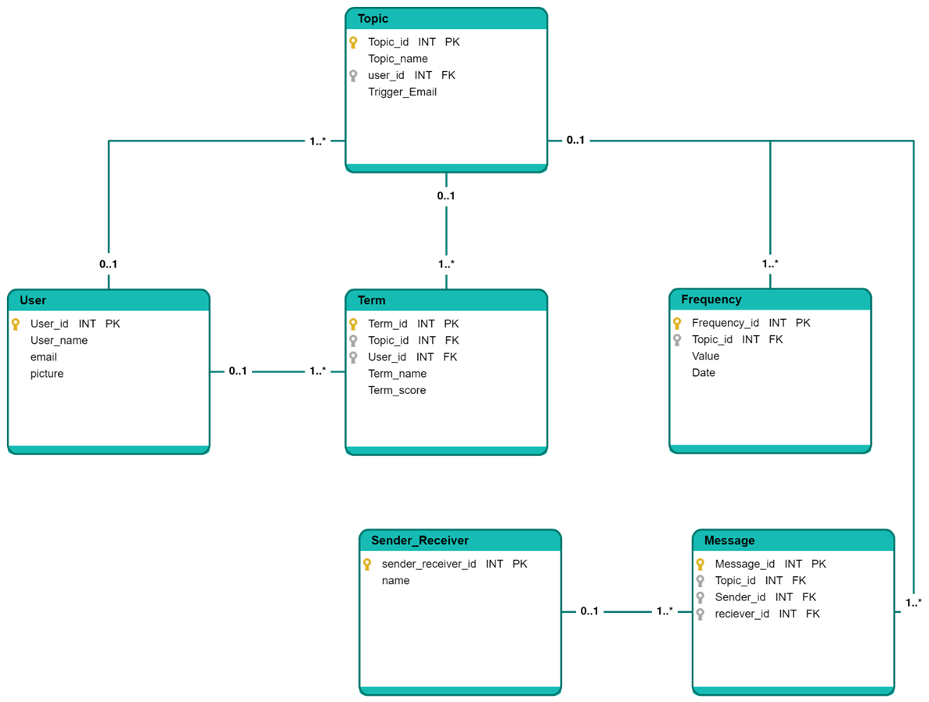
Database Schema

Slide 23
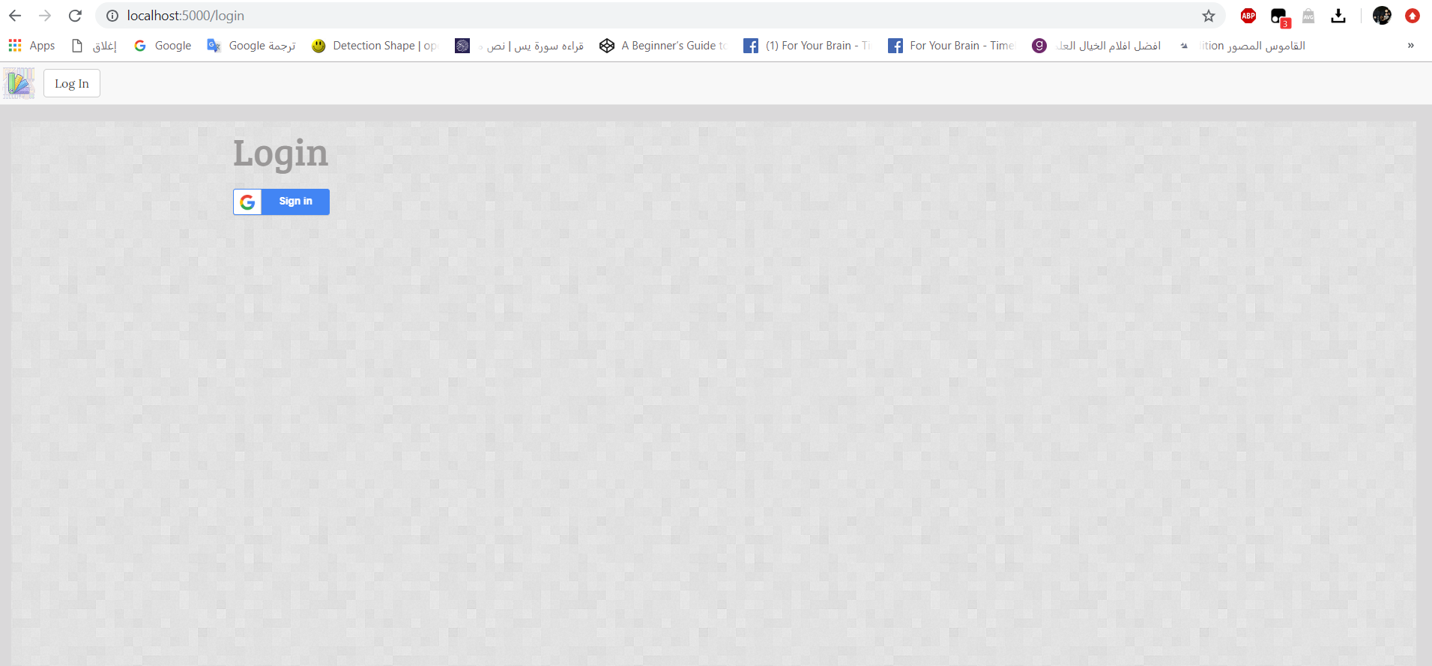
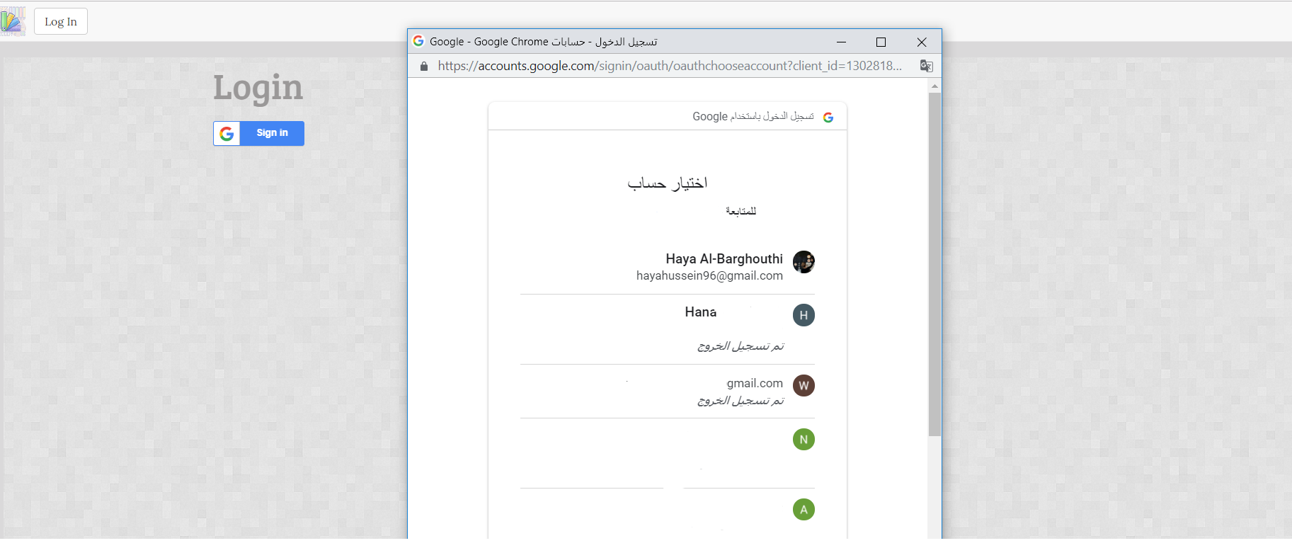
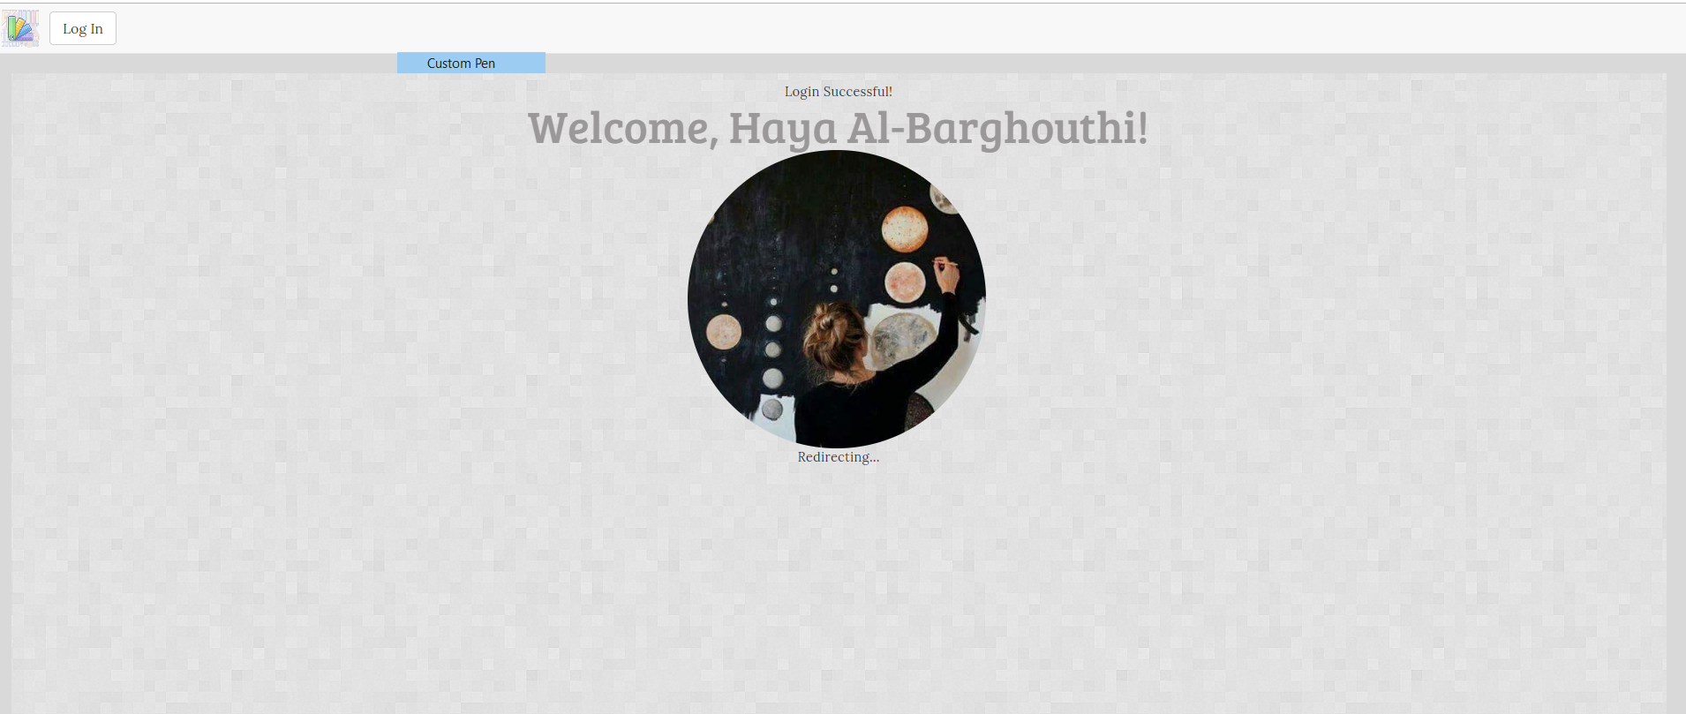
Results
Login

Slide 24
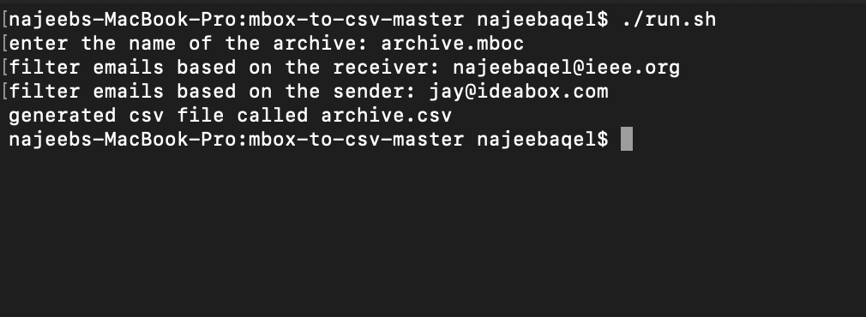
Data Preprocessing
It can be hard form some users to convert emails into csv format, especially thousands of emails in their inboxes.
So, Html Parser script has been created to convert emails from MBOX format to CSV format
Email Parser

Slide 25
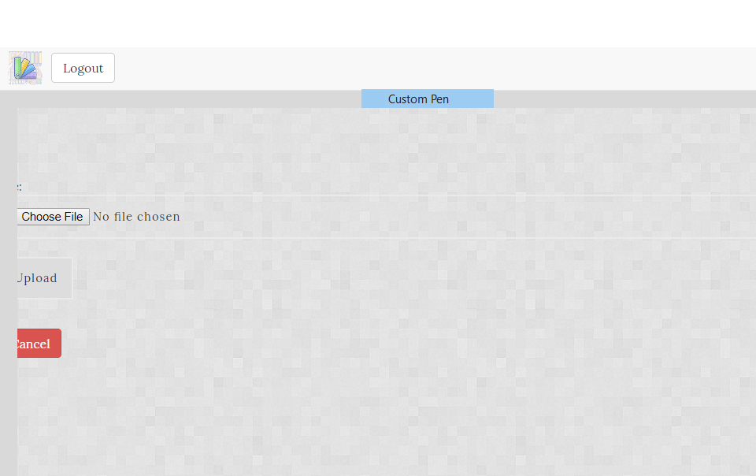
UPLOADING THE DATASET AND TRAINING THE MACHINE LEARNING MODEL:

Slide 26
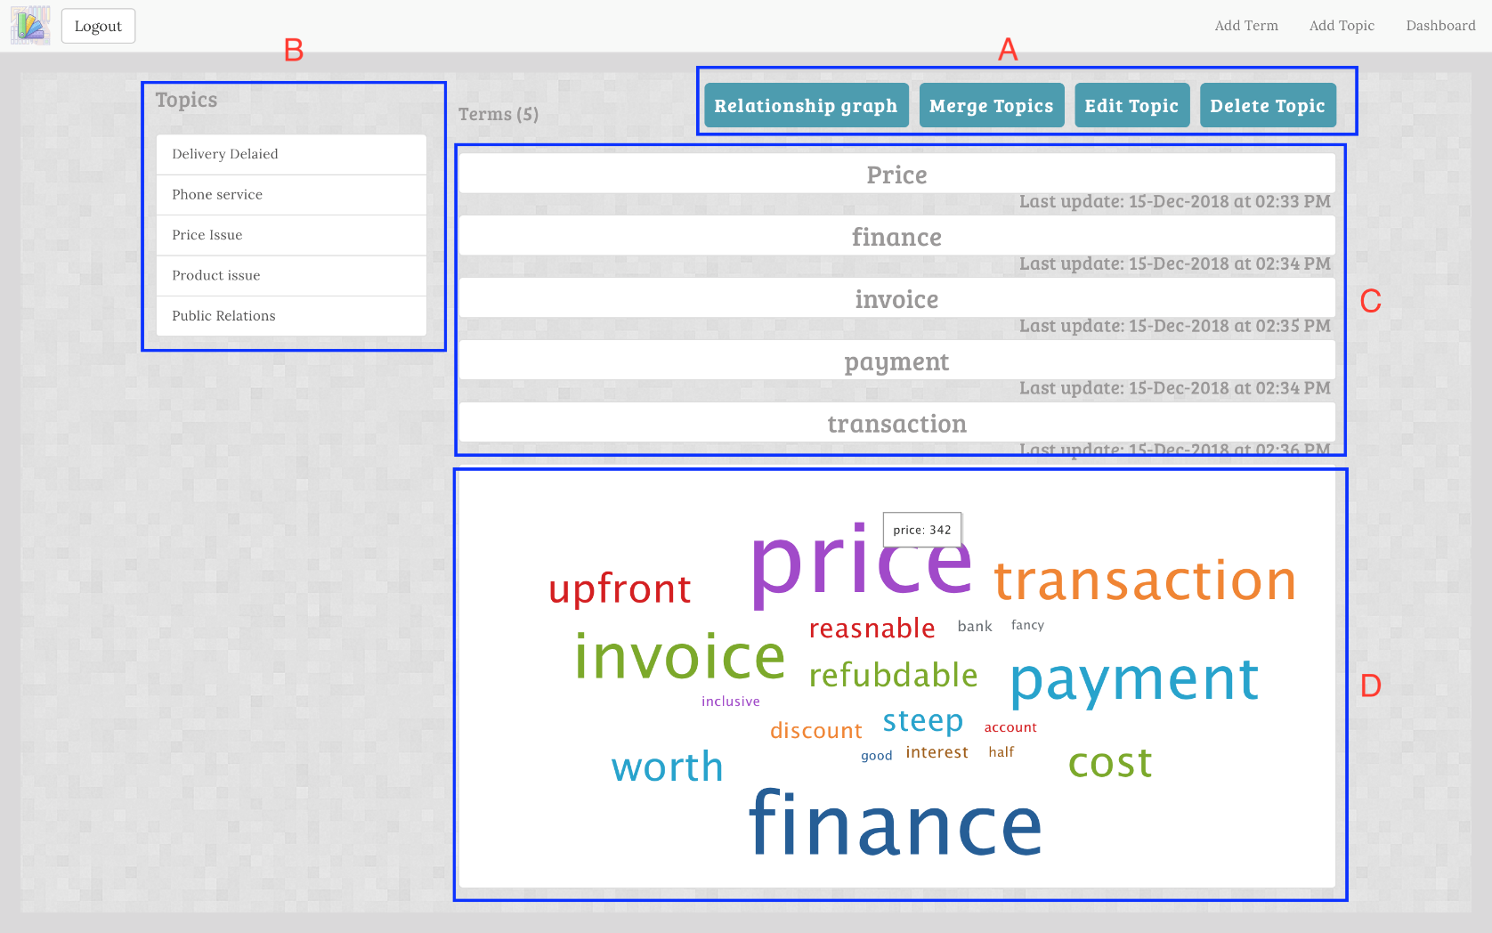
INTERACTIVE CONTINUOUS REFINEMENT APPROACH (ALIGNING THE SYSTEM)
Section A
Section B
Section C
Section D

Slide 27
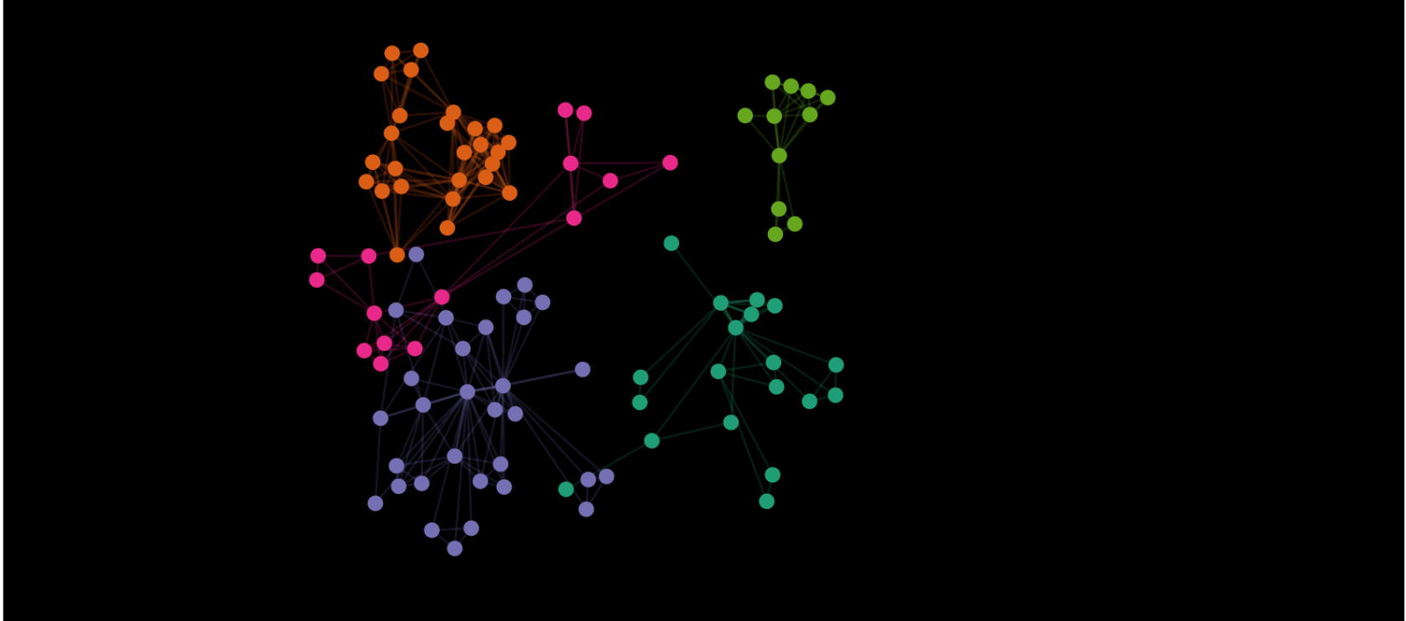
Relationship Graph
It’s important to visualize the human aspect of Emails, using graph community detection (GCD).
graphs will be generated into clusters according to the previously extracted topics.
senders/receivers are represented as nodes and emails are represented as links between them.

Slide 28
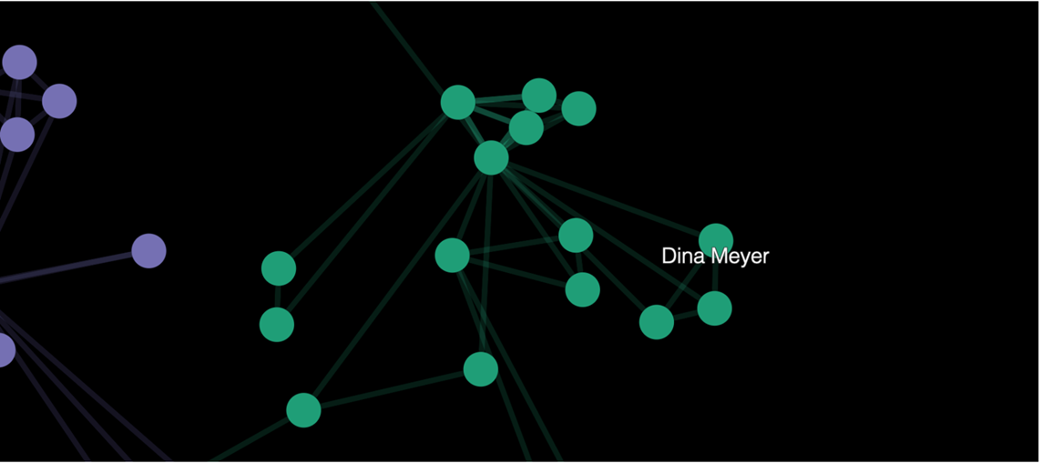
Single cluster
The user can zoom out and zoom in into specific cluster, and when a node is elected the name of the sender/receiver will be displayed.
Single cluster

Slide 29
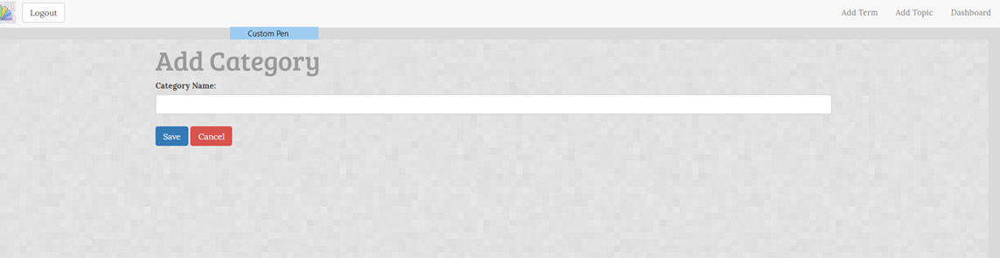
ADDING NEW TOPIC

Slide 30
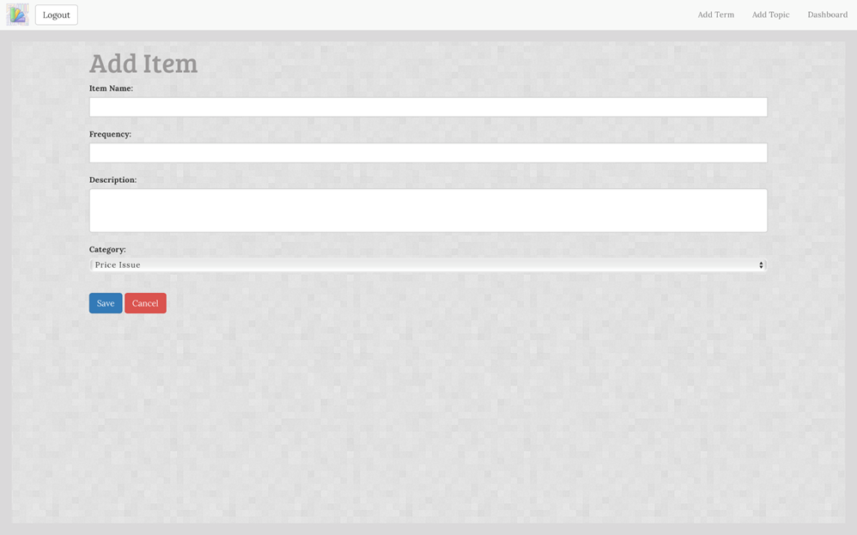
ADDING TERMS

Slide 31
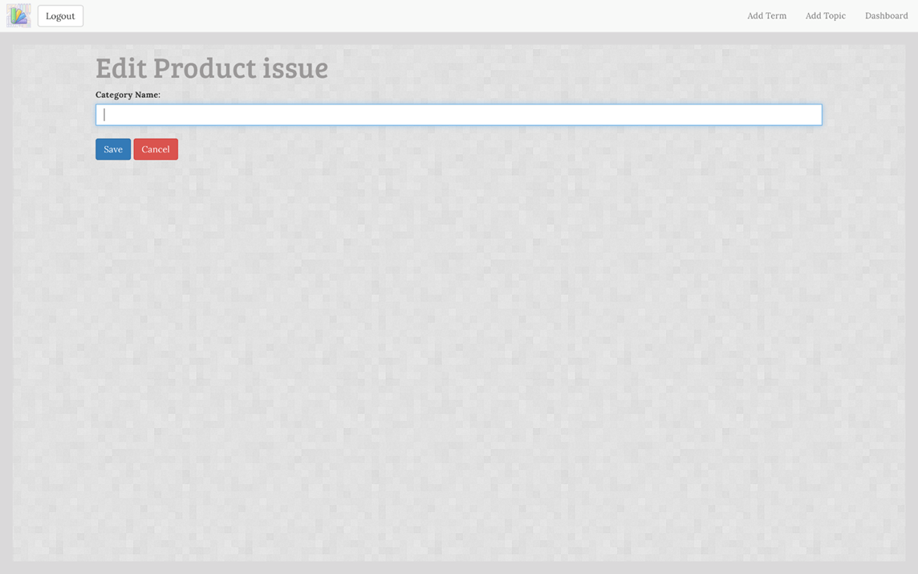
EDIT TOPIC

Slide 32
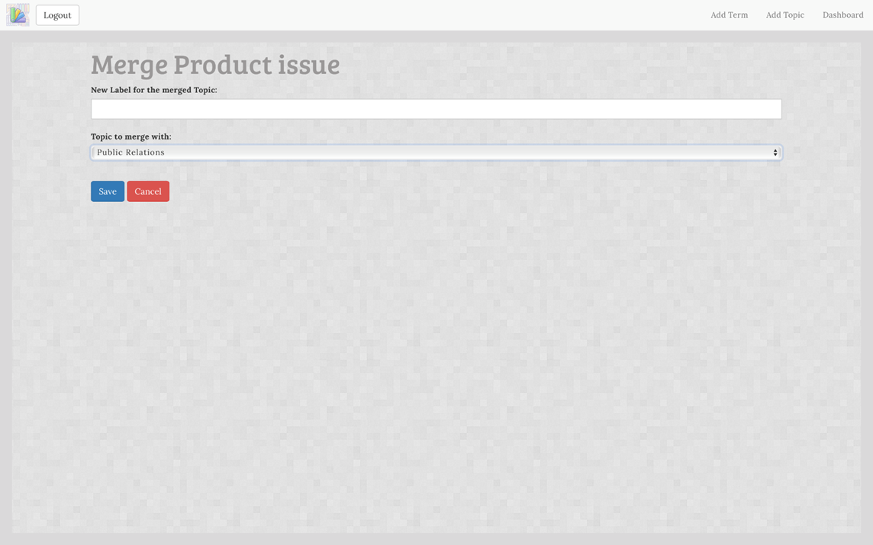
MERGE TOPICS

Slide 33
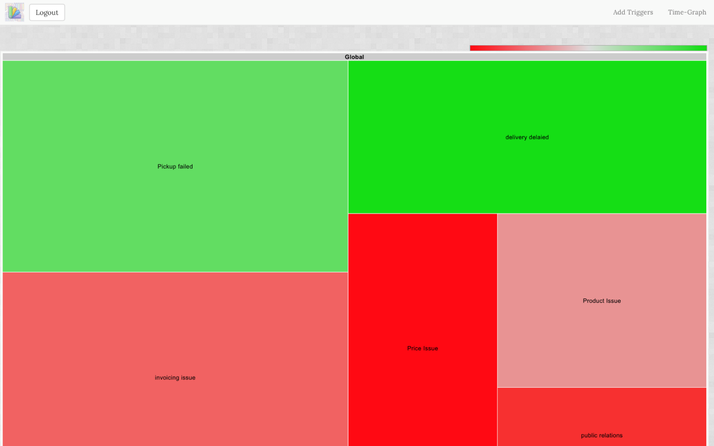
DASHBOARD
Dashboard(Tree-Map)

Slide 34
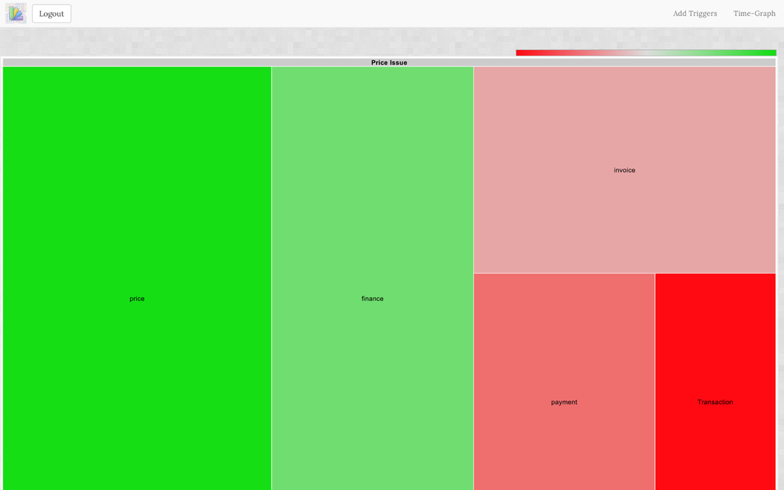
Topic in the tree map
Topic in the tree map

Slide 35
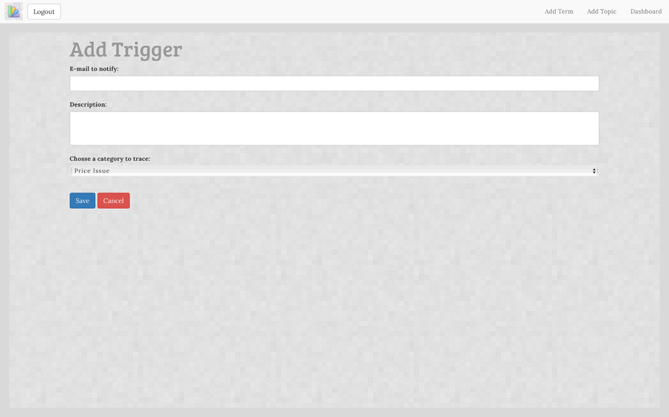
Adding Trigger
Add a trigger

Slide 36
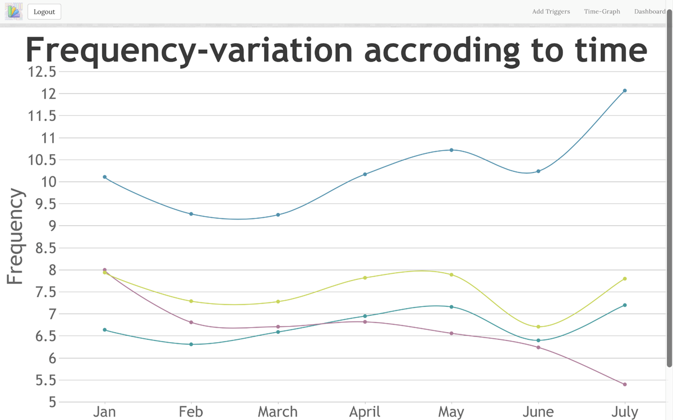
TIME-GRAPH
Time-graphs

Slide 37
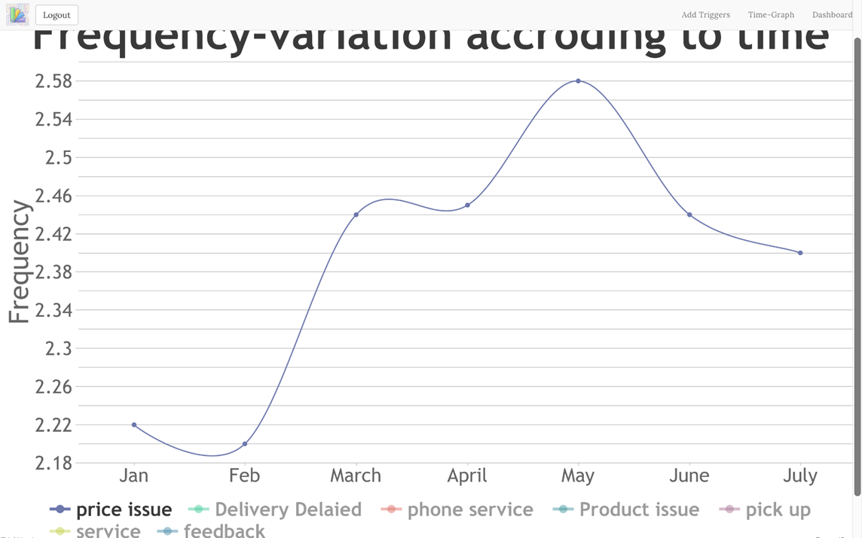
Time-graph of one selected topic
Time-graph of one selected topic

Slide 38
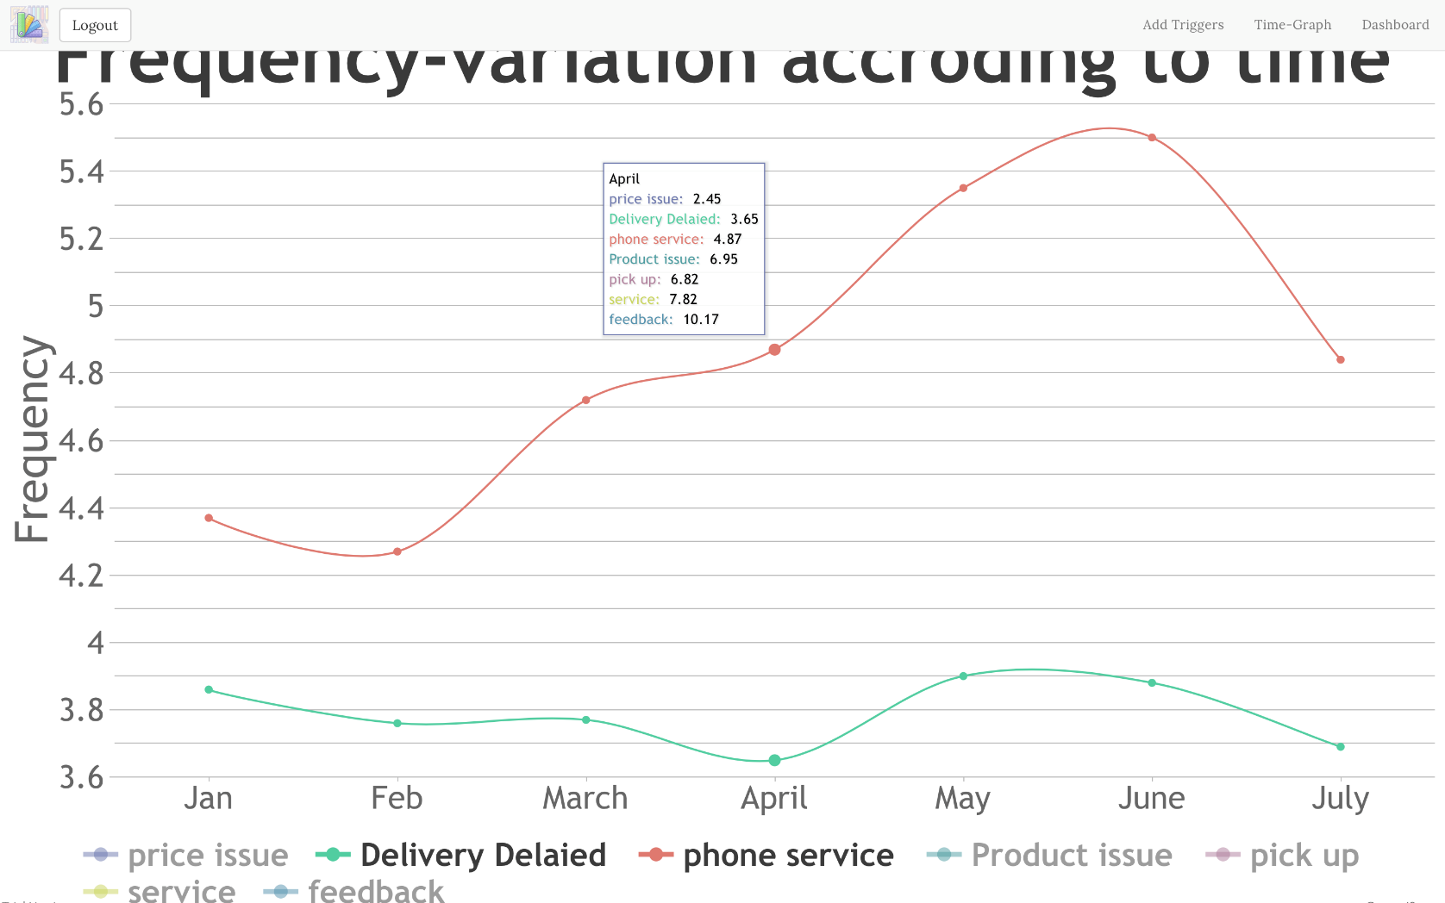
Time-graph (Comparison)
Time-graph (Comparison)

Slide 39
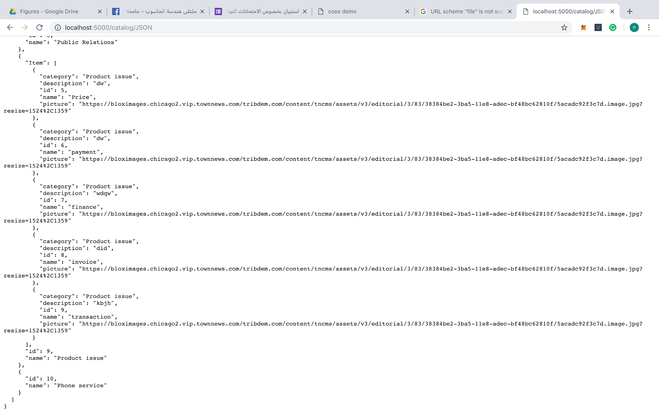
API for system Integration:
To integrate its features into the main system structure, so an API interface has been designed for the whole system where the output can be integrated with other enterprise systems.
JSON files of the extracted topics from the system to integrate it in interprise systems

Slide 40
Future Work
Getting the product to be used widely by companies from different sectors and backgrounds with huge amount of data regarding the classification and categorization process.
improve the process of email classification to be fully automatic, without any interference from users.
The system can also be the base root for building an auto-response service for emails, by time it’s capability of categorizing and understanding email’s contents would dramatically improve, it then can generate auto responses based on the user’s previous interactions with similar emails.

Slide 41
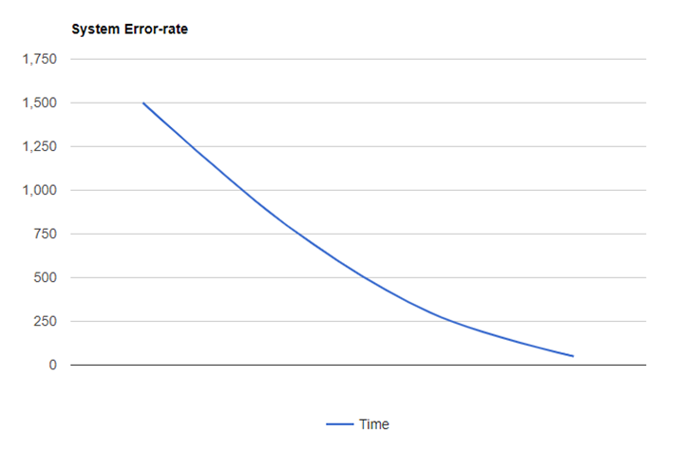
SYSTEM'S FRAUD RATE OVER TIME

Slide 42
Demo

Slide 43
Thank you
Any Questions ??

