Slide 1

Graduation Project
Academic Najah Forum
Team :
Ammar Omar 11822312
Tariq Bahbouh 11821520
Muhammad Draidi 11820392
Supervised By: Dr.Fadi Draidi

Slide 2
ABSTRACT
Communication among university students is essential to enhance the academic experience and achieve academic excellence.
Our project aims to create an interactive digital environment that contributes to enhancing communication between students and encouraging them to exchange experiences and knowledge.
The site provides opportunities for social interaction and shared learning, and seeks to foster a university community spirit.
Our new website project is a modern and effective platform that aims to enhance communication and exchange of experiences among university students.
The website provides an easy-to-use user interface, where students can create personal accounts and join interactive groups according to their academic and cultural interests.
Members can post and ask questions, which contributes to building a supportive virtual community full of opportunities for effective communication and exchange of experiences.

Slide 3
The problem and its solution
We found during our educational stage at the university that there is difficulty in communicating between students and exchanging experiences between them, and this is an important thing at this stage for building social relationships.
That is why we thought of a solution to this problem by building a website that allows communication between students and the exchange of experiences between them

Slide 4
Why Site Is Valuable
For Student :
The website allows students who use it to publish their own publications, such as requesting help in understanding specific subjects or offering assistance in topics in which they are experts and would like to benefit other students, publishing training courses, and allowing communication between students to hold meetings between them.

Slide 5
Why Site Is Valuable
For Admin :
The website allows the admin to add, delete, or modify facultys and facultys sections, as well as for the halls available for reservation, as well as for student accounts.
He can also add a new admin to the website to help him manage it. The website admin can also see the records of entering student accounts and admins’ accounts to ensure complete reliability in website and no errors in account students.

Slide 6






Front/Back-End Technologies

Slide 7
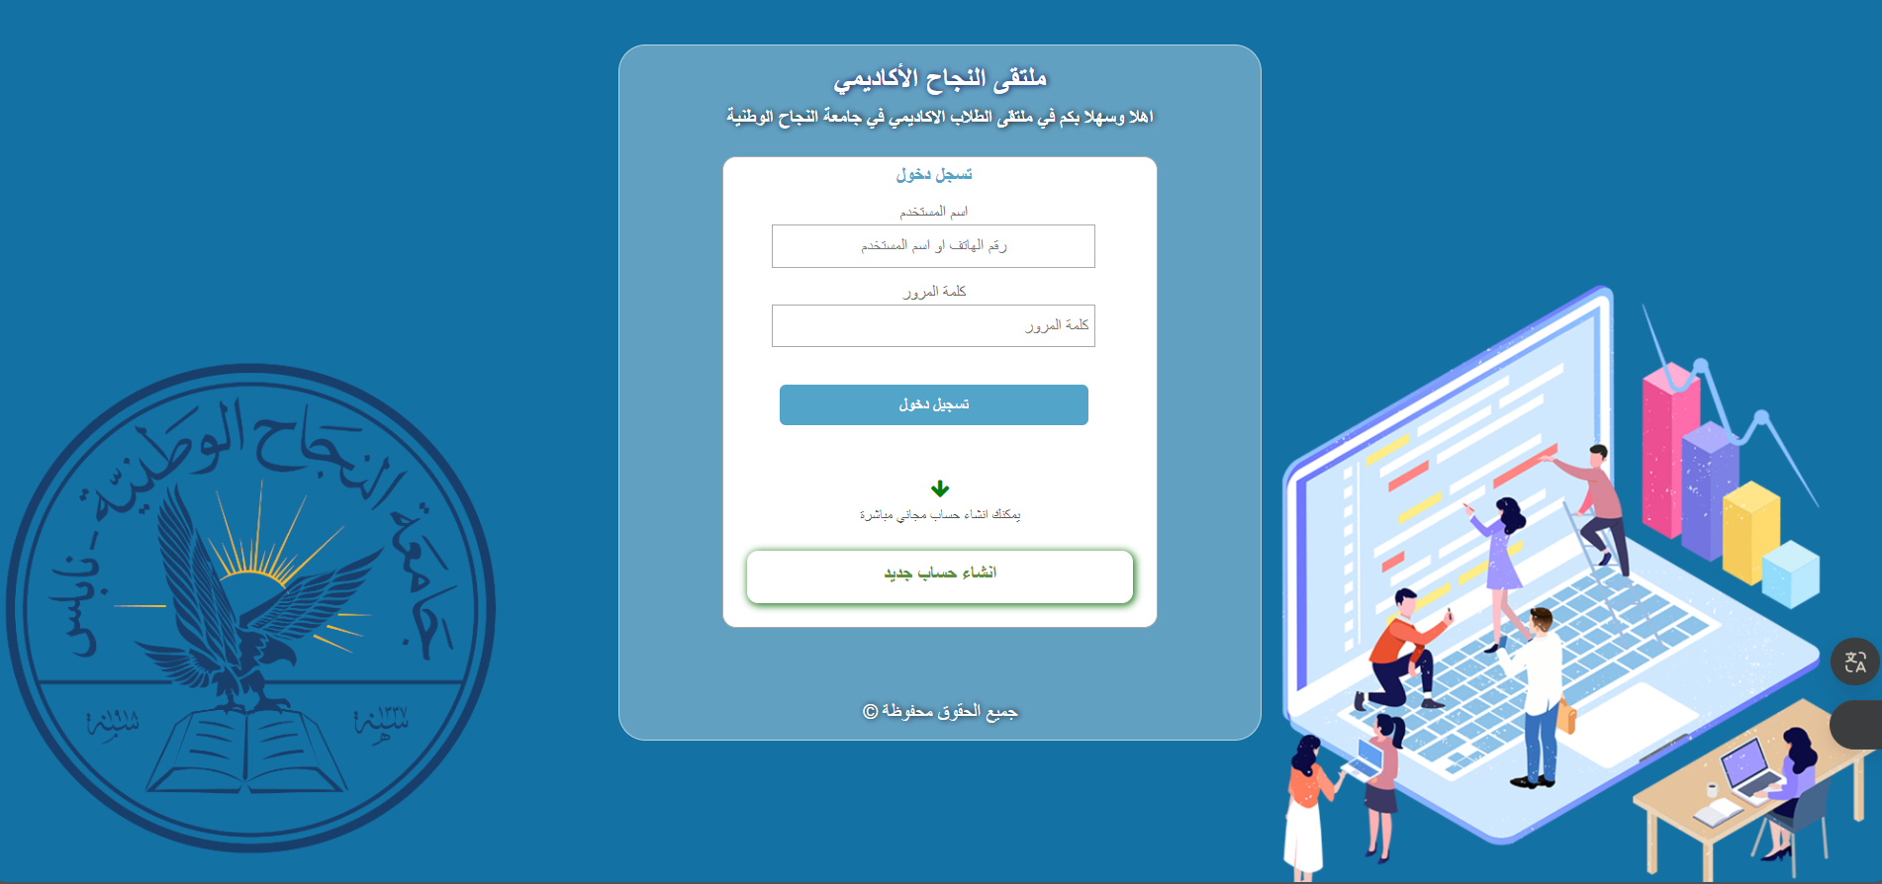

Slide 8
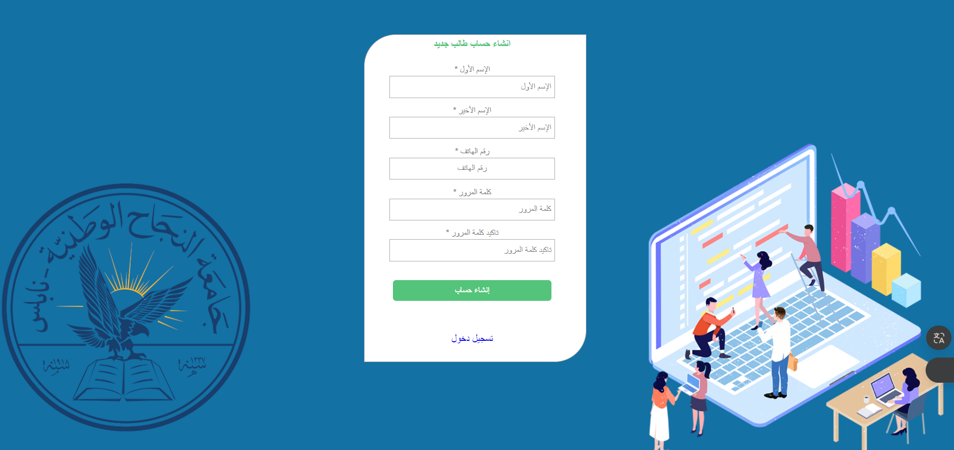

Slide 9
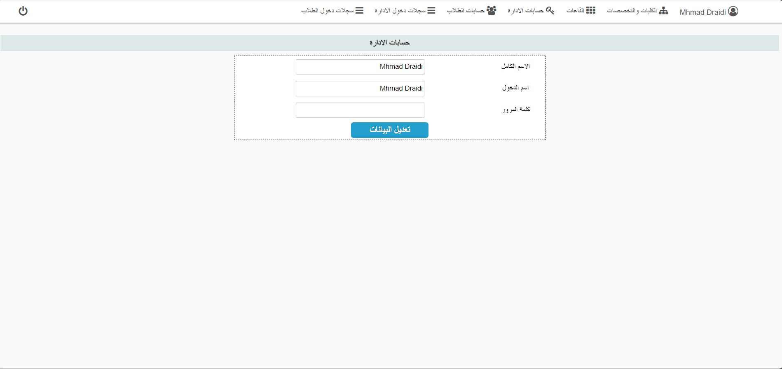

Slide 10
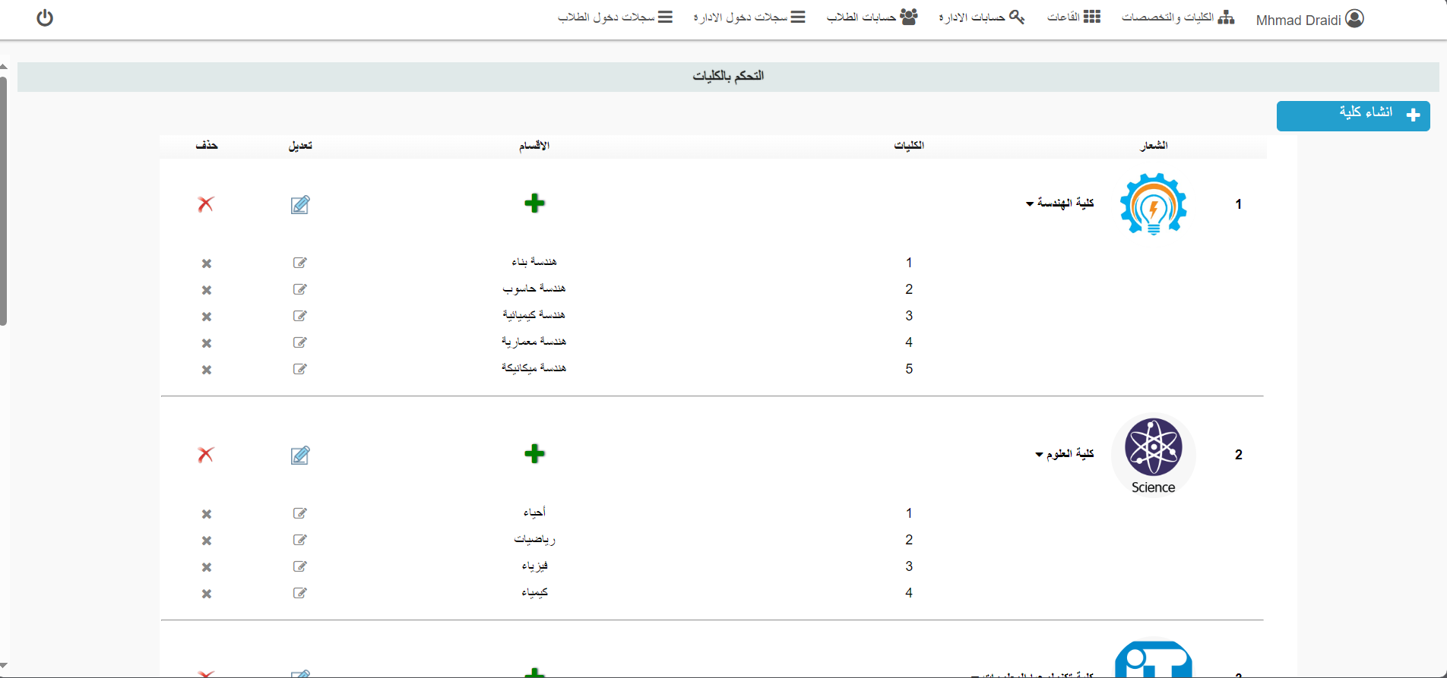

Slide 11
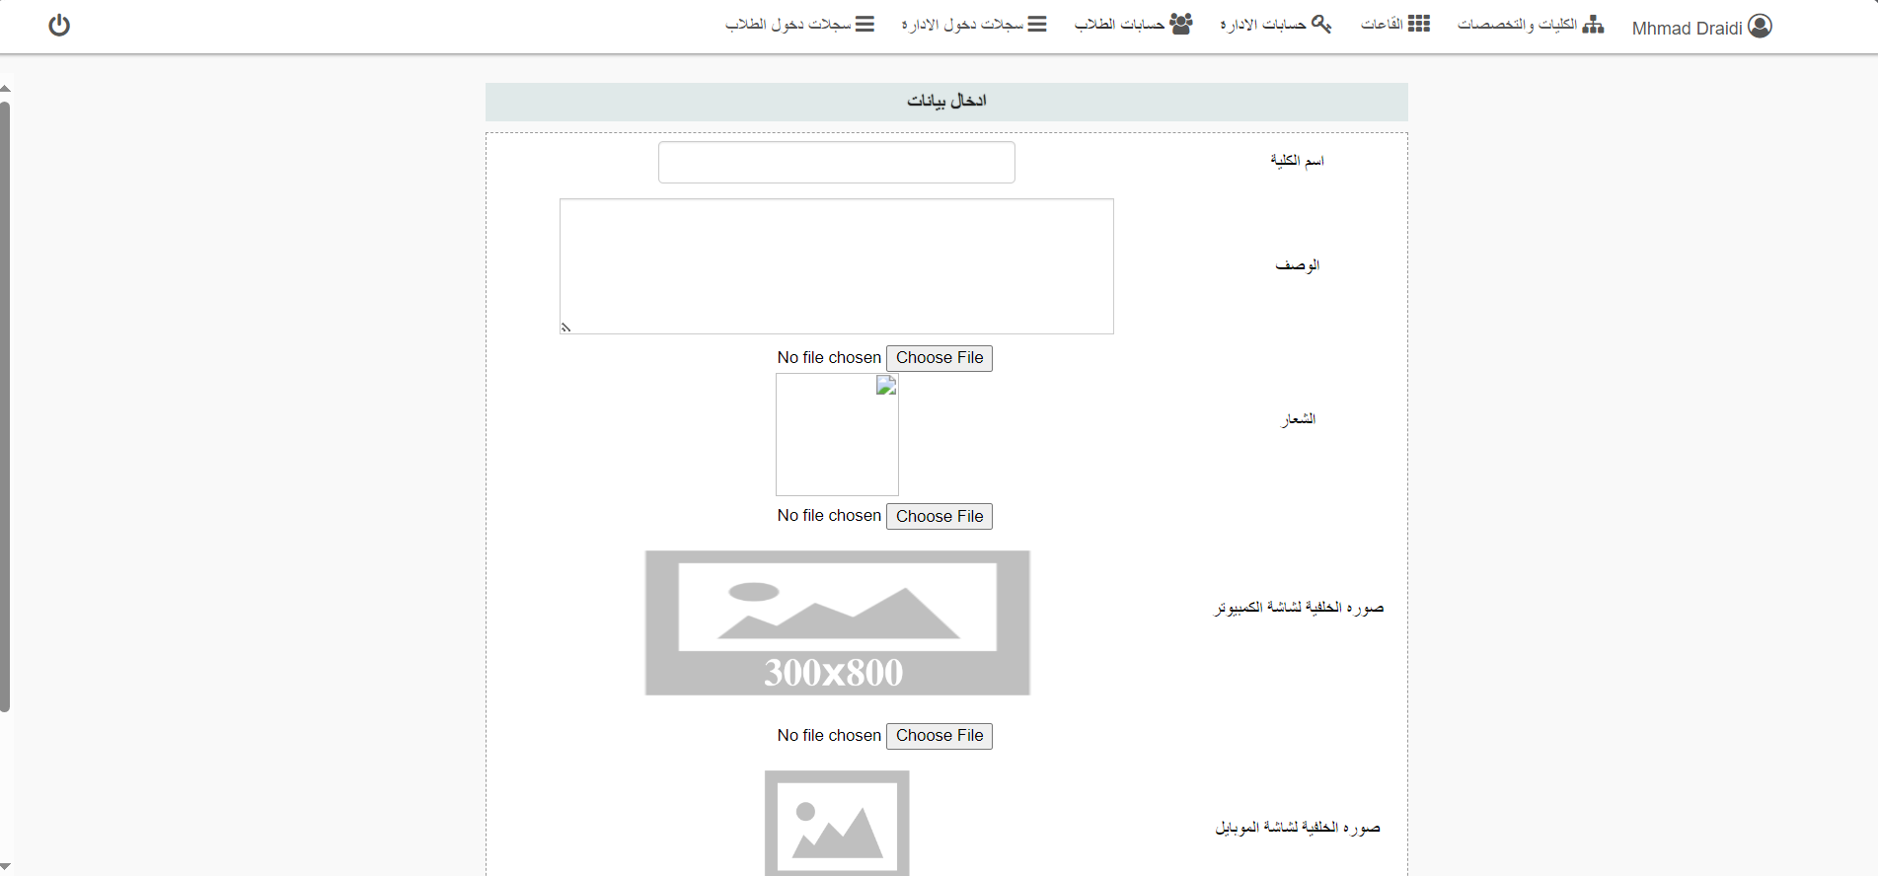

Slide 12
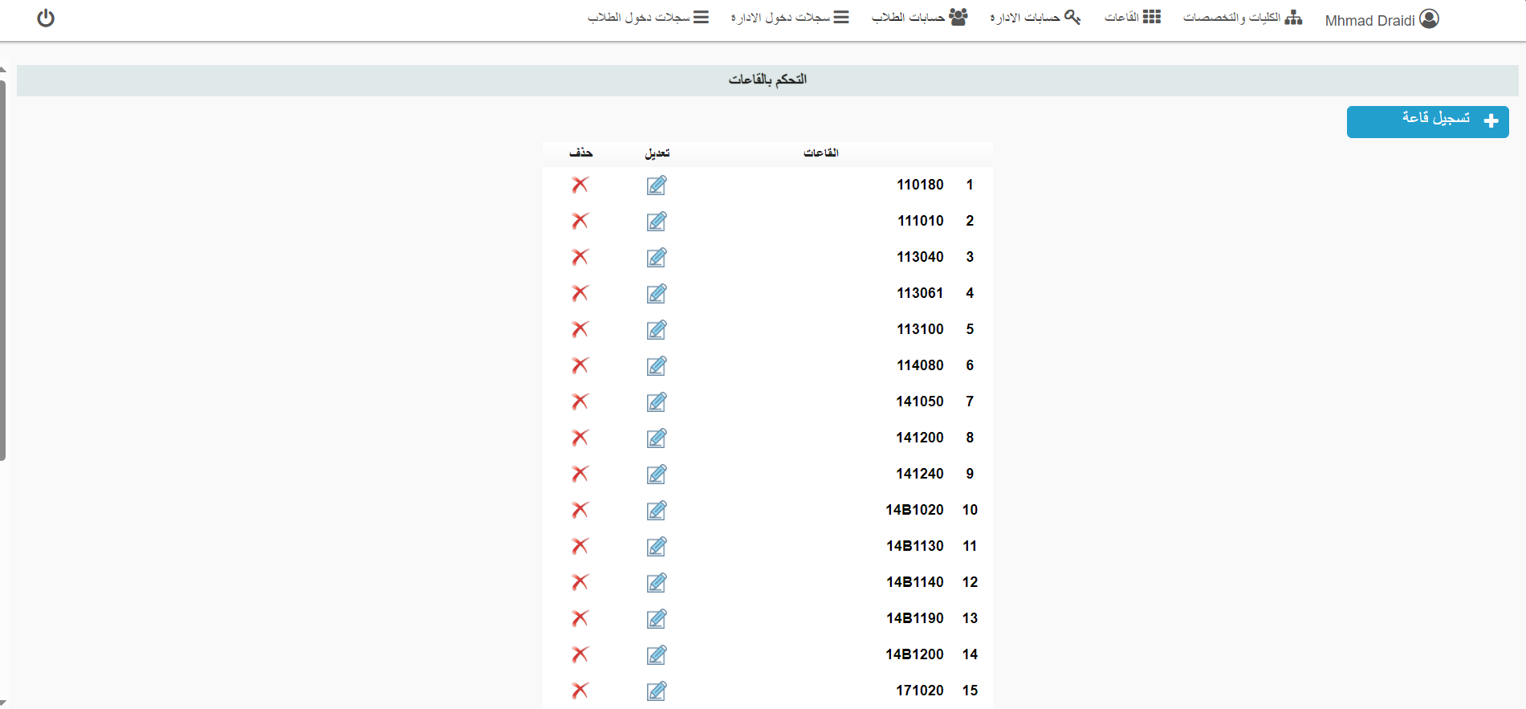

Slide 13
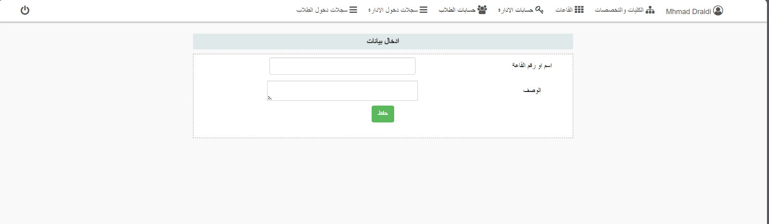

Slide 14
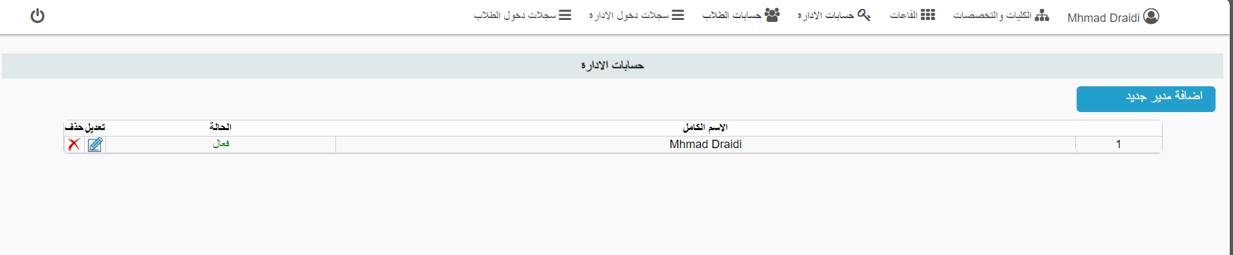

Slide 15
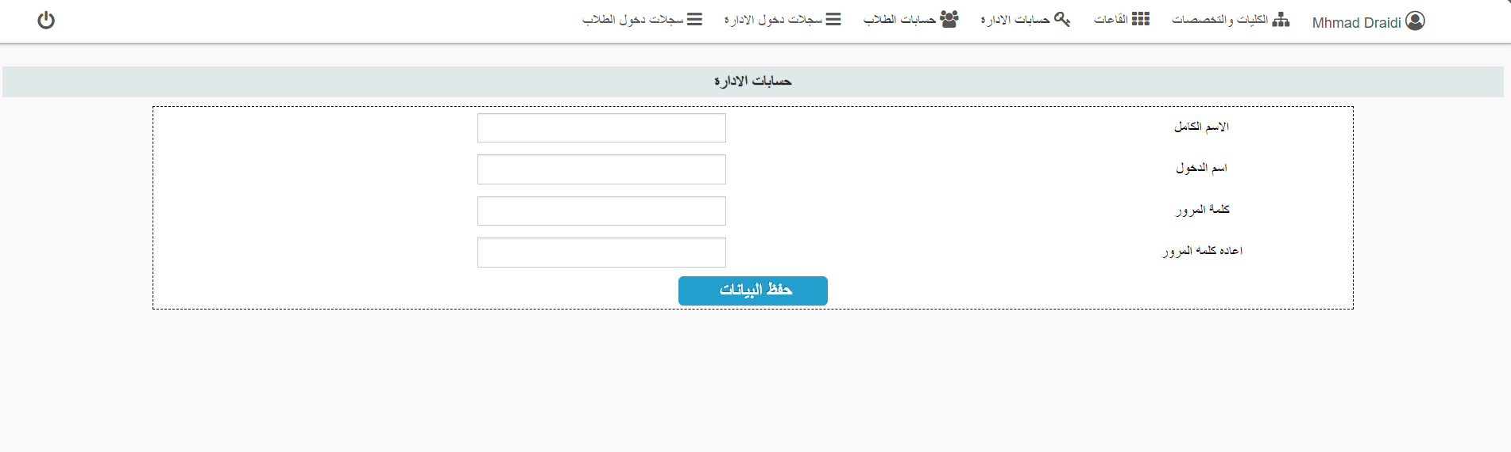

Slide 16
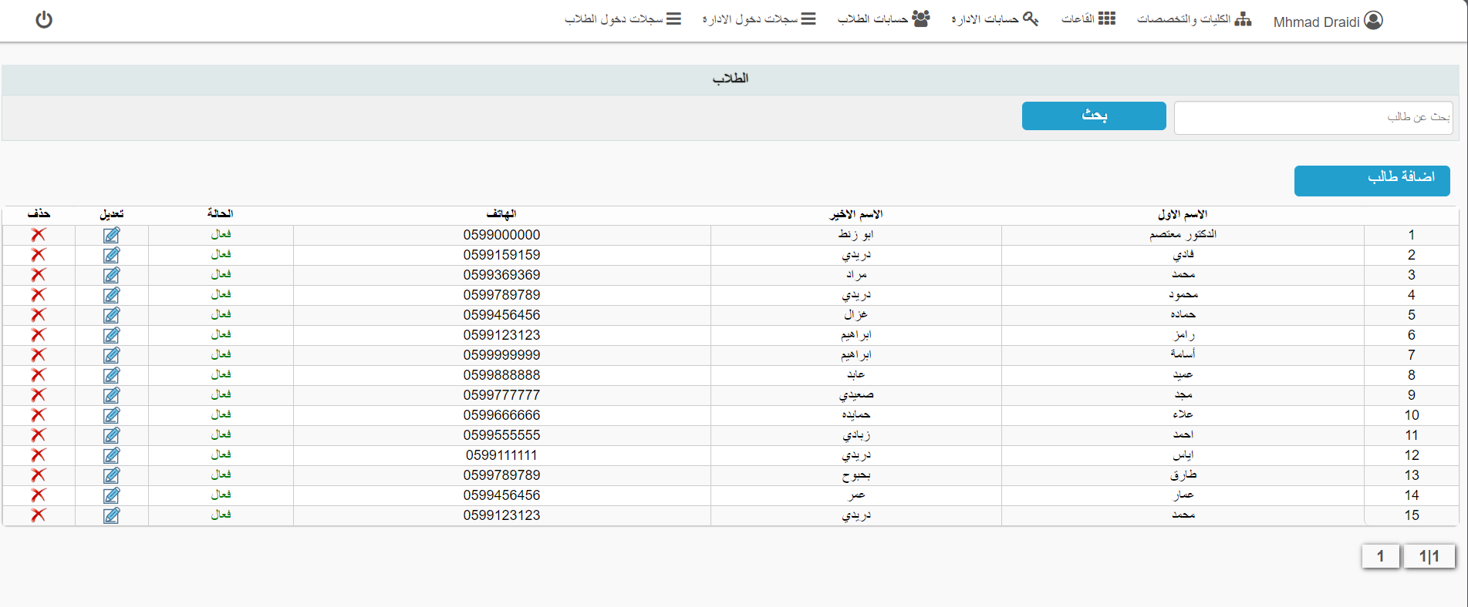

Slide 17
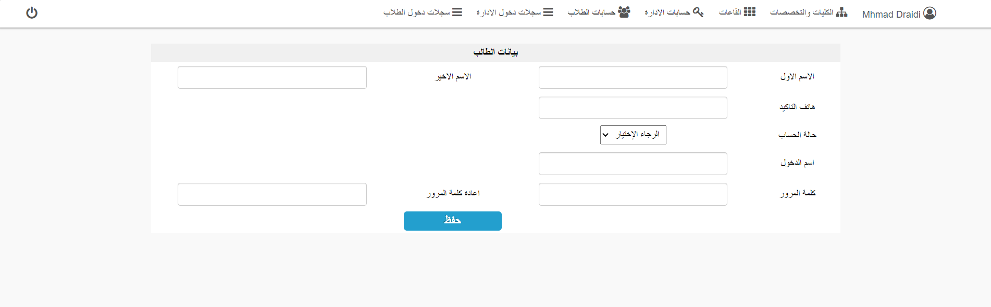

Slide 18
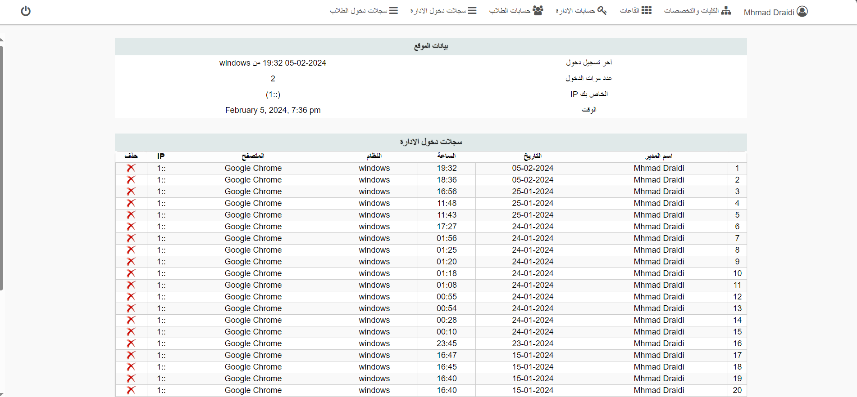

Slide 19
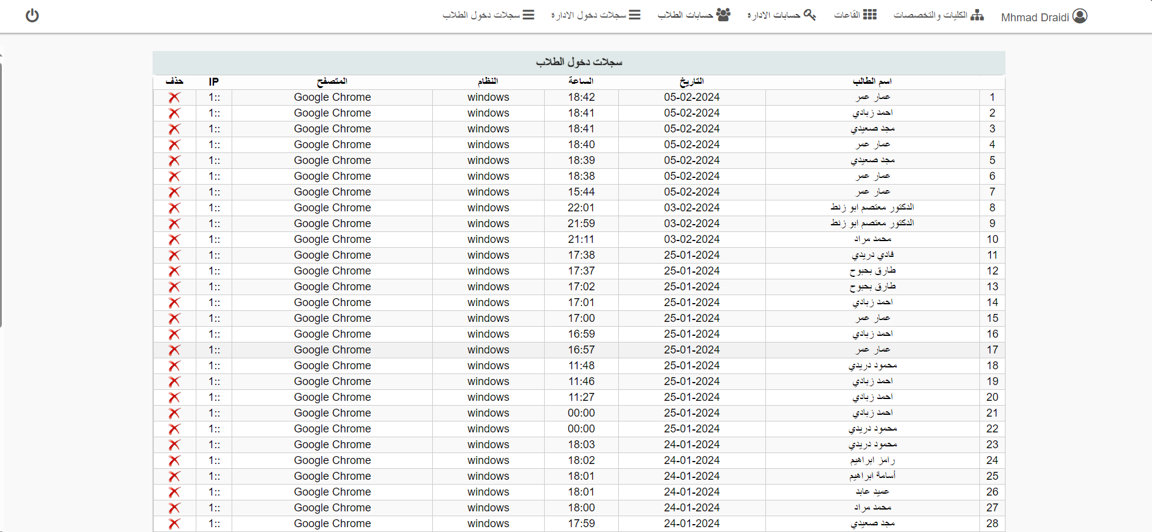

Slide 20
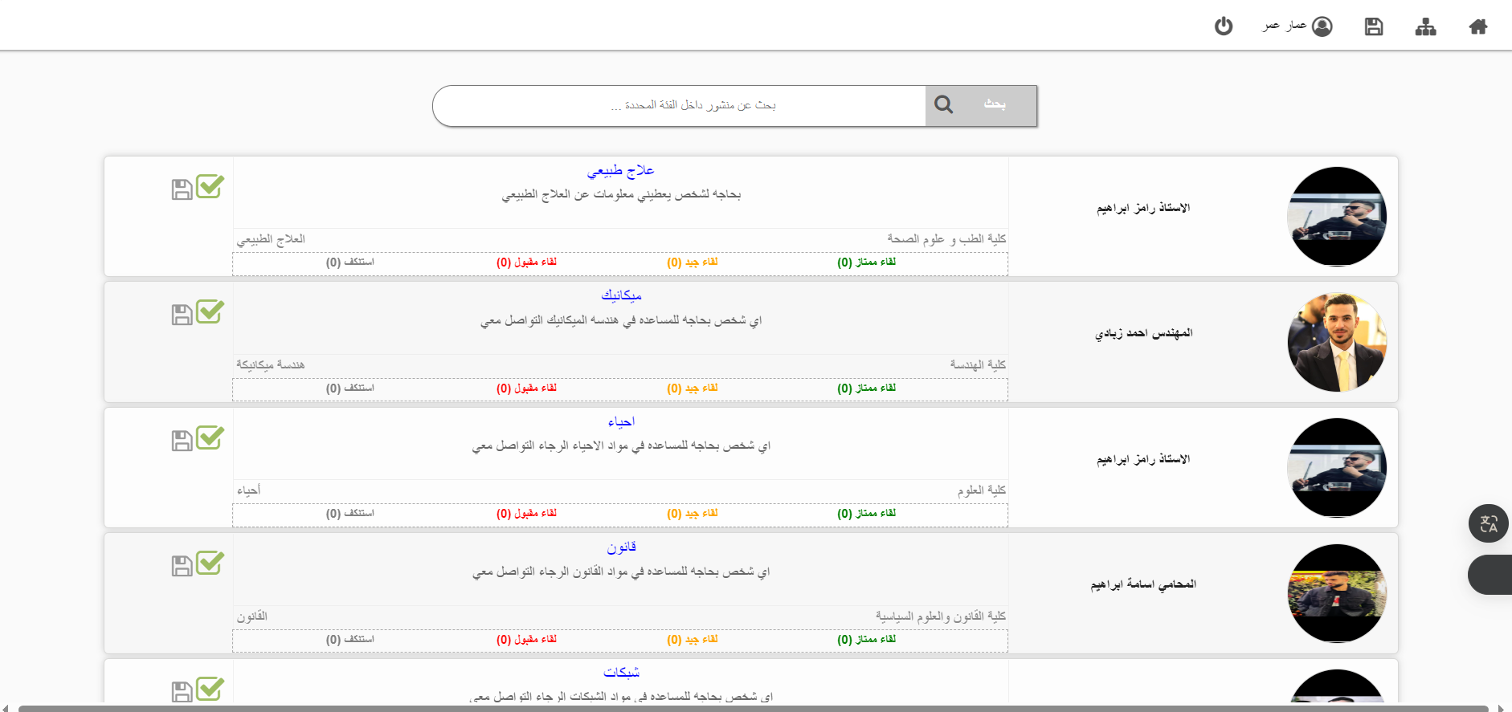

Slide 21
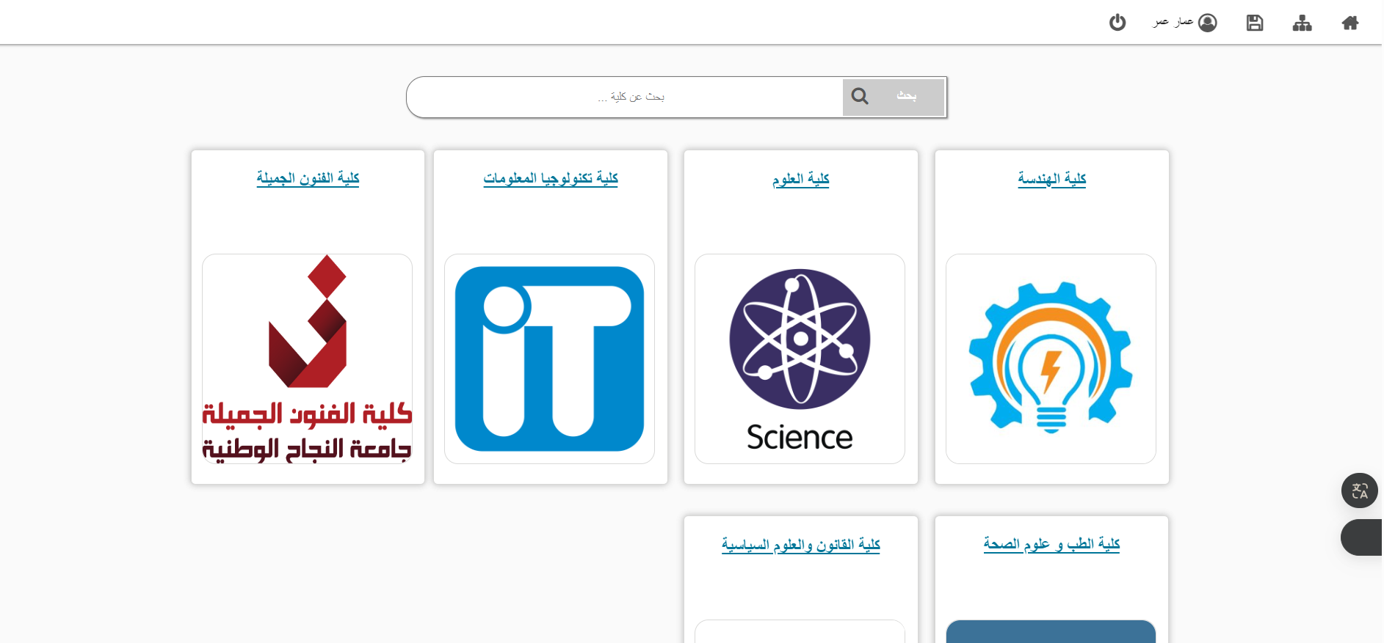

Slide 22
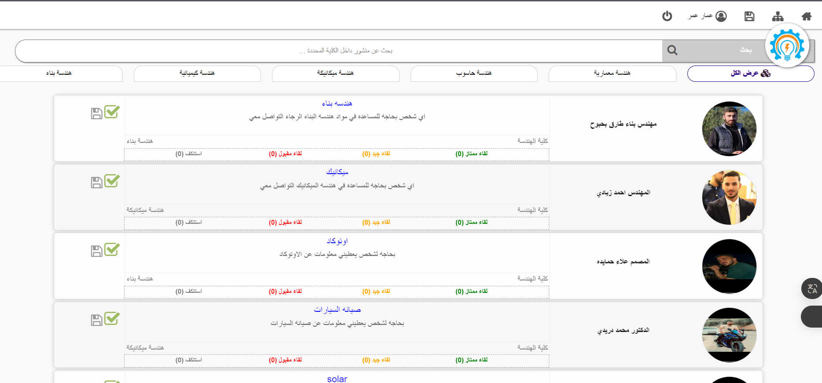

Slide 23
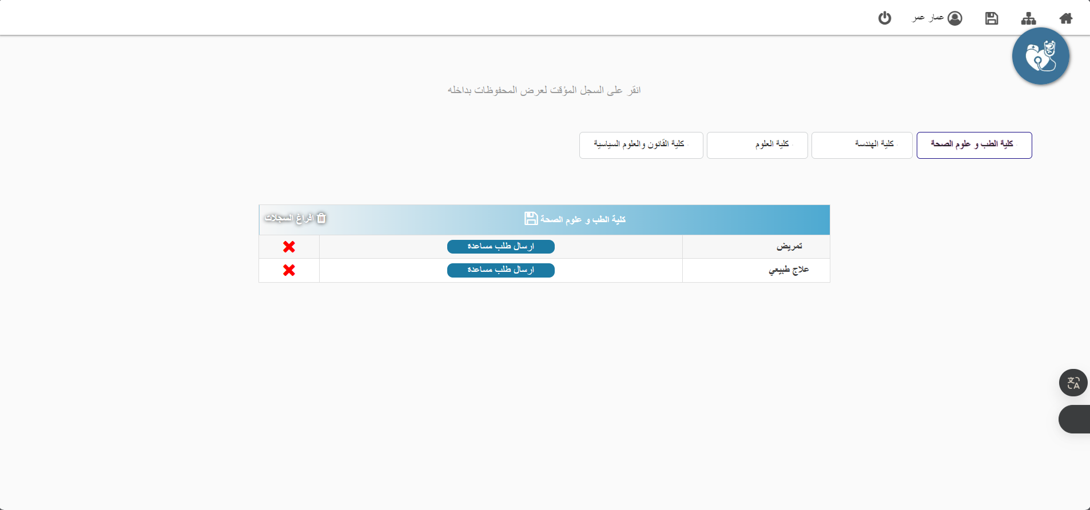

Slide 24
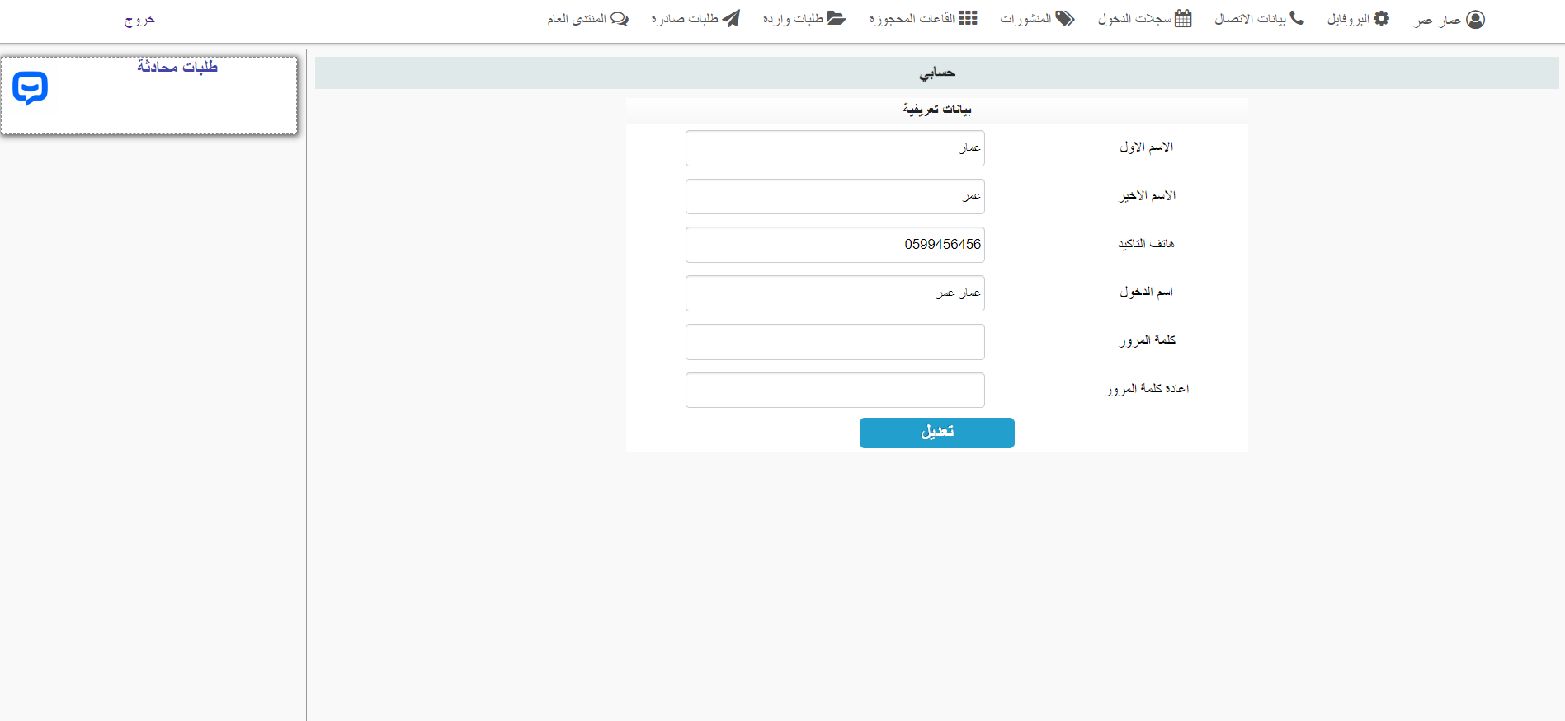

Slide 25
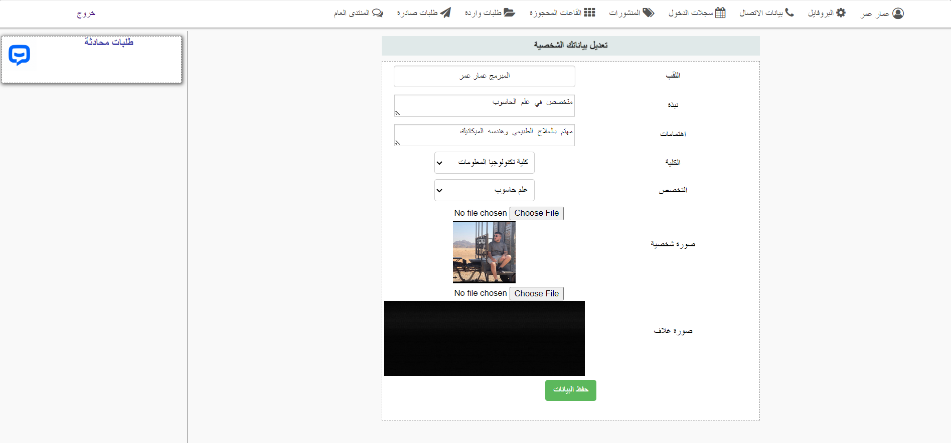

Slide 26
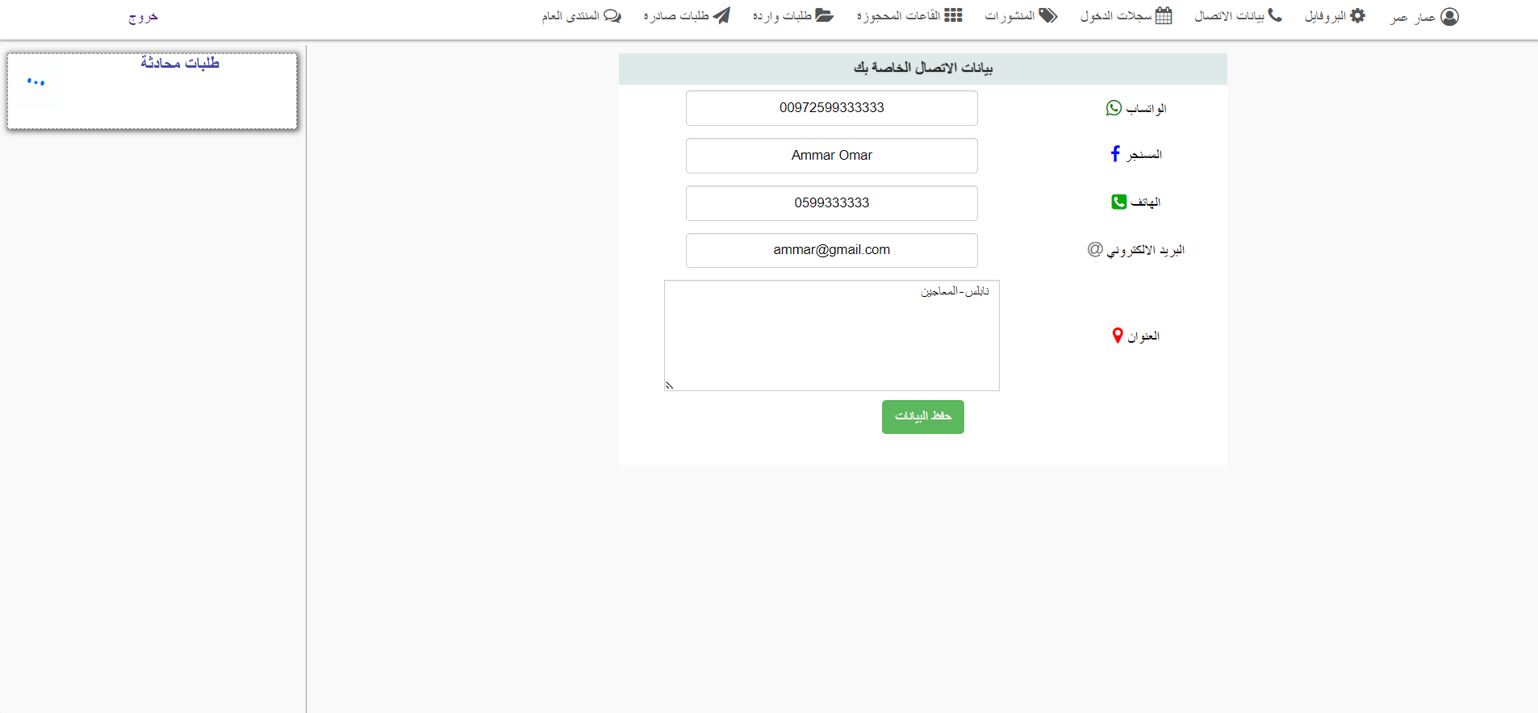

Slide 27
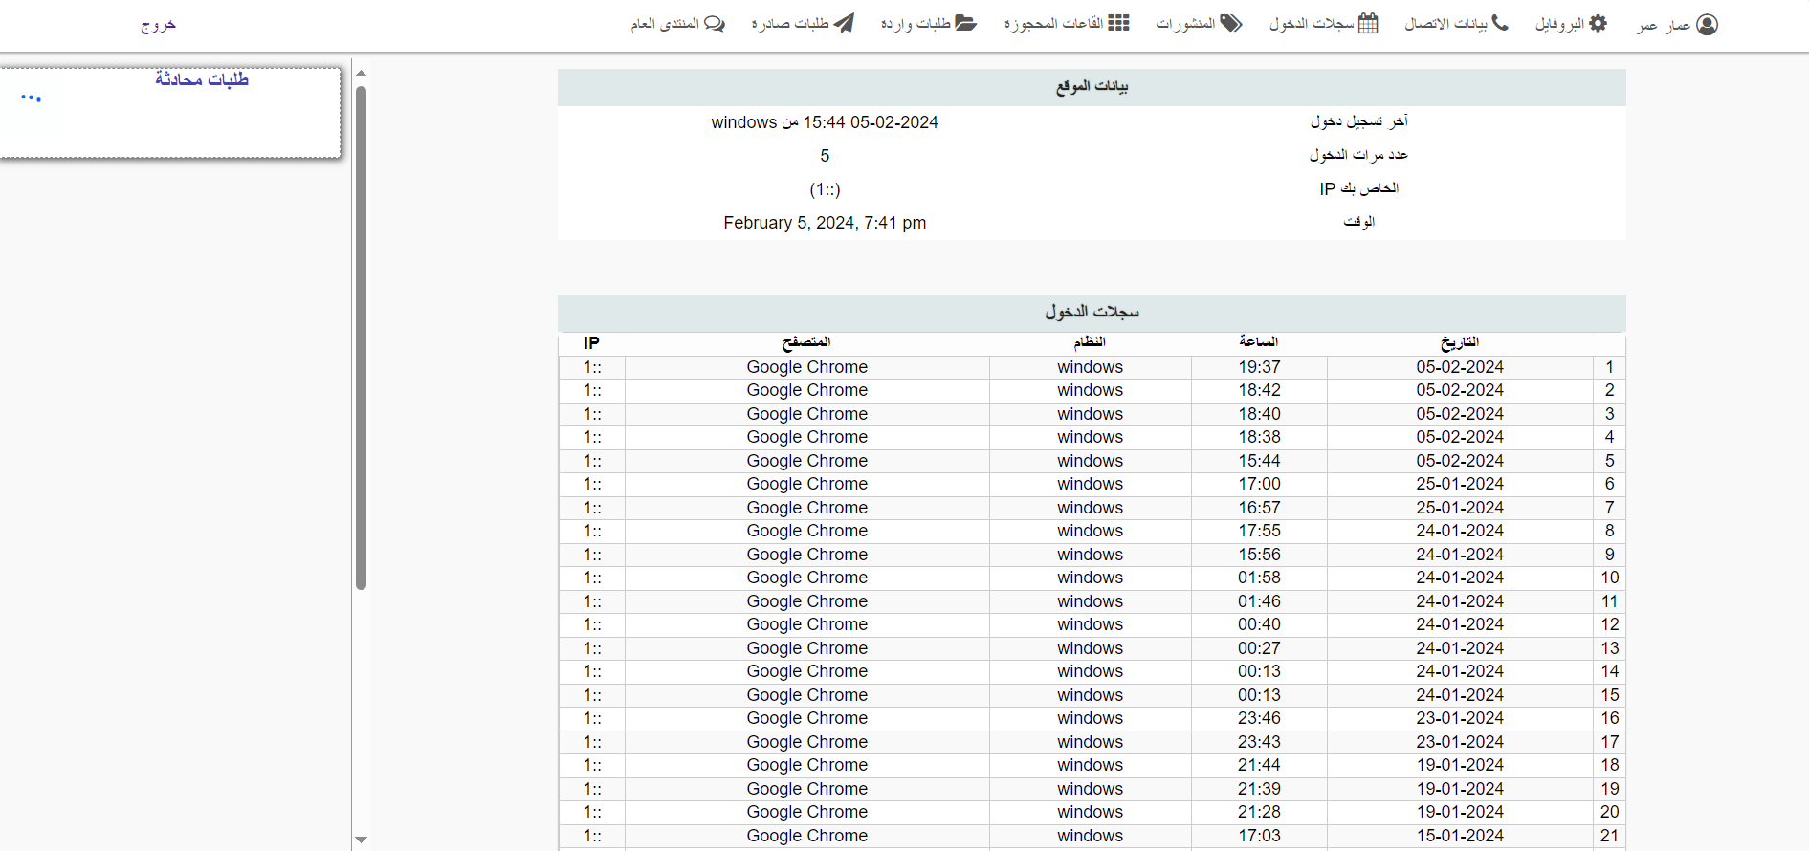

Slide 28
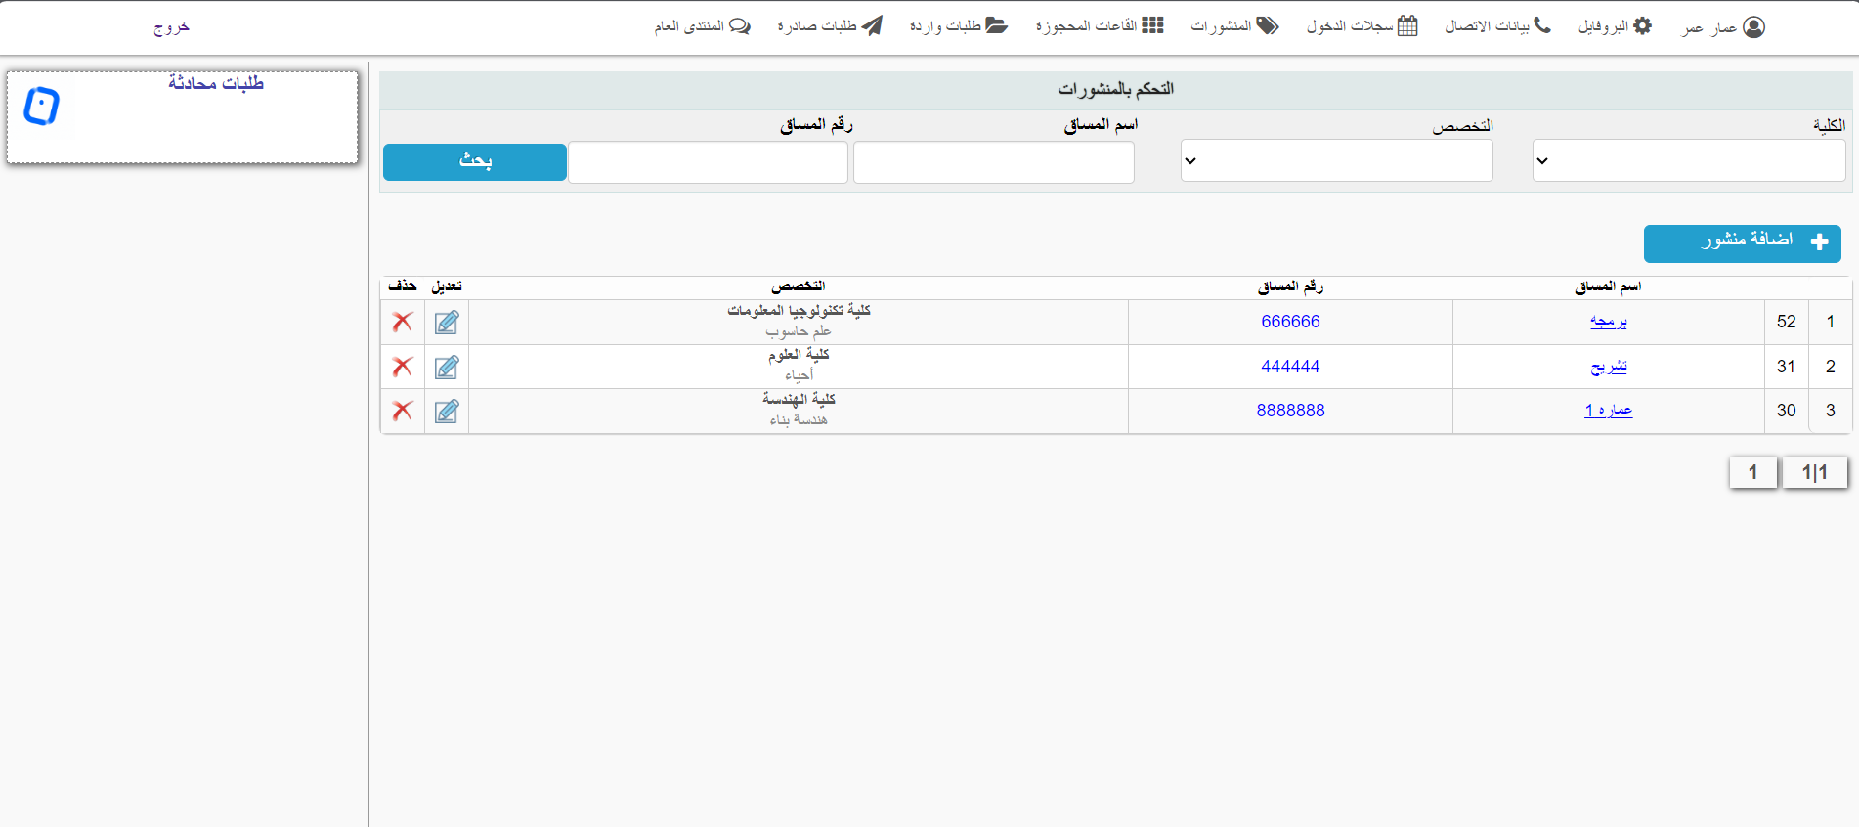

Slide 29
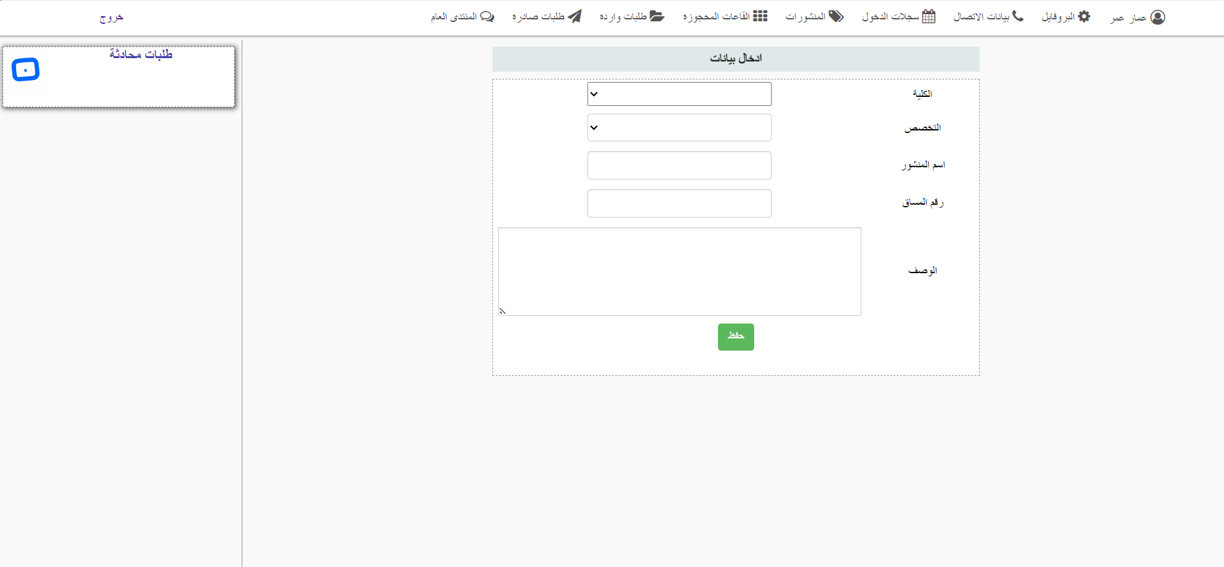

Slide 30
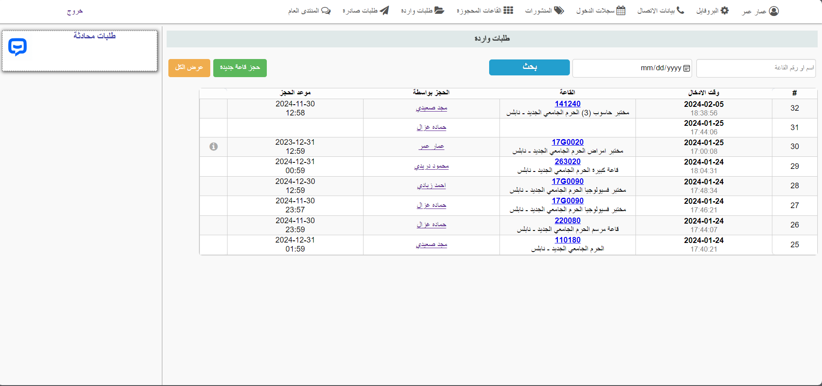

Slide 31
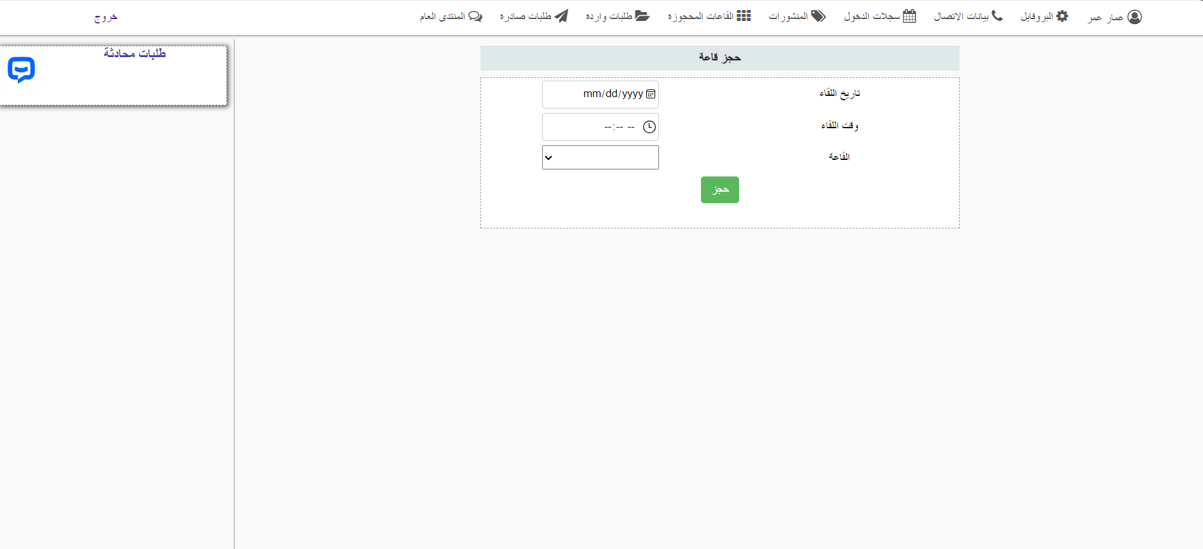

Slide 32
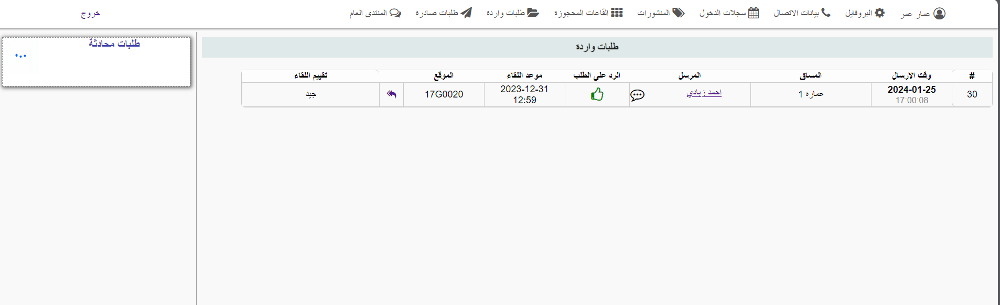

Slide 33
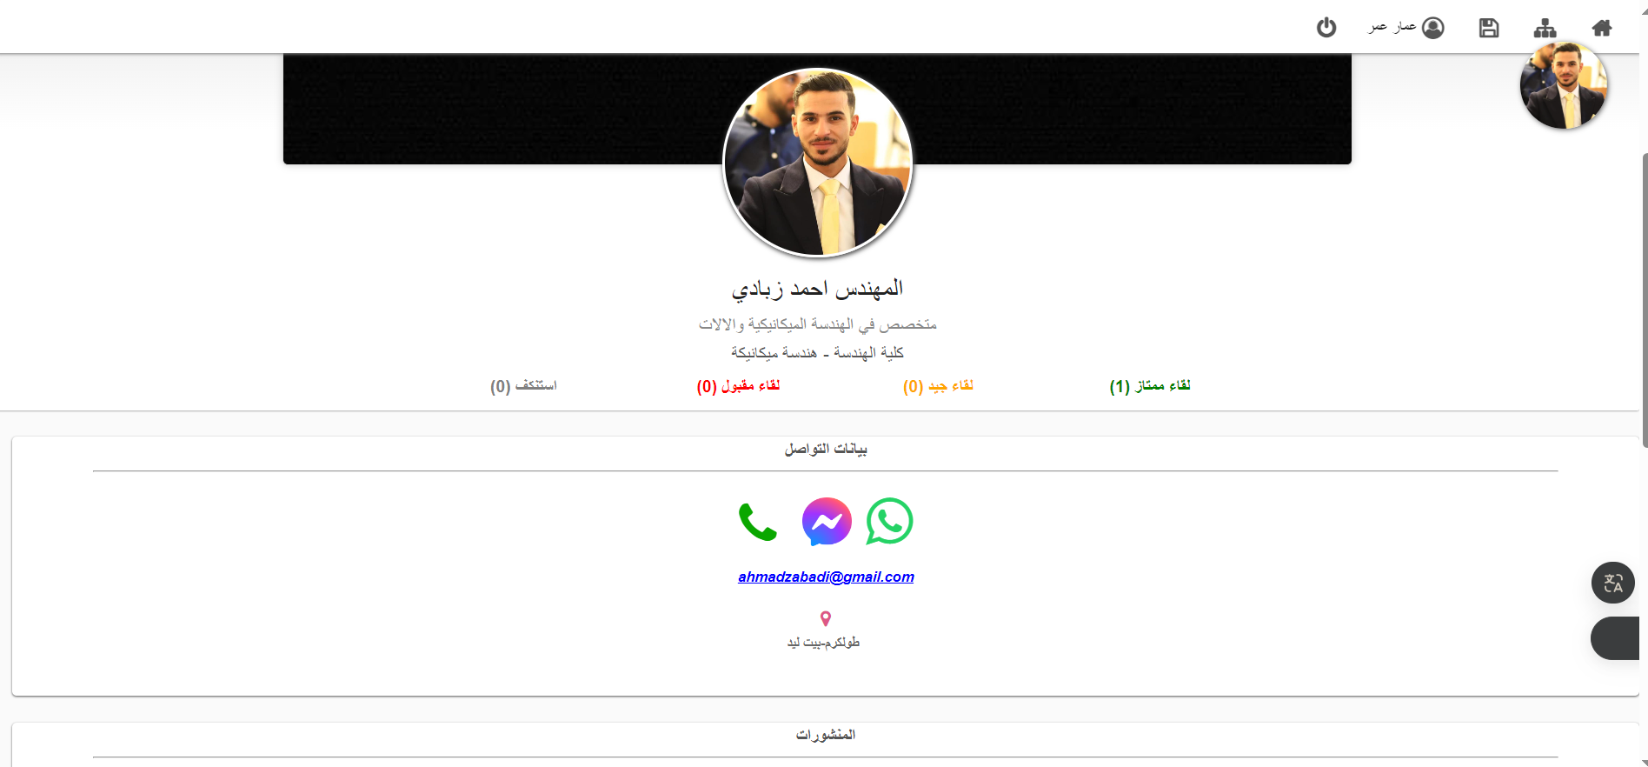

Slide 34
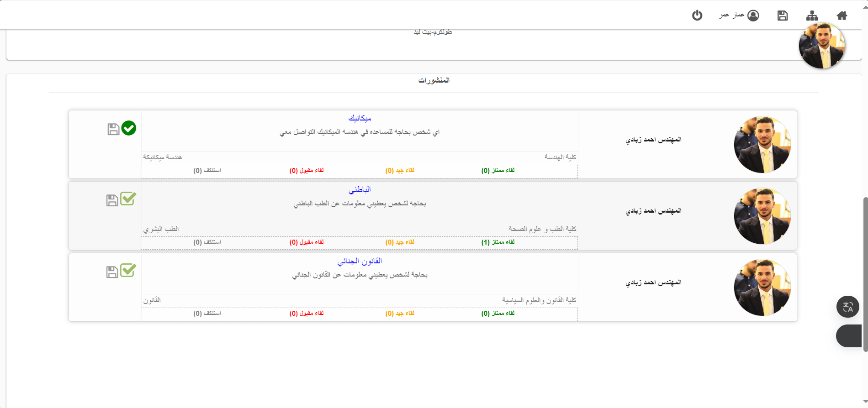

Slide 35
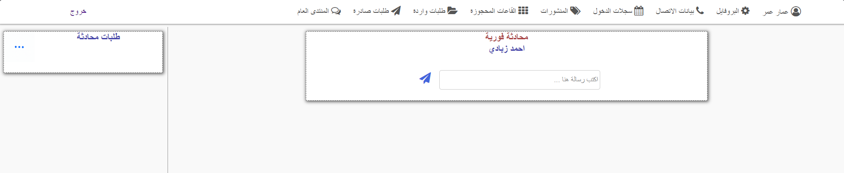

Slide 36
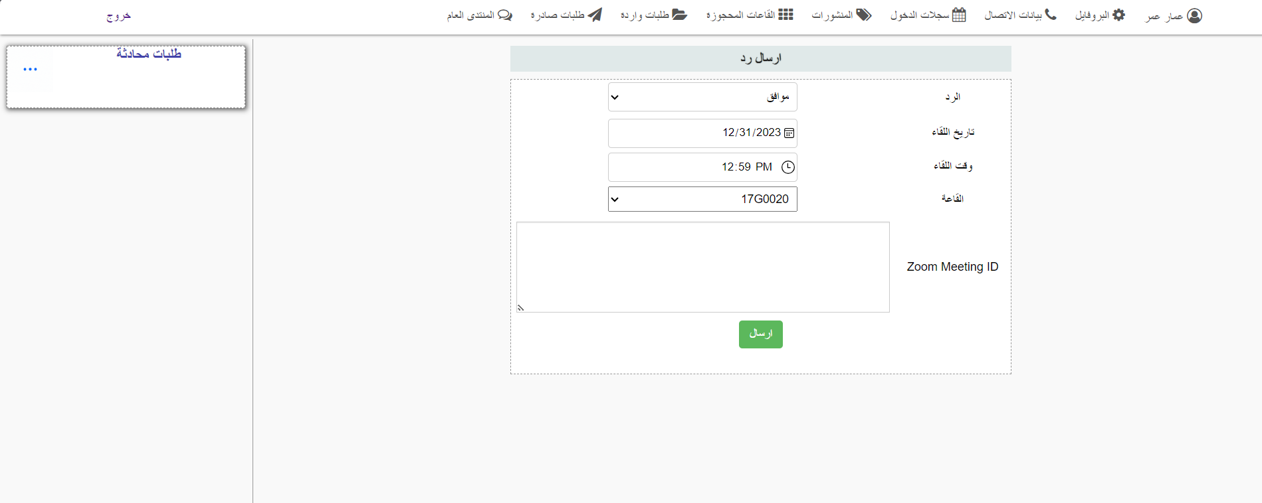

Slide 37
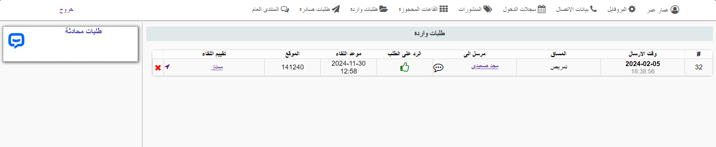

Slide 38
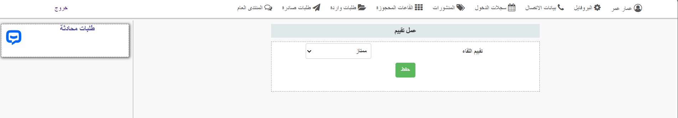

Slide 39
Future vision
Adding a notification feature and a comment feature on posts for forum activities to keep users more effective.
We will create a mobile application to ensure easy and convenient access to the website
We will continue to improve the interfaces for a better user experience.
We will improve the chat system to ensure easy communication between students

Slide 40


