Slide 1
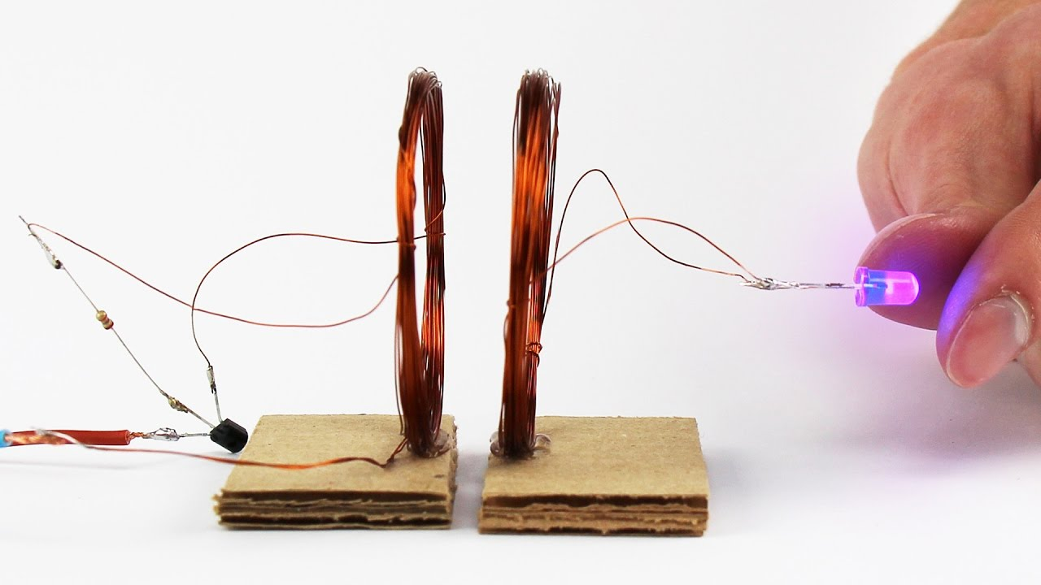
Harvesting Energy Using Piezoelectric Sensors
Wireless Power Transfer Based On Resonant Inductive Coupling
Supervisor : Dr. Kamel Saleh
Work Team:
Saja Nasasrah
Nader Zaineddin
Ahmad Jaari

Slide 2
Contents
Introduction:
  Harvesting energy using piezoelectric sensors.
  Problem statement.
  Wireless power transmission.
Literature review.
Methodology:
  Hardware and circuits design.
  Software simulation.
Results and Discussion.
Conclusion and Recommendations.

Slide 3
  Introduction:
  Harvesting energy using piezoelectric sensors:
energy is the most important aspects in our daily life.
Harvesting power results by walking and converting it to electrical power.
Piezoelectric sensors convert force & acceleration to a flow of electrical charges.(Piezoelectric effect)
Sensors are implemented inside shoes insole.
Produced AC signal converted to DC by passing through bridge rectifier.
The final DC signal is stored into a DC battery mounted to the shoes, for further use.

Slide 4
Problem Statements
It is not convincing to consume the stored energy by removing the battery from the shoes and plugging it again later.
Making wire connections and plugs under or inside the clothes is not convincing too.
Those were the motivations of searching for a wireless power transmission method.

Slide 5
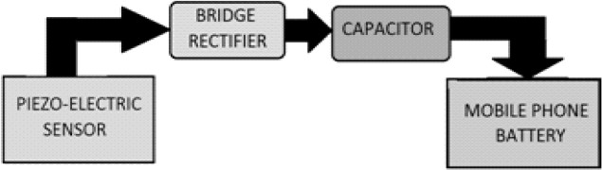
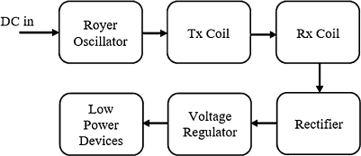
Wireless power transmission
Reduces the hazards of electrical shocks.
Make electrical circuit were wire connections are impossible.
Overview of the electrical flow diagram

Slide 6
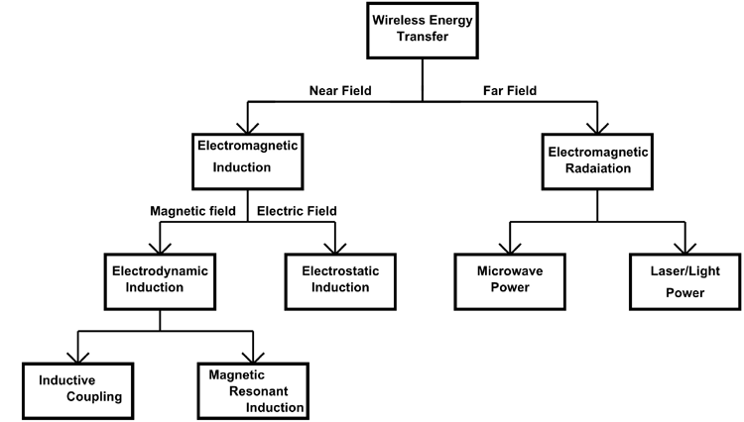
Wireless power transmission methods:

Slide 7
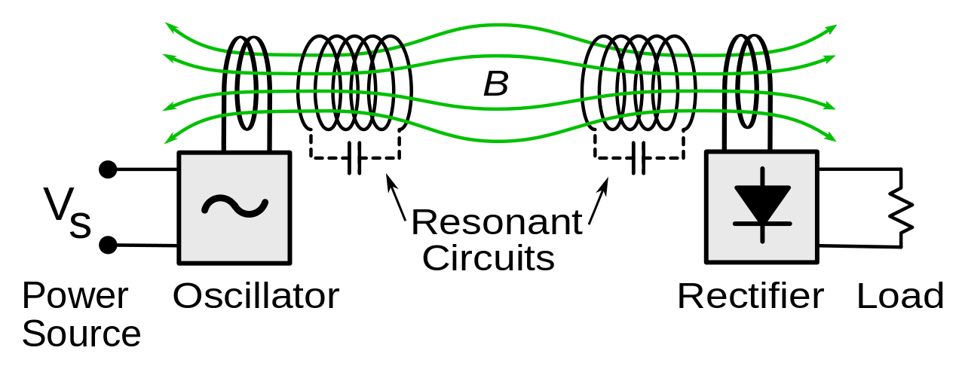
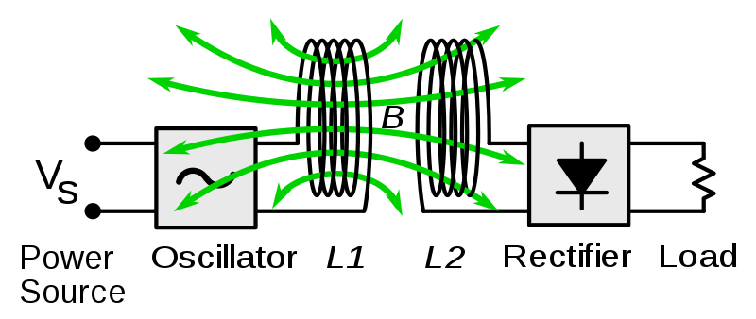
Resonant Inductive Coupling
The WPT using electromagnetic induction was first demonstrated in the early 20th century by Nikola Tesla.
Electromagnetic induction (EMI) has been used for the powering of artificial hearts and implantable devices.
Each coil is capacitively loaded forming a tuned LC resonating at a common frequency, which allows to transmit significant power over a wider ranges.
Resonant Inductive coupling
Normal inductive coupling

Slide 8
Literature review.
1826, Andre-Marie Ampere developed ampere’s circuital law showing that electric current produces a magnetic field.
1831, Michael Faraday developed Faraday’s law of induction.
1862, James Clerk Maxwell synthesized these by deriving Maxwell’s equations.
1893, Nikola Tesla was the first person to introduce the concept of wireless power transfer.
1963, the first microwave power transfer (MPT) system was exhibited at Raytheon.
1964, William C. Brown proposed the first wireless power transfer scheme via microwave beams.
1970s, the WPT technique via radiative EM wave for long-distance attracted interest in industrial, telecommunication, and medical applications.
in the early 21st century, non-radiative wireless power techniques via EM inductive coupling were developed greatly.
In 2007, the Strongly Coupled Magnetic Resonance 6 (SCMR) method was discovered by transferring 60 watts of power at a distance of 200 cm to illuminate a light bulb.

Slide 9
Methodology
Resonant Inductive Coupling
  Inductance induces current in the circuit.
  The capacitor is connected in parallel to the coil
  Energy will be shifting back and forth between magnetic field surrounding the coil and electric field around the capacitor.

Slide 10
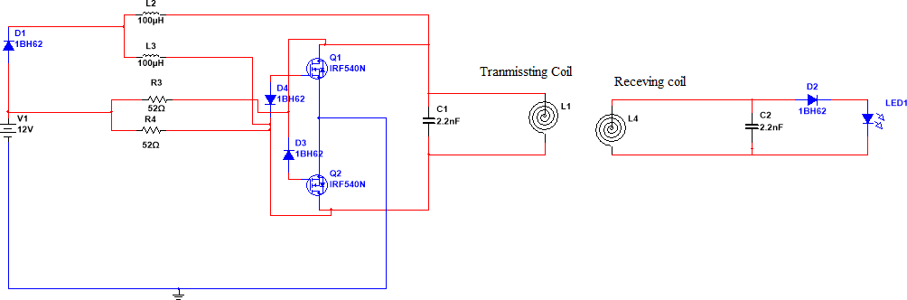
Hardware and circuits design:
Circuit Diagram for transmitting and receiving sides.

Slide 11
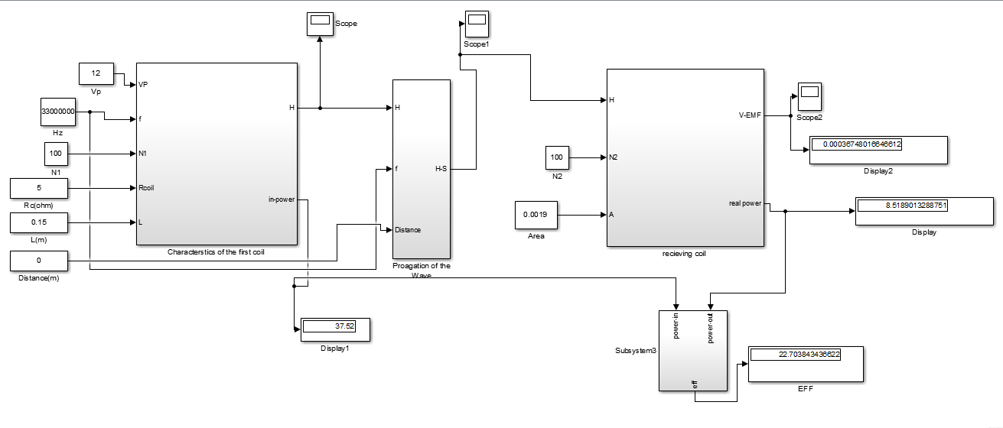
Software & Simulation
Block diagram of the MATLAB simulation

Slide 12
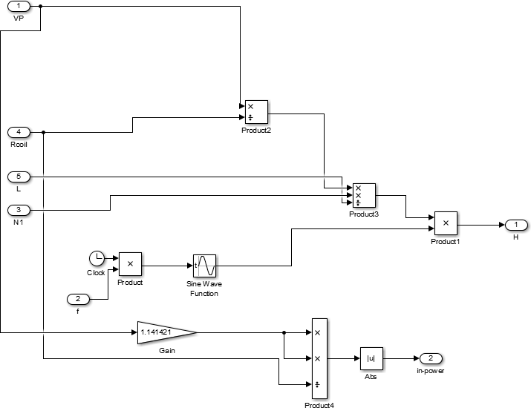
Expanding of the first Block

Slide 13
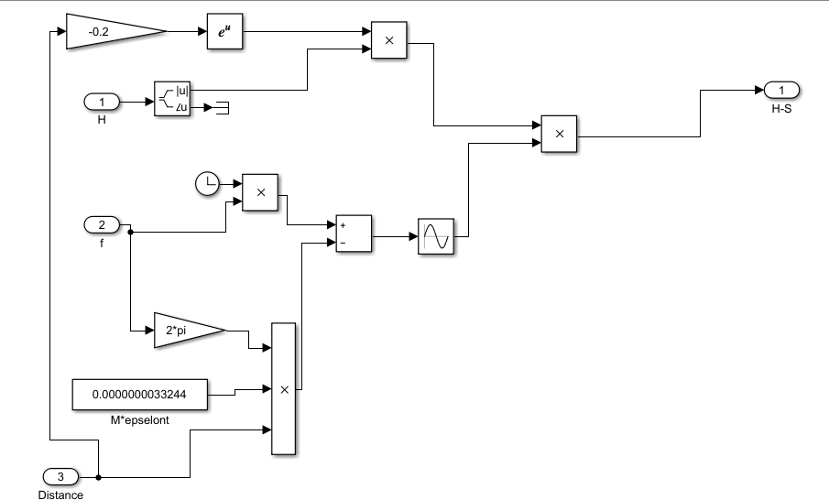
Expanding the second Block

Slide 14
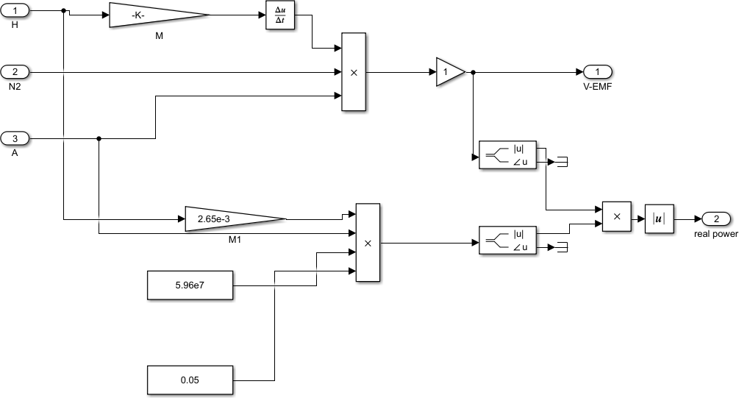
Expanding the third Block

Slide 15
Results and Discussion.
Depending on the following configurations:
  A frequency of 33Mhz.
  Resonant circuit ( 4.7nF and 4.7nH)
  A coil Diameter of 5 cm.
  the coil had 100 turns.
  The following table was the result of calculating the efficiency of the WPT at different distances
Distance(cm) | Efficiency (%)
0 | 22.7
40 | 16.3
100 | 6.8
130 | 3.1
The relationship between distance and efficiency is inverse

Slide 16
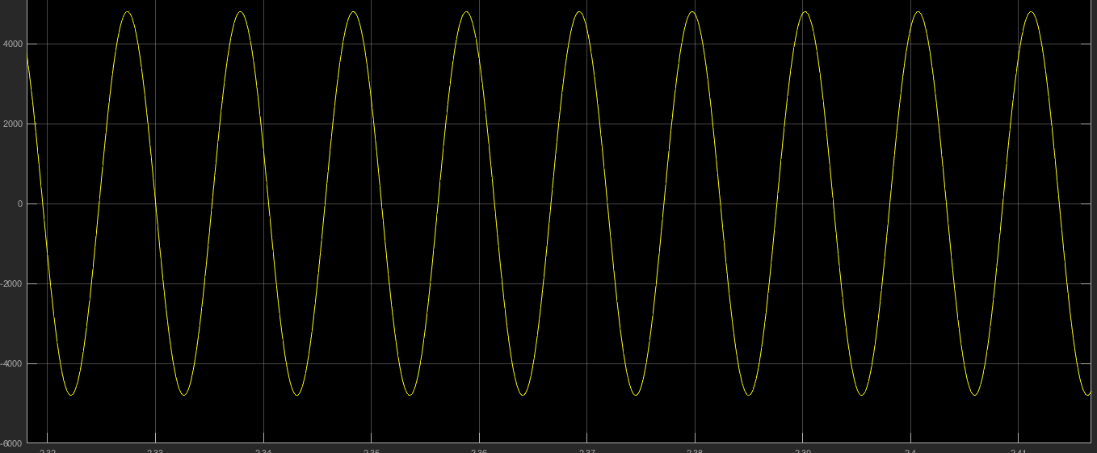
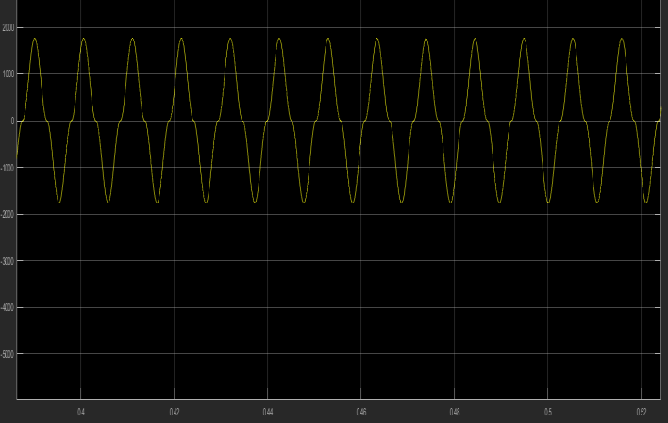
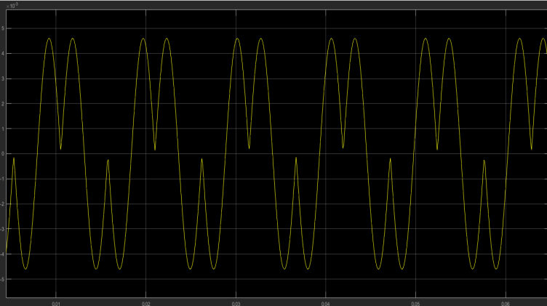
Sent and received signals
magnetic field wave at the transmitting coil
magnetic field wave at receiving coil
electromotive force voltage wave at receiving coil

Slide 17
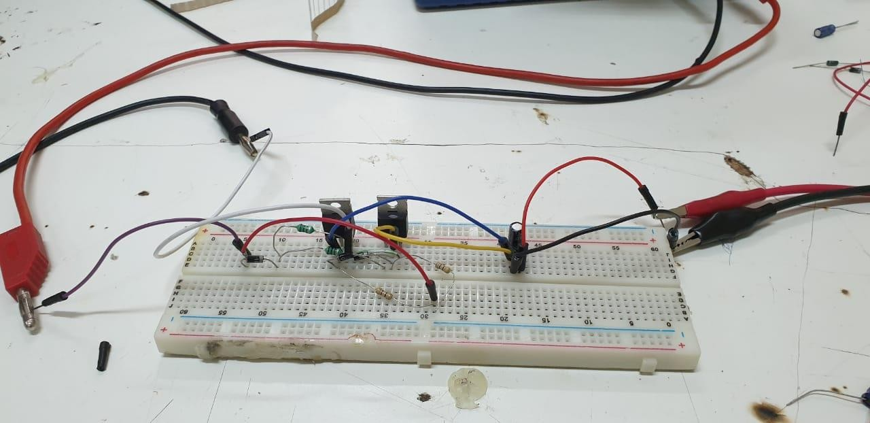
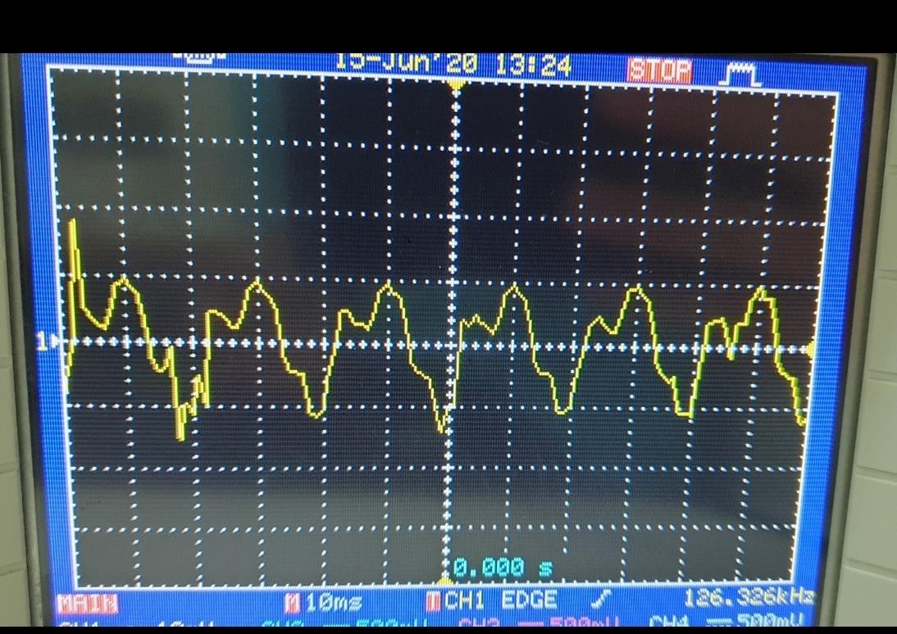
Conclusion and Recommendations
Royer oscillator built on a breadboard
Real output of the built Royer oscillator

Slide 18
Conclusion
We investigate and design a wireless energy transfer system based on two inductively coupled resonant circuits separated by an air gap.
Wireless power transmission has been attracting a wide range of subjects in various fields and became a highly active research area because of their potential in providing high technology to our daily life. In this project, wireless power transmission using resonant inductive coupling has been researched and simulated using mat lab\Simulink.
Resonant inductive coupling is a middle range wireless power transmission method that mainly uses magnetic induction between two coils.

Slide 19

Please, Don’t Forget:

