Slide 1

Table of content
Introduction
Constraints
Project Execution
LensScout

Slide 2

LensScout

Slide 3

Introduction

Slide 4




Problem
Finding Unique Photography Locations.
Managing Events and Portfolios.
Client Interaction and Booking.
Many individuals or property owners have beautiful and unique locations that they would like to rent out for photo sessions. However, they lack a platform to showcase these places to photographers and potential clients.

Slide 5

So what is LensScout ?
LensScout is a mobile app that helps photographers discover and share unique locations for photo shoots. It connects photographers with property owners who have visually appealing spots, allowing photographers to find ideal backdrops and owners to earn by renting out their locations​

Slide 6
2. Project execution

Slide 7

Technologies Used:
Backend:
  Node.js.
  Express framework.
Database:
  Mongodb.
  Firebase.
Backend and Database:
  Nodemon: automatically restarting the node application when the file changes.
  Firebase Storage: to store images.
For Frontend:
Flutter framework.

Slide 8
3. LensScout

Slide 9

Mobile Application
\
User and Photographer side

Slide 10
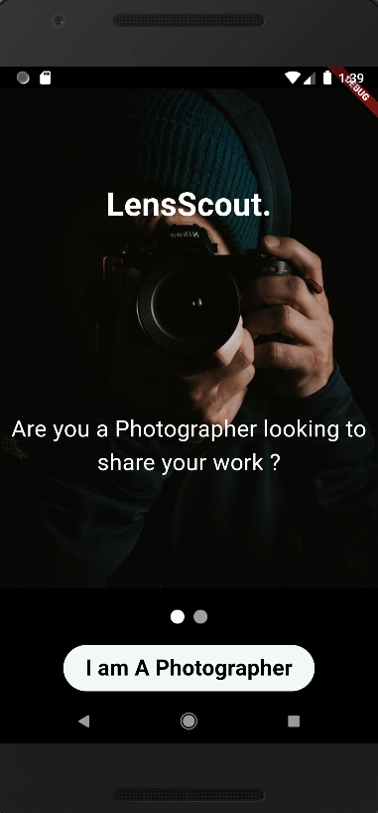
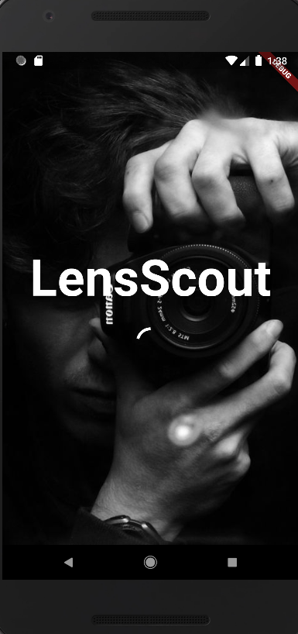
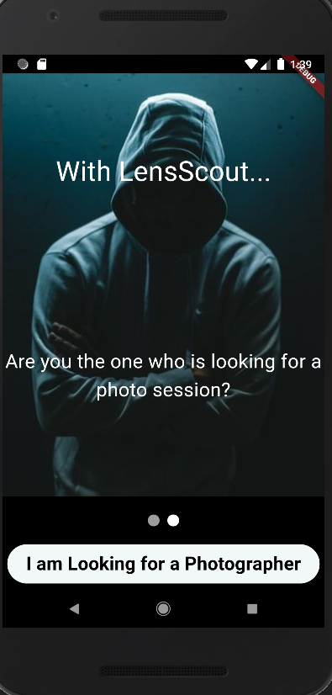
Entry to mobile application

Slide 11
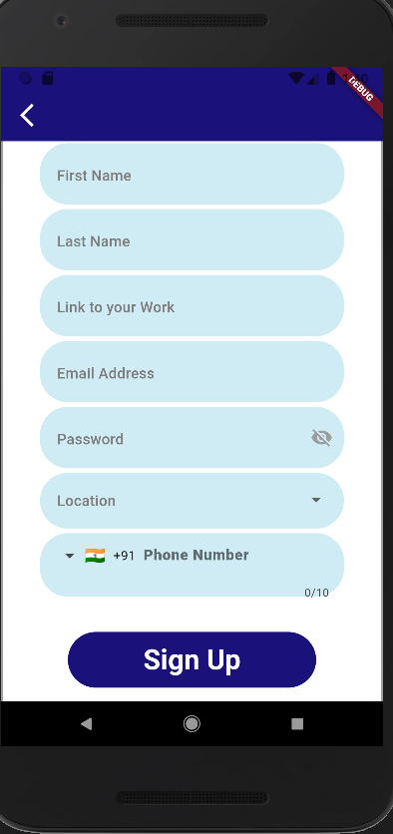
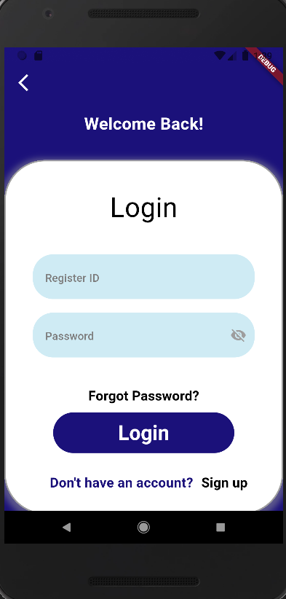
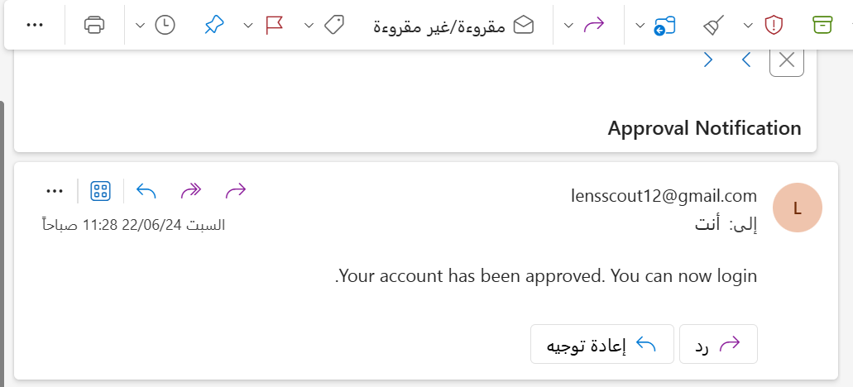
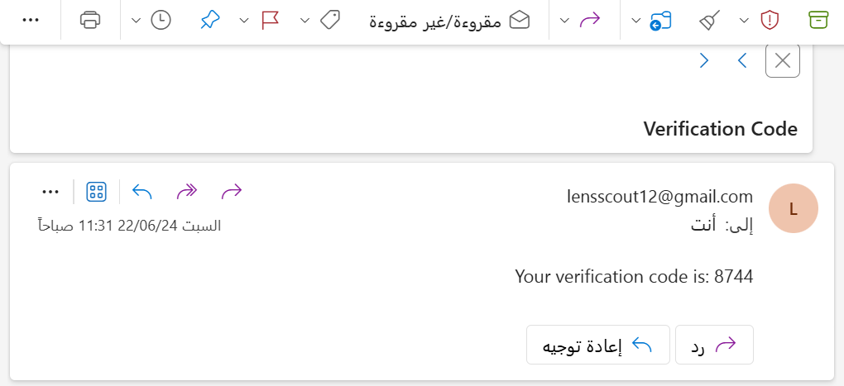
Photographer Signup | Login

Slide 12
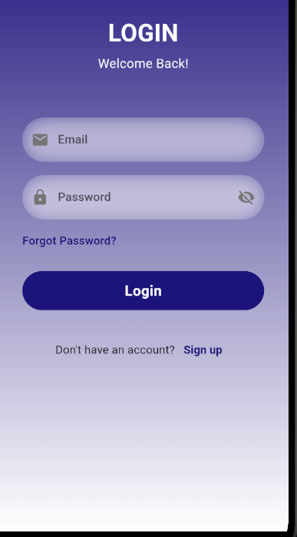
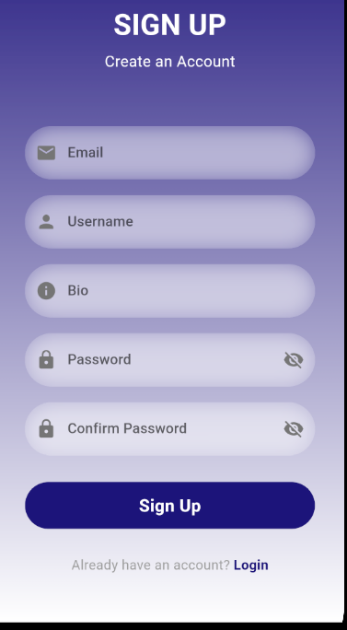
User Signup | Login

Slide 13
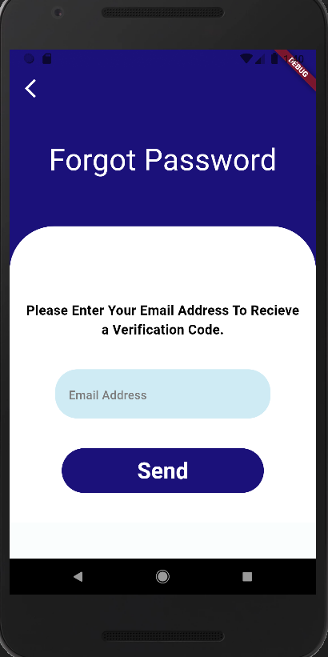
Forget password

Slide 14
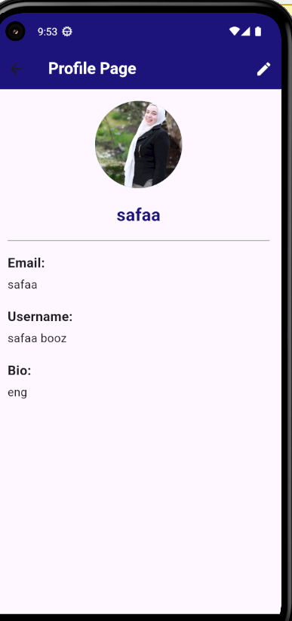
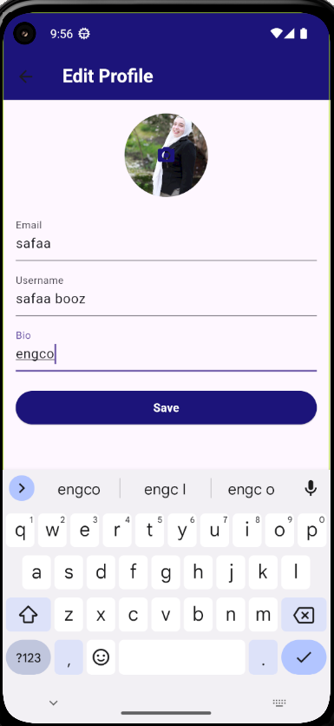
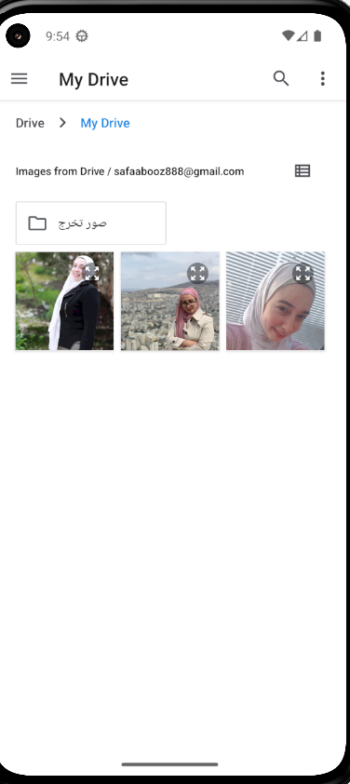
Profile/edit page:

Slide 15
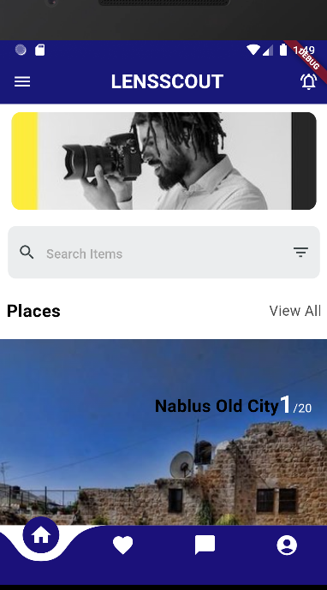
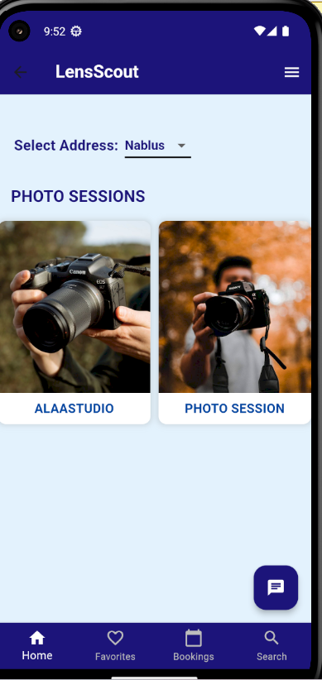
Home page Photographer / User

Slide 16
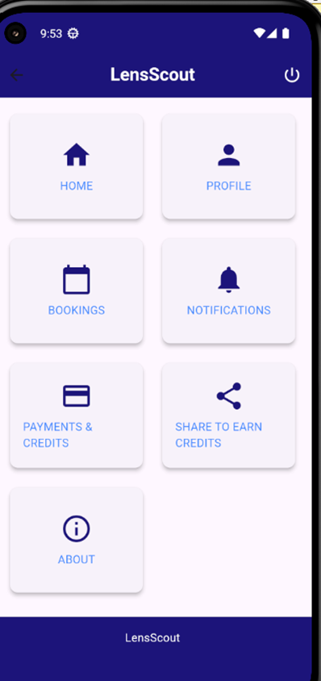
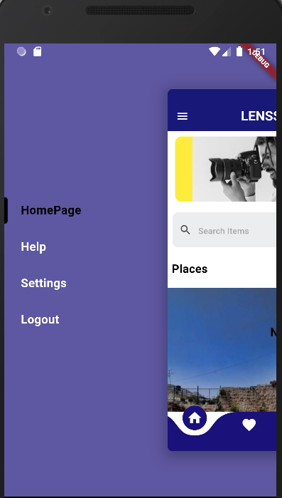
User / Photographer pages Navigator

Slide 17
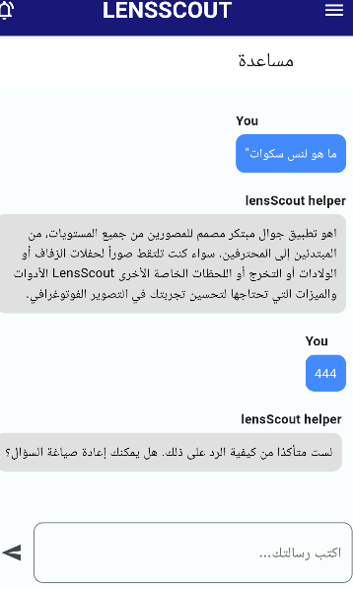
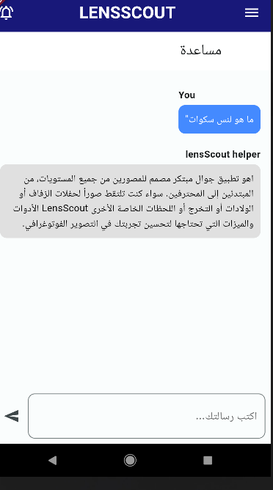
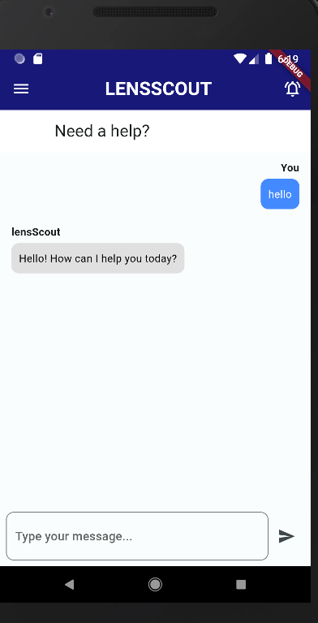
Mobile Chat help

Slide 18
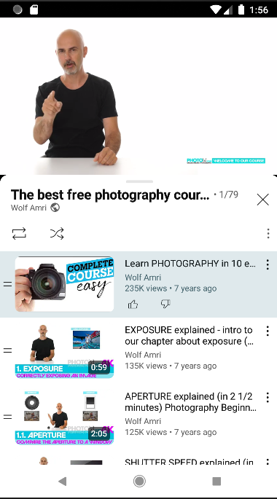
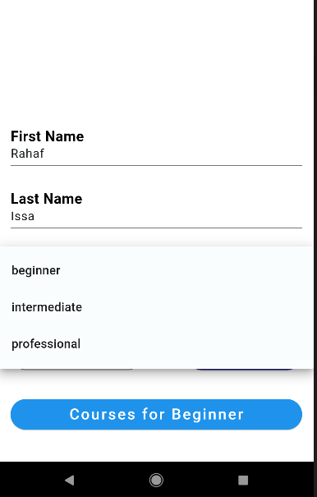
Courses depends on Photographer level- editable

Slide 19
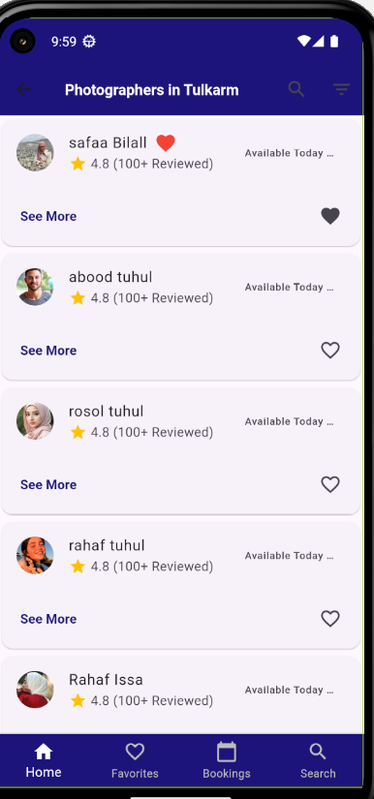
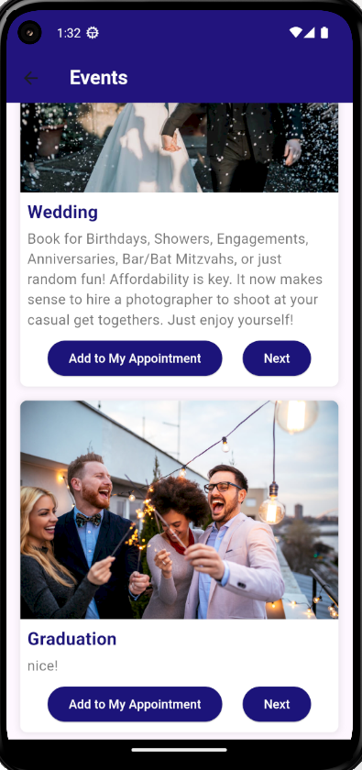
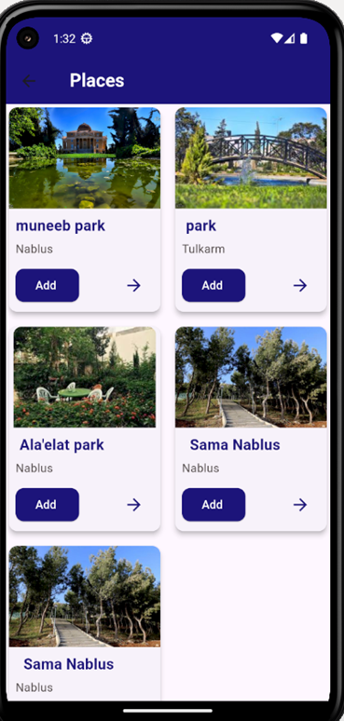
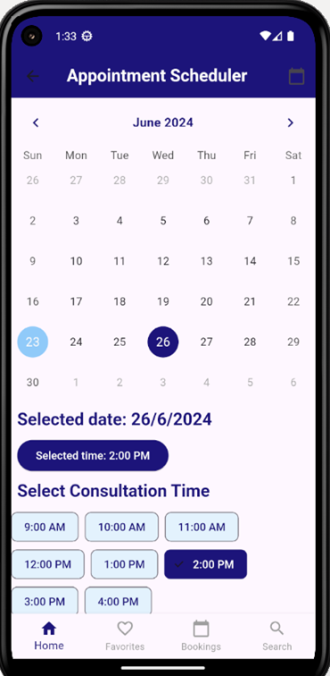
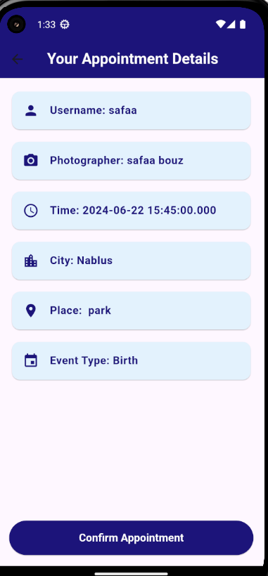
How user Book a session

Slide 20
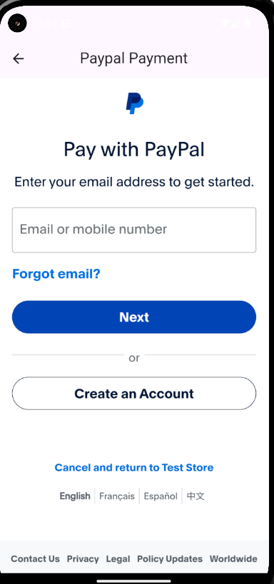
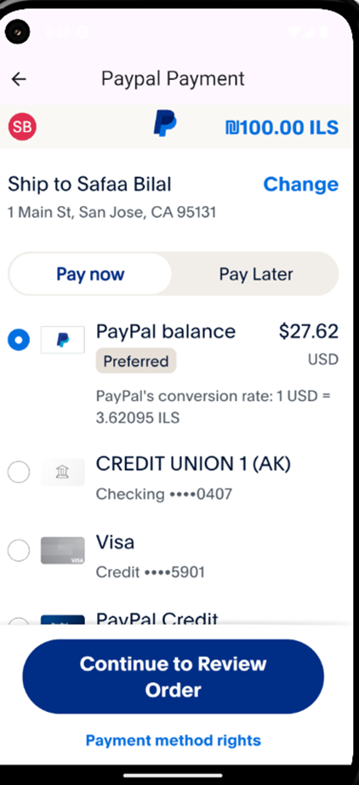
Payment after Booking

Slide 21
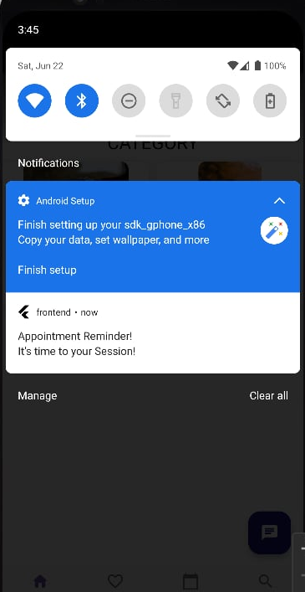
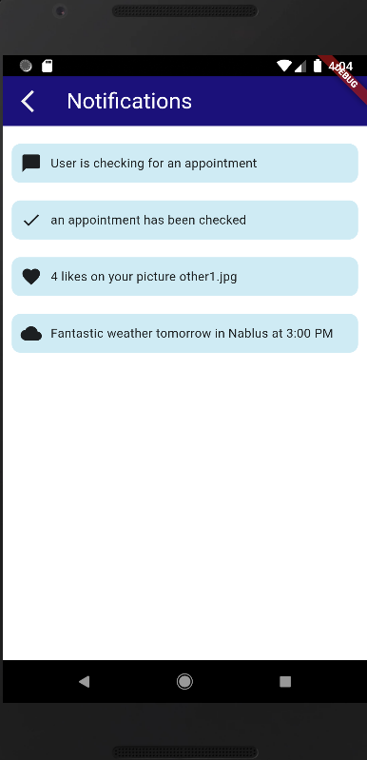
Notification for the session for Photographer and User

Slide 22
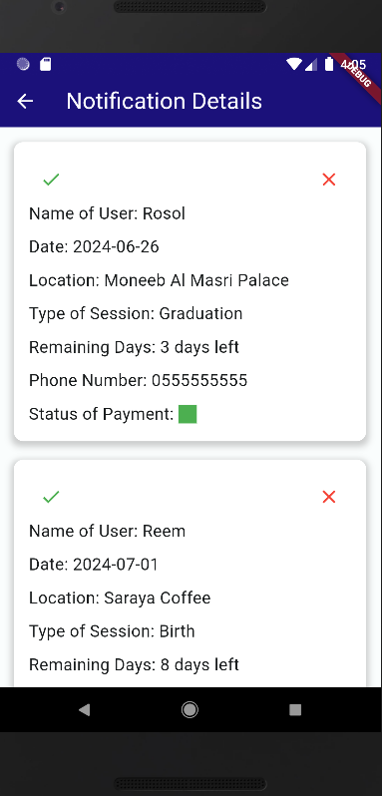
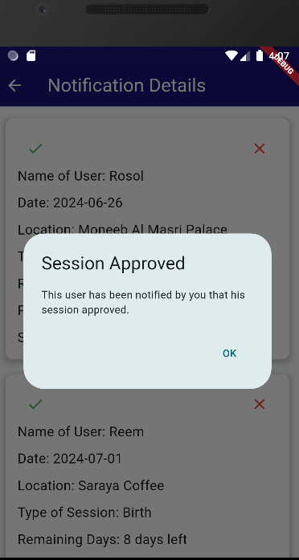
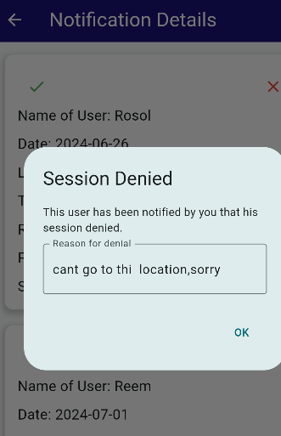
Photographer accept the session or deny it

Slide 23
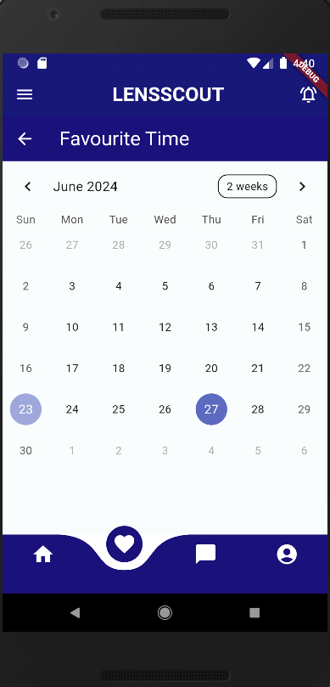
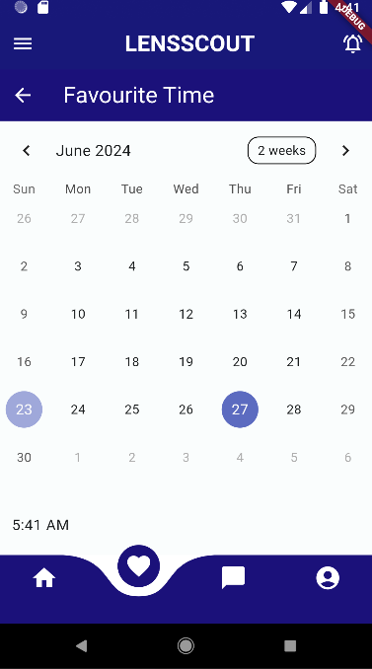
Photographer decide on day suitable to open sessions for users

Slide 24
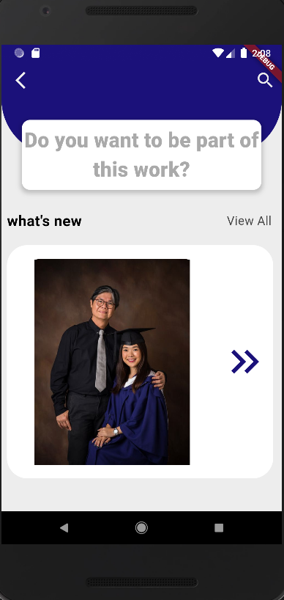
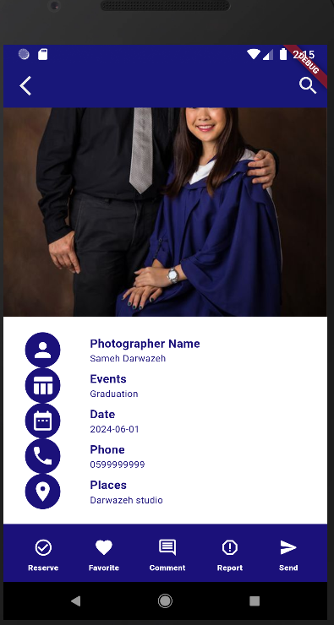
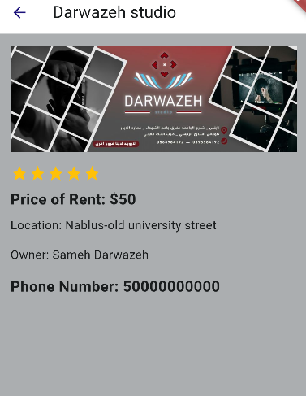
Photographer able to see other photographers work with details

Slide 25
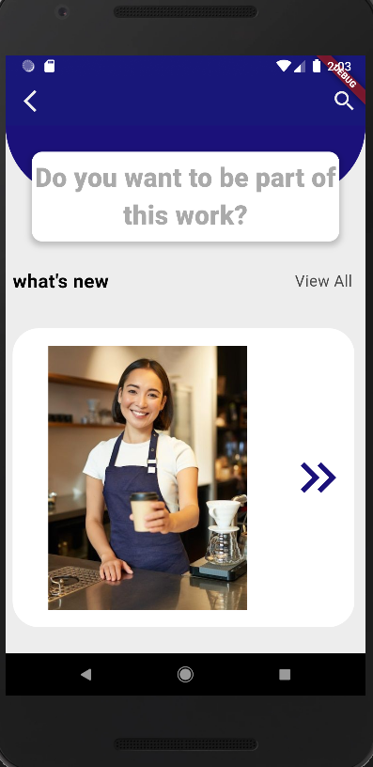
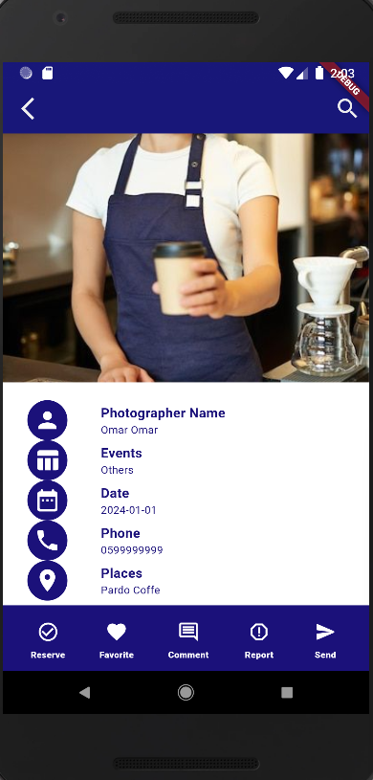
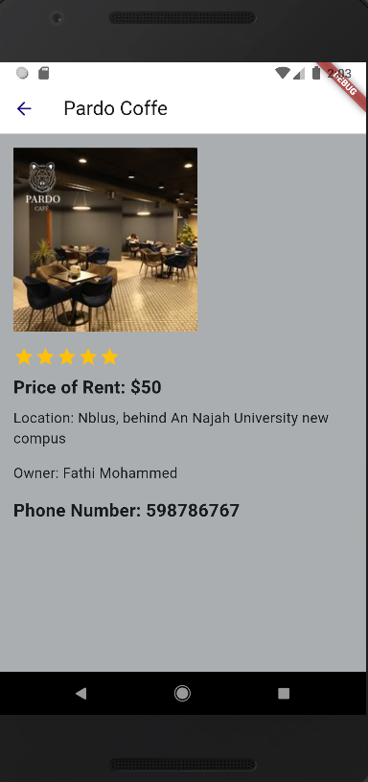

Slide 26
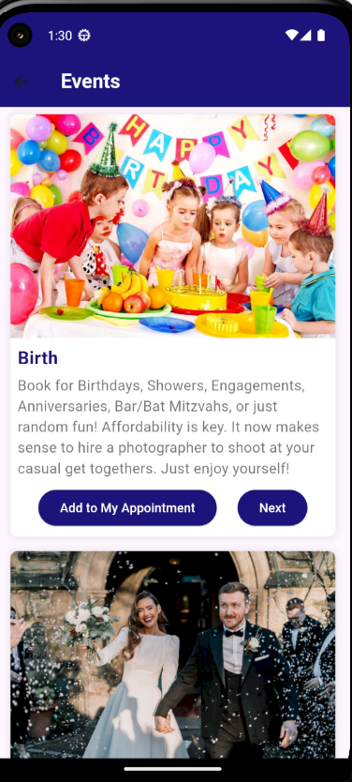
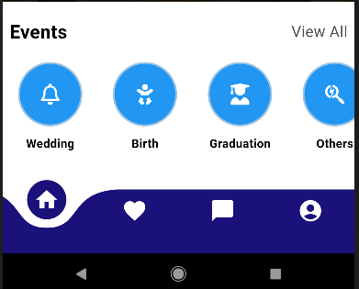
Sessions type that appear for
Photographer / User

Slide 27
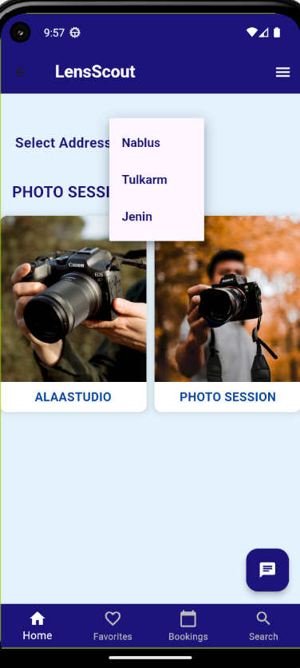
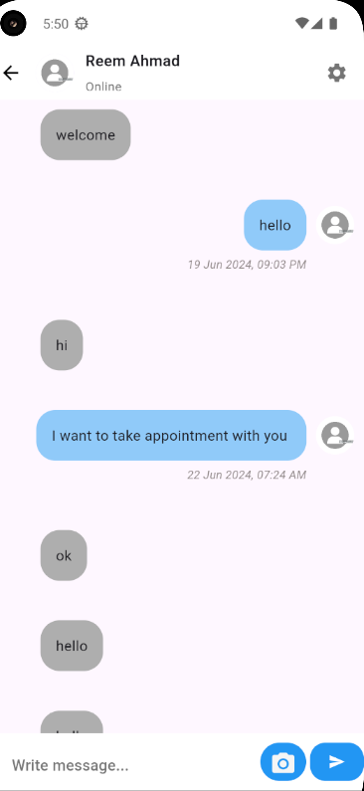
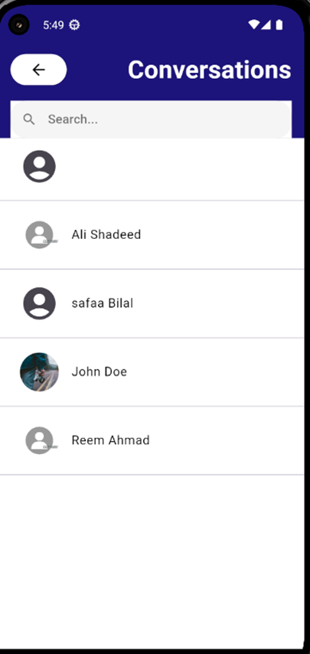
How Communication started between User and photographer

Slide 28
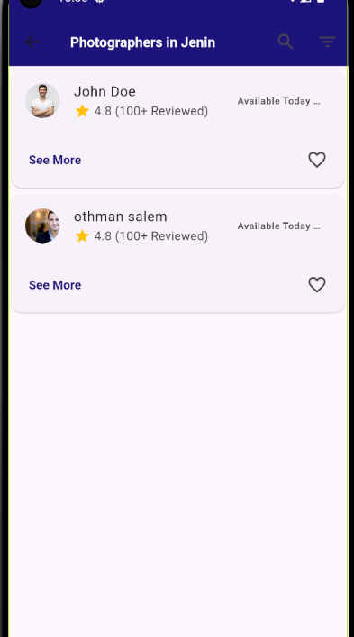
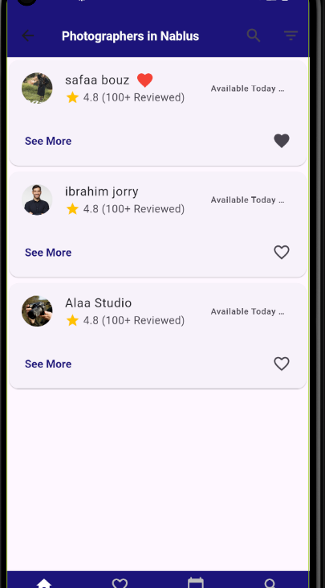
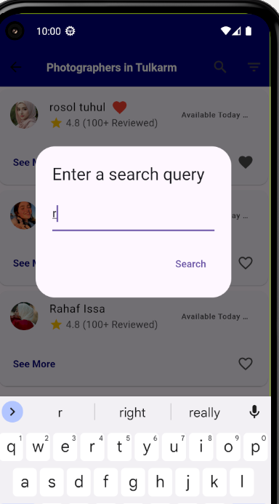
Users Favorite Photographer/s

Slide 29





Slide 30



Slide 31
Website side

Slide 32



Slide 33

User Side:

Slide 34


Slide 35



Slide 36


Slide 37


Slide 38


Slide 39


Slide 40


Slide 41








Constraints
Collaboration and Development:
Coordination challenges due to different emulators used by team members during UI development.
Third-Party Integrations:
Dependence on third-party APIs (e.g., Google Places API) which may have usage limits and reliability issues.
Constraints related to maintaining and updating these integrations.
Network Dependency:
Requires a stable internet connection.
Performance issues in areas with poor network coverage

Slide 42




Future Work
Enhanced Security:
Implement advanced security measures, such as two-factor authentication and data encryption, to further protect user data.
Regularly update security protocols to address emerging threats and vulnerabilities
Third-Party Integrations:
Add recommendation system
Establish a feedback loop with users to prioritize updates based on their needs and suggestions.

Slide 43


Thank You
Please feel free to Ask Rosol And Safaa ☺

