Slide 1

Welcome to My Presentation
Prepared By:
Bana Abdul-Nasser Ameen Jabr
Under Supervision of:
Dr. Imad Al-Qasim
22 December 2016

Slide 2
Outline
Project Description.
Preliminary Design.
SAP 3D model and Checks.
Analysis and Design of concrete parts:
Slabs.
Beams.
Columns.
Footings.
Shear walls.
Ground beams.
Staircase.

Slide 3

3D Analysis & Design of United Motor Trade Company

Slide 4
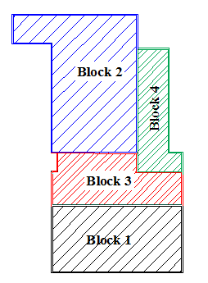
Block Distribution
Numbers of floors
1 | Block 1
2 | Block 2
4 | Block 3
3 | Block4
Total Area of the building 4493.25 m^2

Slide 5
Design Codes
ACI 318-11 (American Concrete Institute).
UBC-97 ( Uniform Building Code).
ASCE7-10 ( American Society Of Civil Engineers).

Slide 6
Materials
Structural materials
Concrete unit weight = 25 kN/m³
Steel yielding strength = 420 MPa
modulus of elasticity (E) of 200 GPa
Non- Structural materials
Material | Unit weight (kN/m³)
Plain concrete | 23
Filler material | 17
Blocks | 12
Masonry stone | 27
Tiles | 26
Polystyrene | 0.3
Polycarbonate | 0.04

Slide 7
Loads
Showrooms Block:
6 | SD kN/m²
3 | Live kN/m²
21 | Wall Weight kN/m
Maintenance Block:
1.5 | SD kN/m²
6 | Live kN/m²
17 | Wall Weight ( East-West) kN/m
22 | Wall Weight ( North-South) kN/m

Slide 8
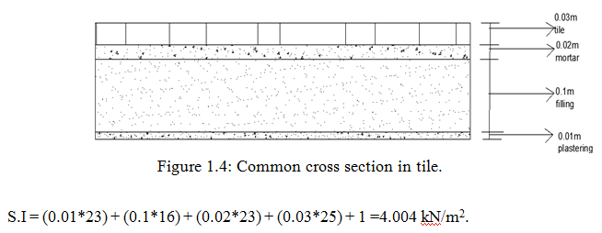
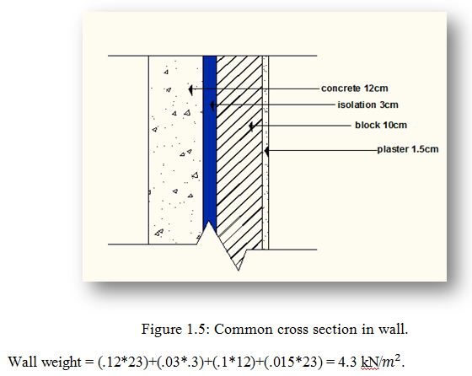

Slide 9
Load Combinations
U=1.4D
U= 1.2D+1.6L+0.5(Lr or S or R)
U =1.2D+ 1.6 (Lr or S or R)+(1.0L or 0.5W)
U =1.2D +1.0W+1.0L+0.5(Lr or S or R)
U=1.2D+1.0E +1.0L+0.2S
U= 0.9D +1.0W
U= 0.9D +1.0 E
Where:
D = Dead load L = Live load E = Earthquake load
Lr = Roof Live floor
S = Snow load
W = Wind load
R= Rain load

Slide 10
Preliminary Design of
Block1 & Block2

Slide 11
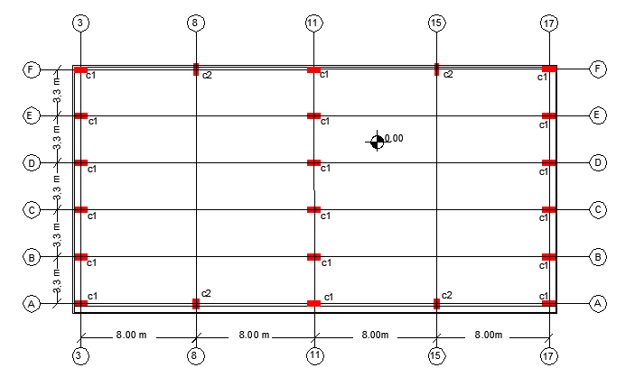
Columns layout of Block 1

Slide 12
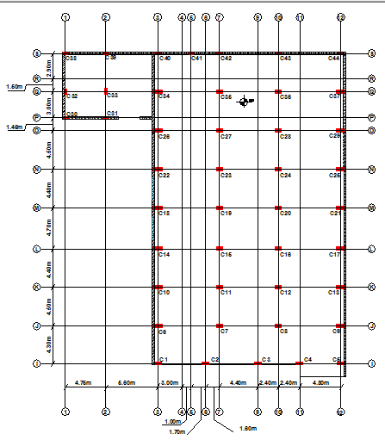
Columns layout of Block 2

Slide 13
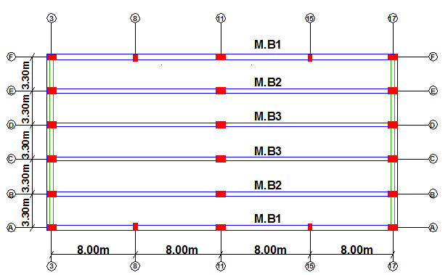
Beams layout of Block 1

Slide 14
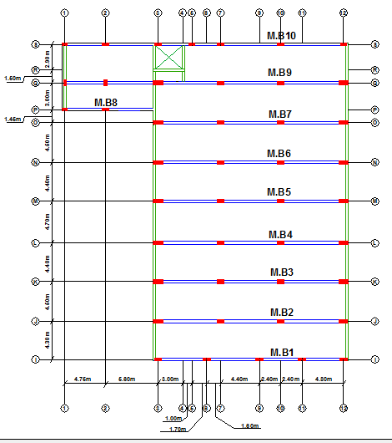
Beams layout of Block 2

Slide 15
Analysis and Design using SAP program

Slide 16
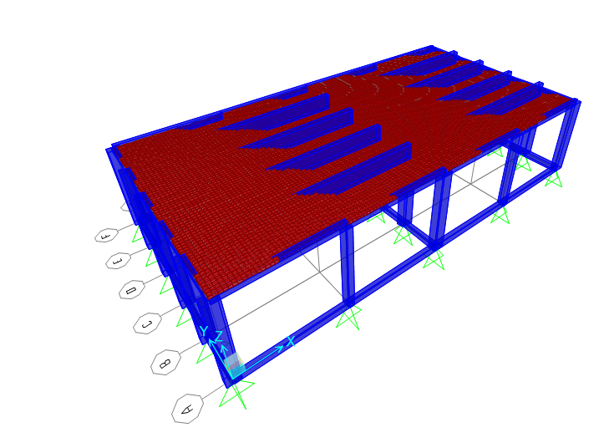
3D model of Block 1

Slide 17
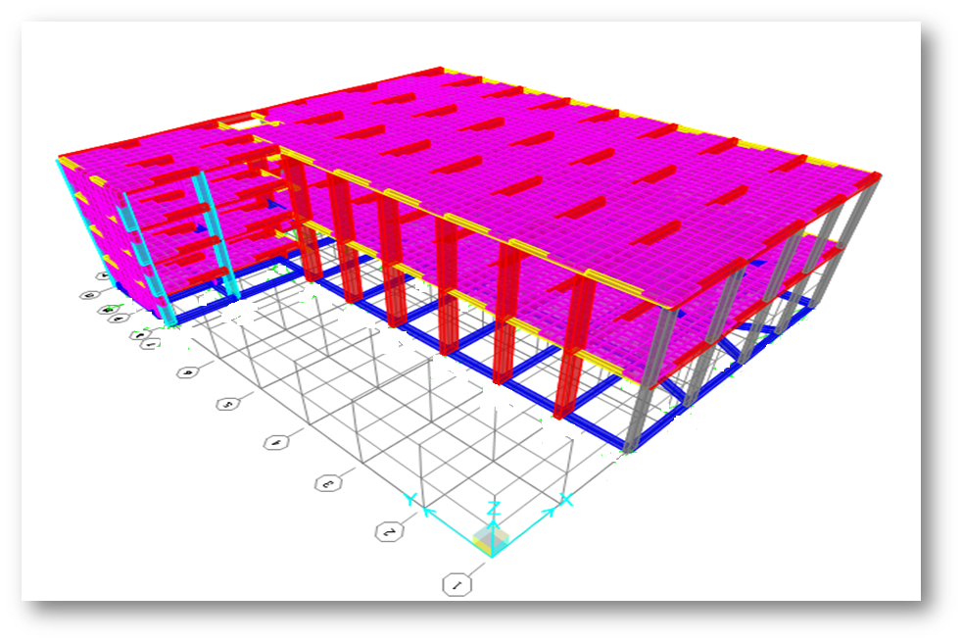
3D model of Block 2

Slide 18
Modifiers for each element
Modifier | Element
0.35 | Slab
0.35 | Beam
0.7 | Columns
0.35 | Shear walls

Slide 19
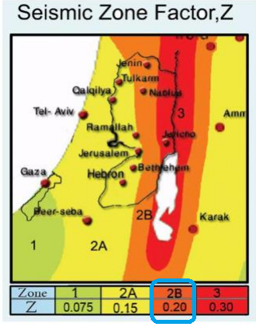
Design for Seismic loads
zone factor is (Z=0.2).

Slide 20
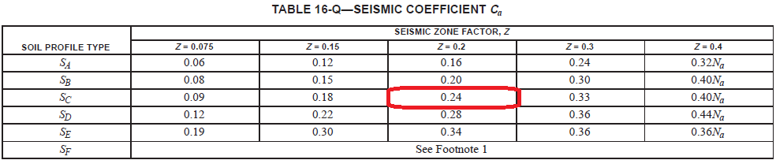
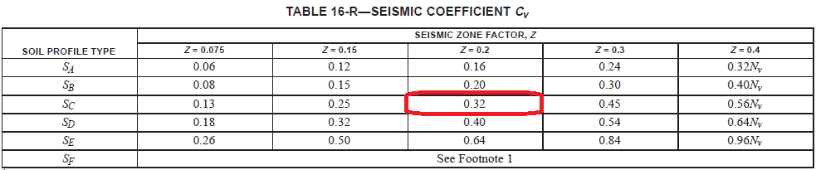
Soil profile type = Sc and seismic zone factor = 0.2, Seismic coefficients Ca & Cv values

Slide 21
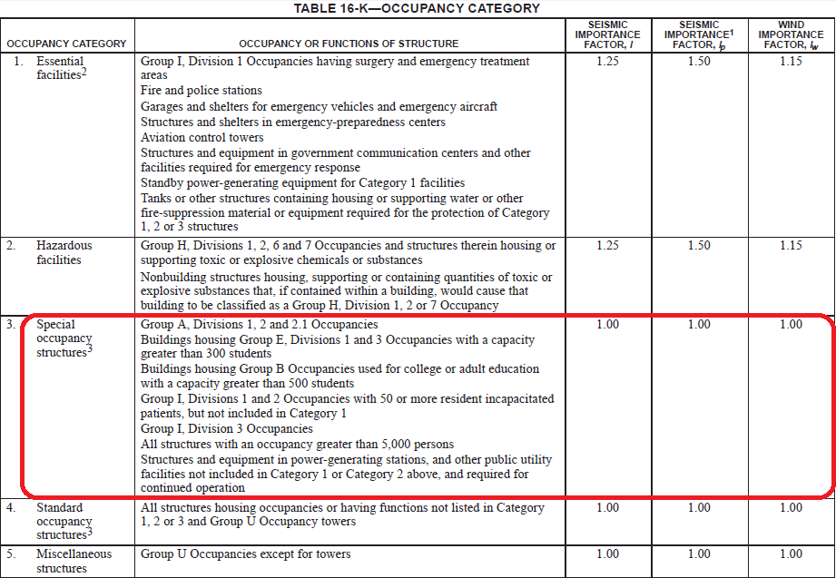

Slide 22
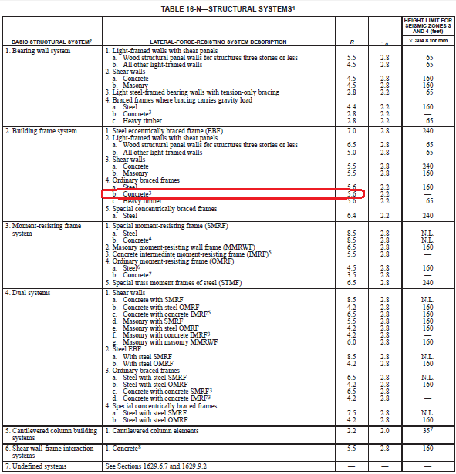
Over strength factor of block1

Slide 23
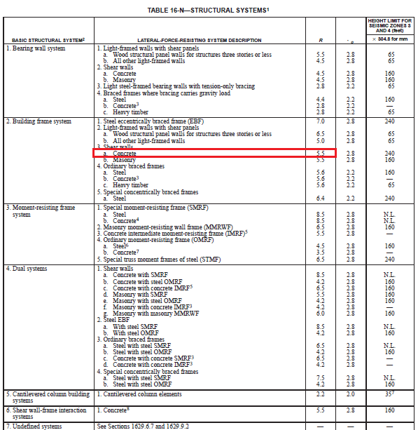
Over strength factor of block2

Slide 24
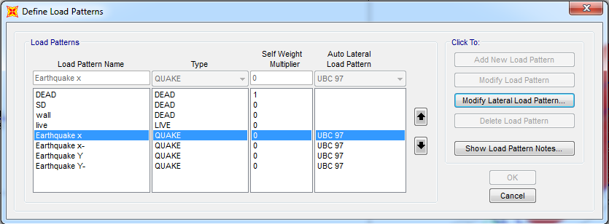
STATIC EQUIVELENT METHOD

Slide 25
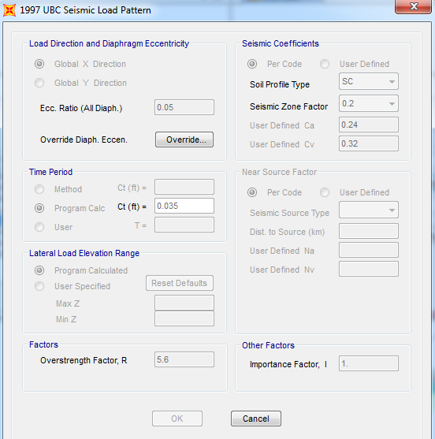
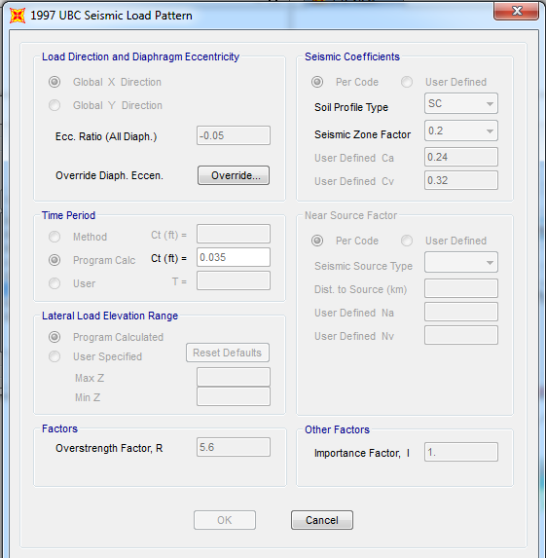

Slide 26
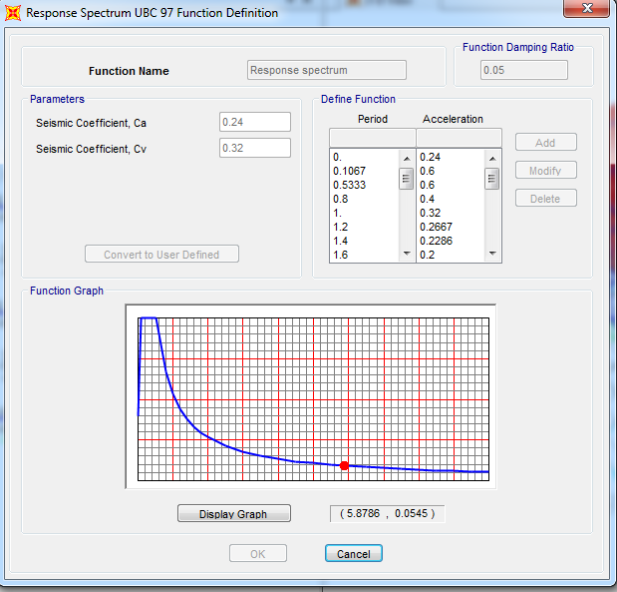
Define response spectrum function of block2

Slide 27
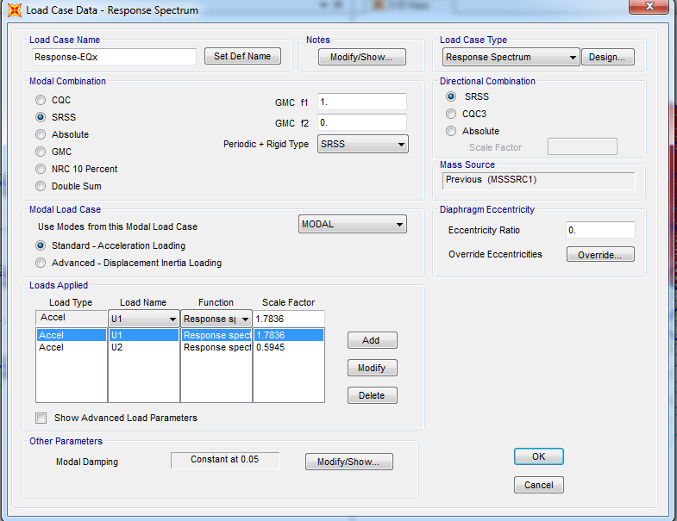
Response spectrum in X-direction

Slide 28
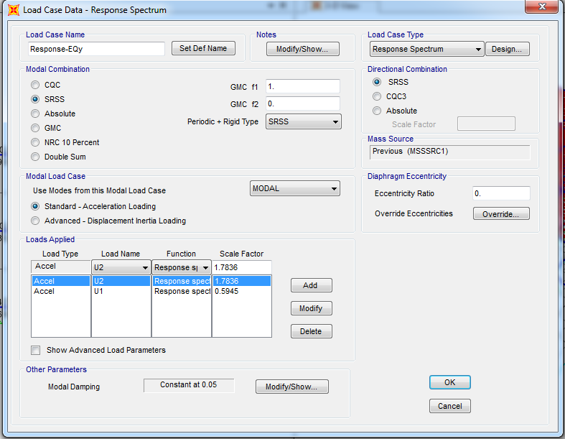
Response spectrum in y-direction

Slide 29
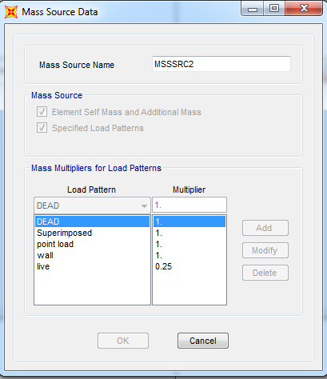
Mass source data

Slide 30
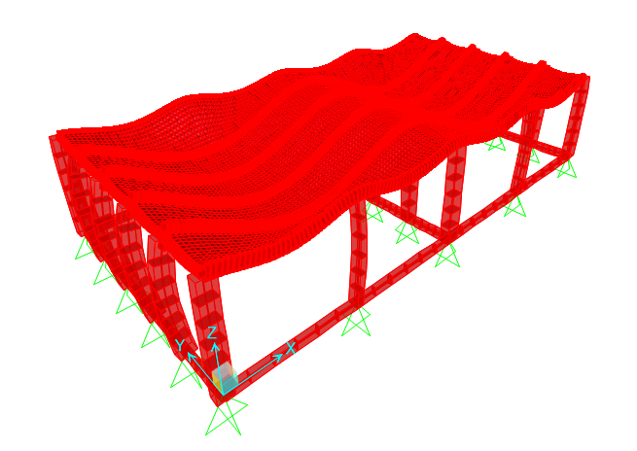
Checks of models
Compatibility check

Slide 31
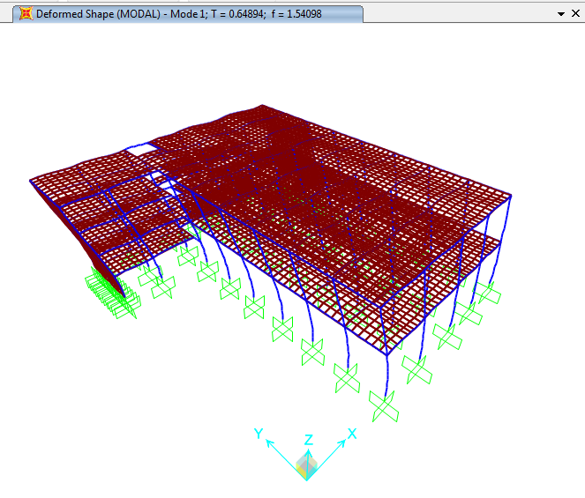

Slide 32
Equilibrium Check
%error | SAP results | Hand calculation | Load type
%0 | 5917.125 | 5917.125 | Dead
%0 | 1584 | 1584 | Live
%0 | 3168 | 3168 | Superimposed
%0 | 693 | 693 | Wall
Block1
Block2
%error | SAP results | Hand calculation | Load type
%0 | 10471.12 | 10471.12 | Dead
%0 | 5742.99 | 5742.99 | Live
%0 | 1435.747 | 1435.747 | Superimposed
%0 | 1632.15 | 1632.15 | Wall

Slide 33
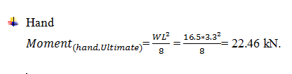
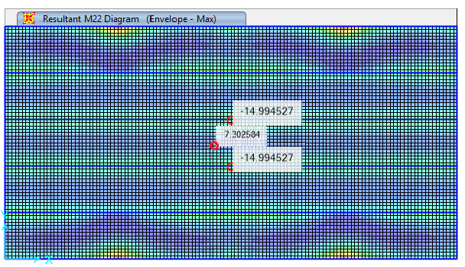

Stress-Strain relationship
Block 1
m
10%

Slide 34

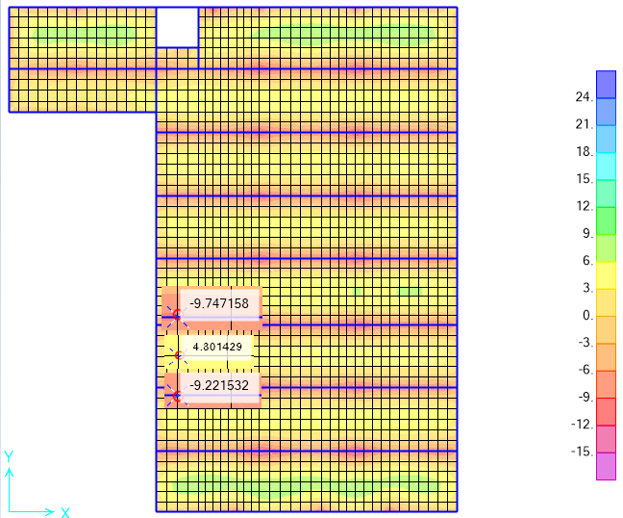

Stress-Strain relationship
Block 2
m

Slide 35
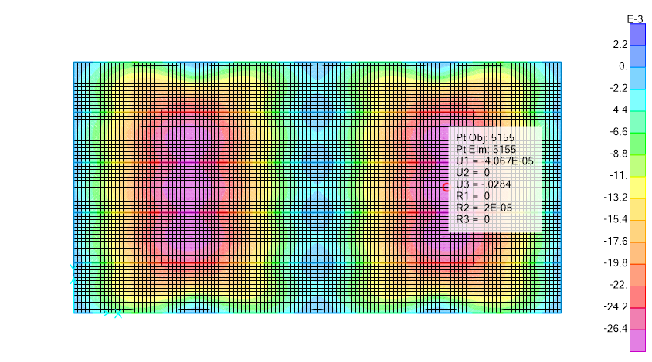
Deflection Check

Slide 36
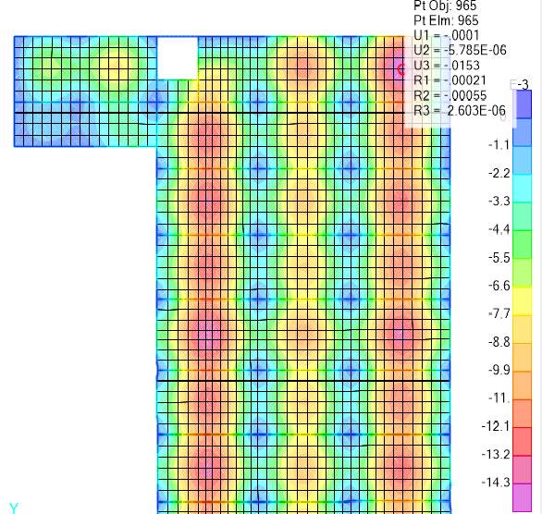

Slide 37
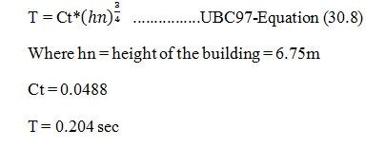
Periodic check
Block 1

Slide 38
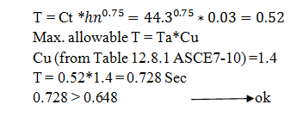
Block2

Slide 39
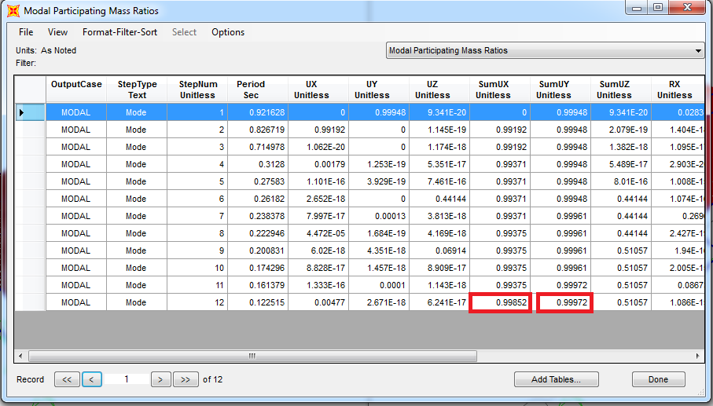
Mass participation ratios
Block 1
The summation of modes in X and Y is greater than 90%.

Slide 40
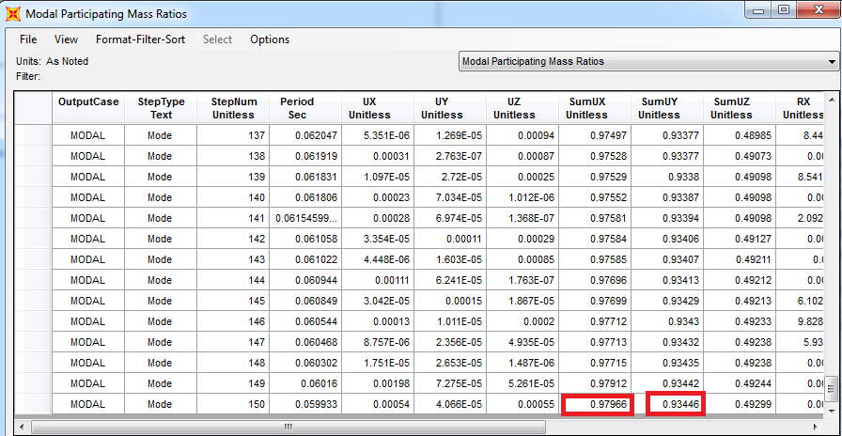
Block2

Slide 41
Analysis and Design of Concrete Parts

Slide 42
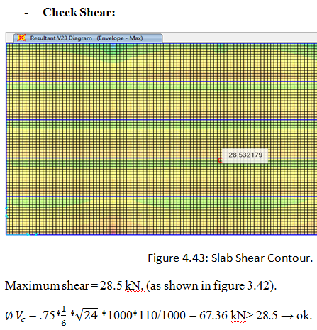
Design of Slabs
Block 1

Slide 43
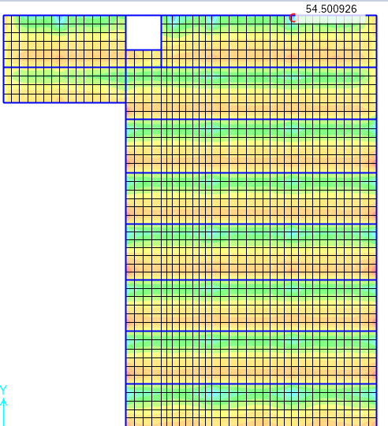

Block 2

Slide 44

Design for flexure
Since all positive and negative moments in both block1 & block2 < Asmin
We use

Slide 45
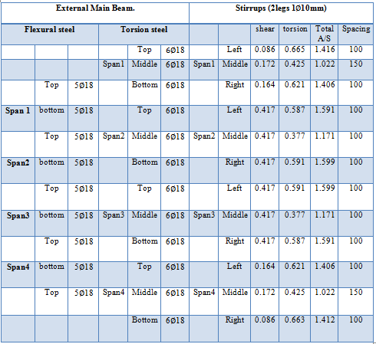
Design of Beams
Block 1

Slide 46
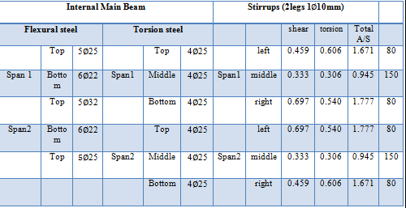

Slide 47
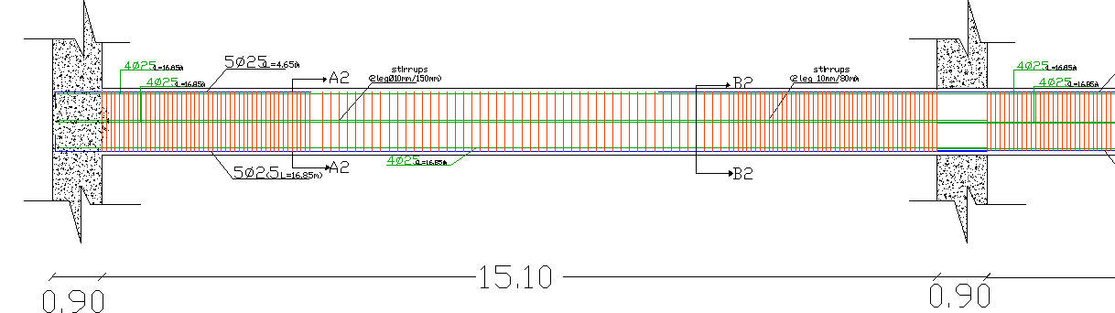
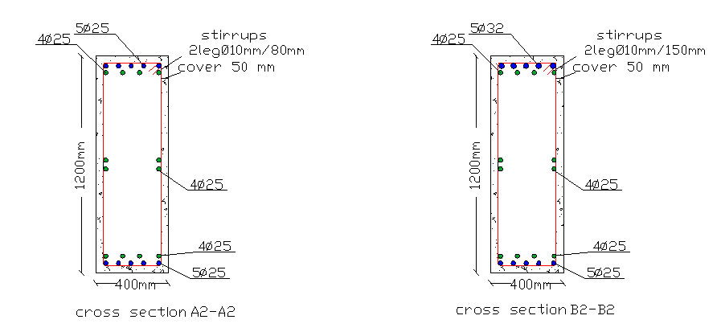

Slide 48
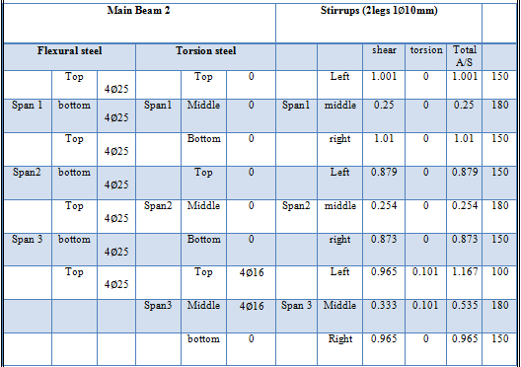
Block 2

Slide 49
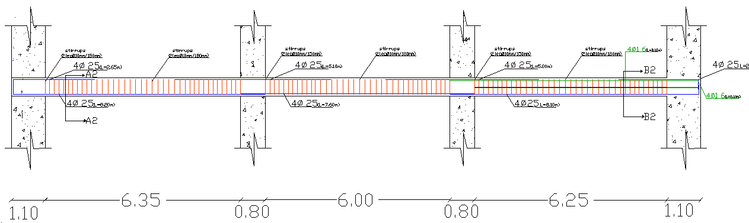
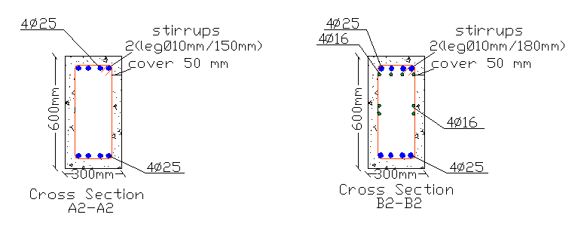

Slide 50
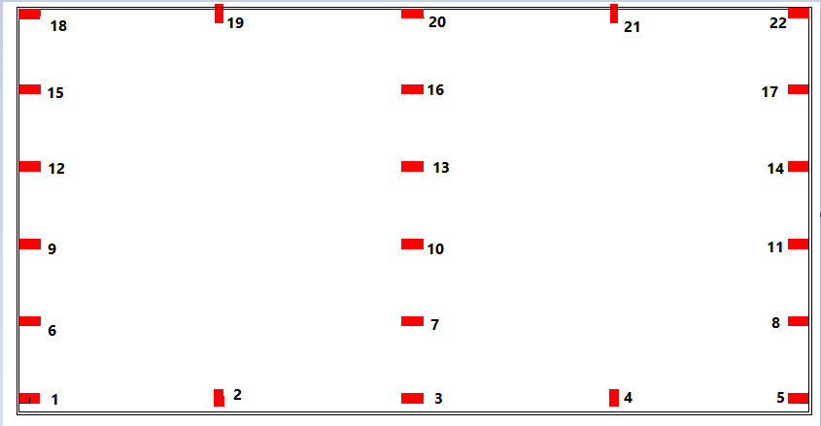
Design of Columns

Slide 51
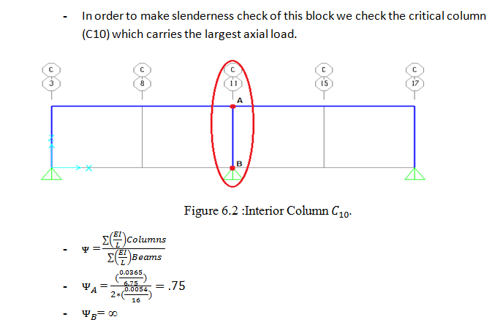
Unbraced columns

Slide 52
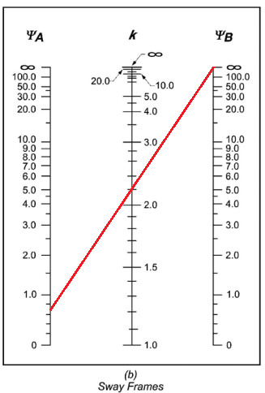


Slide 53
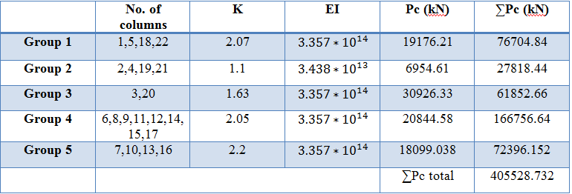
Unbraced columns

Slide 54
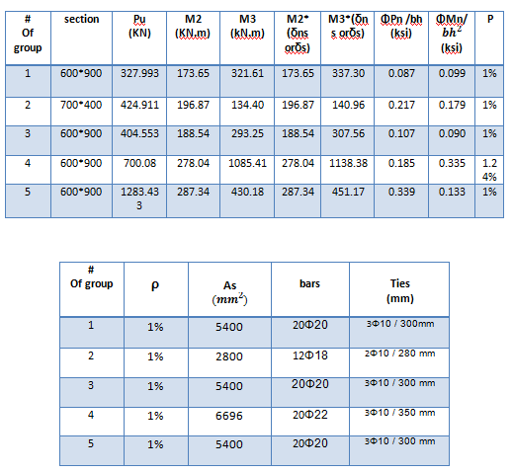

Slide 55
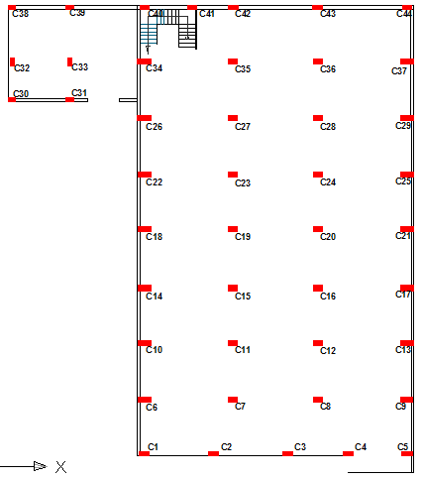

Slide 56
Group number | Axial force range(kN) | Column number
1 | 100-400 | 1,5,32,37
2 | 400-800 | 2,3,4,30,31,38,41,44
3 | 800-1200 | 6,9,10,13,14,17,18,21,22,25,26,29,39,40,42
4 | 1200-1600 | 7,8,11,12,15,16,19,20,23,24,27,28,33,43
5 | 1600-2000 | 34,35,36
Short Columns # | Long Columns #
34,35,39,40,41,42,43 | 1,2,3,4,5,6,7,8,9,10,11,12,13,14,15,16,17,18,19,20,21,22,23,24,25,26,27, 28,29,30,31,32,33,36,37,38,44

Slide 57
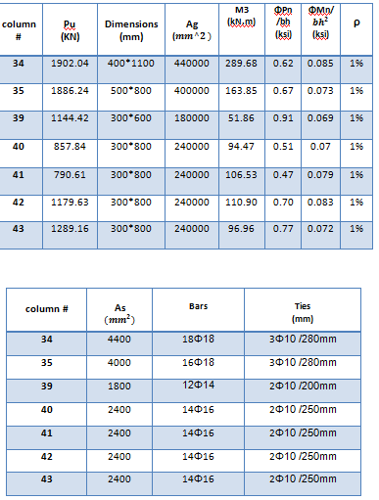
Short columns

Slide 58
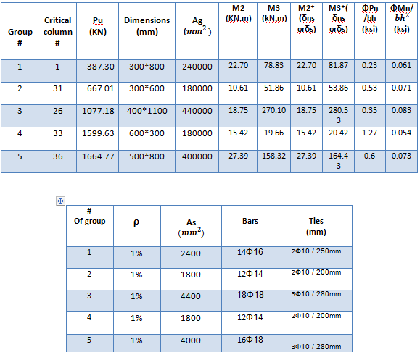
Long columns

Slide 59



Slide 60


Design of Footings
Block 1 (Single Footings)
According to soil test, the allowable bearing capacity for the soil is
250 kN/m2.
For Footing 4

Slide 61


Slide 62


Slide 63


Checks

Slide 64


Slide 65


Slide 66


Slide 67


Slide 68


Slide 69



Slide 70

Block 2 (Mat Footing)

Slide 71


Slide 72



Slide 73


Slide 74



Slide 75

Reinforcement:
Asmin = 0.0018*1000*800 = 1440

Slide 76

Design of ground beams

Slide 77


Slide 78


Design of shear walls

Slide 79

Design of staircase

Slide 80



