Slide 1

Masjed design
An-Najah National University
Presented by:
Dawoud al faris
Sami tayyah
Muhammad abu eishe
Muhammad takrouri
Supervised by :
Dr. Muhanad haj hussein
7/6/2020

Slide 2
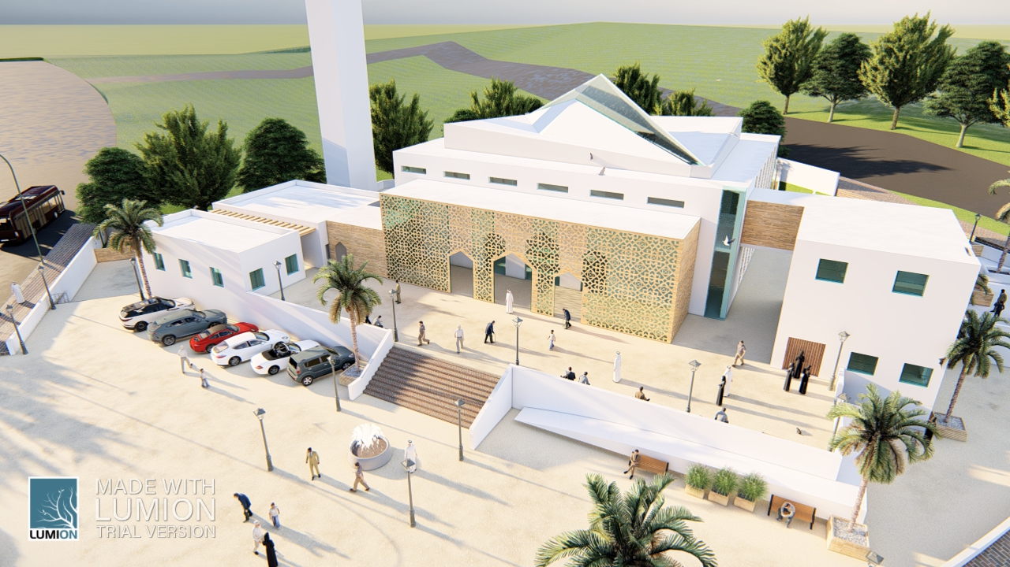
Presentation outline :
1. Introduction
2. Site analysis
3. Architectural design
4. Structural design
5. Electrical design
6. Environmental design
7. Mechanical design
8. Safety design
9. Quantity suvey

Slide 3
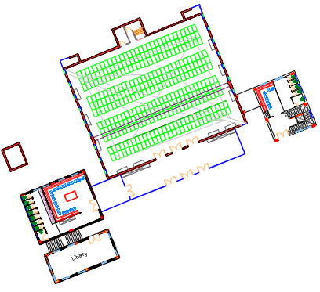
Introduction
Old design
Final design
No. of prayers | Old design | Final design
Men prayers | 235 | 620
Women prayers | 126 | 210

Slide 4
Site Analysis
Land area = 1700 m²
Building area = 895m²

Slide 5
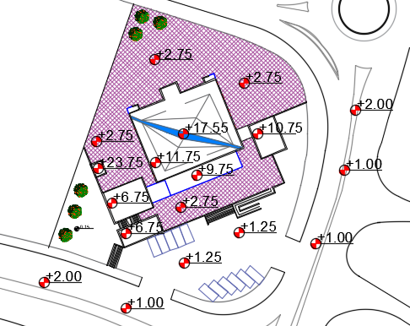
Architectural design
Site plan
-0.15

Slide 6
Mosque components
Main praying block
Women ablution block
Men ablution block
Library block

Slide 7
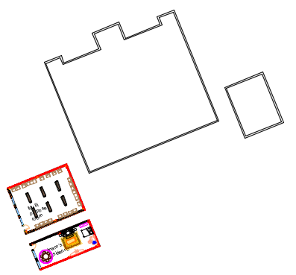
Basement floor

Slide 8
Ground floor

Slide 9
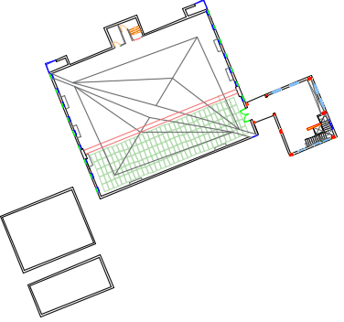
First floor

Slide 10
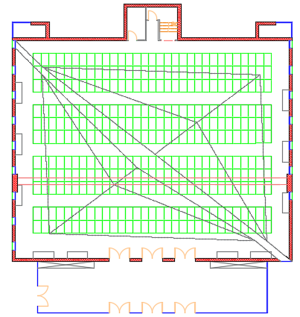
Men praying hall

Slide 11
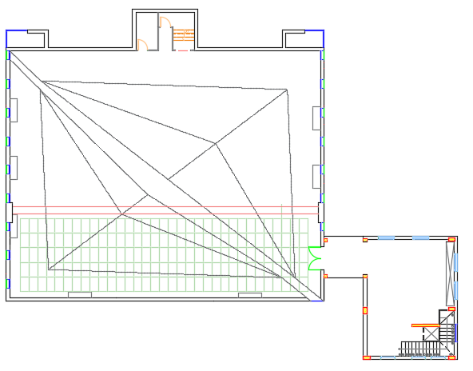
Women praying hall

Slide 12
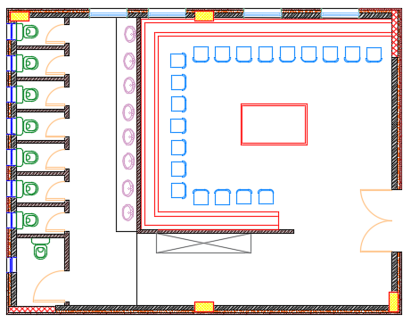
Men ablution

Slide 13
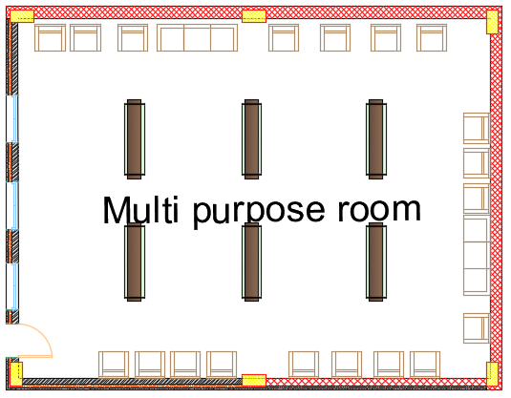
Multi-purpose room

Slide 14
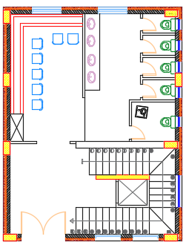
Women ablution

Slide 15
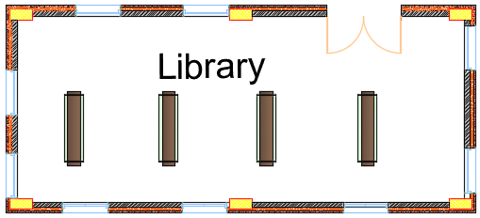
Library

Slide 16
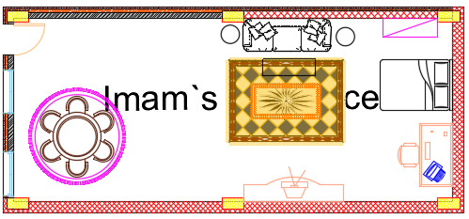
Imam’s residence

Slide 17
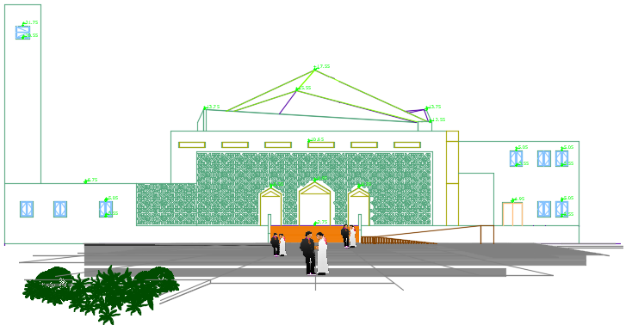
Northern elevation

Slide 18
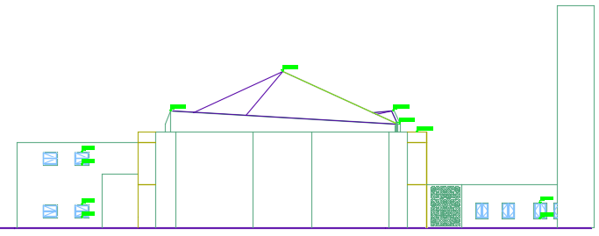
Southern elevation

Slide 19
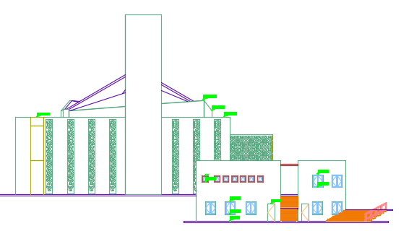
Eastern elevation

Slide 20
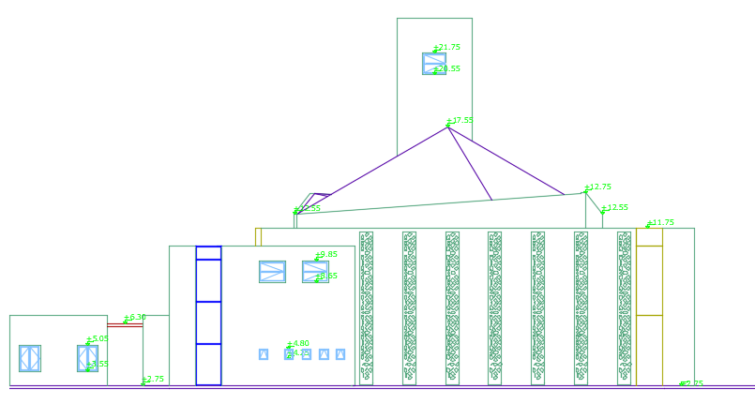
Western elevation

Slide 21
Sections
Section 1-1
Section 2-2
Section 2-2
Section 3-3
Section 4-4
Section 1-1

Slide 22
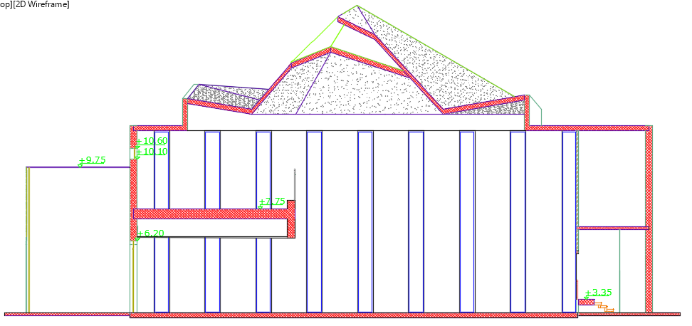
Section 1-1

Slide 23
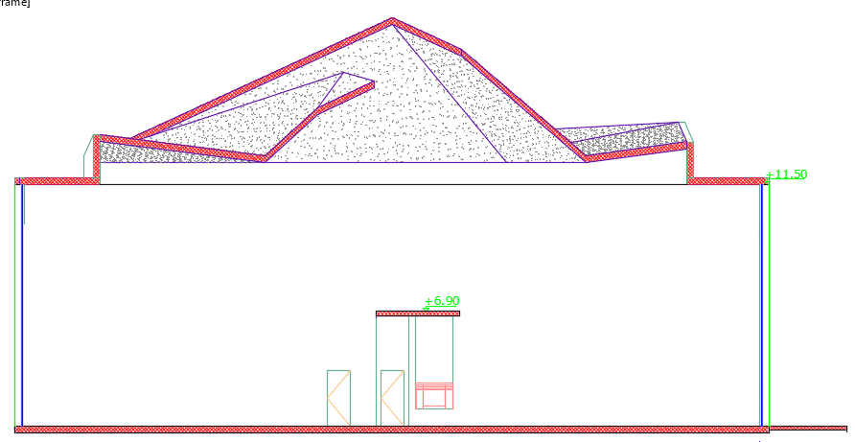
Section 2-2

Slide 24
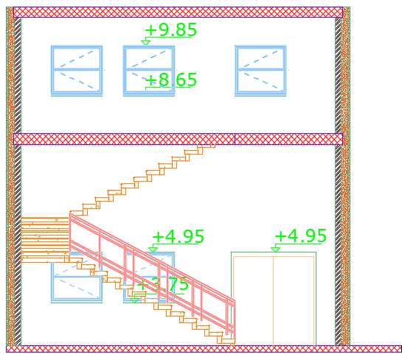
Section 3-3

Slide 25
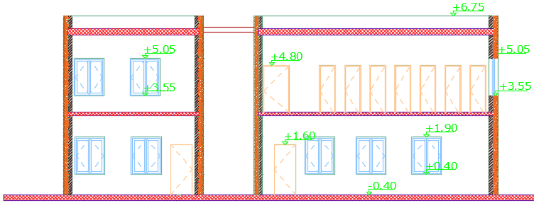
Section 4-4

Slide 26
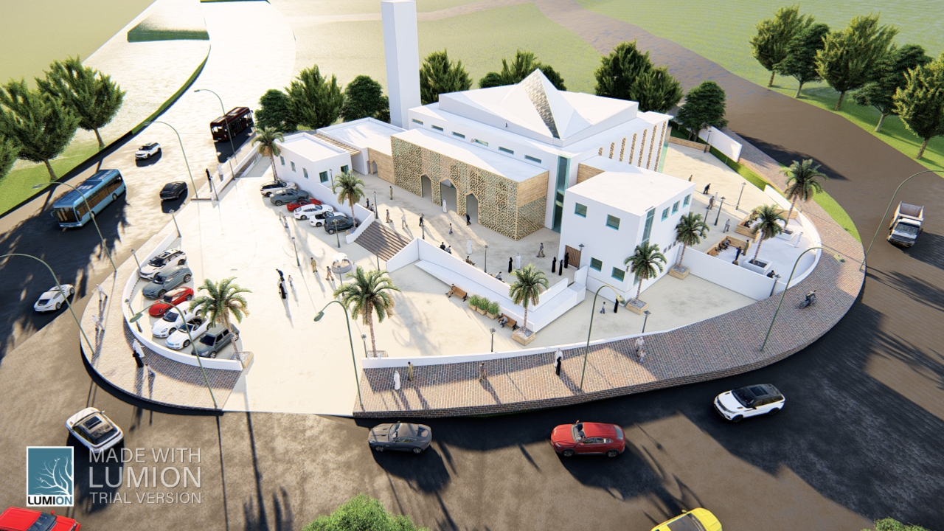
3D views

Slide 27
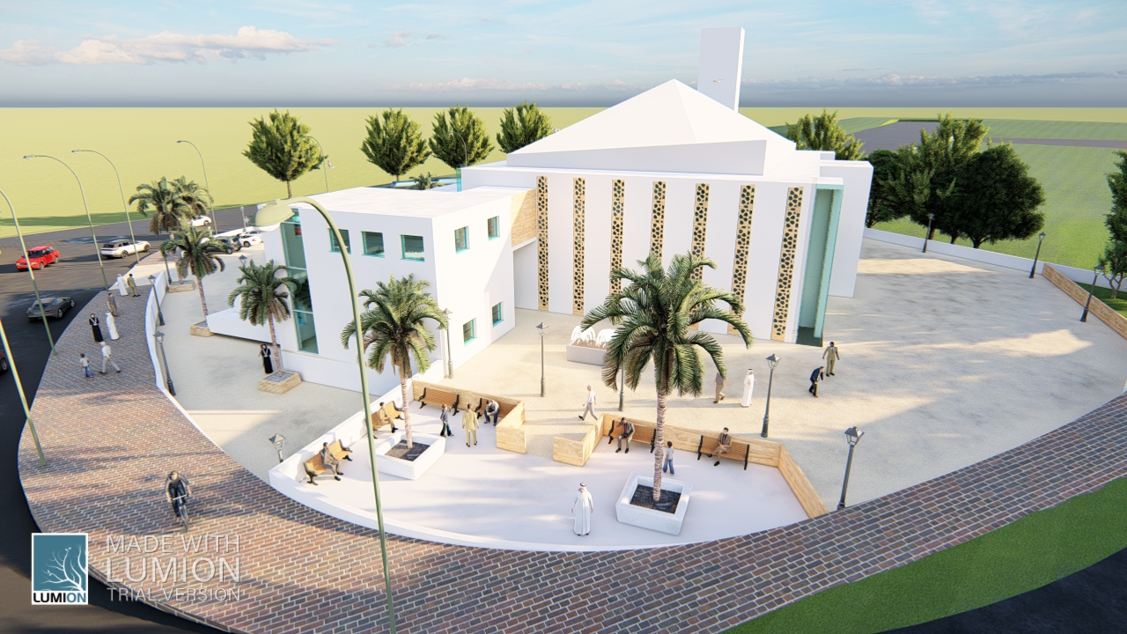

Slide 28
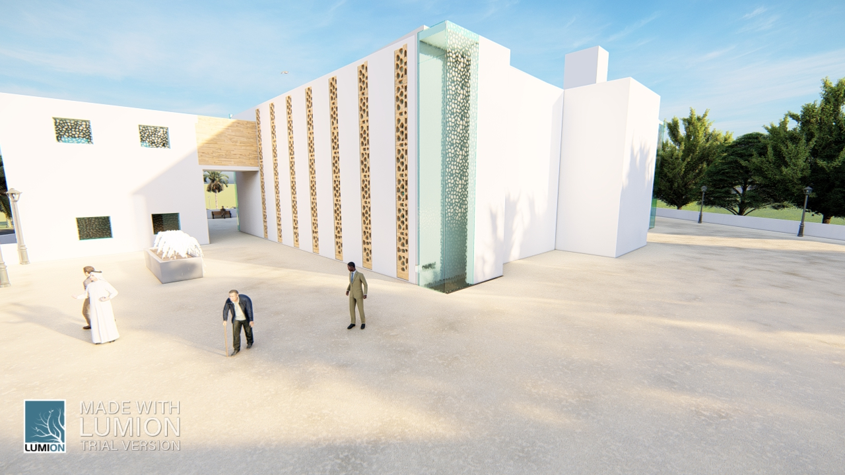

Slide 29
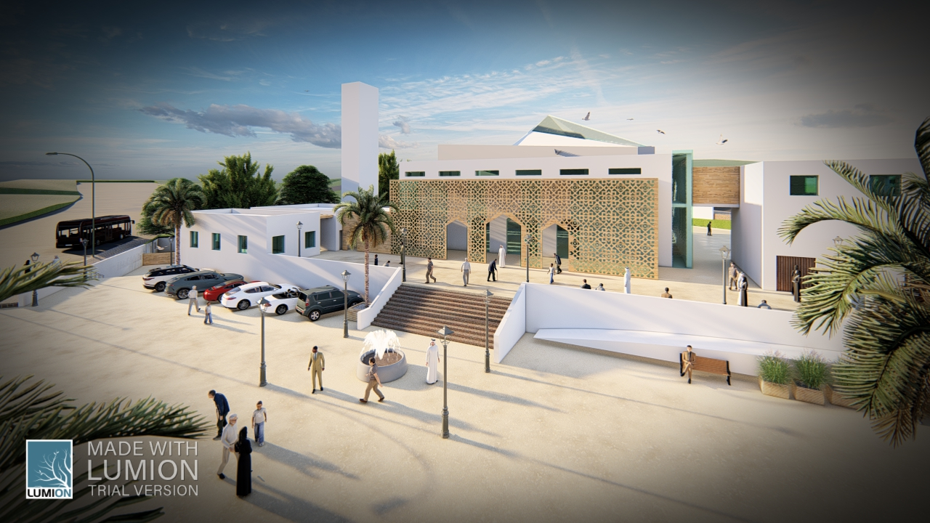

Slide 30
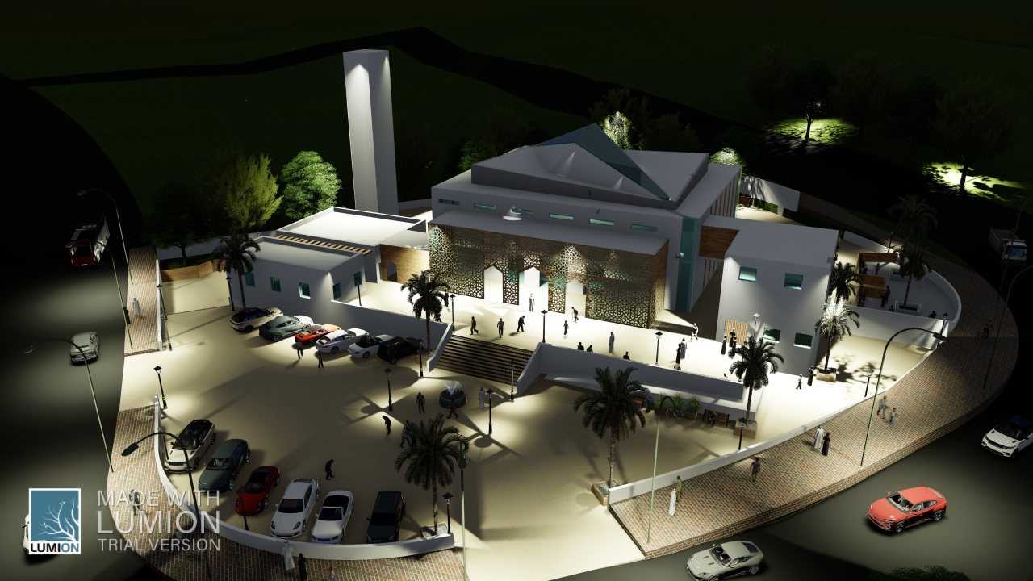

Slide 31
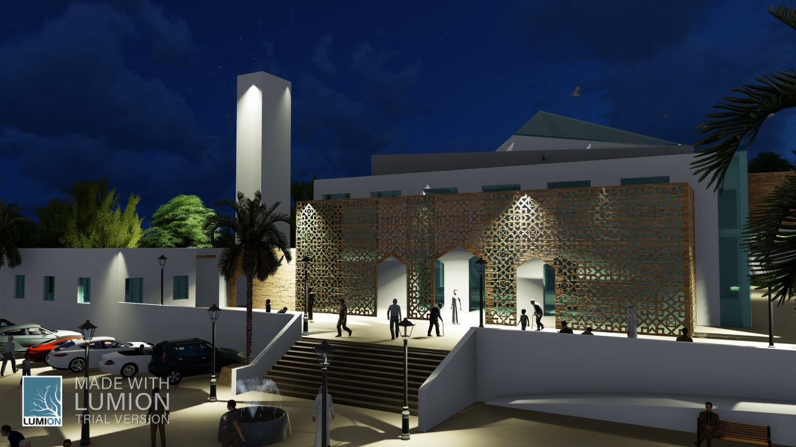

Slide 32
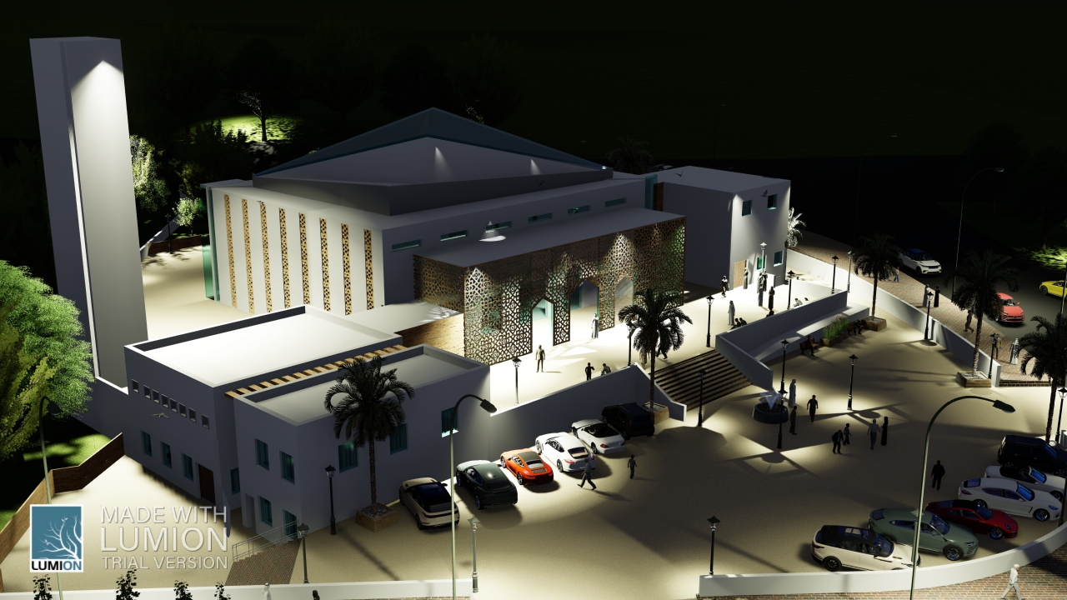

Slide 33
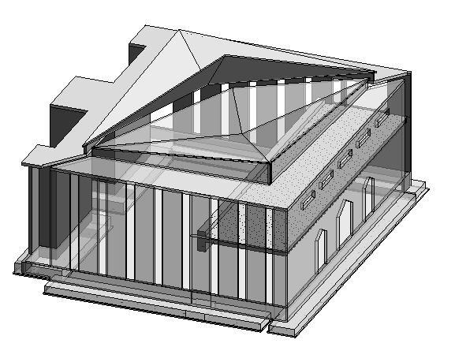
Structural design

Slide 34
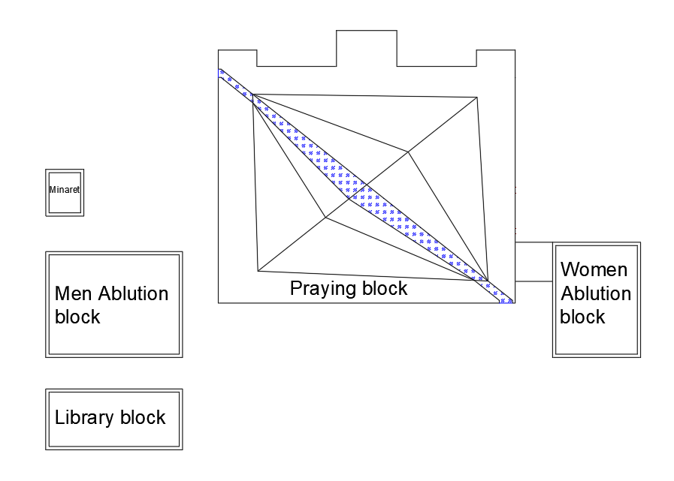
Mosque blocks

Slide 35
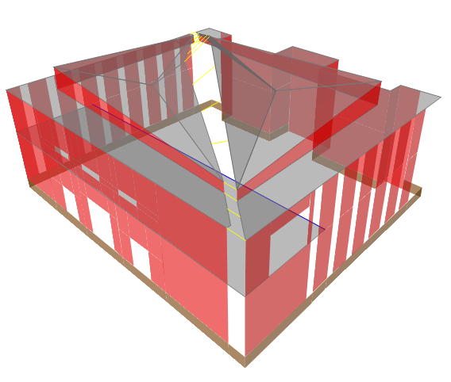
Prying Block 3D View by objects types
Floors
Walls
Underground walls
Beam (concrete)
Steel Members

Slide 36
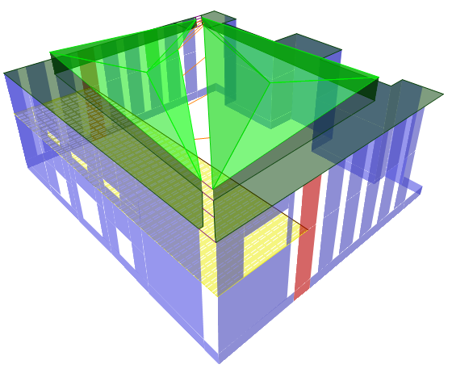
View by sections
Walls b=25cm
Walls b=40cm
Ribbed slab h=50cm
Solid Slab h=25cm
Solid Slab h=12cm
Concrete beam (0.65*1.8)m
Steel member SHS (250*250*10)mm
Steel member SHS (120*120*10)mm

Slide 37
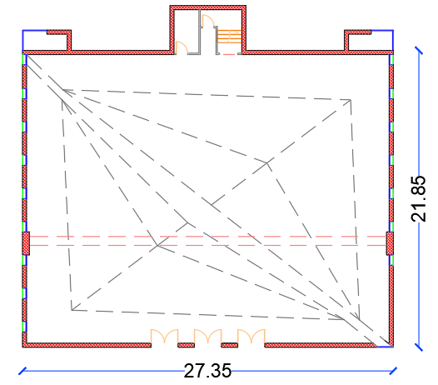
Praying block Dimensions plan

Slide 38
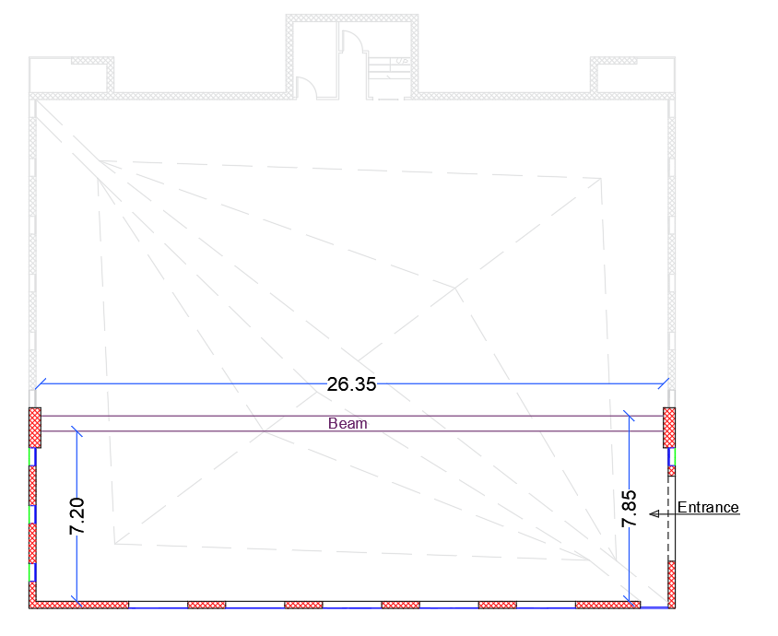
Women`s praying floor dimensions plan

Slide 39
Checks
Model verification Checks
Design checks
compatibility
Equilibrium
Stress Strain
Shear
Defilation
Structural time Period
Model Mass Participation ratio
Base Shear
Drift

Slide 40
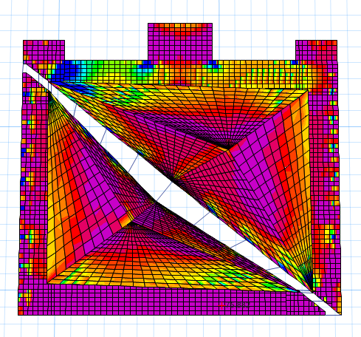
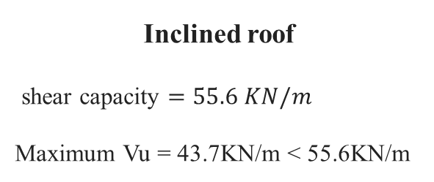
Roof shear check
Horizontal roof
shear capacity = 141KN/m
Maximum Vu = 132KN/m < 141KN/m
Inclined roof
shear capacity $=55.6 KN/m$
Maximum Vu = 43.7KN/m < 55.6KN/m
Code: ACI 318-14

Slide 41
Checks
Model verification Checks
Design checks
compatibility
Equilibrium
Stress Strain
Shear
Defilation
Structural time Period
Model Mass Participation ratio
Base Shear
Drift

Slide 42
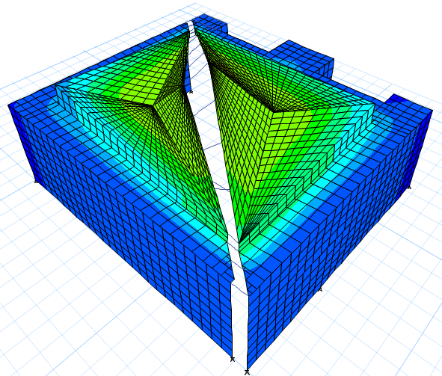
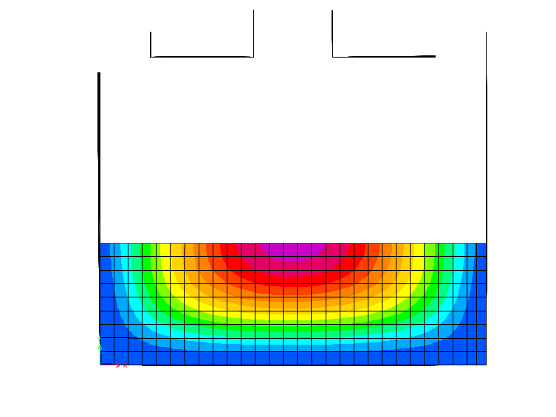
Deflection check
First floor deflection
Max. deflection = 108mm
Roof deflection
Max. deflection = 67mm
Deflection scale
Deflection Limit = 113mm
Code: ACI 318-14

Slide 43
Checks
Model verification Checks
Design checks
compatibility
Equilibrium
Stress Strain
Shear
Defilation
Structural time Period
Model Mass Participation ratio
Base Shear
Drift

Slide 44
Structural time Period
limit for structure time period = 0.2535 second
Period from etabs = 0.201 < 1.4 * 0.2535 ➔ 0.20 < 0.35
According to UBC 97 the structure time period shall be =< 1.4*time period limit
Code: UBC-97

Slide 45
Checks
Model verification Checks
Design checks
compatibility
Equilibrium
Stress Strain
Shear
Defilation
Structural time Period
Model Mass Participation ratio
Base Shear
Drift

Slide 46
Model Mass Participation ratio

Slide 47
Checks
Model verification Checks
Design checks
compatibility
Equilibrium
Stress Strain
Shear
Defilation
Structural time Period
Model Mass Participation ratio
Base Shear
Drift

Slide 48
Base Shear
According to UBC 97 to accept the response spectrum method its base shear have to be equal or larger than the base shear calculated form equivalent static method
While the base shear is depending on the scale factor used to define the response spectrum function.
(Response spectrum must be larger than equivalent static method in order to insure the accuracy and safety of the design)
The scale factor when defining the response spectrum load case = IG/R
Code: UBC-97

Slide 49
Checks
Model verification Checks
Design checks
compatibility
Equilibrium
Stress Strain
Shear
Defilation
Structural time Period
Model Mass Participation ratio
Base Shear
Drift

Slide 50
Drift
When the building period is less than 0.7S then the allowable story drift delta M shall not exceed 0.025 of the story height. –UBC-97 page 16-
Code: UBC-97

Slide 51
Checks
Model verification Checks
Design checks
compatibility
Equilibrium
Stress Strain
Shear
Defilation
Structural time Period
Model Mass Participation ratio
Base Shear
Drift

Slide 52
Design outputs

Slide 53
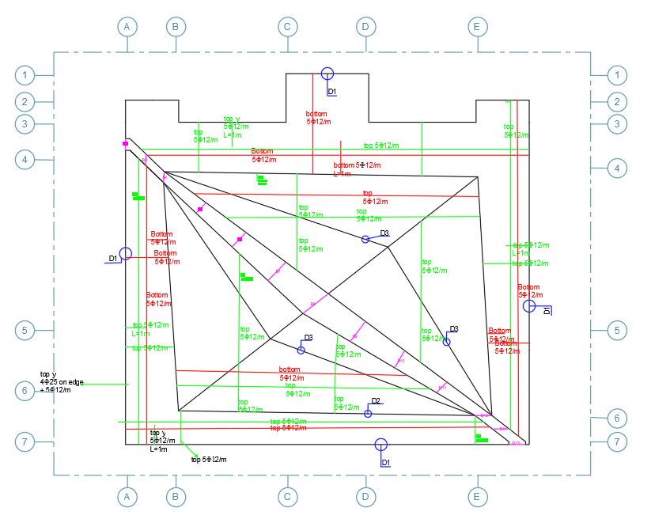
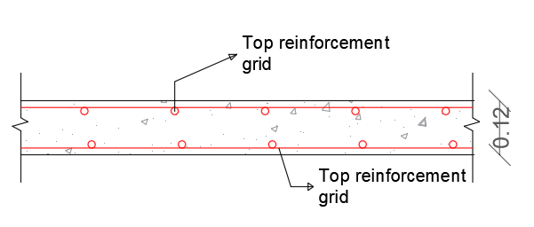
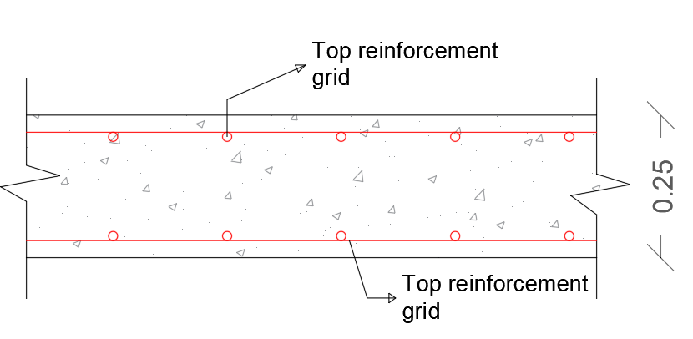
Roof reinforcement Plan
5ɸ12/m
Bottom reinforcement grid 5ɸ12/m
5ɸ12/m
Bottom reinforcement grid 5ɸ12/m

Slide 54
Design outputs
Roof reinforcement

Slide 55
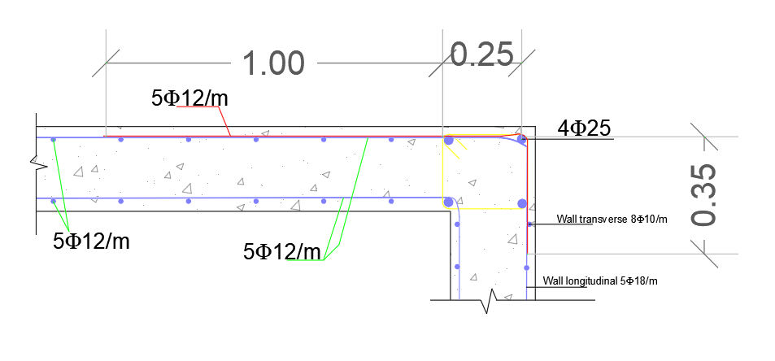
D1

Slide 56
Design outputs
Roof reinforcement

Slide 57
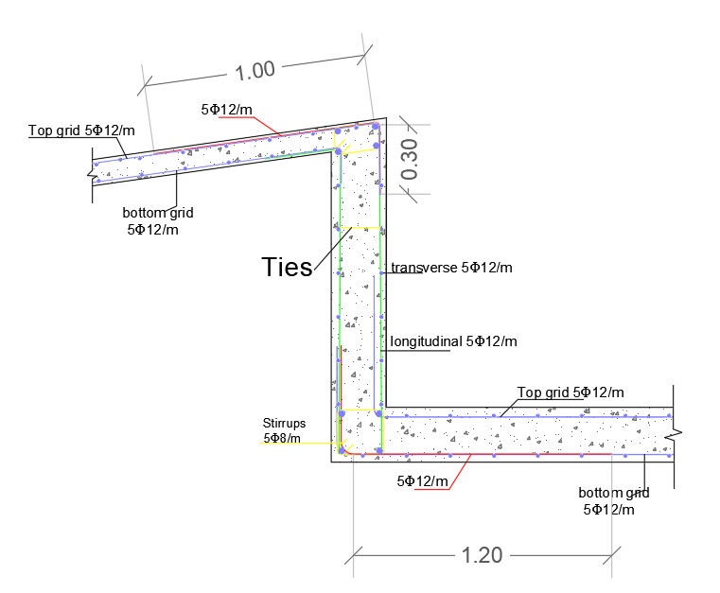
D2

Slide 58
Design outputs
Roof reinforcement
D3

Slide 59
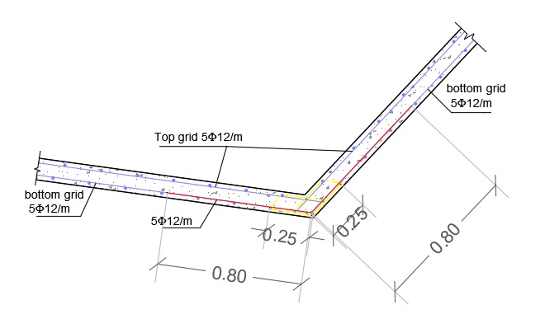
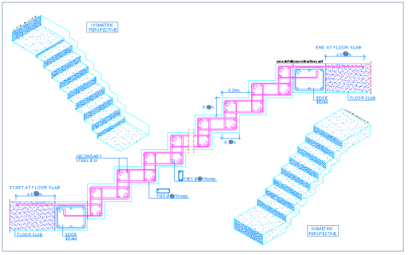
D3

Slide 60
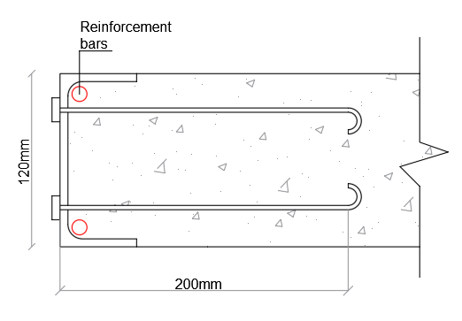
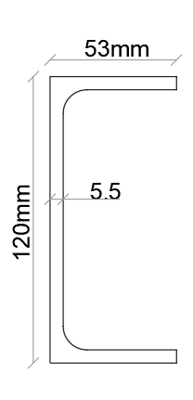
D4

Slide 61
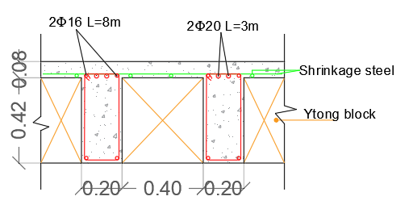
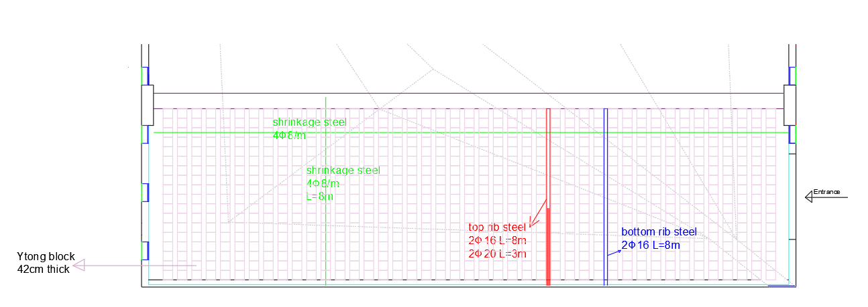
First floor reinforcement
2ɸ16
First floor beam

Slide 62
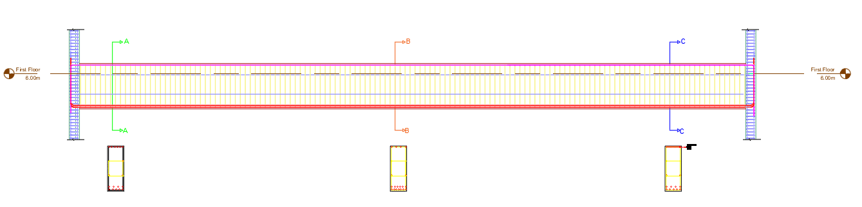
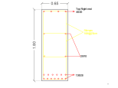




First floor beam reinforcement

Slide 63


Slide 64


Slide 65

Rebar bending Machine

Slide 66



Shear Walls
First floor beam

Slide 67

Shear walls 2-3
4

Slide 68


Shear Walls

Slide 69


Slide 70

Footings

Slide 71

Reinforcement Plan

Slide 72


Slide 73


Slide 74

Horizontal roof
First floor beam
Sh2
Ground floor
F2

Slide 75
Side Blocks

Slide 76



Men`s Ablution block
Women`s Ablution Block
Library Block

Slide 77

Women`s block first floor center lines

Slide 78

Women`s block first floor Beams

Slide 79


Women`s block first floor slab reinforcement

Slide 80
Beams reinforcement
Bottom bars
Top bars

Slide 81


Slide 82
Electrical design
Lighting design

Slide 83
Electrical design
The mosque consists of:
Main praying block
Men ablution block
Library block
Women ablution block

Slide 84

Main praying hall
Challenges:
1-Height more than 9 meters
2-Distribution of light

Slide 85





Electrical design

Slide 86


Electrical design

Slide 87


Electrical design

Slide 88



Electrical design

Slide 89
Men ablution block
Men ablution block consists of two floors:
Men ablution room
Multi- purpose room

Slide 90



Men ablution room

Slide 91




Lux distribution
Imam’s room: sleeping area
Library room: reading area

Slide 92



Electrical connections
Main praying hall

Slide 93


Electrical connections
Wires dimensions

Slide 94




Emergency lights

Slide 95


Emergency lights
Main praying hall

Slide 96

Daylight
Main praying hall

Slide 97


Site lighting

Slide 98

Thermal design
      Shading system:

Slide 99


Thermal design
      Wall layer for prayer hall :
Wall layer for side block

Slide 100


Thermal design
Roof layer:
      floor layer:

Slide 101

Thermal design
      U-Values:

Slide 102
Thermal design
      Total site energy:
 | Total Energy [kWh] | Energy Per Total Building Area [kWh/m2] | Energy Per Conditioned Building Area [kWh/m2]
Total Site Energy | 45663.4 | 40.09 | 40.09
Net Site Energy | 45663.4 | 40.09 | 40.09
Total Source Energy | 121753.7 | 106.89 | 106.89
Net Source Energy | 121753.7 | 106.89 | 106.89

Slide 103

Thermal design
Design builder results:

Slide 104

Thermal design
Design builder results:

Slide 105

HVAC Design
VRF system used.

Slide 106
HVAC Design
Reading from design builder program .
Zone | Design Capacity (kW) | Design Flow Rate (m3/s) | Design Cooling Load Per Floor Area(W/m2)
Men Ablution Area | 5 | 0.3334 | 53.4
Library | 4.43 | 0.2953 | 78.4
MultiPurposeHall | 6.93 | 0.462 | 63.7
Imam Room | 1.9 | 0.1267 | 43.6
Prayer Hall | 46.47 | 3.098 | 92
WomenAblutionArea | 1.22 | 0.0813 | 37.7
Second Floor Looby | 4.04 | 0.2693 | 60.2

Slide 107


HVAC Design
Indoor unit for prayer hall:
we use split unit from Toshiba

Slide 108

HVAC Design
Indoor unit for side block:

Slide 109


HVAC Design
Indoor unit for side block:

Slide 110


outdoor unit for prayer hall
:

Slide 111


outdoor unit for side block

Slide 112

Women prayer area level
:

Slide 113

men prayer area level

Slide 114

Basement level
:

Slide 115

Acoustical design

Slide 116

Acoustical materials used :

Slide 117

RT60
According to the standards,
RT60 should be (1.2-2.0).

Slide 118


STC & IIC
Ceiling
External walls

Slide 119


Loud speakers
TOA F-1300BT/Wt
Specifications

Slide 120

Loud speakers distribution

Slide 121

Total SPL

Slide 122

AL %
AL% between (7-12)
Good intelligibility

Slide 123






Safety design
Fire extinguisher.
Hose station.
Heat detector.
Smoke detector.
Warning signs.
Manual alarm

Slide 124

Safety Plans

Slide 125

Safety Plans

Slide 126

Emergency Egress System

Slide 127
Mechanical design

Slide 128
Mechanical design
Water supply system
HVAC System
Drainage System

Slide 129
Water supply system
Water consumption:
Pray time | No. of prayers | Consumed in ablution | Total consumed water in ablution | No. of prayers | Consumed in W.C | Total consumed water in W.C.
Fajr | 20 | 10 | 200 | 10 | 15 | 150
Douhr | 50 | 10 | 500 | 25 | 15 | 375
Asr | 50 | 10 | 500 | 25 | 15 | 375
Maghreb | 35 | 10 | 350 | 18 | 15 | 270
Isha | 35 | 10 | 350 | 18 | 15 | 270
total consumed water in ablution /day |  |  | 1900 |  |  | 1440
 | Total consumed water in the mosque equals to 3340 liter per day

Slide 130


Water supply system
Number of tank used :
1- For cold water 8 tank (6 for men and 2 for women).
2-for hot water 3 tank (2 for men and 1 for women).

Slide 131

Water supply system
 | Diameter
Vertical pipe | 3 inches
Horizontal pipe | 2.5 inches
Branch pipe | $1$ inch
Auxiliary pump = 6psi. For Men Ablution floor.
Auxiliary pump = 3 psi. For this floor WomenAblution floor

Slide 132

Water supply system

Slide 133

Drainage System

Slide 134

Drainage System

Slide 135

Drainage System

Slide 136

Drainage System

Slide 137
Quantity survey
Item | Toatal cost(NIS)
Earthwork | 6373
Structural work | 732195
finishes | 956091
Mechanical work | 286844
project total cost (NIS) | Project unit cost(NIS/SM)
1981498 | 2211.5

