Slide 1
Smart Vertical Parking System
Prepared by
Ali Odeh
Majd Sawafta
Haya Atyani
Rania Nasser
Supervisor
Dr. Muawia Tahseen Ramadan

Slide 2
Outline
Introduction
Decisions of Parking location
Design of the system
Application
Feasibility study
Conclusion

Slide 3
Introduction
The importance of the project lies in finding an unconventional solution to the problem of traffic jam by connecting vertical parking systems with technology. In this project, vertical parking solution is made smarter, it provides a mechanism that increases the efficiency and develops based on the Internet of Things. This aims to reduce the time and cost of the drivers.

Slide 4
Some of Specification
• Quick Automated Parking and retrieval of vehicles.
• Up to 16 cars can be easily and safely parked.
• Surface space required equivalent to just 2 surface car parking spaces.
• The facade can be chosen in different variants.
• Does not require a parking attendant.

Slide 5
The Advantages of SVPS
1. Easy Installation.
2. Little Space Required.
3. Save & Earn Money.
4. Long Lasting System.
5. Less fuel.
6. Save time.
7. Smart parking will reduce traffic congestion.

Slide 6
Decisions of Parking location
Procedural steps:
Data preparation phase
Preliminary evaluation phase
Best utilization phase

Slide 7
City Center
Rafidia
Puplic Orgnization
Center of City Center
Rafidia center
NNU
center
Mini Cases
Mini Cases Centers

Slide 8
City center:
Number of parking spaces Required
Demand
Available
Purpose of parking the car at city center

Slide 9
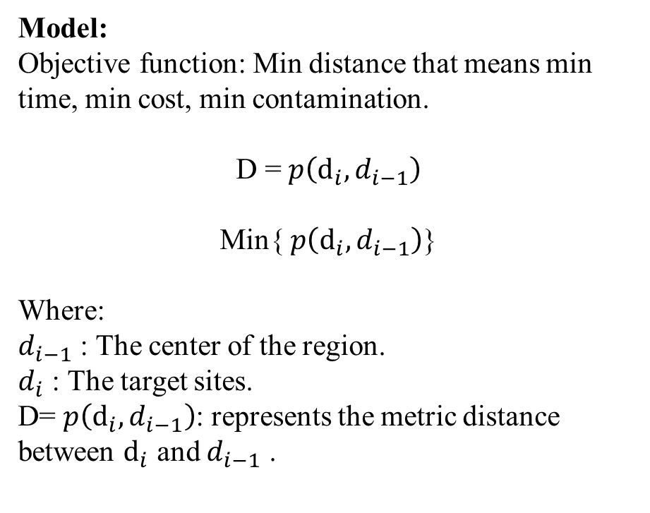
Preliminary evaluation phase:
Model:
Objective function: Min distance that means min time, min cost, min contamination.
D = $p\left(ⅆ_{i},d_{i−1}\right)$
Min{ $p\left(ⅆ_{i},d_{i−1}\right)$}
Where:
$d_{i−1}$ : The center of the region.
$d_{i}$ : The target sites.
D= $p\left(ⅆ_{i},d_{i−1}\right)$: represents the metric distance between $ⅆ_{i}$ and $d_{i−1}$ .

Slide 10
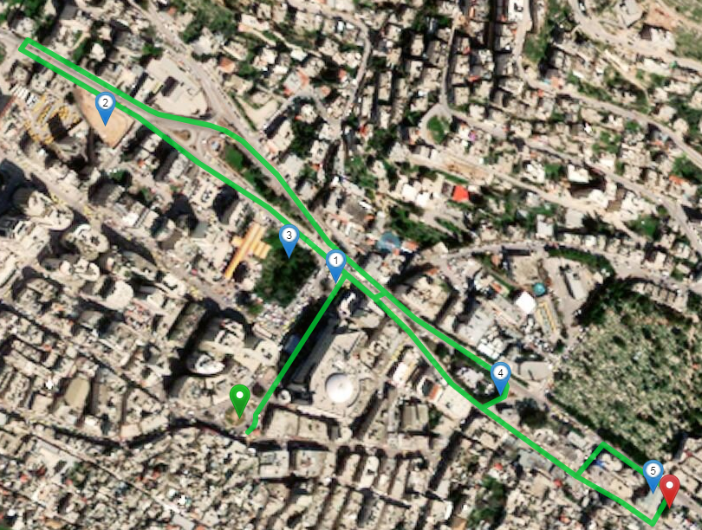
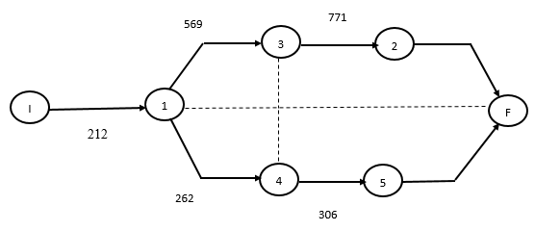
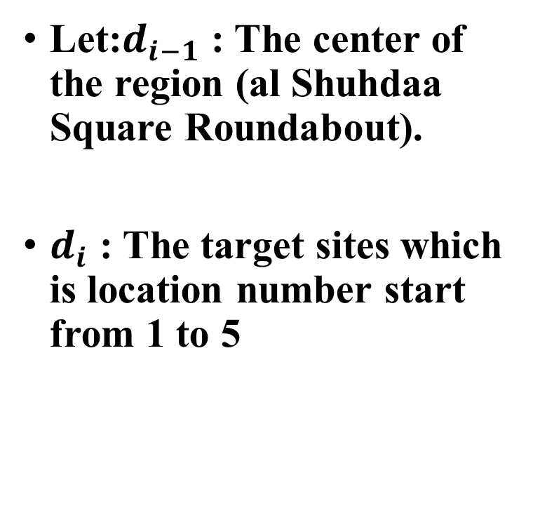
City center:
Let:$d_{i−1}$ : The center of the region (al Shuhdaa Square Roundabout).
$d_{i}$ : The target sites which is location number start from 1 to 5

Slide 11
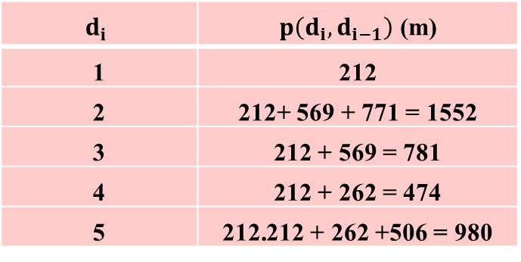
City center
Check:
$$ⅆ_{i}$$ | $p\left(ⅆ_{i},d_{i−1}\right)$ (m)
1 | 212
2 | 212+ 569 + 771 = 1552
3 | 212 + 569 = 781
4 | 212 + 262 = 474
5 | 212 + 262 +506 = 980
Final Arrangement for City center
Location Number 1
Location Number 4
Location Number 3
Location Number 5
Location Number 2

Slide 12
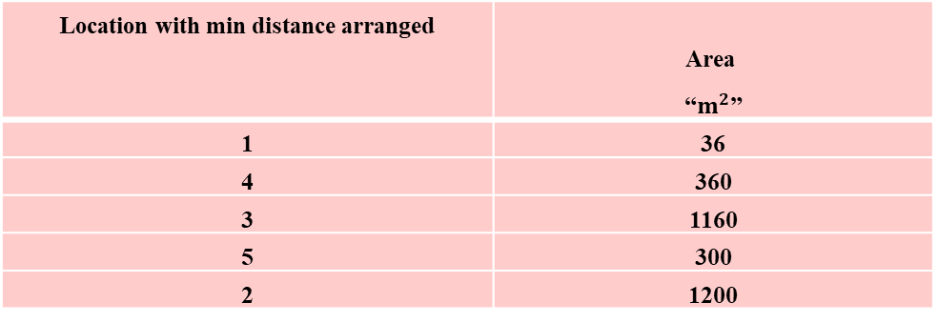
Best utilization phase
Location with min distance arranged | $$\text{Area}$$ “$m^{2}$”
1 | 36
4 | 360
3 | 1160
5 | 300
2 | 1200
city center
(84)
Rafidia
(91)
NNU
(55)
1 system at Loction 1
11 systems at Location 4
35 systems at Location 3
28 systems at Location 2
9 systems at Location
5
The number of systems in each site at city center
Location # 1
Location # 2
Location # 3
Location #4
Location # 5
$$m^{2}$$

Slide 13
Design of the system
The system design
Mechanical design
Electronics Design and Programming

Slide 14
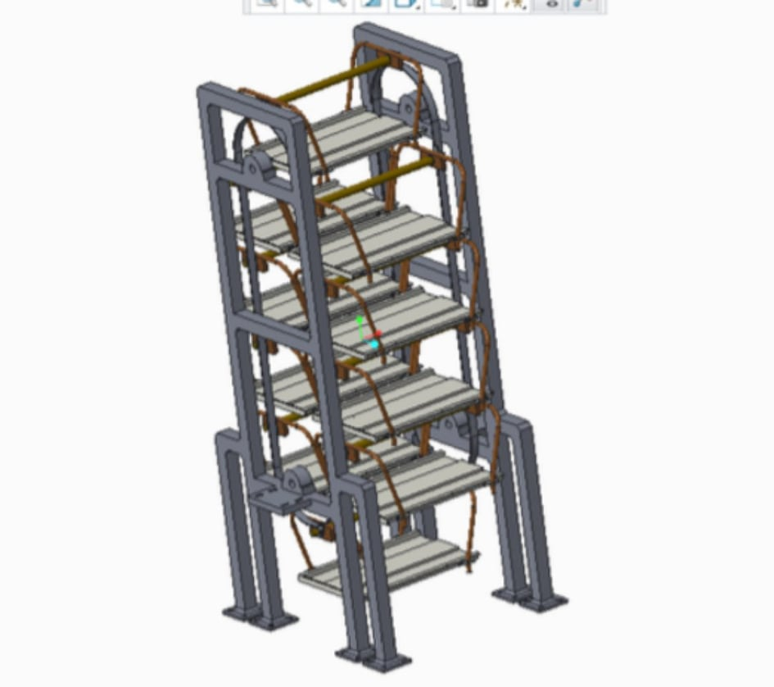
Mechanical design
This smart vertical parking system consists primarily of the main steel frame, sprocket, roller chain, assembly pallet, the transmission system and the control system.

Slide 15
Electronic Design and Programming
This system consists ultrasonic sensors, Arduino uno, breadboard and wires.
A programming language and interface were required to achieve the desired results in order to formulate a logic that would make the Arduino board understand the specifications demanded by it.

Slide 16
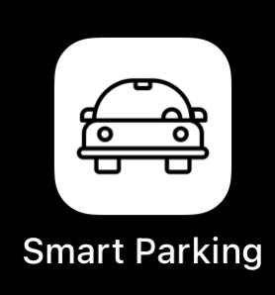
Automated Parking System-Cloud "Application"
With the advent of the Internet of Things (IoT), smart infrastructure became mandatory for cities. Smart parking areas are one of these infrastructures. Thus, an algorithm for smart vertical parking of cars in smart parking areas is intended for this project. This smart architecture is enhancing the efficiency of the Smart Vertical Parking System (SVPS) efficient use of parking slots with less time.

Slide 17
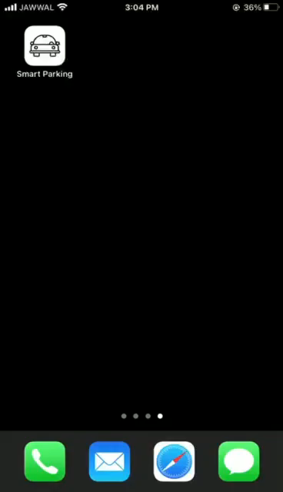
Proposed Work

Slide 18
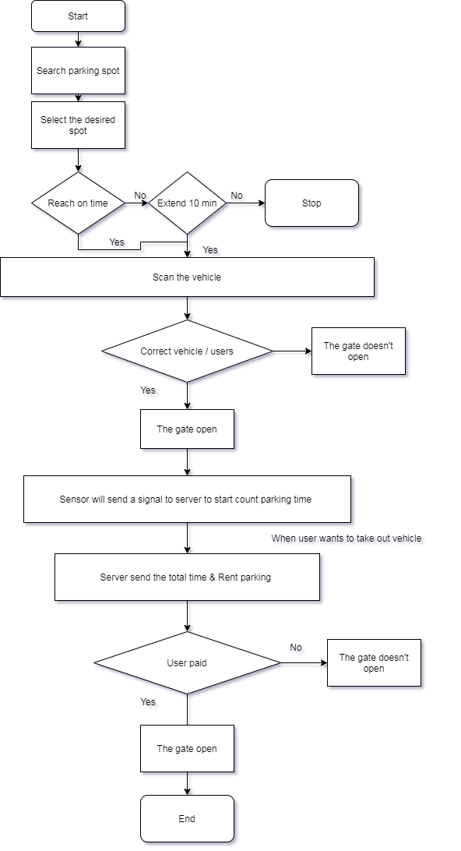
Flowchart

Slide 19

Feasibility study
The feasibility study is an important research for any project, because it includes many topics related to the project, such as technical study, general information and financial study, which are considered among the most important topics because it includes all the costs and returns of the project, and based on these calculations, it may be decided that the project is successful or not.

Slide 20
Feasibility Study Contents
Feasibility study
The service market
Financial section
Business model
Technical section
Marketing strategy
Impact of technology

Slide 21

Financial section
Constituent cost
The operating costs
Revenues

Slide 22
Constituent cost for one system
Clause | The cost (NIS)
Site purchase | X, Because the price of land differs from one region to another, and to be able to calculate it, we have assumed that value 650
Smart vertical parking | 24850
Pre-operating cost | 3000
The summation | 28500
Pre-operating cost
Site purchase
Smart vertical parking

Slide 23


Market Share
The year | Expected annual market share (%)
2021 | 40.22%
2022 | 46.37%
2023 | 52.36%
2024 | 58.22%
2025 | 64.24%
2026 | 70.20%
2027 | 76.14%
2028 | 82.11%
2029 | 88.08%
2030 | 94.04%
2031 | 100.00%

Slide 24

Operational costs
Clause | Cost /Year(NIS)
Manpower | 60000
Electricity consumption costs | 47952
General operating expenses | 5497
The sum | 113449

Slide 25
Cost summary for 10 years
Year | No. of needed system | Salaries and wages | Electricity bill | General operating expenses | Cost of systems | Cost of Rent the land | Sum
2021 | 266 | 60000 | 12755232 | 1462202 | 6610100 | 172900 | 21060434
2022 | 36 | 62400 | 1726272 | 197892 | 894600 | 23400 | 17294898
2023 | 35 | 64896 | 1678320 | 192395 | 869750 | 22750 | 19166009
2024 | 36 | 67491 | 1726272 | 197892 | 894600 | 23400 | 21141018
2025 | 36 | 70191 | 1726272 | 197892 | 894600 | 23400 | 23091282
2026 | 36 | 72999 | 1726272 | 197892 | 894600 | 23400 | 25041654
2027 | 36 | 75919 | 1726272 | 197892 | 894600 | 23400 | 26992138
2028 | 36 | 78955 | 1726272 | 197892 | 894600 | 23400 | 28942738
2029 | 36 | 82114 | 1726272 | 197892 | 894600 | 23400 | 30893461
2030 | 36 | 85398 | 1726272 | 197892 | 894600 | 23400 | 32844309

Slide 26

Annual gross profit / loss
Year | Revenues | Cost | Annual gross profit /losses
2021 | 18558060 | 21060434 | -2502374
2022 | 20953920 | 17294898 | 3659022
2023 | 23301600 | 19166009 | 4135591
2024 | 25710600 | 21141018 | 4569582
2025 | 28093320 | 23091282 | 5002038
2026 | 30471660 | 25041654 | 5430006
2027 | 32858760 | 26992138 | 5866622
2028 | 35250240 | 28942738 | 6307502
2029 | 37632960 | 30893461 | 6739499
2030 | 40020060 | 32844309 | 7175751
Annual gross = Rev. - Cost

Slide 27

Revenue vs Cost chart
The capital payback period is a 19 months
Return on investment =18.82%

Slide 28
Conclusion
Introducing the solution of the smart vertical parking system as a graduation project was very useful that can help in solving the traffic crisis problem by practicing and demonstrating the different discipline that is introduced by the Industrial Engineering Department at An-Najah National University.
1. Determining the appropriate sites.
2. An application has been created to facilitate access to the proposed sites.
3. We made feasibility study.

Slide 29


