Slide 1


Vending Machine
Presented By:
Muath Saed
Hamza Nayef
Supervised By:
Dr. Hanal Abuzant
Summer Semester
2022/2023

Slide 2
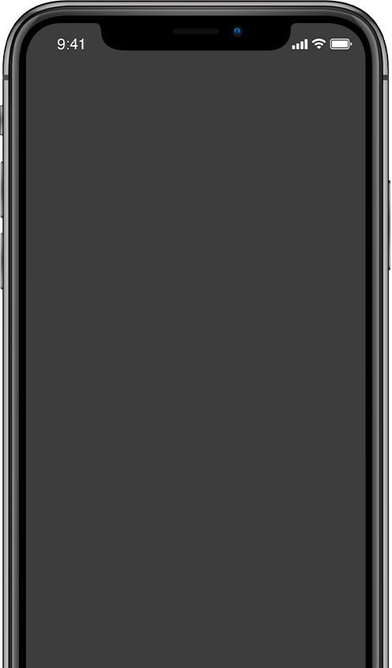
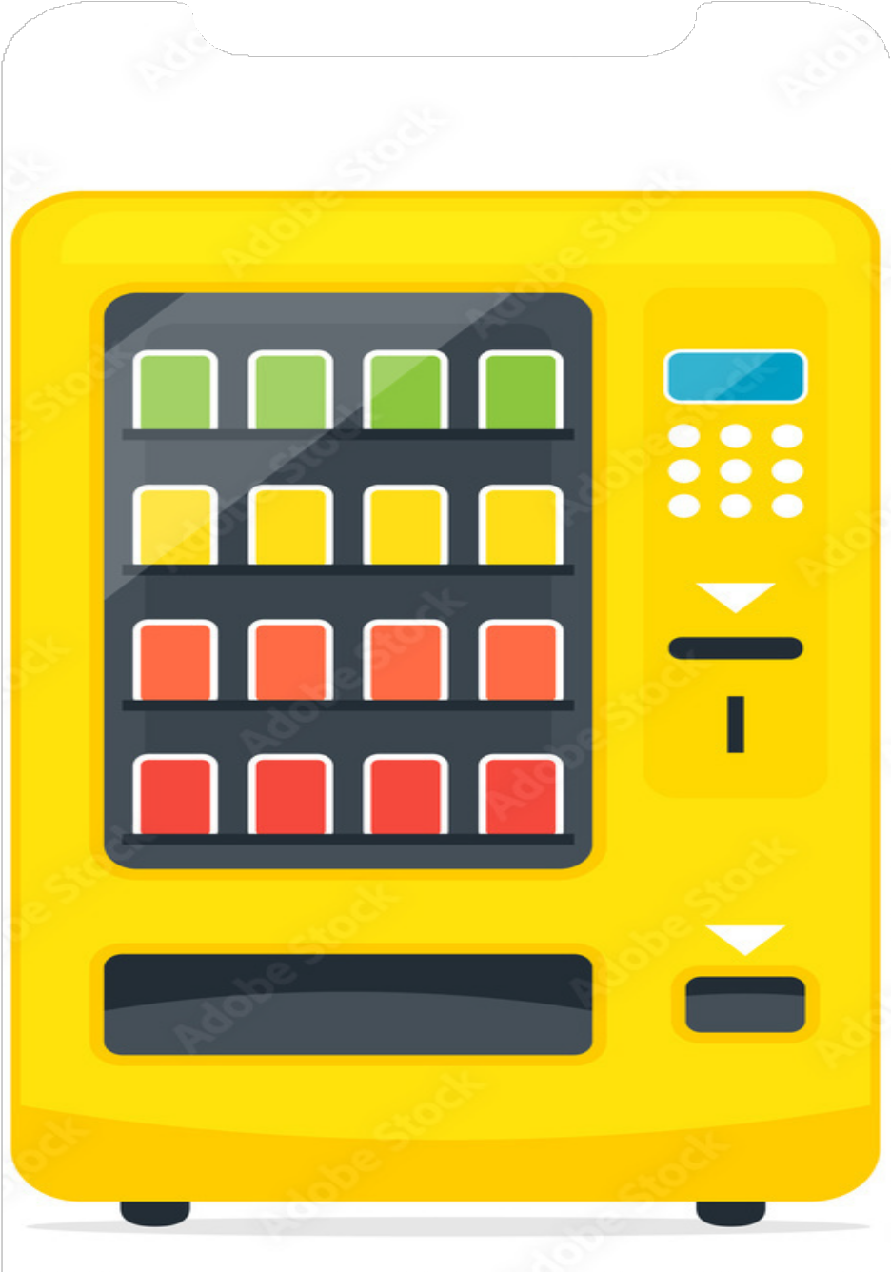
Contents
Introduction
Primary Goals
Constraints
Features
Hardware Parts
Conclusion

Slide 3

Introduction
A vending machine is a self-service device that offers a variety of products and services to users.
These machines are automated and programmed to provide products without the need for direct human intervention.
Vending machines can be found in public and commercial locations such as airports, hospitals, schools, shopping centers, train and bus stations, hotels, and entertainment venues.

Slide 4



Vending Machine
Saving time
Convenience
Primary Goals
Accessibility
Availability 24/7

Slide 5




Constraints
Dealing with small electrical parts was difficult, like drivers.
Sensitive to change in voltage, current, or even the weather. Also, during designing the vending machine, several of the chips were damaged.
Dealing with the mechanical component was very hard for me as a student of computer engineering.

Slide 6

Vending Machine
Buy chosen snacks
The presence of a sensor to monitor product availability
Features
RFID Door Lock
Order by phone

Slide 7

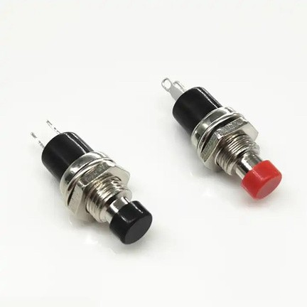
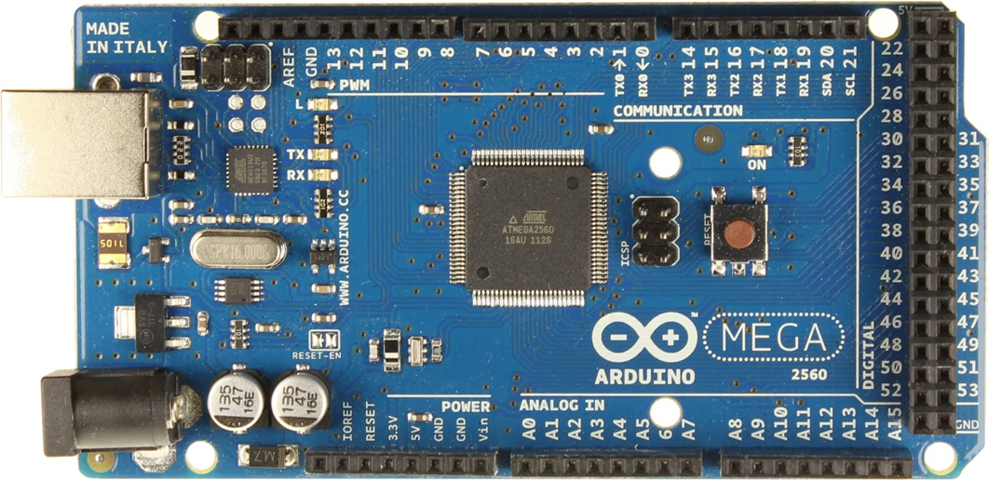
Hardware Parts
Arduino Mega Push Buttons

Slide 8
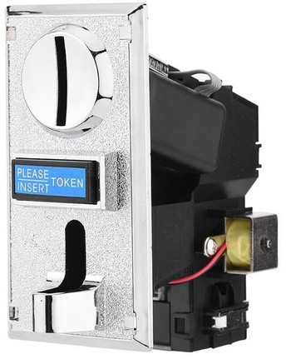
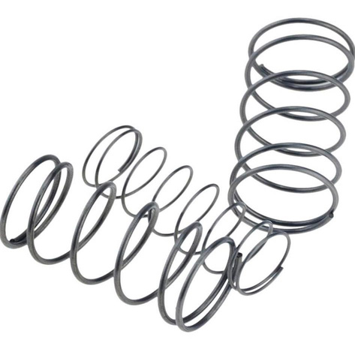
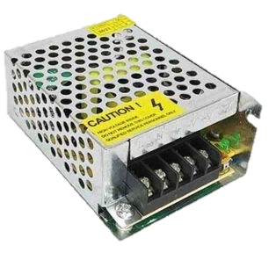
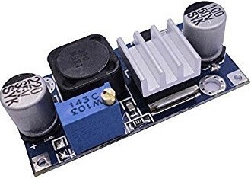
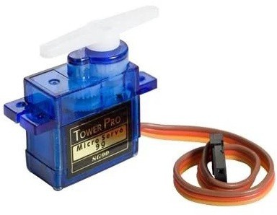
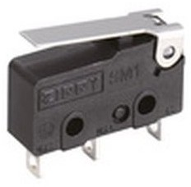
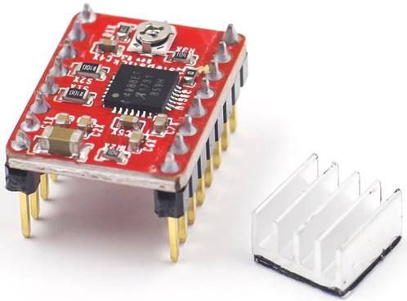
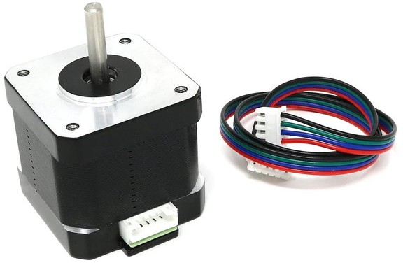
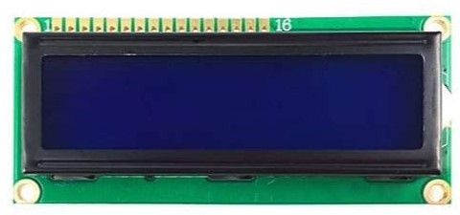
Coin Acceptor
Servo Motor
Power Supply
DC-DC Step Down
LCD
Micro Switch
Stepper Motor
A4988

Slide 9
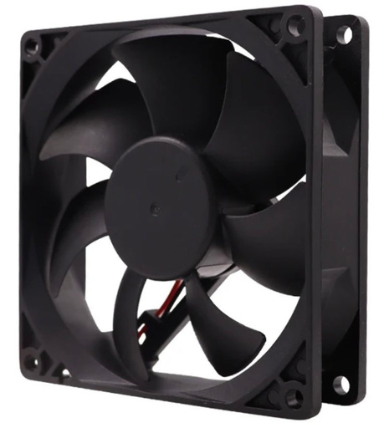
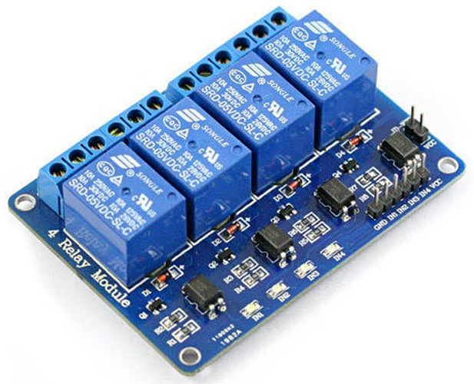
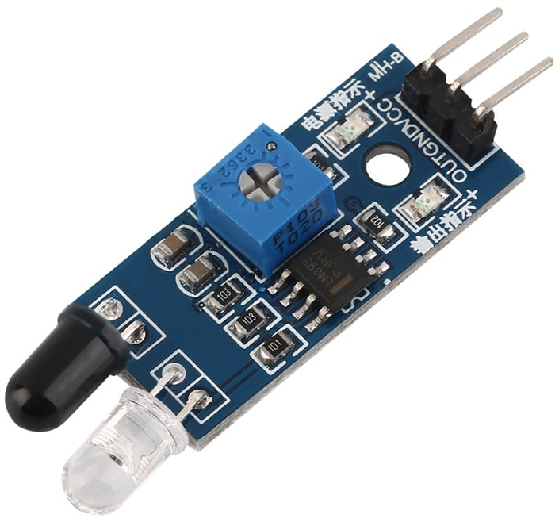
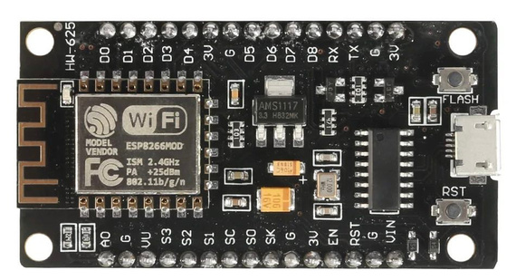

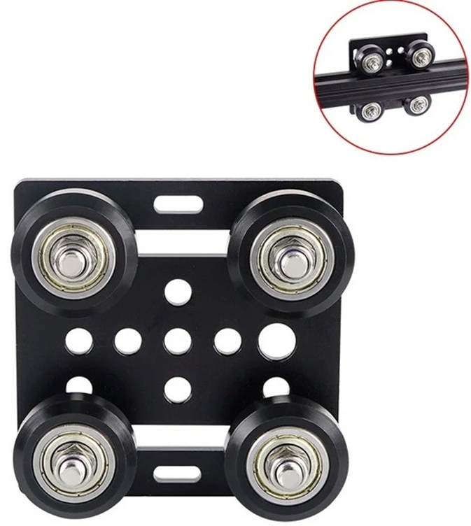
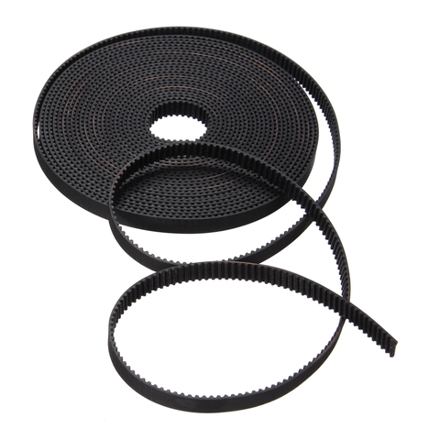
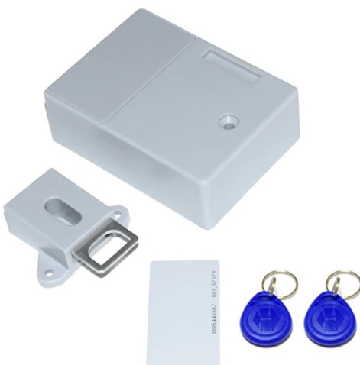
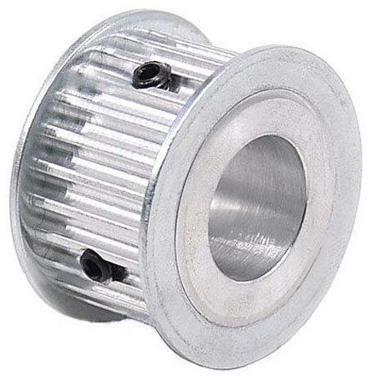
Cooling Fan
IR Sensor
4-Relay Module
ESP 8266
V-Slot
Timing Belt and Pulley
Gantry Plate 4-Wheels
RFID Door Lock

Slide 10


Using the ESP module to connect the vending machine with the mobile application
Selecting the item through the mobile application.
The red cycle means the box is full.
While the gray circle means that the box is empty
When filling the box the color changes to red.

Slide 11


Conclusion
The vending machine's main controller, an Arduino Mega, was successfully
implemented.
In conclusion, the project has
succeeded in achieving all of the outlined goals for enhancing the vending machine's functionality, reliability.

Slide 12



Any Questions?
Ask P.R.C

