Slide 1
Design of A Treatment Plant For Kafr Thulth Town
Prepared by :
Ashar Awad
Zaynab Ishtawi
Submitted to : Dr. AbdALhaleem Kader

Slide 2
ABSTRACT
Problems of the water sector have recently led to continuous deterioration of water quality, limited resources, depletion of the aquifer, Israeli control over surface water reservoirs, and other serious immediate consideration of alternative resources that would alleviate the crisis. This project comprises an integrated sanitation solution with collection systems, and wastewater treatment plant and reuse of the treated water in agriculture and industry sectors, reduce contamination and protect water resources for the village of Kafr Thulth.

Slide 3
Introduction
Wastewater treatment is a process used to convert wastewater into an effluent that can be either returned to the water cycle with minimal environmental issues or reused. Treatment means removing impurities from water being treated; and some methods of treatment are applicable to both water and wastewater. The physical infrastructure used for wastewater treatment is called "wastewater treatment plant" (WWTP).

Slide 4
Objectives
The objective of our project is to conduct a treatment plant by using GPS-X program that receives the whole wastewater which comes from the town and treat it to have a new water source.

Slide 5
SIGNIFICANCE OF THE WORK
Kafr Thulth suffer from the lake of the cesspits that book large spaces. Moreover, high cost of suction drilling from cesspits paid, prevalence of environmental pollution, weaken the town's economy and there is a lot of claims from the citizens.

Slide 6
Approach
Collect information such as: maps, topography, water consumption, waste water properties.
Analyze the data using population analysis, load analysis, hydraulic, hydrology, and environmental engineering concepts.
Model and analyze the treatment plant using GPSX.

Slide 7
DISADVANTAGES OF CESSPITS AND SEPTIC TANKS
Cesspits might infiltrate wastewater into groundwater contaminating shallow aquifers or nearby cisterns.
Methane produced from cesspits increase the potential of fires and explosions if not properly vented.
Evacuation process of cesspits is always accompanied with septic odor nuisance and possibility of surface contamination due to spillage through the evacuation process.
Emptying evacuated wastewater into wadis, agricultural fields and remote locations imposes environmental hazards on groundwater, surface water, and wildlife.
Locations where raw wastewater is delivered provide a suitable environment for growth and spread of flies, mosquitoes, vectors and rodents. Such creatures might spread to nearby villages and cities.

Slide 8
Treatment Plant Mechanism
Preliminary treatment: Inclined Screw Pumps, Fine Screening and Wash Press, Grit Removal and Grit Washing.
Primary treatment: Primary Clarification,
Secondary treatment: Aeration Basins, Final Clarification, Disinfection.
Sludge handling: Anaerobic Digestion, Sludge Storage Tanks.

Slide 9
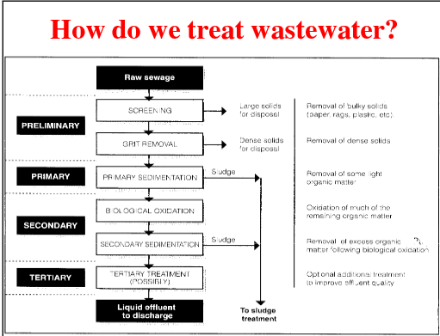

Slide 10
location of WWTP
The location of the plant should be in the lowest point in the village to ensure that the wastewater reaches by gravity, and is close to the wastewater outlet of the network.
The plant should be as far away from the residential areas, and the ownership of the land -if possible- for the municipality, and not contain any water sources.
The land must be in an area where construction is permitted politically and in a safe areaway more than 1.5 KM of buildings and agricultures.
The land must be connected to all transportation, electricity and water services.

Slide 11
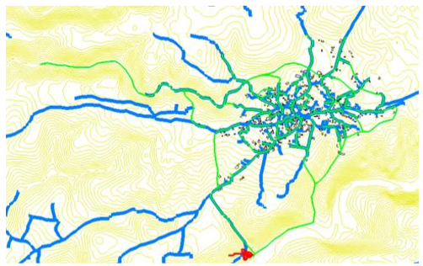
location of WWTP

Slide 12
Methodology
Data Collection
Analysis
Results and recommendations
Methodology

Slide 13
Data Collection
The average, minimum& max flow rate from the results of waste water.
Characteristics of produced waste water from laboratory experiments for Nablus western treatment plant.
Actual prices of material and other works for existing projects.

Slide 14
Methodology

Slide 15
Analysis
Screw pump
Flow measurement
Parshall Flume Design
Preliminary Treatment: Screens Design, Rotamat Fine Screen, Fine screen, Grit Chamber Design.

Slide 16
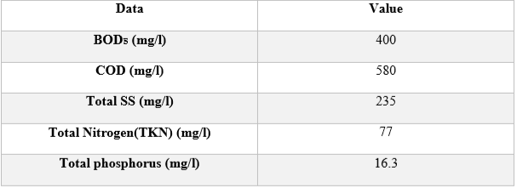
Design of WWTP by using GPS-X program
Properties of the wastewater influent

Slide 17
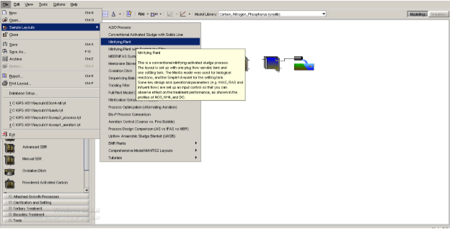
Design of WWTP by using GPS-X program
Sample Layout: Nitrifying Plant

Slide 18
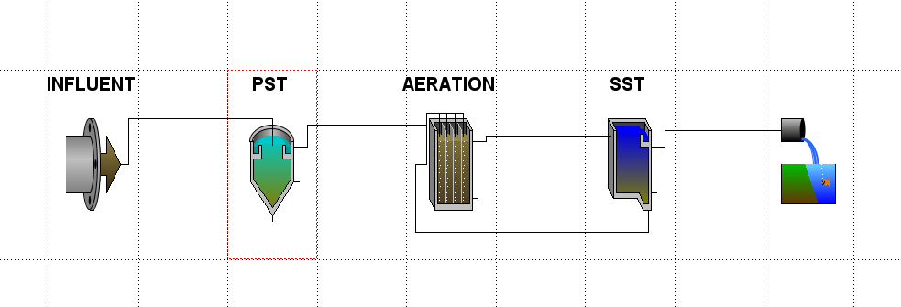
Design of WWTP by using GPS-X program
The layout Of Treatment Plant in GPS-X

Slide 19
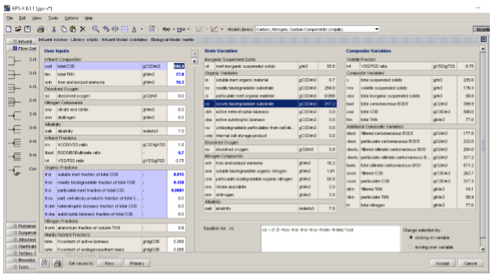
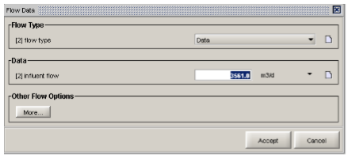
Design of WWTP by using GPS-X program

Slide 20
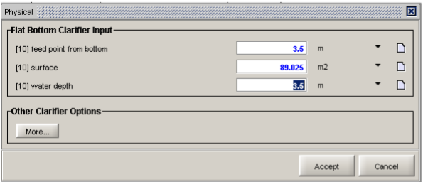
Design of WWTP by using GPS-X program
Primary

Slide 21
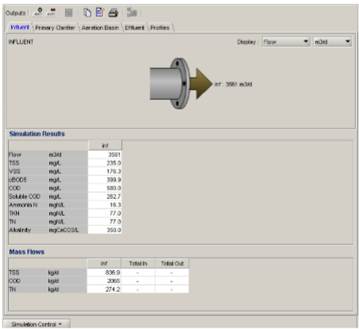
RESULTS
Influent

Slide 22
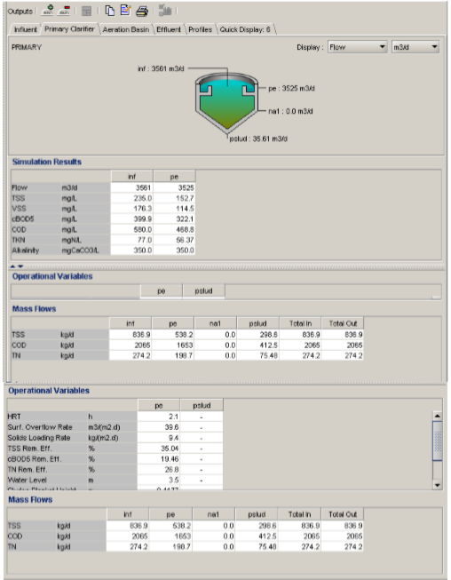
RESULTS
Primary Sedimentation
Tank (PST)

Slide 23
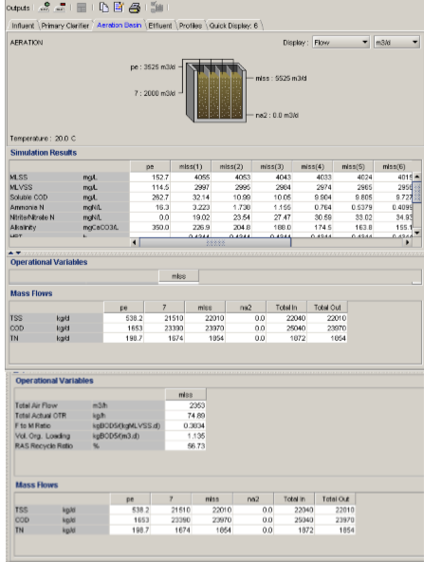
RESULTS
Extended Aeration Tank

Slide 24
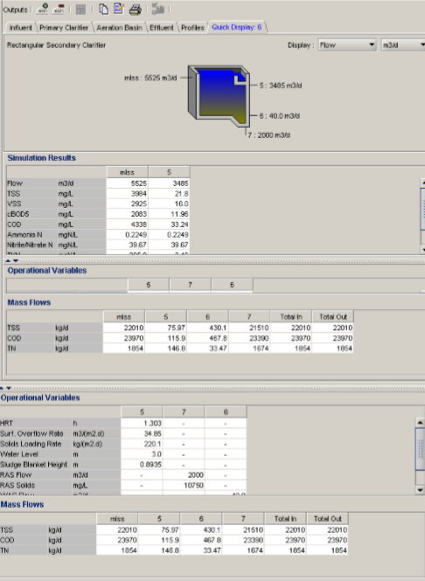
RESULTS
Secondary Sedimentation Tank (SST)

Slide 25
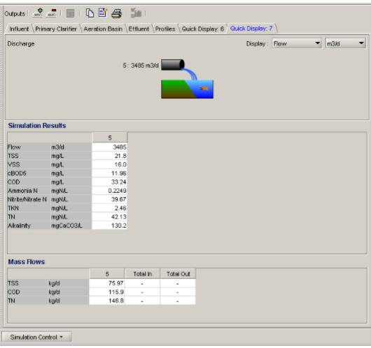
RESULTS
Discharge

Slide 26
RESULTS
The waste water must be treated to 85% from original values. We compare between the standards and the end results, we find that all results were accepted.
The efficiency of removed COD = (580-33.24) / 580*100% = 94.27%
The efficiency of removed TKN = (77-2.46) / 77*100% = 96.8%
The efficiency of removed TSS = (235-21.8)/235*100% = 90.7%

Slide 27
RESULTS
From this standards:
BOD = 11.96< 20
TSS = 21.8< 30
COD = 33.24< 50
TKN = 2.46 < 30
So, we can considered this water is potable

Slide 28

COST ESTIMATE

Slide 29
Conclusion
This project was undertaken to design a wastewater treatment plant with some particular data. The grit chamber, equalization basin, primary sedimentation tank and secondary settling tank have been designed, then the values for mean cell residence time, volume of aeration tank,
hydraulic retention time, f/m ratio, return sludge flow rate, sludge production and oxygen
requirement have been calculated, ultimately the theoretical aspects of grit chamber, waste
sludge and biological phosphorus removal have been covered.
For the treatment plant, the Palestinian specifications for treated wastewater, Comparing the results with the standards we get the quality C.

Slide 30
Recommendation
Based on the results of this project we give the following recommendations to the municipality of Kafr Thulth. First, the village need to construct a wastewater network to reduce the problems resulting from the current practices in the disposal of sewage.
As a priority, the municipality must start building an internal sewerage system to serve the villagers. If funding is available, the treatment plant should be constructed. It is possible to reach an understanding with neighboring villages to be a joint project that serves everyone.

Slide 31
Thank you

