Slide 1
Automatic Farm management
Group members: Morad Mayyaleh
Mahmoud Alsaeed
Motaz Thiab
Supervisor:
Samer mayaleh

Slide 2
Outline
1- Case
2- methology
3- Demo
4- limitation
5- future work

Slide 3
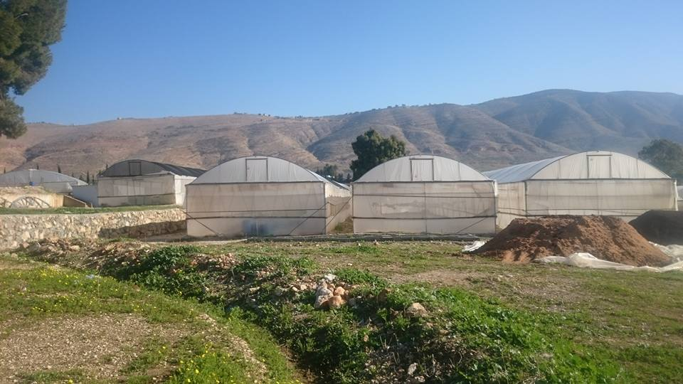
Introduction
Management system
Smart
Automatic
To ensure the reliability and farm efficiency

Slide 4
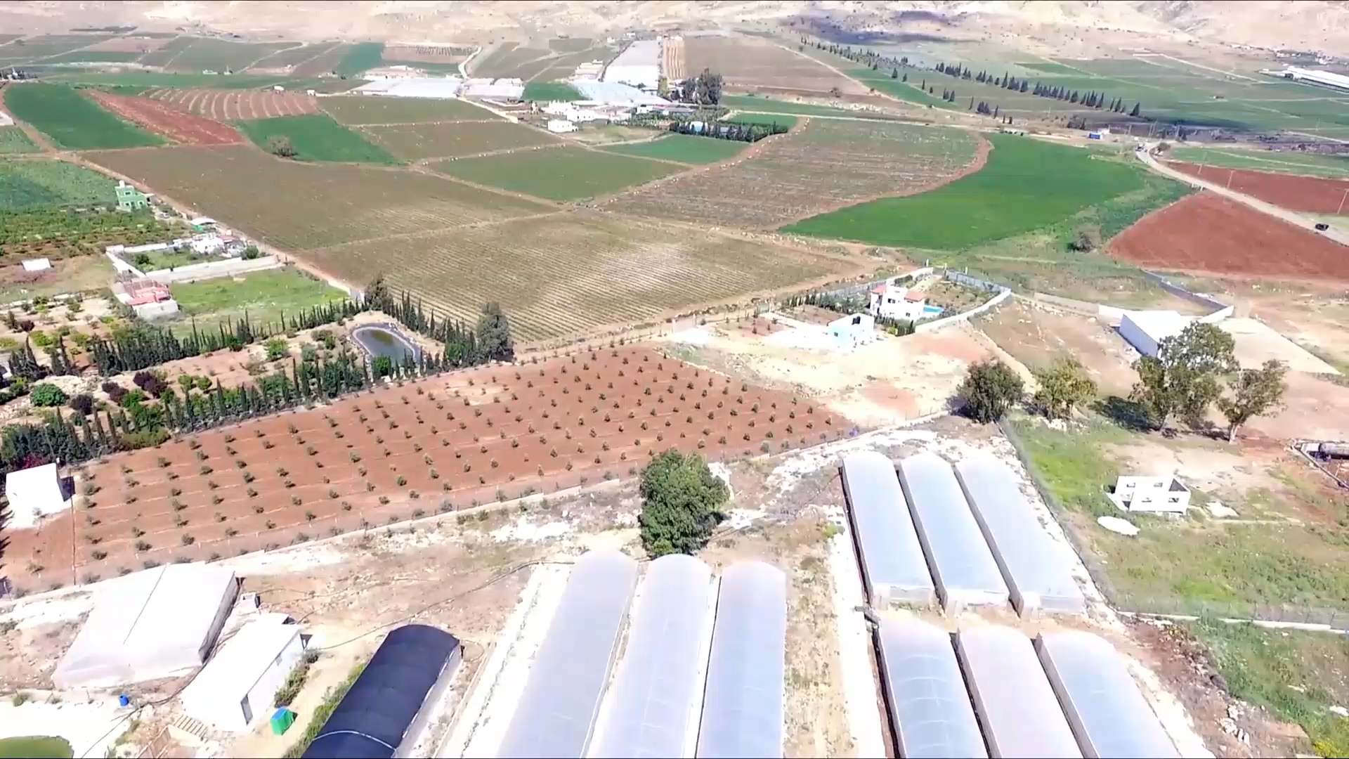

Slide 5
Methology
Our work consisted of three aspects:
Coding of operation
Coding of communication
Demo design

Slide 6

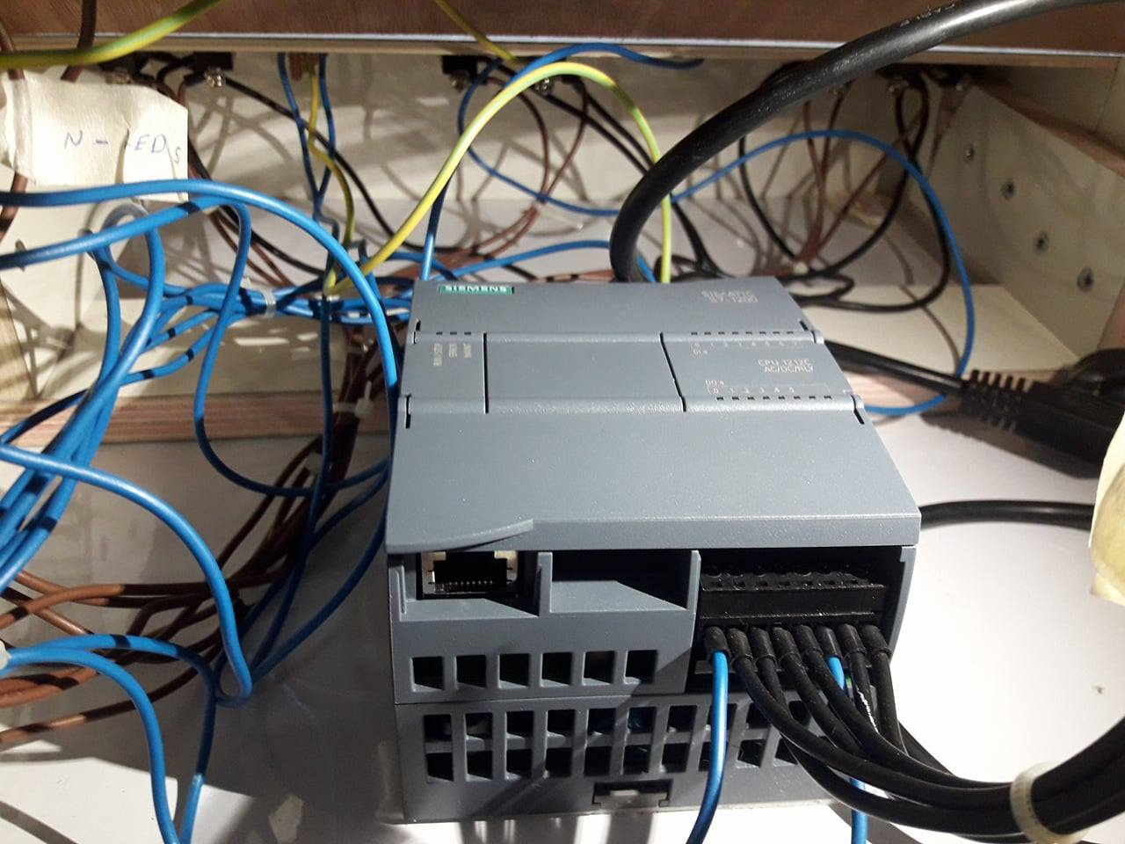
Coding of operation
The used PLC was Siemens s7 1212C AC/DC/RLY
We program the PLC to keep checking and comparing the values from the sensors with the values provided from the user.

Slide 7

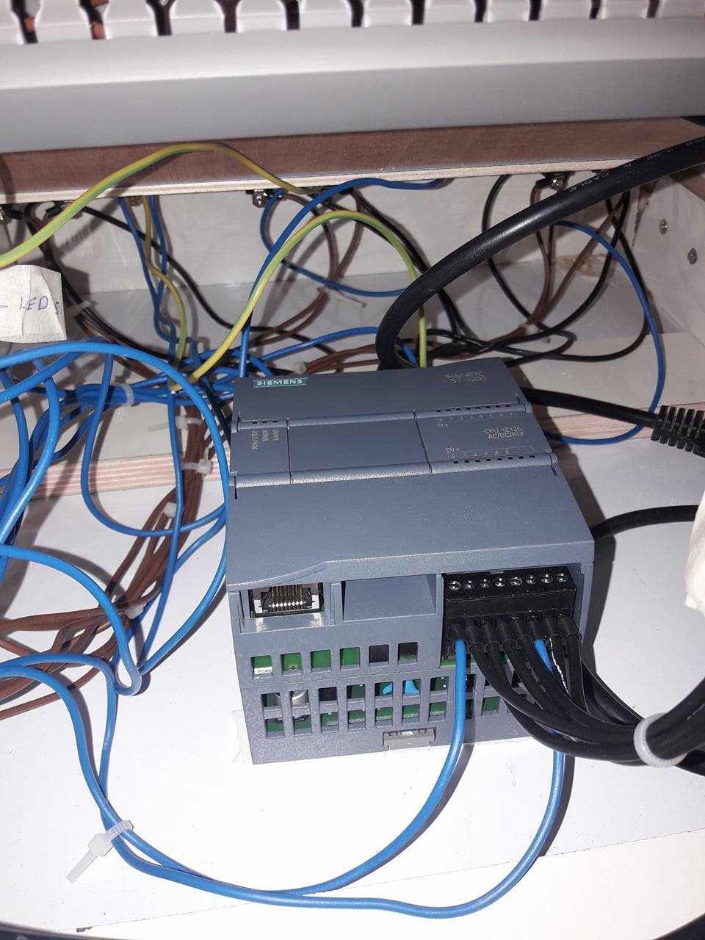
PLC
Why we used it ??
The used software TIA Portal

Slide 8
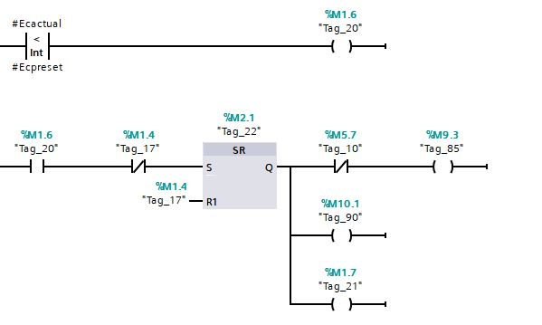
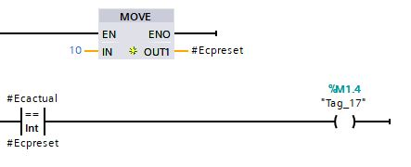
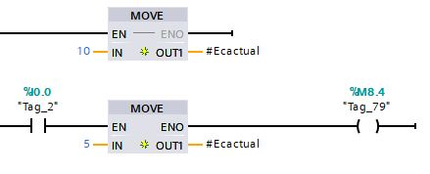

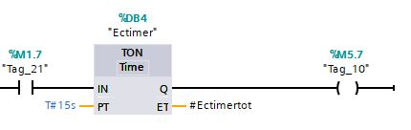
Code of digital inputs

Slide 9
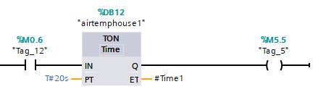
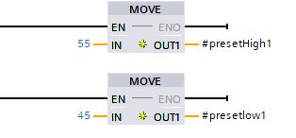
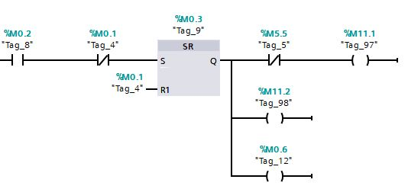
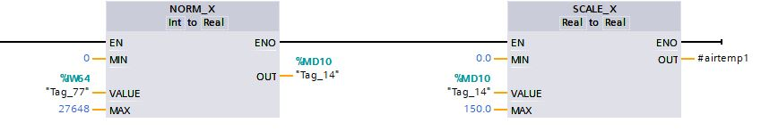
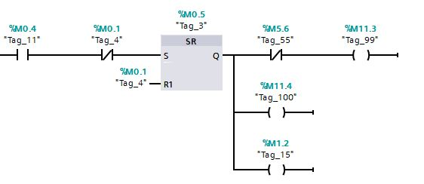
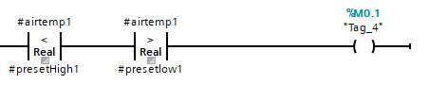

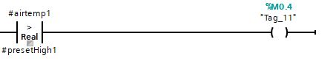
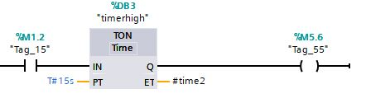
Code of analog inputs

Slide 10
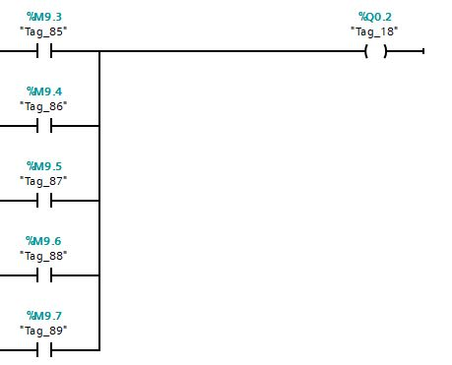
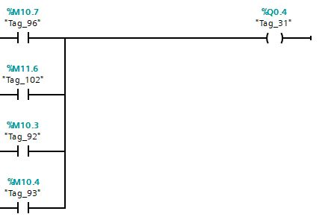
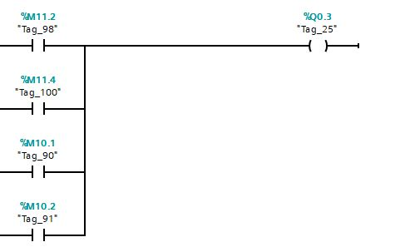
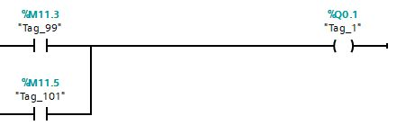
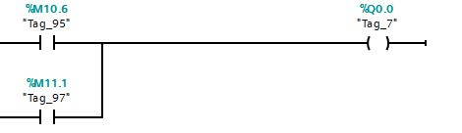
Outputs

Slide 11

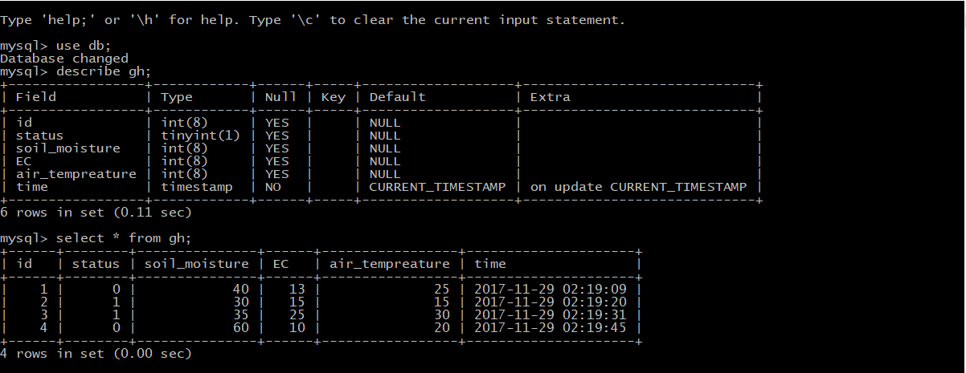
Database
We used MySQL database.
To store user’s commands.
To store the data from the PLC.

Slide 12
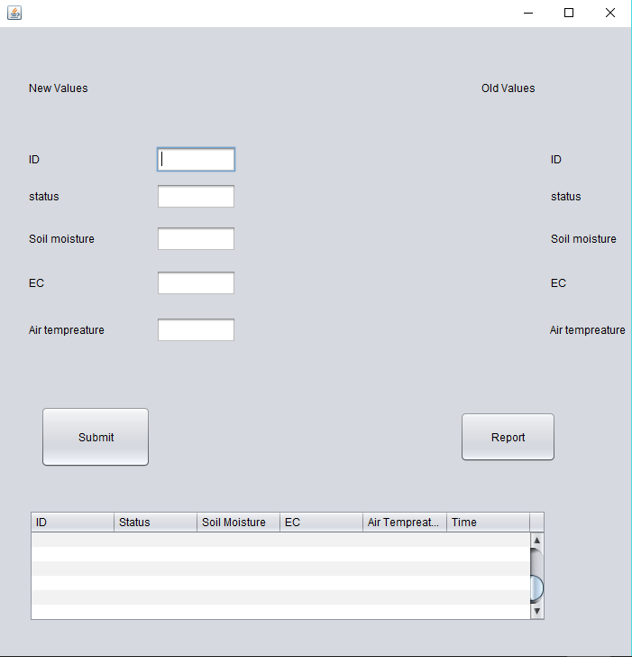
User interface
User friendly.
Allows the user to send and receive data.
Provide reporting functionality.

Slide 13
The code
private void jButton1ActionPerformed(java.awt.event.ActionEvent evt) {
try {
Class.forName("com.mysql.jdbc.Driver");
} catch (ClassNotFoundException ex) {
Logger.getLogger(NewJFrame.class.getName()).log(Level.SEVERE, null, ex);
}
String host="jdbc:mysql://localhost:3306/db";
String name="root";
String pass="1995";
Connection con =null;
try {
con = DriverManager.getConnection(host,name,pass);
} catch (SQLException ex) {
System.out.println( ex.getMessage( ) );
}
if ( con != null)
{ System.out.println("Successfully connected to MySQL database test"); }

Slide 14
catch (SQLException ex) {
Logger.getLogger(NewJFrame.class.getName()).log(Level.SEVERE, null, ex);
}
Statement stm = null ;
String query = " insert into gh (id,status,Soil_moisture,EC,air_tempreature)"
+ " values (?, ?,?,?,?)";
// create the mysql insert preparedstatement
PreparedStatement preparedStmt=null;
try {
preparedStmt = con.prepareStatement(query);
} catch (SQLException ex) {
Logger.getLogger(NewJFrame.class.getName()).log(Level.SEVERE, null, ex);
}
try {
preparedStmt.setInt(1,Integer.parseInt(jTextField2.getText()) );
} catch (SQLException ex) {
Logger.getLogger(NewJFrame.class.getName()).log(Level.SEVERE, null, ex);
}

Slide 15
Coding of communication
It was an integral part in making the system flexible and easily modified
Make the monitoring process easier
We have two connections between the UI and the database and between the UI and the PLC.

Slide 16
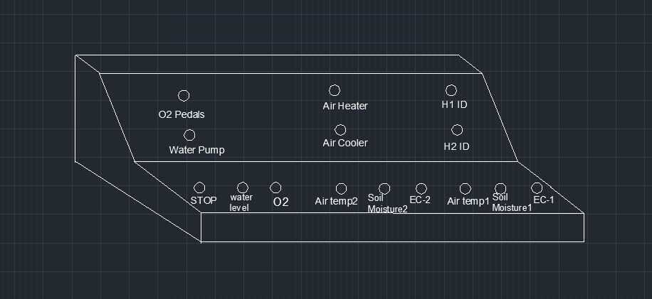
Design

Slide 17
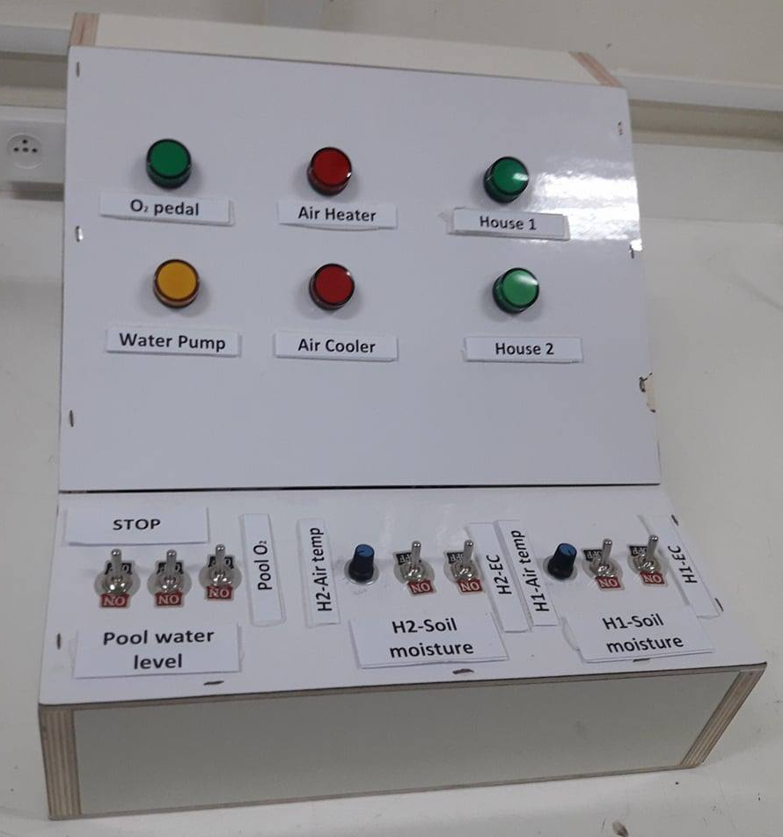
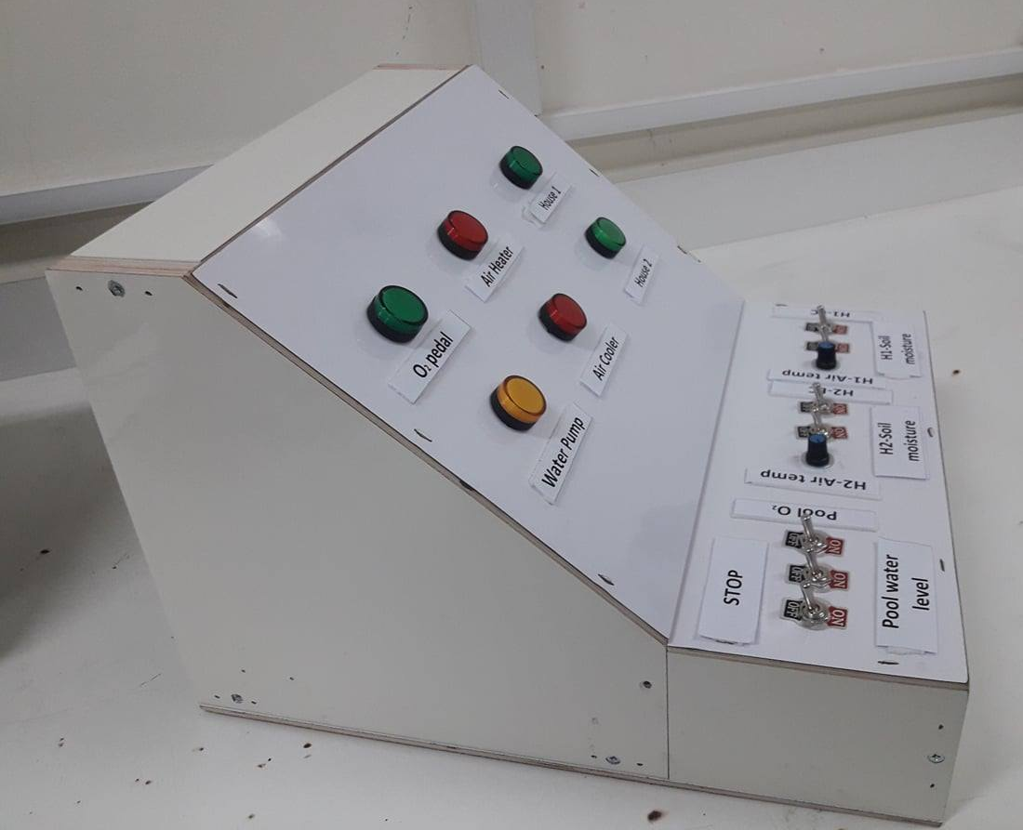
Demo design

Slide 18
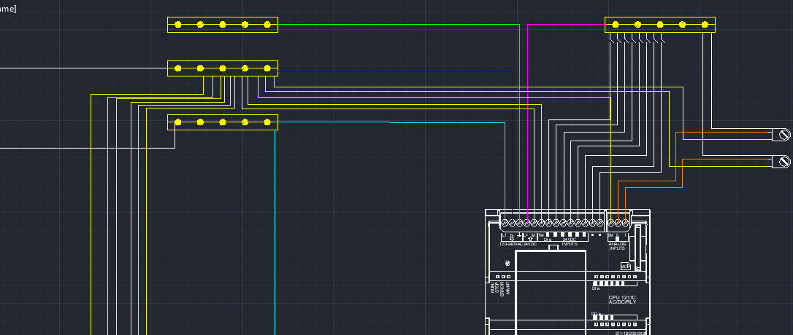
Wiring

Slide 19
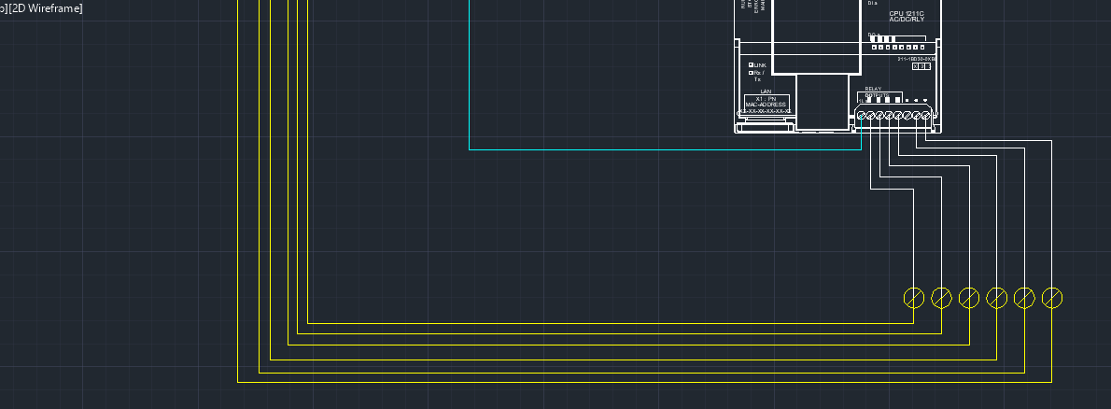

Slide 20
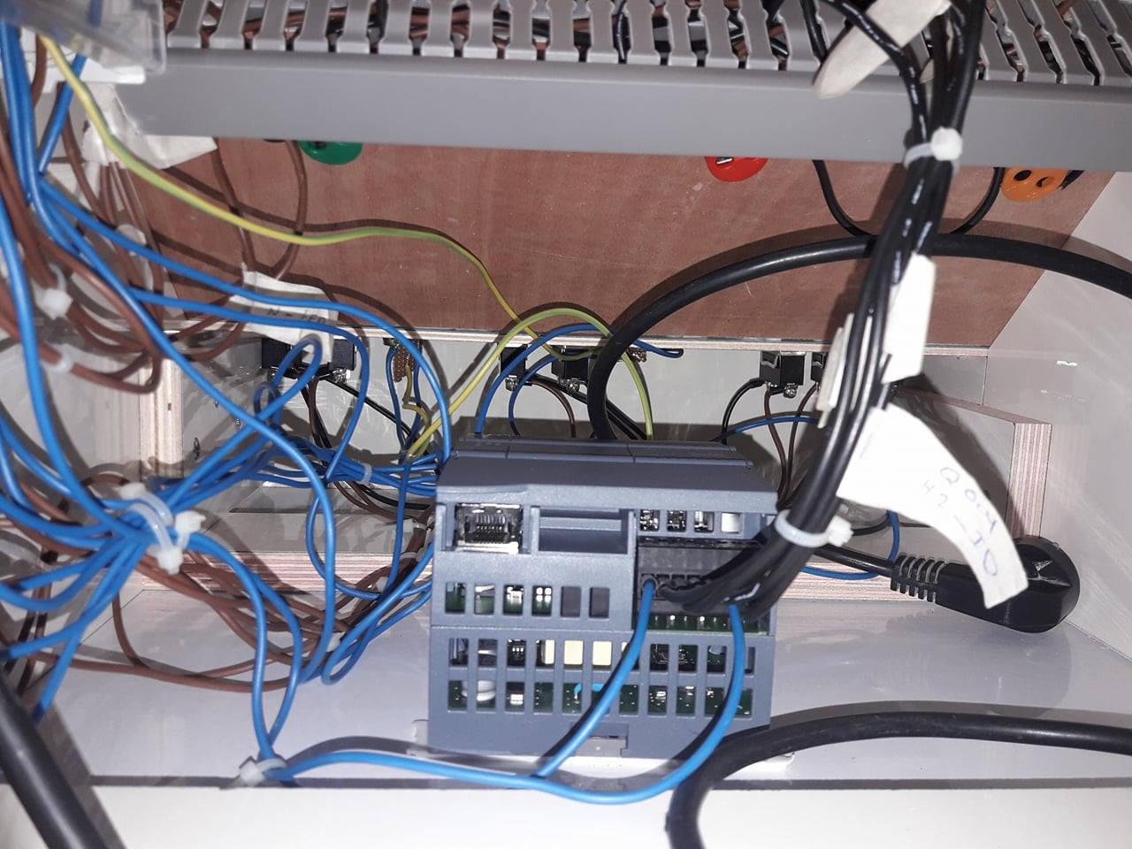
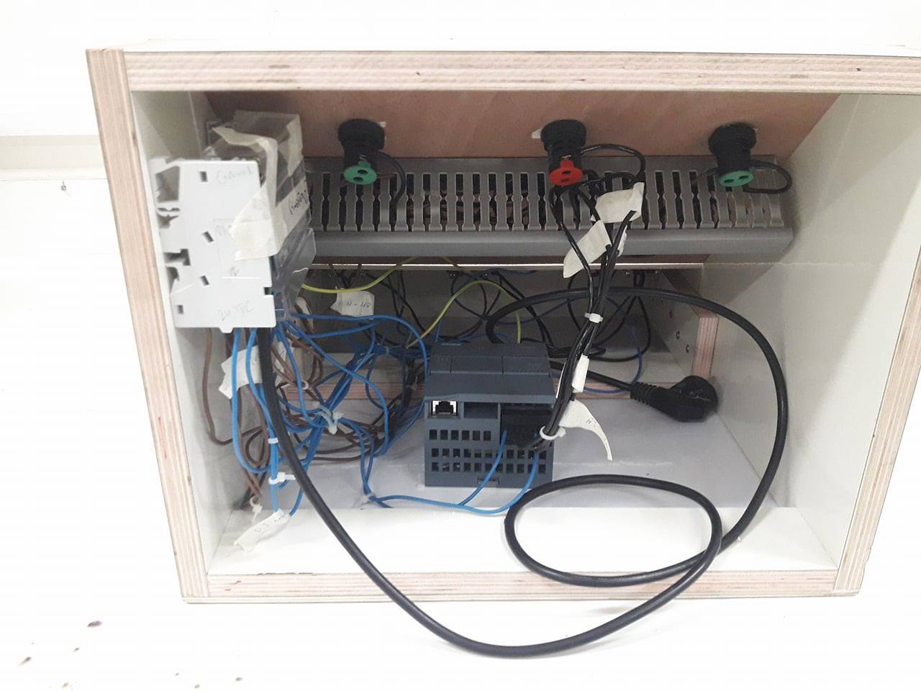

Slide 21
Final product
We made some changes to original for the sake of demonstration.
Our prototype was designed to consider the main issues.

Slide 22
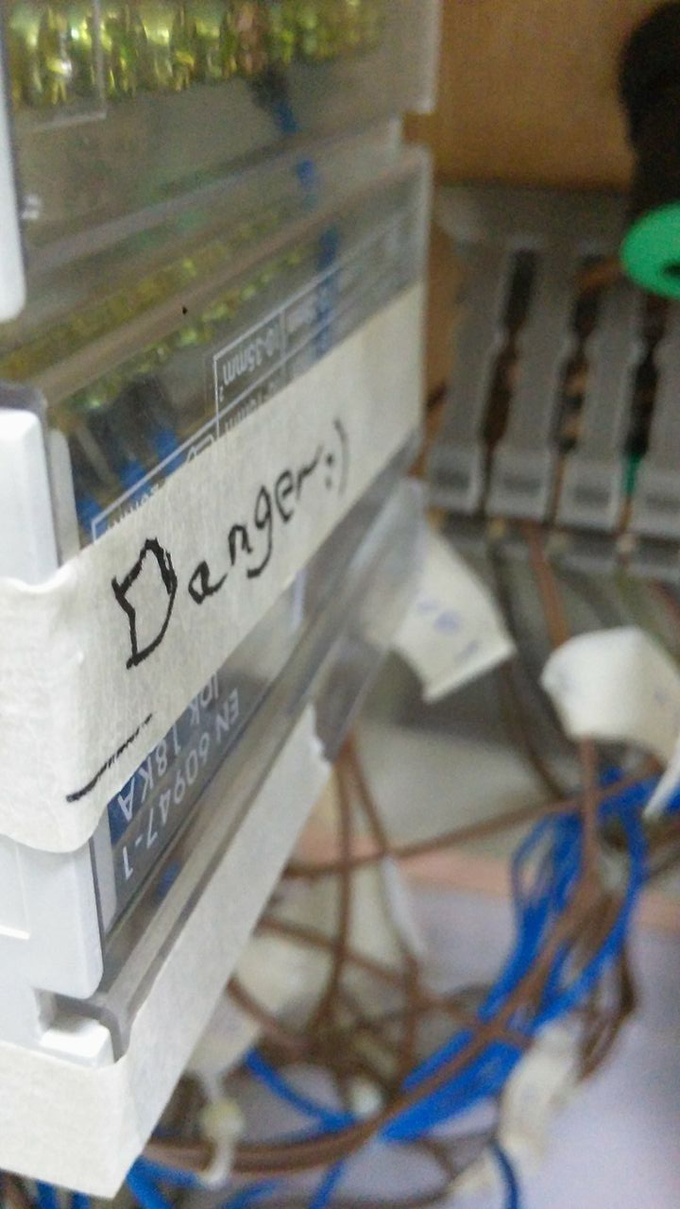
Limitations
The system is local and unreachable form other devices outside the farm.
In the presented prototype the effect of long distances was not considered.

Slide 23
Future work
Increase the relatability of the system.
Make it reachable from devices outside the farm.
Consider the long distances for data transmission.

Slide 24


Slide 25
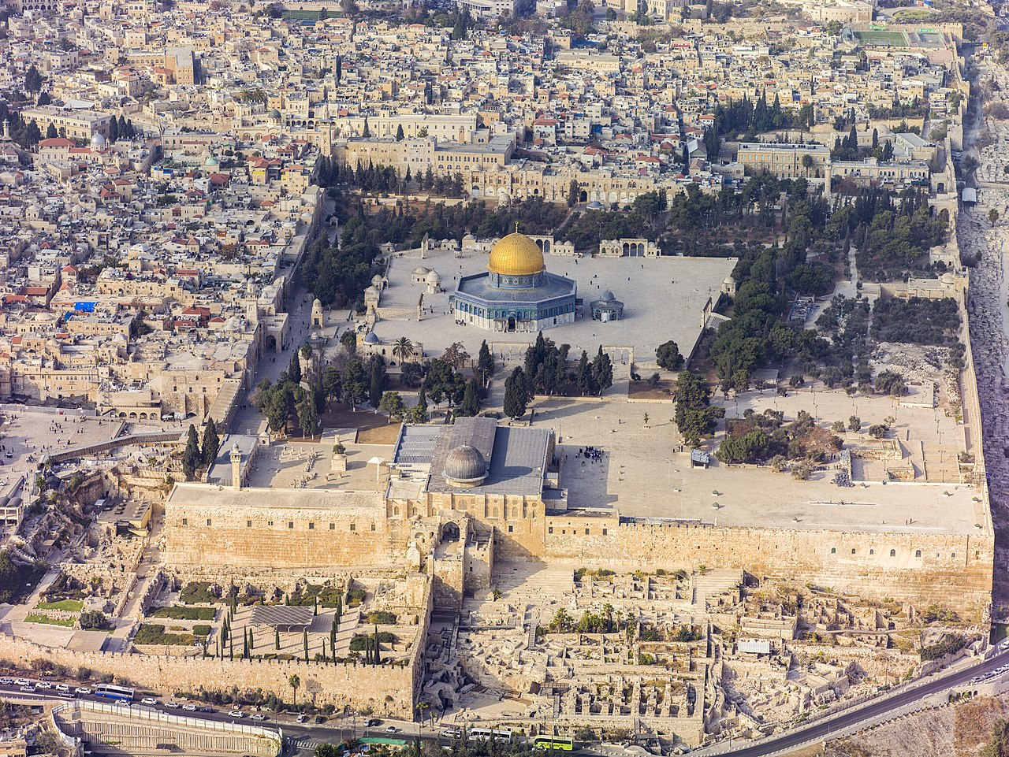
Questions??

