Slide 1


Prepared by:
Sameh Arabasi
Obada Natoor
Ayyash Essam
Supervisor:
Dr.Muhannad Haj Hussein
An-Najah National University
Faculty of Engineering
Building Engineering Department
Graduation project 2
(An Integrated Design For Nablus Municipality)

Slide 2
2
Contents:
Architectural Aspects
Environmental Aspects
Structural Aspects
Quantity Surveying & Cost Estimate
Mechanical aspects
Electrical aspects

Slide 3
3
Contents:
Architectural Aspects
Environmental Aspects
Structural Aspects
Quantity Surveying & Cost Estimate
Mechanical aspects
Electrical aspects

Slide 4
4
Architectural Aspects
Introduction
Site analysis
Architectural modifications

Slide 5
5
Architectural Aspects
Introduction
Site analysis
Architectural modifications

Slide 6
6
Architectural Aspects
Introduction
Site analysis
Architectural modifications

Slide 7
7
Architectural Aspects
Introduction
Site analysis
Architectural modifications

Slide 8
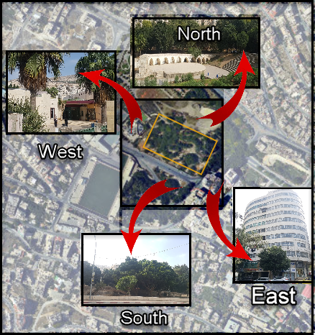
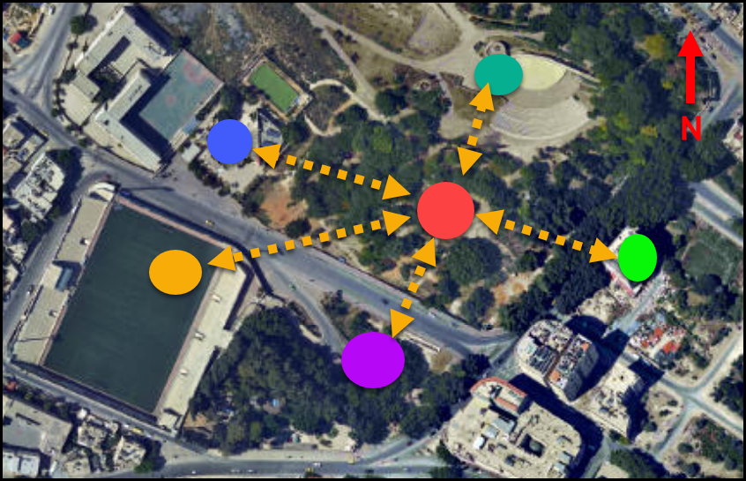
Adjacent Building:
8
Keys Plan for figure:
Nablus Municipality
( proposed location )
Nablus Mall
Roman amphitheater
Nablus International Stadium
Green area
Cultural Center - Hamdi Mango

Slide 9
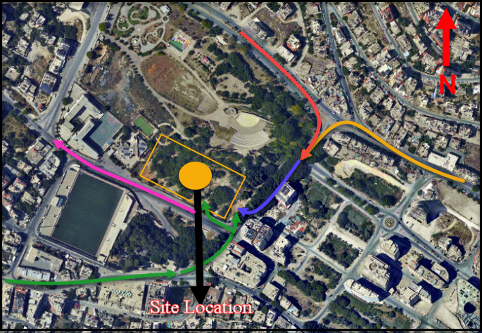
Accessibility:
9
Keys Plan for figure:
Haifa road
Ameer Muhamad street
Al kfair street
King fisal street
Jafffa street

Slide 10
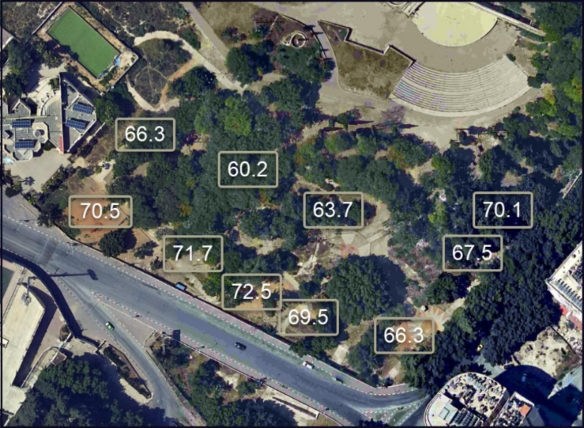


Noise level:
10
Noise level in site from surroundings
At 8:00 AM
At 12:00 PM
At 3:00 PM

Slide 11
11
Architectural Aspects
Introduction:
Site analysis
Architectural modifications

Slide 12
12
Architectural Aspects
Introduction:
Site analysis
Architectural modifications

Slide 13
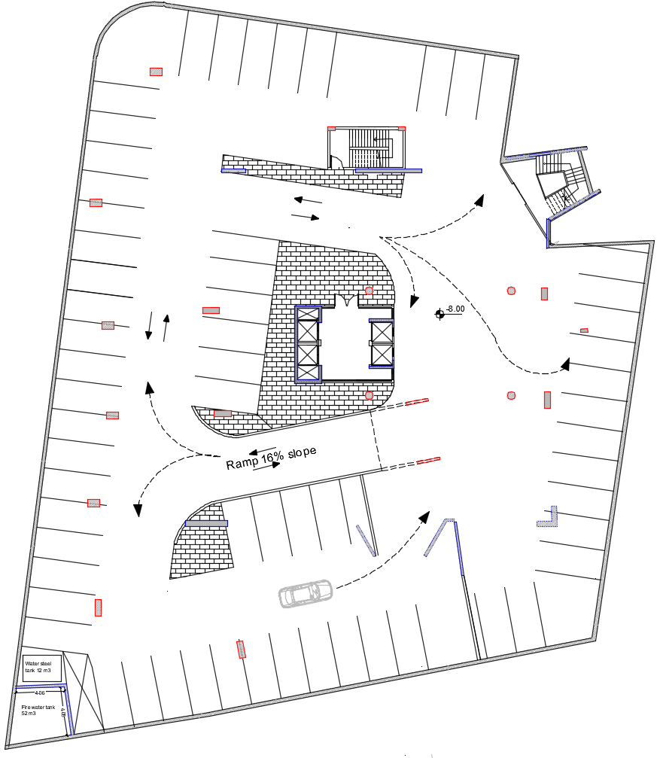
Parking
13
N
After modification
The add second basement floor
with 56 car parking

Slide 14
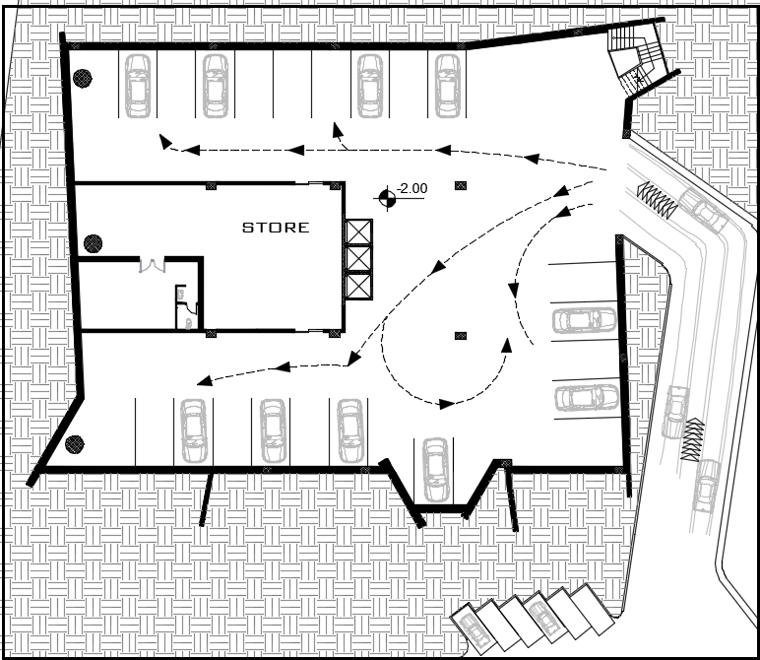
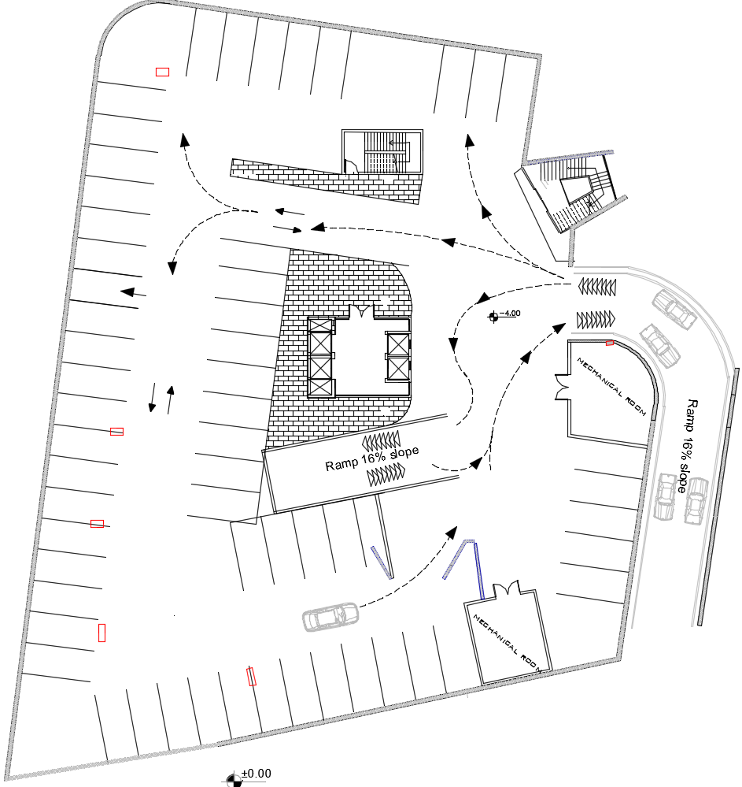
Parking
14
First basement before modification
24 car parking
First basement after modification
54 car parking
N
N

Slide 15
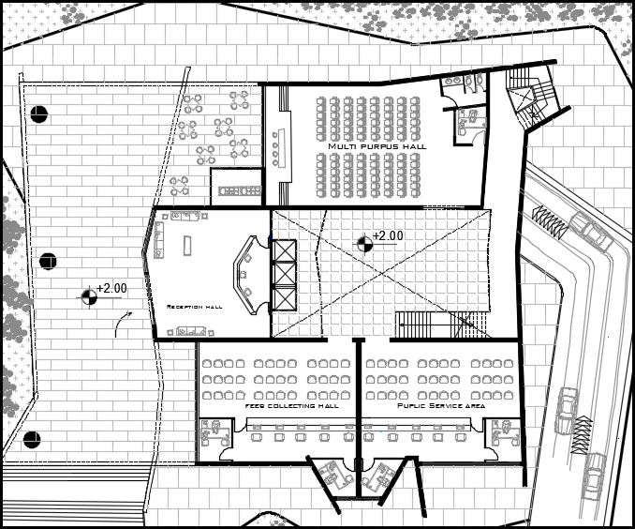
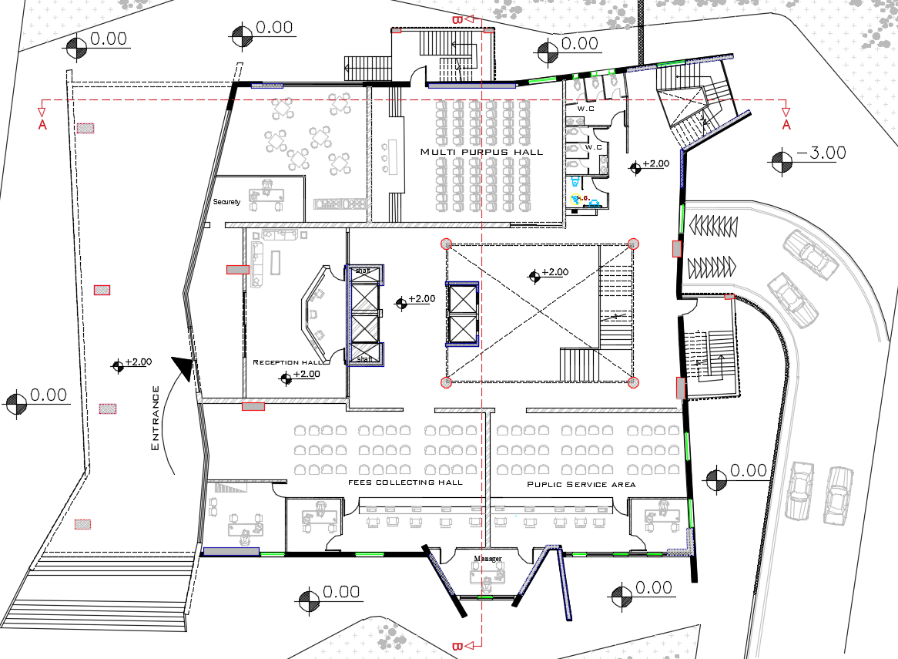
Ground floor
15
Ground floor after modification
Ground floor before modification
N
N

Slide 16
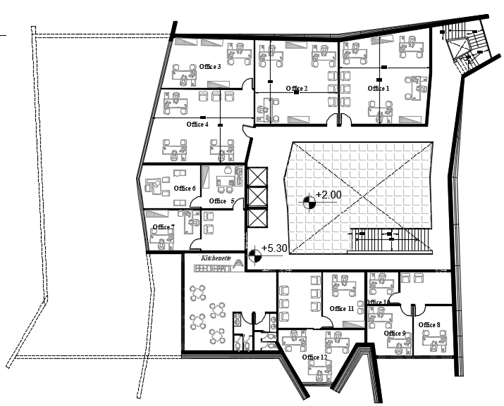
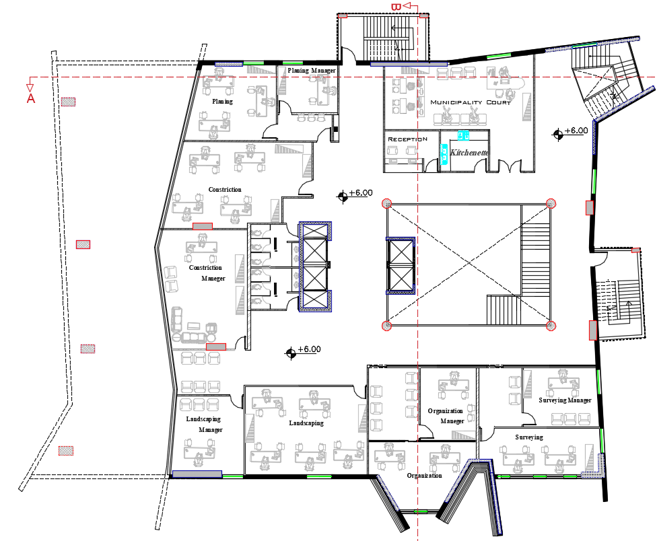
First floor
16
First floor before modification
First floor after modification
N
N

Slide 17
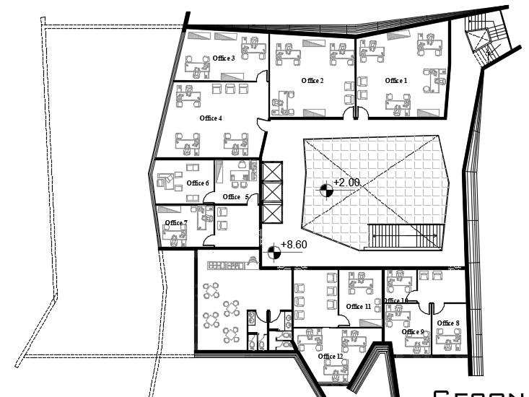
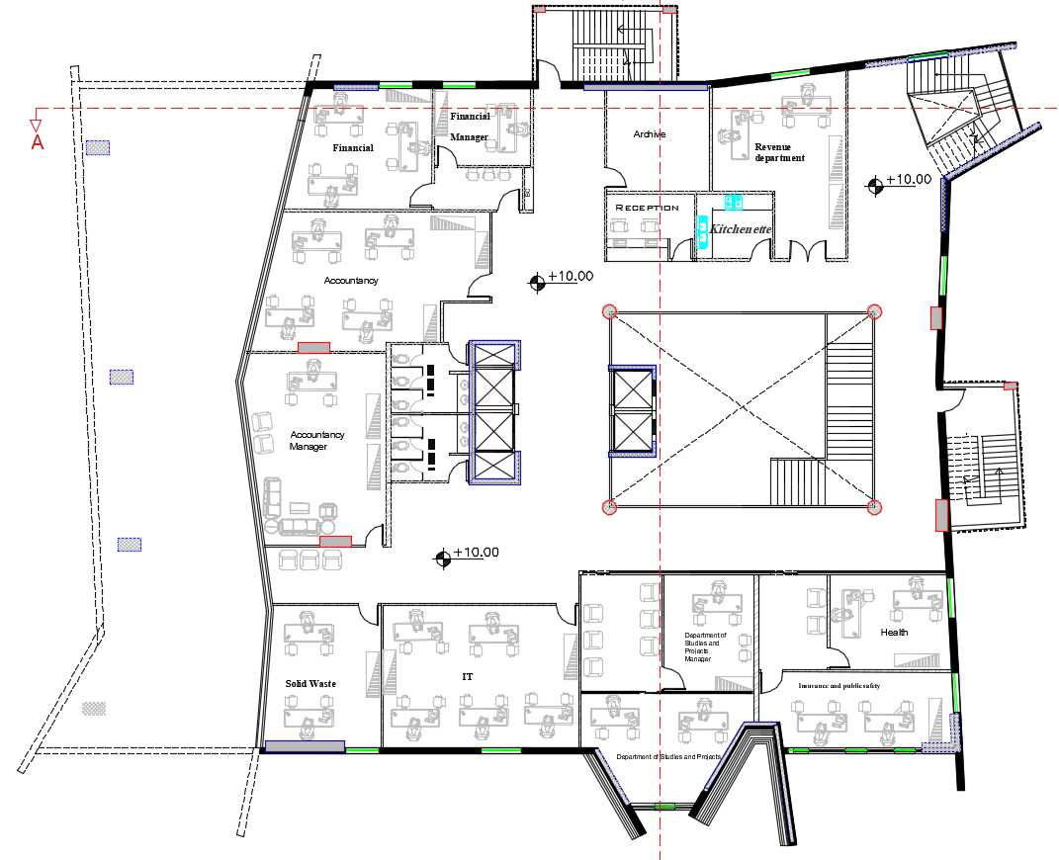
Second floor
17
Second floor before modification
Second floor after modification
N
N

Slide 18
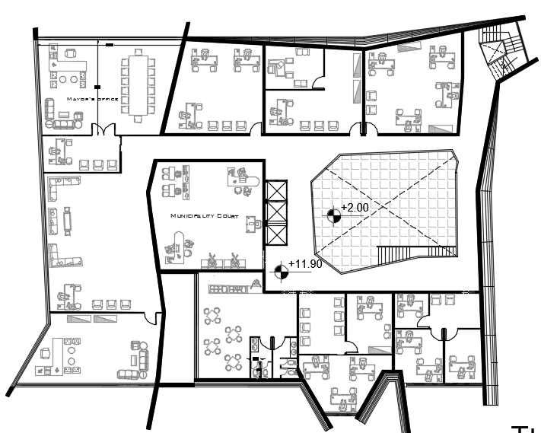
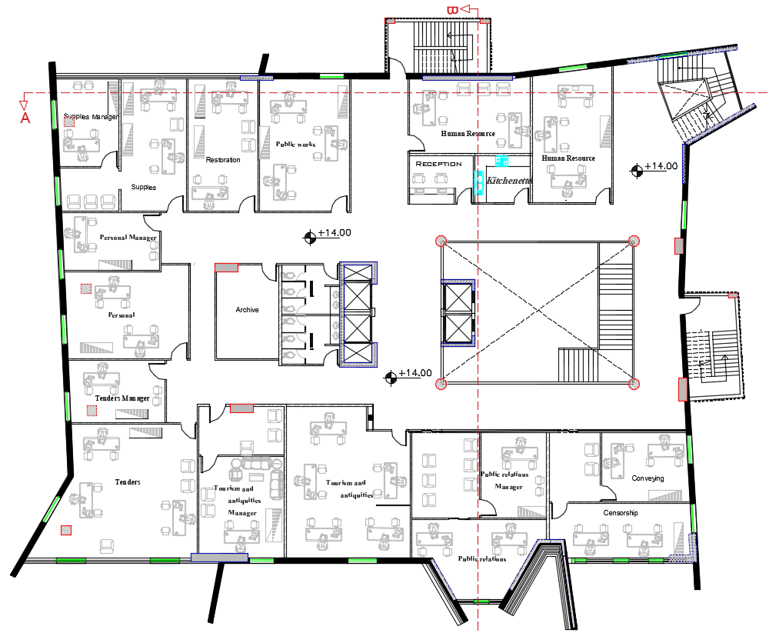
Third floor
18
Third floor before modification
Third floor after modification
N
N

Slide 19
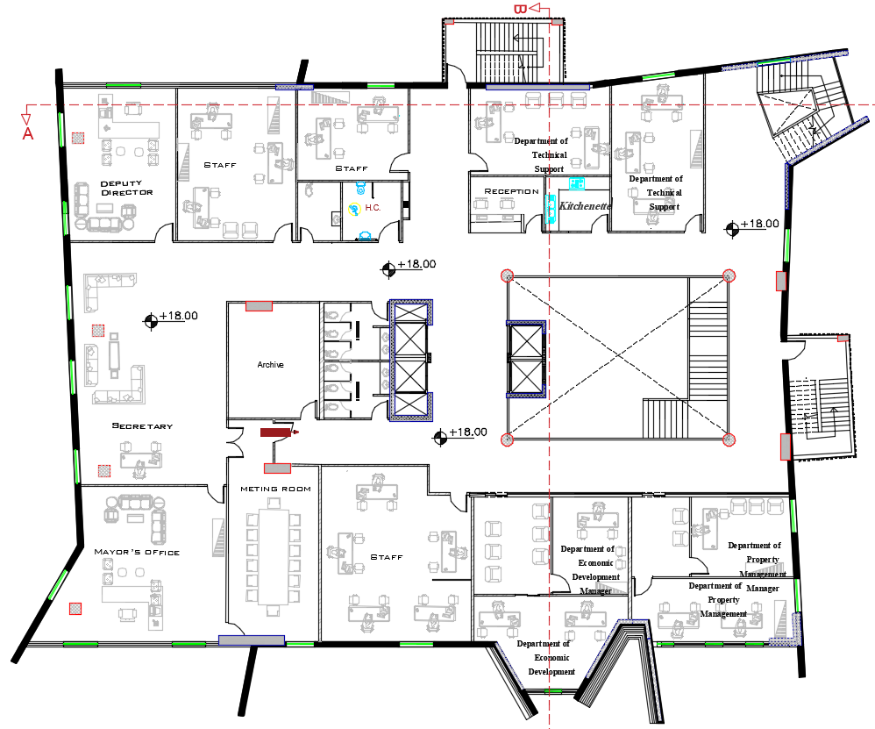
Fourth floor
19
Fourth floor after modification
N

Slide 20
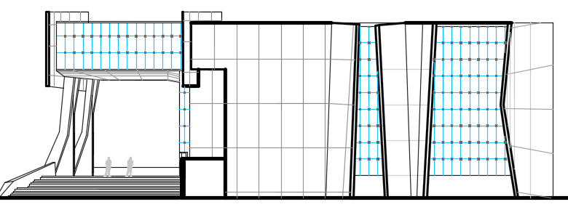
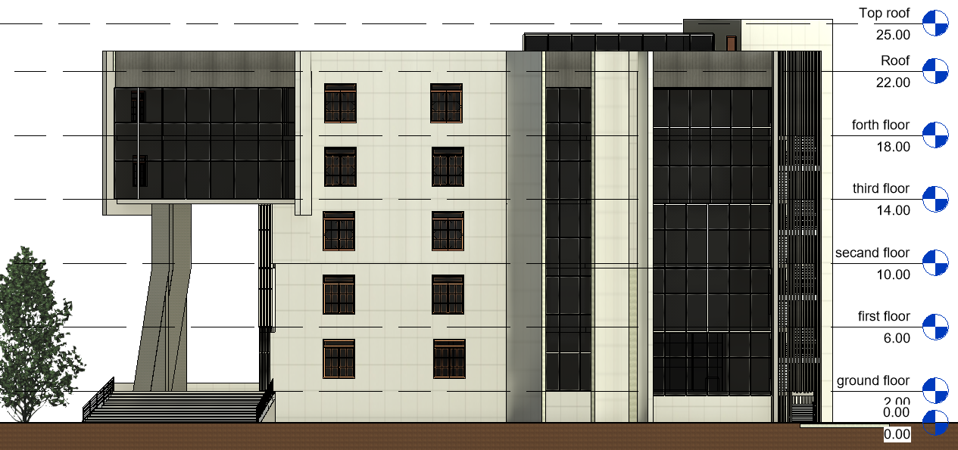
South elevation
20
Before modification
After modification

Slide 21
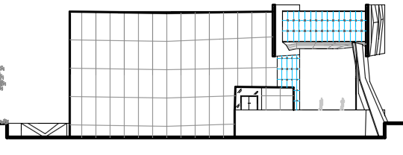
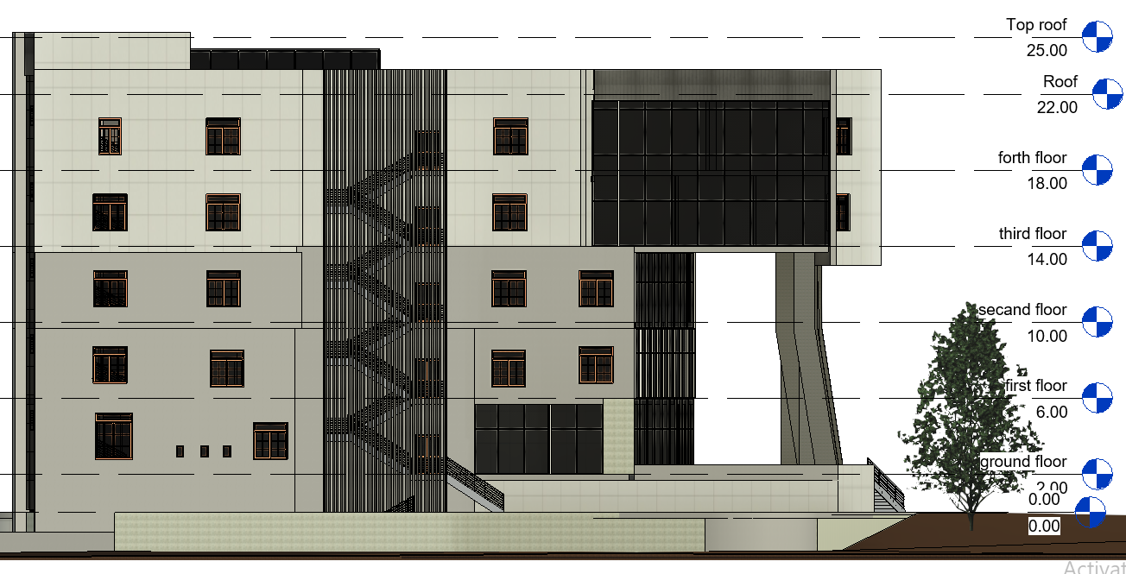
North elevation
21
Before modification
After modification

Slide 22
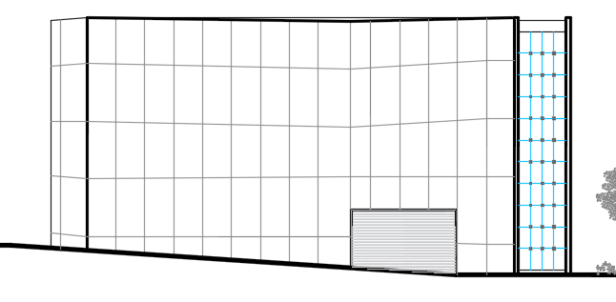
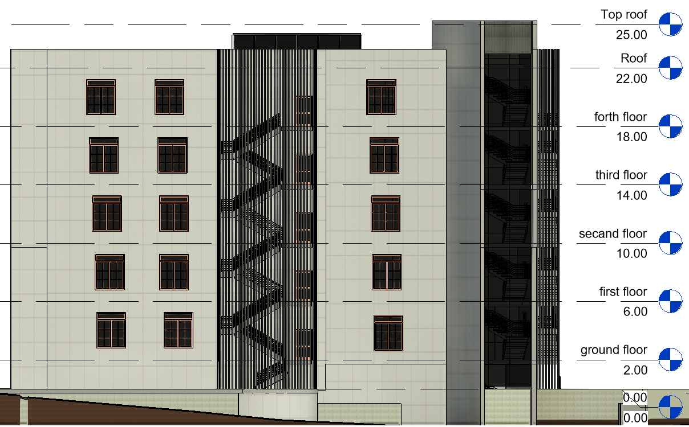
East elevation
22
Before modification
After modification

Slide 23
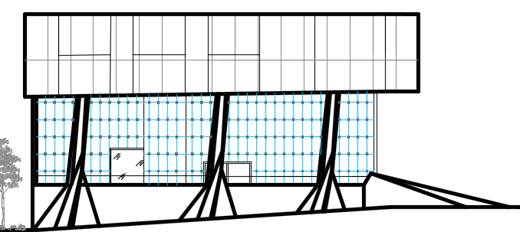
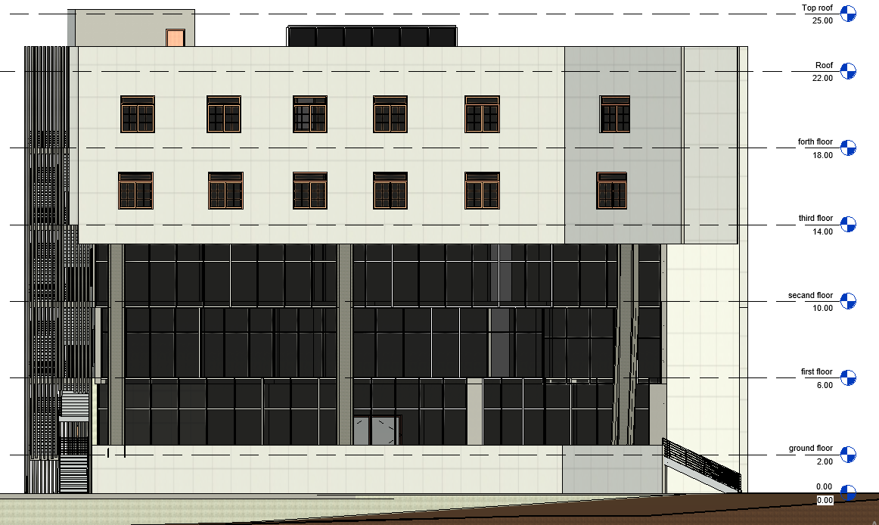
West elevation
23
Before modification
After modification

Slide 24
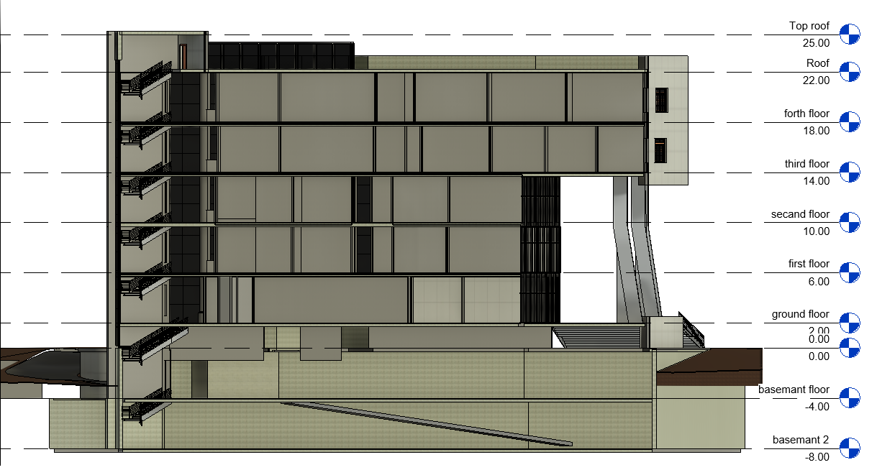
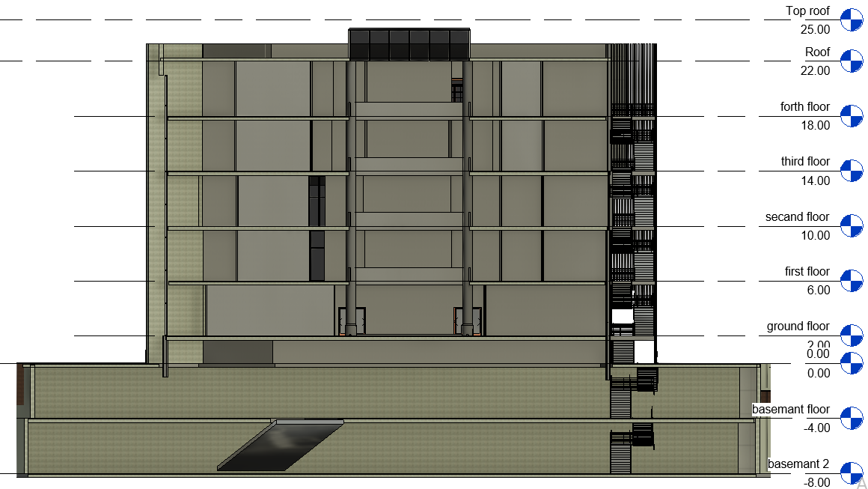
Sections
24

Slide 25
Summary
25
In this part, the areas of each type of room used in the building were compared with the special standards to get an impression of the spaces that have been modified and their compatibility with other approved projects.
space area summary
Conclusion | Project after modification (m²) | Case study (m²) | Standard (m²) | Space Type
We are within standards, this room is ok | 165.3 | 72 | 74. 8 | Multipurpose room
This room is ok | 92.3 | 33.87 | 34 | reception hall
This room is ok | 116 | 36.77 | 40 | Fees collecting hall
This room is ok | 115 | 34.94 | 40 | public room

Slide 26
26
space area summary
Conclusion | Project after modification (m²) | Case study m²)) | Standard m²)) | Space Type
We have a problem with only one of the offices and its area is 8.7 m2 | 8-22 | 8-11 | 14.45 | Offices for one employee
All within standards | 18-37 | 8-15 | 18.5 | Offices for two employees
Offices are ok | 28-60 | 11.36 | 22.5 | Offices for three employees
Ok | 67.3 | 11-16 | 22.5 | Offices for four employees
ok | 14-21 | 12.35 | 10 | Waiting rooms
ok | 8.3 | 5 | 7 | Kitchenette
ok | 1.26 | 1.55 | 1.23 | Bathrooms
Conclusion | Project after modification (m²) | Case study (m²) | Standard (m²) | Space type
ok | 92.4 | 20.26 | 36.42 | Mayor’s office
ok | 2.7 *4.7 | ---- | 4. 5 * 2.25(m) | Parking
So big | 142 | 5 | 10-15 | store
ok | 2m | 1.44 | 1.2m (width) | Corridors

Slide 27
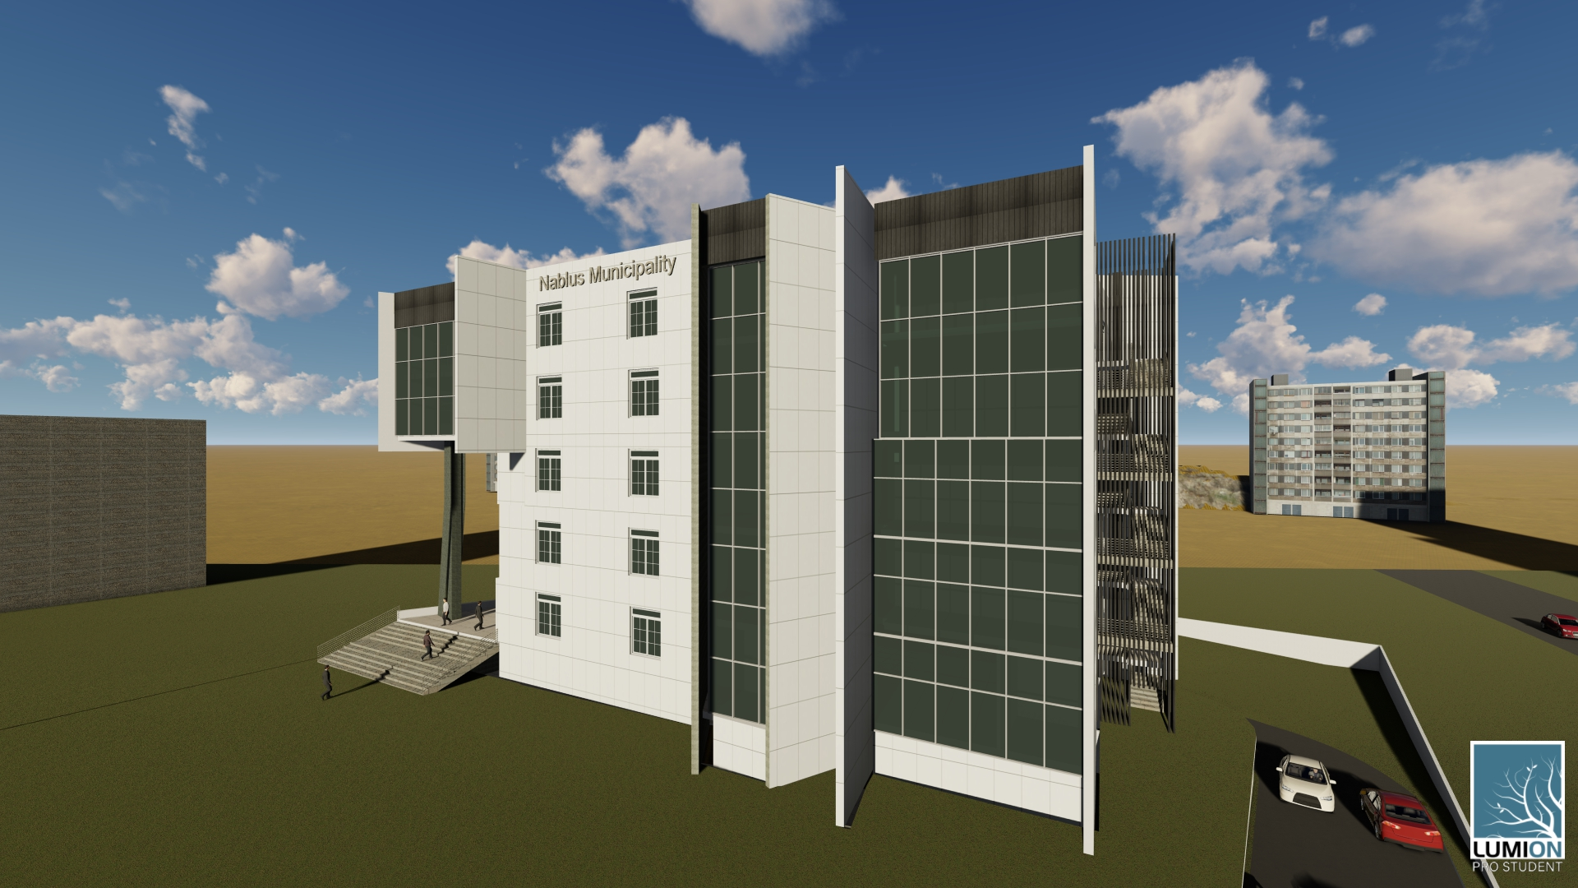
27

Slide 28
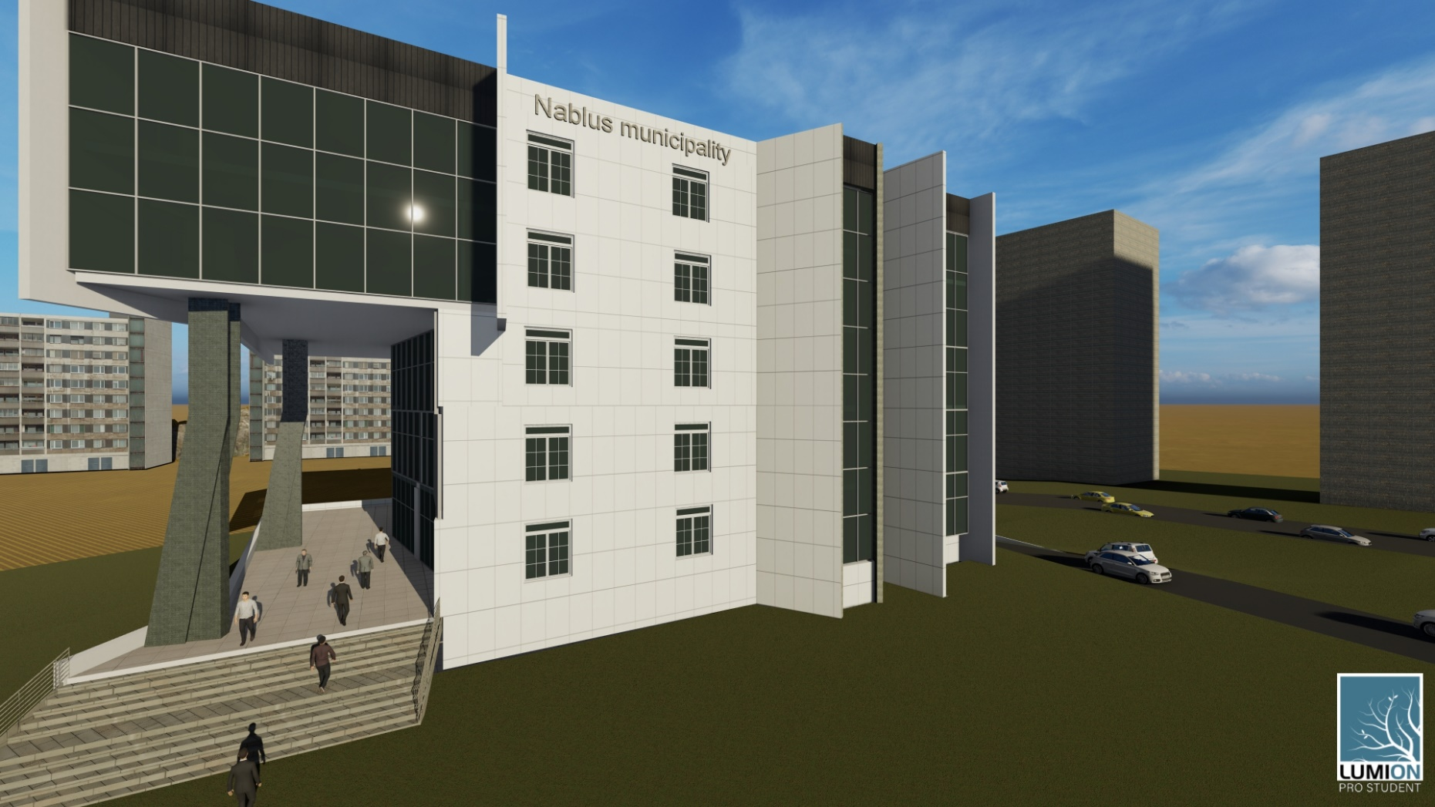

Slide 29
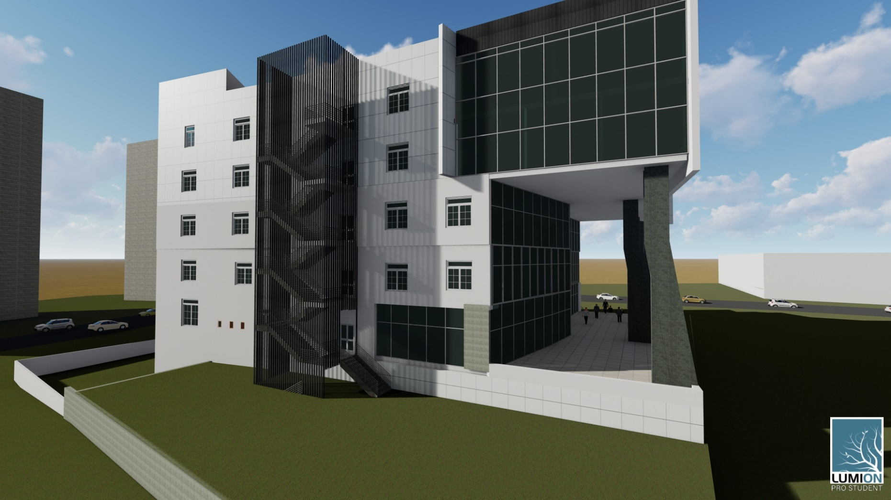

Slide 30
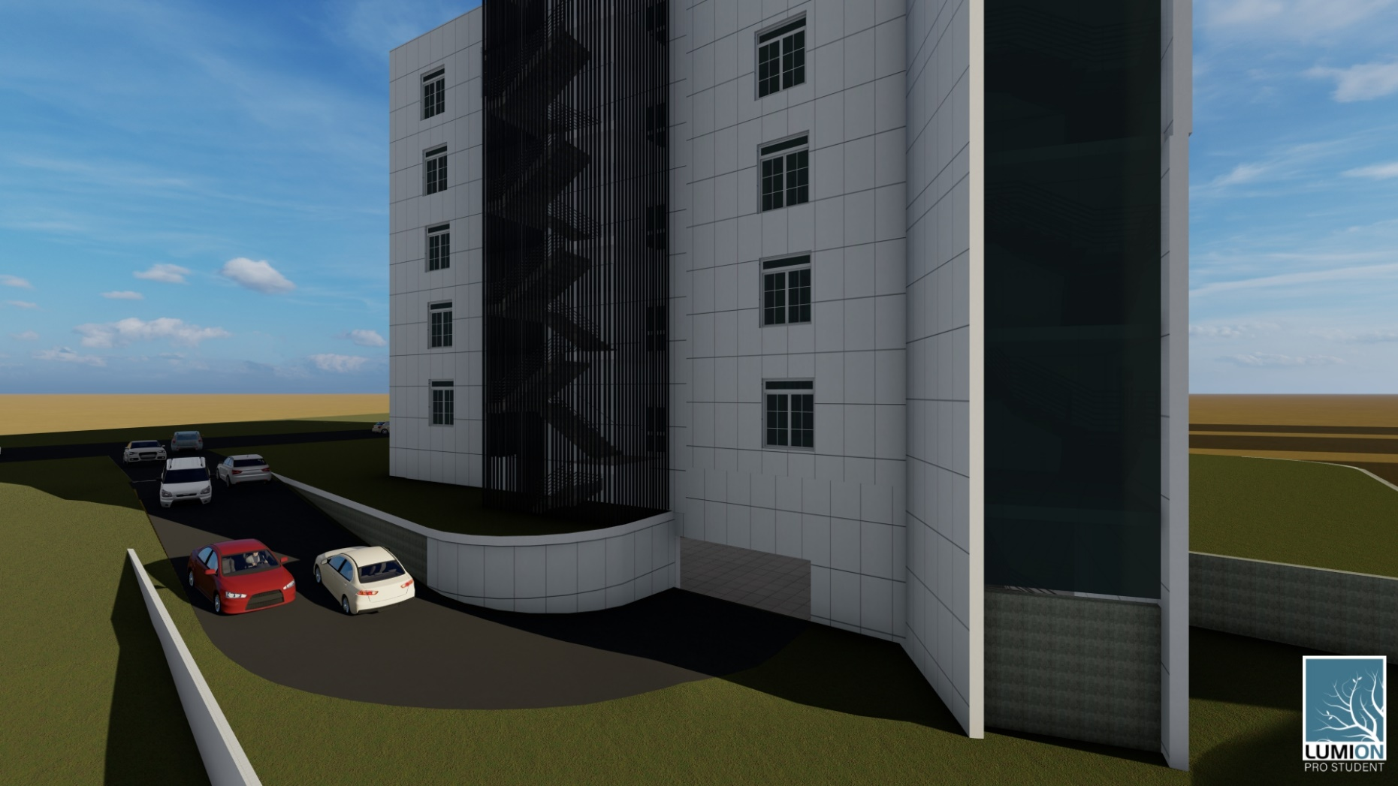

Slide 31
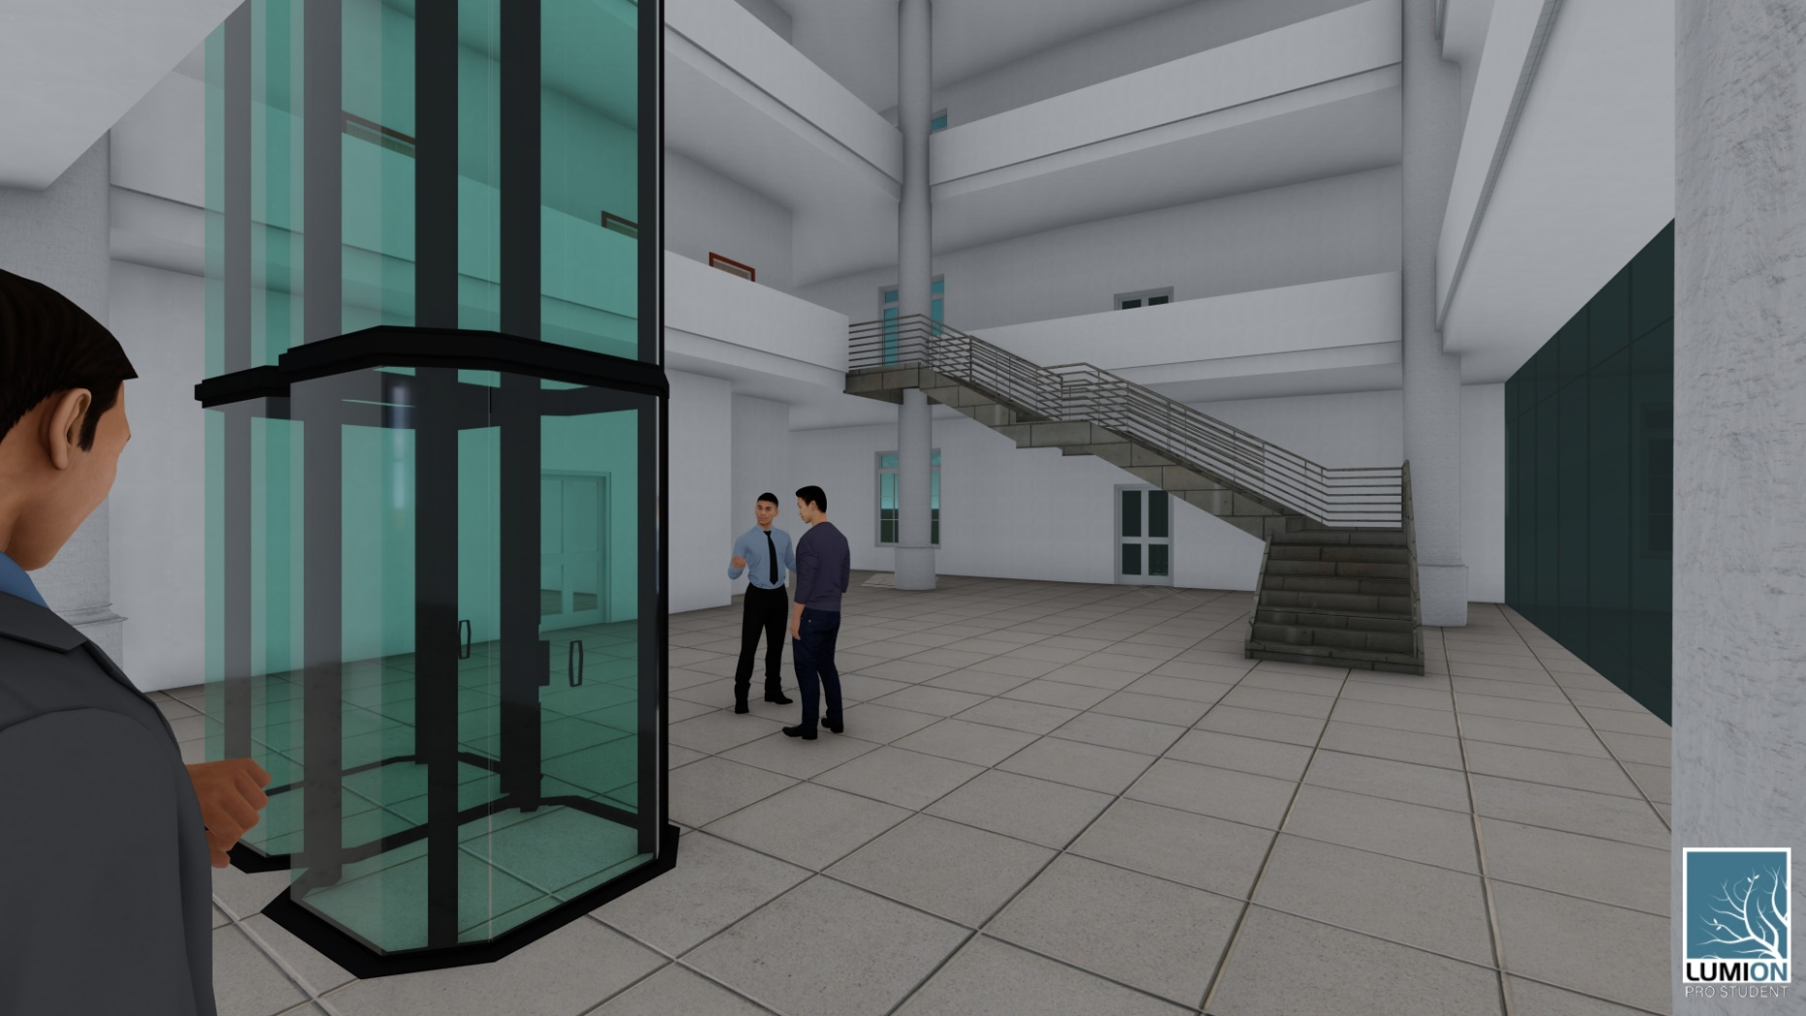

Slide 32
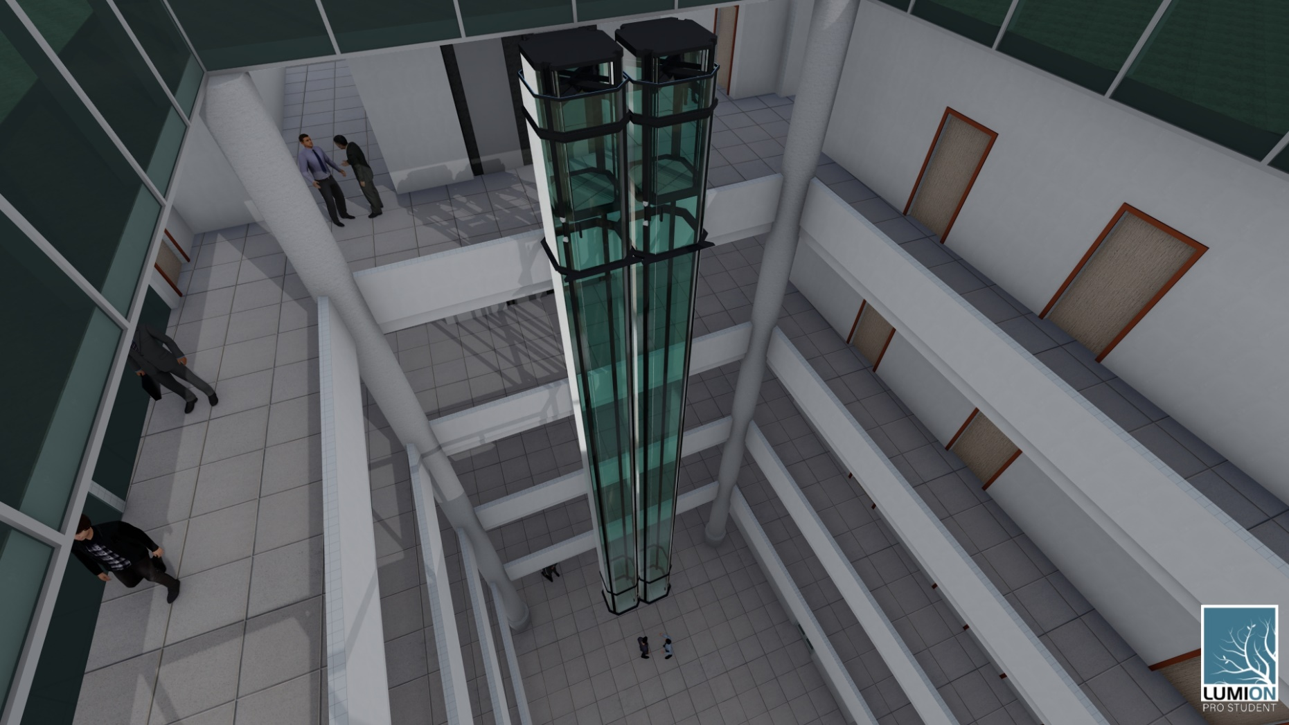

Slide 33
33
Contents:
Architectural Aspects
Environmental Aspects
Structural Aspects
Quantity Surveying & Cost Estimate
Mechanical aspects
Electrical aspects

Slide 34
34
Contents:
Architectural Aspects
Environmental Aspects
Structural Aspects
Quantity Surveying & Cost Estimate
Mechanical aspects
Electrical aspects

Slide 35
35
Structural aspects:
Structural concept and code
Preliminary Design
Checks
Materials and loads
Sections modifier
Elements design

Slide 36
36
Structural aspects:
Structural concept and code
Preliminary Design
Checks
Materials and loads
Sections modifier
Elements design

Slide 37
Structural concept and code
37
Structural concept
The concrete reinforcement system was used in this project with with the Two Way U-boat system and large spans and the structure designed for seismic resistance Building frame system type.
Code:
ACI 318-14 for design
ASCE 7-16 for load design
UBC 97 code for seismic design
Load combinations for gravity loads
ASCE 7-16, Section 2.3.1, provide equations to calculate Service and ultimate gravity load as shown in below equations.
Service = 1.0D + 1.0L
Ultimate U1 = 1.2D + 1.6L
Ultimate U2 = 1.4D

Slide 38
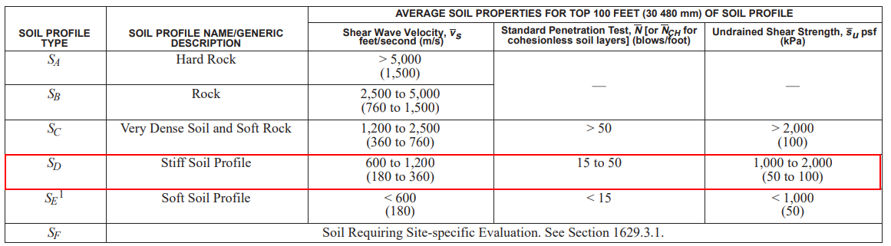
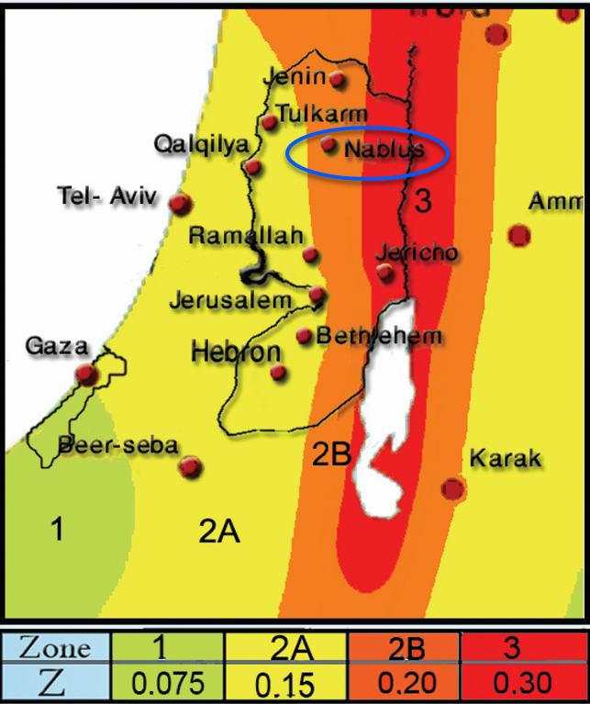
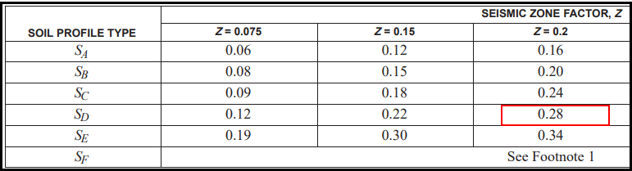
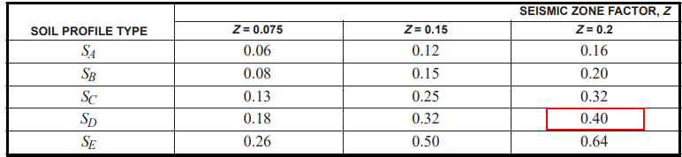
38
seismic design characteristics:
Soil properties
According to UBC 97 code and seismic maps of Palestine was used characteristics used in seismic design
Seismic coefficient Ca
Seismic coefficient Cv
Z-value
Summary of characteristics
Name | R | I | Soil profile | Z zone 2B | Cv | Ca
Value | 5.5 | 1.25 | S_{D} | 0.20 | 0.4 | 0.28

Slide 39
39
    Combination for seismic loads
According to UBC97 code we have ultimate and service equations for seismic forces as show:
Ultimate equation is:
→1.4D
→1.2D+1.6L
→1.34D+L+EQx+0.3EQy
→1.34D+L+0.3EQx+EQy
→0.76 D+EQx+0.3EQy
→0.76 D+0.3EQx+EQy
service equation is:
→D
→D+0.714EQx+0.214EQy
→D+0.214EQx+0.714EQy
→0.9D+0.714EQx+0.214EQy
→0.9D+0.214EQx+0.714EQy
→D+0.75L+0.54EQx+0.16EQy
→D+0.75L+0.16EQx+0.54EQy

Slide 40
40
Structural aspects:
Structural concept and code
Preliminary Design
Checks
Materials and loads
Sections modifier
Elements design

Slide 41
41
Structural aspects:
Structural concept and code
Preliminary Design
Checks
Materials and loads
Sections modifier
Elements design

Slide 42
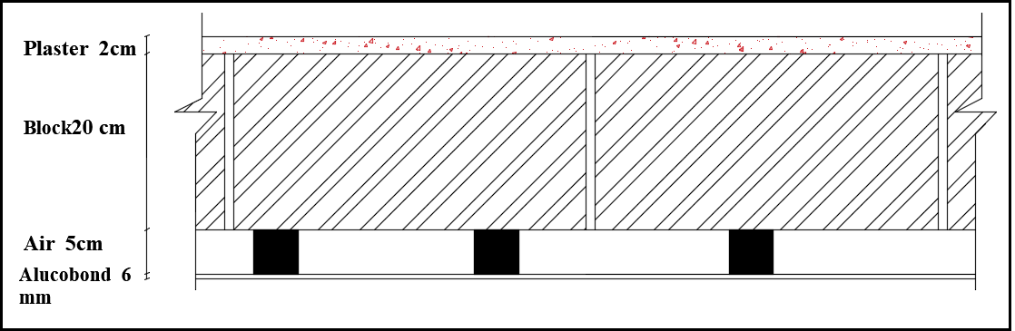
Materials and loads
42
Concrete compressive strength
Modula's of elasticity (E) | concrete Type Fc | Structure type
26587.2 | 32 MPa | Slab
26587.2 | 32MPa | Column
26587.2 | 32MPa | Shear wall
Then the concrete Density = 2500 Kg/m³
And for reinforcement steel
Density = 7800 Kg/m³
Fy = 420 Mpa
Load of external walls:
Take load of external wall 10 KN/m.
Live load =5 KN/m² for all spaces in the building.
Super dead load (SID) = 4 KN/m²
Horizontal Section in wall

Slide 43
43
Structural aspects:
Structural concept and code
Preliminary Design
Checks
Materials and loads
Sections modifier
Elements design

Slide 44
44
Structural aspects:
Structural concept and code
Preliminary Design
Checks
Materials and loads
Sections modifier
Elements design

Slide 45
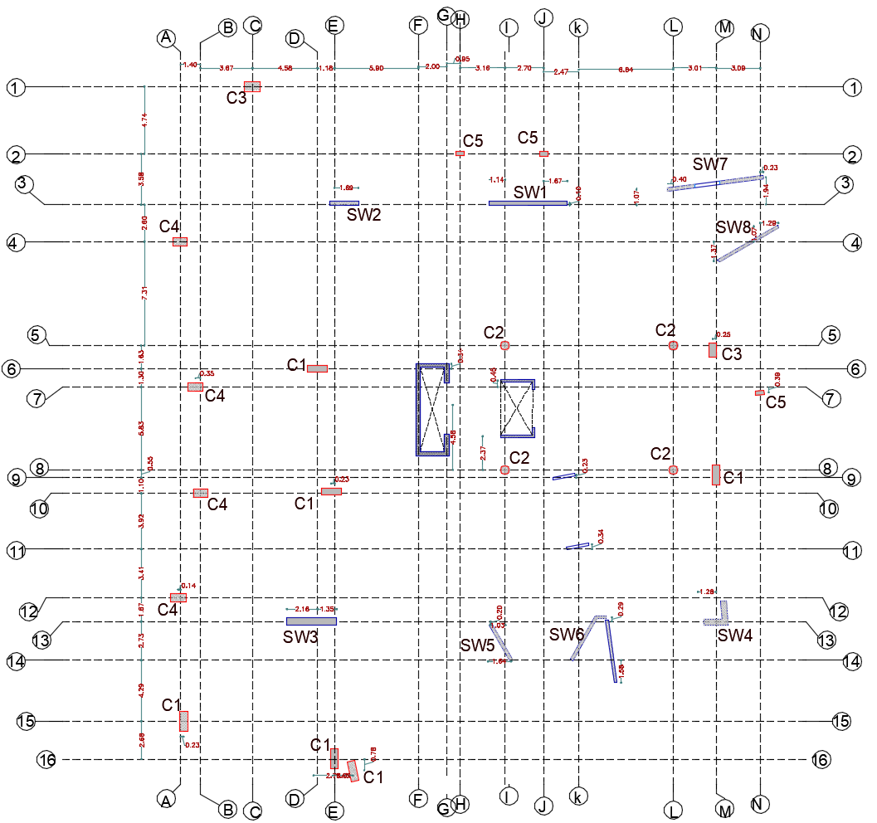
center of column
45

Slide 46
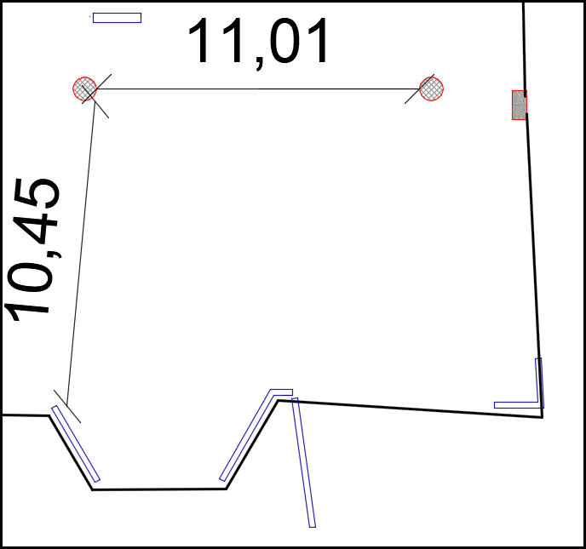
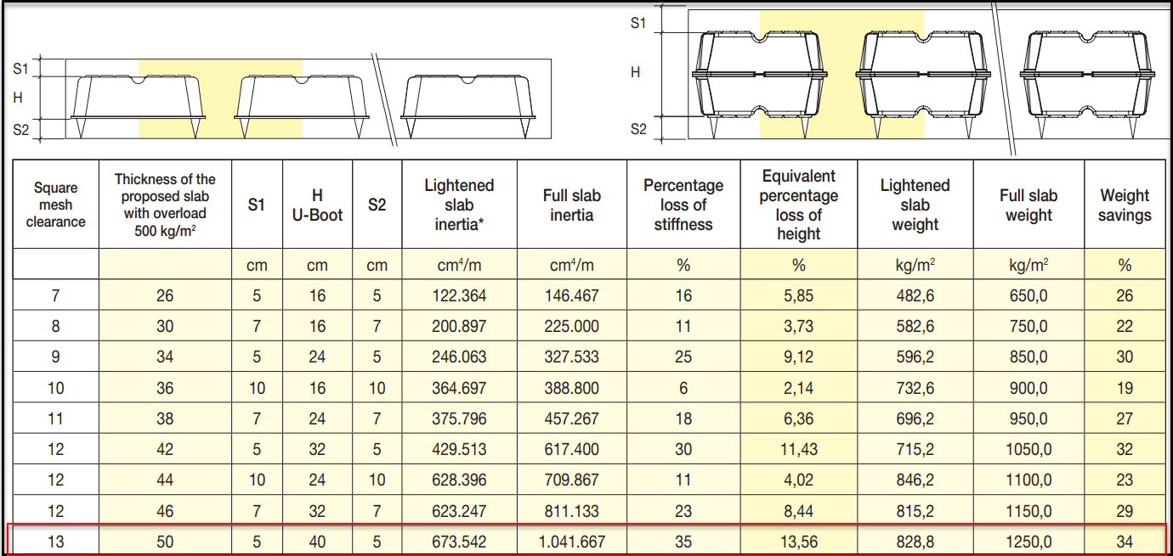
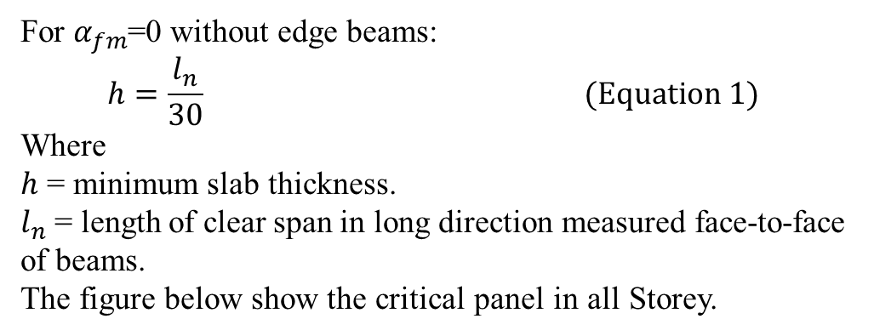
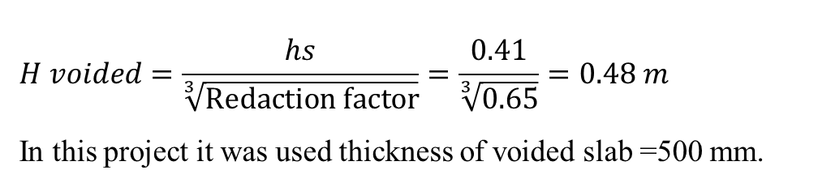
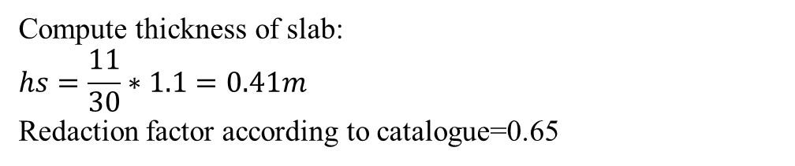
Preliminary Thickness of Slabs
46
ACI 318-14, Section 8.3.1.2, provide min thickness of two- way solid slab depending on stiffness . For flat slab α_{fm}=0
For $α_{fm}$=0 without edge beams:
$$h=\frac{l_{n}}{30} (Equation 1)$$
Where
$h$ = minimum slab thickness.
$l_{n}$ = length of clear span in long direction measured face-to-face of beams.
The figure below show the critical panel in all Storey.
critical panel
U-boot slap catalogue
Compute thickness of slab:
$$hs=\frac{11}{30}∗1.1=0.41m$$
Redaction factor according to catalogue=0.65
$$H voided=\frac{hs}{\sqrt[3]{Redaction factor}}=\frac{0.41}{\sqrt[3]{0.65}}=0.48 m$$
In this project it was used thickness of voided slab =500 mm.

Slide 47
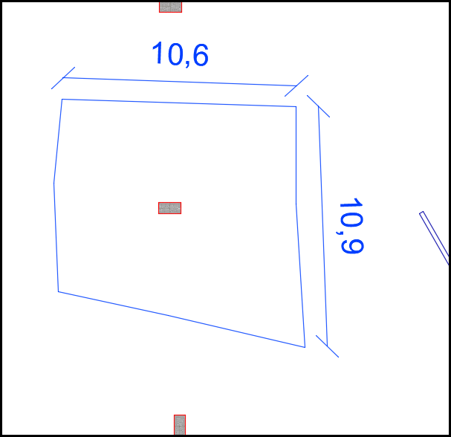
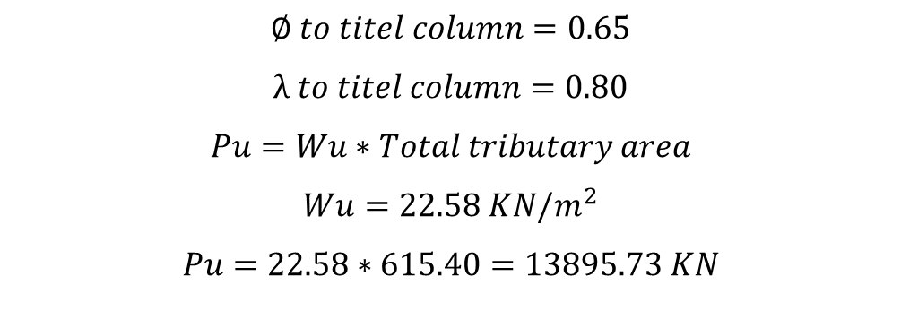
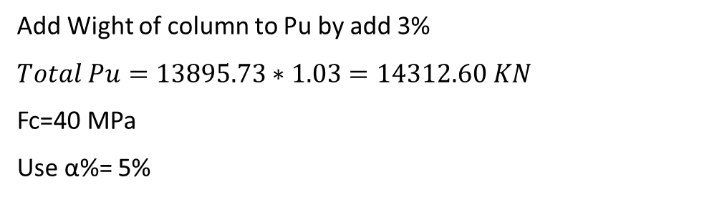
47
    Preliminary Dimensions of Columns
Tributary area for C1
There two type of columns are used in this project:
Type 1: Rectangle column (C1)
$$∅ to titel column=0.65$$
$$λ to titel column=0.80$$
$$Pu=Wu∗Total tributary area$$
$$Wu=22.58 KN/m^{2}$$
$$Pu=22.58∗615.40=13895.73 KN$$
Add Wight of column to Pu by add 3%
$$Total Pu=13895.73∗1.03=14312.60 KN$$
Fc=40 MPa
Use α%= 5%
Column C1
Story | Tributary area
B1 | 111.5
B2 | 111.5
GF | 60.9
F1 | 60.9
F2 | 90.2
F3 | 90.2
F4 | 90.2
Total Area | 615.4
$$So after solution the equation 3 Ag=516402.0782 mm^{2}$$
In this project, dimensions of column type C1 assumed (500*1400) mm

Slide 48
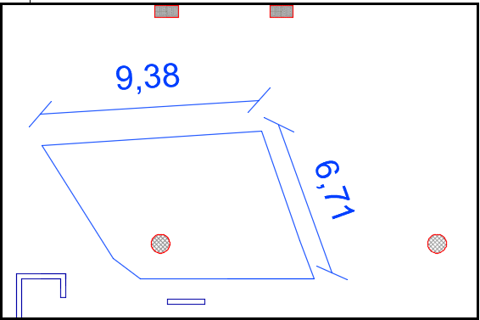
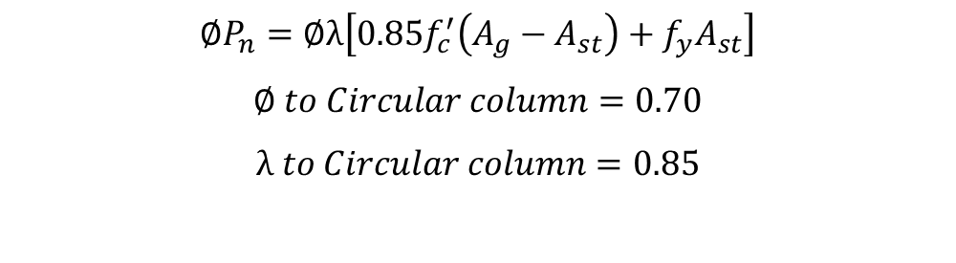
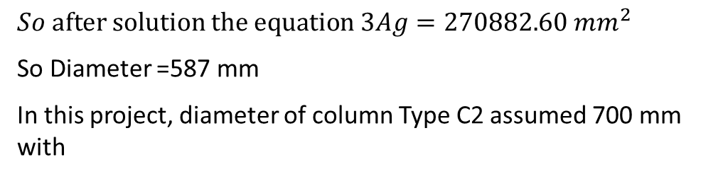
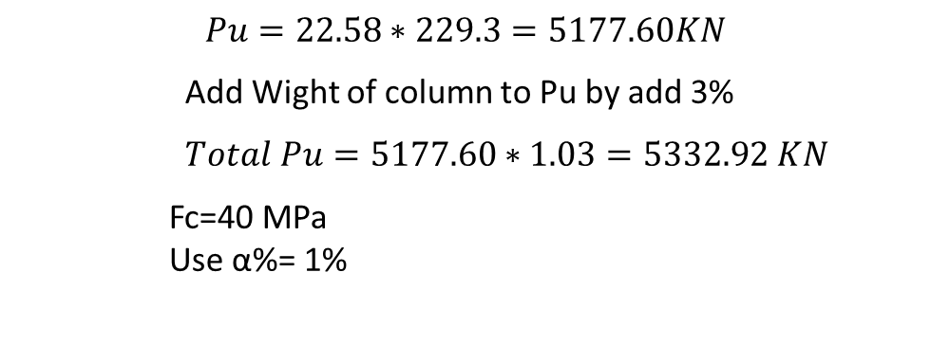
48
Type 2: circular column (C2)
$$∅P_{n}=∅λ\left[0.85f_{c}^{′}\left(A_{g}−A_{st}\right)+f_{y}A_{st}\right]$$
$$∅ to Circular column=0.70$$
$$λ to Circular column=0.85$$
$$Pu=22.58∗229.3=5177.60KN$$
Add Wight of column to Pu by add 3%
$Total Pu=5177.60∗1.03=5332.92 KN$
Fc=40 MPa
Use α%= 1%
Tributary area of column C2
Column C2
Story | Tributary area
B1 | 53.6
B2 | 53.6
GF | -
F1 | -
F2 | 40.7
F3 | 40.7
F4 | 40.7
Total Area | 229.3
$$So after solution the equation 3Ag=270882.60 mm^{2}$$
So Diameter =587 mm
In this project, diameter of column Type C2 assumed 700 mm with

Slide 49
49
Structural aspects:
Structural concept and code
Preliminary Design
Checks
Materials and loads
Sections modifier
Elements design

Slide 50
50
Structural aspects:
Structural concept and code
Preliminary Design
Checks
Materials and loads
Sections modifier
Elements design

Slide 51



51
    Sections modifier
Slab modifiers in ETABS
Columns modifiers in ETABS
Stair Beams modifiers in ETABS

Slide 52
52
    Sections modifier
Slab modifiers in ETABS
Columns modifiers in ETABS
Stair Beams modifiers in ETABS

Slide 53
53
    Sections modifier
Slab modifiers in ETABS
Columns modifiers in ETABS
Stair Beams modifiers in ETABS

Slide 54
54
    Sections modifier
Slab modifiers in ETABS
Columns modifiers in ETABS
Stair Beams modifiers in ETABS

Slide 55
55
Structural aspects:
Structural concept and code
Preliminary Design
Checks
Materials and loads
Sections modifier
Elements design

Slide 56
56
Structural aspects:
Structural concept and code
Preliminary Design
Checks
Materials and loads
Sections modifier
Elements design

Slide 57


    Checks
57
To insure that the structure in ETABS is acceptable we must do the checks (compatibility, equilibrium, and stress strain) to obtain the results and use it in calculations.
    Compatibility check
The structure is compatible since the deformed structure moves as one rigid body. This means that the meshing of the slab and shear areas is obtained correctly.
Type | limitation
2. Equilibrium check | $$5\%$$ | $$\text{it}\text{′}\text{s} acceptable$$
3.1.Axial load | $$5\%$$ | $$\text{it}\text{′}\text{s} acceptable$$
3.2.Moment distribution | $$10\%$$ | $$\text{it}\text{′}\text{s} acceptable$$

Slide 58
    4. Modal mass participate ratio check [MMPR]
58
The Modal mass participation ratio according to UBC 97 code shall be greater than 90% to use response spectrum analysis method.
Case | Mode | Period sec | UX | UY | UZ | Sum UX | Sum UY
Modal | 1 | 1.094 | 0.1338 | 0.0882 | 0 | 0.1338 | 0.0882
Modal | 2 | 0.976 | 0.0003 | 0.2688 | 0 | 0.1341 | 0.357
Modal | 3 | 0.891 | 5.08E-06 | 0.0016 | 0 | 0.1341 | 0.3586
Modal | 74 | 0.069 | 1.07E-06 | 0.0002 | 0 | 0.9014 | 0.9217
As show in the previous table MMPR greater than 90% so we can use response spectrum analysis method.

Slide 59
    4. Modal mass participate ratio check [MMPR]
59
The Modal mass participation ratio according to UBC 97 code shall be greater than 90% to use response spectrum analysis method.
Case | Mode | Period sec | UX | UY | UZ | Sum UX | Sum UY
Modal | 1 | 1.094 | 0.1338 | 0.0882 | 0 | 0.1338 | 0.0882
Modal | 2 | 0.976 | 0.0003 | 0.2688 | 0 | 0.1341 | 0.357
Modal | 3 | 0.891 | 5.08E-06 | 0.0016 | 0 | 0.1341 | 0.3586
Modal | 74 | 0.069 | 1.07E-06 | 0.0002 | 0 | 0.9014 | 0.9217
As show in the previous table MMPR greater than 90% so we can use response spectrum analysis method.

Slide 60

    5. Base Shear check
60
According to UBC97 code the base shear of response spectrum method equal or more than base shear from equivalent static method as following equation.
Base shear force
Load Case/Combo | FX | FY | FZ
 | kN | kN | kN
Dead | 1.09E-05 | -4.85E-06 | 107908.5976
Live | 113.3 | 8.80E-06 | 31008.8449
Sid | 4.36E-06 | -6.51E-07 | 32744.9288
EQx Max | 15566.26 | 6873.5486 | 0.0004
EQy Max | 6441.434 | 15250.5467 | 0.0003
$$V manual = min \left(2.5∗Ca,\frac{Cv}{T}\right)∗ I∗\frac{W}{R}$$
Where:
W=weight=1D+0.25L
T=period and minimum from T limit and T ETABS
Axis | T ETABS | T limit | T used | V ETABS | V manual | old scale factor | New scale factor
x | 1.09 | 0.92 | 0.92 | 15566.263 | 14664.6 | 2561 | 2413
y | 0.97 | 0.92 | 0.92 | 15250.547 | 14664.6 | 1944 | 1869
The equivalent base shear more response spectrum its ok.

Slide 61

    6. Period calculation
61
The UBC97 code provides you with two ways to calculate the period [T], and the method A will be adopted.
$$T method A = Ct ∗ {\left(hn\right)}^{\frac{3}{4}}$$
hn = High of building and equal 32m.
Ct = (0.0488) for all other buildings.
$T method A = 0.0488 ∗ {\left(32\right)}^{\frac{3}{4}}$= 0.66 sec.
T limit = 1.4 * T method A = 1.4 * 0.66 = 0.92 sec.
period calculation
Axis | T ETABS | T Limit
x | 1.094 | 0.92
y | 0.976 | 0.92
The value of period its acceptable but me must check drift and p-dalta

Slide 62
    7. Drift check
62
UBC 97 code give you maximum permissible displacement to the floor from the under floor and should not exceed it.
ΔM =0.7 * R * Δ _{s.}
Where:
ΔM (drift) = Maximum Inelastic Response Displacement.
R: Confidant of seismic system type.
Δ _{s=} Displacement of the floor from the under floor at center of mass.
And ΔM story drift shall not exceed 0.020 times the story height if period greeter than 0.7 sec.
So the drift limitation =0.02*4000=80 mm
Drift check
Story | height (mm) | Ux | Uy | ΔS x | ΔS y | ΔM x | ΔM y | ΔM max
0 | 4000 | 0 | 0 | - | - | - | - | -
1 | 4000 | 0.5 | 0.31 | 0.5 | 0.31 | 1.925 | 1.1935 | 80
2 | 4000 | 0.66 | 0.66 | 0.16 | 0.35 | 0.616 | 1.3475 | 80
3 | 4000 | 9.3 | 10.3 | 8.64 | 9.64 | 33.264 | 37.114 | 80
4 | 4000 | 19 | 20 | 9.7 | 9.7 | 37.345 | 37.345 | 80
5 | 4000 | 30 | 34 | 11 | 14 | 42.35 | 53.9 | 80
6 | 4000 | 42 | 46 | 12 | 12 | 46.2 | 46.2 | 80
7 | 4000 | 53 | 58 | 11 | 12 | 42.35 | 46.2 | 80
8 | 3000 | 61 | 71 | 8 | 13 | 30.8 | 50.05 | 60
All drift value less than limitation so it’s acceptable.

Slide 63

    8. P-delta check
63
$$θ=\frac{P∗∆s}{V∗h}$$
Where:
θ= The stability coefficient.
𝑃= The total vertical design load at and above Level (KN).
Δ _{s=} Displacement of the floor from the under floor at center of mass (mm) .
𝑉= The seismic shear force acting(KN).
ℎ=The story height (mm).
θ max=0.1 and if θ less than θ max its ok(NO P-DELTA)

Slide 64
64
P-delta check in x direction
P-delta check in Y direction
Story | H floor (mm) | P gravity load combination(KN) | Vx(KN) | Ux(mm) | ∆S_{X (mm)} | ƟX | Conclusion
Story8 | 3000 | 852.8859 | 258.3846 | 61 | 8 | 0.00880 | NO P-DELTA
Story7 | 4000 | 21836.1107 | 4962.3656 | 53 | 11 | 0.0121 | NO P-DELTA
Story6 | 4000 | 42703.7115 | 7946.7105 | 42 | 12 | 0.0161 | NO P-DELTA
Story5 | 4000 | 55521.0388 | 10281.8708 | 30 | 11 | 0.0148 | NO P-DELTA
Story4 | 4000 | 74021.8194 | 11792.1384 | 19 | 9.7 | 0.0152 | NO P-DELTA
Story3 | 4000 | 92522.9371 | 12786.0361 | 9.3 | 8.64 | 0.0156 | NO P-DELTA
Story2 | 4000 | 160716.1556 | 14639.9856 | 0.66 | 0.16 | 0.0004 | NO P-DELTA
Story1 | 4000 | 219602.4263 | 16318.332 | 0.5 | 0.5 | 0.0017 | NO P-DELTA
Story | H floor (mm) | P gravity load combination(KN) | EY(KN) | Uy(mm) | ∆S_{y (mm)} | ƟY | Conclusion
Story8 | 3000 | 852.8859 | 274.3843 | 71 | 13 | 0.01347 | NO P-DELTA
Story7 | 4000 | 21836.1107 | 4261.0696 | 58 | 12 | 0.01537 | NO P-DELTA
Story6 | 4000 | 42703.7115 | 6932.9149 | 46 | 12 | 0.01848 | NO P-DELTA
Story5 | 4000 | 55521.0388 | 8999.3629 | 34 | 14 | 0.02159 | NO P-DELTA
Story4 | 4000 | 74021.8194 | 10239.2566 | 20 | 9.7 | 0.01753 | NO P-DELTA
Story3 | 4000 | 92522.9371 | 11074.1372 | 10.3 | 9.64 | 0.02014 | NO P-DELTA
Story2 | 4000 | 160716.1556 | 12482.7326 | 0.66 | 0.35 | 0.00113 | NO P-DELTA
Story1 | 4000 | 219602.4263 | 13884.6412 | 0.31 | 0.31 | 0.00123 | NO P-DELTA
As shown in pervious tables in x,y direction all value of Ɵ less than maximum limitation.

Slide 65
65
Structural aspects:
Structural concept and code
Preliminary Design
Checks
Materials and loads
Sections modifier
Elements design

Slide 66
66
Structural aspects:
Structural concept and code
Preliminary Design
Checks
Materials and loads
Sections modifier
Elements design

Slide 67


    Slab design
67
Punching check:
Punching shear for 3rd floor
Punching shear for basement floor
All value is small than ratio 0.9 and that’s ok

Slide 68

68
Deflection check:
Maximum allowable intermediate deflection from service load
=L/240=12.3/240=51.25 mm
Deflection from service load

Slide 69



69
Shear check:
Shear force V23
Shear force V13
$ØVc = \frac{0.75}{6}∗\sqrt{Fc} ∗b∗d=$ 81.8 kN/m
There are some values above the permissible limit and they have been reinforced to resist the shear forces.

Slide 70


    Slab reinforcement and detail:
70
Plan reinforcement
Plan reinforcement around column

Slide 71



71
General Section b-b
Section c-c for slab detail of link reinforcement
Section a-a in drop panel

Slide 72

    Column design
72
In this project we have five type of column depended on diminution and shape of
cross section. Design of columns use ETABS software and the detail drawing by use
revit software Dimension of columns as shown below in the table.
Type of Column and sizes

Slide 73


73
We take the results from ETABS program as follows :
Longitudinal reinforcement of C1
Shear rebar design for C1

Slide 74


    Column reinforcement and details:
74
For Column C1:
1.40
Column C1 a-a section
Longitudinal section Column C1

Slide 75


75
For Column C2:
1.40
1.40
Longitudinal section Column C2
Column C2 a-a section

Slide 76


76
For non-Prismatic column(C6):
1.90
Column C6 a-a section at top
Longitudinal section Column C6

Slide 77
    Design of beams
77
Type of structure system flat slab without edge beams and add stair beams to install curtain glass. Model in ETABS software add stair beam only but we added beams in edges of slab (B1) in plans of structure, this beam was reinforced minimum area steel.

Slide 78


78
    Beams reinforcement and details:
For stair beams:
stair beam detail
Stair beam section 1-1

Slide 79

    Shear wall design
79
In this project all shear force resisted by shear wall only as building frame system.
We take the results form ETABS as follow .
From the data from ETABS the required reinforcement ratio = 0.0025 more than or
equal minimum ratio0.25% for the longitude bars and the spaces equal
For vertical Use 1 Ø 12 / 30 cm for each layer
For horizontal use 1 Ø 10/ 20 cm for each layer
ETABS result for shear wall 2

Slide 80


80
section detail of reinforcement for SW2
details of reinforcement for SW2

Slide 81
    Design of footing
81
To obtain the best design we use the safe program to design our foundation in our project we use the mat foundation because the soil capacity is small which equal =200kn/m2. In our model we use thickness of it = 0.8 m and use drop panels for punching shear to obtain the correct checks.

Slide 82

Soil pressure check
82
The allowable soil pressure is 200 kn/m^2
Then the results from ETABS = 185.1 kn/m^2
Soil pressure result

Slide 83

Punching shear check:
83
All columns have a punching < 0.9 so its ok
punching check

Slide 84

Statement check :
84
For Settlement check the Settlement must small 10 mm for mat footing in safe equal =
8 mm <10mm so its ok .
Settlement in footing

Slide 85
Footing reinforcement and detail
85
Moment results
Reinforcement M22 | Reinforcement M11 | Moment | ρ M11 | ρ m22 | ρ M11 | ρ M22
bottom | 1505 | 1700 | 0.0075 | 0.0086 | 12Ø 25 / m | 11Ø 28 / m
top | 152 | 364 | 0.0007 | 0.0017 | 7Ø 16 / m | 7Ø 16 / m
We note that ρ M11 & ρ M22 is more than minimum ρmin =0.0018 so we use result ρ
As = ρ *b*d
At M=1505 KN.m ρ=0.00756
= 0.00756* 1000*750 = 5658.8 mm2
We need 12Ø 25 / m

Slide 86

Detail of footing :
86
reinforcement for mat footing

Slide 87


Detail of footing
87
reinforcement for drop panel with mat footing
section in reinforcement for mat footing

Slide 88

Water tank design
88
Sd = 1.29 for water.
Mu design = Mu * Sd * 1.06
ρ =$\frac{0.85∗fc}{Fy}\left(1−\sqrt{1−\left(\frac{2.61∗{10}^{6}∗Mu}{fc∗b∗d^{2}}\right)}\right)$
As = (ρ * b* d)
As min for footing and top slab = (0.0018 * b * h)
As min for wall horizontally = (0.005 * b * h)
As min for wall vertically = (0.003 * b * h)
Show the calculation for reinforcement in water tank
Element | Mu (KN.m/m) | Sd | Mu design (KN.m/m) | ρ | As (mm2/m) | As min (mm2/m) | Bars # Ø db
Wall-H | 24.2 | 1.29 | 31.21 | 0.00051 | 86.7 | 1000 | 7 Ø 14
Wall-V | 23.3 | 1.29 | 29.28 | 0.00047 | 79.9 | 600 | 9 Ø 12
Top slab | 6 | 1.29 | 7.74 | 0.00012 | 20.4 | 306 | 4 Ø 10

Slide 89


Water tank Detail :
89
detailing for water tank from the top view
detailing section for water tank

Slide 90

Design of sheet piles
90
To start work on the excavations of the project and because the depth is 8 meters
below the surface of the earth, methods must be devised to prevent the collapse of the
soil, and in this for a project we used the sheet pile to prevent soil from collapsing
during the work. By used GEO5 software program sheet piles designed and by used
Revit program draw of detail.
Soli properties

Slide 91




Details of sheet piles:
91
Diameters and spaces between piles
Sheet pile depth result
Pile reinforcement details
Distribution of sheet piles

Slide 92
92
Contents:
Architectural Aspects
Environmental Aspects
Structural Aspects
Quantity Surveying & Cost Estimate
Mechanical aspects
Electrical aspects

Slide 93
93
Contents:
Architectural Aspects
Environmental Aspects
Structural Aspects
Quantity Surveying & Cost Estimate
Mechanical aspects
Electrical aspects

Slide 94
94
Environmental Aspects
Shading analyses
Daylight factor
CFD analyses
Thermal comfort analyses

Slide 95
95
Environmental Aspects
Shading analyses
Daylight factor
CFD analyses
Thermal comfort analyses

Slide 96

96
we did a shading analyses for the building before we use the reflected glass and the solar radiation values were high after we used the reflected glass the solar radiation values improved as shown below:

Slide 97
97
Environmental Aspects
Shading analyses
Daylight factor
CFD analyses
Thermal comfort analyses

Slide 98
98
Environmental Aspects
Shading analyses
Daylight factor
CFD analyses
Thermal comfort analyses

Slide 99
Daylight factor analyses:
99
Daylight factor is an index for how much natural lighting is in the space that we have , we made an analyses for all floors and we took the max and min values of the daylight factor in each floor , so we need bigger windows or shading system.

Slide 100


100
Daylight factor analyses
First floor
Ground floor

Slide 101



101
Second floor
Third floor
Fourth floor

Slide 102
102
Environmental Aspects
Shading analyses
Daylight factor
CFD analyses
Thermal comfort analyses

Slide 103
103
Environmental Aspects
Shading analyses
Daylight factor
CFD analyses
Thermal comfort analyses

Slide 104



External CFD
104
Internal CFD
As shown in the figures of the external CFD we can note that the windows that we put for the infiltration has a good location, also we can see that from the internal CFD the velocity of the inside air is good and between the comfortable values 0.3 - 0.9 m/s.

Slide 105
105
Environmental Aspects
Shading analyses
Daylight factor
CFD analyses
Thermal comfort analyses

Slide 106
106
Environmental Aspects
Shading analyses
Daylight factor
CFD analyses
Thermal comfort analyses

Slide 107





107
Thermal design:
U-Value for elements
layers of the external walls
Element | U-Value(W/M2.K)
External walls | 0.471
Roof | 0.39
Floor | 0.535
Windows | 2.6
layers for roof
Glass catalogue
layers for floor

Slide 108

108
PMV CHART

Slide 109

109
Heating Design:
temperatures and heat loss

Slide 110
110
Contents:
Architectural Aspects
Environmental Aspects
Structural Aspects
Quantity Surveying & Cost Estimate
Mechanical aspects
Electrical aspects

Slide 111
111
Contents:
Architectural Aspects
Environmental Aspects
Structural Aspects
Quantity Surveying & Cost Estimate
Mechanical aspects
Electrical aspects

Slide 112





  Lighting design:
112
    As show design for Mayors' office:
Standard | Achieved | Type
 | 510 | lux
 | 0.6 | uniformity
 | 13.7 | UGR

Slide 113


Power in first floor
113
Lighting distribution for first floor

Slide 114



Main distribution board and circuit breaker in the building:
114
Main distribution board
circuit breaker for the lighting
circuit breaker for the HVAC

Slide 115


Elevators power
115
Circuit breaker for elevators
Elevators power connection

Slide 116
116
Contents:
Architectural Aspects
Environmental Aspects
Structural Aspects
Quantity Surveying & Cost Estimate
Mechanical aspects
Electrical aspects

Slide 117
117
Contents:
Architectural Aspects
Environmental Aspects
Structural Aspects
Quantity Surveying & Cost Estimate
Mechanical aspects
Electrical aspects

Slide 118
HVAC – design
118
In this project, we contain multiple spaces, and part of them needs mechanical ventilation, such as the conference room, corridors, assembly rooms, and spaces that do not require mechanical ventilation, such as offices, which depend on natural ventilation, and the design will be based on the use of the cassette for places that not need mechanical ventilation and the fan coil unit for places that need mechanical ventilation.

Slide 119




HVAC Units:
119
cassette catalogue
Fan coil unit:

Slide 120

120
Heating and cooling load:
cooling and heating loads for fourth floor
Zone | Sensible cooling (kW) | Latent cooling(kW) | Cooling Design Capacity (kW) | Cooling Design Flow Rate (m3/s) | Heating loads (kW)
Zone20 | 3.28 | 0.54 | 4.39 | 0.212
Zone9 | 67.21 | 2.81 | 80.53 | 4.45 | 16.85
Zone6 | 1.43 | 0.23 | 1.91 | 0.0911 | 0.6
Zone3 | 1.29 | 0.21 | 1.72 | 0.083 | 0.9
Zone7 | 0.93 | 0.14 | 1.23 | 0.0644 | 0.34
Zone1 | 3.25 | 0.56 | 4.69 | 0.0226 | 0.282
Zone12 | 1.34 | 0.13 | 1.79 | 0.086 | 0.31
Zone21 | 2.31 | 0.19 | 2.87 | 0.144 | 0
Zone22 | 0.99 | 0.18 | 1.34 | 0.06 | 0.62
Zone2 | 3.76 | 0.59 | 5 | 0.24 | 0
Zone4 | 1.6 | 0.26 | 2.14 | 0.105 | 0
Zone8 | 1.38 | 0.21 | 1.82 | 0.089 | 1.16
Zone5 | 2.66 | 0 | 3.06 | 0.1891 | 0
Zone23 | 0.94 | 0.06 | 1.15 | 0.064 | 0.24
Zone17 | 1.91 | 0.16 | 2.39 | 0.1193 | 0
Zone18 | 2.53 | 0.21 | 3.16 | 0.158 | 0
Zone15 | 1.83 | 0.15 | 3.28 | 0.114 | 0
Zone19 | 1.87 | 0.16 | 2.34 | 0.116 | 0
Zone16 | 0.91 | 0.06 | 1.19 | 0.064 | 0.77
Zone14 | 1.46 | 0.01 | 1.8 | 0.0911 | 0
Total for the floor | 103.3 | 7 | 126.8 | 6.8 | 24.6
Fourth floor zone number

Slide 121

HVAC detail :
121
Distribution of Hvac system in fourth floor

Slide 122

water drainage HVAC:
122
We use drainage for Hvac With 1.5’’ with slope 1% for pipes as show in figure.
water drainage HVAC for fourth floor

Slide 123


Acoustical Design
123
We design the acoustical system for Multipurpose and corridor .
speaker Specifications

Slide 124




Selected materials:
124
floor material absorption coefficient
stage material absorption coefficient
walls material absorption coefficient
Celling material absorption coefficient

Slide 125


125
SPL direct for area at 1000 Hz
Total SPL at frequency 1000 Hz

Slide 126

126
For corridors
Calculation of coverage radius:
Where:
H: net height of floor=3.5m
H’: Standing people height =1.6m
=Tan (50) =
𝑟/3.5-1.6
So r =2.20 m
Coverage area = 𝜋 *2.2² =15.2 m².

Slide 127


Acoustical Detail
127
section for corridors speaker
Speakers distribution for first floor

Slide 128
Water supply system
128
Ground Floor
Use 1.5"fort vertical pipes, 1.25"∅horizontal pipes, 3/4"for branches
First floor
Use 1.5"fort vertical pipes, 3/4"∅horizontal pipes, 3/4"for branches
Second floor
Use 1.5"fort vertical pipes, 3/4"∅horizontal pipes, 3/4"for branches
Third floor
Use 1.5"fort vertical pipes, 1.25"∅horizontal pipes, 3/4"for branches
Fourth floor
Use 1.5"fort vertical pipes, 3/4"∅horizontal pipes, 3/4"for branches

Slide 129


Water supply system
129
Ground floor water supply system
first floor water supply system

Slide 130
Drainage System Design
130
Show the calculation for (dfu) in all stories in the building
Fixture un total | Floor | Type | Fixture unit(dfu) | Number
Ground Floor | lavatory | 2 | 7 | 14
W.C | 4 | 7 | 28
First floor | Lavatory | 2 | 6 | 12
W.C | 4 | 6 | 24
Kitchen sink | 2 | 1 | 2
Second floor | lavatory | 2 | 6 | 12
W.C | 4 | 6 | 24
Kitchen sink | 2 | 1 | 2
Third floor | lavatory | 2 | 6 | 21
W.C | 4 | 6 | 24
Kitchen sink | 2 | 1 | 2
Fourth floor | lavatory | 2 | 8 | 16
W.C | 4 | 8 | 32
Kitchen sink | 2 | 1 | 2
diameter& slope for fixtures
fixture | diameter | Slope | pipe
sewer | 2 | 2 | PVC
sewer | 4 | 4 | PVC
drainage | 4 | 1 | PVC
stack | 4 | 0 | PVC
vent | 2 | 0 | PVC

Slide 131


Drainage System Detail
131
Piping distribution and connection for Forth floor
Piping distribution and connection for Third floor

Slide 132
Design of Firefighting System.
132
We use deferent types of fire fighting :
1 – Fire distinguisher
We use a fire extinguisher with foam material because we have a paper and archive books so we cant use water , usually used as a primary option in small fires and are used in the corridors so we put it in corridors in our project.
In our project we use a class A.

Slide 133



Design of Firefighting System
133
Smoke detector
CO2 Sprinklers
hose stations
Co2 Sprinkler
Smoke detector
Hose station

Slide 134


Firefighting detail
134
Distribution fire system for typical floor
Distribution fire system for ground floor

Slide 135

Firefighting detail
135
Emergency exit
The fire exit and the away to escape .

Slide 136
136
Contents:
Architectural Aspects
Environmental Aspects
Structural Aspects
Quantity Surveying & Cost Estimate
Mechanical aspects
Electrical aspects

Slide 137
137
Contents:
Architectural Aspects
Environmental Aspects
Structural Aspects
Quantity Surveying & Cost Estimate
Mechanical aspects
Electrical aspects

Slide 138

Work Breakdown Structure (WBS)
138
Total cost =23,013,615.69 NIS and unit cost=2,467 NIS/SM

Slide 139

Thank you for listening

