Slide 1


AN-Najah National University
Faculty of Engineering & Information Technology
Mechanical and Mechatronics Engineering Department
Graduation Project 2
Standing and Toilet Wheelchair
DONE BY:
Husam Naser
Adel Al-Haj
Abdelatif Hanani
Motaz Al-Nabulsi
SUPERVISOR:
Dr. Mohammad Abuabiah
July 5, 2020

Slide 2
Outline
Introduction.
Types of Wheelchairs.
Standing and Toilet Wheelchair. Why?
Mechanical Part
Electrical Part
Future work

Slide 3

Introduction
140,000 people with movement disability in Palestine [1] .
Palestinian General Union of People with Disability(GUPWD).
Moawiya Mona
[1] Palestinian Central Bureau of Statistics (PCBS)
http://www.pcbs.gov.ps/postar.aspx?lang=ar&ItemID=3317&fbclid=IwAR1wleAHLwtEUYlic2CuYAVR-v-RR3ZVB-dy5BM-dzPudYHodlIurztzTUw

Slide 4

Introduction
Sabrina Jaber

Slide 5
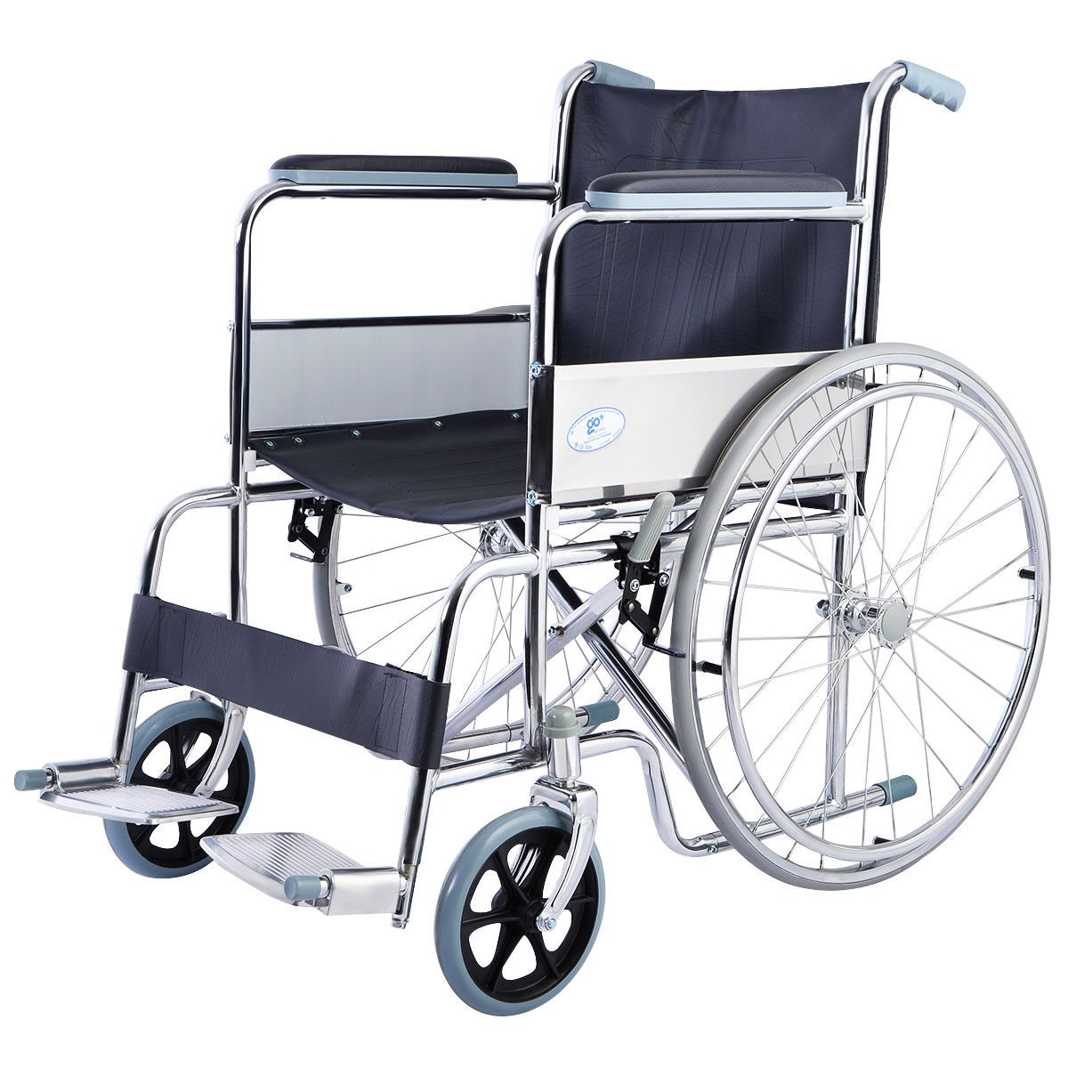
Types of Wheelchairs
Manual Wheelchair (Mechanical).

Slide 6
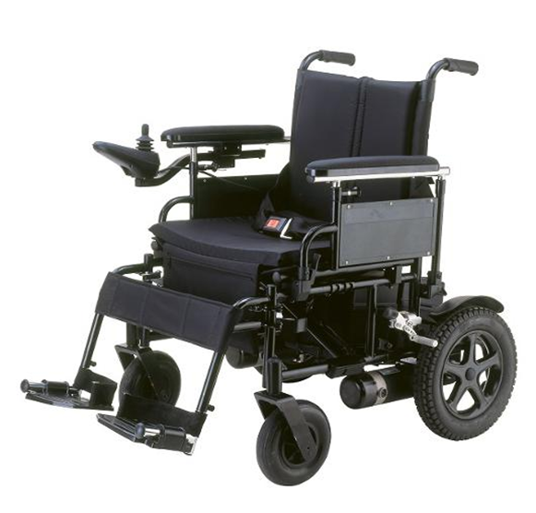
Types of Wheelchairs
Power Wheelchair (Electrical).

Slide 7
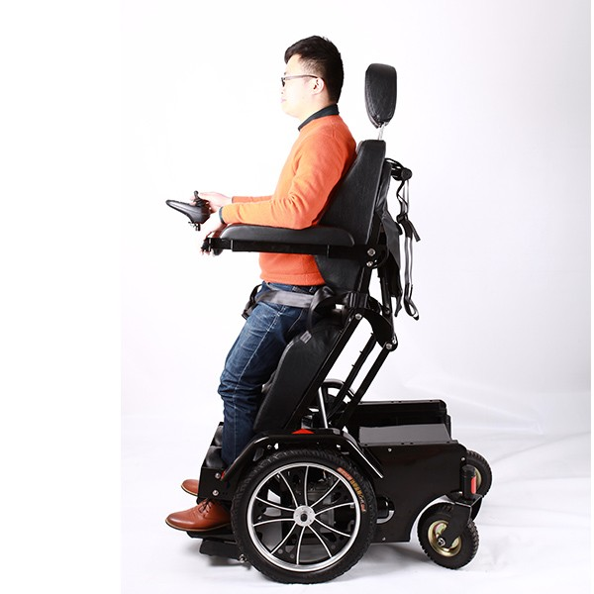
Types of Wheelchairs
Standing Wheelchair

Slide 8
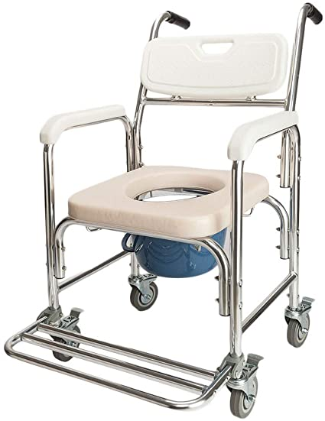
Types of Wheelchairs
Toilet Wheelchair

Slide 9
Health:
Positive Aspect of Standing Wheelchair
Reduces Spasticity(الشلل التشنجي ) :
when you stand up you help the muscles for tension and compression and reduce spasticity, which is causes relaxing for the body.
Improve Blood Flow:
which increases blood flow to your entire body, and supports your overall health.

Slide 10
Toilet Wheelchair
No Shyness
(عدم الإحراج)
Just one Wheelchair
No Muscles Effort

Slide 11
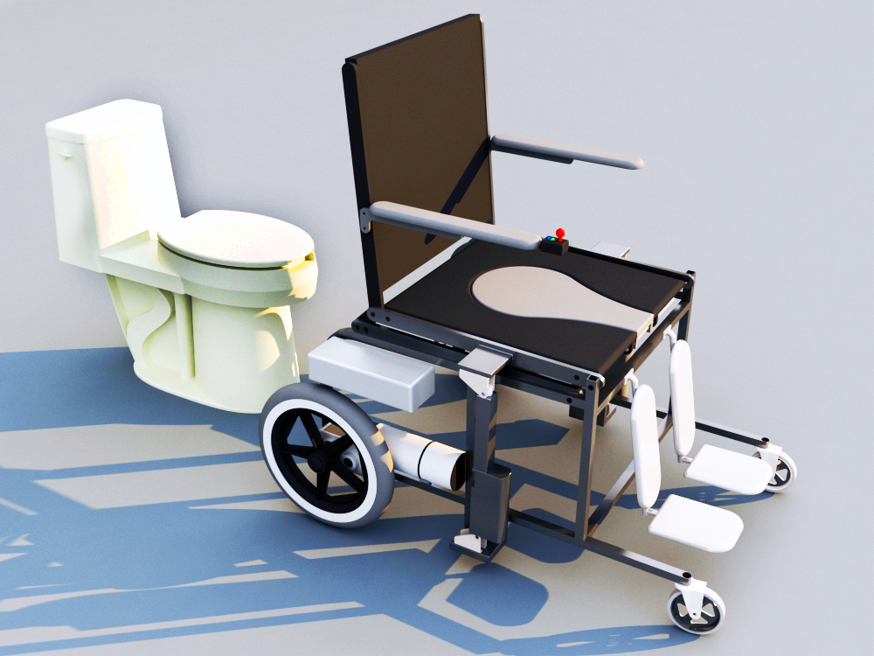
Mechanical Part

Slide 12
Mechanical Part
Human Body Analysis [3]
  The average male weight is 81.9 kg and average female weight is 66.7 kg, we assume that people’s weight is: W = 90 kg.
  And for height, we find average height of male is 181.5 cm, average height of female is 166.8 cm we assume that people’s height is: H = 175 cm.
[3] Tianxiang Mo, YuFeng Sun, and YongHao Yang. New mechanism used in standing wheelchair, 2014.

Slide 13
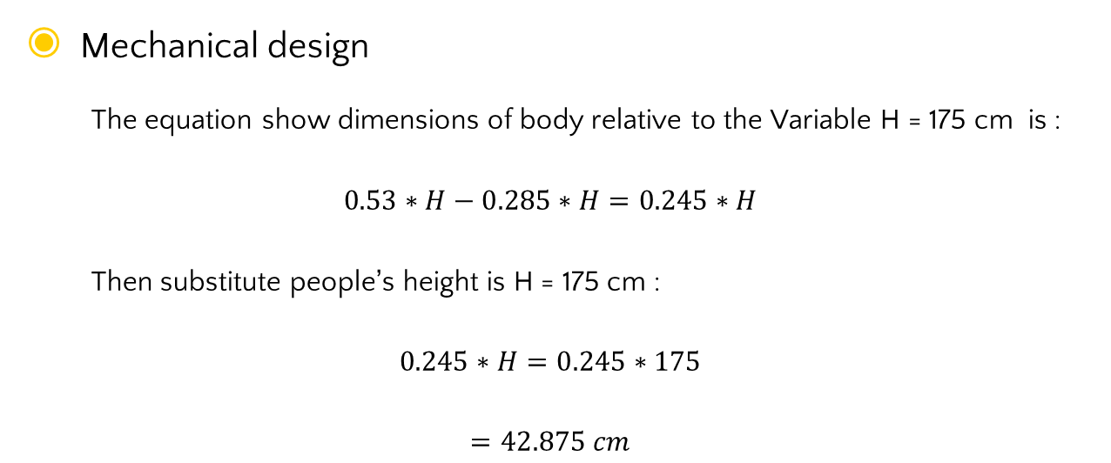
Mechanical Part
Mechanical design
  The equation show dimensions of body relative to the Variable H = 175 cm is :
$$0.53∗H−0.285∗H=0.245∗H$$
  Then substitute people’s height is H = 175 cm :
$$0.245∗H=0.245∗175$$
$$=42.875 cm$$

Slide 14
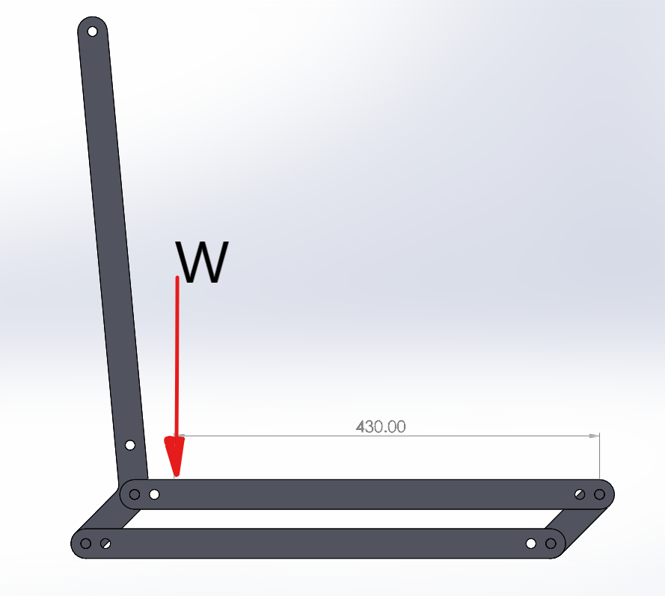
Mechanical Part
According to the human body analysis the weight is 430mm away from joint A
A

Slide 15
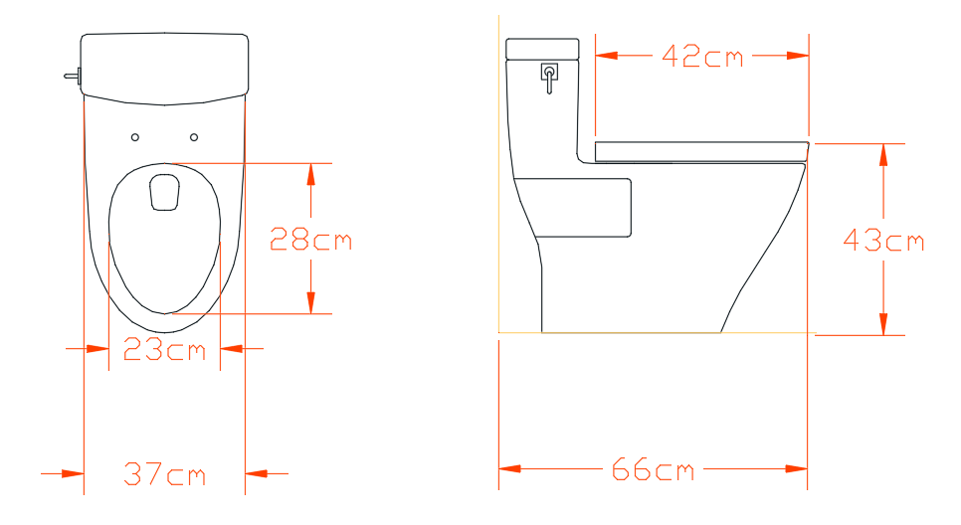
Standard Dimensions

Slide 16
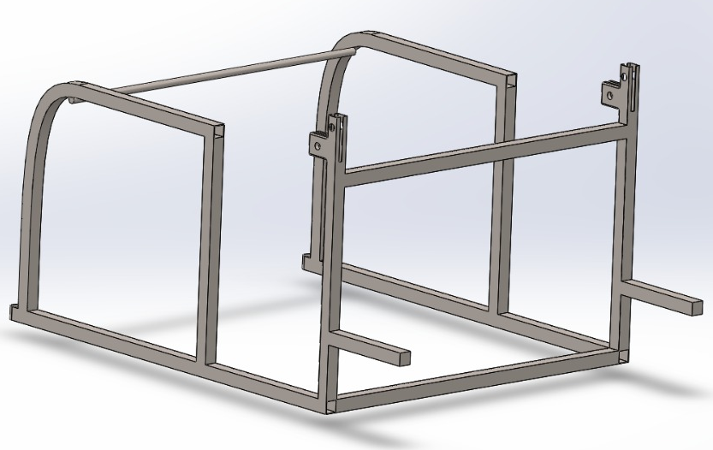
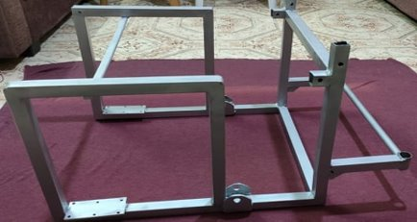
Frame Design

Slide 17
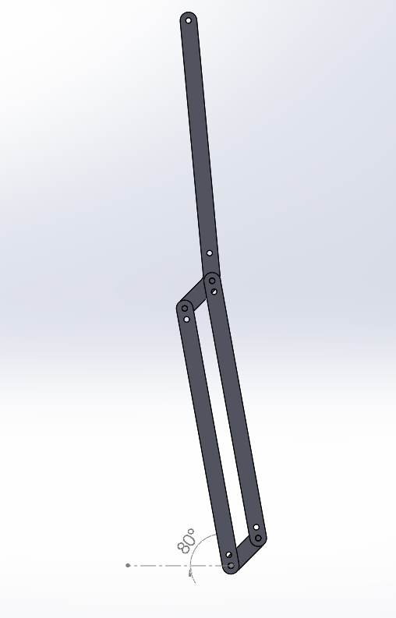
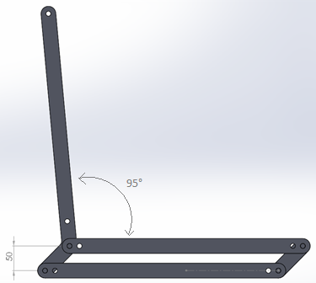
Mechanical Part
Standing mechanism (4-Bar Linkage)
  The most important thing we needed it when the standing position set should the backrest be at the same angle as it is the seat position.

Slide 18
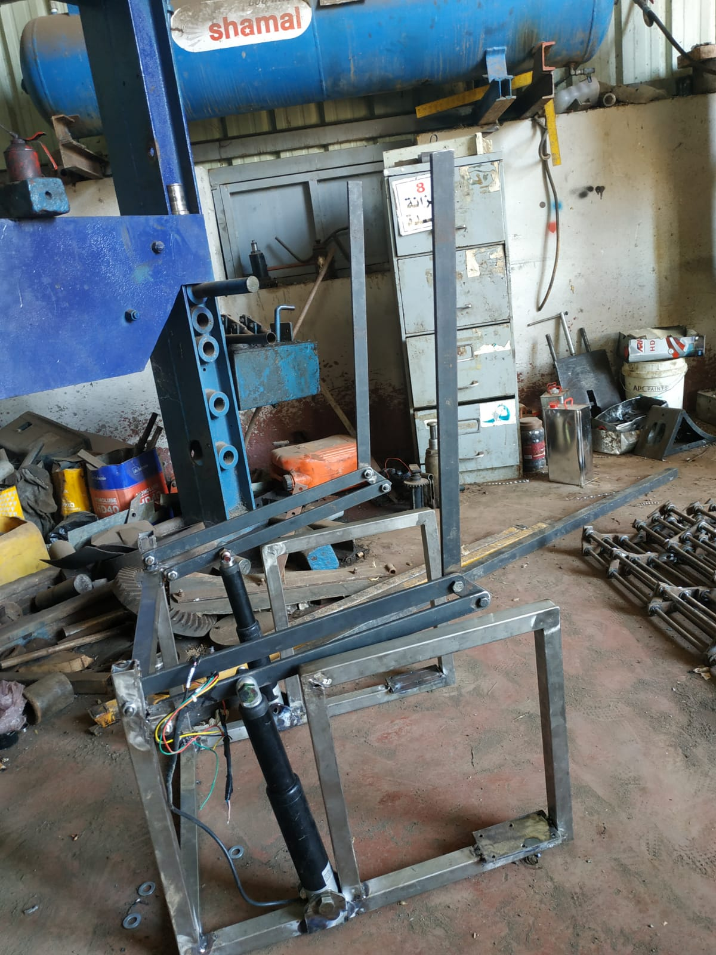
Mechanical Part
Left side four-bar linkage and right side four-bar linkage were made and assembled using a piece of steel

Slide 19
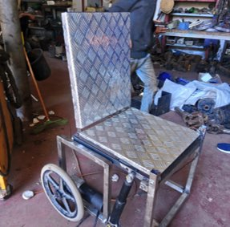
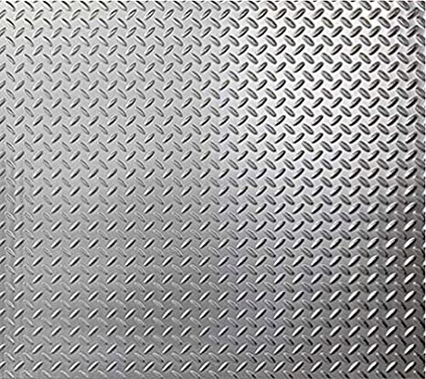
Mechanical Part
Seat and Back
Aluminum sheets

Slide 20
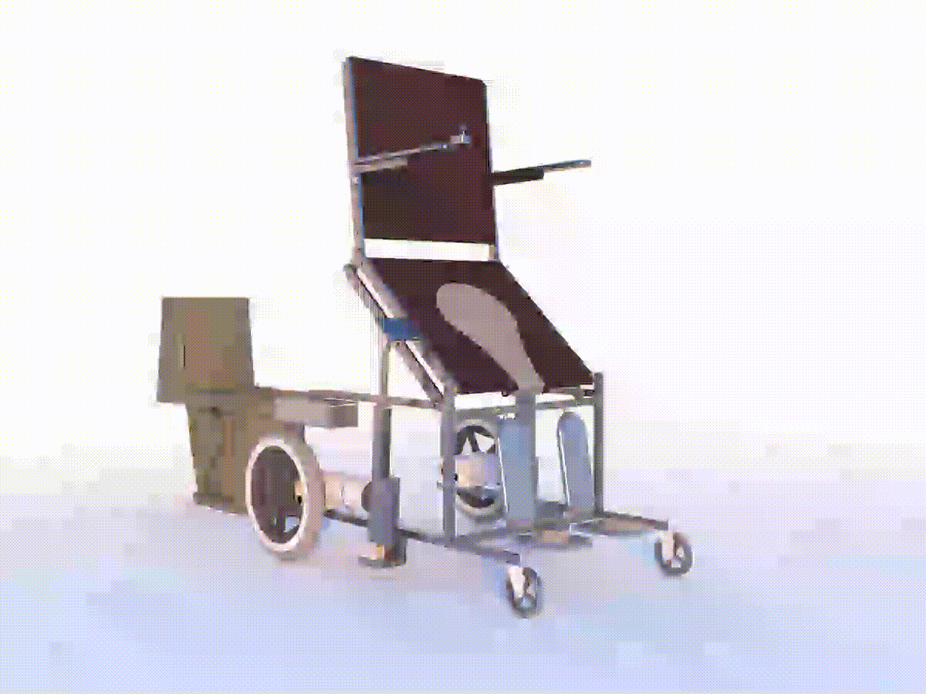
Mechanical Part
Toilet mechanism

Slide 21
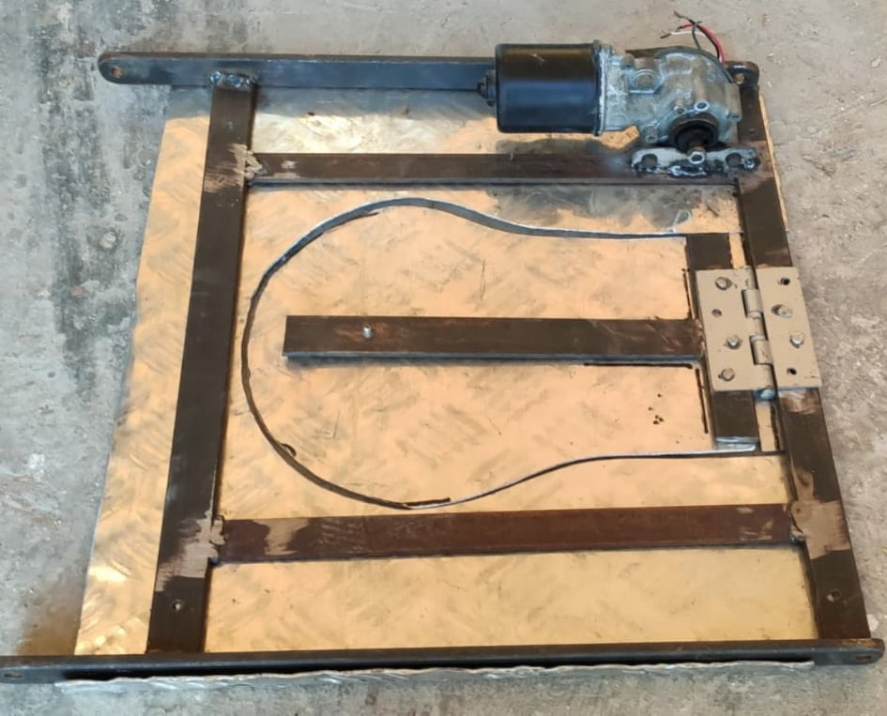
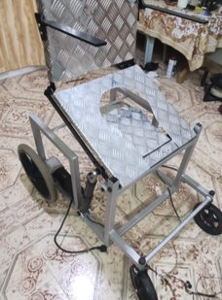
Mechanical Part
Toilet hole

Slide 22
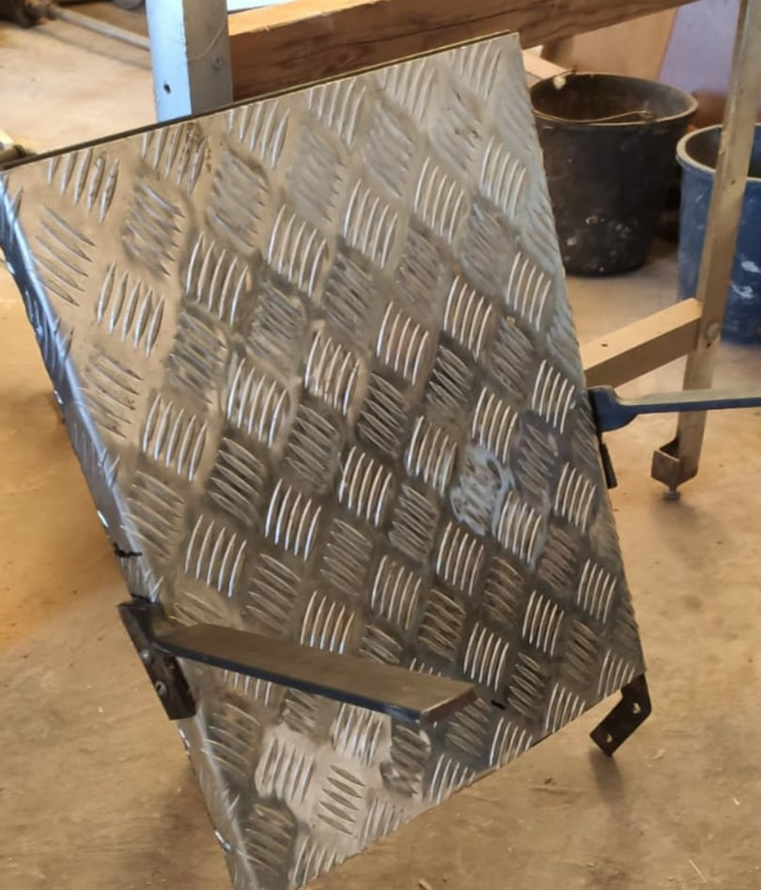
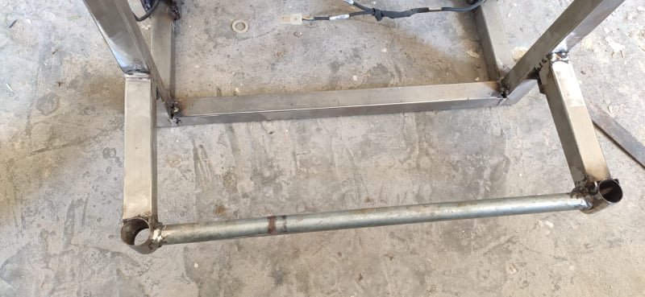
Mechanical Part
Armrest
Footrest

Slide 23
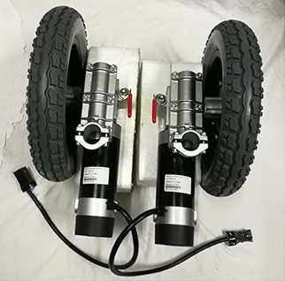
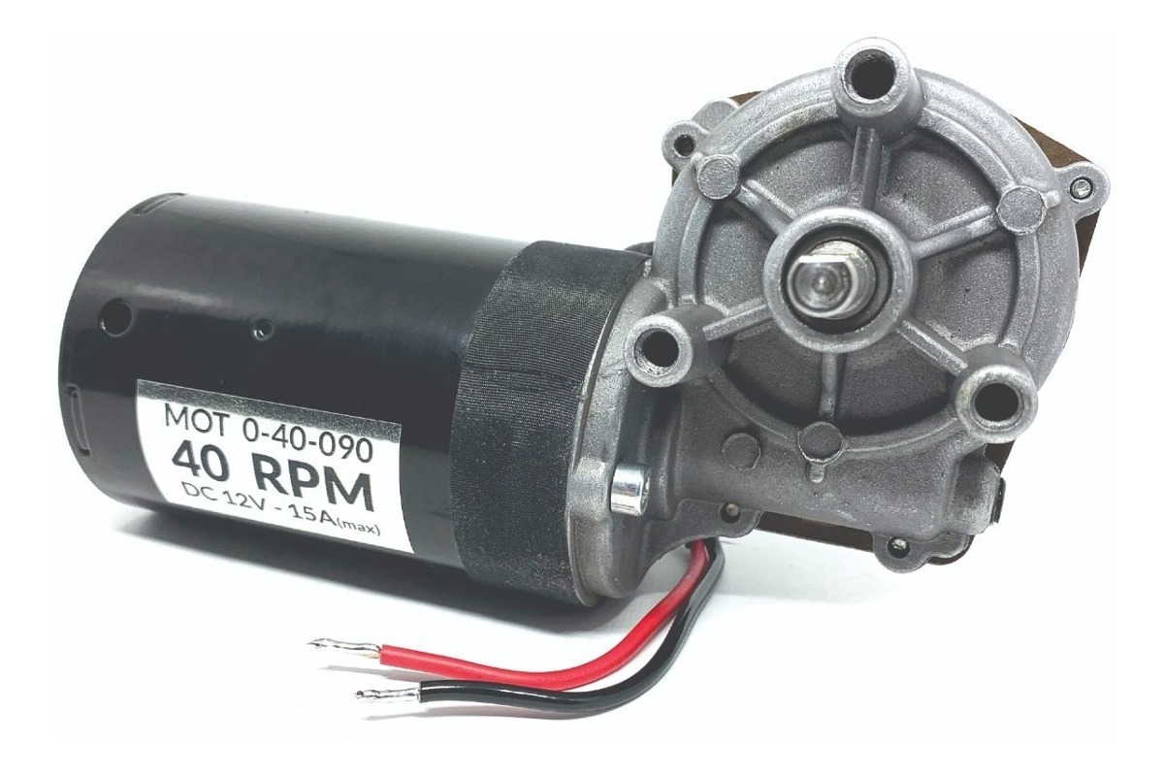
Motors
DC Motor with internal brake
Car windshield wiper motor

Slide 24
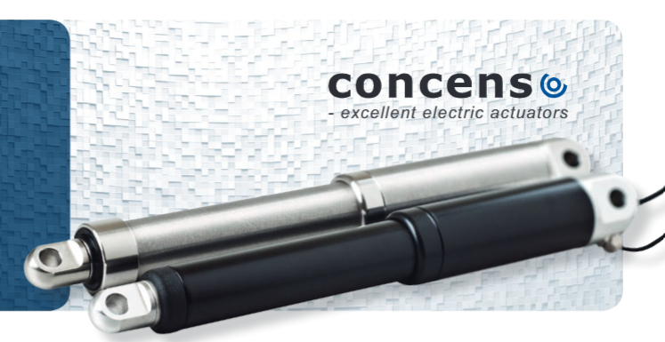
Electrical Part
Linear Actuator Specifications
Manufacturer | concens
Input Voltage | 24V DC
Force | 4500N
Stroke | 100mm
Speed | 6mm/s
Protection class | IP66
Materials | Motor and actuator tube are powder coated steel Piston rod is stainless steel

Slide 25

Battery
Batteries Specifications
Manufacturer | Vision
Model | CP12400F-X
Output voltage | 12V
Capacity | 40Ah
Number of units | 2

Slide 26
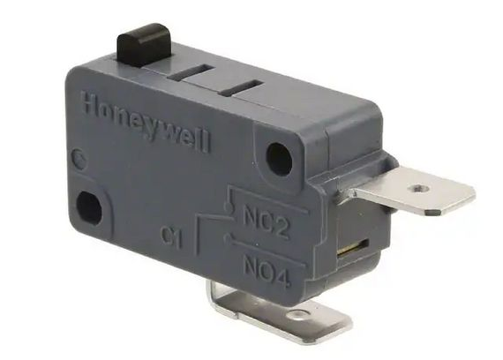
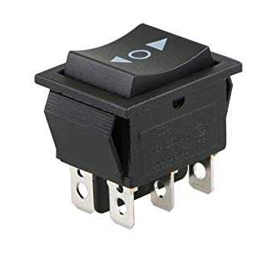
Other Components
Double Pole Double Throw (DPDT) switch
Micro switch (NC)

Slide 27
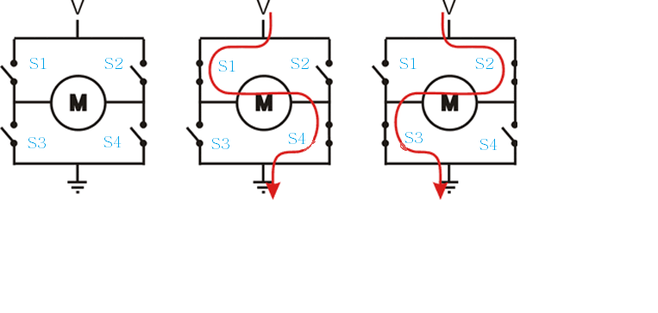
H-Bridge Circuit
H-bridge is an electronic circuit that switches the polarity of a voltage applied to a load

Slide 28
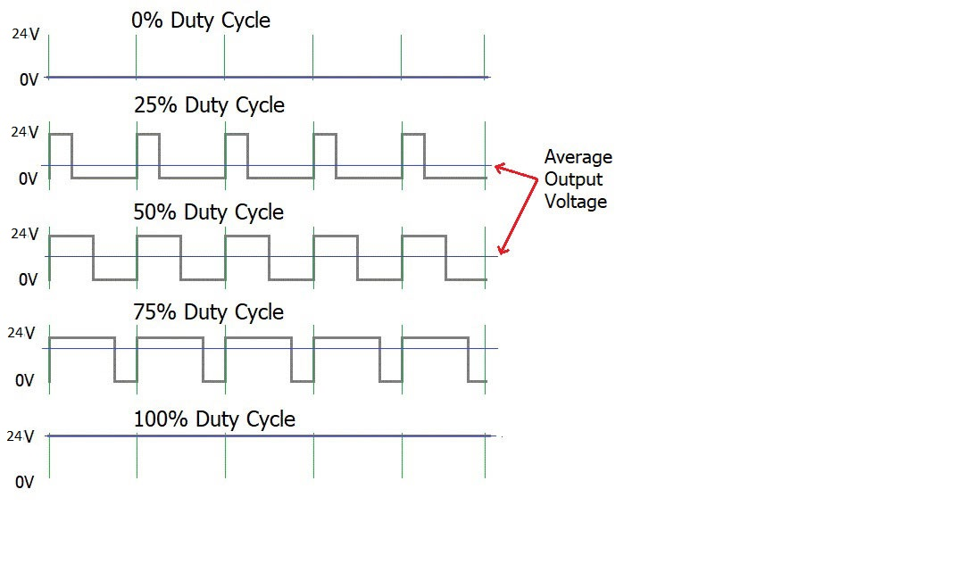
Pules Width modulation (PWM)
Is a method of reducing the average power delivered by an electrical signal, by effectively chopping it up into discrete parts.
The average value of voltage fed to the load is controlled by turning the switch between supply and load on and off at a fast rate

Slide 29
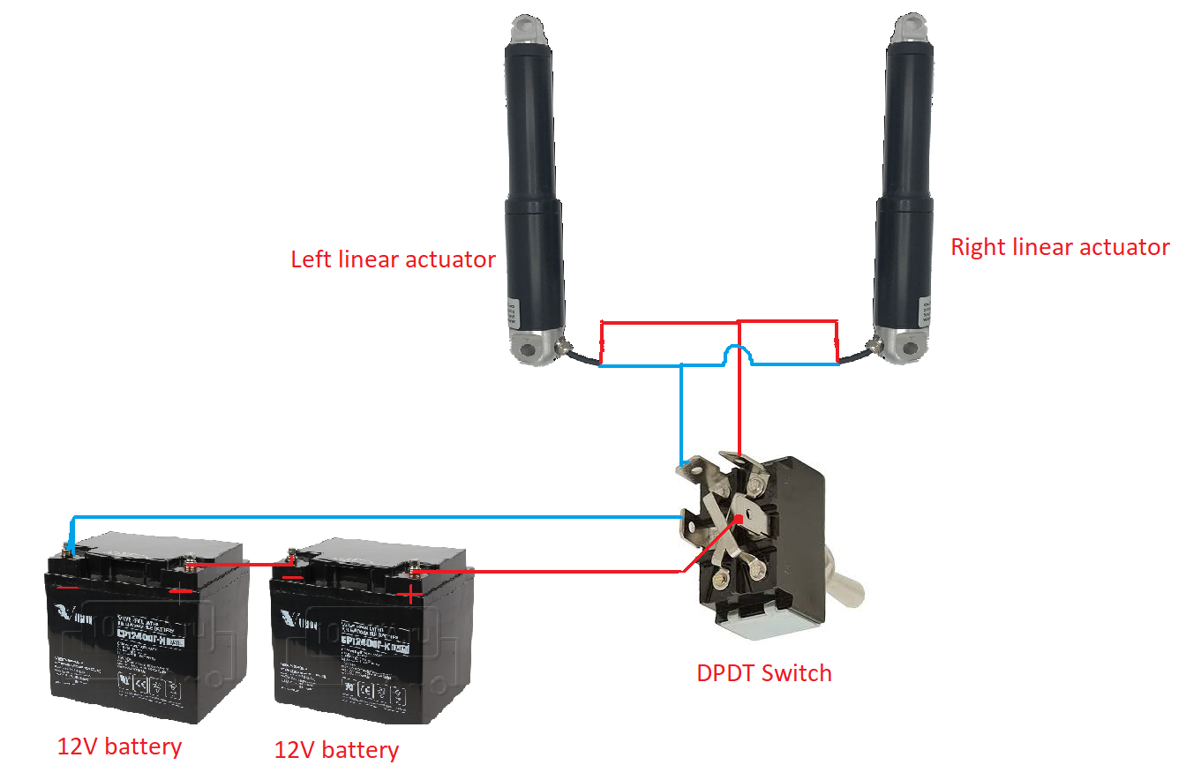
Linear actuator control circuit
To extend and retract the linear actuators DPDT switch was used to reverse the polarity

Slide 30
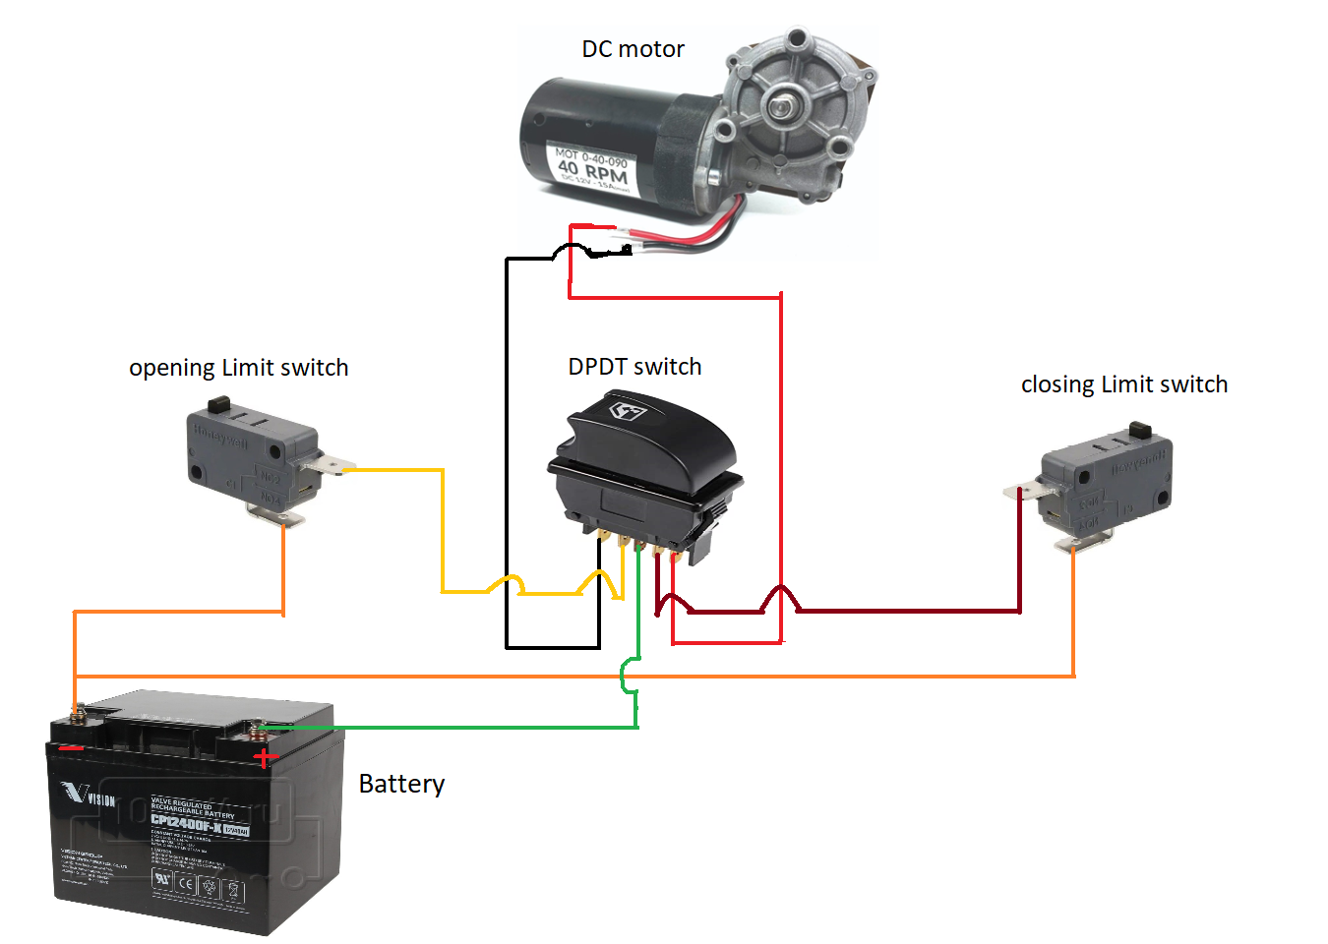
Toilet Cover control circuit
To control the toilet cover motor DPDT switch and two micro switches were used for limiting the movement of the cover

Slide 31
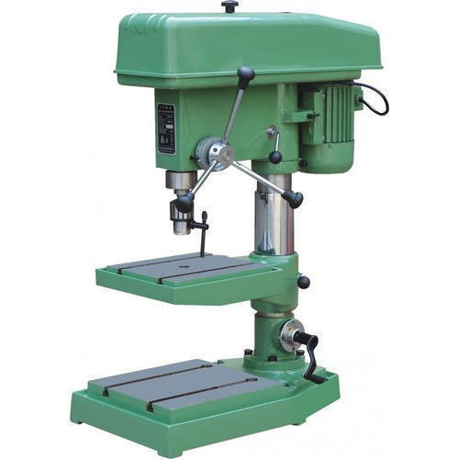
Equipment Used
Drilling machine

Slide 32
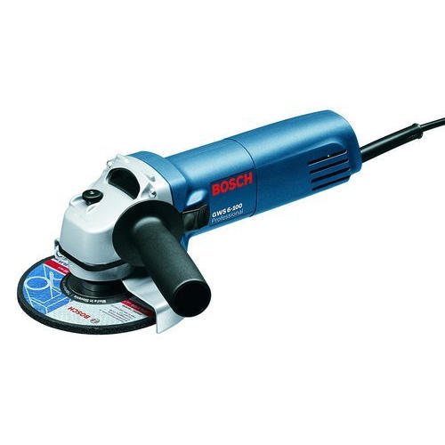
Equipment Used
Cutter disc

Slide 33
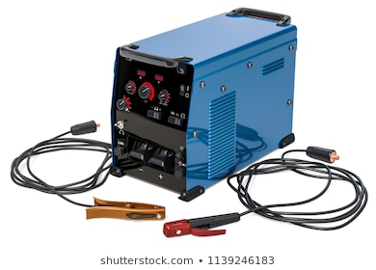
Equipment Used
Arc welding Machin (SMAW)

Slide 34
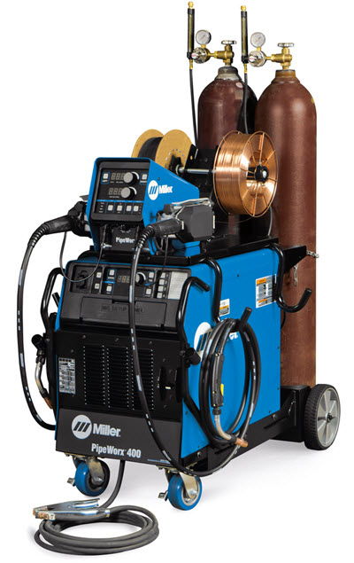
Equipment Used
Gas metal arc welding (MIG)
Other equipment (Vernier, Hammer, Meter, Rasp, Parallel vise).

Slide 35
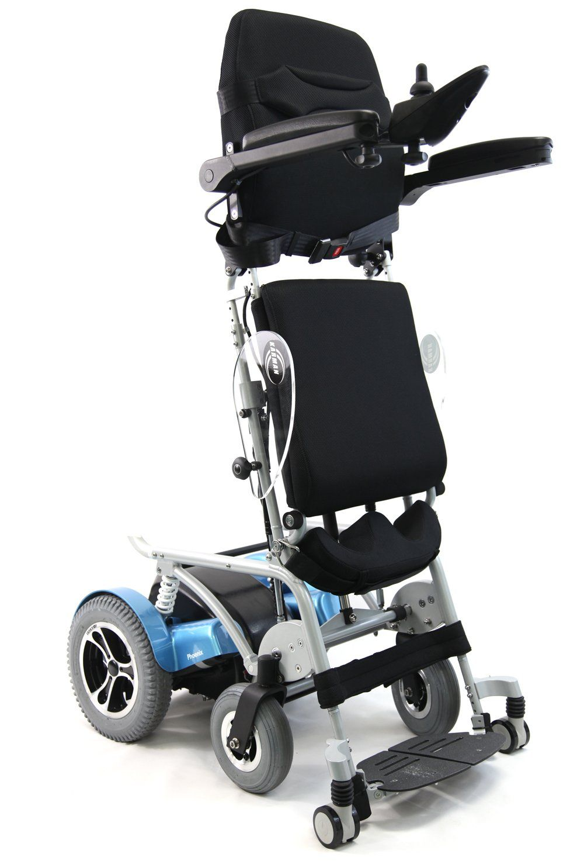
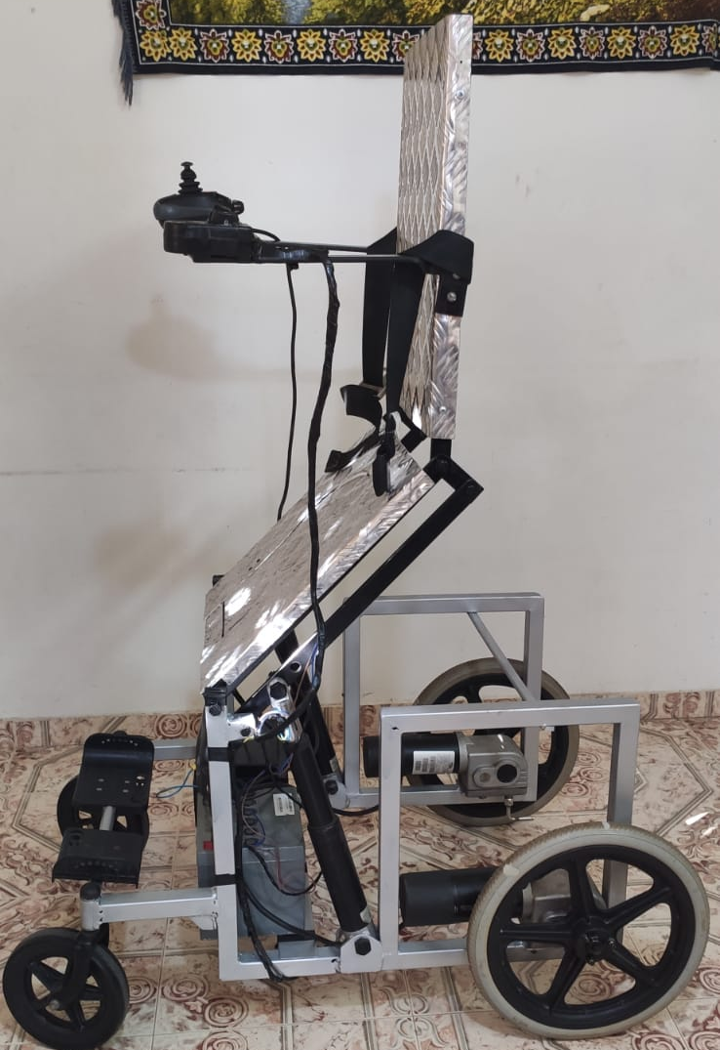
Comparison
Advantages
Lower Price
Two ideas
locally manufacturing
Wheelchair Price
Electrical standing wheelchair (Locally) | Standing and Toilet wheelchair(Prototype)
5800$ | 700$

Slide 36
Future work
Camera and screen
Water nozzle
Easy to use

Slide 37
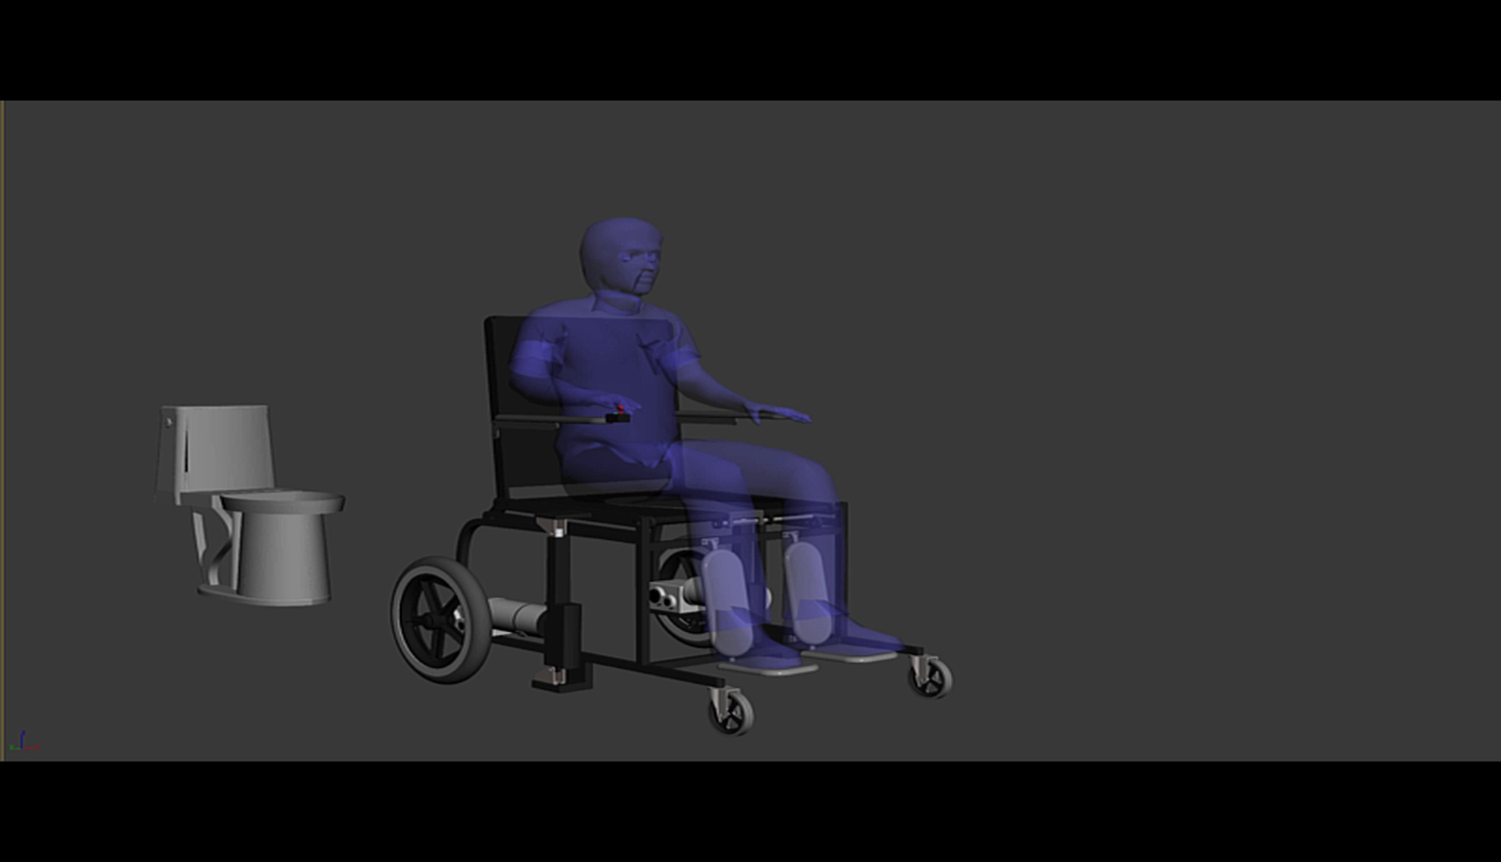

Slide 38
Thanks!
Any questions ?

