Slide 1
Smart wattmeter

Slide 2
INTRODUCTION
1.1Overview
Smart watt meter is a very important way to make our life easy and cheaply.
To me, my home is a collection of existing open source software, some consumer-level hardware, and small pieces of glue code that make them all interact. The magic happens in the way they are combined, and it’s those secrets I’ll be exposing in this book.
1.2 Existing Problem
In our lives we sometimes need to control electrical devices remotely when we are not close to them so in our project we used wireless transmitter and receiver (transceiver) to do this.
1.3Objectives
We aim to make the life more easier and cheaply .

Slide 3
Point of the project
Measure the power(software calculation).
Using Arduino to read value (software ).
Hardware design.
Implementation a control system over a range.
Using transceiver and Arduino to control loads(hardware).

Slide 4
tools
1-Transceiver(NRF 24L01).
2-Instrument transformer and we use:
1.Current transformer.
2.Voltage transformer.
3-Relay to control load.

Slide 5
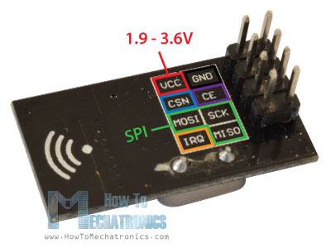
1.Wireless Transceiver (nRF24L01).

Slide 6
1-This circuit is a 2.4 GHz transceiver with a built in antenna.
2- The board communicates with the Arduino using SPI. This device allows two Arduinos to talk to each other such that either device can transmit or receive data.
3-The device uses communication addresses called the "pipe". To communicate the transmitter and receiver must have the same "pipe" address. Any receiver that has the same address as the transmitter will receive data.

Slide 7
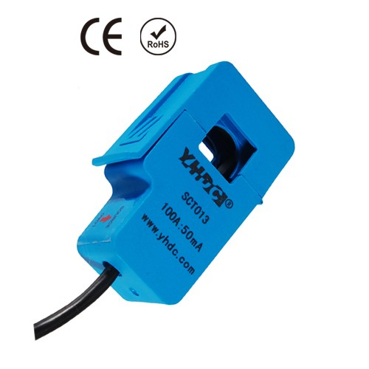
Current clamp meter).)2.Current transformer

Slide 8
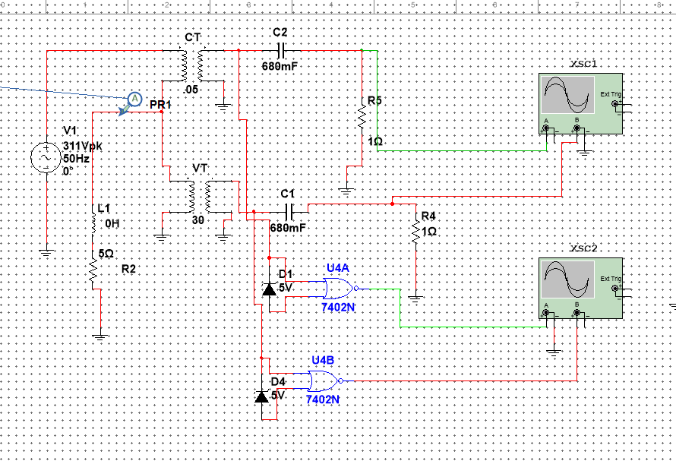
Software Circuit design

Slide 9
Software power table
Load | Volt(v) | Current(A) | Ts(ms) | p.f | Power(w) | figure
R=50 L=100m | 220 | 3.65 | 1.623 | .87 | 698.6 | 1.1 1.2
R=10 L=100m | 220 | 6.5 | 3.49 | .496 | 652 | 2.1 2.2
R=10 L=0 | 220 | 19.7 | .74 | .97 | 4203 | 3.1 3.2
R=50 L=400m | 220 | 1.6 | 3.99 | .31 | 109 | 4.1 4.2
R=2 L=0 | 220 | 69.9 | .99 | .96 | 14763 | 5.1 5.2
R=100 L=0 | 220 | 2.17 | .499 | .987 | 472 | 6.1 6.2
R=200 L=200m | 220 | 1.04 | 2.66 | .684 | 156.6 | 7.1 7.2

Slide 10
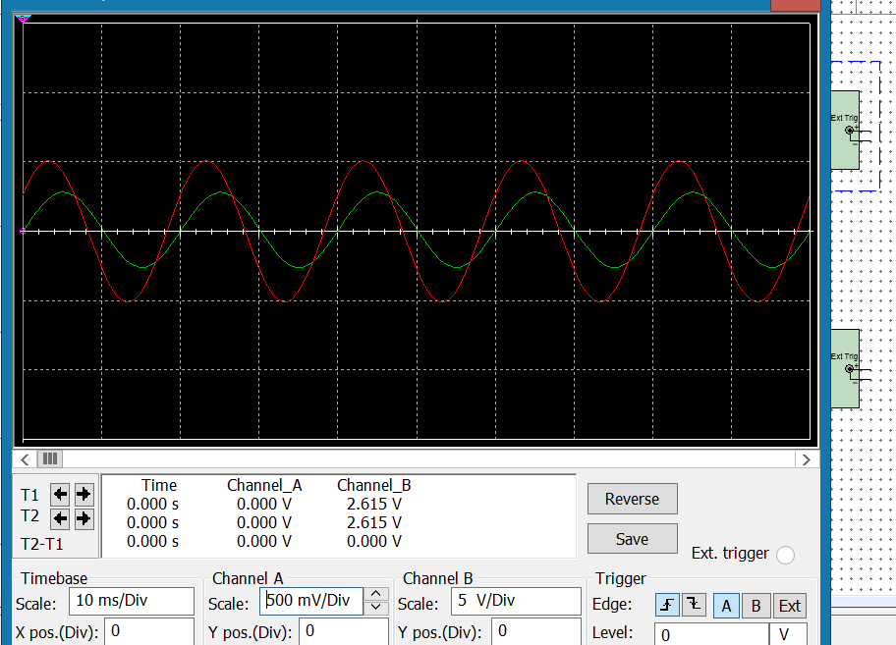
Results
(R=50 L=100mH)voltage and current

Slide 11
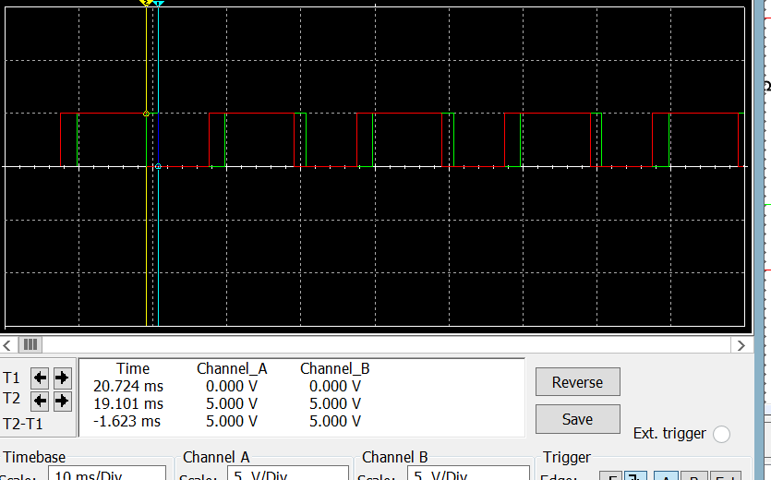
(R=50 L=100m)phase angle

Slide 12
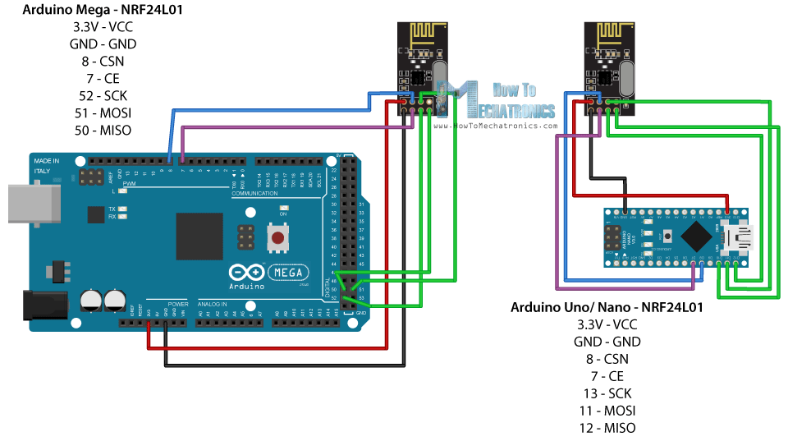
1-Wireless Transceiver (nRF24L01) connection with Arduino

Slide 13
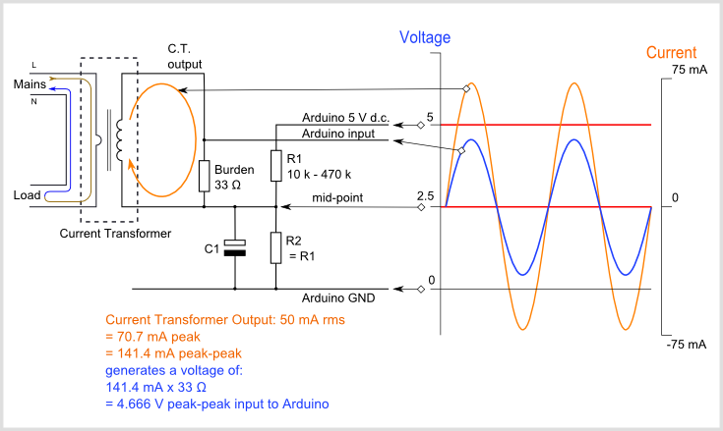
.2-CURRENT transformer

Slide 14
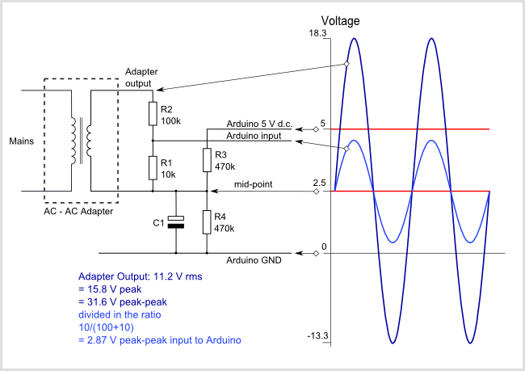
.3-Voltage transformer

Slide 15

Project block diagram
CURRENT SIGNAL
Control load
Arduino 1
VOLTAGE SIGNAL
pf
I
v
POWER
transreciver1
transreciver2
arduino2
ORDER

Slide 16
Hardware design table
Load | Volt(v) | Current(A) | p.f | Power(w)
Hair dry I | 220 | .38 | .97 | 81.77
Hair dry II | 220 | 1.27 | .97 | 376.9
Hair dry III | 220 | 3.26 | .97 | 695.01
Hair dry IIII | 220 | .86 | .97 | 183
Hair dry IIIII | 220 | 4.79 | .97 | 1022
Hair dry IIIIII | 220 | 8.53 | .97 | 1798
Water heater | 220 | 8.89 | .98 | 1958

Slide 17
The code process
CURRENT AMP
TIME DIFFERENCE(PF)
VOLTAGE AMP
POWER
T.C1 READ POWER
SEND DATA
T.C2 RECIVE DATA
SHOWS
ARDUINO 2:GIVE ORDER by T.C2
SEND
T.C1 RECIEVE DATA
ARDUINO 1 :CONTROL LOAD

Slide 18
THE VIDEO

