Slide 1

Faculty of Engineering and Information Technology
Civil Engineering Department
Design of Om-Salama Street in Nablus City
Dec-2019

Slide 2
Prepared by:
Jinan Turkman
Sahar Antari
Hadeel Yassin
Under Supervision of:
Prof. Sameer Abu-Eisheh

Slide 3
Study Area
Objectives
Methodology
Data collection and analysis
Design control and criteria
Geometric design of roads facilities
Cost estimation
Conclusion and Recommendations

Slide 4
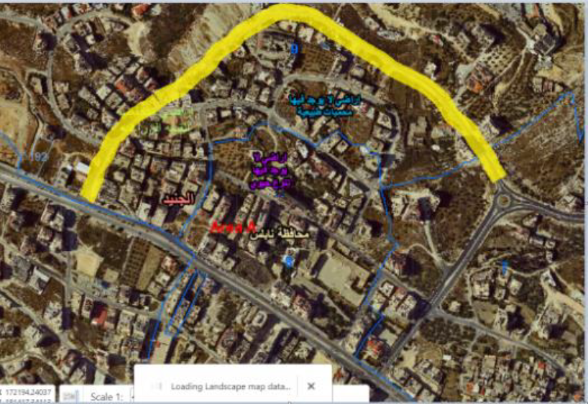
Study Area
Om- Salama street
Rafedia-PALTEL Intersection
Om-Salama Roundabout

Slide 5
Importance of the project
Reduction in traffic volumes and the resulting congestion and delay on both Tunis and Rafedia Streets.
2) The opened sections have low design standards, which need to be upgraded to solve the associated challenges.
3) By designing Om-Salama Street a new access for Rafedia main Street will be provided, as well as for nearby developments.

Slide 6
Objective
The main objective of this project is to propose a proper new design for the planned Om-Salama Street, but not yet totally opened starting from Om-Salama roundabout on Tunis Street to Rafedia main Street.

Slide 7
Methodology
Reconnaissance visit to the street location
Collecting available information such as: contour maps and Master Plan from Nablus Municipality
Conducting field studies such as manual counts for traffic volume study, delay and inventory study
Analysis and evaluation of traffic existing conditions
Designing the horizontal, vertical alignment, and typical cross-sections of the road and intersections using Civil 3D software
Proposing of the proper traffic control devices
Estimating the quantities and the cost of implementation
Identify the design criteria

Slide 8
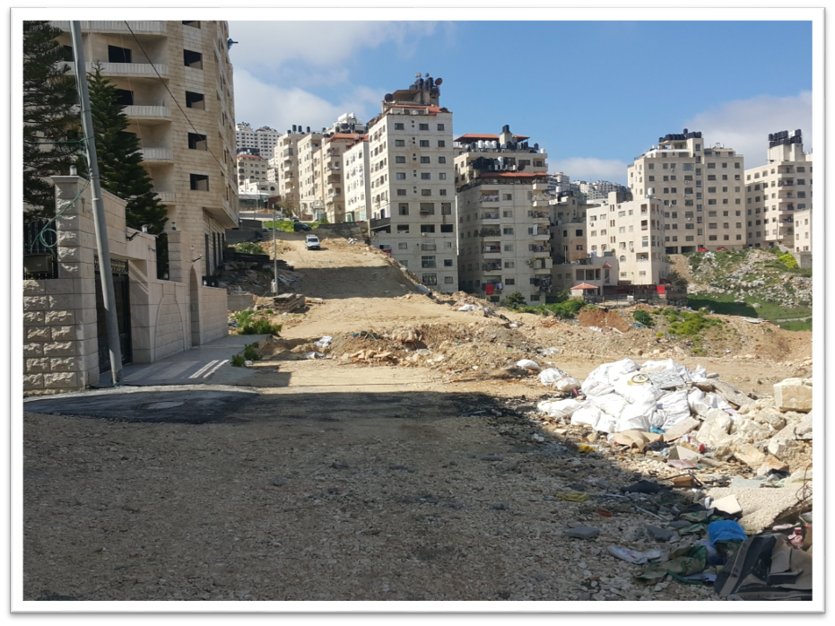
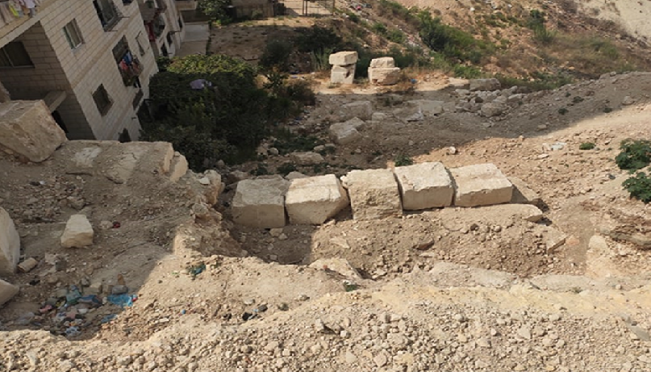
Data collection and analysis
Reconnaissance visit

Slide 9
Origin-Destination study
Section of the study is starting from Rafedia PALTEL intersection to Tunis Street through Arabic Bank. The results as follow:
The number of downward cars passing through Rafedia and Tunis Streets in the peak hour =183 vehicle.
Total number of downward cars passing through Rafedia then Tunis Street in the peak hour =115 vehicle.
Then, percent of vehicles that use both streets=62.84%
Total number of upward cars passing through Tunis to Rafedia Street in the peak hour =255 vehicle.
Total number of downward cars passing through Rafedia then Tunis Street in the peak hour =166 vehicle.
Then, percent of cars using both streets=62.74%

Slide 10
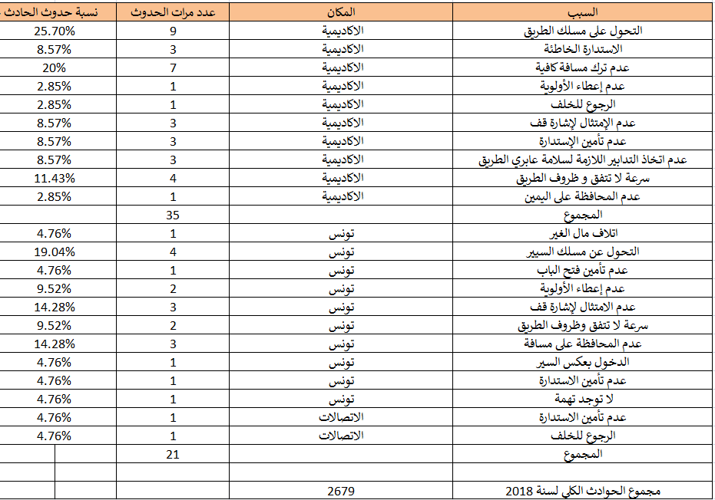
Accidents on Rafedia and Tunis Streets
Depending on Nablus police station, 35 accidents occurs on University Street with different reasons and 19 accidents on Tunis Street in 2018.

Slide 11
Results of PHV
Intersection | Peak Hour | PHV (vph)
Om-Salama Roundabout | 7:30-8:30 a.m. | 1200
Rafedia intersection | 7:30-8:30 a.m. | 2860
Intersection 1 | 7:30-8:30 a.m. | 291
Intersection 2 | 7:30-8:30 a.m. | 433
Intersection 3 | 7:30-8:30 a.m. | 198

Slide 12
Level of service
Name of intersection | LOS
Rafedia-PALTEL intersection | H
Intersection 1 | A
Intersection 2 | A
Intersection 3 | A
Om-Salama roundabout | D

Slide 13
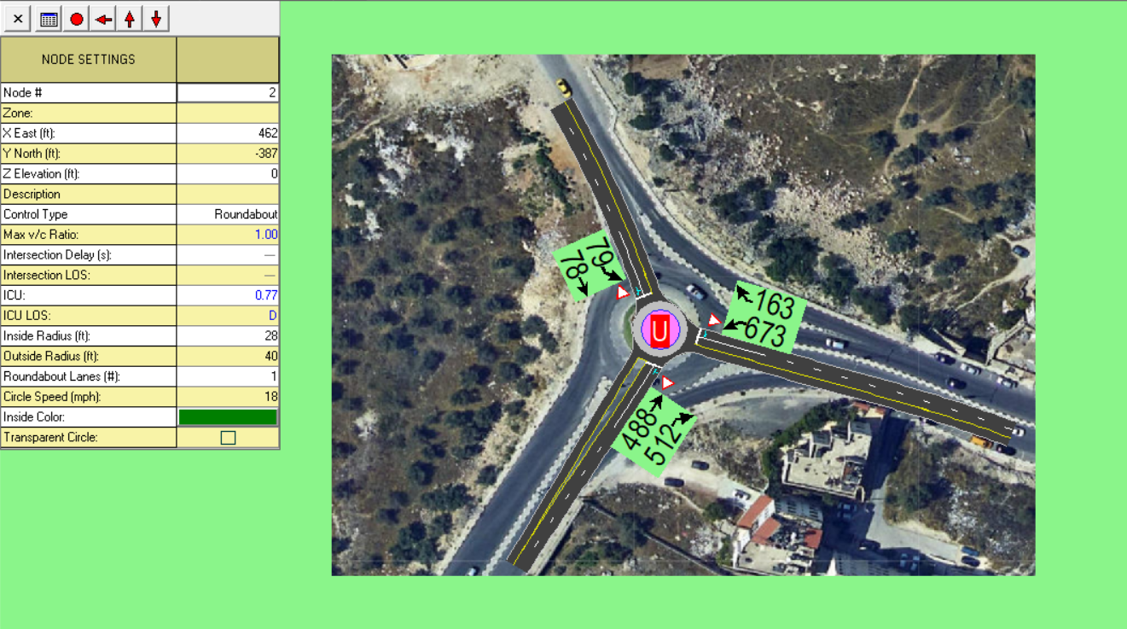
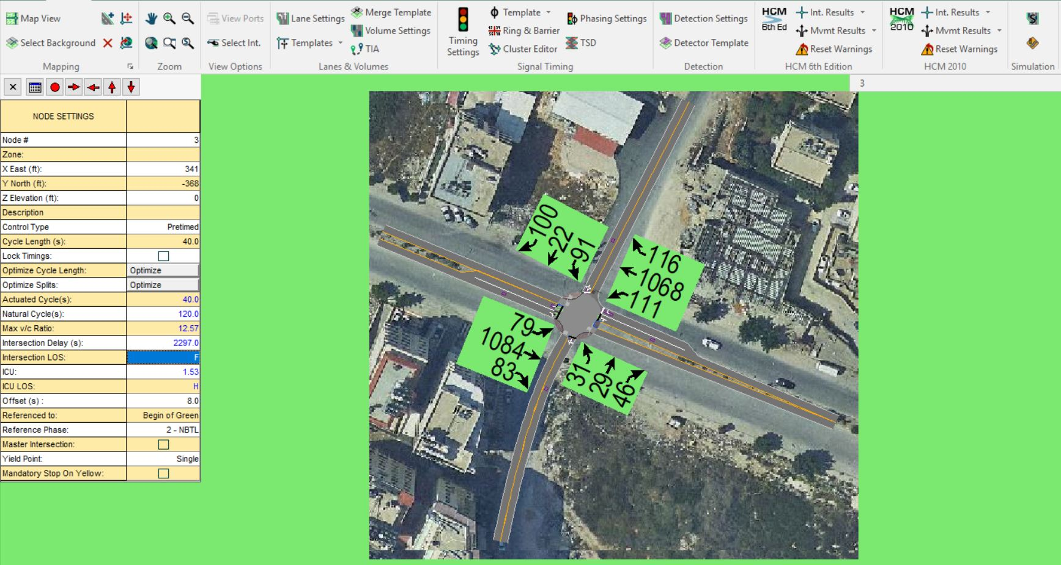
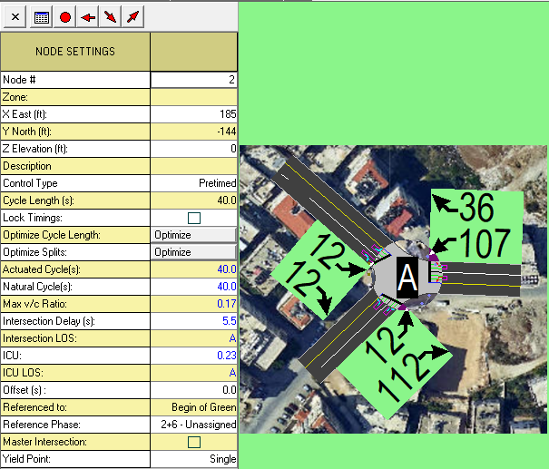
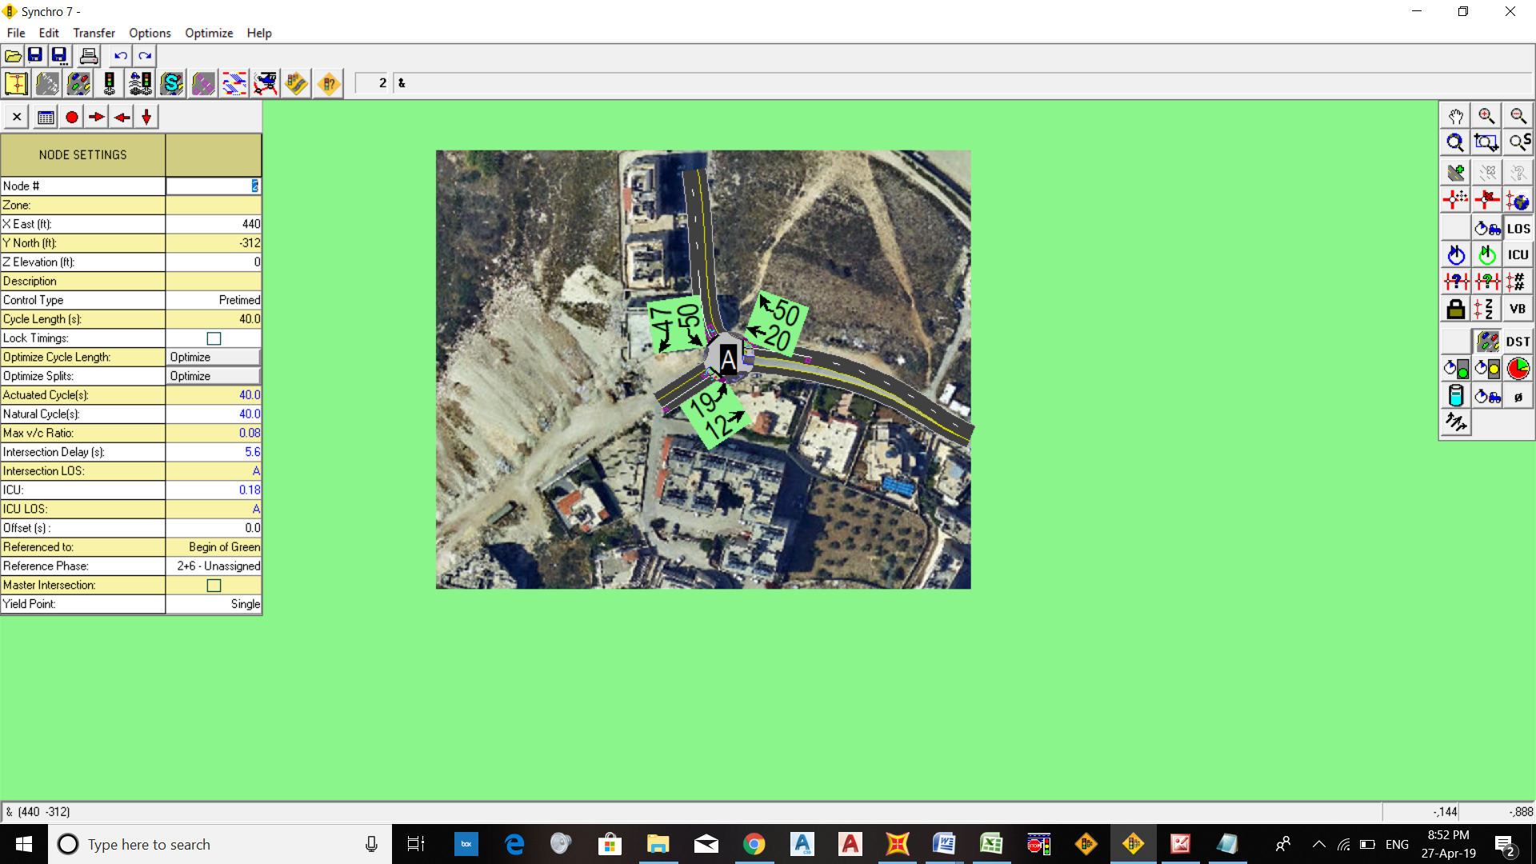
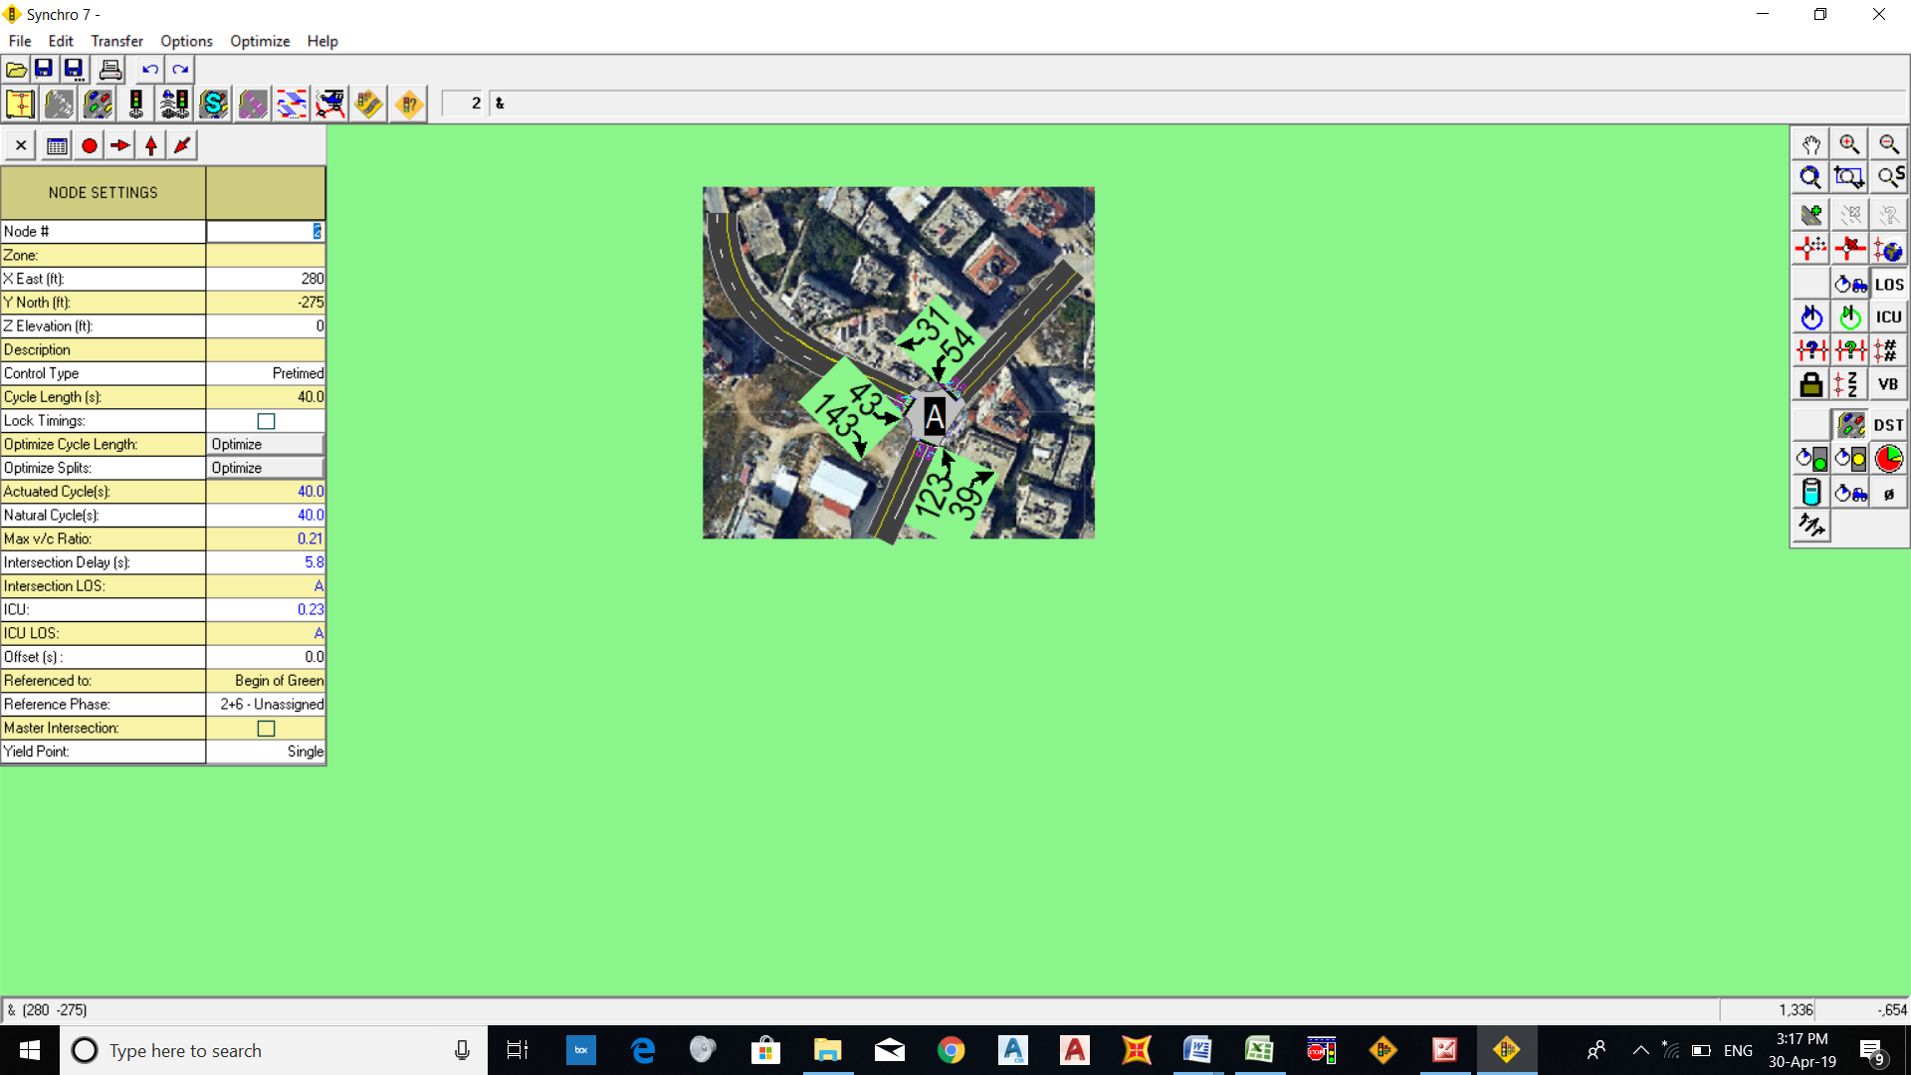

Slide 14
Delay and travel time
Travel time starting from Rafedia PALTEL intersection through Arabic Bank on Tunis to the center of city= 5:14
Actual travel time for the same previous intersection= 7:60
Then, Delay =2:46 minutes.
Travel time starting form center of city through Om-Salama to Rafedia main Street at Rfedia PALTEL intersection = 4:47
Actual travel time= 7:15
Then, Delay approximately= 3:32 minutes

Slide 15
Future traffic volume on Om-Salama Street
The design volume=V₀*(1+r) ^{n}
=656*(1+0.056)²⁰
=1950 vehicle/hr for first direction.
The design volume=V₀*(1+r) ^{n}
=360*(1+0.056)²⁰
=1070 vehicle/hr for second direction.

Slide 16
Design Criteria
Item No | Item Description | Used
1 | Functional Classification | Urban Collector Road
2 | Design Speed | 50 Km/hr
3 | Design Vehicle | SU-9
4 | Stopping sight distance | 65 m
5 | Max Grade | 11% and 12%
6 | Supper elevation | 6%
7 | Width of Lane | 3.5
8 | No. of Lanes/ direction | 2
9 | Cross Slope | 2%
10 | LOS (after 20 years) | D

Slide 17
Geometric design of highway facilities
Design of the horizontal alignment:
NO | Type | Start Station | End Station | Length | Radius | Minimum Radius | Design Speed
1 | Line | 0+000.00m | 0+057.34m | 57.339m |  |  | 50 km/h
2 | Curve | 0+057.34m | 0+145.26m | 87.920m | 250.000m | 86.000m | 50 km/h
3 | Curve | 0+145.26m | 0+289.80m | 144.543m | 700.000m | 86.000m | 50 km/h
4 | Line | 0+289.80m | 0+388.64m | 98.835m |  |  | 50 km/h
5 | Curve | 0+388.64m | 0+524.23m | 135.590m | 112.000m | 86.000m | 50 km/h
6 | Line | 0+524.23m | 0+694.94m | 170.713m |  |  | 50 km/h
7 | Curve | 0+694.94m | 0+743.00m | 48.059m | 140.000m | 86.000m | 50 km/h
8 | Line | 0+743.00m | 0+846.10m | 103.104m |  |  | 50 km/h
9 | Curve | 0+846.10m | 0+880.44m | 34.340m | 100.000m | 86.000m | 50 km/h
10 | Line | 0+880.44m | 0+913.91m | 33.468m |  |  | 50 km/h

Slide 18
B. Design of the vertical alignment
No. | PVI Station | PVI Elevation | Grade In | Grade Out | Profile Curve Type | Profile Curve Length | K Value
1 | -0+000.74m | 568.707m |  | -2.40%
2 | 0+028.62m | 568.003m | -2.40% | -11.35% | Crest | 58.000m | 6.48
3 | 0+106.77m | 559.134m | -11.35% | -16.00% | Crest | 61.000m | 13.1
4 | 0+199.39m | 544.311m | -16.00% | -13.54% | Sag | 41.000m | 16.644
5 | 0+308.75m | 529.502m | -13.54% | 1.25% | Sag | 71.000m | 4.8
6 | 0+636.34m | 533.598m | 1.25% | -12.51% | Crest | 97.000m | 7.049
7 | 0+796.20m | 513.599m | -12.51% | -0.70% | Sag | 82.000m | 6.943
8 | 0+886.78m | 512.965m | -0.70% | -4.68% | Crest | 49.000m | 12.313
9 | 0+914.17m | 511.683m | -4.68%

Slide 19
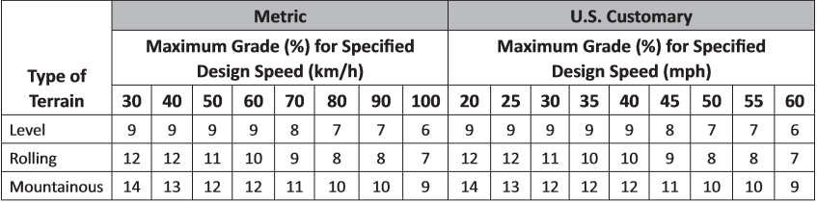
Grades
The entrances of buildings along the street should be taken into consideration and to control cut and fill process. This resulted in maximum grade of 16%.

Slide 20
Cross section element design
It was observed that there is a need for retaining wall at some locations at the left side of the road as there was more than 3 meter fill at these locations. The retaining wall was from boulders not reinforced concrete. The following are range stations where the retaining wall was placed.
1- 0+220 to 0+400
2- 0+560 to 0+660

Slide 21
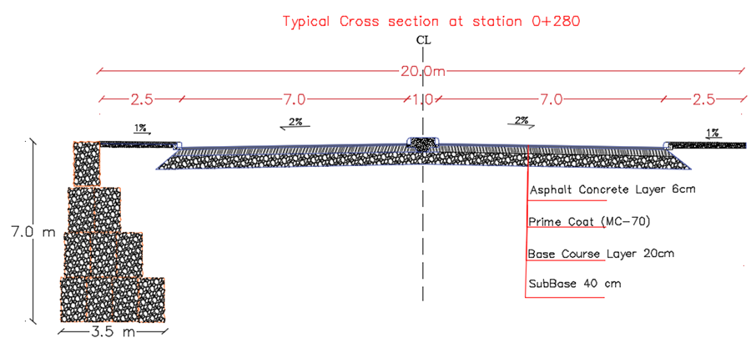

Slide 22
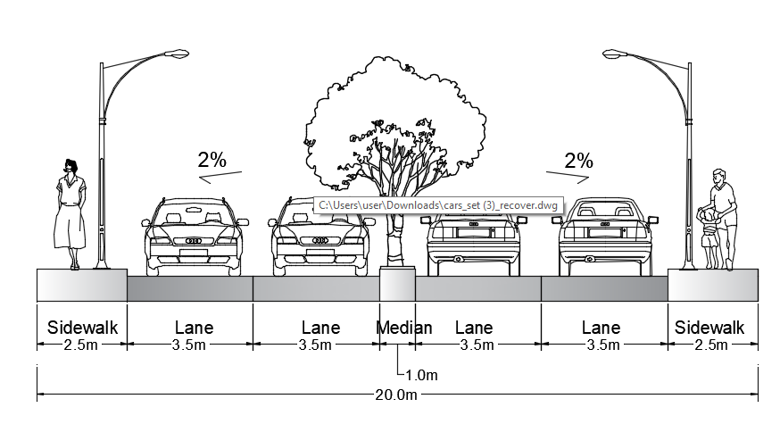
Two main cases are used along Om Salama Street.
First Case: Two lanes in each direction with a 1m width of median and 2.5m sidewalk

Slide 23
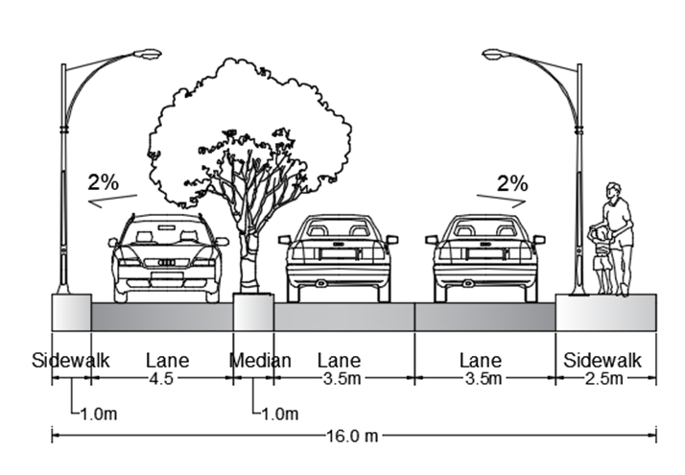
Second Case: This case was used as the width of Om Salama decreased from 20 m to 16.0 m. It is from station (0+840) to (0+914)

Slide 24
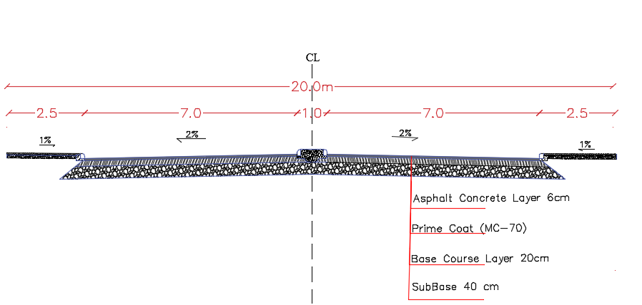
Pavement design
Base coarse= 40 cm.
Base coarse= 20cm.
Asphalt= 6cm.

Slide 25
INTERSECTIONS AND ROUNDABOUT DESIGN
For Om Salama Street the intersections were at grade intersection with three legs. There were six internal intersections along the street and two roundabouts, at the beginning and end points.
Geometric and channelization of intersection
The internal ones were designed using Civil 3D software. Also, vehicle tracking (single unit truck SU-9) during design process.

Slide 26
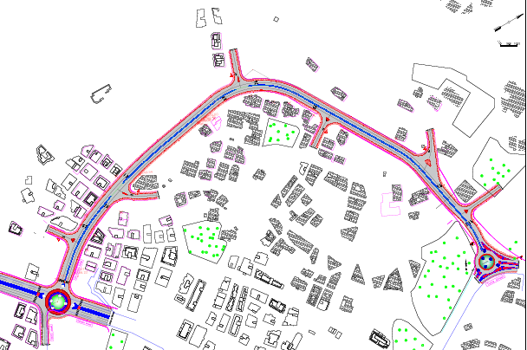
Locations of intersections (1-6)
N
Intersection 4
Intersection 3
Intersection 2
Intersection 5
Intersection 6
Intersection 1

Slide 27
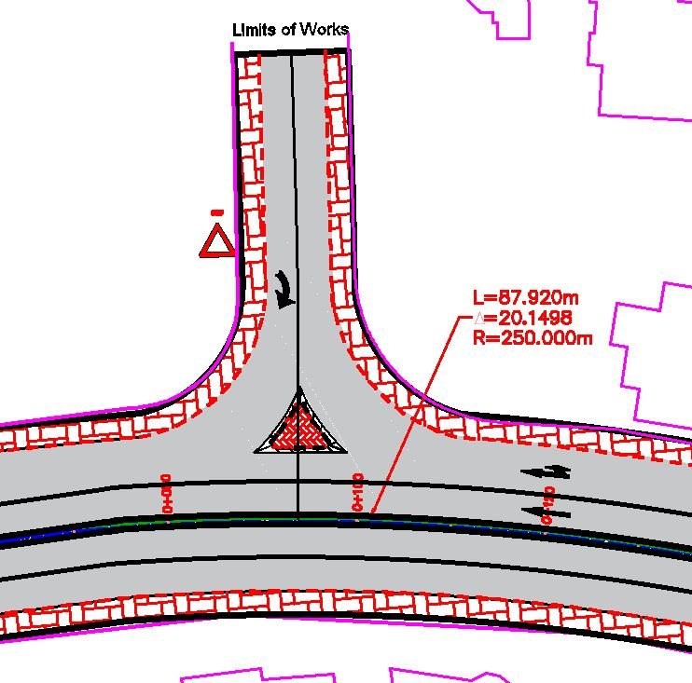
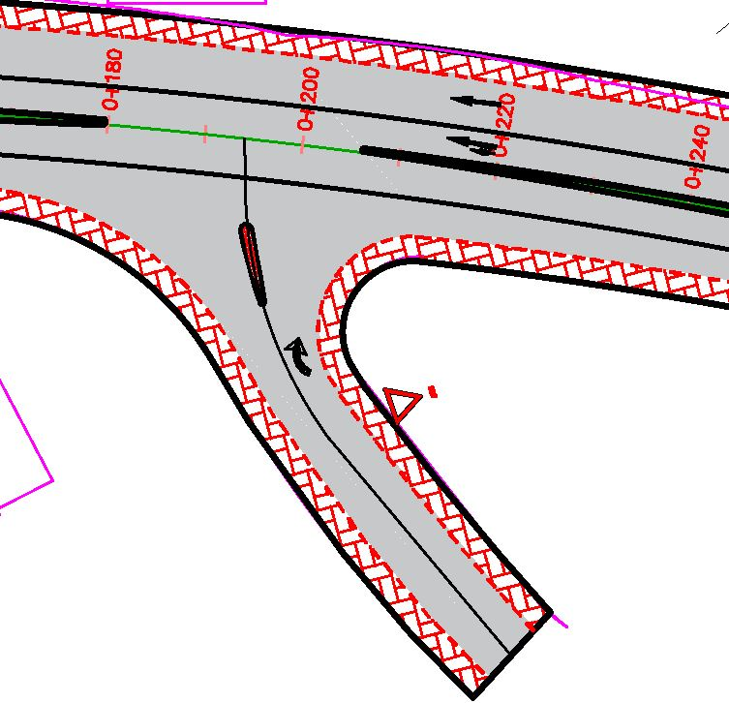
Intersection 1
Intersection 2

Slide 28
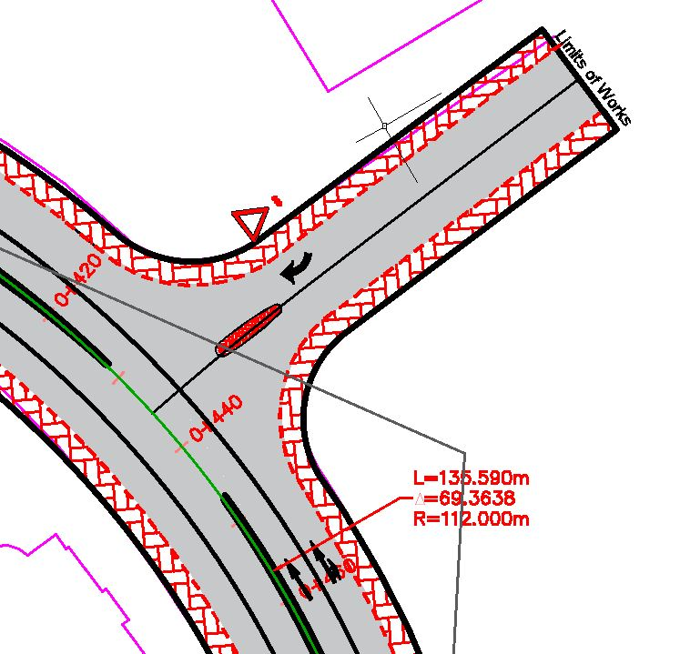
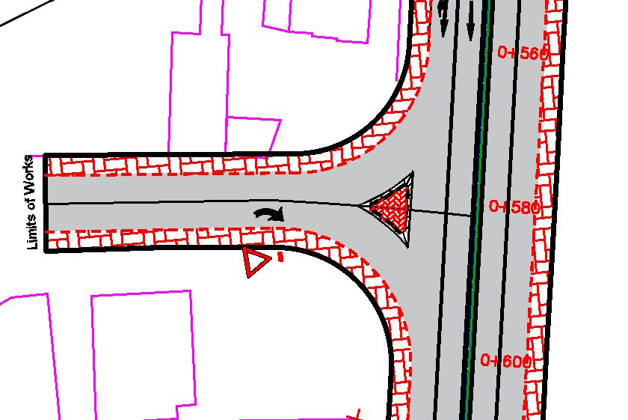
Intersection 3
Intersection 4

Slide 29
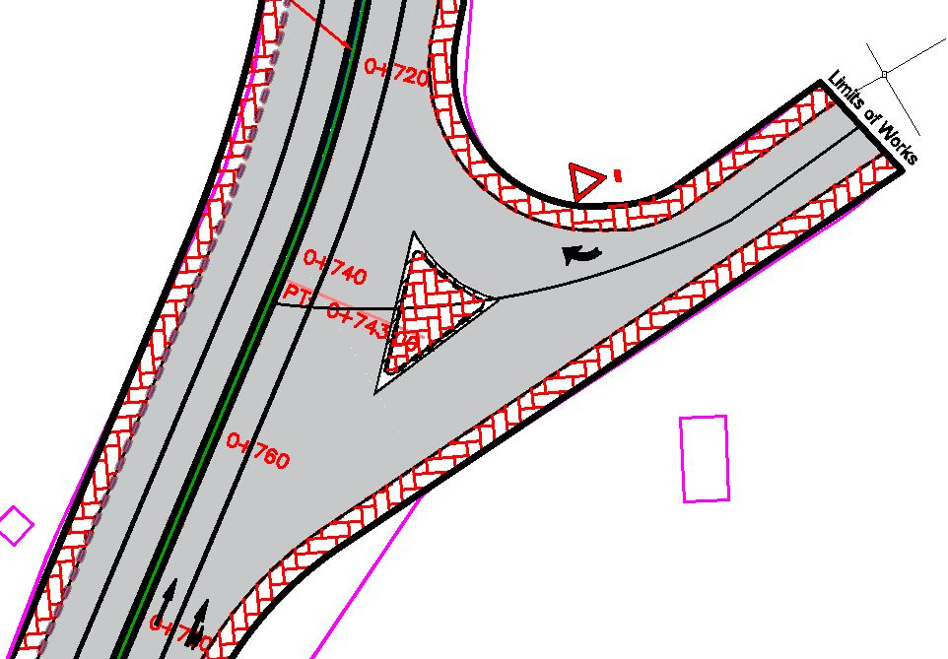
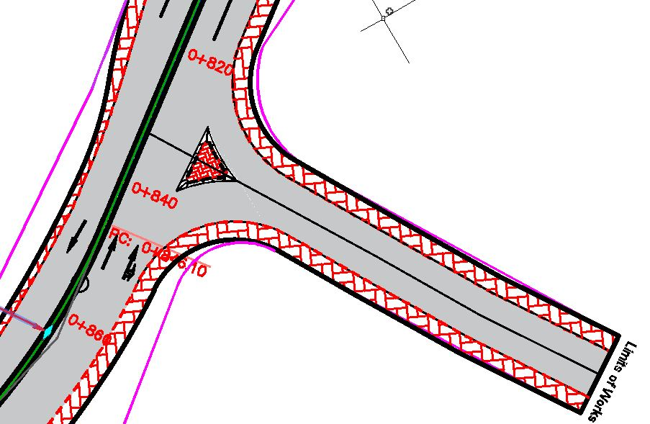
Intersection 5
Intersection 6

Slide 30
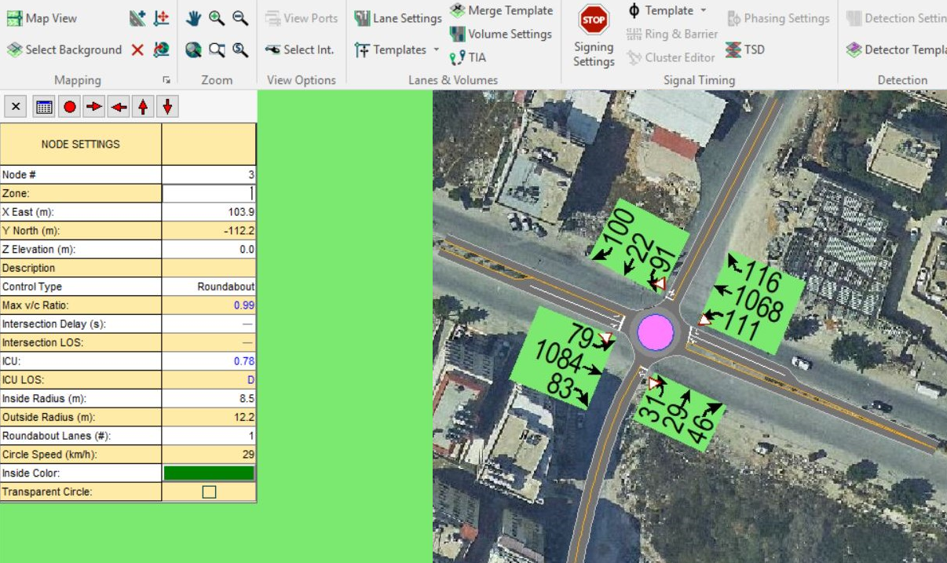
Rafedia-PALTEL Roundabout
If a roundabout is placed at the intersection of Rafedia, it will rise from H to D

Slide 31
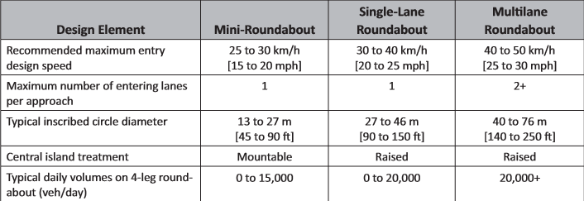
Rafedia-PALTEL Roundabout

Slide 32
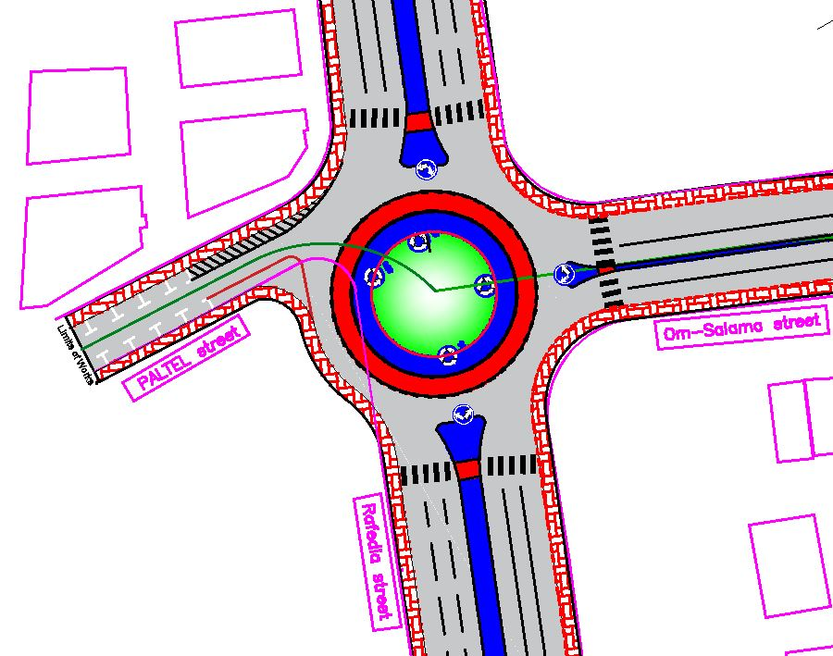
Rafedia-PALTEL Roundabout

Slide 33
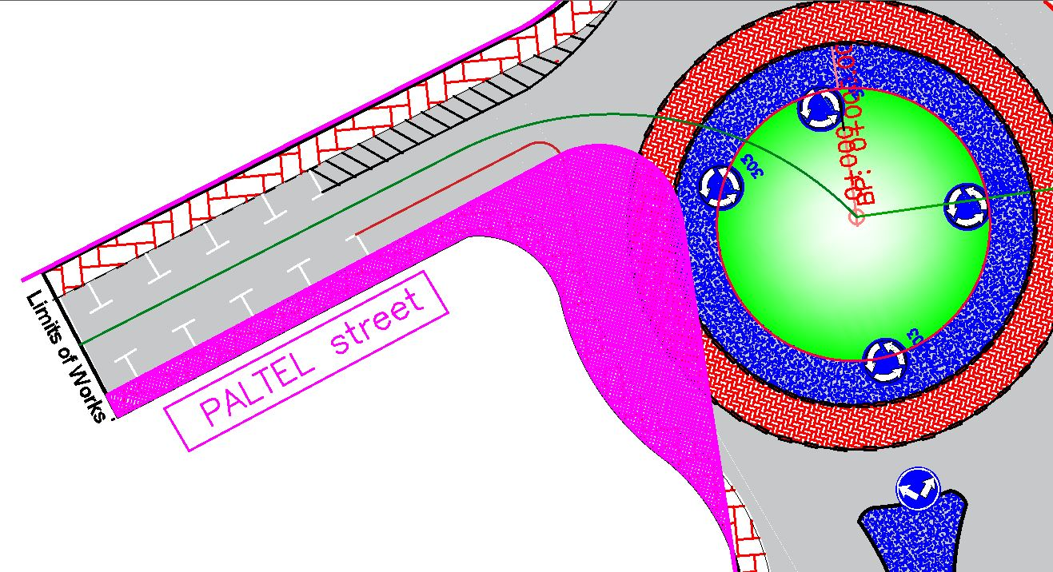
An area 310.2 m2 is needed to be taken from the owners of a nearby plot at PALTEL road

Slide 34
Om-Salama Roundabout
The cross section was adjusted from 4 lanes to 3 lanes.
This transition was by using taper with 1:10 ratio

Slide 35
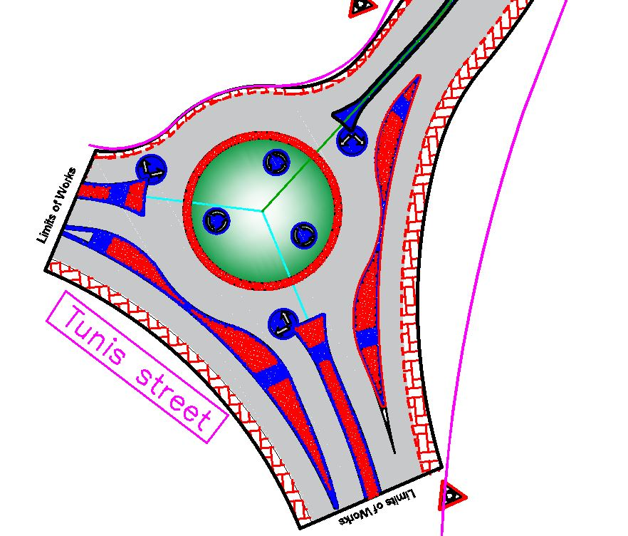
Om-Salama Roundabout

Slide 36
Cost Estimation
Description | Unit | Quantity | Cost/Unit (NIS) | Total (NIS)
Cut | m³ | 240 | 15 | 3600
Fill | m³ | 460 | 15 | 6900
Sub-base course | m² | 17680 | 15 | 265200
Base course | m² | 17680 | 18 | 318240
Asphalt layer | m² | 14260 | 36 | 513360
Guard rail | m | 280 | 350 | 98000
Retaining wall | m² | 1470 | 875 | 1286250
Curbstone | m | 4660 | 50 | 233000
Sidewalk interlocking blocks | m² | 6752 | 70 | 472640
Traffic signs | no. | 13 | 300 | 3900
Pavement marking | m | 2500 | 18 | 45000
Total Cost of Project |  |  |  | 3,246,090

Slide 37
Conclusion
Reduce the large traffic volume, congestion and delay on Tunis and Rafedia street specially at their intersection, as Rafedia Street is considered as one of most important streets in Nablus City.
Provide a new access point for Rafedia main street and the nearby development.
It is expected this road will facilitate the development in the nearby area.
Total cost of the project for the road reached 3,246,090 NIS.

Slide 38
Recommendations
Nablus Municipality is encouraged to attain the needed funds to reconstruct and develop the whole Road.
Design a proper drainage system (especially at the low points on the street) in order to avoid acceptable future problems in the road layers.
Design the boulders retaining wall.
Street lighting should be installed along the street, as this is an urban road and where two sag curves design criteria (Minimum K for headlight Sight distance) could not be achieved on the street.

