Slide 1


NAJAH UNIVERSITY
SMART
HOME
SUPERVISOR: DR. SAMER ARANDI
PARTICIPANTS: MUJAHED &OSAMA

Slide 2
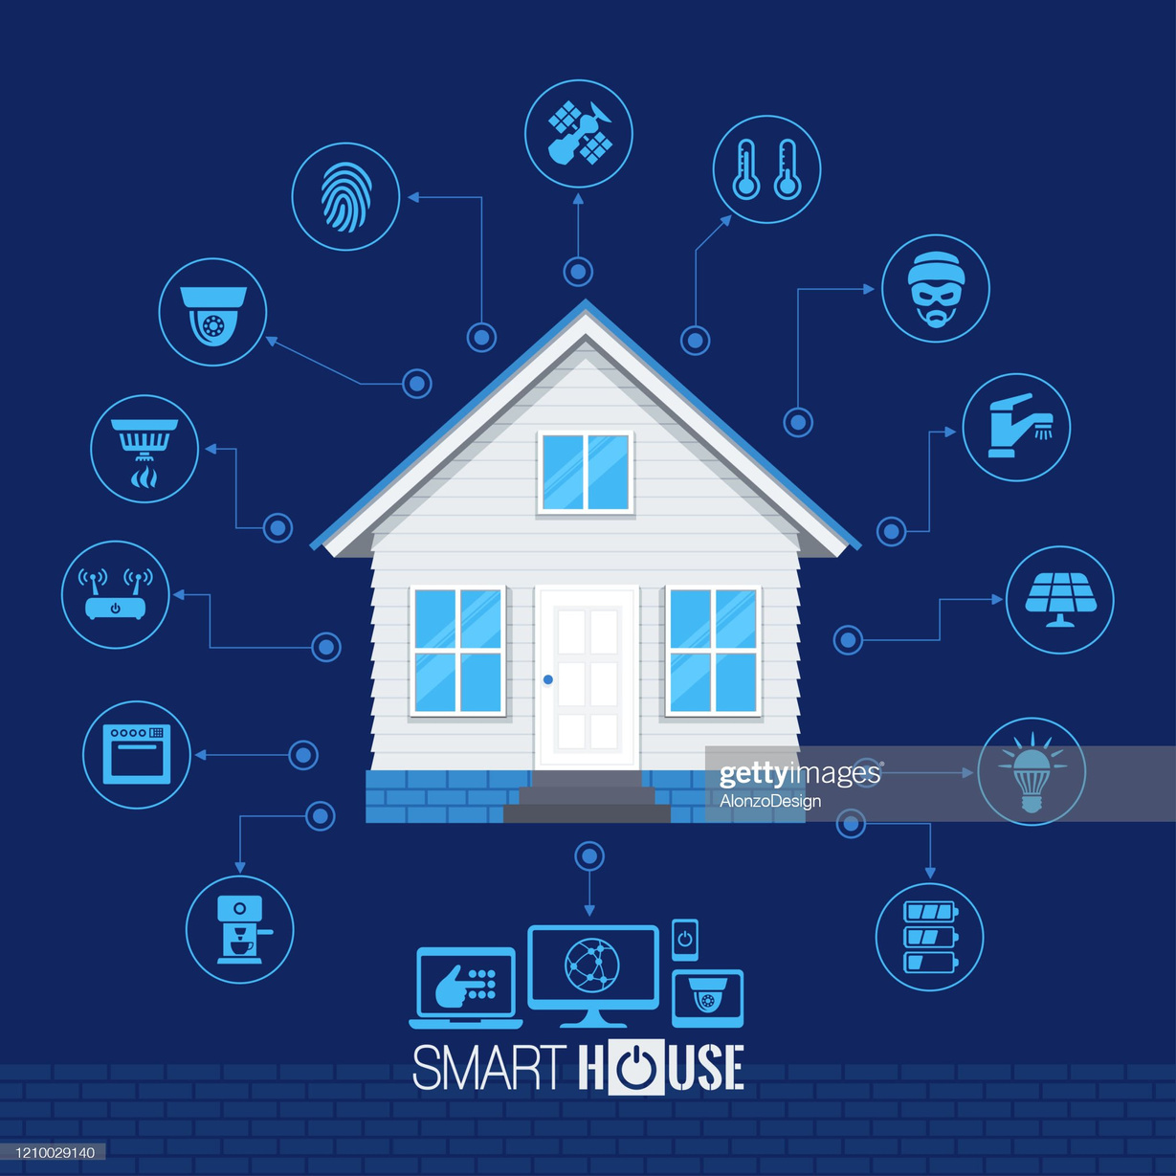
PROBLEM AND OBJECTIVE

Slide 3
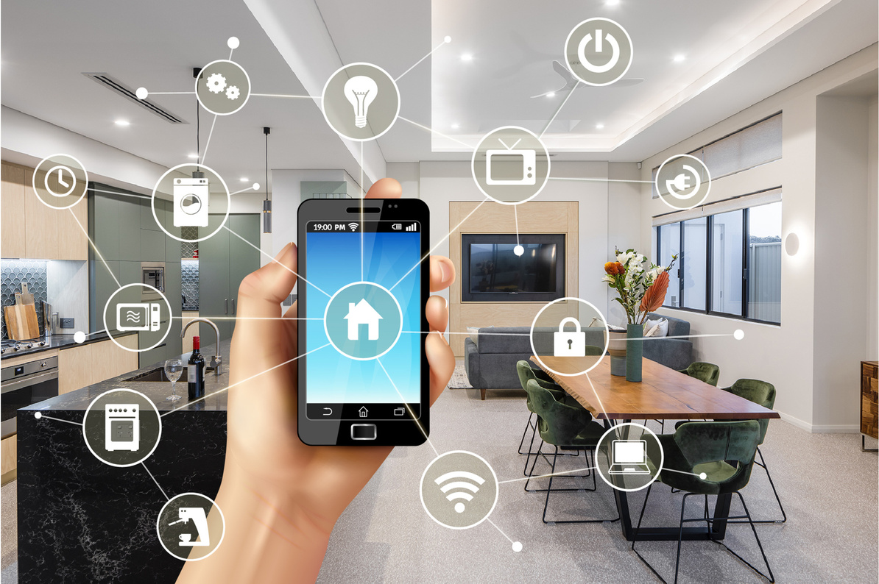
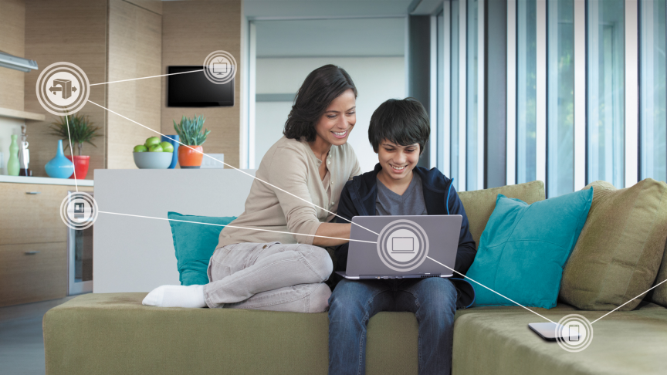
Motivation
1
TIME SAVING
It saves your time and makes you use it wisely
2
CONVENIENCE
You can count on it to do your home chores especially for disabled people.
3
ENERGY EFFICIENCY
controlled in a smart way
4
MODERNITY AND LUXURY
it is Fancy to have a smart house

Slide 4

IMPLEMENTATION
SUBSYSTEM , COMPONENT AND MOBILE APP

Slide 5
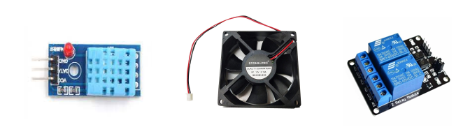
1 AIR CONDITION SYSTEM
This system is responsible for maintaining a certain temperature level.
1
HOW IT IS WORK ?
When the read temperature is greater than a certain threshold the fan will turn on, and when it’s lower it turns off. The user can control the threshold value from the mobile app.
2
TOOLS :
  Temperature Sensor
  Relay
  12v Fan

Slide 6
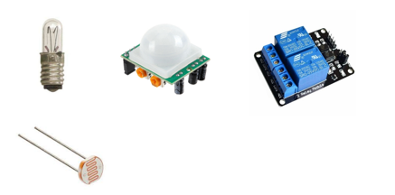
2 OUTDOOR LIGHTING SYSTEM
This system can be managed in an automatic or manual way .
1
HOW IT IS WORK ?
When a motion is detected and the luminous intensity is lower than a certain level the lamp will be on. Also, the lamp can be controlled from the mobile app.
2
TOOLS :
  12v Lamp
  Motion Sensor
  Relay
  LDR

Slide 7
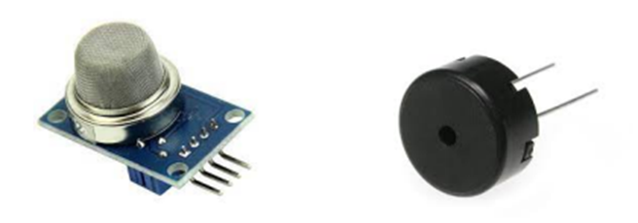
3 FIRE DETECTION AND ALARM SYSTEM
This system basically depends on smoke detection.
1
HOW IT IS WORK ?
When the smoke sensor detects smoke the system turn on the buzzer. Also, the user can turn on/off the buzzer but, still can see the detection state.
2
TOOLS :
  Smoke Sensor
  Piezo Buzzer

Slide 8
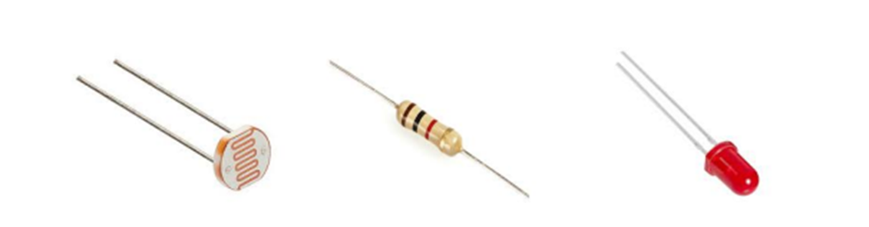
4 INDOOR LIGHTING SYSTEM:
This system can be managed in an automatic or manual way .
1
HOW IT IS WORK ?
It depends on the luminous intensity level to turn on the LEDs. Also, the user can turn it on/off from the mobile app.
2
TOOLS :
  LDR
  Resistor
  LEDs

Slide 9
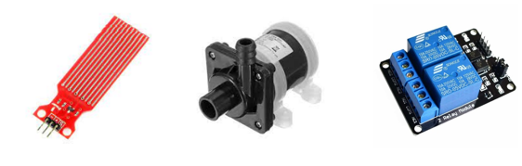
5 WATER TANK FILLING SYSTEM
The system's responsibility is to fill the water tank in an automatic or manual way.
1
HOW IT IS WORK ?
When the water level gets lower than a certain level the system will start the water pumping into the tank. Also, the user can turn on the pump manually from the mobile app.
2
TOOLS :
  Water Level Sensor
  12v pump
  relay

Slide 10
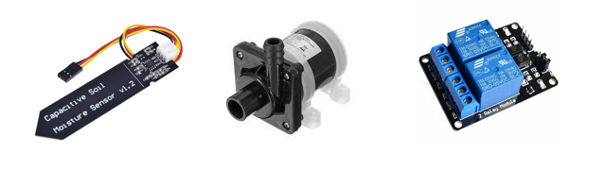
6 IRRIGATION SYSTEM
This is an irrigation system to irrigate the crops
1
HOW IT IS WORK ?
When the soil humidity is lower than a specific value the system will automatically run and start irrigate. Also , the user can contol it from the Application.
2
TOOLS :
  12v pump
  relay
  soil moisture sensor

Slide 11
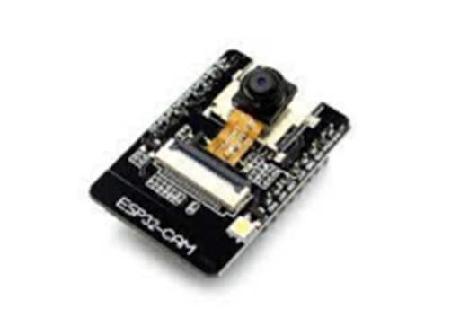
7 MONITORING SYSTEM
This system gives the user the ability to monitor his home whenever he wants.
1
HOW IT IS WORK ?
as it contains an ESP32Cam connected directly with the Android app. The user can open the Android application and start monitoring his home easily.
2
TOOLS :
  ESP32Cam

Slide 12
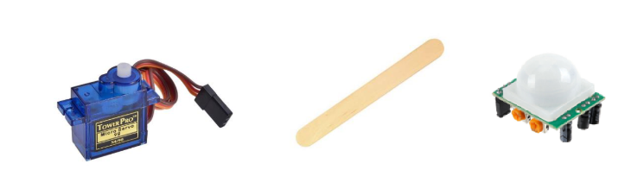
8 HOUSE GATE SYSTEM
This system is responsible of open and closing the house gate in a manual way(from the mobile app) and opening automatically by the motion sensor.
1
HOW IT IS WORK ?
The gate system work through an ice cream stick tied to the motor which stops as a barrier behind the door when it is in a closed position to prevent anyone from entering and if someone wants to enter, the stick will move away from the door. in the automatic mode, if there is a motion from the motion sensor then the gate will open, and when the motion stops the gate will close.
2
TOOLS :
  servo motor
  ice cream stick
  motion sensor

Slide 13
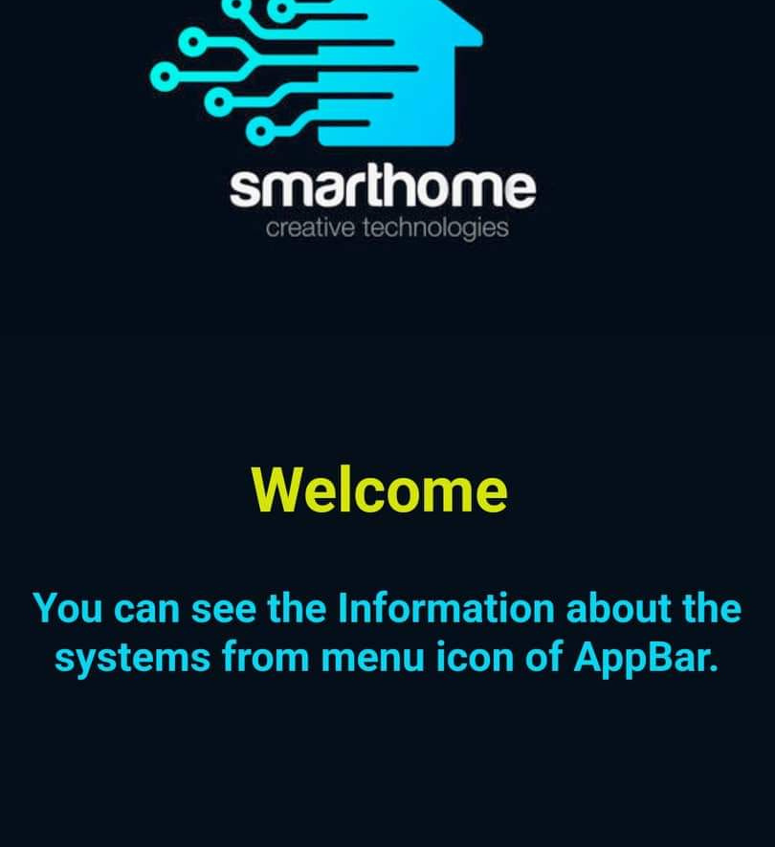
MOBILE APP.
THIS IS THE SOFTWARE WHICH
give the user to control
and monitor the house
remotely.

Slide 14

CONSTRAINS
CHALLENGES WE FACED IN THIS PROJECT

Slide 15
CONSTRAINTS
1
the lack or high price of the component .
2
Learn and master flutter language.
3
Dealing with some parts of the project that need a special process.

Slide 16
FUTURE WORK
1
Making the monitoring system more sophisticated and dependent on the movement and sound surrounding it and making it rotatable to cover more area
2
Giving the user the ability to control the windows and doors of the interior rooms
3
Increase the security of the house by setting a password to enter the house and operating an alarm if an attempt is made to open the main door by force

Slide 17
THANK
YOU

