Slide 1
CONTROL STREET Lighting
Prepared by :maram hanani

Slide 2
Out line
Why this project where selected?
Some street principle
Where should lighting pole install?
What type of lamp use in street?
About the project

Slide 3
Why ?
High power consumed by street lighting every day .
Higher cost
The main target is saving energy

Slide 4
Some principles in street
Height of pole :15 M max
Distance: 4 * height of the pole
Material used : steel
N= Eav*Area/((Rnw)*M.F
N : number of pole(street light )
Rnw: factor from catalog .
M.F : mainteace factor

Slide 5
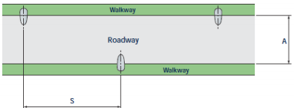
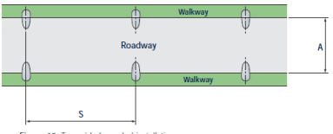
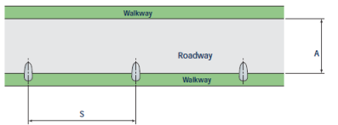
Where should lighting pole install?

Slide 6
What type of lamp use in street?
Power | Type of lamp | Type of street
2000w | Sodium | Highways
1000w | Mercury | Main street
400-250w | Matald halide | Public street
80w | Matald halide | Intenral road

Slide 7
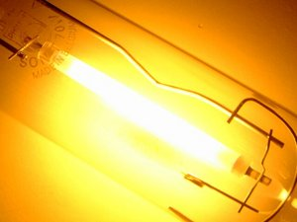
In general high pressure sodium lamps(HPS) is the most one used
the light color is mixed of golden , yellow , red
24000 hours lifetime
Efficiency:125 LM/W

Slide 8
About the project
In this project LEDs where used
Infrared
Two motion sensore
LDR
Potentiometer
Controller
In order to save energy

Slide 9

LED
Light emitting diode
Semiconductor device which produce visible light when a current pass through it
Adv
Long life time(25000+h)
Environmentally friendly
Not effected by cold temperatures‘
Controllable
The led symbol is

Slide 10
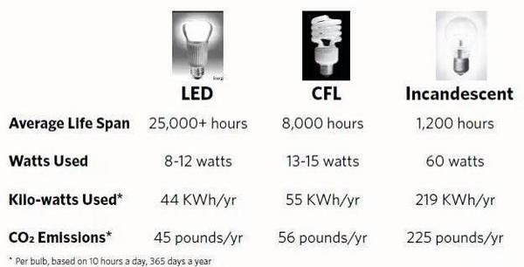

Slide 11
In this project I have use 6 culms each consist of 3LEDs
The total number of led=6*3=18 LEDs

Slide 12
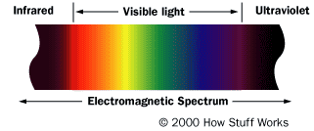
infrared
Invisible radiant energy electromagnetic radiation
The wave length is longer than the visible light
0.7-300 micrometer
Its absorb or emitted by molecules when they change there vibration movement

Slide 13
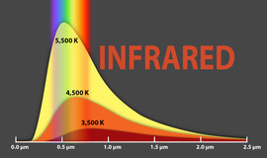
Heat and infrared

Slide 14
PIR sensore
Passive infrared
Use to detect whether human has moved in or out sensor range
Its small, inexpensive ,low power ,easy to use
Detect change in the amount of infrared radiation
Convert it to a chang in the voltage

Slide 15
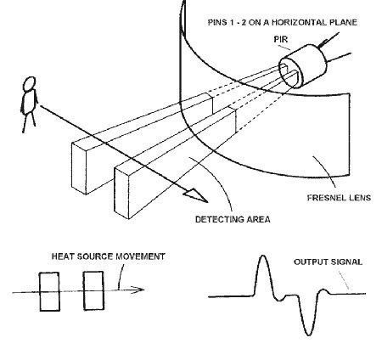

Slide 16
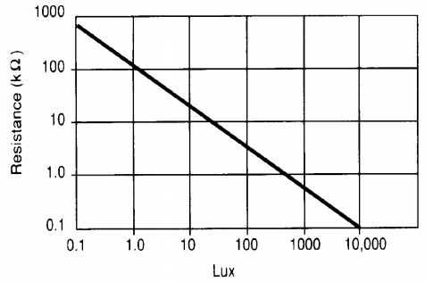
LDR
Light dependant resistance
Inversely dependant
It use an active semiconductor layer

Slide 17
Potentiometer
To Provide a variable resistance
Moving the slide of resistor lead to movement in the value
R=Row*L/A
Control the rate of the LEDs blink

Slide 18
CONTROLLER
Arduino Uno(microcontroller)
14 digital input/output pins
Crystal oscillator 16MH
USB to connect with computer

Slide 19
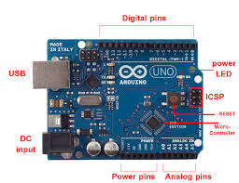

Slide 20
Result
The project

