Slide 1
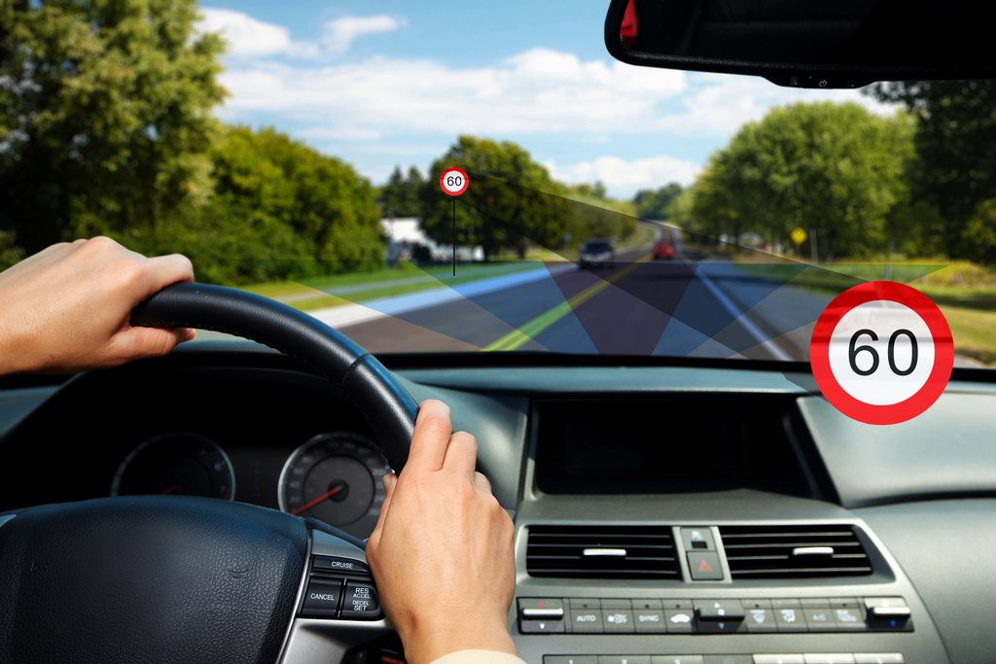
“Traffic sign recognition by using convolutional neural network “
Supervisor: Dr. Allam Mousa
Proposed by:
Sondos Khatatbeh [11821330]
Salam Nazzal [11819640]

Slide 2
Table of Contents
Abstract
Introduction
-Artificial intelligence
- Overview of the project
Methodology
-Neural network
-Network layers
-An overview of the CNN algorithm
Traffic sign recognition
-The first model
-The second model
Results And Analysis
Discussion
Conclusion

Slide 3
Abstract
In recent years there has been a rapid increase in technology that brought changes in human’s life which helps us to make tasks so easier even the complex management systems. traffic sign recognition is one of the important factor to be considered. To recognize the traffic signs we build a model using convolutional neural networks and this model will recognize the traffic signs. This algorithm is optimized by different optimizers’ algorithm such as Adam, AdaDelta, AdaGrad, RMSprop and SGD. The SGD algorithm achieved most accuracy so we consider it for optimizing our CNN model, In this project we discussed how the CNN algorithm trains the model to recognize and classify the traffic signs images by different optimization algorithms, and it is found that the SGD gives most accuracy than others. Trying new models to increase of test accuracy to do generalization very well and the final model achieved highest accuracy that is 99.446%. Camera of laptop and loading images is developed on python to test the traffic signs. We implemented this project to detect traffic signs on the road by using camera, recognize and classify them, and give the driver voice alarm containing the meaning of that signs by converting text to speech. This model can improved to detect signs in road by high quality cameras, recognize and classify them to help drivers and reduce accidents rate.

Slide 4
Introduction
Artificial intelligence
Artificial intelligence is the ability of machines to display similar intelligence to human. There are three main types of artificial intelligence: Artificial narrow intelligence (ANI) is weak or narrow AI because it displays intelligence less than the human brain, it cannot do several tasks or make intelligent decisions without human intervention, artificial general intelligence (AGI) demonstrates intelligence equal to humans, it is able to do any task that a human can, and it can solve multiple problems rather than a single one, artificial super intelligence (ASI) demonstrates intelligence exceed human intelligence so it become self-improving.

Slide 5
overview of this project
There are different types of algorithms in deep learning that we want to discuss. Every algorithm is designed to solve type of problems, we want to choose the suitable one for our project to build the model by it. We want to recognize the traffic signs and classify it by using convolutional neural network and understand how the training and validation are done by it. Before we implement this project by CNN algorithm, we want to understand about the neural network and how the CNN differs from ordinary neural network. So this report is organized as follows: in the first chapter we give an introduction of the project, in the second chapter we present the previous related works of the project, in chapter three we talk about the methodology of the project, chapter four gives the result and analysis of the implementation of the project, chapter five gives the conclusion and future work and the final chapter gives the references.
Due to the usage of in-vehicle video cameras, traffic sign detection is a factor in this project. These video cameras record any road signs, including warnings, speed limits, no overtaking signs, etc., and display them on the dashboard of the vehicle, This technology's goal is to increase driver safety, particularly when the driver is fatigued or otherwise unable to pay close attention to the road signs. Who among us hasn't occasionally known what the posted speed limit is? This is so that confusion and even distraction can result from signage that varies from part to section on a single road.

Slide 6
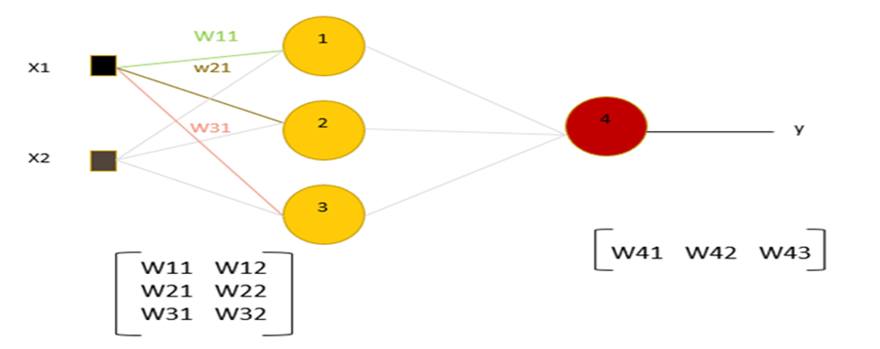
Methodology
Neural network
Neural network is computational model has a network architecture that made of artificial neurons. This structure has specific parameters that can modify it for performing certain tasks. Neural network contains of these layers: input, hidden and output layer. Single neural network is network without any hidden layer, multi-layer neural network is either shallow with single hidden layer or deep neural network with multi hidden layers. These layers contain of neurons which is mathematical functions, each input number in input layer have weight that is randomly initialized by the model, these weights are what makes each neuron unique. They are fixed during testing, but during training these are the numbers we’re going to change in order to ‘tune’ our network. The inputs are multiplied by corresponding weights and sum everything together, the result of that is a number then it is inputted to nonlinear activation function, it is function that is applied to see if the nodes active or not and enable the CNN model to learn more complex things. The neural network without activation function is just a linear regression model that means the weights and bias would simply do a linear transformation. The nodes is connected to each other that means the output of each layer in neural network is become input of the next layer.

Slide 7
An overview of the CNN algorithm
The convolutional neural network is a deep learning algorithm that commonly used for computer vision applications. It is best suited for image classification and is used to classify images into different categories to which they belong. It has been observed that CNN is more efficient and faster than a regular deep neural network for problems related to computer vision. A Convolutional Neural Network are very similar to ordinary neural networks. They are made up of neurons with learnable weights and biases which is also known as supervised learning. All the basic idea learned or used for ordinary neural networks are also applicable to CNN’s. The only difference between CNN and the ordinary neural network is that CNN assumes that input is an image rather than a vector. This vastly reduces the number of parameters to be tuned in a model. Convolutional neural networks or CNN’s are very important in the computer vision field. CNN help in running neural networks directly on images and are more accurate than many of the deep neural networks. Convolutional Nets models are easy and faster to train on images comparatively to the traditional models

Slide 8
Network layers
Convolutional layer
In this layer the input image (N-dimensional metrics) convolved with a set of convolutional kernels (filters) to generate the feature map as output of this layer.
Pooling layer
The output of convolutional layer become the input of this layer, so the feature map is sub-sampled by this layer, it takes the larger size feature maps and shrinks them to lower sized feature maps. While shrinking it always preserve the most dominant features in each pool steps.
Activation function
In CNN architecture, after each learnable layers (layers with weights) nonlinear activation layers are used, this non-linearity behavior enables the CNN model to learn more complex things. The most commonly used activation functions in CNN is (ReLU, softmax)
Fully connected layer
The output of the pooling layer is set of the feature maps, those metrics are flattened to create a vector and this vector become the input of this layer to generate the final output of CNN, this layer is used for classification.

Slide 9
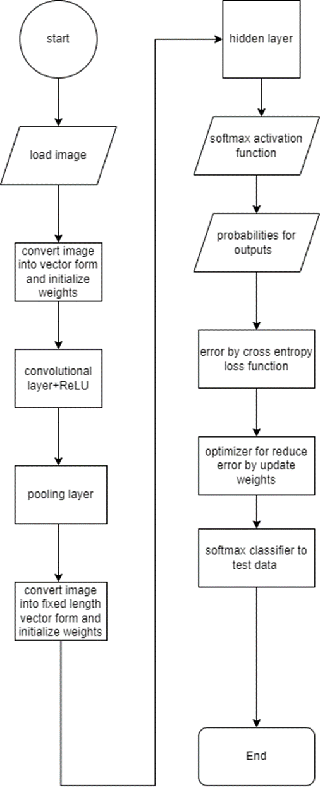
flowchart for CNN algorithm

Slide 10
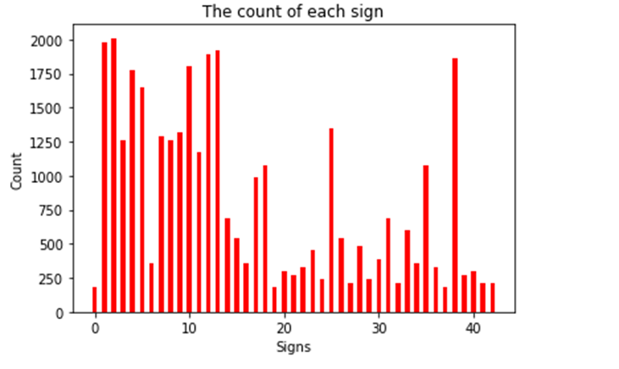
Traffic sign recognition
After the traffic sign has been detected, the recognition and classification of it is done by using convolutional neural network algorithm.
The implementation of traffic sign recognition
The dataset that we use is GTSR, it contains more than 50,000 images in total and more than 40 classes, the training data contains of 39,209 images existing in 43 classes, each class represents a specific sign. The testing data is almost 12630 images.
The number of images in each class is shown in figure:

Slide 11
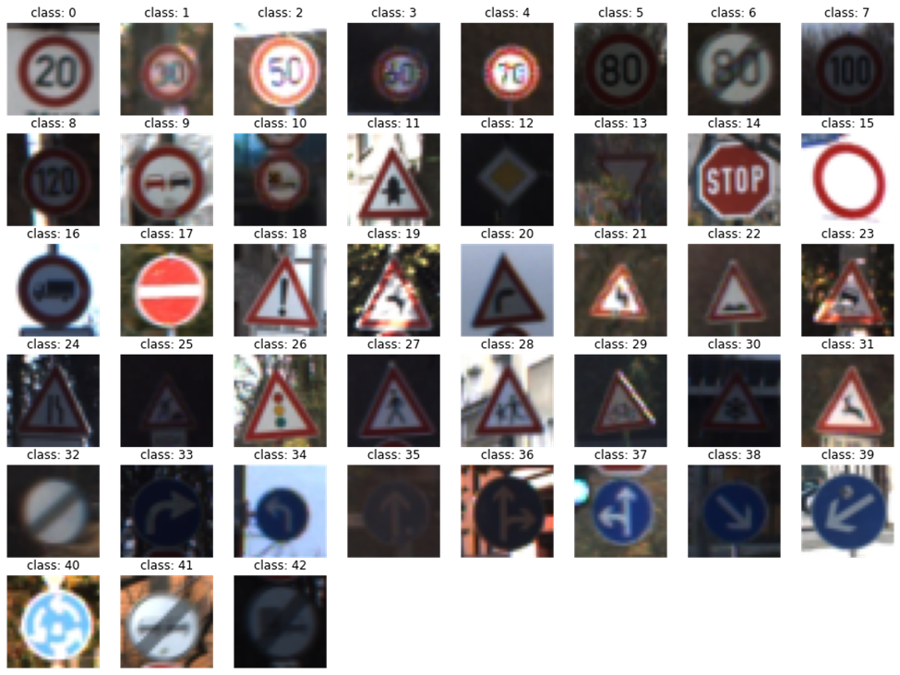
some traffic sign images in Dataset

Slide 12
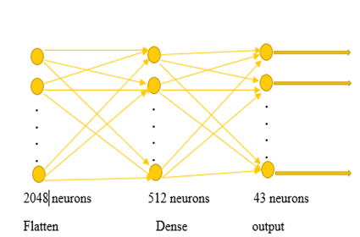
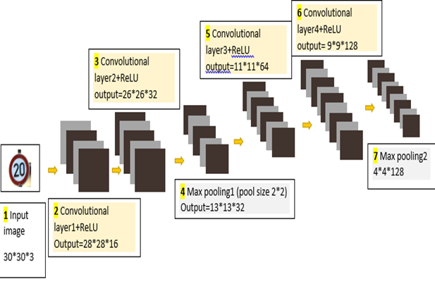
The first model
In our model the size of input image is 30*30 and we use valid padding (the size of image is shrinking because p=0), in pooling layer the pool size is 2*2
feature extraction network in first model classifier network in first model

Slide 13
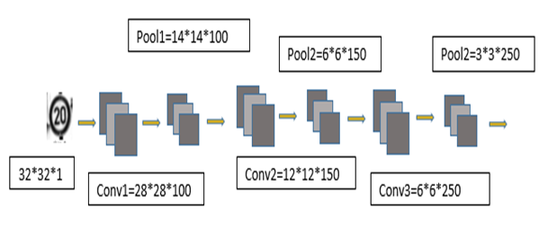
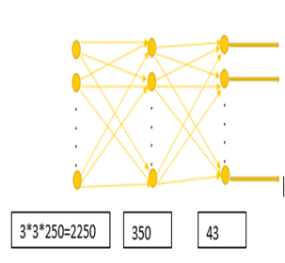
The second model
There is a main problem appears in overfitting that reduces the model’s ability to generalize, so we used techniques to prevent it, dropout and batch normalization. We modified the old model in CNN layers as shown:
In our new model the size of input image is 32*32 and we use valid padding (the size of image is shrinking because p=0), in pooling layer the pool size is 2*2
feature extraction in second model classifier network in second model

Slide 14
There are numerous issues with dataset which represent the real world problems faced in actual traffic sign recognition:
1.Class imbalance: Apparently dataset is very unbalanced, some of the classes having 2000 samples and some of them having only 200 samples. This imbalance biases the model to predict classes with higher number of sample more frequently than the ones with less number of samples to achieve better accuracy.
2.High contrast variation: The images differ significantly in terms of contrast and brightness. It is difficult to human to understand and classify some of these signs which are in total darkness.
3.Small dataset: Even though we have about 35k train images, they are not quite enough to perform well in all general case scenario. More data also helps with overfitting.
So we try to solve these problems to generalize the model over new data and get good accuracy in testing and prediction. So we summarized this in three ways, CLAHE-gray for high contrast variation, flipping or augmentation for imbalanced dataset to increase the number of data in each class.
4.CLAHE-gray:
CLAHE stands for "Contrast Limited Adaptive Histogram Equalization." It is a method for enhancing the contrast in images, specifically in areas that have low contrast. It works by dividing the image into small blocks called "tiles," and then applying histogram equalization to each tile separately. The contrast enhancement is limited by a parameter called "clip limit," which prevents the amplification of noise or other small variations in the image. CLAHE is commonly used in image processing, particularly in medical imaging and microscopy

Slide 15
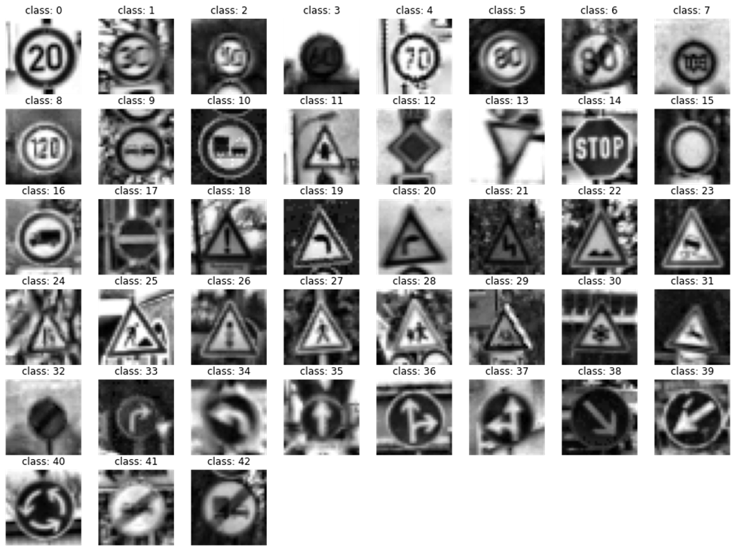
some Image after CLAHE -gray

Slide 16
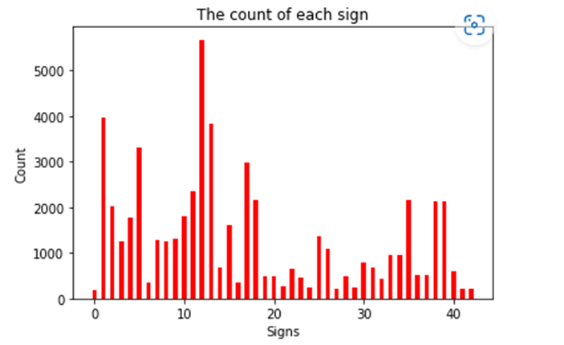
5.Flipping
This technique helps to increase the size of the dataset and improve the robustness of the model by introducing new variations of the training data. We used horizontally, vertically, both and cross flipping.
Horizontally flipping: is a list of integers representing classes of traffic signs that can be flipped horizontally without affecting their meaning. For example, traffic signs with class number 11, 12, 13, 15, 17, 18, 22, 26, 30, 35 can be flipped horizontally.
Vertically flipping: is a list of integers representing classes of traffic signs that can be flipped vertically without affecting their meaning. For example, traffic signs with class number 1, 5, 12, 15, 17 can be flipped vertically.
Both flipping: is a list of integers representing classes of traffic signs that can be flipped horizontally and vertically without affecting their meaning. For example, traffic signs with class number 32, 40 can be flipped both horizontally and vertically.
Cross flipping: is a 2-dimensional array of integers representing classes of traffic signs that can be flipped horizontally and vertically and still retain their meaning. For example, traffic signs with class number 19, 20, 33, 34, 37, 36, 39, 38 can be flipped both horizontally and vertically.
the count of each sign after flipping

Slide 17
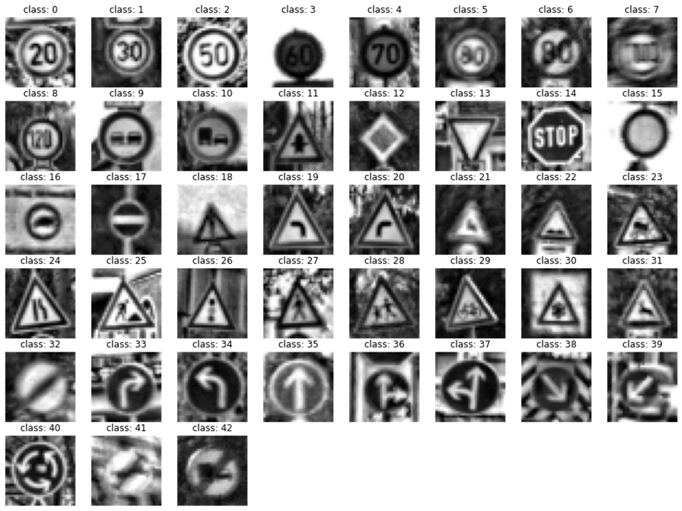
some images after flipping

Slide 18
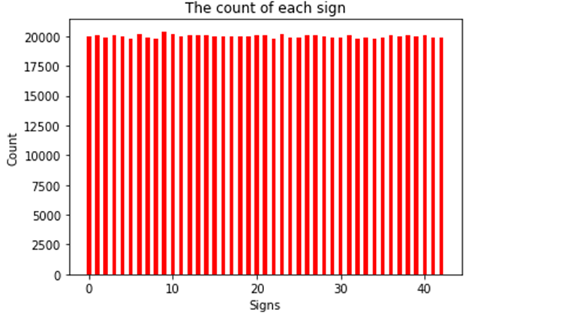
6.Augmentation
We want to get balanced dataset to improve the results. So, we built a dataset by geometrically transforming (translation, rotation, shear mapping, scaling) the same sign image. This can be done easily by applying torchvision. transforms in PyTorch
We used Weighted Random Sampler to sample from the dataset with the desired class balance. When the model is trained using this sampler, it will have a balanced exposure to all the classes, reducing the chances of overfitting to a specific class. It takes in two arguments, the first is the array of weights created earlier, and the second is the number of samples to generate from the dataset. In this case, it is 43 * 20000, where 43 is the total number of classes and 20000 is the number of samples to generate from the dataset. So classes with fewer samples will have higher weights and classes with more samples will have lower weights.
the count of each sign after augmentation

Slide 19
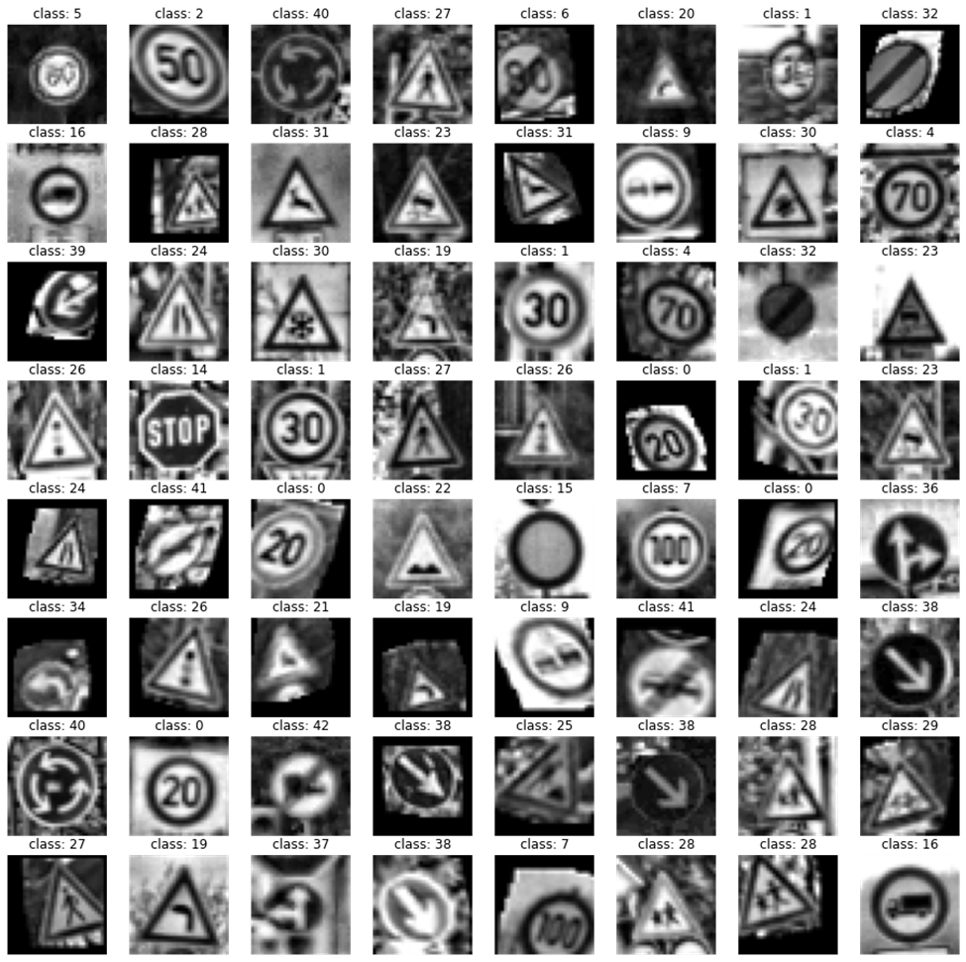
some images after augmentation

Slide 20
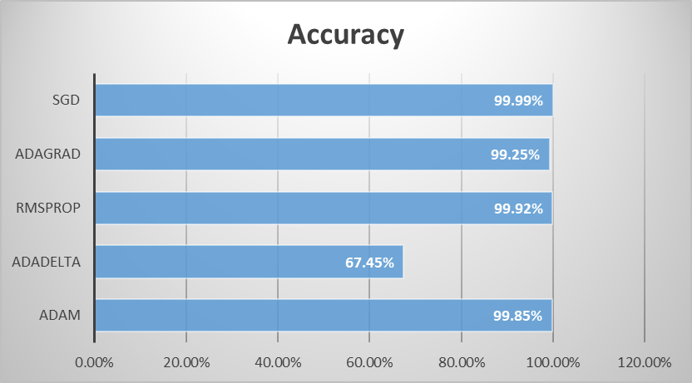
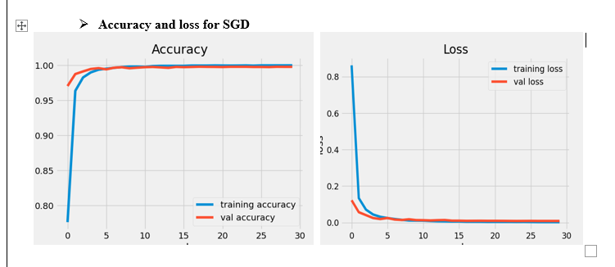
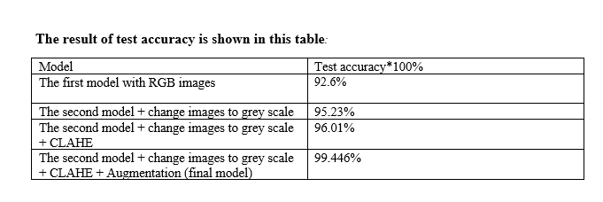
Results and analysis

Slide 21
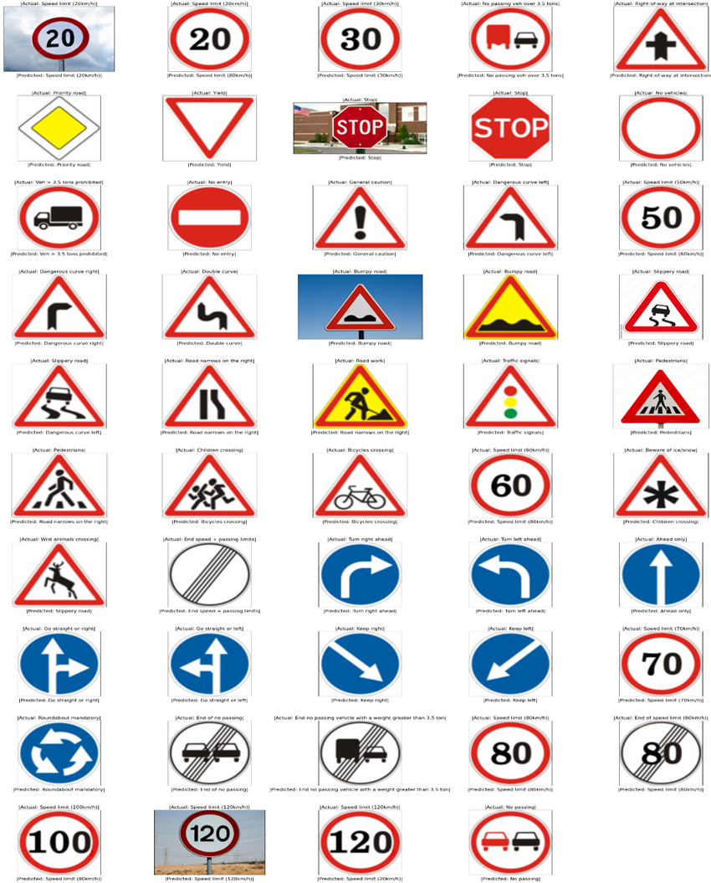
Examples of predict some new images by final model

Slide 22
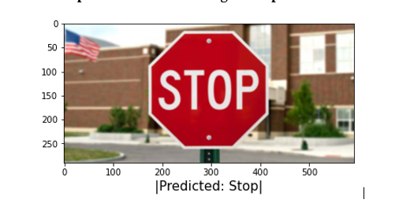
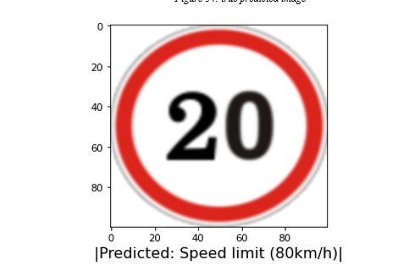
False and true predict of one new image example

Slide 23
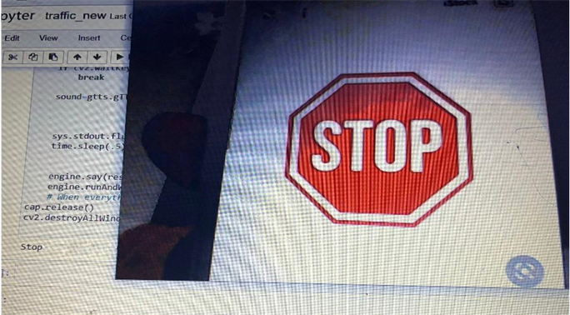
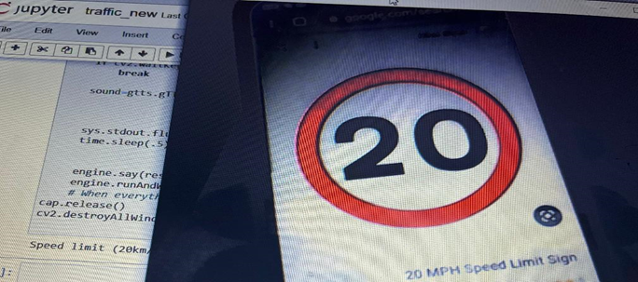
Predict images using camera

Slide 24
Discussion
We faced many problems in this project, the most important of it that the model can’t do generalization, so the model trains well but it can’t recognize new images. In CNN, to get a good model that can generalize new images we must prevent the overfitting and taking care of improving the test accuracy. So we modified the model and applying CLAHE and augmentation to get 99.446% test accuracy, this is very good accuracy to recognize new images.
This high accuracy doesn’t mean that the model recognize all new images, it’s still misrecognizing some new images, may the difference of some traffic signals in many countries cause this problem.
Another problems that we faced, the very huge time in training because of GPU in our device and the camera is very slow when we want to test some new images.

Slide 25
Conclusions and Recommendation
In this project we discussed how the CNN algorithm trains the model to recognize and classify the traffic signs images by different optimization algorithms, and it is found that the SGD gives most accuracy than others. Trying new models to increase of test accuracy to do generalization very well and the final model achieved highest accuracy that is 99.446%. Camera of laptop and loading images is developed on python to test the traffic signs. We implemented this project to detect traffic signs on the road by using camera, recognize and classify them, and give the driver voice alarm containing the meaning of that signs by converting text to speech. This model can improved to detect signs in road by high quality cameras, recognize and classify them to help drivers and reduce accidents rate.

