Slide 1

Developing a Day Care Center for An-Najah National University
Eman Arafat
Raghad Al Alawneh
Suad Abu Hadrous
Walaa' Sawaftah
A Graduation Project
In The Department
Of Industrial Engineering
Presented in Partial Fulfillment of the Requirements
for the Degree of Bachelor (Industrial Engineering)
Under The supervision of
Dr. Mohammed Othman
Tuesday
7-12-2013

Slide 2

Agenda
Introduction
Market Study
Facility planning
Organization Structure
Financial Feasibility Study
Strategic Planning

Slide 3
Introduction
Child care or day care is the care of a child during the day by a person other than the child's legal guardians, typically performed by someone outside the child's immediate family. Day care is an ongoing service during parents' time at work.
it is difficult to select a day care arrangement because of the enormous differences of the quality of care offered;
Each family has to make decisions with what it can find in its neighborhood, within its budget, and fitting its schedule.
Notes:
Our project is concerned with the planning and designing a high quality day care center at An-Najah National University in Nablus, Palestine. It investigates the importance of including market study and facility planning within the development process to provide high quality and standarized daycare for the children of An-Najah University
staff and other graduate students.
Now, what is a day care?! (read above first dot)
Parents usually have two limitations, (read dots two and three with details from report)
Our project's significant stems from the needs of parents to feel relaxed and happy. We’re planning a high quality day care with the minimum costs. We're doing a one in a kind of a project, beside the favor we're making for the parents, this Project will rise up the value of our university by leading its way to perfection.

Slide 4
Objectives
To increase the profits of An-Najah National University by adding another source of income.
To reduce barriers for parents to attend/ work at An-Najah University;
To supplement and complement parental care and values;
To ensure parental input in the delivery of child care;
To promote excellence in the field of child care;
To advance the field of child care in the community.

Slide 5
Market research
Methodology
1. Questionnaires to be filled by customers
2. Investigating reasons of failure for the Old campus Day care.
Notes:
Read the title then explain : we used two methods to evaluate the current situation of the day care in Nablus, these are : visits to 2 day cares in nablus
and questionnaires to be filled by the customers.
During our visits to the centers, we were able to set different disadvantages like :
Then read the slide (advantages and disadvantages

Slide 6
Questionnaires
A questionnaire form was developed to be filled by the parents, the objective was to know the needs of the parents, whether are satisfied or not
Out of a 100 questionnaires we had 77 ones got filled correctly with no missing fields.
Some of the analyzed data are as in figures :
Notes:
Read the first point then explain : Our aim from the questionnaires was to evaluate the performance of current day cares investigating their weaknesses in order to improve it in our day care.
Read the second point then explain : This means that the response rate is about 77% which is an acceptable one, giving a final sample of 77 individual
Read the third point then explain the figures in next slide.

Slide 7
Notes:
The first figure shows the current day care satisfaction from the customers in terms of the fees. The half of them say that the fees are expensive. Less than the other half says they’re stabile.
And so (kamliii)

Slide 8
Questionnaire recommendations
It is recommended to establish a new day-care at the university campus for the benefit of the workers and married students.
The suggested day-care should have a high quality service and have the modern physical environment in order to continue with its duties.
The registration fees should be suitable and fit the workers financial status .
The crew of the suggested day-care should be educated and from who hold B.A Degree on the specialization of children education .
Modern kinds of communication channels between the day-care and the parents should be adopted in order to strengthen the relationships between the two parties.
Necessary accommodations should be included in the day-care physical setting ( computers, Audio- lingual games and so on.)
It is preferable to use the English language as a second one in the day-care teaching process .
Modern methods of teaching ( activities, discovering environment , etc..) should be adopted.
It is better for the university to administrate the day-care .
It is better that the kindergarten should have spacious classrooms with suitable number of children and adequate instructors and babysitters.
Notes:
Read only

Slide 9
Old Campus Day care
Factors founded on the current daycare could make it successful :
These factors was effective at the first, but now its not enough to keep the daycare away from failing
Closeness from the university
Cheep rent
The babysitters with long term experience
Notes:
3- The cheep rent of the building (old system for the rent).

Slide 10
from the data collected we could recognize that the actual reasons led the day care to fail, are the following:
economically
administratively
Failure reasons
The design of the
building
educationally

Slide 11
mismanagement
mismanagement
miscommunication
Problems between workers themselves
Misunderstanding of tasks
Problems between union and parents

Slide 12
Educational process:
The current day care failed in satisfying this term, due to different reasons, like:
1- The ages of the babysitters
2- The educational aims in the current day care limited on social sides not educational.
3- There is no learning materials.
4- There is no teaching rooms due to the bad design of the day care.
5- There is no rule to separate the kids in age groups, to provide each group in the suitable educational service
Notes:
this can be useful in term of dealing with babies, but could be bad in term of giving a high quality educational service, and they
\couldn’t follow the changes and up dates in educational process from.1
Being the kids with the same nanny all time for a long period which lead to fond the child to this nanny , so the kid didn’t accept any other nanny, and that wasn’t acceptable from the parents.
The parents asked to hire someone who specializes in upbringing and raising of children in order to improve the minds and ideas of the kids by doing some activities, skills and intelligence games. Because from the experts view point the kid in this period of life need to combines between learning proper style of acting and behavior on the one hand, and education based on experienced people from the other hand.
From the viewpoint of parents, the nannies differentiate between children depending on various considerations, and that create many problems and misunderstanding between the parents and babysitters.

Slide 13
Design of the building:
Description of the building:
Two rooms for kids, for different ages
One room for playing, having television, and small number of simple toys which not suitable for all Childs.
Small kitchen, having refrigerator and gas.
Two bathrooms, one for the kids, the other for the nannies
Notes:
The building was established in 1970, with two floors as a family house not business building, in 1983 the owner family rented the ground floor for the union of worker of AN-Najah National University, to be school for learning the principals of programs and computers, after 14 years, in 1997 it changed to be the current day care for AN-Najah national university, and it’s still until now.
The building now is divided for two sections, the first one for the family owner and the second is the current day care, and here we will describe the building

Slide 14
problems on the building
1- limited area of the day care
2- limited area for the playground
3- The fact that the building doesn’t own but rented
4- Lighting, ventilation and wetness
5- safety factors that missed in the building
Notes:
نقل الكليات للجديدة قلل الاطفال والزيادة بالدفع كل شهر

Slide 15
Cost analysis:
the reason from financial view:
1- Mismanagement
2- No business plan
3- Decreasing the number of child's on the daycare's
Notes:
نقل الكليات للجديدة قلل الاطفال والزيادة بالدفع كل شهر

Slide 16
The cost in the day car divided into two types:
1- fixed cost:
cost | Value
Salary | 740 JD
Others ( rents ) | 1600 JD
workers | Salary
babysitters | 620 JD
Cleaner | 120 JD
Total | 740 JD
2- variable cost: it ranges from 100- 150 JD
Notes:
الاذرز من مسؤليات الجامعة
الرواتب كتير قليلة

Slide 17
the profit= 45* 18 = 810JD/ months
the cost = 840JD/ month
from these result we can know that the day care is economically failed
Notes:
Fixed cost = 88%

Slide 18
The possibility of development:
we want to exploits the advantage of the current day care from the closeness and the cheep rent, and try to improve and avoid the loss, we need to expanding the day car, and this solution is not available, because the owner of the building as we know from them when we had a meeting with them, that they rejected the idea itself of existing day care , moreover they want to stop rent the building, to use the building for different issue, even that the day car got evacuation warning for three times, so it’s impossible to expand the day care, and if the day care still cause loss in money the union will close it soon

Slide 19
Facility planning
Methodology:
Facility Location
Facility layout
Furniture
Notes:
Start with : The physical environment can either contribute to children's development and support staff and parent goals or create a permanent impediment to the operation of a high quality program. Designing a high-quality, developmentally appropriate day care facility is a highly complex task which requires specialized and unique skills. The design and layout of the physical environment, which includes the building, interior finishes, outdoor spaces, selection of equipment and room arrangement has a profound impact on children's learning and behavior and on teachers' abilities to efficiently do their jobs.
Read the first point. Then say : we’re now going to discuss the location of the day care.
Read the second point.

Slide 20
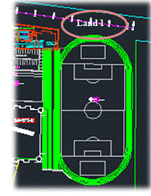
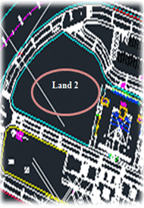
Location
Having the campus as a location of our day care made things really easier for us.
The only available lands inside the campus were two:
Notes:
Because we have specific customers, whom are An Najah university's parents, and due to the insistence from working mothers during the questionnaires collection, we decided that the best location of the day care is inside the campus itself.
Read the slide and note that land one to the west……..etc
then say : As a result, and depending on common and engineering senses, the second land will be chosen for the project.
several advantages were found in this land, like:
Lowering the cost of the project since the land is already an ANU property;
Availability of green areas.

Slide 21
Layout:
An effective facility layout ensures that there is a smooth and steady flow of production material, equipment and manpower at minimum cost. Facility layout looks at physical allocation of space for economic activity in the plant. Therefore, the main objective of the facility layout planning is to design effective workflow as to make equipment and workers more productive
Notes:
After the location is set, the internal layout should to be determined and designed based on systematic planning layout procedures

Slide 22
Facilities of the Day care
Nom. | Name of area | Age group | Quantity
1 | Lobby | ----------- | 1
2 | Reception area | ----------- | 1
3 | Office | ---------- | 2
4 | Staff room | ----------- | 1
5 | Clinic | ----------- | 1
6 | Laundry room | ----------- | 1
7 | Cafeteria | children (toddlers\pre-k\k) | 1
8 | Kitchen | For cooks | 1
9 | Computer & reading lab. | children (toddlers\pre-k\k) | 1
10 | Infants room | 1-12 months | 1
11 | Toddlers' room | 12 months -3 years | 2
12 | Pre-kindergarten | 3-5 years | 2
13 | Kindergarten | 5-6 years | 1
14 | Storage area | ----------- | 1
Notes:
Read slide only

Slide 23
Layout procedure
using here is Muther's Systematic Layout Planning (SLP) Procedure.
The first step was assigning the important Factors affecting our layout design.
Factors and their Weights
 | Factor | weight
1 | Closeness (distance) | 0.5
2 | Noise level | 0.2
3 | Shared facility | 0.3

Slide 24
Relationship Scores between Departments
17 | 16 | 15 | 14 | 13 | 12 | 11 | 10 | 9 | 8 | 7 | 6 | 5 | 4 | 3 | 2 | Dep.1
 |  |  |  |  |  |  |  |  |  |  |  |  |  |  |  |  | Dep.1
_ | _ | _ | _ | _ | _ | _ | _ | _ | _ | _ | 5 | 6 | 9 | 9 | 10 | _ | F.1
 |  |  |  |  |  |  |  |  |  |  | 2 | 2 | 8 | 9 | 10 |  | F.2
 |  |  |  |  |  |  |  |  |  |  | 3 | 7 | 8 | 9 | 10 |  | F.3

Slide 25
the total weight for each relationship

Slide 26
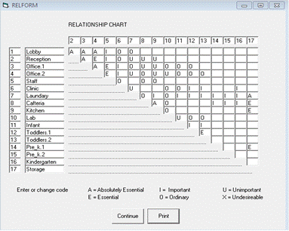
relationship chart using BLOCKPLAN software

Slide 27
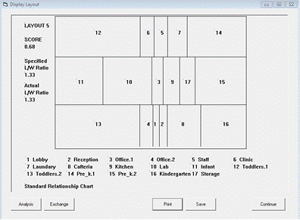
Best layout by PLOCKPLAN program

Slide 28
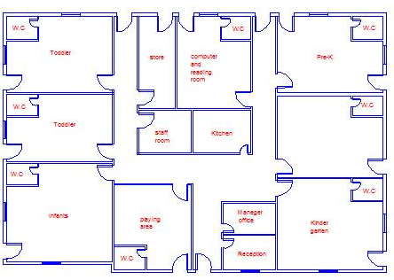

Slide 29
Furniture
Office requirements
Classes requirements
Notes:
As described in the report in tables, we have two main categories of needed furniture, office’s and classes’, both are shown in the coming AutoCAD drawing

Slide 30
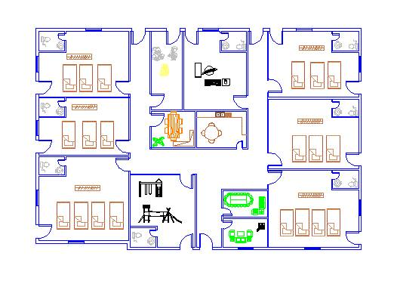

Slide 31
Video to be added!!! :D

Slide 32
ORGANIZATION STRUCTURE
Organizational structure effects on organizational action:
Provides the foundation on which standard operating procedures and routines rest.
Determines which individuals get to participate in which decision-making processes, and thus to what extent their views shape the organization’s actions

Slide 33
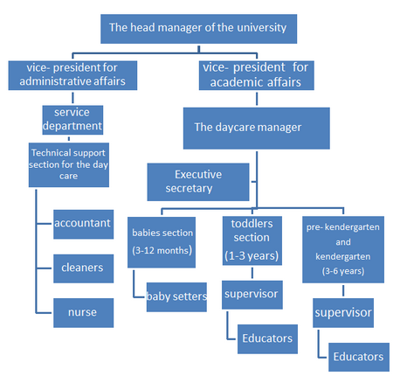
Notes:
the main reason of the failure is the mismanagement. This chapter presents the organizational structure for the proposed daycare including the job description for work position. a list of rules suggested at the day care.

Slide 34
Job description
It’s a list that used for general tasks, functions, and responsibilities of a position, Its qualifications or skills needed.
Notes:
Because the mismanagement was one of the main reasons for the failure in the old campus daycare We developed a job description card for each position in the organization structure

Slide 35
Job description card
Job description: daycare manager
Management: academic affairs for An-Najah University
Responsible: vice- president for academic affairs Category: administrative
The main aim for the job: Follow up the works daycare, and follow all the meeting with the general administration, moreover prepare the business development studies, and public budget.
Tasks and activities: Prepare the annual budget for the daycare Planning and budgeting Follow up the annual budget.
Meetings of the Board of Legislators Documentation the meetings. Follow up the implementation the decisions of the board of legislators.
Notes:
An example of job description card

Slide 36
Follow up the jobs for the department Administrative issues: Coordinate all aspect of the daycare; include ensuring compliance with all applicable licensing, regulatory, and accrediting. Follow up all about the workers issue. Coordinate parent partnership plan including orientations, workshops, parent groups, use of Parent Resource Room, newsletters, bulletin boards and class parent involvement activities train and supervise professional and paraprofessional staff Develop and supervise classroom program, curriculum and schedules to ensure best practices and developmentally appropriate practices. Oversee food service Determine safety, maintenance and security requirements for the facility Purchasing and Procurement issues: Prepare purchasing orders. Follow up the provides the services and material needed for the daycare. Follow up the annual inventory. Others: Prepare different reports about the overall performance of the daycare. Provide different developmental proposal for the university.
Notes:
ما ترتعبو هدول ما رح تحكيهم بالتفصيل بس بدنا نحطهم كاملين بالسلايدز حتى

Slide 37
Education need: Associates Degree in Early Childhood Education Bachelor's degree in Administrative Sciences Skills need: Knowledge of child care licensing regulations Excellent communication skills both orally and written good presentation skills Excellent organizational, multi-tasking and report writing skills Ability to supervise employees effectively Computer skills Experience need: Experience in developing, teaching and conducting classes or workshops for child care staff and parents Supervision and staff management experience Ability to pass a Medical examination including chest x-ray or tuberculin test as required by child care licensing

Slide 38
Internal regulations of the daycare
In order to increase the chance of success we will establish a list of regulation to prevent any problems or troubles in the daycare and solve it immediately if it is find.
.

Slide 39
Educators:
Commitment to be present at the time.
Commitment to the hall and do.
Baby-sitters commitment not to utter abusive terms inside the hall.
Commitment to submit a request for any vacation or absence.
Any problems occur between parents and staff should refer to the administration of the day care.
Notes:
These rules upon on all the stakeholders in the daycare such as:

Slide 40
Parents:
Commitment to visiting time.
Compliance with day care laws.
Mutual respect between parents and educators.
Parents follow their children periodically through the nannies.
Commitment present & departure time.

Slide 41
Administration:
Recruitment and employment workers, vacations and solving problem between the stakeholders or delegate somebody in these cases.
Committed to the financial matters such as salaries, purchases ...
Committed to the consideration of reports submitted by the stakeholders.
On the children waiting list the priority for some kids as the following:
o Children of An-Najah staff members
o Children of An-Najah students.
o Families that have one or more siblings.
o Others families outside of the An-Najah National University.
o Full time Children for all the previous categories.

Slide 42
Determine Daycare holidays\ closure depending on the university calendar.
Additive fees will be subject to Parents who pick up their children after 5:00 pm.
Parents allowed to visit the daycare at any time with the need to undergo to the laws of the daycare. But the others must make arrangement with the day care administration in advance.
If parents decided to withdraw their child \ children from the daycare it must be a prior knowledge to the administration and then the withdrawal form is filled. Specific fee is paid to withdraw the child from the daycare.
Attendance Sheets parents are required to sign an attendance record at the end of each month attesting the presence of their child at the Center.

Slide 43
Feasibility Study
Methodology
Expected Demand
Requirements
Costs
Revenues
Analysis

Slide 44
Actual market
Age group | Nom. Of children | percentage
0-1 | 36 | 9.230%
1-2 | 53 | 13.589%
2-3 | 55 | 14.102%
3-4 | 70 | 17.948%
4-5 | 90 | 23.076%
5-6 | 86 | 22.051%
 | 390 | ~ 100%

Slide 45

Forecasted market
Applying this equation, we will be able to estimate the number of kids joining our center for the first year;
Where
Q = Nom. Of kids expected to enroll in the center during an 8 months period
N = Total Nom. Of existing kids
A = Awareness x availability (fractions)
P = Probability of enrolling = C_{def} x F_{def} + C_{prob} x F_{prob}
Q = 390 x (100%*70%) x [(.5*.7) + (.25*.2)] = 110 kid

Slide 46
Age group | Nom. of kids
0-1 | 10
1-2 | 15
2-3 | 15
3-4 | 20
4-5 | 25
5-6 | 25
 | 110

Slide 47
Requirements
Age group | No. Of kids | Educator :kid ratio | Educators needed
0-1 | 10 | 1:5 | 2
1-2 | 15 | 1:8 | 2
2-3 | 15 | 1:10 | 2
3-4 | 20 | 1:15 | 2
4-5 | 25 | 1:20 | 1
5-6 | 25 | 1:25 | 1
Total | 110 | -- | 10
Notes:
+ area and furniture requirements which are shown in tables in the report!

Slide 48
Age group | Name of room | Kid :room capacity | No. Of Rooms needed | Area\room
0-1 | Infants room | 10:1 | 1 | 31.5 m²
1-2 | Toddlers 1 | 15:1 | 1 | 38.5 m²
2-3 | Toddlers 2 | 15:1 | 1 | 42 m²
3-4 | Pre-k 1 | 20:1 | 1 | 35 m²
4-5 | Pre-k2 | 25:1 | 1 | 38.5 m²
5-6 | KG | 25:1 | 1 | 42 m²
-- | Lab | -- | 1 | 30 m²
-- | Cafeteria | -- | 1 | 15 m²
-- | Kitchen | -- | 1 | 7.5 m²
-- | Gym | -- | 1 | 14 m²
-- | Other areas | -- | -- | 110 m²
Total area | -- | -- | -- | 404 m²

Slide 49
Costs-Start up cost
Details | Costs in $
Land | 12,530.5
Construction (building) | 404m² * 500$\m² = 202,000
Construction (Outdoor area) | 1096m² * 60$\m² = 65,760
License | 404*17nis =6,868nis = 1,907.7$
Design | 404*50nis = 20,200nis= 5,611$
Water subscription | 357
Electricity subscription | 400
 | 288,565.7+ 20,000(other costs) = 308,565.7$

Slide 50
Costs-Other start up Costs
Details | Costs in $
Furniture | 30,000
Computers | 14,000
Printers | 800
Smart boards | 3500
Kitchen kit(refrigerator, stove, dish washer, and other cooking tools) | 3000
Laundry room kit (washer and dryer) | 2000
Cleaning equipment | 2000
Office equipment | 2000
 | 57,300$
Net Start up = 365,865.7$

Slide 51
Costs- Running Costs-Regular
Details | Costs in $\month
Electricity consumption | 300
Water consumption | 100
Internet and telephone services | 200
Maintenance | 100
Gas | 50
Office materials | 300
Cleaning materials | 300
 | 1350$\month

Slide 52
Costs-Running Costs-Wages
Position | Nom. Of employees | Monthly wage ($\month) | Sum. Of wages ($\month)
principle | 1 | 800 | 800
secretary | 1 | 400 | 400
educator | 10 | 415 | 4150
Cook | 1 | 350 | 350
Cleaner | 2 | 280 | 560
 |  |  | 6,260$\month

Slide 53
Costs-Running Costs-Insurances
For students
Age group | Nom. Of students | Cost($)\month
Less than 3 years | 45 | 20*45=900nis\year= 250$
3 years and above | 65 | 6*65=390nis\year= 108$
For employees
Position | Nom. Of employees | Cost($)\month
Principle | 1 | 4
Secretary | 1 | 2
Teachers | 10 | 10*2= 20
Cleaners | 2 | 2.24
Cook | 1 | 2.5
For the building
308,565.7*0.005\12= 128.5
 |  | 500$\month
Net Running Costs= 98,110$\month

Slide 54
Revenues
Age group | Nom. Of children | Fees | Income
1-12 months | 10 | 100$\month | 1000$
1-2 years | 15 | 100$\month | 1500$
2-3 years | 15 | 120$\month | 1,800$
3-4 years | 20 | 120$\month | 2,400$
4-5 years | 25 | 150$\month | 3750$
5-6 years | 25 | 150$\month | 3750$
 |  |  | 14,200$\month

Slide 55
Analysis
Pay-Back Period = Start-up costs\Monthly profits
Monthly profits = monthly income – monthly running costs =14,200- 8,110 = 6,090$\month
Pay-back period= 365,865.7\6,090 = 63 months = 5 years.
Benefits\Costs Analysis:
= 14,200\8,110 = 1.7>1 , the project is feasible
Average rate of return:
= annual profits\initial cost = 73,080\365,865.7 * 100%= 20%

Slide 56
Strategic Planning for early childhood
Goals for strategic learning plan:
play-based activities
Physical.
Social.
Emotional.
Language Development.
Cognitive Skills.
Notes:
The strategic plan for early childhood education will focus on children learning through play, because it has been thought that children learn more efficiently and gain more knowledge through play-based activities such as dramatic play, art, and social games, In the new daycare, the early learning and child care (ELCC) curriculum refers to how organize opportunities for children to learn throughout the day, this will based on the daycare goals for children’s social, emotional, physical and cognitive development; below we will discuss each one:

Slide 57
Our purpose
Skilling and knowledge.
Confidence to participate effectively in the community and the economy.
Providing high quality learning.

Slide 58
Our outcomes
Early years.
School education.
Skills and employment.
Resourcing and capability.
Notes:
Early years: quality early years services
School education: learning and successfully transitioning to further education, training and work
Skills and employment: successful participate in broader community
Resourcing and capability: Resources targeted to improve learning and skilling outcomes

Slide 59
Program in KG.a
Program in languages, which are Arabic and English languages.
arts and musical program: moral and religious values taken in the arts classes as a daily stories
Mathematics programs.

Slide 60
Yearly plan
Semester | starting date | Ending date
Firs semester | 1-1-2014 | 30-4-2014
First month |  | Special activities
 |  | first week which include a parents day for giving them idea about the system in the daycare
Second month |  | It could have a opening day and parents day
Third month |  | Outdoor trips
Fourth month |  | The final week will have activities for ending the semester, and also a party witch will include the parents participations.

Slide 61
Monthly plan
Semester | starting date | Ending date
Firs semester | 1-1-2014 | 30-4-2014
First month |  | Special activities
 |  | first week which include a parents day for giving them idea about the system in the daycare
Second month |  | It could have a opening day and parents day
Third month |  | Outdoor trips
Fourth month |  | The final week will have activities for ending the semester, and also a party witch will include the parents participations.

Slide 62
Weekly and daily plan
Children last Week Describe the state of children last week |  | Objective(s) for this week Describe the aspects (e.g. children's emotion, will, and attitude) that you hope to develop through the activities of this week, with reference to their state last week
Date | Sun Mon Tue Wed The
Outcomes | Write down what you hope children experience (concrete activities) in order to achieve the objective(s)
Environment | Write down how to create an appropriate environment for children to enjoy the activities
Activities of Children | Write down the detailed activities that you have planned with reference to children’s state last week
Points | Write down the following points Concrete instruction plans in carrying out activities How to behave toward each child Consideration that should be given when taking care of children
Review & Evaluation | Write down the review and evaluation everyday

Slide 63
Thank you for your time ☺

