Slide 1
Implementation of Lean Manufacturing Technique at the National Company of the Aluminum and Profiles Industry (NAPCO)
Prepared By
Abeer Shqiqat Safaa Dwikat Sana Fatyer
Supervised By
Dr. Yahya Saleh
Eng. Basheer Shaheen

Slide 2
Contents
Introduction
Lean Manufacturing Definition
Types of waste
Case Study NAPCO Company
Problem Statement
Methodology
Conclusion
Recommendation
2

Slide 3
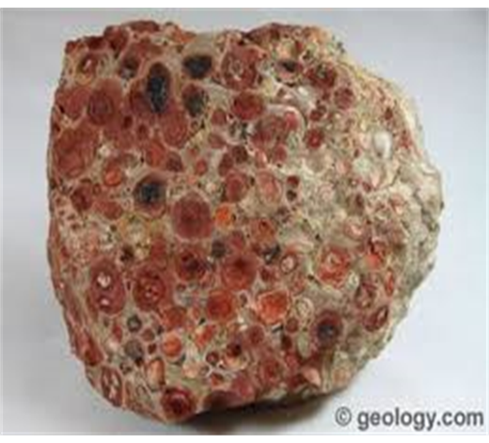
Introduction
Aluminum is the third most abundant element in nature.
The main source of aluminum is an ore known as Bauxite.

Slide 4
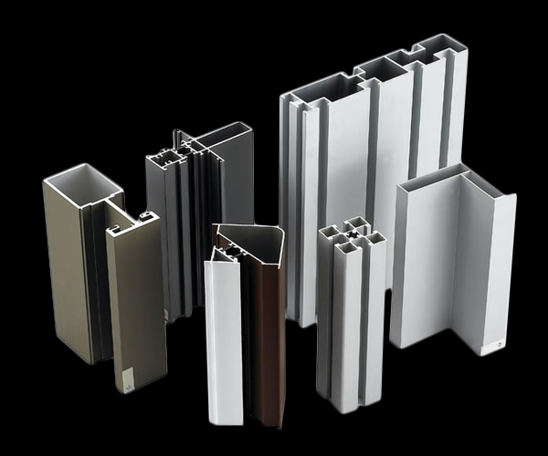
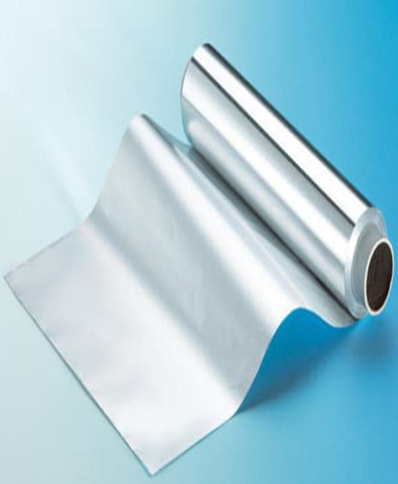
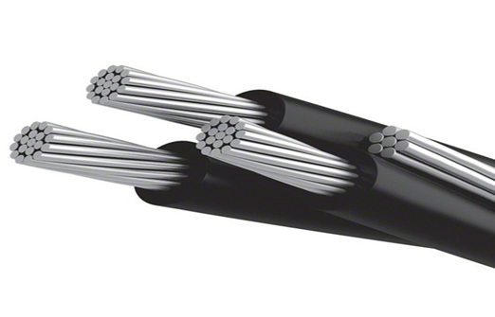
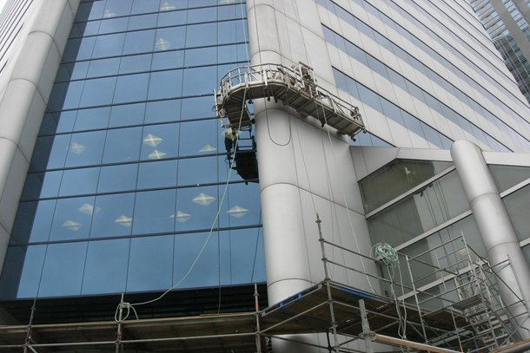

Aluminum has many properties that make it widely used in many industries and in transportation, packaging ,building and electrical equipment.

Slide 5
Lean Manufacturing Definition
Lean is a business philosophy that continuously shortens the time between customer order and shipment by eliminating anything that increases the cost of production and time of delivery to customers.

Slide 6
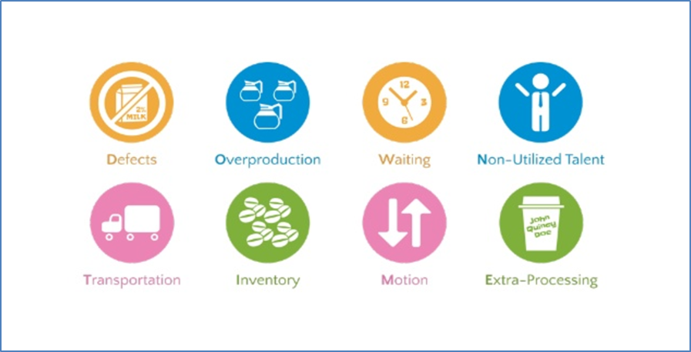
Types of Waste (TIMWOODS)

Slide 7
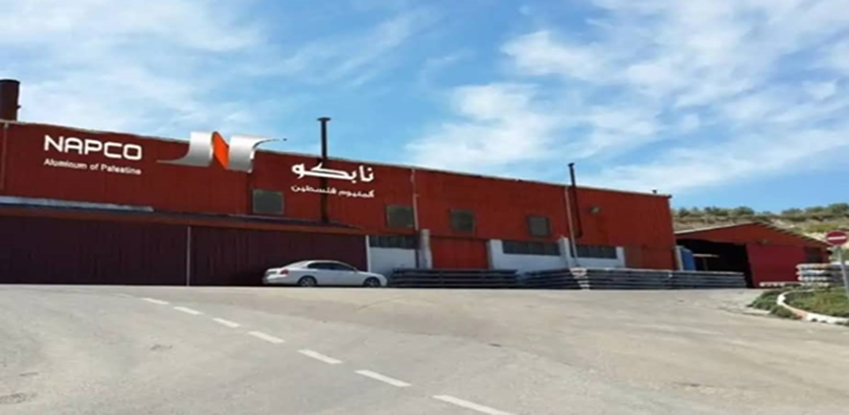
Case Study NAPCO Company
NAPCO National Aluminum and Profiles Company is the first manufacturer of aluminum profiles in Palestine, it is established in 1991, located in the West Bank city of Nablus.

Slide 8
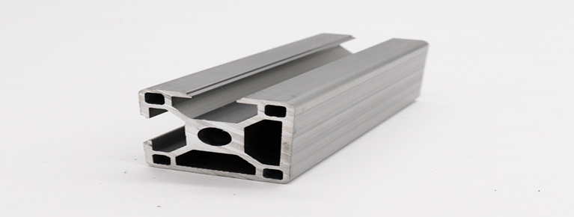
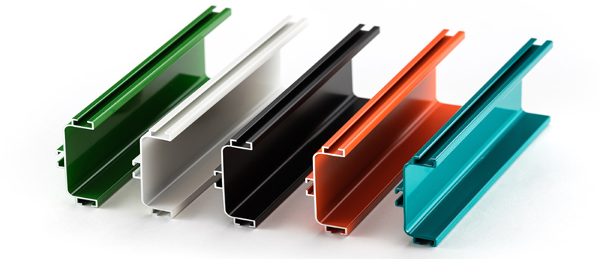

Families of products at NAPCO
Mill (semi) finished profile
Anodizing profiles
Powder coated profile

Slide 9
Constraints
Difficulty in collecting and providing some financial data.
Prevent imaging of some equipment and machines.
The need to spend hours in the manufacturing line to
understand operations.

Slide 10
NAPCO has been encountering a significant percentage of delays in delivering orders to customers relative to their promised dates of delivery.
For nearly 70% of total sales are powder coating products, which cause the largest proportion of delays.
Problem Statement

Slide 11
Problem Statement (cont.)
The annual average total production of powder coated aluminum profiles is around 3500 tons.
About 2.2% of this quantity (I.e. 70 tons) is wastes , which accounts to about 420,000$ per year.

Slide 12
Methodology
By applying DMAIC approach in Aluminum powder coating, which consists of define, measure, analyze, improve and control phase.

Slide 13
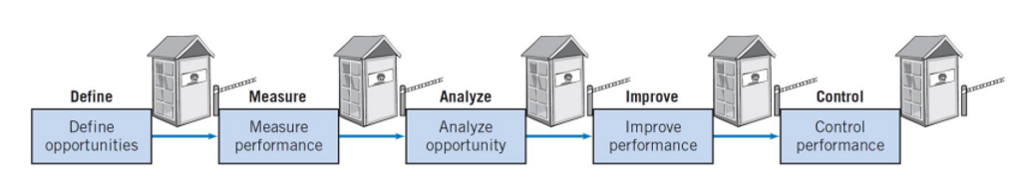
DMAIC Methodology
It is a problem solving methodology that used to improve, optimize and stabilize processes to improve the quality and reduce the problems.

Slide 14
1. Define Phase
It consists of defining the scope, the goal, the process and the customer.
The scope of work is defined through meeting with sales, quality and production departments, by return to historical data about 500 tons / month of total products are sold and about 350 tons of powder coating, 100 tons of semi-finished profiles and 50 tons of anodizing profile.
So, approximately 70% of total sales are powder coating products, which cause the largest proportion of delays.

Slide 15

Define Phase (cont.)
This project seeking to achieve several goals. The most important ones are to solve the problem of delays of orders by eliminating/ reducing the potential wastes, improve efficiency, decrease the costs and hence increase the customer satisfaction.
The sequence of operations shown by
the process flow chart shown in the
next slide.

Slide 16
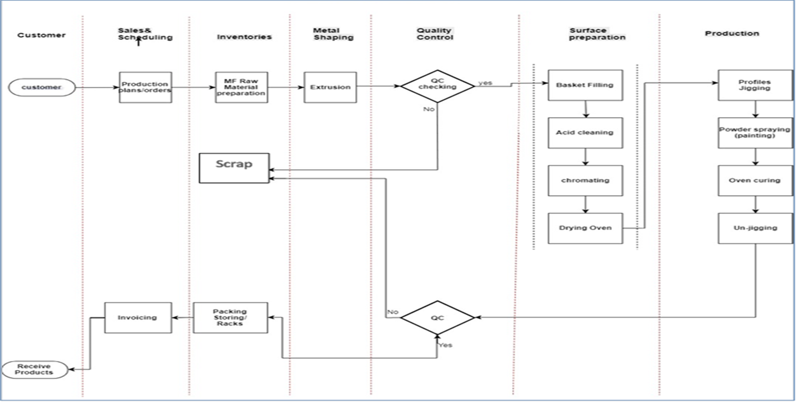

Slide 17

2. Measure Phase
In the measure phase, the team
focuses on collected data which
takes time and effort.

Slide 18
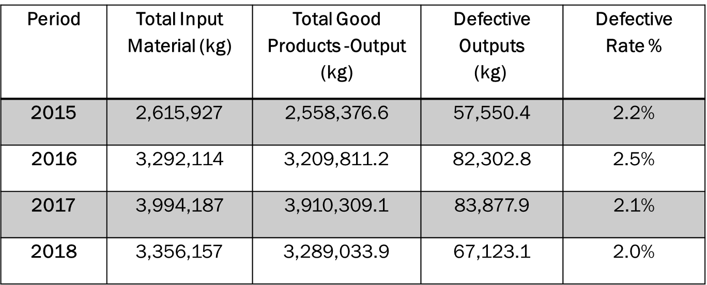
Measure Phase (cont.)
Defective Quantities in kg (2015-2018)

Slide 19
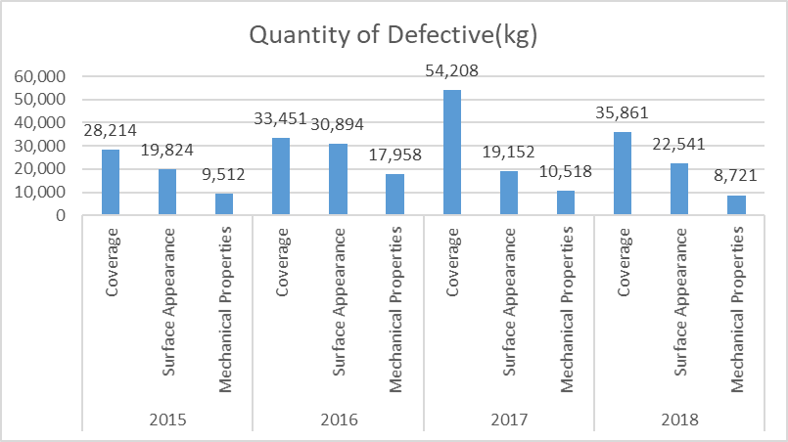
Measure Phase (cont.)
There are three type of defect, which are coverage, surface appearance and mechanical properties.

Slide 20
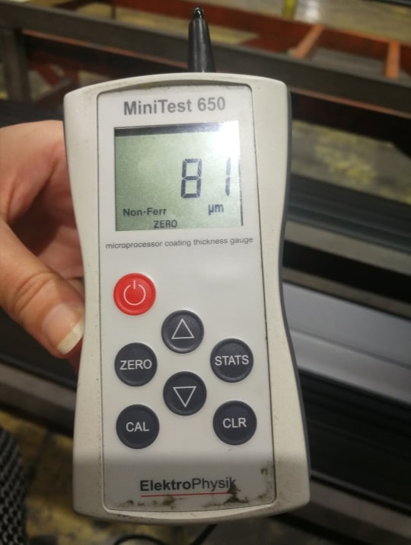
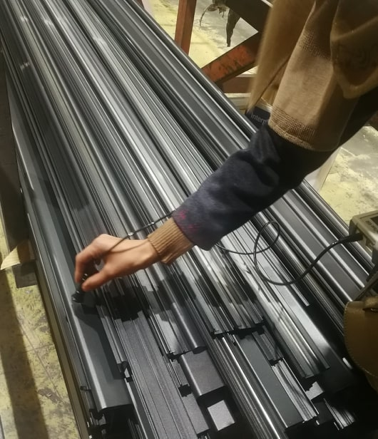
Measure Phase (cont.)
The thickness of the powder (micron level) is a significant quality characteristic that couldn’t be neglected in the powder coating process for aluminum profiles.

Slide 21
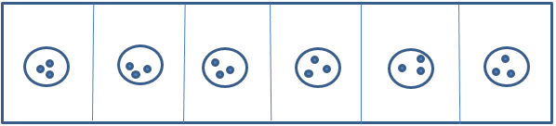
Measure Phase (cont.)
Micron level was measured depend on ISO (2360)

Slide 22

3. Analyze Phase
The team analyzed the current performance of powder coating line based on the collected data, by using:
Cause and Effect Diagram
Pareto Chart
Control Chart

Slide 23
Analyze Phase(cont.)
Types of waste found at powder coating line:
  Transportation
  Waiting
  Over processing
  Defect

Slide 24
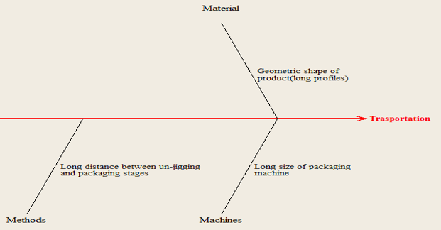
Analyze Phase(cont.)
1.Transportation: it is including unnecessary movement of parts and products, excessive-handling of materials.

Slide 25
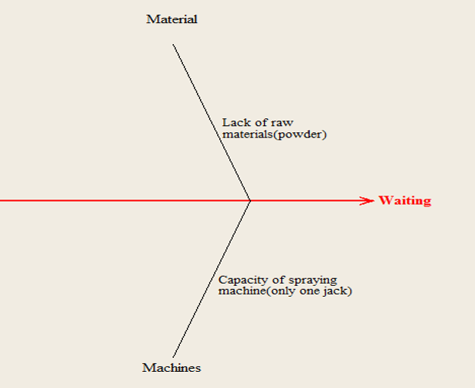
Analyze Phase(cont.)
2.Waiting: it is occurring when goods are not moving or being processed, it is the act of doing nothing .

Slide 26
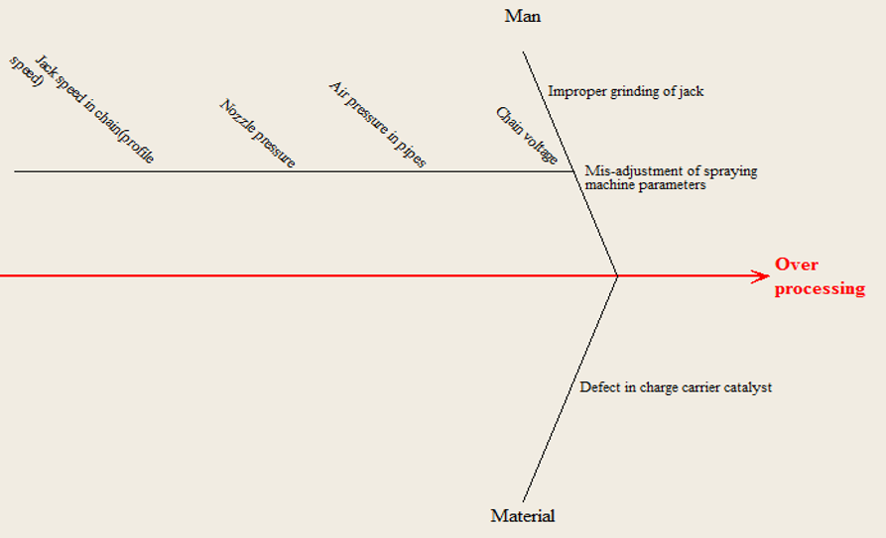
Analyze Phase(cont.)
3. Over processing: it is according to do work that doesn’t bring additional value or it adding extra features to a given product than customer required .

Slide 27
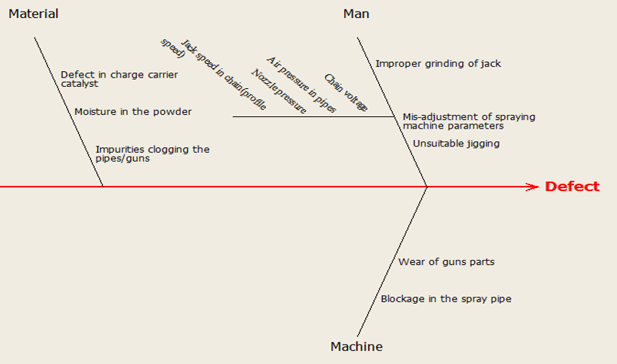
Analyze Phase(cont.)
4. Defects: it occurs when service or products deviate from the specification or what the customer needs.

Slide 28
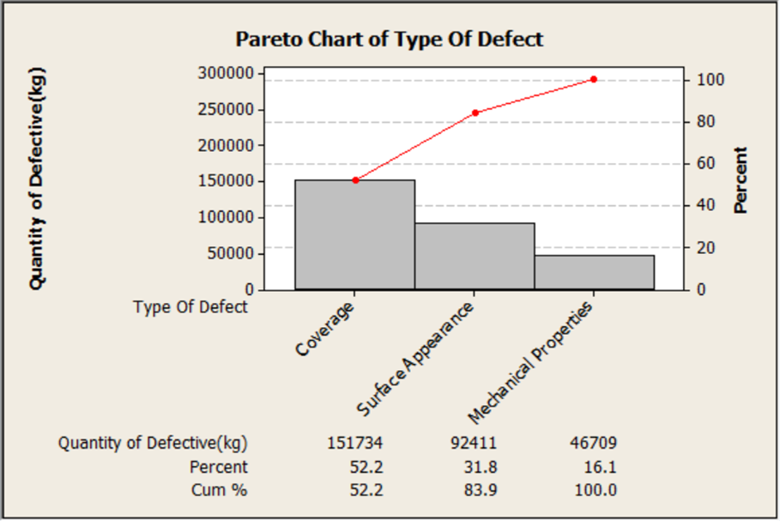
Analyze Phase(cont.)
Analyze Types of Defect by Pareto Chart .
Coverage an surface appearance are responsible for 83.9 % of the defects.
Where the micron level is a major factor covering these two main defects.

Slide 29
Analyze Phase(cont.)
The representative random sample size of profile required to measure the micron level is 114 profiles was measured based on the following
equation:
$$n= \frac{N}{{(1+Ne}^{2})}$$
Where n: sample size, N: population size (2273 profiles) , e: level of precision (error) = 5%, confidence level= 95%.

Slide 30
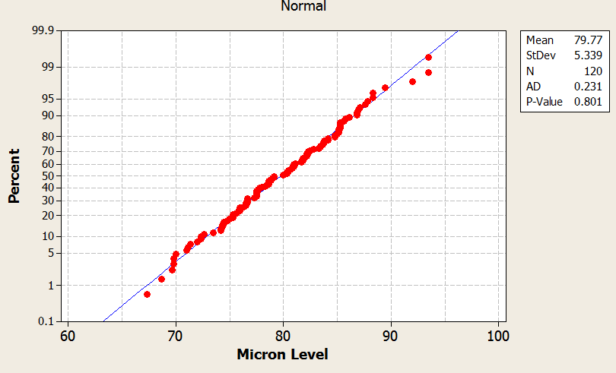
Analyze Phase(cont.)
Normality Test: it has a null-hypothesis of that the population is normally distributed, against its alternative hypothesis that population is not normally-distributed

Slide 31
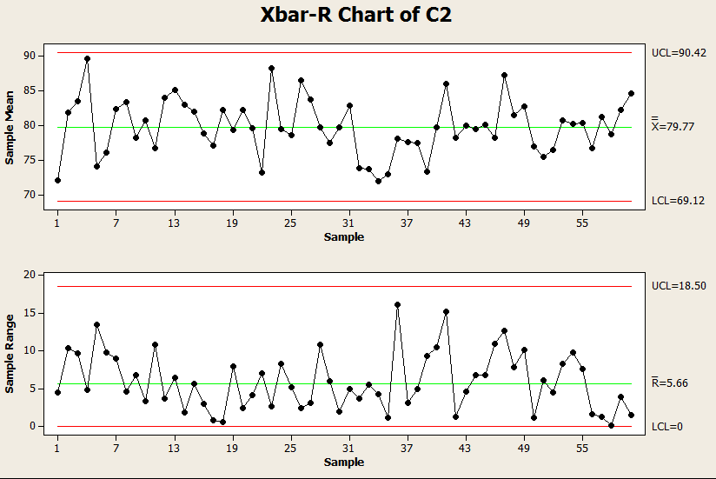
Analyze Phase(cont.)
      Control Chart : it is a statistical graphical tool used to evaluate the stability of the process.

Slide 32
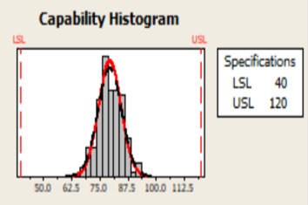
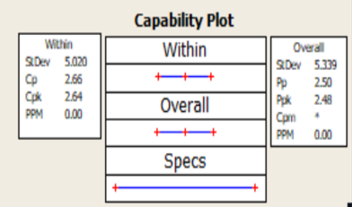
Analyze Phase(cont.)
      Process Capability: It considers the ability of the process to produce products or service that meet the design specifications.

Slide 33

Improve Phase
In this phase, team move on to solution improvement.

Slide 34
Improve Phase (cont.)
It was observed that the mean of micron level equals 79.77 µm which is shifting above the target value by 9.77 µm, where the target value is 70 µm, that causes additional consumption of powder, so some actions should be accomplished by applying design of experiments.
Design of Experiment :It is a systematic method to identify the relationship between factors affecting on a process to reduce manufacturing cost by minimizing process variation and reducing rework, scrap, and the need for inspection.

Slide 35
Improve Phase (cont.)
Design of Experiment consists of.
inputs (factors)
Nozzle pressure
Air pressure in pipes
Jack speed in chain
Chain voltage
Levels
Nozzle pressure: (0 - 100) %.
Air pressure in pipes: (2 - 8) bar.
Speed of chain: (1.8 - 2.3) m\min.
Chain voltage: (65 – 80) KV.
3. Response
The micron level.

Slide 36
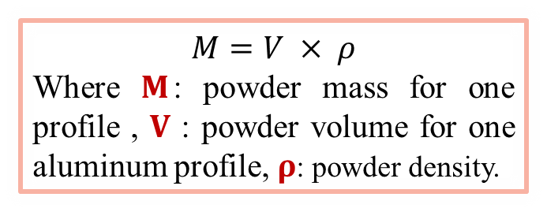
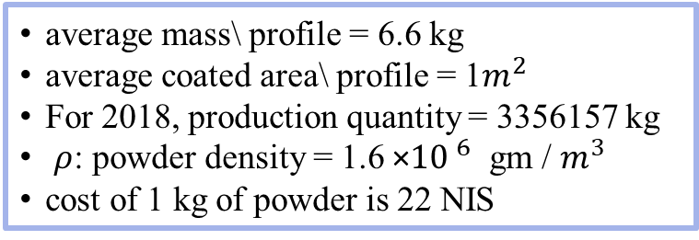
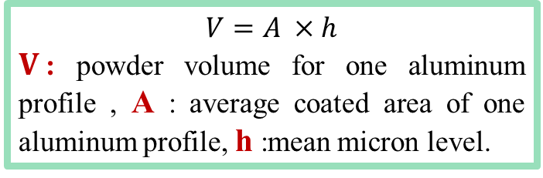
Improve Phase (cont.)
The course of actions resulted from applying the DOE will make incremental improvement to reduce the micron level from 79.77 µm (case 1) to 75 µm (case 2), then the savings in paint calculated theoretically in 2018:
average mass\ profile = 6.6 kg
average coated area\ profile = 1$m^{2}$
For 2018, production quantity = 3356157 kg
$ρ$: powder density = 1.6 ×${10 }^{6}$ gm / $m^{3}$
cost of 1 kg of powder is 22 NIS
$$M=V × ρ$$
Where $M$: powder mass for one profile , $V$ : powder volume for one aluminum profile, $ρ$: powder density.
$$V=A ×h$$
$V$: powder volume for one aluminum profile , A : average coated area of one aluminum profile, h :mean micron level.

Slide 37
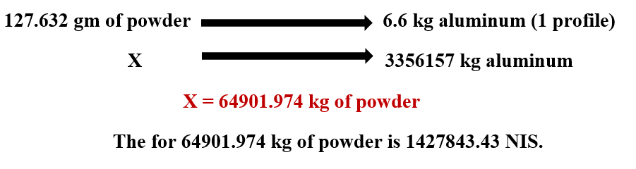

Improve Phase (cont.)
Case 1 :when the micron level = 79.77µm
M= 127.632 gm
V$=$7.977 $×$ ${10 }^{−5}$ $m^{3}$

Slide 38
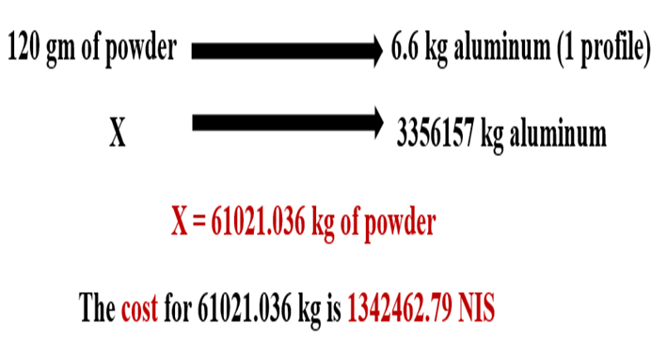

Improve Phase (cont.)
Case 2 :when the micron level = 75 µm
M=120 gm
V$=\text{7.5 }× {10 }^{−5} m^{3}$

Slide 39
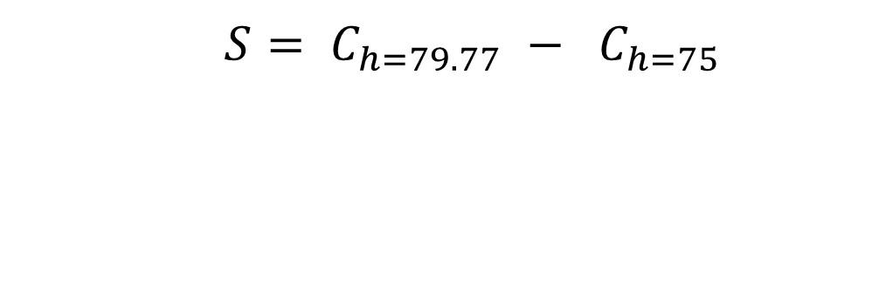
Improve Phase (cont.)
saving from reduction of powder thickness (micron level)
 | $$S= C_{h=79.77} − C_{h=75}$$
= 85380.64 NIS saving

Slide 40
Improve Phase (cont.)
    Recommendation for Waste Reduction
Transportation :this waste can be disposed of by changing the layout of work place and reducing the distance between these two stations.
Waiting : this waste can be disposed of by add another spraying machine to reduce the number of waited jacks as the drying oven can accommodate more than one jack.

Slide 41
Improve Phase (cont.)
3. Over processing:
over-processing caused by mis-adjustment by workers of the parameters can be solved by commitment of worker for all production instructions.
Another Couse of over-processing is improper grinding of jack can be solved by good grinding for the contact area of ​​the jack with the profile to maintain the conductivity between the profile and the jack to ensure the profile attraction of the powder.

Slide 42
Improve Phase (cont.)
4. Defect
over-processing caused by mis-adjustment by workers of the parameters can be solved by commitment of worker for all production instructions
Another Couse of over-processing is improper grinding of jack can be solved by good grinding for the contact area of ​​the jack with the profile to maintain the conductivity between the profile and the jack to ensure the profile attraction of the powder.
perform powder testing procedures before using it in the coating process to ensure that it is not moistened .
provide periodic preventive maintenance actions of the spraying machine parts to ensure that there are no impurities causing the closure of spray gun openings and to ensure that the components of guns are not worn.

Slide 43

  Control Phase
This phase aims to control the developments made in the improve phase, so it will monitor the critical process characteristics and document the new performance to ensure the validity of improvement actions that will provide sustainability over time.

Slide 44
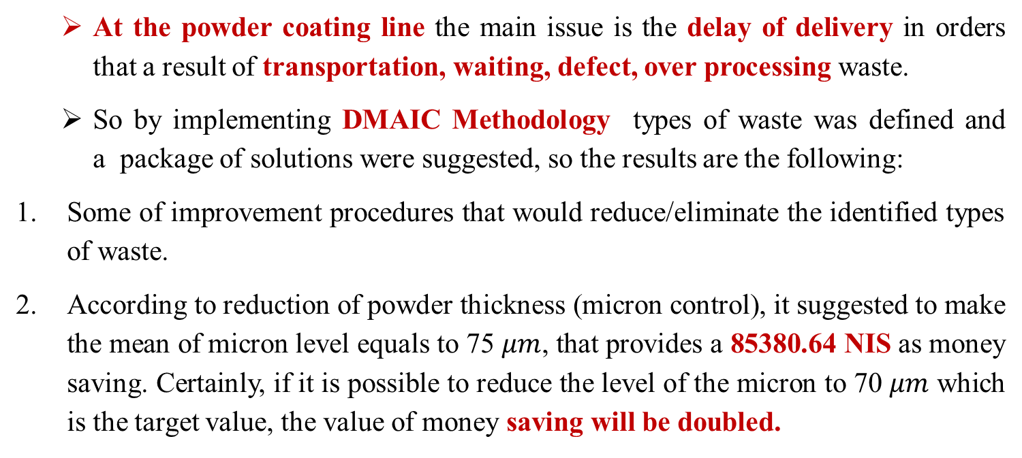
Conclusion
At the powder coating line the main issue is the delay of delivery in orders that a result of transportation, waiting, defect, over processing waste.
So by implementing DMAIC Methodology types of waste was defined and a package of solutions were suggested, so the results are the following:
Some of improvement procedures that would reduce/eliminate the identified types of waste.
According to reduction of powder thickness (micron control), it suggested to make the mean of micron level equals to 75 $μm$, that provides a 85380.64 NIS as money saving. Certainly, if it is possible to reduce the level of the micron to 70 $μm$ which is the target value, the value of money saving will be doubled.

Slide 45
Recommendation
Continuous monitoring of the worker’s performance during the working hours according to the adjustment of spraying machine parameters.
2. Performing a periodic maintenance of machines, especially spray machine.

Slide 46
Recommendation (cont.)
3. Increase the space of storage area to accommodate additional quantities of profiles that had a high level of demand.
4. Adopting data recording procedures related to the results of mechanical tests for the different orders.
5. Before using the powder, periodic testing of the powder moisture and quality should be performed.

Slide 47
Thank you

