Slide 1
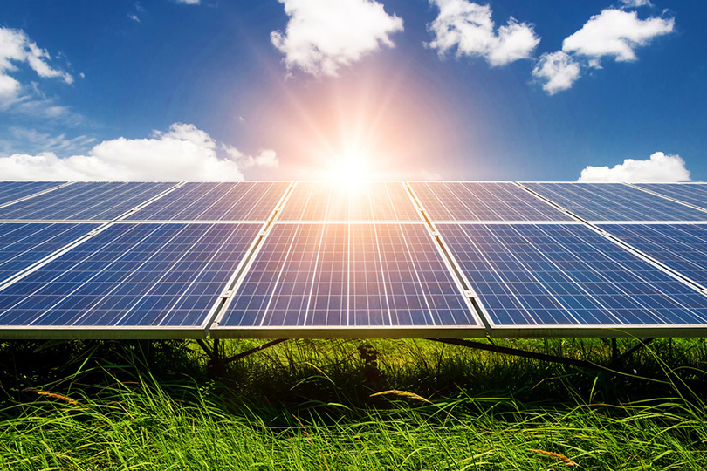
An-Najah National University
Faculty of Engineering
Electrical Engineering Department
Graduation Project 2
"Automatic solar cells cleaning"
Prepared By:
Ata Jawabreh
Abdullah Dweikat
Supervisor: Dr. Raed Jaber

Slide 2
Introduction
over view
A solar cell, or photovoltaic cell, is an electrical device that converts the energy of light directly into electricity by the photovoltaic effect, which is a physical and chemical phenomenon.
The common single junction silicon solar cell can produce a maximum open-circuit voltage of approximately 0.5 to 0.6 volts.
Although solar cells produce electricity, there are many factors that reduce their production efficiency. One of the most important of these factors is dust. The accumulation of dust on the surface of electrical cells blocks part of the light, which reduces light absorption and reduces efficiency while increasing the rate of dust accumulation.

Slide 3
Types of solar cells and their characteristics
The most popular types of solar panels:
Solar Panel (Mono-cristallin): Is characterized by the purity of silicon crystals from which the cells are made and this type is the most expensive and also gives the cells high efficiency, which reduces the number The panels need them to give the same amount of electricity from other types, and they are also characterized by their ability to work efficiently in low light, in addition to their high life span,the efficiency of this type is 16%.
Poly-cristallin solar panel: It is called polycrystalline solar panels, and differs from the mono-type in the form, where the cells are compact squares, and their efficiency is medium, which leads to the need for a greater number of them to obtain the same electricity, which is less expensive than the mono-type , And comes with a great lifetime, The efficiency of this type of cell is 13%.
Thin film solar panel: This type is characterized by its flexibility and ease of installation, which is thin, and it is cheap compared to other types, and is not affected by climatic changes and clouds, but its efficiency is low, which calls for the use of a greater number of cells to cover more areas to obtain The same amount of electrical energy that can be obtained from other types, as well as a small shelf life.The efficiency of this type is 3% -6%, and it is less expensive than the previous two types.

Slide 4
Objectives
The project focuses on the importance of cleaning the solar panels, as the periodic cleaning of the surfaces of the solar cell panels helps to stabilize energy production at a certain rate and give us the best results.
The main objective of the project is to identify the cleaning systems for solar panels applied in practical life, know how they work and know the most important steps to be followed before starting the process of cleaning the solar panels.

Slide 5
Tips and facts about cleaning solar panels
Some tips for manually cleaning the solar panels
Clean solar panels from the ground: Safety methods must be observed to clean the solar cells. If the solar panels are located on the roof of the house and are difficult to access, do not try to risk going up to clean them.
Optimally time the cleaning of the solar panels: It is preferable to clean the solar panels in the early morning periods or in the evening periods or in case the weather is cloudy so that cleaning in the presence of scorching sunlight leads to the evaporation of water and this works to consume more water than the amount needed for cleaning.
Solar Panel Cleaning Materials and Methods: When cleaning solar cells, you should avoid using metal objects to remove small objects stuck to the glass in order not to cause corrosion, which creates shadows on the cells. For oily stains, use chemicals to remove them, such as isopropyl alcohol, as a stain cleaner and make sure to separate the materials that use the brush or fabric to avoid electric shock and caution when cleaning with water.

Slide 6
Important facts about cleaning solar panels
The panels shall be cleaned according to the manufacturer's instructions in order not to lose the plate warranty.
Washing and cleaning solar panels is necessary because the accumulation of dirt and dust leads to a decrease in the productivity of solar cells and may reach 40%.
It is preferable to wash the solar panels in the early morning periods or in the evening periods so that the temperature of the panels is not high, which affects the cells negatively, especially when cleaning with water
Manual cleaning of solar panels wastes a lot of water, which results in wasting a lot of money in the cleaning process, especially if we clean every day.
Continuous cleaning of cells maintains their productivity, especially when using filtered water in the cleaning process.

Slide 7
Solar cell cleaning methods and types
Cleaning methods
Dry cleaning of solar panels :
Solar panels have recently increased in dry desert regions due to the intensity of solar radiation in these areas, but the installation of solar panels in desert areas makes them more prone to dust.
We often resort to dry cleaning where water is not used in this method of cleaning, and this may be due to the lack of water availability in these areas or the difficulty in obtaining it as a result of the distance from the areas where the water is present, or it may be that the country where the panels are located suffers from problems In terms of water availability.
Wet cleaning of solar panels:
This method is spread in the areas where there is a water source close to where the panels are installed and in home systems with easy access to the panels to clean them.
Water or other liquids can be used for cleaning, depending on the type of stains that can be found on the panels, for example, when the panels are located in an area near the airports, oil stains can form on the panels and cannot be removed with water, and here they must be removed using organic solvents.

Slide 8
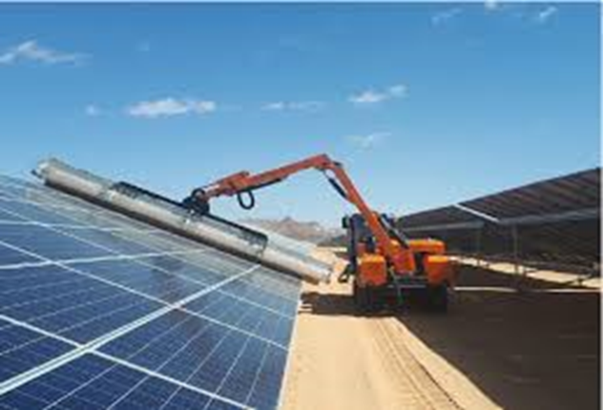
Types of cleaning systems
Truck mounted cleaning systems
Cleaning systems installed on a truck consisting of a small truck on which a large brush is installed and are driven in the corridors between the rows of solar panels.
Each cleaning mechanism has a special control system to control the amount of pressure applied to the panels and humiliate to avoid any damage to the panels.
To be able to use this system for cleaning, the panels must be installed in rows and allow trucks to pass between them, and this distance often ranges between (2.5-3 meters). In addition, it must leave space at the end of the panels to enable the truck to turn, and the panels must be at an angle Milan allows the application of this technique effectively.
The weight of the brush and the device as a whole should be taken into consideration according to the standards of the plate factory so that the plates are leaders to bear their weight in order to protect the plates from damage .

Slide 9
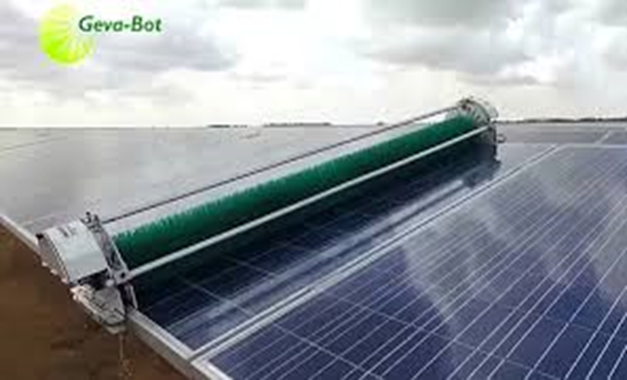
Semi-automatic cleaning systems
The cleaning device must be installed directly at the beginning of each row of panels. The installation process is carried out by two factors, after which the device begins to clean automatically in one direction, and these devices are usually provided with sensors to sense the end of the network panels to return to their start automatically. After cleaning up the grid, the two workers are taken to the next row of panels.
One of the advantages of this system is that it can be easily disassembled and installed when needed, so the number of devices we need is reduced compared to fully automated systems.
It works with special batteries and therefore can be stored when it is not needed in a safe place and protect it from damage and ensure that it continues to work for a longer period.

Slide 10
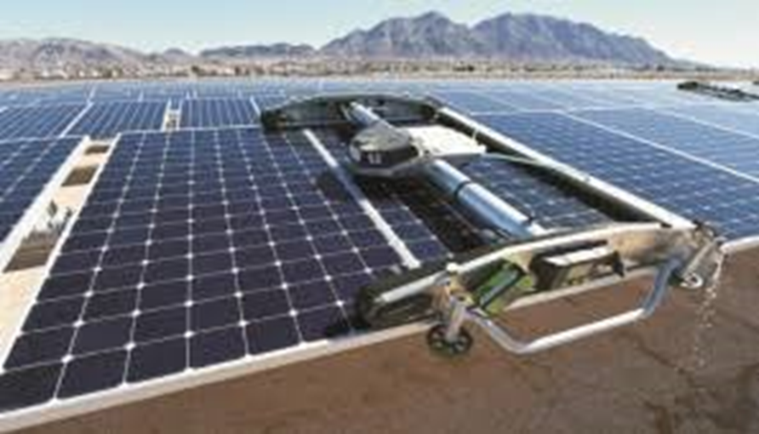
Fully automatic cleaning systems
The automatic cleaning device is installed at the beginning of each row of panels and a place is allocated at the beginning of each row to stop the device without leaving a shadow on the panels and stay in it when it does not work and proceed from it when working and return to it after the completion of each cleaning process.
The device is programmed to move on each row of panels separately and cleans them, and these devices are usually equipped with sensors to stop the weather conditions so that they do not operate at an inappropriate time (for example during a storm).
It is also provided with a special battery and in some models it can be charged from the row of plates that you clean.

Slide 11
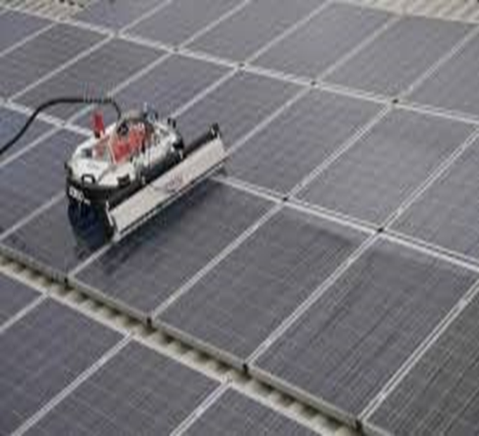
Portable cleaning systems
They are devices up to one square meter and move on the roof of the solar panel system.
When operating automatically, they are equipped with sensors to know system boundaries and edges and to move in different directions to clean up other parts of the system. There are other models that are controlled by a remote control by an operator.
Portable cleaning devices are among the most used, especially in solar systems that follow the movement of the sun.

Slide 12
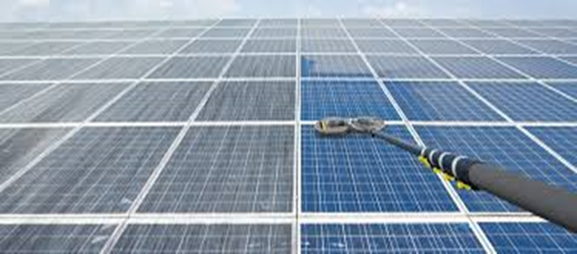
5. Manual cleaning of the solar panels
Manual cleaning of the solar panels remains the preferred option in many cases, despite its seriousness if the cleaning instructions are not followed.
In the cases of small home stations: automatic cleaning is not economically feasible or even practical, and therefore manual cleaning is a chore and usually the owner of this solar system cleans himself.
In the case of large stations: the labor force may be low price, and therefore solar electric station operators prefer to use manual cleaning because it is more economical.
Also, in some poor areas, projects are obligated to manual cleaning to create job opportunities for the local community, even if this solution is not the most economical.

Slide 13
Feasibility study on solar panel cleaning systems
Component | Description of Component | Result
Load Estimation | Total Estimated Load | 48.787 kWh/day
PV Array | Capacity of PV array | 13 Kw
 | Number of modules in series | 2
 | Number of modules in parallels | 36
 | Total number of modules | 72
Battery Bank | Battery bank capacity | 6377Ah
 | Number of batteries in series | 4
 | Number of batteries in parallel | 5
 | Total number of batteries required | 20
Voltage Regulator | Capacity of voltage regulator | 34A
 | Number of voltage regulators required | 1
Inverter | Capacity of the inverter | 15 kVA
Wire | Between PV modules and batteries through voltage regulators | 34A, 1.22mm2
 | Between battery bank and inverter | 358A, 32 mm2
 | Between inverter and load | 40 A, 3 mm2

Slide 14
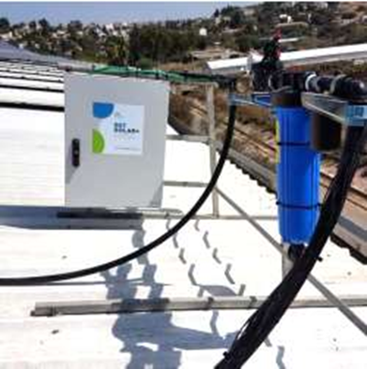
Solar panel cleaning system using filtered water cleaning system
The solar panel cleaning system that will be studied depends on the cleaning system in Bazy Company.
The system relies on automatic cleaning of solar panels by using filtered water.
The cleaning system uses filtered water to wash the solar panels every 24 to 72 hours according to the programmed instructions, as the filtered water is used by a purification technology that prevents the solar panels from calcification and is suitable for cleaning.
System parts
Control panel: The control panel shall be installed near the filter system where the control panel will operate the electronic valves and operate at a voltage ranging from 110 to 220 volts.

Slide 15
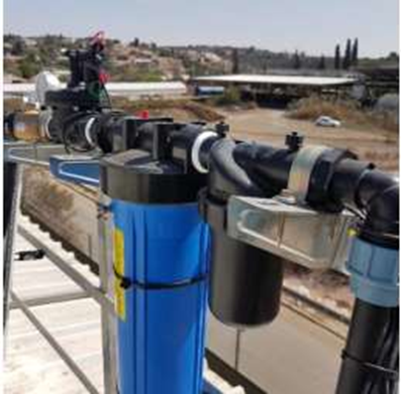
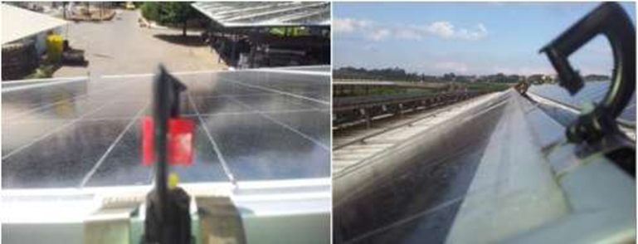
Filter system: Uses a self-maintenance electric filter where it maintains itself every time the system works and the filter maintains a high water pressure as it works on the normal network pressure 3 bar.
Steel cleats: It is used to install water sprinklers sturdily to ensure steady water pumping onto solar panels.
Water sprinklers: Sprinklers are used to cover the surface of a 1 * 2 meter solar panel and it consumes 60 liters per hour and is specially designed so that you do not shade the panels.

Slide 16
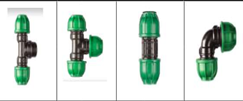
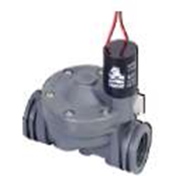
Valves and their fittings: Valves are used to pump water, they pump and stop water electrically, and there are special connections for connecting valves and tubes.

Slide 17
Characteristics and objectives of the cleaning system
The system has unique features:
Safe and highly effective: The system cleans the solar panels by purifying the water and then spraying it on the roofs of the panels. This prevents lime from accumulating on the glass, and local water can then be filtered and used in the cleaning process. The system also prevents all possible risks that may occur and the system can be activated remotely in the event that the areas near it are exposed to fire and distribute water regularly during the cleaning process. It is highly efficient and saves effort and time.
Ease of handling and comprehensive warranty: Where cleaning is in proportion to the external conditions to maintain the effectiveness of the solar panels and uses patented high-efficiency fasteners and clips. No cleaning tools or chemical cleaning materials are used, which reduces maintenance operations. The system is designed to comply with all standards and requirements of the manufacturers of the panels Solar.
Compatible with any solar system: The system works automatically and works with all maintenance and operating systems, which allows monitoring the system's performance from anywhere and knowing its improvement.

Slide 18
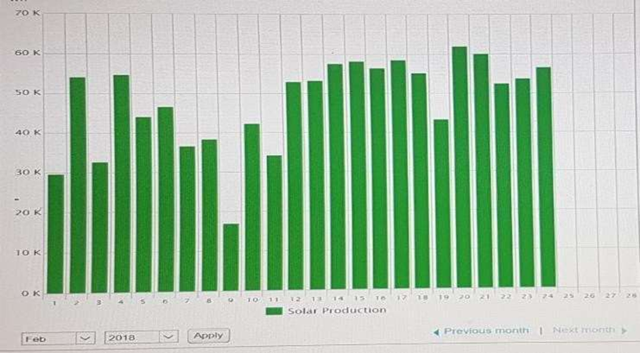
•The system focuses on major objectives:
The system is fully automatic and requires no human intervention.
Easy to implement.
There are no maintenance costs.
Very little water use (1-1.5 liter per panel)
An increase in solar energy production.
Clean the panels only at night

Slide 19
Feasibility study of an off-grid photoelectric system using the Bazy Cleaning System
Suppose dust reduces the efficiency of solar cells by 10%, due to the dry, dusty climate
If we use Bazy cleaning system, the system parts will cost $ 2207.
The system has a power of 13 KW and to calculate the power generated by the system:
=P(kw)*5.5(hour)*0.8=13*5.5*0.8=57.2KWh/day
The amount of power loss due to the impact of dust=5.72kw/day
Annual power loss =5.72*365=2087.8kWh/year.
Annual loss value = 2087.8kWh/year *0.21$ = 438.438 ($/y)
Payback period = 2207/438.438 =5.03378 year, Almost equal 5 years and 13 days.

Slide 20
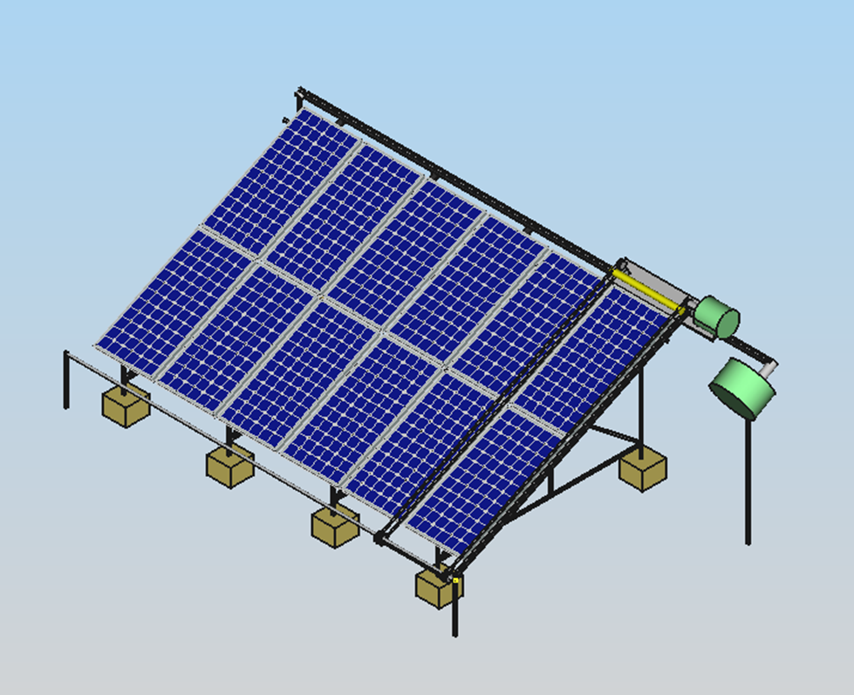
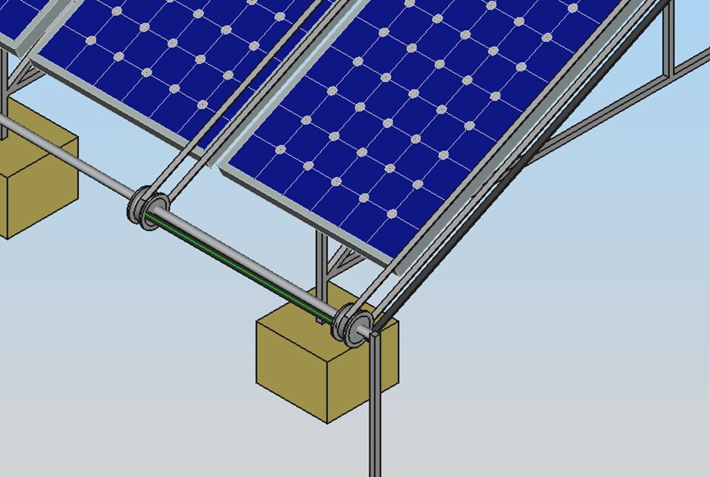
Solar panels cleaning system using Automatic PV dry cleaner
Cleaning system design

Slide 21
Feasibility study of an off-grid photoelectric system using the automatic dry cleaning system
Parts | Price($)
Metal body | 198.70
Belt | 93.67
Brush | 14.19
Pulleys | 14.19
Ac induction motor with gear : 120w 15 rpm | 139.09
Ac induction motor with gear : 200w 25rpm | 141.93
Limit switches*20 | 28.39
Electrical panel | 85.16
Cb *2 | 28.39
Elcb *1 | 17.03
Speed Controller*2 | 28.39
Micro Controller | 2.84
Powersupply | 2.84
Wires and others | 28.39
Total price | 823.2$
Total price for the parts needed to install an automatic dry cleaning system on a 13 kw system=823.2$
Payback period = 823.2/438.438 =1.87757 year, Almost equal 1 years,10 months and 16 days.

Slide 22
Guiding rules for cleaning solar panels
Guiding rules for cleaning solar panels According to Canadian Solar Company
Cleaning activities lead to the risk of damaging the units and components of the matrix, in addition to increasing the risk of potential electric shock. Before that cleaning check the units carefully to make sure there are no cracks or Damaged connections or connections.
The voltage and current present in a matrix during daylight hours are sufficient for a fatal electric shock and do not submerge the unit, partially or completely, in water or any other cleaning solution and make sure to separate the circuit before starting the cleaning.
Ensure that the array is separated from other active components (such as a reflector or assembled boxes) before starting cleaning and proper protection (insulated clothing, gloves, etc.) must be worn.
Do not use abrasive or electrical cleaners on the unit and do not use abrasive cleaners, degreasers or any unauthorized chemical (such as oil, lubricants, pesticides, etc.) in the unit and do not use corrosive cleaning solutions .
Canadian Solar Inc. recommends Avoid the cleaning methods of the rotating brush, as it can create fine cracks in the PV units and the observed dirt is cleaned with a gentle cleaning tool.
Do cleaning activities while avoiding the hottest hours of the day,to avoid thermal stress on the unit , and we recommend using water with a low mineral content near the neutral pH and the maximum recommended pressure is 4 MPa (40 bar).

Slide 23
Guiding rules for cleaning solar panels According to Jinko Solar Company
A build up of dust or dirt on the module(s) front face will result in a decreased energy output. Clean the panel(s) preferably once per annum if possible (depend on site conditions) using a soft cloth dry or damp, as necessary. Water with high mineral content may leave deposits on the glass surface and is not recommended.
Never use abrasive material under any circumstances.
In order to reduce the potential for electrical and thermal shock, Jinko recommends cleaning PV modules during early morning or late afternoon hours when solar radiation is low and the modules are cooler, especially in regions with hotter temperatures.
Never attempt to clean a PV module with broken glass or other signs of exposed wiring, as this presents a shock hazard.
Never use chemicals when cleaning modules as this may affect the module warranty and energy output.

Slide 24
Guiding rules for cleaning solar panels According to ReneSola Solar Company
The cleaning process can only be applied at low radiation.
A soft cloth or sponge can only be used to clean the surface of the glass.
Only clean water can be used as a cleaning solvent.
The contrast should range from water temperature to unit temperature in the range of -5 ℃ to + 10 ℃.
The water pressure should be less than 1000 Pa.
The necessary electrical protection should be taken.
No other chemical could be used in cleaning process.
No aggressive tool or coarse mettrial is permitted
Do not trample or strike on modules.
In cleaning process, the modules must not be under a load circumstance.
Do not touch exposed cables or connectors.
Forbidden to remove dust in dry way.
Forbidden to clean modules before cooling down.

Slide 25
Conclusion
The importance of cleaning the solar panels is based on maintaining their energy productivity, as cleaning the solar cells helps to benefit from the largest amount of sunlight in generating electrical energy.
When cleaning solar panels, you must adhere to the necessary rules during the cleaning process because they may cause the solar system to be endangered or damaged it, which leads to physical damage and sometimes even death because the energy from one plate is sufficient to kill a person.
We noticed that the cleaning system using filtered water is more expensive than the dry cleaning system we designed it as the payback period for the dry cleaning system was less than the pay back period for the filtered water cleaning system, and the dry cleaning system does not need somewhat large operating expenses such as the operating expenses used In pumping water to the filtered water cleaning system.

Slide 26
The end

