Slide 1


An Integrated Gym Information System With Online Subscription
Yamama Hanani Ruba Sharaya Masa Saif
2024-2025

Slide 2

About Sport Clinic Gym
  Medical Gym Located in City
Mall in Nablus
  Founded in 2021
  Fitness services, injury rehabilitation
personal training, nutrition,
and diet

Slide 3







Why Odoo?
Problems
An Integrated Gym System With Online Subscription and Virtual Training Features
Objectives

Slide 4

PROBLEMS
  Lack of Integration Between Departments
  Random Management of Trainers
  Lack analysis Preparing Reports
  Using Paper & Excel Sheet

Slide 5
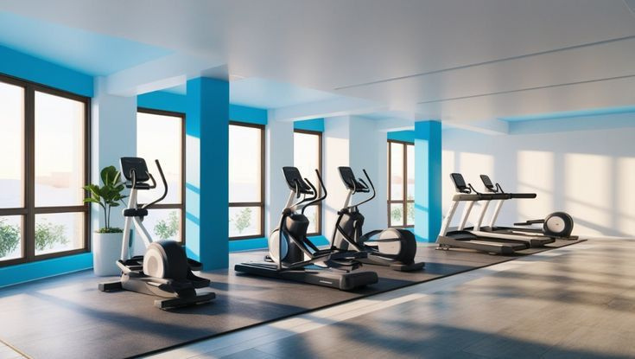


Senario For Subscription
1.
Initial Communication
5.
Confirming Registration
Filling Out the Registration Form
2.
6.
Payment
3.
Scheduling the Interview
7.
Starting the Program
4.
Attending the Interview

Slide 6



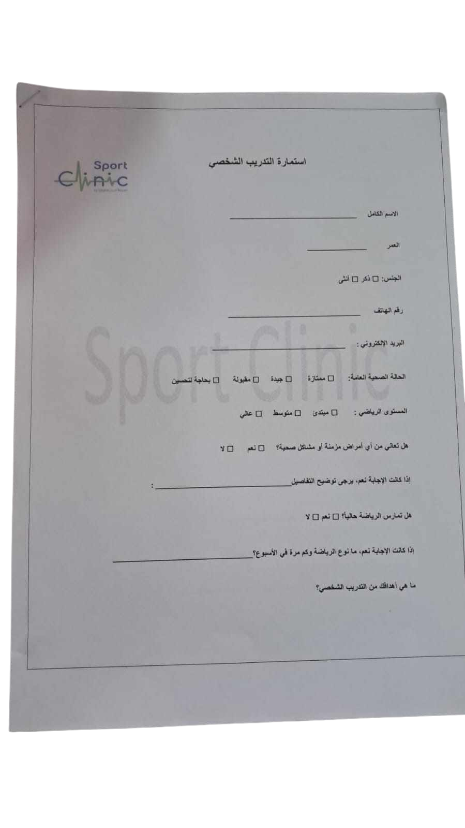
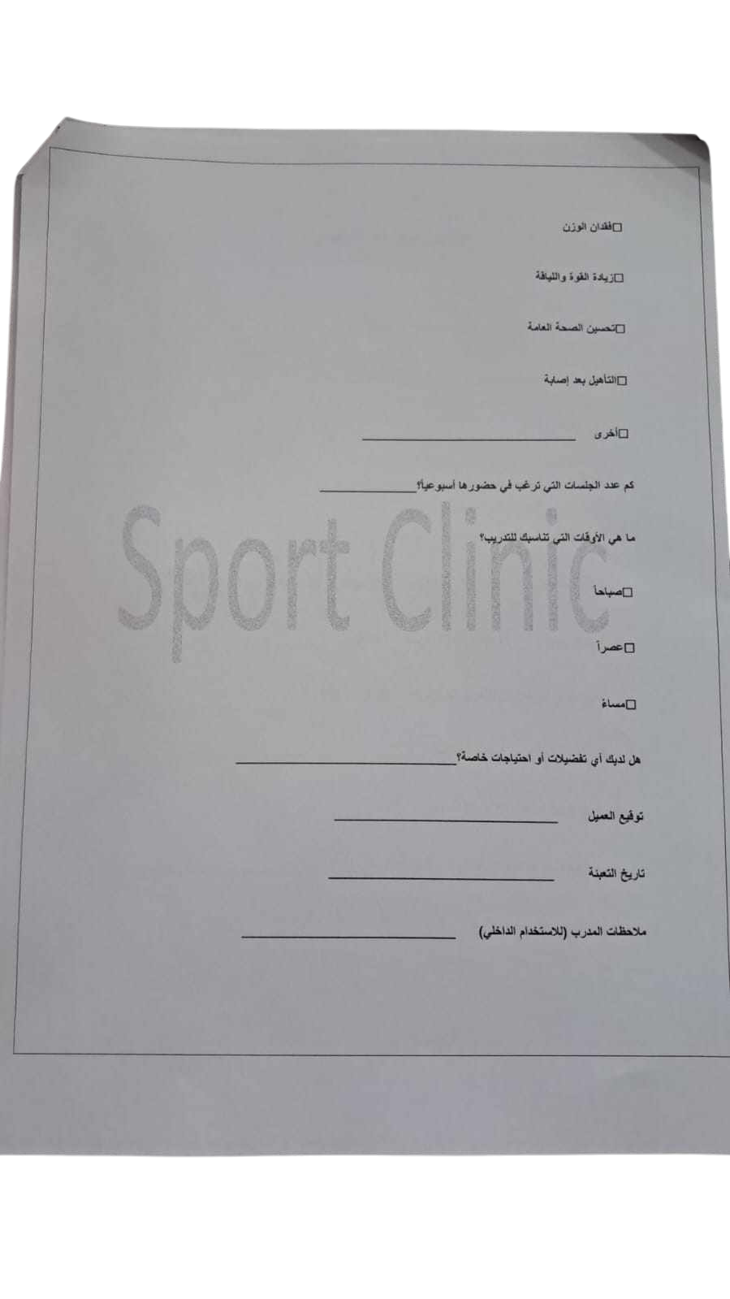

Slide 7

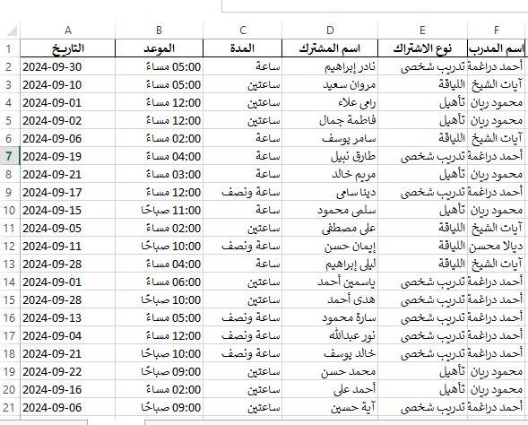

Slide 8















Why ODOO ?

Slide 9
One-in-all application
Integrated
Why Odoo?
User Friendly
Cost-effective

Slide 10
Modules
WEBSITE
GYM
Diet & Nutrtion
CRM
Subsicrption
Calendar
Inventory
Sales
Appointment
E-Learning
To-Do
Live Chat

Slide 11
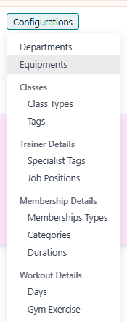
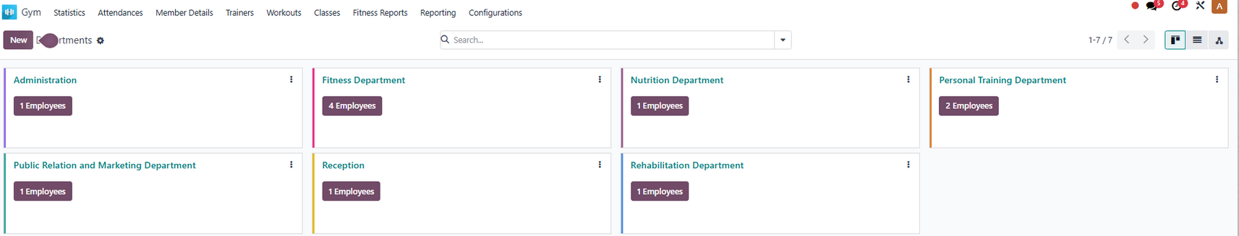


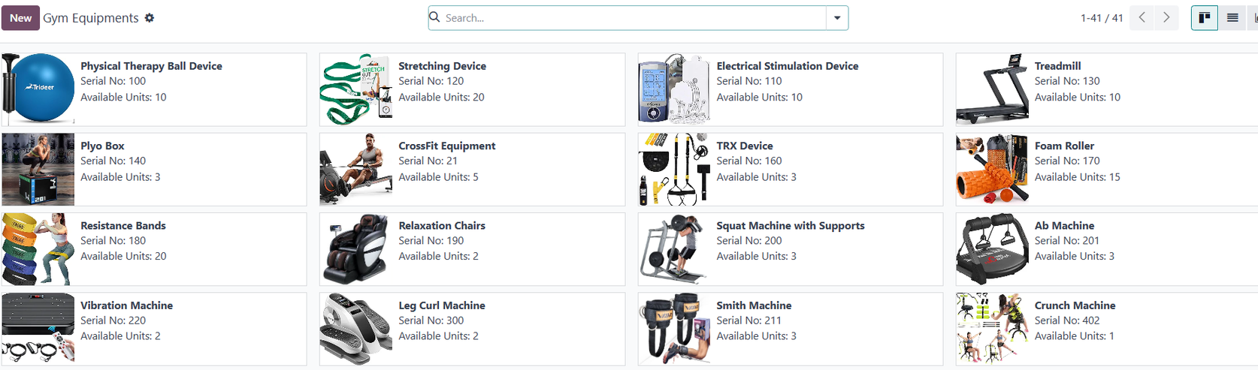
Gym Managment:
Configurations:
All Departments in Sport Clinic
Equipment

Slide 12
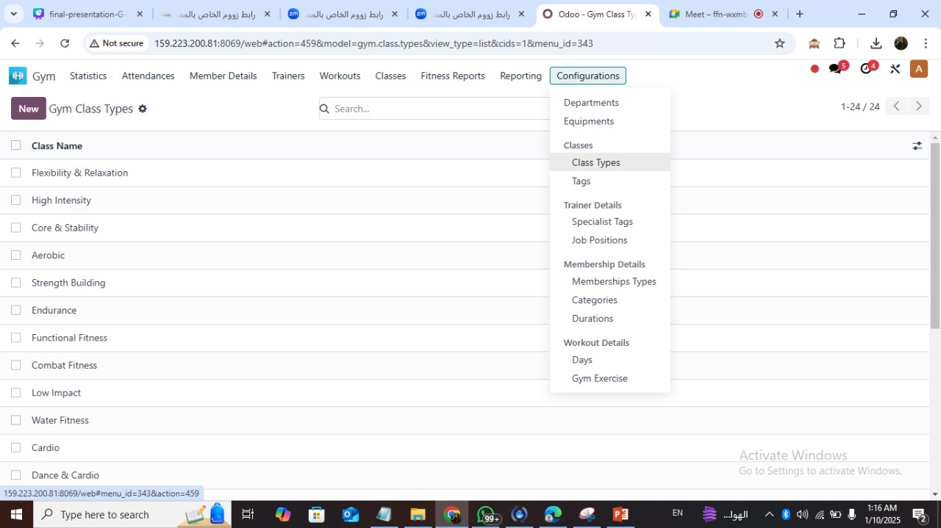

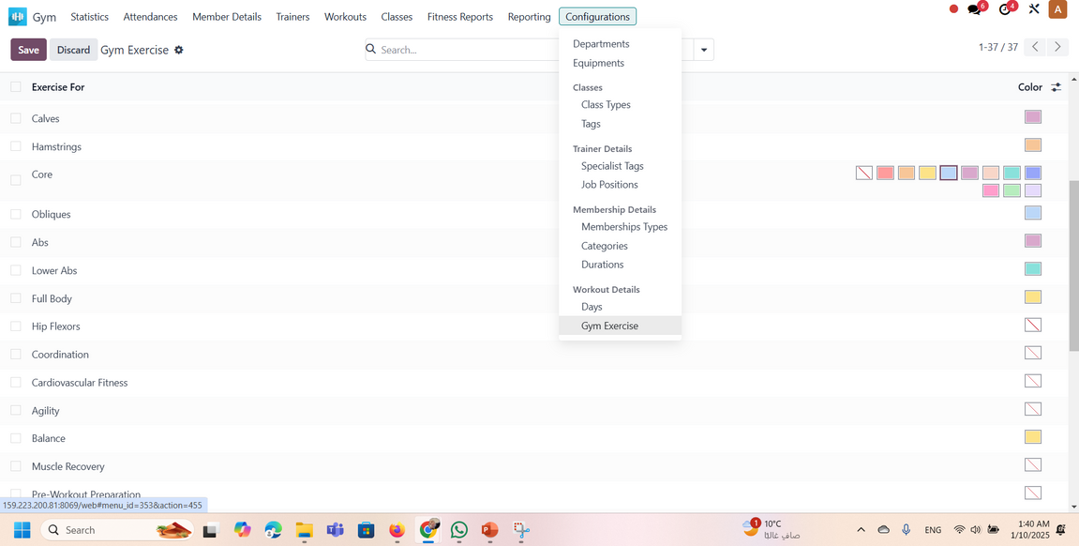
Configurations:
Class Types
Exercises For Any Part of The Body

Slide 13
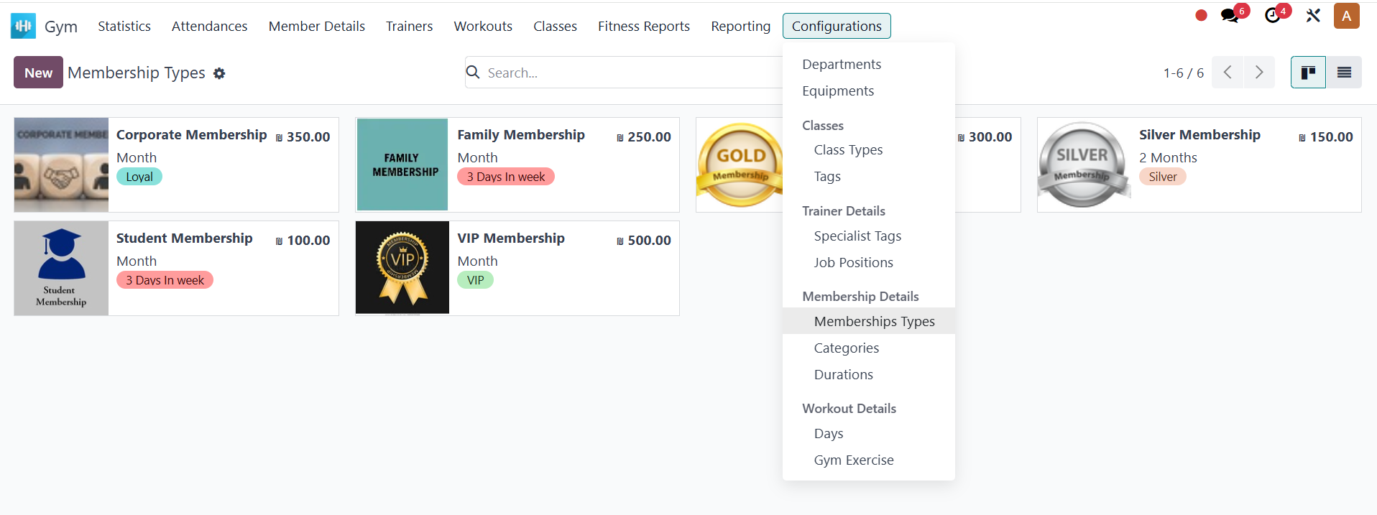
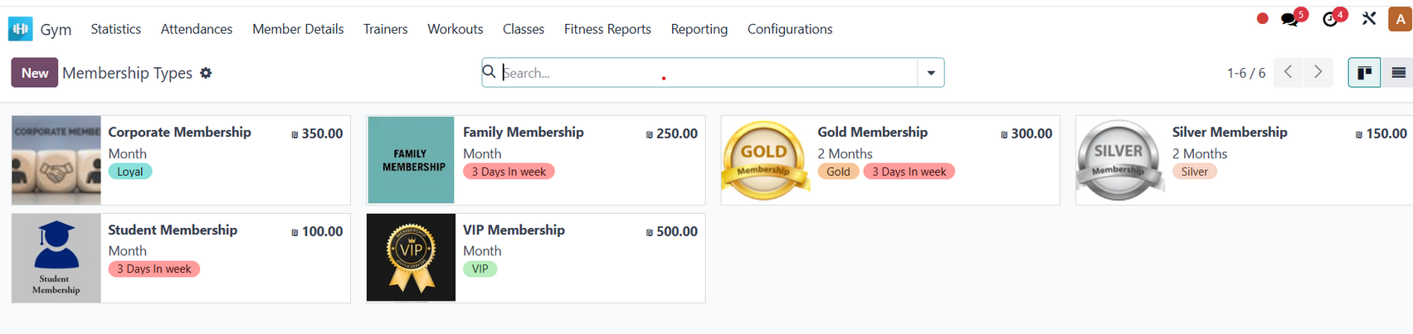
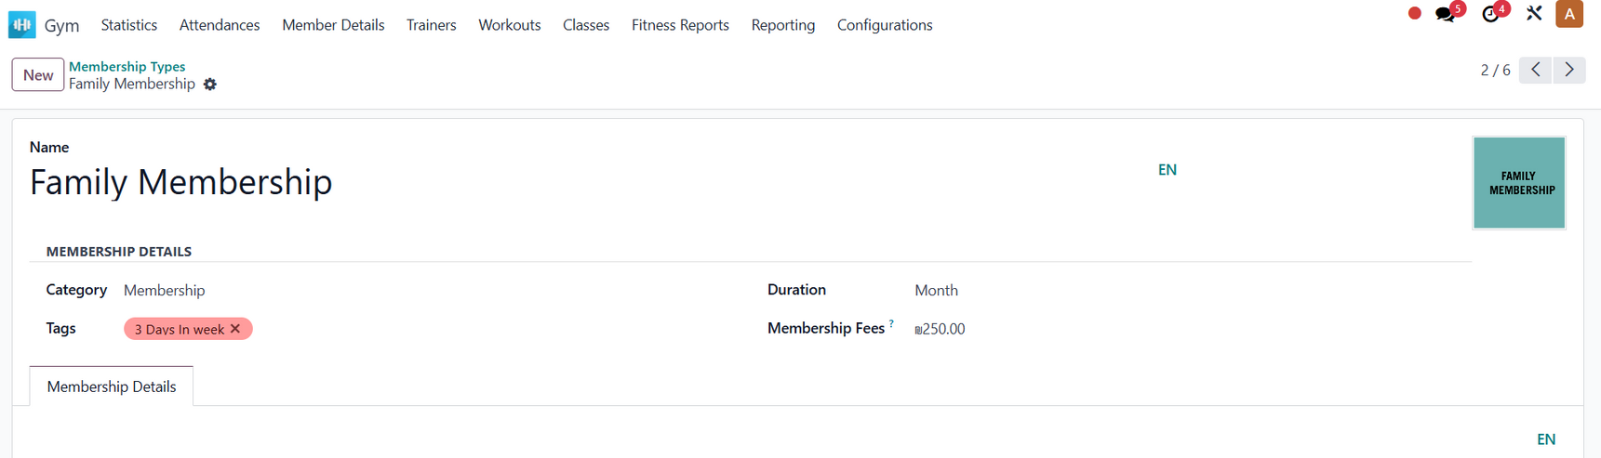

Configurations:
Membership Types
Write The Membership Nmae
Membership Details

Slide 14
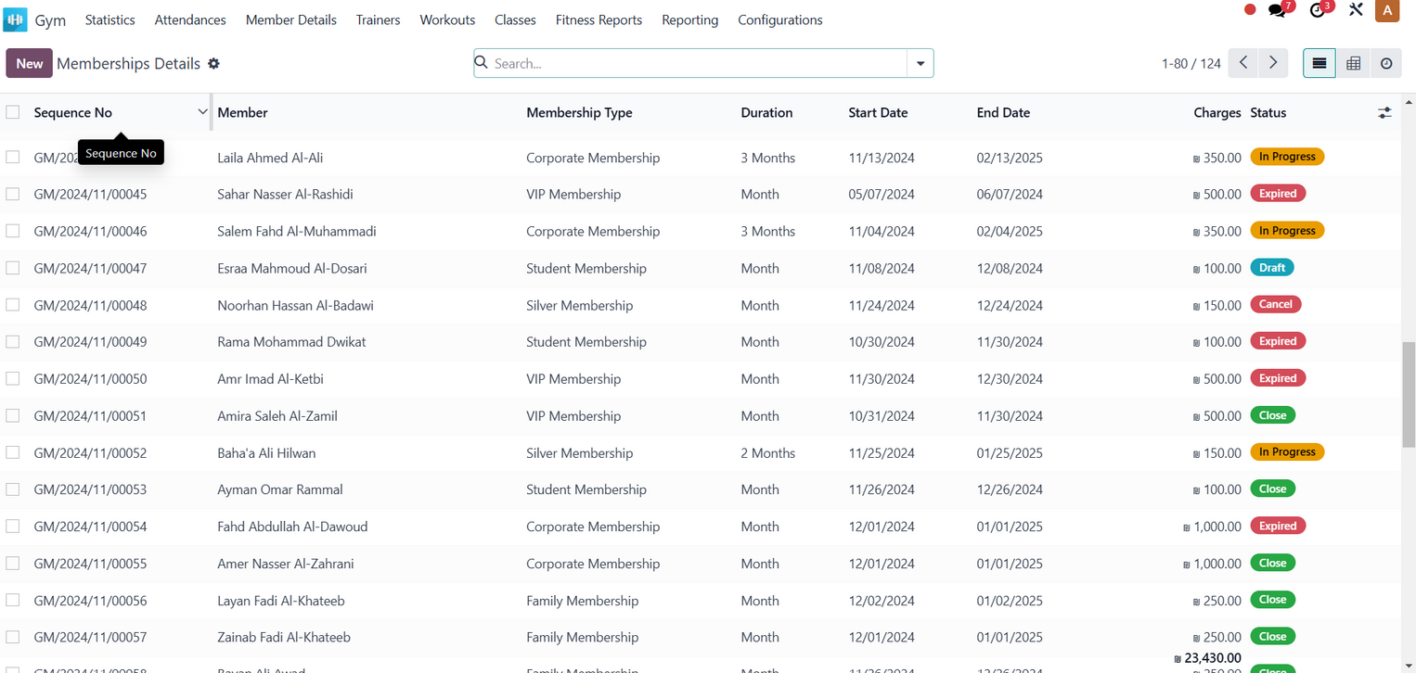

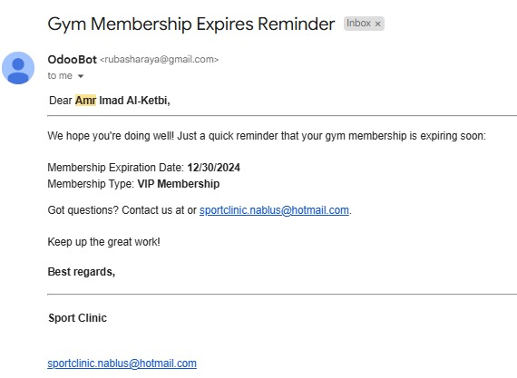
Memberships Details
Reminder

Slide 15
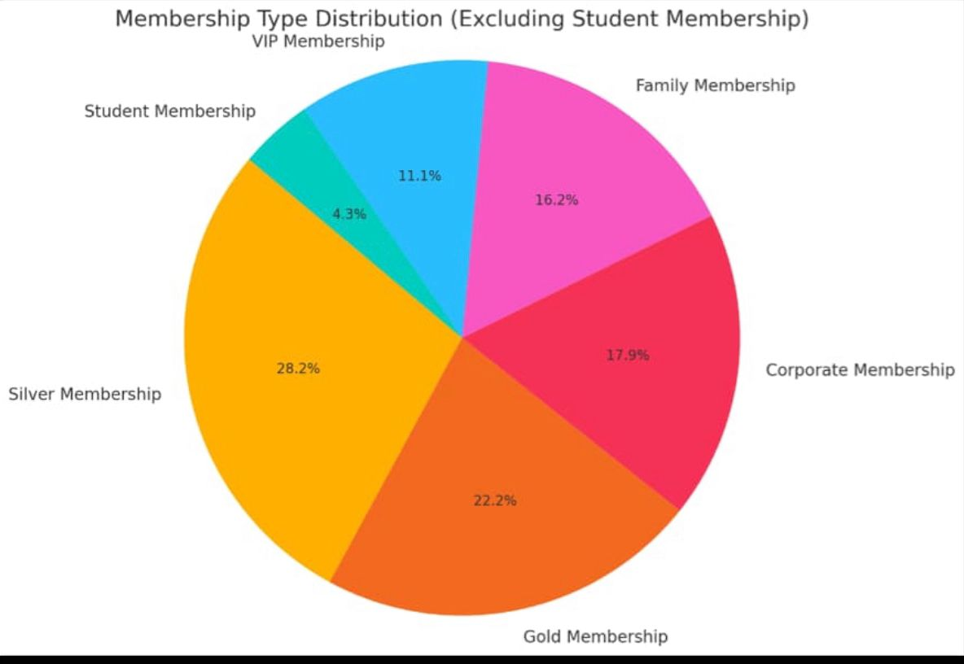
Membership Type Distribuation

Slide 16
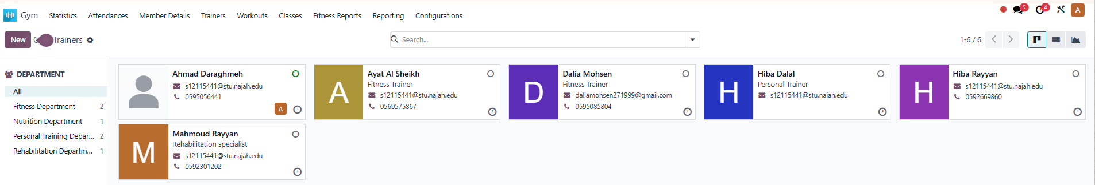
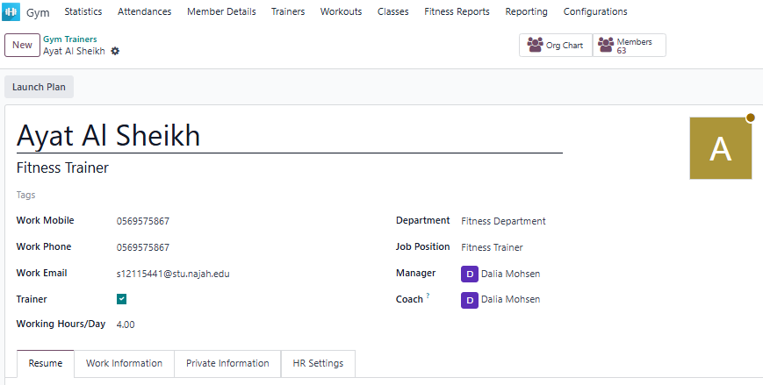
Trainers :
All Trainers in Sport Clinic
All informaion about trainer

Slide 17
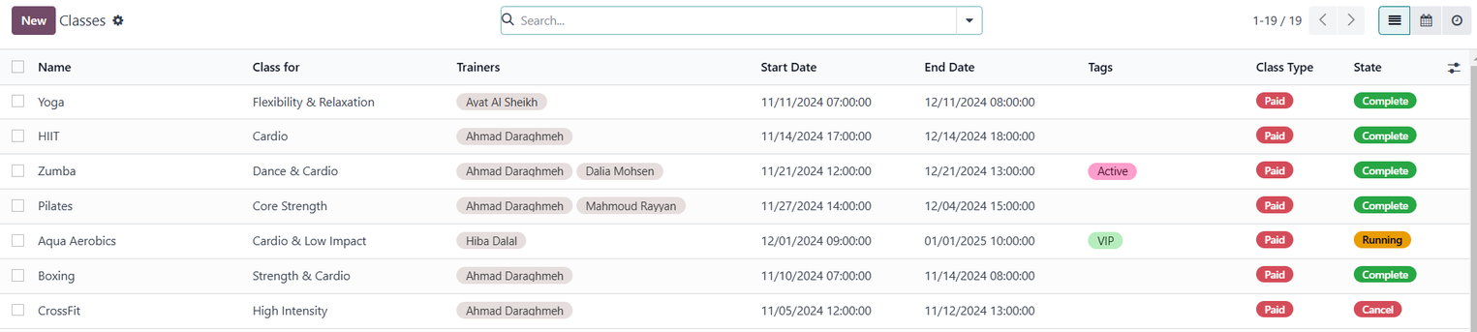
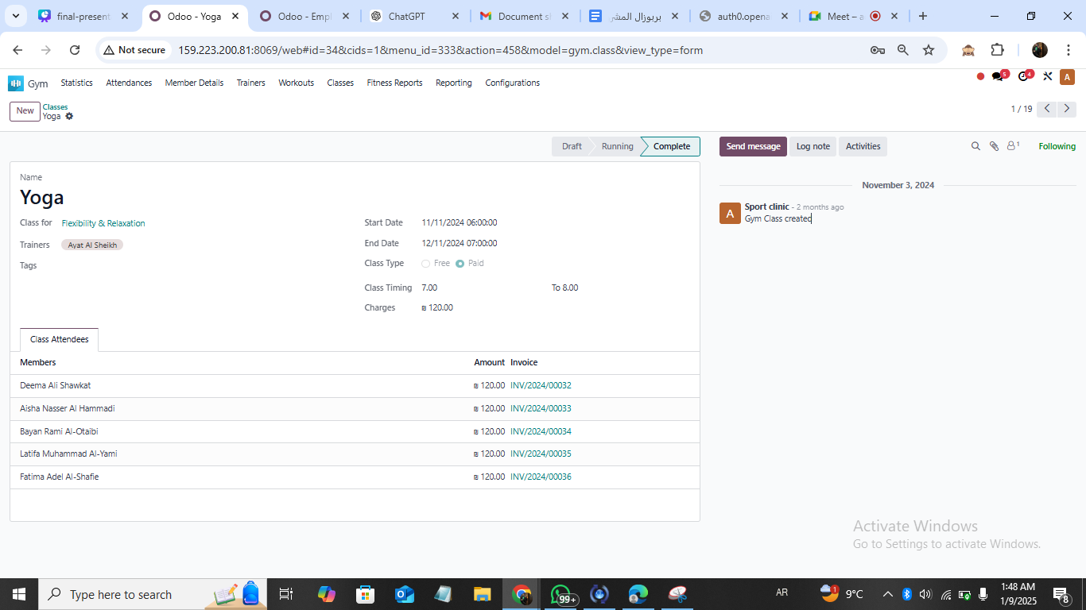

Classes:
Members in Yoga Class

Slide 18
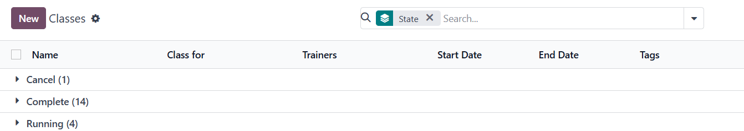
Group By State:

Slide 19
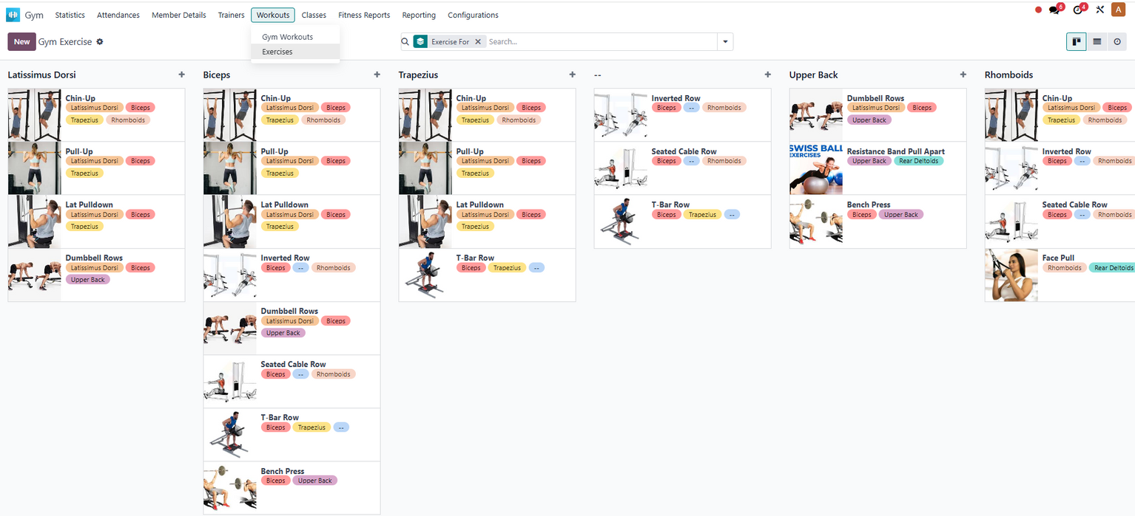


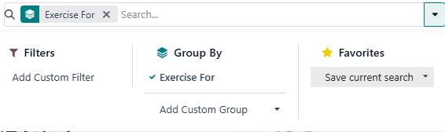
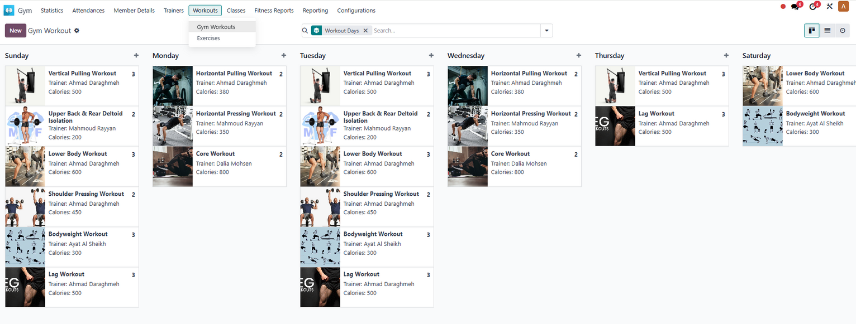
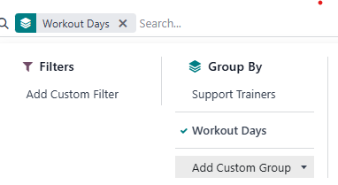
Exercises :
Group By The Exercise For What
Workouts :

Slide 20
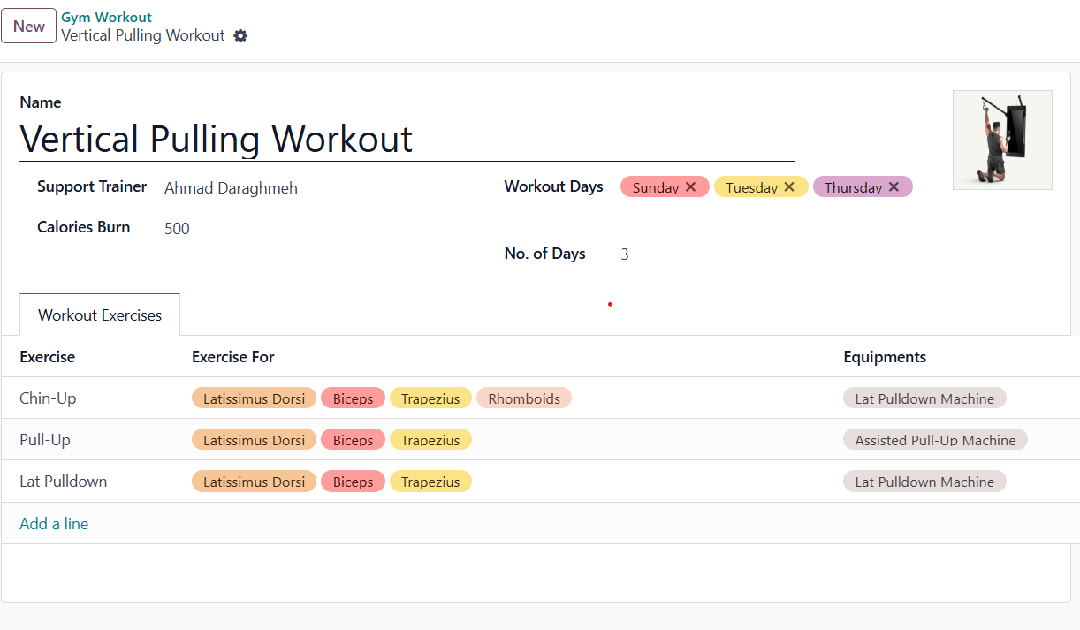
Gym WorkOut:
Details In Workouts
Equipment Used in Each Exercise
Here, automatically, the Exercises we can add it

Slide 21
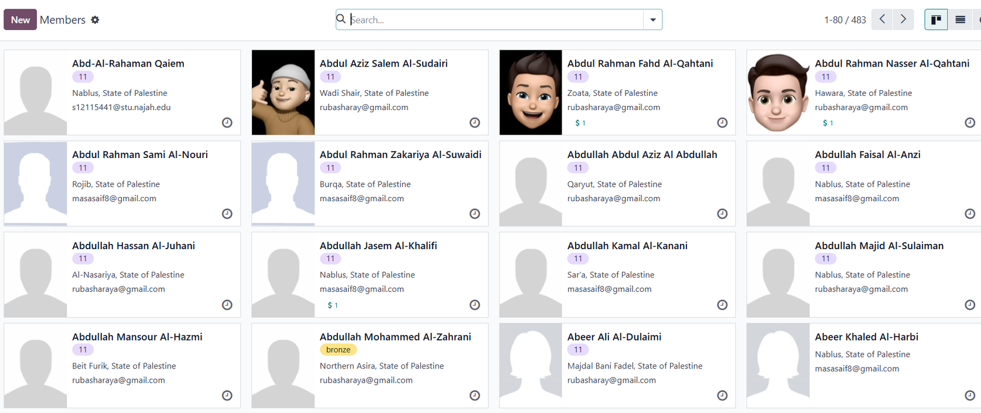
Members :

Slide 22
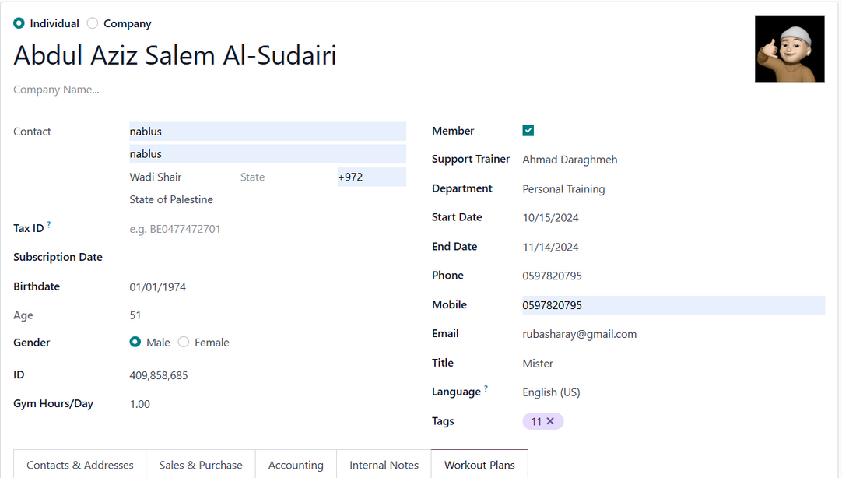
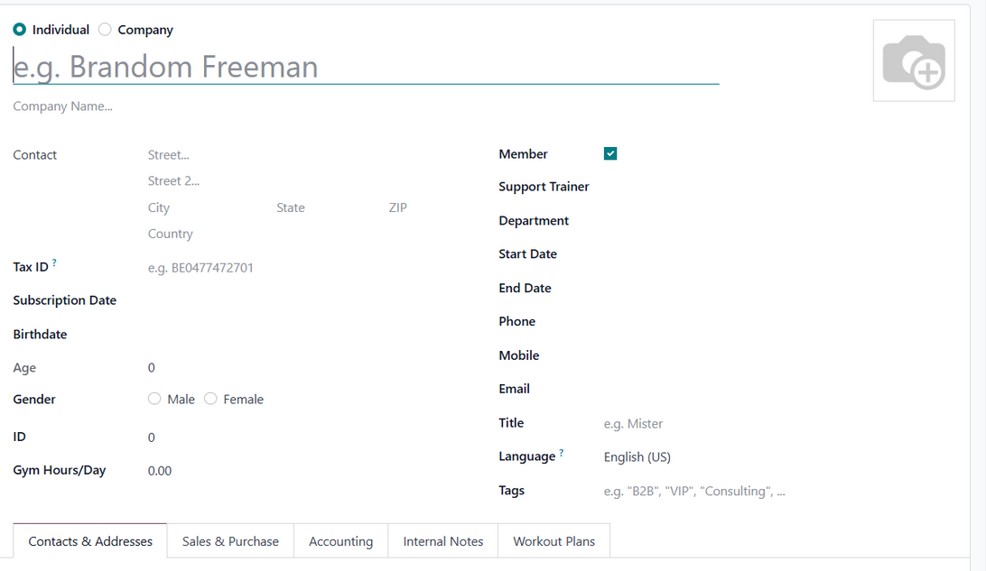
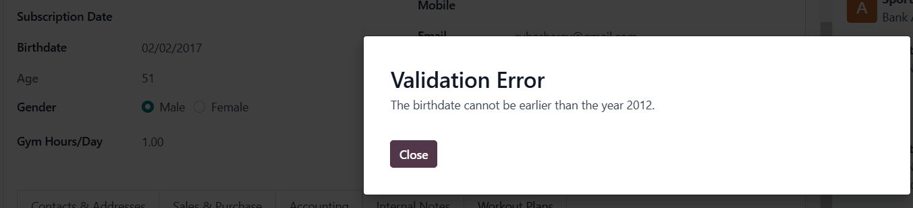
Members :
The birthdate cannot be older than 2012

Slide 23
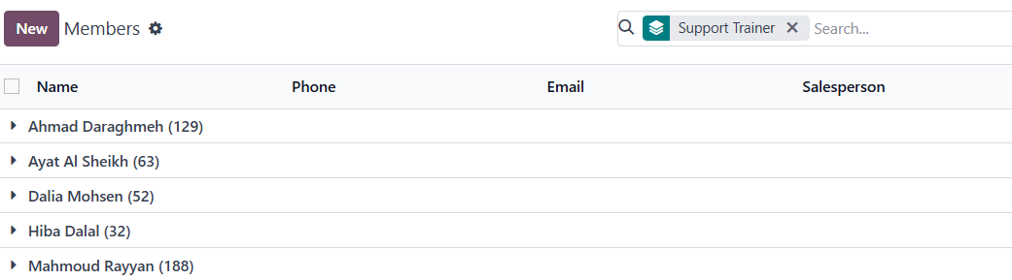


Members :
All Member in Sport Clinic Group by Support Trainer

Slide 24
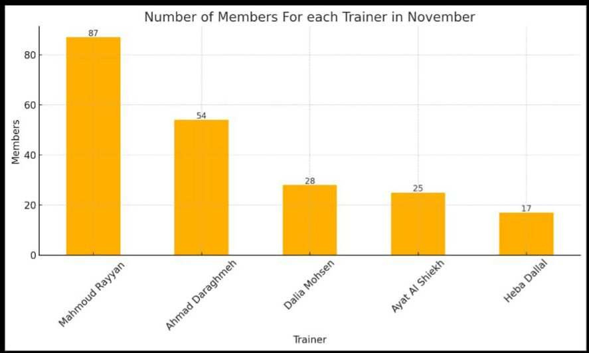

Slide 25
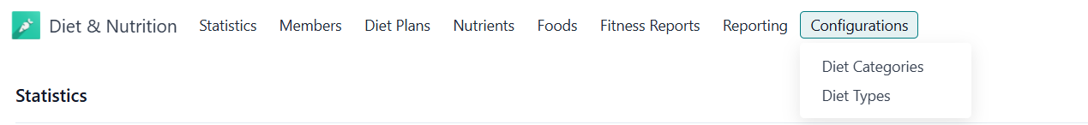
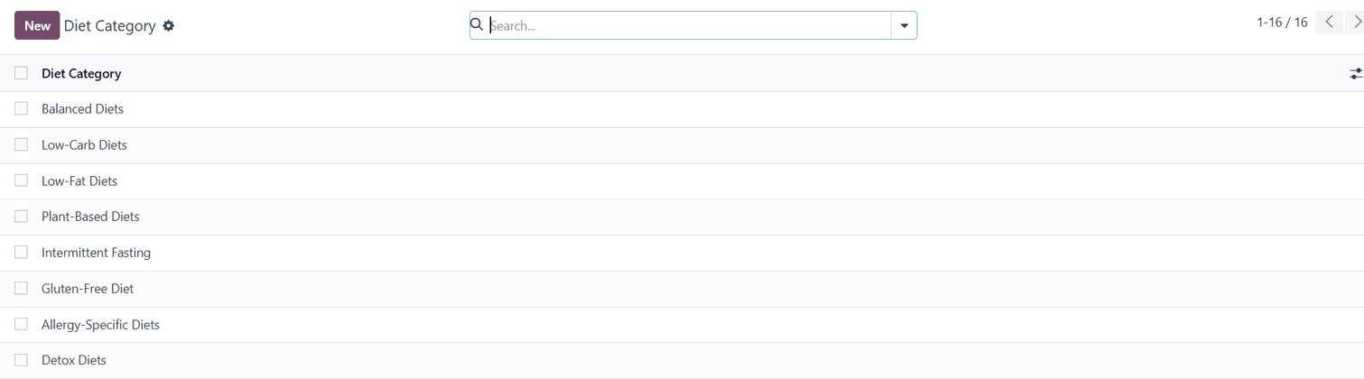
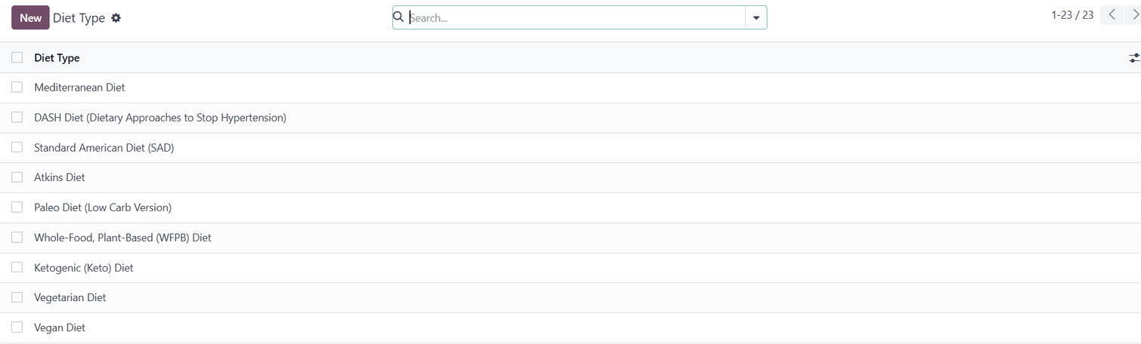
Diet& Nutrition
Configuration:
Diet Category
Diet Type

Slide 26
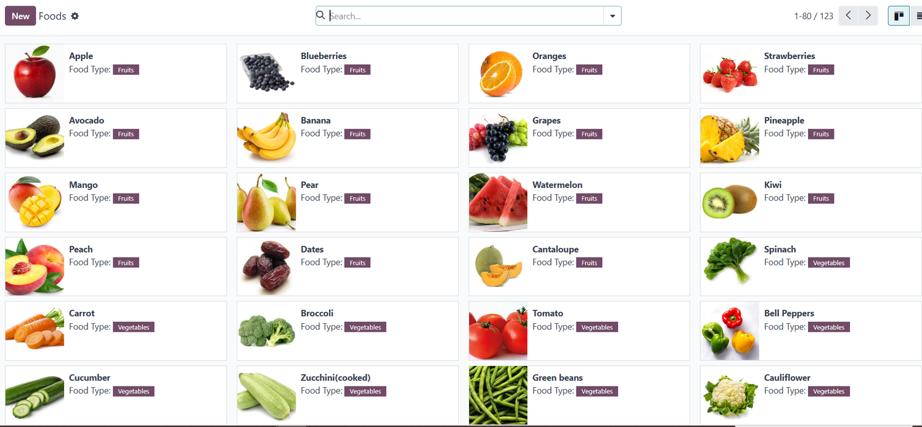
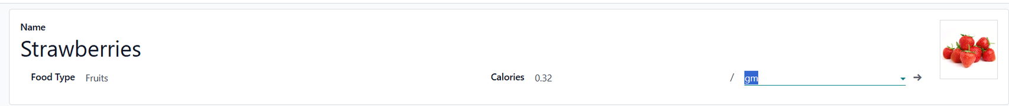
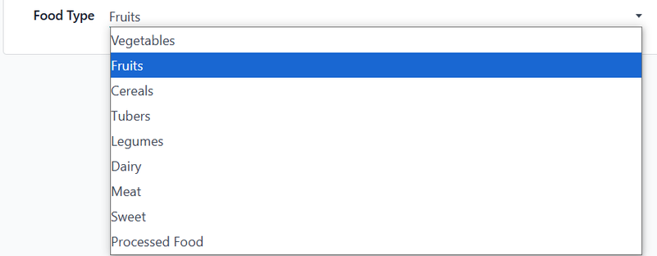
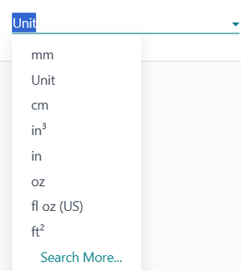
Foods:
Put Food Name

Slide 27
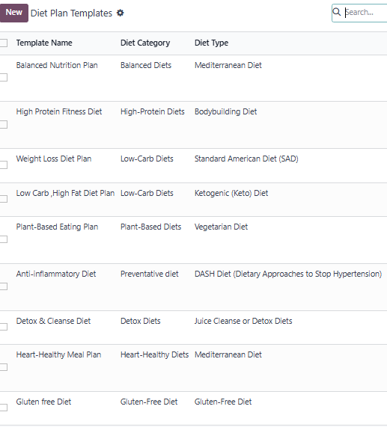
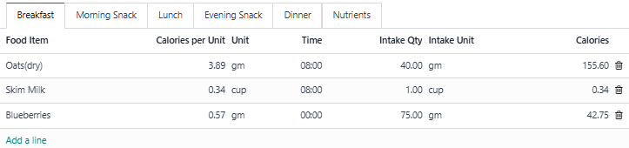
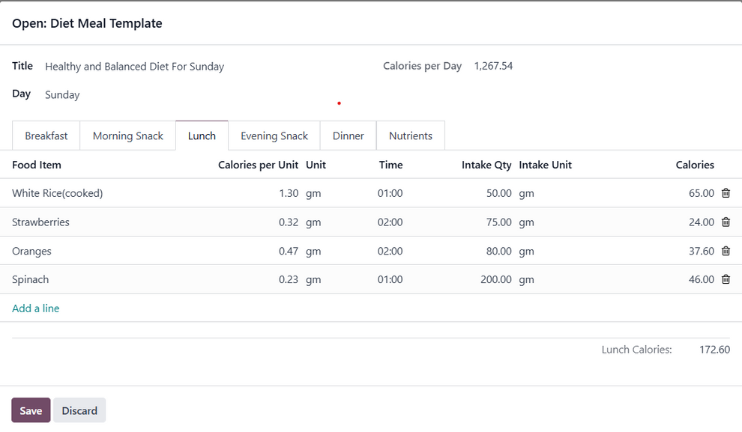
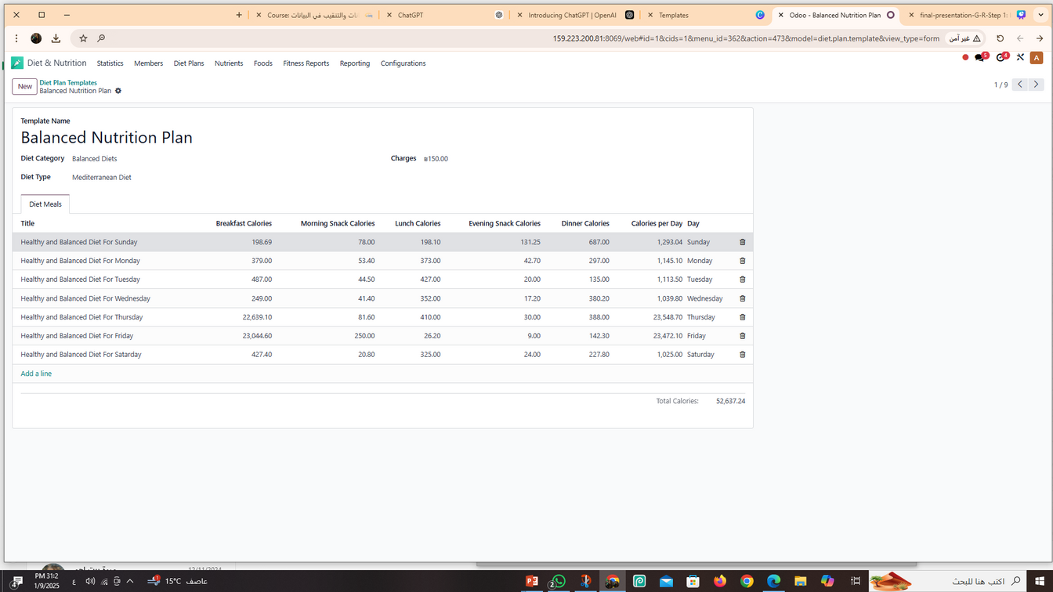
Diet Plans:
Diet Plan Templates:
Diet Meal Template:

Slide 28
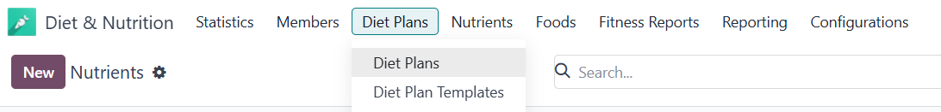
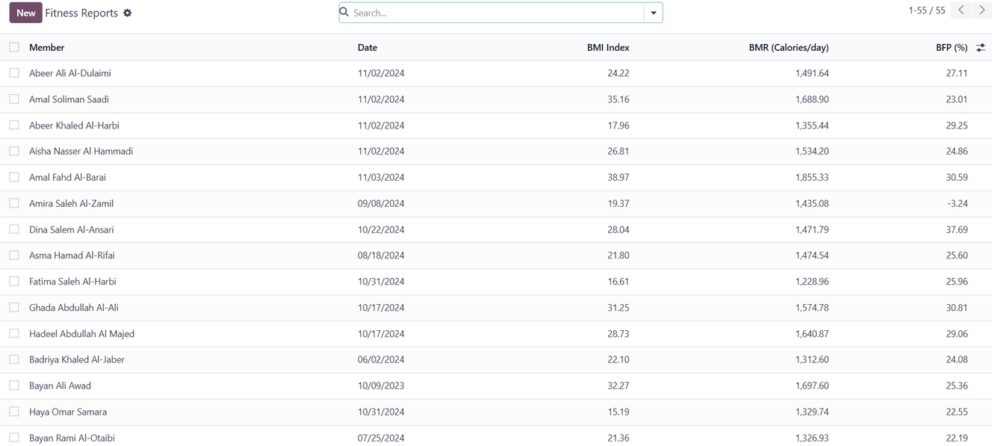
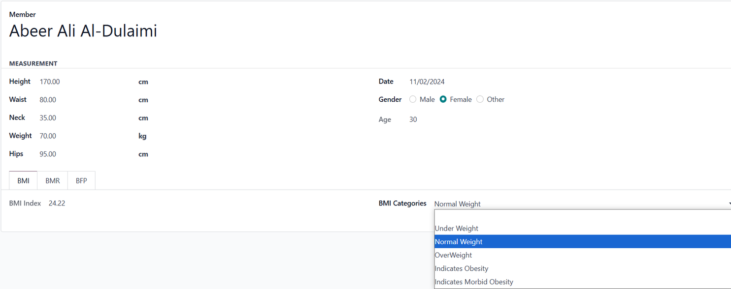
Fitness Report:
Put Your Name
Based On BMI Determines His Condition

Slide 29
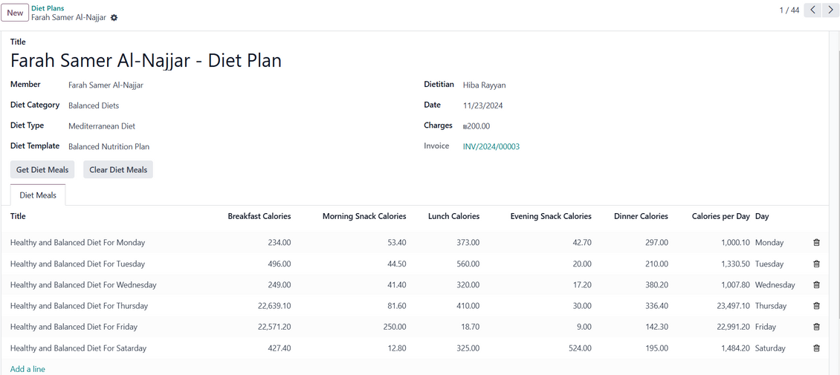
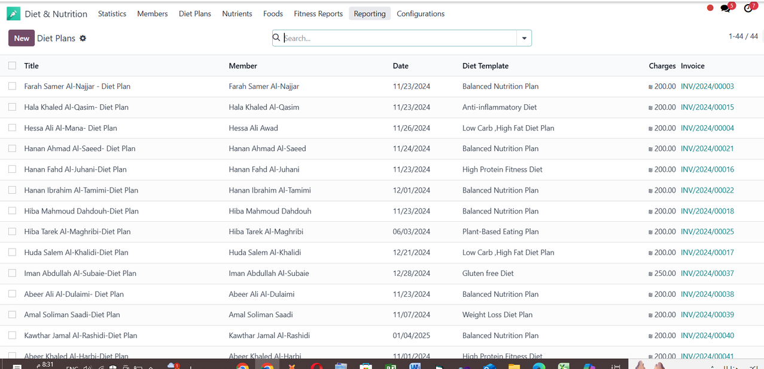
Diet Plans:

Slide 30
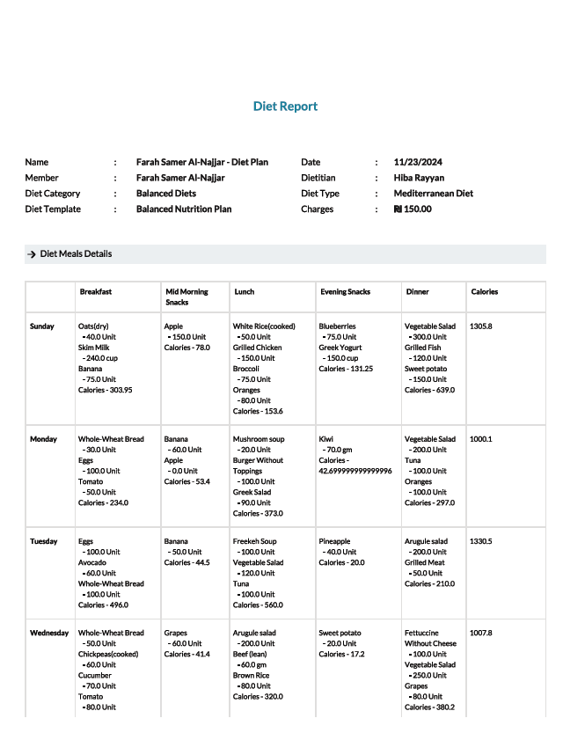
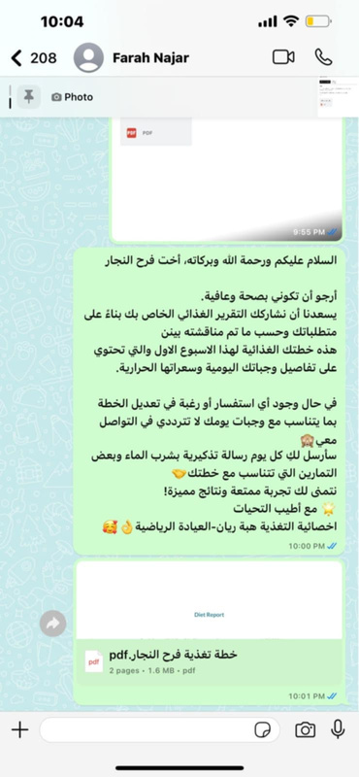

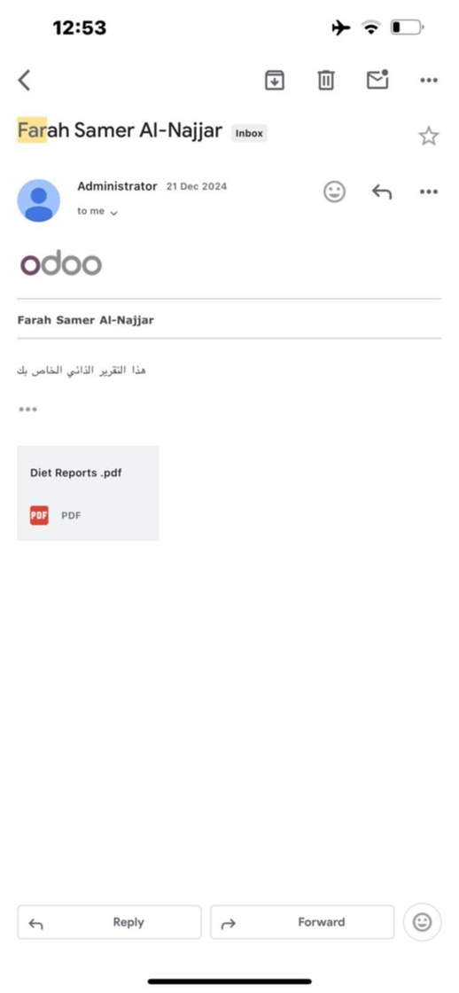
Diet Report:
Send via Whatsapp
Send via email

Slide 31

Diet Plans Filter By Date & gender

Slide 32


Diet Plans:
Diet Plans Filter By Date
Group By Date Month

Slide 33
Inventory & Sales :
Inventory module in odoo is a powerful tool to manage our inventory and sales , How?
1- Create and manage service
2- Manage Warehouse
3- Create Subscriber Invoice
4- Tracking Inventory levels in real -time

Slide 34



Inventory:

Slide 35




Configuration:

Slide 36



Configuration:

Slide 37


Products:

Slide 38





Slide 39





E Learning
Course Name
Course Category
Course Content

Slide 40
Website Home Page

Slide 41





-

Slide 42

-

Slide 43

-

Slide 44

-

Slide 45



Slide 46





Slide 47



Community -Website
About Us
FAQ Page

Slide 48






Forum
Community -Website
user of the website can post any Questions or feedback.
How it Appears to the Administrator
After Accepted

Slide 49




Courses:
Can’t open the content before you buy

Slide 50





Courses:
When You Finish The Content, Click Here
After You Pay, The Content Will Appear
You Can Leave The Course

Slide 51




Shop:
Categories Added to Facilitate the Shopping
If we click in one category
All Products On this Category Will Appear
To Choose The Size
To Choose The Color

Slide 52



Appointment:
All appointments appear here for the user

Slide 53







Subscription:
From Header Here Forms For Subscription
Validation For Birthdate

Slide 54



CRM:
User information converted to CRM

Slide 55



Subscription:
After Confirming the Request
Ameer

Slide 56


Payment is cash upon the first meeting
Subscription:

Slide 57




Subscription:
An email is sent to the customer to sign and pay

Slide 58

Ameer Became a Member in Sport Clinic

Slide 59



Slide 60


To Do:
Task is divided according to the days of the week

Slide 61


Slide 62



Slide 63


Slide 64



