Slide 1
Restuarant Application
Manegement & Delivery Application
Lama kharaz
- Supervised by: Dr.Asmaa Afeefi

Slide 2
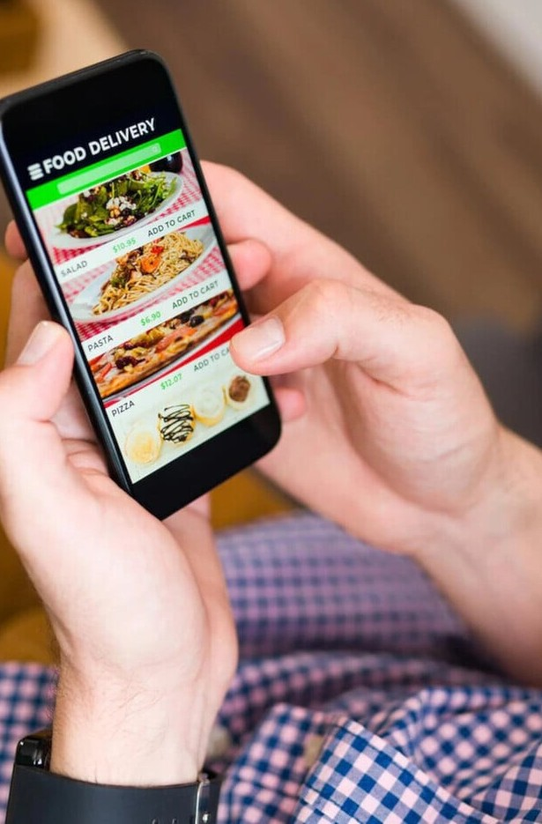
Why Online ?
In today's fast-changing business environment extremely important to be able to respond to client needs in the most effective and timely manner, If your customers wish to see your business online and have instant access to your meals and services .

Slide 3
About Restaurant Application?
The restaurant store sells a variety of meals. This project allows the sale of meals on more professional platforms. It also allows the customer to view the different meals and can also place an order. This project provides easy access to customers by locating(GPS) the customer and sending it to the appropriate delivery service.

Slide 4
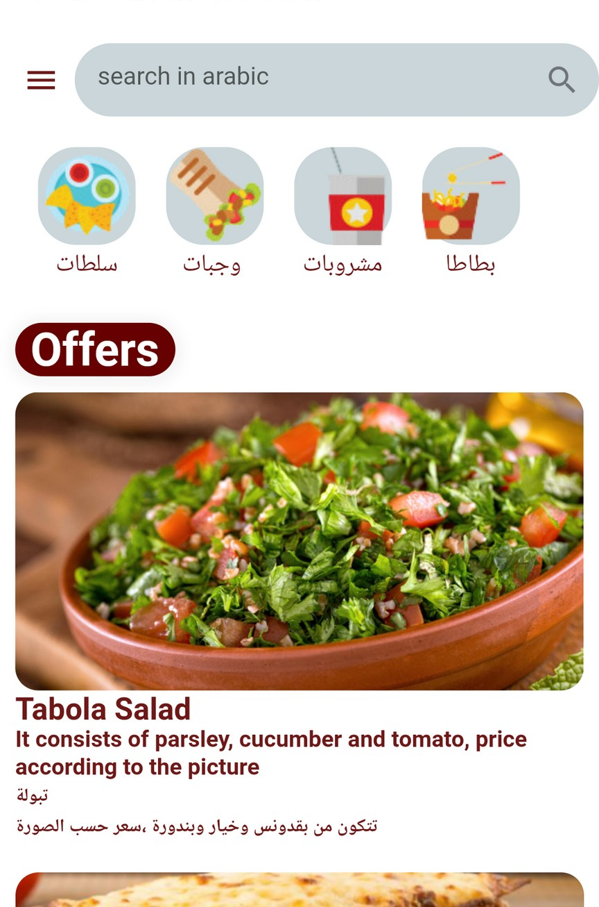
Customer Side
In the restaurant app, customers can have a unique shopping experience that is different from all other apps. Through the dashboard interface, they can see all the meals that have a discount, search for specific meals, apply favorites, and get the desired meal. Each customer has his own account that enables him to store products in the favorite and cart and upload their information. their accounts by logging in and signing up.

Slide 5
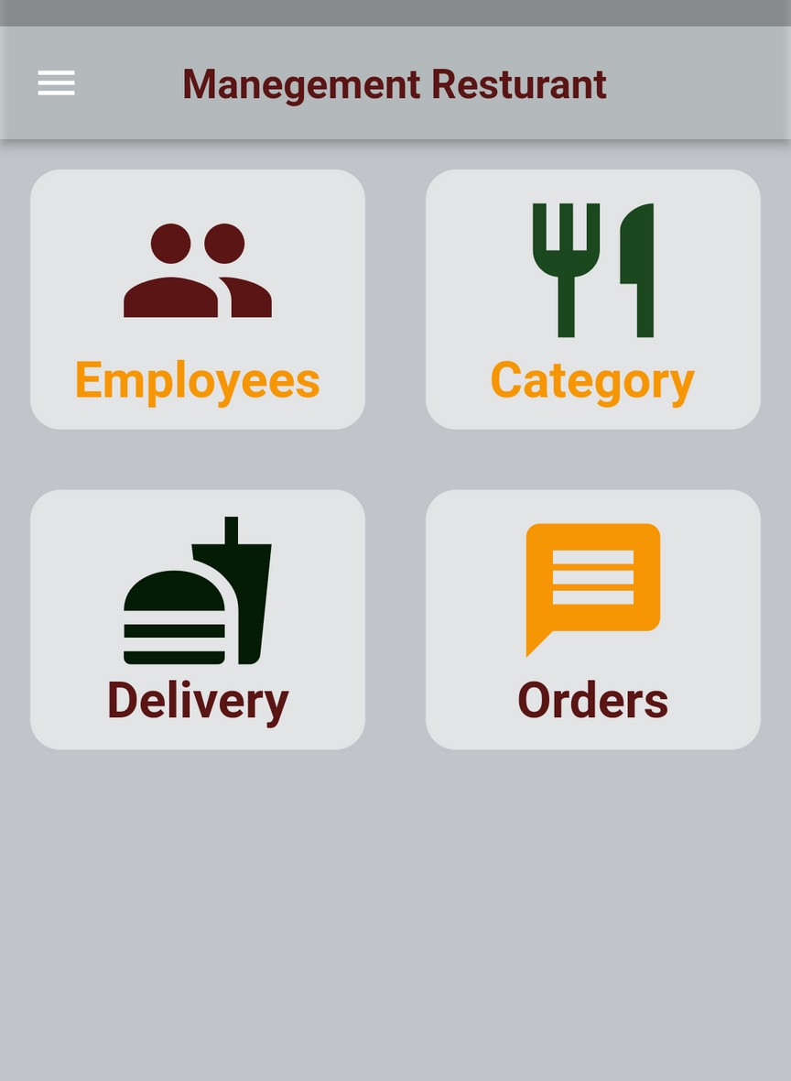
Mangement App
Administration application, through which workers are added and their personal information is modified or deleted.
A specific Category, food is added, modified, or deleted.
Delivery is added or modified to personal information or deleted through the management application.
The management application shows all order records, and here it chooses the available or appropriate delivery for each order.

Slide 6
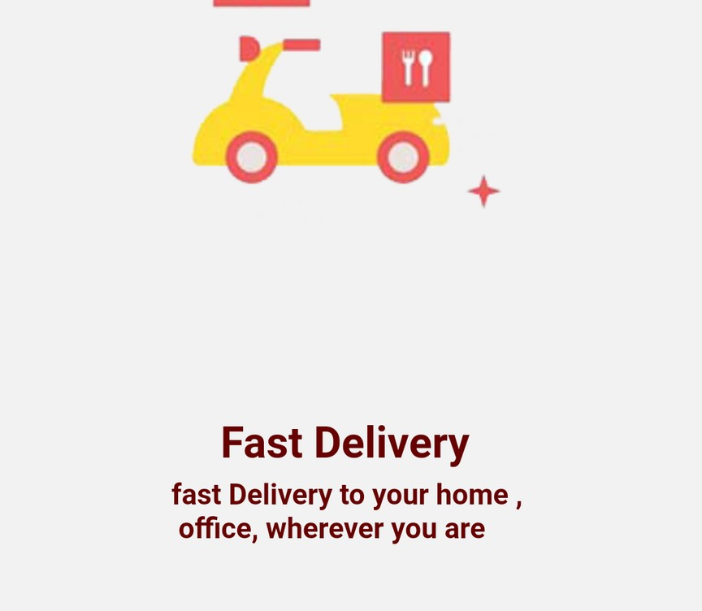

Delivery App
All orders selected by the administration are sent to the personal computer of Delivery. The order information can be seen in terms of the customer’s name, the date of the order, and the customer’s location is tracked through GPS

Slide 7


Technologies and Tools
PHP as Backend Programming Language.
Flutter as Frontend Framework - Dart Language.
MySQL (phpMyAdmin) - Database.

Slide 8
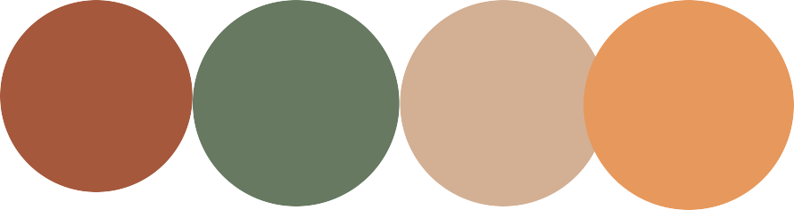

Objectives
The main reason that encouraged us to develop the idea of the application and work on it is the high demand of people to buy meals online and without hesitation, as well as the need for people to buy their needs online without having to. GO.

Slide 9

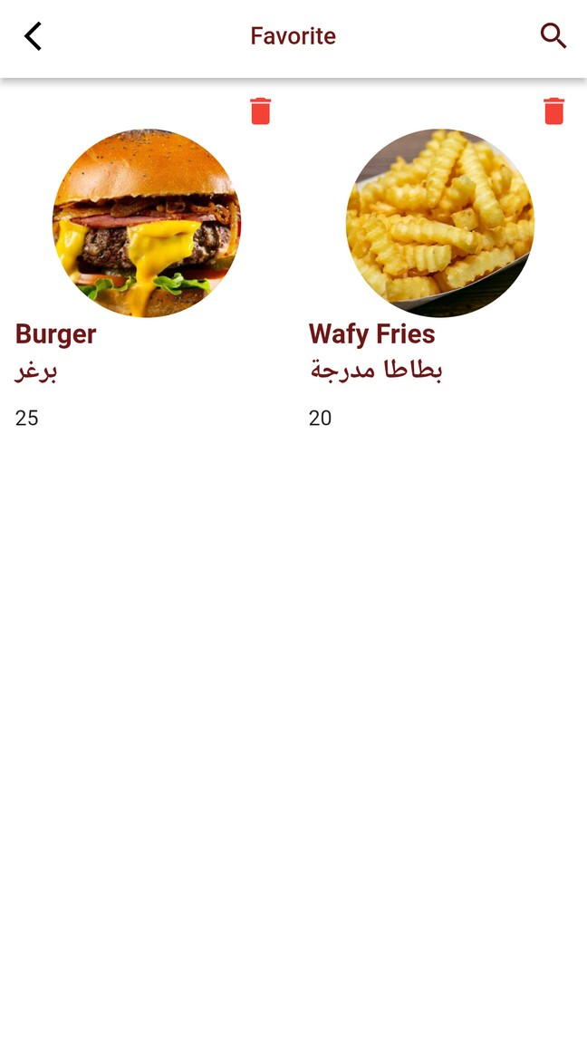
Favorite Features:
Customers can take advantage of this feature to mark the items they like without having to add them to their shopping cart.

Slide 10

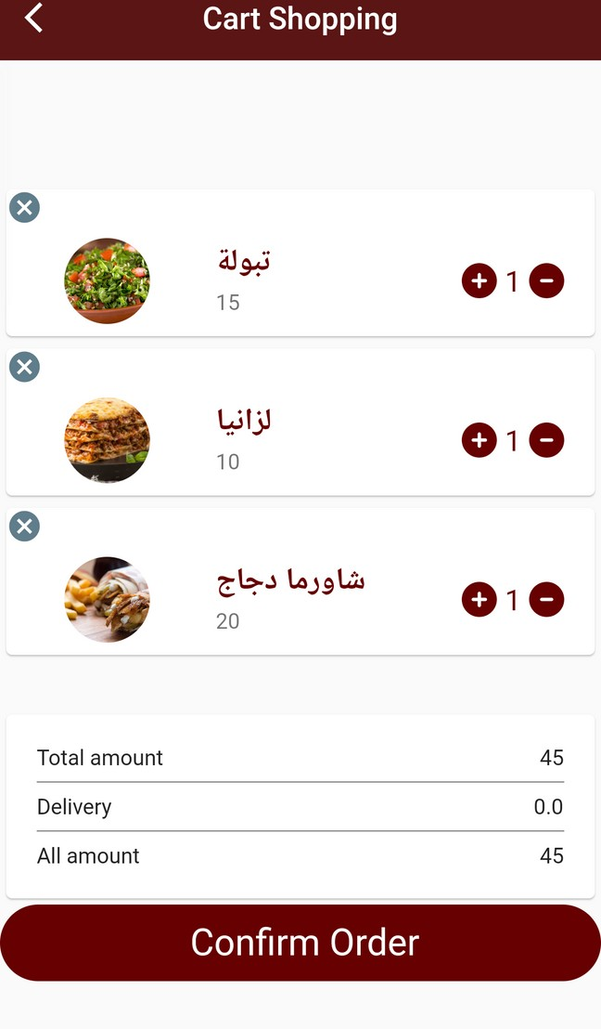
Shopping Cart Feature:
This feature is a must-have in any online store.
A shopping cart allows customers to realize their order in several stages. A customer can add a product to the cart, and if they don't want to proceed to checkout immediately,
return to it easily

Slide 11

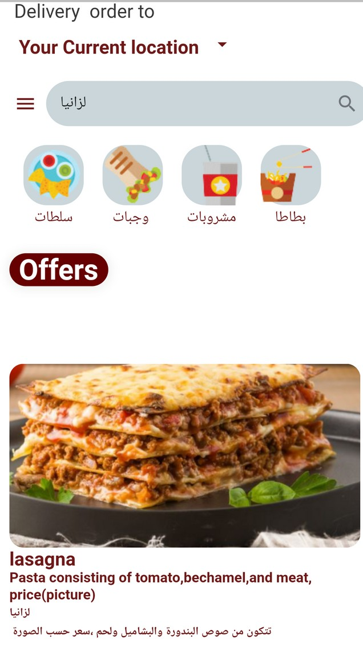
Search Feature:
Search is one of the features of the e-commerce app that makes it easier to use. They come to save time and effort on the users.

Slide 12
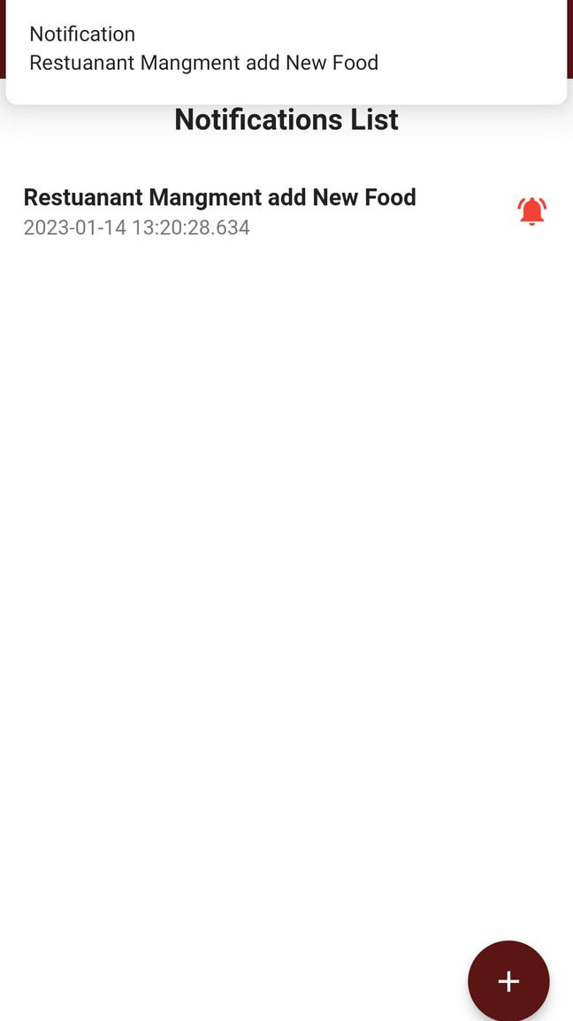
Notification Feature:
The notification system pushes notifications in the
restaurant application if the
admin adds a new food

Slide 13
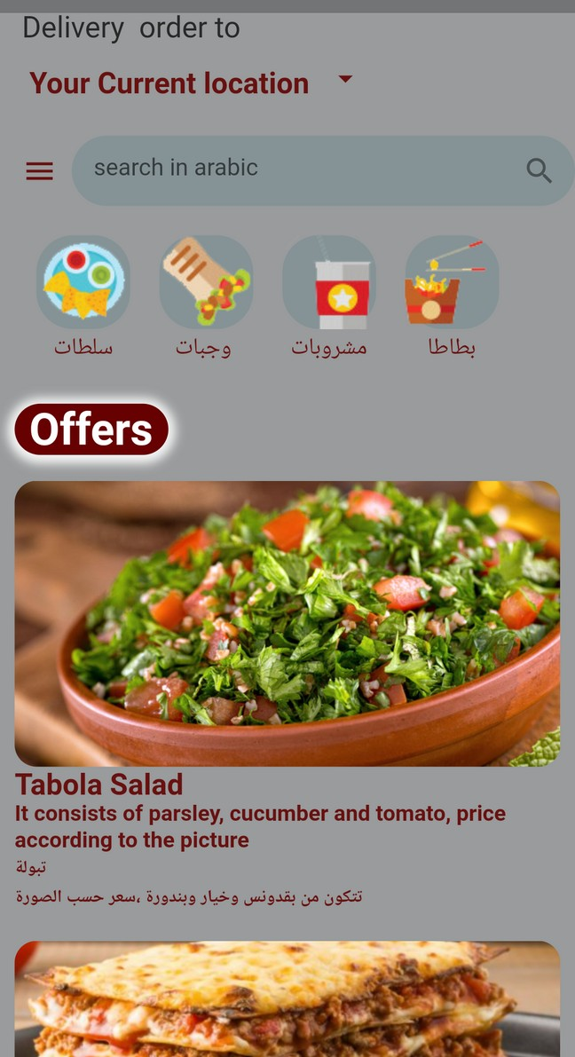
Dual Mode Feature:
when you click to button convert to dark mode,when you click another convert to white mode.

Slide 14
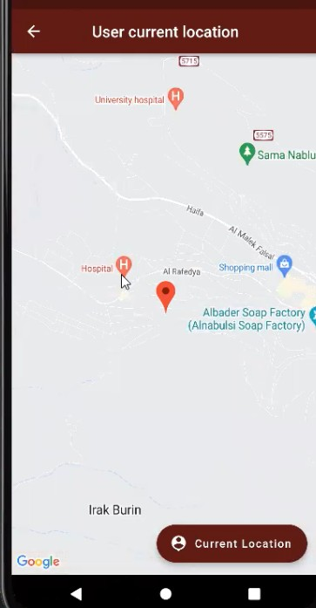
Gps Feature:
Customer location tracking system through delivery to deliver the order

Slide 15
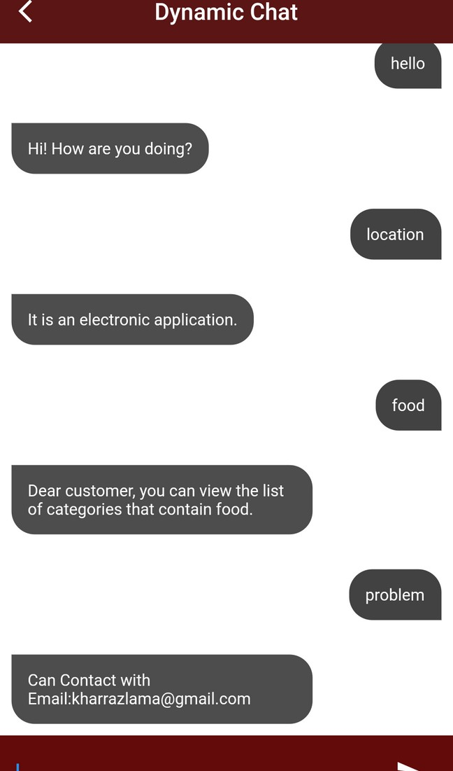
Dynamic Chat Feature:
The automatic response feature, when inquiring about food, how to order, the site, or about a problem, it is answered automatically

Slide 16
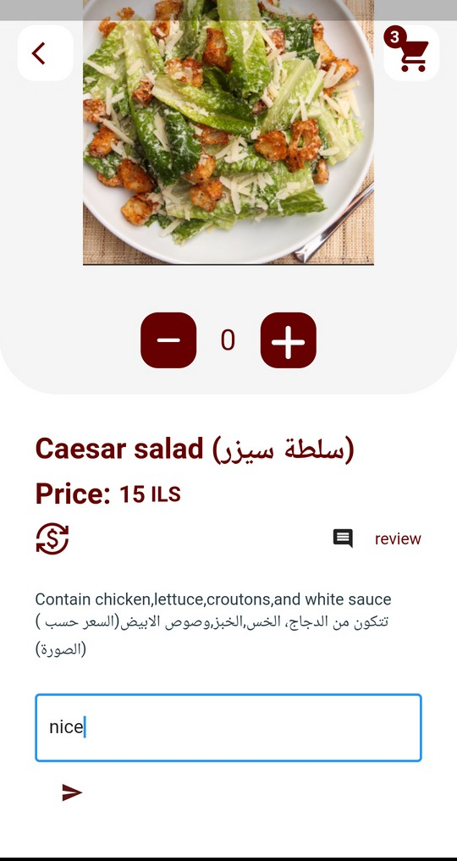
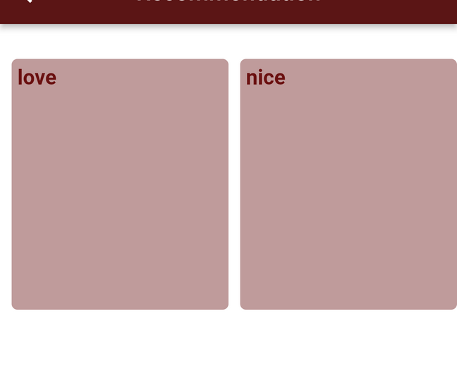
Comment Feature:
The comment feature is available for a customer without showing identity, and there is an interface that shows all customer comments

Slide 17
In order to improve the application we can add an advanced recommendation system using AI
Future Works:
Tracking Delivery

Slide 18

THANK YOU FOR LISTENING
Lama Kharaz
Supervised by : Dr.Asmaa Afeefi

