Slide 1
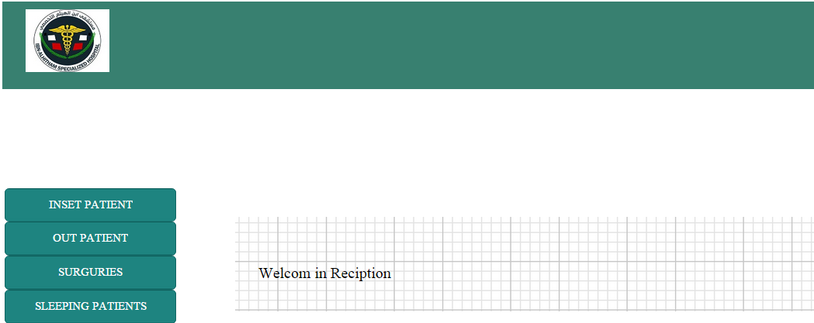
Reception department that deals with patient information

Slide 2
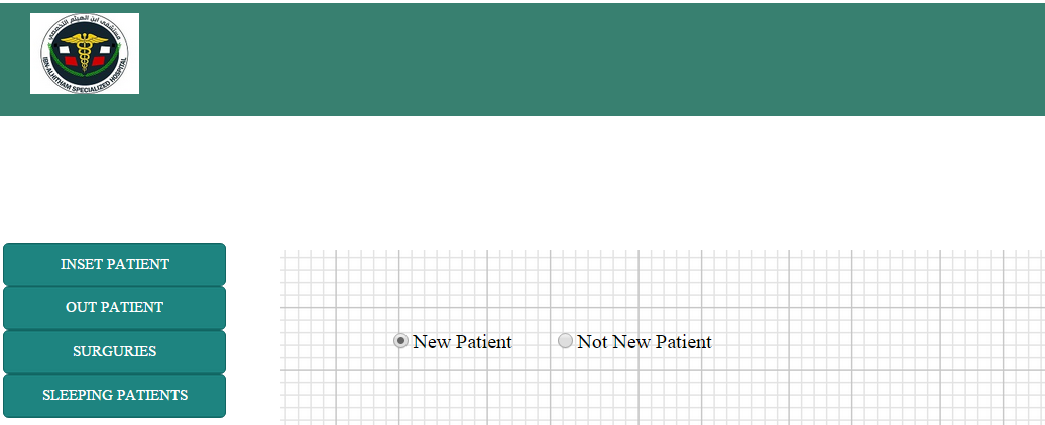
Check if the patient is coming to the hospital at first time or not

Slide 3
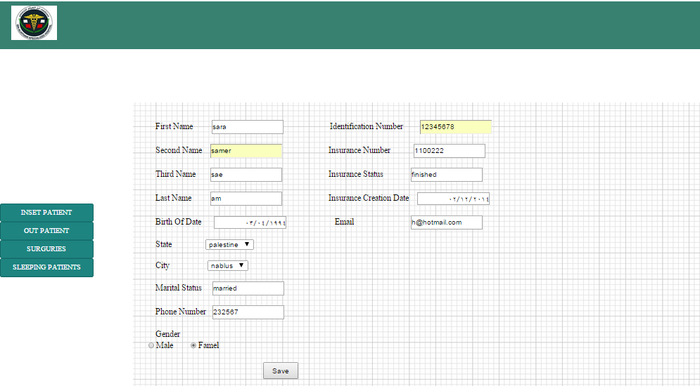
If patient is new, then the reception admin get all information about him

Slide 4
After this operation the patient has a unique number and medical file number in this hospital

Slide 5
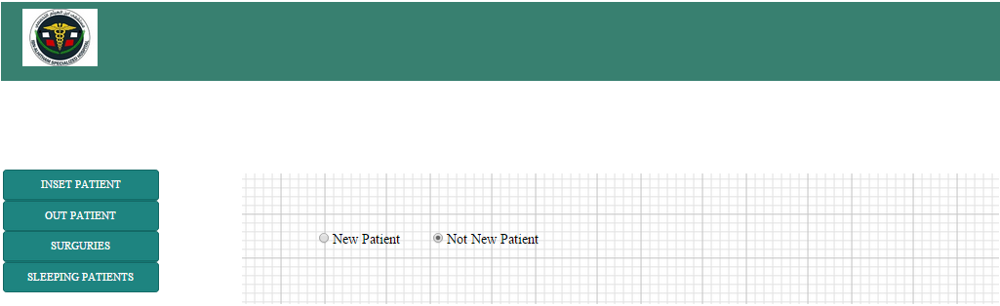
If the patient is not new

Slide 6
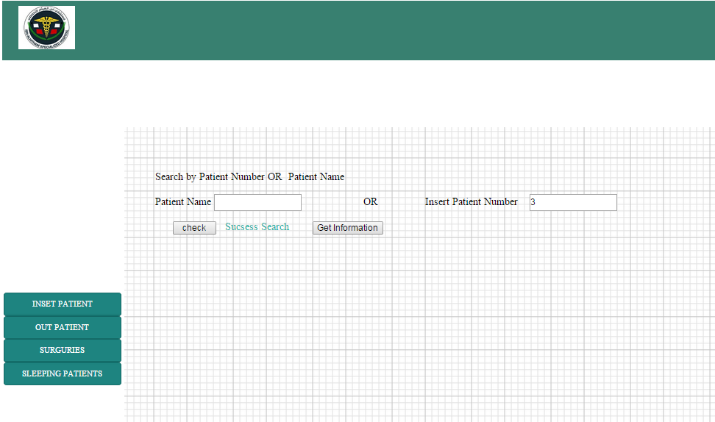
The admin check if his number exist

Slide 7
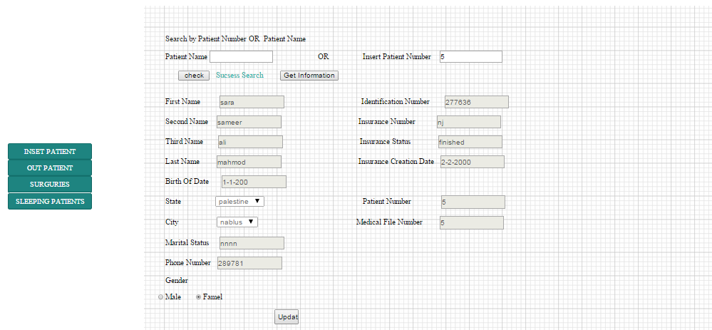
Then he can get all patient information and update in these information

Slide 8
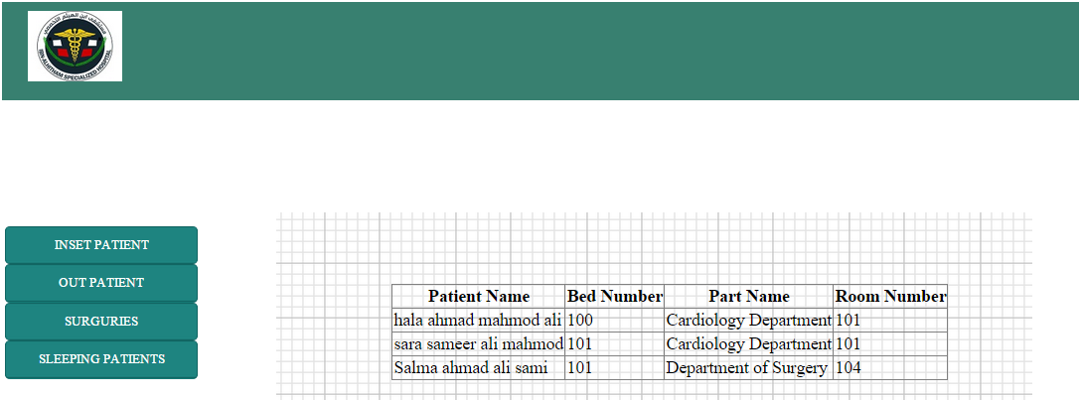
Reception admin can access all names of sleeping patient in hospital

Slide 9
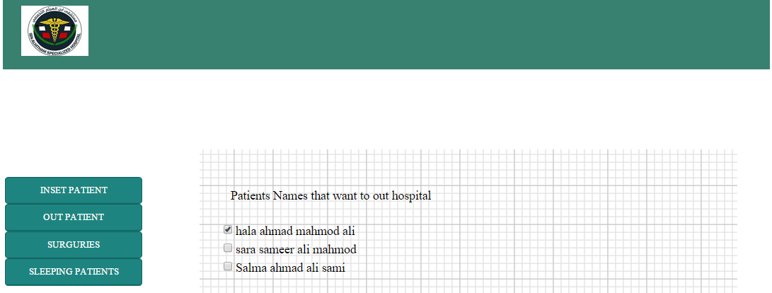
These name of sleeping patients in hospital that want to outing

Slide 10
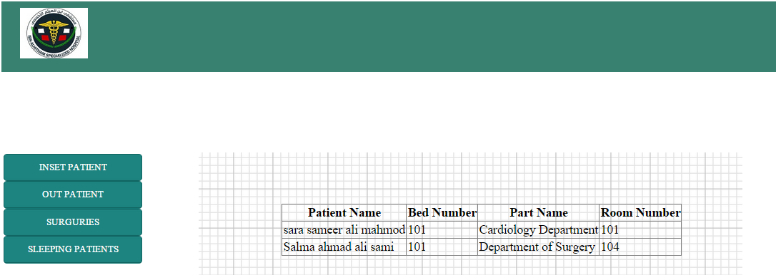

Slide 11
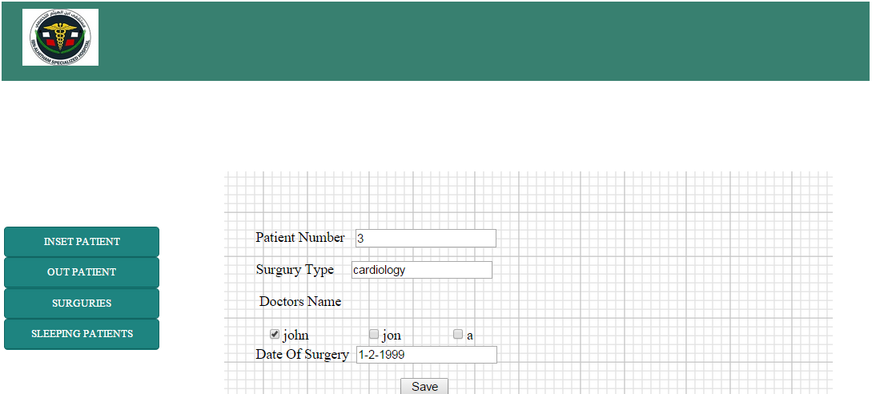
Admin can insert a surgeries details

Slide 12
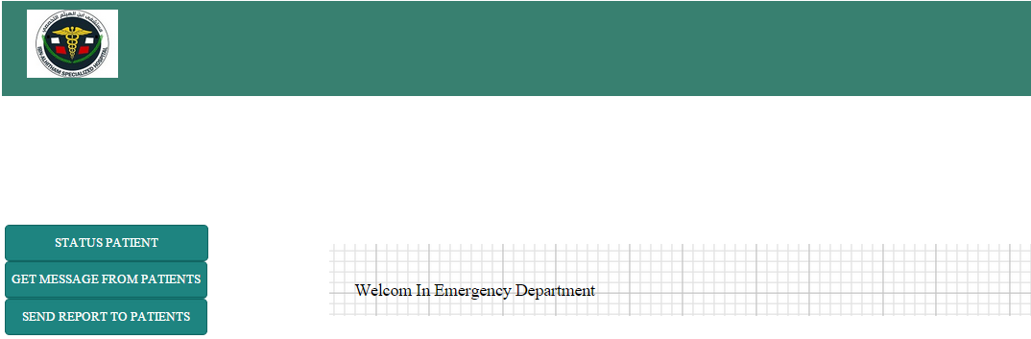
The second step is to Emergency Departments to deal with Patient Status

Slide 13
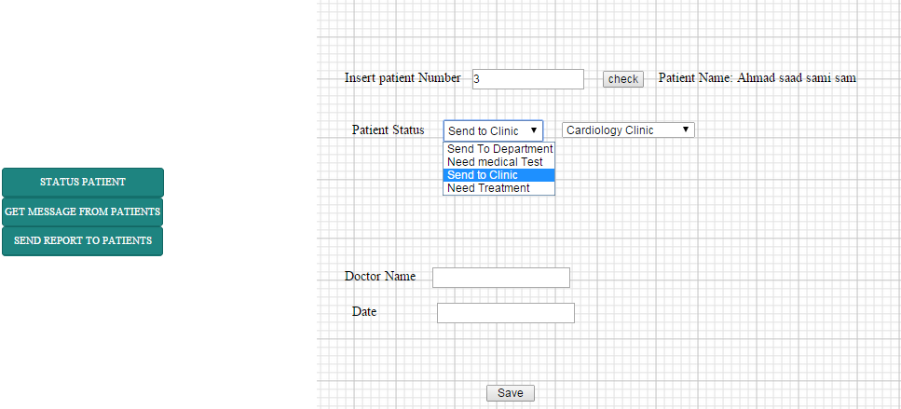
The Emergency Department set the patient Status

Slide 14
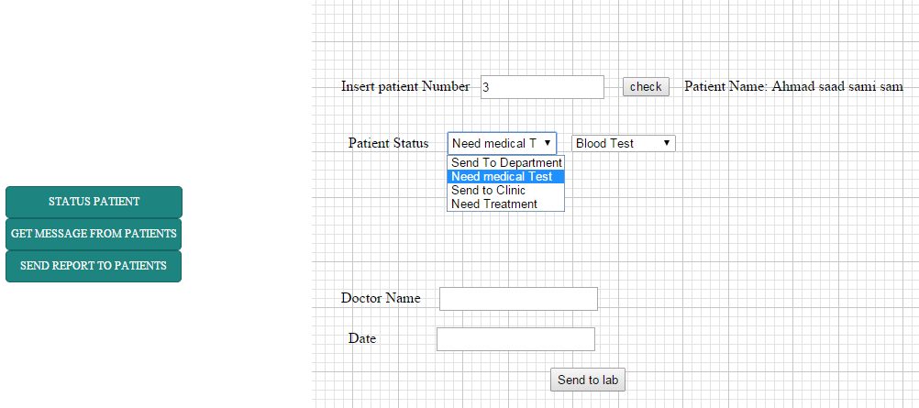
The patient Need a medical test then the doctor specify the test type and send this to Laboratory

Slide 15
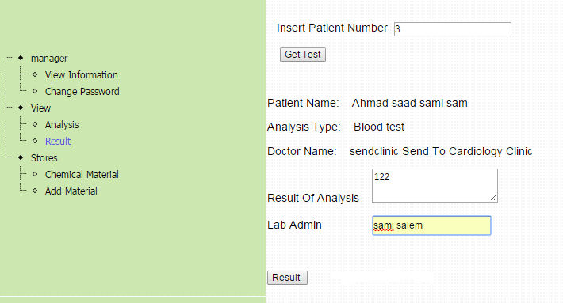
Laboratory Admin get the test

Slide 16
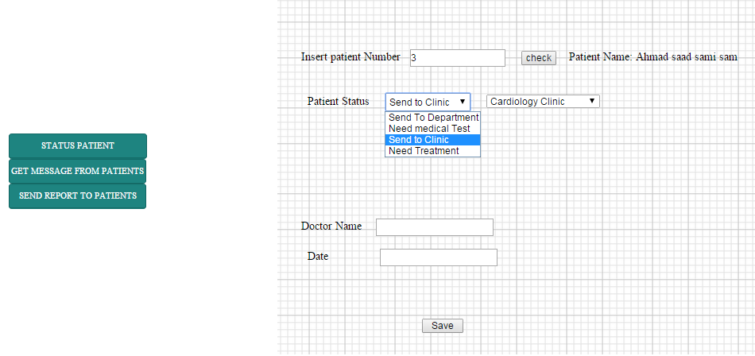

Slide 17
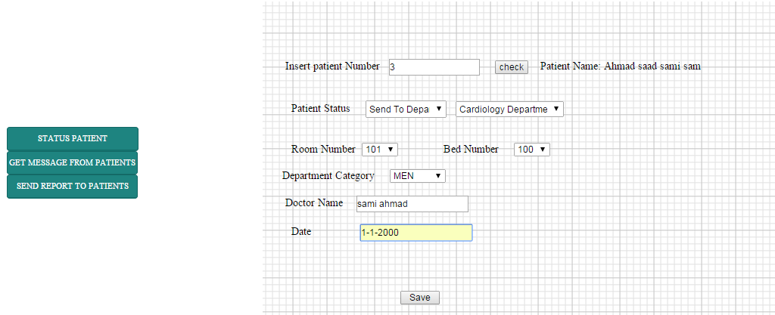
Send Patient to suitable Department

Slide 18
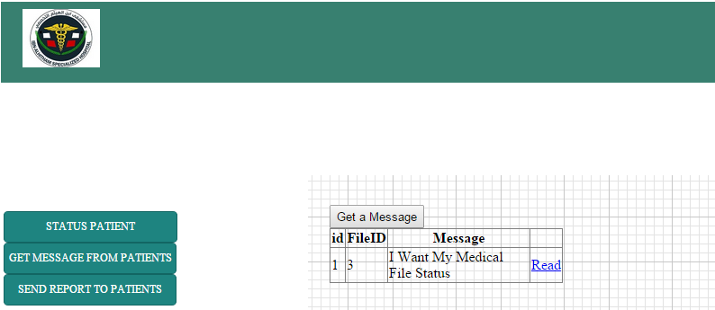
These Messages from Patients that send to emergency part to get a medical report about his status

Slide 19
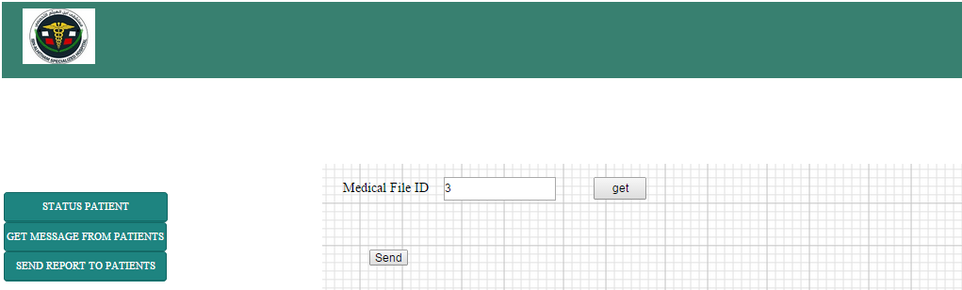
To send a medical report for Patients

Slide 20
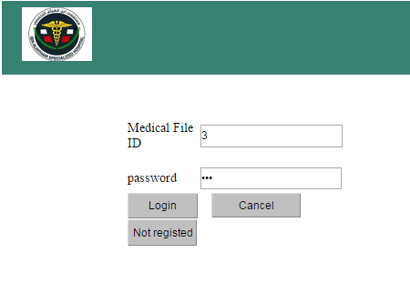
Login for the patient

Slide 21
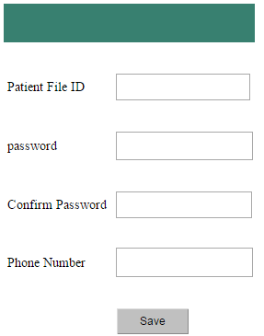
Patient registers with his Medical File Number

Slide 22
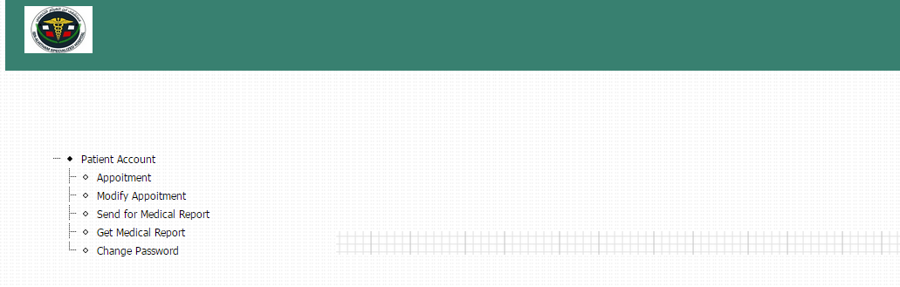
Patient Account

Slide 23
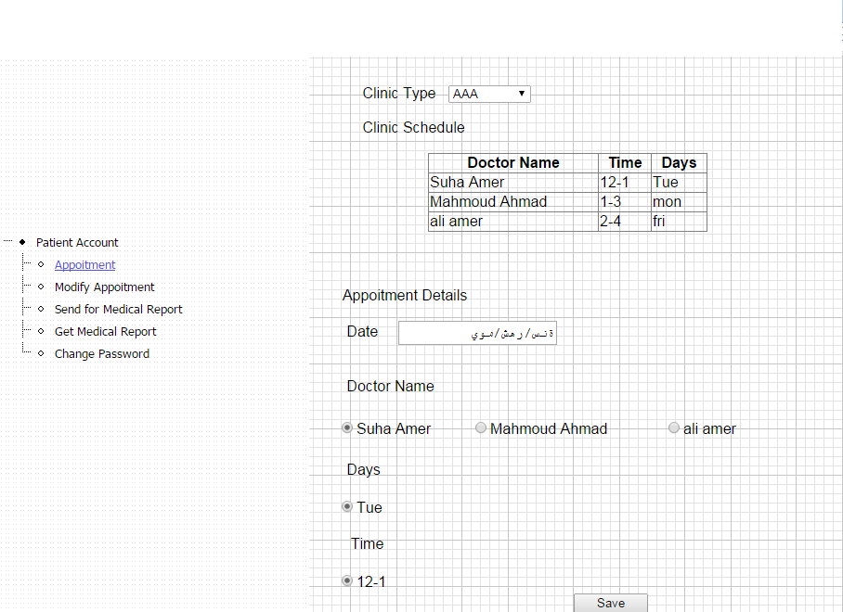
Appointment in Clinic

Slide 24
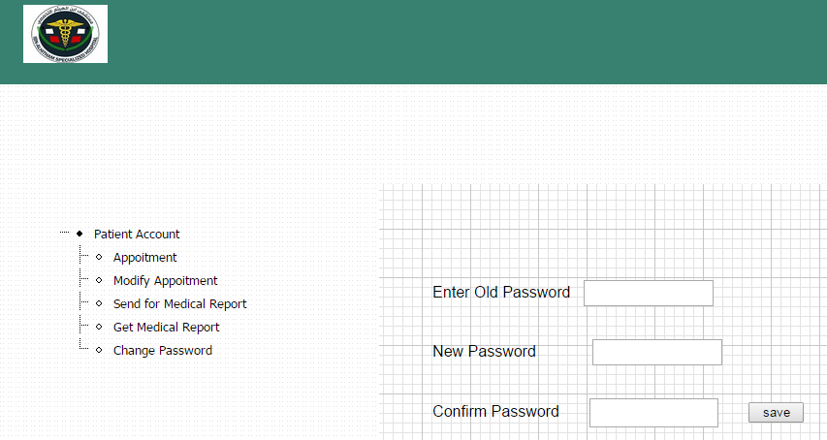

Slide 25
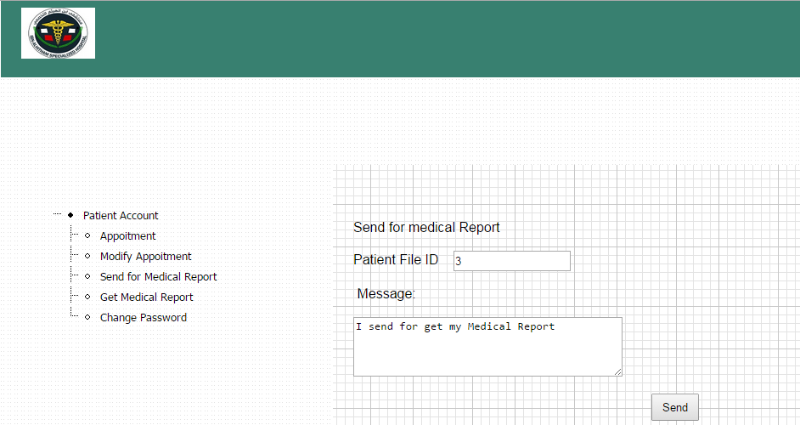
Patient can send a message to Emergency department for his status

Slide 26
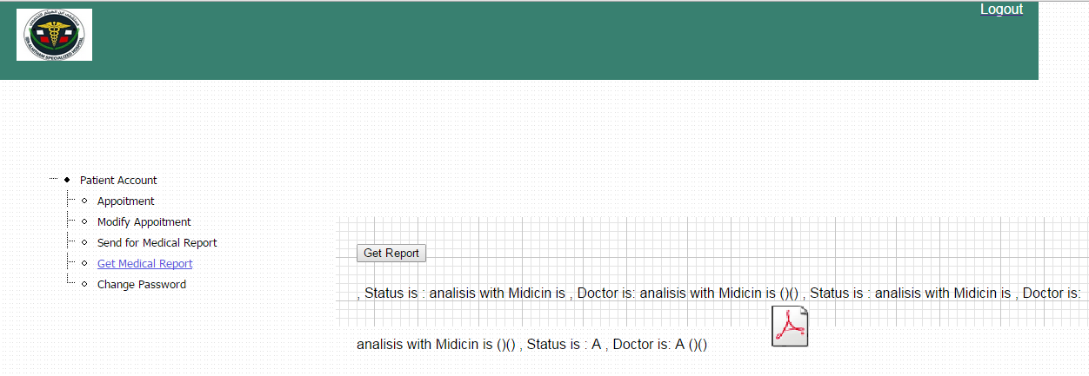
The report send by Emergency part

Slide 27
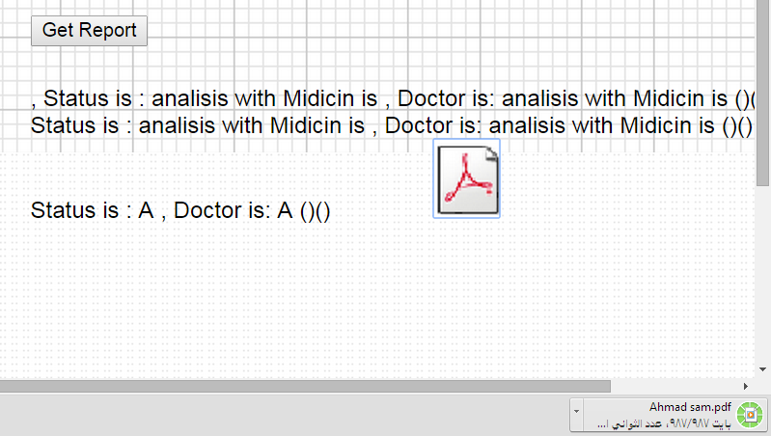
Patient can get a PDF Report

Slide 28
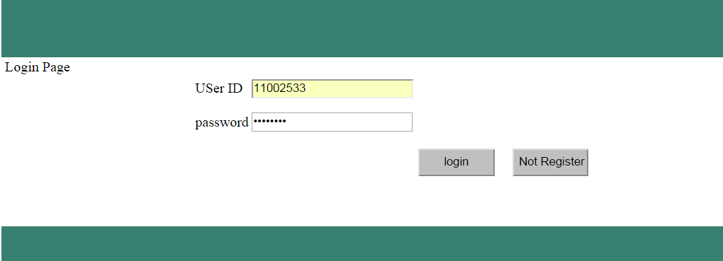
Login Page For Admins and Employees

Slide 29
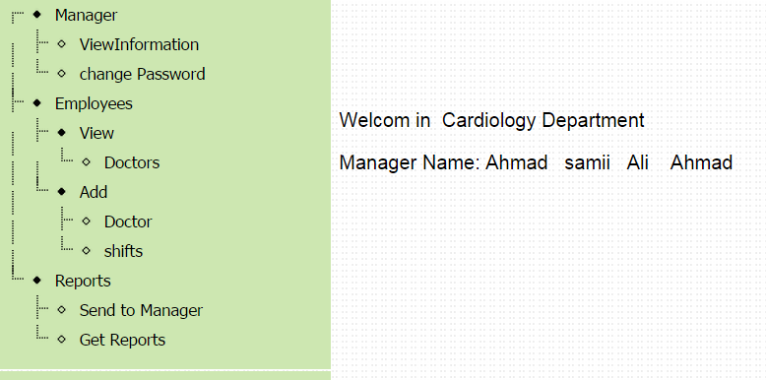
Department Manager Page

Slide 30
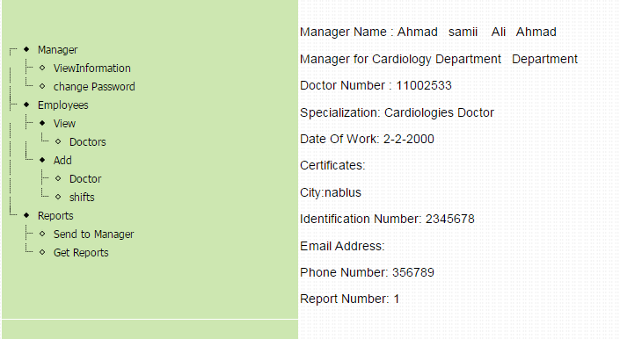
Manager Information

Slide 31
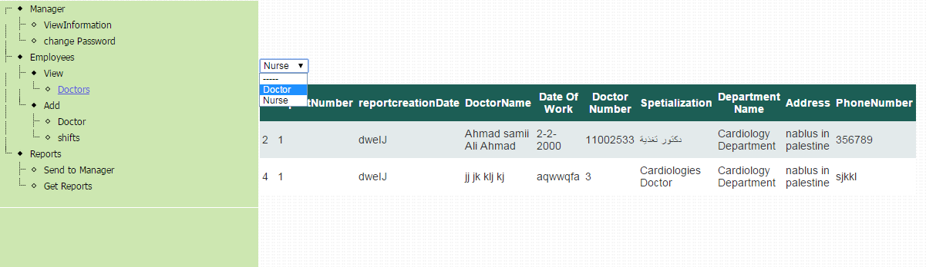
Manager Can view and Add Doctors to Department

Slide 32
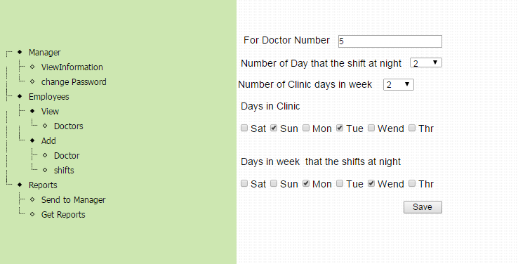
And insert his shifts schedule

Slide 33
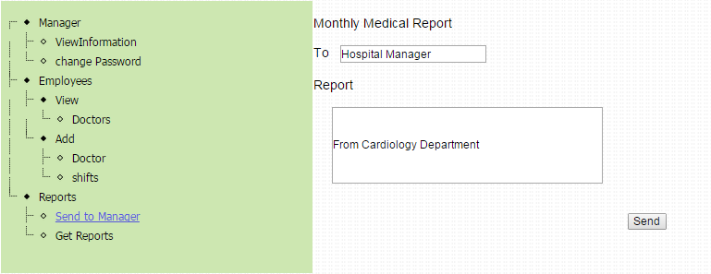

Slide 34
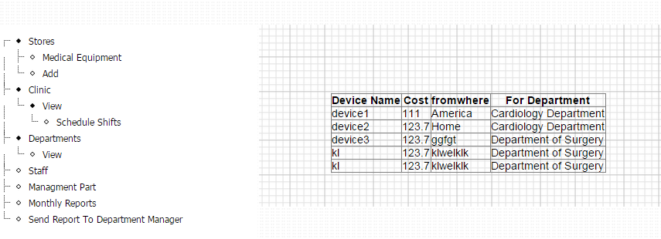
Hospital Manager

Slide 35
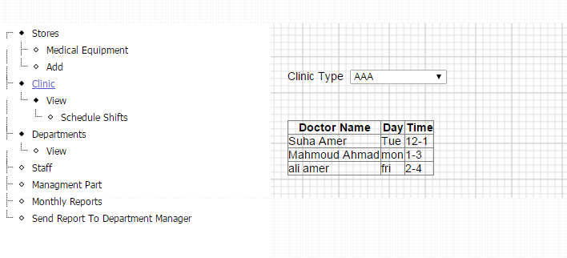
Can Access Clinic Informaion

Slide 36
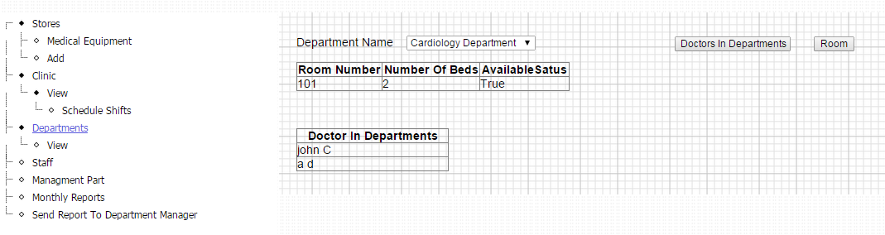
Can Access Departments withDetails

Slide 37
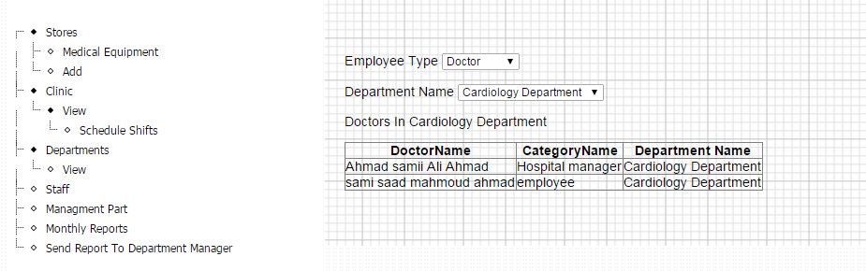

Slide 38
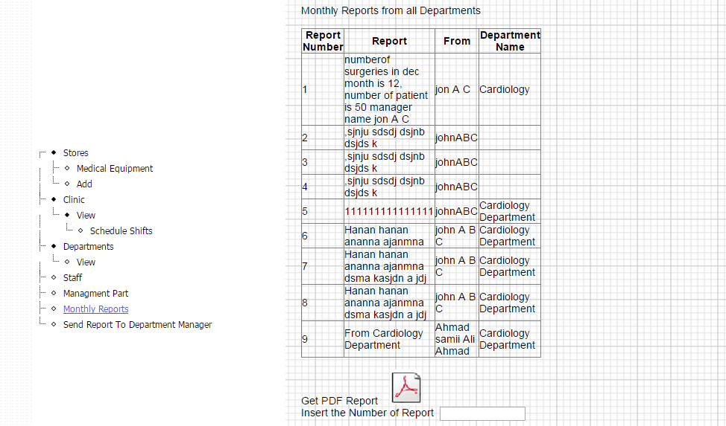

Slide 39
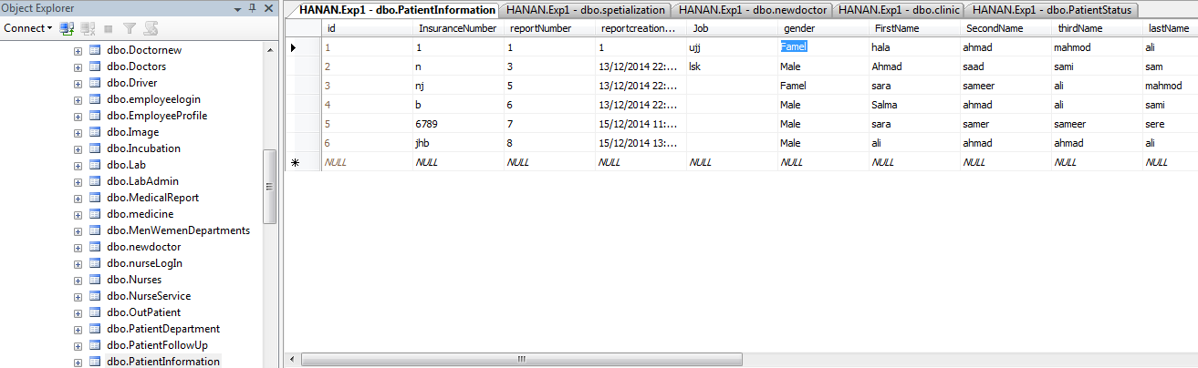
database

