Slide 1
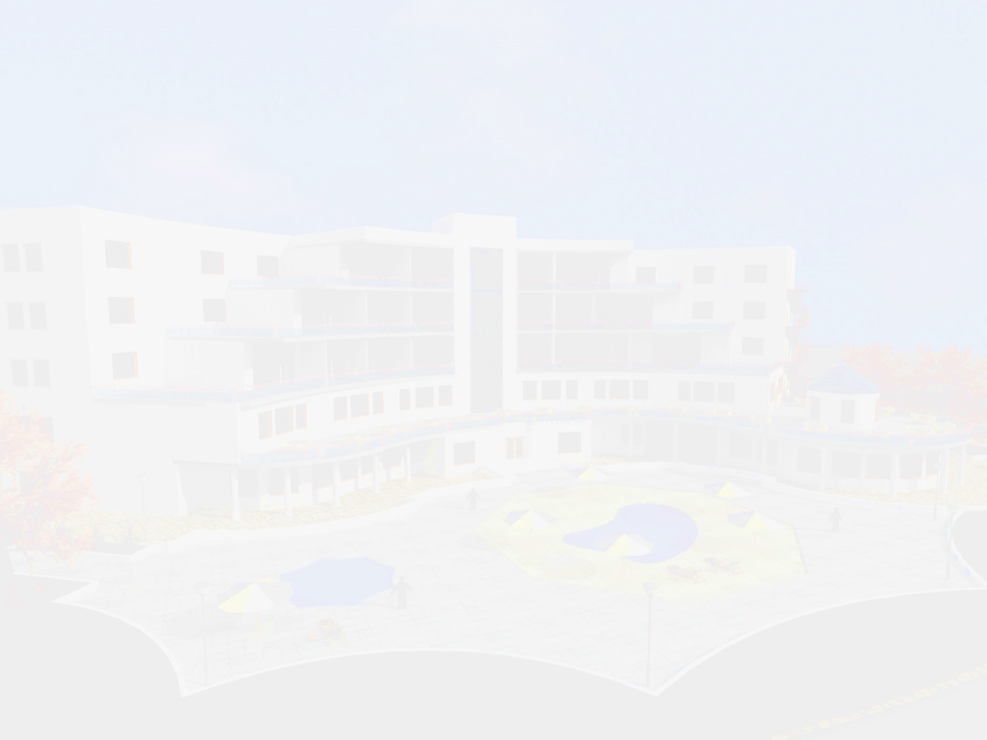
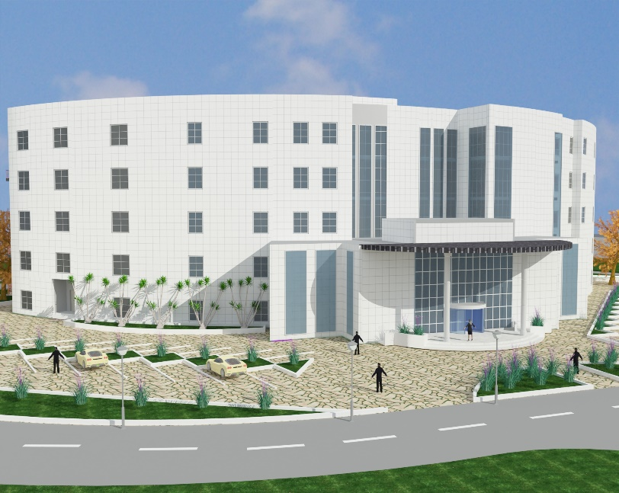

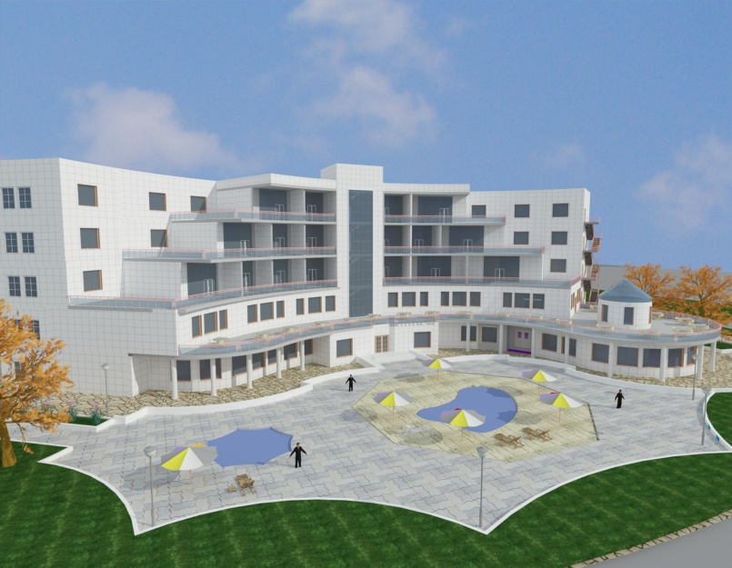
An-Najah National University
Faculty of Engineering
Building Engineering Department
2015-2016
Graduation Project – 2
Hotel Redesign
Prepared By:
Ramzi Osama Demyati
Angham Essam Abd-Aldaim
Alaa Ibrahim turkman
Project supervisor:
Eng. Fadi Fatayer

Slide 2
CONTENTS
Introduction
Site of the project
Architectural Design
Structural Design
Environmental Design
Electrical Design
Mechanical Design
Safety Design
Cost Estimation

Slide 3

INTRODUCTION
The main concept of this project was to redesign an architecture students graduation project, and focus was been on structure, environmental, electrical, mechanical and safety design to make a comfortable hotel and easy use for disabled people .

Slide 4
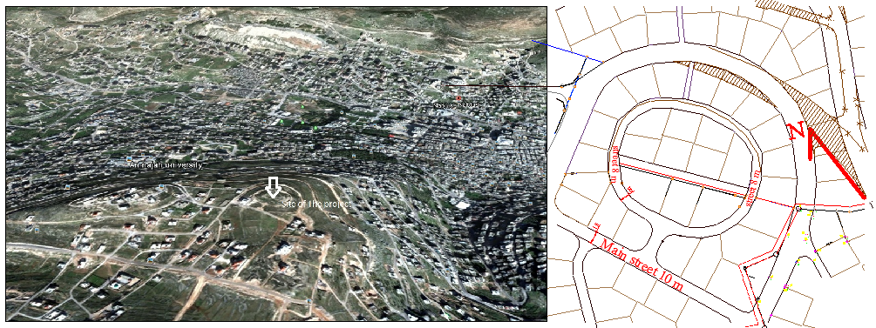
SITE OF THE PROJECT
An Najah University
Site of the poject

Slide 5
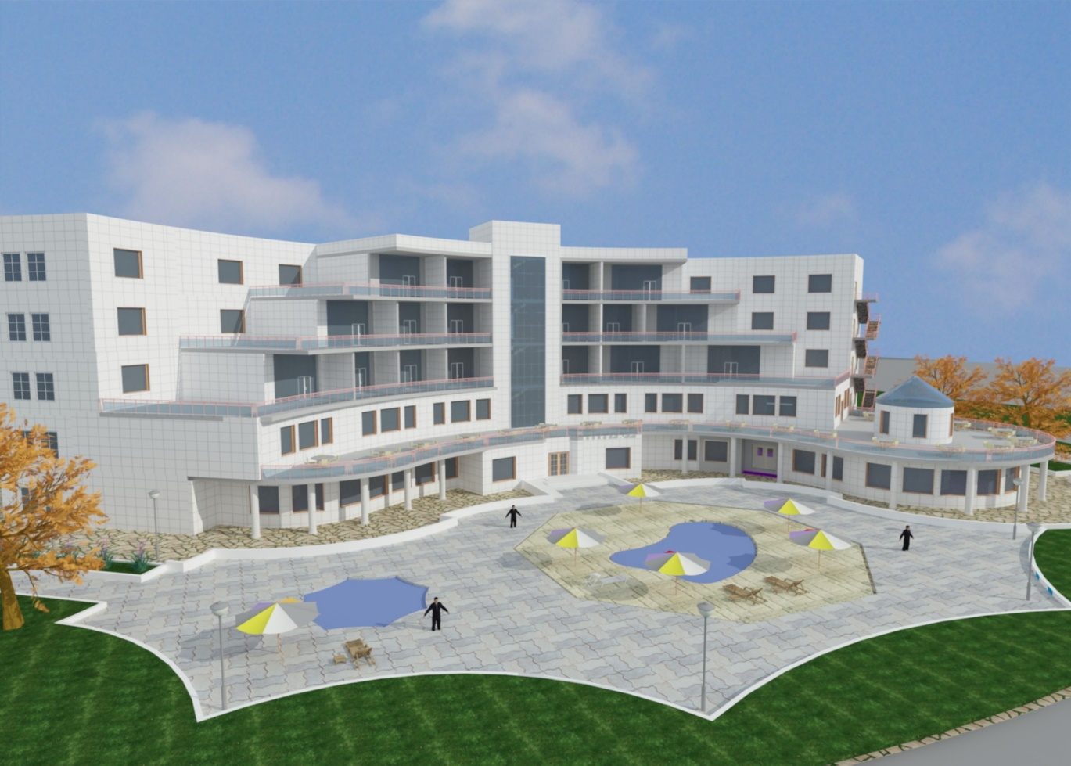
ARCHITECTURAL DESIGN

Slide 6
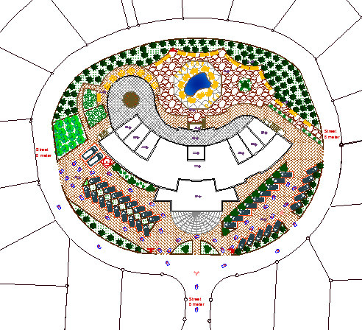
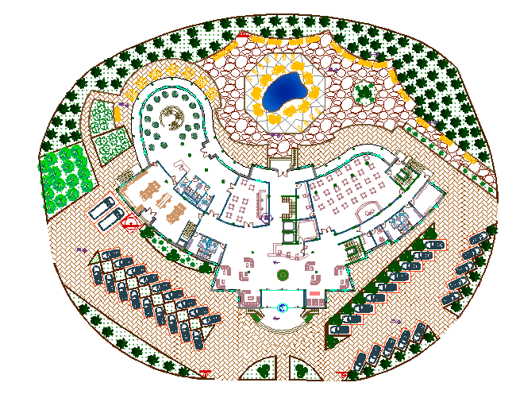
Site Plan and Master Plan
Master Plan
Site Plan

Slide 7
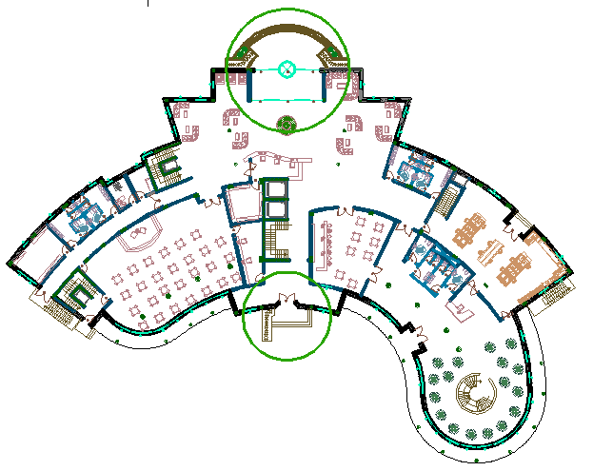
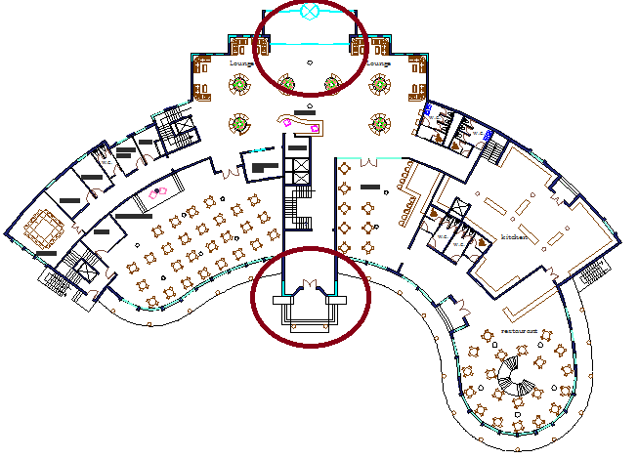
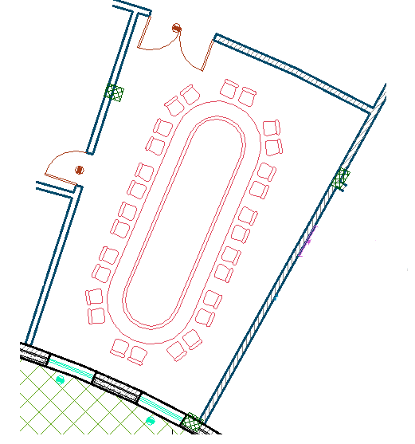
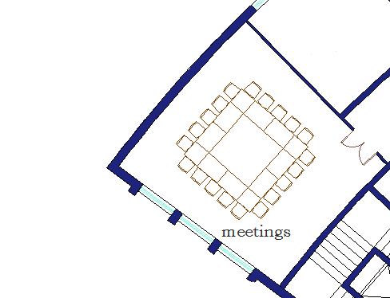
Modifications
Original
Redesigned
Original
Redesigned

Slide 8
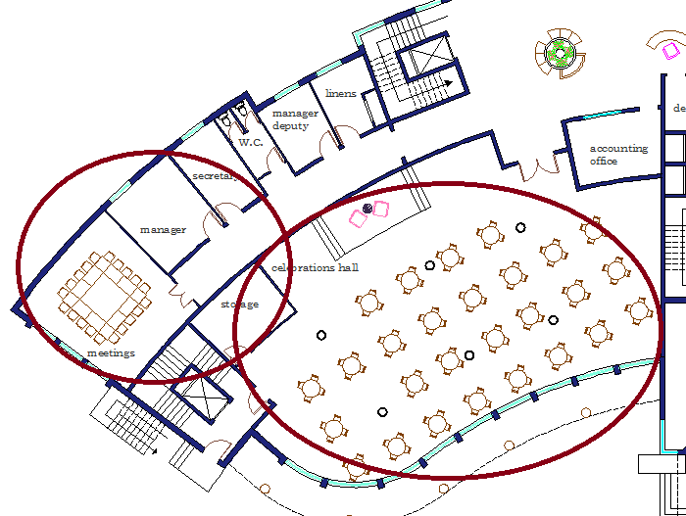
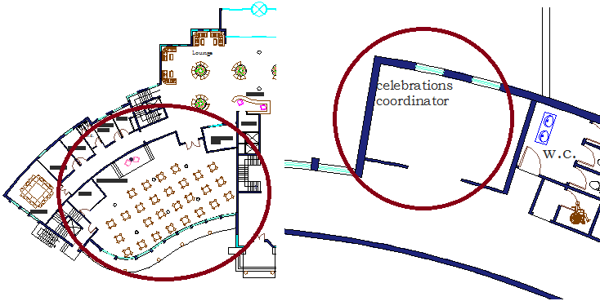
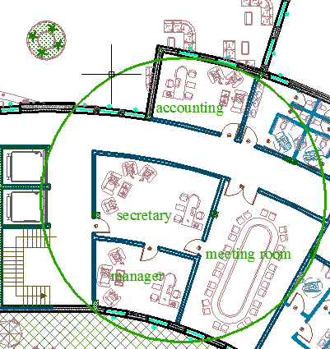
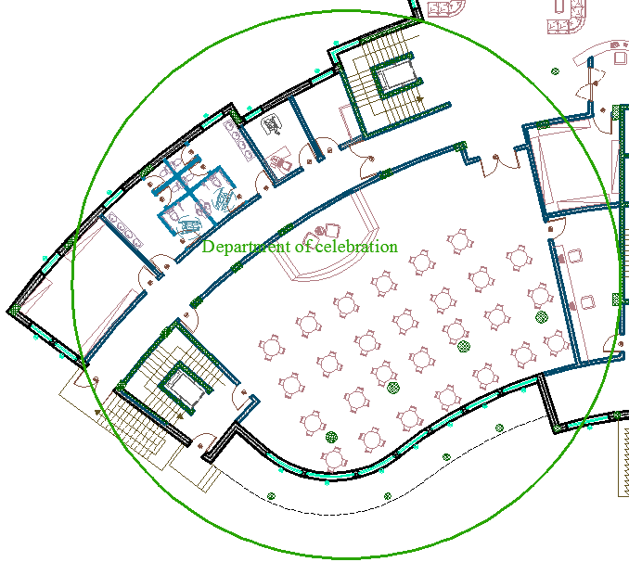
Modifications
Original
Redesigned

Slide 9
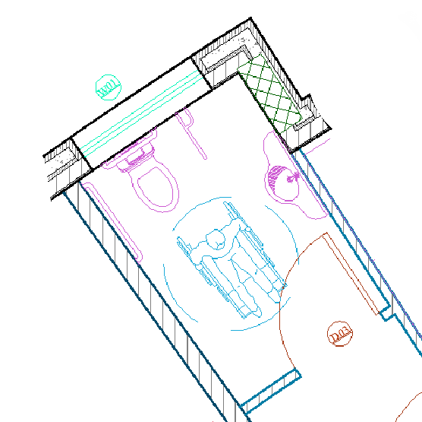
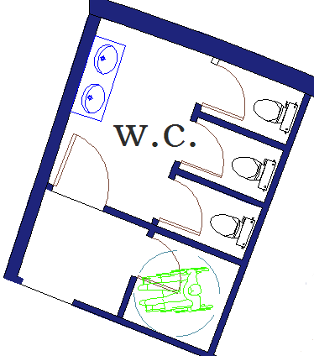
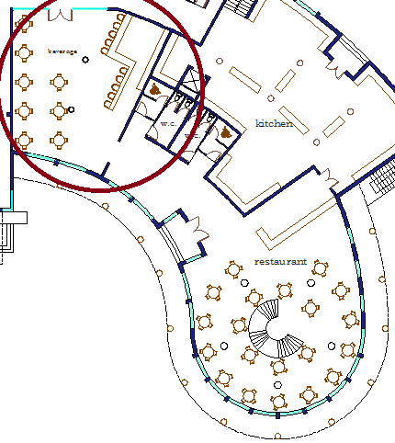
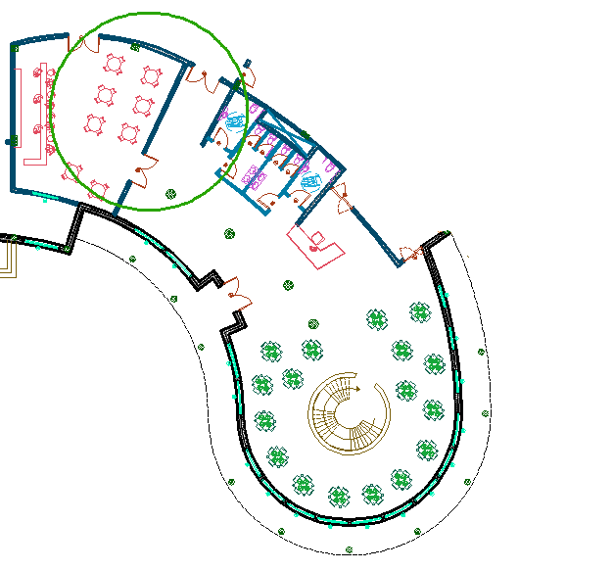
Modifications
Original
Redesigned
Original
Redesigned

Slide 10
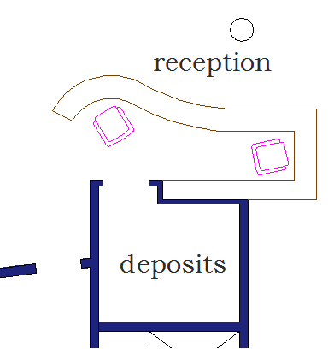
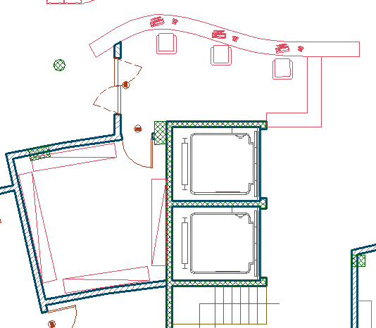
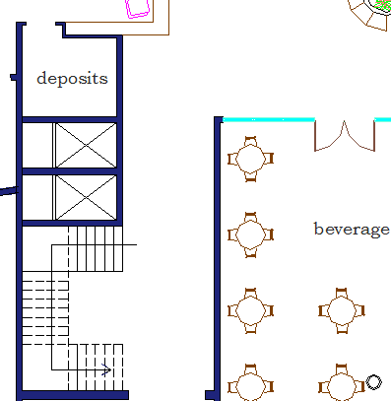
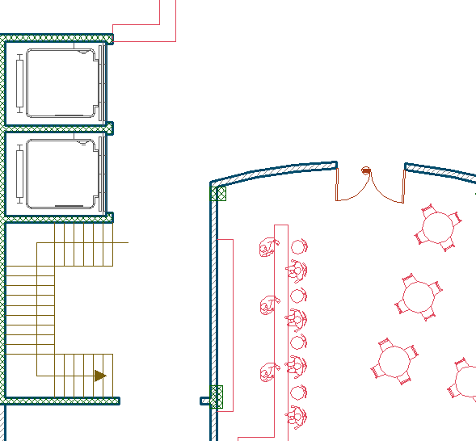
Modifications
Original
Redesigned
Original
Redesigned

Slide 11
Modifications
In the original design plans, there is no elevator transports food from the kitchen to the bedroom.
In the redesign plans, we made the elevator that serves the restaurant and serves the bedrooms also.
In the original design plans, there is no suites in the hotel.
In the redesign plans, four suites became in the plans; two suites in the third floor, one suite in the fourth floor and one suite in the fifth floor.

Slide 12
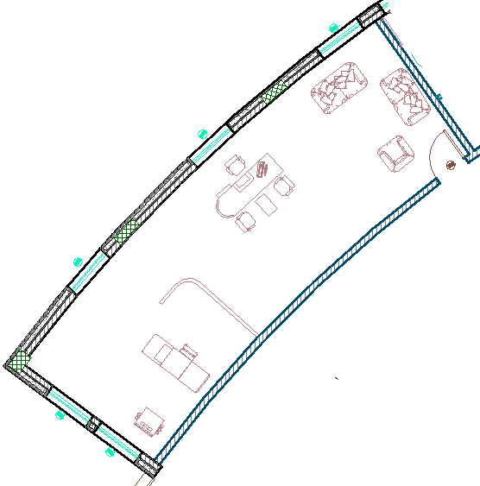
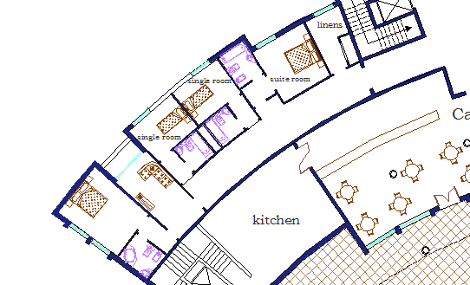
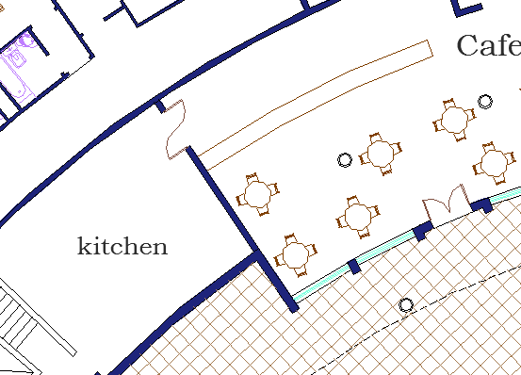
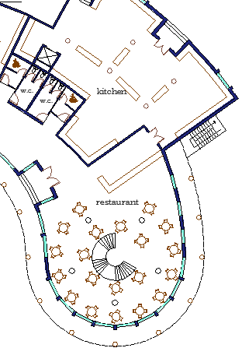
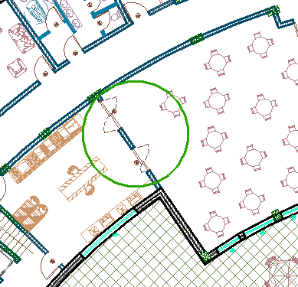
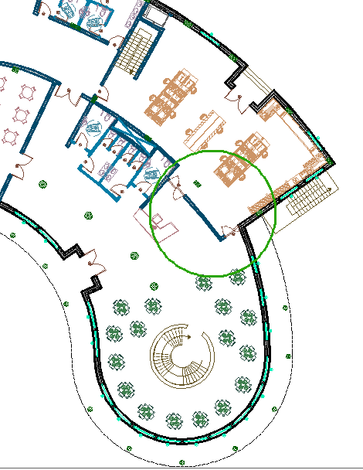
Modifications
Original
Redesigned
Original
Redesigned

Slide 13
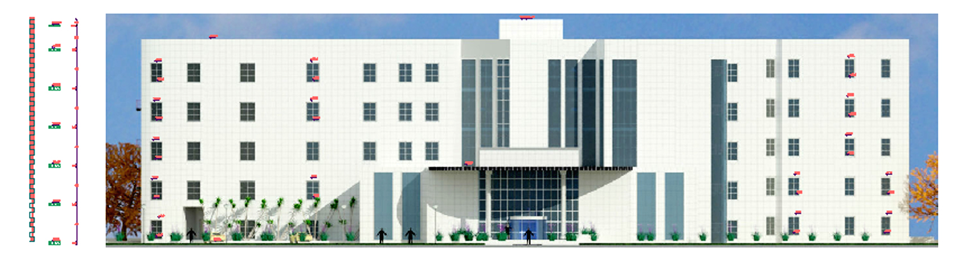
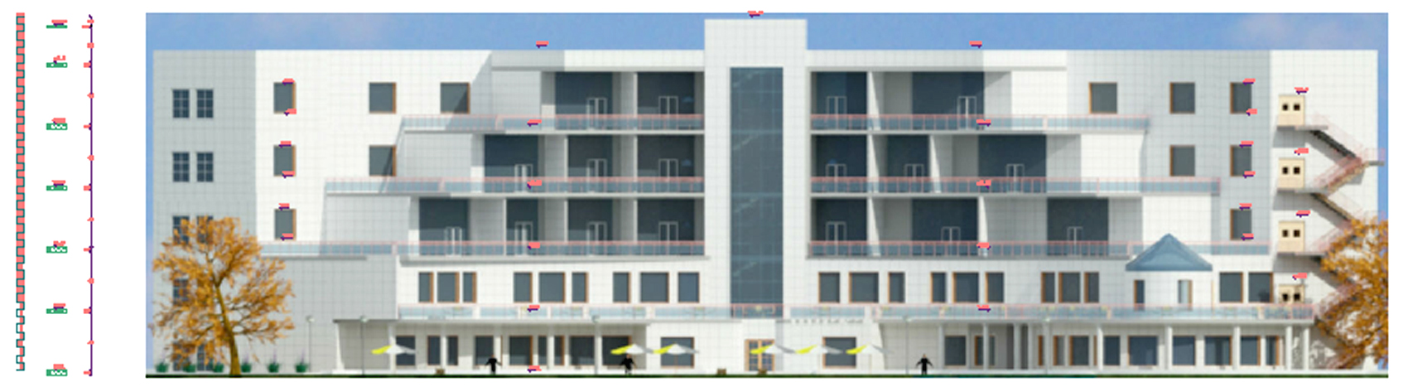
Elevations
Southwest
Northeast

Slide 14
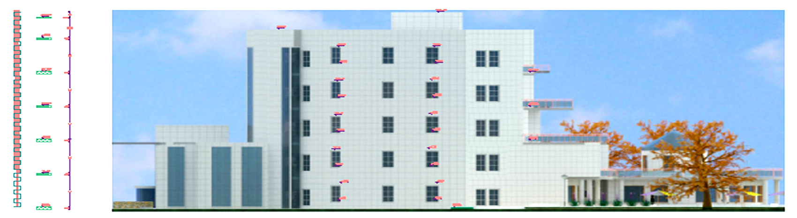
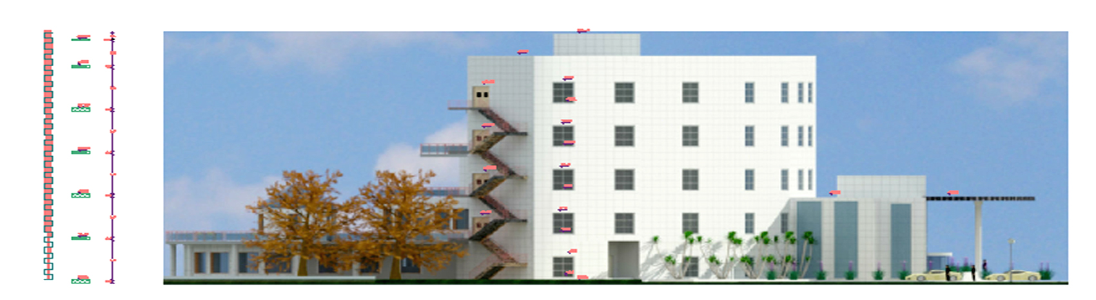
Elevations
Northwest
Southeast

Slide 15
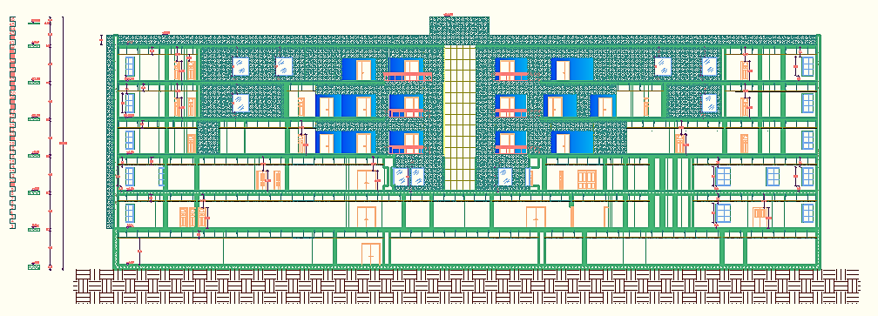
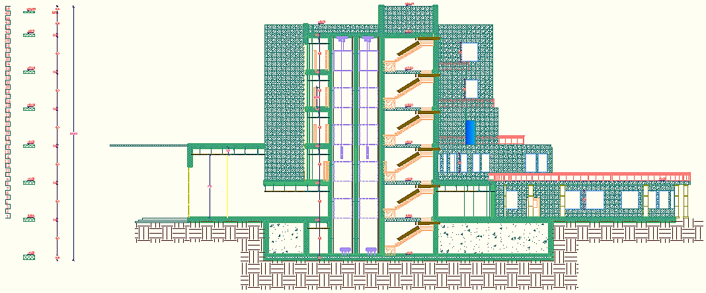
Sections
Section A-A
Section B-B

Slide 16
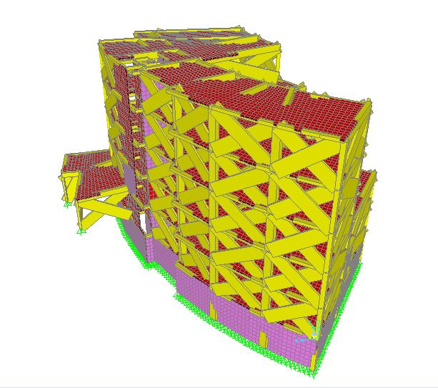
STRUCTURAL DESIGN

Slide 17
Design Codes
ACI -318-08 for reinforced concrete structural design.
UBC -97 for earthquake load computations.
ASCE for load computations.

Slide 18
Material Property
Compressive strength of Concrete “f′c”.
    For columns f′c = 28 MPa
    For slabs f′c = 24 MPa
    For all other elements in structure such as blinding and bracing f′c = 16 MPa
Yielding strength of steel fy = 420 MPa.
Soil Property
Soil bearing capacity = 350 KN/m2
Soil profile = S_{B}

Slide 19
Loads
Dead loads (D.L): 5 KN/m²
Super Imposed dead load (SI): 3.5 KN/m²
Live Load (L.L): 5 KN/m² (for first floor)
3KN/m² ( for other floors)
Lateral loads consider earthquake load.

Slide 20
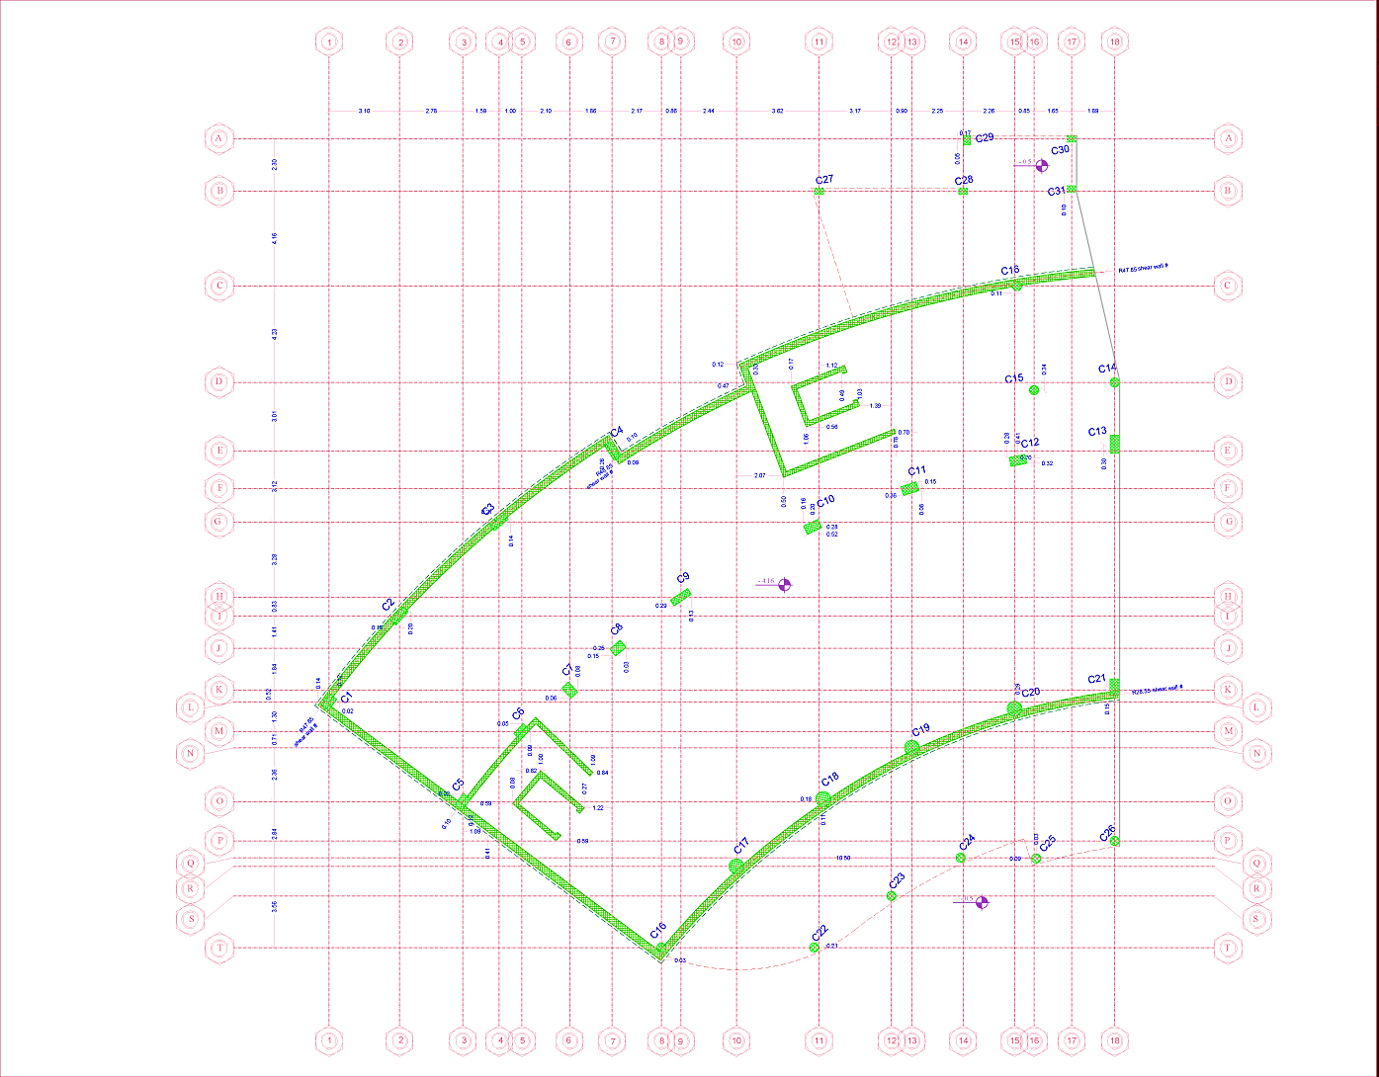
Column Center Lines Grid

Slide 21
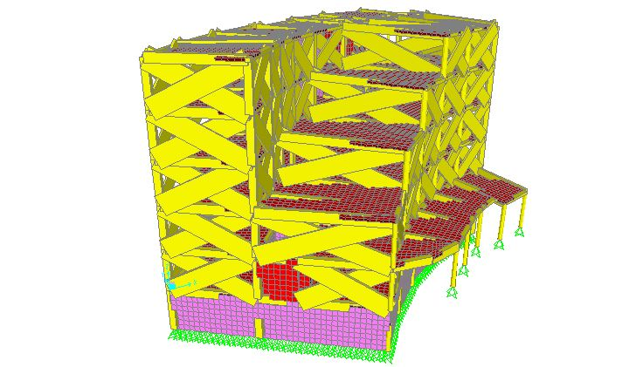
Hotel 3D Model - SAP

Slide 22
DESIGN and REINFORCEMENT of STRUCTURAL ELEMENTS
Slab (one way with drop beam)
Beams
Columns
Shear wall
Basement wall
Stair
Footings

Slide 23
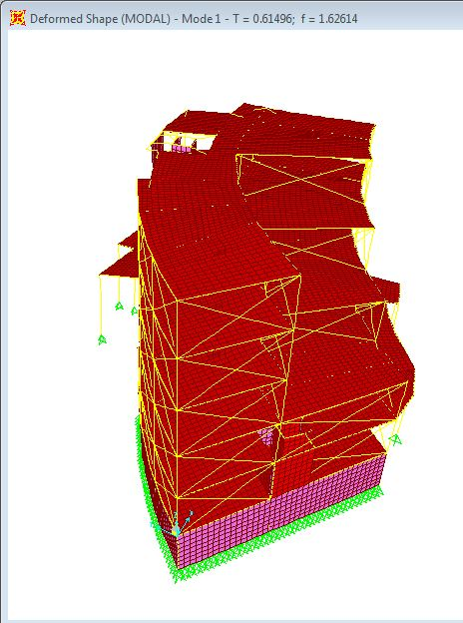
Model Checks
Compatibility

Slide 24
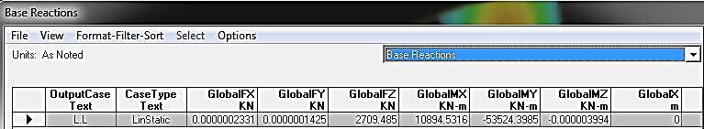
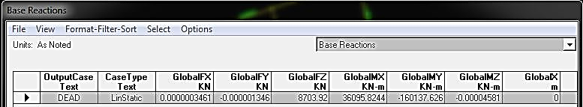
Model Checks
Equilibrium
Load | Manual calc. | SAP results | Error %
LIVE | 2751.5 | 2709.5 | 1.54
DEAD | 8745 | 8704 | 0.47

Slide 25
Model Checks
Internal Forces
Element | Ultimate Force SAP | Ultimate Force manual | % of error
Column | 5317 KN | 5150.3 KN | 3.1
Beam | 1191.8 KN.m | 1265 KN.m | 6
Slab | 68 KN.m/m | 69.2 KN.m/m | 1.7

Slide 26
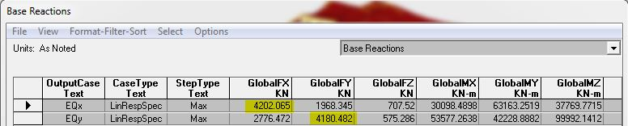
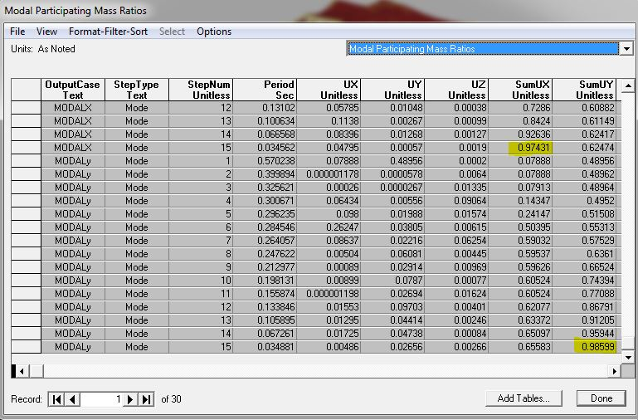
Seismic design
Cv = 0.2
Ca = 0.2
I = 1
R = 5
Soil profile S_{B}
Z = 0.2
From SAP
Base shear ( V ) = 4181 KN
Checks on SAP model
Mass participation ratio is larger than 90% in X, Y .
 | From SAP | From manual | % of error
Period (sec) | 0.615 | 0.52 | 18

Slide 27
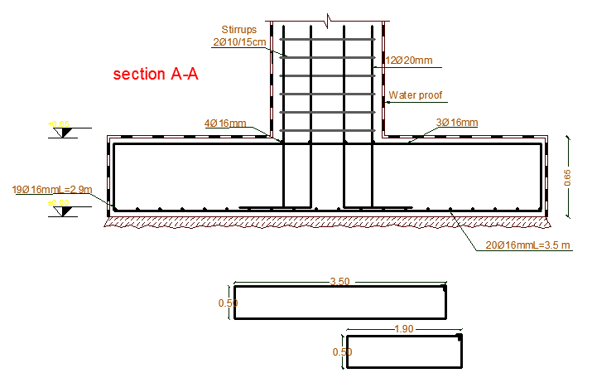
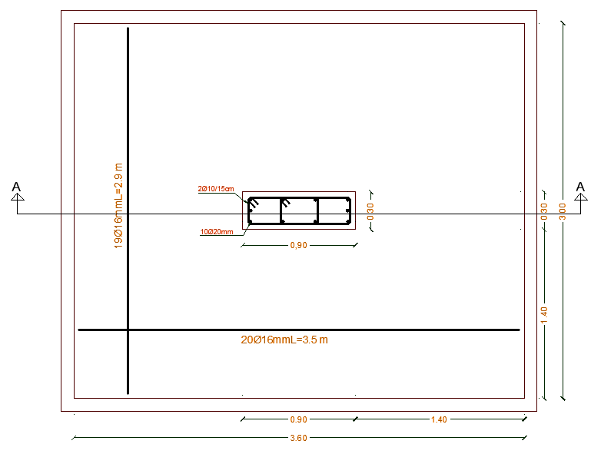
Footing Reinforcement Details
Single Footing

Slide 28
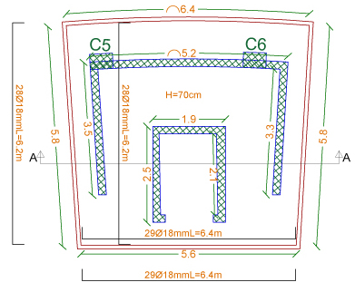
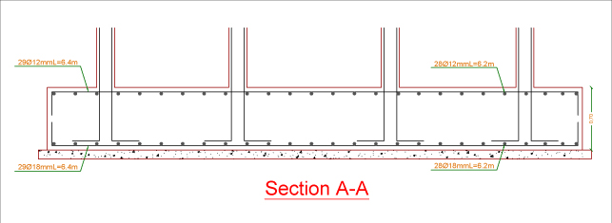
Footing Reinforcement Details
Mat Footing

Slide 29
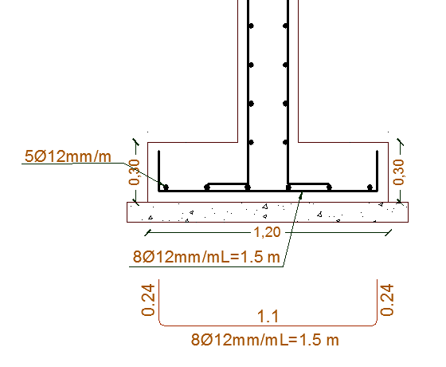
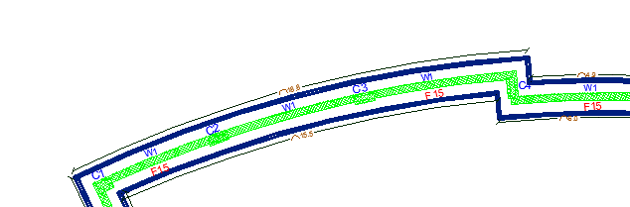
Footing Reinforcement Details
Wall Footing

Slide 30
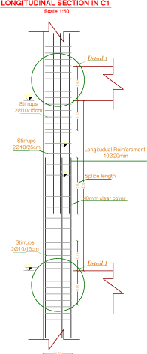





Column Reinforcement Details

Slide 31



Beam Reinforcement Details

Slide 32



Slab Reinforcement Details

Slide 33


Shear Wall Details

Slide 34

Basement Retaining Wall Details

Slide 35

Stair Reinforcement Details

Slide 36

Environmental DESIGN

Slide 37


Thermal Insulation
External Wall Section
External Wall Prosperities

Slide 38
Thermal Insulation
U-Value Of The Other Elements
Elements | U-Value
Ground Floor | 0.54
Ceiling | 0.49
Partition | 2.3
Roof | 0.37
Window | 2.7

Slide 39


Thermal Insulation
Cooling load

Slide 40


Thermal Insulation
Heating load

Slide 41

Natural Daylight Analysis
Heating load

Slide 42
Acoustical Design
Sound Transmission Class (STC)
STC-Values Between Different Spaces |  | Recommendation
Bedroom to Bedroom | 52 | > 52
Bedroom to bathroom | 58 | > 56
Corridor To Bedroom | 58 | > 52
Impact Insulation Class (IIC)
We used one way ribbed slab with thickness = 300 mm
IIC = 70

Slide 43



    Acoustical Design
    Reverberation Time (RT)
    Meeting Room
    RT = 0.88
    RT = 0.77

Slide 44


    Acoustical Design
    Transmission loss (TL)
    Meeting Room
    LT = 48.4 > 42
    LT = 40.6 > 40

Slide 45

Electrical DESIGN

Slide 46



    Sockets Arrangement
    Switches Used

Slide 47




    Artificial Lighting
Lounge

Slide 48



    Artificial Lighting
Restaurant

Slide 49



    Artificial Lighting
Meeting Room

Slide 50



    Artificial Lighting
Bedroom

Slide 51




Mechanical DESIGN

Slide 52


    Water Supply System
    The consumption of water in hotels = 500 liter /day/ person

Slide 53


    Drainage System

Slide 54


    Drainage System
    Grey Water
    Black Water

Slide 55


    H-VAC System
    VRF

Slide 56


    H-VAC System
    VAV

Slide 57

Safety
DESIGN

Slide 58


    Safety System

Slide 59

    Safety Signs

Slide 60


    Evacuation

Slide 61

Cost Estimation

Slide 62
The total cost of the HOTEL is about 11.15 million shekel.
The total cost per meter square for the HOTEL is about 2028 shekel.

Slide 63


