Slide 1
All in one toy robot
Supervised by:
Emad Natsheh
&Slaiman Abu Kharmeh
Prepared by:
Danah Aker
Ataa Shaqour

Slide 2
Table of contents
Main Idea
Features
Hardware modules
How it works?
Constraints
Future Work

Slide 3
Main Idea
A toy robot that contains a set of features that can do it autonomously
Can be controlled via remote control or mobile application

Slide 4
Main features
Line following
Follow me
Manual Mode
01
02
03
04
05
Obstacle avoiding
Sumo

Slide 5
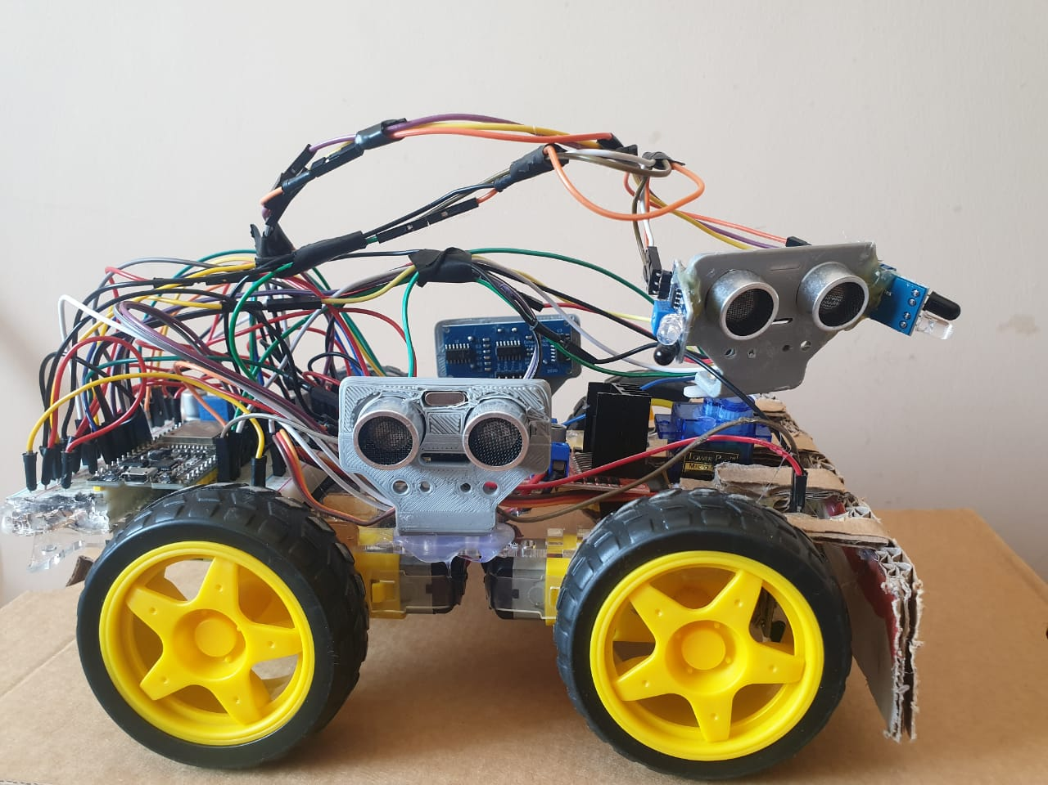
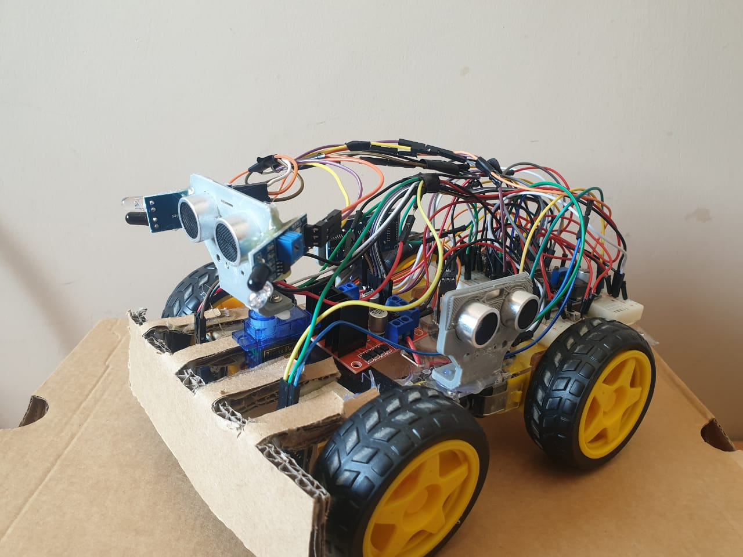
Hardware modules

Slide 6
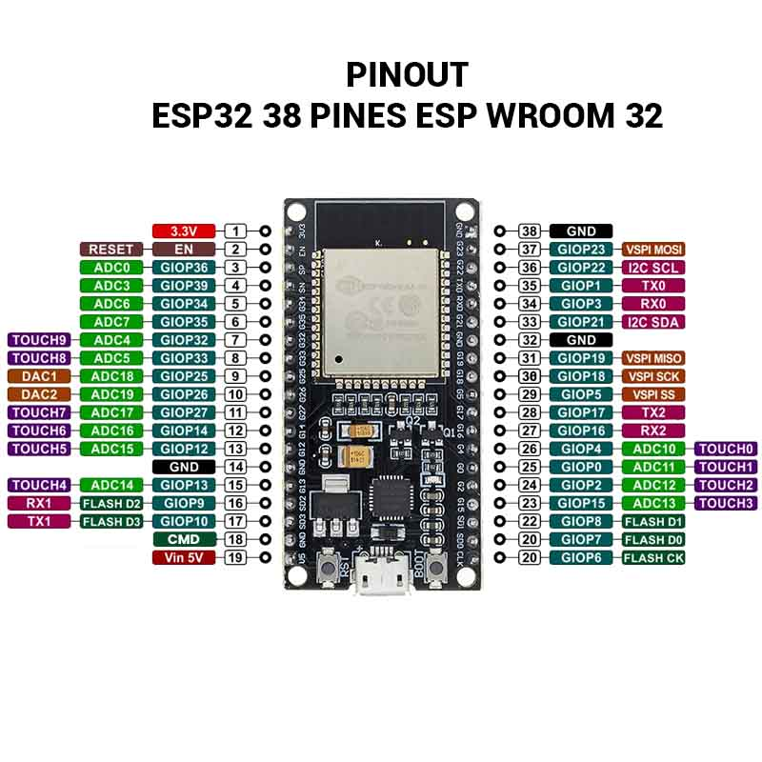
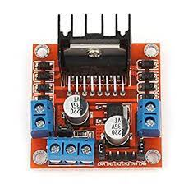
Hardware modules
Fig.1 ESP32-Wroom
Fig.2 H-Bridge

Slide 7
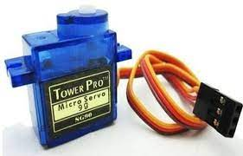
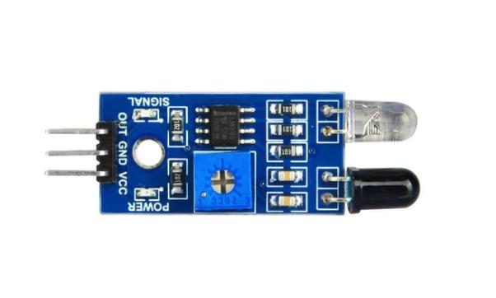
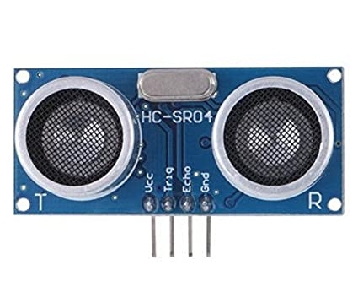
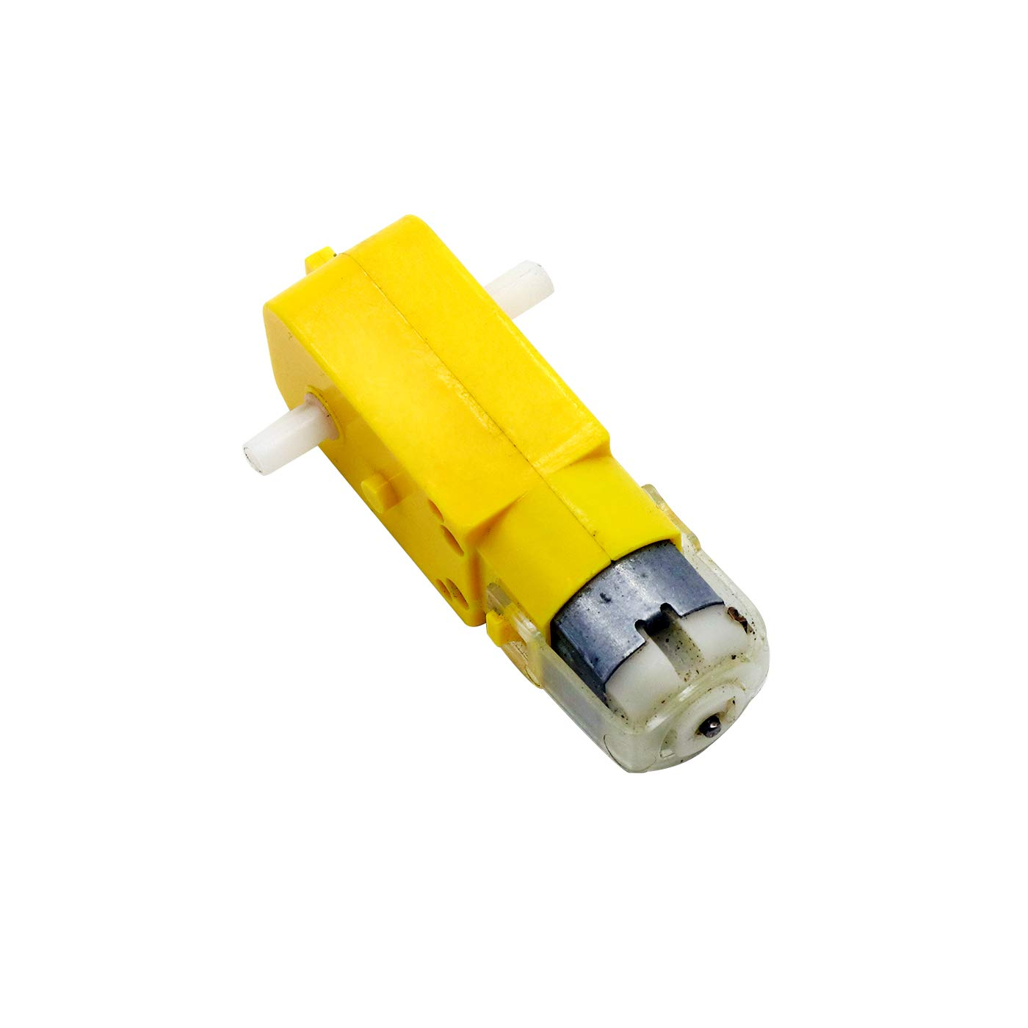
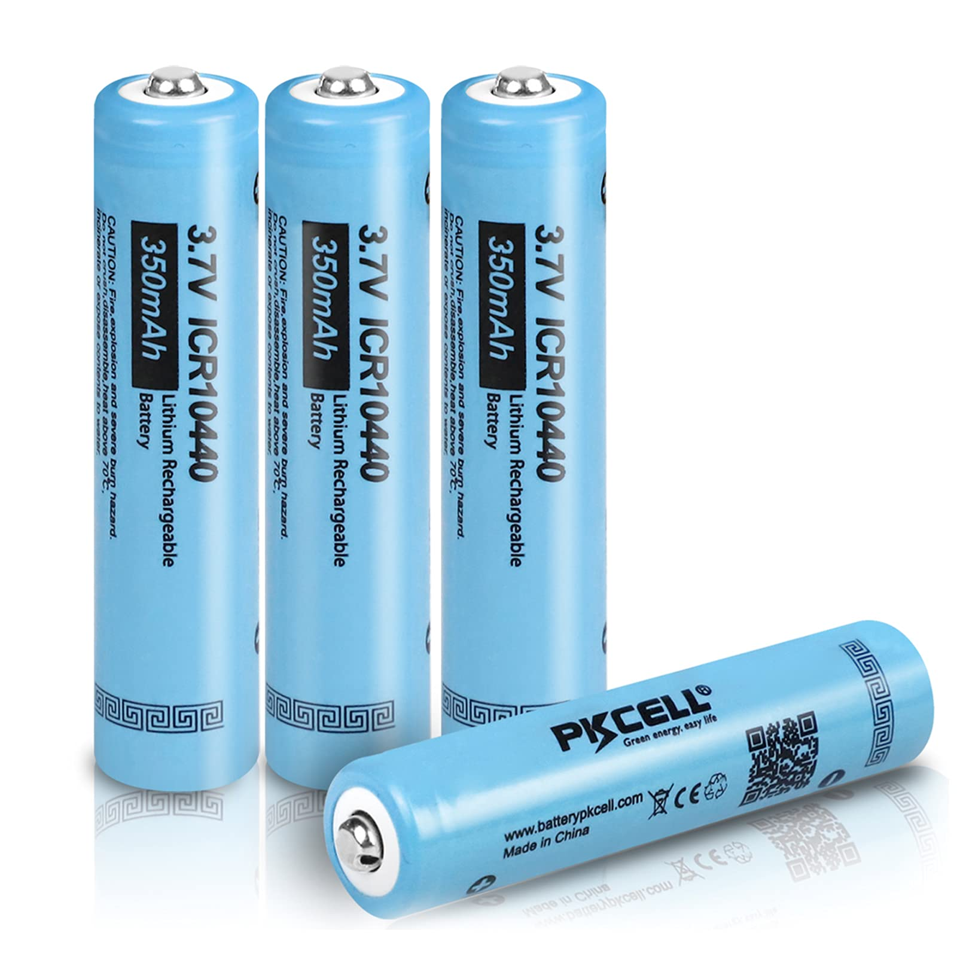
Hardware modules
Fig. 4. IR sensor
Fig. 5. Ultrasonic sensor
Fig. 3. Servo Motor
Fig. 6. DC-Gear Motor
Fig. 7. Battery (4.2V)

Slide 8
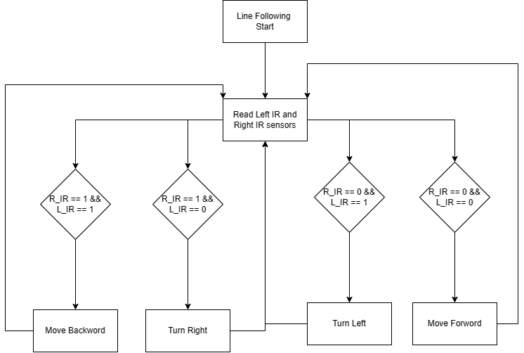
How it works?
Fig.7.Line Following Flowchart

Slide 9
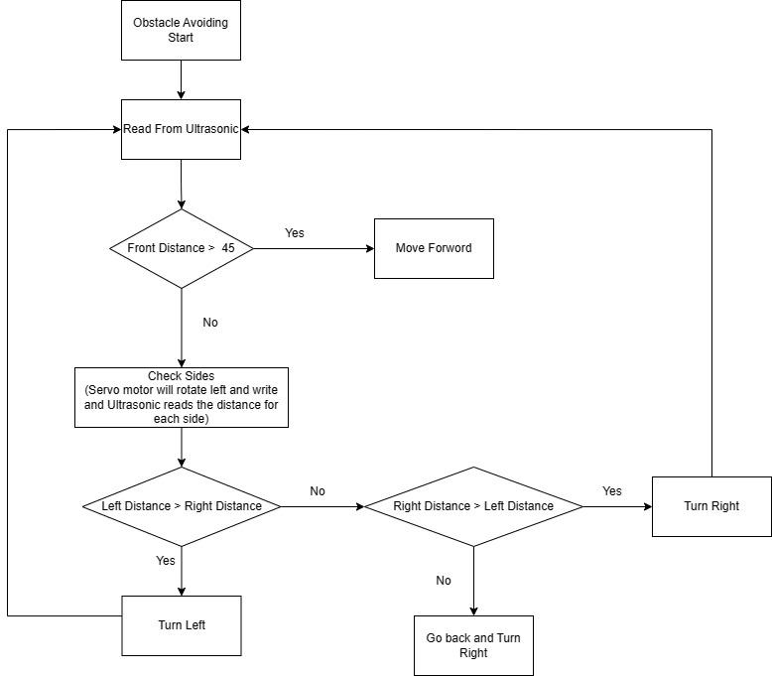
Fig.8.Obstacle Avoiding Flowchart

Slide 10
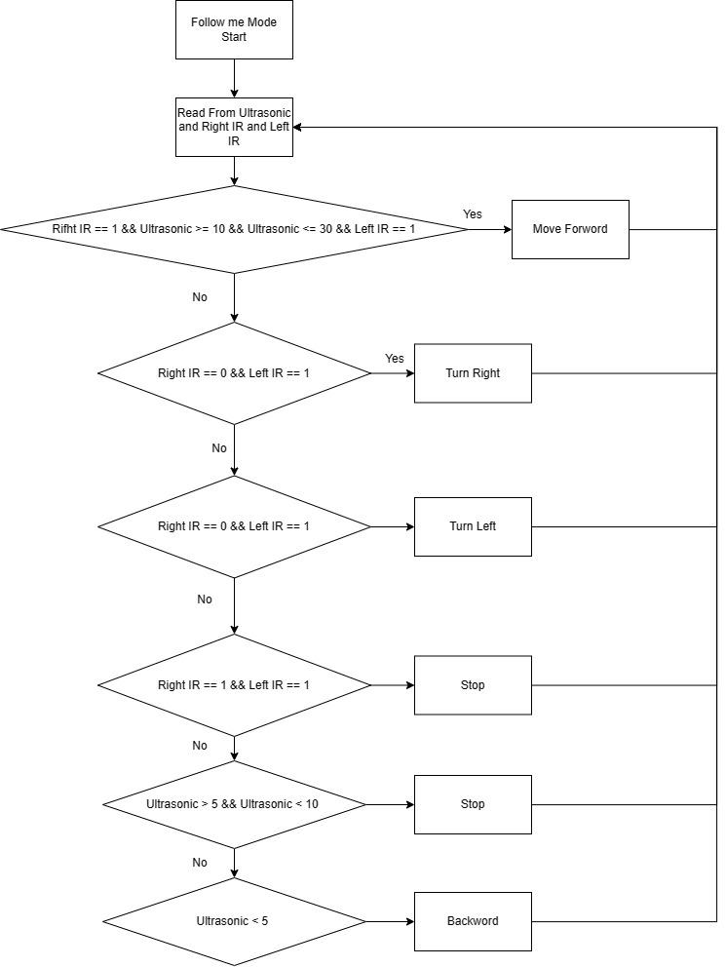
Fig.9. Follow Me Flowchart

Slide 11
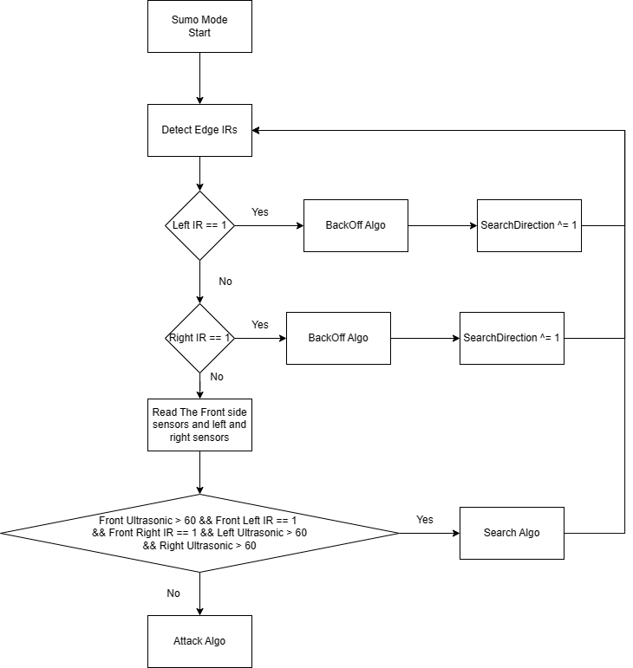
Fig.10. Sumo Mode Main Flowchart

Slide 12
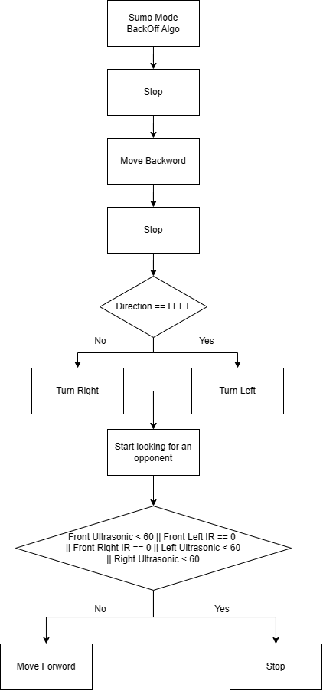
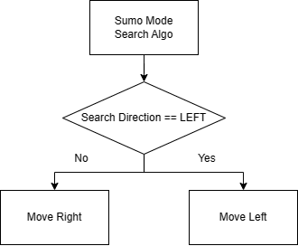
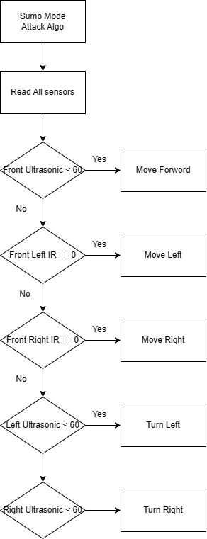
Fig.12. Sumo Mode Search Flowchart
Fig.11. Sumo Mode Backoff Flowchart
Fig.13. Sumo Mode Attack Flowchart

Slide 13
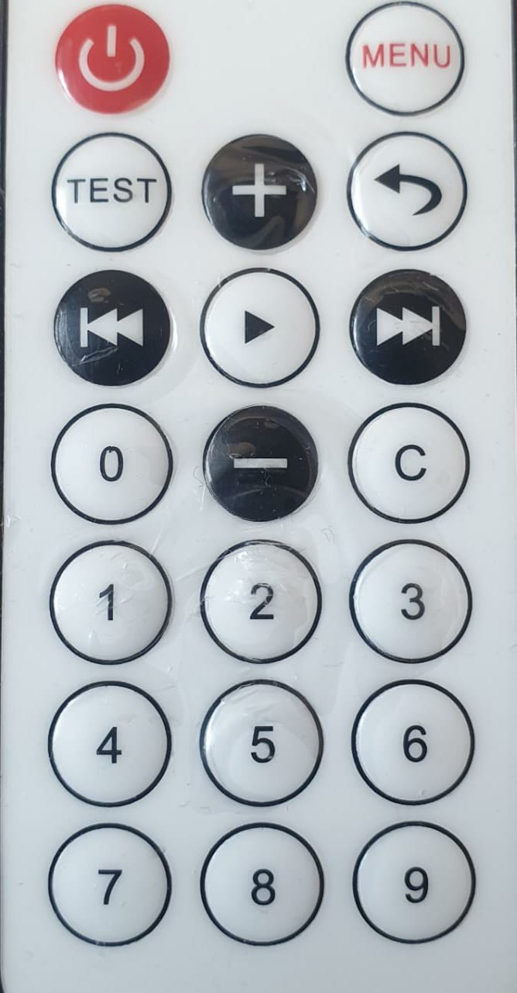
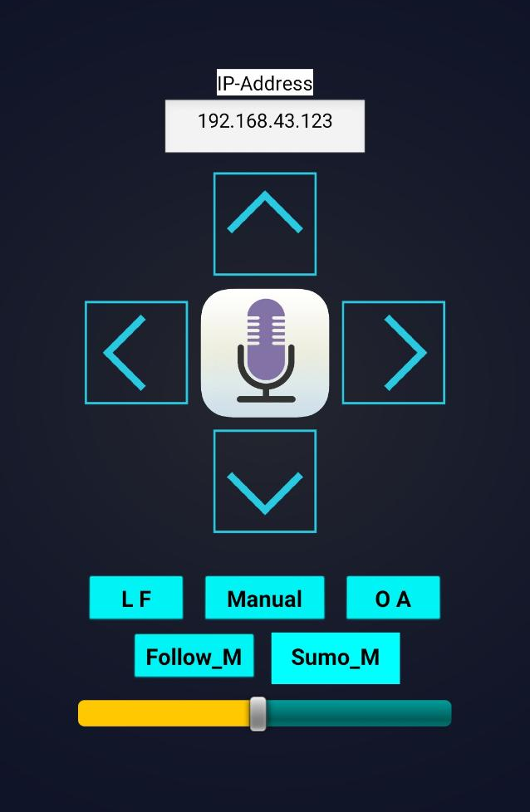
Manual Mode
Fig.14. Remote Control
Fig.15. Mobile App.

Slide 14
Constraints
Car robot body
Bad quality
IR sensors
Sunlight affects its behaviour.
VENUS
Venus has a beautiful name and is the second planet from the Sun

Slide 15
Future work
Gesture recognition
Improve sumo mode
Use better material
Cross platform

Slide 16
Any Questions?

