Slide 1
Graduation Project (2)
Techno-economic study of Installing grid- connected PV system for Kufradan’s Girls School
Prepared by:
Sana Abed
Dana Amarneh
Supervisor:
Dr. Mohammed Alsayed

Slide 2
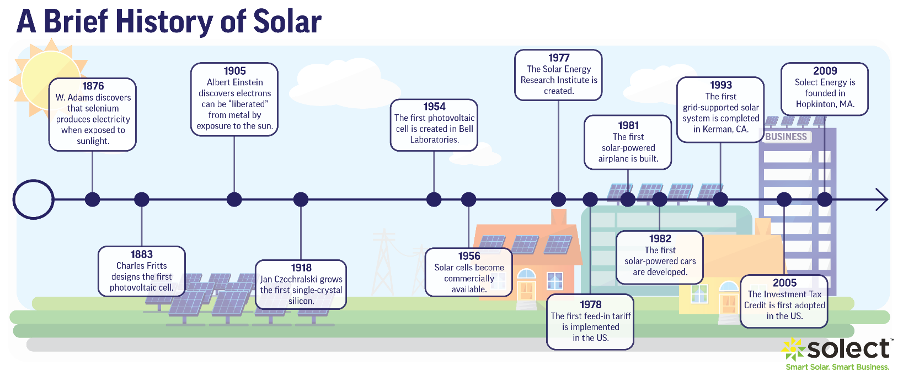
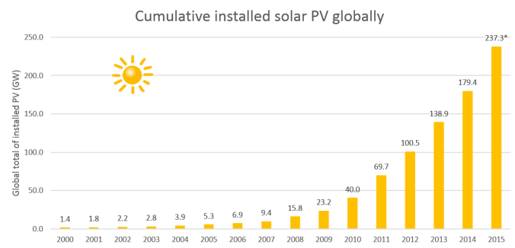
Introduction

Slide 3
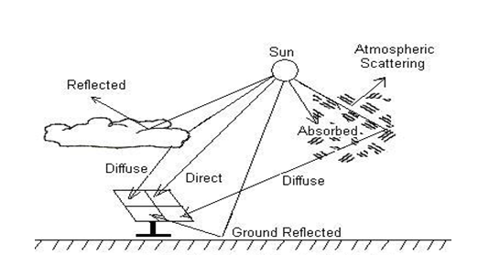
The amount of solar radiation that reaches the Earth's surface varies due to changing weather conditions and the variable position of the Earth for the sun, during the day and throughout the year. The sum of the radiation that hits the surface of the photovoltaic cell consists of three basic parts:
1.Direct Beam Radiation.
2.Diffuse Radiation.
3.Reversible optical beam.

Slide 4
1.2Photovoltaic cells:
Photovoltaic (PV) cells convert light energy into electricity. The term ‘photo’ is derived from the Greek word ‘phos’, which means ‘light’. ‘Volt’ is named for the scientist Alessandro Volta (1745-1827) who pioneered the study of electricity. Photovoltaics literally means light-electricity. PV cells are also commonly known a ‘solar cells’ .

Slide 5
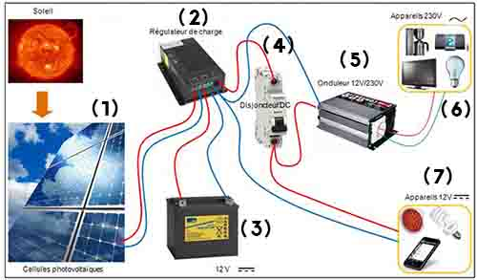
1.3Solar System Components:

Slide 6
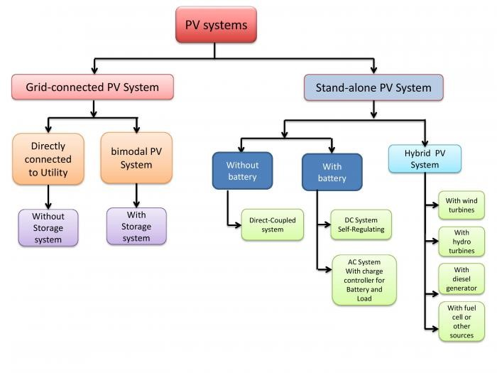
1.4Types of Solar PV Systems connections:

Slide 7
Problem statement
The price of electricity in Palestine is high compared to other countries due to the occupation and the taking of electricity from Israel and also because of the lack of environmental resources for electricity.
Solar radiation in Palestine is good With technological advances and the development of solar cells, Palestinians have been seeking to reduce electricity imported from Israel and reduce electricity bills.

Slide 8
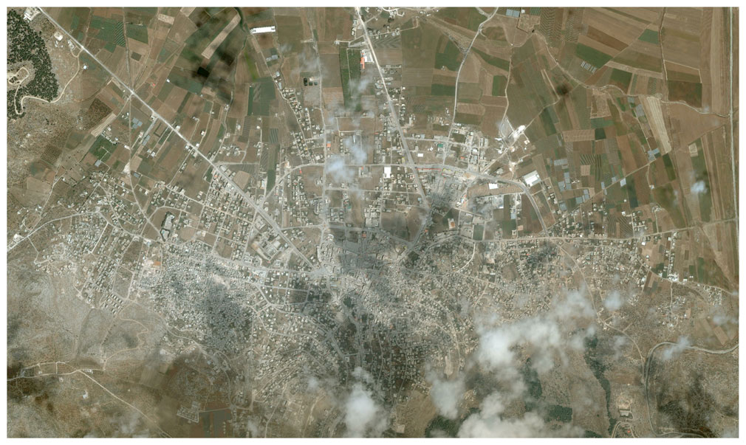
Chapter 2:
2.1Location:

Slide 9
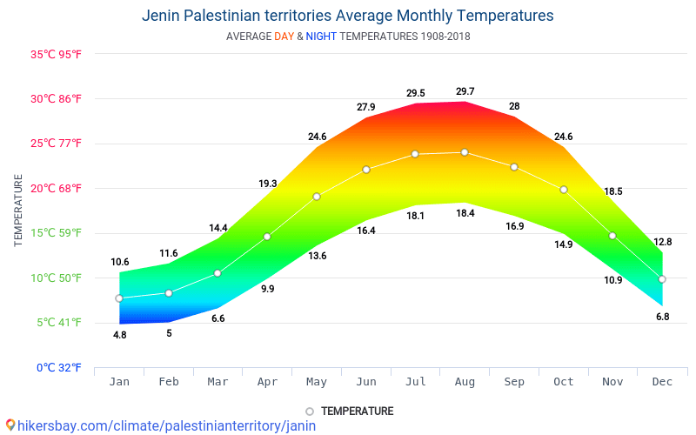
The climate of the Jenin area differs from the general climate of Palestine, because of its topographic status. This situation reduced the city's use of temperate and temperate western and southwestern winds.

Slide 10
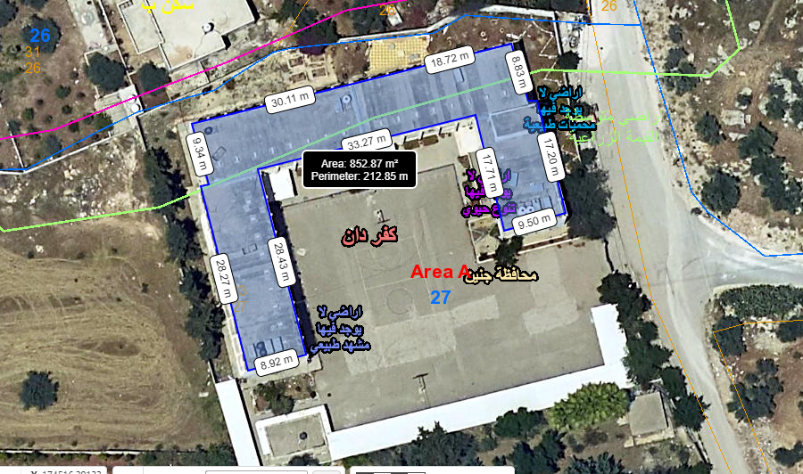
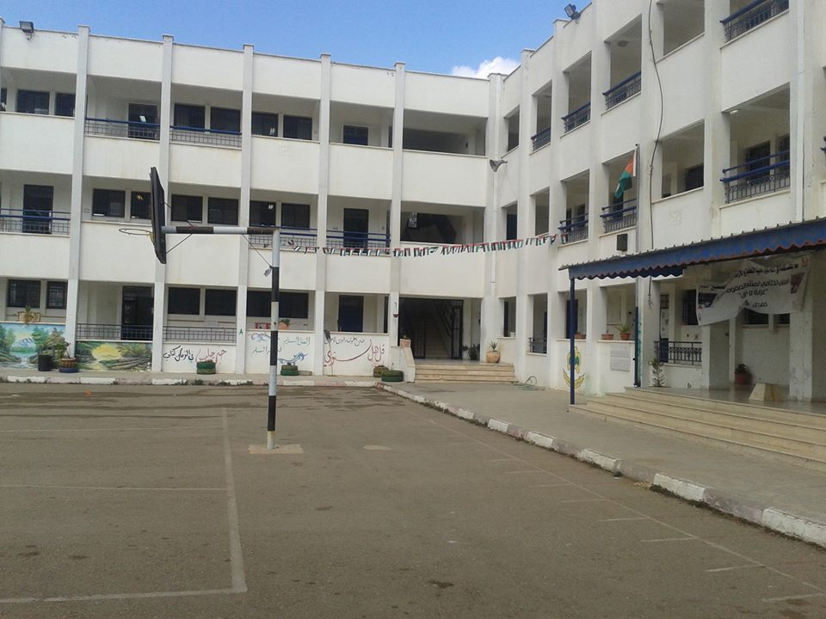
The school is located on Kufradan on an area of 4715 m² and has a surface area of 452 m². It contains 21 sections for grades 1 through 8, with 32 teachers, administrators and secretaries.

Slide 11
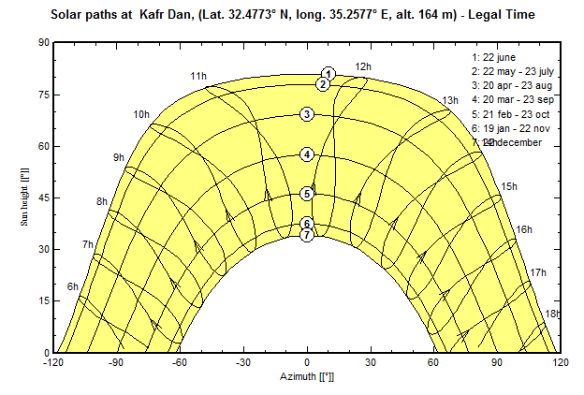
2.2Orientation of the PV system:

Slide 12
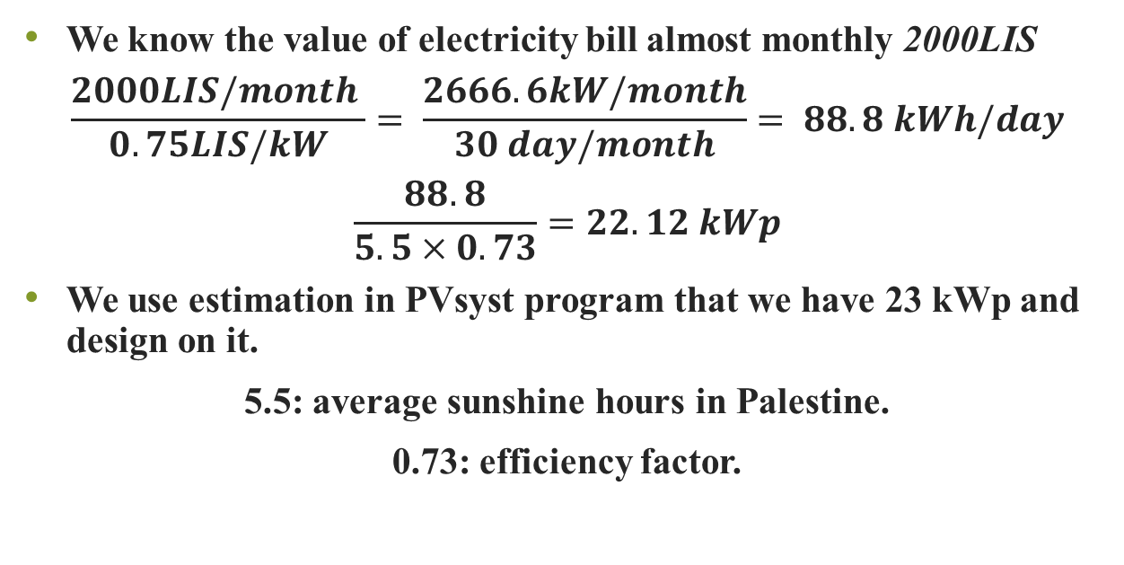
2.3Design of the PV system:
2.3.1Manual Design:
We know the value of electricity bill almost monthly 2000LIS
$$\frac{2000LIS/month }{0.75LIS/kW}= \frac{2666.6kW/month}{30 day/month}= 88.8 kWh/day$$
$$\frac{88.8}{5.5×0.73}=22.12 kWp$$
We use estimation in PVsyst program that we have 23 kWp and design on it.
5.5: average sunshine hours in Palestine.
0.73: efficiency factor.

Slide 13
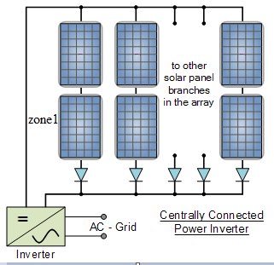
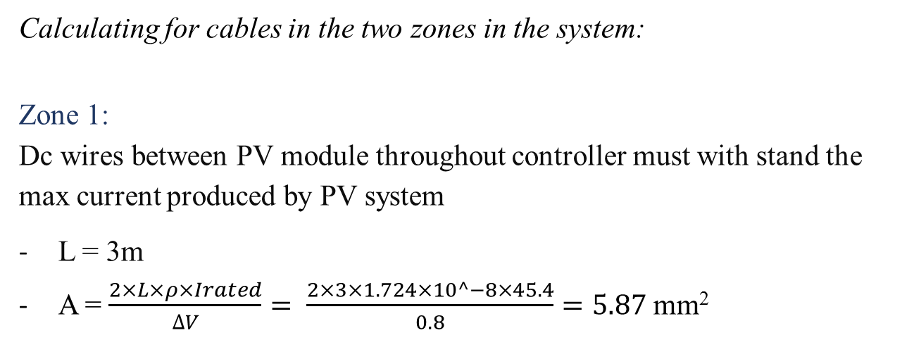
Calculating for cables in the two zones in the system:
Zone 1:
Dc wires between PV module throughout controller must with stand the max current produced by PV system
L = 3m
A = $\frac{2×L×ρ×Irated}{∆V}= \frac{2×3×1.724×10^−8×45.4}{0.8}=5.87$mm²

Slide 14
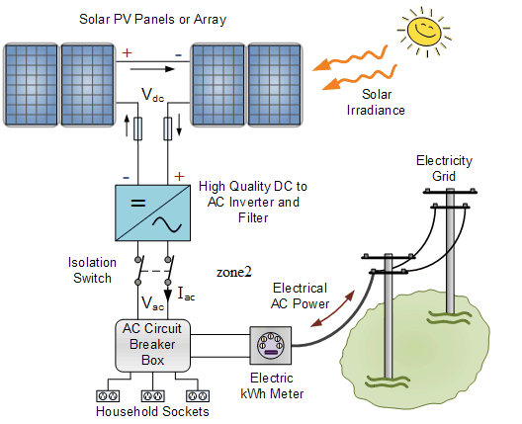

Zone 2:
Cable size between Inverter and the load
I_{max} = $\frac{inverter}{Vout}=\frac{4000}{220}=18.18 A$
I_{rated} =$Imax×1.25=22.72 A$
∆V = $0.04 × 220=8.8V$
L = 10m
A = $\frac{2×L ×Irated×ρ}{∆V}$
= $\frac{2×10×22.72×1.724×10^−8}{8.8}=0.516$mm²

Slide 15
2.3.2PVsyst Program:
PVsyst is designed to be used by architects, engineers, and researchers. It is also a very useful educative tool.
PVsyst significantly reduces the costs (both financial and time) associated with identifying and assessing potential energy projects.

Slide 16
Information from program:
Number of PV modules in series are 20 modules.
In parallel are 4 strings.
Total number of PV modules: 80 modules.
Peak Power of system 265 Wp.
Array global power: 21.2 kWp.
Array operating characteristics at (50°C): V mpp: 565 V. I mpp: 34 A.
P mmp: 19.33 kWp.
Numbers of inverters 2 inverters.
Performance Ratio (PR): 84.07%.

Slide 17
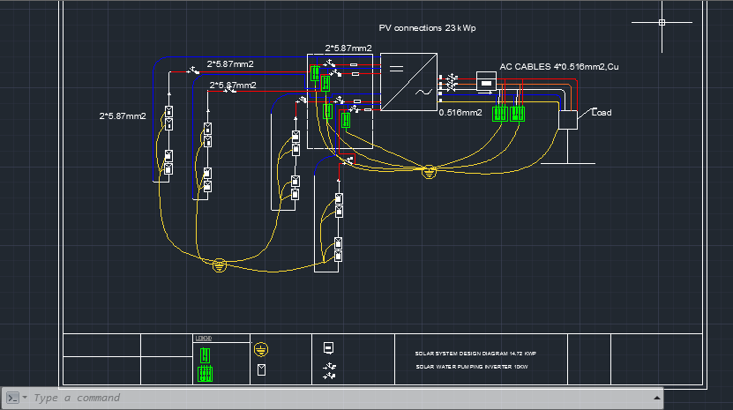

Slide 18
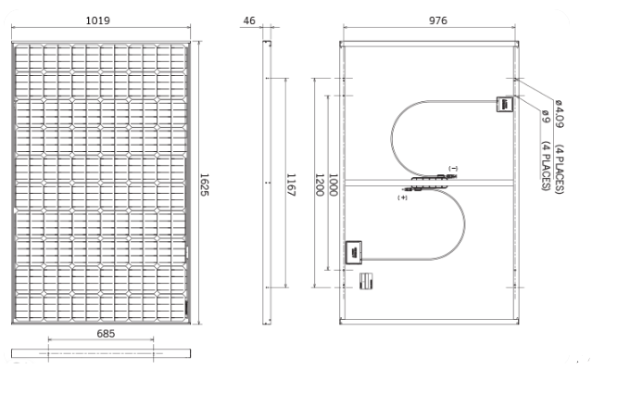
2.4PV modules used:
Mitsubishi electric photovoltaic modules.
Monocrystalline silicon
78mm*156mm

Slide 19
2.5Protection system:
2.5.1Circuit breakers:
Circuit breakers are one of the most important parts of electrical circuits. It protects the solar system from catching fire if a short circuit occurs, and protects the wires from excessive heat that causes fires.

Slide 20
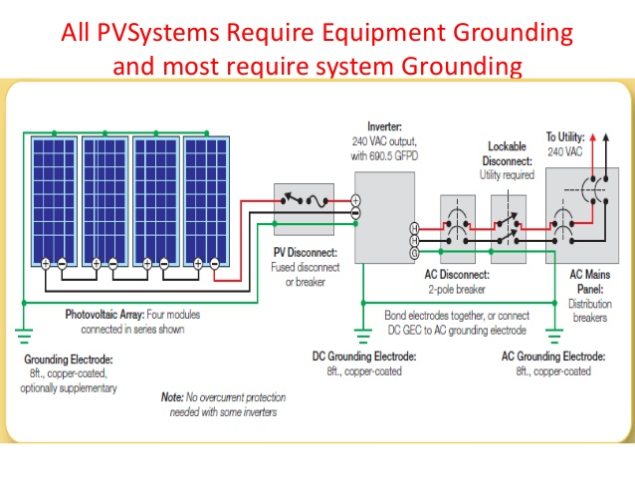
2.5.2Earthing system:

Slide 21
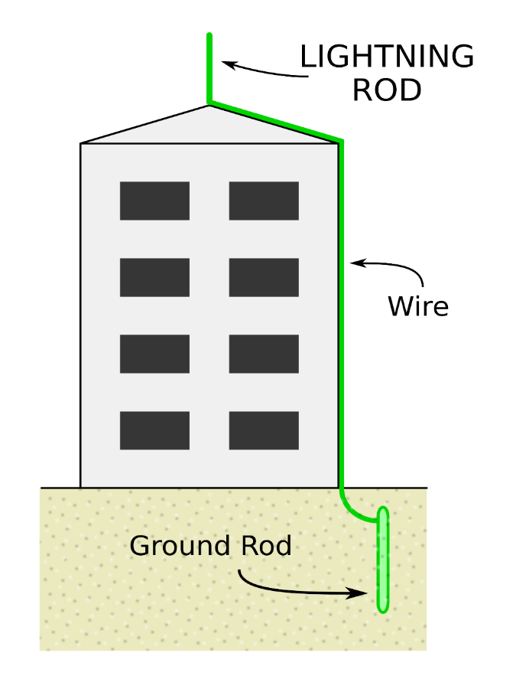
2.5.3Surge arrester:

Slide 22
2.6Shading:
Shading analysis is one of the most essential steps in phase of solar energy system design or analysis.
The availability of Photovoltaic (PV) and increased interest in using and installing this system encourages the need to review the methodologies and assumptions used to develop.

Slide 23
Shading Calculations:
Depending on J.K Copper’s method :
* Tilt angle = 30 ̊
An array consists of eleventh PV modules (eleventh rows)
Eq 1: S=H/tanVSA
Eq 2: H=sin Ba * wp
Eq 3: tan VSA=tanαs / cosɸ
αs: Altitude angle.
ɸs: Azimuth angle of the sun.
ɸc: Azimuth angle of the collector.
Ba: Tilt angle.
Wp: PV width.
S: Shading distance.

Slide 24
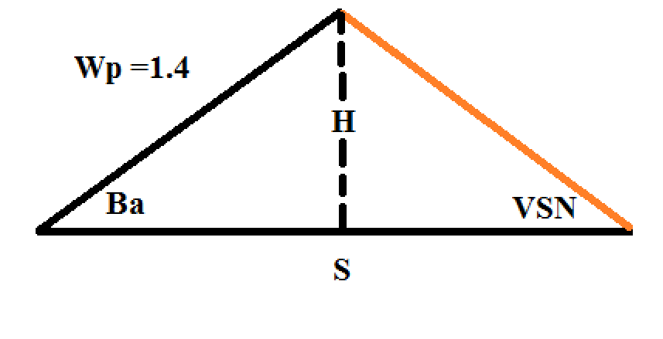
considering the maximum self-shading on the 21st of December at 14:00 ,
αs at 14:00 = 25.07
ɸs at 14:00 = 215.87
ɸc = 180 ̊ from North
then:
Tan VSA=tan 25.07 / cos (215.87-180)
tan VSA = 0.5775
H=sin 30 *1.4
H = 0.7
Back to Eq 1:
S=0.7 / 0.5775
S = 1.212 meter

Slide 25
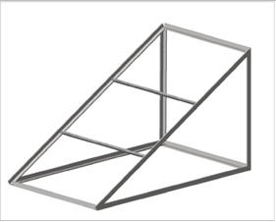
2.7Mounting structure design:
PV arrays must be mounted on a stable, durable structure that can support the array and withstand wind, rain, hail, and corrosion over decades.
In our system we use fixed structures at an angle of 30 degrees and southward

Slide 26
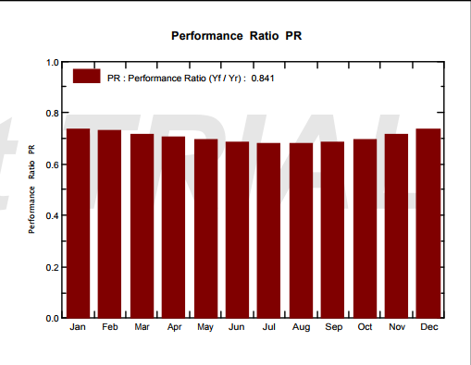
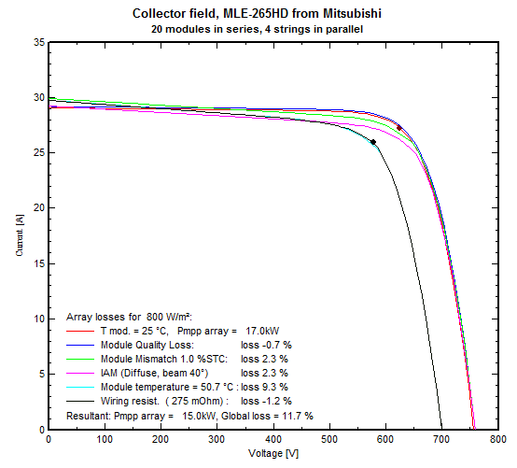
Chapter 3:
Discussion:

Slide 27
Chapter 4:
Feasibility of the project:
Project life is 25 years and the payback period are 16.6 years; that conclude the project and the design was successful and ready for practical application, which will save on the electric school bill and by design will achieve the desired material return in addition to educating the students to a new type of clean energy sources.

Slide 28
Chapter 5:
Conclusion:
The sun is a powerful source that can help our planet by providing us with clean, reusable energy to run our world. Using this energy is free, does not cause pollution, and if used wisely can help us become less dependent on other forms of energy that are more expensive and destructive.
Hence, officials must work to raise awareness of this clean energy and seek to spread it in various ways, because it is in the public interest as it reduces the need for energy from the occupied side.
The project targeted a school and the selection was successful, as it was efficient at the highest stages and the losses were very few, which made the overall project has a material return to the school and not only to reduce the electricity bill for the school.
In conclusion such projects must be supported and a generation of practitioners should be trained and worked on to expand them.

Slide 29


